Slide 1


Magnets 302.2.02 and 03 –
Strand Procurement and Testing
Cable Fabrication
Lance Cooley – NHMFL/ASC (302.2.02 L3)
Vito Lombardo – FNAL (302.2.02 CAM)
Ian Pong – LBNL (302.2.03 L3 and CAM)
Jonathan Lee – LBNL Intern Student

Slide 2
Outline
Cable Summary
Wire Summary
Cable and Wire Details for Coil -- x4 times
  Summary
  Date and Lengths
  Strand and SS Core ID
  Respooling Wire Diameter
  Cable Mechanical QC
  Braiding Details
  Wire Parameters
    S & V QC data, XS RRR and Witness I_{C} and RRR
  SSL
Summary

Slide 3
Cable Summary
Coil | Cable | Strand | Spec.
QXFA116 | P43OL1105 | 0.85 mm 108/127 | HiLumi (2017)
QXFA117 | P43OL1107 | 0.85 mm 108/127 | HiLumi (2017)
QXFA207 | P43OL1106 | 0.85 mm 108/127 | HiLumi (2017)
QXFA209 | P43OL1114 | 0.85 mm 108/127 | HiLumi (2017)
QXFA115 | P43OL1102 | 0.85 mm 108/127 | HiLumi (2017)
QXFA 209 made with strand exchanged from CERN
QXFA 116 backup sample needed to pass supplier QC (spool PO08S00216A02U)
PxxOLnnnn is the cable ID:
  “xx” is the project and strand type
    30 series = QXF gen 1 with annealed strands;
    40 series = QXF gen 2 with annealed strands;
    Odd = cored cable; x3, x5, x7 determines strand type
  “nnnn” is the cable map number

Slide 4
Cable Summary
Coils used:
  116, 117, 207, 209 (spare: 115, presented previously and approved for MQXFA04)
Corresponding cables:
  P43OL1105, P43OL1107, P43OL1106, P43OL1114
All cables are 2nd generation QXF cables with 108/127 RRP® strands procured under LARP
All AUP cables

Slide 5
Wire Summary
All “HiLumi” spec, these are spools manufactured after 2017 CERN-LARP spec review
  Procured by LARP under:
    FNAL 632982 C – Spec 0 (coils 116, 117)
    FNAL 632982 D – Spec 0 (coils 116, 117, 207)
  Procured by CERN under:
    CERN Contract F663 Ship F and Ship G (coil 209)
0.85 mm, Ti-doped, reduced Sn
LARP procurement spec was US-HiLumi-Doc-40, modification to HT was applied to PO 632982, changing the final stage from 665°C for 75 h to 665°C for 50 h.
  Purpose: protect 15% rolled RRR in exchange for minimal trade-back of critical current (this will be evident for coil 209)
  Coil HT has always been 665 °C / 50 h per Doc 109
CERN procurement spec HT for Ship F and Ship G was 665°C for 75 h – so, I_{C} higher but RRR lower

Slide 6
Billets in the LARP production run
331 A
314 A
Supplier is conservative by 2.1% after accounting for heat treatment
2.1% is comparable to the inter-lab test uncertainty (1.6 % in 2015) and past BNL-OST comparison (3% primarily due to strain).

Slide 7
Strand Procured by LARP and Supplier’s QC
A change of the heat treatment was approved in 2017 → shift in data
Final step from 665C 75hr to 665C 50hr
  4.9% reduction in I_{c}(15 T) for 14.7% gain in RRR (15% rolled)
Verification testing did not receive HT change notice in time
Round
Rolled
314 A
331 A

Slide 8
Billets in the LARP production run
PO624035
PO632982
AUP
A
B
C
D
Due to HT
Due to Test
Spec (round)
331 A
314 A
Spec (15% rolled)
Supplier is conservative by 2.1% after accounting for heat treatment
2.1% is comparable to the inter-lab test uncertainty (1.6 % in 2015) and past BNL-OST comparison (3% primarily due to strain).

Slide 9
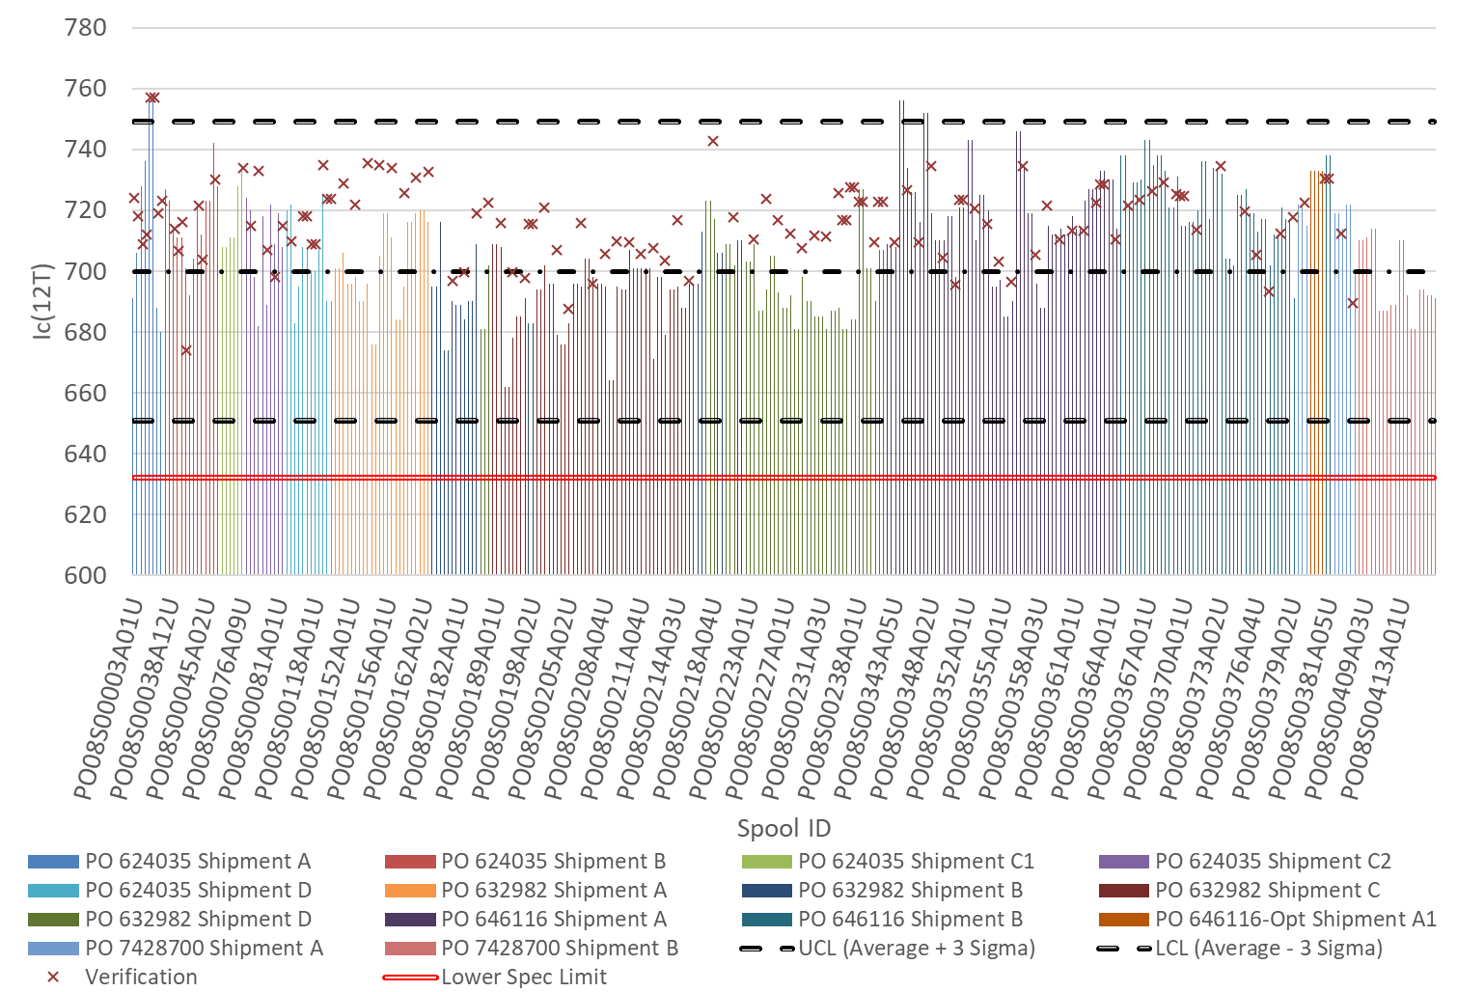
Ic@12T
LARP
AUP
3-sigma (99.7%) SPC upper
X = verification test
3-sigma (0.3%) SPC lower
SPEC
117
117
115
209
116
116
207

Slide 10
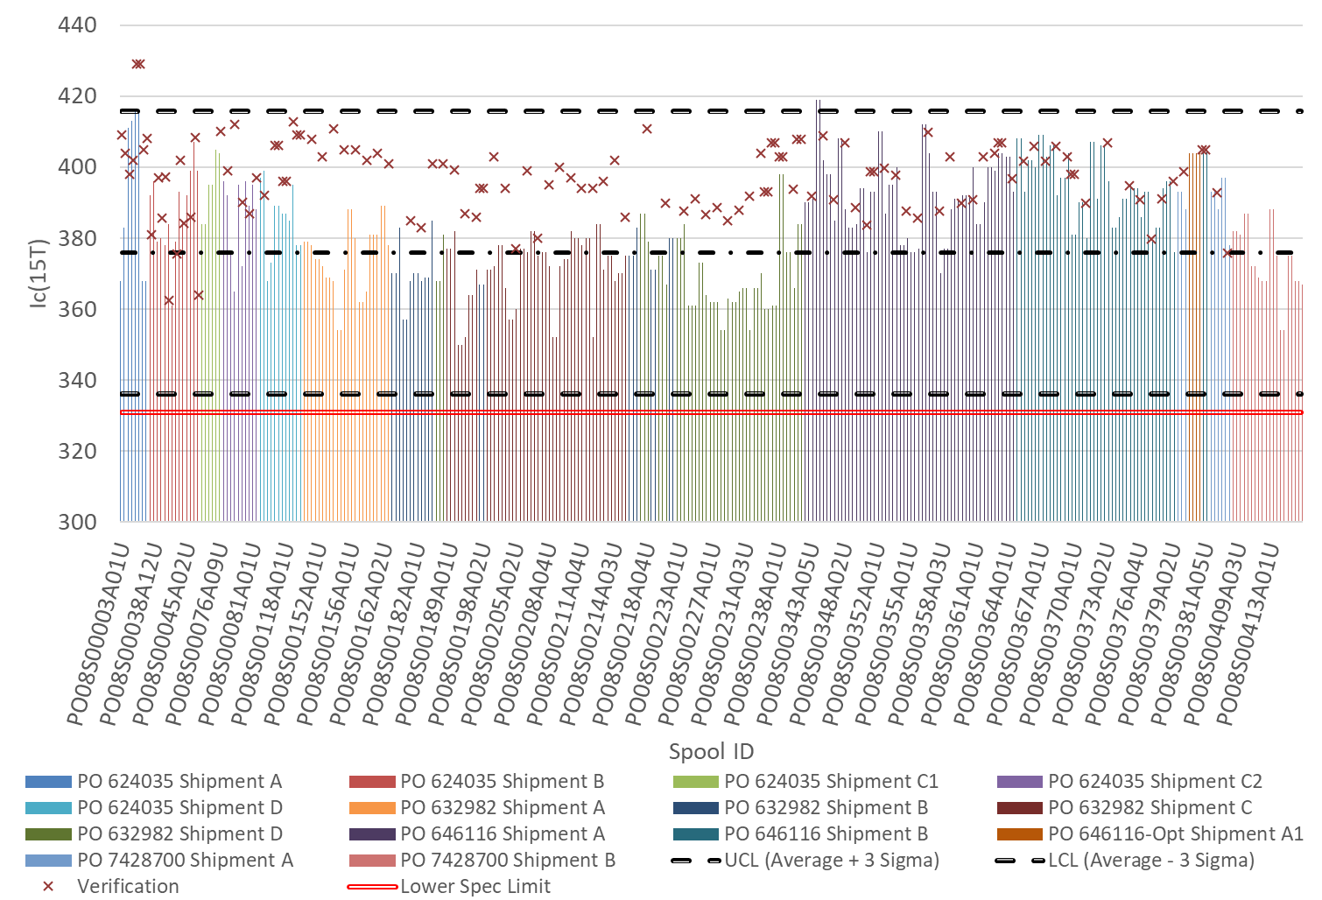
Ic@15T
LARP
AUP
3-sigma (99.7%) SPC upper
X = verification test
3-sigma (0.3%) SPC lower
SPEC
117
117
115
209
116
116
207

Slide 11
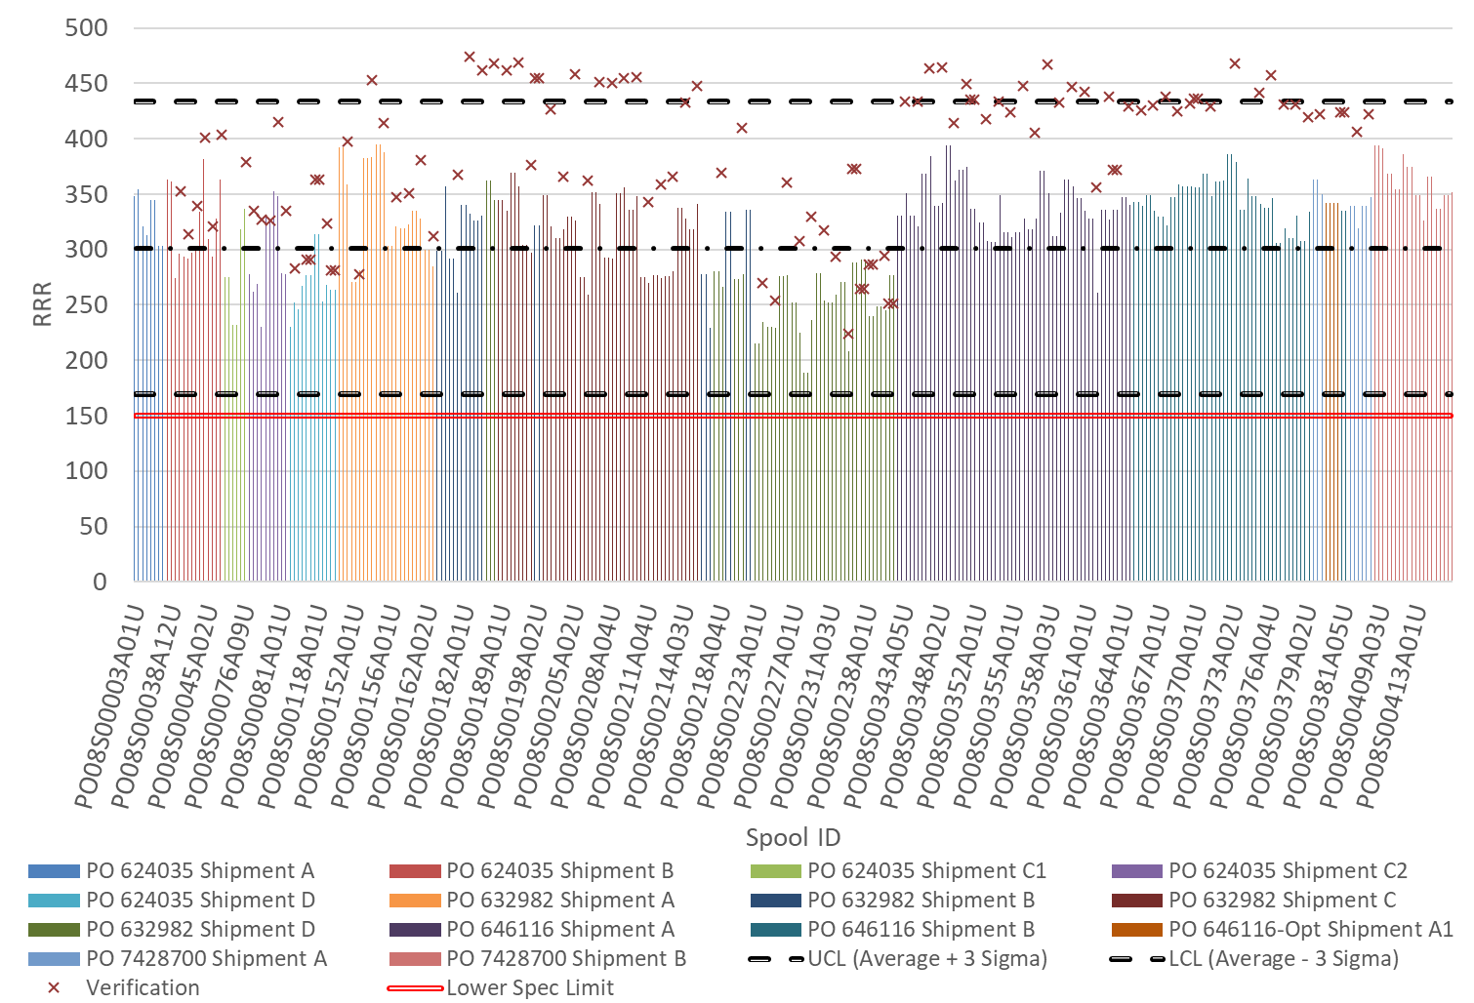
3-sigma (99.7%) SPC upper
LARP
AUP
3-sigma (0.3%) SPC lower
SPEC
RRR Round wire
117
117
115
X = verification test
209
116
116
207

Slide 12
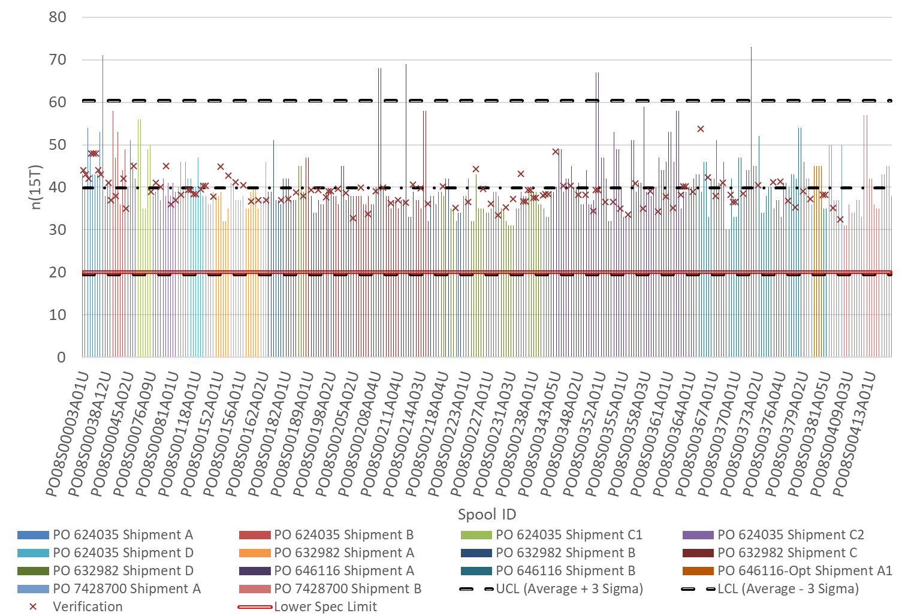
LARP
AUP
N-value at 15 T
X = verification test
3-sigma (99.7%) SPC upper
3-sigma (0.3%) SPC lower
SPEC
117
117
115
209
116
116
207

Slide 13
QXFA-116 / P43OL1105

Slide 14
Cable Summary
Magnet: MQXFA-05
Coil: QXFA-116
Corresponding Cable: P43OL1105 (AUP 010)
Cable is 2nd generation QXF cables with 108/127 RRP® strands procured under LARP

Slide 15
Wire Summary
All “HiLumi” spec, procured by LARP under:
  FNAL 632982 C – Spec 0 (33 ULs)
  FNAL 632982 D – Spec 0 (7 ULs)
0.85 mm, Ti-doped, reduced Sn

Slide 16
P43OL1105 – Cable Date, Lengths
Cable Manufacture Date
  2019 01 29 (Production run)
Cable Length:
  484 m (LBNL, fabricated, including LBNL samples)
  468 m (shipped to NEWT, including S & V samples)
  462.9 m (Measured by FNAL)

Slide 17
P43OL1105 – Strand and SS Core ID
Spool:
  PO08S00209A03U x 9 ULs
  PO08S00204A02U x 7 ULs
  PO08S00204A01U x 8 ULs
  PO08S00216A02U x 9 ULs
  PO08S00231A03U x 7 ULs
Core:
  120L41A7322313
    Core width: 12.0 mm; material: 316L;
    Heat: 844979; Lot: 16-597;
    Chemical Properties CoT/CoC 172660-1: 0.14 wt% Co
From 5 billets

Slide 18
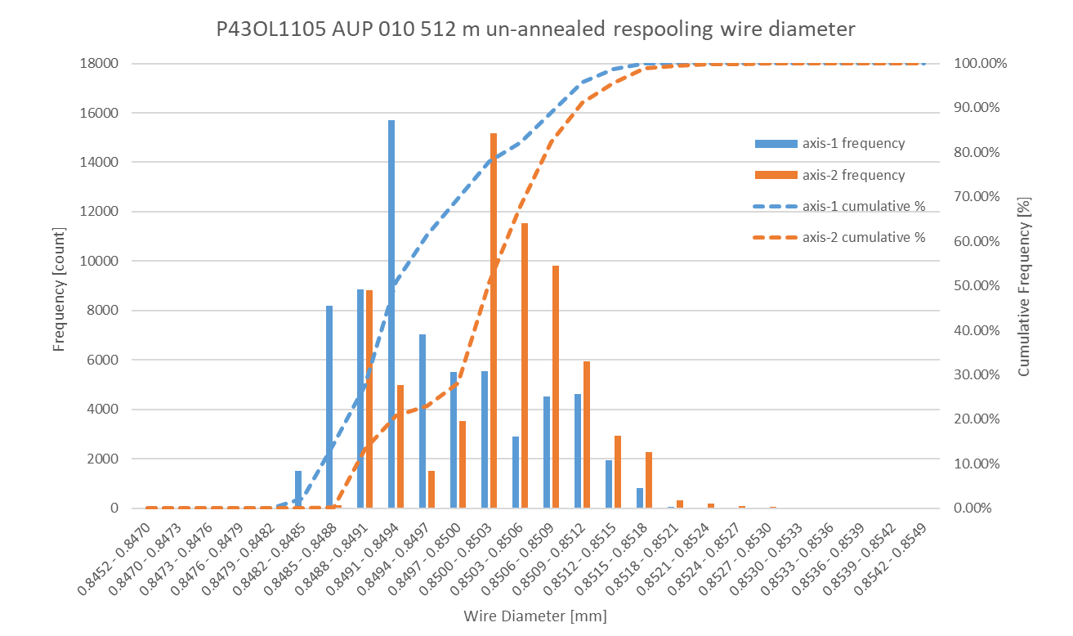
P43OL1105 Respooling Wire Diameter
Below LSL: 0.00%
Above USL: 0.02%

Slide 19
P43OL1105 – Cable QC Data Summary
CME:
Residual Twist:
  115°
10-stack:
  Qualification: 1.534 mm
  Production tail end: 1.531 mm
 | Pressure (MPa) | Angle (°) | Width (mm) | Thickness (mm)
Maximum | 17.1 | 0.445 | 18.165 | 1.533
Average | 17.0 | 0.425 | 18.151 | 1.529
Minimum | 16.9 | 0.399 | 18.145 | 1.525
Sigma | 0.02 | 0.008 | 0.002 | 0.001

Slide 20
Rollers: P-91 (2017-12-08) and P-92 (2017-12-08)

Slide 21
Rollers: P-91 (2017-12-08) and P-92 (2017-12-08)

Slide 22
Rollers: P-91 (2017-12-08) and P-92 (2017-12-08)

Slide 23
P43OL1105 – Braiding
Fiberglass Lot #100415
P/I: 18.0
Spool tension: 10 lbs. (payoff); 20 lbs. (takeup)
Bobbin payoff tension: 0.125 lbs. (min), 0.250 lbs. (max)
NEWT 10-stack QC:
  Cycle #1) 0.149 mm; #2) 0.145 mm; #3) 0.142 mm;
  Mean 0.145 mm
LBNL 10-stack verification QC:
  Cycle #1) 0.147 mm; #2) 0.143 mm; #3) 0.141 mm;
  Mean 0.143 mm
Vector #464342

Slide 24
P43OL1105 – Wire Parameters
Properties | Inspected Average
Wire Diameter | 0.850 ± 0.0008 mm (LBNL)¹
Cu ratio ª | 54.3% (OST)
Strand twist pitch ª | 18.1 mm (OST)
RRR (RW) ª | 324 (OST)
RRR (15% rolled) ª | 217 (OST)
I_{C} (4.2 K, 15 T) ª | 367 A (OST)
I_{C} (4.2 K, 14 T) ª | 459 A (OST)
I_{C} (4.2 K, 13 T) ª | 564 A (OST)
I_{C} (4.2 K, 12 T) ª | 683 A (OST)
ª First billet averaged, then weighted average according
to the spool distribution in the cable
¹ As-received, all LBNL respooling data; mean ± 1 sigma

Slide 25
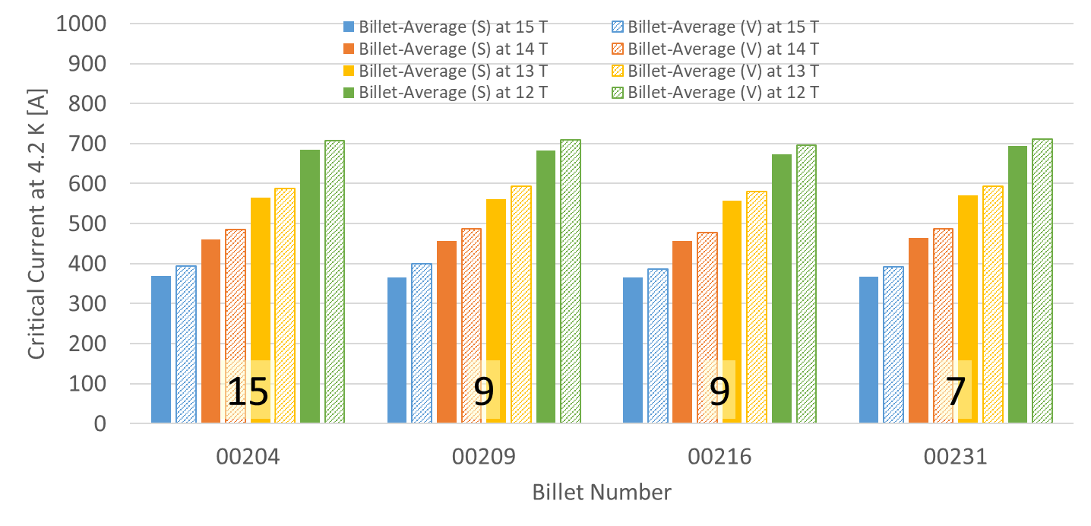
P43OL1105 – Wire Parameters
Supplier (S) and Verification (V) I_{C} Data
Number of spools from that billet used in the cable

Slide 26
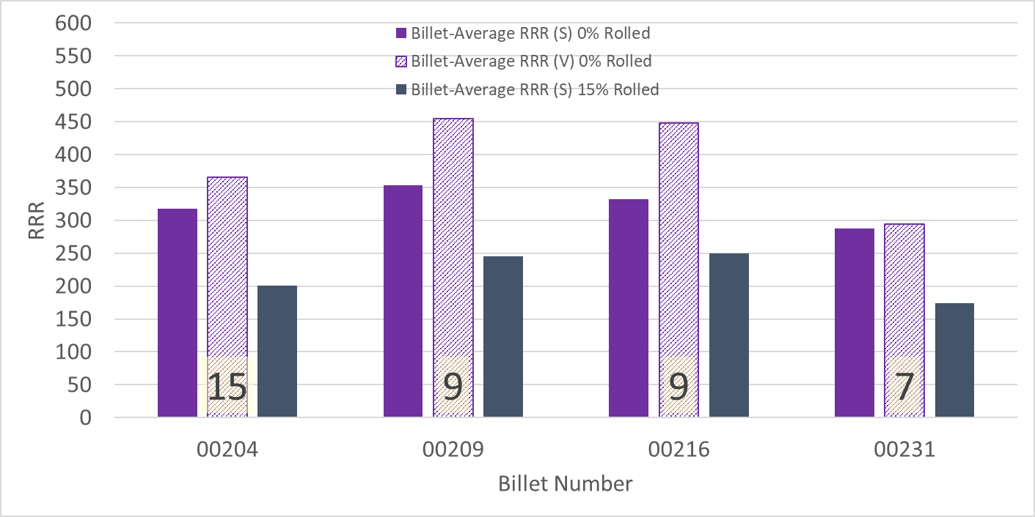
P43OL1105 – Wire Parameters
Supplier (S) and Verification (V) RRR Data
Number of spools from that billet used in the cable

Slide 27
P43OL1105 – Extracted Strand RRR
 | Cable ID | No. of Units from Billet (spool) | HT/sample ID | Major edge RRR | Minor edge RRR | Straight section 1 RRR | Straight section 2 RRR
ID #1 | P43OL1105AE01E PO08S00209A03U | 9 (9) | LRLK180613ALC1 | 416 | 401 | 423 | 440
ID #2 | P43OL1105AE06E PO08S00209A03U | 9 (9) | LRLK180613ALC1 | 362 | 307 | 455 | 457
ID #3 | P43OL1105AE27E PO08S00204A01U | 8 (15) | LRLK180613ALC1 | 356 | 331 | 443 | 420
ID #4 | P43OL1105AE33E PO08S00204A01U | 8 (15) | LRLK180613ALC1 | 426 | 318 | 434 | 454
ID #5 | P43OL1105AE43E PO08S00216A02U | 9 (9) | LRLK180613ALC1 | 357 | 324 | 458 | 457
Vector #464342

Slide 28
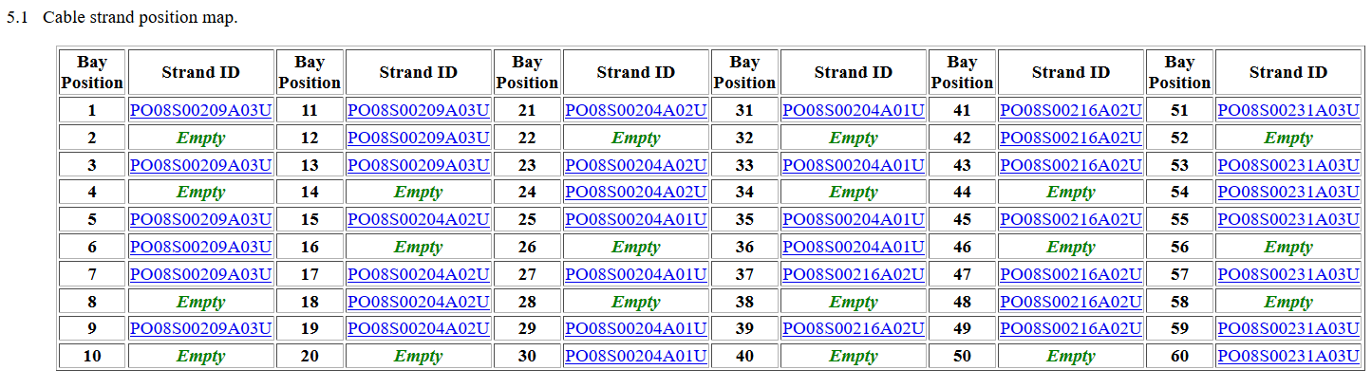
P43OL1105 – Witness Samples
RRR extracted strand
Witness extracted strand (XS)
Witness virgin strand (VS)
All tests succeeded

Slide 29
P43OL1105 – Witness Samples
ID | RRR (293K / 20K) XS > 100 RW > 150 | Ic(12T) XS > 600 RW > 632 | Ic(13T) | Ic(14T) | Ic(15T) XS > 314 RW > 331
PO08S00216A02U | 234
PO08S00209A03U | 312 | 719 | 600 | 493 | 397
P43OL1105AE01E | 189 | 671 | 555 | 449 | 357
P43OL1105AE11E | 285 | 682 | 568 | 466 | 377
P43OL1105AE37E | 265
P43OL1105AE48E | 196
nnnQ denotes a critical current measurement that showed a transition but quenched before the criterion was reached
Q denotes a critical current measurement that did not show a transition before quenching

Slide 30
Margins | Margin | Operating Point (X)
Load line margin (purple arrow) | 25.1% | 74.9%
Current margin (green arrow) | 60.7% | 39.3%
Temperature margin [K] | 5.2 | 7.1

Slide 31
QXFA-117 / P43OL1107

Slide 32
Cable Summary
Magnet: MQXFA-05
Coil: QXFA-117
Corresponding Cable: P43OL1107 (AUP 012)
Cable is 2nd generation QXF cables with 108/127 RRP® strands procured under LARP

Slide 33
Wire Summary
All “HiLumi” spec, procured by LARP under:
  FNAL 632982 C – Spec 0 (26 ULs)
  FNAL 632982 D – Spec 0 (14 ULs)
0.85 mm, Ti-doped, reduced Sn

Slide 34
P43OL1107 – Cable Date, Lengths
Cable Manufacture Date
  2018 07 05 (Production run)
Cable Length:
  467 m (LBNL, fabricated, including LBNL samples)
  455 m (shipped to NEWT, including S & V samples)
  451.6 m (Measured by FNAL)

Slide 35
P43OL1107 – Strand and SS Core ID
Spool:
  PO08S00206A02U x 4 ULs
  PO08S00189A02U x 4 ULs
  PO08S00209A04U x 6 ULs
  PO08S00211A02U x 6 ULs
  PO08S00227A04U x 6 ULs
  PO08S00211A01U x 6 ULs
  PO08S00223A01U x 8 ULs
Core:
  120L39A7322313
    Core width: 12.0 mm; material: 316L;
    Heat: 844979; Lot: 16-597;
    Chemical Properties CoT/CoC 172660-1: 0.14 wt% Co
From 6 billets

Slide 36
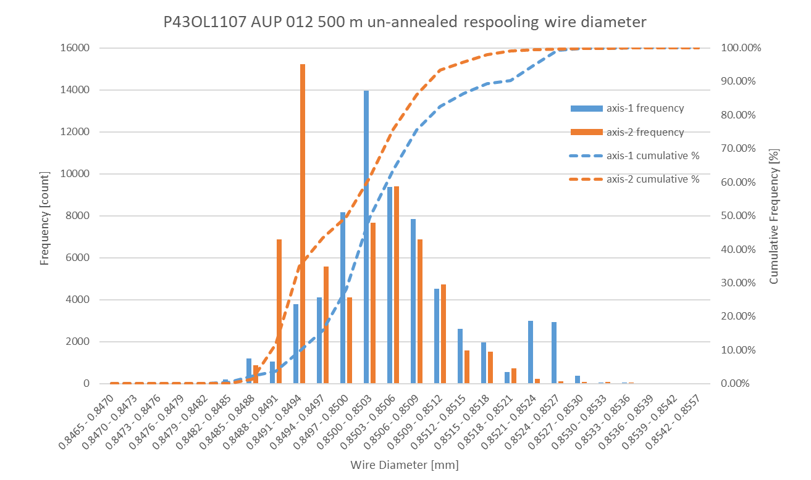
P43OL1107 Respooling Wire Diameter
Below LSL: 0.00%
Above USL: 0.22%

Slide 37
P43OL1107 – Cable QC Data Summary
CME:
Residual Twist:
  145°
10-stack:
  Qualification: 1.534 mm
  Production tail end: 1.530 mm
 | Pressure (MPa) | Angle (°) | Width (mm) | Thickness (mm)
Maximum | 17.0 | 0.467 | 18.164 | 1.535
Average | 17.0 | 0.441 | 18.152 | 1.529
Minimum | 17.0 | 0.413 | 18.142 | 1.524
Sigma | 0.01 | 0.010 | 0.003 | 0.002

Slide 38
Rollers: P-91 (2017-12-08) and P-92 (2017-12-08)

Slide 39
Rollers: P-91 (2017-12-08) and P-92 (2017-12-08)

Slide 40
Rollers: P-91 (2017-12-08) and P-92 (2017-12-08)

Slide 41
P43OL1107 – Braiding
Fiberglass Lot #100415
P/I: 18.0
Spool tension: 10 lbs. (payoff); 20 lbs. (takeup)
Bobbin payoff tension: 0.125 lbs. (min), 0.250 lbs. (max)
NEWT 10-stack QC:
  Cycle #1) 0.149 mm; #2) 0.146 mm; #3) 0.145 mm;
  Mean 0.147 mm
LBNL 10-stack verification QC:
  Cycle #1) 0.142 mm; #2) 0.141 mm; #3) 0.139 mm;
  Mean 0.140 mm
LBNL boat subsequently found to have possibly misaligned
CAPA: hardware record to include realignment
Vector #464342

Slide 42
P43OL1107 – Wire Parameters
Properties | Inspected Average
Wire Diameter | 0.850 ± 0.0009 mm (LBNL)¹
Cu ratio ª | 54.3% (OST)
Strand twist pitch ª | 18.4 mm (OST)
RRR (RW) ª | 286 (OST)
RRR (15% rolled) ª | 188 (OST)
I_{C} (4.2 K, 15 T) ª | 372 A (OST)
I_{C} (4.2 K, 14 T) ª | 466 A (OST)
I_{C} (4.2 K, 13 T) ª | 572 A (OST)
I_{C} (4.2 K, 12 T) ª | 693 A (OST)
ª First billet averaged, then weighted average according
to the spool distribution in the cable
¹ As-received, all LBNL respooling data; mean ± 1 sigma

Slide 43
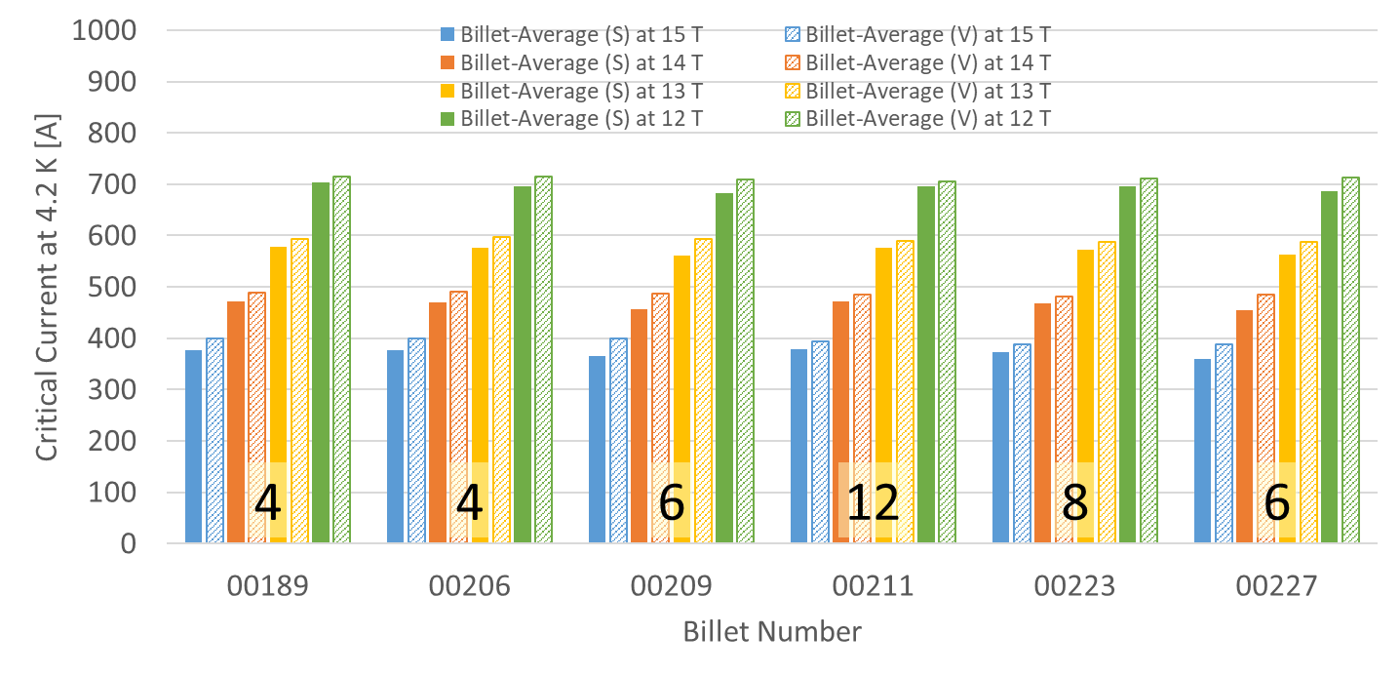
P43OL1107 – Wire Parameters
Supplier (S) and Verification (V) I_{C} Data
Number of spools from that billet used in the cable

Slide 44
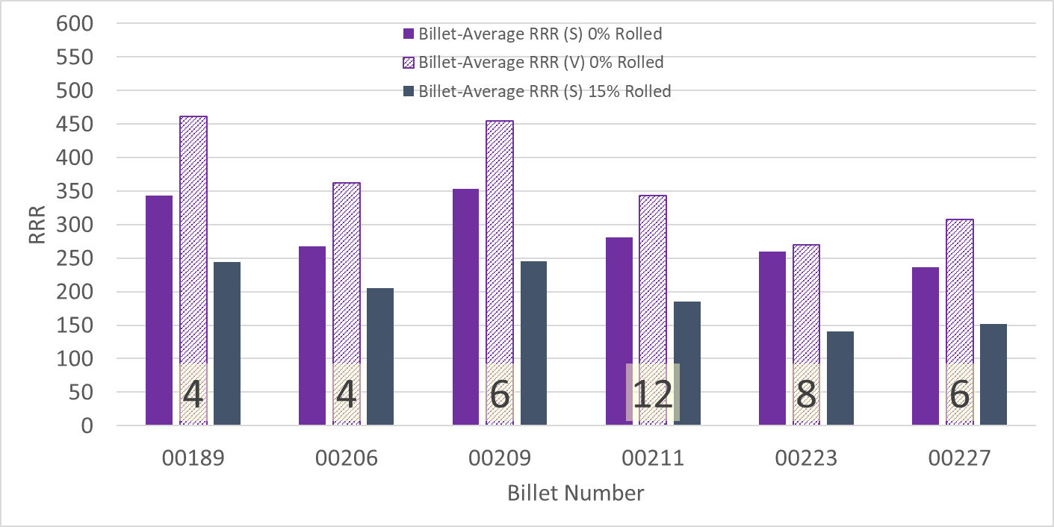
P43OL1107 – Wire Parameters
Supplier (S) and Verification (V) RRR Data
Number of spools from that billet used in the cable

Slide 45
P43OL1107 – Extracted Strand RRR
 | Cable ID | No. of Units from Billet (spool) | HT/sample ID | Major edge RRR | Minor edge RRR | Straight section 1 RRR | Straight section 2 RRR
ID #1 | P43OL1107AE33E PO08S00227A04U | 6 (6) | LRLK180717ALC1 | 282 | 216 | 343 | 303
ID #2 | P43OL1107AE37E PO08S00227A04U | 6 (6) | LRLK180717ALC1 | 293 | 231 | 338 | 331
ID #3 | P43OL1107AE15E PO08S00209A04U | 6 (6) | LRLK180717ALC1 | 390 | 324 | 398 | 402
ID #4 | P43OL1107AE49E PO08S00223A01U | 8 (8) | LRLK180717ALC2 | 287 | 214 | 372 | 335
ID #5 | P43OL1107AE54E PO08S00223A01U | 8 (8) | LRLK180717ALC2 | 286 | 164 | 315 | 278
Vector #464342

Slide 46
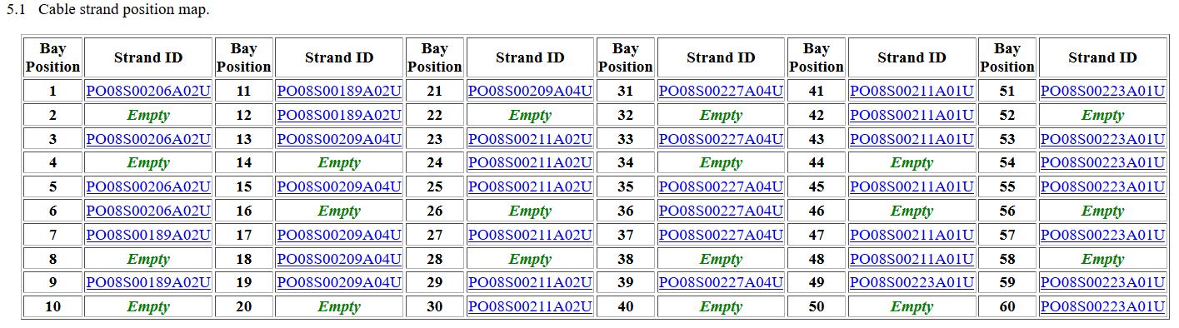
P43OL1107 – Witness Samples
Witness extracted strand (XS)
Witness virgin strand (VS)

Slide 47
P43OL1107 – Witness Samples
ID | RRR (293K / 20K) XS > 100 RW > 150 | Ic(12T) XS > 600 RW > 632 | Ic(13T) | Ic(14T) | Ic(15T) XS > 314 RW > 331
PO08S00223A01U | 201 | 694 | 575 | 470 | 378
PO08S00211A01U | 231
P43OL1107AE49E | 149 | 676 | 562 | 459 | 369
P43OL1107AE54E | 125 | 641 | 532 | 433 | 348
P43OL1107AE43E | 189 | 590 | 574 | 475 | 385
P43OL1107AE47E | 174 | 676 | 560 | 456 | 367
nnnQ denotes a critical current measurement that showed a transition but quenched before the criterion was reached
Q denotes a critical current measurement that did not show a transition before quenching

Slide 48
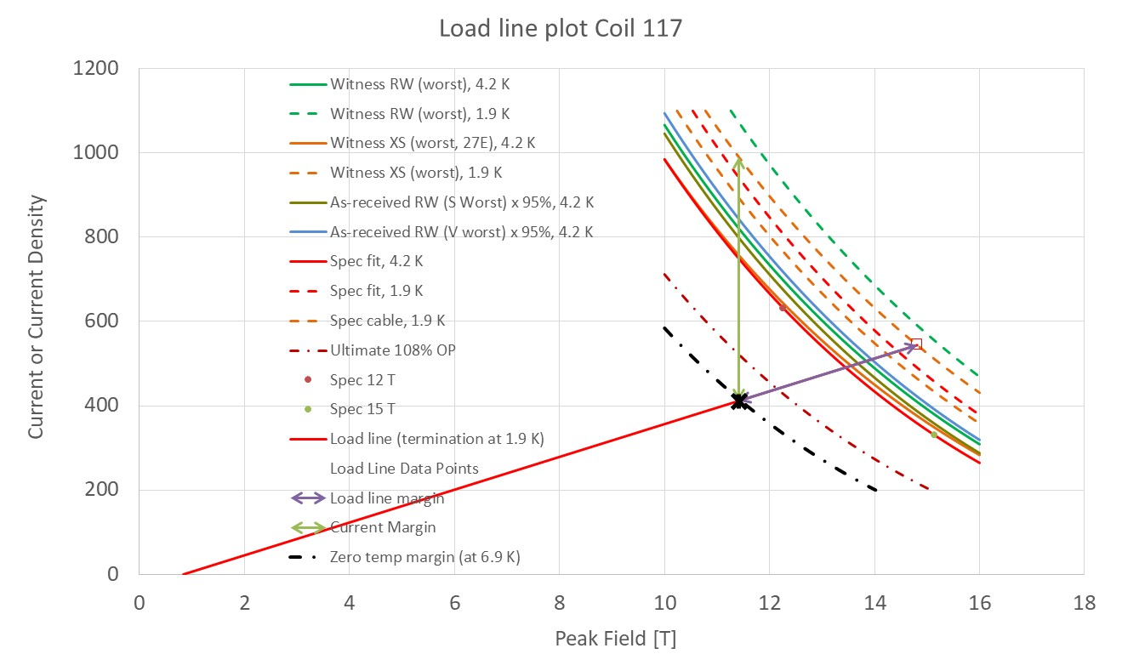
Margins | Margin | Operating Point (X)
Load line margin (purple arrow) | 24.3% | 75.7%
Current margin (green arrow) | 58.4% | 41.6%
Temperature margin [K] | 5.0 | 6.9

Slide 49
QXFA-207 / P43OL1106

Slide 50
Cable Summary
Magnet: MQXFA-05
Coil: QXFA-207
Corresponding Cable: P43OL1106 (AUP 011)
Cable is 2nd generation QXF cables with 108/127 RRP® strands procured under LARP

Slide 51
Wire Summary
All “HiLumi” spec, procured by LARP under:
  FNAL 632982 D – Spec 0
0.85 mm, Ti-doped, reduced Sn

Slide 52
P43OL1106 – Cable Date, Lengths
Cable Manufacture Date
  2018 06 18 (Production run)
Cable Length:
  465 m (LBNL, fabricated, including LBNL samples)
  455 m (shipped to NEWT, including S & V samples)
  ??? m (Measured by BNL)

Slide 53
P43OL1106 – Strand and SS Core ID
Spool:
  PO08S00220A01U x 1 ULs
  PO08S00220A02U x 3 ULs
  PO08S00220A03U x 1 ULs
  PO08S00220A05U x 2 ULs
  PO08S00225A03U x 2 ULs
  PO08S00224A02U x 3 ULs
  PO08S00225A02U x 2 ULs
  PO08S00239A07U x 1 ULs
  PO08S00224A01U x 1 ULs
  PO08S00239A04U x 1 ULs
  PO08S00225A05U x 2 ULs
  PO08S00239A02U x 2 ULs
  PO08S00239A01U x 2 ULs
  PO08S00224A04U x 1 ULs
  PO08S00225A01U x 3 ULs
  PO08S00239A06U x 2 ULs
  PO08S00223A02U x 11 ULs
Core:
  120L40A7322313
    Core width: 12.0 mm; material: 316L;
    Heat: 844979; Lot: 16-597;
    Chemical Properties CoT/CoC 172660-1: 0.14 wt% Co
From 5 billets

Slide 54
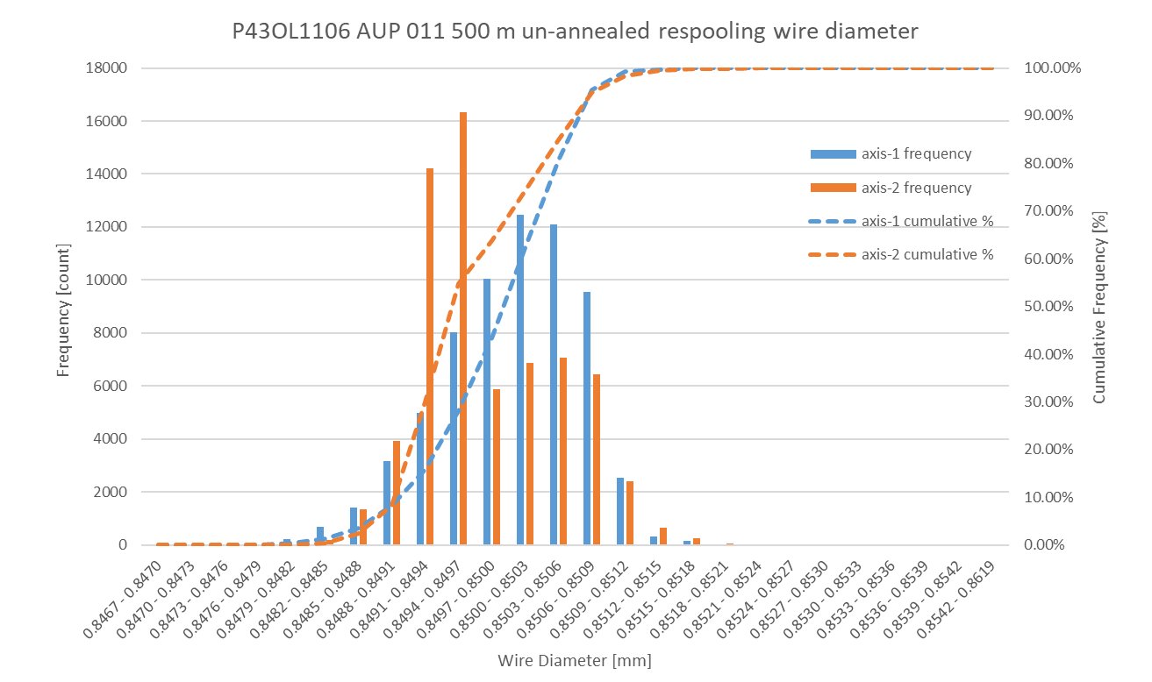
P43OL1106 Respooling Wire Diameter
Below LSL: 0.00%
Above USL: 0.04%

Slide 55
P43OL1106 – Cable QC Data Summary
CME:
Residual Twist:
  130°
10-stack:
  Qualification: 1.533 mm
  Production tail end: 1.531 mm
 | Pressure (MPa) | Angle (°) | Width (mm) | Thickness (mm)
Maximum | 17.0 | 0.459 | 18.159 | 1.531
Average | 17.0 | 0.426 | 18.149 | 1.526
Minimum | 17.0 | 0.398 | 18.143 | 1.523
Sigma | 0.01 | 0.009 | 0.002 | 0.001

Slide 56
Rollers: P-91 (2017-12-08) and P-92 (2017-12-08)

Slide 57
Rollers: P-91 (2017-12-08) and P-92 (2017-12-08)

Slide 58
Rollers: P-91 (2017-12-08) and P-92 (2017-12-08)

Slide 59
P43OL1106 – Braiding
Fiberglass Lot #100415
P/I: 18.0
Spool tension: 10 lbs. (payoff); 20 lbs. (takeup)
Bobbin payoff tension: 0.125 lbs. (min), 0.250 lbs. (max)
NEWT 10-stack QC:
  Cycle #1) 0.149 mm; #2) 0.147 mm; #3) 0.145 mm;
  Mean 0.147 mm
LBNL 10-stack verification QC:
  Cycle #1) 0.146 mm; #2) 0.143 mm; #3) 0.141 mm;
  Mean 0.143 mm
Vector #464342

Slide 60
P43OL1106 – Wire Parameters
Properties | Inspected Average
Wire Diameter | 0.850 ± 0.0006 mm (LBNL)¹
Cu ratio ª | 54.7% (OST)
Strand twist pitch ª | 18.7 mm (OST)
RRR (RW) ª | 258 (OST)
RRR (15% rolled) ª | 168 (OST)
I_{C} (4.2 K, 15 T) ª | 368 A (OST)
I_{C} (4.2 K, 14 T) ª | 463 A (OST)
I_{C} (4.2 K, 13 T) ª | 571 A (OST)
I_{C} (4.2 K, 12 T) ª | 694 A (OST)
ª First billet averaged, then weighted average according
to the spool distribution in the cable
¹ As-received, all LBNL respooling data; mean ± 1 sigma

Slide 61
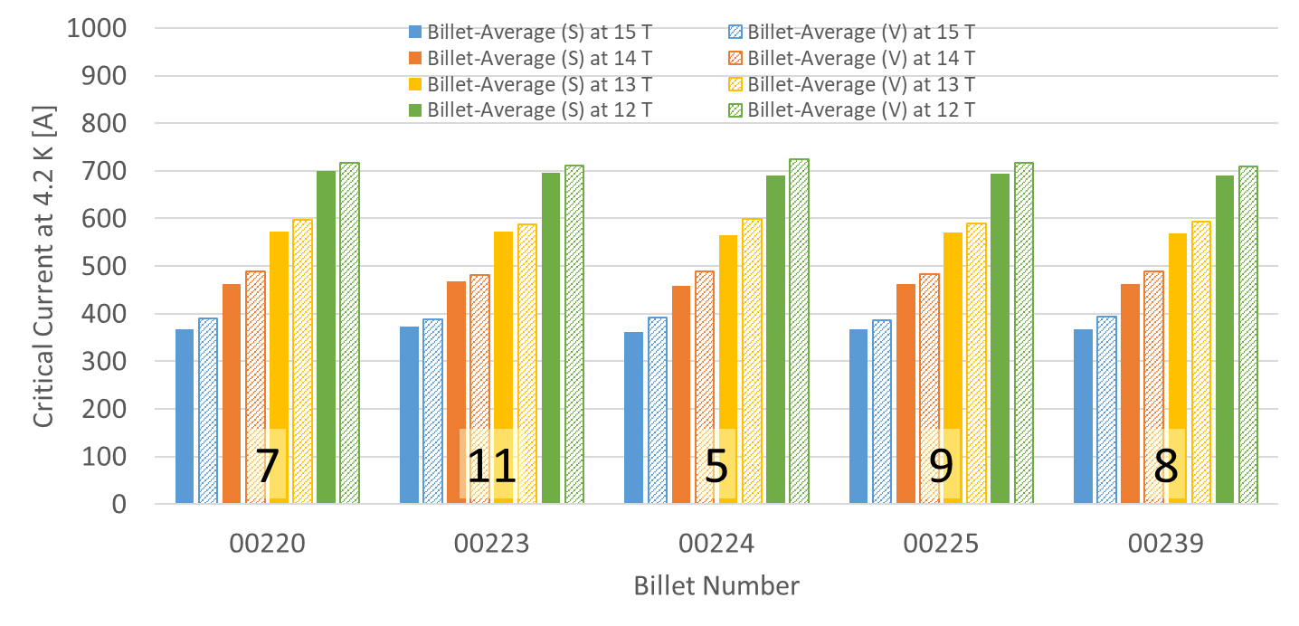
P43OL1106 – Wire Parameters
Supplier (S) and Verification (V) I_{C} Data
Number of spools from that billet used in the cable

Slide 62
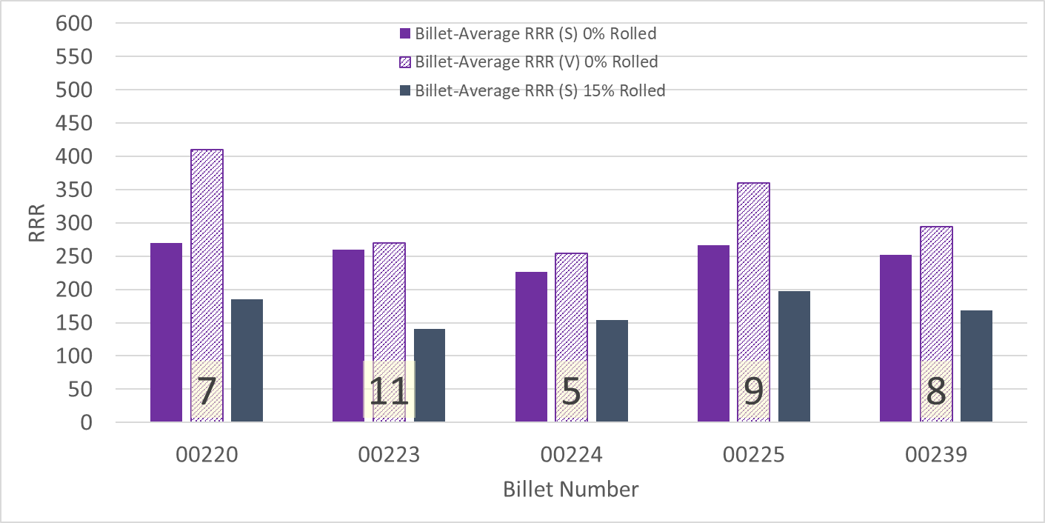
P43OL1106 – Wire Parameters
Supplier (S) and Verification (V) RRR Data
Number of spools from that billet used in the cable

Slide 63
P43OL1106 – Extracted Strand RRR
 | Cable ID | No. of Units from Billet (spool) | HT/sample ID | Major edge RRR | Minor edge RRR | Straight section 1 RRR | Straight section 2 RRR
ID #1 | P43OL1106AE05E PO08S00220A02U | 7 (3) | LRLK180717ALC1 | 284 | 270 | 399 | 410
ID #2 | P43OL1106AE17E PO08S00224A02U | 5 (3) | LRLK180717ALC1 | 271 | 200 | 307 | 301
ID #3 | P43OL1106AE37E PO08S00225A01U | 9 (3) | LRLK180717ALC1 | 312 | 238 | 326 | 334
ID #4 | P43OL1106AE45E PO08S00223A02U | 11 (11) | LRLK180717ALC1 | 189 | 175 | 252 | 259
ID #5 | P43OL1106AE49E PO08S00223A02U | 11 (11) | LRLK180717ALC1 | 263 | 222 | 304 | 305
Vector #464342

Slide 64
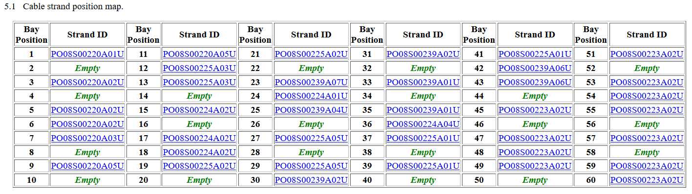
P43OL1106 – Witness Samples
Witness extracted strand (XS)
Witness virgin strand (VS)
All tests were successful

Slide 65
P43OL1106 – Witness Samples
ID | RRR (293K / 20K) XS > 100 RW > 150 | Ic(12T) XS > 600 RW > 632 | Ic(13T) | Ic(14T) | Ic(15T) XS > 314 RW > 331
PO08S00223A02U | 292 | 671 | 549 | 441 | 351
PO08S00220A02U | 388 | 678 | 555 | 447 | 352
P43OL1106AE45E | 253 | 654 | 541 | 439 | 349
P43OL1106AE55E | 228 | 617 | 494 | 400 | 310
P43OL1106AE05E | 310
P43OL1106AE17E | 236
nnnQ denotes a critical current measurement that showed a transition but quenched before the criterion was reached
Q denotes a critical current measurement that did not show a transition before quenching

Slide 66
Margins | Margin | Operating Point (X)
Load line margin (purple arrow) | 25.0% | 75.0%
Current margin (green arrow) | 61.0% | 39.0%
Temperature margin [K] | 5.1 | 7.0

Slide 67
QXFA-209 / P43OL1114

Slide 68
Cable Summary
Magnet: MQXFA-06
Coil: QXFA-209
Corresponding Cable: P43OL1114 (AUP 016)
Cable is 2nd generation QXF cables with 108/127 RRP® strands procured under LARP

Slide 69
Wire Summary
All “HiLumi” spec, procured by CERN under:
  CERN Contract F663
0.85 mm, Ti-doped, reduced Sn
Strand data from CERN:
ID | Ic12 A | Ic15 A | RRR | n15 | Ic15 roll A | RRR roll
AO08S00125A01U.Y | 707 | 393 | 218 | 31 | 399 | 101
AO08S00125A01U.X | 711 | 395 | 201 | 34
AO08S00136A01U | 675 | 373 | 254 | 43 | 375 | 146
(Spec) | 632 | 331 | 150 | 30 | 314 | 100

Slide 70
P43OL1114 – Cable Date, Lengths
Cable Manufacture Date
  2018 12 19 (Production run)
Cable Length:
  481 m (LBNL, fabricated, including LBNL samples)
  455 m (shipped to NEWT, including S & V samples)
  ??? m (Measured by BNL)

Slide 71
P43OL1114 – Strand and SS Core ID
Spool:
  AO08S00123A02U x 3 ULs
  AO08S00136A03U x 3 ULs
  AO08S00123A04U x 5 ULs
  AO08S00136A01U x 12 ULs
  AO08S00125A01U x 17 ULs
Core:
  120L35A7322313
    Core width: 12.0 mm; material: 316L;
    Heat: 844979; Lot: 16-597;
    Chemical Properties CoT/CoC 172660-1: 0.14 wt% Co
From 3 billets

Slide 72
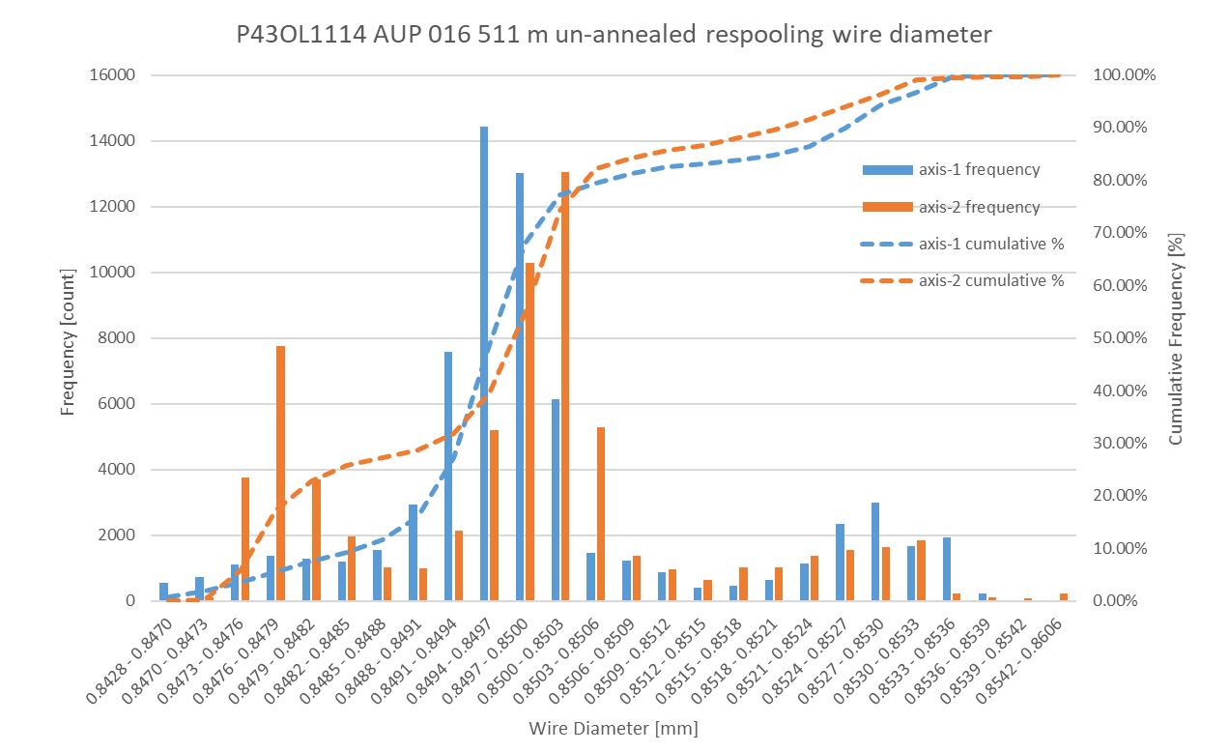
P43OL1114 Respooling Wire Diameter
Below LSL: 0.42%
Above USL: 4.68%
(Does not exceed Diameter DR Criteria 1 or 2, therefore no DR needed)

Slide 73
P43OL1114 – Cable QC Data Summary
CME:
Residual Twist:
  120°
10-stack:
  Qualification: 1.529 mm
  Production tail end: 1.533 mm
 | Pressure (MPa) | Angle (°) | Width (mm) | Thickness (mm)
Maximum | 17.1 | 0.426 | 18.173 | 1.531
Average | 17.0 | 0.406 | 18.152 | 1.527
Minimum | 17.0 | 0.385 | 18.147 | 1.523
Sigma | 0.01 | 0.006 | 0.003 | 0.001

Slide 74
Rollers: P-91 (2017-12-08) and P-92 (2017-12-08)

Slide 75
Rollers: P-91 (2017-12-08) and P-92 (2017-12-08)

Slide 76
Rollers: P-91 (2017-12-08) and P-92 (2017-12-08)

Slide 77
P43OL1114 – Braiding
Fiberglass Lot #100858
P/I: 18.0
Spool tension: 10 lbs. (payoff); 20 lbs. (takeup)
Bobbin payoff tension: 0.125 lbs. (min), 0.250 lbs. (max)
NEWT 10-stack QC:
  Cycle #1) 0.146 mm; #2) 0.144 mm; #3) 0.143 mm;
  Mean 0.144 mm
LBNL 10-stack verification QC:
  Cycle #1) 0.139 mm; #2) 0.138 mm; #3) 0.136 mm;
  Mean 0.138 mm (see DR #11758)
LBNL boat subsequently found to have possibly misaligned
CAPA: hardware record to include realignment
Vector #464342

Slide 78
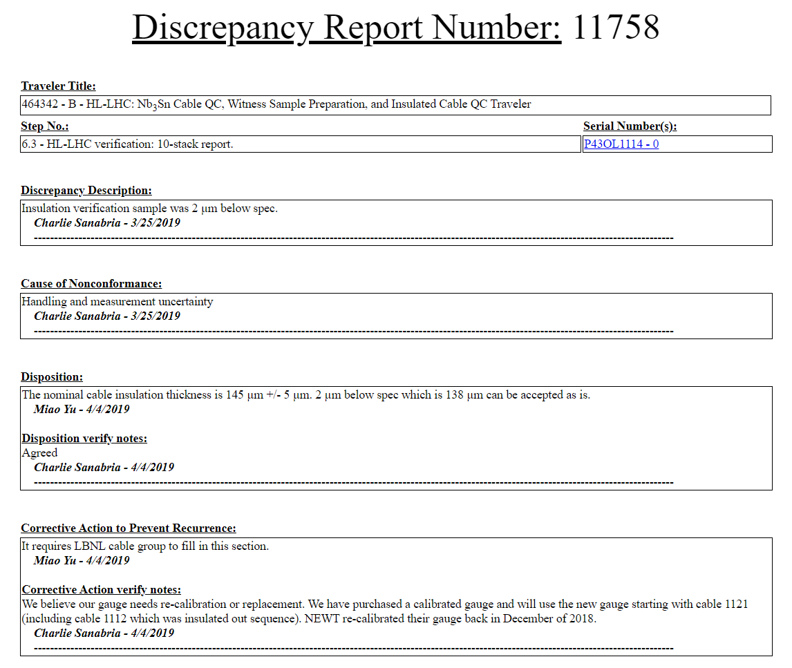
DR #11758

Slide 79
P43OL1114 – Wire Parameters
Properties | Inspected Average
Wire Diameter | 0.850 ± 0.0015 mm (LBNL)¹
Cu ratio ª | 54.6% (OST)
Strand twist pitch ª | 19.3 mm (OST)
RRR (RW) ª | 226 (OST)
RRR (15% rolled) ª | 119 (OST)
I_{C} (4.2 K, 15 T) ª | 390 A (OST)
I_{C} (4.2 K, 14 T) ª | 481 A (OST)
I_{C} (4.2 K, 13 T) ª | 584 A (OST)
I_{C} (4.2 K, 12 T) ª | 701 A (OST)
Supplier QC: 665°C for 75 h
ª First billet averaged, then weighted average according
to the spool distribution in the cable
¹ As-received, all LBNL respooling data; mean ± 1 sigma

Slide 80
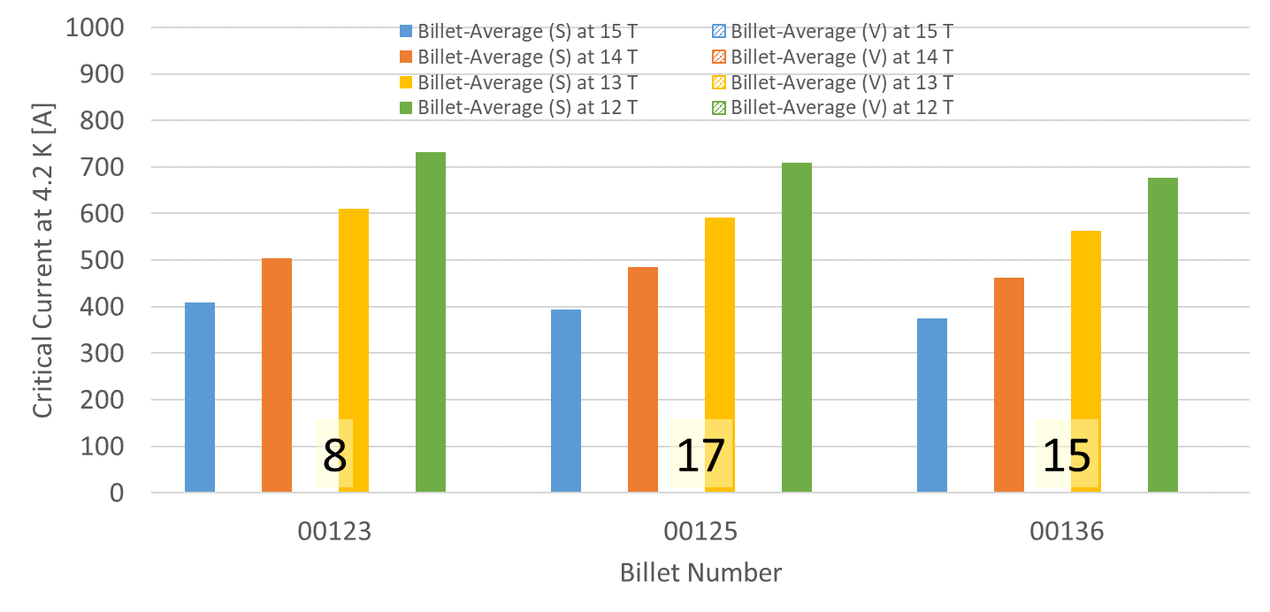
P43OL1114 – Wire Parameters
Supplier (S) and Verification (V) I_{C} Data
Number of spools from that billet used in the cable

Slide 81
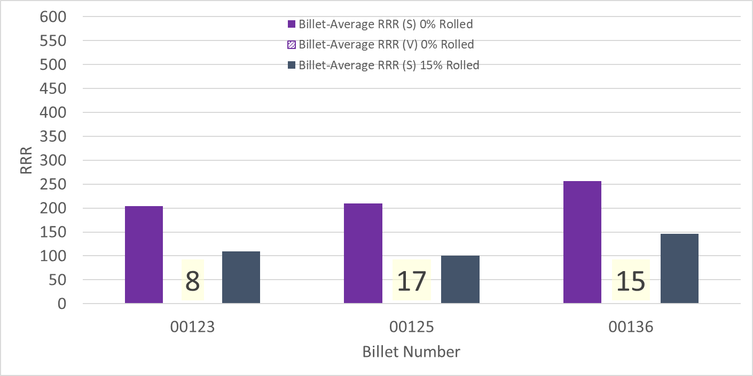
P43OL1114 – Wire Parameters
Supplier (S) and Verification (V) RRR Data
Number of spools from that billet used in the cable

Slide 82
P43OL1114 – Extracted Strand RRR
 | Cable ID | No. of Units from Billet (spool) | HT/sample ID | Major edge RRR | Minor edge RRR | Straight section 1 RRR | Straight section 2 RRR
ID #1 | P43OL1114AE19E AO08S00136A01U | 15 (12) | LRLK190205ALC1 | 269 | 276 | 335 | 353
ID #2 | P43OL1114AE18E AO08S00136A01U | 15 (12) | LRLK190205ALC1 | 250 | 317 | 325 | 333
ID #3 | P43OL1114AE37E AO08S00125A01U | 17 (17) | LRLK190205ALC1 | 228 | 227 | 341 | 336
ID #4 | P43OL1114AE36E AO08S00125A01U | 17 (17) | LRLK190205ALC1 | 179 | 272 | 321 | 328
ID #5 | P43OL1114AE11E AO08S00123A04U | 8 (5) | LRLK190205ALC1 | 225 | 278 | 297 | 280
Vector #464342

Slide 83
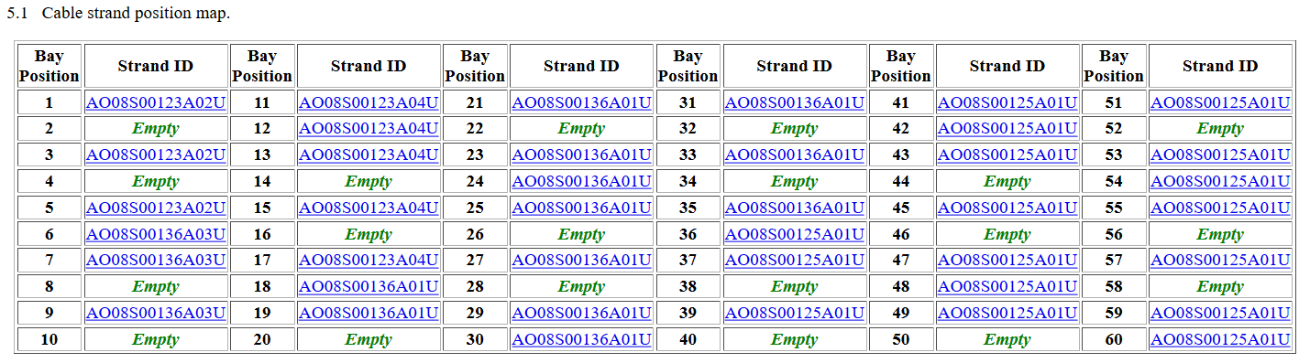
P43OL1114 – Witness Samples
Witness extracted strand (XS)
Witness virgin strand (VS)
All tests were successful
  Virgin strand tests were not stable on inner taps

Slide 84
P43OL1114 – Witness Samples
ID | RRR (293K / 20K) XS > 100 RW > 150 | Ic(12T) XS > 600 RW > 632 | Ic(13T) | Ic(14T) | Ic(15T) XS > 314 RW > 331
PO08S00125A01U | 304 | 729 | 605 | 495 | 400
PO08S00136A01U | 296 | 709 | 592 | 486 | 395
P43OL1114AE36E | 221 | 731 | 613 | 505 | 412
P43OL1114AE39E | 233 | 727 | 608 | 502 | 409
P43OL1114AE18E | 250
P43OL1114AE21E | 252
Extracted strands and witness samples using 665°C for 50 h
clearly outperform the supplier data to CERN using 665°C for 75 h
nnnQ denotes a critical current measurement that showed a transition but quenched before the criterion was reached
Q denotes a critical current measurement that did not show a transition before quenching

Slide 85
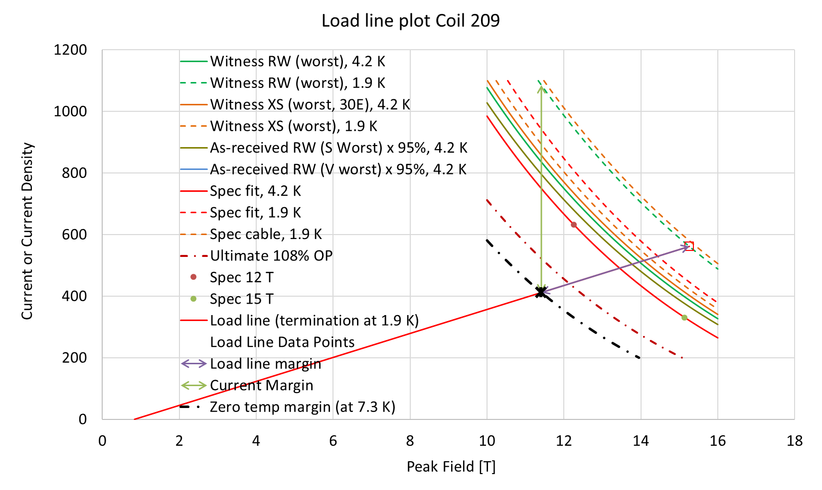
SSL
Margins | Margin | Operating Point (X)
Load line margin (purple arrow) | 26.7% | 73.3%
Current margin (green arrow) | 62.1% | 37.9%
Temperature margin [K] | 5.4 | 7.3

Slide 86
Summary
Coil | SSL field (T) | SSL current (kA) | I_{OP}/I_{SSL} (%) | T margin (K) | Cable I_{C} (kA) | I_{OP}/I_{C} (%)
MQXFA116 | 15.0 | 22.0 | 74.9 | 5.2 | 41.9 | 39.3
MQXFA117 | 14.8 | 21.8 | 75.7 | 5.0 | 39.6 | 41.6
MQXFA207 | 14.9 | 21.9 | 75.0 | 5.1 | 42.2 | 39.0
MQXFA209 | 15.3 | 22.5 | 73.3 | 5.4 | 43.4 | 37.9
MQXFA115 | 15.2 | 22.3 | 73.9 | 5.3 | 43.8 | 37.6
Although the strand for coil 209 did not test well according to CERN data, the coil performs well based on XS data.

Slide 87
Extra – Spare Coil QXFA-115 / P43OL1102
As presented on 2019 10 30 at MQXFA04 Coils Acceptance

Slide 88
QXFA-115 / P43OL1102

Slide 89
P43OL1102 – Cable Date, Lengths
Cable Manufacture Date
  2018 05 18 (Production run)
Cable Length:
  470 m (LBNL, fabricated, including LBNL samples)
  449 m (Measured by FNAL)

Slide 90
P43OL1102 – Strand and SS Core ID
Spool:
  PO08S00239A05U x 2 ULs
  PO08S00220A04U x 3 ULs
  PO08S00230A04U x 3 ULs
  PO08S00239A03U x 3 ULs
  PO08S00235A01U x 12 ULs
  PO08S00237A01U x 17 ULs
Core:
  120L43A7322313
    Core width: 12.0 mm; material: 316L;
    Heat: 844979; Lot: 16-597;
    Chemical Properties CoT/CoC 172660-1: 0.14 wt% Co
From 5 billets

Slide 91
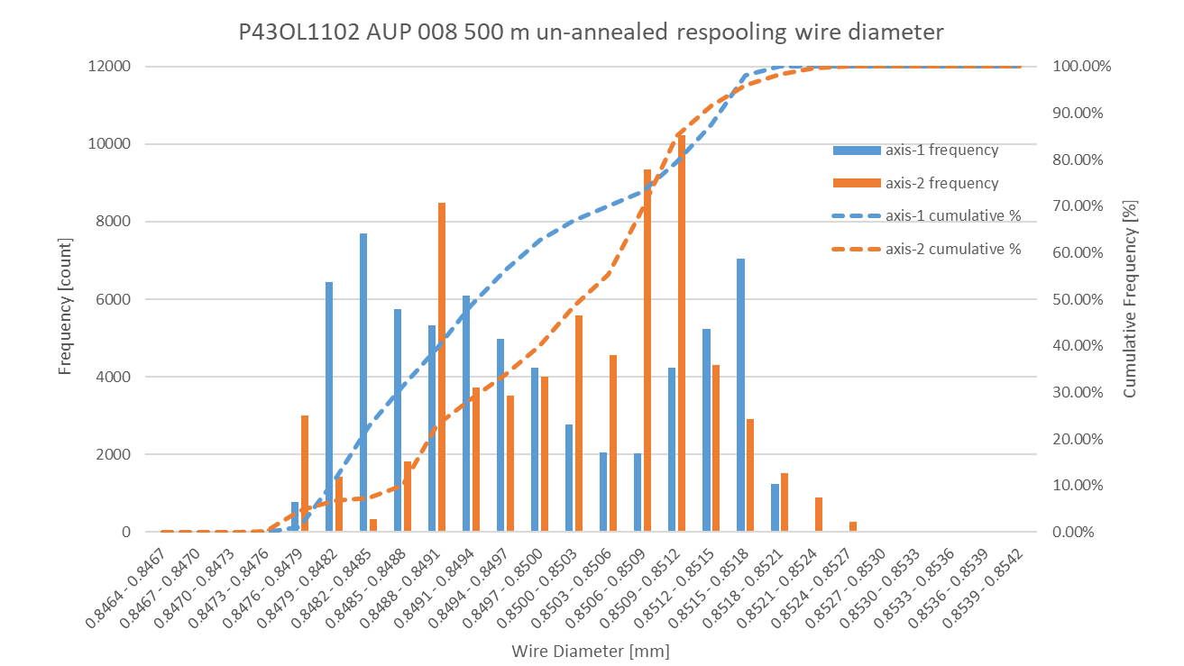
P43OL1102 Respooling Wire Diameter
Below LSL: 0.00%
Above USL: 0.00%

Slide 92
P43OL1102 – Cable QC Data Summary
CME:
Residual Twist:
  135°
10-stack:
  Qualification: 1.525 mm
  Production tail end: 1.528 mm
 | Pressure (MPa) | Angle (°) | Width (mm) | Thickness (mm)
Maximum | 17.1 | 0.451 | 18.169 | 1.530
Average | 17.0 | 0.425 | 18.153 | 1.526
Minimum | 16.9 | 0.395 | 18.145 | 1.522
Sigma | 0.01 | 0.009 | 0.004 | 0.001

Slide 93
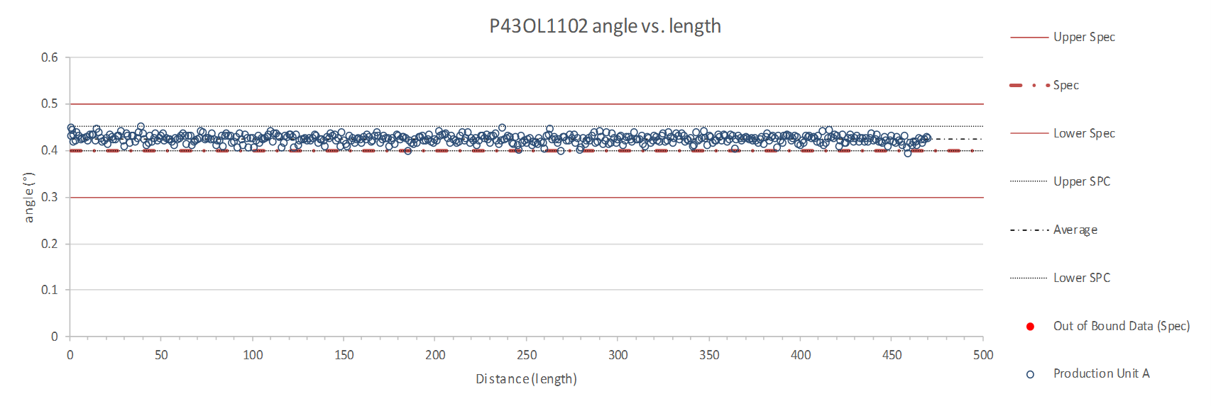
Rollers: P-91 (2017-12-08) and P-92 (2017-12-08)

Slide 94
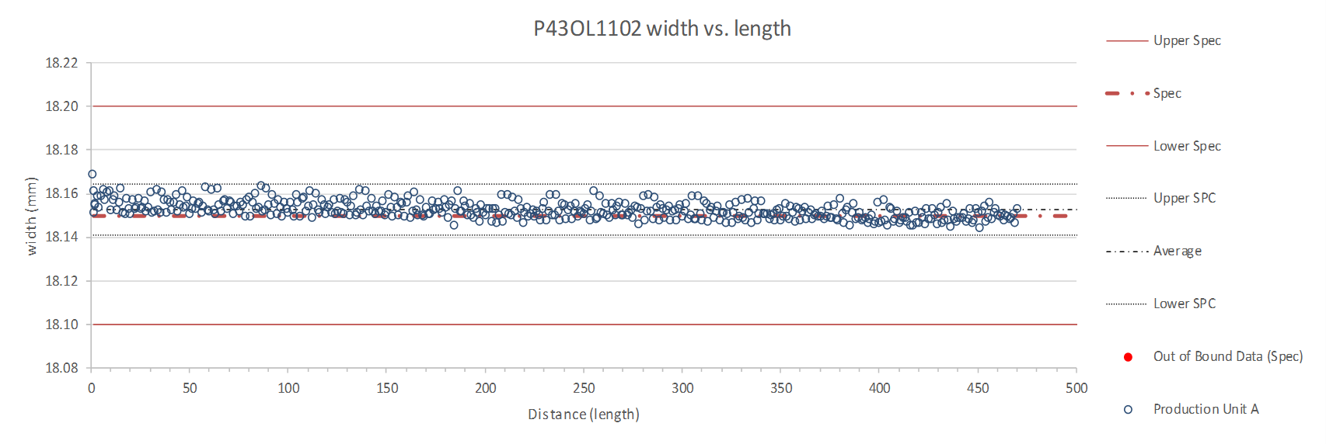
Rollers: P-91 (2017-12-08) and P-92 (2017-12-08)

Slide 95
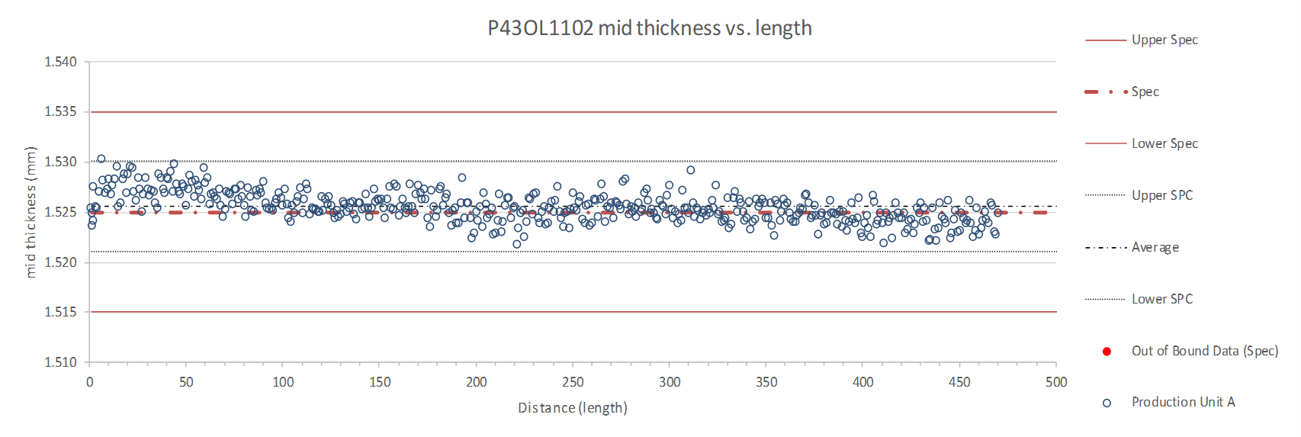
Rollers: P-91 (2017-12-08) and P-92 (2017-12-08)

Slide 96
P43OL1102 – Braiding
Fiberglass Lot #100415
P/I: 18.9
Spool tension: 10 lbs. (payoff); 20 lbs. (takeup)
Bobbin payoff tension: 0.125 lbs. (min), 0.250 lbs. (max)
NEWT 10-stack QC:
  Cycle #1) 0.150 mm; #2) 0.147 mm; #3) 0.146 mm;
  Mean 0.148 mm
LBNL 10-stack verification QC:
  Cycle #1) 0.143 mm; #2) 0.140 mm; #3) 0.137 mm;
  Mean 0.140 mm
Vector #464342

Slide 97
P43OL1102 – Wire Parameters
Properties | Inspected Average
Wire Diameter | 0.850 ± 0.001 mm (LBNL)¹
Cu ratio ª | 55.1% (OST)
Strand twist pitch ª | 18.6 mm (OST)
RRR (RW) ª | 263 (OST)
RRR (15% rolled) ª | 154 (OST)
I_{C} (4.2 K, 15 T) ª | 365 A (OST)
I_{C} (4.2 K, 14 T) ª | 459 A (OST)
I_{C} (4.2 K, 13 T) ª | 567 A (OST)
I_{C} (4.2 K, 12 T) ª | 690 A (OST)
ª First billet averaged, then weighted average according
to the spool distribution in the cable
¹ As-received, all LBNL respooling data; mean ± 1 sigma

Slide 98
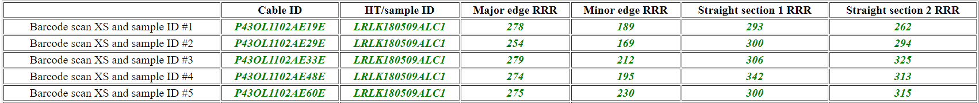
P43OL1102 – Extracted Strand RRR
Vector #464342

Slide 99
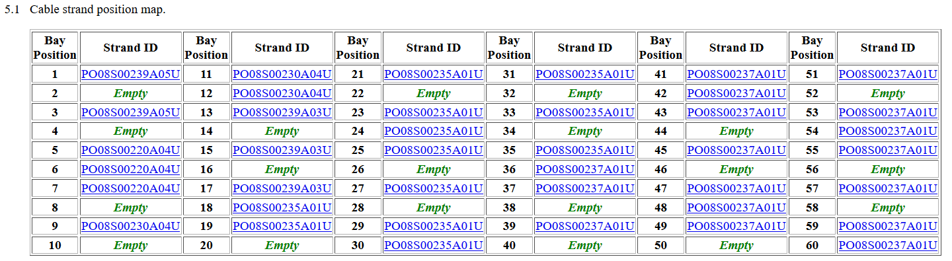
QXFA-CL-115 Cable P43OL1102
Witness extracted strand (XS)
Witness virgin strand (VS)
NO tests of backup samples were required to fulfill witness sample testing requirements
  Unstable tests are shaded above

Slide 100
Coil QXFA115, cable 1102 – Witness samples
ID | RRR (293K / 20K) XS > 100 RW > 150 | Ic(12T) XS > 600 RW > 632 | Ic(13T) | Ic(14T) | Ic(15T) XS > 314 RW > 331
PO08S00235A02U | 192 | 700 | 581 | 473 | 380
P43OL1102AE18E | 127 | 688 | 569 | 463 | 370
P43OL1102AE35E | 125 | 688 | 572 | 468 | 380
P43OL1102AE41E | 125
P43OL1102AE59E | 104
nnnQ denotes a critical current measurement that showed a transition but quenched before the criterion was reached
Q denotes a critical current measurement that did not show a transition before quenching

Slide 101
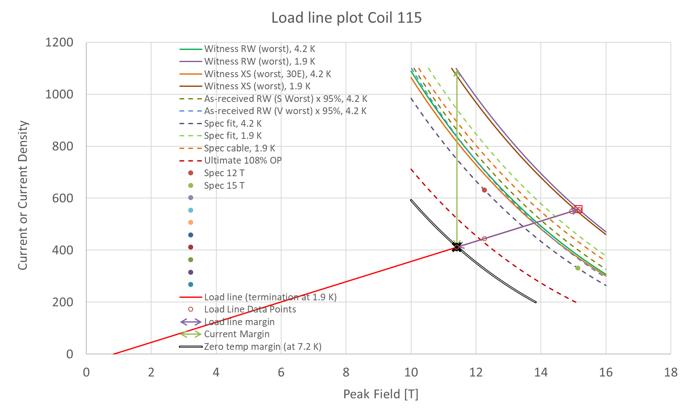
Coil 115 SSL
Margins | Margin | Operating Point (X)
Load line margin (purple arrow) | 26.2% | 73.9%
Current margin (green arrow) | 62.4% | 37.6%
Temperature margin [K] | 5.3 | 7.2

Slide 102
Summary of Data
Coil | SSL field (T) | SSL current (kA) | I_{OP}/I_{SSL} (%) | T margin (K) | Cable I_{C} (kA) | I_{OP}/I_{C} (%)
MQXFA112 | 15.0 | 22.1 | 74.6 | 5.2 | 41.7 | 39.5
MQXFA113 | 15.1 | 22.2 | 74.3 | 5.3 | 42.3 | 38.9
MQXFA203 | 15.4 | 22.6 | 72.8 | 5.5 | 45.1 | 36.5
MQXFA206 | 15.2 | 22.3 | 73.9 | 5.3 | 43.8 | 37.6
MQXFA115 | 15.2 | 22.3 | 73.9 | 5.3 | 43.8 | 37.6

