Slide 1


QXFA209 Coil Review
Jesse Schmalzle
January 29, 2020

Slide 2
Outline
Notes
Reaction plots
Electrical Data
CMM
DRs

Slide 3
QXFA209
Cable ID P43OL1114
After to change for B6 adjustment
  5 layers glass on pole
  5 mil G11 shims on midplane
Lead / Wire length
  3050 mm IL / 1250 m m OL coil leads
  1 m coil tap wires
  5.1 m splice tap wires
    A01 / B01 connected in wiring pocket
  5.1 m LE / 1.0 m NL quench heater wires

Slide 4
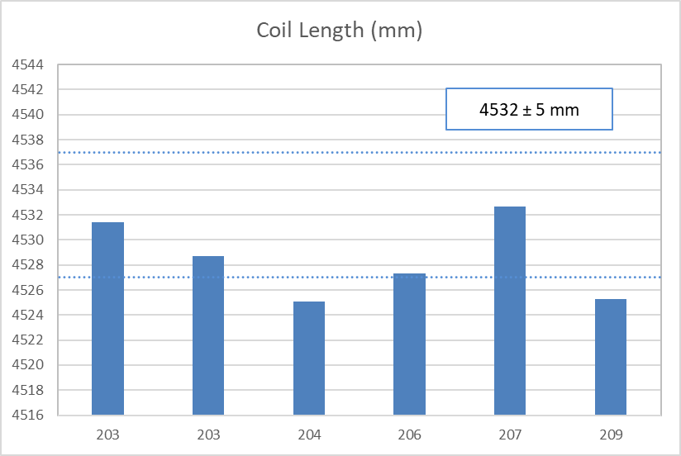
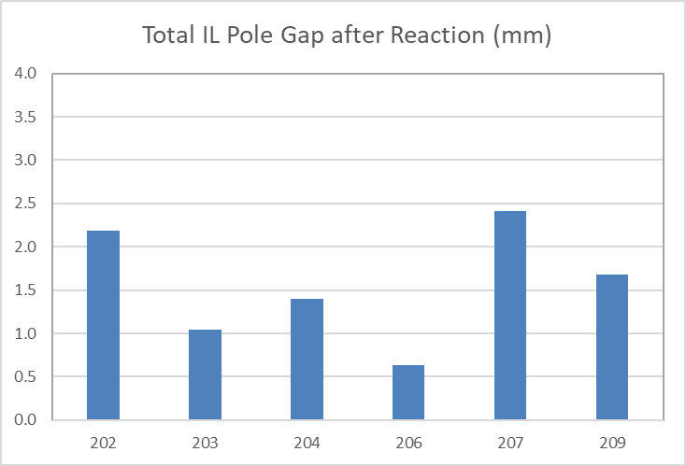
QXFA209
Coil Length / Pole gaps
  DR – overall length 4525.2 mm outside 4532 ± 5 mm spec.
(207 initial pole gaps set incorrectly)

Slide 5
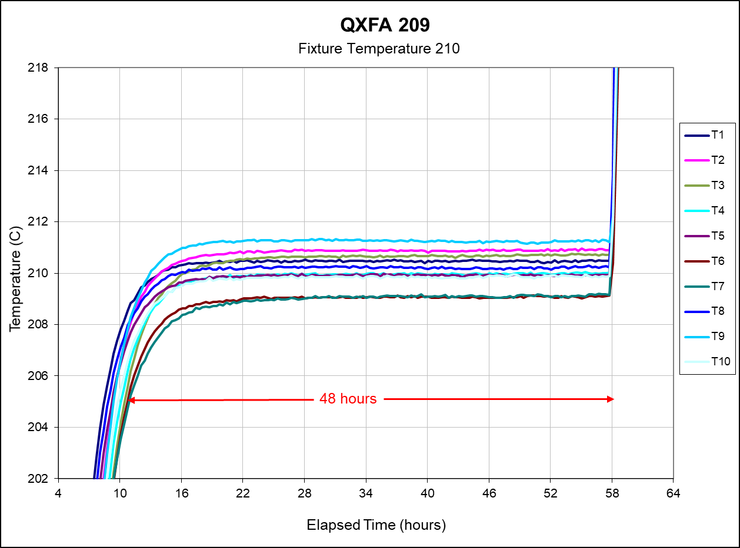
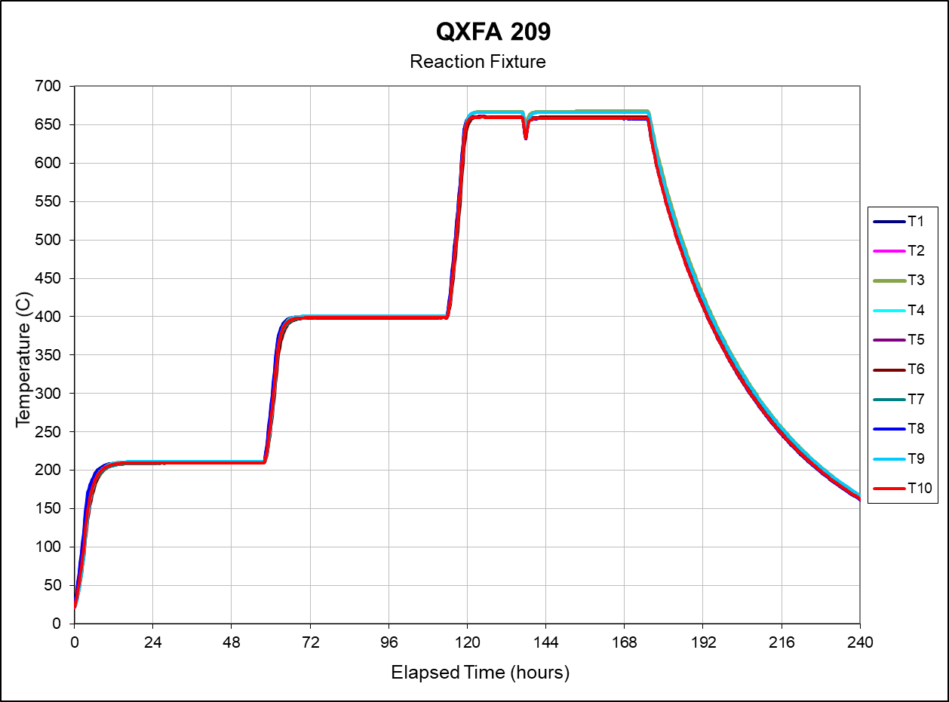
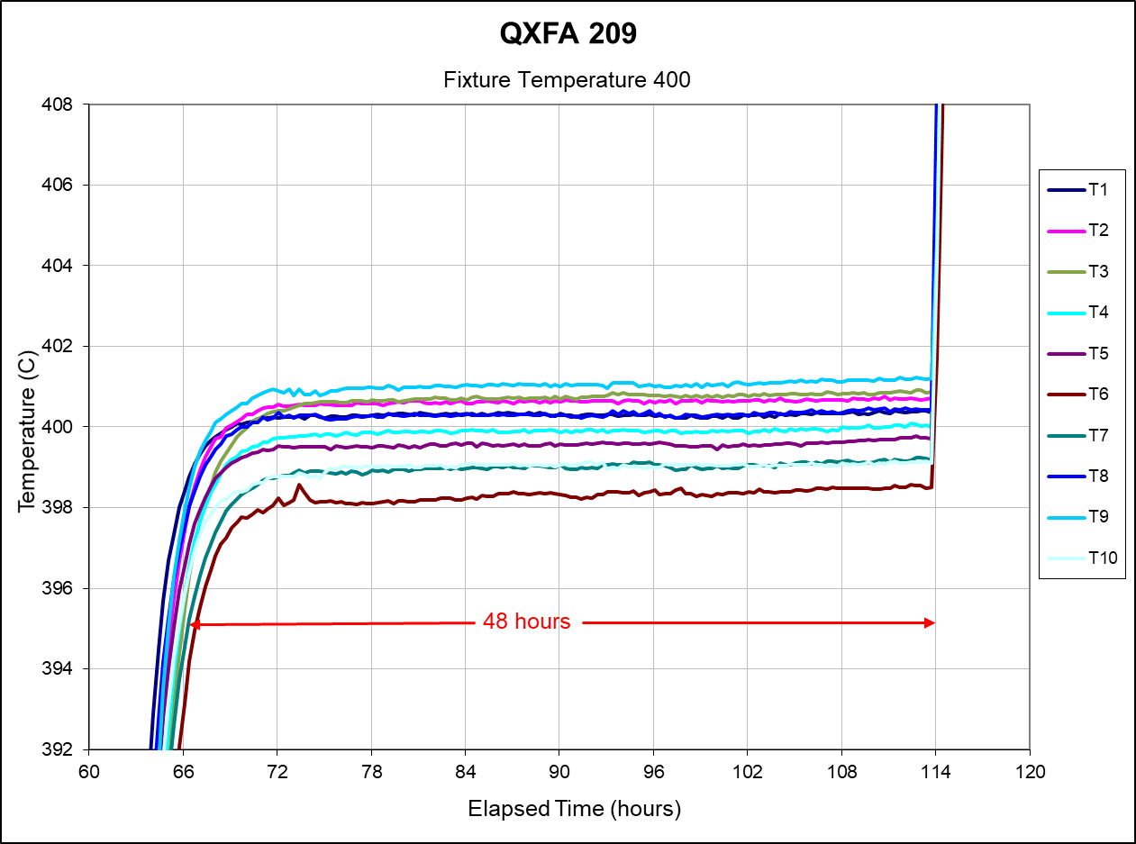
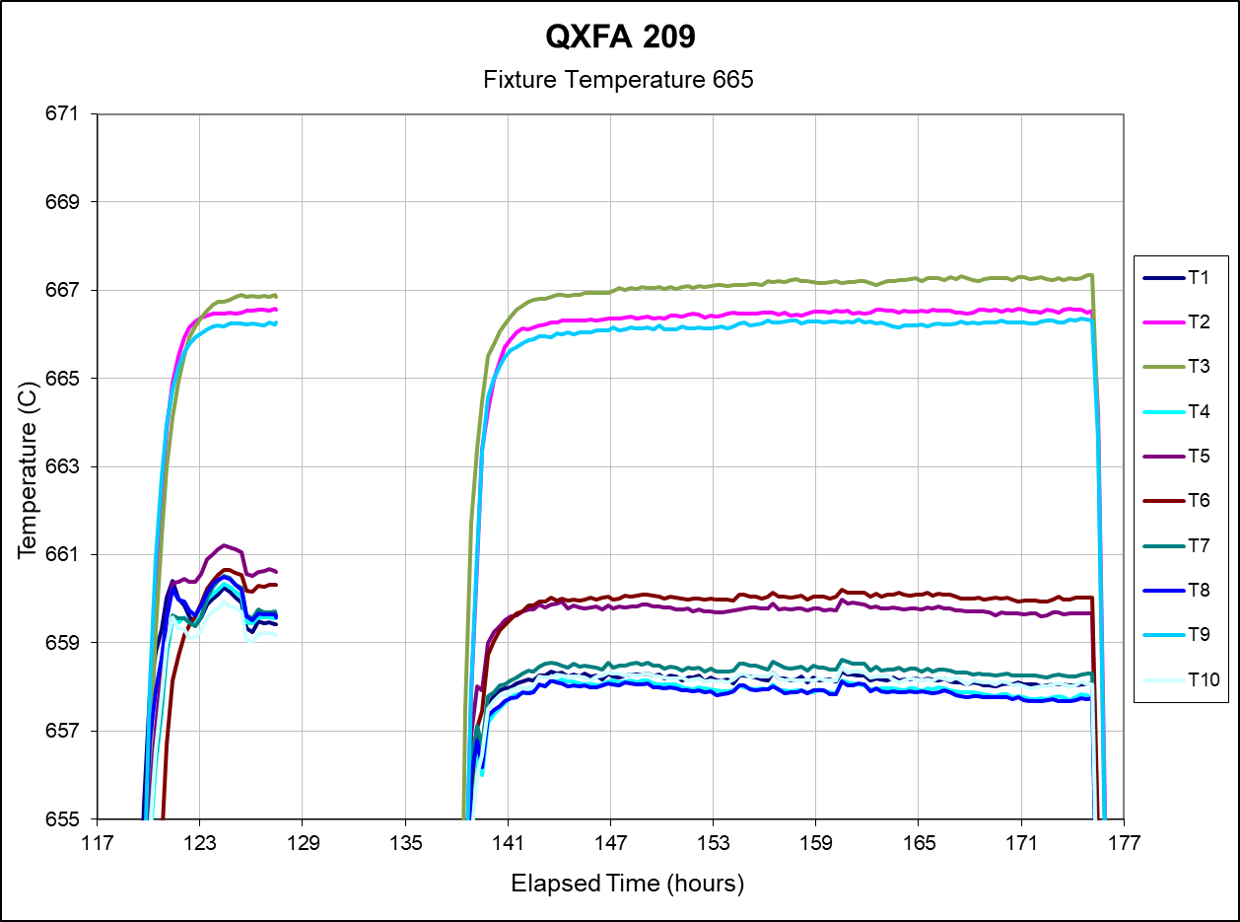
QXFA209
Reaction cycle – DR - data acquisition down, oven shut off
DR – data acquisition down, oven shut off.

Slide 6
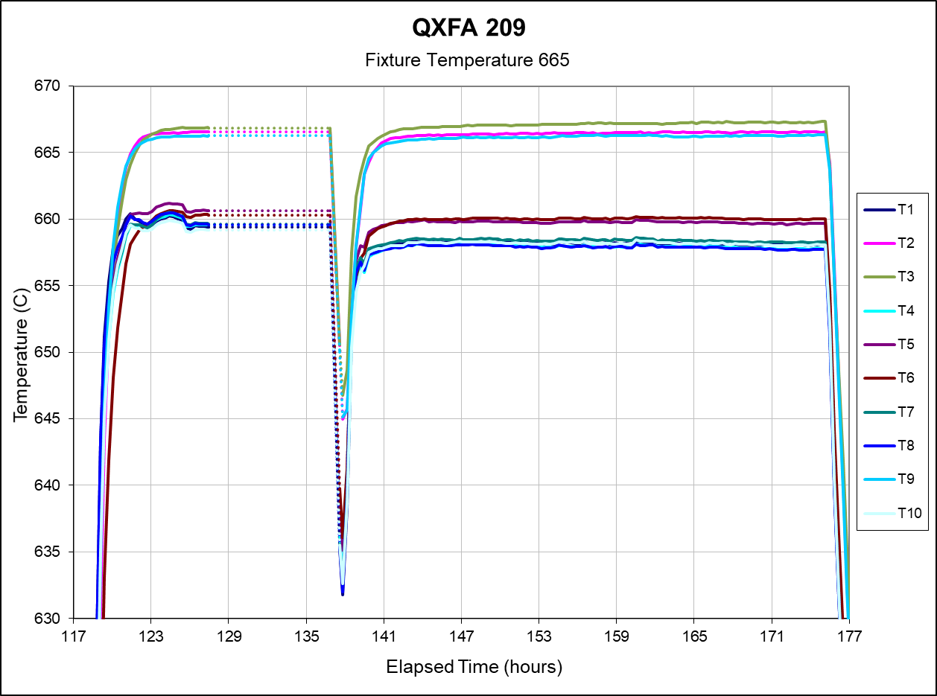
QXFA209
Reaction DRs
  Oven control reset during the 665 plateau – oven cooled to approx. 640 C before cycle was resumed – control down for less than 1 hour.
  Issue with data acquisition computer – no temperature data recorded for about 10 hours. (including period where the oven reset and began to cool).
  Required total time at plateau was achieved.
  TC spread at 665 outside 665 +/- 5 window – lowest observed 658 C.
    Issues with ceramic insulated TCs at 665 – changed to all sealed tube TCs after this coil.

Slide 7
QXFA209
Final electrical checks (RLQ, hipot, impulse) – no issues:

Slide 8
QXFA209

Slide 9
QXFA209

Slide 10
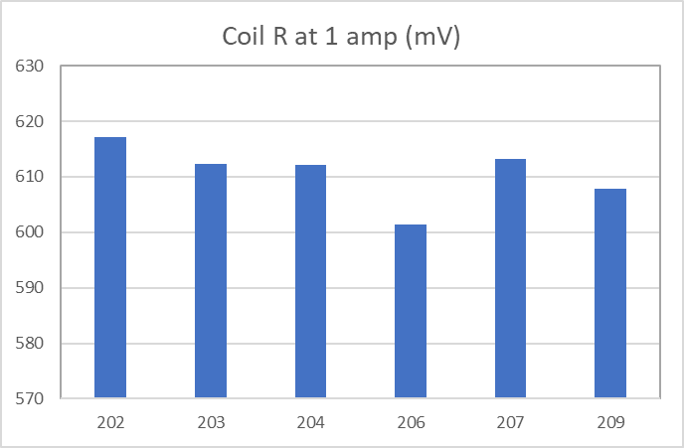
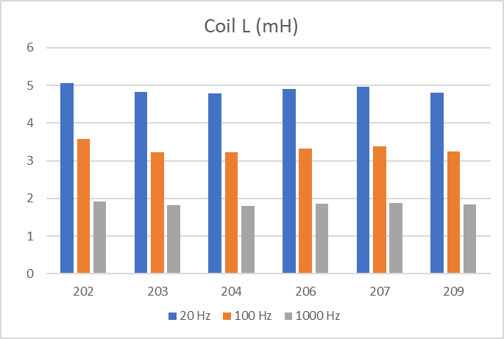
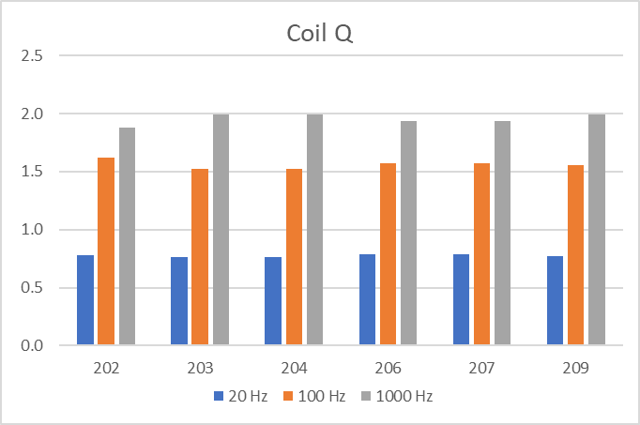
QXFA209

Slide 11
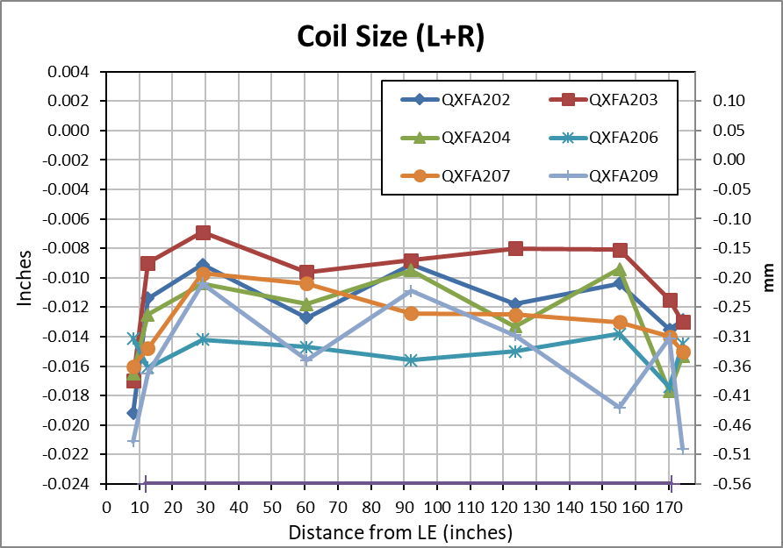
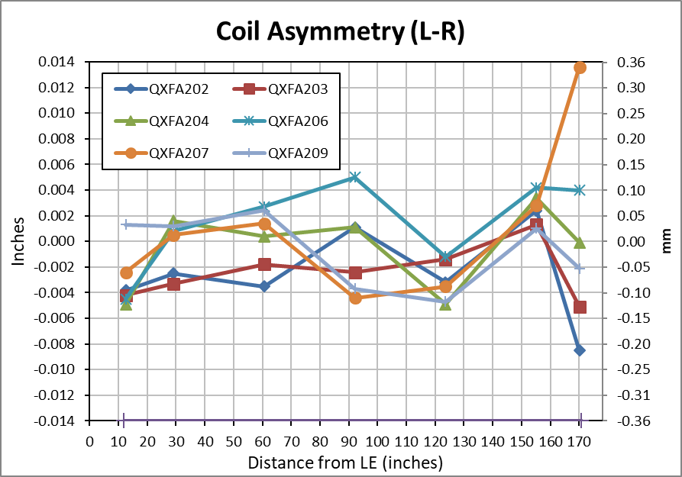
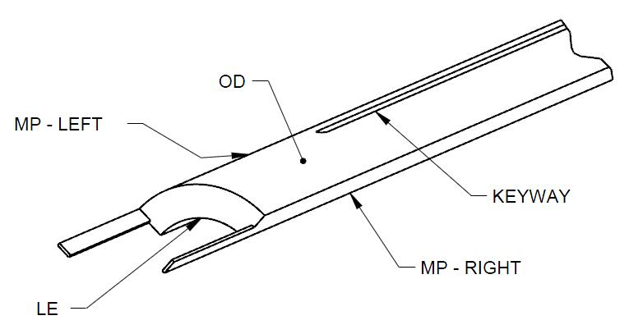
QXFA209
Faro arm coil size measurements:
  Primary best fit to coil OD, secondary to keyway (midplane where no keyway).
Nominal Coil Dimensions:
Outer Radius = 113.376 mm
Midplane offset = .125 mm
Keyway Width = 14.00 mm

Slide 12
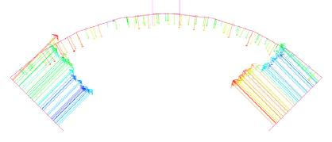
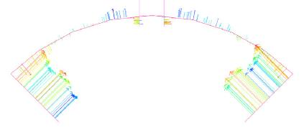
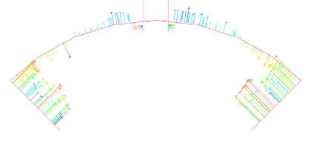
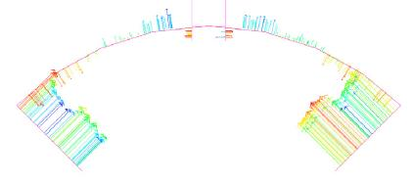
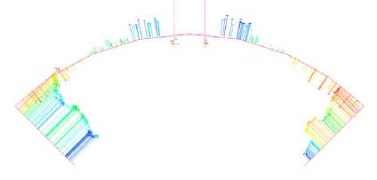
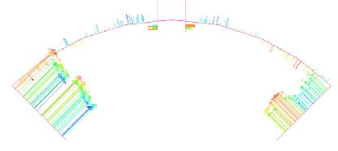
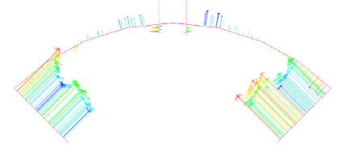
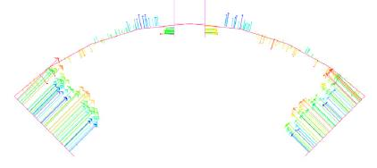
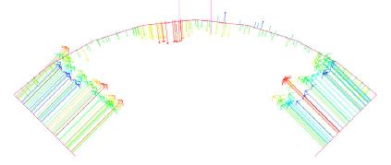
QXFA209
8 (207)
13 (320)
29 (740)
61 (1540)
92 (2340)
124 (3140)
155 (3940)
170 (4323)
174 (4426)

Slide 13
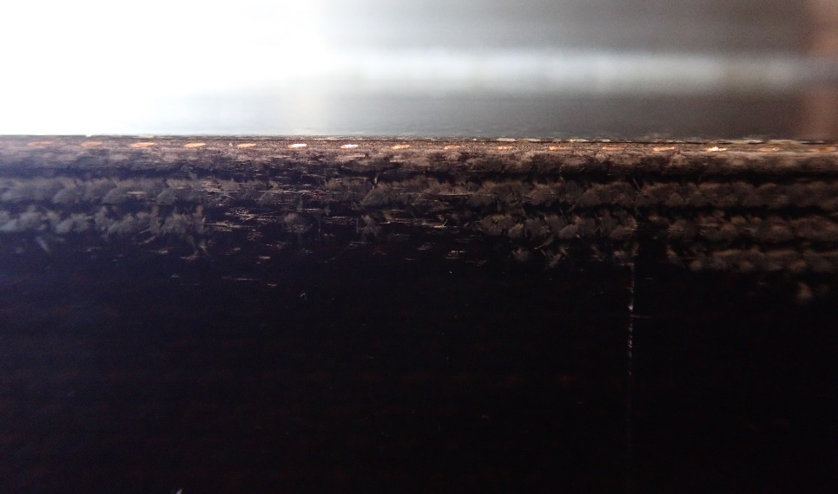
QXFA209
DRs
  React oven control & data acquisition issues.
  Some react TCs outside 665 +/- 5 allowable, min observed 658 C.
  Chipped ceramic coating on OL spacer B2-OR2 after reaction.
    Patched with Kapton.
  Coil overall length 4525.2 mm (spec 4532 ± 5 mm) .
  Small spots of exposed copper on corner of midplane turn at coil ID.
    Area 89”-95” from coil LE, non-transition side.
    In removing epoxy flashing, sanded thru epoxy layer.
    Covered area with 1 mil Kapton tape.

Slide 14

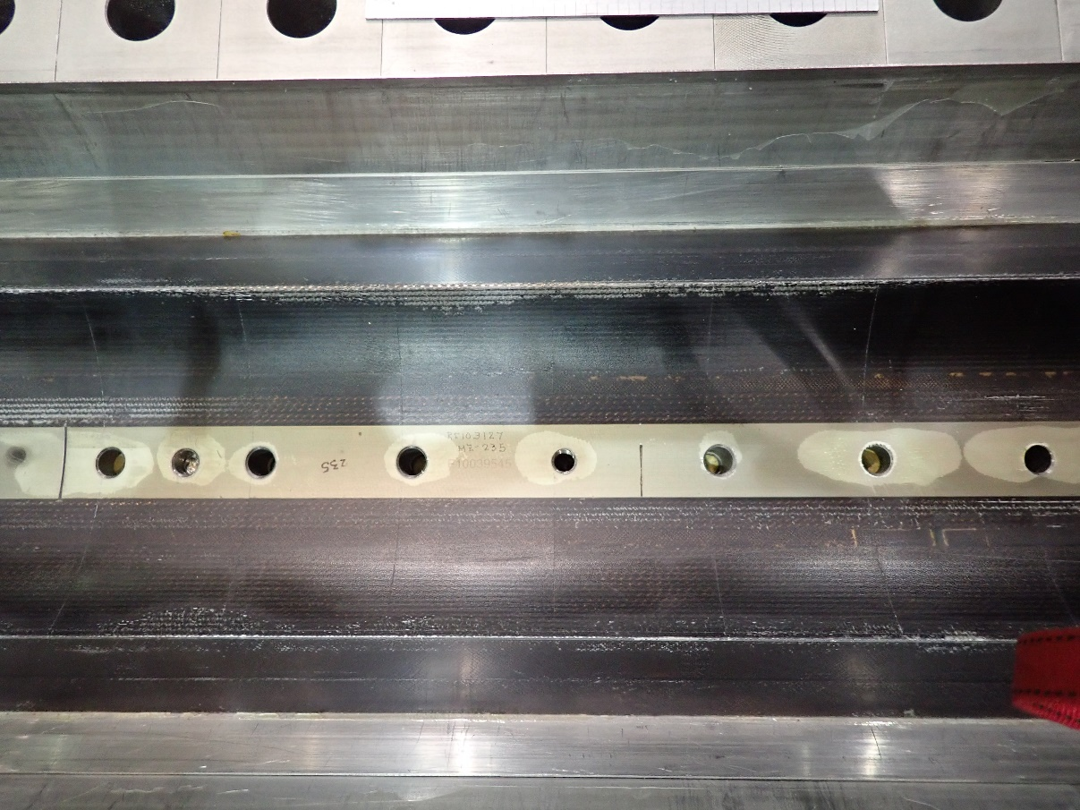
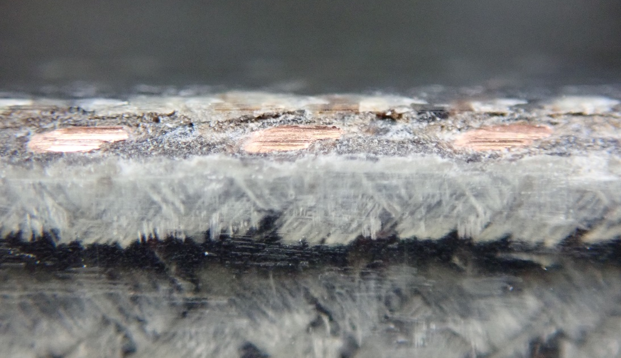
QXFA209
DRs
  Small spots of exposed copper on corner of midplane turn at coil ID.

