Slide 1
All-hands meeting - Introduction
Jim Kowalkowski 14 Jan 2020

Slide 2
Key deliverables
Year 2 (Reminder)
Complete Pythia8 generator tuning analysis with optimizations
Prototype workflow & data tools
improved optimization techniques
NOvA 2D analysis workflow with advanced parameter estimation
higher dimensional fit studies
reconstruction framework integration on HPC
Year 3 (this year)
Fully automated Pythia8 generator tuning workflow on HPC
advanced data & memory use
matrix element calculations
NOvA 4D analysis with neutrino / antineutrino datasets
event selection and storage tier additions impact studies
higher dimensional fit studies
Notes:
As we more calculation towards reconstruction and what happens in the framework algorithms, the same techniques will be applied: reading the right information to be operated on into memory, using vectorized libraries for high-level operations on the data, using the interconnects to round up results that are distributed around the system.

Slide 3
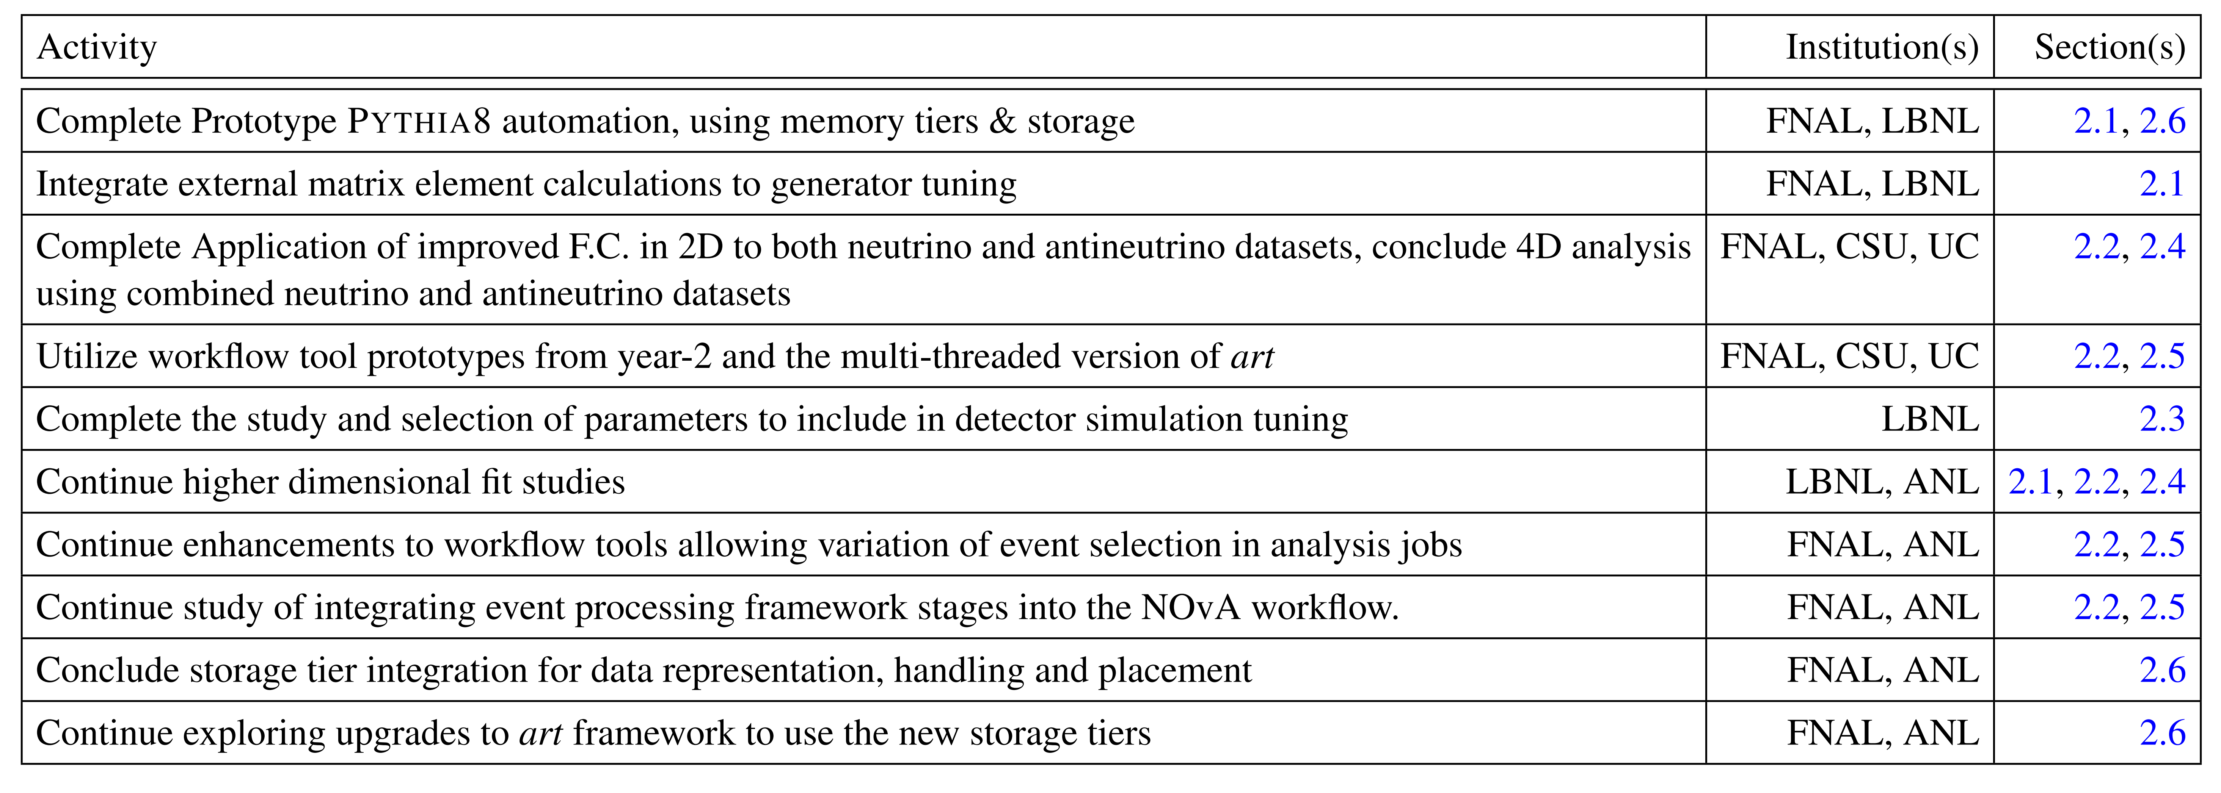
Year 3 milestones
Notes:
As we more calculation towards reconstruction and what happens in the framework algorithms, the same techniques will be applied: reading the right information to be operated on into memory, using vectorized libraries for high-level operations on the data, using the interconnects to round up results that are distributed around the system.

Slide 4
The mid-term review
Due February 18th!
Need list of publications (in the works and completed)
Want to have the following in order:
Website needs a complete update
Repositories needs some additional organization, especially the general ones
Getting code into DOE code areas: need to utilize the DOE code resources and website
Science highlights: have several ready to go, need up on the website and migrated to the SciDAC one (automated now). These can also be used for the highlight slides for the review process.
There is financial information that must be filled out for each institution by task. The spreadsheet is available in the SciDAC Google Drive review folder

Slide 5
Project status
Resources and hiring…
Looking now for additional person on the FNAL side
Assignment will start with either CMS analysis, ICARUS workflow, or Pandana depending on who the person is
Deviations from the proposal plan…
ATLAS and analysis tasks
Tools for running and using physics generators
Participation in conferences and workshops
What is our focus this year?
What are the plans for
CMS generator work,
ATLAS analysis
Neutrino program science

Slide 6
Important items
NERSC allocation – we have about 5M hours for 2020. I preapproved everyone’s account for continuation into 2020.
ALCF director’s allocation – waiting to hear back on this one. We will need to convert to something different (similar to ERCAP at NERSC) when we can actually do science runs and studies at larger scale.
Machine learning workflows and integration into analysis continues to be important. We have an opportunity to work with the ML Exa.TrkX project within the ICARUS/LArSoft workflow (the last step).
We will need to plug into the broader community within HEP this year (LHC in particular). Please help watch for workshops and conferences that will help.
I think coordination with experiments on data access and conversion will continue to be an issue. We are getting good practice with NOvA.
Attempted to introduce Basecamp into the project but that did not work out. I’m trying to find something that will be more useful. Github might be the answer if I can get the licensing issues sorted out.

Slide 7
What should we accomplish this week?
Have status reports and technical discussions on subproject issues and ongoing work
Get a list of short and mid-term goals and deliverables documented (science and computing
Short = now through March
Mid-term = now until the PI meeting in July 2020
End-of-year = Oct 1 2020
Record the outstanding items (tasks or deliverables) that we need to complete for each subproject

Slide 8
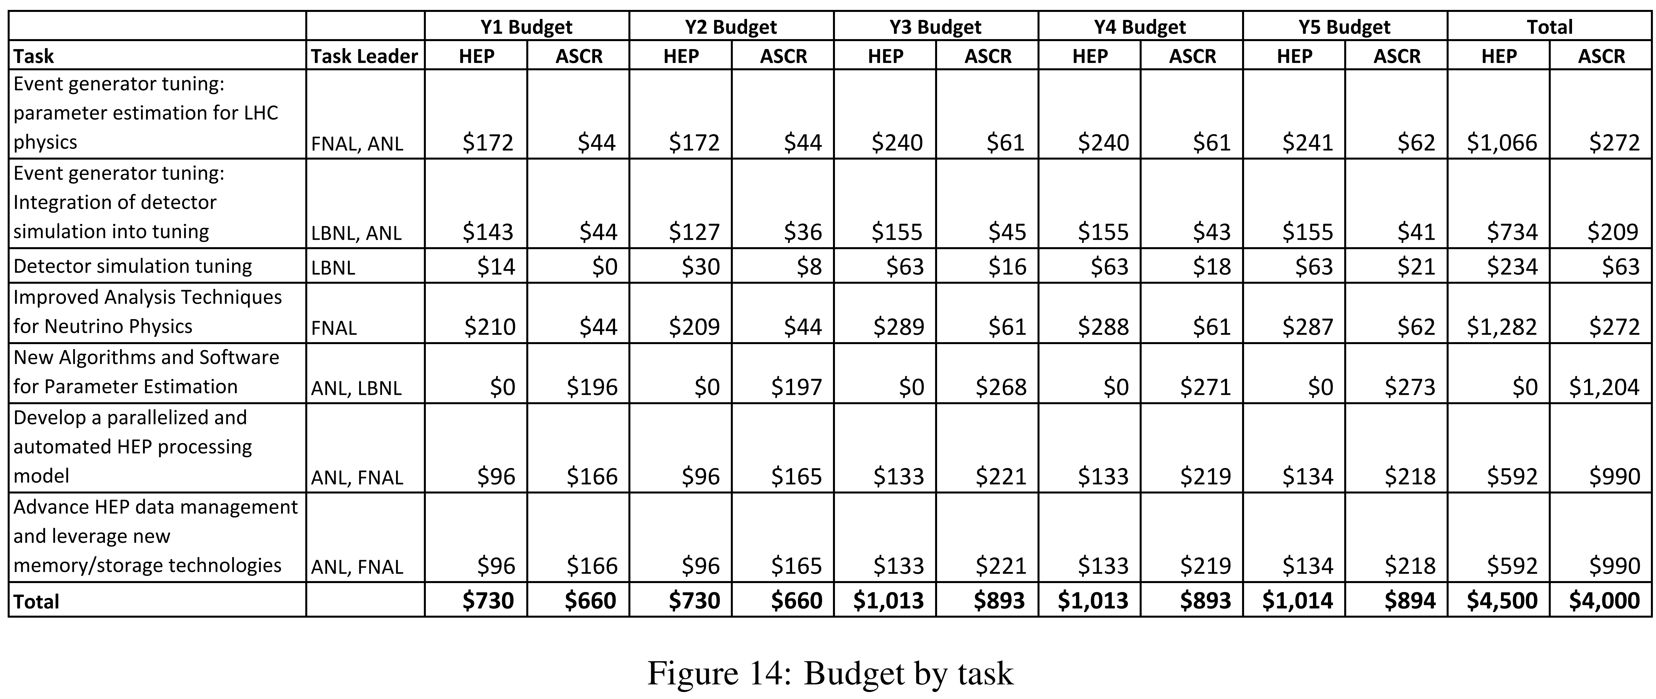
Reminder – see Google sheet

