Slide 1
Automated Parameter Tuning for Event Generators
Wenjing Wang & Juliane Mueller

Slide 2
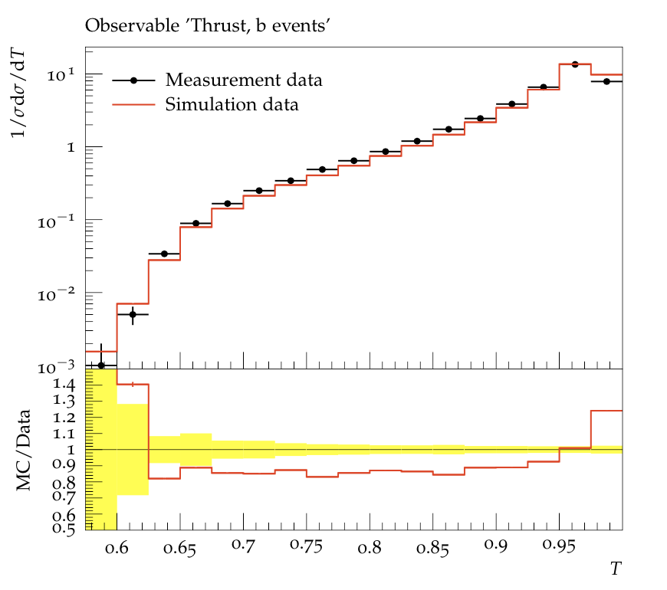
Our goal is to optimize the parameters of an approximation model
Objective function: $\underset{}{min χ^{2}\left(p,w\right)=\sum_{i=1}^{n_{obs}}{w_{i}∗\sum_{b_{i}=1}^{J_{b_{i}}}{\frac{{\left(f_{b_{i}}\left(p\right)−D_{b_{i}}\right)}^{2}}{Δf_{b_{i}}{\left(p\right)}^{2}+ΔD_{b_{i}}^{2}}}}}$
Where:
$w_{i}$ are the weights corresponding to the $i$th observable
$n_{obs}$is the total number of observables we have
$J_{b_{i}}$ is the total number of bins in the $i$th observable
$D_{b_{i}}$ is the observational data in bin $b_{i}$ of the $i$th observable
$f_{b_{i}}\left(p\right)$is the model that approximates the data in the bin $b_{i}$ (ideally from the MC generator, but we use polynomial or rational approximation of MC output)
$p$ are the model’s parameters (with real physical meaning)
Goal:
Find the parameters $p$ and the weights $w$ such that “$χ^{2}$ is minimized”

Slide 3
What does “Minimizing $χ^{2}”$ mean?
Objective function: $\underset{}{min χ^{2}\left(p,w\right)=\sum_{i=1}^{n_{obs}}{w_{i}∗\sum_{b_{i}=1}^{J_{b_{i}}}{\frac{{\left(f_{b_{i}}\left(p\right)−D_{b_{i}}\right)}^{2}}{Δf_{b_{i}}{\left(p\right)}^{2}+ΔD_{b_{i}}^{2}}}}}$
Finds the weights $w$ and parameters $p$ such that “all observables are fit equally well”
But: some observables cannot be explained by the model no matter what we do
Find the observables that can be explained by the model and optimize $χ^{2}$only wrt. to those
We do a “prescreening” where we optimize $p$ for each observable separately (we obtain $n_{obs}$ values) and we use outlier detection to identify observables that cannot be explained by the model –> assume there is only one observable, we try top fit the model as best as we can but it still does not look right
We filter out these “unexplainable” observables and optimize $χ^{2}$ only over a subset of the observables

Slide 4
We use a bilevel optimization approach to solve the problem
Objective function: $\underset{}{min χ^{2}\left(p,w\right)=\sum_{i=1}^{n_{obs}}{w_{i}∗\sum_{b_{i}=1}^{J_{b_{i}}}{\frac{{\left(f_{b_{i}}\left(p\right)−D_{b_{i}}\right)}^{2}}{Δf_{b_{i}}{\left(p\right)}^{2}+ΔD_{b_{i}}^{2}}}}}$
In the objective function: the model parameters $p$ depend on our choice of weights $w$: $p^{∗}(w)$
In a bilevel optimization approach, we optimize at the upper level over the weights $w$, and at the lower level we find the best $p^{∗}$ that we can achieve given the current values for $w$
$$\min_{w, p^{∗}}{g(w, p^{∗})}$$
$$p^{∗}=\min_{p}{χ^{2}(p|w)}$$
$\sum_{i=1}^{n_{obs}}{w_{i}=1}$, $w_{i}∈[0,1]$
Upper level objective
Lower level problem – this is solved with PROFESSOR
Constraints on weights to prevent trivial solutions

Slide 5
Bilevel optimization: upper level objective functions
“Portfolio”:
For given $w$, compute the best $p^{∗}$ (solve lower level problem)
For each observable $i$, compute: $χ_{i}^{2}\left(p^{∗} | w\right)$error → I have $n_{obs}$ of these
Compute mean $m(p^{∗}|w)$ and variance $σ^{2}\left(p^{∗}|w\right)$ over all $χ_{i}^{2}(p|w)$
Weighted sum of mean and variance of the observable errors:
Define $g\left(w,p^{∗}\right)=m\left(p^{∗}|w\right)+λ σ^{2}(p^{∗}|w)$, $λ$ is parameter, but we set it to 1
Score:
$s\left(p^{∗} | w\right)=median of \left[{\left(\frac{f_{b}\left(p^{∗} | w\right)−D_{b}}{ΔD_{b}}\right)}^{2}+log⁡(ΔD_{b}^{2})\right]$
Define $g\left(w,p^{∗}\right)=\sum_{i=1}^{n_{obs}}{s(p^{∗}|w)}$
$$\min_{w, p^{∗}}{g(w, p^{∗})}$$
$$p^{∗}=\min_{p}{χ^{2}(p|w)}$$
$\sum_{i=1}^{n_{obs}}{w_{i}=1}$, $w_{i}∈[0,1]$

Slide 6
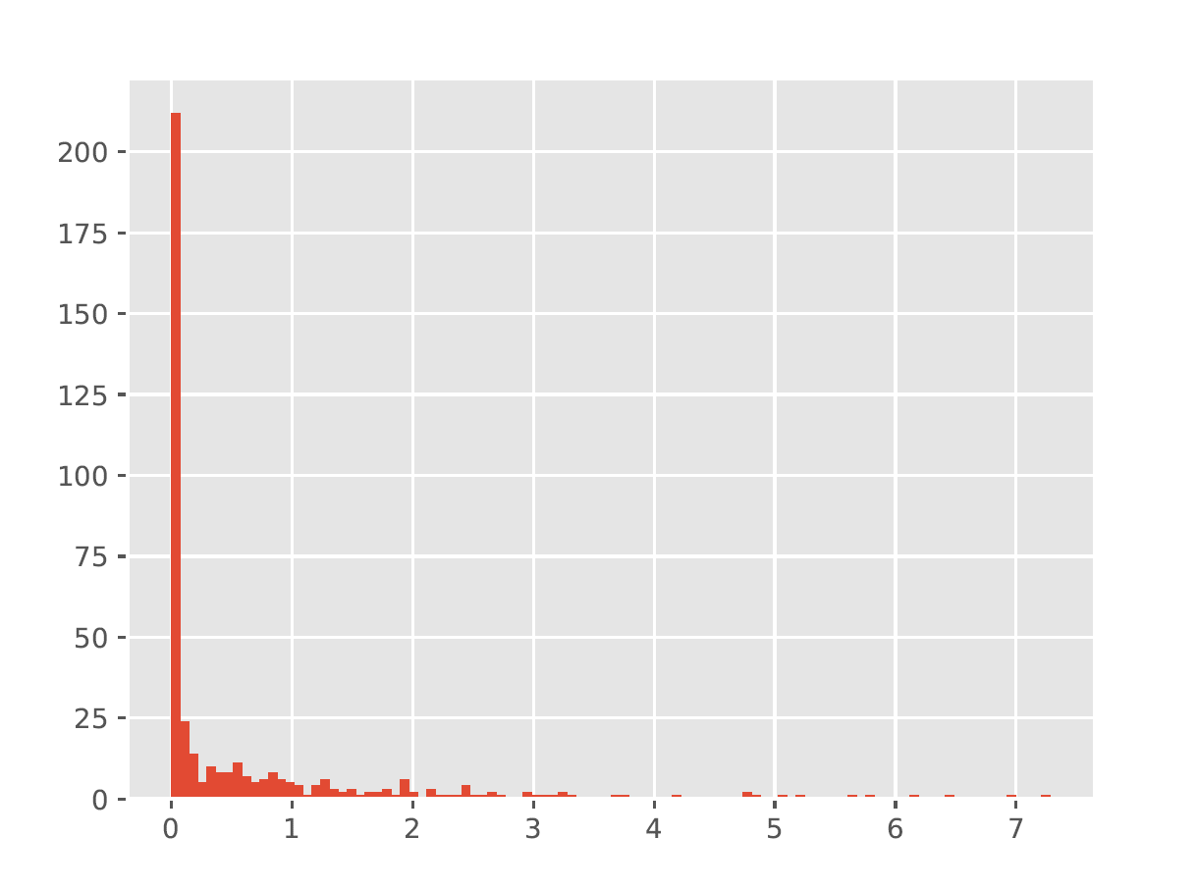
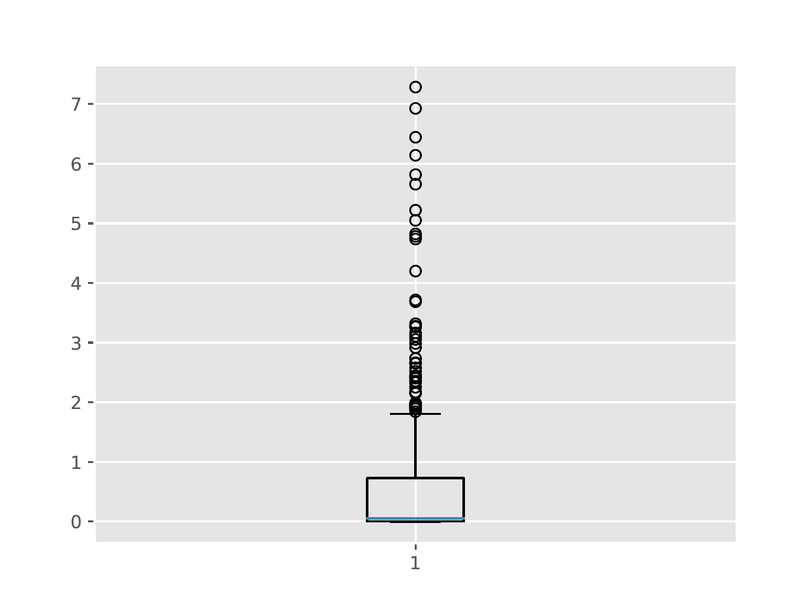
Wenjing has been working with A14 data (some 400 observables)
“Prescreening” results:
Histogram shows the $χ^{2}/ndf$ distribution when optimizing the parameters $p$ for each observable individually
Or same $χ^{2}/ndf$ values represented in different format
Based on these results, Wenjing identified 12 outliers (=observables with $χ^{2}/ndf$ so large that they cannot be explained by the model

Slide 7
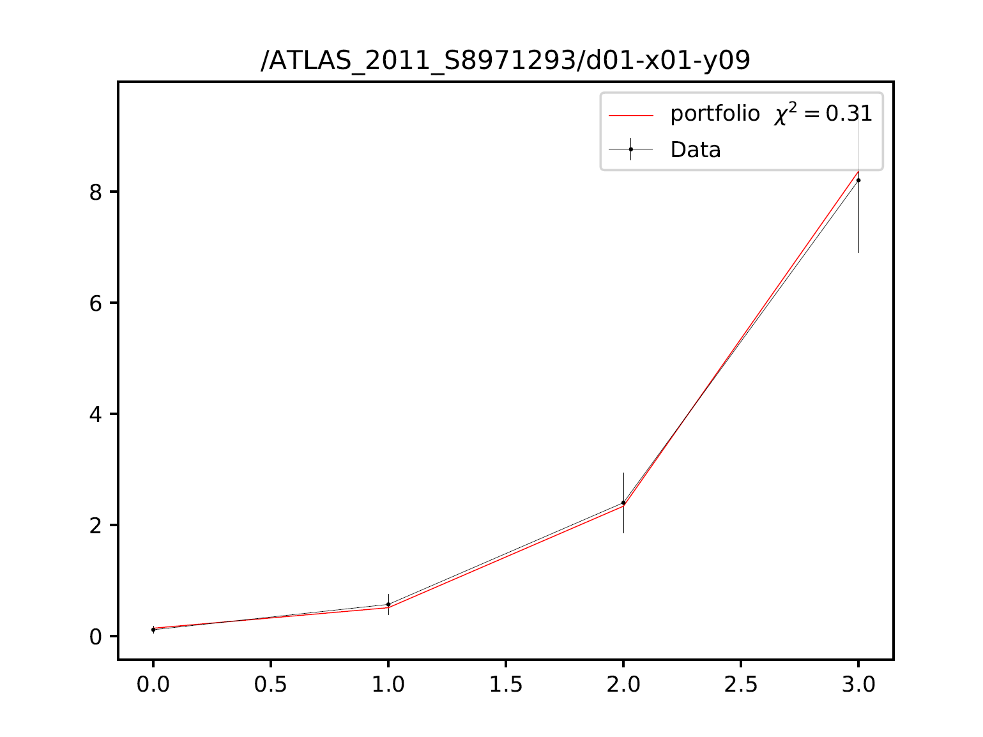
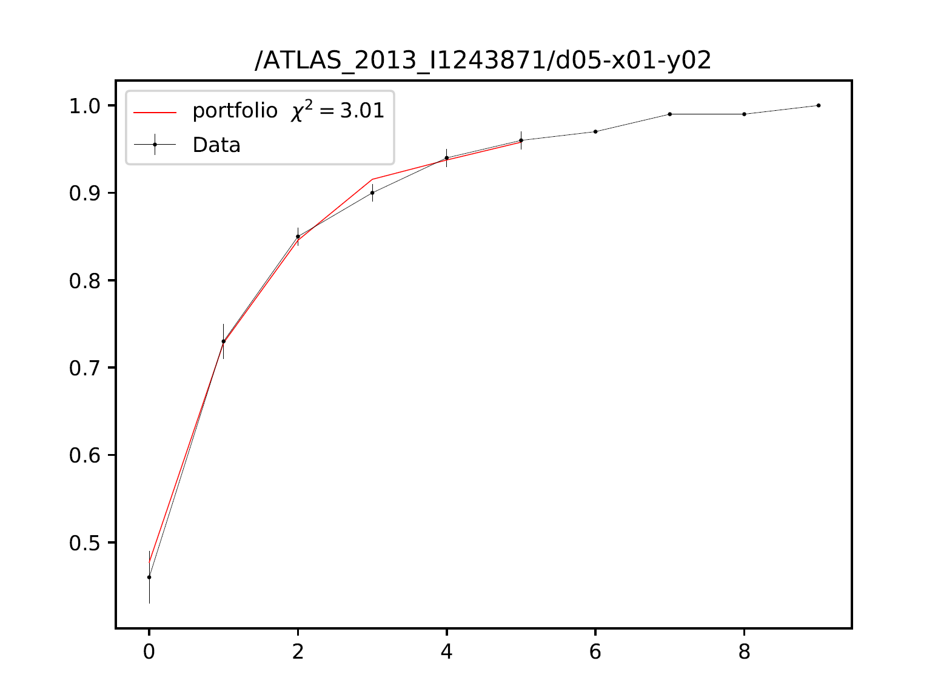
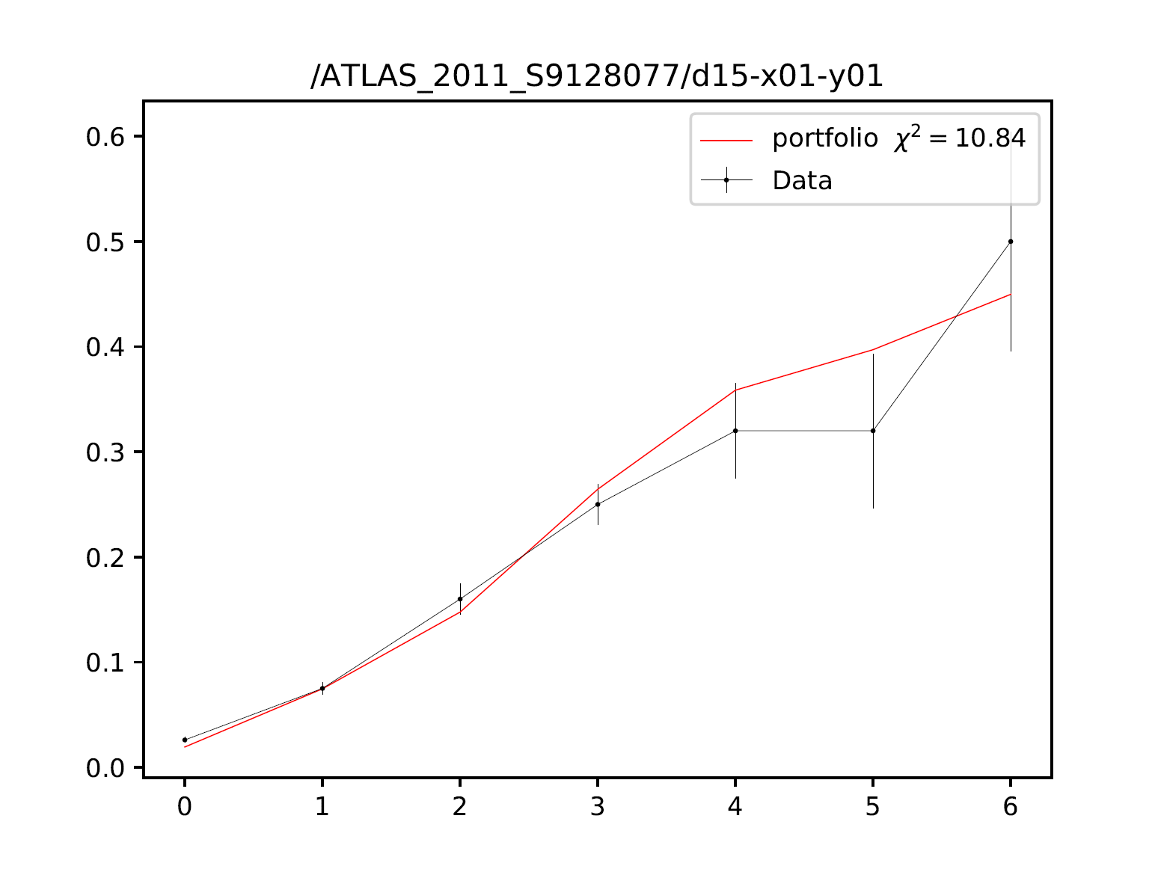
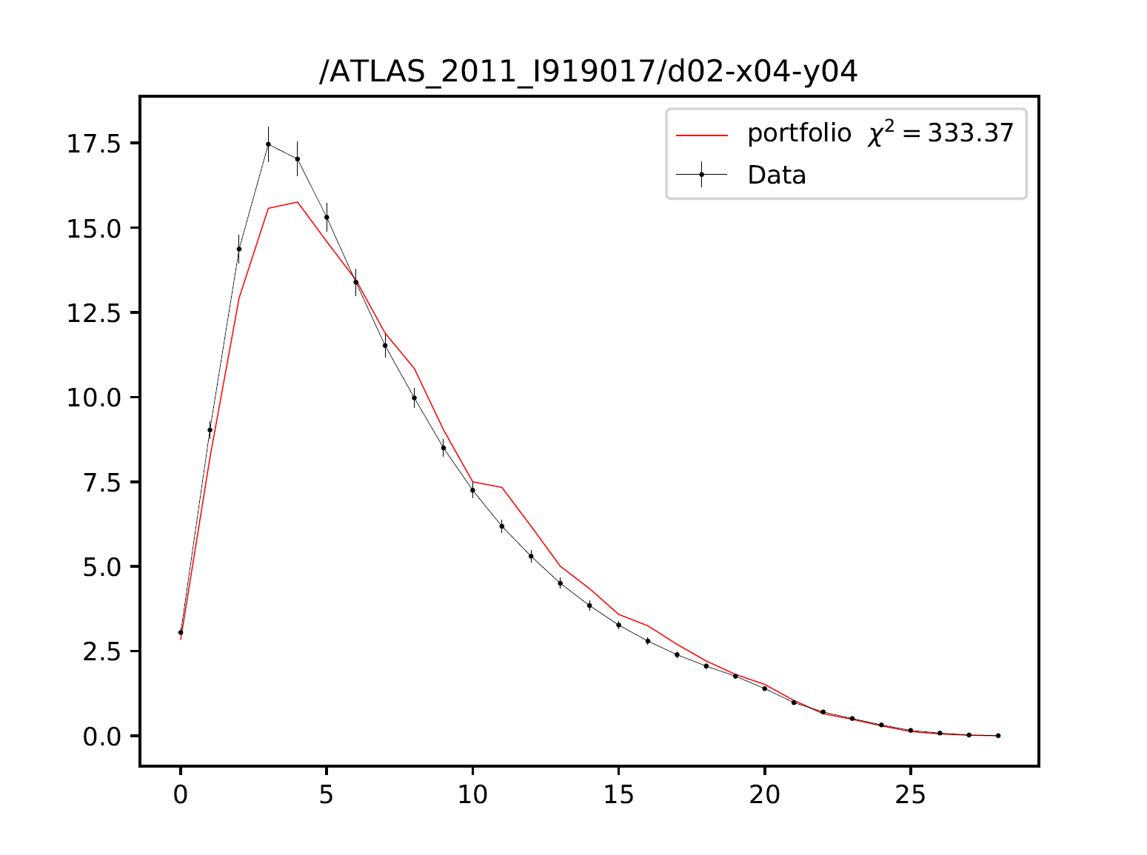
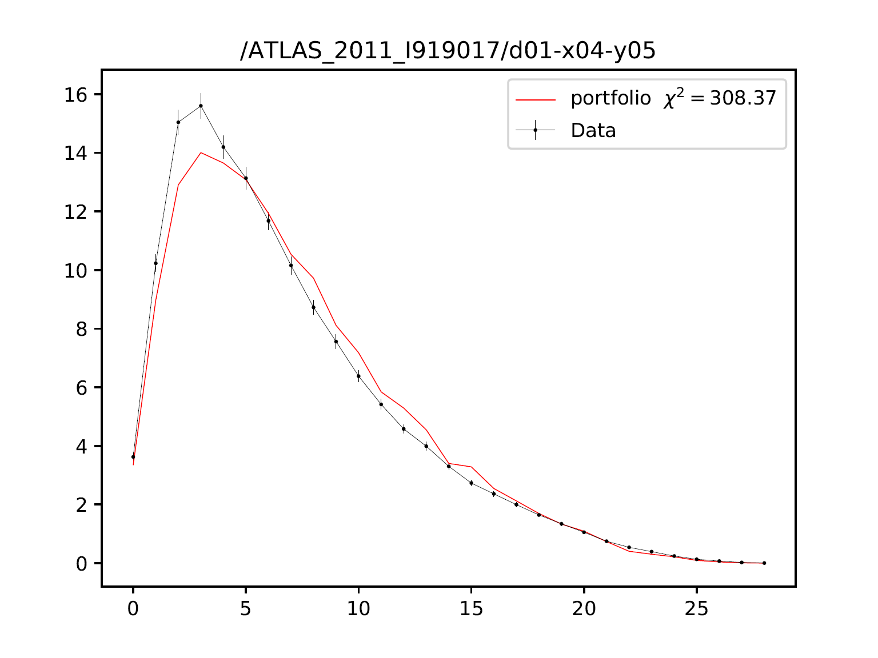
An exercise to see how much difference the inclusion/exclusion of “unexplainable” observables makes
Grab the 3 observables with lowest individual $χ^{2}$ and the 2 observables with highest individual $χ^{2}$ and solve the bilevel optimization for al 5 observables
$χ^{2}$=0.31
$χ^{2}$=10.84
$χ^{2}$=3.01
Legend:
Black is data
Red is optimized model
$χ^{2}$=308.;87
$χ^{2}$=333.37

Slide 8
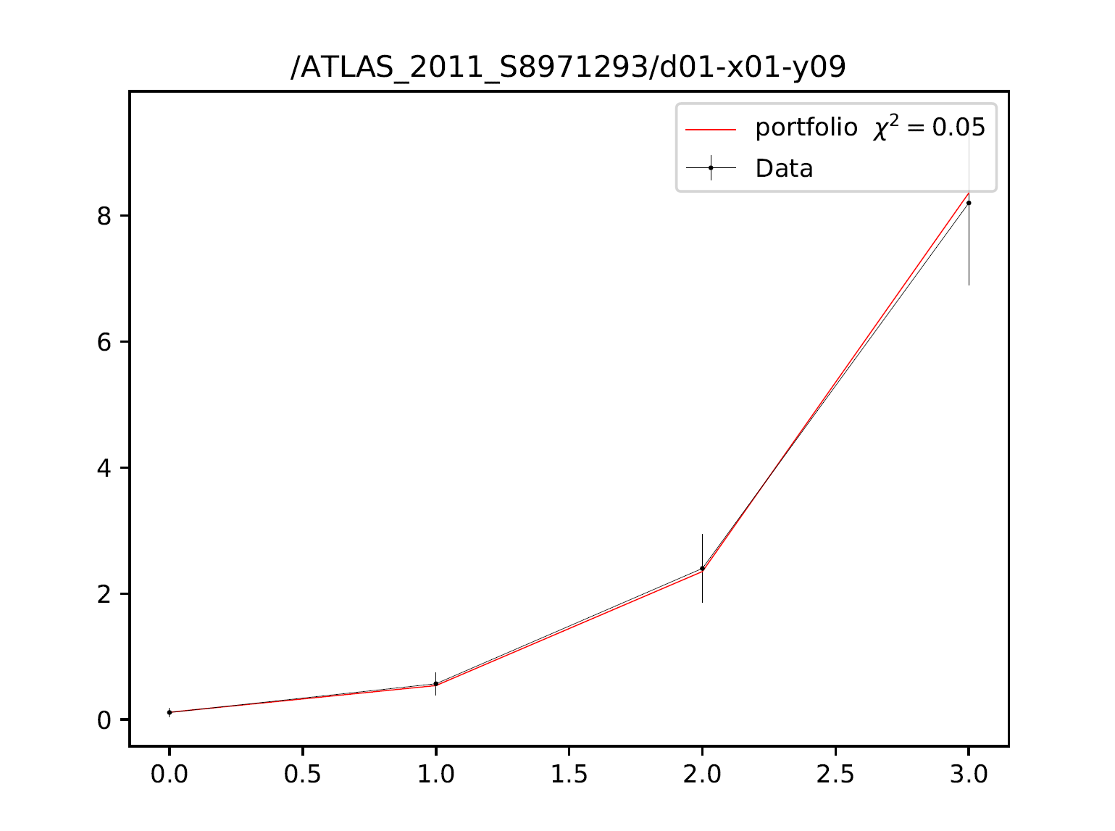
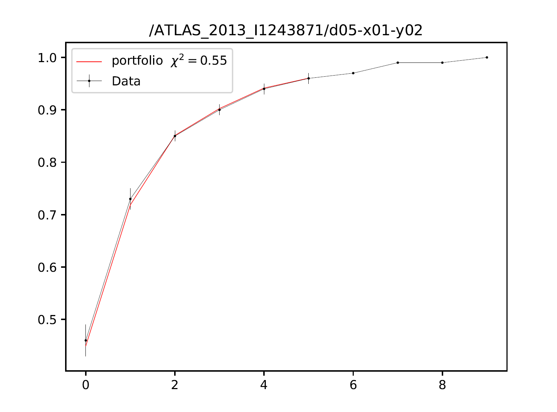
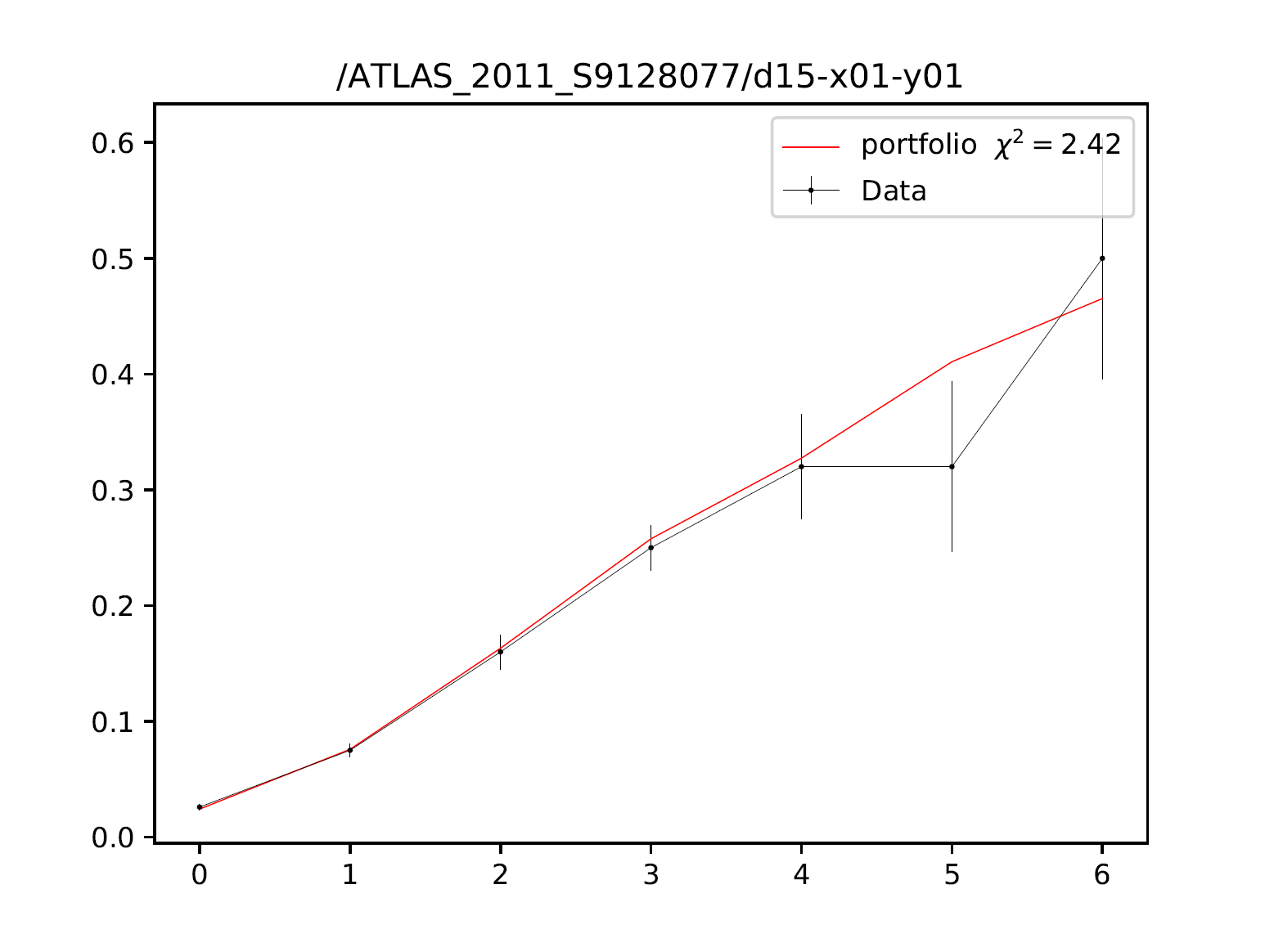
Same exercise as before, but we optimize only over the 3 “best” observables
Grab the 3 observables with lowest individual $χ^{2}$ and solve the bilevel optimization for all 3 observables
$χ^{2}$=2.42
$χ^{2}$=0.05
$χ^{2}$=0.55
Legend:
Black is data
Red is optimized model
Comparison to what we had before:
$χ^{2}$=0.31
$χ^{2}$=10.84
$χ^{2}$=3.01

Slide 9
What we’ve3 learned so far
Investing some compute time upfront to determine which observables should be excluded from optimization is well worth it (e.g., A14 some 400 optimizations, and can be done in parallel)
Exclusion of unexplainable observables helps the optimization to find better parameters (and better fits for those observables that can be explained) → need to check if this is generally true
Currently: writing the results up in a paper, focusing on automatic weight adjustment and bilevel optimization
What we still have to do: more tests to verify the bilevel prescreening method generalizes/scales well to different sizes of data sets and different numbers of parameters
Comparison to the A14 published fit – did we actually do better?

