Slide 1
Engineering the World’s Largest Digital Camera
Tim Bond
Feb 18, 2020

Slide 2
Introduction / Background

Slide 3
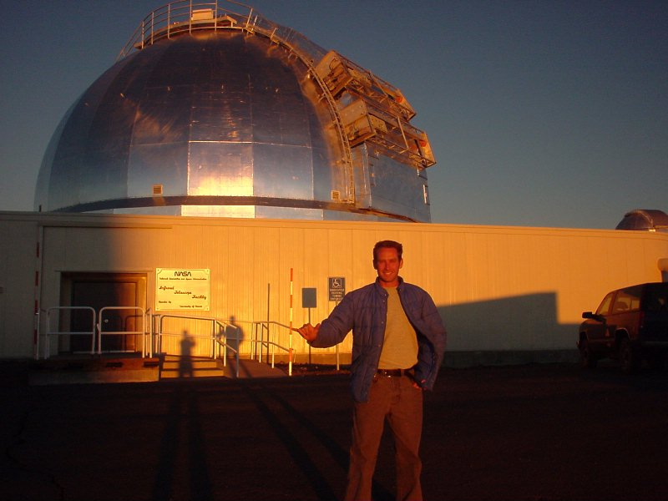
Introduction
Tim Bond
Engineering Manager / CAM for the Integration & Test Subsystem of the LSST Camera Project.
Here to give an brief overview of LSST, to discuss a few of the more interesting technical aspects of the Camera itself, and to describe some of the challenges that the I&T Subsystem has encountered.
Link to today’s slide set: https://stanford.box.com/s/jfwmzcqkyq8en01ggystz4rxmrpkxlv7
Link to older SPIE paper with similar information : https://stanford.box.com/v/bond-spie2018-paper

Slide 4
Introduction
Education:
Applied Mathematics Engineering Degree at Queen’s University – Kingston, Ontario.
Fully accredited Mechanical Engineering Degree combined with a pure Mathematics Degree.
28 Years Engineering Experience:
2 years TRIUMF (Vancouver – British Columbia)
4 years Canadian National Research Council/HIA (Victoria – British Columbia)
3 years Carnegie Observatories (Pasadena - California)
14 years UH-IFA / NASA IRTF (Honolulu - Hawaii)
5 years SLAC / DOE (Menlo Park – California)
Relevant Skills:
Opto-mechanics, precision mechanisms, IR instrumentation (cryogenics / vacuum systems).
Specific to astronomical instrumentation and telescope systems.
Includes - structural analysis, opto-mechanics, precision mechanisms, thermal analysis, precision motion control, vacuum design, cryogenics, facility level HVAC, large hydraulic systems, optical system design / tolerancing, and FEA.
Basically - pure technical during earlier parts of my career.
Systems Engineering, and Project Management.
Less “hands on” but more “big picture”.
Requirements derivation and verification, interface control, work breakdowns, budgets, schedules, team planning and logistics, risk assessment, staff performance evaluation and career building.

Slide 5
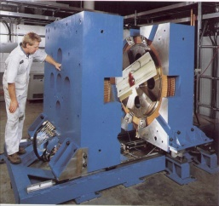
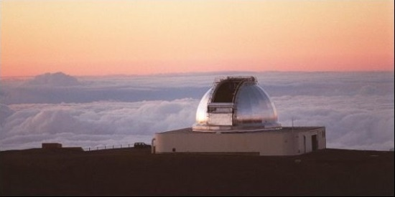
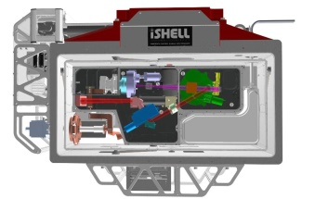
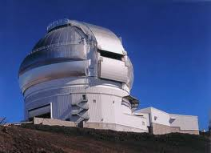
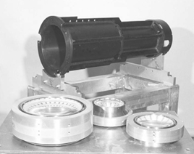
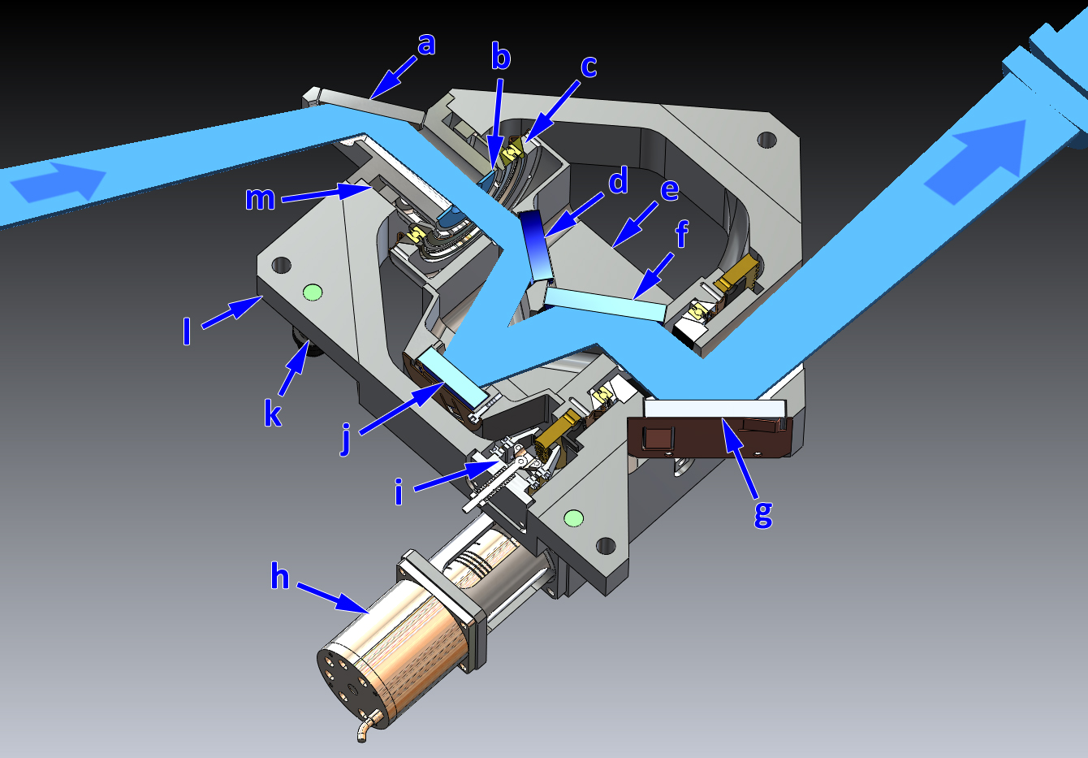
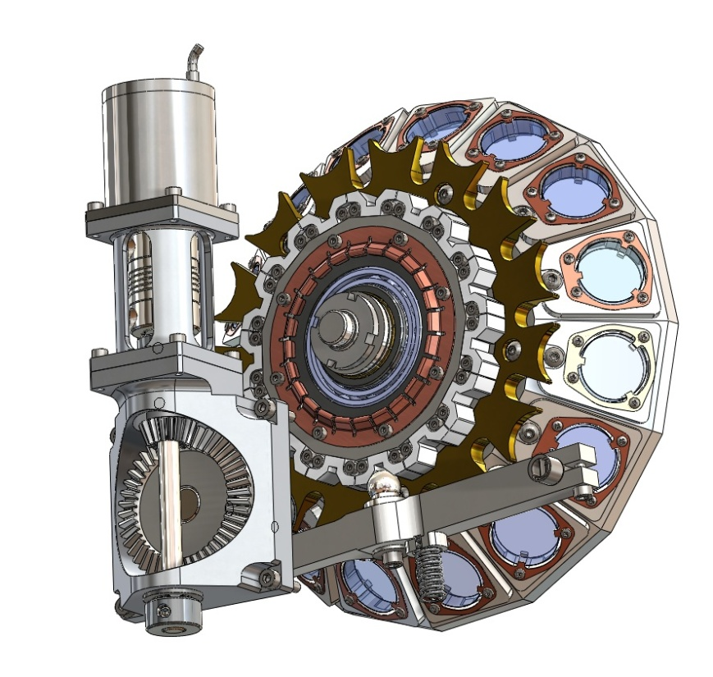
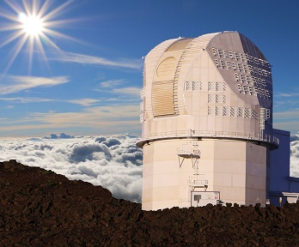
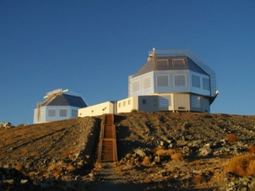
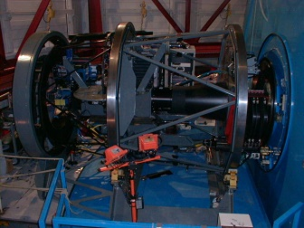
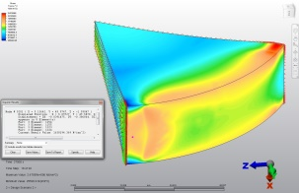
Background

Slide 6
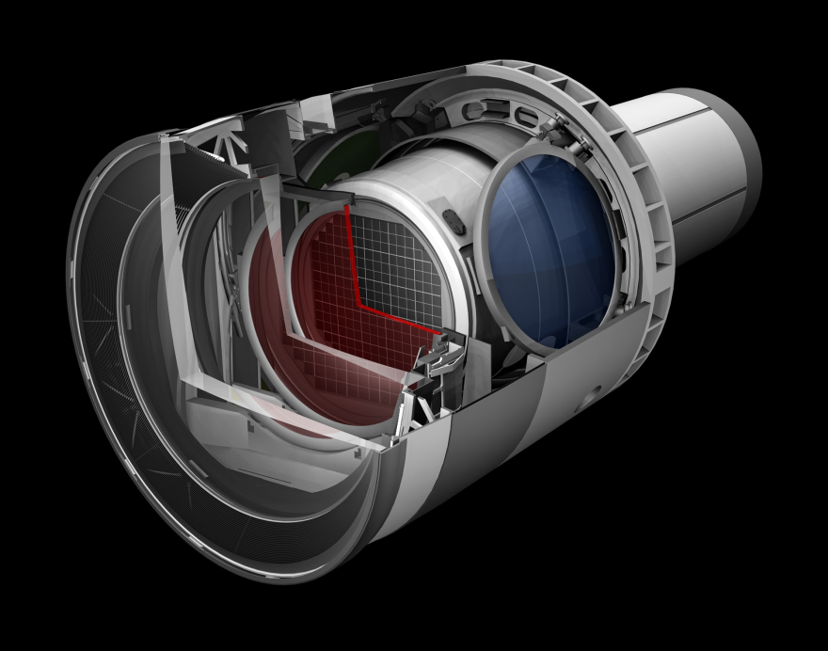
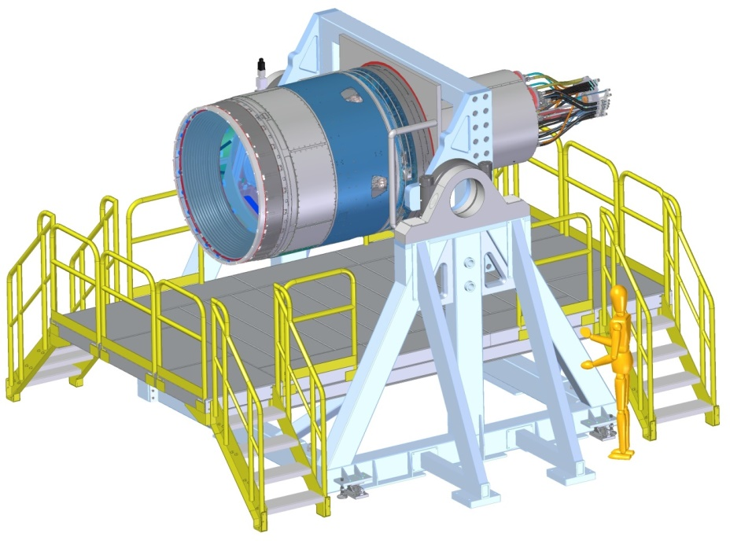
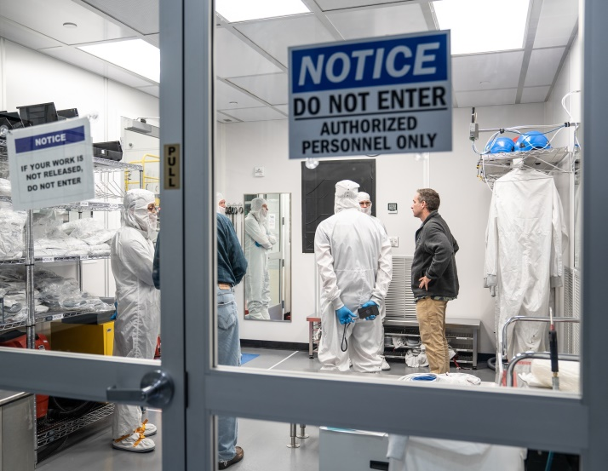
Background
5 years SLAC / DOE (Menlo Park – California)
LSST Camera I&T Subsystem Manager & CAM.

Slide 7
LSST Project / LSST Camera

Slide 8
LSST → Rubin Observatory
Rubin Observatory’s Legacy Survey of Space and Time

Slide 9
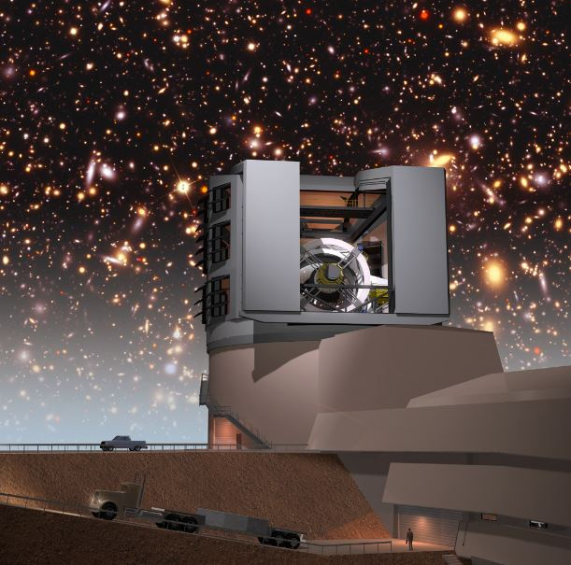
LSST Project - Overview
The LSST is an integrated survey system designed to conduct a decade-long, deep, wide, fast time-domain survey of the optical sky.
How does it do this - Essentially the plan is to take a high resolution image of a piece of the sky every 19s, all night, every night for 10 years running and make this information available in a large database.
The key elements are:
8-meter class wide-field ground based telescope.
3.2 giga-pixel camera.
An automated data processing, storage, and distribution system.
Why does it do this - to provide a vast astronomical dataset for unprecedented discovery of the deep and dynamic universe.
Taking a census of moving objects in the solar system.
Mapping the structure and evolution of the Milky Way.
Exploring the transient optical sky.
Determining the nature of dark energy and dark matter.
Who - LSST is a Public/Private, Interagency Project ($681M).
The National Science Foundation ($473M).
The Department of Energy ($168M) - Camera fabrication.
Private Support ($40M).

Slide 10
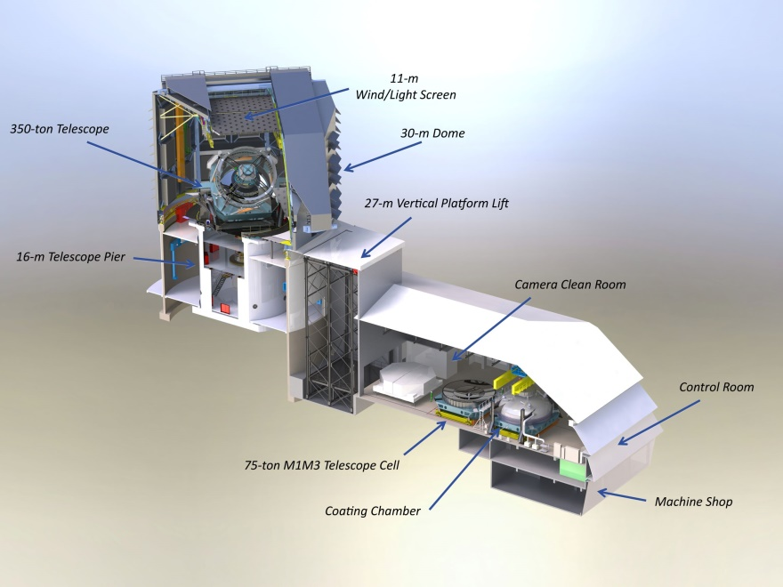
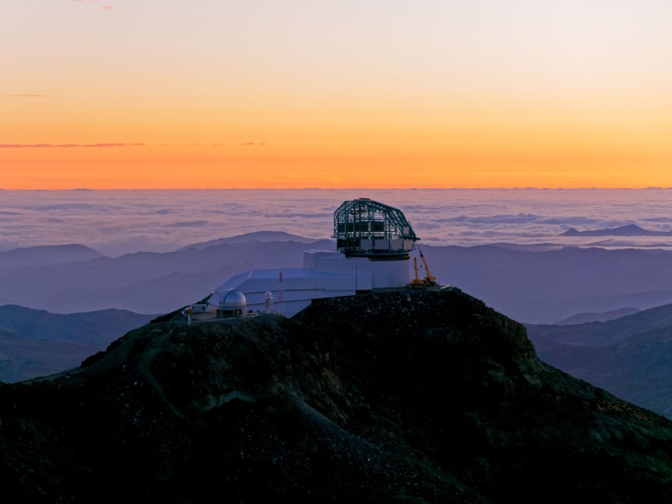
LSST Project – Site & Facility
The facility is currently under construction in north-central Chile, on the Cerro Pachón ridge in the foothills of the Andes Mountains.
About 100 km from the support town of La Serena.
Dedicated 8m class telescope specialized for wide fields and fast slewing rates.
The main telescope building supports a 30m rotating dome, and is attached to a 3000m² service and operations building.
The facility also contains a dedicated cleaning and coating plant where mirrors will be initially coated, as well as periodically washed and recoated.

Slide 11
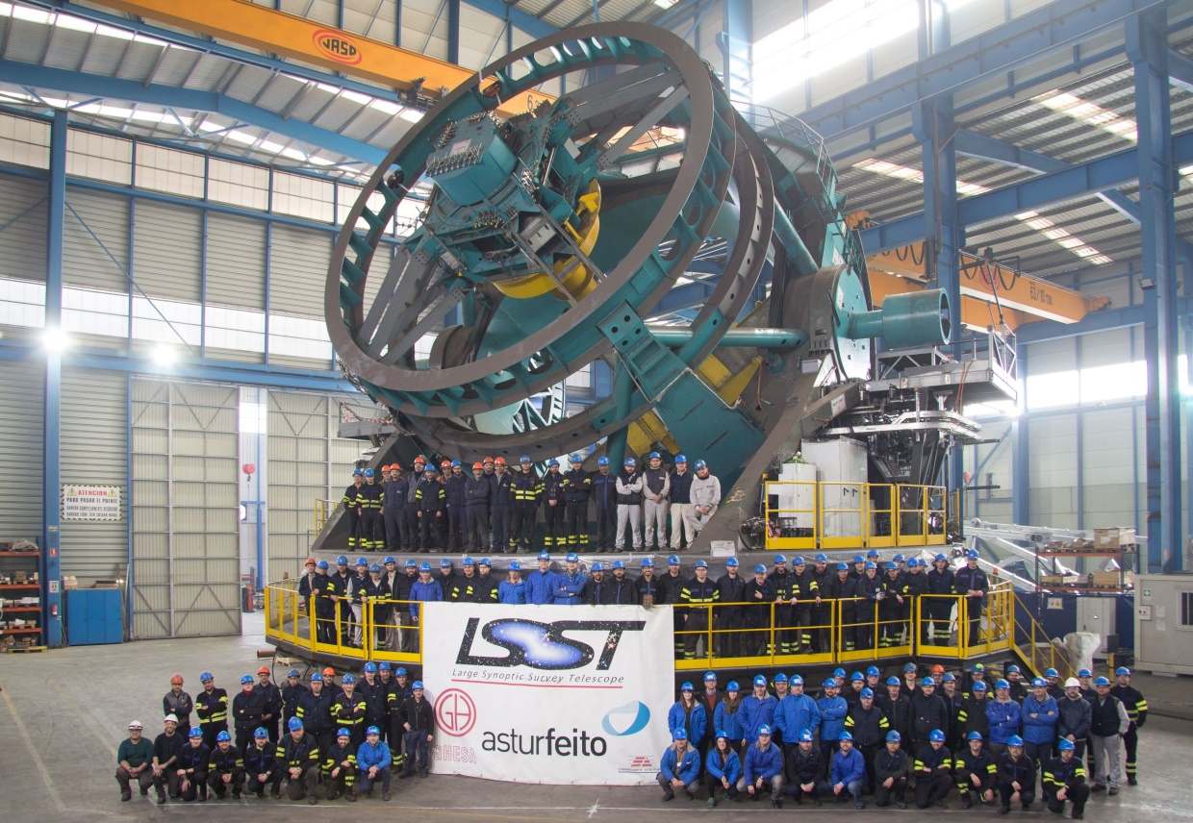
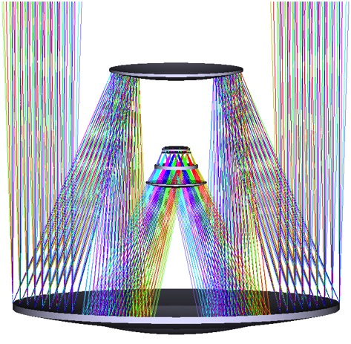
LSST Project - Telescope
8.4m primary, 3.4m convex secondary, and a 5.0m tertiary mirrors.
Primary (M1) and tertiary (M3) are formed from the same blank.
The secondary mirror (M2) is the largest convex mirror ever made.
The next three elements – all transmissive lenses - form the entrance to the camera and the cryostat.
The optical design delivers a relatively large 3.5 degree field of view.
The 350 ton telescope itself is capable of slewing and settling in an impressively short period of time – 4s for a 3.5 degree slew.

Slide 12
LSST Camera - Overview
The LSST camera will be the largest digital camera ever constructed.
At 1.65 m in diameter and 3 m long, it is roughly the size of a small car and has a mass of 3 000 kg.
The diameter of the array of sensors at the focal plane is approx. 63 cm.
Focal plane is occupied by 21 raft platforms with each raft comprised of a 3 x 3 square of 4k x 4k charge-coupled devices (CCDs).
Total of 189 CCD’s or 3.2 Giga-pixels.
A single image captures a 3.5 degree circular field of view.
Capable of taking 2 images every 38s.

Slide 13
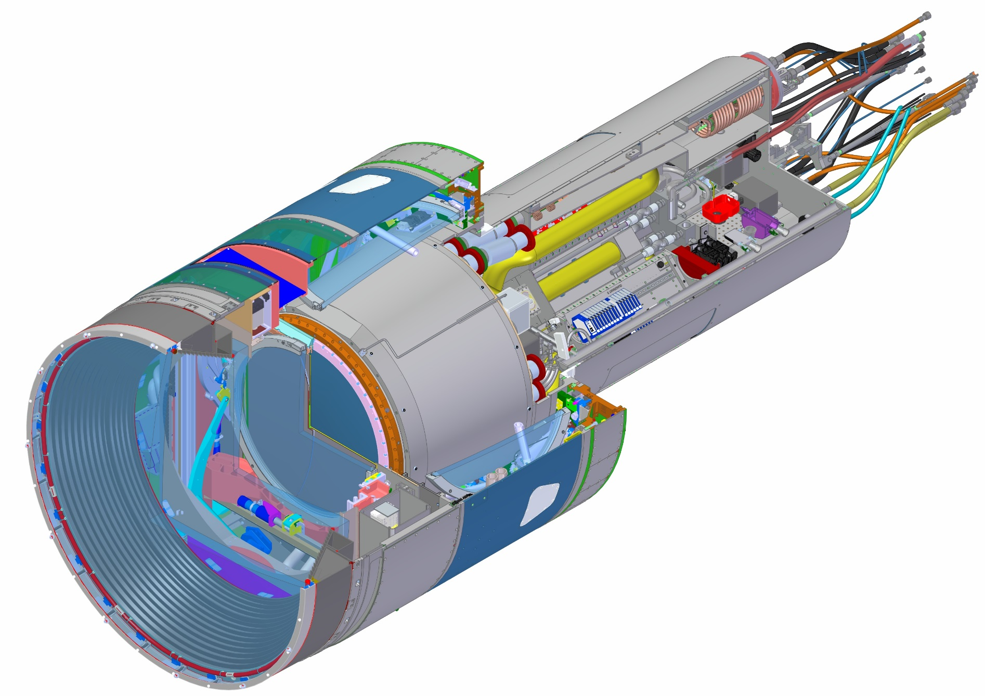
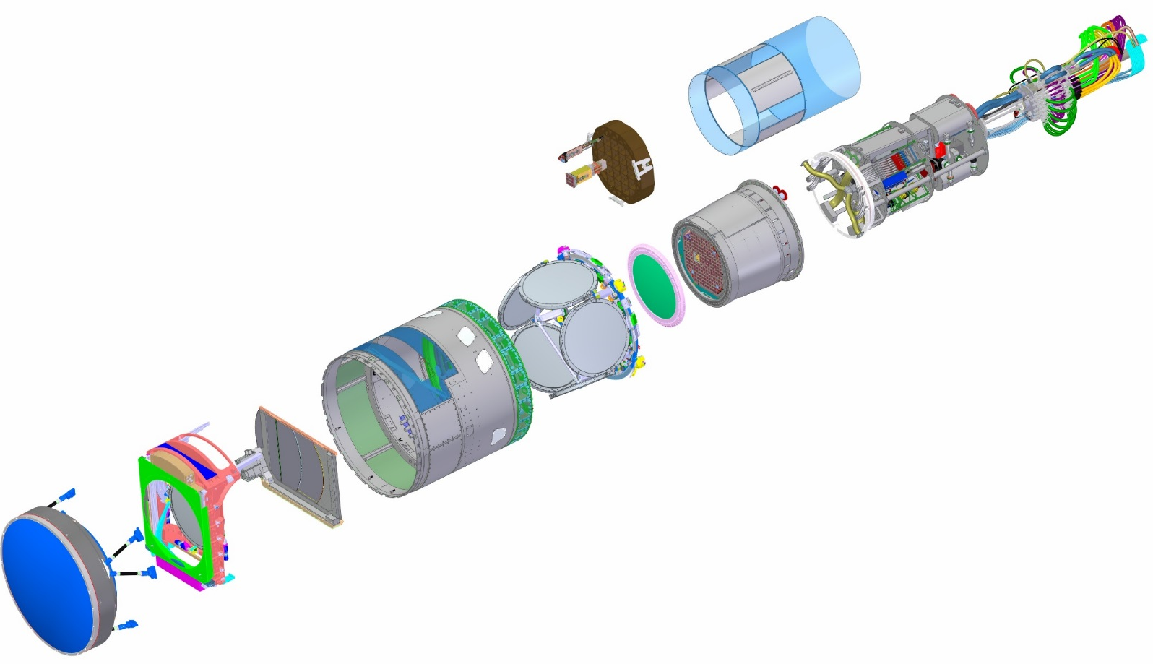
LSST Camera - Overview
WBS | Baseline ($K) | % complete
3.06.05 Utility Trunk | $1,385 | 91%
WBS | Baseline ($K) | % complete
3.04.02 Corner Raft Tower | $7,064 | 100%
WBS | Baseline ($K) | % complete
3.04.01 Science Raft Tower | $17,507 | 100%
WBS | Baseline ($K) | % complete
3.03 Sensors | $34,011 | 100%
WBS | Baseline ($K) | % complete
3.07.02 Aux Electronics | $2,298 | 100%
WBS | Baseline ($K) | % complete
3.06.01 Camera Body | $2,395 | 99%
WBS | Baseline ($K) | % complete
3.06.04 Cryostat | $16,394 | 99%
WBS | Baseline ($K) | % complete
3.06.02 Shutter | $3,030 | 98%
3.05.04 L3 Lens Assembly
3.05.02 Filters (6)
WBS | Baseline ($K)
3.06.03 Filter Exchange System | Contributed
WBS | Baseline ($K) | % complete
3.01 Management | $15,225 | 95%
3.02 Systems Integration | $9, 308 | 96%
3.05 Optics | $28,094 | 93%
3.07.01 Control System | $5,055 | 93%
3.07.02 Data Acq Sys | $5,424 | 100%
3.08 Integration and Test | $13,233 | 83%
TOTAL | $160,423 | 96.3%
3.05.03 L1-L2 Lens Assembly

Slide 14
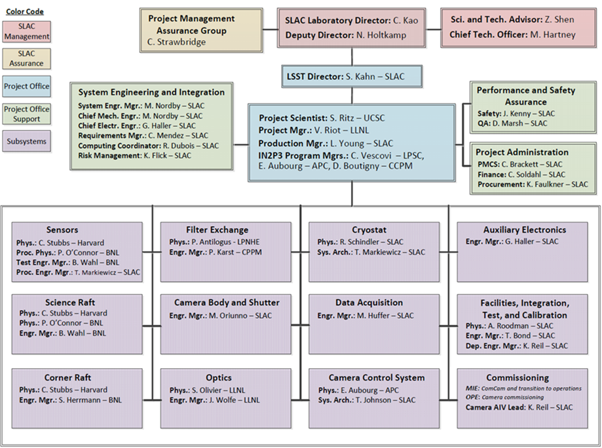
LSST Camera – I&T Subsystem
The I&T Subsystem tasked with the assembly and testing of the LSST Camera.
We are located at SLAC National Accelerator Laboratory in Menlo Park, CA. (Stanford Campus).
The I&T Subsystem is one of twelve individual subsystems that make up the LSST Camera Project.
The total LSST Camera budget is $168M, with the I&T Subsystem alone accounting for ~$13M of that total budget.

Slide 15
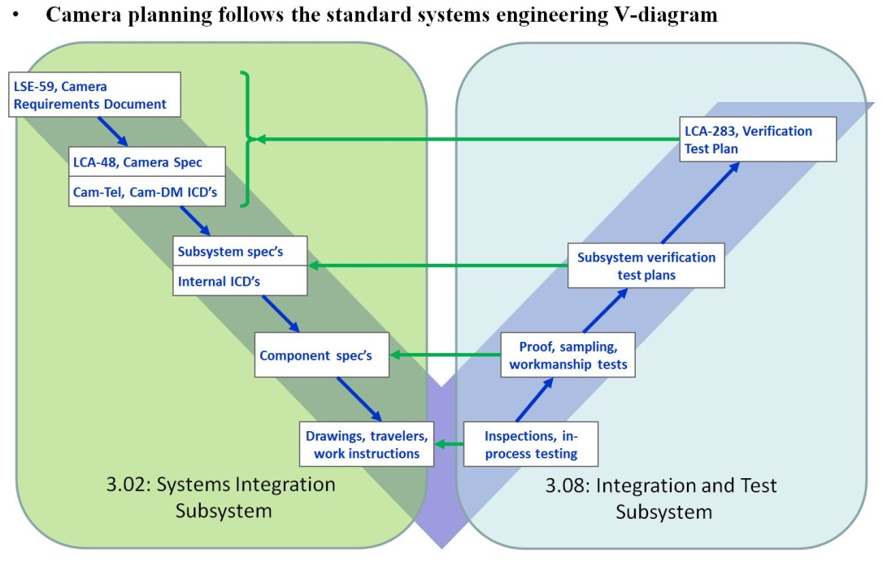
LSST Camera – I&T Subsystem
The LSST Camera design and development process incorporates an extremely thorough Systems Engineering process, but unlike many similar projects, the I&T Subsystem is not a subgroup of the overall Systems Engineering group.
In the case of the LSST Camera, these tasks are divided amongst two individual groups.
As can be seen in the familiar V-diagram (Figure 6) the LSST Camera model places tasks on the left side of the lifecycle diagram that are realized in the early design and development phases of the Camera into the Systems Integration (SI) group.
Tasks associated with the receiving and verifying of actual hardware are shown of the right side of the diagram and have been allocated to the I&T Subsystem.

Slide 16
Camera Specific Technologies

Slide 17
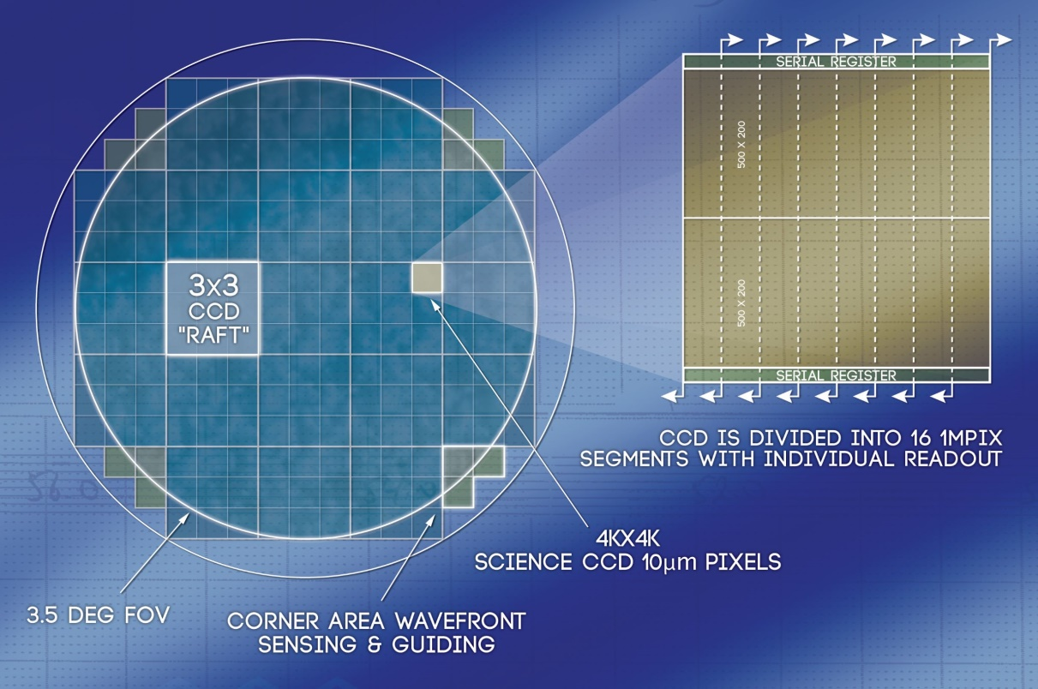
Camera Specific Hardware
Focal Plane:
The “heart” of the instrument is the focal plane.
Just over 200 sensors total (including guiders and wavefront sensors).
63cm diameter focal plane with extremely tight flatness specification.
Needed +/- 11um over the full 64cm.
Silicon Carbide structural support:
Needed to be able to accommodate the 120deg C temperature change.
Needed to be able to accommodate the changes in orientation (structural stiff).
Low read noise: < 10 electrons.

Slide 18
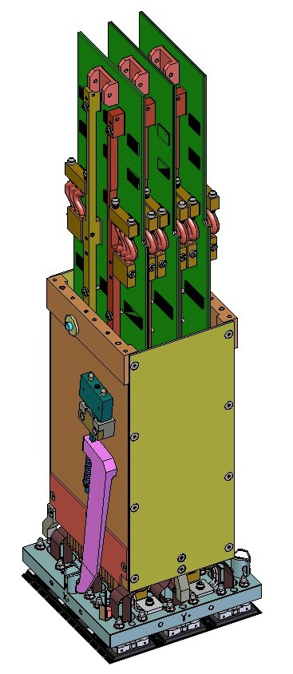
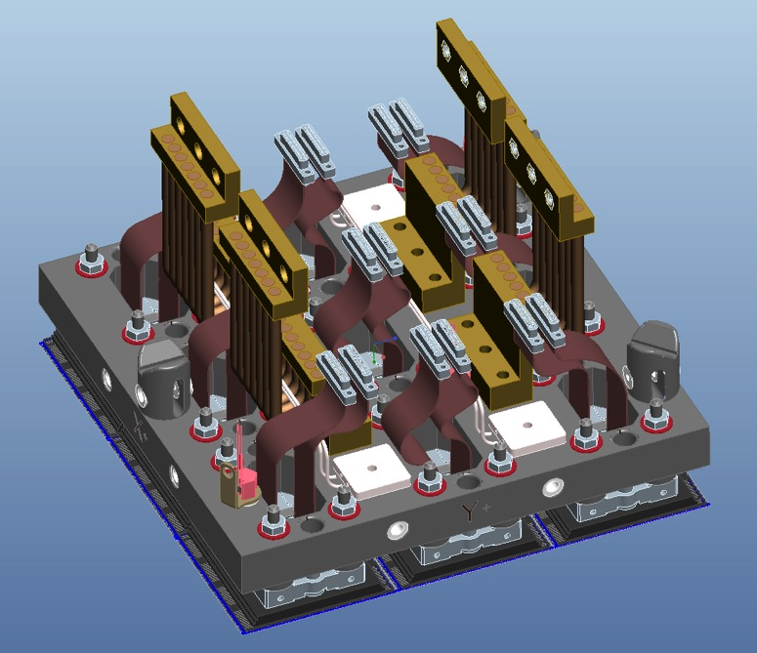
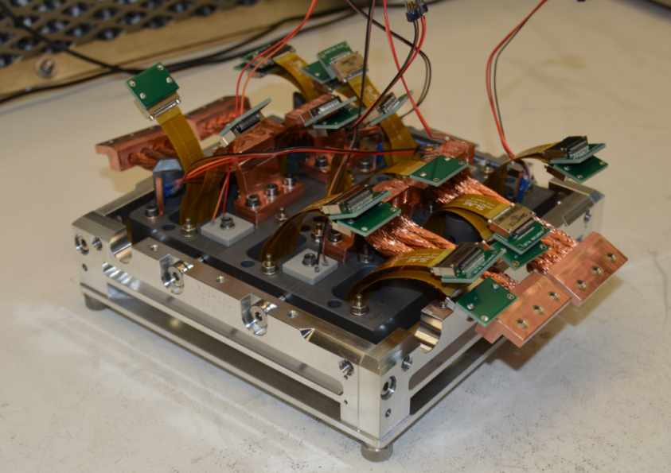
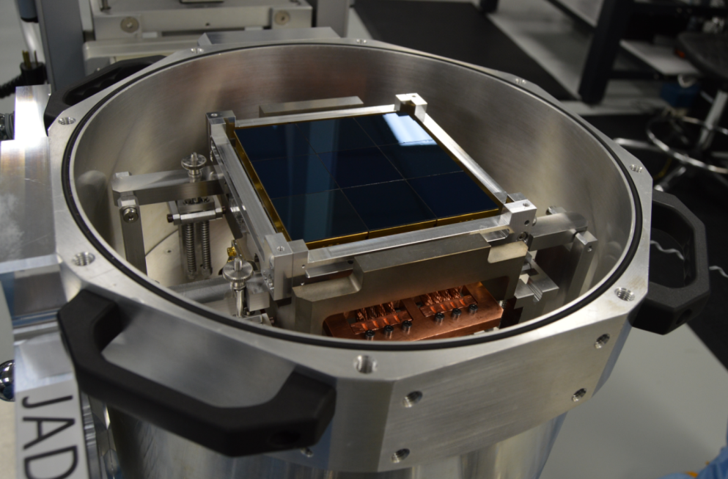
Camera Specific Hardware
Science Rafts:
In order to scale, we need to locate the electronics for each sensor within its footprint.
We chose to scale in quantum of 9 sensors = 1 raft.
All the electronics for a raft (3 REB boards and the copper cooling “crate” are located behind in the footprint.
Sensors are mounted on a 125 x 125mm SiC plate that is separable from the electronics crate (by a 4mm expansion) and located with 3 ball & V-grooves.

Slide 19
Camera Specific Hardware
Science Rafts:
As the rafts are raised into the cryostat, the SiC base plate engages with a SiC “grid structure” via the three SiC precision balls (V-grooves).
As the electronics crate is further retracted, it eventually engages with a copper cooling plate where it is fastened with standard fasteners.
The sensors are now structurally removed from the electronics, but are still thermally and electrically connected.
Cooling for the focal plane in provided by the Cryo-plate (-135 deg C) through the copper crate walls
Cooling for the electronics is provided by the Cold-Plate (-40 deg C) through deployable thermal straps on the boards.
Only the weight of the sensors and SiC base plate is carried by the grid structure.

Slide 20
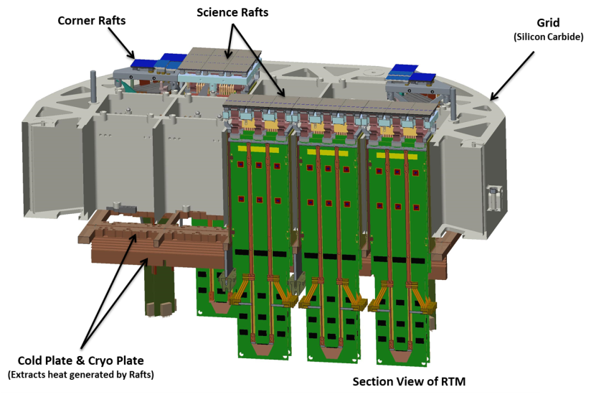
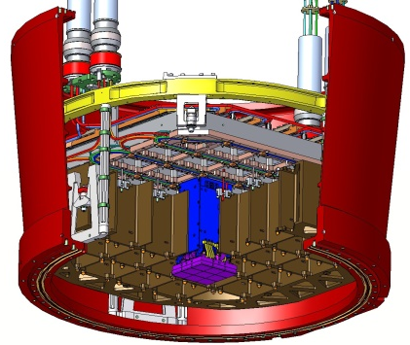
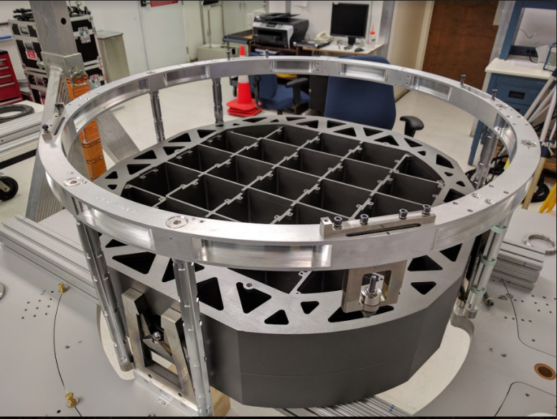
Camera Specific Hardware
Focal Plane Structural Support – SiC Grid:
The structural support for the focal plane is provided by the Grid.
The Grid needs to be stiff and relatively unaffected by the large (~120C) temperature change that is must undergo.
Carbon fiber reinforced Silicon Carbide was chosen for the base material, but then the manufacturing of such an object becomes very challenging.
The ball cups (for the 3 ball/v-grooves) needed to be machined to ±3um flatness over the full 63cm focal plane diameter.
Any additional adjustment to accommodate irregular rafts can be made by selection of a ball size from premeasured lots of precision balls.

Slide 21
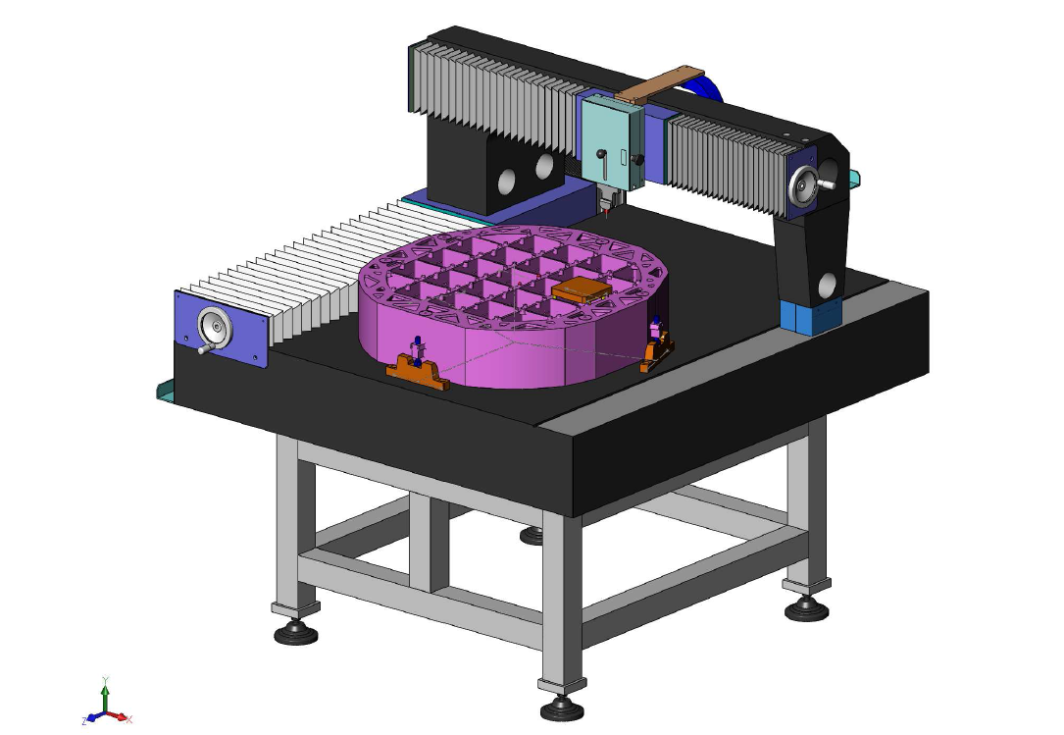
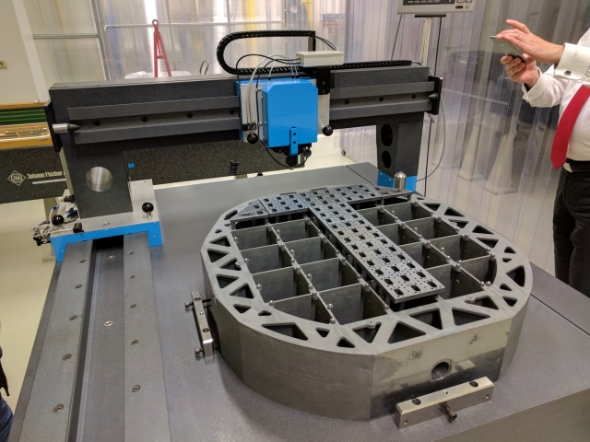
Camera Specific Hardware
Focal Plane Structural Support – SiC Grid:
Steps for fabrication:
Greenbody machining.
Firing / infiltration.
Grinding – general dimensions.
Precision grinding and metrology of the ball cups.
Dedicated “machining and metrology” table was custom designed for the final ball cup fabrication steps and the final metrology.
Granite table with air bearings (similar to a coordinate measuring machine).
In the end, the contract with ECM and their subcontractor provided for <4um PV planarization across the Grid.

Slide 22
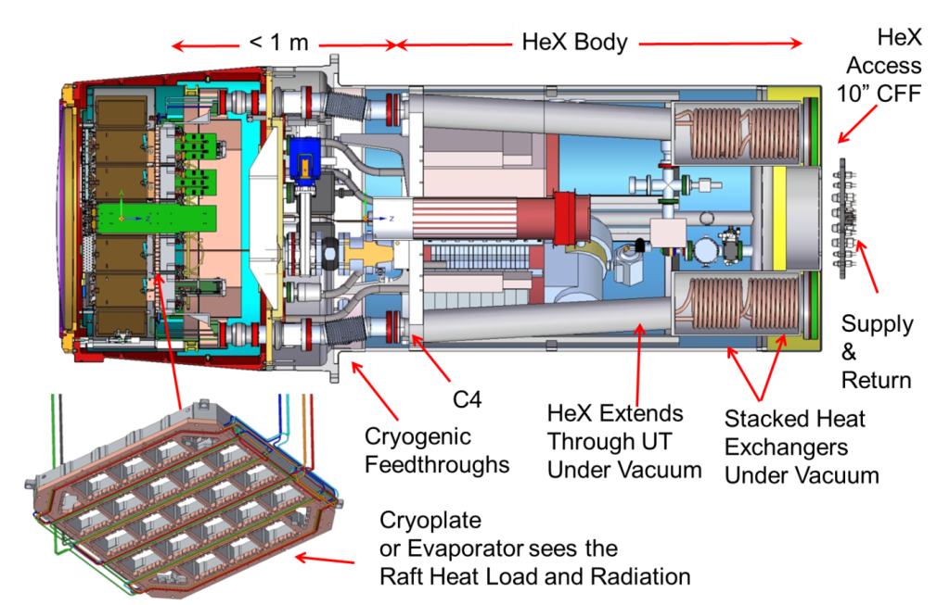
Camera Specific Hardware
Refrigeration Systems:
The Camera requires 2 different cooling system (actually 8 units of two different flavors).
These systems were a custom development in partnership with an outside refrigeration vendor.
The cooling capacity is required at the Camera location, 60 m from compressors (which are mounted on lower portion of the telescope)
2x Cold systems - cooling for the electronics.
6x Cryo systems - cooling to the focal plane.
All 8 systems counter-flow heat exchangers and expansion capillaries in the utility trunk.
Compact low mass on moving camera.
Reliable 24/7 operation.
Low vibration < 1𝝁𝒎.
Don’t underestimate refrigeration systems!

Slide 23
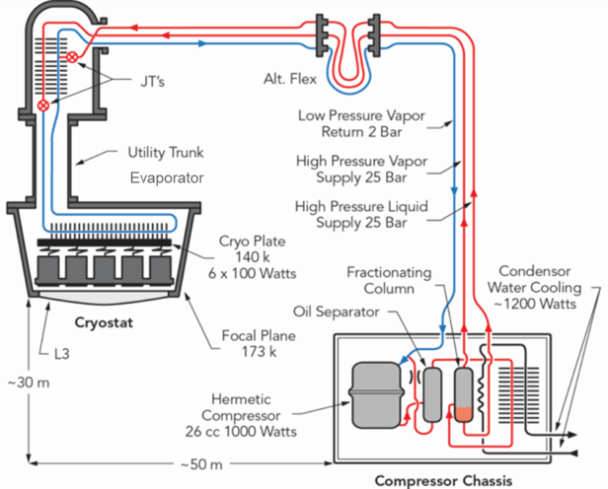
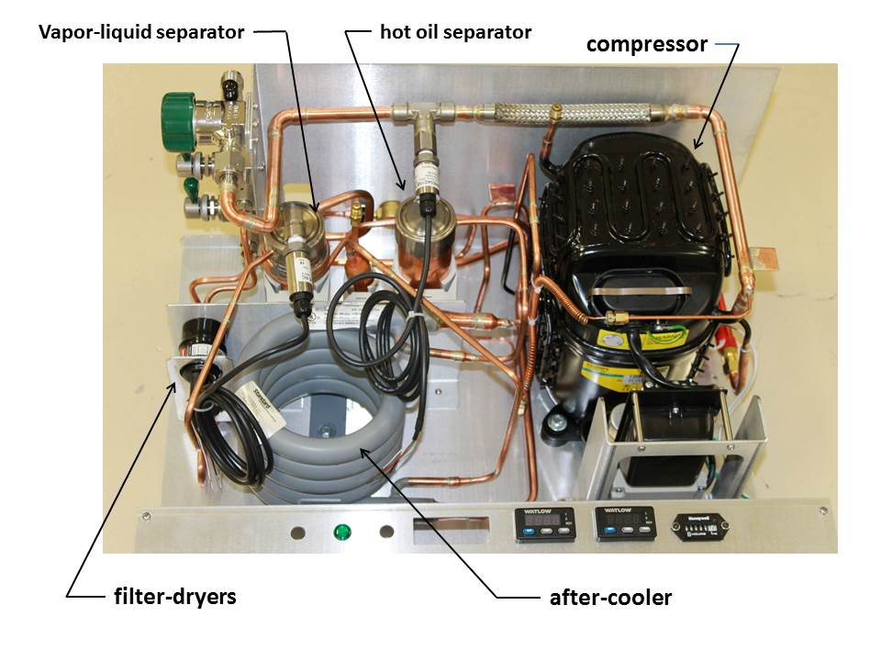
Camera Specific Hardware
Refrigeration Systems:
6 units are “Cryo” cooling systems:
Provide ~95 Watts of cooling (per unit) at -135 deg C.
Used for cooling the focal plane and grid.
Key system design points:
Kleemenko Auto-Cascade Refrigeration Circuit
Custom recipe utilizing mixed refrigerants (not off the shelf).
2 stage cascaded cooling, 1st by liquid phase and 2nd by vapor phase.
2 supply lines (liquid & vapor) and 1 suction return line.
Refrigerant supply separated into liquid and vapor streams in a phase separator.
Counter-flow heat exchangers & expansion capillaries located in the rear of the utility trunk.
Evaporator tubes embedded in cryo-plate.
Water-cooled compressor and aftercooler.

Slide 24
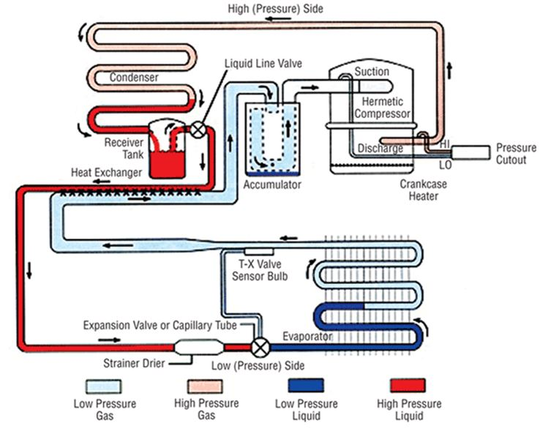
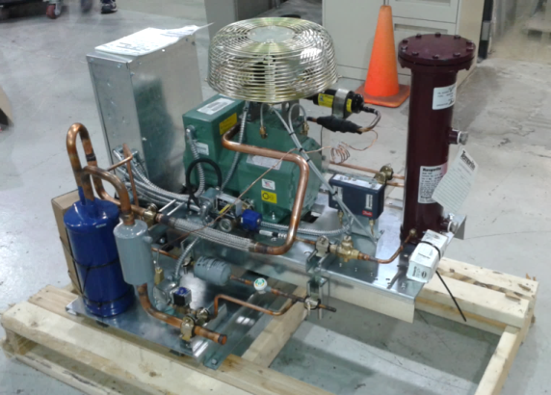
Camera Specific Hardware
Refrigeration Systems:
2 units are “Cold” cooling systems:
Provide 545 Watts of cooling (per unit) at -40 deg C.
Used for cooling the electronics.
System design points:
Conventional vapor compression refrigeration.
Employs standard R507A refrigerant mixture.
2 stage cascaded cooling, 1st by liquid phase and 2nd by vapor phase.
Single supply line (liquid), single return line (vapor)
Counter-flow heat exchangers & expansion capillaries located in the utility trunk.
Evaporator tubes embedded in cold-plate.
Water-cooled Compressor and Aftercooler ****

Slide 25
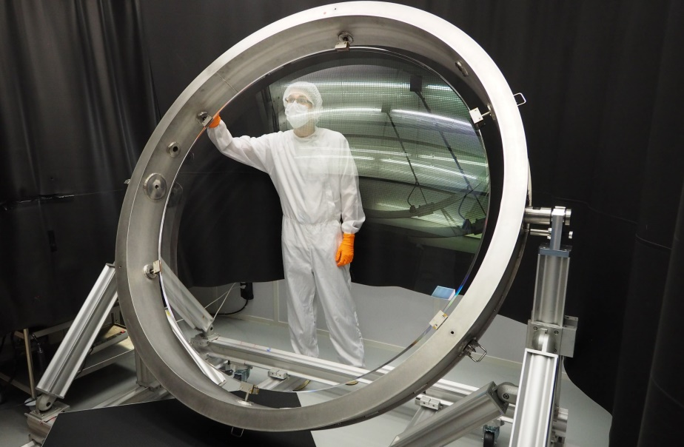
Camera Specific Hardware
Optics:
The first element of the camera (L1) is the largest lens in the world at 1.6m dia.
It is mounted within a carbon fiber cell, in a doublet arrangement with L2 and serves as the front sealing surface of the camera.
The fabrication was a feat itself, but now I&T deals with handling (mounting and aligning) and the risks associated.
Delicate – both glass and the bond lines.
Risk – very large setback if we have any issues with this element.
The cell (including lenses) weighs about 500kg and is mounted with a hexapod structure.

Slide 26
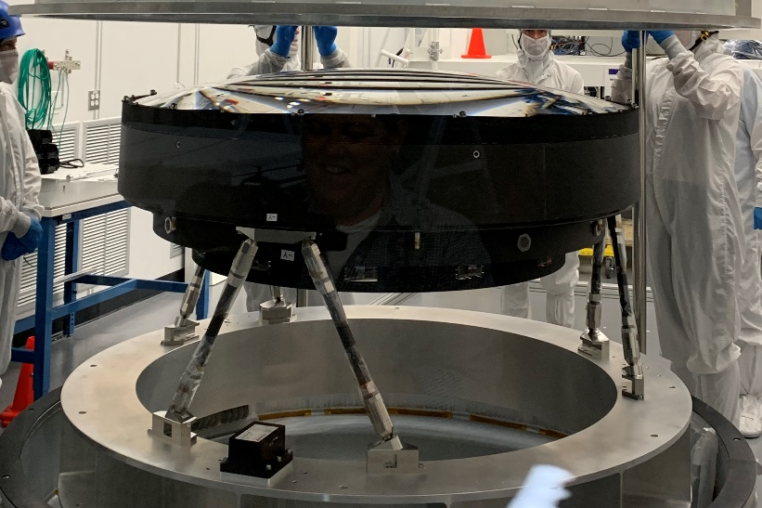
Camera Specific Hardware
Optics:
Not a “perfect” hexapod, but we can accomplish the adjustments required through manipulation of the strut lengths.
The tolerances for the mounting of the optic are relatively tight (on the order of 25um)
Need a way to get a fine resolution adjustment on the length of the truss with a large overall throw (up to 10mm).
This is accomplished with a differential threading scheme – one end of the strut has 32 TPI joint, and the other end has a reverse thread at 30 TPI.
Resulting final resolutions:
Coarse adjustment = 0.85mm / turn.
Fine Adjustment = 0.05mm / turn.

Slide 27
Camera Specific Hardware
Shutter:
Requirements:
The shutter open & close time shall be 0.98 seconds or less with a goal of 0.9 seconds.
The shutter shall be designed for at least 1 000 000 open/close cycles per year.
When exposed to diffuse light, the closed camera shutter shall attenuate the light flux by 10 000.
Relatively large structure with an extremely tight space to fit within.
Features:
4x Carbon Fiber blades.
Chicane features on end of blades for light sealing.
Stepper motors are used with closed loop control for meeting accuracy requirements.
Prototype made to run 2.2M cycles to ensure maintenance cycles and cleanliness specification.
First run at horizontal configuration: ~400k cycles
Second run at 45% configuration: ~1.8M cycles

Slide 28
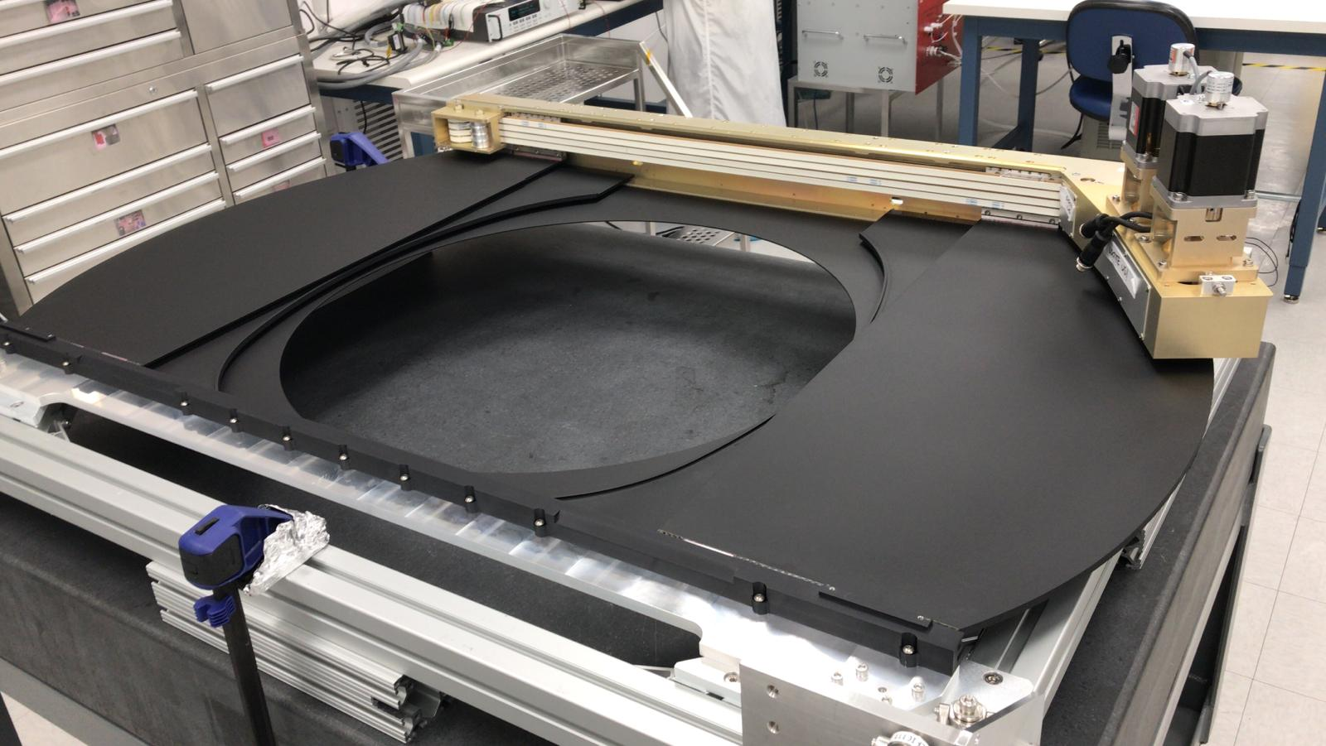
Camera Specific Hardware
Shutter:
Movie available: https://stanford.box.com/s/t35k1gi24v2uhvubiku7xvcjxr0d3xo6

Slide 29
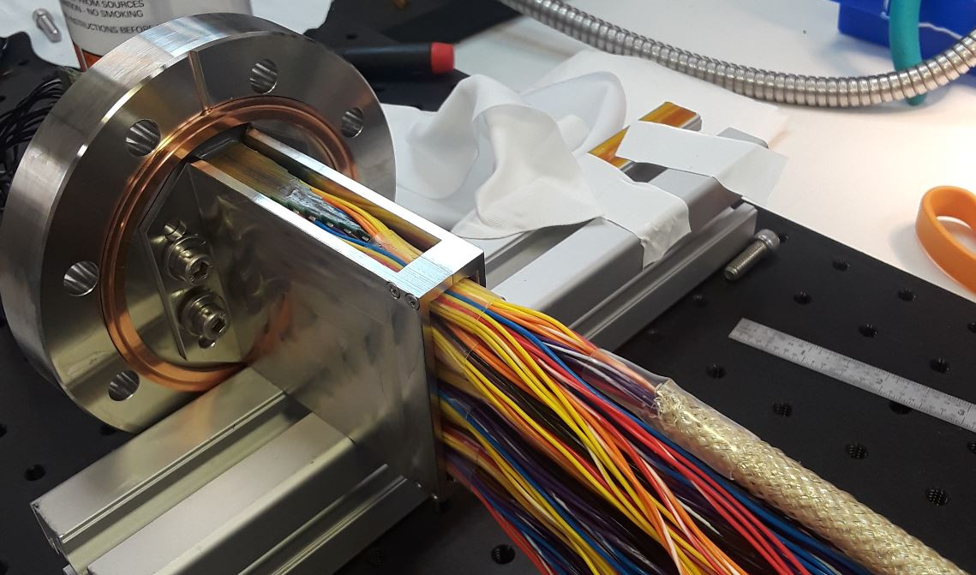
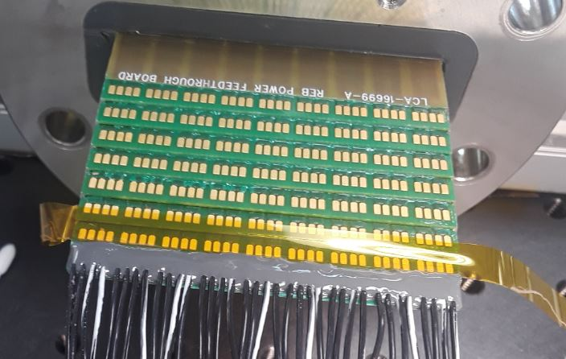
Camera Specific Hardware
Power Feedthroughs:
We had a vendor selected to produce these for us but they were unable to meet the vacuum qualification requirements (and they basically gave up after several tries).
SLAC had an “in house” contingency plan based on using multi-layered circuit boards.
576 wires penetrations in 16 layers, with 36 solder pads per layer.
Circuit board potted into flange with stycast™.
Standard 4.5” ConFlat™ flange blank.

Slide 30
I&T Specific Issues and Solutions

Slide 31
I&T Specific Topics
Raft Integration Gantries:
Specialized systems developed specifically for the installation of the Raft Tower Modules through the grid and into the cryostat.
Focal Plane Metrology:
A custom metrology system was developed and the results from the first metrology run are presented.
I&T Planning:
The basic process we used for planning and identifying all handling equipment and test hardware needed to complete the Camera.
I&T Subsystem Management:
A few key observations / takeaways from our experiences thus far in the process.

Slide 32
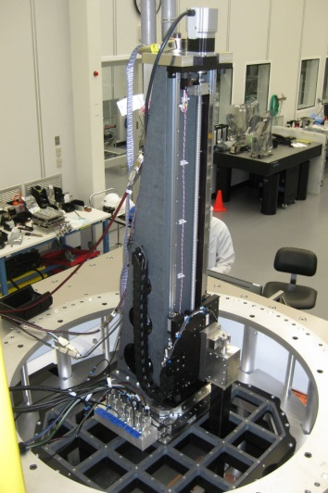
Raft Integration Gantries
The Raft Integration Gantry is a stand alone structural system with a collection of stages (X, Y, Theta, and Z), that is designed specifically for the controlled insertion of Science and Corner Rafts into the Cryostat focal plane.
These gantries come in two flavors – one for dealing with the 21 Science Rafts, and one for dealing with the 4 Corner Rafts.
Raft integration / removal processes occur while the Cryostat is mounted in the Bench for Optical Testing (BOT). This is a large structure that holds the cryostat downward facing and allows access at both front and back of the cryostat.
The IG is easily deployed by an overhead crane into the desired bay necessary for the insertion / removal process.
The insertion (or removal) of an individual raft into the focal plane was considered to be the most complicated (and highest RISK) of the processes that I&T would have to undertake during the construction of the Camera.

Slide 33
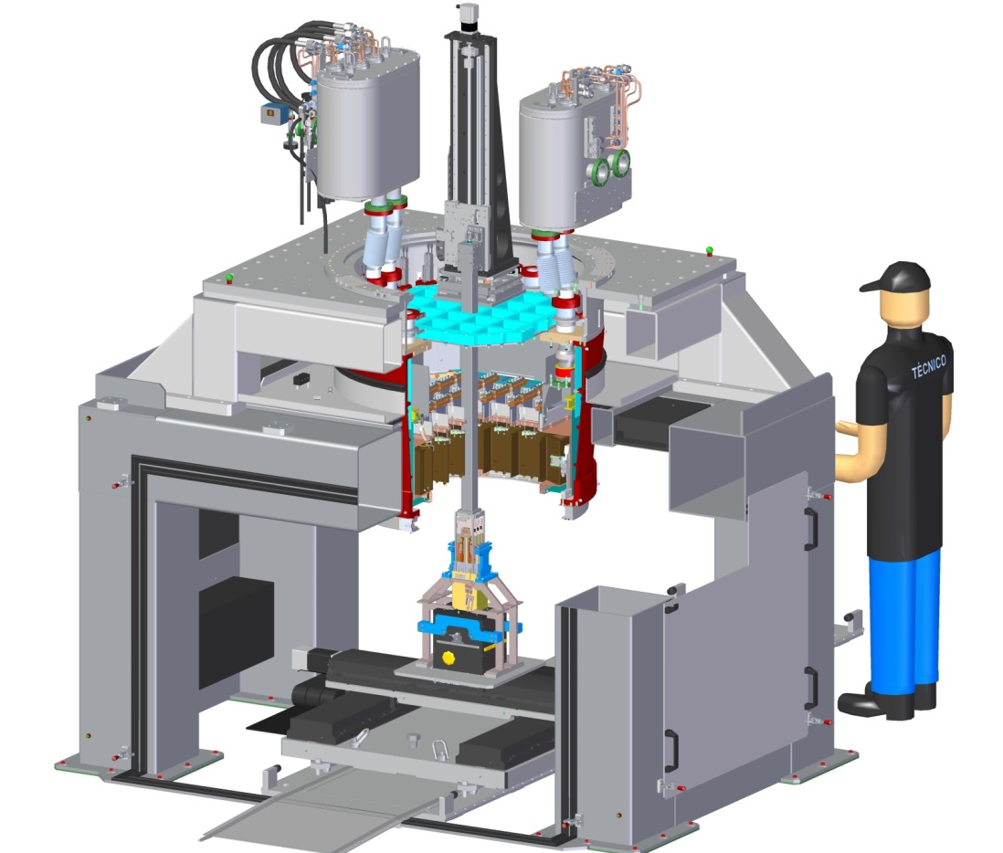
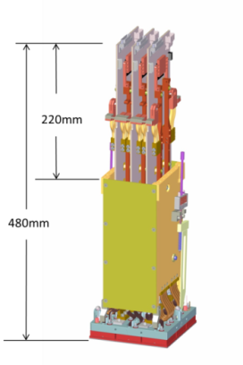
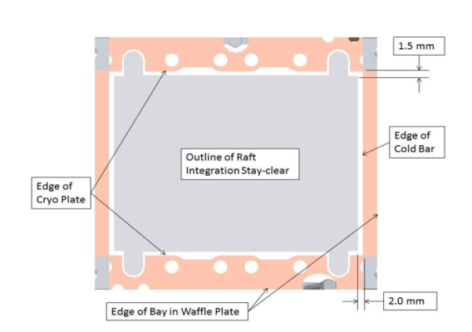
Raft Integration Gantries
The Integration Gantry arm needs to reach through the back of the cryostat to engage with the science raft.
Attaches to the top of an RTM (which is about 480 mm long).
Arm length is 1 000 mm.
620 mm draw of RTM into final position.
<2 mm spacing clearance over the majority of the draw into the cryostat.
< 500 um spacing near the end of the draw.

Slide 34
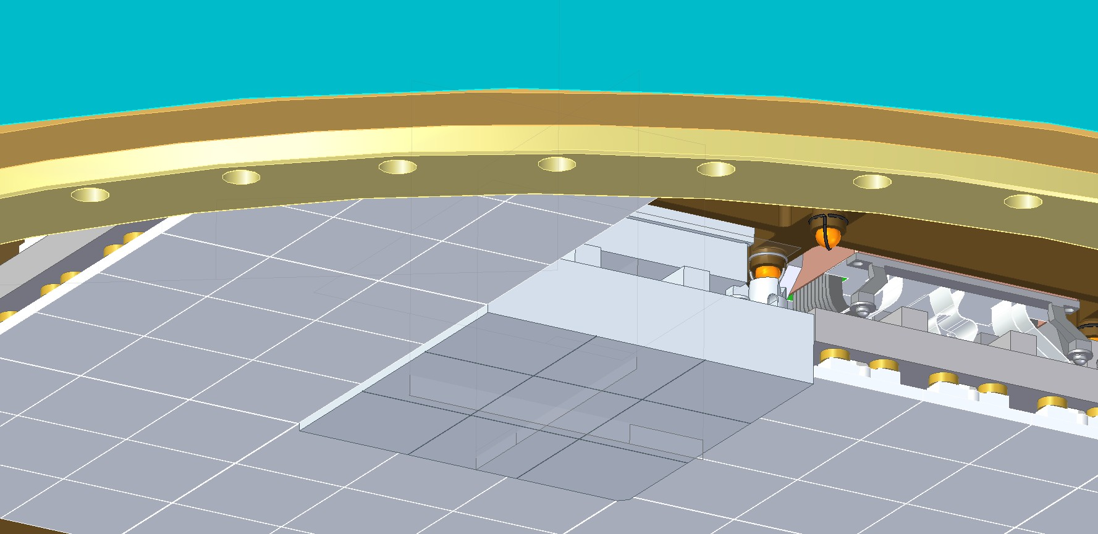
Raft Integration Gantries
500 microns spacing - “nominally”
250 micron spacing - “bad cases”
125 micron spacing - “absolute worst case”
Highest I&T RISK!!

Slide 35
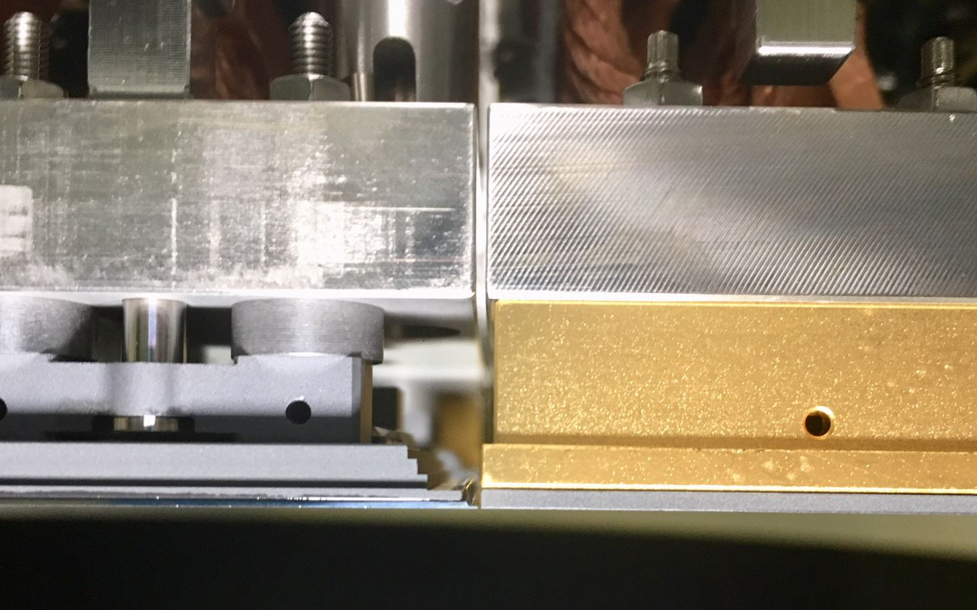
Raft Integration Gantries
500 microns spacing - “nominally”
250 micron spacing - “bad cases”
125 micron spacing - “absolute worst case”
Highest I&T RISK!!

Slide 36
Raft Integration Gantries
500 microns spacing - “nominally”
250 micron spacing - “bad cases”
125 micron spacing - “absolute worst case”

Slide 37
Raft Integration Gantries
Integration Gantry stages.
Granite main structure - for both precision and stiffness (developed by Tru-Stone Technologies – division of Starrett).
THK rails and lead screw:
Rails: “super” precision = <4um running parallelism over 940mm travel.
Lead screw: 4mm pitch with C5 accuracy (<25 micron fluctuations in travel).
Renishaw Resolute™ absolute linear encoders (sub micron resolution).
Carbon fiber arm for lightweight and stiffness.
Stage Travel distances and resolutions:
Z-axis: 625 mm travel / 50 µm resolution.
XY-axes ± 2.0 mm travel / 10 µm resolution.
Theta-axis ± 0.5º travel / 0.057º resolution.
Load cell on Z stage: responds to < 1N force; with the monitoring software set to “trip” at 5 N.
Granite Base
Step motor, coupling, brake and ball screw support nut
THK LM Super Precision Guide Rails
X-Y-Theta Stage
Integration Arm
50mm x 50mm x 1000mm
Waffle Plate

Slide 38
Raft Integration Gantries
The monitoring cameras are mounted to observe each corner of a raft being integrated.
The system has 4x telecentric lenses (constant magnification with distance) with a depth of field sufficient (35 mm depth of field at f/8 ) to monitor the RTM and its already-installed neighbors during the installation process.
Lens: Opto-Engineering 23064-07.
Camera: Matrix Vision BlueFox3-2051G.
The workhorse GUI integrates the images from the monitoring cameras and the outputs from the “region of interest” edge/gap finder subroutine (1 sec update rate).

Slide 39
Raft Integration Gantries
Historical translational data analysis plots.
Single Scientist dedicated to monitoring during the install process.
Used to track the history of the raft as it is moved up into place.
Gantry stages control console
Used for control of the stages on the gantry.
Developed in house by the same team that develops the CCS.
X-Axis:
Y-Axis:

Slide 40
IG Related – Installation Steps
The Gantries are lifted into place above the back of the open bay where the raft will be drawn into.
The systems are initialized and operation is confirmed prior to installing the insertion arm.
The orientation of the gantry can be clocked to accommodate the different location on the back of the cryostat. The interfaces are double checked to confirm XY motion is as expected.
The insertion arm is installed onto the gantry Z-stage.

Slide 41
IG Related – Installation Steps
With the arm attached to the Gantry, it is lowered through the Cryostat and Grid.
Spacing on top of the cryostat is very tight with the refrigeration heat exchangers taking up large amounts of real estate.
Temporary cabling is in place for operation of the RTMs, remove from the Quadbox (electronics rack for the final camera configuration).

Slide 42
IG Related – Installation Steps
The lower end of the arm is attached to the back of the Science Raft (or corner Raft) that is to be inserted.
The Science raft to be inserted has just gone through a complete final diagnostic and “pre-flight” checklist prior to insertion.
The gantry is actuated to start the process of drawing the raft up into the cryostat.
At this point the sensors are cantilevered out approximately 1.5m from the attachment point on the gantry.

Slide 43
IG Related – Installation Steps
For the first ~20cm of travel the clearances around the raft are relatively large (several mm) and the rate of insertion is on the order of mm/sec.
As the crate and electronics begin to pass the previously installed sensors, the clearances get a little tighter and there are a few features that we slow down for, and take more care as we pass.
Eventually we get to a point where there is enough space for the monitoring cameras to be installed below the raft.

Slide 44
IG Related – Installation Steps
Once installed, the monitoring cameras give us excellent feedback as to the positioning relative to the neighboring rafts and X-Y-T adjustments can be made accordingly.
Additional lighting is attached to the monitoring cameras to help visual monitoring. Several spotters check clearances during each movement.
The insertion speed is significantly reduced and visual confirmation (from both below and above) are given for set increments of movement.

Slide 45
IG Related – Installation Steps
During the final few mm of travel, the cameras are used almost exclusively to help guide the raft as the gaps and reflections are very hard to discern.
The installation is slowed significantly at this point and will be as slow as 50um increments for the final few mm of Z travel.
It is not unusual for there to be some sideways motion of the sensors as v-grooves on the RSA feet begin to engage the three balls.

Slide 46
IG Related – Installation Steps
With the RSA seated onto the three balls, there is a “sigh of relief”, and the crate is pulled the additional 4mm to engage with the cryo-plate at the top end of the cryostat.
All of the fasteners are installed at the top and the thermal straps are deployed.
The cables are attached to the top of the raft and a final “aliveness” test is performed to confirm the connectivity and that the raft is operational as expected.

Slide 47
IG Related – Installation Steps
Movies Available:
(16Mb) Single raft: https://stanford.box.com/s/pnjrhwxz3v9i1jdxrvahnr23zda6sf35
(>500Mb) Full Cryostat: https://stanford.box.com/s/sqbnnnz1125xe4hbjlbtdyeazf6bxh9t

Slide 48
IG Related – Installation Steps

Slide 49
Metrology
Single Raft Focal Plane Metrology:
A custom metrology system was developed for confirming the flatness of the focal plane after all of the rafts were installed.
A single raft version of the system was developed and used for acceptance of the individual rafts from the Science Raft and Corner raft Subsystems.
Principle is based on the use of two Keyance™ sensors mounted on an XY stage facing opposite directions. One of the two sensors is faced onto a known optical reference flat.
The resolution of the sensors is better than 1 um.
The sum of the two sensor readings will be insensitive to the irregularities in the stage travel during the scan.

Slide 50
Metrology
Full Cryostat Focal Plane Metrology:
A version large enough to scan the final focal plan has been developed.
It utilizes the existing XY stages used for raft insertion and EO testing.
Principle is the same, but a reference flat (ULE glass) is used, that only covers a portion of the focal plane (largest flat available using passive supports - Whiffletree mechanism).
The flat is rotated into 8 different locations and the results “stitched” together to get the final full focal plane flatness.
The reference flat is mounted with an invar hexapod structure to minimize the effect of any thermal variations.

Slide 51
Metrology
“Preliminary” Focal Plane Metrology Results:
Getting very close to our requirements of ±11.0 um
Some errors in the “stitching” that you can actually see in the results.
Some errors in the “re-referencing” that was done to help reduce the thermal effects.
Also needs to be some “noise” removal that will help reduce the width.
Currently approximately 97% within specification..

Slide 52
I&T Planning
Logistical planning:
“If you fail to plan, you are planning to fail!” ― Benjamin Franklin.
“Plans are of little importance, but planning is essential.” ― Winston Churchill.
“Plans are nothing; planning is everything.” – Dwight D. Eisenhower.

Slide 53
I&T Planning
Logistical planning:
“If you fail to plan, you are planning to fail!” ― Benjamin Franklin.
“Plans are of little importance, but planning is essential.” ― Winston Churchill.
“Plans are nothing; planning is everything.” – Dwight D. Eisenhower.
“Everybody’s got a plan until they get hit.” – Joe Lewis

Slide 54
I&T Planning
Logistical planning:
I&T team produced highly detailed schematic work flow diagrams for all assembly and test processes that occur during the I&T phase of the Camera:
Enabled us to identify exactly where in the I&T sequence individual camera components are needed and/or expected.
Identified where all the individual verification tests occur within the assembly flow sequence.
Identified all individual components or subassemblies very specifically (i.e. by drawing #).
Includes all deliverables from individual subsystems as well as I&T.
Camera components.
Any additional fixtures required specific to the subsystem.
I&T developed fixtures and equipment.
Temporary “engineering” level operating or test equipment.
Captured onto formal drawings and added to LSST Camera configuration control system.
LCA-11685: Camera Integration and Test Flow Diagram. (I&T – Camera Assembly and testing processes)
LCA-15106: Camera Integration and Test eTraveler Flow Chart. (I&T Raft re-verification)
Instrumental in helping us to identify the additional elements needed from subsystems and to ensure they were called for in the appropriate ICD with I&T.

Slide 55
I&T Planning
All of the I&T scope is captured in these diagrams.
This is a single page of a total of 16 pages (11x17) used to describe the I&T activities.
All of the content was subject to a dedicated Integration Readiness Reviews (IRRs) prior to any processes being initiated.

Slide 56
I&T Planning
The main truck identifies the individual assembly processes and test processes that are necessary.
Color coded boxes are used for identification of the Subsystem responsible for providing the hardware.
Box outline defines “test step”, “assembly step”, Camera hardware, handling equipment, or test equipment.

Slide 57
I&T Planning
Having the high fidelity estimates of the process greatly improved the ability to plan the effort and time required – and to feed that information back into our P6 scheduling software.
In a few cases, the P6 estimates had to be replanned to match the new higher fidelity estimates. This helped give us confidence that we would be able to meet our schedule (and budget) obligations.

Slide 58
I&T Planning
Finally – the list of activities was broken down into individual procedures and processes. Each of these were developed into its own process document (EXCEL) or an eTraveler (both requiring review and approval through the appropriate approvals process).

Slide 59
I&T Planning
With all of the necessary travelers identified, it was simply a case of assigning appropriate staff members to the processes and have them become the responsible party for the activity in question.

Slide 60
I&T Planning
In the case of Science raft re-verification, we modified our processes slightly to account for unplanned changes in the process sequence.
The science raft re-verification activity was a bit more of a production run type process with many identical tasks taking place repeatedly.
There were also many cases where test stations needed to be used out of the normal sequence.
This figure captures all of the possible states that a raft may exist in while proceeding through the I&T acceptance testing sequence.
From this figure, the individual eTravelers that are needed are easily identifiable.

Slide 61
I&T Planning
Again – a similar list of eTravelers flowed out of the above diagram, and were then assigned to individual team members as the responsible party.

Slide 62
I&T Planning
The eTraveler contains highly detailed procedures for the individual process along with all additional information necessary to perform the particular activity.
These electronic records are available at any time (pre and post assembly) for all Camera hardware, thus allowing easy access to any piece of hardware’s assembly/test history.

Slide 63
I&T Management
Management “Observations”…
Planning
Proved to be invaluable, yet cannot be too rigid – need to be prepared to change as necessary.
Team cohesiveness
It was extremely important to get all of the team members pulling the oars in the same direction, early in the process so that we were on our game later when issues started to arise.
Team member flexibility
Some folks are not going to be pigeon-holed into the role you presume they are – work to their strengths.
Openness to criticism / reviews
We had 16 Camera Level Reviews (2 to go) in the past 4 years - not including DOE level reviews.
At times this seemed excessive, but in hindsight these were extremely beneficial.
Face of issues - Evaluating risks, being agile, working smart.
Need to be agile when things do not go as planned. You may even need to take some risk, but by being smart with your path forward, the risk is small, and impact can be minimized.

Slide 64
Summary / Conclusions

Slide 65
Summary
Where we currently stand
Just finished integration the RTMs into the cryostat – started EO testing.
Main camera body is being build up in parallel – getting ready to install the Cryostat into it this spring.
L1/L2 gets assembled onto the camera this summer/fall.
5 months of testing and verification.
Ship to the summit in Chile early 2021.
How we are doing
Schedule is slipping slightly (order of days) but we have some float at the telescope.
Holding our currently allocated budget.
How do we feel
Very EXCITED to see all of this coming together!!

