Slide 1
ICEBERG Status and Schedule Update
Shekhar Mishra
1/9/2020

Slide 2
Links
ICEBERG Elog
SP FD Cold Electronics Test Stands Wiki
Run Plan and Project Schedule
ICEBERG Documentation DUNE Electrical and Grounding Approval

Slide 3
ICEBERG Cryogenic Upgrade
Upgraded Internal Filter has been installed on Top Plate after generation of media at MicroBooNE.
Internal Filter with New heater and RTDs for the operation of were installed and tested on the Top Plate.
No change in ground current was observed.
Condenser Upgrade
20 micron Sintered Metal Rod and Mole Sieve for the condenser return are installed
Mole sieve heater was assembled, tested
All parts for the snorkel are ready, awaiting installation of Top Plate
All the cryostat RTDs have been calibration in CTS and installed in the cryostat.

Slide 4
ICEBERG TPC
TPC Wire Bias has been tested to full power
Cathode/Field Cage Power is having issues above 7000 V.
The issue is with SHV cable, we are getting a new one made
A Hardware interlock to stop TPC wire and Cathode/Field Cage from being turned ON has been designed, built and tested.
When 48 V for CE Power is OFF
Or this will also turn off TPC if PTC voltage goes below 45 V.
We need to fine tune the trip time.

Slide 5
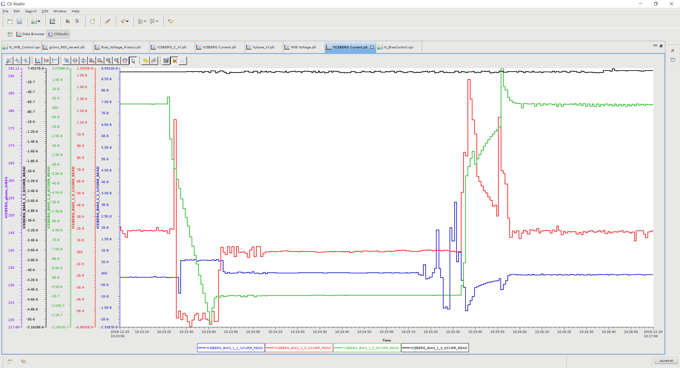
PL506 to MPOD Inhibit
Turn ON/OFF of MPOD to 100 Volts, 20 seconds to get to 100/0 Volts is consistent with ramp at present set at 5 V/sec
PL506 turned to 44 V in 1 Volt step, MPOD tripped at 44 V.

Slide 6
Electrical Test of Sub-System
Task Name | Duration | Start | Finish | Predecessors | Resource Names | Comments
Electrical Test of SubSystems | 25 days | Mon 12/2/19 | Fri 1/3/20
Test of MPOD Power Supplies with 0 Volt no SHV connected | 10 days | Mon 12/2/19 | Fri 12/13/19 |  |  | Passed
Test of PL506 with 0 Volts with no cables connected | 2 days | Thu 12/12/19 | Fri 12/13/19 |  |  | Passed
Test of TPC Wire Bias and CP/FC HV system (Without CE) | 0.5 days | Thu 12/5/19 | Thu 12/5/19 |  |  | Passed
Test of Internal Filter Heater and RTD System (Stand Alone Bench Test) | 2 days | Wed 12/11/19 | Thu 12/12/19 |  |  | Passed
Test of Sintered Metal Rod/Mole Sieve Heater (Stand Alone Bench Test) | 0.5 days | Fri 12/13/19 | Fri 12/13/19 | 45 |  | Passed
ICEBERG PL506 and MPOD Safety Loop Installed and Tested | 1 day | Thu 12/19/19 | Thu 12/19/19 |  |  | Passed
Test of Internal Filter (IF) Installed on Top Plate (without CE installed) (Stand Alone) | 1.5 days | Tue 12/24/19 | Wed 12/25/19 | 31 |  | Passed
Test of Internal Filter Installed on Top Plate and TPC Wire Bias and CP/FC HV System (Without CE) | 1 day | Wed 12/25/19 | Thu 12/26/19 | 48 |  | Passed (CP/FC up to 2kV)
Test of IF and Sintered Metal Heater power and TPC Wire Bias and CP/FC HV System (Without CE) | 1 day | Thu 12/26/19 | Fri 12/27/19 | 49 |  | Sintered Metal will not be powered
Field Cage HV test to full power awaits parts.
Will not install FEMBs on to the TPC till this is done.

Slide 7
FEMBs
BNL has mailed 8/10 repaired FEMBs.
We have a total of 9 FEMBs now at Fermilab.
Fermilab has tested 6 (5 from BNL and 1 Spare) with its data and power cables.
Test of the remaining will be done by 1/10 AM
A review of the FEMB power distribution will happen on 1/10/20 PM.
Installation in the week of 1/13

Slide 8
Photon Detector
A low voltage MPOD for PD will arrive at Fermilab on 1/10/20.
We are continuing to working on a new design of PD-PSDB.
Plan remains that PD will inserted in the TPC and wired up to the Tee inside the cryostat for the Run-2C.
PD will not be powered in Run-2C

Slide 9
Schedule
ICEBERG Closed 1/16/20
Fill Start 1/20/20
ICEBERG Full 1/23/20
Task Name | Duration | Start | Finish
Re-Building TPC | 3 days | Mon 1/13/20 | Wed 1/15/20
Install CE | 1 day | Mon 1/13/20 | Mon 1/13/20
Test with CE on TPC (No Bias, With Bias, +CP/FC) | 2 days | Tue 1/14/20 | Wed 1/15/20
Install PD in the TPC | 0.25 days | Mon 1/13/20 | Mon 1/13/20
Re-Building ICEBERG | 6 days | Thu 1/16/20 | Thu 1/23/20
Put top plate back on cryostat and leak check | 0.5 days | Thu 1/16/20 | Thu 1/16/20
Attach External Snorkel to Top Plate | 0.5 days | Thu 1/16/20 | Thu 1/16/20
Ensure that Snorkel is not acting like an antenna | 0 days | Thu 1/16/20 | Thu 1/16/20
Purge/ Vacuum ICEBERG | 1.5 days | Fri 1/17/20 | Mon 1/20/20
Fill ICEBERG | 4 days | Mon 1/20/20 | Thu 1/23/20

