Slide 1
Status of Detector Transports
Updates on roller transport devices
Examine “how it works”
Future plans

Slide 2
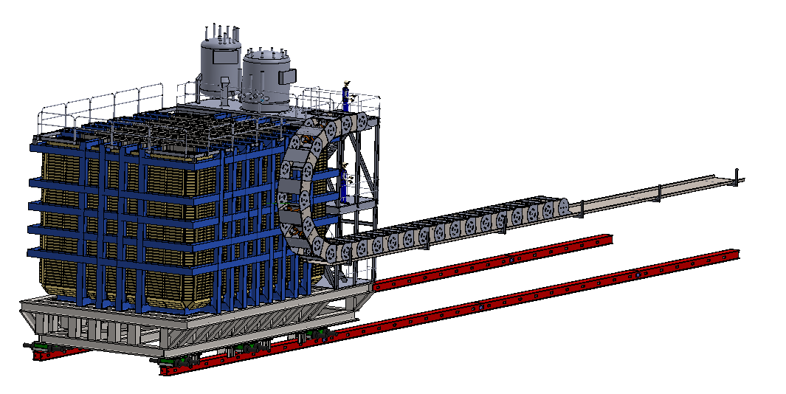
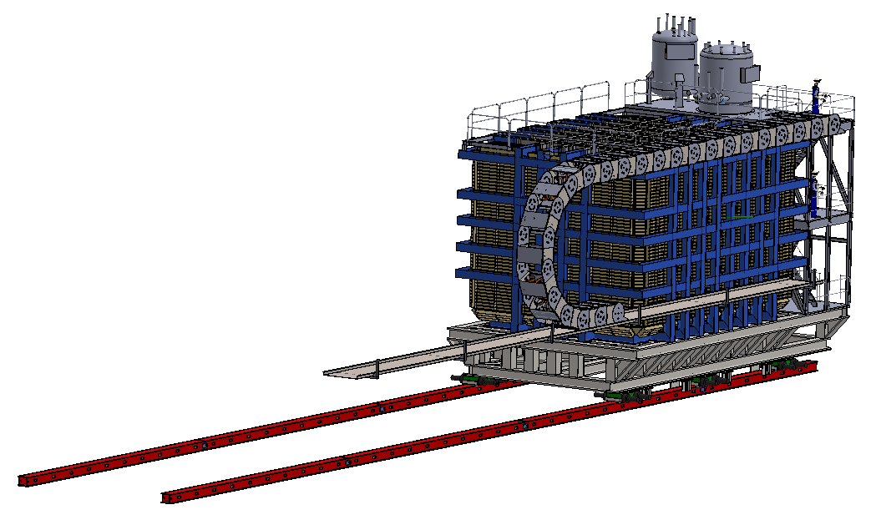
DUNE ≡
Slow, smooth, and controlled movement over 30.5m and carry 900 tonnes

Slide 3
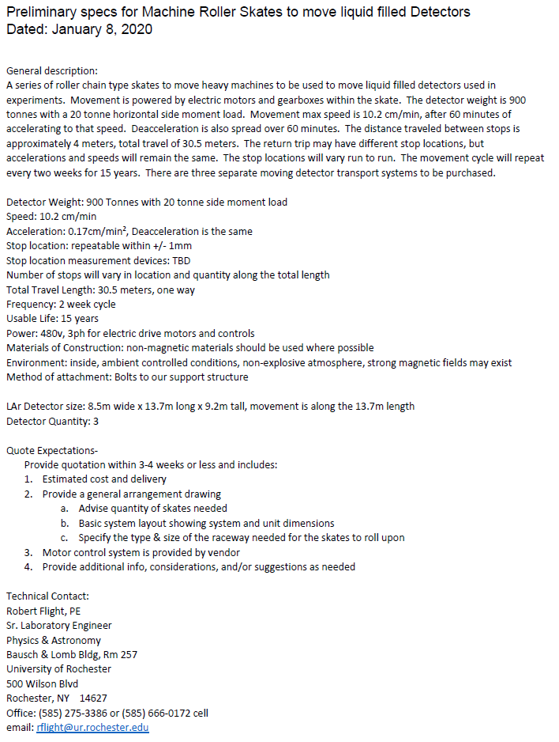
DUNE ≡
Created the “shopping list”
Requested quotes from several manufacturers
Only Hilman can meet the powered spec

Slide 4
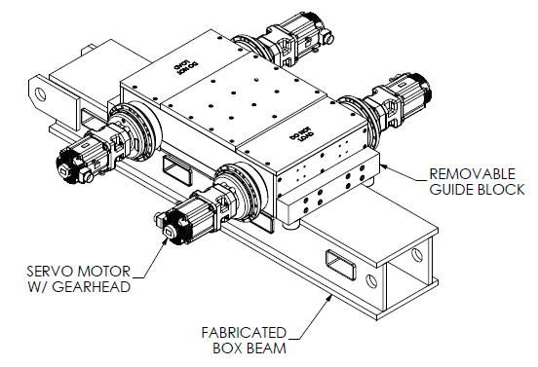
DUNE ≡
Use a Hilman Roller, often called a ‘skate’
Hilman 200 Ton capacity unit

Slide 5
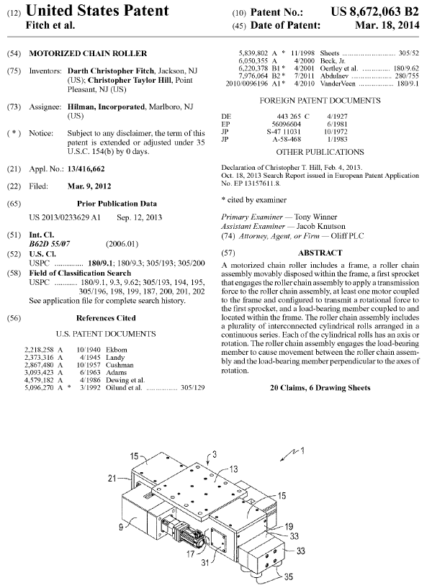
DUNE ≡
Non-powered Hilmans are used through out FNAL for heavier loads than we need to move
There are several manufacturers of the non- powered skates, but only Hilman has the powered version, and its patented.
Using a linear gear system would not be a smooth movement system
A powered Hilman should be the choice, but limits us to a single vendor

Slide 6
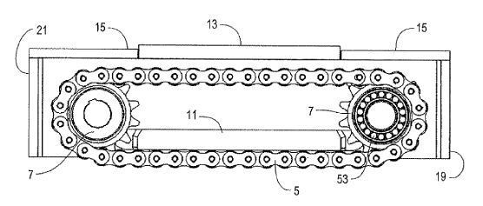
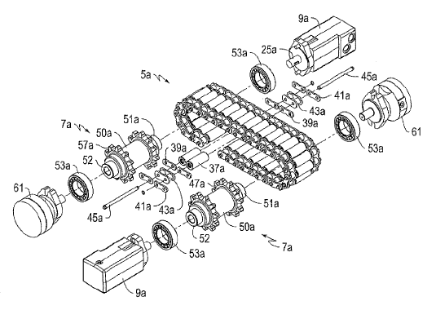
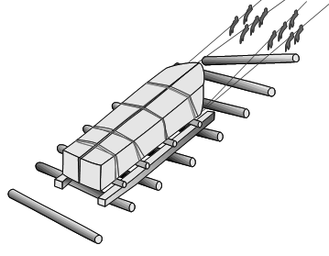
DUNE ≡
It’s the modern version of rolling stuff on logs
The recirculating rollers support the load at plate #11
Similar to a motor driven bulldozer track

Slide 7
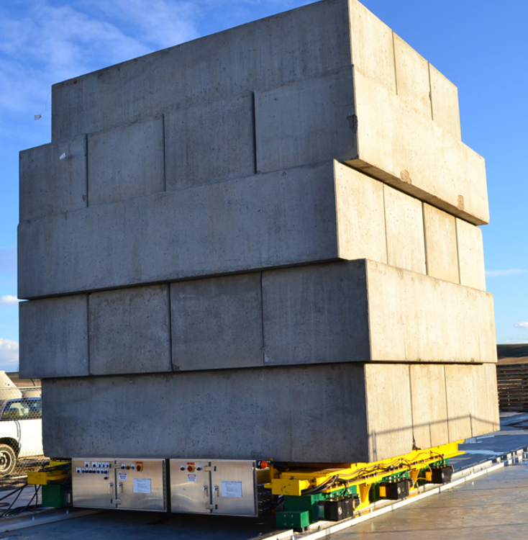
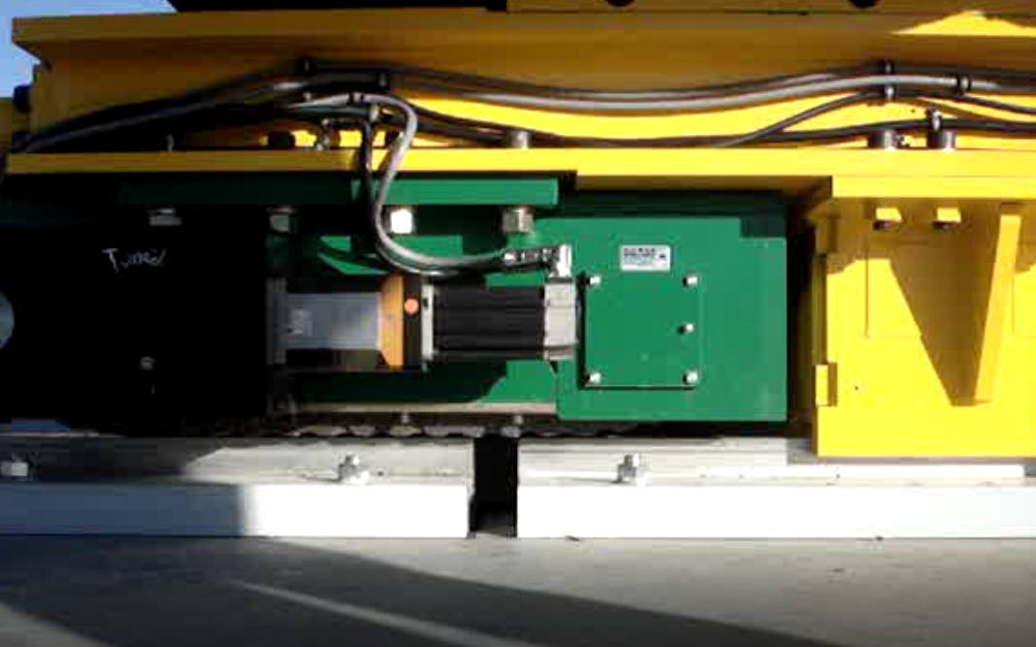
DUNE ≡
This example shows (6) 100 ton electric motorized roller assemblies moving a 400 ton test load at 1 ft/min for a nuclear waste conversion plant. Our loads are higher and speeds slower.

Slide 8
DUNE ≡
This video shows it’s slow, smooth, and can bridge gaps

Slide 9
DUNE ≡
Hilman provided an initial quote with a 20 week delivery for (6) 200 Tonne units, rails, and motor control system
TBD- define & install a linear location system to know each detector position within the hall and accommodate the variable stop locations
One system would be used for each detector
Using a system under SAND is TBD
Future plans
Visit Hilman in NJ
Better understand the details of their proposal
Refine specs, requote, etc
Order a system for trials

Slide 10
DUNE ≡
Discussions

