Slide 1
LAr Cryostat Procurement Costing
Andrew Lawrence ND Mechanical Designer
5 March 2020

Slide 2
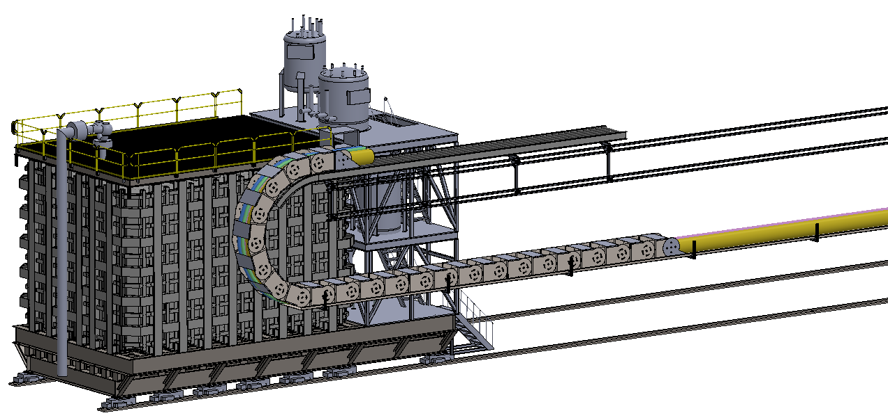
LAr Cryostat Procurement Costing Full Scope: Generating Cost Estimates from Conceptual Designs
Cryogenics Mezzanine
Mezzanine
Energy Chain
Items To Cost
1. Pedestal Structure
2. Roller System
3. Cryogenics Mezzanine
4. Energy Chain
5. Energy Chain Support
6. Cryostat Structure
Pedestal Structure
Hillman Rollers
5 March 2020

Slide 3
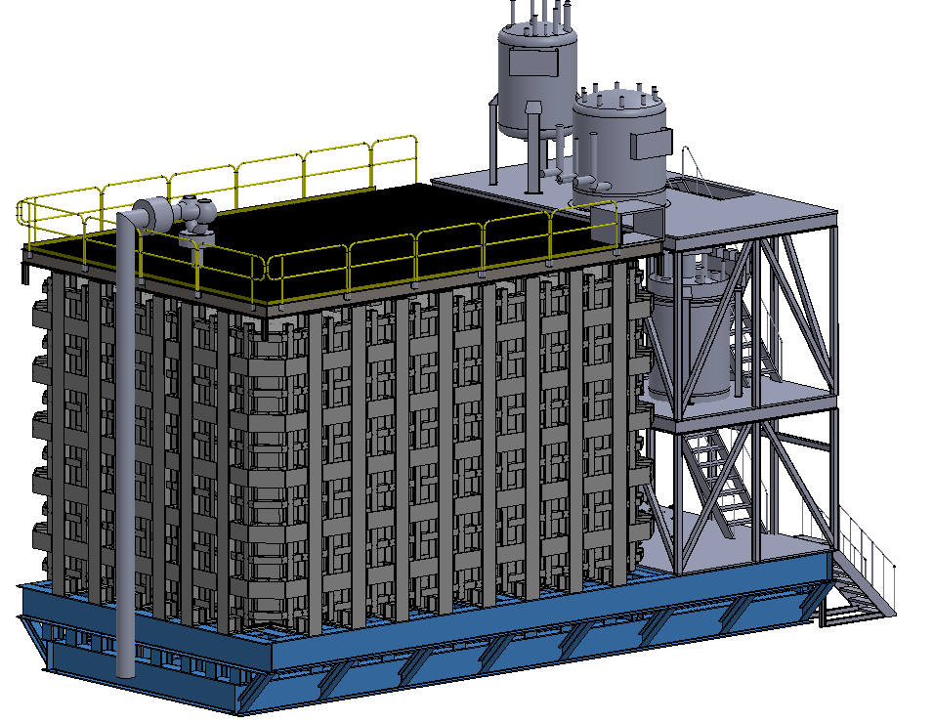
LAr Cryostat Procurement Costing Pedestal Structure
Critical that platform maintains a level surface throughout life of cryostat
Current design aims to overestimate cost with excess number of beams
Vendor | Timeframe | Cost
Structural Strategies | 15 weeks | received
JML Fabrication | 16-18 weeks | received
Cedar Valley Steel | TBD | TBD
Keller Technology | TBD | TBD
Line Items To Cost
Steel (60* ton) *to be reduced
Fabrication
Shipping
Equipment
5 March 2020

Slide 4
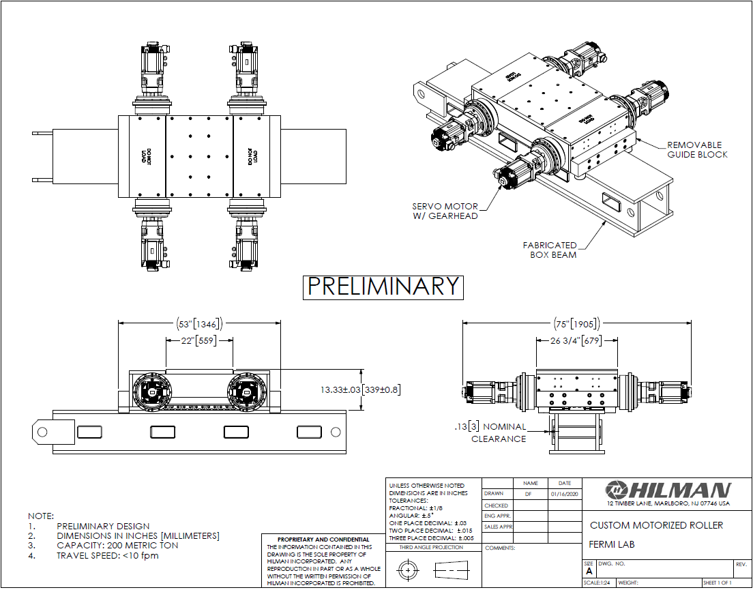
LAr Cryostat Procurement Costing Roller System
Introduction of new Hilman Roller Design by Bob Flight
New load capacity: 200 tonne
Cuts quantity needed and cost
Vendor | Timeframe | Cost
Hilman | 20-24 weeks | received
Quote includes 6 rollers and control systems
*Hilman is currently the only vendor capable of this request
5 March 2020

Slide 5
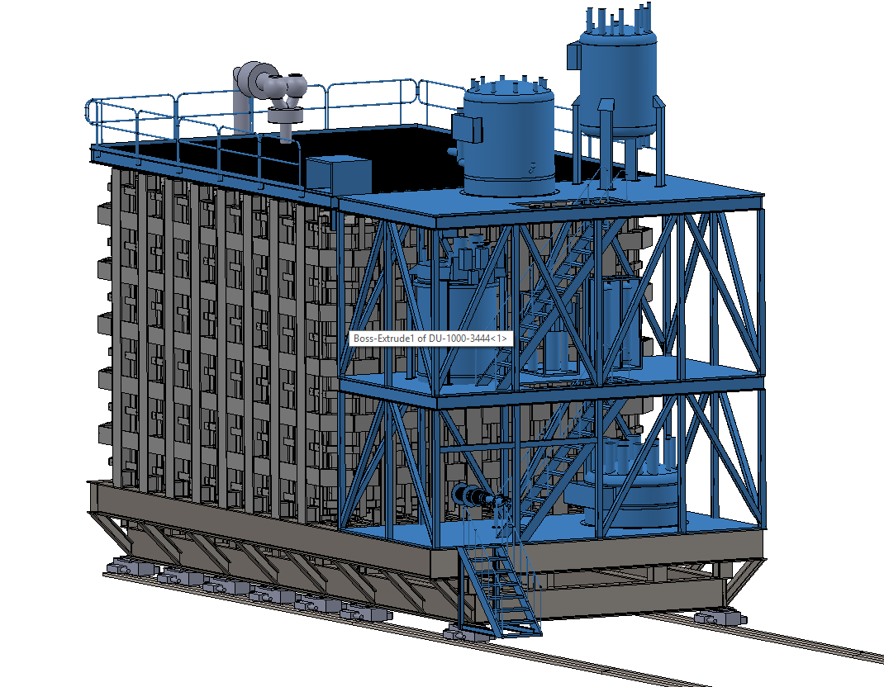
LAr Cryostat Integration Update Conceptual Design of Mezzanine for Cryogenics
Vendor | Timeframe | Cost
Structural Strategies | 6 weeks | received
JML Fabrication | 6-8 weeks | received
Cedar Valley Steel | TBD | TBD
Keller Technology | TBD | TBD
Current Cryogenics model is not fully populated
5 March 2020

Slide 6
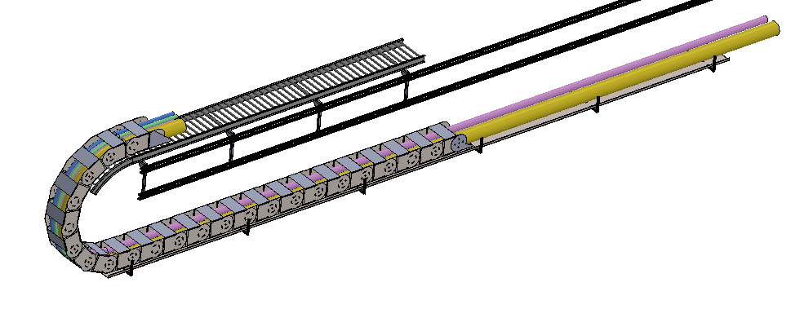
LAr Cryostat Procurement Costing Energy Chain and Support System
Rolling Support Structure
Wall Mounted Support Tray
Allows for 30.5m travel
Pipe length fixed along full travel
Traveling support structure
*update for correct piping once determined
Part | Cost
Energy Chain | received
Support Tray | received
Rolling Support | TBD
5 March 2020

Slide 7
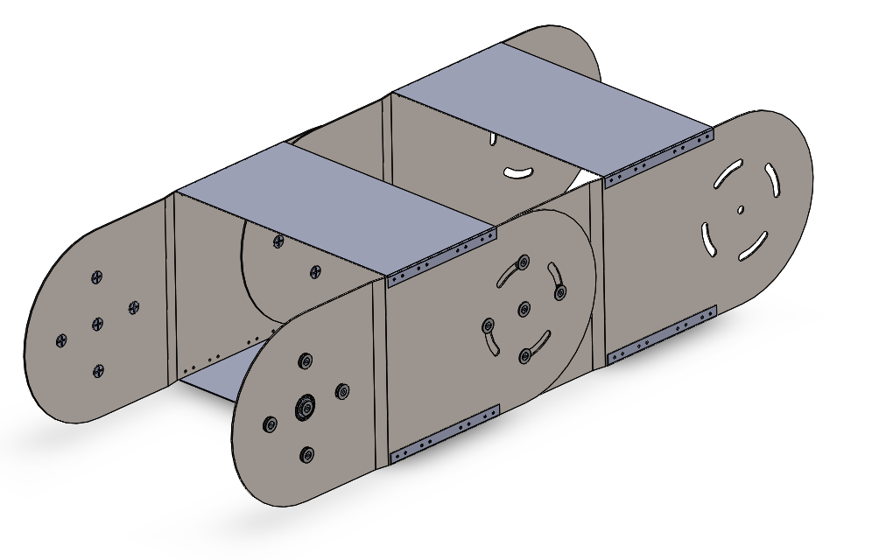
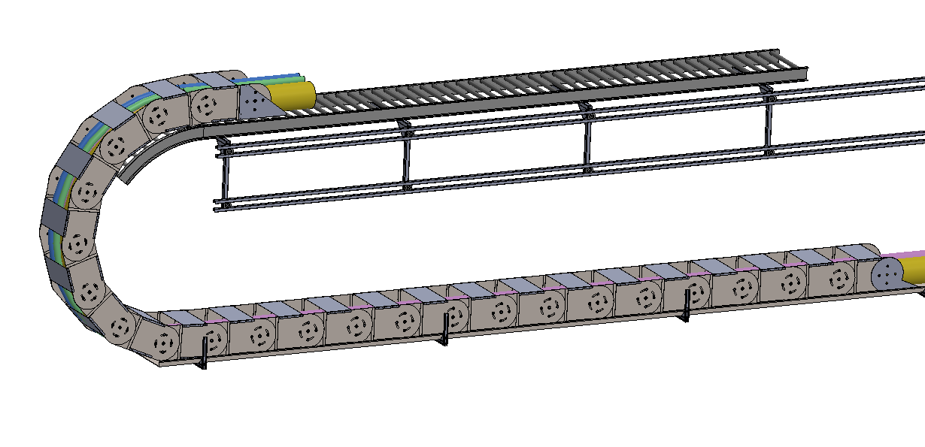
LAr Cryostat Procurement Costing Energy Chain and Support System
Updated design includes wall mounted traveling support structure to reduce strain on energy chain components
Fully Metal Structure
Distance per link: 1.2m
Width: 1.1m
Able to secure pipes on each linkage
# of links: 23
*capable of being made in-house
5 March 2020

Slide 8
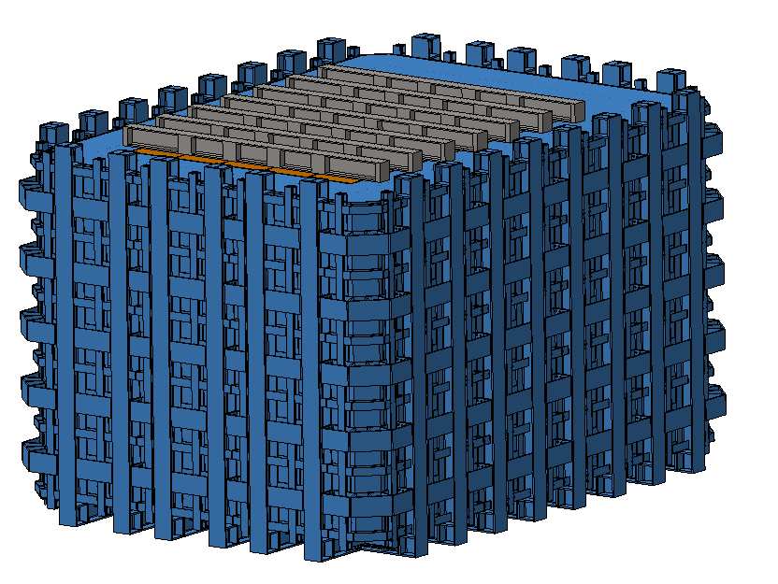
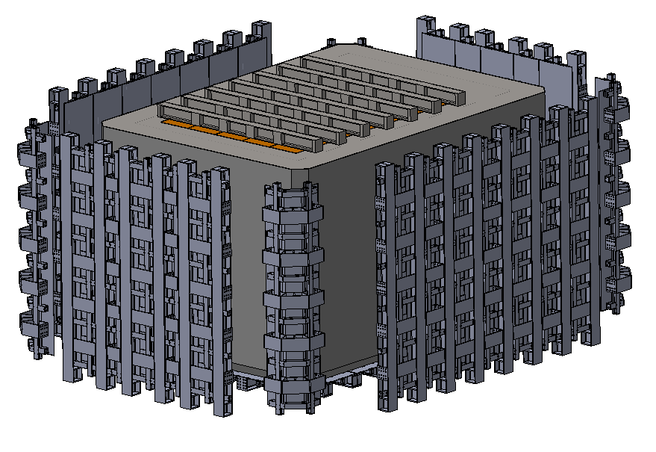
LAr Cryostat Procurement Costing Beam Structure for Pressure Vessel
Currently wrapping up drawings for all 7 subassemblies and will have quotes in the next two weeks
Vendor | Timeframe | Cost
Structural Strategies | TBD | TBD
JML Fabrication | TBD | TBD
Cedar Valley Steel | TBD | TBD
Keller Technology | TBD | TBD
5 March 2020

