Slide 1
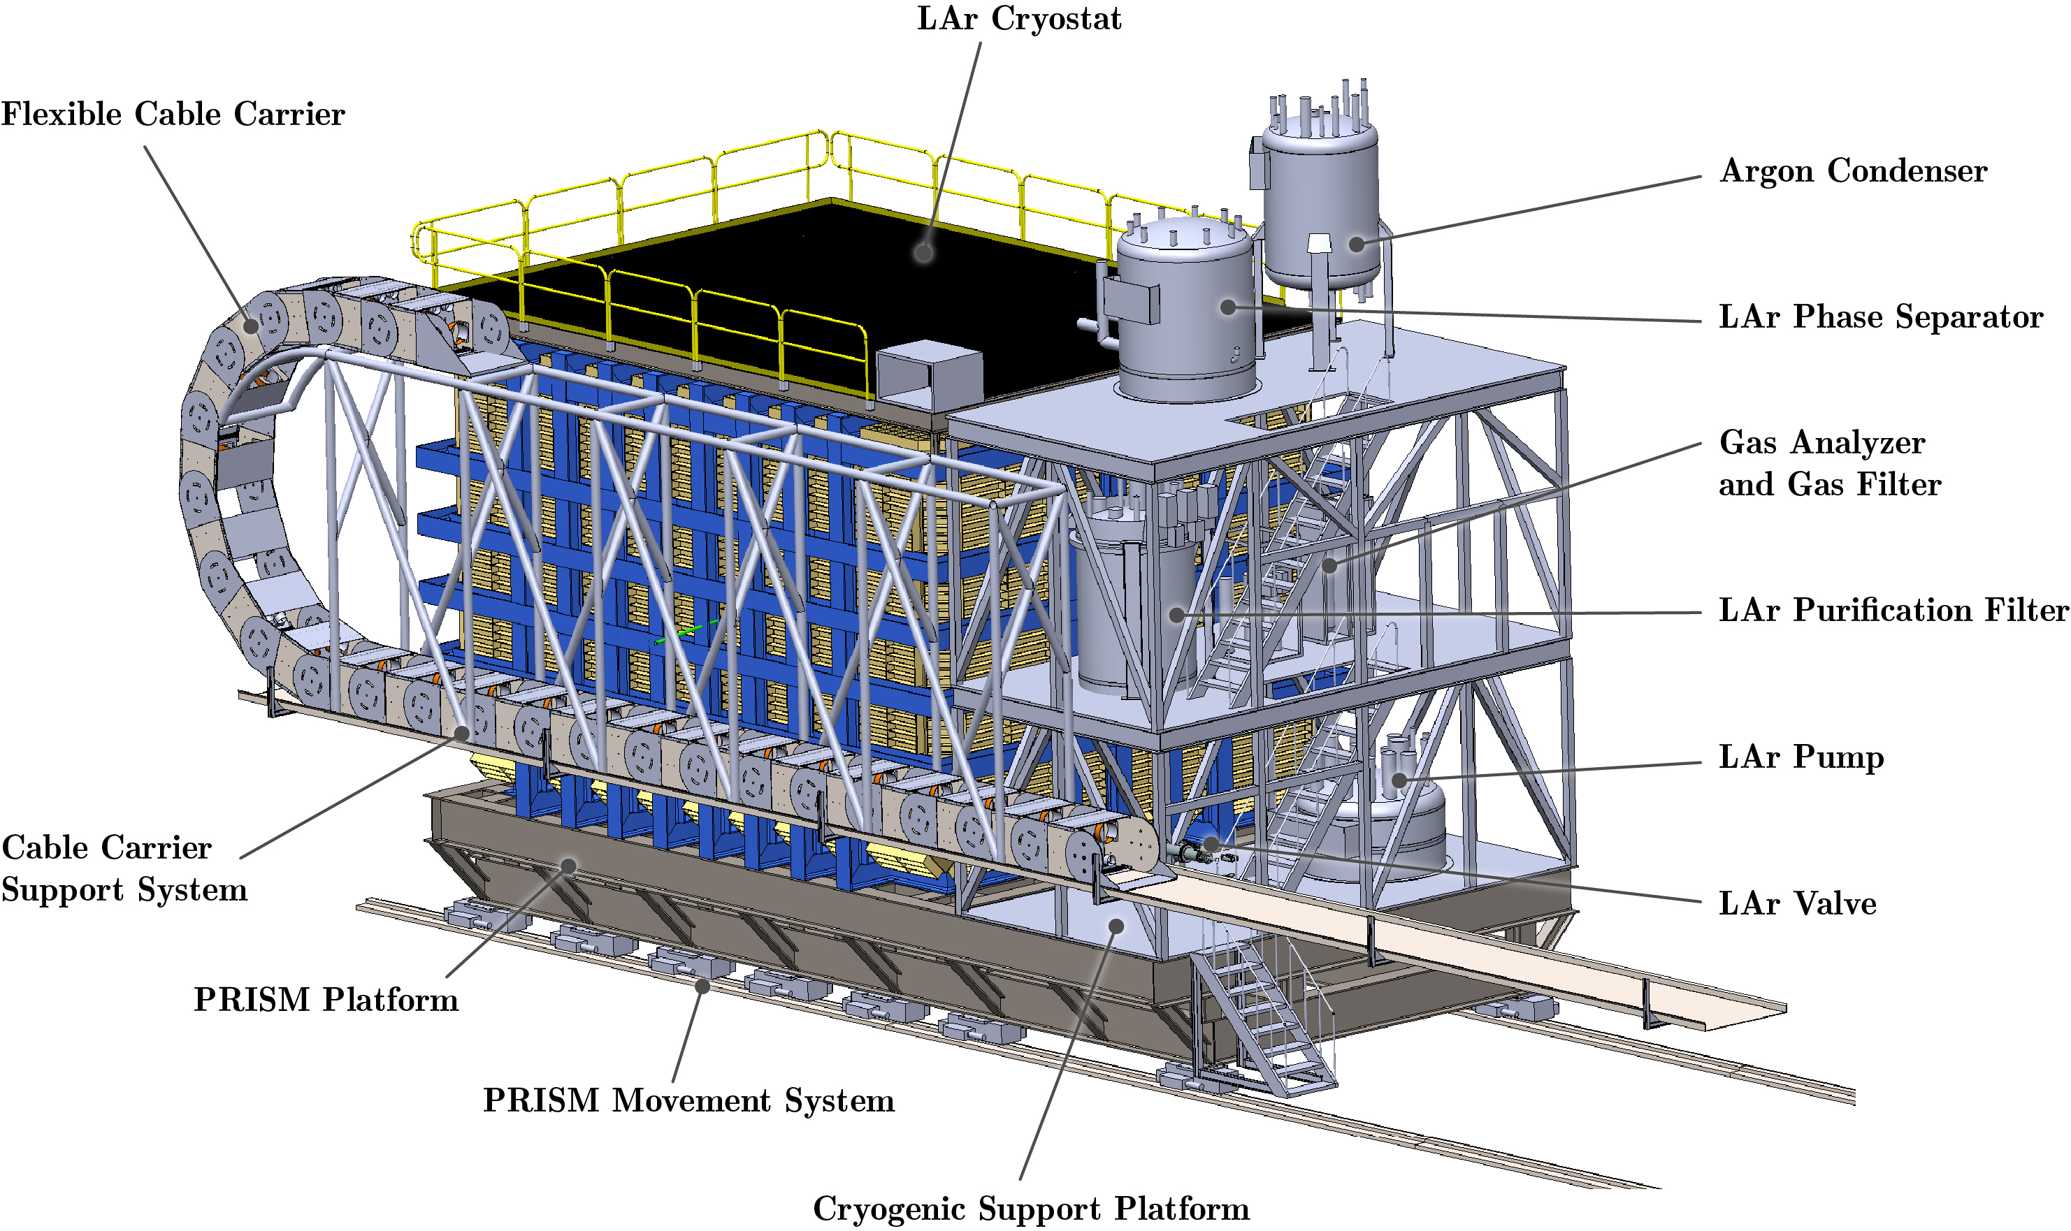
ND-LAr Integration Status

Slide 2
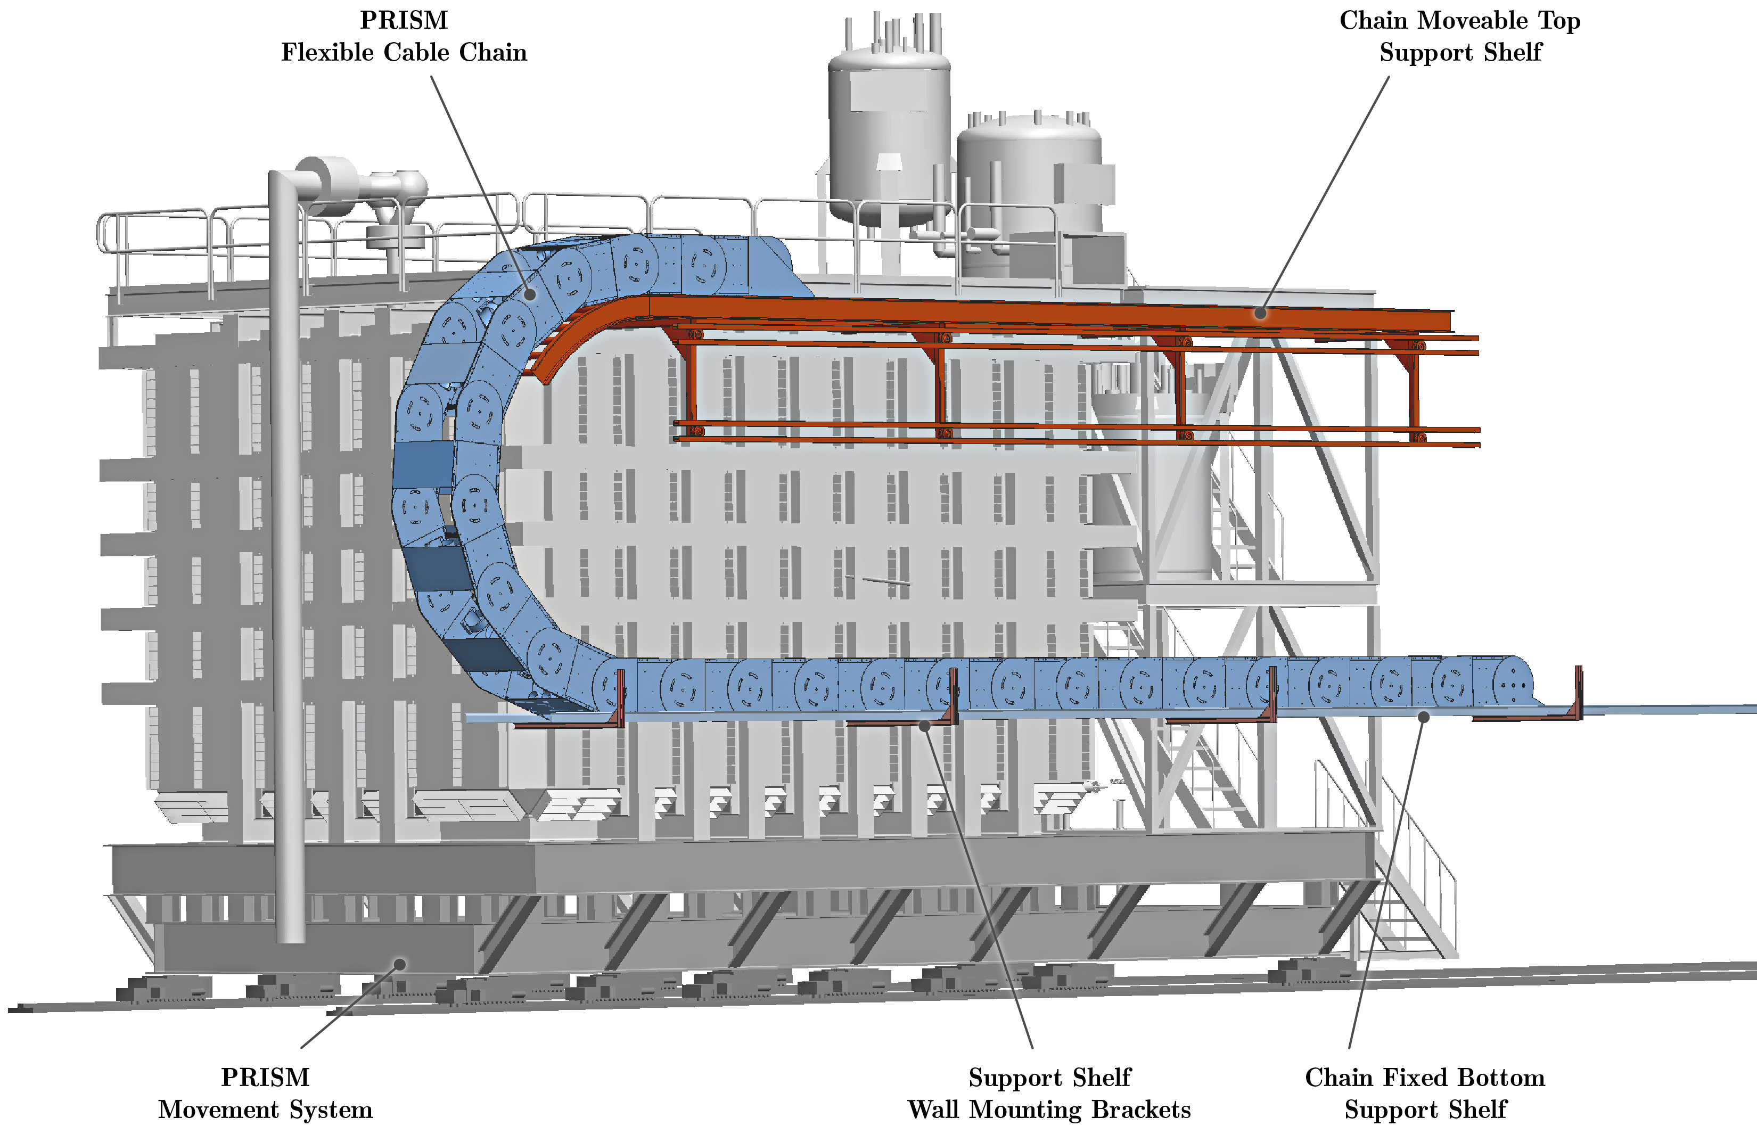
ND-LAr Integration Status

