Slide 1
INFN Update
INFN-LASA SRF Team
January 9th, 2020

Slide 2
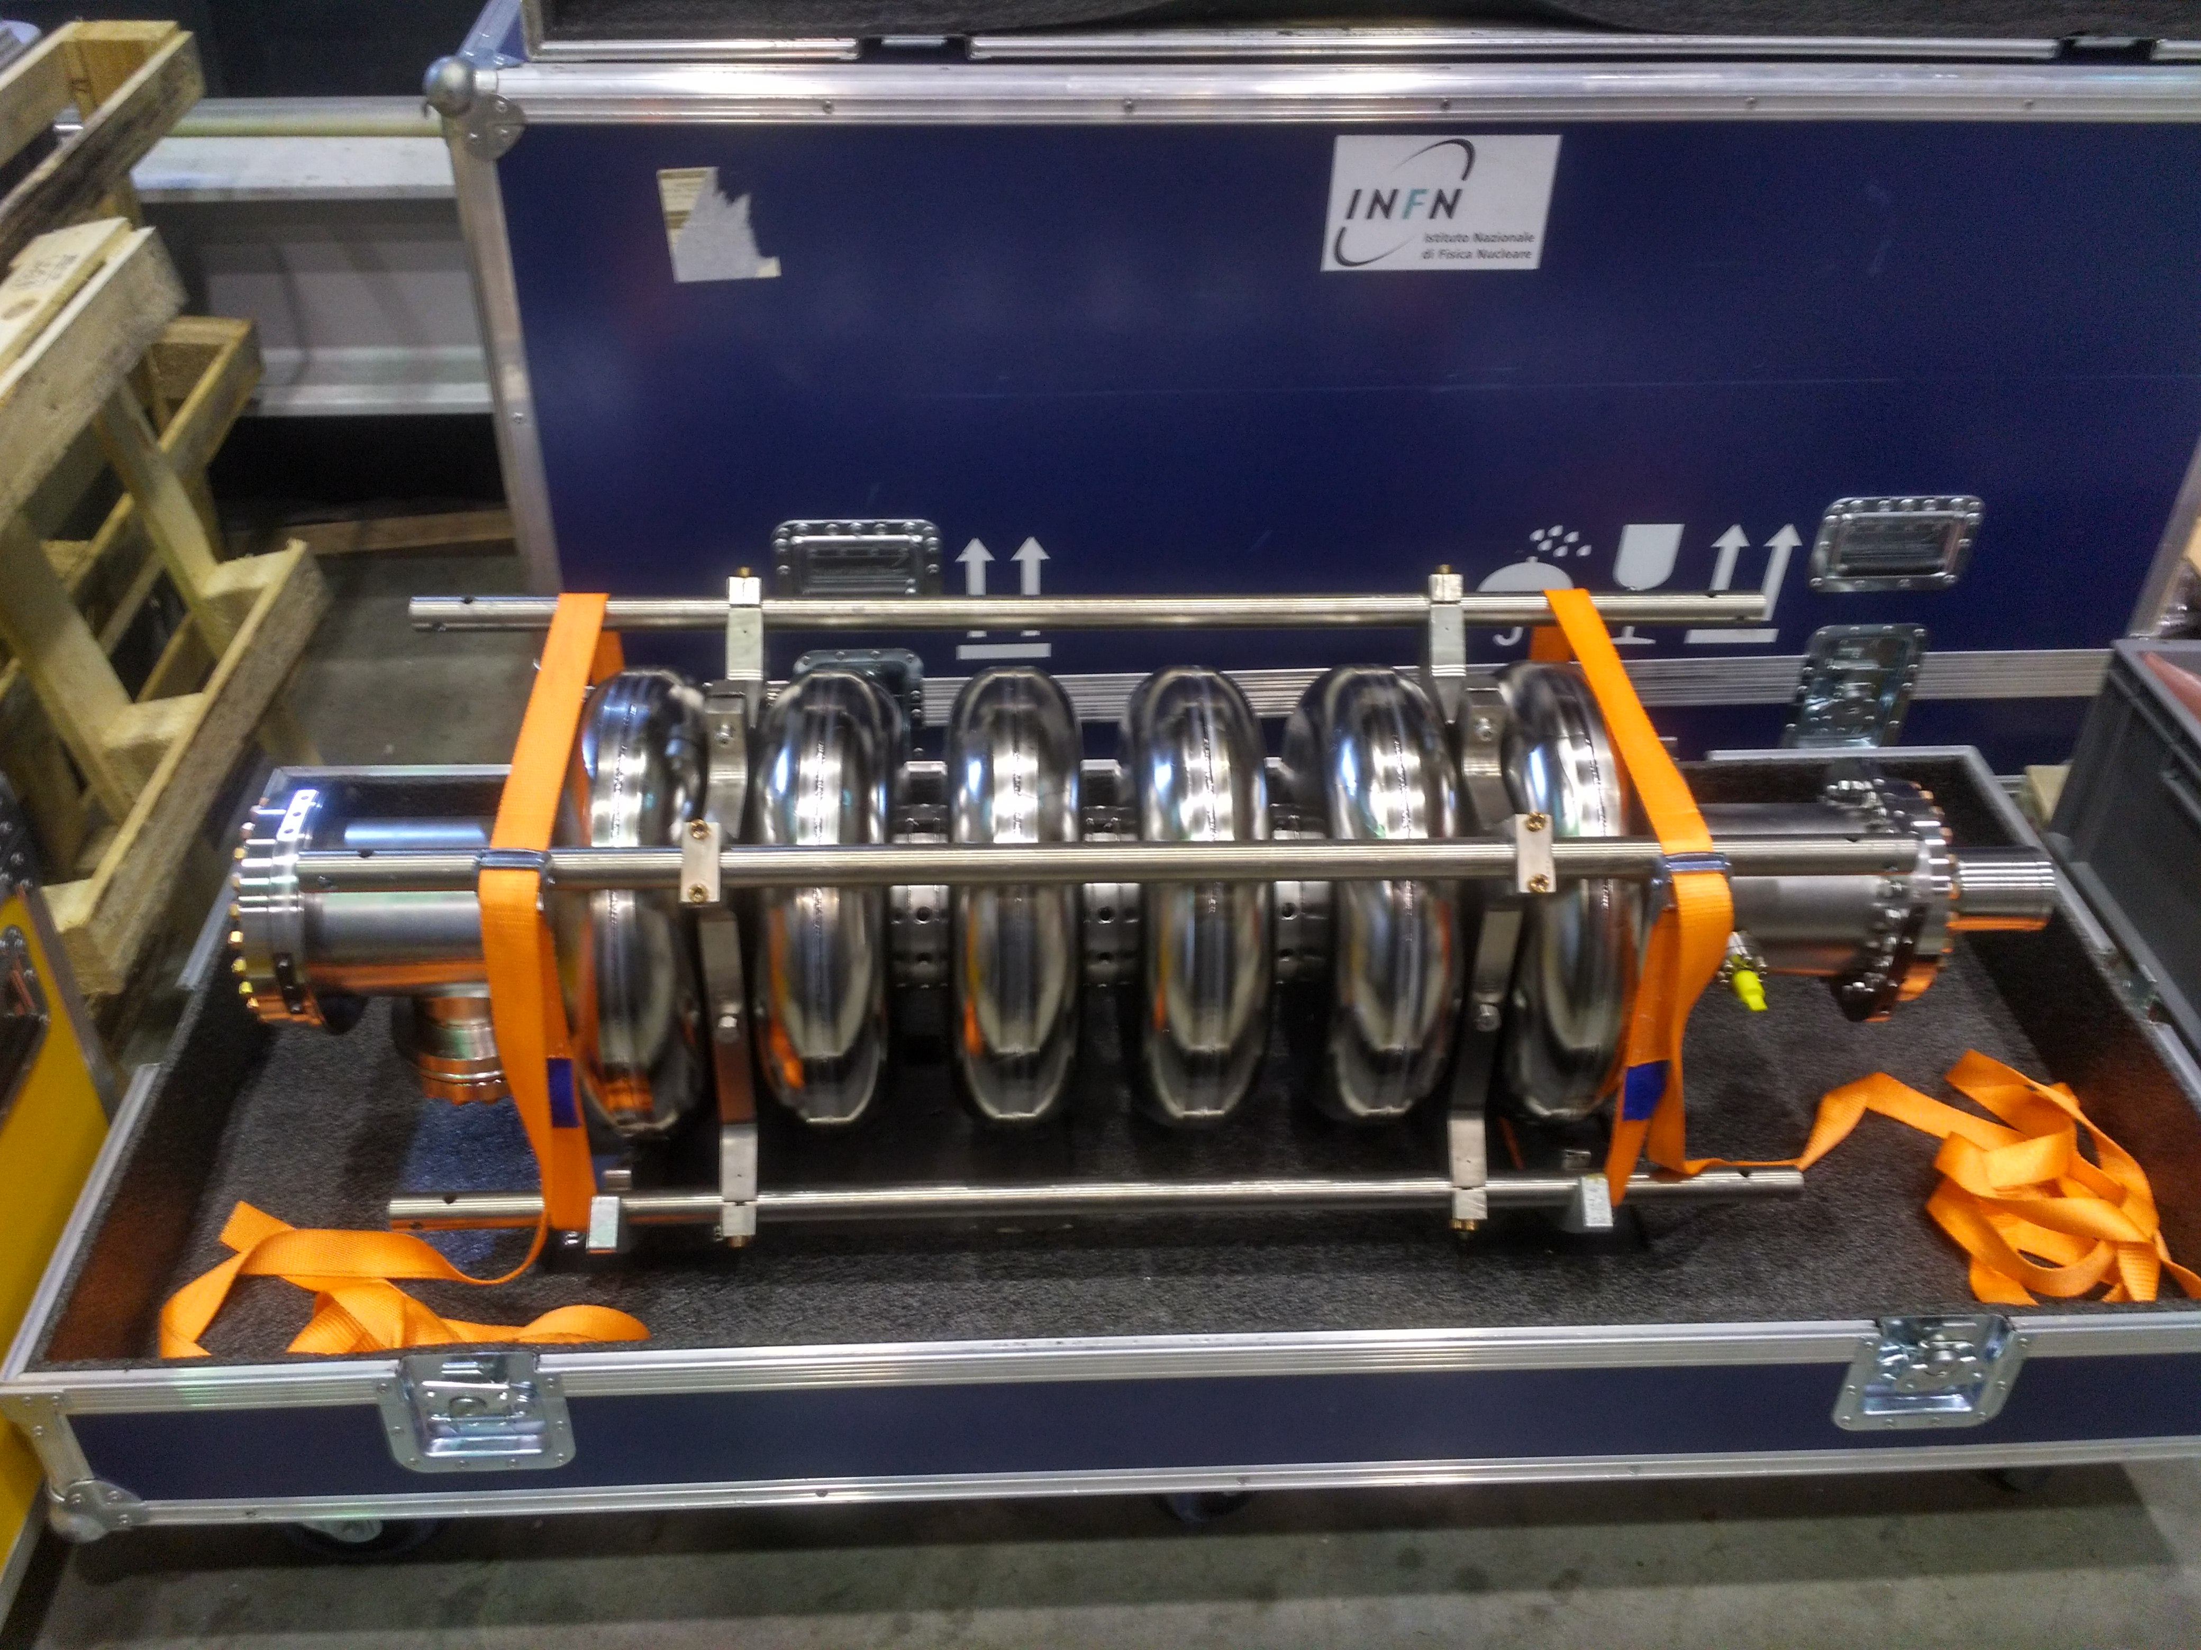
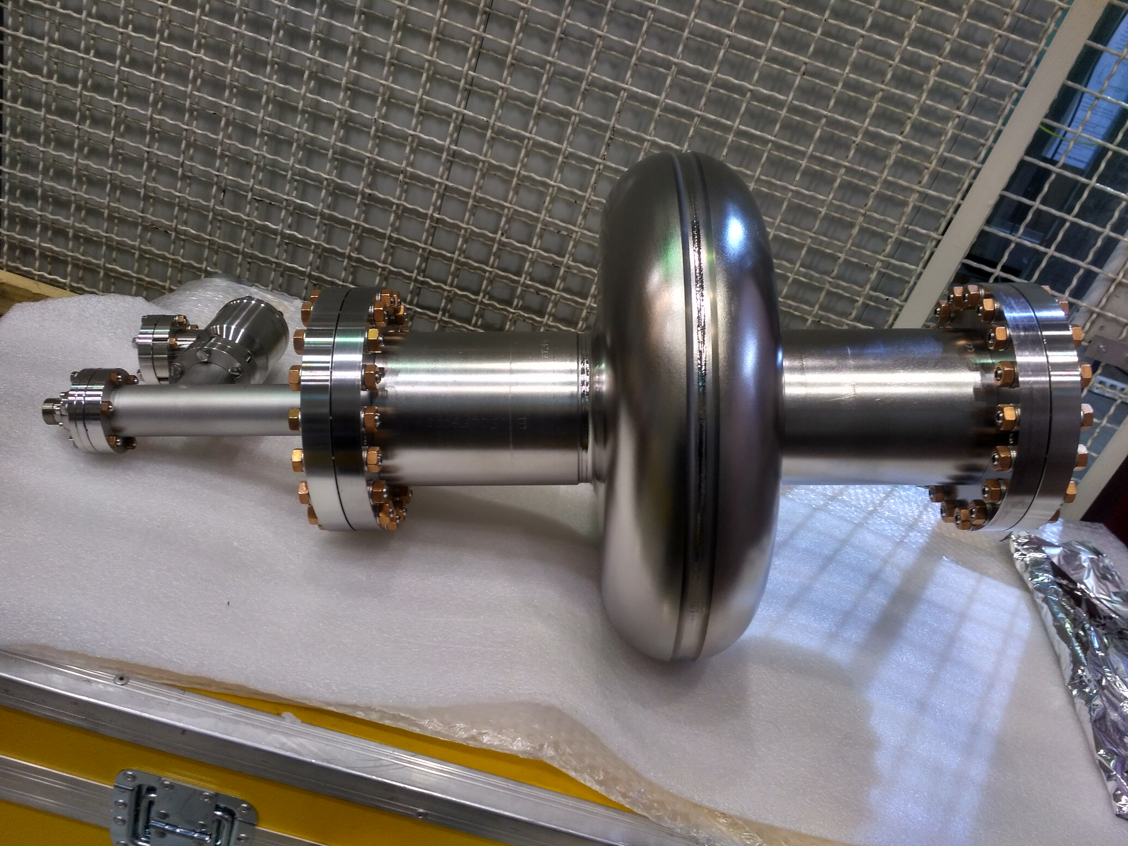
INFN activity for LB650 - Prototypes
LB650 single-cell cavity and ESS-like Large-Grain prototype already left LASA toward Fermilab. The expected delivery date will be soon communicated after custom formalities.
LB650 single cell is as welded but equipped with all ancillaries (flanges, feedthroughs, valve)
ESS-Like proto is ready for VT, under vacuum (just tested at LASA)
The info required to process and test cavities at FNAL premises are being shared:
Data to issue Pressure Notes
Technical specs of RF and vacuum interfaces

Slide 3
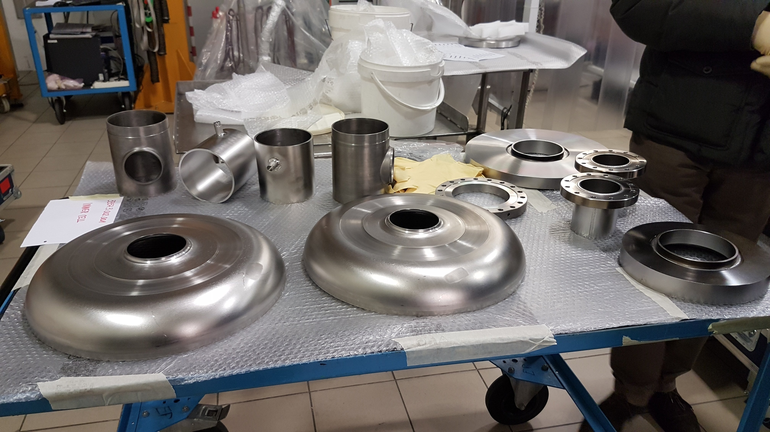
INFN activity for LB650 - Prototypes
LB650 of both 5-cell cavities fabrication is steadily progressing:
All half-cells deep-drawn, some already machined and 2 already RF measured (results OK)
Flanges and beam-tubes ready, final welding is required
Transition rings ready as raw, next final machining.
Delivery still shooting for end of February

Slide 4
INFN activity for LB650 - EP
The already existing EP plant at E. Zanon (used for XFEL and LCLS-II cavity production) is being optimized on the new cavity geometry and shape.
Some additional components soon to be delivered at Zanon:
Acid Chiller
Acid Heat-exchanger
PVDF acid container tank
Acid membrane pump
Multi-channel scanning tool for US measurements
And others at LASA for a test bench to validate CFD simulations of chemical treatments through Particle Image Velocimetry (PIV) camera:
1:4 transparent replica of the LB650 cavity made in silicon
Glycerol, refractometer, viscosity meter, flowmeter
PVDF pipes and membrane pump
Aluminum cylindrical enlargement has been procured to increase cathode surface and get 1:10 electrode-to-cavity surface ratio.
First assembly test at Zanon was OK.

Slide 5
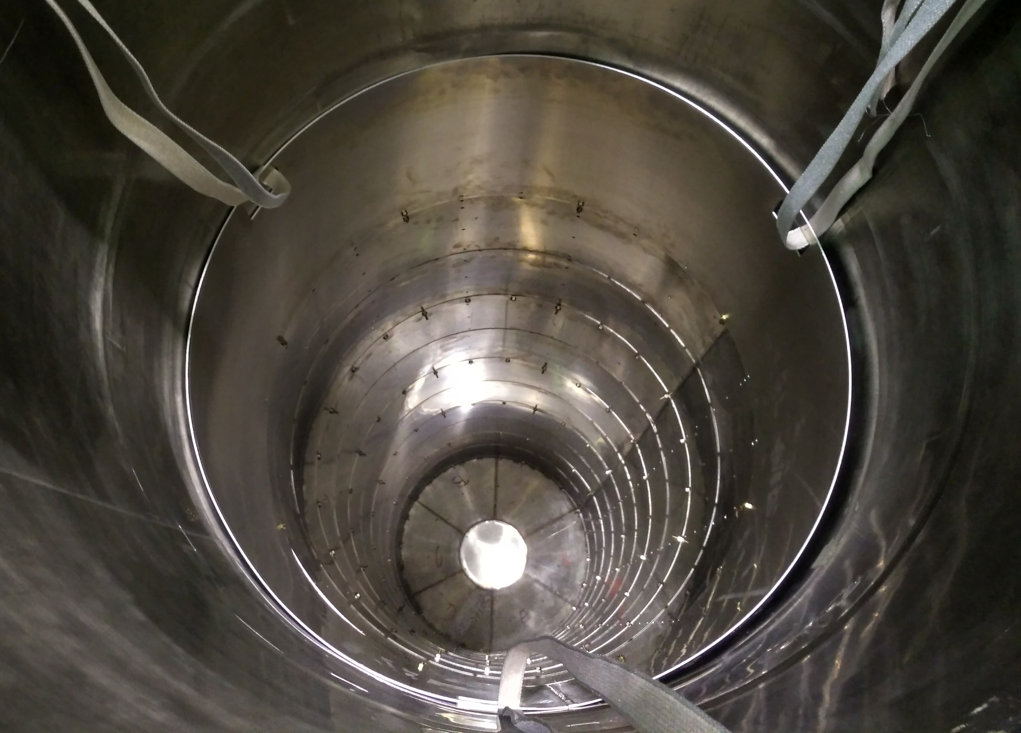
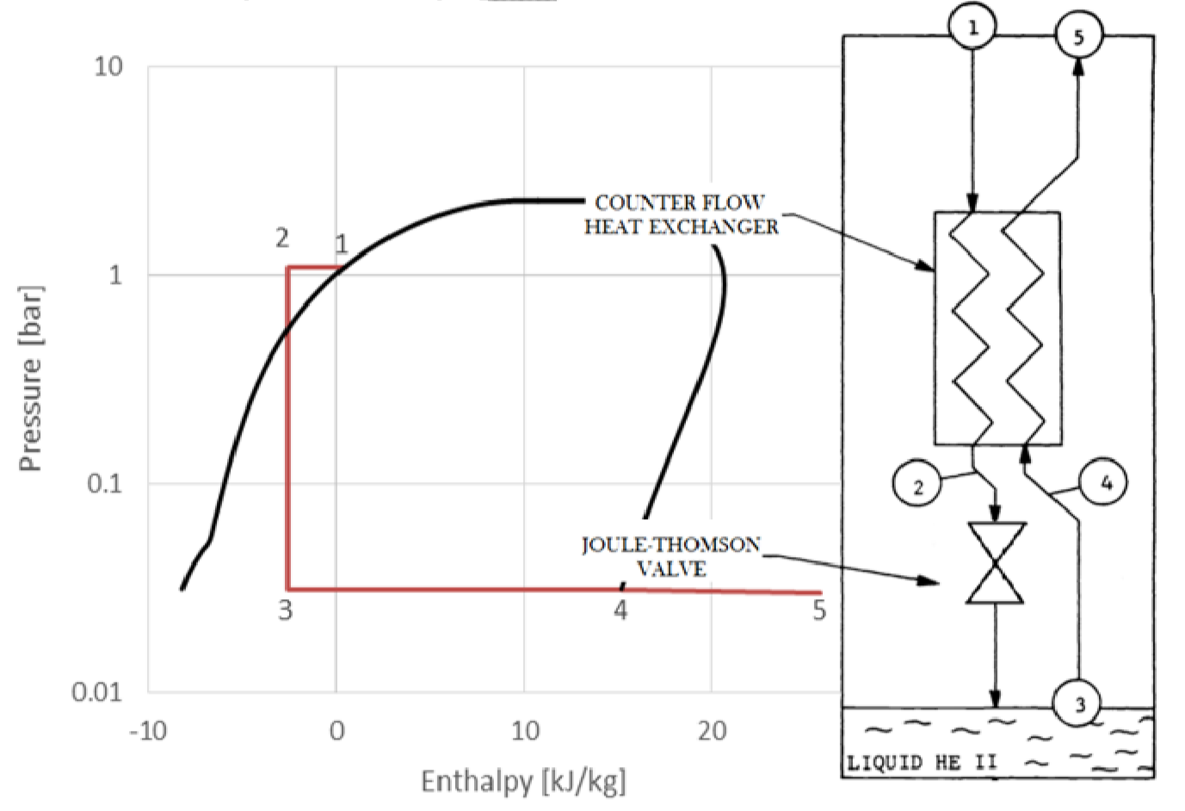
INFN activity for LB650 - infrastructure
INFN cold test infrastructure at LASA is being upgraded.
Cylindrical cryo-perm inner shield ordered in order to halve the currently measured 8 mG average remnant field in the cavity equator region.
Test installation successfully done at LASA, next heat-treatment
Boost in cryogenic plant performances:
Higher cryogenic power, up to 70 W at 32 mbar => new RV pump already ordered, delivery by March.
Refilling at 2.0 K hardware already ordered, activity kick-off meeting is next.

