Slide 1
IOTA/FAST Shutdown/Startup Report
Darren Crawford

Slide 2
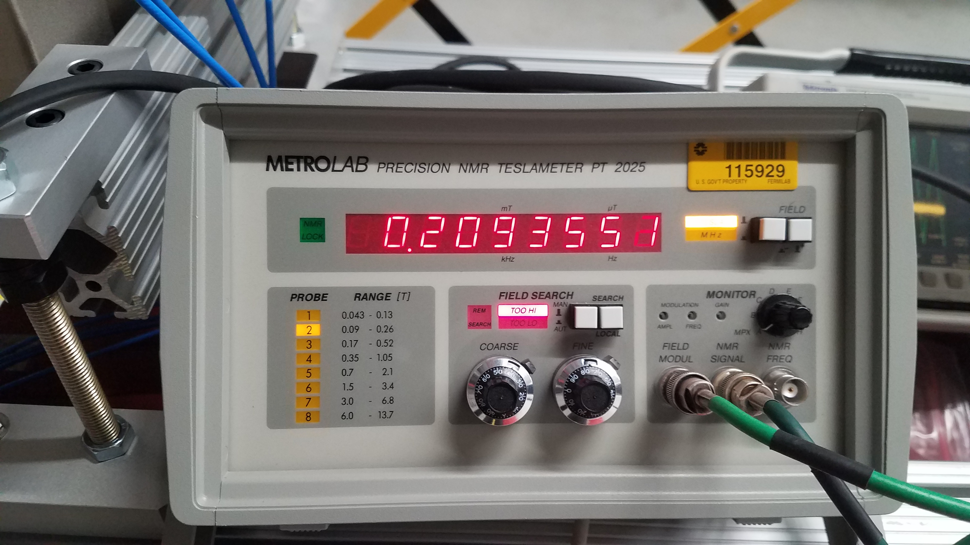
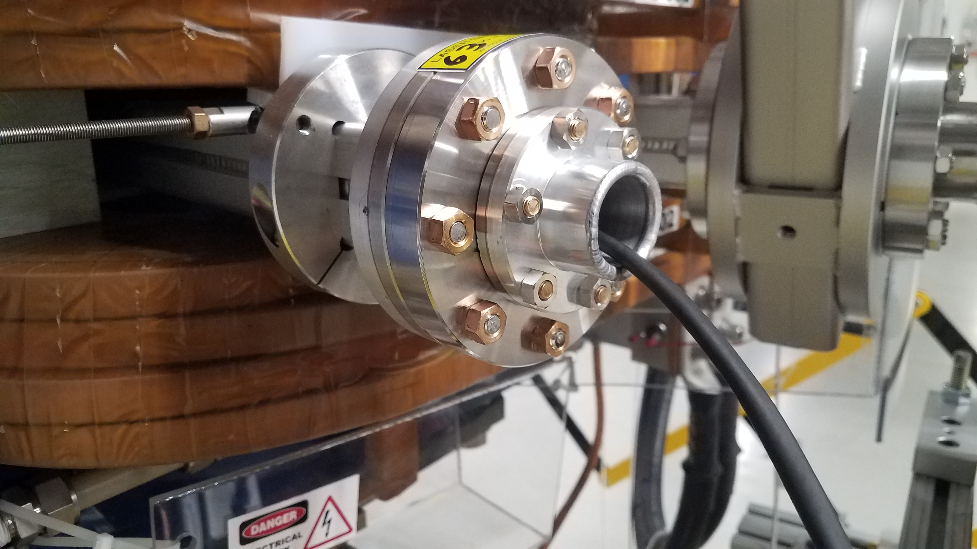
FAST D600 NMR System
The high energy beamline was vented from GV600 to GV612 and the NMR well was reinstalled.
The D600 magnetic field is supposedly linear with a slope of 1 T/1000 A.
We switched to probe 2 (0.09 to 0.26 T) which is in range for the field at 120 A. The gauss probe measured 0.137 T.
Kermit slowly scanned this field until he found a signal at 0.1369760 T. The signal is very noisy and the Metrolab Precision Teslameter cannot not lock to the field.
Probe #1 has been ordered since D600 operates at 69 A for 100 MeV beam.

Slide 3
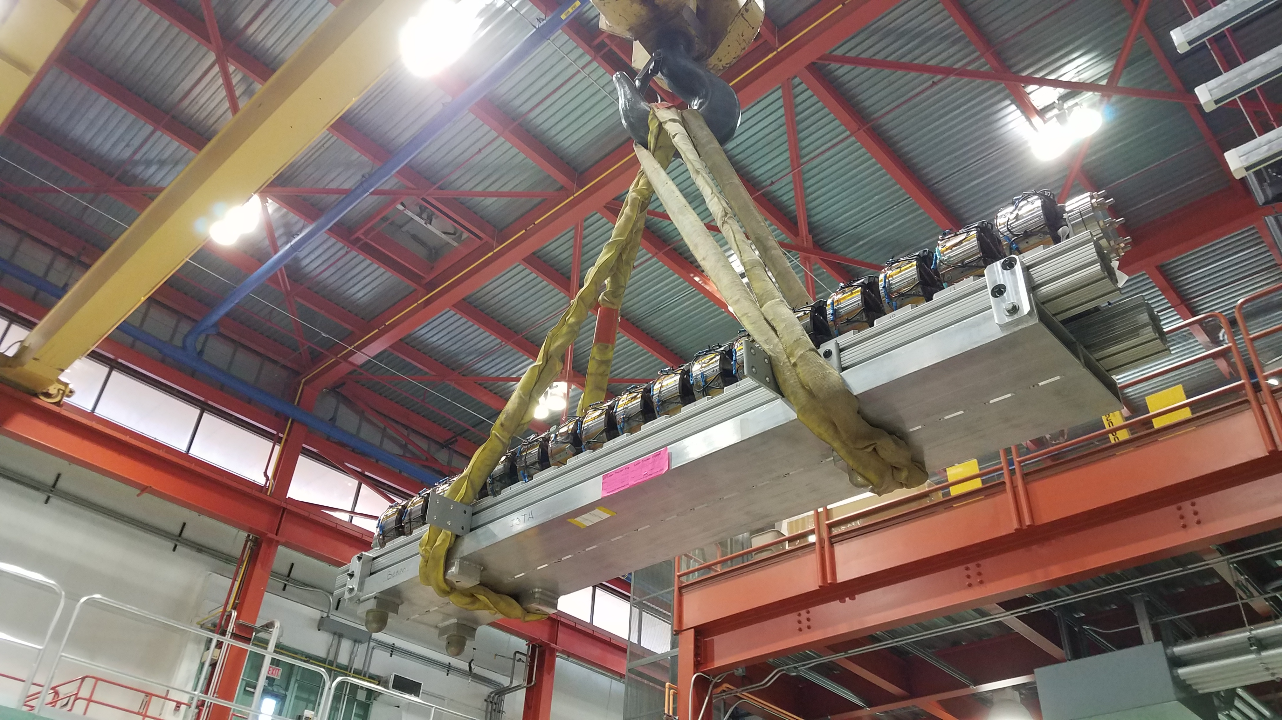
IOTA Octupole Installation
Octupole fields were measured at TD.
Magnets were secured to the stand.
Spool was welded and leak checked.
Stand was installed in IOTA and leak checked.
All octupoles have been electrically verified after installation.

Slide 4
IOTA Undulator
The undulator was reinstalled in its original configuration.
Parts for automation system are still being machined.
Lead bricks still need to be installed.

Slide 5
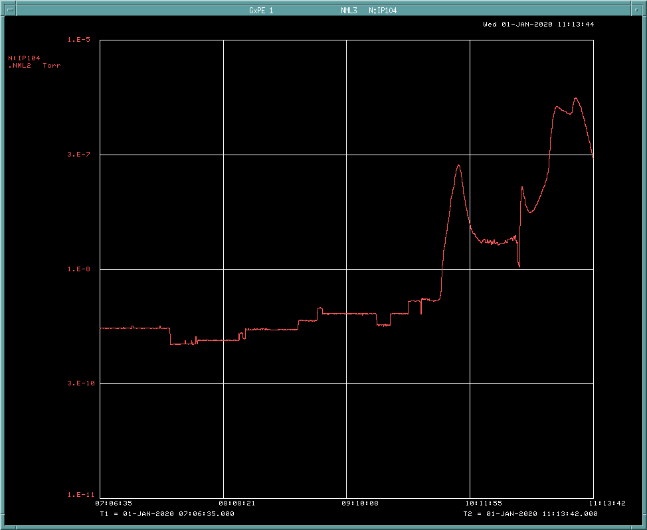
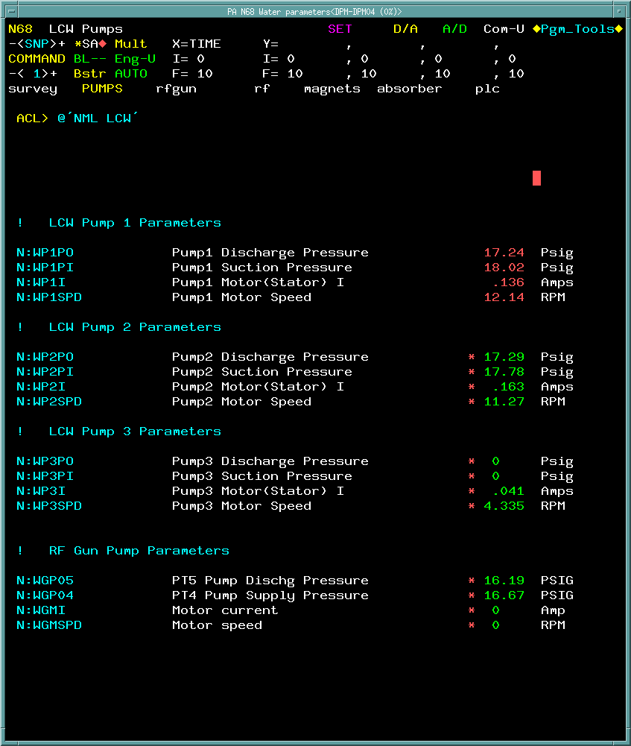
January 1st Power Glitch
There was a site-wide power glitch around 09:30.
NML cryo, vacuum, water systems were effected.
Joe and Joaquim started recovery of the cryo systems.
Lab B compressors tripped off.
North and South engines had major electrical issues.
Cavities were moved to their warm positions.
The vacuum systems for FAST Linac and IOTA stayed on.
Pressure increased around CC2 due to lack of cryo-pumping.
The LCW system tripped off.
LCW pump #1 was turned on.
RF Gun Water skid was turned on.
All IOTA main quadrupole power supplies tripped off.
Air compressor system remained operational.

Slide 6
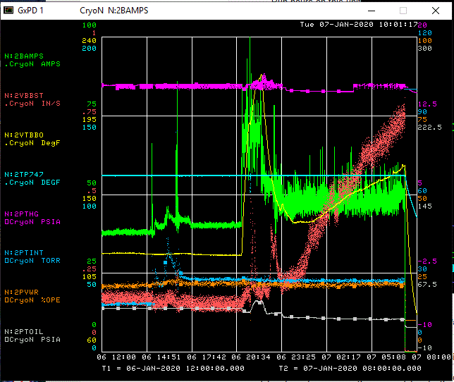
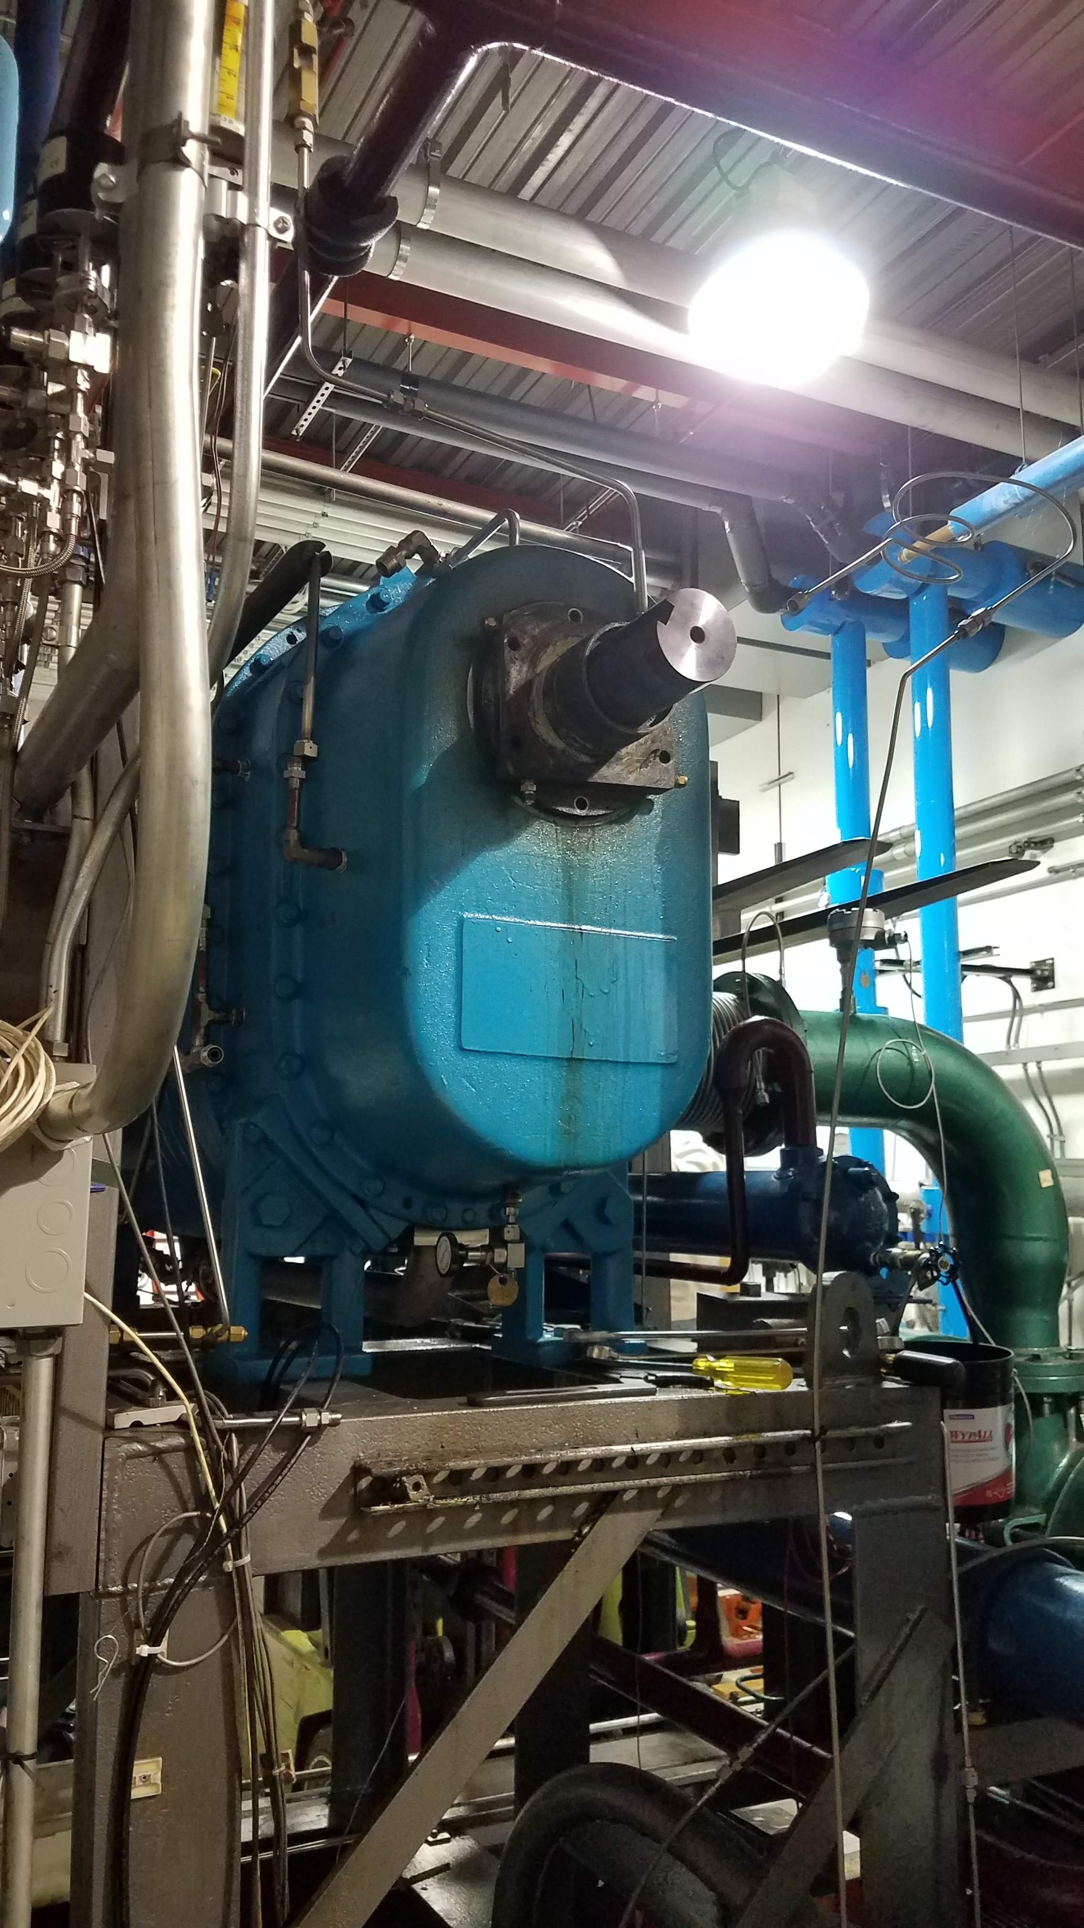
Kinney Skid Booster Pump
Tuesday January 7 at 07:14 the Kinney booster pump tripped on low oil and high vibration. When inspecting the unit locally, a waterfall was discovered coming out of the belt guard. Best guess is a bearing failure. The Booster Gear/Bearing oil outlet temperature (2VTBBO) was on the rise as well, with a big spike to 220 °F around 22:00 Monday.
It appears the Kinney vibration began climbing around midnight and failed later in the morning.
The Booster pump needs to be replaced with the spare. Estimate is 2 weeks (minimum) for replacement.

Slide 7
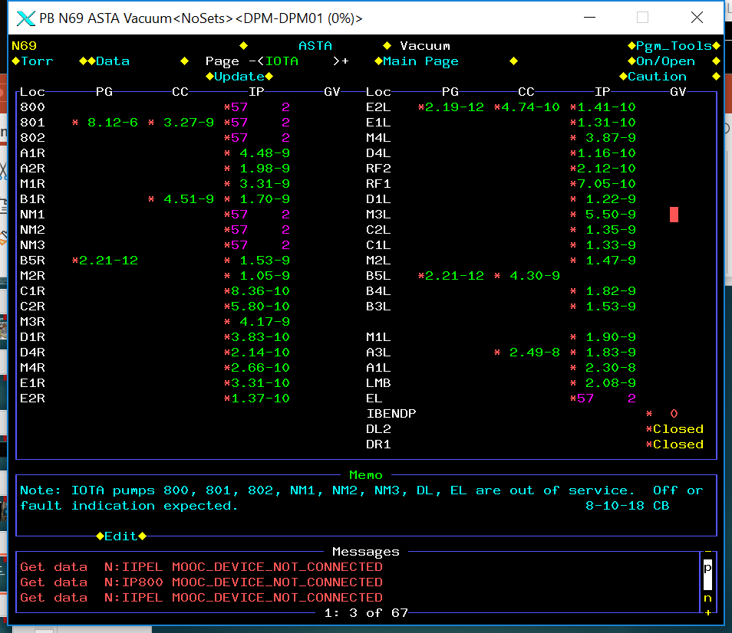
Current Status
IOTA pump down is 10⁻⁹ Torr.
Girders DR, ER, EL are 10⁻¹⁰ Torr.
Vacuum valve control cables can be reconnected and valves opened.
Cryo system is holding at 5 K.
Booster pump replacement issues identified.
Need Standard Cartage riggers to remove failed pump and install spare.
Requires a quote that needs to be walked through Procurement.
Harris Equipment will be contracted to tune the spare pump after installation.
Need additional systems checks post-glitch.

Slide 8
Strategy During Repair Period
Assist in any way to shorten repair period
Optical Stochastic Cooling
Proton Source

