Slide 1
$n→\overline{n}$ and $p→K^{+}\overline{ν}$, Atmospheric $ν$ Backgrounds, Event Generation and Reconstruction An Update
By J. L Barrow, jbarrow3@vols.utk.edu
URA Visiting Scholar, FNAL
DUNE HEP Working Group Biweekly, January 17, 2020
This presentation is based upon work that is supported by the Visiting Scholars Award Program of the Universities Research Association. Any opinions, findings, and conclusions or recommendations expressed in this material are those of the author(s) and do not necessarily reflect the views of the Universities Research Association, Inc.

Slide 2
$n→\overline{n}$ Progress

Slide 3
DUNE HEP Working Group Collaborators
I’d also like to thank Robert Hatcher, Wanwei Wu, Steven Gardiner, and Aaron Higuera for discussion. Thanks to Georgia Karagiorgi and Jeremy Hewes for getting things started as well!
Viktor Pěč
Yeon-jae Jwa

Slide 4
Motivations for Experimental Detection of $n→\overline{n}$ Transformations
Any matter-antimatter asymmetry created by $(B−L)$ conserving SM/BSM interactions is thought to be erased during the EW phase transition
Sphaleron “washes out” effectively all asymmetry (Dolgov, 1982, among others)
Some models DO violate $\left(B−L\right)$
…or, $ΔB=2$ processes, like neutron-antineutron ($n→\overline{n}$) oscillations
These searches can probe BSM physics above LHC scales
A “post-sphaleron” baryogenesis (PSB) [Babu, Mohapatra et al., 2006 and 2013]
Observation of the transformation would be a spectacular discovery
Could explain the BAU, making leptogenesis “interesting…[but] irrelevant”—Mohapatra
…or rule out “compelling” PSB entirely—Nelson

Slide 5
The Need to Understand $n→\overline{n}$ Simulation Systematics …in the context of automated reconstruction and analysis techniques (CNNs, BDTs)
How do we understand the usefulness and stability of prospective, Monte Carlo-derived limits?
When we simulate events, how stable are signal efficiencies?
When we simulate backgrounds, how stable are rejection rates?
In some respect, these questions go beyond simple statistics…
Do our final state signal and/or background topologies change depending on the underlying nuclear and intranuclear cascade models?
In GENIEv3.0.6, there are three main nuclear models currently available:
Bodek-Ritchie (relativistic) nonlocal Fermi gas
Local (nonrelativistic) Fermi Gas
Effective Spectral Function (nonlocal)
There are two main intranuclear cascades currently available:
hA2018 (single effective interaction)
hN2018 (full intranuclear cascade model)
Notes:
Different models have different underlying assumptions—just show two plots, don’t go into any of the detail
Doesn’t need to be complete to make point; underlying momentum assumptions are different
Make font much bigger; get rid of stat boxes

Slide 6
The Importance of Some Physical Correlations
$$p$$
$$\overline{n}$$
$$n$$
$$p$$
$$\vec{P_{F}^{i}}=\vec{P_{F}^{i}}\left(\left|\vec{r}\right|\right)$$
$$n$$
The correlation of radius and momentum has been previously ignored for all $n→\overline{n}$ simulations in all experiments
High radii lead to…
Fewer FSIs, more meson emission
Lower total momentum (near ideal case)
Preliminary
To be published
October 22nd, 2019

Slide 7
Some GENIEv3.0.6 Intranuclear $\overline{n}N$ Initial States (Single Nucleon Momentum)
GENIEv3.0.6 hA/hN2018 and Local Fermi Gas
GENIEv3.0.6 hA/hN2018 and Bodek-Ritchie
GENIE truth-level—no DUNE reconstruction yet
Notes:
Make use of this plot rather than previous
Use animation between models to go through logical chain consistently and quickly

Slide 8
Some GENIEv3.0.6 Intranuclear $\overline{n}N$ Initial States (Momentum vs. Radius) …internal correlations or no?
GENIEv3.0.6 hA/hN2018 and Local Fermi Gas
GENIEv3.0.6 hA/hN2018 and Bodek-Ritchie
GENIE truth-level—no DUNE reconstruction yet
Notes:
Make use of this plot rather than previous
Use animation between models to go through logical chain consistently and quickly

Slide 9
Some GENIEv3.0.6 Intranuclear $\overline{n}N$ Initial States (Mesonic Parameter Space)
GENIEv3.0.6 hA/hN2018 and Local Fermi Gas
GENIEv3.0.6 hA/hN2018 and Bodek-Ritchie
GENIE truth-level—no DUNE reconstruction yet
Notes:
Make use of this plot rather than previous
Use animation between models to go through logical chain consistently and quickly

Slide 10
Some GENIEv3.0.6 Intranuclear $\overline{n}N$Final States (Pionic parameter space only)
The intranuclear cascade kills most of the original shape of the parameter space
Approximate atmospheric $ν$ parameter space is overlayed
Will greater localization matter?
Effects on FS topologies?
GENIEv3.0.6 hN2018 and Local Fermi Gas
GENIEv3.0.6 hN2018 and Bodek-Ritchie
GENIE truth-level—no DUNE reconstruction yet
Notes:
Make table of row and column for FSI differences

Slide 11
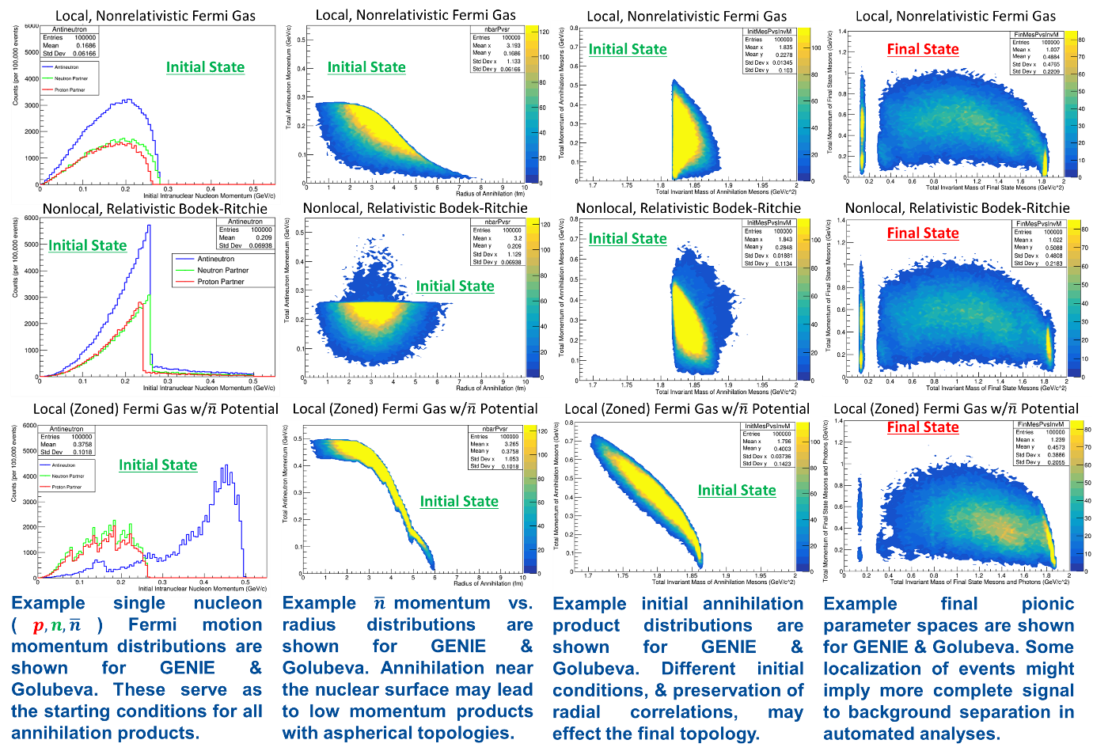

Slide 12
Assessing Simulation Systematics—Nearing Completion
Six independent model configurations (tunes) for $\overline{n}Ar$ are complete
$\left\{hN2018,hA2018\right\}⨂\left\{Bodek−Ritchie, Local Fermi Gas, Eff.Spectral Function\right\}$
$n→\overline{n}$ event productions and truth-level validation of all models is complete
Importation into DUNE’s LArSoft detector reconstruction chain is nearly complete
E. S. Golubeva’s $n→\overline{n}$ MCs will be imported into LArSoft reconstruction chain in coming weeks
Three flavor, fully oscillated atmospheric $ν_{ℓ}Ar$ background sample productions are complete
Completed with FNAL/Northwestern colleagues, detector reconstruction chain nearly complete
Using Honda fluxes, again running over identical model configurations
Will then compare all 100,000/100,000 signal/background event samples pairwise
Columbia University-developed CNN automated analysis framework ready to go
Will possibly run jointly with a BDT
This will give 6-8 independent signal efficiencies/background rates, and so 6-8 $τ_{n→\overline{n}}$ values
The spread of these values will hint at the signal/background (in)variance due to microscopic dependencies in nuclear modeling—if stable, not to worry!
Will complete technical note and DUNE official publication in coming months
A similar program will follow for $p→Kν$ in DUNE (event production also complete)
Notes:
Shorten for details; don’t mention CNN directly, just that this will be a complete DUNE official analysis

Slide 13
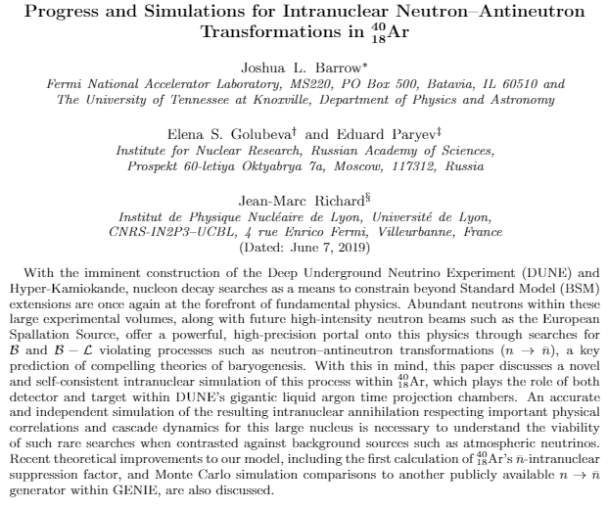
New Paper on arXiv
arXiv:1906.02833
Collaboration with Elena Golubeva and Eduard Paryev (INR), and Jean-Marc Richard (Lyon)
Focusses on updates to our $n→\overline{n}$ simulation
Can now run intranuclear and extranuclear annihilation processes for ${}_{6}^{12}C$ and ${}_{18}^{40}{Ar}$ (EG)
Intranuclear $\overline{n}$ potential is taken into account (EP, EG)
Mass defect is now included (EP)
New intranuclear suppression factor calculation (JMR)
New annihilation position calculation (JMR)
Also compares our ${}_{18}^{40}{Ar}$ simulation to GENIE v3.0.2 module
Originally developed by Jeremy Hewes
Shows some importance of initial radial position and momentum
Localization of signal within particular parameter space could be important for event identification above background

Slide 14
New ESS NNBar Collaboration HIBEAM/ANNI Whitepaper/Review in Development
Headed by David Milstead and Yuri
Coauthors include Mike Snow, Albert Young, Rabindra Mohapatra, Zurab Berezhiani,…and many others
For a private, uneditable preview, see here (will appear on the arXiv in…1.5 months?)
Will focus on specific capabilities of the ANNI/HIBEAM beamline at the European Spallation Source for BSM neutron oscillation searches
$n→\overline{n}, n→n^{′}→\overline{n}$
$n→n^{′}, n→n^{′}→n$
I’ve calculated the sensitivities for most or all of these given current McStas models of the ANNI beamline
Just have to write! Edit! Edit! Edit!
This document will act as an official statement from the NNBar Collaboration on the two-stage approach we are advocating in pursuit of a full NNBar beamlien ($300m$, bottom moderator)
Use R&D time in pursuit of discovering/constraining/eliminating $n→n′$ for full $n→\overline{n}$
Rebuild collaboration, learn from magnetic field technicalities
Will be cited in our Swedish funding proposals

Slide 15
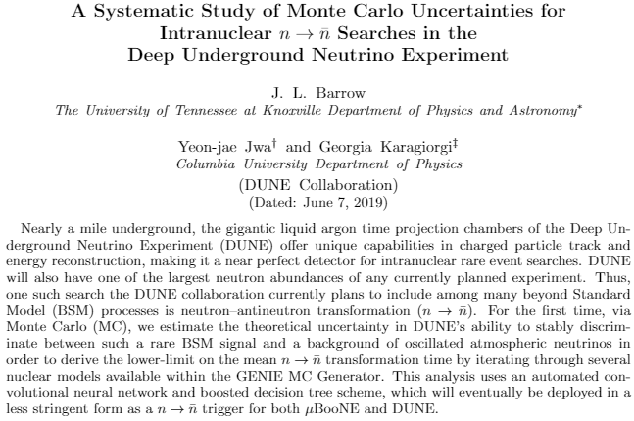
Next $n→\overline{n}$ Paper to Appear Soon?
Collaboration with Yeon-jae Jwa and Georgia Karagiorgi (Columbia University)
Preliminary, but reconstruction soon to be complete!
Will focus on iterative, pairwise comparisons of different nuclear models of Fermi motion and intranuclear transport between signal and background events
Will use automated convolutional neural network analyses to discriminate between signal and background (YJJ, GK)
Will output different (though possibly similar) values of $τ_{n→\overline{n}}$
Most signal events are simulated, must be reconstructed within simulated DUNE detector (JLB)
JMR’s radial annihilation position distribution will be integrated soon
New 3-flavor oscillated atmospheric neutrinos must be generated and reconstructed (JLB)
Must take EG’s simulation and input into DUNE detector (JLB)
Altogether, will iterate over six atmospheric simulation, and up to fourteen $n→\overline{n}$ signal simulations
Can study stability of signal efficiencies and background rates
PRELIMARY

Slide 16
Atmospheric $ν$ Progress
Oscillations and Reconstruction

Slide 17
FNAL Collaborators—see their recent atm. $ν$ PRL
Working toward a technical note which will incorporate LArSoft reconstruction output into a migration matrix for the responses of the DUNE 10 kt detector module for all neutrino directions with $Eϵ\left(0.1,100\right)GeV$
Pedro Machado
Ivan Martinez-Soler

Slide 18
Goals for “the” atmospheric samples
To generate a set of oscillated Honda atmospheric samples across nuclear model configurations to serve as background for rare event searches such as $n→\overline{n}$ and $p→K^{+}\overline{ν}$
Oscillations provide a portal for $ν_{τ}$ appearance, and can particularly give rise to CC backgrounds to $n→\overline{n}$ due to multipionic decays, though NC backgrounds are still expected to dominate for $n→\overline{n}$
These samples are being generated to study the effect of nuclear model configuration iteration on the separability of signal and background, not themselves to be used for oscillation studies
Will use “nominal” oscillation parameters from world data best fits, but can be editable if you like
$2×6×100,000$ samples will be generated (and reconstructed)
Six nuclear model configurations: $\left\{hN2018,hA2018\right\}⨂\left\{BR,LFG,ESF\right\}$
For $n→\overline{n}$ using out of the box GENIE cross sections and generators, as dictated by tunes
For $p→K^{+}ν$ using a new additional $K^{+}$ production channel, recommended by Marco Roda
Plan to have all of these available through the FNAL GENIE and DUNE gpvm machines

Slide 19
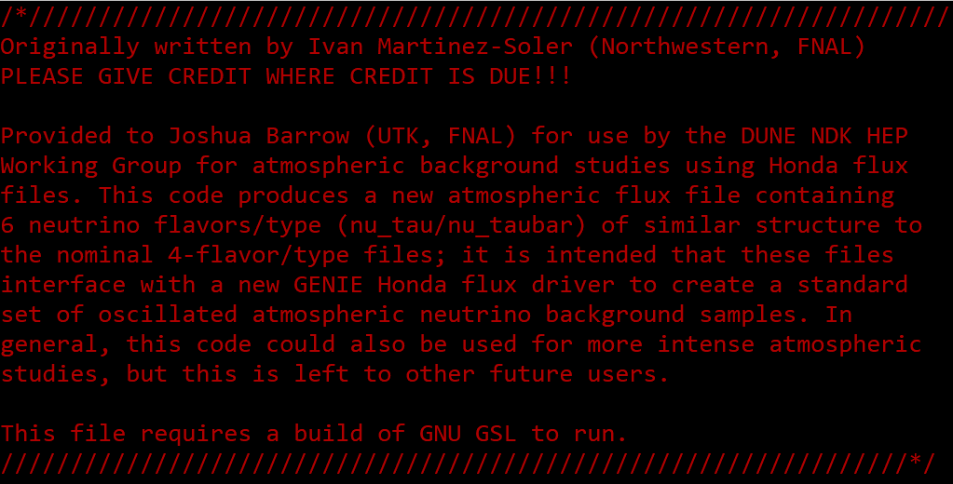
Process for atmospheric oscillation calculations
After discussions, was given modified code by Ivan using GSL libraries
Calculates oscillation probabilities and total event numbers from given Honda flux file structures for any site in average $ν_{ℓ}/yr$ from $0.1−10,000 GeV$
Assumes the normal hierarchy
Includes density changes in the earth’s geological makeup (as concentric shells)
Averages over angular bins
Treats atmosphere as vacuum, with $ν$ production height set at $15 km$ (this is a parameter)
$θ_{12}=33.48°,θ_{13}=8.5°,θ_{23}=45°,Δm_{21}^{2}=7.5×{10}^{−5} eV^{2},Δm_{31}^{2}=2.5×{10}^{−3}eV^{2},δ_{CP}=90°$
All parameters can be easily changed, and it is all scriptable
AtmFlxOsc.cpp
by Ivan Martinez-Soler
$$⟹$$
g++ -o flux AtmFlxOsc.cpp -lgsl –lgslcblas
./flux hms-ally-20-12-solmax.d > hms-ally-20-12-solmax_3FlavOsc.d
hms-ally-20-12-solmax.d
See Honda group site and associated article
hms-ally-20-12-solmax_3FlavOsc.d
Notes:
g++ -o flux AtmFlxOsc.cpp -lgsl –lgslcblas
./flux hms-ally-20-12-solmax.d > hms-ally-20-12-solmax_3FlavOsc.d

Slide 20
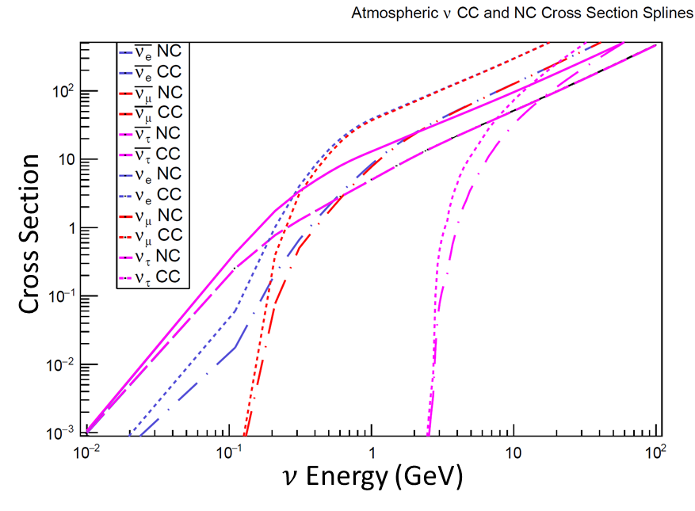
GENIE changes and sample production
Quite simple changes were made to GENIE’s src/Tools/Flux/GAtmoFlux.cxx and GHAKKMAtmoFlux.cxx flux drivers to allow for six $ν$ types to be read in from newly calculated oscillated Honda flux files
These are available in my personal geniegpvm repository, but will not be pushed to git for now (ever?), as I doubt that GENIE has an interest in integrating them into their build
See /genie/app/users/jbarrow/genie-v3/Generator
Six new nuclear model configuration tunes were constructed
$\left\{hN2018,hA2018\right\}⨂\left\{BR,LFG,ESF\right\}$, based on G18_02a
Splines are generated across all $ν$ types for all of these nuclear model configurations
Differences in models can have marginal differences on how cross sections are calculated due to momentum distributions

Slide 21
Still need to estimate the total number of atmospheric interactions!
$$N\sim \sum_{f=1}^{6}{N_{f}}\sim 40kt Ar×Avogadro×40 nucleons×\sum_{f=1}^{6}{\sum_{E_{i}}^{E_{m}}{σ\left(E_{i,f}\right)⋅Φ_{Honda}(E_{i,f})}}$$

Slide 22
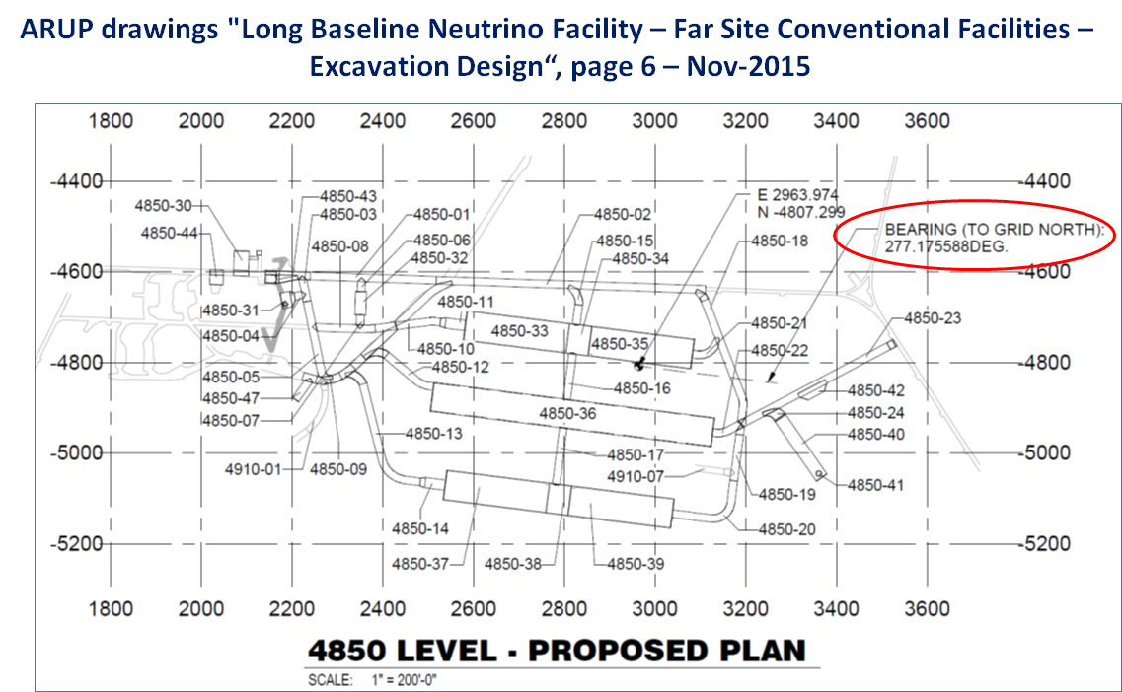
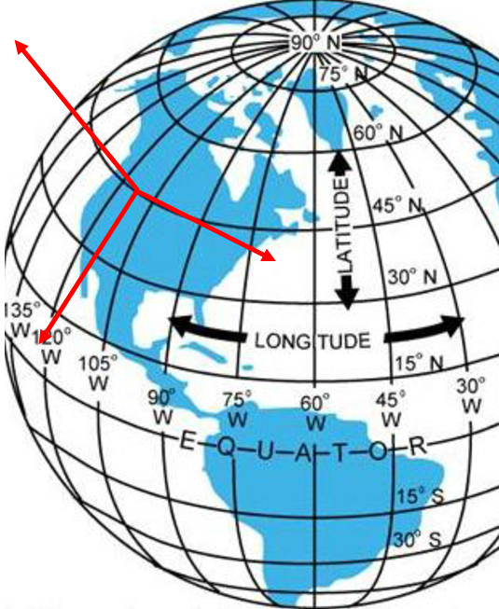
Topocentric Horizontal Coordinates vs. DUNE Coordinates
$$Z_{Honda}$$
$$Y_{Honda}$$
$$Z_{DUNE}$$
$$Y_{DUNE}$$
$$X_{Honda}$$
$$X_{DUNE}$$
Rotations of right-handed coordinate systems must be performed within GENIE generation steps using two Euler angles: $−R 0.125237636,-1.57079633,0.0 \sim −R 7.17°,−90°,0°$
Notes:
gevgen_atmo -f HAKKM:/genie/app/users/jbarrow/genie-v3/Generator/hms-ally-20-12-solmax_3FlavOsc_cosZ_0p9_1p0_phi_0_30.d[12],/genie/app/users/jbarrow/genie-v3/Generator/hms-ally-20-12-solmax_3FlavOsc_cosZ_0p9_1p0_phi_0_30.d[-12],/genie/app/users/jbarrow/genie-v3/Generator/hms-ally-20-12-solmax_3FlavOsc_cosZ_0p9_1p0_phi_0_30.d[14],/genie/app/users/jbarrow/genie-v3/Generator/hms-ally-20-12-solmax_3FlavOsc_cosZ_0p9_1p0_phi_0_30.d[-14],/genie/app/users/jbarrow/genie-v3/Generator/hms-ally-20-12-solmax_3FlavOsc_cosZ_0p9_1p0_phi_0_30.d[16],/genie/app/users/jbarrow/genie-v3/Generator/hms-ally-20-12-solmax_3FlavOsc_cosZ_0p9_1p0_phi_0_30.d[-16] -g 1000180400 -n 25000 -R 0.125237636,-1.57079633,0.0 -E 0.1,100.0 -o NNBarAtm_hA_BR_DUNErot_cosZ_0p9_1p0_phi_0_30 --cross-sections nuall_NNBarAtm_hA_BR.xml --tune J19_00a_00_00a --event-record-print-level 1

Slide 23
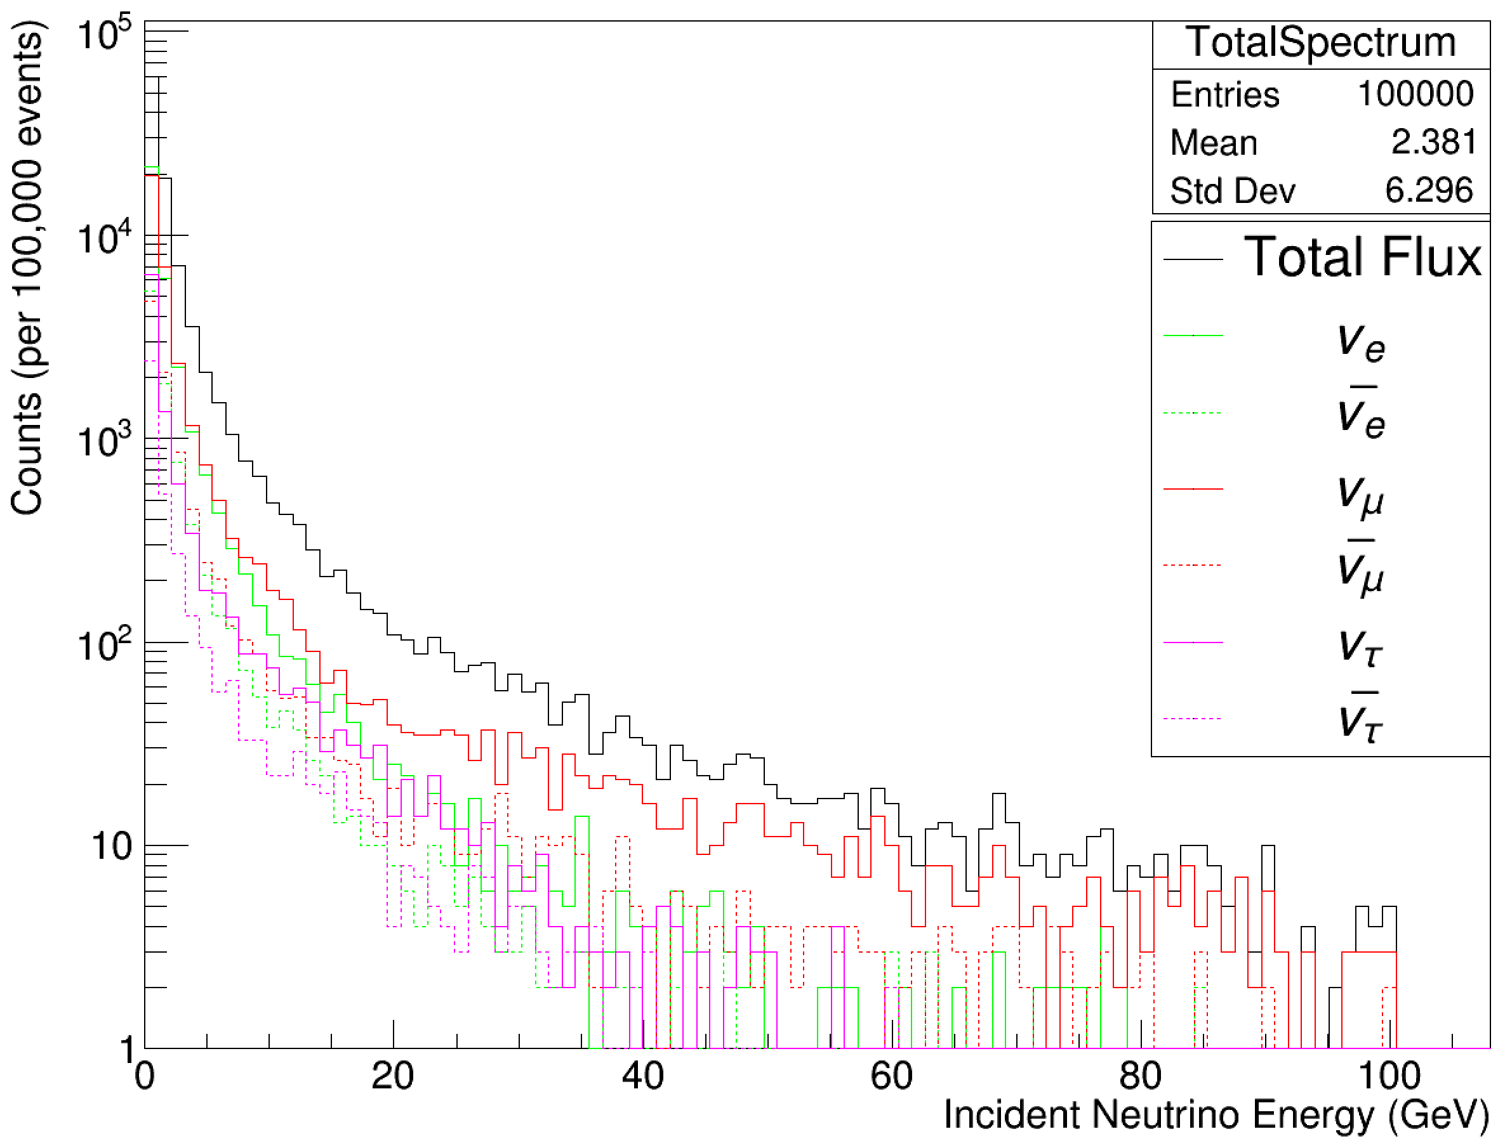
Comparisons: $E_{ν}$
Super-Kamiokande
Homestake site, GENIE production
($0.1−100.0 GeV$, $100,000$ events)
Homestake site, GENIE production
($0.1−2.0 GeV$, $10,000$ events)
Notes:
General tail off behavior is similar, but no easily comparable energy spectrum could be found for an adequate comparison

Slide 24
Azimuthal angle $φ$
Uses GENIE/Honda Coordinates
Notes:
Rotationally invariant across 360 degrees (as it should be)

Slide 25
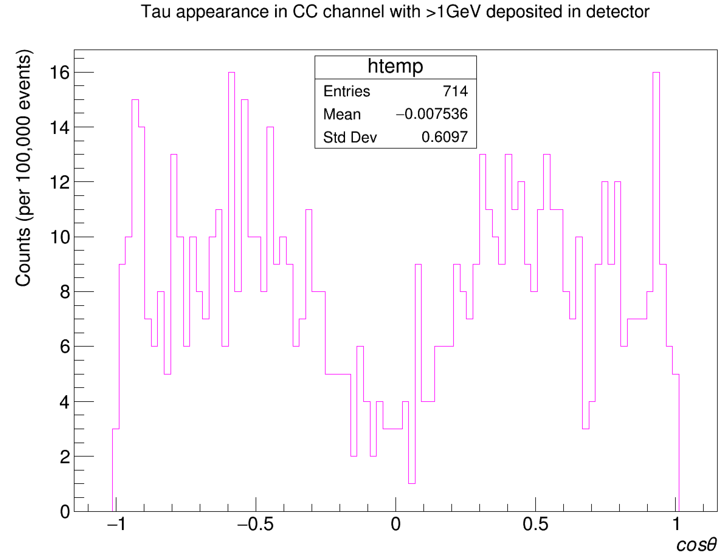
Comparisons: $ν_{τ}$ counts by $cos⁡(θ)$
Super-kamiokande
($5326$ days, CC, $>1.3 GeV$ Visible Energy)
Homestake site, GENIE production
($0.1−100 GeV$, $100,000$ events)
Uses GENIE/Honda Coordinates
Notes:
Not necessarily precisely applicable due to the fact that SK uses CC events with 1.3 GeV or more of visible energy, and I am only running a small 0.1-2.0 GeV sample of 10,000 events; thus, all of these are NC events, technically…but, the shape seems similar

Slide 26
A word on other backgrounds… …need to check that many rare SM branching channels are included in GENIE!

Slide 27
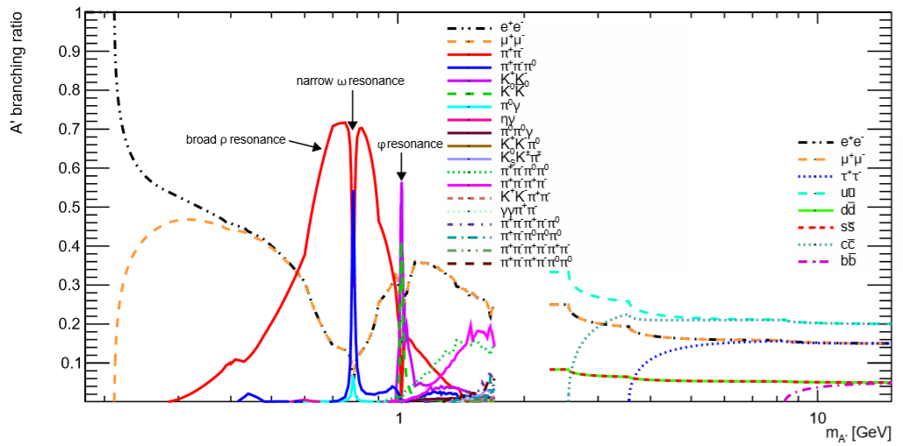
Updating ROOT’s/GENIE’s PDG particle decay library
In order to make sure that we have a definitive set of background simulations, we have to include very small but observed branching fractions to GENIE’s decay library
Located in $GENIE/data/evgen/catalogues/pdg/genie_pdg_table.txt, will be located on my own fork
Updates many of the exclusive heavy meson resonance decays
If observed (meaning there is a $<XX\%$ in the PDG, but not simply a “seen” tag), I take the upper limit and cut it in half
Example: $\frac{Γ_{i}}{Γ}\left(η→2μ^{+}2μ^{−}\right)<3.6×{10}^{−4}⟹1.8×{10}^{−4}$
Still needs more investigation, but am running with basic phase space assumptions now
Many of these heavy resonance decays come from heavy baryon resonances
Can have multipionic/kaonic decays that lead to backgrounds
Many of these were not included in the library, and have now been added (highlighted at left)
Added new channels through $f_{0}\left(1500\right)$

Slide 28
$n→n′$ Progress

Slide 29
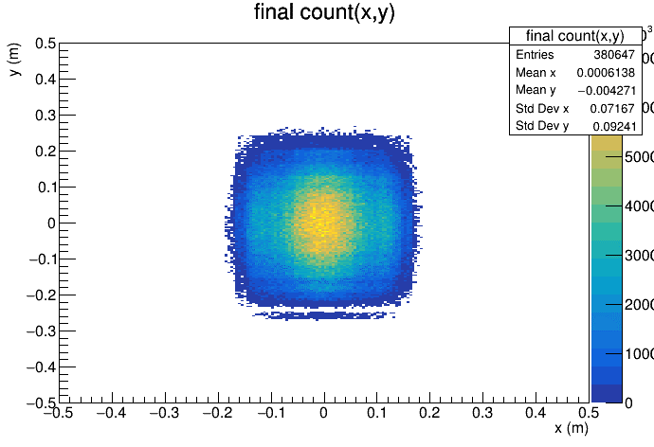
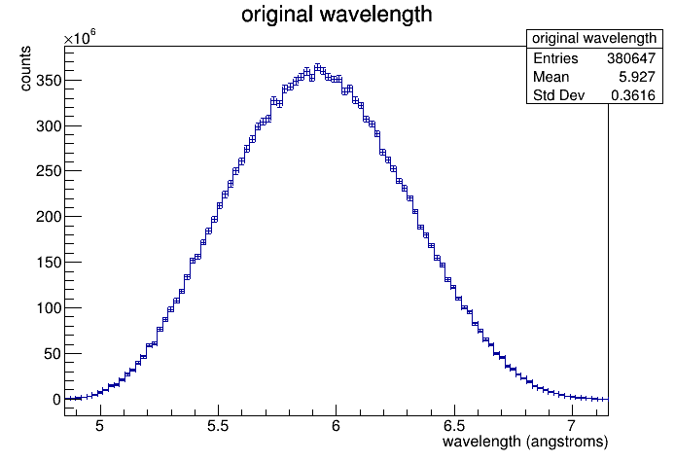
New McStas Simulation of GP-SANS Beamline from Lisa
Lisa DeBeer-Schmidtt has completed a full McStas simulation of the GP-SANS HFIR beamline
Includes source term, all beamline components
Including velocity selector!
Event samples with and without neutron guides
Can use “no guides” sample, backtrace, and then compute with slits
Multiple new McStas event files are ready to be analyzed
All samples are taken at the exit from the collimator sections
I already have some basic ROOT/C++ code ready to go for this
Does basic beam characterizations
Will be able to hand these to Lawrence for further background simulations
Need to implement magnetic field transport for sensitivity studies given different neutron wavelengths
Alex Blose has started some work on this, but need more help!

