Slide 1
Initial Cryostat Sizing
Colin Narug
12/11/2020

Slide 2
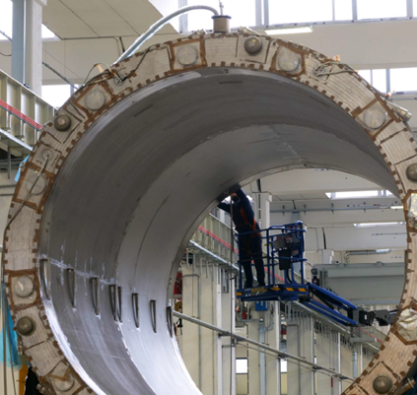
Initial Design
Initial Design based on NICA MPD
Initial thickness found using BPVC VIII Part 4
  External thickness is dependent on unsupported length
    NICA used 2 supports across length, DUNE design will likely use 4

Slide 3
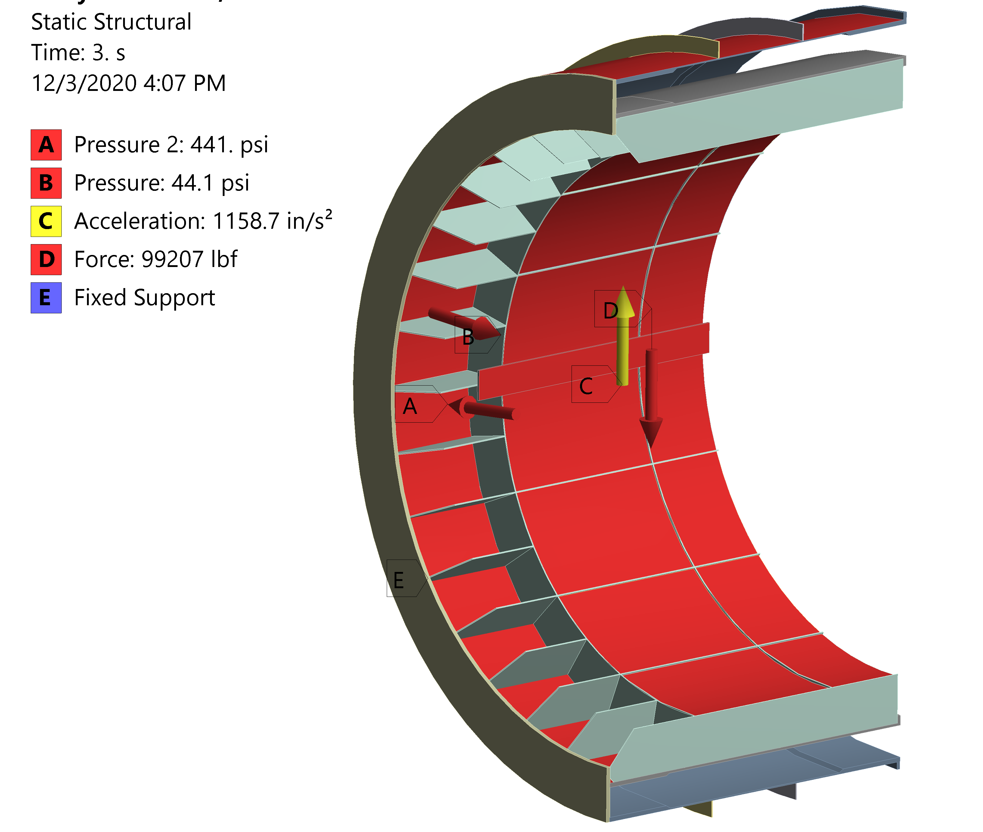
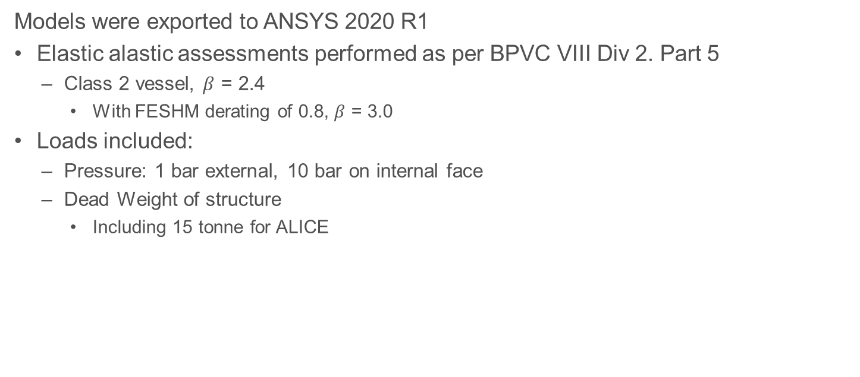
Initial Simulation
Models were exported to ANSYS 2020 R1
Elastic alastic assessments performed as per BPVC VIII Div 2. Part 5
  Class 2 vessel, $β$ = 2.4
    With FESHM derating of 0.8, $β$ = 3.0
Loads included:
  Pressure: 1 bar external, 10 bar on internal face
  Dead Weight of structure
    Including 15 tonne for ALICE

Slide 4
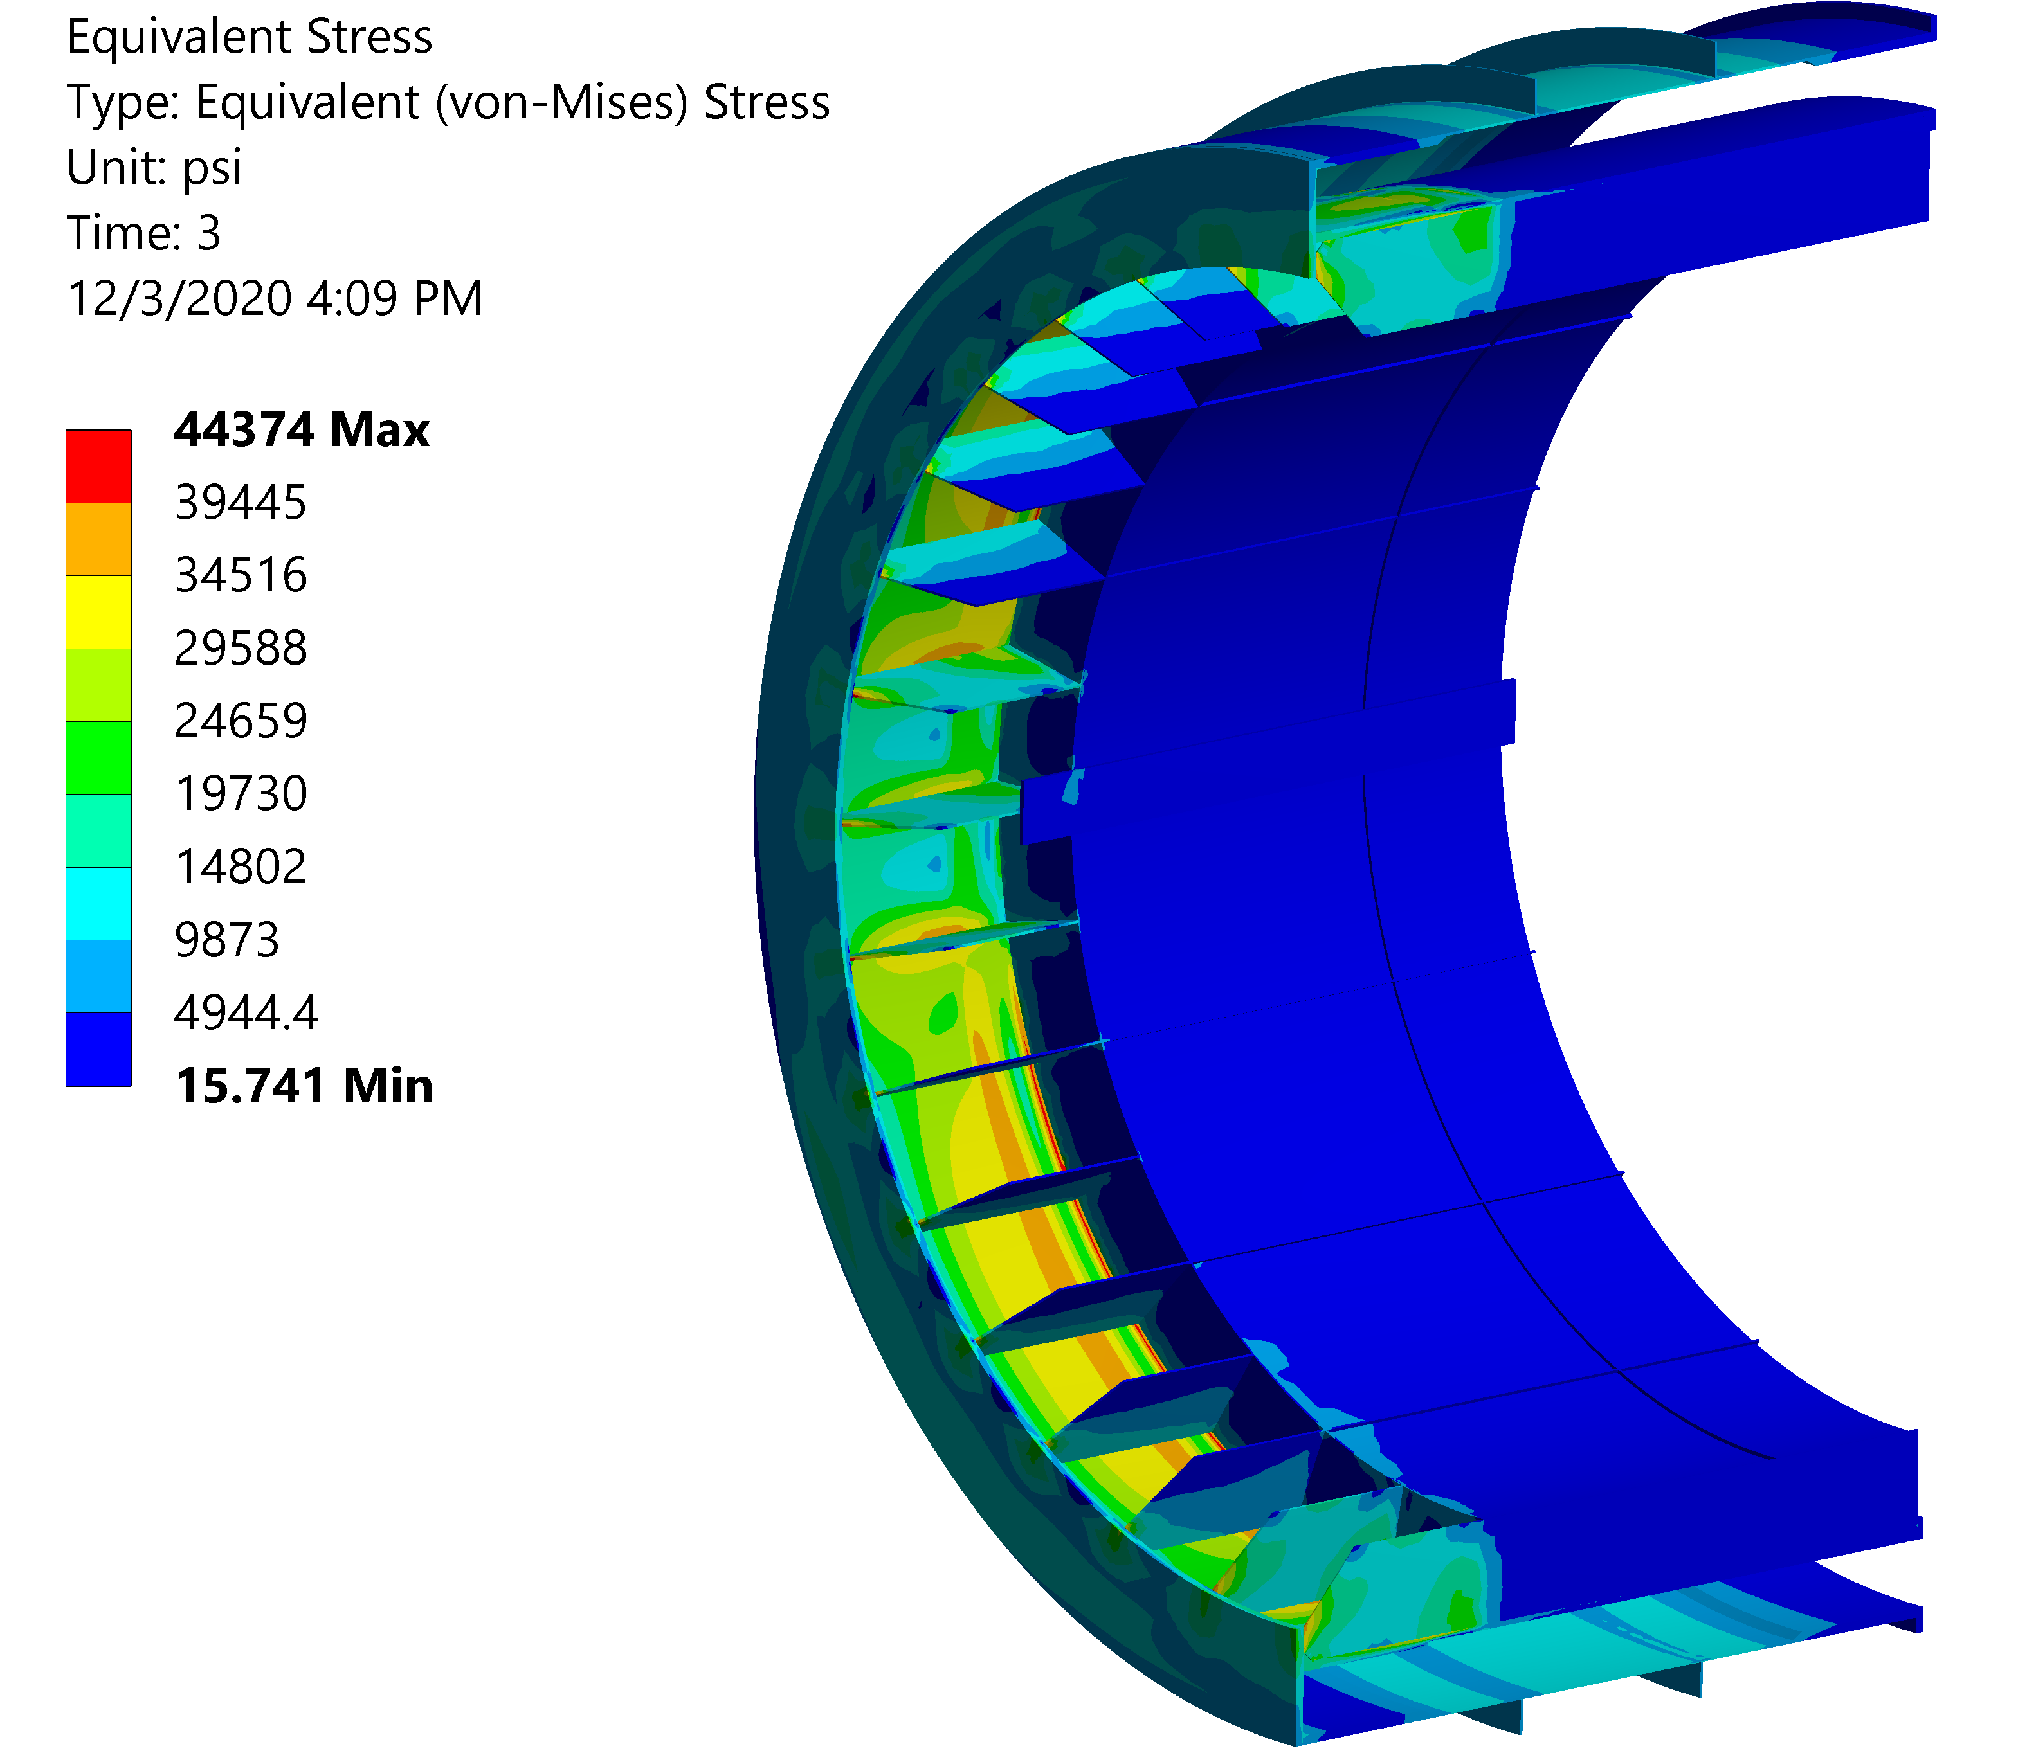
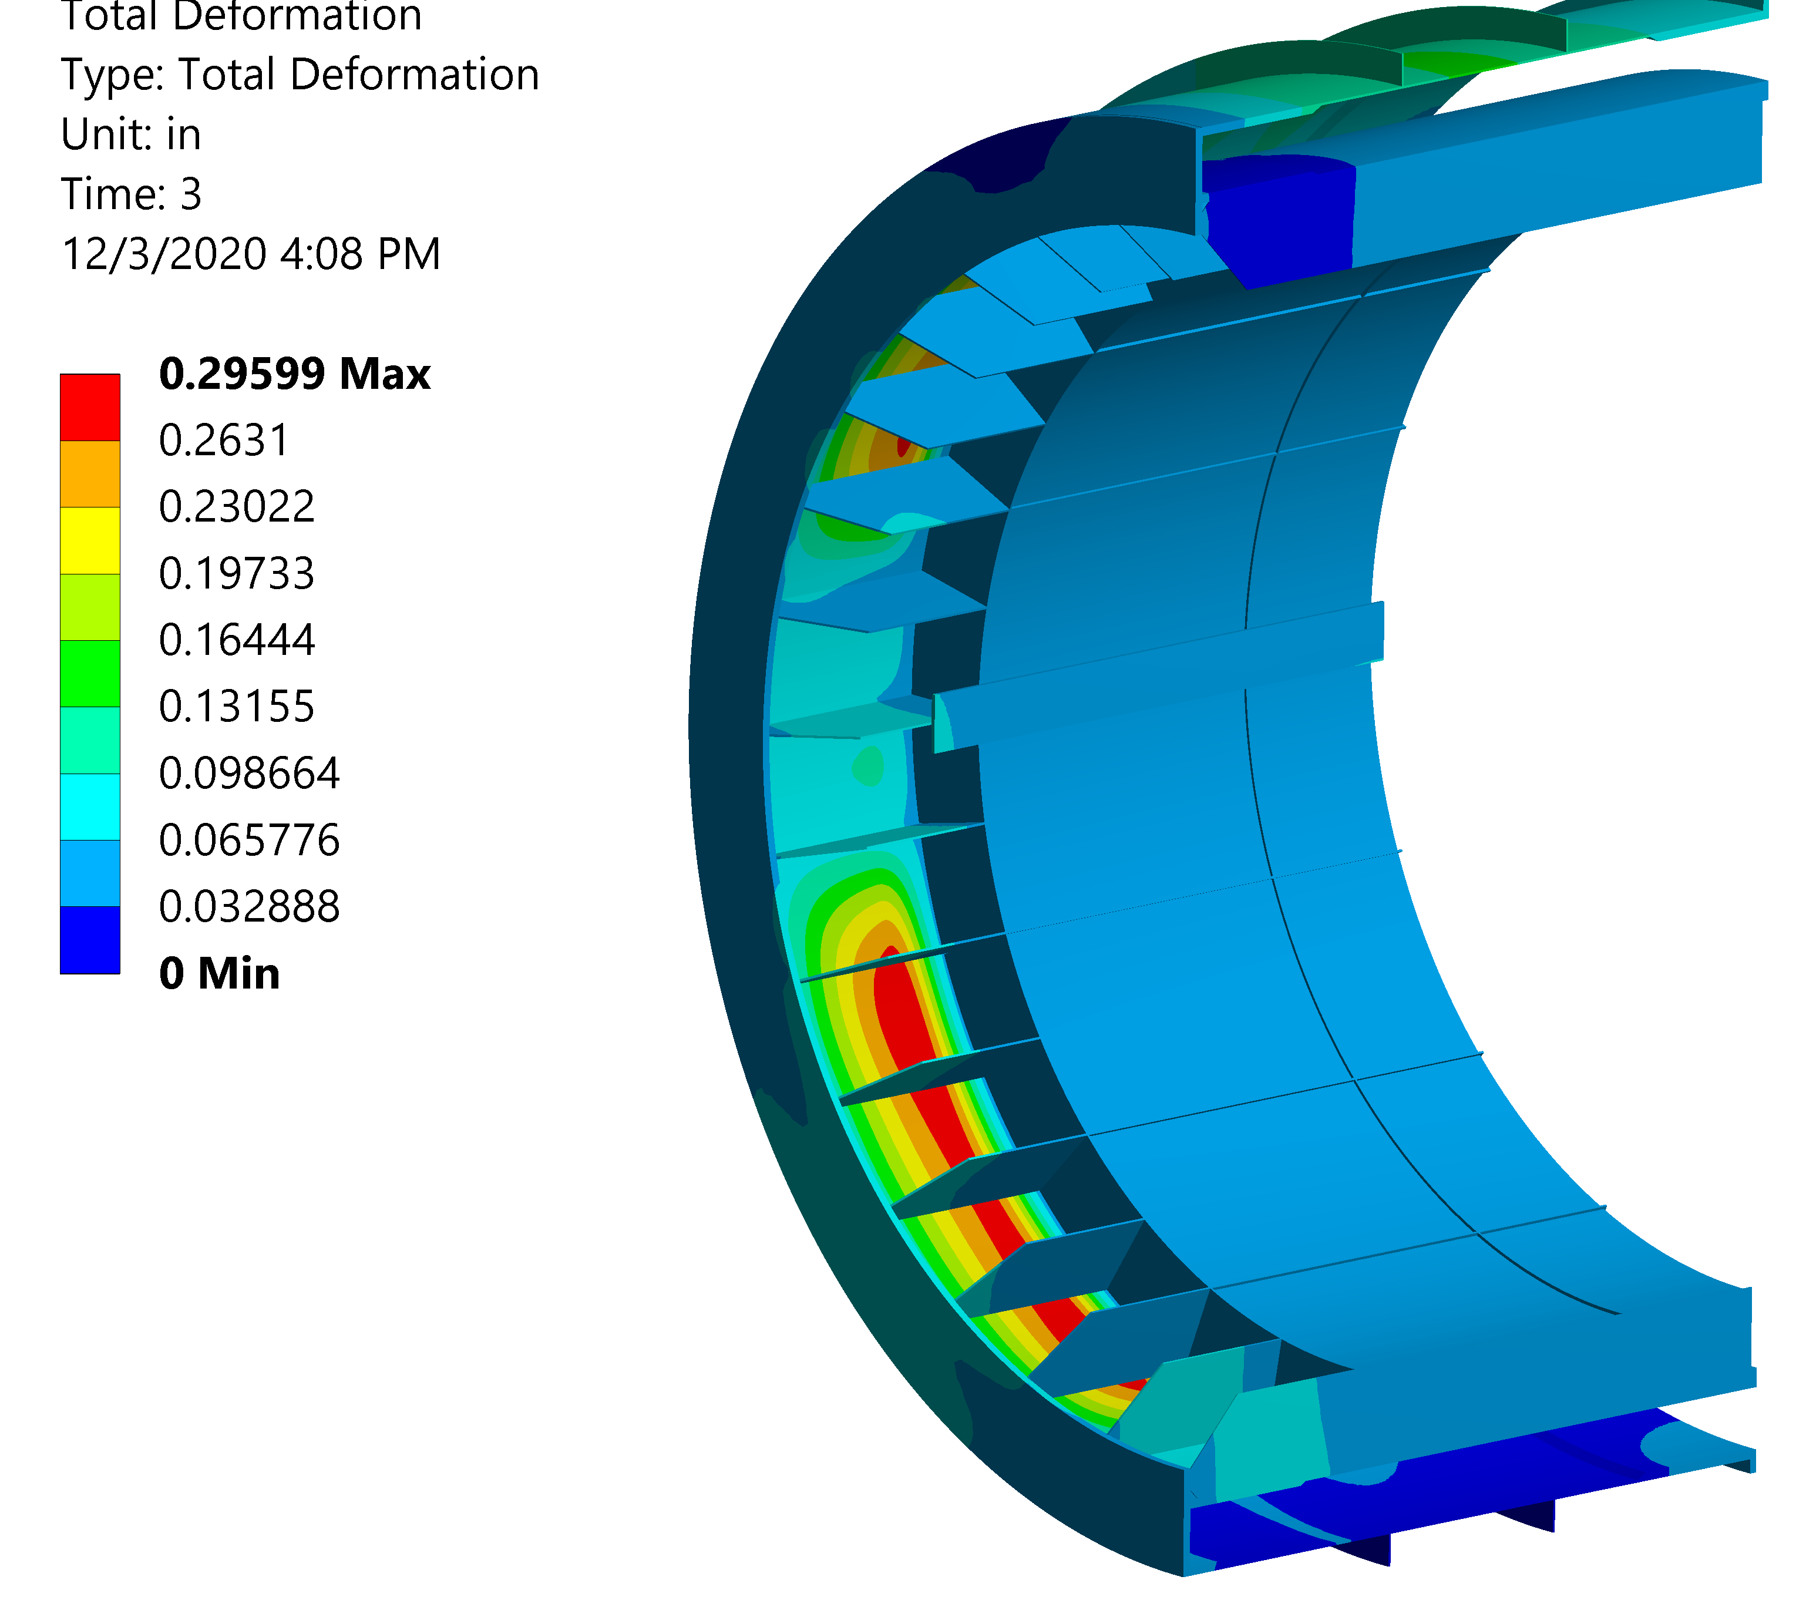
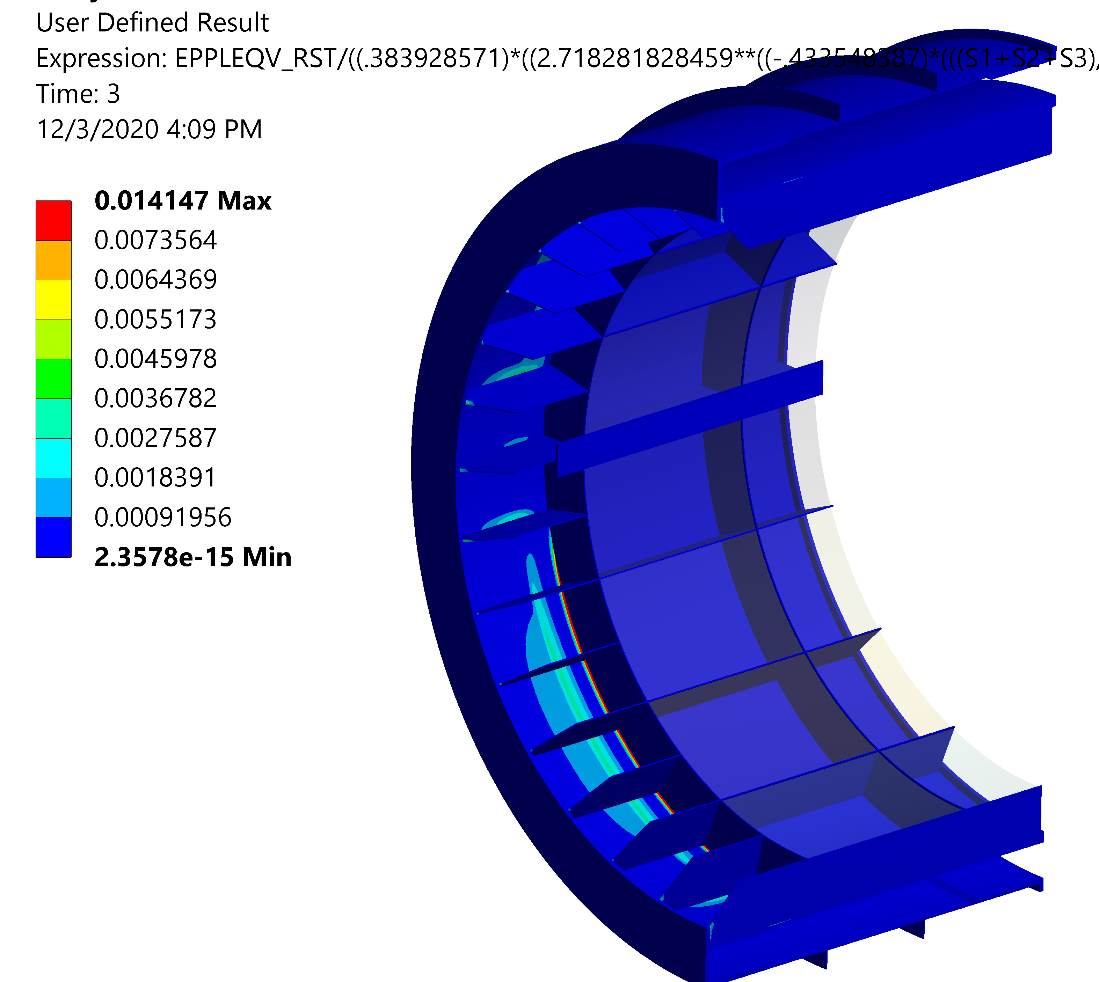
Initial Simulation Results
Results indicate that parts are currently overdesigned.
  Many parts are simplified, and assumptions were made, but show that design is promising.
    Meet plastic collapse and local collapse requirements
Simulations involving more complex loadings currently running

Slide 5
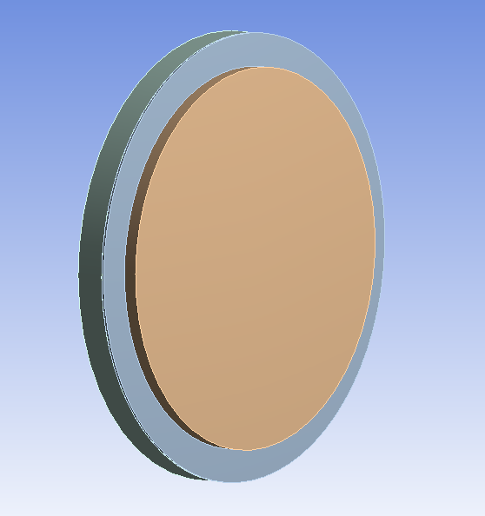
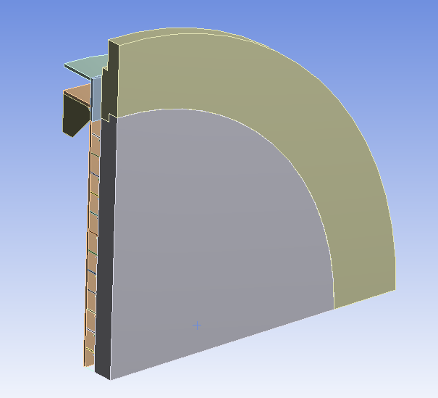
Stayed Design
Stayed design will be needed to resist internal pressure
Simplified model of end cover was created to build from.
Models solved:
  11” Thick Plate
  Thin Plate
    Unstayed Design
      Failed to solve, therefore not a valid design
    Stayed design
      Quick unoptimized design created to verify design
        981, ¾” bolts, spaced ~7.07 inches apart
Similar results for both Ti Gr 3 and 316LN
  Only 316LN results showed

Slide 6
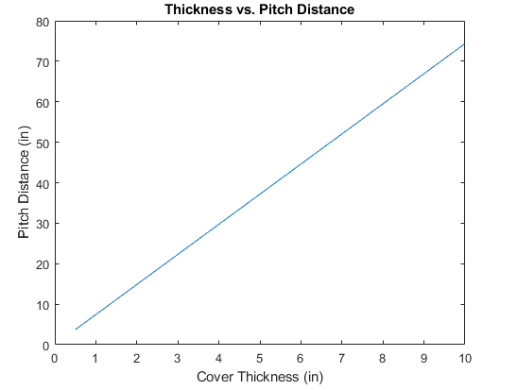
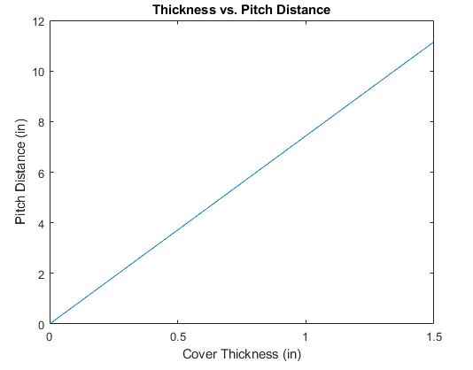
Stayed Face Requirements
As per 4.9.3
Thickness calculations as per 4.9.3.2
  Diameter required is about 0.66”
    Round up to 0.75”
Maximum stayed plate thickness:
  4.9.4.1(b): 1.5” for welded in stay bolts
  4.9.4.2(c): 0.5” for welded stays
    Indicates welded stays not viable
Pitch shall not exceed 20 inches

Slide 7
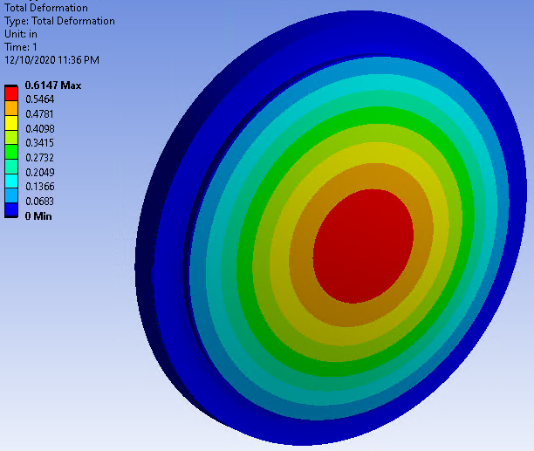
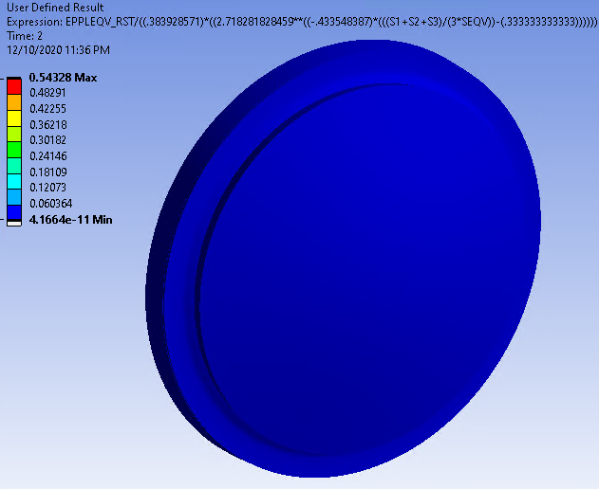
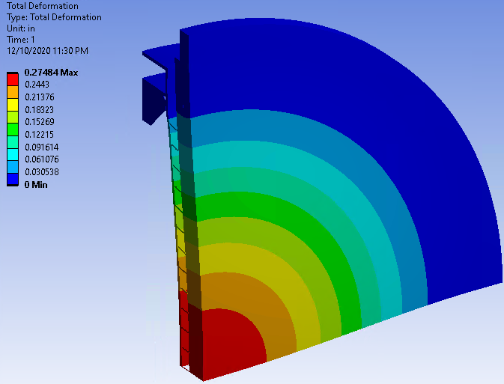
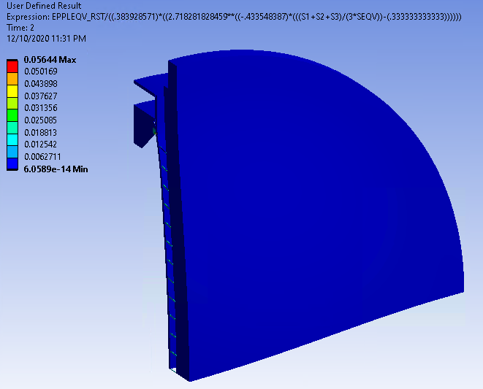

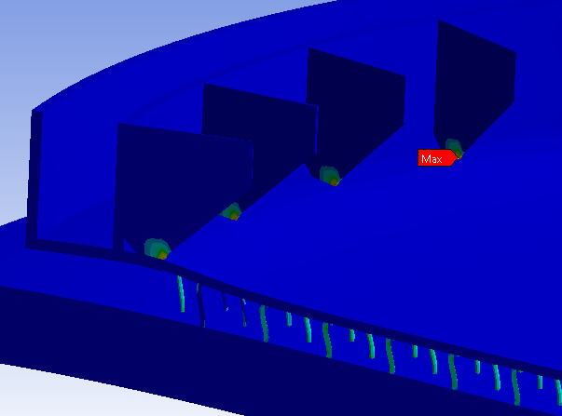
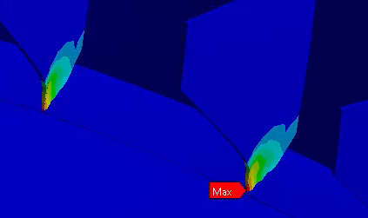
Simulation Results
Using an internal pressure of 10 bar and external pressure of 1 bar…
Both models meet plastic collapse and local failure requirements
  Thicker end cover is closer to failure than stayed design

