Slide 1
Report from HEP
[Teleworking from home in Frederick, MD since March 17th]
12 August 2020
Fermilab 53rd Annual Users Meeting
Defining the Decade
Alan Stone
Office of High Energy Physics
Office of Science, U.S. Department of Energy

Slide 2
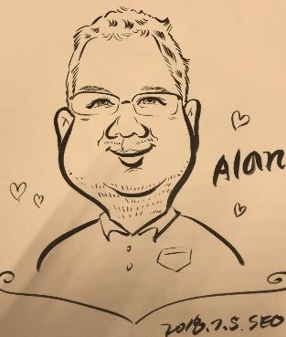
Hello, My Name Is… Alan Stone
Started at DOE on 4 January 2009 at Germantown, MD
  Official title: Physicist, GS-15 with the Department of Energy, Office of Science, Office of the Deputy Director for Science Programs, Office of High Energy Physics
  Program Manager for Intensity Frontier 2009-2014*
  Program Manager for Budget 2014- Present
  Prior to coming to DOE in 2009, worked at Fermilab (D0, CMS) and CERN (L3) on particle collider physics. Received Ph.D. from Louisiana State University in 1999.
HEP Budget and Strategic Planning
  Responsible for the formulation and execution of the $1B program, and the implementation guided by the community-driven long-range plan.
  Work closely with leadership and scientific staff at the DOE national labs on SC and HEP strategic initiatives, tactical planning, and policy, including: fostering a diverse, equitable, and inclusive workforce; revitalizing the science and technology infrastructure; and developing a robust long-term budget process
  Mentor and provide coaching to early-stage career scientists who are navigating the next steps in their career: students, post-docs, faculty, lab scientists
Read 2000+ new, renewal, and supplemental proposals
Conducted 200+ university and lab site visits in U.S. and abroad
Organized & participated in 100+ panel reviews
Attended 50+ conferences, workshops, and topical meetings
1 TYDASTW Day

Slide 3

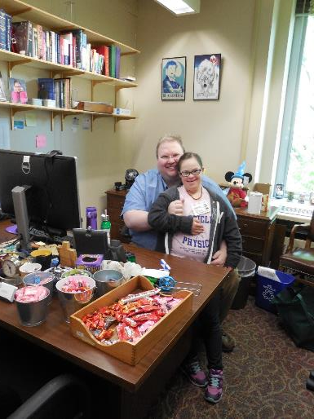
Take Your Daughters and Sons to Work Day [25 April 2019 – DOE, Germantown, MD]
Enable The Mind, Encourage The Heart

Slide 4

Opening Remarks
The DOE Office of Science (SC) is fully committed to fostering safe, diverse, equitable, and inclusive work, research, and funding environments that value mutual respect and personal integrity
  July 2020 HEPAP presentation by Dr. Julie Carruthers https://science.osti.gov/hep/hepap/Meetings/202007
The P5 report strategy continues to be
successful
  The HEP community is producing excellent
  science results
  Support from Administration, Congress, and
  international partners continues to be strong
  Community engagement remains important
  as we lay the foundation for the next long-term
  strategic plan
    Snowmass 2021 presentation at HEPAP
COVID-19 pandemic
  HEP continues to be interested in hearing from
  community
  July 2020 HEPAP presentations on community-gathered impacts https://science.osti.gov/hep/hepap/Meetings/202007

Slide 5
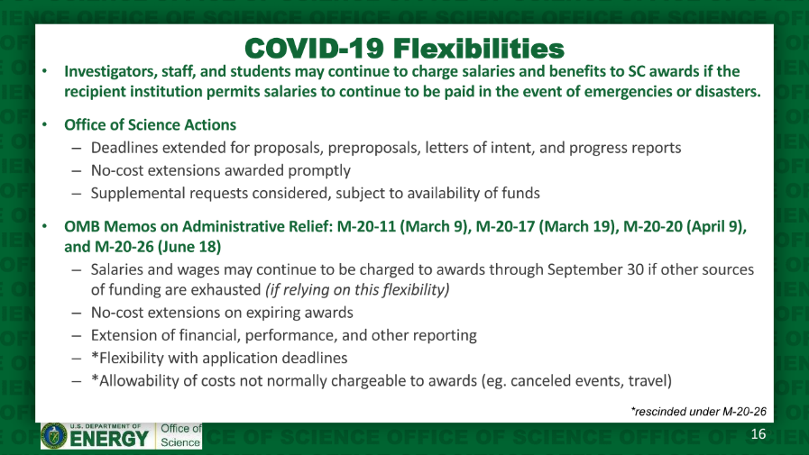
Message from Office of Science https://science.osti.gov/hep/hepap/Meetings/202007
Dr. Harriet Kung, Deputy Director for Science Programs

Slide 6

Constitution and Disclaimers
More in back-up
U.S. Constitution. Article 1, Section 8, Clause 8: “The Congress shall have Power… To promote the Progress of Science and useful Arts”
The constitutional rationale for selective support of pure scientific research lies primarily in the stimulation of educational initiatives that train the scientists and engineers that serve constitutional functions, particularly national security.
Lobbying (http://energy.gov/management/lobbying)
  Generally prohibited from contacting or encouraging others to contact a state or federal legislator or executive branch official in an attempt to influence the enactment or modification of legislation or other specified activities
Partisan Political Activity (https://osc.gov/Pages/HatchAct.aspx)
  In general, executive branch federal employees may not:
    Use official authority or influence to interfere with an election
    Solicit or discourage political activity of anyone with business before their agency
    Engage in political activity while: on duty, in a government office, wearing an official uniform, or using a government vehicle

Slide 7


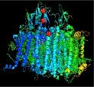

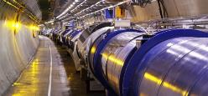

What is the Office of Science?
The Mission of the U.S. Department of Energy is to ensure America’s security and prosperity by addressing its energy, environmental and nuclear challenges through transformative science and technology solutions.
DOE Office of Science is the lead federal agency supporting fundamental scientific research for energy and the largest supporter of basic research in the physical sciences in the United States, fulfilling a Mission to:
Deliver scientific discoveries and major scientific tools to transform our understanding of nature
Advance the energy, economic, and national security of the United States
More in back-up
Advanced Scientific Computing Research
Basic Energy Sciences
Biological and Environmental Research
Fusion Energy Sciences
High Energy Physics
Nuclear Physics

Slide 8
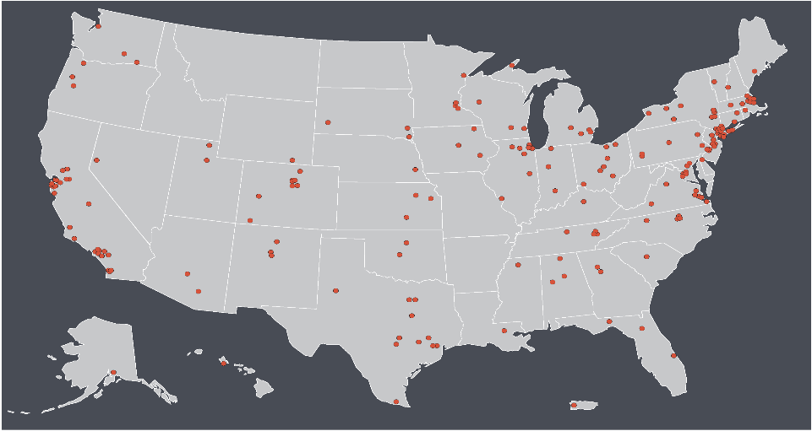
Particle Physics in the United States
Scientists, engineers, and technicians at more than 180 universities, institutes, and laboratories throughout the U.S. are working in partnership with their international colleagues to build high-tech tools and components, conduct scientific research, and train and educate the next generation of innovators. Particle physics activities in the U.S. attract some of the best scientists from around the world.
Dots represent Laboratories and Universities receiving funding in 2019 for particle physics from DOE or NSF

Slide 9
HEP: A Mission-Driven Agency
The mission of the HEP program is to understand how the universe works at its most fundamental level by discovering the elementary constituents of matter and energy, probing the interactions between them, and exploring the basic nature of space and time.
Experimental Science and Technology R&D is “mission-driven”:
  Develops and supports a specific portfolio of projects. Emphasis is placed on supporting science collaborations in all stages, conducting experiments, and seeking the best possible science results.
  Makes significant, coherent contributions to facilities/experiments selected for the program, including project management.
  Supports R&D that will advance the state-of-the-art in particle accelerators and detectors, which will lead to new, more capable facilities.
  Supports R&D to enable new and transformative capabilities in QIS, AI/MI, and crosscutting technology areas
Theory supports activities that provide the vision and the mathematical framework for understanding and extending our knowledge of particles, forces, space-time, and the universe.
HEP supports ~85% of the U.S. particle physics (in $), incl. ~all national labs

Slide 10
Core Research vs. Early Career
Core Research and Early Career Research Award proposals are subject to scientific & technical merit and program policy factors, and a comparative review is used to enhance the validity of the written evaluations
  Many factors weigh the selection process (and funding recommendations)
    Compelling research proposal for next ~3-5 years
      Interesting? Novel? Significant? Plausibly achievable?
      Incremental? Implausibly ambitious? Poorly presented?
    Significant recent contributions in last 3-5 years
      Synergy and collaboration within group (as appropriate)
      Contributions to the research infrastructure of experiments
    Alignment with HEP programmatic priorities
    Balanced program of R&D/design, support of construction or operations, data analysis
      This may span multiple experiments over the proposal’s project period
Early Career Research Award is more competitive and should address:
  What is the key challenge being addressed? [New Tool and/or New Physics]
  Why is the PI best positioned to take on this project? [Uniqueness]
  How does this research exploit/engage the capabilities of the institution? [Leverage]
  What resources are required to carry out this project successfully? [Budget]
  Robust 5-year timeline: milestones, deliverables, & workforce training? [Management]
  Why you are a future leader in high energy physics? [Leadership]
33

Slide 11
Develop a Personal Roadmap
Timescales for HEP projects from conception to first data will only get longer in the continued pursuit of discovery science due to cost, size and complexity
HEP academic research track (Univ. or Lab) will benefit from developing a near-, mid- and long-term research plan
  Balance research between ongoing experiment, upgrades and R&D with future experiment
New Univ. tenured-track faculty or lab scientist is likely to “hit the ground running” by continuing the research conducted during their most recent post-doc position
  This is perfectly normal. Most people are hired with this consideration.
  A rising trajectory, clear leadership positions, track record of accomplishments, mentoring, etc.
Before preparing that first proposal, map out your long-term strategic goals (10+ years)
Will you be working on that same experiment in 5 years? How about 10 years? In 20 years?!
Optimize your start-up or LDRD funds by expanding your research portfolio and seeding a future looking project/experiment
With your strong participation, major projects like Mu2e, LBNF/DUNE, Vera Rubin Observatory, and HL-LHC CMS and ATLAS will complete on time and be poised to reap the physics data on Day 1
Can you envision you (and your colleagues) shepherding the “post-P5” projects?

Slide 12

Tell a Story
The best compliment that you can get
from a reviewer: “This was a pleasure
to read.”
  Avoid the trap of “narrow casting.” Readers
  of your proposal will come from many
  disciplines within particle physics, accelerator
  science, and related fields
Intersperse graphics to stimulate and illustrate
  A single high-resolution photo is often more impactful than a few paragraphs of narrative
  Avoid using: a copy of a copy; a collage of tiny plots; a graphic that is outdated
Begin with “Why?”
  Why tends to reach an emotional chord with audiences that can inspire the actions you desire. When communicating about vision, values, broad concepts, start with the why
  What – once inspired, adults have a strong desire to know more about the what
  Who refers to the breakdown of your research team as you pose your questions. Be mindful to think cross functionally
  Where needs a thoughtful, detailed analysis for your efforts to be most successful
  When will give you a sense of direction and sometimes urgency
  How is usually the “work horse” of your planning team and guides your project planning with tasks and tactics
More in back-up

Slide 13
Increasing Investments to Early Career Research Program
Launched in FY 2010 with ARRA funding https://science.osti.gov/early-career
Established Program to Stimulate Competitive Research (EPSCoR) supported 1 Theory ECA in FY 2011, 1 Intensity ECA in FY 2013, and 1 Cosmic in FY 2020
Funding nadir was FY 2013, the first year impacted by sequestration
Full-funding requirement took affect in FY 2014 (awards < $1M)
120 total HEP awards to date: 71 University and 49 National Labs
  In FY 2020, 15 awards (10 Univ, 5 Lab) is the largest cohort in a single year
More in back-up

Slide 14
HEP PI Meeting: August 24-26, 2020
We invite all current PIs, co-PIs, those interested in applying to future HEP FOAs, and interested national laboratory staff
Meeting will be fully online using Zoom and will include:
  General presentations during plenary session covering the overall DOE-HEP program, budgetary issues, different HEP FOAs at DOE to which PIs may apply
  Parallel sessions led by DOE-HEP PMs for each research program thrust area
    Energy, Intensity, & Cosmic Frontiers, Theoretical HEP, Accelerator R&D, Detector R&D, Computational HEP, Quantum Information Science, Artificial Science/Machine Learning
  With interest, other special topics sessions may be added as time permits
    Early Career research; DEI in HEP; impacts of the COVID-19 pandemic
  Opportunities for separate 1-on-1 or small group sessions between PMs and PIs across the different HEP program areas during the course of the 2-3 days
Please register online at: https://www.orau.gov/heppi2020/
For questions, contact:
  Christie Ashton christie.ashton@science.doe.gov
  Abid Patwa abid.patwa@science.doe.gov

Slide 15
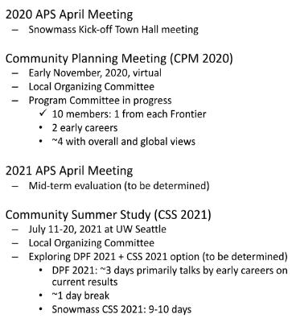
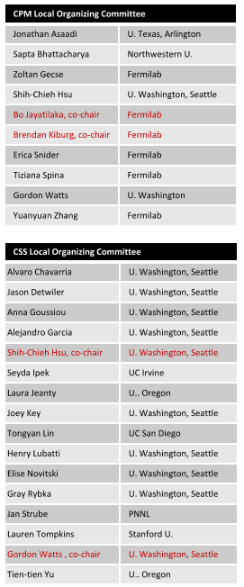
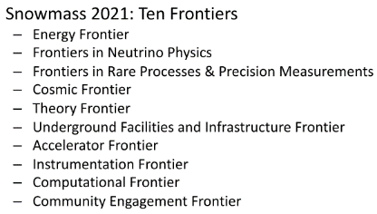
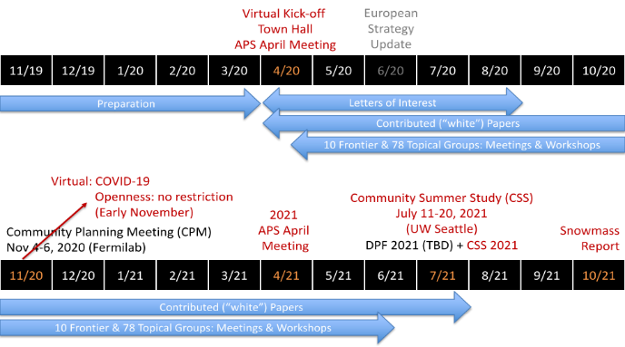
Snowmass21.org
To provide timely input to the FY 2025 budget formulation, the next P5 report will be required by March 2023

Slide 16
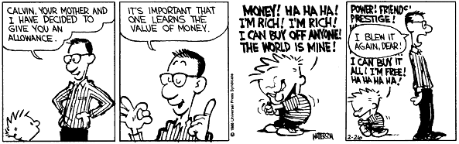
HEP FOAs & New Initiatives https://science.osti.gov/hep/Funding-Opportunities
There is one “continual” FOA (DOE/SC Open Solicitation) and these annual FOAs:
  Research Opportunities in HEP (a.k.a. Comparative Review FOA)
    In FY 2020, expanded to include Detector R&D Consortiums
  Early Career Research Program
  Quantum Information Science
  Traineeship in Accelerator Science & Technology
    In FY 2021, will expand to include Detector R&D
  U.S.-Japan Science and Technology Cooperation Program
  Artificial Intelligence/Machine Learning
FOAs that launch new initiatives are informed through:
  Strategic plans (HEPAP P5, AAAC Decadal Survey)
  Basic Research Needs Workshops
  Whitepapers

Slide 17
AAAS Science & Technology Policy Fellowships https://www.aaas.org/programs/science-technology-policy-fellowships
AAAS STPF provide opportunities to outstanding scientists and engineers to learn first-hand about policymaking and contribute their knowledge and analytical skills in the policy realm.
  Fellows serve year-long assignments in the federal government and represent a broad range of backgrounds, disciplines, and career stages.
    Some executive branch fellowships may be renewed for a second year at the mutual agreement of the host office, the fellow, and STPF.
  AAAS places more than 250 fellows each year across all branches of federal government.
Over 3,500 alumni conduct and communicate their science to support public policy in national and international arenas.
  They are leaders in government, academia, industry and the nonprofit sector.
  At the end of the fellowship, about half of each year’s fellowship class remains in the policy arena, a quarter return to their previous field, and the other quarter strike out into new territory.

Slide 18
More Fellowship Opportunities https://www.profellow.com/
Victory Congressional Fellowship
  Year-long fellowship offers an opportunity to work with LGBT Equality Caucus co-chair. This is an educational and leadership development program in legislative process and careers in policy-making.
Congressional Black Caucus Foundation Fellowship
  20-month program to work with congressional members and committees. Fellows learn how to conduct legislative analysis, respond to constituent mail, draft talking points and speeches for members, and coordinate logistics and public testimony for congressional hearings.
IEEE-USA Engineering & Diplomacy Fellowship
  Year-long fellowship offers an opportunity for the science, technology and engineering community to provide technical expertise to the U.S. State Department, and help raise awareness of the value of your input while you learn about and contribute to the foreign policy process.
James Smithson Fellowship Program
  Year-long fellowship opportunity for scholars in the fields of science, humanities and the arts, interested in gaining a better understanding of the interplay between research and public policy and discourse. Fellows receive hands-on experience exploring relationships between research and public policy through interaction with Smithsonian and policy leaders in DC
Emerging Markets Development Advisers Program
  One-year assignment, cooperative activity between U.S. Agency for International Development (USAID) and IIE. EMDAP advisers provide technical assistance and support to overseas organizations in USAID-assisted countries. EMDAP advisers are selected for their background and skills, their leadership qualities, problem-solving capabilities, and communication, analysis abilities in regions including Africa, Asia, Latin America, the Caribbean, and the Middle East.
State Policy Fellowship Program
  Two-year program with an influential state-based policy organization or with the Center on Budget and Policy Priorities in Washington, D.C. Fellows research and write analyses on current policy issues; brief policymakers, journalists, etc.; and serve as a resource for advocates and community groups.
STPI’s Policy Fellowship Program
  Two-year fellowship provides a unique opportunity for collaborative research for leaders in the White House Office of Science and Technology Policy (OSTP) in the Executive Office of the President and other Federal Government organizations. Fellows work with teams of researchers to support a wide variety of S&T policy-related tasks.
TechCongress Congressional Innovation Fellowship
  Fellows choose a placement with a Member of Congress or Congressional Committee and report directly to a senior staffer (like a Chief of Staff or Staff Director) in that office from January through December. Fellows also develop and produce a fellowship project on an issue of their choosing.
Hellman Fellowship in Science and Technology Policy
  One-year fellowship to work with senior scientists and policy experts on critical national and international policy issues related to science, engineering, and technology.
Presidential Innovation Fellows
  One-year fellowship that seeks to attract top innovators into government, capable of tackling issues at the convergence of technology, policy, and process. Fellows are embedded within federal agencies to collaborate on challenges with innovators.

Slide 19


ORISE
Whether you are an undergraduate, graduate student, postdoc, or early-career professional, ORISE provides various resources to address the career planning and professional development needs of all research and non-research participants.
  What STEM Careers are in High Demand?
  Internship or Entry-Level Position?
  Find a Recruiting Event
  How to Write a Cover Letter
  Is a Resume the Same as a CV?
  Personal and Professional Recommendations: What’s the Difference?
  What is a Virtual Career Fair?
  How to Boost Your Visibility through Networking
  What to Expect During an Interview
  Learn about ORISE-Managed STEM Programs
Resources for K-12 Teachers and Students

Slide 20
SC Workforce Development for Teachers and Scientists (WDTS)
Science Undergraduate Laboratory Internships (SULI)
  Summer 2020 SULI closed (Applications due May 28, 2020)
Community College Internships (CCI)
  Fall 2020 CCI closed (Applications due May 28, 2020)
Visiting Faculty Program (VFP)
  Summer 2020 VFP closed Jan. 2020, notifications in April
Office of Science Graduate Student Research Program (SCGSR)
    Two annual solicitations with May and November deadlines
Albert Einstein Distinguished Educator Fellowship
  2020-2021 cycle closed on November 14, 2019
More information and key dates for all programs at:
  https://science.osti.gov/wdts
More in back-up

Slide 21
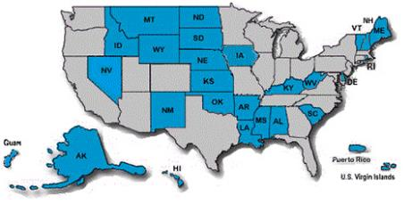
DOE Experimental Program to Stimulate Competitive Research (EPSCoR)
42 USC13503 [Title 42 U.S. Code Chapter 134, Subchapter X, section (§) 13503. Supporting research and technical analysis]:
  EPSCoR shall assist those States that-
    Historically have received relatively little Federal research and development funding
    Demonstrated a commitment to develop their research bases and improve science and engineering research and education programs at their universities and colleges.
Program Priorities:
  DOE EPSCoR is a science-driven,
  merit-based program that supports
  early stage research activities spanning
  the broad range of science and
  technology programs
  In addition, the program places high
  priority on increasing the number of scientists
  and engineers in energy-related areas.
  Program places particular emphasis and importance of collaboration among young faculty, postdoctoral associates, graduate/undergraduate students supported by EPSCoR with scientists from the DOE national labs where unique scientific and technical capabilities are present.
2020 EPSCoR awards to HEP PIs:
Matthias Fuchs, Univ. Nebraska, "High-efficiency, high-current laser-driven electron injector"
Jake Bennett, Univ. of Mississippi, "CP violation searches and distributed computing development with the Belle II experiment..."

Slide 22
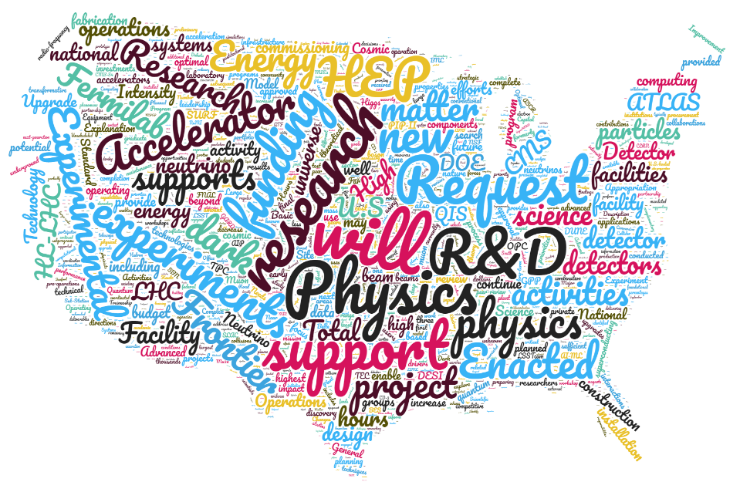
A Few Minutes on Budget
Word cloud: FY 2020 HEP Budget Narrative

Slide 23
Fiscal Year 2020 Federal Budget*
*Before Covid19 Pandemic Response
March 11, 2019: President submitted budget request
Jul 2019: Congress passed FY20/21 budget resolution
Dec 20, 2019: President signs appropriations
OMB estimates Federal revenue to be $3.645 trillion
Income taxes: $1.824 trillion
Payroll taxes: $1.295 trillion
All Other: $0.508 trillion
OMB estimates the Federal government to spend $4.746 trillion
President requests $1.426 trillion discretionary spending
OMB estimates mandated benefits to cost $2.841 trillion
Social Security: $1.102 trillion
Medicare: $0.679 trillion
Medicaid: $0.418 trillion
All Other: $0.642 trillion
OMB estimates interest payments on National debt to be $479 billion
Deficit projected at $1.092 trillion*
[CBO reports deficit at $1.9 trillion through first 8 months]
Sources: https://thebalance.com https://www.cbo.gov/

Slide 24
U.S. Congress Supports P5 Strategy
U.S. Congress continues to show strong support for executing the P5 strategy, and for accelerating the pace of projects
~280M
Post-P5
(+36% in
5 years)
When the P5 report was released in May 2014, the FY 2015 budget was already in Congress and the FY 2016 budget was being formulated
Arguably the first impact (success!) of the P5 report was not seen until FY 2016, and continues today…

Slide 25
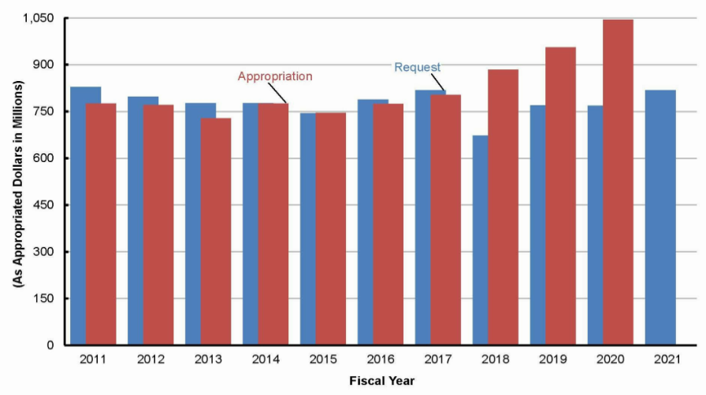
HEP Request (blue) vs. Appropriation (red)
[FY 2011-2021]

Slide 26


Office of Science - FY 2021 Research Initiatives
New Research Initiatives
  Integrated Computational and Data Infrastructure for Scientific Discovery
  Next Generation Biology Initiative
  Rare Earth / Separation Science Initiative
  Revolutionizing Polymer Upcycling
  Strategic Accelerator Technology Initiative
  Data and Computational Collaboration with NIH
Ongoing Research Initiatives
  Artificial Intelligence and Machine Learning
  Biosecurity
  DOE Isotope Initiative
  Exascale Computing Initiative
  Microelectronics Innovation
  Quantum Information Science
  U.S. Fusion Program Acceleration

Slide 27
FY 2021 House Mark
House Appropriations Full Committee Mark Up: Monday July 13, 2020
Office of Science – The bill provides $7.05 billion, an increase of $50 million above the FY 2020 level and $1.2 billion above the request.
  HEP $5M increase from $1.045 billion to $1.050 billion
Emergency funding – The bill provides $6.25 billion for Office of Science national laboratories, scientific user facilities, and universities to accelerate ongoing construction projects across the country.
At SC Level:
  - $75M for equipment and infrastructure for QIS Research Centers
At HEP level: (total ~$1,305M)
  - $641M for LBNF - $62M for CMB S4
  - $284.4M for PIP-II - $9M for Mu2e
  - $200.3M for LHC computing and equipment - $6M for SuperCDMS
  - $100M for Wilson Hall renovations - $2.1M for LSST
In SLI program, two projects benefit Fermilab: (total $82.5M)
  $77M for Utilities Infrastructure Project
  $5.5M for the Integrated Engineering Research Center

Slide 28

Discussion

Slide 29
Small Wins:
Redefining the Scale of Social Problems
The massive scale on which social problems are conceived precludes innovative action because bounded rationality is exceeded and dysfunctional levels of arousal are induced. Reformulation of social issues as mere problems allows for a strategy of small wins wherein a series of concrete, complete outcomes of moderate importance build a pattern that attracts allies and deters opponents. The strategy of small wins incorporates sound psychology and is sensitive to the pragmatics of policymaking.
Karl E. Weick (Cornell University)
January 1984
American Psychologist

Slide 30
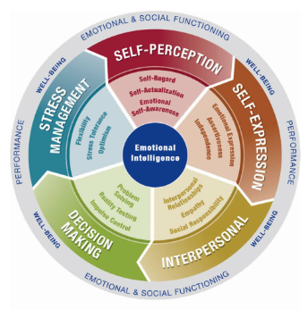
Principles of DEI are Central to My Work-Life
Six years ago, I started a journey of personal growth, professional development, and mental health therapy
  To be a better father, husband, friend, colleague, and followerer
  To become a mentor
  To be a coach
  To be a champion
  To lead positive change
  (see next slide…)
I continue to look for small wins and focus my efforts to removing obstacles, such as:
  Workplace culture.
  Lack of female and/or underrepresented minority leaders (role models)
  Affordability and accessibility of childcare.
  Paid family leave
  Hiring veterans, veterans’ partners, and people with disabilities.

Slide 31
Implicit Bias in Scientific Peer Review
[Introduced this slide to Intensity Frontier Panel Review Nov 2015]
How does implicit bias influence your evaluations?
A few key characteristics of implicit biases
  Implicit biases are pervasive and robust. Everyone possesses them
  Implicit and explicit biases are generally regarded as related but distinct mental constructs
  The implicit associations we hold arise outside of conscious awareness
  We generally tend to hold implicit biases that favor our own in-group
  The implicit associations that we have formed can be gradually unlearned and replaced with new mental associations
  http://kirwaninstitute.osu.edu/research/understanding-implicit-bias/
In a perfect world, peer review would require scientific research to pass a uniformly high bar based solely on its merit
  Physicists, like all people, will find it difficult to set aside all of their biases
  Single-blind peer review allows conscious and unconscious biases regarding the author’s professional reputation, age, gender, race, or institutional affiliation to influence reviews
  In theory, concealing the identity of the PI(s) would remove these biases
  However, the high degree of specialization in particle physics makes the preservation of anonymity very challenging
Test yourself for implicit bias
  https://implicit.harvard.edu/implicit/selectatest.html
From this small step, DEI quickly evolved to a key topic for all HEP reviews, meetings, and practices.

Slide 32
Promoting DEI in Office of Science Business Practices https://science.osti.gov/hep/hepap/Meetings/202007
In 2018, the Office of Science initiated an internal review of its business practices to identify opportunities to better promote diversity, equity, and inclusion in our award making and awards management processes, and better communicate policies, practices, and procedures to our research community. SC established an internal D&I Working Group to carry out this review.
Charge:
Assess what SC is currently doing to improve diversity, equity and inclusion.
Identify opportunities for SC to demonstrate that diversity, equity, and inclusion are foundation to SC business practices:
Through its processes and procedures for research awards to universities and the DOE labs;
Through its processes and procedures for PI meetings, workshops, and advisory committees; and
Through better outreach and communications (internally and with the SC research communities).
SC D&I Working Group Recommendations
15 Recommendations were generated from the working group in all discussion topic areas. Each recommendation has multiple components and includes the development of resources and tools, guidance and training (e.g. for program managers, reviewers, etc.)
The recommendations are aimed at ensuring that SC’s business processes:
Are supportive and inclusive of women and underrepresented minorities in STEM fields;
Allow for more rigorous tracking of diversity of applicants, awardees, and reviewers;
Limit and mitigate implicit bias behaviors; and
Encourage inclusive and professional behaviors in all SC sponsored activities.
The full recommendations report is with SC senior leadership for review and concurrence. Upon approval, SC will reconstitute a working group focused on implementation.
Communications to the SC community will be a part of the rollout of any new policies and procedures that SC implements.

Slide 33
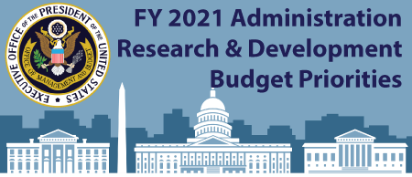
Passion? Responsibility? Burden?
Scientists have a moral obligation first to be good citizens, second to be good scholars, and third to be good scientists. The most powerful argument we could find in favor of advocacy holds that good citizens in democracies have a moral obligation to advocate to the best of their ability in the interest of helping society.
  John A. Vucetich, Michael Paul Nelson
  Minding Nature: Summer 2010, Volume 3, Number 2
Everyone should be encouraged and applauded
for any efforts to broaden the workforce pipeline,
to provide a sense of belonging for under-
represented groups, and to foster a equitable
and inclusive culture.
Questions: Is it fair that a post-doc [insert: grad
student, untenured faculty] may spend 10-20% time
on DEI efforts, while other post-docs in similar positions
devote zero time? Does this post-doc risk career
advancement? Should everyone bear the
burden, and contribute time towards DEI efforts?
Answer: From my conversations with so many people
active in moving the needle in the right direction, this
is a passion, often motivated by personal experiences.
This is an opportunity, not a burden. Mandating that
everyone contribute to these efforts is not practical.
  Employers may consider this as part of performance plan
Support may be available for compelling, well-
described, evidence-based STEM and DEI activities.
Proposals will be subject to peer-review.
Crosscutting Action Priorities
Build and Leverage a Diverse, Highly Skilled American Workforce
  Prioritize efforts to build strong foundations for STEM literacy, to increase diversity, equity, and inclusion, in skilled trades that do not require a four-year degree
  Build R&D capacity at institutions that serve high proportions of underrepresented or underserved groups

Slide 34
Case Studies: Advantages, Barriers, and Risks at All Career Stages
An undergraduate from a low-income background receives a full-tuition scholarship to your institution, but needs a job to pay for housing, books, and other expenses. He also tries to send money home to his family.
A senior at an HBCU has been accepted into your graduate program. She has strong research experience and recommendation letters because of summer internships. Your institution has a notoriously difficult comprehensive exam process – half of the students drop out. She’s worried about being able to pass the exams.
A promising assistant professor wants to have a child. However, she’s only a couple years from tenure and is concerned about maintaining her productivity. When some of her male colleagues had children, they were back at work full-time within a few days – that wouldn’t be feasible for her.

Slide 35
With More Time…
Callisto: Sexual Assault on College Campuses
Double Blind Peer Review
Evidence-Based Strategic Plans
SEISMIC: Sloan Equity and Inclusion in STEM Introductory Courses
Strengthening National Lab and Historically Black Colleges & Universities and Minority Serving Institutions Partnerships
Veterans' and Military Spouses Employment Opportunities
Job programs for adults with developmental disabilities
…

Slide 36
Summary
Broad support is enabling us to implement the P5 strategic plan and achieve its vision!
  Many thanks to the DOE Management, the Administration, and Congress for their support
  SC programs in QIS, Computing, WDTS, and Science Laboratories Infrastructure (SLI) provide additional support to enable P5 goals
DOE/HEP Research Program rolls on, despite some delays, including notably COVID-19:
  HEP staff have done outstanding work to make sure the normal processes for lab and university research awards continue
  Awards are being made near usual rate in a reasonably timely fashion
  HEP prioritized support for continuing grad students and postdocs
  Largest HEP Early Career cohort ever (15)!
  HEP plans to continue in this way into FY 2021
    More details and info at HEP PI virtual meeting in August 24-26
FY 2021 discretionary spending levels have been authorized and we have a House Mark, but there are many uncertainties
  FY 2021 is an election year: Increased uncertainty
  COVID-19 Impacts: Escalating costs due to schedule delays, standing army costs
  Stimulus Funding: Will Congress appropriate funds for SC infrastructure projects?
  Length & number of Continuing Resolutions
  Government Shutdown?
The particle physics community is successfully implementing the P5 strategy by delivering on projects and producing excellent science, even while facing recent challenges
We will continue to work with the community and our international partners as we begin the next phase of long-term community planning

Slide 37



Slide 38
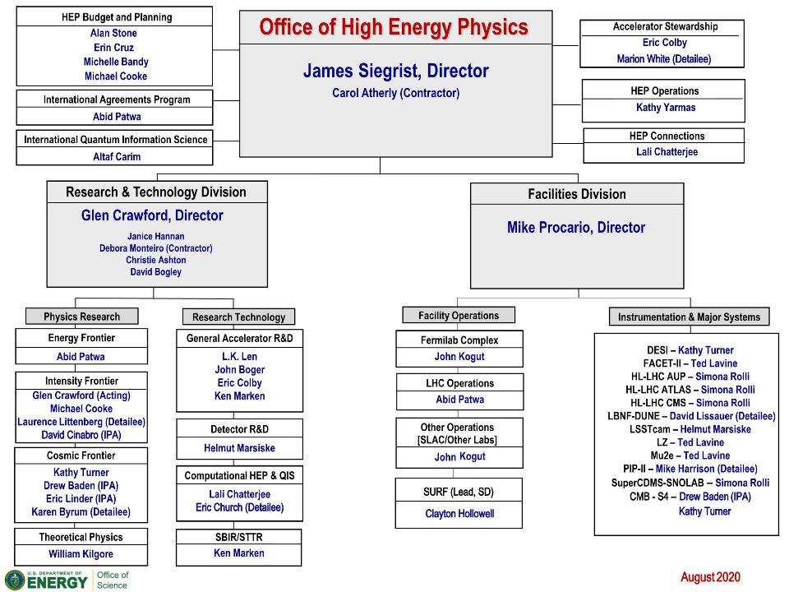

Slide 39





Comings & Goings
Incoming:
  Clayton Hollowell – SURF Program Mgr. (DOE; in Lead, SD) [April 2020]
  Eric Church – Computational HEP & QIS (Detailee, PNNL) [April 2020]
  David Cinabro – Intensity Frontier (IPA, Wayne State) [June 2020]
  Marion White – Accelerator Stewardship (Detailee, ANL) [August, 2020]
Outgoing:
  Bill Wisniewski – LBNF/DUNE (Detailee, SLAC) [April 2020]
DOE Federal Position for HEP Intensity Frontier
  Brian Beckford (currently U. Michigan) will start in late August 2020!
DOE Federal Position for HEP Communications & Strategic Planning
  Anticipate an announcement in the future—all qualified candidates encouraged!
Two AAAS Fellows begin in September 2020
  Focus areas of Strategic Communications and Scientometrics
Always looking for candidates to help with critical tasks
  Interested parties should contact HEP Management!
  Investigating alternate hiring opportunities beyond IPAs and Detailees
Hollowell
Church
Cinabro
Beckford
White

Slide 40
High Energy Physics Advisory Panel https://science.osti.gov/hep/hepap
Jointly chartered since October 2000 by the Department of Energy (DOE) and the National Science Foundation (NSF), HEPAP reports both to DOE’s Office of High Energy Physics and the NSF’s Mathematical & Physical Sciences directorate under the guidelines established by the Federal Advisory Committee Act (FACA) of 1972.
DOE and NSF continue to work together to enhance ongoing U.S. leadership in the three frontiers of high energy physics.
HEPAP’s activities include:
  Periodic reviews of existing high energy physics programs
  Providing advice on the formulation of long-range plans, priorities, and strategies for the nation’s high energy physics program, e.g. P5
  Recommending appropriate levels of funding to assure a world leadership position
  Making recommendations to help maintain appropriate balance between competing elements of the program
Special attention is paid by both NSF and DOE to obtain a diverse membership with a balance of disciplines, interests, experiences, points of view, and geography.
Prof. Alan Bolton
Kansas State University
March 2022
Dr. John Byrd
Argonne National Laboratory
March 2023
Prof. Janet Conrad
Massachusetts Institute of Technology
March 2021
Prof. Rohini Godbole
Indian Institute of Science
March 2021
Prof. Jordan Goodman
University of Maryland
March 2021
Dr. Anna Grassellino
Fermi National Accelerator Laboratory
March 2023
Prof. JoAnne Hewett, Chair
SLAC National Accelerator Laboratory
Prof. Michael Hildreth
Notre Dame University
March 2022
Prof. Kent Irwin
Stanford University
March 2021
Prof. Young-Kee Kim
University of Chicago
March 2021
Prof. Donatella Lucchesi
University of Padova
March 2021
Prof. Rachel Mandelbaum
Carnegie Mellon University
March 2023
Prof. Alysia Marino
University of Colorado
March 2022
Prof. Meenakshi Narain
Brown University
March 2021
Dr. Soren Prestemon
Lawrence Berkeley National Laboratory
March 2022
Dr. Patrizia Rossi
Thomas Jefferson National Accelerator Facility
March 2022
Prof. Mark Wise
California Institute of Technology
March 2023

Slide 41
Grand Challenge: Communicating Results
Scientists typically communicate research results via exclusionary practices:
  Peer-reviewed publications – narrow casting
  Conferences – insular
  Public Media – broad casting, attention grabbing
Stakeholders often overlooked when scientists convey clear research results
  Legislative: House and Senate
  Executive: OMB, OSTP, Funding agencies
  Office of Science
  Advocacy groups
Difficult to read plots: jargon, indecipherable units, key message
Funding -> Experiment -> Data -> Research -> Results -> Dissemination -> Impact -> Next Stage -> Funding
How likely is a Professor working on CMS to understand new neutrino results?
What is the key highlight for Office of Science for budget formulation?
Why does this research require new or additional funding?

Slide 42
FY 2020 HEP Funding in Historical Context
SSC Funding
FY | $M
1987 | 0.0
1988 | 33.0
1989 | 98.1
1990 | 216.9
1991 | 241.5
1992 | 482.6
1993 | 512.9
1994 | 640.0
1995 | 0.0
Adjusting for inflation, based on the Consumer Price Index published by the U.S. Bureau of Labor Statistics, FY 1987 funding 495.4M in FY 2020 dollars is about 1,115M. However, over that period of time, Lab and University cost escalation outpaced CPI…
ARRA Funding
FY | $M
2008 | 0.0
2009 | 236.5
2010 | 0.0
$ in millions
Students at public 4-year institutions paid $1,480 in tuition in 1987 ($3,190 in 2017 adjusted dollars). By 2017, the average tuition cost rose to $9,970.

Slide 43
Historical Chart of HEP Projects
FY 1996 – FY 2020
Current P5
HEP funded $2.0B in projects from FY 1996-2015 (14% of total budget)
HEP funded $1.4B in projects from FY 2016-2020 (30% of total budget)

Slide 44

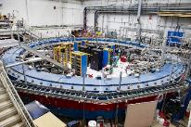
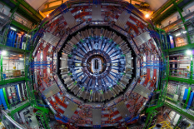
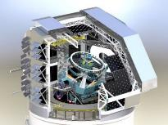
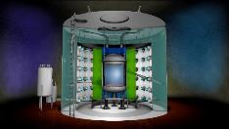
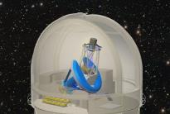
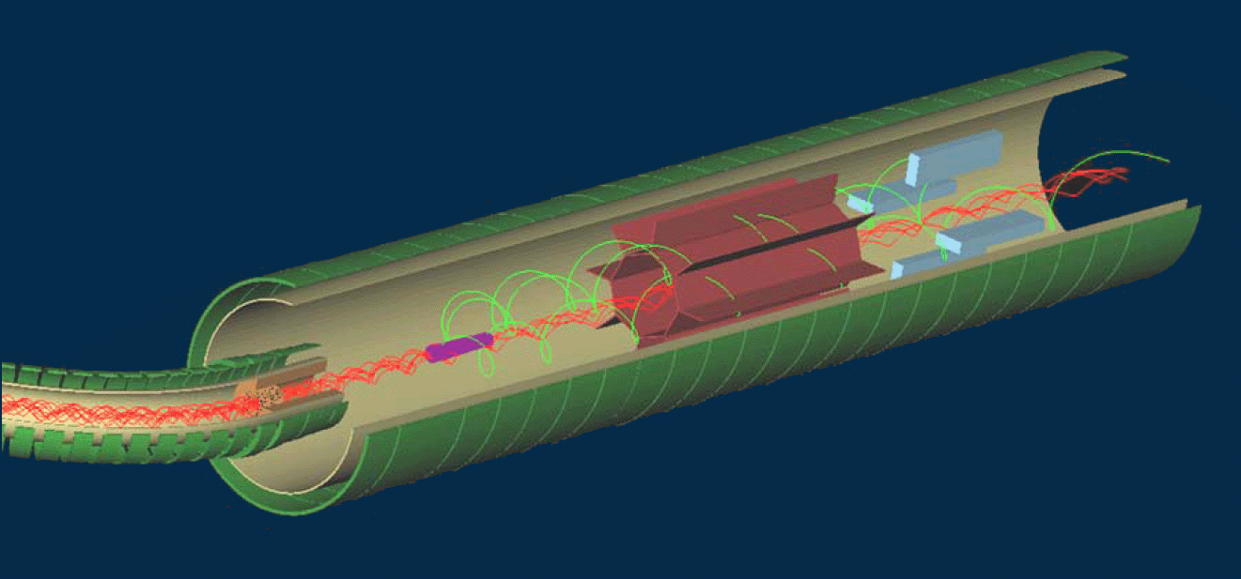
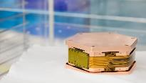
Delivery of Early Science from New Projects
By FY 2020, eight projects recommended by P5 have received final funding
  Muon g-2, CMS Upgrade, ATLAS Upgrade, LSSTcam, Mu2e, LZ, SuperCDMS-SNOLAB, DESI
  DOE Total Project Costs ~ 650M
  (FY 2010-2019)
  Research has been reduced or constrained for a decade while building next generation of instruments for HEP
HEP recognizes the urgency to increase support to Research to ensure efficient, reliable, and high quality physics data taking,
and to augment efforts towards
early & visible science.
  Boost the number of graduate
  students & post-docs
Muon g-2
ATLAS
CMS
LSSTcam
LZ
DESI
Mu2e
SuperCDMS SNOLAB

Slide 45
Quantum Information Science (QIS)
QuantISED Topics
QuantISED Research
Cosmos & Qubits & Foundational HEP-QI-QC
Quantum Computing for HEP Experiment
QIS Based Experiments for P5 Science Drivers
QuantISED Res Technology
Quantum Sensors
Quantum Communications
Quantum Controls, readouts, FPGAs
HEP QIS budget in FY 2020 ($38.5M) supports:
  Multidisciplinary SC Quantum Information Science (QIS) Research
  Centers in support of the National Quantum Initiative
  HEP QIS research program, Quantum Information Science Enabled
  Discovery (QuantISED)
QuantISED topics are aligned to OSTP QIS categories
  QuantISED is coordinated with and reports to SC, DOE, and OSTP
HEP competed QuantISED in FY 2018 & 2019 and seeded
HEP-QIS interdisciplinary research at Labs & Universities
  FY 2020 Lab plan: Consolidate FY 2018-initiated programs for three-
  year efforts through peer-reviewed renewal proposals, totaling
  about $14M/year for three years. The Lab programs engage multiple university collaborators.
  FY 2020 University consortia renewal proposals focused on the subcategories identified in research above; HEP recommended 5 university awards totaling about $3M/year for three years
  We expect FY 2019 awards to apply for renewals next year
The SC QIS PI meeting that was planned for March 2020 has been postponed to 2021 and will include the SC QIS Research Centers (announcements in late August)

Slide 46


HEP Center for Computational Excellence
HEP-CCE
Bridge between the broader HEP community, HPC-oriented HEP research teams, and ASCR expertise and resources
Develop and make available selected HPC tools/capabilities to aid HEP science in coordinated work with ASCR
Current activity focused on projects to study use of ASCR HPC systems, especially near-future exascale resources, for all HEP frontiers
Primary targets are experiments taking data in FY 2020+ (ATLAS, CMB-S4, CMS, DESI, DUNE, LSST DESC)
Current Activities
Two projects started in CY 2020, two will ramp up in
FY 2020-2021
Portable Parallelization Strategies – investigating software portability solutions (Kokkos, SYCL, Alpaka, OpenMP) via a small number of HEP testbeds as example cases for each option
Fine-grained IO and Storage – data representations tuned for HPC storage systems and optimized for HEP IO patterns; optimization of data reads to algorithm consumption requirements, memory mapping optimizations
Event Generation and Complex Workflows
The exascale systems Aurora (Argonne) and Frontier (Oak Ridge) expected in the 2021/22 timeframe; both systems are >1EF, ~10PB system memory, >200PB file systems at ~10TB/s. One cabinet is roughly 10PF; both systems are CPU/GPU (compute dominated by the GPUs)
Notes:
Notes:
As desired

Slide 47
Artificial Intelligence & Machine Learning in SC
The President has placed a high priority on American leadership in the Industries of the Future (IOTF):
  Artificial intelligence (AI), quantum information science (QIS), advanced manufacturing, biotechnology, and 5G/advanced wireless technologies
As part of the AI initiative, the FY 2020 appropriation included $71M in AI funding for Office of Science ($15M for HEP)
  SC has prioritized investments in AI/ML for user facilities focusing on accelerator optimization, control, prognostics, and data analysis
On March 9, 2020, SC released a lab funding announcement on Data, Artificial Intelligence, and Machine Learning at DOE Scientific User Facilities
  The application deadline was May 1, 2020
  The proposals are under review; awards expected to be announced in late August 2020 (to be funded in FY 2021)
  HEP is participating in this lab call with BES and NP

Slide 48
Artificial Intelligence & Machine Learning in HEP
In FY 2020, the $15M for HEP AI/ML will:
  Tackle the challenges of managing increasingly high volumes and complexity of experimental and simulated data across the HEP experimental frontiers, theory, and technology thrusts
  Address cross-cutting challenges across the HEP program in coordination with DOE investments in exascale computing and associated AI efforts
Since AI/ML techniques are already widely used in many areas of HEP, HEP prioritized key AI/ML activities in:
  Ongoing DOE lab research programs
  New & renewal applications under its standard FOAs and lab calls
  Over $3M supported Early Career Research Awards
    5 existing and 4 new

Slide 49

Formulation
FY 20XX Budget | DOE Internal Planning with OMB and OSTP Guidance |  |  |  |  |  |  |  |  |  |  |  | OMB Review |  |  |  | Budget Release | Congressional Budget and Appropriations |  |  |  |  |  |  | Spend the Fiscal Year Budget
 | Oct | Nov | Dec | Jan | Feb | Mar | Apr | May | Jun | Jul | Aug | Sep | Oct | Nov | Dec | Jan | Feb | Mar | Apr | May | Jun | Jul | Aug | Sep | Oct | Nov | Dec | Jan | Feb | Mar | Apr | May | Jun | Jul | Aug | Sep
 | CY(XX–3) |  |  | Calendar Year (20XX–2) |  |  |  |  |  |  |  |  |  |  |  | Calendar Year (20XX–1) |  |  |  |  |  |  |  |  |  |  |  | Calendar Year 20XX

Slide 50
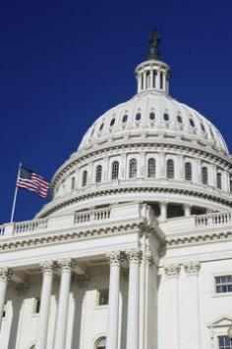

Budget and Accounting Act of 1921
Before the Budgeting & Accounting Act of 1921, no single government entity oversaw the entire budget
  Departments submitted budget requests directly to Congress
After WWI, the Act was passed to provide more control over government expenditures
  Budgeting debates hinge on powers given to Congress and President in this Act
  Restrictions keep either branch from dominating budget decisions
The Act requires the President to submit a budget to Congress every year
The act created:
  Bureau of the Budget (BoB), giving President control over individual departments, evaluating competing requests
  General Accounting Office tells House and Senate what may be necessary to balance the budget
Reorganization Act of 1939 created the Executive Office of the President (EOP), and BoB moved from Treasury to EOP
  In 1970, BoB reorganized by Executive Order (Nixon) as the Office of Management and Budget
  OMB is the largest agency within the EOP

Slide 51
Three Phases of Budget Process
Formulation: Executive branch prepares the President's Budget Request
  White House Office of Management and Budget (OMB) controls this process, providing guidance to Executive branch agencies
Congressional: Enacts laws that control spending and receipts
  Congress considers the President's Budget proposals, passes a budget resolution, and enacts the regular appropriations acts and other laws that control spending and receipts
Execution: Executive branch agencies carry out program
  OMB apportions funds to Executive Branch agencies, which obligate and disperse funding to carry out their programs, projects, and activities
Formulation
Congressional
Execution
FY 20XX Budget | DOE Internal Planning with OMB and OSTP Guidance |  |  |  |  |  |  |  |  |  |  |  | OMB Review |  |  |  | Budget Release | Congressional Budget and Appropriations |  |  |  |  |  |  | Spend the Fiscal Year Budget
 | Oct | Nov | Dec | Jan | Feb | Mar | Apr | May | Jun | Jul | Aug | Sep | Oct | Nov | Dec | Jan | Feb | Mar | Apr | May | Jun | Jul | Aug | Sep | Oct | Nov | Dec | Jan | Feb | Mar | Apr | May | Jun | Jul | Aug | Sep
 | CY(XX–3) |  |  | Calendar Year (20XX–2) |  |  |  |  |  |  |  |  |  |  |  | Calendar Year (20XX–1) |  |  |  |  |  |  |  |  |  |  |  | Calendar Year 20XX

Slide 52
The U.S. Federal Budget Cycle
Typically, three budgets are being worked on at any given time
  Executing current Fiscal Year (FY; October 1 – September 30)
  OMB review and Congressional Appropriation for upcoming FY
  Agency internal planning for the second FY from now
FY 2020 Budget | Spend the Fiscal Year Budget
FY 2021 Budget | OMB Review |  |  |  | Budget Release | Congressional Budget and Appropriations |  |  |  |  |  |  | Spend the Fiscal Year Budget
FY 2022 Budget | DOE Internal Planning with OMB and OSTP Guidance |  |  |  |  |  |  |  |  |  |  |  | OMB Review |  |  |  | Budget Release | Congressional Budget and Appropriations |  |  |  |  |  |  | Spend the Fiscal Year Budget
 | Oct | Nov | Dec | Jan | Feb | Mar | Apr | May | Jun | Jul | Aug | Sep | Oct | Nov | Dec | Jan | Feb | Mar | Apr | May | Jun | Jul | Aug | Sep | Oct | Nov | Dec | Jan | Feb | Mar | Apr | May | Jun | Jul | Aug | Sep
 | CY 2019 |  |  | Calendar Year 2020 |  |  |  |  |  |  |  |  |  |  |  | Calendar Year 2021 |  |  |  |  |  |  |  |  |  |  |  | Calendar Year 2022
You are here

Slide 53








Overview of Budget Formulation Process
OMB provides policy guidance for Executive branch agency budget requests
  Absent more specific guidance, agencies start with outyear estimates from previous budget
OMB works with agencies
  Identify major issues, develop plans for fall review, plan analysis of issues that will require decisions
OMB provides detailed instructions for submitting budget material
Agencies submit budgets to OMB
OMB reviews budget proposals
  Considers Presidential priorities, program performance, budget constraints
OMB provides recommended budget proposal to President and provides passback to agencies
Agencies may appeal to OMB and the President
Agencies prepare and OMB reviews final congressional budget justification materials
February: President transmits budget to Congress
Spring
Spring & Summer
June
Sept.
Fall
Late Nov.
Dec.
Jan.
…

Slide 54



Creating the DOE HEP Budget Request
White House
“Thread the needle”
White House Priorities
OMB Directives
Top-down and bottom-up influences to the DOE HEP budget
Advisory Panels (HEPAP, AAAC)
Community-driven Strategic Plans (P5)
Review Committee & Workshop Reports
Project Performance
DOE/SC Management
DOE/HEP Program
Particle Physics Community
Department of Energy

Slide 55
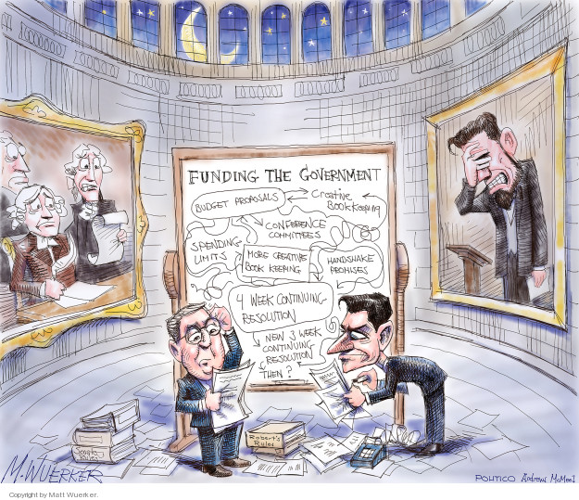
Congressional
FY 20XX Budget | DOE Internal Planning with OMB and OSTP Guidance |  |  |  |  |  |  |  |  |  |  |  | OMB Review |  |  |  | Budget Release | Congressional Budget and Appropriations |  |  |  |  |  |  | Spend the Fiscal Year Budget
 | Oct | Nov | Dec | Jan | Feb | Mar | Apr | May | Jun | Jul | Aug | Sep | Oct | Nov | Dec | Jan | Feb | Mar | Apr | May | Jun | Jul | Aug | Sep | Oct | Nov | Dec | Jan | Feb | Mar | Apr | May | Jun | Jul | Aug | Sep
 | CY(XX–3) |  |  | Calendar Year (20XX–2) |  |  |  |  |  |  |  |  |  |  |  | Calendar Year (20XX–1) |  |  |  |  |  |  |  |  |  |  |  | Calendar Year 20XX

Slide 56
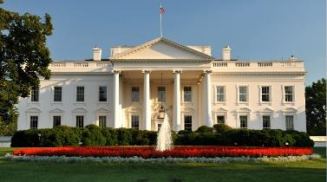

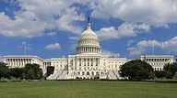
Congressional Budget and Impoundment Control Act of 1974 [aka CBA]
Prior to 1974, Congress had no formal process for establishing a federal budget. The Act was passed in response to feelings in Congress that President Nixon was abusing his power of impoundment by withholding funding of programs he opposed.
CBA created the Congressional Budget Office (CBO), which gained more control of the budget, limiting the power of the OMB.
Established timetable for the budget process, and Committees on the Budget in the House and Senate
The Act passed easily while the administration was embroiled in the Watergate scandal and was unwilling to provoke Congress.
On or Before: | Action to be completed:
1st Mon. in Feb. | President submits his budget
<6 weeks after PBR submitted | Committees submit views and estimates to Budget Committees
April 15 | Congress completes action on the concurrent resolution on the budget
May 15 | Annual appropriation bills may be considered in House
June 10 | House Appropriations Committee reports last annual appropriation bill
June 15 | Congress completes reconciliation
June 30 | House completes action on bills
October 1 | Fiscal year begins

Slide 57
Congressional Budget Process
Budget Resolution
  Overall appropriation committee sets each subcommittee’s allocation of spending authority for the next fiscal year and aggregate spending and revenue levels for 5 years
Authorization legislation
  May create or continue agencies, programs, or activities as well as authorize and recommend funding levels for the subsequent enactment of appropriations
Appropriation bills (must originate in House)
  12 bills define discretionary spending and provide the funding for authorized agencies, programs, or activities
President Submits Budget Request
1st Monday in February
House & Senate Markup Appropriations Bills
May
House & Senate Reconcile Appropriations Bills
June
House & Senate Pass Budget Resolutions
April
House & Senate Vote on Appropriations Bills
June
President Signs Appropriations Bills

Slide 58
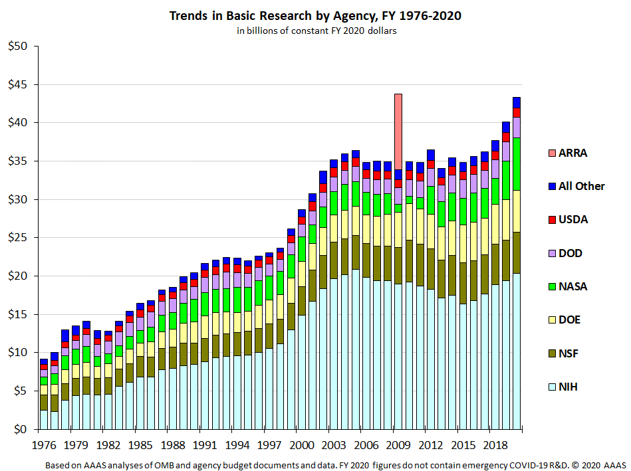
Appropriations Subcommittees
Agriculture, Rural Development,
Food and Drug Administration,
and Related Agencies
Commerce, Justice, Science,
and Related Agencies
  NASA and NSF
Defense
Energy & Water Development
  Department of Energy
Financial Services and General
Government
Homeland Security
Interior, Environment, and Related Agencies
  Specific portions of Department of Health and Human Services
Labor, Health and Human Services, Education, and Related Agencies
  Department of Health and Human Services (with above exceptions)
Legislative Branch
Military Construction, Veterans Affairs, and Related Agencies
State, Foreign Operations, and Related Programs
Transportation, Housing and Urban Development, and Related Agencies

Slide 59
Authorizations and Appropriations
Basic Purposes of Authorization
  Establish/continue/modify federal programs
  Provide Congress budget authority and guidance for appropriations
Direct or Mandatory Spending
  Mandatory spending is done automatically based on eligibility or formula, includes entitlement programs like Medicare and Social Security
  Authorization must change to reduce funding; not part of annual appropriation process
Annual Appropriations
  Discretionary spending determined by appropriations process, includes National defense, food safety, education, and science research
  Provided in 12 appropriation acts, it is less than 1/3 of current federal expenditures
Renewing Authorizations
  Reauthorization can extend a program
  Unless prohibited, new appropriations may also extend a program

Slide 60
HEP Role in Congressional Process
The budget narrative provides the justification for the level of support in the President’s Budget Request
  Narrative provides overview of the HEP program, highlights
  from the past year, and discussion of:
    Line Item Construction, Major Items of Equipment, New Initiatives or New Starts, Facilities Operations, and Research program priorities
  Detailed funding of Budget Request vs. Prior Year Request (or Enacted)
  “Explanation of Changes”
    Additional scope of work (Increase) or Emphasis/Focus/Priority (Decrease)
    Focus on what can be done, with priorities
Agencies usually invited to brief Congress on budget request
  Opportunity to reinforce overall strategy. Highlight key elements of request
    Congress must individually approve each DOE project >$5M
  Informational request for additional detail
  Respond to requests regarding impact of alternative funding decisions

Slide 61
Impacts of a Continuing Resolution
If the U.S. Congress and the President have not passed all appropriations bills by September 30, a Continuing Resolution (CR) may be passed to avoid a U.S. Government shutdown
  Must pass some level of appropriations to have legal authority to spend money!
  CRs typically extend level of funding from the previous year for a set amount of time with no significant programmatic changes (a.k.a. “no new starts”)
Therefore, a CR may impede the start of new projects
  Projects with total cost >$5M must be approved by Congress in an appropriations bill before funding can begin
  It is possible, though not typical, for CRs to include “anomalies” that would allow new starts
A CR may also impact the ramp-up of new projects
  DOE is committed to the successful execution of projects that have reached
  CD-2 and aims to provide the baseline funding profile
  Projects that have not reached CD-2 are most likely to be impacted under a CR
A CR may also impact future-year planning…

Slide 62
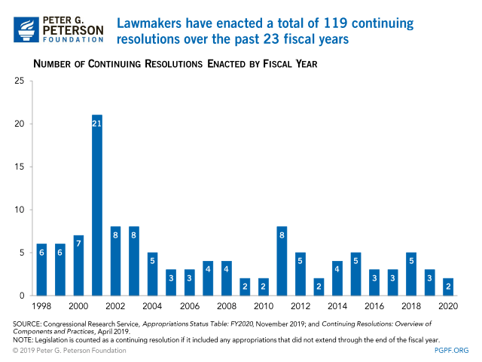
Number of Continuing Resolutions:
FY 1999 – FY 2020
Between fiscal year 1977 and fiscal year 2018, Congress only passed all twelve regular appropriations bills on time in four years - fiscal years 1977, 1989, 1995, and 1997.
In fiscal years 2007, 2013, and 2014, Congress enacted an extended CR to provide funding for the remainder of the fiscal year, e.g. full-year CR, (not included in the total number).

Slide 63

Execution
FY 20XX Budget | DOE Internal Planning with OMB and OSTP Guidance |  |  |  |  |  |  |  |  |  |  |  | OMB Review |  |  |  | Budget Release | Congressional Budget and Appropriations |  |  |  |  |  |  | Spend the Fiscal Year Budget
 | Oct | Nov | Dec | Jan | Feb | Mar | Apr | May | Jun | Jul | Aug | Sep | Oct | Nov | Dec | Jan | Feb | Mar | Apr | May | Jun | Jul | Aug | Sep | Oct | Nov | Dec | Jan | Feb | Mar | Apr | May | Jun | Jul | Aug | Sep
 | CY(XX–3) |  |  | Calendar Year (20XX–2) |  |  |  |  |  |  |  |  |  |  |  | Calendar Year (20XX–1) |  |  |  |  |  |  |  |  |  |  |  | Calendar Year 20XX

Slide 64
Budget Execution
Start from the general plan laid out in budget formulation, modified by the actual appropriation, taking into account:
  Strategic plan for program (P5, AAAC Decadal Survey)
  Available funding vehicles (Grants, Contracts, Cooperative Agreement)
  Stewardship of DOE National Laboratories (SC User Facilities)
  Support for Projects
  Coordination with partners (International, Other Federal, Universities)
  Diversity, Equity, Inclusion.
    https://science.osti.gov/-/media/ascr/ascac/pdf/meetings/201909/JCarruthers_ASCAC_201909.pdf
Note that it typically takes some time to translate Congressional Appropriation into detailed agency-level budgets:
  Appropriations bills are long and detailed
  If in a CR, have to resolve current spending level versus final Appropriation
  There may be “rescissions” and/or recovery of prior year balances
  Occasionally there are internal contradictions or errors
  Agency CFOs have to resolve all this and get agreement with OMB before issuing current FY “allotments” of budget authority > 2-3 months

Slide 65

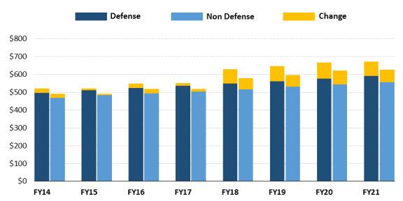
Bipartisan Budget Act of 2019 (H.R. 3877)
Signed on August 2, 2019, includes Budget Resolutions for FY 2020 and FY 2021
The bill raises the 2011 Budget Control Act (BCA) budget caps for both defense and nondefense for FY 2020 and FY 2021, the final 2 years of the discretionary caps.
The bill also suspends the debt ceiling through July 31, 2021 and extends cuts on certain mandatory programs from FY 2027 to FY 2029.

Slide 66
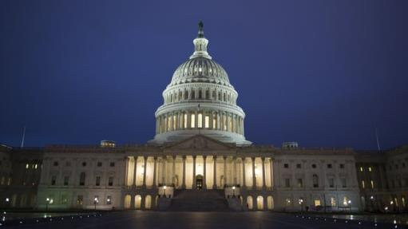
FY 2020 Two CRs and an Appropriations
H.R. 4378: Continuing
Appropriations Act, 2020, and
Health Extenders Act of 2019
Sep 27, 2019: President Trump signed a 7-week continuing resolution into law, delaying the possibility of another government shutdown
  CR#1 funded agencies at 2019 levels through Nov. 21
Nov 21, 2019: President Trump signs H.R. 3055, giving lawmakers more time to set spending levels and pass the 12 appropriations bills
  CR #2 funded agencies at 2019 levels through Dec.20
On December 20, President Trump signed into law H.R. 1158: Consolidated Appropriations Act, 2020 and H.R. 1865: Consolidated Domestic and International Assistance Bill, setting overall spending levels for federal agencies through September 30, 2020

Slide 67
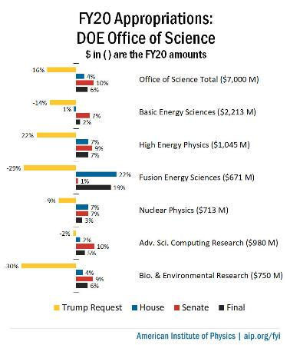
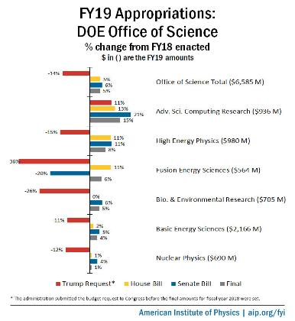


FY 2019 vs FY 2020 Office of Science
HEP increase of +7% from 980M in FY 2019 to 1045M in FY 2020
Strong support in QIS and Artificial intelligence Research
Increased construction funding for LBNF/DUNE and PIP-II. Strong support for HL-LHC projects.
Increased support for Sanford Underground Research Facility
HEP increase of +8% from 908M in FY 2018 to 980M in FY 2019
All projects were addressed at their baseline levels. Five projects receive final planned funding:
  Mu2e, LZ, DESI, SuperCDMS-SNOLAB, and FACET-II

Slide 68
FY 2020 HEP Appropriation
HEP Funding Category ($ in K) | FY 2018 Actual | FY 2019 Actual | FY 2020 Appropriation | FY 2020 Appropriation - FY 2019 Actual
Research | 359,177 | 384,286 | 389,577 | +5,291
Facilities/Operations | 270,488 | 258,364 | 317,929 | +59,565
Projects | 278,335 | 337,350 | 337,494 | +144
Total | 908,000 | 980,000 | 1,045,000 | +65,000
FY 2020 Appropriations supports the SC and P5 priorities
  SC: Interagency and international partnerships, national laboratories, R&D initiatives
  P5: preserve vision, modify execution
FY 2020 HEP Budget continues support for P5-guided investments in mid- and long-term program
  “Building for Discovery” by supporting P5 projects to enable future program
  Research support advances P5 science drivers and world-leading, long-term R&D in Advanced Technology, Accelerator Stewardship, Quantum Information Science, and Artificial Intelligence & Machine Learning
  Operations support enables world-class research at HEP User Facilities:
    Fermilab Accelerator Complex, Brookhaven Accelerator Test Facility (ATF), SLAC Facility for Advanced Accelerator Experimental Tests (FACET)

Slide 69
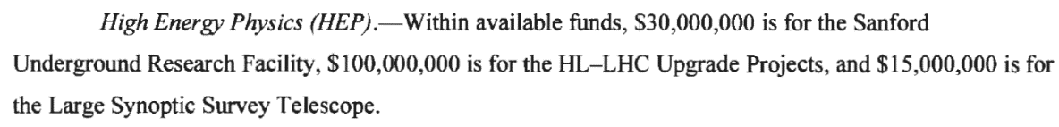
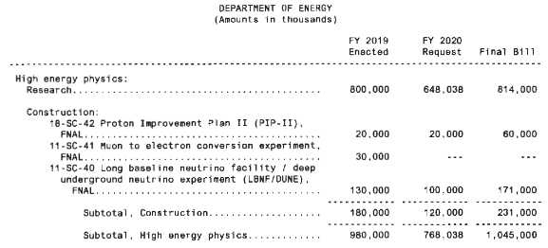
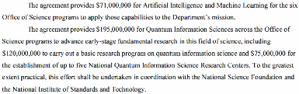
Report Language Matters!
Congress will usually specify top-line budget for a program and sometimes direct specific project or subprogram budget levels
  It is up to program management to make things work “within available funds”
Example: HEP received $1,045M in the FY 2020 Congressional Appropriation, about $277M above the FY 2020 President’s Budget Request
  Congressional “Research” line includes everything other than Line Item Construction, or what HEP traditionally calls Research, Operations, and Projects
  Congressional direction included specific amounts for Line Item Construction, Projects, Vera C. Rubin Observatory, and SURF; HEP cannot adjust what is spent on those items
Congressional directional at the SC level for QIS and AI/ML propagated down to HEP

Slide 70
Funding: Projects (FY2019) Transition to Operations (FY 2020)
 | Project | FY 2019 Actual | FY 2020 Appropriation | FY 2020 Appropriation - FY 2019 Actual
Major Item of Equipment (MIE) and Other Project Costs (OPC) | LBNF/DUNE OPC | 1,000 | 4,000 | +3,000
 | PIP-II OPC | 15,000 | 494 | -14,506
 | HL-LHC ATLAS | 27,500 | 24,500 | -3,000
 | HL-LHC CMS | 27,500 | 23,475 | -4,025
 | HL-LHC AUP | 50,000 | 52,025 | +2,025
 | LZ | 14,450 | 0 | -14,450
 | SuperCDMS-SNOLAB | 2,550 | 0 | -2,550
 | DESI | 9,350 | 0 | -9,350
 | FACET II | 10,000 | 0 | -10,000
 | CMB-S4 (OPC) | 0 | 2,000 | +2,000
 | MIE Subtotal | 157,350 | 106,494 | -50,856
Line Item Construction (LIC) | LBNF/DUNE | 130,000 | 171,000 | +41,000
 | PIP-II | 20,000 | 60,000 | +40,000
 | Mu2e | 30,000 | 0 | -30,000
 | LIC Subtotal | 180,000 | 231,000 | +51,000
 | Project Total | 337,350 | 337,494 | +144
Net reduction from FY 2019 to FY 2020 for MIEs and LIC OPC was about $50M, which was redirected to Facilities/Operations: Cosmic Frontier (DESI, LZ, Vera Rubin), Fermilab Accelerator Complex, FACET-II, SURF, and Test Facilities.

Slide 71
FY 2020 Funding by Subprogram
HEP Funding Category ($ in K) | FY 2018 Actual | FY 2019 Actual | FY 2020 Appropriation | FY 2020 Appropriation - FY 2019 Actual
Energy Frontier | 183,219 | 235,403 | 229,666 | -5,737
Intensity Frontier | 247,048 | 247,256 | 251,666 | +4,410
Cosmic Frontier | 119,630 | 105,084 | 95,858 | -9,226
Theoretical, Computational, and Interdisciplinary Physics* | 76,176 | 87,043 | 112,560 | +25,517
Advanced Technology R&D* | 125,643 | 109,190 | 107,711 | -1,479
Accelerator Stewardship* | 15,885 | 16,024 | 16,539 | +515
Construction (Line Item) | 140,400 | 180,000 | 231,000 | +51,000
Total | 908,000 | 980,000 | 1,045,000 | +65,000
* Includes reserve funds pending final decision. Funding levels may change.
Energy: -5M HL-LHC Projects
Intensity: -14.5M PIP-II OPC; +3M DUNE OPC; Fermilab Acc Complex ramps up
Cosmic: -26.35M DESI, LZ, and SuperCDMS-SNOLAB projects; +2M CMB; Operations ramps up +20.4M
Theory, Computational, and Interdisciplinary: +11M QIS; +10M AI/ML; +2.5M LQCD
Advanced Technology: -10M FACET-II SLAC; Operations ramps up

Slide 72
HEP Budget ($k) FY 2011-2020
Research, Operations, Projects: (Construction and MIEs)

Slide 73
HEP Budget ($k) FY 2011-2020
(excluding Line Item Construction TEC)
High Energy Physics | FY 2011 | FY 2012 | FY 2013 | FY 2014 | FY 2015 | FY 2016 | FY 2017 | FY 2018 | FY 2019 | FY 2020
Research | 408,360 | 391,329 | 361,766 | 360,932 | 334,225 | 320,816 | 321,892 | 334,750 | 356,752 | 364181
SBIR/STTR | 19,842 | 20,327 | 20,791 | 21,601 | 20,768 | 20,847 | 22,151 | 24,427 | 24,095 | 25396
Facilities/Ops | 264,389 | 249,241 | 265,123 | 278,683 | 264,634 | 258,236 | 258,696 | 270,488 | 260,803 | 317929
Projects (excl LIC TEC) | 102829 | 101963 | 88853 | 84305 | 109373 | 129001 | 128761 | 137935 | 158350 | 106494
Total | 795,420 | 762,860 | 736,533 | 745,521 | 729,000 | 728,900 | 731,500 | 767,600 | 800,000 | 814,000

Slide 74
HEP Facilities/Operations ($k) FY 2011-2020
MIE Transition to Experimental Ops:
DESI, LZ, LSSTCam & Vera Rubin Observatory, and SuperCDMS-SNOLAB.
SURF refurbishment.
Increase to SC User Facilities:
Fermilab Acc. Complex, BNL ATF, SLAC FACET-II

Slide 75
HEP Research ($k) FY 2011-2020
-87M
FY11 to FY16 for Research
MIEs
+56M from FY11 ($103M) to FY16
($159M)
LICs
+66M from FY11 ($0) to FY16
($66M)
Research Growth
Driven by QIS and AI/ML

Slide 76
HEP Research ($k) FY 2014-2020
+48.5M
FY17 to FY20
QIS +38.5M
AI/ML
+10M

Slide 77
Procurement Requests (aka Grants)
Awards are fixed once made
  Funding cycle of 1-5 years
  Funding adjustments (downward) are possible if circumstances change
  Changes are also possible through submission of supplementary proposals
Continuations
  About half of HEP’s PRs are continuations, providing > 50% total grand funding
  Progress reports can be submitted as soon as PIs get the PAMS notification in early December (two weeks!)
Early submission will help ensure on-time processing by HEP and SC of continuation funding before the end of the grant budget period (March 31, 202X or later).
Office of High Energy Physics | # of Procurement Requests |  | Funds Awarded
 | FY 2018 | FY 2019 | FY 2018 | FY 2019
Total | 347 | 364 | $126,857,897.03 | $121,820,365.80
Award Revision | 5 | 8 | -$116,531.97 | -$200,950.29
Continuation | 155 | 180 | $72,350,000.00 | $71,705,000.00
New | 91 | 55 | $26,363,429.00 | $17,263,816.09
No Cost Extension | 48 | 58 | $0.00 | $0.00
Renewal | 36 | 56 | $26,210,000.00 | $32,635,500.00
Supplemental | 12 | 7 | $2,051,000.00 | $417,000.00

Slide 78
Lab Funding ($k) – FY 2017-2019
 | FY 2017 Actual | FY 2018 Actual | FY 2019 Actual
Research | 217,892 | 213,454 | 230,489
Facilities/Operations | 250,611 | 260,761 | 261,188
Projects | 218,586 | 278,335 | 337,350
Total | 687,089 | 752,550 | 829,027

Slide 79
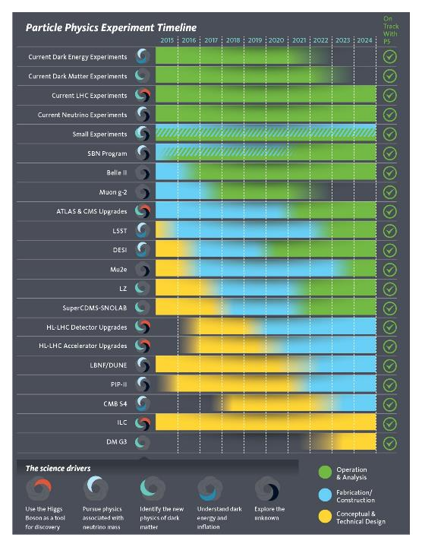
P5 Implementation Status – FY 2019
All Projects on budget & schedule
Projects fully funded as of FY19
  Muon g-2: 1st beam 2017
  LHC detector upgrades: on track for 2019/20 installation
  DESI: 1st light 2019
  DM-G2 (superCDMS & LZ): 1st data 2020
  Mu2e : 1st data in 2023
  LSST: full science operations 2023
HL-LHC accelerator and detector upgrades started on schedule
LBNF/DUNE & PIP-II schedules advanced due to strong support by Administration & Congress
CMB S4: developing technically-driven schedule to inform agencies, NAS Astro 2020 Decadal Survey
DM-G3: R&D limited while fabricating G2
ILC: cost reduction R&D while waiting for decision from Japan
Broad portfolio of small projects running

Slide 80
HEP Small Projects
Several new small HEP projects were initiated in FY 2020:
  T2K upgrade
  NA61 upgrade
  Dark Matter New Initiatives (R&D awards) for LDMX and TESSERACT
  Sector 30 beamline AIP Phase I at SLAC
“Small” projects currently HEP-supported (incl. new since P5):
Intensity Frontier
ANNIE
COHERENT
Heavy Photon Search
KOTO
LArIAT
NA61 Upgrade
PROSPECT
SBN Program
WATCHMAN
T2K Upgrade
Cosmic Frontier
ADMX-G2
eBOSS
HAWC
SuperCDMS-SNOLAB
SPT-3G
Dark Matter New Initiatives
  ADMX Extended (2-4GHz)
  OSCURA (Skipper CCD detector)
  DM-Radio axion search
  TESSERACT (Multiple detectors, w/TES readout)
  Beam Dump exp at LANL
  Light Dark Matter Experiment (LDMX)

Slide 81
Research Funding Challenges
Most of the recent HEP budget growth is in Projects, without similar increases in Operations and Research
  HEP-style Projects depend heavily on Research and Ops support for R&D, QA/QC, integration, installation, and commissioning
  Given that there is a lot of current Research and Ops effort committed to active experiments, this is not optimal for successful project execution
  Balancing Research and Ops with the needs of current and future projects will require careful prioritization
This is a complex interlocking problem with many contributing factors
  Cannot simply “trim the big projects” (or other “simple” solutions) without having impacts elsewhere
  HEP Program Managers work on this ~every day

Slide 82
Compounding Effects of Success
A number of smaller issues have created a cumulative effect that impacts the Core Research program
  Cost of doing business has increased significantly, year by year, reducing the buying power of research dollars
  The University Research community has grown, which adds more competitors to the pool for comparative review
  Research efforts necessary to support P5 projects are increasing due to the size, sensitivity, and complexity compared to previous generations
  SC Initiatives focuses increasing resources into QIS, AI/ML, Microelectronics
  Operations costs necessary for experiments are increasing as P5 projects are successfully completing and starting to take data
  Additional investments in S&T infrastructure are necessary to increase capacity, efficiency, and support larger user community
These effects are tied to the high level of support received through appropriations based on the very successful execution of the P5 strategy so far

Slide 83
FY 2020 Budget Review Takeaways
(Research Only)
P5 has been wildly successful, and we will need plenty of new (mid- to large-scale) ideas, to prepare for the next long-term strategic plan
  Future Energy Frontier Colliders and Detectors
  Underground HEP Science
  Next-generation Dark Energy and Dark Matter experiments
  PIP-II/Booster Upgrade (non LBNF) program
  Technology R&D demonstrators
  Leverage non-HEP facilities and accelerators
However… within core Research, resources for R&D will continue to be constrained for the next several years as we deliver on P5 projects, operations, and research
  Need to leverage all available other sources (LDRD, US-Japan, QIS, non-DOE, Early Career, University Start-up, AI/ML, WDTS, EPSCoR, etc.)
Basic Research Needs (BRN) Workshop and the resulting report may provide compelling justification for new funding
  Invest in Adv. Tech R&D, Theory, QIS, AI/ML, Crosscuts (SC, Private Sector, etc.)
  Recent BRNs: Accelerator (Compact Sources), Dark Matter (HEP) and Microelectronics (BES), Detector R&D (HEP)
Continuous pipeline of new initiatives (20M+/3-5 years) for FY 2022 and beyond. Understanding these investments will take 3-5 years for initial outcomes
  Addresses the priorities of the Administration, DOE and Office of Science
  Builds R&D by distinct thrusts or consortiums (Comparative Review/Detector R&D)

Slide 84

FY 2021 President’s Budget Request

Slide 85
FY 2021 HEP Budget Request
HEP Funding Category ($ in K) | FY 2019 Actual | FY 2020 Enacted | FY 2021 Request | FY 2021 vs. FY 2020
Research | 372,629 | 390,077 | 328,903 | -61,171
Facilities/Operations | 266,556 | 316,429 | 285,725 | -30,704
Projects | 340,815 | 338,494 | 818,131 | -134,994
Total | 980,000 | 1,045,000 | 818,131 | -226,869
FY 2021 President’s Budget Request is overlay of Administration, SC, P5 priorities
  SC: interagency partnerships, national laboratories, accelerator R&D, QIS, AI/ML
  HEP: continue successful P5 execution, advance Administration and DOE/SC initiatives
FY 2021 HEP Budget continues support for P5-guided investments
  Research: Continue U.S. leadership in LHC, muon experiments, international neutrino experiments at Fermilab, dark matter, dark energy, and vibrant theory program; QIS; AI/ML; Microelectronics centers (with ASCR, BES, and FES); Strategic Accelerator Technology Initiative; Traineeships in accelerator science
  Operations: Support HEP user facilities and running P5-recommended experiments
  Line Item Construction and Projects: HL-LHC Accelerator and ATLAS & CMS Detectors, LBNF/DUNE, PIP-II, new MIE start for CMB-S4

Slide 86
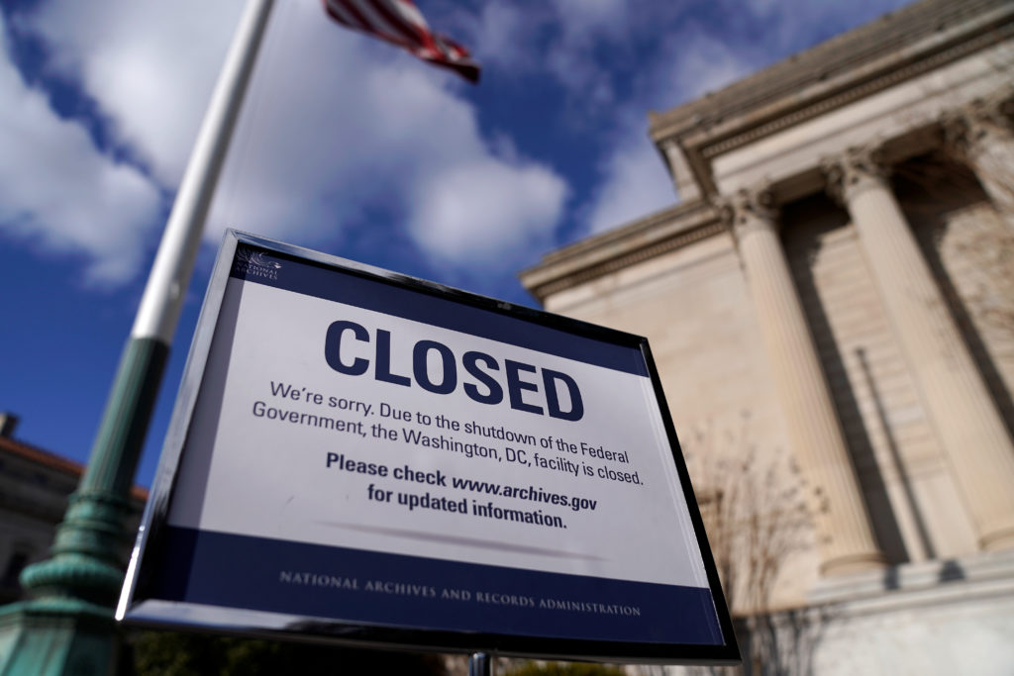

Slide 87
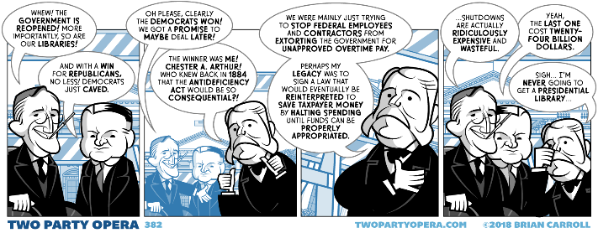
Antideficiency Act (ADA) of 1884
Current version enacted on September 12, 1982
It shall not be lawful for any department of the government to expend in any one fiscal year any sum in excess of appropriations made by Congress for that fiscal year, or to involve the government in any contract for the future payment of money in excess of such appropriations
ADA has its roots in post-Civil War.
  Many agencies, particularly the military, would intentionally run out of money, obligating Congress to provide additional funds to avoid breaching contracts.
  Some agencies went so far as to spend their entire budget in the first few months of the fiscal year, funding the rest of the year after the fact with additional appropriations from Congress.
To some extent, but not entirely, it implements the provisions of Article One of the United States Constitution, Section 9, Clause 7 (the "power of the purse"): "No money shall be drawn from the treasury, but in consequence of appropriations made by law."
The Government Accountability Office, inspectors general, and individual agencies investigate potential violations of the ADA every year. The act has ramifications for agencies and individual employees alike.
  Although no one has ever been convicted or indicted for ADA violation, punitive administrative actions are routinely taken against government employees.
The ADA is cited as the reason for a government shutdown when Congress misses a deadline for passing an interim or full-year appropriations bill.

Slide 88
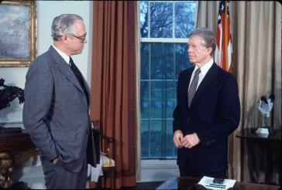
Government Shutdown
Until 1980, there was no such thing as a “government shutdown.” When presidents didn’t have cash, they spent on credit. If Congress failed to pass a budget on time, federal agencies just carried on with work until appropriated funding was authorized retroactively.
Benjamin Civiletti, Pres. Carter’s attorney general, was asked for a legal opinion on what exactly the federal bureaucracy is supposed to do when Congress doesn’t pass a budget by deadline, as they did every fiscal year of Pres. Carter’s presidency.
On April 25, 1980, he wrote to Pres. Carter “My Dear Mr. President; It is my opinion that, during periods of ‘lapsed appropriations,’ no funds may be expended except as necessary to bring about the orderly termination of an agency’s functions.”
  Expenditure of additional funds without congressional approval would violate the Antideficiency Act
The law’s language was “plain and unambiguous,” and that it barred agencies from “incurring pay obligations once its authority to expend appropriations lapses.” The only legitimate use for funds once a budget deadline has passed is to facilitate an “orderly termination”, the reason federal employees get to go into work for a few hours to batten down the proverbial hatches on the first day of a shutdown.
In a second legal opinion on the matter, Civiletti carved out exemptions to his austere, “either exists or it does not” rule. The Executive has the constitutional “leeway to perform essential functions and make the government ‘workable’”—this is the reason “essential” air traffic controllers still go to work while most of “nonessential” NASA stays home.

Slide 89
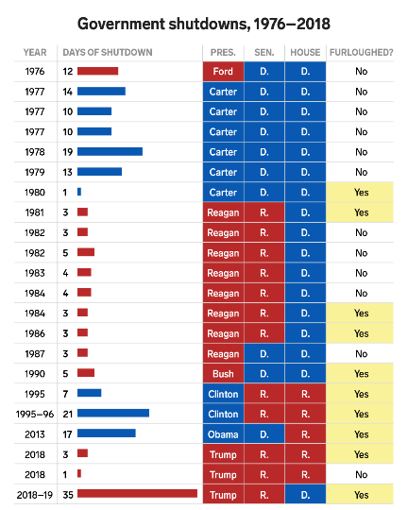
How Many Times Has the
Government Shutdown?
Since the passage of the Congressional Budget and Impoundment Act of 1974, there have been 22 gaps in budget funding
Before 1980, the government did not shut down but rather continued normal operations through six funding gaps.
Since 1981, ten funding gaps of three days or less have occurred, mostly over a weekend when government operations were only minimally affected.
There have been 4 “true” shutdowns where operations were affected for more than one business day.
The first two happened in the winter of 1995-1996, when President Bill Clinton and the Republican Congress were unable to agree on spending levels and shut down the government twice, for a total of 26 days.
The third was in 2013 when the House and Senate standoff on funding the Affordable Care Act resulted in a 16-day shutdown.
The fourth (partial) shutdown, starting Dec 22, 2018 and lasted 35 days, centered on a dispute over border wall funding.

Slide 91
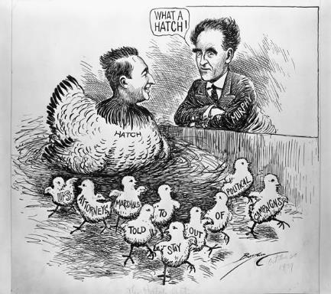
Hatch Act of 1939
The Hatch Act, officially, An Act to Prevent Pernicious Political Activities, is a United States federal law, enacted by Congress in 1939. The main provision prohibits employees in the executive branch of the federal government, except the president, vice-president, and certain designated high-level officials, from engaging in some forms of political activity.
Sen. Carl Hatch, D-N.M., introduced the act after learning that New Deal–era government programs, specifically the Works Progress Administration, were using federal funds overtly to support Democratic Party candidates in the 1938 elections.
The law was an attempt to regulate corruption and possible intimidation of federal employees in the civil service by their elected supervisors. The act banned the use of federal funds for electoral purposes and forbade federal officials from coercing political support with the promise of public jobs or funds.
Executive branch federal employees are still forbidden to use their authority to affect the results of an election.
    Use official authority or influence to interfere with an election
    Solicit or discourage political activity of anyone with business before their agency
    Engage in political activity while: on duty, in a government office, wearing an official uniform, or using a government vehicle

Slide 92
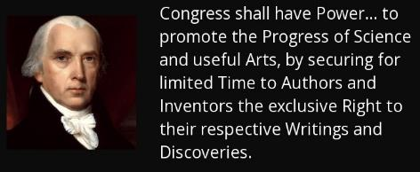
Federal Support of Science and Engineering
The Founders understood the importance
of science and technology in the long-term
future of the United States. Without science
and engineering advancement, in the face of
advancement by others, the US could not compete with ideological and economic challengers.
Scientific and technological advancement funded by the Federal Government has a strong constitutional foundation in the Preamble’s mandated promotion of the “common Defence and general Welfare.” Congress enumerated powers in Article I, Section 8. Implementation of those powers requires federal involvement in science and engineering research, for example:
  Clause 5 – fixing of “the Standard of Weights and Measures.”
  Clause 6 – detection and prevention “of counterfeiting.”
  Clause 7 – establishment and implied improvement of “post Roads” and, by logical extension, more modern means of delivering communications.
  Clause 8 – evaluation of “Discoveries” in “Science and the useful Arts” for the purpose of “securing…exclusive rights” for “Inventors.”
  Clause 12 and 13 – “support” of “Armies” and maintenance of “a Navy” and, by logical extension, future forces necessary to the “common Defence.”
  Clause 15 and 16 – support of the “Militia” and their use to “repel Invasions.”
  Clause 18 gives Congress the power “to make all laws necessary and proper for carrying into Execution the foregoing Powers, and all other Powers vested by this Constitution in the Government of the United States, or in any Department or Officer thereof.”

Slide 93
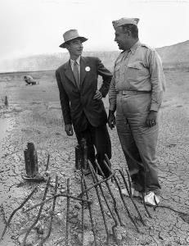
Science Policy and the Constitution
Under Clause 2 of Article II, Section 2, Presidents have the power to appoint “…by and with Advice and Consent of the Senate…all other Officers of the United States…whose Appointments… shall be established by Law…” including individuals responsible for federally supported research in science and technology
The President has significant discretion in assigning science and technology research duties to federal Departments and Agencies so long as Congress can constitutionally fund their implementation.
Since the nation’s founding, federally supported or managed big science and engineering efforts have contributed to national defense or to treaty enforcement.
  Canals, locks, dams, and levees beginning in the early 1800s;
  Agricultural research through Land Grant academic
  institutions (1860s and 1890s);
  Transcontinental Railroad in the late 1860s;
  Aeronautical research that began early in the 1910s;
  The Manhattan Project of the 1940s;
  Nuclear Navy and related power systems, and communication
  satellites in the 1950s;
  The Apollo Moon-landing Program of the 1960s.
The constitutional rationale for selective support of pure
scientific research lies primarily in the stimulation of
educational initiatives that train the scientists and engineers
that serve constitutional functions, particularly national security.
Dr. Robert Oppenheimer and General Leslie Groves
https://www.americasuncommonsense.com/

Slide 94



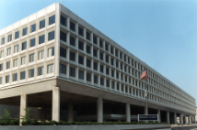
Mission of the Department of Energy
The mission of the Energy Department is to ensure America’s security and prosperity by addressing its energy, environmental and nuclear challenges through transformative science and technology solutions.
  Catalyze the timely, material, and efficient transformation of the nation’s energy system and secure U.S. leadership in clean energy technologies.
  Maintain a vibrant U.S. effort in science and engineering as a cornerstone of our economic prosperity with clear leadership in strategic areas.
  Enhance nuclear security through defense, nonproliferation, and environmental efforts.
  Establish an operational and adaptable framework that combines the best wisdom of all Department stakeholders to maximize mission success.

Slide 95
What is the Office of Science?
ACTIVITY/AGENCY | YEARS | AUTHORIZATION
Manhattan Project | 1942 – 1946 | none
Atomic Energy Commission | 1946 – 1974 | P.L. 79-585
Energy Research and Development Administration | 1974 – 1977 | P.L. 93-438
Office of Energy Research | 1977 – 1998 | P.L. 95-91
Office of Science | 1998 – present | P.L. 105-245
DOE
Today the DOE Office of Science is
The nation’s largest supporter of basic research in the physical sciences
The steward of 10 national laboratories
The lead agency supporting fundamental research for energy production and security

Slide 96
DOE Office of Science Research Programs
Basic Energy Sciences (BES)
Understanding, predicting, and ultimately controlling matter and energy flow at the electronic, atomic, and molecular levels
Advanced Scientific Computing Research (ASCR)
Delivering world leading computational and networking capabilities to extend the frontiers of science and technology
Biological and Environmental Research (BER)
Understanding complex biological, climatic, and environmental systems
Fusion Energy Sciences (FES)
High Energy Physics (HEP)
Nuclear Physics (NP)
Building the scientific foundations for a fusion energy source
Understanding how the universe works at its most fundamental level through research, projects, and facilities
Discovering, exploring, and understanding all forms of nuclear matter
https://www.energy.gov/science/office-science

Slide 97
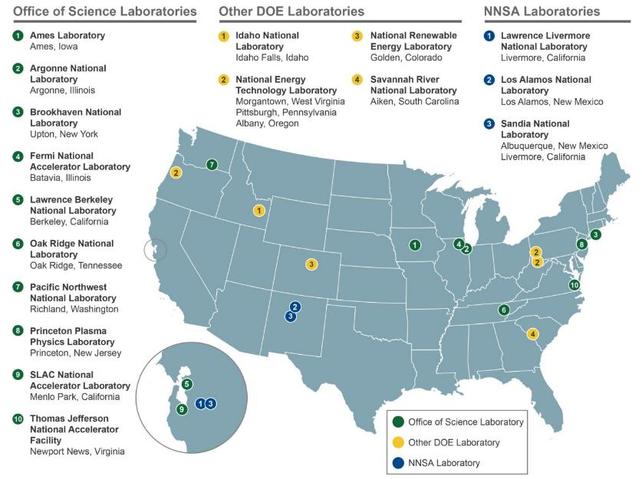
Seventeen DOE National Laboratories

Slide 98
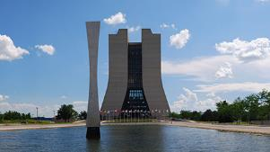

Stewardship of DOE
National Laboratories
Together, the 17 DOE laboratories comprise a preeminent federal research system, providing the Nation with strategic scientific and technological capabilities. The laboratories:
  Execute long-term government scientific and technological missions, often with complex security, safety, project management, or other operational challenges;
  Develop unique, often multidisciplinary, scientific capabilities beyond the scope of academic and industrial institutions, to benefit the Nation’s researchers and national strategic priorities; and
  Develop and sustain critical scientific and technical capabilities to which the government requires assured access.
Location: Batavia, Illinois
Type: Single-program laboratory
Contractor: Fermi Research Alliance, LLC
Responsible Site Office: Fermi Site Office
Website: https://www.fnal.gov
Physical Assets:
6,800 acres and 365 buildings
2.4 million GSF in buildings
Replacement Plant Value: $2.44B
28,913 GSF in 10 Excess Facilities
22,155 GSF in Leased Facilities
Human Capital:
1,810 Full Time Equivalent Employees (FTEs)
22 Joint faculty
95 Postdoctoral Researchers
65 Undergraduate Students
30 Graduate Students
3,746 Facility Users
7 Visiting Scientists
FY 2019 Costs by Funding Source:
(Cost Data in $M):
Lab Operating Costs: $491.64M
DOE Costs: $490.12M
SPP (Non-DOE/Non-DHS) Costs: $1.51M
SPP as % Total Lab Operating Costs: 0.3%

Slide 99
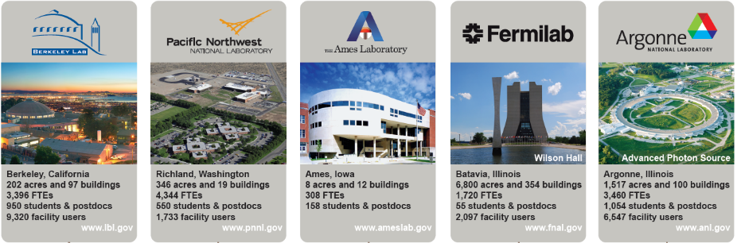

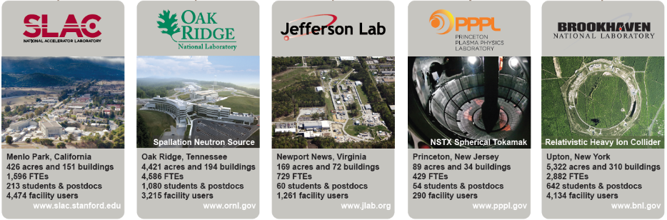
Office of Science oversees 10 of 17 DOE National
$898M in FY 2019
$939M in FY 2019
$54M in FY 2019
$491M in FY 2019
$837M in FY 2019
Founded 1931
202 acres, 97 buildings
3,129 FTEs, including: 428 post-docs, 441 students, and 239 joint faculty
2,043 visiting scientists
12,763 facility users
Founded 1965
781 acres, 77 buildings
4,177 FTEs, including: 223 post-docs, 737 students, and 112 joint faculty
60 visiting scientists
1,734 facility users
Founded 1947 (1942)
10 acres, 13 buildings
307 FTEs, including: 44 post-docs, 180 students, and 45 joint faculty
120 visiting scientists
Founded 1967
6,800 acres, 366 buildings
1,782 FTEs, including: 95 post-docs, 103 students, and 21 joint faculty
8 visiting scientists
3,635 facility users
Founded 1946 (1942)
1,517 acres, 154 buildings
3,237 FTEs, including: 260 post-docs, 595 students, and 2343 joint faculty
790 visiting scientists
7,921 facility users
$542M in FY 2019
$1,825M in FY 2019
$160M in FY 2019
$97M in FY 2019
$588M in FY 2019
Founded 1962
426 acres, 150 buildings
1,602 FTEs, including: 145 post-docs, 327 students, and 32 joint faculty
22 visiting scientists
2,931 facility users
Founded 1943
4,421 acres, 272 buildings
4,708 FTEs, including: 281 post-docs, 936 students, and 196 joint faculty
1,533 visiting scientists
3,289 facility users
Founded 1962
169 acres, 69 buildings
693 FTEs, including: 33 post-docs, 62 students, and 28 joint faculty
1,491 visiting scientists
1,630 facility users
Founded 1961 (1951)
91 acres, 30 buildings
447 FTEs, including: 21 post-docs, 43 students, and 7 joint faculty
50 visiting scientists
292 facility users
Founded 1947
5,322 acres, 315 buildings
2,379 FTEs, including: 121 post-docs, 448 students, and 139 joint faculty
2,176 visiting scientists
3,198 facility users

Slide 100





HEP Major Laboratory Investments
Cross-disciplinary R&D with material science and advanced computing, including instrumentation
Dielectric accelerator R&D with the Argonne Wakefield Accelerator
Computational Cosmology
High performance computing applications in HEP, leveraging Argonne Leadership Computing Facility (ALCF)
Laser-driven plasma wakefield accelerator technology (BELLA)
Silicon detectors for LHC, dark matter, and dark energy experiments
Leveraging NERSC for high-throughput computing & large-scale simulations and Energy Sciences Network (ESnet) for big data transfer, including LHC
Host Lab for LZ experiment and Dark Energy Spectroscopic Instrument (DESI)
Brookhaven Accelerator Test Facility
Detector R&D and readout development, leveraging Instrumentation Division
Host Lab for U.S. ATLAS, hosting ATLAS Tier-1 computing center
Fermilab Accelerator Complex User Facility supports beam-driven neutrino science and precision science experiments
Superconducting RF accelerator technology, high-intensity particle beams and high-power targets
Extensive infrastructure for accelerator and detector R&D, including specialized facilities for design, fabrication and testing
Host Lab for LBNF/DUNE, PIP-II, HL-LHC AUP, HL-LHC CMS, and U.S. CMS, hosting CMS Tier-1 computing center
Beam-driven plasma wakefield accelerator technology (FACET)
Kavli Institute for Particle Astrophysics and Cosmology
Host Lab for SuperCDMS-SNOLAB dark matter experiment and Vera Rubin Observatory

Slide 101































28 scientific
user facilities
OLCF
ALCF
NERSC
ESnet
EMSL
ARM
JGI
SNS
HFIR
ALS
APS
LCLS
NSLS-II
SSRL
CFN
CINT
CNM
CNMS
TMF
DIII-D
NSTX-U
CEBAF
ATLAS
RHIC
FRIB
FACET II
ATF
Fermilab AC

Slide 102



U.S. Long-Term Particle Physics Strategy
The global vision presented in the 2014 Particle Physics Project Prioritization Panel (P5) report was the culmination of years of effort by the U.S. particle physics community
  2012 – 2013: Scientific community organized year-long planning exercise (“Snowmass”)
  2013 – 2014: U.S. High Energy Physics Advisory Panel convened P5 to develop a plan to be executed over a ten-year timescale in the context of a 20-year global vision for the field
P5 report enables discovery science with a balanced program that deeply intertwines U.S. efforts with international partners
  U.S. particle physics community strongly supports strategy
  U.S. Administration has supported implementing the P5 strategy through each President’s Budget Request
  U.S. Congress has supported implementing the P5 strategy through the language and funding levels in appropriations bills
  International community recognizes strategy through global partnerships

Slide 103






The High Energy Physics Program Mission
…is to understand how the universe works at its most
fundamental level:
  Discover the elementary constituents of matter and energy
  Probe the interactions between them
  Explore the basic nature of space and time
The Office of High Energy Physics fulfills its mission by:
  Building projects that enable discovery science
  Operating facilities that provide the capability to perform discovery science
  Supporting a balanced research program that produces discovery science

Slide 104







P5: Science Drivers of Particle Physics
The P5 report identified five intertwined science drivers, compelling lines of inquiry that show great promise for discovery:
Use the Higgs boson as a new tool for discovery
Pursue the physics associated with neutrino mass
Identify the new physics of dark matter
Understand cosmic acceleration: dark energy and inflation
Explore the unknown: new particles, interactions, and physical principles
*2013
*2015
*2011
* Since 2011, three of the five science drivers have
been lines of inquiry recognized with Nobel Prizes

Slide 105



U.S. Administration Supports P5
U.S.-CERN Agreement, signed May 6, 2015, in D.C.
  By U.S. Secretary of Energy Ernest Moniz, CERN Director General Rolf Heuer, and U.S. National Science Foundation France Cordova
  Aligns European and American long-range strategic plans in particle physics
UK-U.S. Science & Technology Agreement, signed Sep 20, 2017, in D.C.
  By UK Science Minister Jo Johnson and U.S. Acting Assistant Secretary of State for Oceans and International Environmental and Scientific Affairs Judith Garber
  First major project under this agreement is UK investment of £65 million ($88 million) in LBNF/DUNE
DOE-DAE (India) Project Annex II on Neutrino Research signed April 16, 2018, in New Delhi
  By U.S. Secretary of Energy Rick Perry and India’s Atomic Energy Secretary Sekhar Basu
  Expands accelerator science collaboration to include science for neutrinos

Slide 106
Appropriators Noticed the P5 Report
FY 2014 House Energy and Water Development Appropriations Report:
  “the Committee supports the Office of Science’s challenge to the High Energy Physics community to identify an LBNE construction approach that avoids large out-year funding spikes or to identify viable alternatives with similar scientific benefits at significantly lower cost.”
FY 2015 House Energy and Water Development Appropriations Report:
  “The Committee notes that the high energy physics research community is currently engaged in developing a ten-year plan for U.S. particle physics, which will include a ten-year report by the Particle Physics Project Prioritization Panel under various budget scenarios. The Committee applauds the Department for this undertaking . . .”
FY 2016 House Energy and Water Development Appropriations Report:
  “The Committee strongly supports the Department’s efforts to advance the recommendations of the Particle Physics Prioritization Panel and urges the Department to maintain a careful balance among competing priorities and among small, medium, and large scale projects.”
FY 2017 House ($823M) and Senate ($833M) marks above President’s Request ($818M), final appropriation for DOE High Energy Physics was $825M
FY 2019 Senate Energy and Water Development Appropriations Report ($1010M):
  “The Committee recommends $1,010,000,000 for High Energy Physics. The Committee strongly supports the Department’s efforts to advance the recommendations of the Particle Physics Project Prioritization Panel Report [P5], which established clear priorities for the domestic particle physics program…”

Slide 107

Infrastructure

Slide 108





The Science Laboratories Infrastructure (SLI) Program
Mission:
To support scientific and technological innovation at the Office of Science (SC) laboratories by funding and sustaining general purpose infrastructure and fostering safe, efficient, reliable and environmentally responsible operations.
Priorities:
Improving SC’s existing physical assets (including major utility systems)
Funding new cutting-edge facilities that enable emerging science opportunities.
Realized through projects that support/enable SC’s current and future mission needs
  State-of-the-art facilities that are flexible, safe, and sustainable;
  Collaborative and interactive work environments that foster innovation;
  Infrastructure & utilities that are modern, available, efficient, and safe
Primary Focus:
Line-Item Construction Projects
Core General Purpose Infrastructure Investments
Photos (from top to bottom): Recently completed SLI projects are (top to bottom) include Renovate Science Laboratories-Phase 2 at BNL; Seismic Modernization and Replacement of Buildings-Phase II at LBNL; the Energy Sciences Building at ANL; Infrastructure and Operational Improvements Project at PPPL; and the Photon Science Laboratory Building at SLAC.

Slide 109

New Strategy to Invest in Fermilab Core Campus Revitalization
HEP-funded projects ~15M/yr. not enough to revitalize and support P5
  And, each project >5M has to be signaled 18 months in advance to make it into PBR
Fermilab indirect-supported investments are lagging the other SC labs
DOE Science Laboratories Investment (SLI) program is seeking strong Sponsor and Lab investments to bring lab infrastructure into the 21st century
  Central Utility Building, Site-wide Utility Systems
Fermilab, with the Site Office and HEP, is preparing a Mission Need Statement (CD-0) for the purpose of replacing aged, obsolete, and severely deteriorated aspects of the laboratory’s systems and facilities infrastructure, with modern, world-class facilities for particle physics research through the current P5, and into the next.
IERC is funded through the SLI program
On July 16, 2019, Fermilab received authorization to start construction of the IERC.
IERC will be Fermilab’s largest purpose-built laboratory and office building since Wilson Hall was completed in 1974. The building will integrate engineering resources currently scattered across the laboratory and provide state-of-the-art facilities that will enable the design and construction of high-performance particle physics detectors.

Slide 110

Fermilab: Master Substation Radial-Feed Project
SCOPE
PROJECT SCOPE Includes connection to existing MSS feeders with new medium-voltage underground feeders in concrete duct bank system and routing to electrical switches in accelerator campus Utility Corridor.
DRIVING CONSIDERATIONS MSS provides electrical service to the Fermilab footprint area, the Main Ring area and north half of the site. It contains new, modern, arc-resistant switchgear and control systems that provide increased operator safety, reliability, and flexibility. This is the preferred power source for the Accelerator Campus.
CAMPUS MASTER PLAN ALIGNMENT Several projects are planned for the central campus area including the IERC & ASTC buildings as well as the PIP-II, Mu2e, and LBNF projects. MSS will serve either as the primary or secondary electrical substation to the above listed projects.
COST
TOTAL PROJECT COST FY20 $7,500,000
FUNDING SOURCE / STATUS HEP / Funded
PROJECT PLAN STATUS In process
DEMOLITION INCLUDED Demolition of existing switchgear and abandon underground cable systems
IMPACT ON OPERATING COSTS $10K/FY. Planned (does not include emergency repair costs) in annual dollars
RISKS / ALTERNATIVES
ASSOCIATED RISKS Kautz Road Substation Failure Failure of a major project – Utility Corridor
ALTERNATIVES CONSIDERED / RECOMMENDED The alternatives include increased capacity feeders from Master Substation (MSS). This alternative is not recommended due to single source failure risk.

Slide 111


Fermilab: IB4/MP9 Cleanroom & Facilities Consolidation
SCOPE
PROJECT SCOPE Removal of existing vacuum furnaces, ovens and welding glove box at MP9 to free up footprint for new cryomodule assembly cleanroom. Retrofit of IB4 with equipment removed from MP9 Addition of HPR clean room in IB4 dedicated to 650 MHz PIP-II cavities Expand the existing MP9 cryomodule assembly cleanroom for PIP-II 1500kVA Transformer & Switch Acquisition
DRIVING CONSIDERATIONS PIP-II is in need of a new, larger and dedicated clean room for cryomodule assembly and one for vertical HPR Consolidate all SRF cavity processing facilities for both R&D and project & production activities at IB4, improving efficiency and reducing risk. Consolidation of clean rooms for cryomodule assembly in MP9, improving efficiency.
CAMPUS MASTER PLAN ALIGNMENT Reinforces Campus Master Plan: Guiding Principles to support cutting-edge research and build new capabilities to support groundbreaking particle physics and accelerator science research.
INDUSTRIAL BUILDING 4 (IB4)
POLARIZED PROTON LAB (MP9)
COST
TOTAL PROJECT COST FY20 $3,400,000
FUNDING SOURCE/STATUS HEP / Funded
PROJECT PLAN STATUS In process
DEMOLITION INCLUDED Demolition to retrofit interior spaces at IB4/MP9 is included.
IMPACT ON OPERATING COSTS Consolidation of clean rooms for cryomodule assembly in MP9 and SRF cavity processing in IB4 will substantially improve operational efficiency, potential reduction of 1 technician/year.
RISKS / ALTERNATIVES
ASSOCIATED RISKS Challenge to meet PIP-II deliverables on schedule Risk of cost increase and schedule delays to PIP-II due to inadequate cleanroom facilities for high pressure rinse (HPR) and cleanroom assembly Inefficiency due to facilities spread across all campus
ALTERNATIVES CONSIDERED / RECOMMENDED Utilize existing building infrastructure to execute PIP-II deliverables. Not recommended: Additional strain on existing facilities with delays to project schedule. Construct separate facility. Not recommended: not cost effective.

Slide 112

SLAC: Sector 30 Transfer Line (S30XL)
SCOPE
PROJECT SCOPE Construct an 80 meter beam line that connects to Linac Coherent Light Source (LCLS)-II SRF in order to extract dark current for science and test beam studies parasitic to the LCLS-II FEL DOE BES program
DRIVING CONSIDERATIONS Beamline will be first stage of a connection between the Continuous Wave LCLS-II SRF linac and End Station A in support of HEP experiments. Beamline will transport 4 to 8 GeV electrons with average currents up to 1 mA and a 50% duty cycle. Beamline operation must remain parasitic to LCLS-II Free Electron Laser operation and is expected to be available ~5,000 hours/year.
RISKS / ALTERNATIVES
ASSOCIATED RISKS 1) Interference with LCLS-II operations 2) Extraction kicker limited in pulse length or repetition rate
RISK MITIGATION STRATEGY Review design and interference mitigation with LCLS-II management and operation teams Continued R&D with improved power transistors to meet high power design goals; reduce effective duty until goals are achieved.
ALTERNATIVES CONSIDERED / RECOMMENDED Do nothing, utilize other GeV-class low current beams from other laboratories. Not recommended: only other CW e- source is JLab and it is heavily oversubscribed. Construct separate facility to generate GeV-class low current beams. Not recommended: not cost effective.
COST
TOTAL PROJECT COST FY20 $3,563,000 construction + $400,000 design + $1,262,000 Contingency
FUNDING SOURCE/STATUS HEP AIP ($4,655,000) / SLAC PSF ($300,000)
PROJECT PLAN STATUS In design
DEMOLITION INCLUDED None
IMPACT ON OPERATING COSTS $200,000/FY – general maintenance and operations for Stage A

Slide 113

SCOPE
PROJECT SCOPE Procurement of a new liquefier and associated plumbing and electrical connections. Removal of >40-year-old liquefier, preparation of site for new liquefier, installation of new liquefier and connection to existing Helium storage and recovery lines. Commissioning of new liquefier and associated systems.
DRIVING CONSIDERATIONS Improved performance of helium liquefier (higher efficiency, higher capacity, reduced maintenance & operational support), enabling faster, more cost-effective, and a higher number of magnet tests. Smaller per-test operating cost due to reduced maintenance and technical oversight costs.
CAMPUS MASTER PLAN ALIGNMENT LBNL long-term goal of a sustainable approach to helium stewardship, via broad and efficient helium gas recapture, purification, storage, & liquefaction.
LBNL: Berkeley Center for Magnet Technology Helium Liquefier
COST
TOTAL PROJECT COST FY20 $3,940,000 (includes 35% contingency)
FUNDING SOURCE/STATUS HEP - Partially funded
PROJECT PLAN STATUS In process
DEMOLITION INCLUDED Removal of existing old liquefier, site prep for new liquefier.
IMPACT ON OPERATING COSTS Increased Liquefier usage due to enhanced performance and ease of use, offset by reduction in maintenance costs.
RISKS / ALTERNATIVES
ASSOCIATED RISKS Risk of failure of existing liquefier and resulting inability to perform large magnet tests; Risk of significant dark time between removal of old, and installation of new, liquefier, jeopardizing critical magnet tests for HEP programs
RISK MITIGATION STRATEGY (if not funded) Increase maintenance efforts on existing liquefier, refurbishment of helium transfer lines to reduce losses
ALTERNATIVES CONSIDERED / RECOMMENDED Outsource all magnet tests to other laboratories. Not recommended due to breadth of tests impacted, and potential loss of core competencies.

Slide 114

Infrastructure Takeaway
Additional investments are necessary to increase capacity and efficiency due to
  Increased demands on Fermilab to deliver on large-scale projects much greater size, complexity and cost than done before (LCLS-II, LBNF, PIP-II, Mu2e)
  Provide higher beam intensity
  Manage increasing data processing and storage
  Support a growing user population
Infrastructure support at other SC labs and institutions being assessed for impact, capability, ROI, etc.
Funding for infrastructure needs to be factored into the next community planning process
  HEP, SLI, Other SC, Public/Private
  Small, Medium, Large Projects; Costs/Schedules
  Investments made by Other Projects, Facilities, or Indirect-Support

Slide 115
Government-Wide Diversity and Inclusion Initiative
Our Nation derives strength from the diversity of its population and from its commitment to equal opportunity for all. We are at our best when we draw on the talents of all parts of our society, and our greatest accomplishments are achieved when diverse perspectives are brought to bear to overcome our greatest challenges.
— President Barack Obama,
Executive Order 13583 - August 18, 2011

Slide 116

Dimensions of Diversity
Personality includes an individual's likes and dislikes, values, and beliefs.
  Shaped early in life and is both influenced by, and influences, the other layers throughout one's lifetime and career choices.
Internal dimensions include aspects of diversity over which we have no control
  Layer in which many divisions between & among people exist and which forms the core of many diversity efforts.
  These dimensions include the first things we see in other people, such as race or gender and on which we make many assumptions and base judgments.
External dimensions include aspects of our lives which we have some control over, which might change over time, and which usually form basis for decisions on careers & work styles.
  Layer often determines with whom we develop friendships & what we do for work. This layer also tells us much about whom we like to be with.
Organizational dimensions concerns the aspects of culture found in a work setting.
  While much attention of diversity efforts is focused on the internal dimensions, issues of preferential treatment and opportunities for development or promotion are impacted by aspects of this layer.
While the "Internal Dimensions" receive primary attention in successful diversity initiatives, the elements of the "External" and "Organizational" dimensions often determine the way people are treated, who "fits" or not in a department, who gets the opportunity for development or promotions, and who gets recognized.

Slide 117
What’s the Difference? Diversity
Diversity: the presence of difference in individual attributes such as national origin, language, race, color, disability, ethnicity, gender, age, religion, sexual orientation, gender identity, socioeconomic status, veteran status, and family structures. Diversity can also refer to differences of thought and life experiences.
  “How can we get more people with marginalized identities into our pipeline?”
  “How can we incentivize recruiting ‘diverse candidates’”?
  “How many more of [pick any minoritized identity] group do we have this year than last?”
  Drawn in part from Dafina-Lazarus Stewart, Bowling Green State University
https://www.insidehighered.com/views/2017/03/30/colleges-need-language-shift-not-one-you-think-essay

Slide 118
What’s the Difference? Inclusion
Inclusion: a culture that connects each employee to the organization; encourages collaboration, flexibility, and fairness; and leverages diversity throughout the organization so that all individuals are able to participate and contribute to their full potential.
  “What is the experience for individuals who are the minority within the organization?”
  “Do people with marginalized identities feel a sense of welcome and belonging?”
  “What don’t we realize we are doing that is negatively impacting our new, more diverse, teams?”
  Drawn in part from Dafina-Lazarus Stewart, Bowling Green State University
https://www.insidehighered.com/views/2017/03/30/colleges-need-language-shift-not-one-you-think-essay

Slide 119
What’s the Difference? Equity
Equity: a set of conditions that allows everyone to access the same opportunities. Equity acknowledges that individuals start out with different advantages, and identifies and seeks to mitigate structural barriers.
  “What can we do to make sure everyone can succeed?”
  “What conditions have we created that maintain certain groups as the perpetual majority here?”
  “Are our structures and processes having the intended consequences and outcomes?”
  Drawn in part from Dafina-Lazarus Stewart, Bowling Green State University
https://www.insidehighered.com/views/2017/03/30/colleges-need-language-shift-not-one-you-think-essay

Slide 120

Multi-university project to tackle equity and inclusion in STEM
Many students attend college dreaming of careers in science, technology, engineering and math fields. At public research universities like the University of Michigan, introductory courses in these subjects are the first steps on a path to a STEM degree.
These classes are huge, enrolling hundreds—even thousands—of students. They also can be challenging, causing many students to stumble on these first steps.
As a result, students often shift course, abandoning their dreams of working in a STEM discipline, researchers say. This is especially true for students who do not see themselves represented among the current ranks of STEM professionals. When this happens, the researchers say, society loses solutions to problems these students might have addressed and discoveries they could have made.
Concerns about equity and inclusion in STEM education go beyond gender to concerns about race, socioeconomic status, religion, sexual orientation, politics and generation in college. For example, African Americans and Hispanics hold only 9% and 7% of STEM career positions, respectively..
Students that are first-generation, low-income and underrepresented minorities can be lost at three times the rate of white students who have benefitted from greater prior opportunities to learn the material. Even if they stay in the class, they are often a full course grade behind other students.
Sources:
https://sites.google.com/umich.edu/SEISMIC/ https://www.symmetrymagazine.org/

Slide 121
Thought exercise
Think about a process at your institution in which you are a key player.
Where in that process does individual decision-making come into play? How might unconscious biases effect the outcome at those points?
Does the process look the same to different people? What challenges and risks are involved, and do they impact everyone in the same way?
Have you sought out the information you need to make that process more equitable? Are you aware of your own biases, and have you asked others about their experiences?

Slide 122

Reflection
Stand up if you were the first person in your family to go to college
Stand up if you or someone in your family is a veteran or active military
Stand up if you have a family member with a physical disability
Stand up if a family member is (was) affected by dementia
Stand up if you have a family member with special needs

Slide 123

DOE Supports Mission-Driven Science
All proposals requesting Office of Science support must be written in the context of the agency mission
Proposals responding to the FY20XX Research Opportunities in High Energy Physics and Early Career Research Program [HEP] Funding Opportunity Announcements (FOAs) need to align with at least one of the P5 science drivers

Slide 124
Funding Vehicles for Federal Funds
DOE National Laboratories
  Most are Government Owned/Contractor Operated (GOCO) Federally Funded Research and Development Centers (FFRDCs) and operate under Management and Operating (M&O) contracts
  Laboratory research is mission driven and funded through Field Work Proposals (FWPs)
    Comparative reviews of the Lab Research programs held every 4-5 years
  Laboratories propose yearly financial plans based on DOE guidance
    Mechanisms exist to tune funding each month
Universities
  Submit grant proposals in response to a Funding Opportunity Announcement (FOA)
    Independent peer review informs the selection of awards
  Award is ~fixed once made, with funding cycle of 1-5 years
    Funding adjustments (downward) are possible if circumstances change
    Changes are also possible through submission of supplementary proposals

Slide 125

Grant Process
Grant applications must be submitted through Grants.gov
Instructions for preparing and submitting grant applications are contained in the Funding Opportunity Announcements posted on Office of Science web pages, at www.grants.gov, and at www.FedConnect.net
The rules governing SC's grants and cooperative agreements are regulations codified in the Code of Federal Regulations (CFR).
Acquisition and contracting services are provided by the DOE Office of Science Consolidated Support Center (CSC).
  The ISC is a virtual organization comprised of the combined support capabilities of offices in Lemont, Illinois, and Oak Ridge, Tennessee.
More info: SC Grants & Contracts support: science.energy.gov/grants/

Slide 126
Grants and Contracts
A grant is a form of financial assistance to a designated class of recipients authorized by statute to meet recognized needs, while a contract involves the purchase of a product or service for federal use or, as stated in the Federal Grant and Cooperative Agreements Act, for the direct benefit of the government.
Contracts are subject to the Federal Acquisition Regulation at Title 48 of the Code of Federal Regulations.
  Grants are governed by “common rules” in the OMB Circulars as incorporated into grantor agency regulations.
GRANTS
• Flexible instrument designed to provide money to support a public purpose.
• Governed by the terms of the grant agreement
• Flexible as to scope of work, budget, and other changes
• Diligent efforts are used in completing research and the delivery of results
• Payment awarded in annual lump sum
• Annual reporting requirements
• Principal Investigator has more freedom to adapt the project and less responsibility to produce results
CONTRACTS
• Binding agreement between a buyer & a seller to provide goods/services in return for consideration.
• Governed by Federal Acquisition Regulations
• Relatively inflexible as to scope of work, budget, and other changes
• Significant emphasis placed on delivery of results, product, or performance
• Payment based on deliverables & milestones
• Frequent reporting requirements
• High level of responsibility to the sponsor for the conduct of the project and production of results

Slide 127
DOE SC Graduate Student Research Fellowships
DOE SC Graduate Fellowship program has 2 calls per year, supporting student internships with DOE lab mentors in the summer (deadline previous Fall) and during the school year (deadline previous Spring).
Spring 2020 solicitation closed, next solicitation opens August 2020 for interns starting June 2021 or later. Internship period is flexible: 3-12 months
This program has supported 15-20 HEP graduate students per year and has a high success rate for eligible applications. You can view the solicitation at https://science.osti.gov/wdts/scgsr/
Recent Addition: Convergence Research Topical Areas, for research of interest to 2 or more SC offices and are treated somewhat differently in review. Please encourage likely candidates.
Convergence Research Topical Areas
  (a)Microelectronics (ASCR, BES, HEP)
  (b)Data Science (ASCR, BES, BER, FES, HEP, NP)
  (c)Fundamental Symmetries (BES, HEP, NP)
  (d)Accelerator Science (ASCR, BES, BER, FES, HEP, NP)

Slide 128

US-Japan Student Exchange Program https://www.bnl.gov/ozaki/
Strengthens US-Japan scientific collaboration by facilitating greater cooperation in projects of mutual benefit to Japan and the U.S. in the areas of accelerator and particle physics. Each year, up to five proposals will be selected in the U.S. and up to five in Japan.
  Graduate students enrolled in U.S. Physics Ph.D. programs are eligible to submit a proposal to conduct HEP research or technology R&D in Japan
  The duration of the award is for a three- to twelve- month period
  The award will provide travel, housing and cost of living expenses stipend for the stay in Japan. Tuition will be the responsibility of the students and their home institution
  In 2019:
    2 students from Japan visited U.S.
    4 students from U.S. visited Japan
  2020 Program:
    8 applications to U.S. side, 5 selected
    3 applications to Japan side, 3 selected
    All recommended applications were approved at the Joint selection meeting in January 2020
  Next application opens in November 2020 for exchanges starting in June 2021

Slide 129
Laboratory Directed Research and Development (LDRD)
LDRD serves a number of important purposes.
  Enables high risk R&D at the Department’s laboratories in areas of potential value to national R&D programs.
  Flexibility allows the laboratories to assemble experts from different fields into teams whose collaboration uncovers synergies and multidisciplinary solutions not otherwise evident without the freedom to reach across traditional technical boundaries.
  LDRD serves as a proving ground for advanced R&D concepts that are often subsequently pursued by DOE programs and, at the same time, helps the Government identify more creative approaches to fulfilling future mission needs.
LDRD projects are selected on a competitive basis through rigorous management and peer review processes.
Among the most valuable aspects of the LDRD program is its role as an excellent professional development tool.
  The LDRD program is instrumental in the laboratories’ ability to attract promising young scientists and engineers, providing the basis for continually refreshing the laboratory research staff, as well as for the education and training of the next generation of scientists.
  Includes support for both undergraduate and graduate students working on LDRD projects, technical staff retention associated with opportunities to retain and hone scientific skills via LDRD, and a range of university collaborations stimulated via LDRD projects.

Slide 130
Small Business Innovation Research (SBIR) & Small Business Technology Transfer (STTR)
The SBIR Program was established by Congress in 1982 [Public Law 97-219]. Major goals are:
  Stimulate technological innovation and use small business to meet Federal R&D needs
  Foster and encourage participation by the socially and economically disadvantaged small businesses, and those that are 51 percent owned and controlled by women, in technological innovation
  Increase private sector commercialization of innovations derived from Federal R/R&D, thereby increasing competition, productivity, and economic growth
SBIR and STTR Have Three Distinct Phases
  Phase I explores the feasibility of innovative concepts with awards up to $225,000 and 12 months.
  Phase II is the principal R&D effort, with awards up to $1,500,000 and 2 years.
  Phase III offers opportunities to small businesses to continue their Phase I and II R&D work to pursue commercial applications of their R&D with non-SBIR/STTR funding.
Differences between SBIR and STTR
  STTR project requires the small business (applicant) to be teamed with a non-profit research institution, typically a university or Federal Laboratory.
  STTR program is focused on the transfer of technology from the Research Institution to the small business and ultimately to the marketplace through a Phase I-II-III sequence.
  STTR: PI could be primarily employed at either the Research Institution or the small business.
    SBIR: PI must be primarily employed at the proposing small business, meaning that he or she cannot work full time elsewhere during the project period.
  Up to 60% of the research effort for an STTR project can be subcontracted
    There is a 33% limit on Phase I SBIR subcontracting (increases to 50% in Phase II)
For FY 2019-2022: SBIR rate = 3.2%, STTR = 0.45%
  Construction funding is exempted.

Slide 131
Small Business Innovation Research (SBIR) and
Small Business Technology Transfer (STTR) Program
FY 2020 HEP Topic Areas:
  Advanced Concepts and Technology for Particle Accelerators
  Radio Frequency Accelerator Technology
  Laser Technology R&D for Accelerators
  Superconductor Technologies for Particle Accelerators
  High Energy Physics Electronics
  High Energy Physics Detectors and Instrumentation
  Quantum Information Science (QIS) Supporting Technologies
FY 2020 Phase I (R2) closed 2/24/2020
  FY 2019 decrease in awards due to an increase
  in maximum award amount from $150K to $200K
  Proposal volume trends with number of published
  subtopics
  Number of awards depends on budget (statutory)
FY 2020 Phase II (R2) closed 4/21/2020
  Phase II proposal volume fluctuates
    Number of sequential proposals unpredictable
  FY 2020 proposal decrease due to decreased FY19
  Phase I awards; also option to defer Phase II proposals one year
  Number of awards depends on budget (statutory)
Phase I
Phase II (* indicates preliminary decisions)
FY | Proposals | Awards | Award %
2016 | 208 | 30 | 14.4%
2017 | 179 | 37 | 20.7%
2018 | 164 | 40 | 24.4%
2019 | 165 | 30 | 18.2%
2020 | 131 | 37 | 28.2%
FY | Proposals | Awards | Award %
2016 | 34 | 15 | 44.1
2017 | 39 | 17 | 43.6
2018 | 45 | 18 | 40.0
2019 | 47 | 18 | 38.3
2020 | 37 | 16* | 43.2*

Slide 132







DOE Particle Physics Agency Partnerships
Proposal driven program
Funds facilities and equipment, such as telescopes, through cooperative agreements with research consortia
Mission driven program
National Laboratory enterprise and National User Facilities provide important capabilities & expertise
Mission driven program
Expertise in human spaceflight, aeronautics, space science, and space applications
Partnership enables unique science opportunities
HEPAP Coordination
AAAC Coordination
Strong connections
Energy Frontier
Modest ties
Intensity Frontier
Strong connections
Cosmic Frontier
Space-based experiments
Strong connections
Theoretical Physics
Modest ties
Technology R&D

Slide 133






Program Advice and Coordination
Formal advice (Federal Advisory Committee Act)
  High Energy Physics Advisory Panel (HEPAP)
    Jointly serves DOE and National Science Foundation (NSF)
    2014: P5 long-term strategy report
    2015: Accelerator R&D Subpanel report
  Astronomy and Astrophysics Advisory Committee (AAAC)
    Advises DOE, NSF, and NASA on selected issues of mutual interest within the fields of astronomy and astrophysics (e.g. CMB-S4 Conceptual Design Team)
Community input
  National Academies of Science: Astronomy and Astrophysics Decadal Survey (New Worlds, New Horizons)
  DOE Workshop reports, including Quantum Sensors, Accelerator R&D Roadmaps, Technology Connections, Basic Research Needs, etc.
International coordination
  CERN Council (LHC)
    Governs CERN by defining its strategic programs, setting and following up its annual goals, and approving its budget
  International Neutrino Council (LBNF/PIP-II)
    International consulting body for DOE that facilitates high-level global coordination across the LBNF/PIP-II enterprise
  Resources Review Board (DUNE)
    Facilitates Fermilab’s coordination of resource-related matters for DUNE

Slide 134
DOE Roles and Responsibilities
Certain functions are considered “inherently governmental” and reserved for Federal staff, including:
  Determination of agency policy, such as determining the content and application of regulations, among other things
  Determination of Federal program priorities for budget requests
  Determination of budget policy, guidance, and strategy
  Approving, awarding and administering government prime contracts
    Including determining what supplies or services are to be acquired with government funds
Moreover, since Federal staff are normally hired following civil service laws, there is a strong precept that contractors must not act as Federal staff and vice versa, e.g.:
  Government employees do not directly supervise contractors
  Federal staff are generally not involved in contractor personnel decisions
For all intents and purposes, DOE labs are prime contractors and lab employees are contractor employees

Slide 135
DOE Lab Roles and Responsibilities
Facility Operations and Construction
  Performance judged against specified metrics (e.g. pb⁻¹ ; EVMS)
  Includes maintenance, upgrades, planning for new facilities
  User support
HEP Research and Technology R&D
  Nurture and support HEP research collaborations to enable discovery science
  Participation in all phases – from design, construction, operations & analysis
  Particular emphasis on:
    Management, design, construction and operation of HEP experiments
    Integration of cross-cutting activities, e.g.: computation, simulation and theoretical research, in support of HEP program
    Exploiting lab infrastructure and resources to develop next-generation particle accelerator and detector technologies for the advancement of HEP and science more broadly

Slide 136
University Roles and Responsibilities (DOE Perspective)
HEP Research and Technology R&D
Contribute significantly to HEP research collaborations to enable discovery science
Participation in all phases – from design, construction, operations & analysis
Particular emphasis on:
  Advanced training of students and postdocs
  Data analysis and comparison with theoretical models
  Vision and theoretical framework for understanding the Standard Model and beyond
  Novel and innovative concepts and approaches
  Design of future HEP experiments

Slide 137
Starting Notes
A faculty position does not guarantee anyone a DOE grant
All proposals are subject to peer-review
Review process is comparative and competitive
A grant is financial assistance funded by taxpayer dollars
A contract is the purchase of a product or service for federal use
A laboratory position does not guarantee new resources

Slide 138
Early Career Research Program
ERCP Launched in 2009 across all Office of Science.
  Successor to and replacement of highly successful DOE-HEP-OJI program (1978-2009), upon which it is modelled.
Open to university tenure-track professors and laboratory scientists holding equivalent appointments who are within ten years of receiving their PhD.
  FY 2020 cycle closed. Awards announced June 23, 2020.
  FY 2021 cycle begins TBD. Open to candidates obtaining Ph.D. in year 2010 or later
Common Office of Science criteria:
  Mandatory five-year program.
  ≥$750K for university PIs, ≥$2,500K for lab PIs.
  Funding can be front (or back) loaded
Program designed to be highly competitive with high impact.
  Identify and support the future HEP research leaders
  Over 11 years, 120 awards made from 1035 submitted proposals = 11.6%

Slide 139
Overall ECRP Process (HEP)
Typically, the process runs from October – June. FY 2020 schedule was highly compressed.
Pre-review
January: Mandatory Pre-proposals due. Eligibility checks. Program planning.
Review
Process
April: Mail-in review of all proposals via PAMS (at least three reviews each).
May: Super-panel discussion and ranking of selected proposals.
Post-review and award
May: HEP selection of candidate awardees, nominations to Office of Science.
June: Office of Science selection and announcement of awardees.
September: Awards begin.
March: Proposals received.
February: Encouragement/discouragement to develop full proposals.
April: HEP selection of proposals for subprogram panel review, based on mail-in reviews (or sub-panel).

Slide 140
HEP ECRP Review Procedure
Three-step merit review process:
  Stage 1: Three to six mail-in reviews collected for each candidate in each research subprogram*.
    *Advanced Accelerator R&D, Cosmic Frontier, Detector R&D, Energy Frontier, Intensity Frontier, Theoretical and Computational HEP.
  Stage 2: Finalists selected based on mail-in reviews, programmatic priorities, and panel discussions.
  Stage 3: Panel review of N proposals selected by subprogram panels, with a super-panel evaluating all proposals together.
“Super Panel” approach:
  Lab and university proposals are reviewed together.
  All six subprogram Accelerator R&D, Cosmic, Detector R&D, Energy, Intensity and Theory are reviewed together.
    We do not expect panelists to be experts in all proposal topics, but take a “big picture” view of which proposals/PIs are most likely to impact HEP.

Slide 141
ECRP Merit Review Criteria
Six criteria for all proposals across Office of Science:
  Scientific and/or Technical Merit of the Project
  Appropriateness of the Proposed Method or Approach
  Competency of Research Team and Adequacy of Available Resources
  Reasonableness and Appropriateness of the Proposed Budget
  Relevance to the mission of the DOE Office of High Energy Physics (HEP) program
  Potential for leadership in the scientific community
All are important; the blue ones typically provide more differentiation between proposals.
“Mission relevance” is important; HEP does not like to use the Early Career award to launch a new Project.

Slide 142
Early Career Merit Review
1. Scientific and/or Technical Merit of the Project
  What is the scientific innovation of proposed research? How does the proposed research compare with other research in its field, both in terms of scientific and/or technical merit and originality? How might the results of the proposed research impact the direction, progress, and thinking in relevant scientific fields of research? What is the likelihood of achieving influential results? Is the Data Management Plan suitable for the proposed research and to what extent does it support the validation of research results?
2. Appropriateness of the Proposed Method or Approach
  Does the proposed research employ innovative concepts or methods? How logical and feasible are the research approaches? Are the conceptual framework, methods, and analyses well justified, adequately developed, and likely to lead to scientifically valid conclusions? Does the applicant recognize significant potential problems and consider alternative strategies?
3. Competency of Applicant's Personnel and Adequacy of Proposed Resources
  Does the proposed work take advantage of unique facilities and capabilities? What are the past performance and potential of the Principal Investigator (PI)? How well qualified is the research team to carry out the proposed research? Are the research environment and facilities adequate for performing the research?
4. Reasonableness and Appropriateness of the Proposed Budget
  Are the proposed budget and staffing levels adequate to carry out the proposed research? Is the budget reasonable and appropriate for the scope?
5. Relevance to the Mission of the Specific Program (e.g., ASCR, BER, BES, FES, HEP, or NP) to which the Application is Submitted
  How does the proposed research contribute to the mission of the program in which the application is being evaluated?
6. Potential for Leadership within the Scientific Community
  Scientific leadership can be defined very broadly and can include direct research contributions. How has the PI demonstrated the potential for scientific leadership and creative vision? How has the PI been recognized as a leader?

Slide 143
Early Career Proposal Framework
What are the problems you are trying to solve?
Isn’t someone else doing it? Alternatively isn’t that already being funded?
How does this research exploit/engage the unique capabilities of your institution?
What are the resources you need to do this project?
Outline a five year timeline, with key deliverables and personnel.
Why you are a future leader in high energy physics?

Slide 144

Identify The Problem
Are you creating a new tool or capability for a larger audience?
Will you reduce the risk/cost to a project?
Can you substantially increase the sensitivity of the experiment?
Are you advancing the knowledge of the field in a significant way?
Always start with the big question.
  What are the major obstacles?
  Is this an interesting challenge?
  Can you articulate the problem to a general audience?
  Can you tell a story? [More later…]

Slide 145

Justify that You can solve the Problem
There are two key takeaways
  Provide compelling argument backed up with evidence: simulation, LDRD, startup, letters of support, track record
  Explain how the proposed research:
    Is above and beyond currently supported effort
    Is not supported
    by baseline project
    Is not duplicative
    (Federal funding)

Slide 146

What Is Your “Unfair Competitive Advantage?”
This has greater weight for the proposals submitted from the DOE National Laboratories
  In particular, we are interested in how the proposals leverage a lab’s unique facilities and capabilities.
  If this is not called out, a lab proposal has a lower chance in getting funded.
For the experimental and technology proposals submitted from the Universities
  We are also interested in how the proposals leverage the Universities facilities and resources
  Reminder: Grants are financial assistance agreements and do not cover all costs

Slide 147


Validate: Costs, Resources, Schedule
Outline a five year timeline, with yearly key deliverables, all personnel, roles and responsibilities
  Consider month by month plan
  What is a credible hiring plan?
  Do you need to front-load funding to support engineering and equipment?
    For example: 200/200/150/100/100
  Can you delay the hire of a post-doc?
  Do you have external dependences, and if so, does your schedule and deliverables make sense?
    For example: Will the widget arrive too late for the project baseline decision?
  Have you validated all expenses?

Slide 148

Demonstrate Leadership
Presidential Early Career Awards for Scientists and Engineers (PECASE)
  PECASE-eligible candidates are selected from the pool of Early Career awardees
  http://science.energy.gov/about/honors-and-awards/pecase/
Scientific leadership can be defined very broadly and can include direct research contributions
  How has the PI demonstrated the potential for scientific leadership and creative vision?
  How has the PI been recognized as a leader (collaboration, institution, community service)?
  Does the PI have a track record for mentoring students and post-docs?
Ensure the CV is correct and current
Polish up your public-facing online presence
  Do you have a professional, PR-friendly photo posted on your institution’s web site?

Slide 149

2019 PECASE Award Ceremony
Paul Dabbar, DOE Undersecretary
of Energy for Science
Prof. Tracy Slatyer, MIT
  HEP Early Career 2015
Prof. Thomas Hartman, Cornell
  HEP Early Career 2015
Prof. Jesse Shelton, UIUC
  HEP Early Career 2017

Slide 150

Beware of Red Herrings
A red herring is something that misleads or distracts from a relevant or important issue.
Examples include:
  Vague narrative descriptions, poorly described tables and figures, or dubious budget requests will lead reviewers/panel to make their own interpretations
  Other (funded) research that is not crisply delineated from the proposed research
  Unclear explanations of supported personnel, required resources, and timeline for deliverables
  Grammar

Slide 151

Speaker’s Pet Peeves
Avoid starting sentences – and especially paragraphs – with “It is…”
  You can confuse the reader. What exactly does “it” refer to?
Constrain the usage of conjunctive adverbs (see table below)
  Use Search and count. I’ve read proposals with >20 uses “finally”. Trimming these “filler” words down will free up space for constructive narrative.
Be precise – eliminate the usage of significantly, substantially, very, really, etc.
  Instead, try “increase signal by a factor of 2” or “reduce background by 20%”
Single spaces between sentences. Use the Oxford comma.
Expressing what you WILL do is much more important than what you can or may do
  Search/replace usages: can, could, may, might
Jargon, Acronyms, and Initializations
  Always define. Not every reader is an expert in your sub-field
  If only used once or twice, can you drop it entirely?
  Keep in mind that each instance of an unfamiliar word, phrase, or term will interrupt the reader’s comprehension

Slide 152






Start with the Answer
Grab the attention of the reader, by providing the Why within a few sentences in the very first paragraph using Plain English
  Do not bury the lead with X paragraphs on the history of Y physics and Z experiment
  The context to the thesis of your project should be deferred to the narrative section, and in some cases, the appendix.
  Ask non-physicists to read it, and see if they can paraphrase your opening paragraph.
Drawing an analogy to films, TV, and novels. Starting with the answer builds Suspense
  A filmmaker who puts the ending at the beginning is hoping to entertain us with HOW events unfold
  Readers feel suspense when they are deeply curious about what will happen next, or when they know what is likely to happen but don't know how it will happen. Even in historical fiction, with characters whose life stories are well known, the why usually brings suspense to the novel.

Slide 153
Proposals: What To Do
Do Follow Instructions
Read the current FOA thoroughly, as well as any supporting materials, e.g. FAQ
Do seek out advice & support from trusted colleagues & mentors
Your institution has invested a lot of time and money hiring you. They want you to succeed. Let them help you
Request a review of the proposal.
There are resources at most institutions
SC rules & procedures and HEP program requirements are regularly updated
Do learn the rules, regulations, and costs of your institution
Funds are awarded to the institution. Understand direct and indirect rates, benefits, and restrictions
Do follow through on reviewer feedback
Give weight to the critical reviews
Arguing with HEP that 3 out of 5 reviewers thought your proposal was excellent does not address the 2 reviewers who had a different opinion
Do follow proper English grammar and composition
Careless editing will annoy or confuse reviewers
Hire someone to proof-read your proposal
Do ask for what you reasonably need
Standard research requests
Salary and travel
Other Personnel including post-docs, students, Engineer, etc.
Equipment, M&S, Tuition remission
Realistic funding expectations
Establish a relationship with your budget office or sponsored research office
50% FTE to proposal
Early Career >$150k Univ & >$500k Lab
Stagger personnel

Slide 154
Proposals: What Not To Do
Do Not submit a proposal late
You should assume that applications received after the deadline will not be reviewed or considered for award
Do Not brag or exaggerate
Be professional and objective.
Do Not bury the message
The narrative should be accessible to a review panel with a wide range of expertise
Use the weeks or months after the FOA is made public to prepare and then submit your proposal early
Fully list your accomplishments in the bio. Include your mentoring.
Accurately and reasonably describe research plan
Avoid jargon when possible. Same with acronyms.
Describe in clear and concise language. Tell a story.
Do Not submit a sloppy budget
The budget sheets and justification should be prepared with the same care as the narrative
Reviewers will call out any:
Excessive or inappropriate requests
Arithmetic errors
Poorly justified expenses
Do Not be discouraged
Competition is strong.
Some very good proposals are declined due to limited resources.
That first feedback is so valuable.
Do Not dwell on the past
General rule of thumb (1/3:2/3).
No more than one-third of proposal devoted to past efforts
Majority of proposal narrative should be forward looking

Slide 155
Final Word: Engagement
Review criteria for HEP Comparative Review and Early Career includes “leader within the proposed effort and/or potential future leader in the field”
  Important to seek out and/or volunteer for roles and responsibilities which increase visibility and provide career advancement opportunities
  Editorial Boards, Sub-detector systems, Physics Working Groups, Run Coordinator, Analysis Coordinator, etc.
  Service work for community is also valued, e.g. co-chairing a conference committee; serving on a DOE or NSF review panel; running DEI program at your institution
When asked to review, co-chair, attend, speak, etc. respond promptly!
  It’s ok to say no, but we will work to accommodate your work-life constraints
  You need the experience
  Ask for feedback (if possible)
Talk to your community representatives
HEPAP: High Energy Physics Advisory Panel
  http://science.energy.gov/hep/hepap/
AAAC: Astronomy and Astrophysics Advisory Committee
  https://www.nsf.gov/mps/ast/aaac.jsp
APS Division of Particles and Fields
  https://www.aps.org/units/dpf/
HEP Organization
  Introduce yourself to the DOE Program Managers
Ask questions

Slide 156
HEP Early Career Demographics

Slide 157





FY 2020 HEP Early Career Awards: Univ.
Jonathan Asaadi, U. Texas Arlington^
  Discovery Science with New Multi-modal Pixel-based Noble Element Time Projection Chambers
Javier Duarte, U. California San Diego*
  Real-Time Artificial Intelligence for Particle Reconstruction and Higgs Physics
Heather Gray, U. California Berkeley*
  Probing the Flavor Dependence of Higgs Couplings with Charm Tagging
Luchang Jin, U. Connecticut*
  Lattice Calculation of the QED Corrections to Meson Leptonic Decay
Hugh Lippincott, U. California Santa Barbara
  HydroX: Using Hydrogen Doped in Liquid Xenon to Search for Dark Matter
* First HEP Early Career Awards at these Institutions
* First HEP Early Career Award in Detector R&D at a University

Slide 158





FY 2020 HEP Early Career Awards: Univ.
Michael Mooney, Colorado State U.*
  Constraining the Electromagnetic Shower Energy Scale at LArTPC Neutrino Detectors Near and Far
Lado Samushia, Kansas State U.#
  Robust Dark Energy Constraints with Dark Energy Spectroscopic Survey
Louise Skinnari, Northeastern U.
  Exploring the Energy Frontier through Precision Tests and Fast Tracking with the CMS Detector
Douglas Stanford, Stanford U.
  Quantum Black Holes and Wormholes
Michael Troxel, Duke U.
  Accurate Dark Energy Constraints via the Precise Characterization of Galaxy Intrinsic Alignment Coupled with Shear and Redshift Interference
* First HEP Early Career Awards at these Institutions
# Also funded by DOE Established Program to Stimulate Competitive Research

Slide 159





FY 2020 HEP Early Career Awards: Labs
Robert Ainsworth, FNAL
  Ensuring Bunch Stability in Multi-MW Beams
Laura Fields, FNAL
  Precision Neutrino Fluxes for LBNF/DUNE
Jonathan Jarvis, FNAL
  Next-Generation Beam Cooling and Control with Optical Stochastic Cooling
Brendan O’Shea, SLAC
  Improving Accelerators with Diagnostics Optimized for Artificial Intelligence
Tong Zhou, LBNL
  Multi-kHz Laser-plasma Accelerator Driven by Spectrally Combined Fiber Laser

Slide 160







FY 2019 HEP Early Career Awards: Univ.
Thomas Dumitrescu, UCLA
  New Tools for Strongly Coupled Quantum Field Theories
Cora Dvorkin, Harvard U.
  Discovering Dark Matter Clumps and Primordial Particles with Galaxies
Tim Eifler, U. Arizona
  Multi-Probe Cosmology with DES and LSST
Sowjanya Gollapinni, U. Tennessee
  Development of a Laser Calibration System for the DUNE Far Detector
Scott Hertel, U. Massachusetts, Amherst
  Optimization and Calibration of a 4He-based Detector for Low-Mass Dark Matter
Laura Jeanty, U. Oregon
  Searches for New Long-Lived Particles and Upgrades to the ATLAS Inner Detector
Elisabeth Krause, U. Arizona
  Joint Analyses of Lensing, Clustering, and Galaxy Clusters with DES and LSST

Slide 161







FY 2019 HEP Early Career Awards: Labs
Viviana Cavaliere, BNL
  Boosting New Physics Searches with Higgs Differential Cross-Section Measurements
Diana Gamzina, SLAC
  Mechanics of Materials’ Interaction with Electromagnetic Waves in Accelerator Cavities
Pedro Machado, FNAL
  The Next Revolution in Neutrino Physics
Peter Sorensen, LBNL
  Tagging Radon Daughter Backgrounds in a Crystalline Xenon TPC: A Solid Future for the LZ Dark Matter Search Experiment
Nhan V. Tran, FNAL
  Deep Learning Acceleration of the Boosted Higgs Program and HEP Computing
Jingke Xu, LLNL
  Pursuing the Ultimate Power of Xenon Dark Matter Detectors
Xingchen Xu, FNAL
  Development of Next-Generation Nb₃Sn Superconductors for Energy-Frontier Circular Colliders

Slide 162







FY 2018 HEP Early Career Awards: Univ.
Thomas Faulkner, University of Illinois
  New perspectives on QFT and gravity from quantum entanglement
Alexie Leauthaud-Harnett, University of California, Santa Cruz
  Exploiting Synergies Between Lensing and BAO Surveys for Improved Cosmological Constraints
Themis Mastoridis, California Polytechnic State University
  Optimal Design of Radio Frequency Algorithms and Models for Next Generation Accelerators
Benjamin Safdi, University of Michigan
  Particle Dark Matter Across Scales
Hee-Jong Seo, Ohio University
  Optimal and robust reconstruction of BAO, redshift-space distortions and the Alcock-Paczynski effect
David Simmons-Duffin, Caltech
  Precision Computations in Strongly Coupled Conformal Field Theories
Rachel P. Yohay, Florida State University
  Probing New Physics with Tau Leptons using the CMS Detector

Slide 163







FY 2018 HEP Early Career Awards: Labs
Artur Apresyan, FNAL
  Exploring the Lifetime Frontier with New Detectors and New Searches
Daniel Bowring, FNAL
  Microwave Single-Photon Sensors for Dark Matter Searches and Precision Neutrino Measurements
Daniel A. Dwyer, LBNL
  Improving Neutrino Detection in DUNE with Pixel Sensors
Michael Kagan, SLAC
  Exploring the Higgs Sector at the Energy Frontier with Bottom Quarks, Machine Learning, and the Upgraded ATLAS Pixel Detector
Aritoki Suzuki, LBNL
  Development of high throughput techniques for SC microfabrication, assembly and deployment for future high energy physics experiments
Kazuhiro Terao, SLAC
  GPU/FPGA Accelerated Deep Learning Technique Development for Discovering Physics in Liquid Argon Time Projection Chambers
Javier Tiffenberg, FNAL
  Towards table-top neutrino detectors: A 10 kg Skipper-CCD experiment

Slide 164











FY 2017 HEP Early Career Awards
Zeeshan Ahmed (Detector, SLAC) Development of High-density Microwave-multiplexed Transition Edge Sensor Bolometers for next-generation CMB Cameras
Qiang Du (Accelerator, LBNL) Scalable Control of Multidimensional Coherent Pulse Addition for High Average Power Ultrafast Lasers
Alexander Himmel (Intensity, FNAL) Seeing Neutrinos: The Physics Potential of Photon Signals in DUNE
Ben Hooberman (Energy, UIUC) Probing Naturalness with Searches for Supersymmetric Higgs Partners at the LHC
Anja von der Linden (Cosmic, SUNY SB) Towards Precision Cluster Cosmology with LSST
Marilena Loverde (Theory, SUNY SB) Discovering dark energy, dark matter and neutrino properties with cosmic structure
Emilio Nanni (Accelerator, SLAC) High-Gradient Accelerators at THz Frequencies
Michael Schneider (Cosmic, LLNL) Dark Energy Constraints from Weak Gravitational Lensing in the Large Synoptic Survey Telescope (LSST)
Jessie Shelton (Theory, UIUC) Hidden sectors from cosmos to colliders
Alessandro Tricoli (Energy, BNL) Unveiling the electroweak symmetry breaking mechanism at ATLAS and at future experiments with novel silicon detectors
Chao Zhang (Intensity, BNL) Optimization of Liquid Argon TPCs for Nucleon Decay and Neutrino Physics

Slide 165







FY 2016 HEP Early Career Awards
Kristian Hahn (Northwestern University) “Dark matter and Track Triggering with the CMS Experiment”
Shih-Chieh Hsu (University of Washington) “Search for Dark Matter using mono-Higgs and the ATLAS Pixel Detector”
Christoph Lehner (BNL) “New methods enabling a precise first principles computation of the muon anomalous magnetic moment”
Chad Mitchell (LBNL) “Compensation of Nonlinear Space Charge Effects for Intense Beams in Accelerator Lattices”
Sam Posen (Fermilab) “Developing the Next Generation of Superconducting RF Cavities with Nb3Sn”
Jen Raaf (Fermilab) “Coming in from the Cold: A High-Pressure Gaseous Argon Time Projection Chamber as an Option for the DUNE Near Detector”
Eduardo Rozo (Arizona) “Constraining Dark Energy with Galaxy Clusters and Baryon Acoustic Oscillations”

Slide 166





FY 2015 HEP Early Career Awards
Phillip Barbeau (Duke University) “Coherent Neutrino-Nucleus Scattering: A Tool to Search for New Physics”
Nathaniel Craig (University of California, Santa Barbara) “Leveraging the Higgs to Discover Physics Beyond the Standard Model”
Thomas Hartman (Cornell University) “Universality in Quantum Gravity”
Tracy Slatyer (Massachusetts Institute of Technology) “Confronting Dark Matter with the Multiwavelength Sky”
Peter Winter (ANL) “Muon g-2: Precision Determination of the Magnetic Field and Enhanced Trolley Features”

Slide 167






FY 2014 HEP Early Career Awards
Eric Dahl. Northwestern. “A Scintillating Xenon Bubble Chamber for Dark Matter Detection”
Peter Graham. Stanford. “New Searches for Ultralight Particles”
Anna Grassellino. Fermilab. “Impurity Doping of Niobium for Ultra Efficient Superconducting RF Cavities”
James Hirschauer. Fermilab. “Search for new phenomena at the 13 TeV LHC: Fast start and strong finish”
Stephanie Majewski. University of Oregon. “Search for New Physics with Top Quarks and Upgrade to the ATLAS Liquid Argon Calorimeter”
Xin Qian. Brookhaven National Laboratory. “Detector Development towards Precision Measurements of Neutrino Mixing”

Slide 168
FY 2013 HEP Early Career Awards
Adam Bolton (University of Utah) “Integrating Advanced Software and Statistical Methods for Spectroscopic Dark-Energy Surveys”
Clarence Chang (ANL) “Exploring Fundamental Physics through New Measurements of the Cosmic Microwave Background Polarization”
Clifford Cheung (California Institute of Technology) “The Higgs Frontier”
Stefan Hoeche (SLAC) “High Precision Event Simulation for the LHC”
Andrew Ivanov (Kansas State University) “Quest for a Top Quark Partner and Upgrade of the Pixel Detector Readout Chain at the CMS”
Matthew Jewell (University of Wisconsin Eau Claire) “Mechanical Performance of HTS Superconductor for HEP Applications”
Jelena Maricic (University of Hawaii) “Resolving Reactor Antineutrino Anomaly with Strong Antineutrino Source” #
Toyoko Orimoto (Northeastern University) “Search for the Higgs and Physics Beyond the Standard Model with the CMS Electromagnetic Calorimeter”
Andrew Tolley (Case Western Reserve University) “Exploring the Fundamental Origin of Cosmic Acceleration”
# Also funded by DOE Established Program to Stimulate Competitive Research

Slide 169
FY 2012 HEP Early Career Awards
PI |  | Institution | Year PhD | Thrust
Carosi | Gianpaolo | LLNL | 2006 | Cosmic
Casey | Brendan | Fermilab | 2001 | Intensity
Essig | Rouven | SUNY Stony Brook | 2008 | Theory
Hartnoll | Sean | Stanford | 2005 | Theory
Mandelbaum | Rachel | Carnegie Mellon | 2006 | Cosmic
Padmanabhan | Nikhil | Yale | 2006 | Cosmic
Senatore | Leonardo | Stanford | 2006 | Theory
Shen | Tengming | Fermilab | 2010 | Acceler.
Snopok | Pavel | IIT | 2007 | Acceler.
Whitehead | Lisa | Houston | 2007 | Intensity
Zeller | Geralyn | Fermilab | 2002 | Intensity
Zhu | Junjie | Michigan | 2004 | Energy

Slide 170
FY 2011 HEP Early Career Awards
PI | Institution | Subprogram | Proposed Research
Aaron S. Chou | FNAL | Cosmic | Search for Holographic Noise from the Planck Scale
Sarah Demers | Yale | Energy | Taus and the Trigger for Discovery at ATLAS
Aran Garcia-Bellido | Rochester | Energy | Precision Physics and Searches with Top and Bottom Quarks
Carter Hall | Maryland | Cosmic | The search for weakly interacting dark matter with liquid xenon
Christopher Hirata | Caltech | Theory | Cosmological Probes of Fundamental Physics
Alberto Nicolis | Columbia | Theory | Quantum Field Theories for Cosmology
Ryan B. Patterson | Caltech | Intensity | Developing novel techniques for readout, calibration, and event selection in the NO A long-baseline neutrino experiment
Thomas Proslier | ANL | Accelerator | Atomic Layer Deposition: An innovative approach to improve the performance of high energy physics accelerators
Anze Slosar | BNL | Cosmic | Cosmology with the Lyman-alpha forest
Jesse Thaler | MIT | Theory | Interpreting New Data from the High Energy Frontier
Anastasia Volovich | Brown# | Theory | Miracles in Scattering Amplitudes: from QCD to Gravity
Faya Wang | SLAC | Accelerator | RF Breakdown Dependence on Electric and Magnetic Fields and Pulsed Heating
Jinlong Zhang | ANL | Energy | Enhancement of the Trigger Capability for New Physics at the Large Hadron Collider
# Also funded by DOE Established Program to Stimulate Competitive Research

Slide 171
FY 2010 HEP Early Career Awards
PI |  | Institution | PhD | Thrust
Marino | Alysia | Colorado | 2004 | Intensity
Schwartz | Matthew | Harvard | 2003 | Theory
Mauger | Christopher | LANL | 2002 | Intensity
Smirova | Evgenya | LANL | 2005 | ACC
Bauer | Christian | LBNL | 2000 | Theory
Newman | Jeffrey | Pittsburgh | 2000 | Cosmic
Halyo | Valerie | Princeton | 2001 | Energy
Wang | Lian-Tao | Princeton | 2002 | Theory
Schwartzman | Ariel | SLAC | 2004 | Energy
Shih | David | Rutgers | 2006 | Theory
Nadolsky | Pavel | SMU | 2001 | Theory
Mahapatra | Rupak | Texas A&M | 2000 | Cosmic
Farbin | Amir | Texas Arlington | 2003 | Energy
Huber | Patrick | Virginia Polytechnic | 2003 | Theory

