Slide 1
FERMILAB-SLIDES-20-036-E-PPD-T
GENIE Event Generator Implementation of
Total Inclusive Quasielastic Electron Scattering Cross Sections and Two-Body Dynamics
for Future Neutrino Experiments
Current Leptonic-Focused Scaling Results and Data Validations
Using the Quantum Monte Carlo Short-Time Approximation in GENIE
by Joshua Barrow (jbarrow@fnal.gov)
With Saori Pastore (saori@wustl.edu), Steven Gardiner (gardiner@fnal.gov), and Minerba Betancourt (betan009@fnal.gov)
Fermilab New Perspectives, July 20th, 2020
This presentation is based upon work that is supported by the Visiting Scholars Award Program of the Universities Research Association. Any opinions, findings, and conclusions or recommendations expressed in this material are those of the author(s) and do not necessarily reflect the views of the Universities Research Association, Inc.

Slide 2
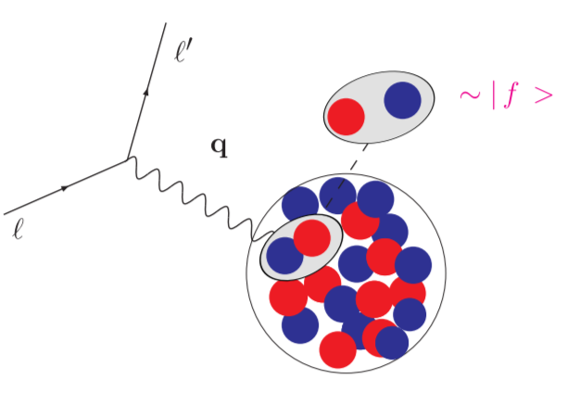
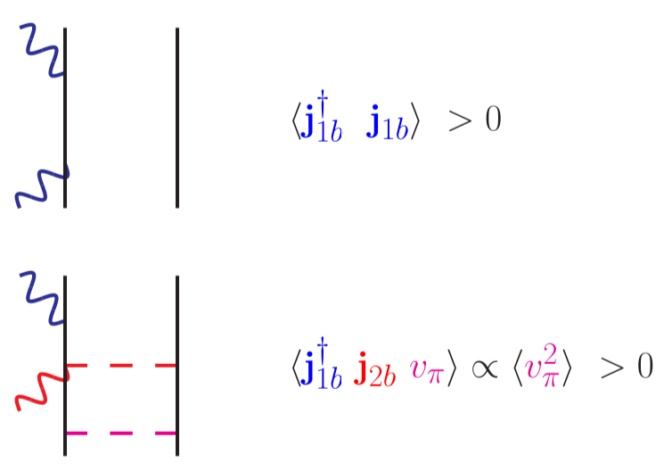
STA: The Inclusion of Two-Body Physics: 1b-1b, 1b-2b, 2b-1b, 2b-2b
The nuclear response in a mode $α$ can be expanded to include two-body terms for short times, where
$$e^{i\left(\hat{H}−ω\right)t}=e^{i\left(\sum_{i}{t_{i}}+\sum_{i<j}{v_{i,j}}−ω\right)t}≈\sum_{i}{t_{i}}+\sum_{i<j}{v_{i,j}}=P\left(t\right)$$
$$⟹R_{α}\left(q^{μ}\right)=\int{dt\left[\left\langle 0 | O_{α}^{†}\left(q^{μ}\right)e^{i\left(\hat{H}−ω\right)t}O_{α}\left(q^{μ}\right) | 0\right\rangle \right]}≈\int{dt\left[\left\langle 0 | O_{α}^{†}\left(q^{μ}\right)P\left(t\right)O_{α}\left(q^{μ}\right) | 0\right\rangle \right]}$$
$$⟹R_{α}\sim O_{α;i}^{†}P\left(t\right)O_{α;i}+O_{α;i}^{†}P\left(t\right)O_{α;j}+O_{α;i}^{†}P\left(t\right)O_{α;i,j}+O_{α;i,j}^{†}P\left(t\right)O_{α;i,j}$$
This naturally leads us to consider lepton scattering off of pair objects
$$\left|\left.f\right\rangle \right.\sim \left|\left.ψ_{p^{′},P^{′},J,M,L,S,T,M_{T}}\left(r,R\right)\right\rangle \right.$$
Correlated two-nucleon wave-functions allow for a full solve of the Schrödinger equation
Retains all nuclear and electroweak interactions induced by an $e$ or $ν$
Does not directly include real $Δ$-resonance for $π$-production

Slide 3
STA: The Inclusion of Two-Body Physics: Densities
One can encode all of this structure within response densities, $𝒟$
$$R_{α}\left(q^{μ}\right)\sim \int{dΩ_{P^{′}}dΩ_{p^{′}}dP^{′}dp^{′}δ\left(ω+E_{0}−E_{f}\right)⋅\left[{p^{μ}}^{′2}{P^{μ}}^{′2}\left\langle 0 | O_{α}^{†}\left(q^{μ}\right) | {p^{μ}}^{′},P^{μ}′\right\rangle \left\langle {p^{μ}}^{′},P^{μ}′ | O_{α}^{†}\left(q^{μ}\right) | 0\right\rangle \right]=⋯}$$
$$⋯=\int{dP^{′}dp^{′}δ\left(ω+E_{0}−E_{f}\right)⋅𝓓\left({p^{μ}}^{′},{P^{μ}}^{′};q^{μ}\right)}$$
Contains information about semifinal states…
…the contents of the nucleus after the probe interacts with the pair
“Exclusive” information on specific nucleon pair kinematics
Correctly accounts for interference terms
Leads to enhancement of the transverse response, and thus, the overall cross section
See S. Pastore et al. for details in PRC

Slide 4
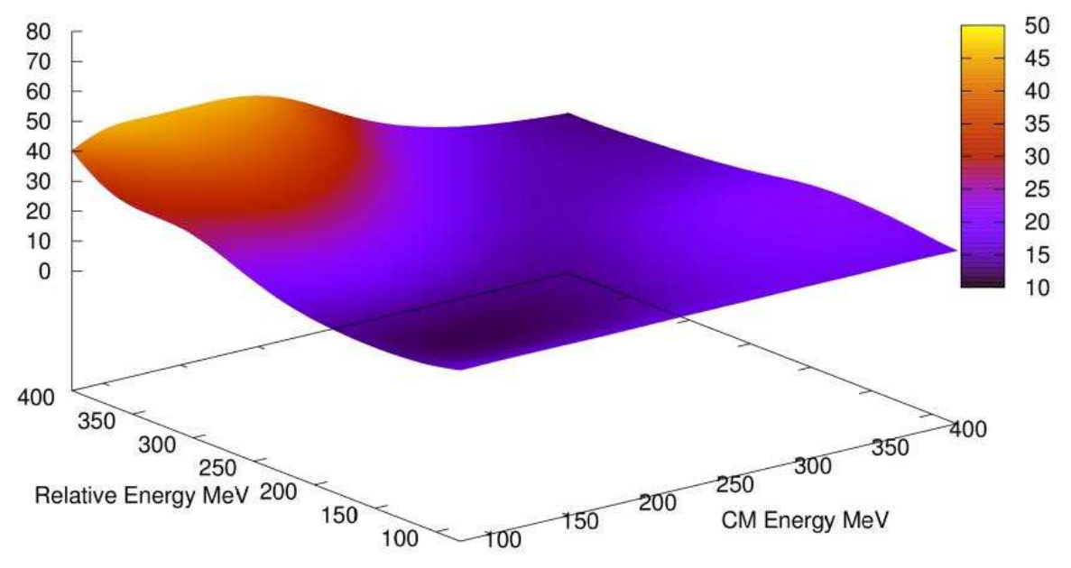
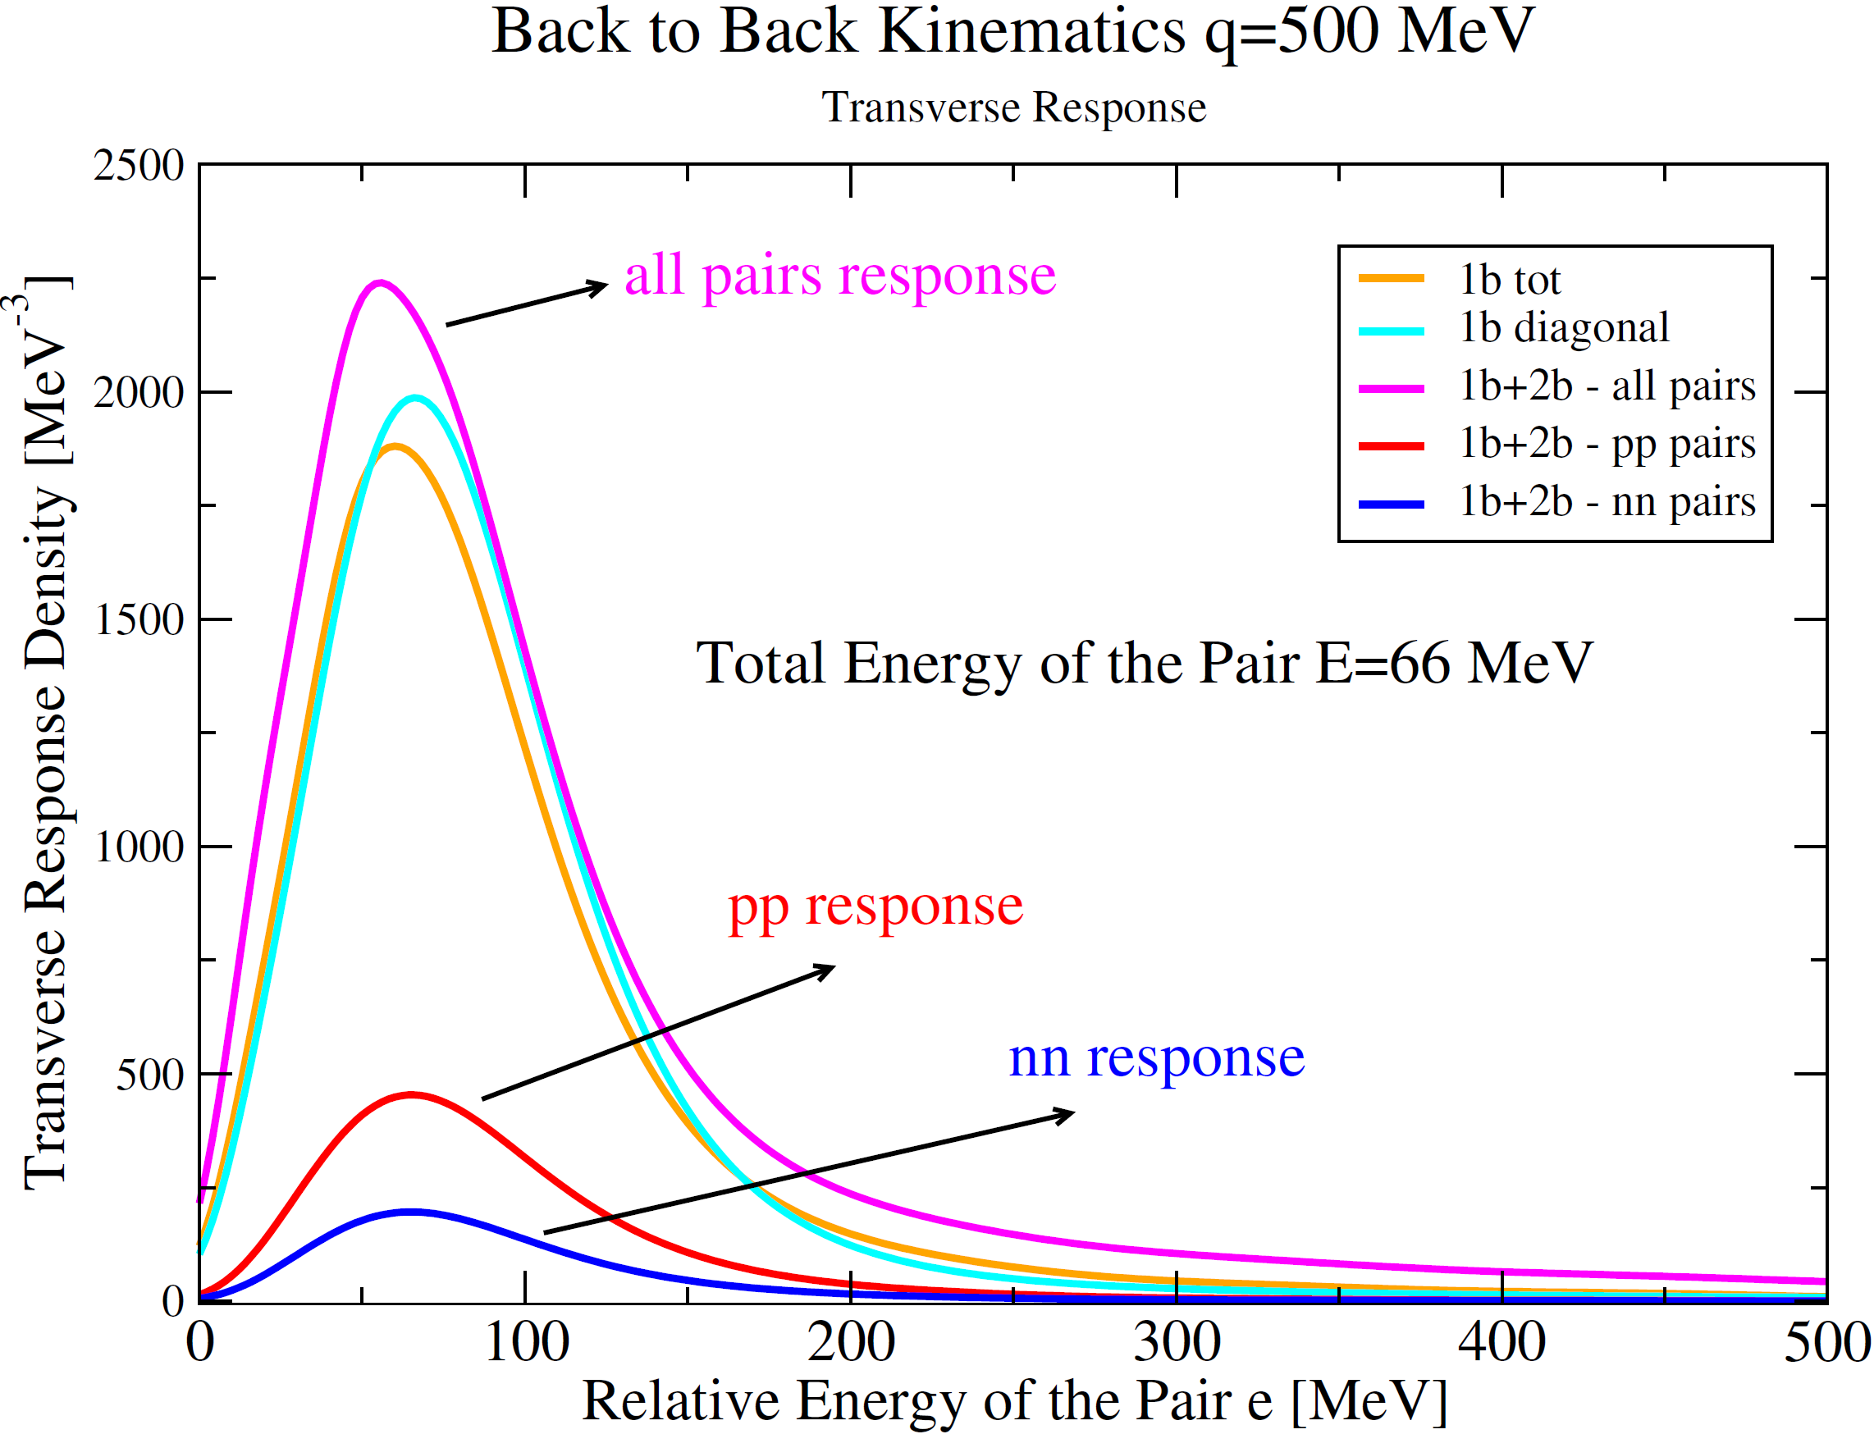
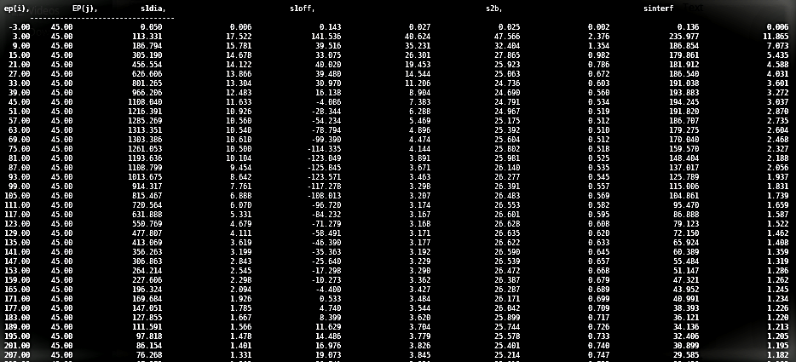
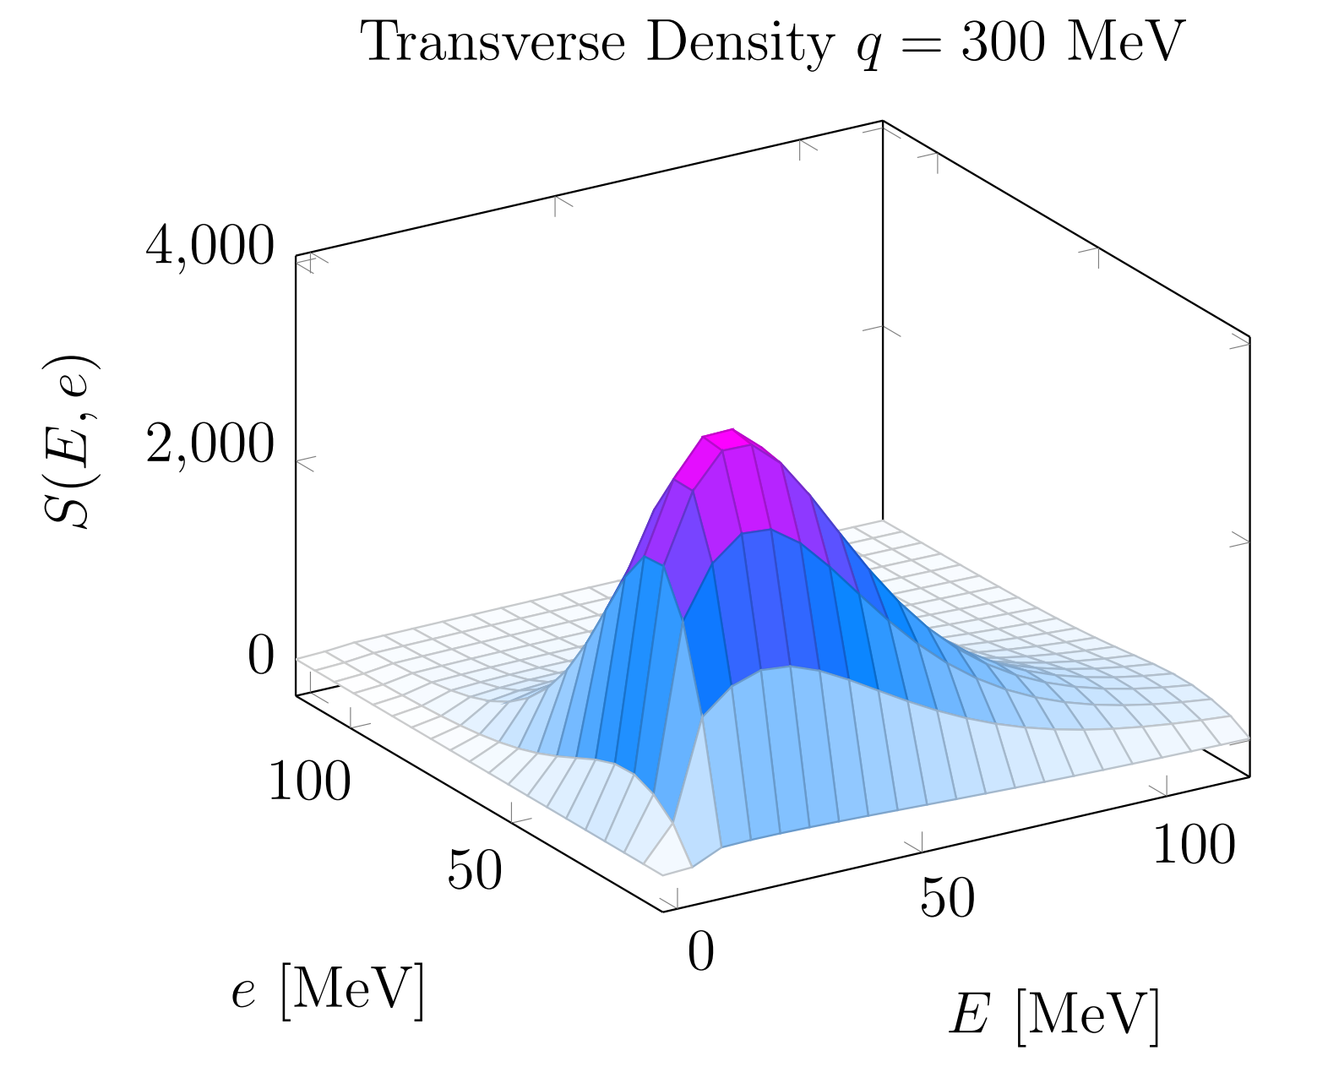
Current QMC STA Outputs for $e{}_{2}^{4}{He}$
Preliminary
Tables are currently available for densities and responses
Contain kinematics relevant to the $\sim$quasielastic regime ($ω\tilde{ϵ}\left(0,800\right]MeV$ )
$\left\{e^{′},E^{′}\right\}⊗\left[\left\{𝒟_{α,1b}^{i→i},\overline{𝒟_{α,1b}^{i→i,stat.}}\right\}+\left\{𝒟_{α,1b}^{i→j},\overline{𝒟_{α,1b}^{i→j,stat.}}\right\}+\left\{𝒟_{α,2b}^{ij→ij},\overline{𝒟_{α,2b}^{ij→ij,stat.}}\right\}\right]$
Particle identities of struck pair, radii, and separation distance are all already available (or are in principle) within this and other consistent schemes
Table reading and interpolation algorithms have been developed for this model within GENIE

Slide 5
Leptonic cross section modeling: HadronTensor framework
Use a very general form to provide differential prediction for lepton kinematics
Hadronic tensor pre-calculated and tabulated for efficient evaluation in GENIE
Elements expressed as a function of
$$ω=E_{ℓ}−E_{ℓ^{′}}$$
$$q=\left|p_{ℓ}−p_{ℓ^{′}}\right|$$
First new GENIE model that uses these: SuSAv2 (G. Megias et al.)
Approved for next public GENIE release (v3.2)
Serves as the MC base for our QMC STA (leptonic) event generator utilizing hadron tensor table-making
$eA$ validation informs $νA$ modeling
Consistent microscopic description of scattering will eventually be implemented for EM/CC/NC scattering
$$\frac{d^{2}σ}{dE_{ℓ^{′}}dcos\left(θ_{ℓ^{′}}\right)}=\frac{\left|k^{′}\right|}{\left|k\right|}\frac{G_{F}^{2}}{2π}L_{μν}W^{μν}$$
$$\frac{d^{2}σ}{dE_{ℓ^{′}}dΩ_{ℓ^{′}}}=σ_{M}\left[ν_{L}R_{L}\left(q,ω\right)+ν_{T}R_{T}\left(q,ω\right)\right]$$
SuSAv2 prediction compared to T2K data
SuSAv2 implementation note
Adapted from S. Gardiner

Slide 6
QMC STA $e{}_{2}^{4}{He}$ Response Comparisons Used in GENIE for Interpolation
The interference and one-body off-diagonal terms show asymmetric and even destructive behavior to the total response
Nuclear responses are available for $\left\{np,pp,nn\right\}$ scattering
$pp$ responses are nonzero for both longitudinal and transverse modes
$nn$ is effectively zero for the longitudinal response
Current experimental response data interpolated by I. Sick and K. F. von Reden for $e{}_{2}^{4}{He}$
Both match rather well using different data and independent interpolation methods
Shows great agreement at larger values of $\left|\vec{q}\right|≥400 MeV/c$ when outside of the lower energy elastic response regime
PRELIMINARY
Phys. Rev. C 65, 024002

Slide 7
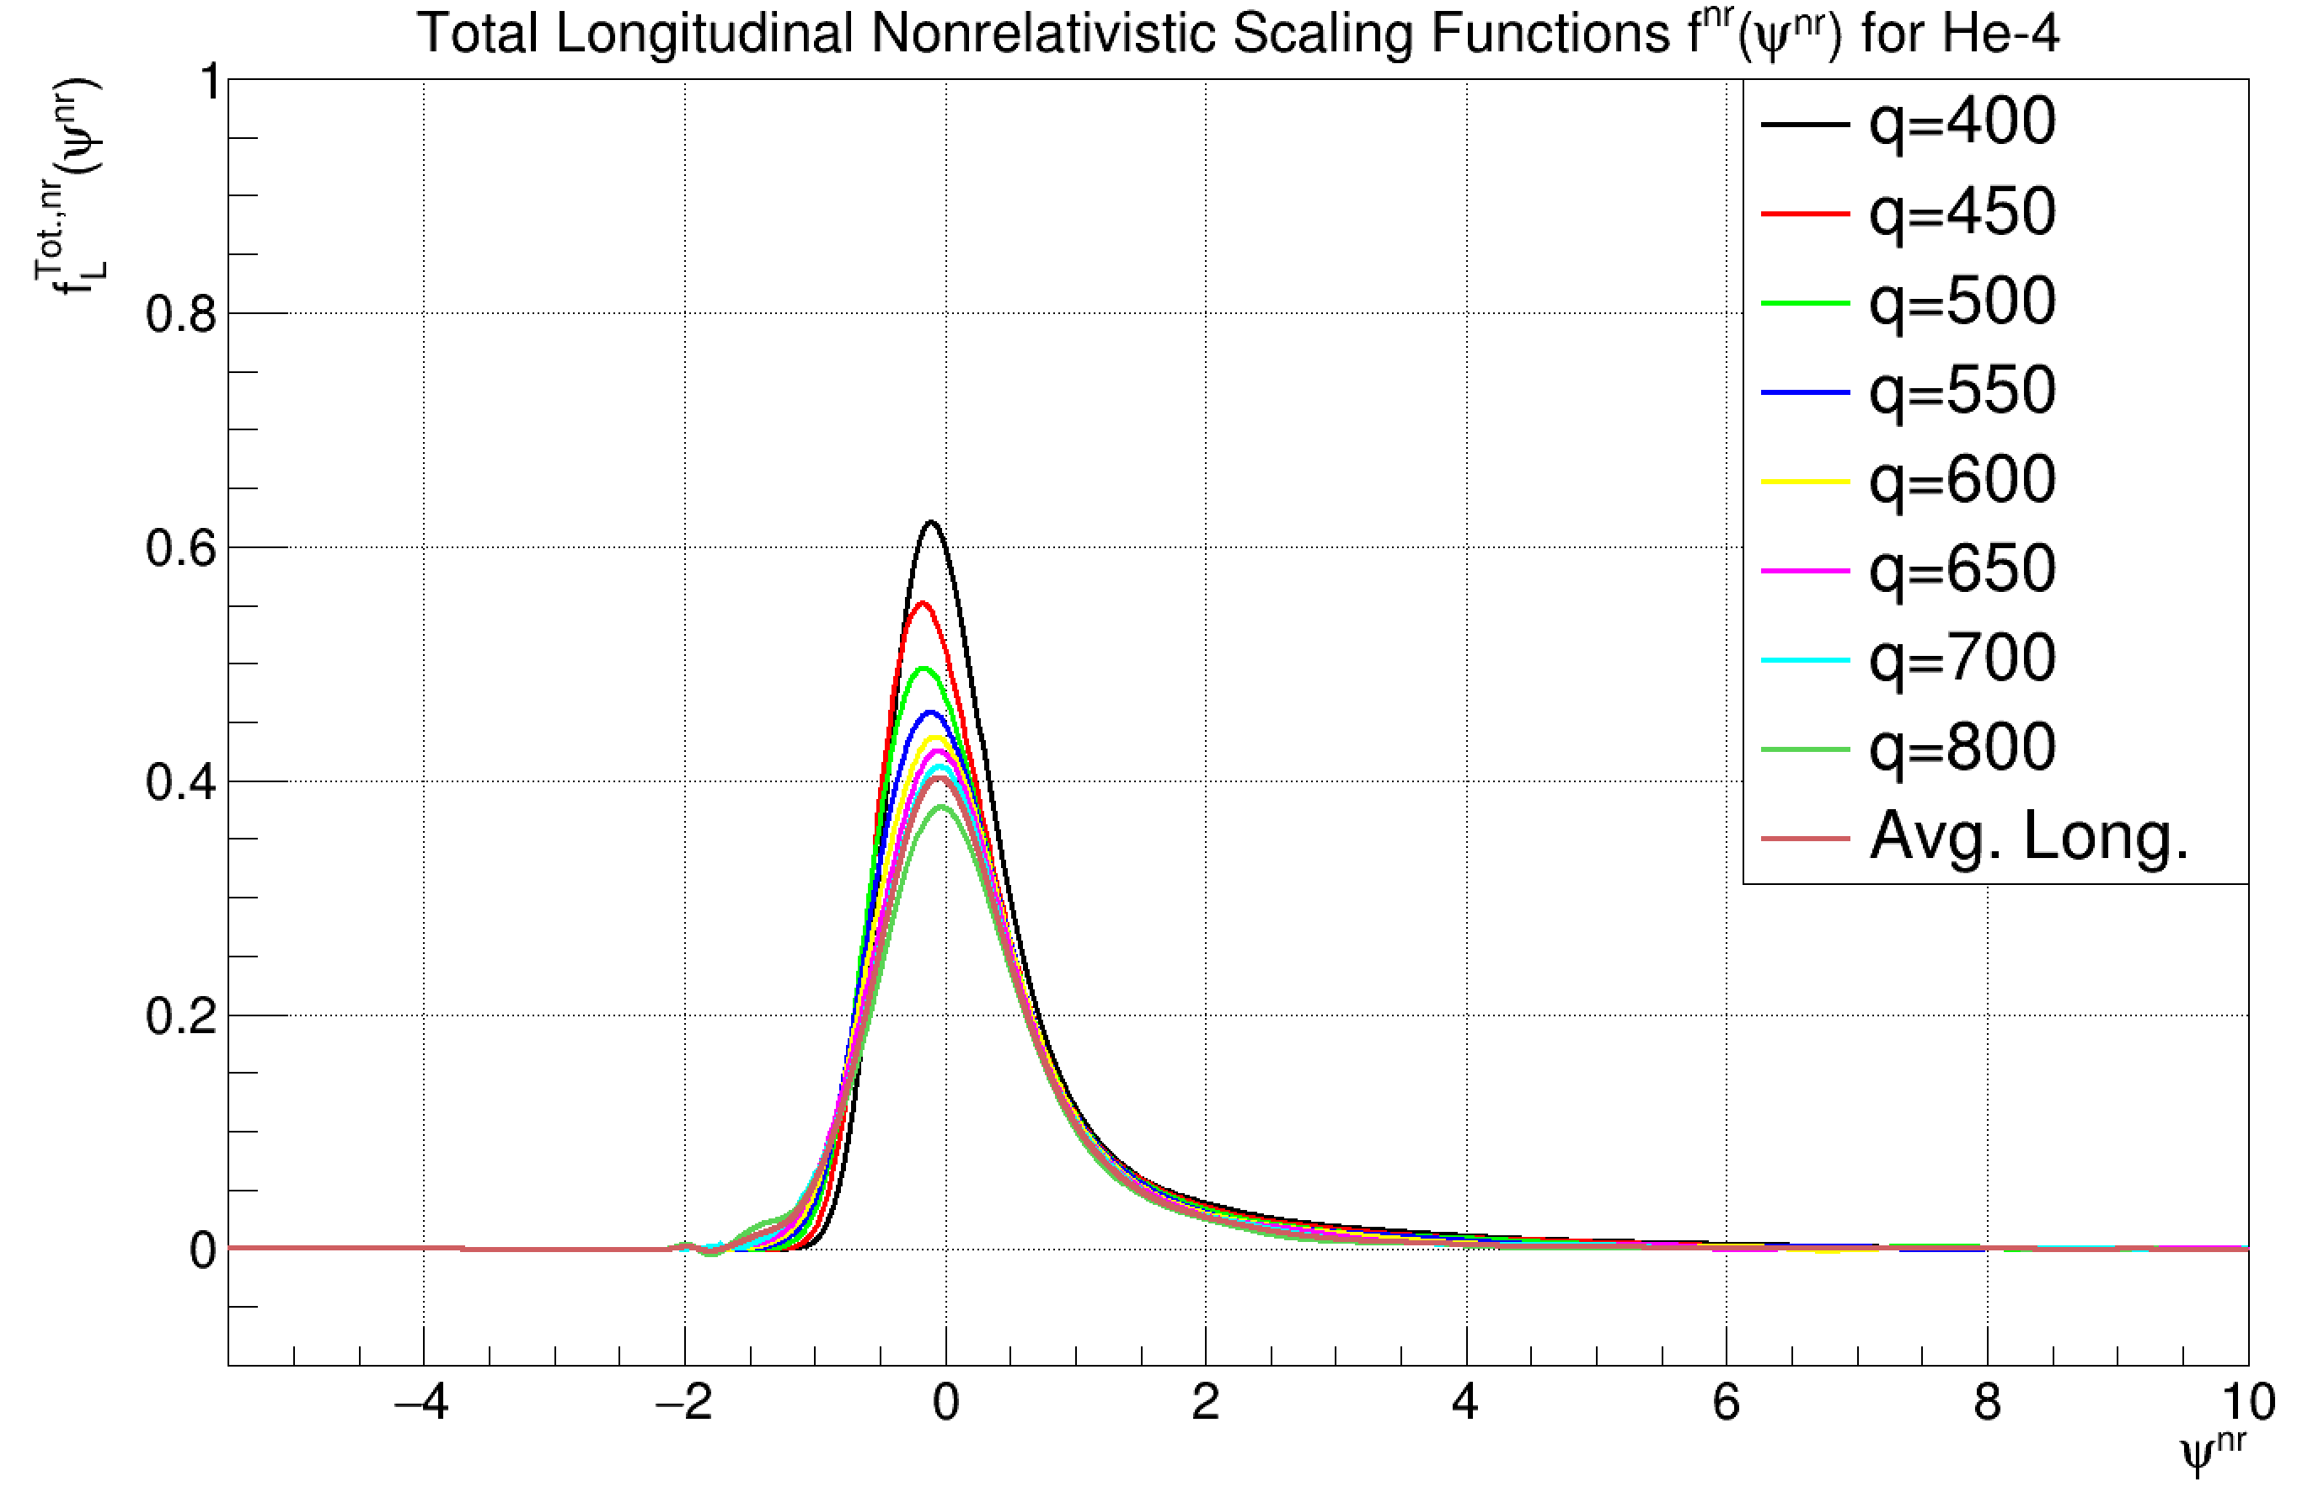
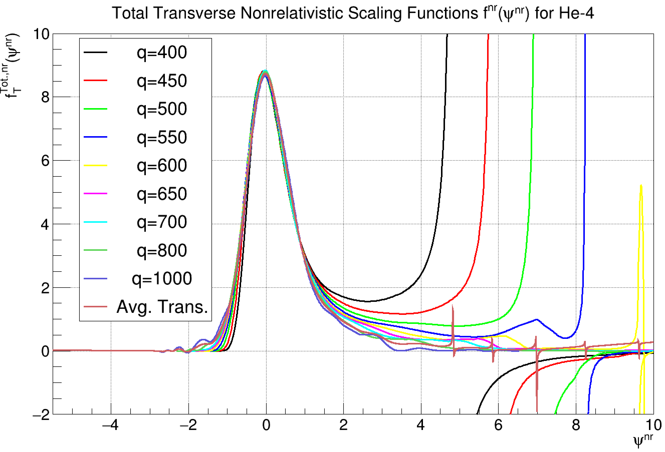
Total Nuclear Response Function Scaling Studies
Thanks to Noemi Rocco, Alessandro Lovato, Steve Dytman, and Joe Carlson in alerting us to these techniques
For more background, see PhysRevC.60.065502, PhysRevC.96.015504, PhysRevC.97.055501
Scaling behavior seems to be observed in the responses when
$$ψ^{nr}\left(\left|\vec{q}\right|,ω\right)=\frac{m_{N}}{\left|\vec{q}\right|k_{F}}\left(ω−\frac{q^{2}}{2m_{N}}\right)→\frac{m_{N}}{\left|\vec{q}\right|k_{F}}\left(ω−\frac{q^{2}}{2m_{N}}−ε\right)$$
$$f_{L}^{nr}\left(ψ^{nr}\right)=\frac{k_{F}\left|\vec{q}\right|\left(Q^{2}+4m_{N}^{2}\right)}{4𝒩m_{N}^{3}}\frac{R_{L}^{nr}\left(\left|\vec{q}\right|,ω\right)}{{\left[G_{E,p}\left(\left|\vec{q}\right|\right)+G_{E,n}\left(\left|\vec{q}\right|\right)\right]}^{2}}$$
$$f_{T}^{nr}\left(ψ^{nr}\right)=\frac{2k_{F}m_{N}\left|\vec{q}\right|}{𝒩}\frac{R_{T}^{nr}\left(\left|\vec{q}\right|,ω\right)}{{\left|\vec{q}\right|}^{2}{\left[G_{M,p}\left(\left|\vec{q}\right|\right)+G_{M,n}\left(\left|\vec{q}\right|\right)\right]}^{2}+k_{F}^{2}{\left[G_{E,p}\left(\left|\vec{q}\right|\right)+G_{E,n}\left(\left|\vec{q}\right|\right)\right]}^{2}(1−ψ^{nr})}$$
Average over all scaling functions
$${\overline{f_{α}}}^{nr}\left[ψ^{nr}\right]=\frac{1}{10}\sum_{i=1,q=400}^{i=10,q=1000}{f_{α}^{nr}\left[ψ^{nr}\left(\left|q_{i}\right|\right)\right]}$$
to find o$ur q\sim$invariant scaling function
Invert equation to find new responses in $1MeV/c$ spacing from $\left|q\right|ϵ\left\{1,2000\right\}\text{MeV}$ for both components—allows for expansive interpolation beyond original response ranges
$R_{α}^{STA}\left(\left|q\right|,ω\right)=\frac{1}{k_{F}}$ $G_{α}^{nr}\left(\left|q\right|\right){\overline{f_{α}}}^{nr}\left[ψ^{nr}\right]$
PRELIMINARY
PRELIMINARY

Slide 8
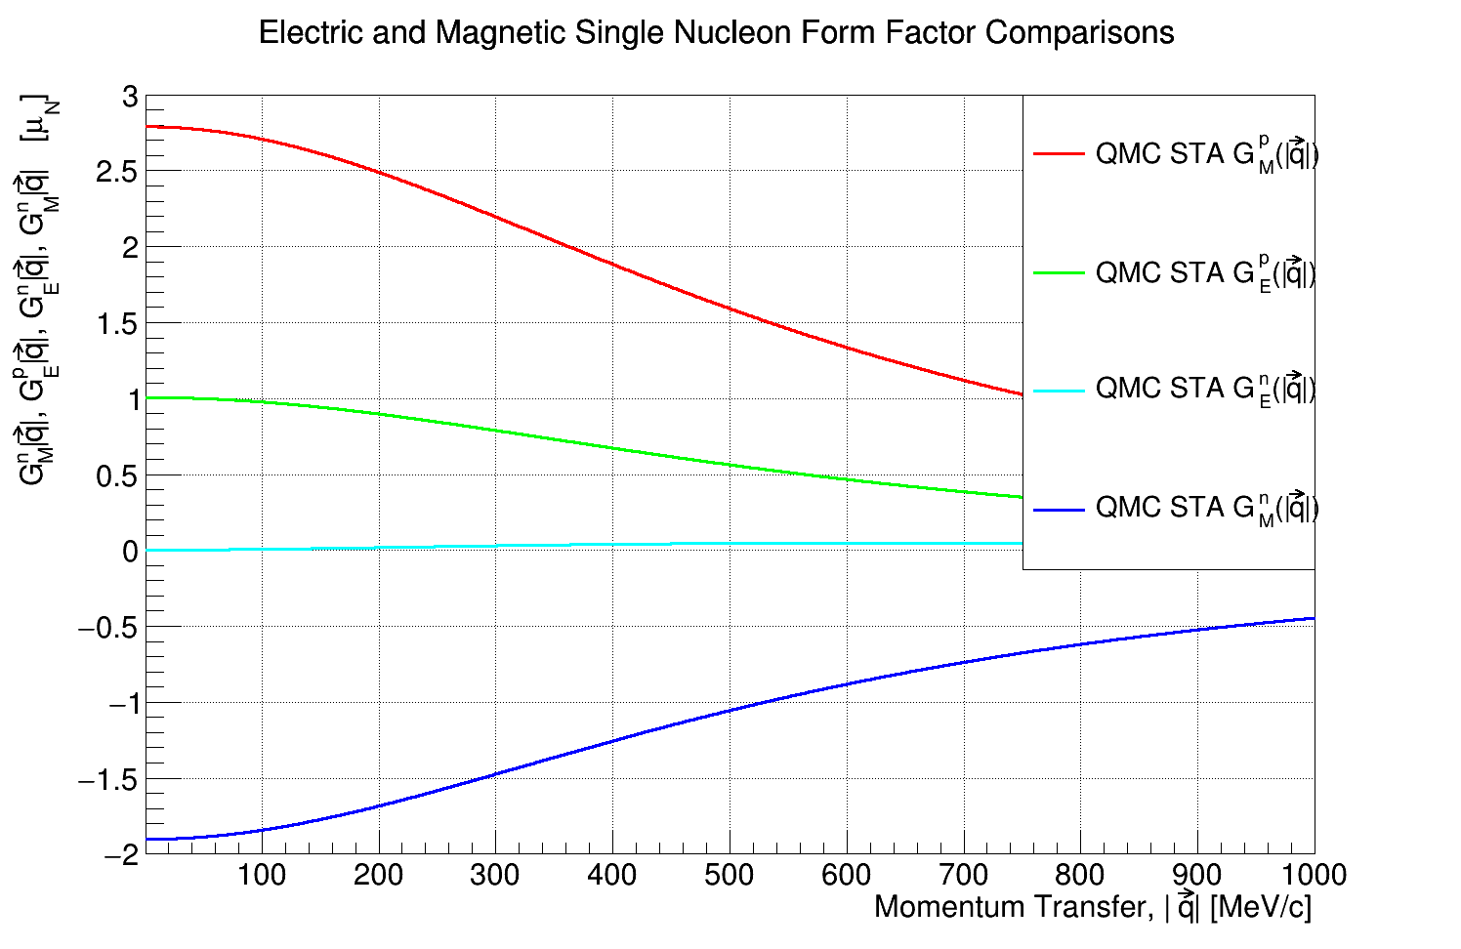
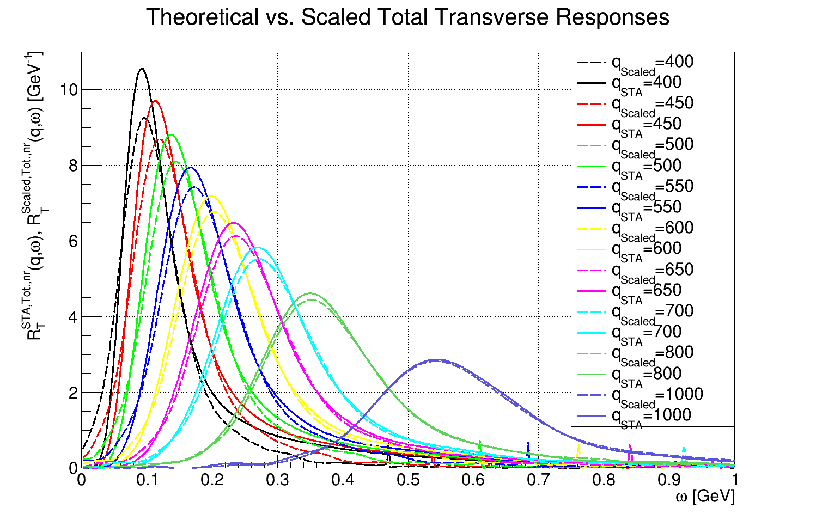
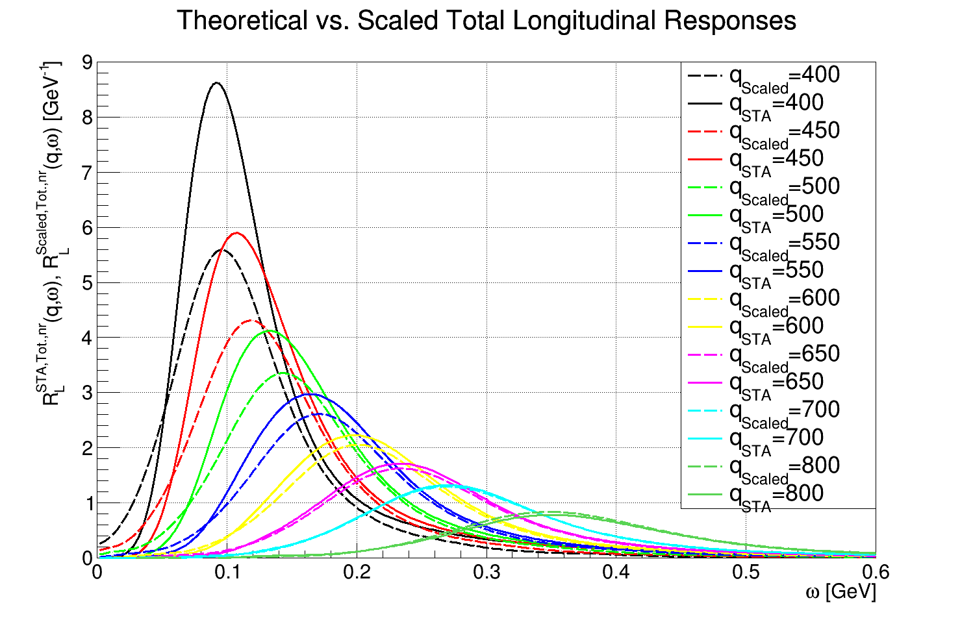
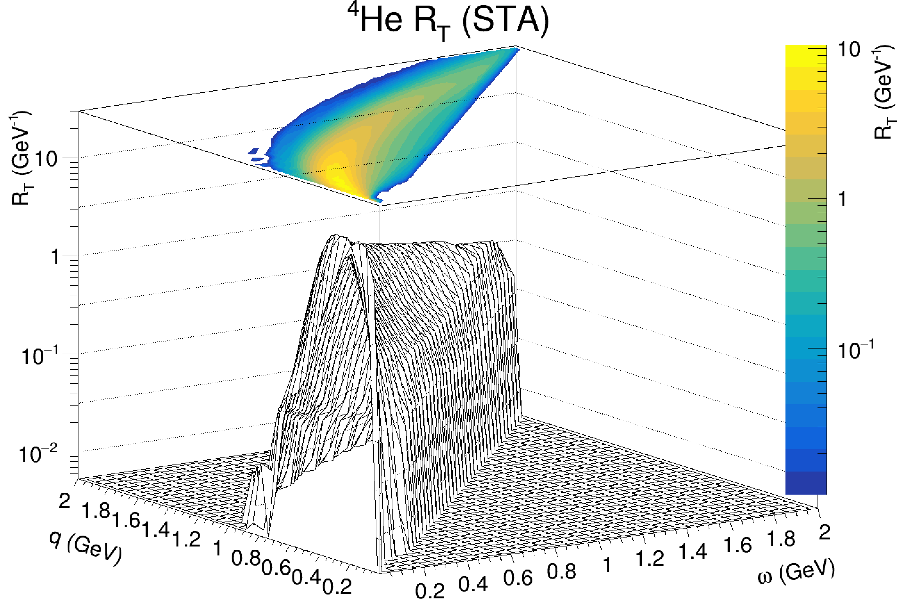
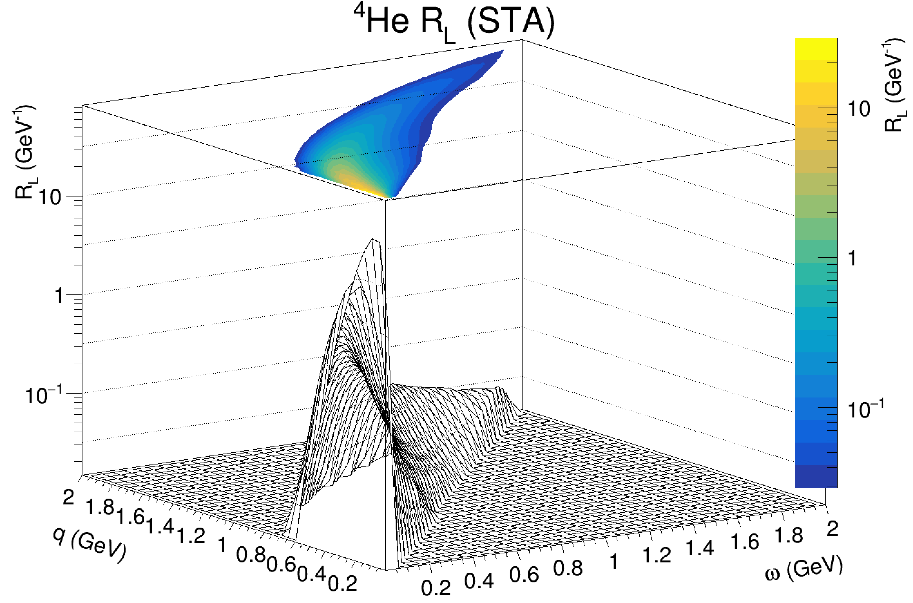
Expansive Bilinear Interpolation of Scaled ${}_{2}^{4}{He}$ STA Response Functions
PRELIMINARY
PRELIMINARY
Scaled transverse responses show good agreement
Effectively no elastic peak present
Scaled longitudinal responses show decrease in strength
Effectively removed elastic peak due to higher proportion of average-weighting coming from higher momentum transfers
PRELIMINARY
PRELIMINARY

Slide 9
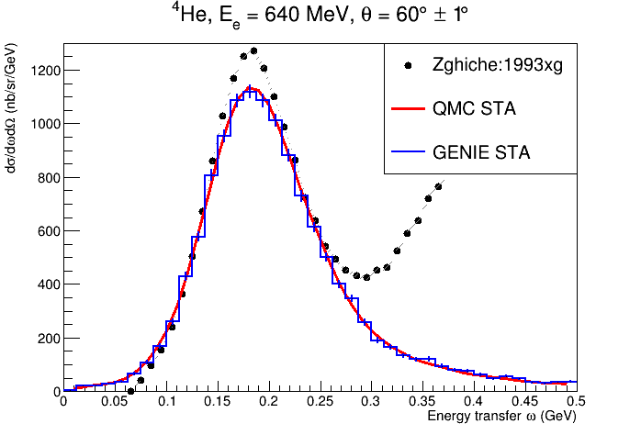
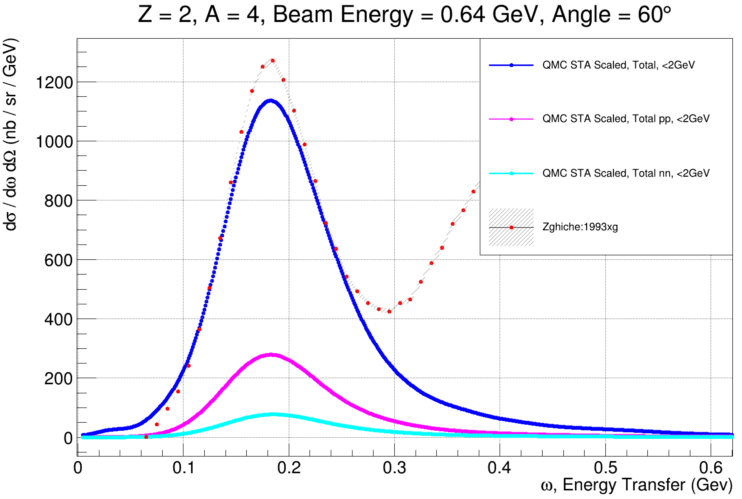
Leptonic $\frac{d^{2}σ}{dE^{′}dΩ′}$predictions and event generation validation underway
GENIE’s HadronTensor formalism has easily integrated QE QMC STA scaled/interpolated responses for event generation
Built on SuSAv2 generator
GENIE and scaled theoretical responses show great agreement
Both correctly underpredict QE peak due to lack of $π$-production
PRELIMINARY
[Rev. Mod. Phys. 80, 189-224, 2008]
QE EM Scattering Archive

Slide 10
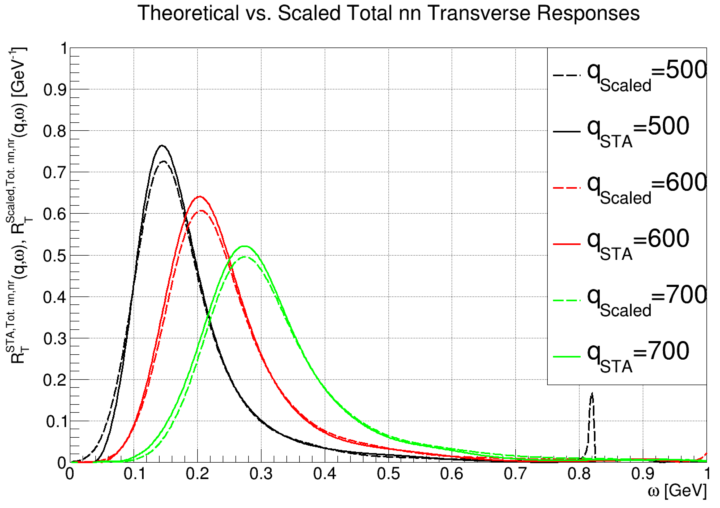
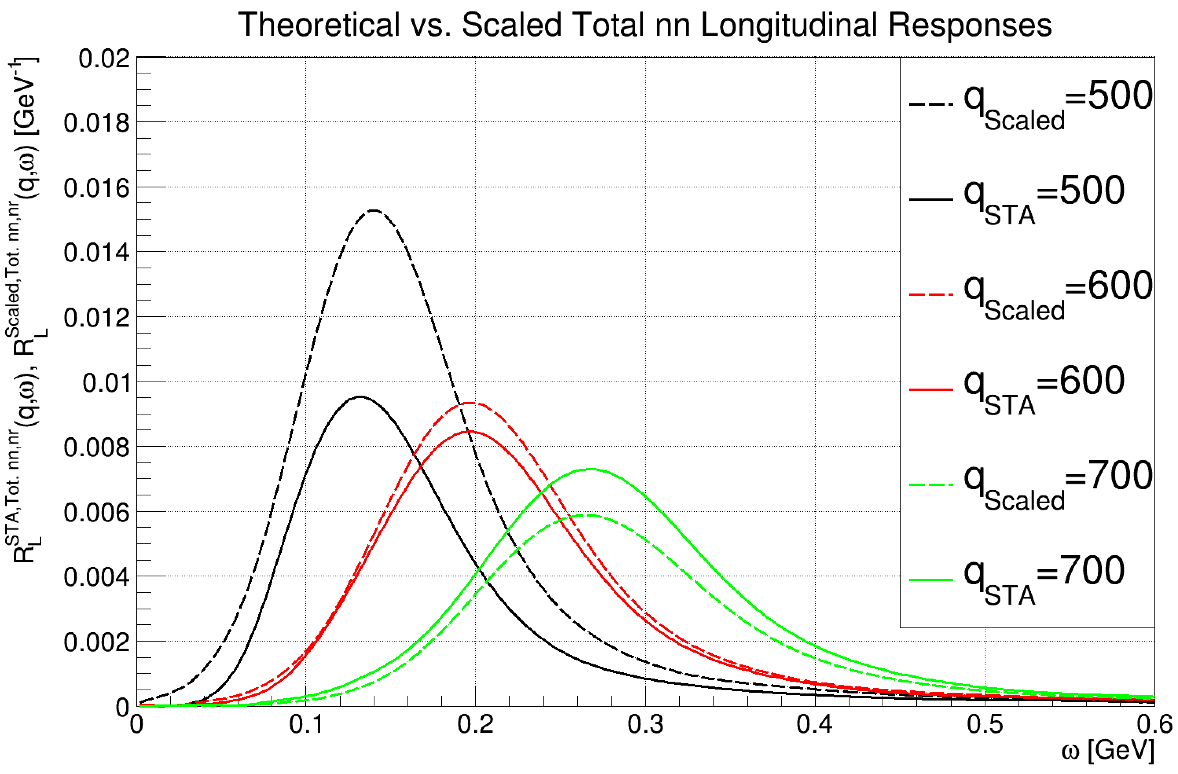
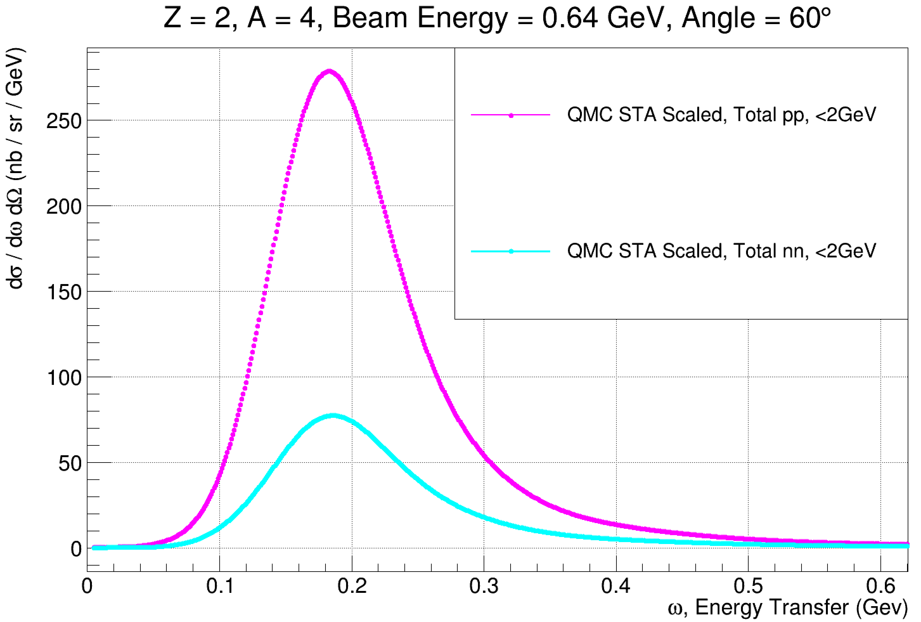
Leptonic two-nucleon $\frac{d^{2}σ}{dE^{′}dΩ′}$predictions
The same scaling analysis can be completed for a number of pure two-body longitudinal and transverse nuclear response functions
Scaling of $nn$ and $pp$ nuclear responses works quite well due to their relative lack of two-body currents
Going through a similar scaling and interpolation, we can create pure two-body scattering double differential cross sections
Approximates expected two-body final states in $e{}_{2}^{4}{He}$ scattering
Interference of $eN→eNN$ and $eNN→eN$ states must be accounted for
Can only be completed with a full FSI model integration (forthcoming)
Angular distributions will be approximated

Slide 11
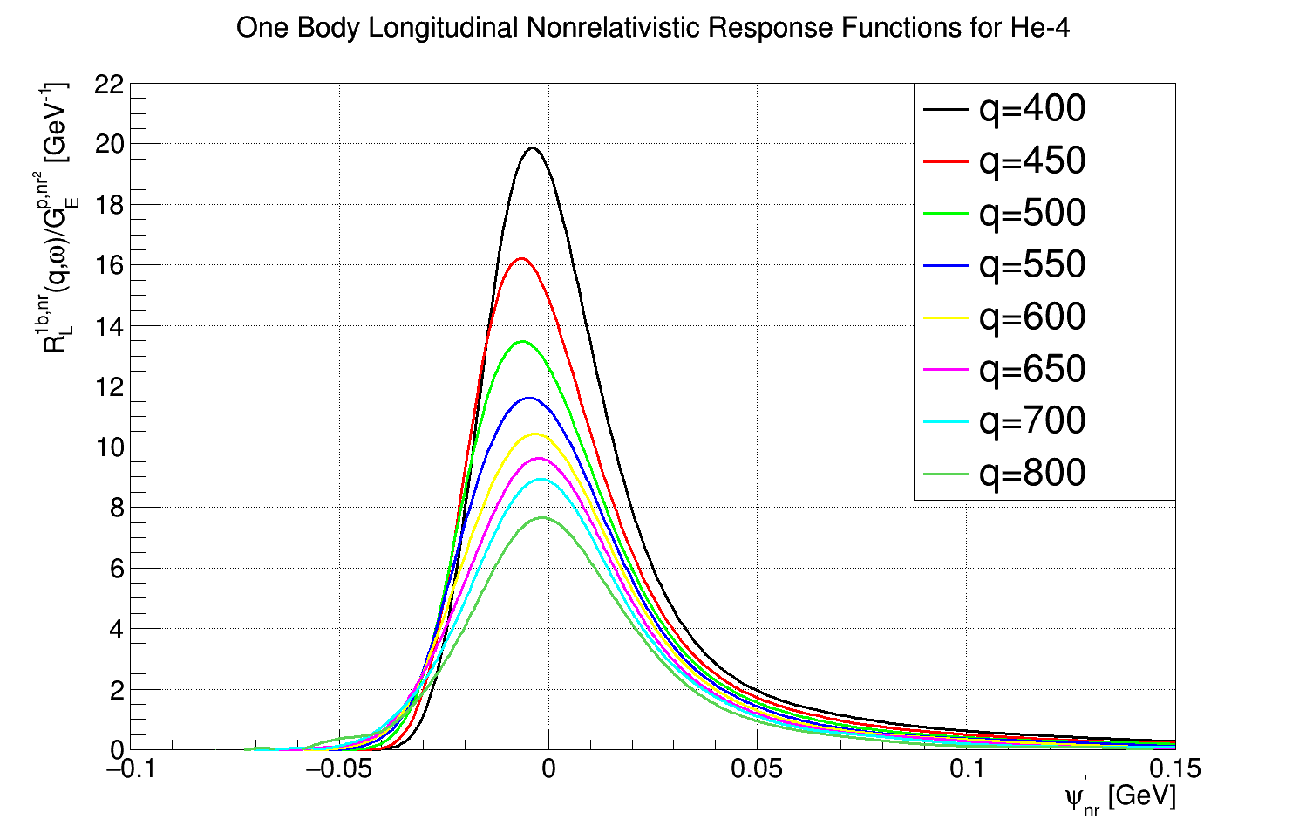
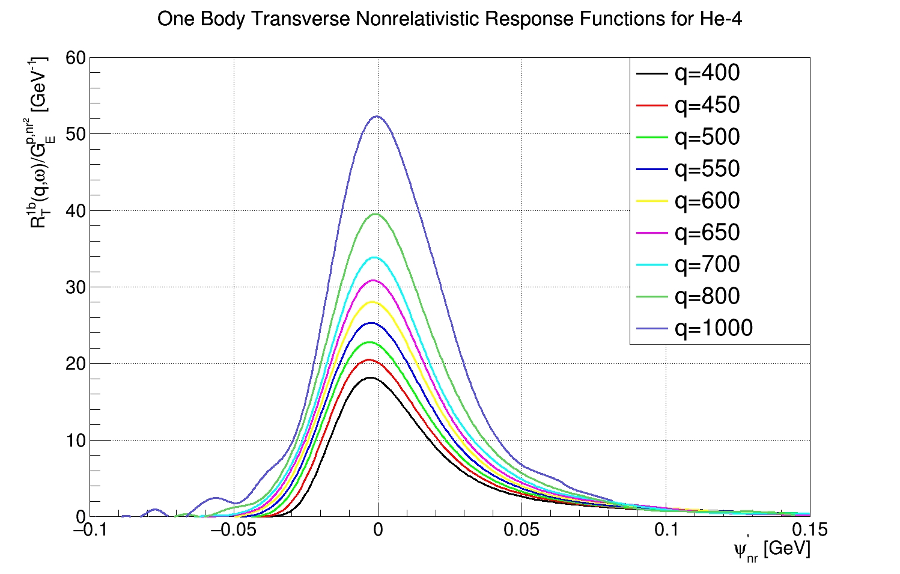
Interceding Interpolation Algorithms
Alignment-DEVELOPING
Does not use scaling function, purpose built
Exploit alignment of responses in new parameter space of $\left\{\sim R,\left|q\right|,ψ′\right\}$
Use same GENIE bilinear interpolation on this surface via a simple change of variables from $ω→ψ′$ (dimensional!)
Convert back from $ψ′→ω$, then recover full $\left\{\sim R,\left|q\right|,ω\right\}$ surface
Moment Morphing-DEVELOPING
A nonlinear technique of interpolation developed by and used within HEP/LHC communities
Directly available within ROOT and thus GENIE
Can handle high-dimensional, sparse systems
Can utilize moment morphing interpolation for response densities and nuclear responses separately as a cross check (with 𝟏 𝐌𝐞𝐕/𝐜 spacing)
By integrating response densities, will recover responses identically spaced
This is very important for interfacing the hadronic two-body part of the nuclear responses and cross sections to create final states after FSI
PRELIMINARY
PRELIMINARY
PRC.60.065502,PRC.96.015504

Slide 12
Interpolation of response densities across $q$ using nonlinear moment morphing
Two-dimensional distributions, dependent on lepton kinematics
Computationally expensive! Need many CPU hours to produce, even on a sparse grid
We achieve smoothly-varying interpolation of these using a numerical technique called "moment morphing“
Will form foundations of full generator with correlated leptonic and hadronic semifinal state production before nuclear transport
Pioneered to solve similar problems for LHC experiments
See arXiv:1410.7388 for more details
PRELIMINARY

Slide 13
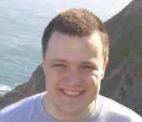
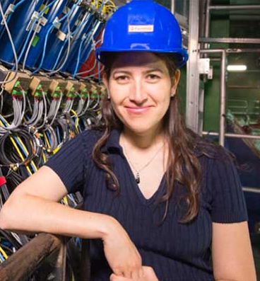
Collaborators—Thank-you!
Steven Gardiner, FNAL
Saori Pastore, WUSTL
Joshua Barrow, UTK
Minerba Betancourt, FNAL

Slide 14
Summary and To-Dos
First QMC-STA EM QE GENIE implementation focused on leptonic final states is effectively complete
Scaling analysis shows great promise
Matches available QE EM scattering double differential cross section data very well up to $\sim 2GeV$
Other interpolation mechanisms to follow soon
Stay tuned to the arXiv!
Still to complete:
Go beyond the lepton to create one and two-hadron final states
Compare to available two-body final state data
Must integrate our approach within GENIE FSI models
Will require “guessing” angular distributions
${}_{2}^{3}{He}$!!! ${}_{6}^{12}C$!!! $ν‼!$

Slide 15
Backup Slides

Slide 16
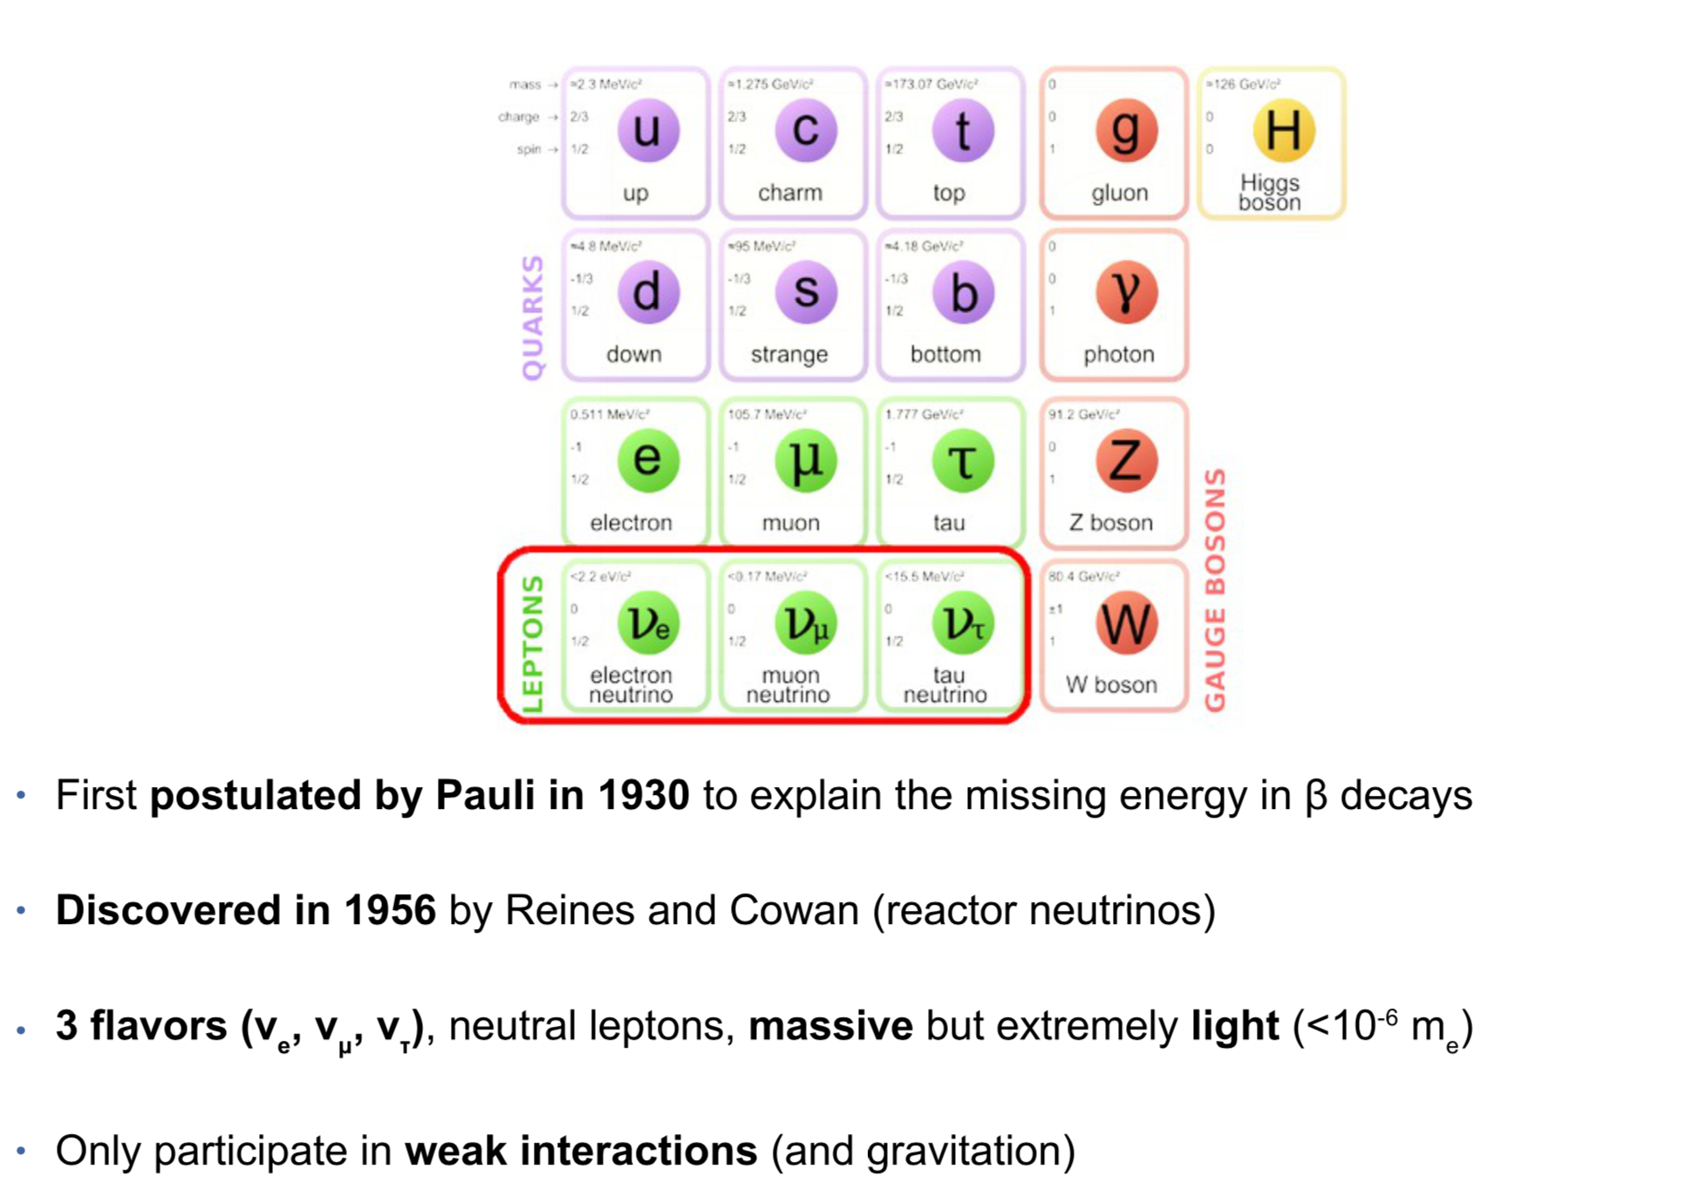
Neutrinos in the Standard Model

Slide 17
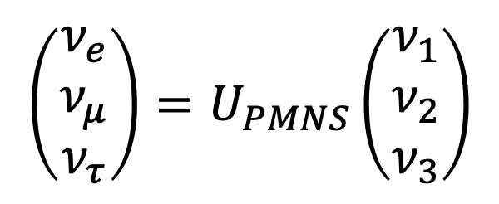
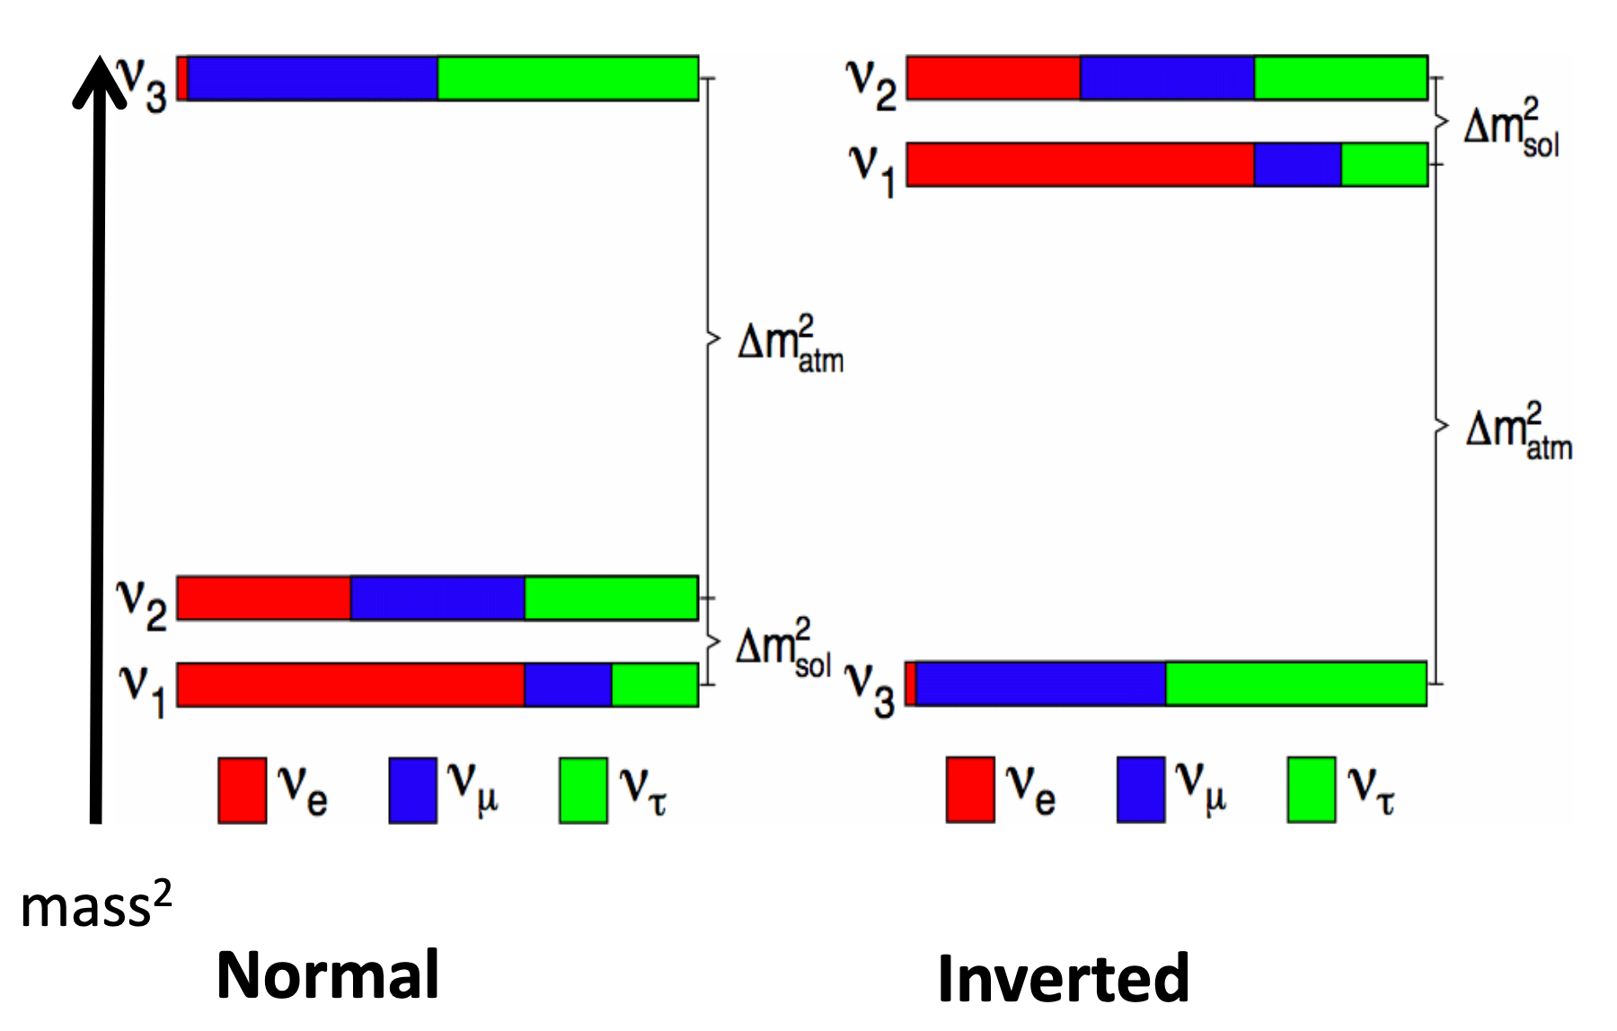
Neutrino Oscillations
Compelling evidence from solar and atmospheric neutrino experiments
The 3 known neutrino flavors represent mixtures of at least 3 mass states
3-flavor model parameterized by the Pontecorvo-Maki-Nakagawa-Sakata (PMNS) matrix
Key questions remain:
Do neutrinos and antineutrinos oscillate differently? (CP violation)
Is v3 the heaviest or lightest of the known mass states? (Mass ordering)
Is the 3-flavor model sufficient to describe nature? (Sterile neutrinos)

Slide 18
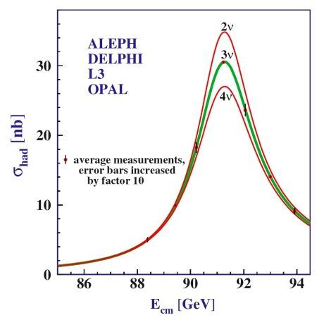
Neutrino Oscillations
Compelling evidence from solar and atmospheric neutrino experiments
The 3 known neutrino flavors represent mixtures of at least 3 mass states
3-flavor model parameterized by the Pontecorvo-Maki-Nakagawa-Sakata (PMNS) matrix
Key questions remain:
Do neutrinos and antineutrinos oscillate differently? (CP violation)
Is v3 the heaviest or lightest of the known mass states? (Mass ordering)
Is the 3-flavor model sufficient to describe nature? (Sterile neutrinos)
Strong evidence for 3 active neutrino flavors

Slide 19
Importance of neutrino cross sections for answering the big questions

Slide 20
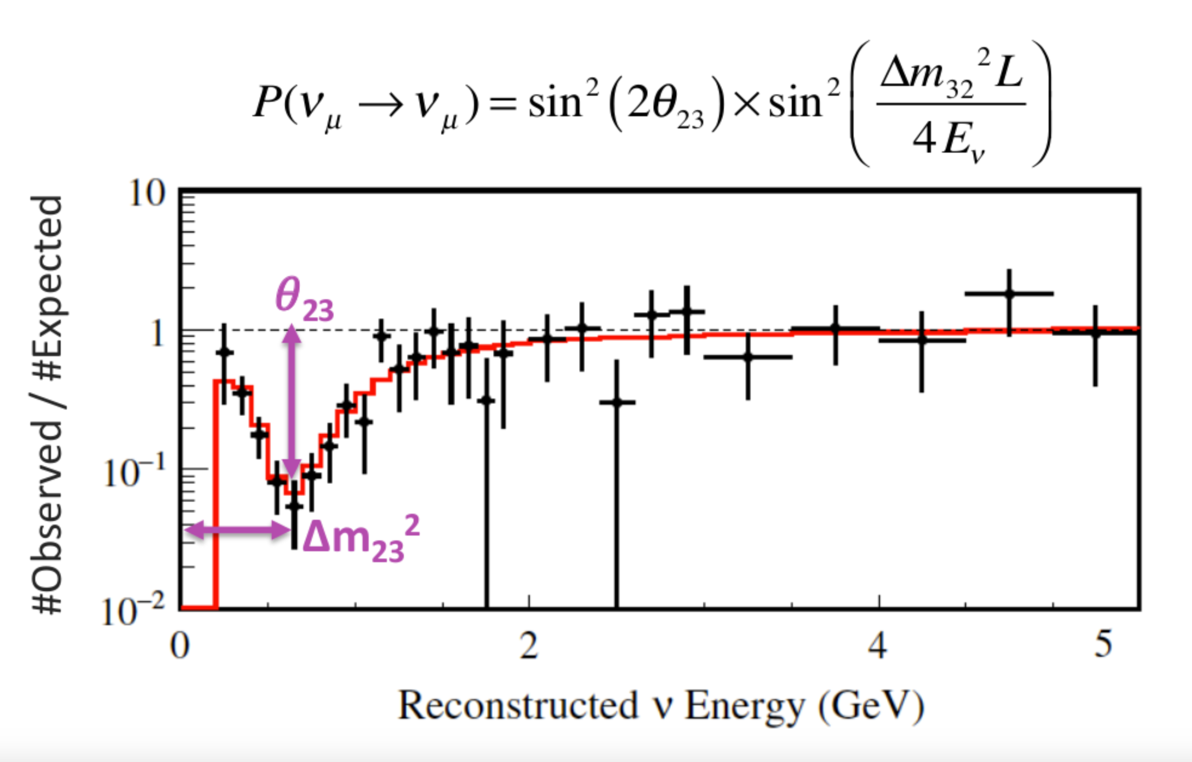
Example analysis from the T2K experiment
Disappearance
Measure deficit of detected vμ relative to expectation without oscillations
Fit as a function of reconstructed energy
Extract PMNS matrix parameters
We can't measure the neutrino energy directly
Instead, we estimate it event-by-event based on the final particles we can see
Modeling deficiencies in the cross section prediction can lead to bias!
T2K Collaboration, Phys. Rev. D 91, 072010

Slide 22
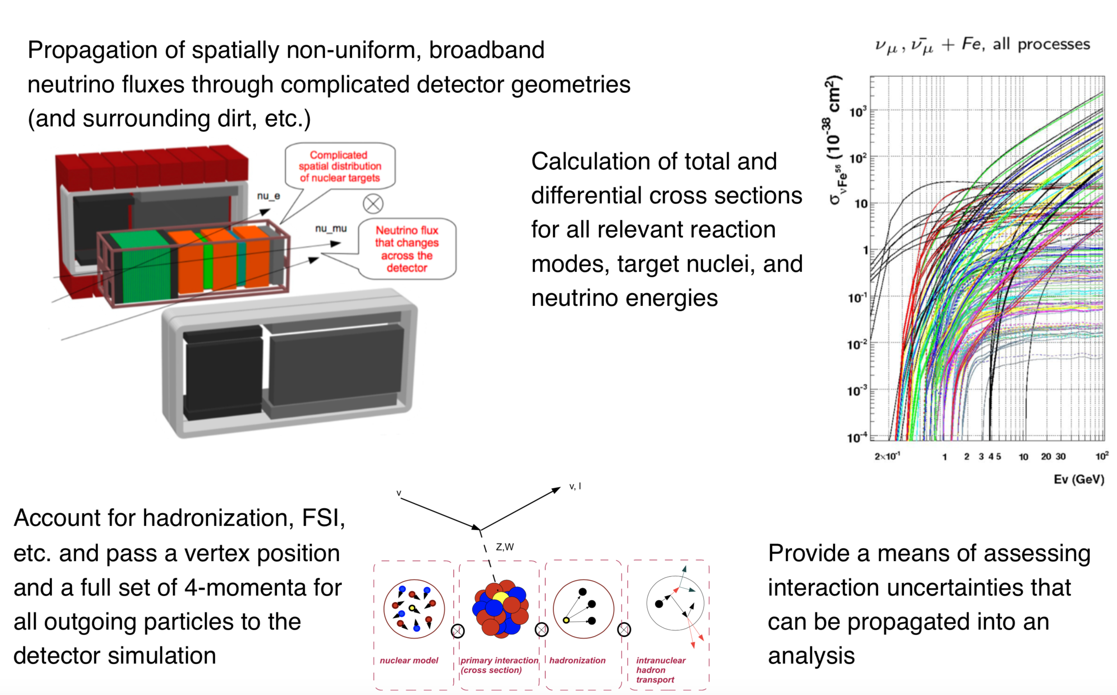
What tasks are involved in predicting event rates?
Images by C. Andreopoulos

Slide 23
What tasks are involved in predicting event rates?

Slide 24
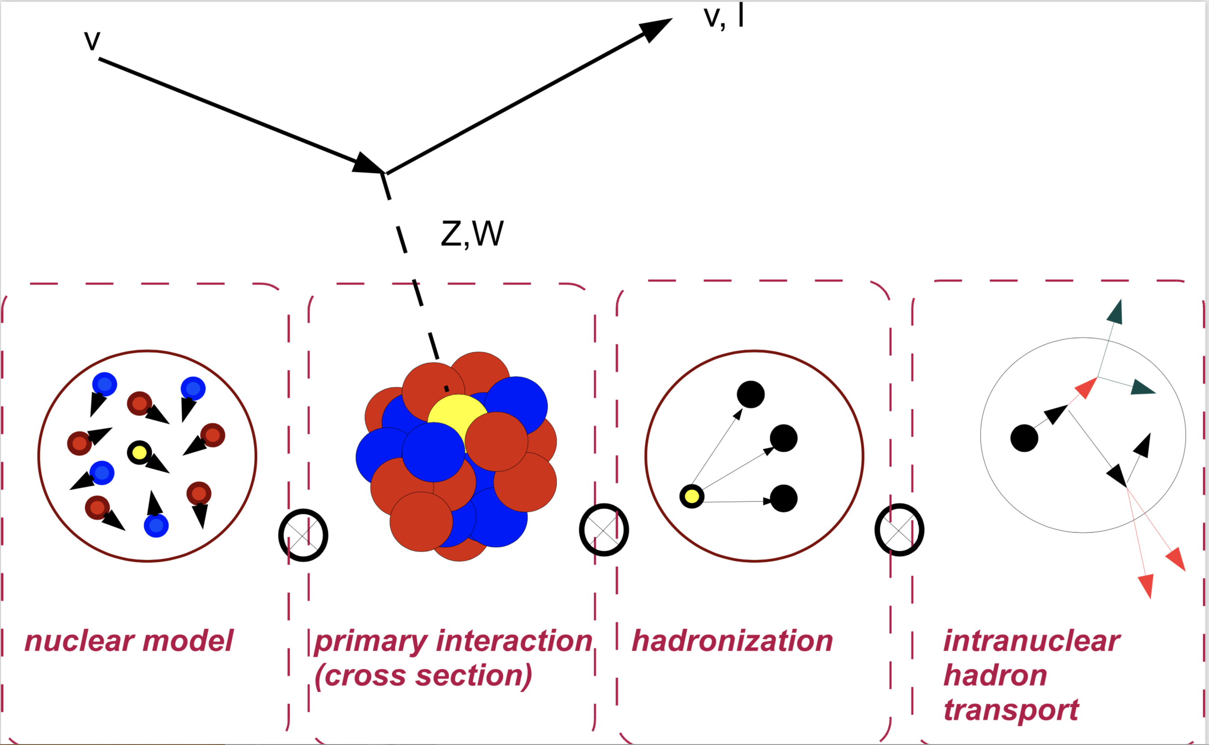
Generators resort to an approximate picture of the relevant physics
"Traditional" treatment includes
Fermi gas model of initial nuclear state
No shell structure, correlations, etc.
Neutrino scatters on a single bound nucleon
Two-nucleon contributions known to be important!
Interference between processes neglected
"Square then sum" → Not what you learned in quantum mechanics class . . .
Semi-classical transport of hadrons out of the nucleus
Rescattering cross sections based on hadron-nucleus data

Slide 25
Generators resort to an approximate picture of the relevant physics
"Traditional" treatment includes
Fermi gas model of initial nuclear state
No shell structure, correlations, etc.
Neutrino scatters on a single bound nucleon
Two-nucleon contributions known to be important!
Interference between processes neglected
"Square then sum" → Not what you learned in quantum mechanics class . . .
Semi-classical transport of hadrons out of the nucleus
Rescattering cross sections based on hadron-nucleus data
High-precision needed to definitively answer open questions: can we do better?

Slide 26
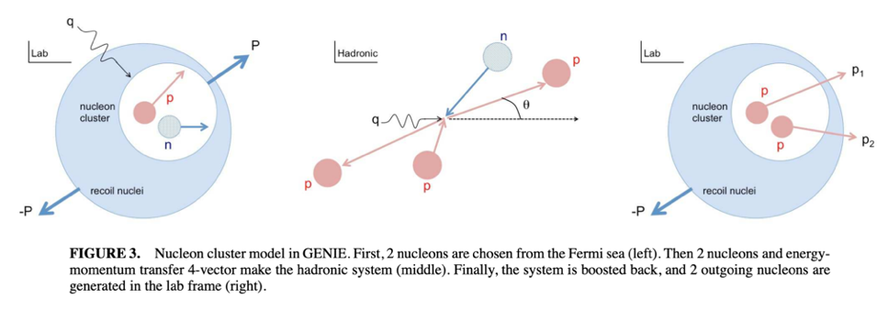
Two-nucleon physics in event generators: "nucleon cluster model"
Generators are beginning to include these contributions, but in a very rough way
STA calculations allow us to do this much more rigorously

Slide 27
How electron scattering can inform neutrino scattering
Historically, $ν$ event generators have not been very well validated
Many models, already highly phenomenological, lack the observed behavior
This has lead scientists to reconsider how they make and test their models, going beyond simple consistency checks and making a foray into data comparisons
For electron scattering, one can parametrize the cross section in terms of longitudinal and transverse nuclear response functions
$$\frac{d^{2}σ}{dE^{′}dΩ′}=σ_{M}\left[ν_{L}R_{L}\left(q,ω\right)+ν_{T}R_{T}\left(q,ω\right)\right]=σ_{M}\left[{\left(\frac{Q}{q}\right)}^{4}R_{L}\left(q,ω\right)+\left(\frac{Q^{2}}{2q^{2}}+\tan^{2}{\frac{θ}{2}}\right)R_{T}\left(q,ω\right)\right]$$
For a full model of $V$ and $V−A$ generalized lepton scattering, one can parametrize the cross section in terms of five similar nuclear response functions
If the underlying theoretics are identical, one can in principle validate a $ν$ scattering model using electron scattering comparisons
The underlying intranuclear dynamics should be identical! It’s the same nucleus!

Slide 28
STA: The Inclusion of Two-Body Physics: Nuclear Response
The second order correction to a Hamiltonian describing a system of bound nucleons comes from two-body interaction terms in a high-order expansion:
$$\hat{H}=\sum_{i}{t_{i}}+\sum_{i<j}{v_{i,j}}+⋯$$
Considering the modes of possible lepton interaction, one conceives of longitudinal and transverse responses $ρ$ and $j$, respectively:
$$O_{L}\sim ρ=\sum_{i=1}^{A}{ρ_{i}}+\sum_{i<j}^{A}{ρ_{i,j}}+⋯≡O_{L;i}+O_{L;i,j}+⋯$$
$$O_{T}\sim j=\sum_{i=1}^{A}{j_{i}}+\sum_{i<j}^{A}{j_{i,j}}+⋯≡O_{T;i}+O_{T;i,j}+⋯$$
The total inclusive cross section can be parametrized in terms of the nuclear response:
$$\frac{d^{2}σ}{dE^{′}dΩ′}=σ_{M}\left[ν_{L}R_{L}\left(q^{μ}\right)+ν_{T}R_{T}\left(q^{μ}\right)\right]=σ_{M}\sum_{f}{δ\left(ω+E_{0}−E_{f}\right)\left[{\left|\left\langle f | ν_{L}O_{L}\left(q^{μ}\right) | 0\right\rangle \right|}^{2}+{\left|\left\langle f | ν_{T}O_{T}\left(q^{μ}\right) | 0\right\rangle \right|}^{2}\right]}=⋯$$
$$⋯=σ_{M}\int{dt\left[\left\langle 0 | O_{L}^{†}\left(q^{μ}\right)e^{i\left(\hat{H}−ω\right)t}O_{L}\left(q^{μ}\right) | 0\right\rangle +\left\langle 0 | O_{T}^{†}\left(q^{μ}\right)e^{i\left(\hat{H}−ω\right)t}O_{T}\left(q^{μ}\right) | 0\right\rangle \right]}$$

Slide 29
Current QMC STA Response Density Outputs for $e{}_{2}^{4}{He}$

Slide 30
Some future plans on a full GENIE generator module…
$→$Putting it all together!
What new things need to be considered within GENIE to deal with both leptonic and hadronic variables?

Slide 31
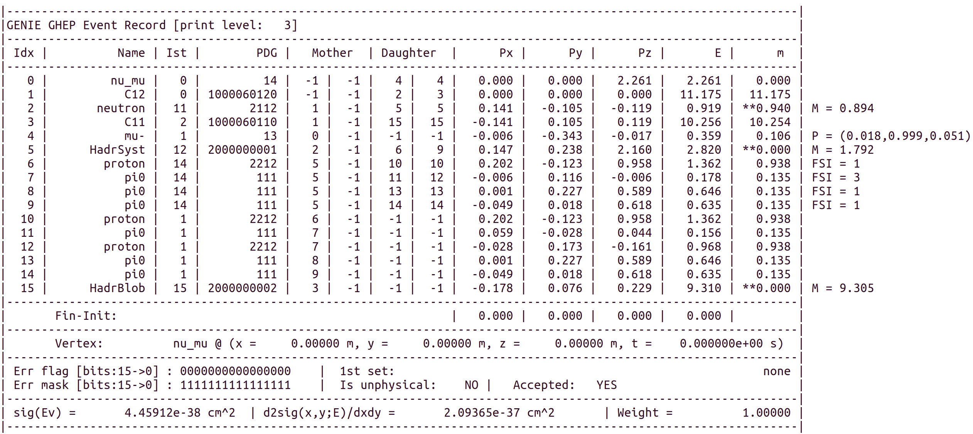
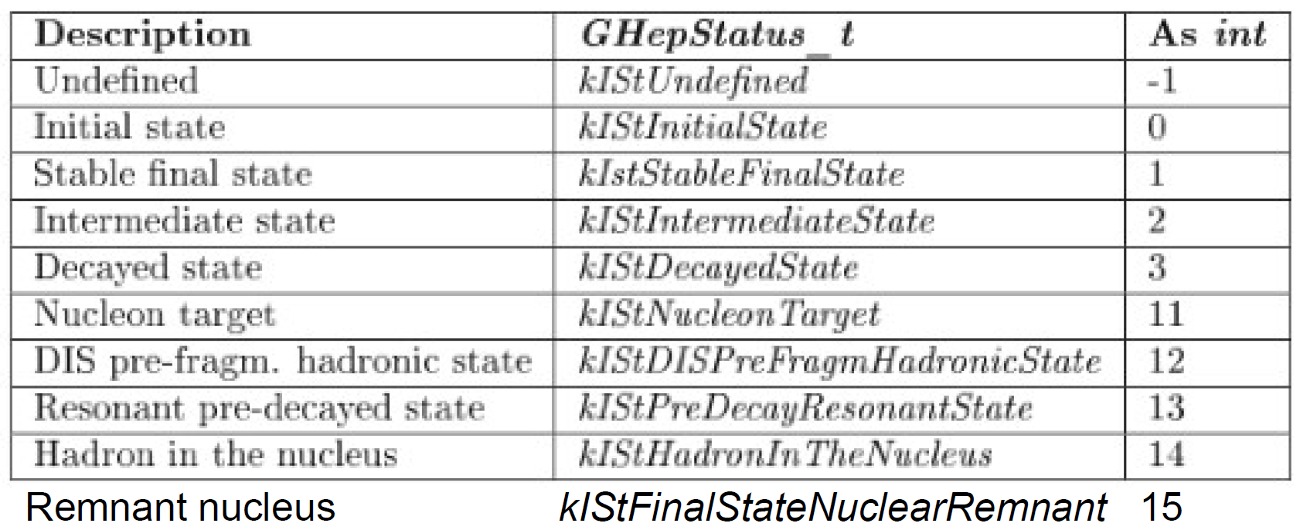
The GENIE Generator

Slide 32
GENIE Implementation
We have begun the implementation of the QMC STA within GENIE using semi-final states from tabulated response densities
This will be tricky, to say the least…
GENIE’s normal operating mode is almost always dependent on an predominately single particle paradigm
Initial state preparation—$avoidable?$
Single nucleon lepton scattering
Single nucleon momentum distributions in nuclear models
Single nucleon initial positions
Some two-body dynamic options becoming available as we speak (SuSA), but initial correlations are highly approximate
Final state preparation—$unavoidable!$
Propagation of single particles through the nucleus using an intranuclear cascade

Slide 33
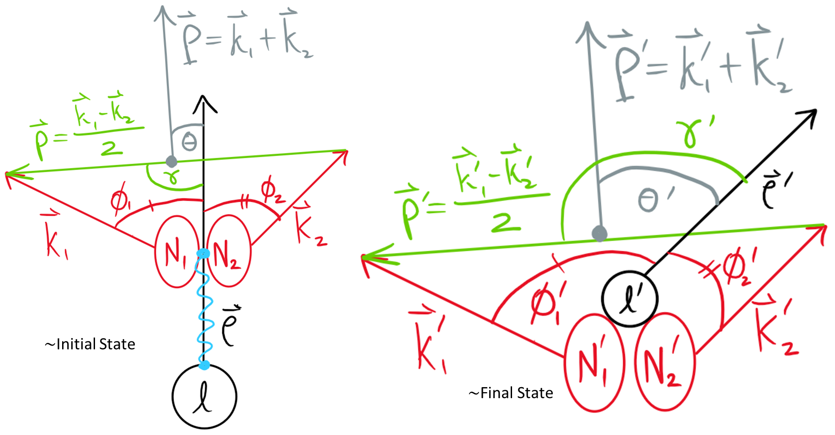
QMC STA Simulation:
33

Slide 34
Requirements Going Forward with GENIE for Two-Body Physics
An attempt at a general framework is being pursued
When new nuclear responses and response density tables become available for larger nuclei, can simmply “drop something in”
Must hand off two-nucleon configurations properly to GENIE…
Attain particle identities
Select all angles (currently integrated out) via some method…
The geometric interpretation of electromagnetic nuclear responses is well understood, but how to define this generically for electroweak processes needs much more consideration
Derive individual nucleon momenta via law of cosines
Track individual nucleons through the intranuclear cascade
Critically dependent upon initial positions and separations
One or both nucleons may not be emitted due to low momentum transfer
A phenomenological momentum cutoff must be considered for each struck nucleon

Slide 35
Summary
Neutrino MC generators must grow and evolve their capabilities as we enter the precision era for oscillation studies
One step in this evolution is implementation of the QE QMC STA model using semi-final states and extensively validated on electromagnetic data
Avoids phenomenological nuclear models of initial states in Monte Carlo
A new series of total inclusive electromagnetic scattering cross sections are now available from $e{}_{2}^{4}{He}$ nuclear responses with $\left|\vec{q}\right|\tilde{ϵ}\left(300,800\right]MeV/c$
Employs two-body physics in an inherent way (exclusive cross sections!)
Full implementation of this model is progressing for GENIE
Must still formulate algorithms to efficiently and accurately pass two-body kinematics and particle identity information to the intranuclear cascade
This will eventually allow for the study of potential final state topologies in experimental detectors

Slide 36
Current and Future Generator Validation
Ample amounts of data are available for $e{}_{2}^{3}{He}$, $e{}_{2}^{4}{He}$ and $e{}_{6}^{12}C$ scattering
Will serve as a good testing ground for models of total inclusive electromagnetic quasielastic cross sections (before electroweak modeling)
Will compare to other GENIE nuclear models ($χ^{2}$ analyses to follow)
Publication in preparation now of initial implementation
JLab two-body final state data should also be investigated!
Once our full generator is complete, tested, and validated on $e$ data, we will proceed to $ν$ generation
Will eventually involve more response densities (five in total) for inclusion of CC interactions
Will similarly compare to data where available…
…and other GENIE nuclear and interaction models
Publication(s) will follow soon after

Slide 37
Scripts for Comparisons Against World Data are Working
Simple interfaces between GENIE’s SuSAv2 HadronTensor framework have been made for easy plotting of interpolated cross sections from given theoretical nuclear response functions
Some validation of responses and their interpolation within GENIE to $\frac{d^{2}σ}{dE^{′}dΩ^{′}}\left(\left|\vec{q}\right|,ω\right)$ still needs to be completed
Scripts run interpolations within the HadronTensor framework
Create table outputs for input to simple plotting scripts
Can compare all available outputted model cross sections for $e{}_{2}^{4}{He}$ to available World Data

