Slide 1
IOTA/FAST Shutdown/Startup Report
Darren Crawford

Slide 2
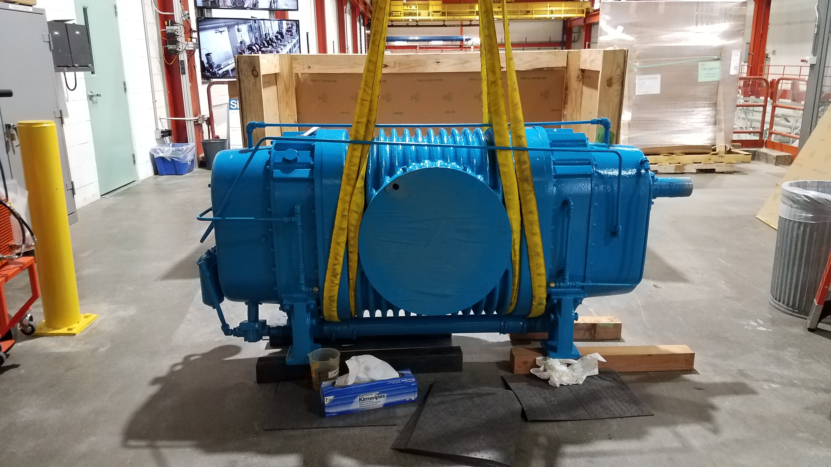
Kinney Skid Booster Pump
Tuesday January 7 at 07:14 the Kinney booster pump tripped on low oil and high vibration. When inspecting the unit locally, a waterfall was discovered coming out of the belt guard. Best guess is a bearing failure.
The rigging and installation contracts were sent to the DOE Site Office for approval.
Davis-Bacon Act check for both companies.
Rigging contract was approved yesterday afternoon.
Insurance issue with Harris Equipment.

Slide 3
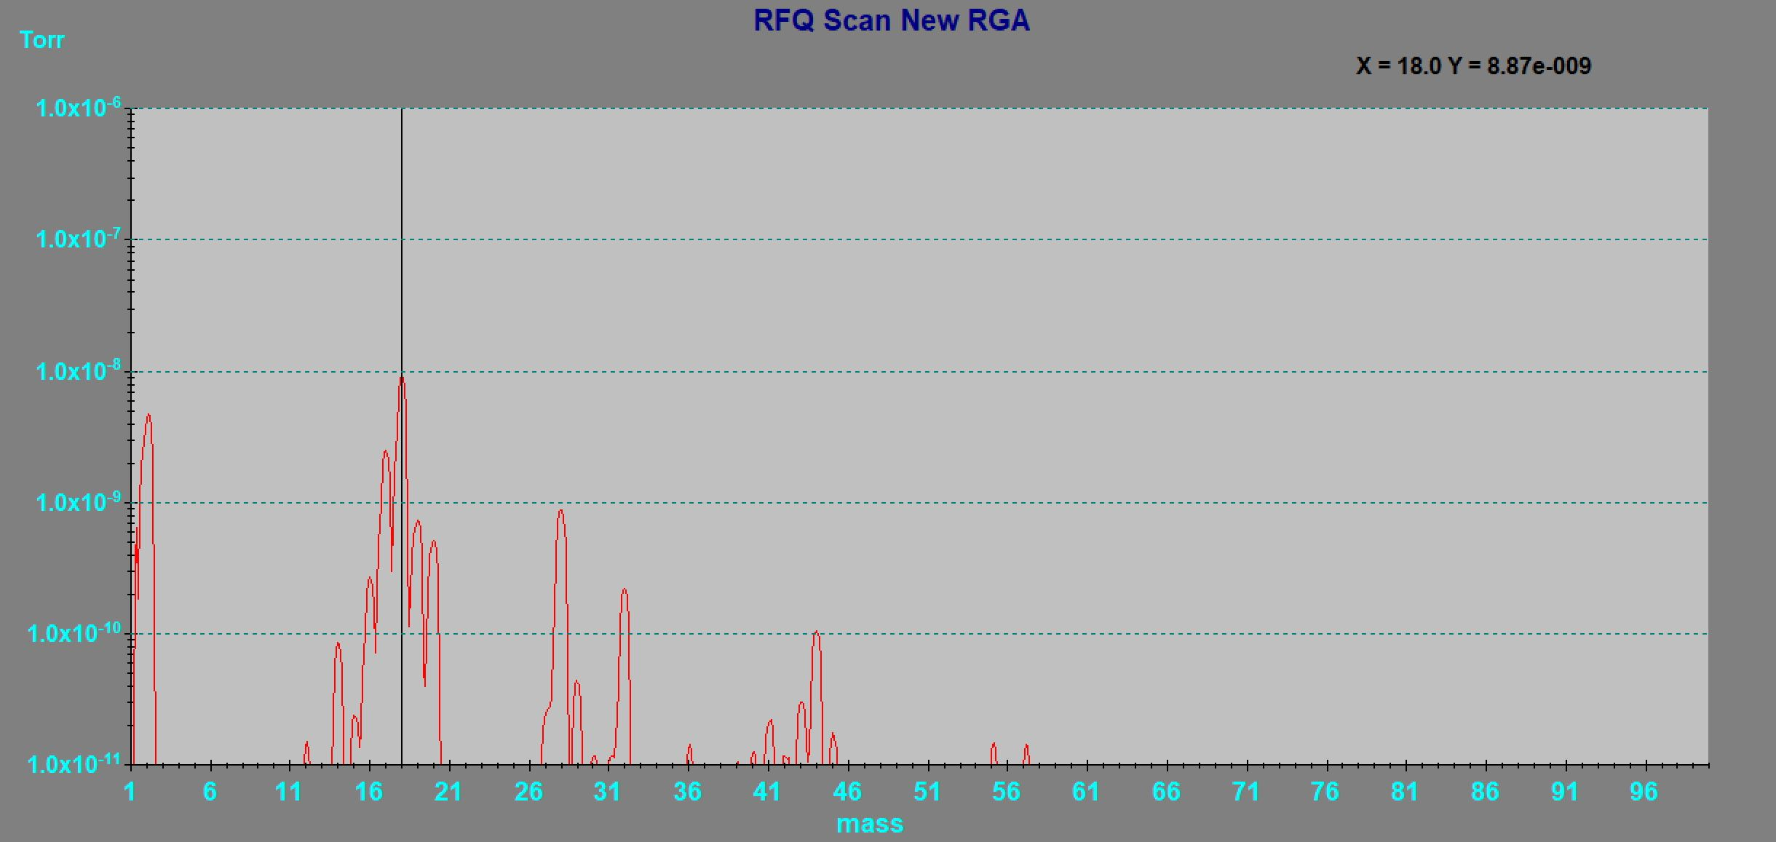
This week
Proton Source RFQ new RGA installation
HINS items to Excess
Cave placed back into Supervised Access mode.
Heat tape prototype testing

Slide 4
Current Status
Cryo system is holding at 5 K
Cave in Supervised Access mode
Next Week
Rigging of Booster pump
Place RFQ in Cave
Other News
March 23-April 3 shutdown of KRS. Switchover over KRS feeds to MSS.
May 31st is the start of the 16-20 week summer shutdown.

