Slide 1
NuMI Target Systems AIP FY20 Q1 Updates
Yun He
Proton PMG / AEM Meeting, February 6, 2020

Slide 2
Outline
Project status
Org chart 2020
Activities completed in 2019 summer shutdown
Activities for 2020
  Plans for 2020 summer shutdown
  Horn 1 module drives changeout
  Absorber hall cooling systems
  Target autopsy
  Hadron beam monitor
  MARS/FEA simulations
Project performance report
Summary
More details are available at the project SharePoint:
https://web.fnal.gov/project/TargetSystems/NuMI-AIP/

Slide 3
Project Status
Financials | 12/31/2019 | 1/31/2020
Budget | 5,600,000
Obligated | 2,452,508 | 2,663,082
Remaining | 3,147,492 | 2,936,918
Project kickoff: Jan. 2019
Mid-term milestone: End of 2019 summer shutdown
Resources: AD/TSD, AD/MSD, PPD, FESS, TD
Contingency spend down: Added 6 new activities
Tasks | 50% | 80% | 100% | Status
MARS/FEA simulations |  |  |  | Added DS systems (decay pipe, absorber)
Pre-target Be window |  |  |  | Final welding / leak check
1 MW Target |  |  |  | Closed
1 MW Horn 1 |  |  |  | Stripline final machining
Stripline air diverter T-block |  |  |  | Weld SS-steel pipe transition, design coffin
Target / horn 1 module drives |  |  |  | Fabrication and mock-up test, installation
RAW skids |  |  |  | Added Absorber Hall systems
Target hall chiller/air handling |  |  |  | Added Absorber Hall systems
Target chase shielding |  |  |  | Closed
Tritium mitigation |  |  |  | Implementation
Decay pipe window |  |  |  | Drawings generation
Hadron monitor & absorber |  |  |  | Collaboration with U of Texas
Target autopsy |  |  |  | New task

Slide 4
Org Chart 2020
NuMI Target Systems AIP (2020)
Bob Zwaska, Project Director
Yun He, Project Manager
Marty Murphy, Deputy PM for Shutdowns
Alyssa Payleitner, Project Controls
Katsuya Yonehara, Project Scientist
Technical Advisor
Kris Anderson
Procurement Assistance
Greg Bulat
FEA Assistance
Zhijing Tang
A1901.03.01
Horn 1 & Stripline
Kris Anderson
A1901.04.01
RAW System
Abhishek Deshpande
A1901.05.01
Decay Pipe Window
Mike Campbell
A1901.02.01
Pre-Target Window
George Lolov
A1901.06.01
Hadron Monitor
Katsuya Yonehara
A1901.03.02
Air Diverter T-Block
George Lolov
A1901.04.02
Target Chase Cooling
Lee Hammond
A1901.02.02
Target Baffle & Core
Kavin Ammigan
A1901.06.02
MARS Modelling
Igor Rakhno
A1901.03.03
Modules
Vladimir Sidorov
A1901.04.03
Target Chase Shielding
Joseph Angelo
A1901.02.03
Target Autopsy
George Lolov
A1901.04.04
Tritium Mitigation
Keith Gollwitzer
Task closed
Added activities (NuMI DS Systems)
New task

Slide 5
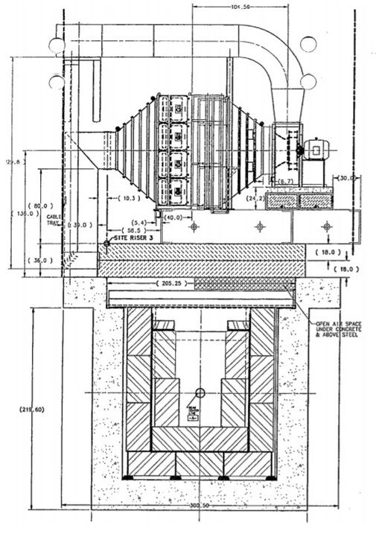
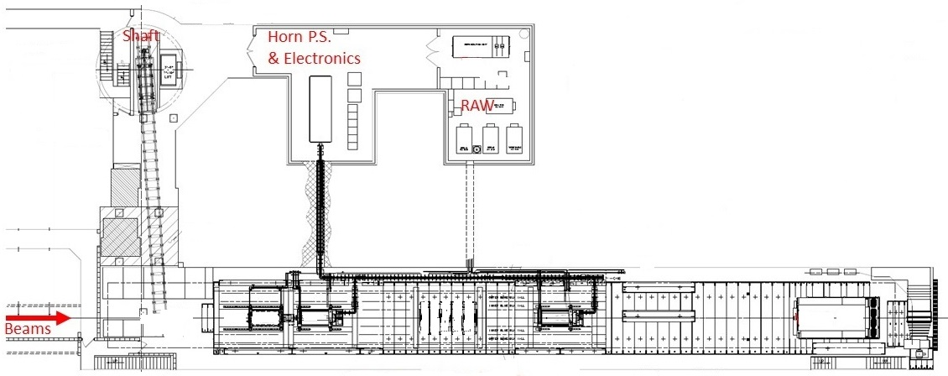
Activities Completed in 2019
2019 summer shutdown | 2020 summer shutdown | Other tasks
1 MW target installation | Horn 1 module drives | MARS simulations
Target & Horn 1 RAW upgrade | 1 MW horn 1 installation | Pre-target window spares
Target chase cooling / air upgrade | Stripline air diverter T-block | Decay pipe window
Target chase supplemental shielding | Absorber hall systems | Tritium mitigation
NuMI Target Hall
Focus of today’s talk
80% completed
Supplemental shielding
Air handling unit
Target

Slide 6
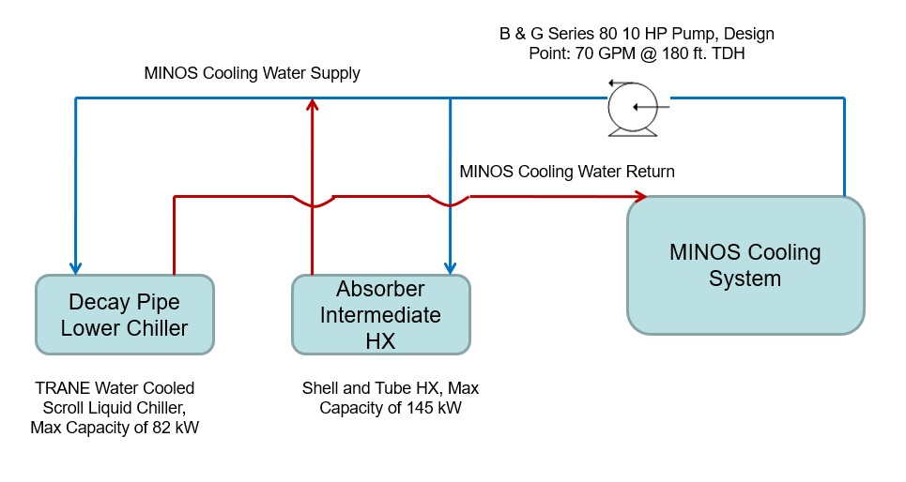
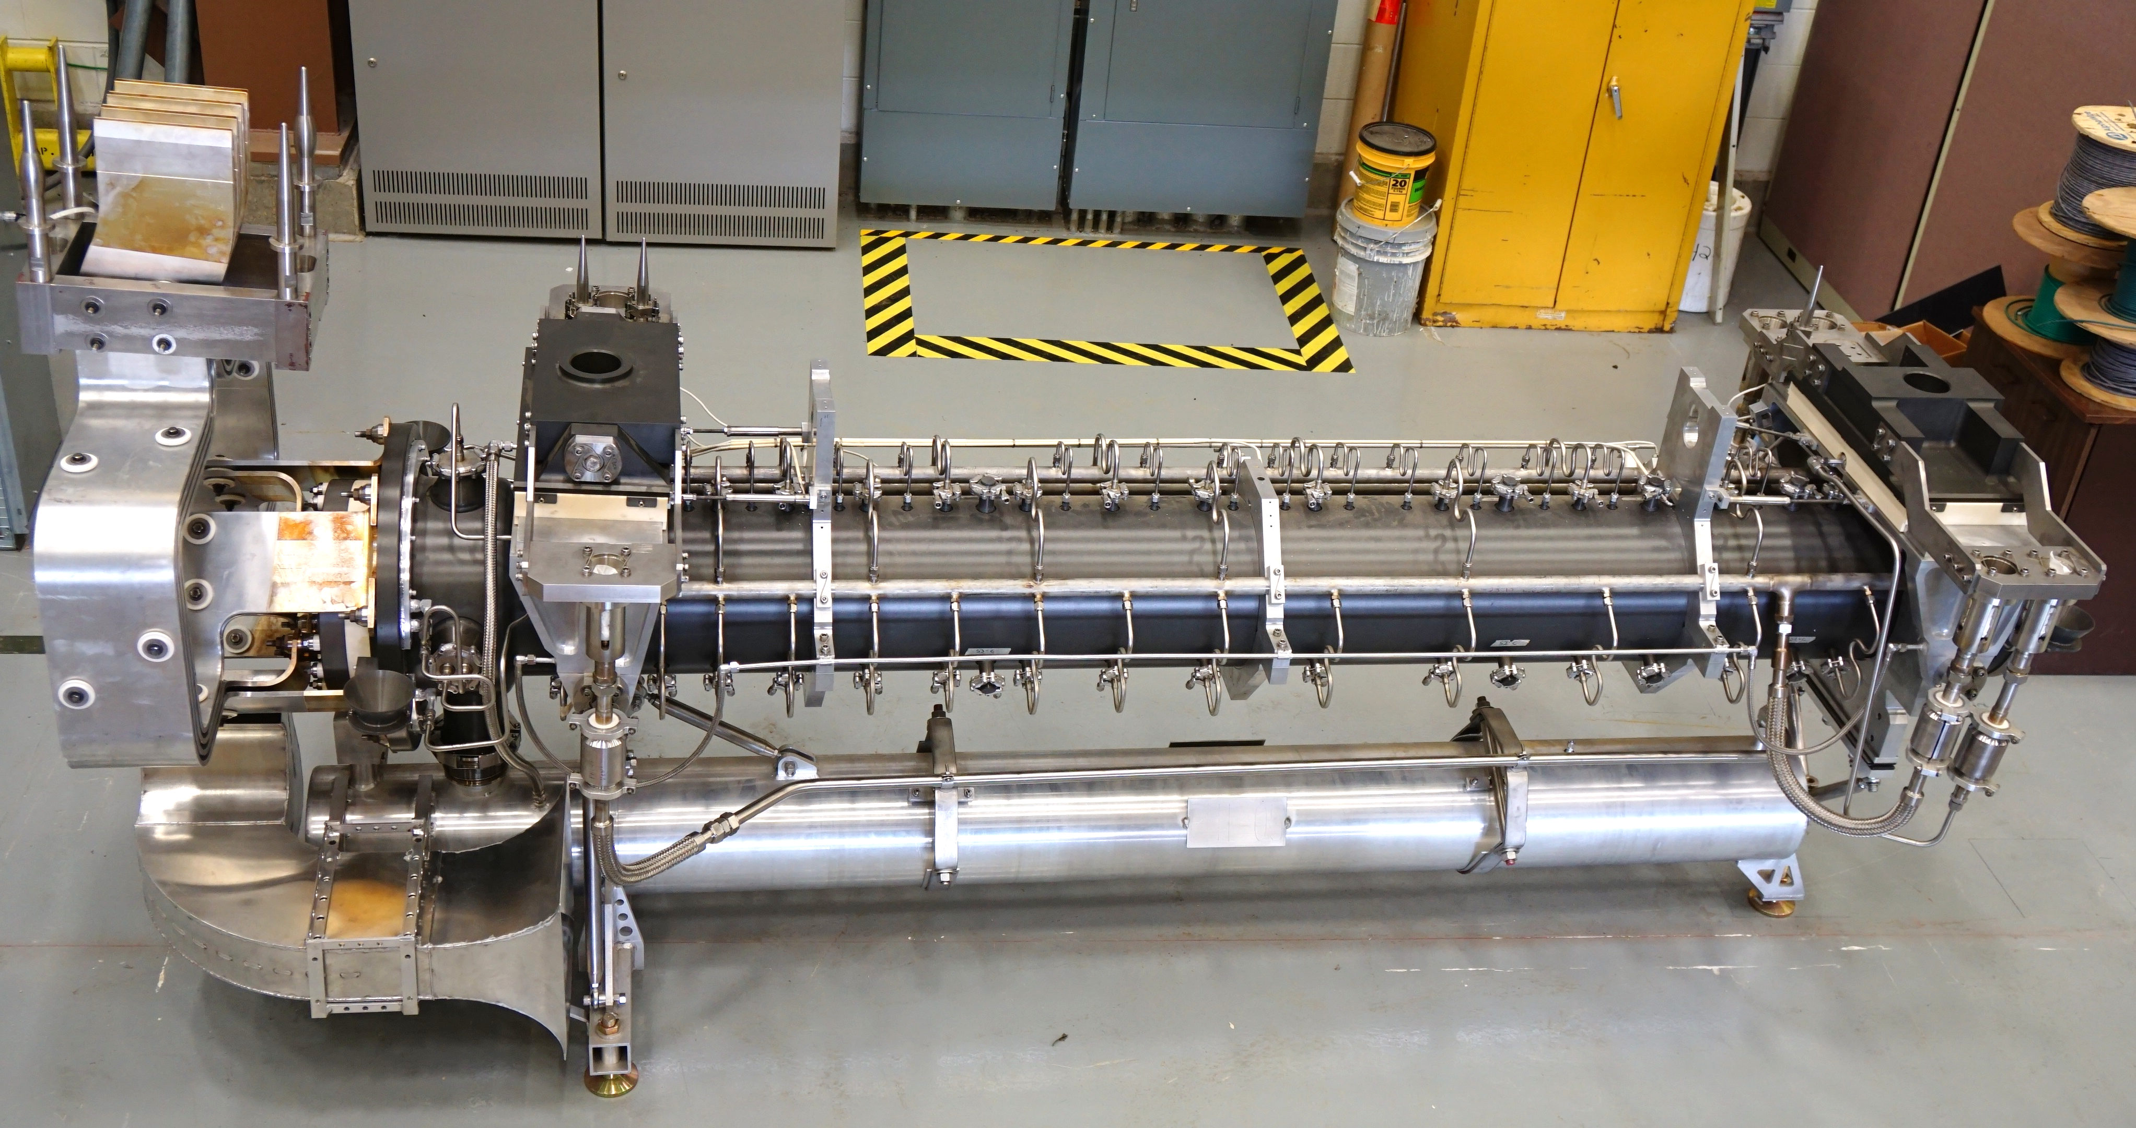
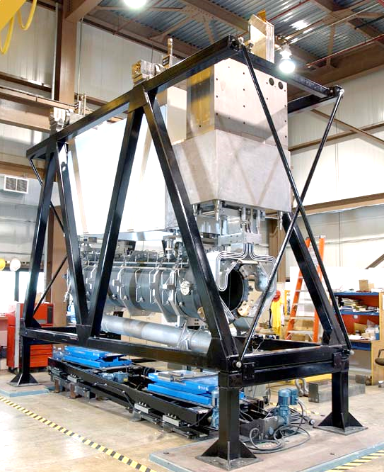
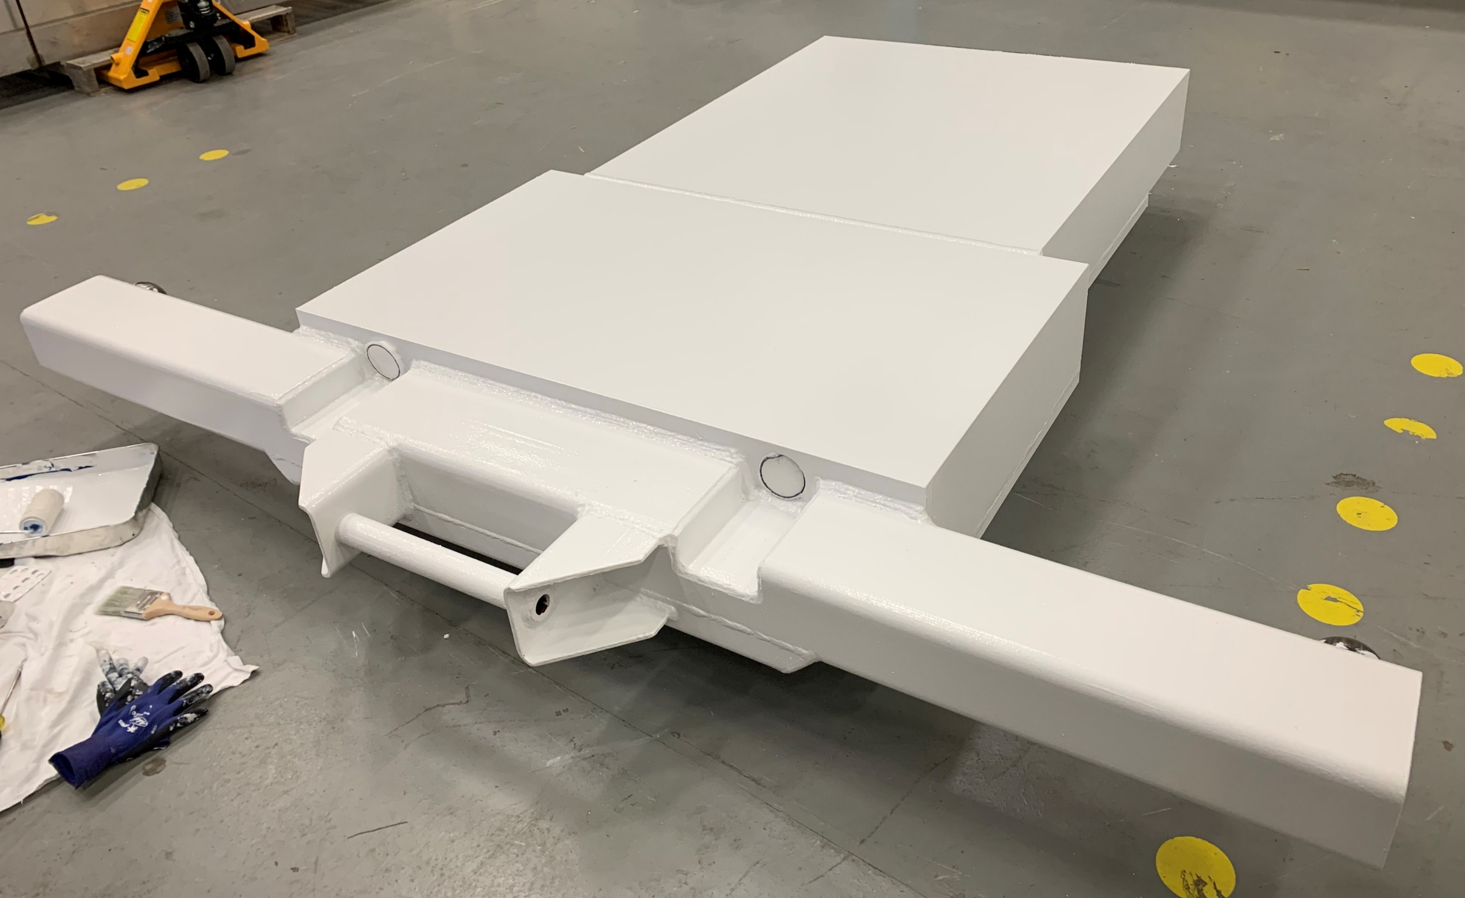
Plans for 2020 Summer Shutdown (Draft)
Tasks | 2 | 3 | 4 | 5 | 6 | 7 | 8 | 9 | 10 | 11 | 12 | 13 | 14 | 15 | 16
Absorber hall RAW/chiller
Horn 1 module drives changeout |  |  | TA-03 to C0
1 MW Horn 1
Stripline air diverter T-block

Slide 7
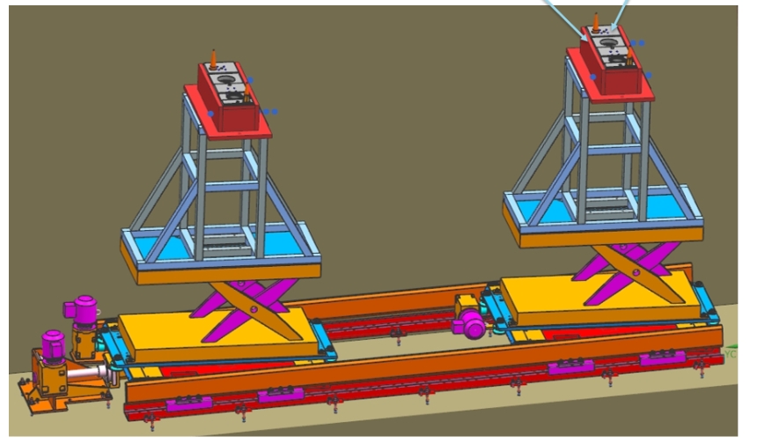
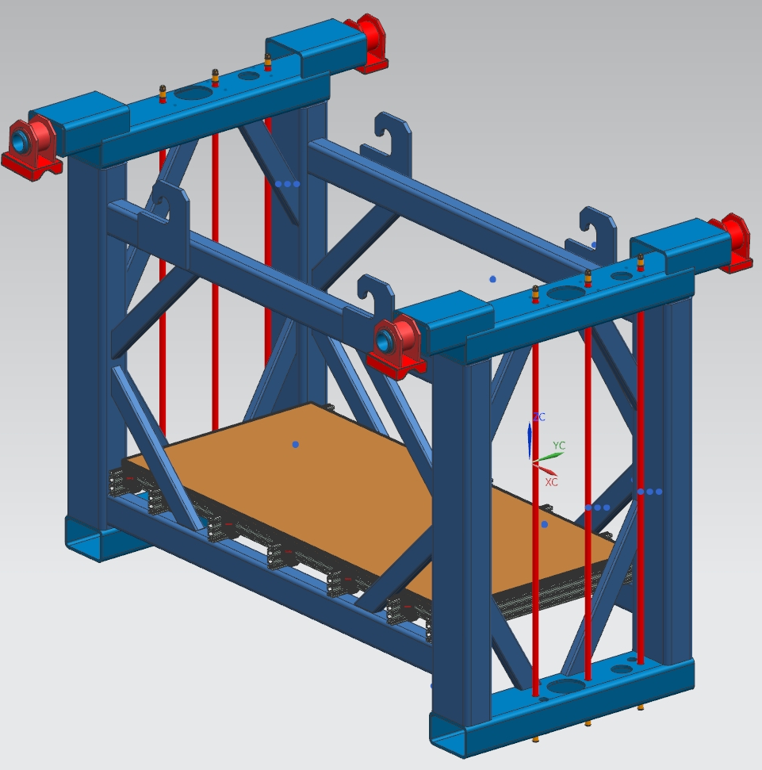
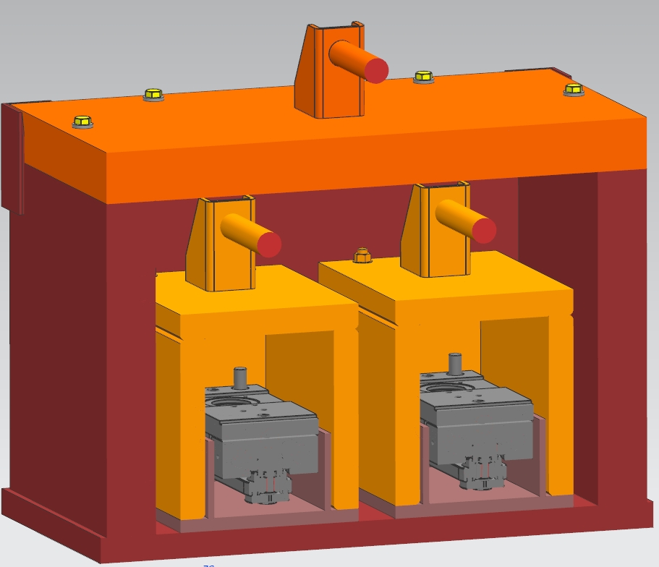
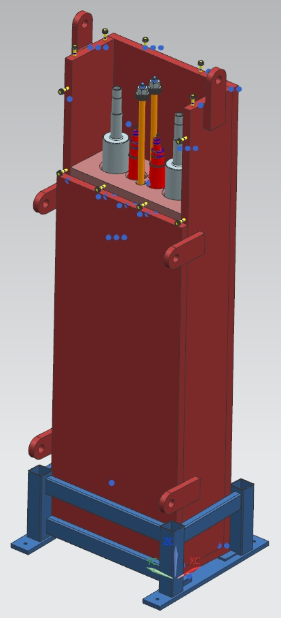
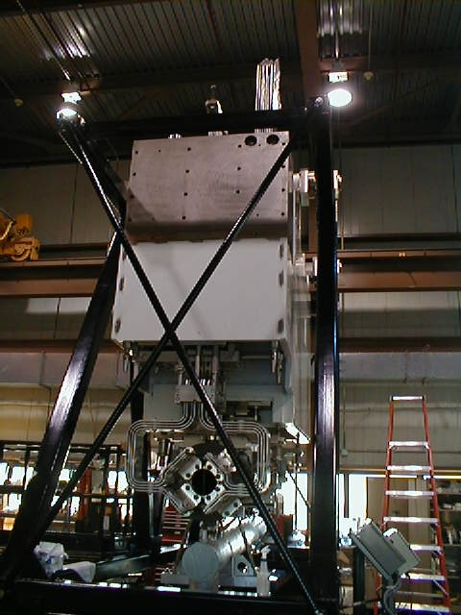
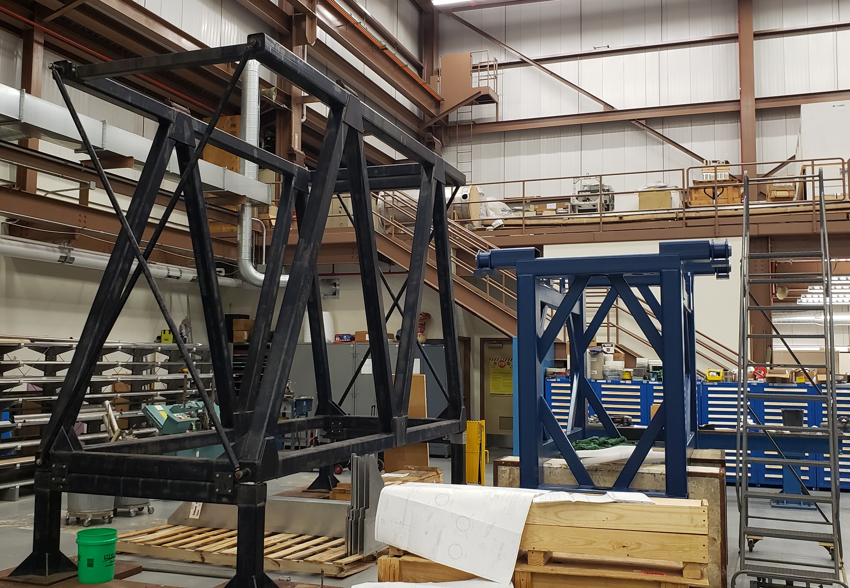
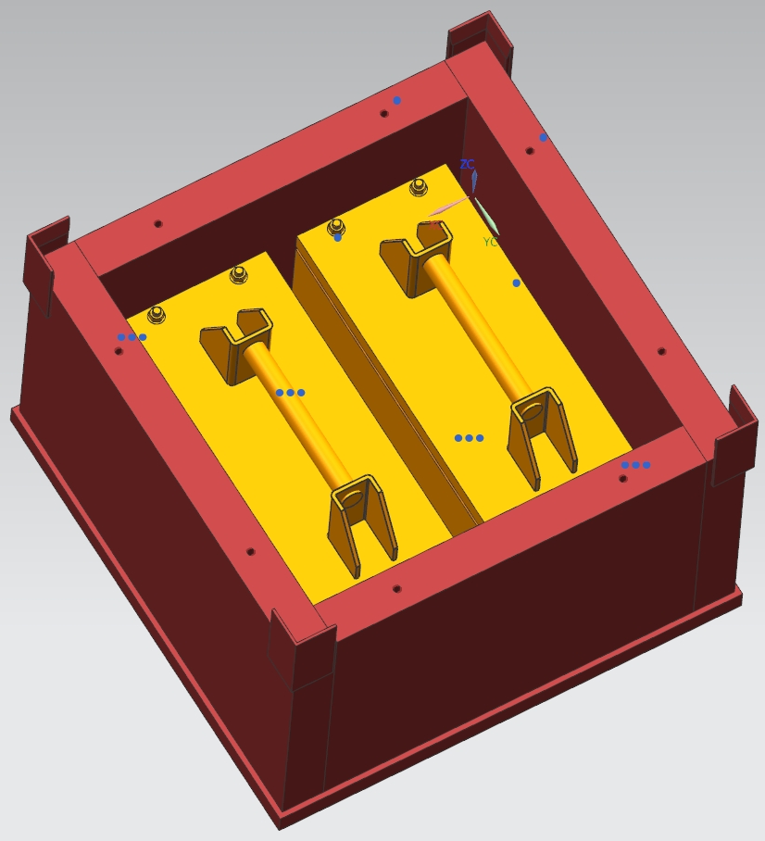
Horn 1 Module Drives Changeout (Vladimir Sidorov)
Fabrication: 70%
Remaining:
Shafts, upper/lower blocks
Casks for spent components, Feb - May
Platform for mock-up training, Feb - March
Next:
Transverse drive pre-assembly, March
Lower transverse drive remote handling training, April – May
challenging: radiation environment, old parts corroded
Spent components storage/transportation/disposal

Slide 8
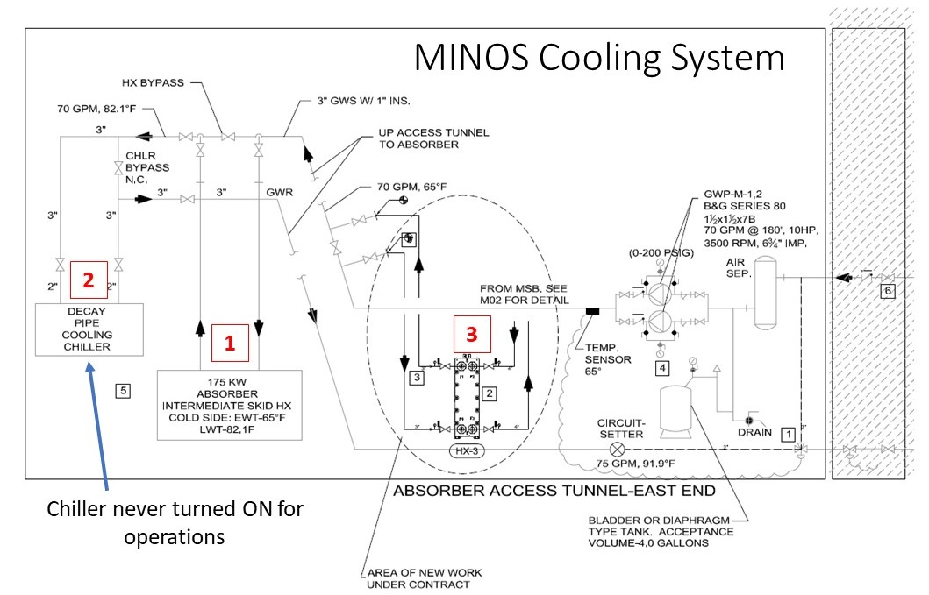
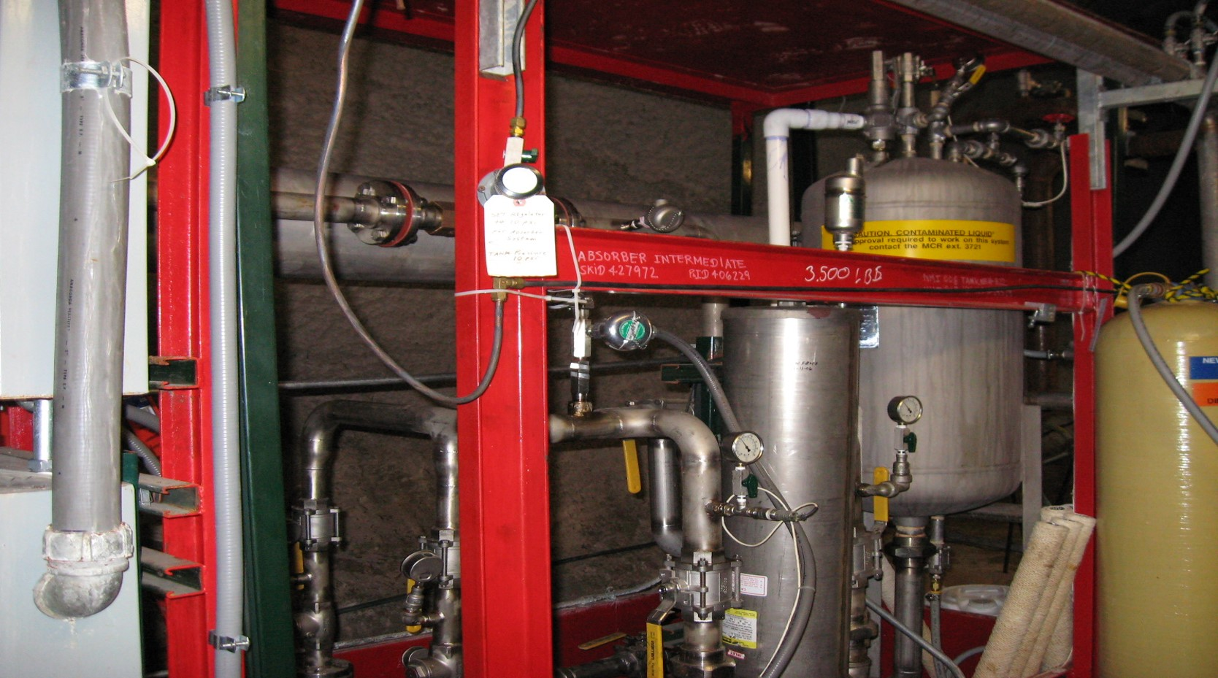
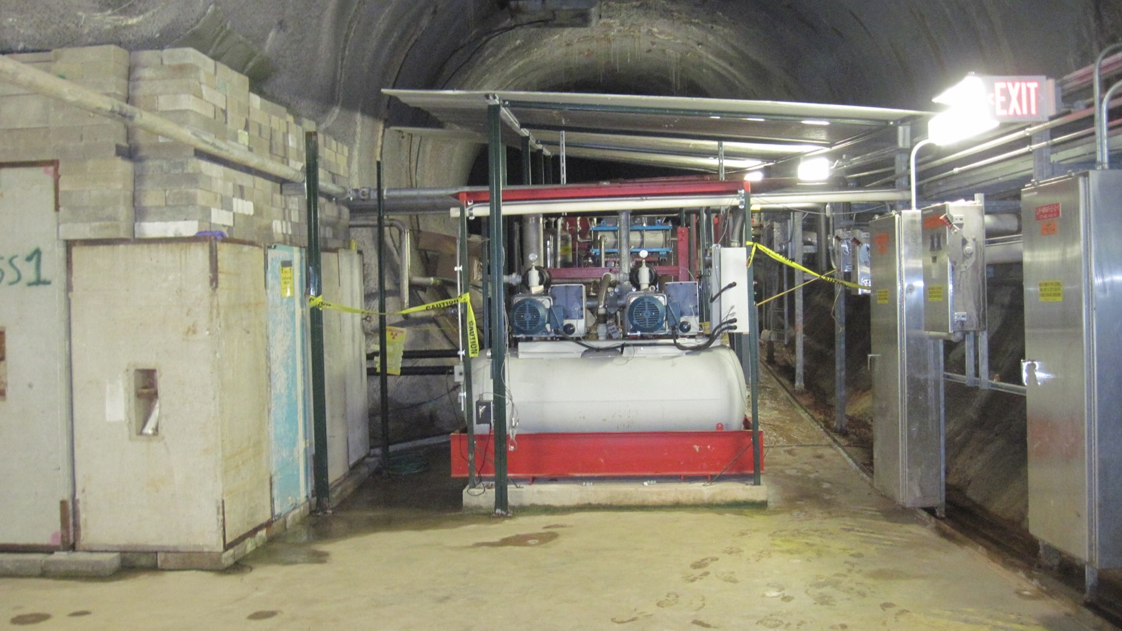
Absorber Hall Colling System (Abhishek Deshpande, Lee Hammond)
1). Add a redundant heat exchanger in the Absorber intermediate skid
  the current HX is old and is in a location hard to perform the changeout work in the event it fails
2). Replace the Decay pipe chiller with a heat exchanger
  this chiller has never been turned on for beam operations
3). Piping work in the MINOS cooling system Absorber access tunnel-east end
4). MINOS surface chiller upgrade
  for a dry cooler to provide free cooling to the MINOS CHW loop during winter

Slide 9
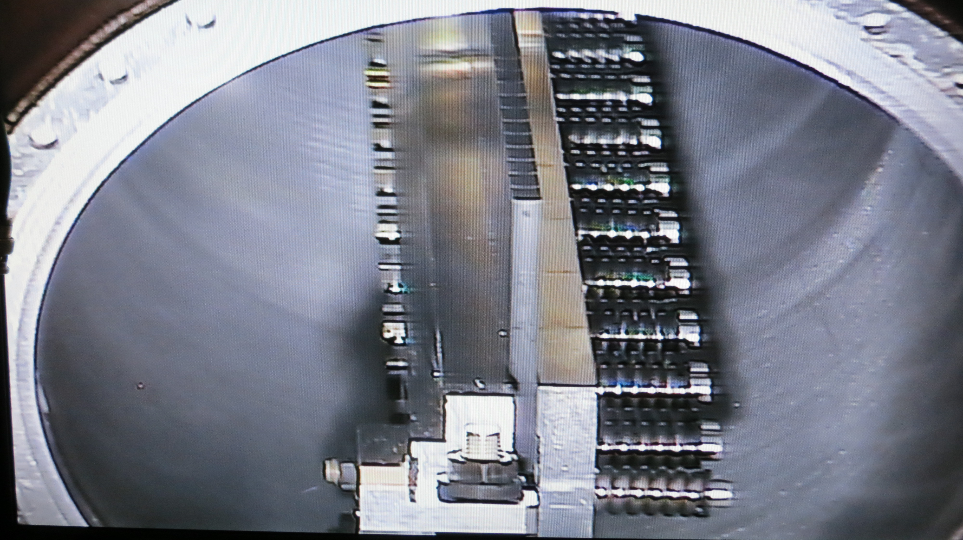
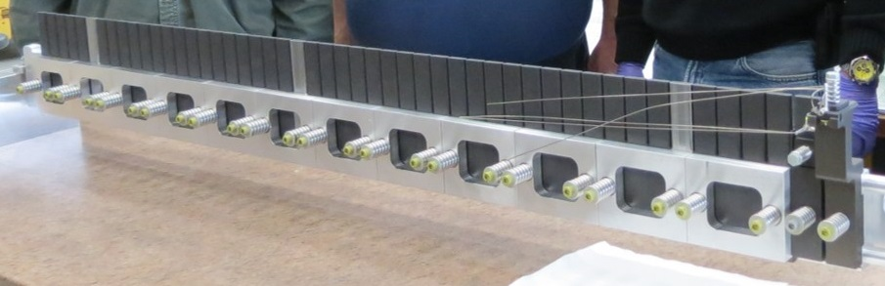
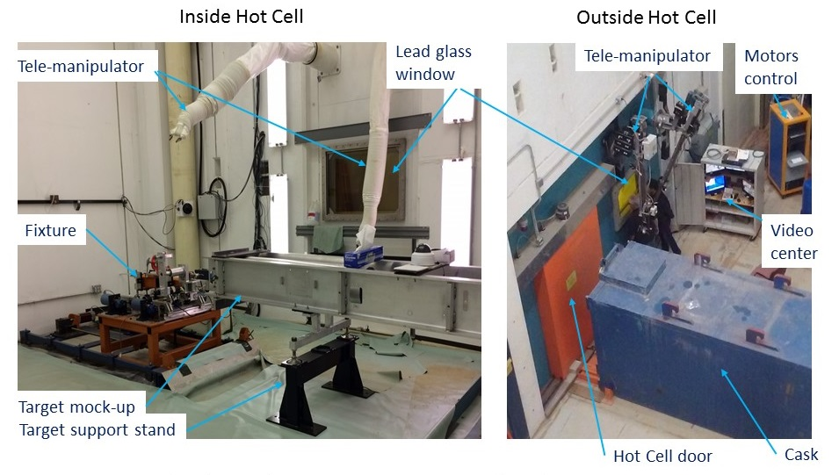
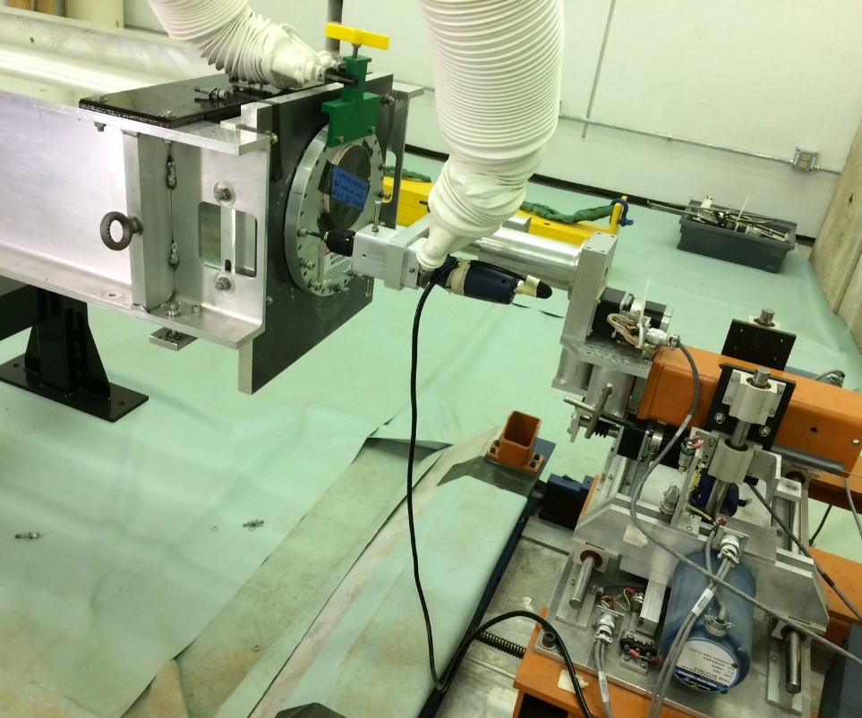
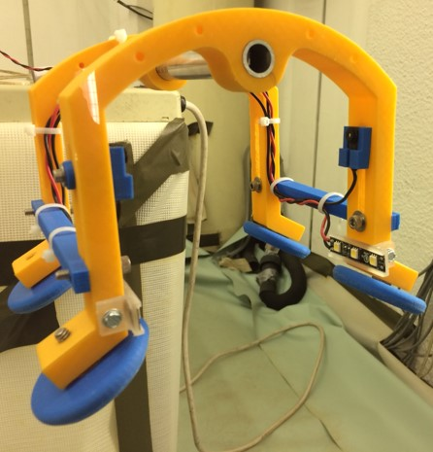
Target Autopsy (George Lolov)
Target autopsies of spent targets TA-01 and TA-02 in C0 Remote Handling Facility:
Visual inspection to provide information regarding target fins condition, beam operation alignment, and beams simulations;
Extract Graphite / Beryllium fins to understand irradiation effects in Be vs. Graphite.
TA-01 with DS flange removed (2018)
TA-02 target fins prior to installation
3 Be fins
Beam spot

Slide 10
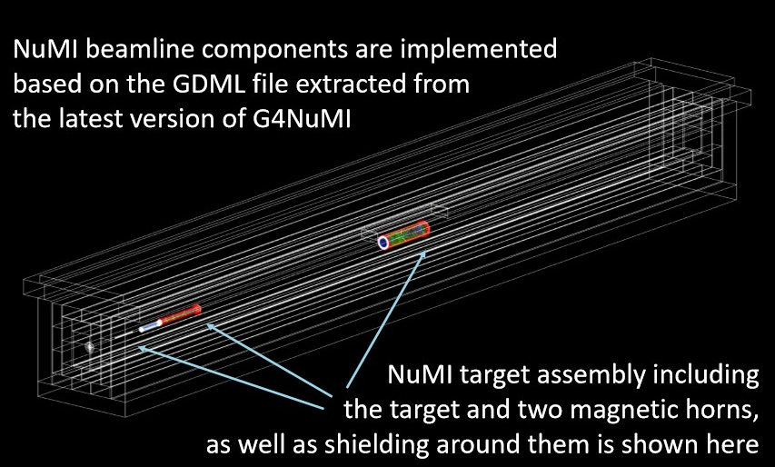
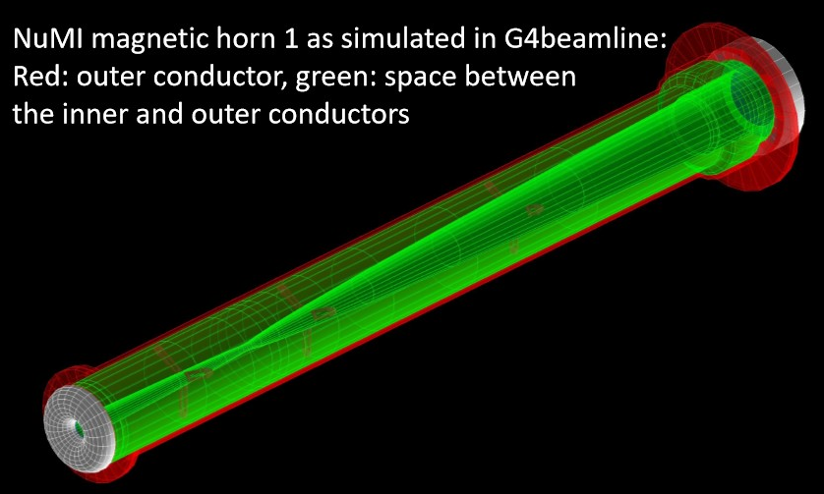
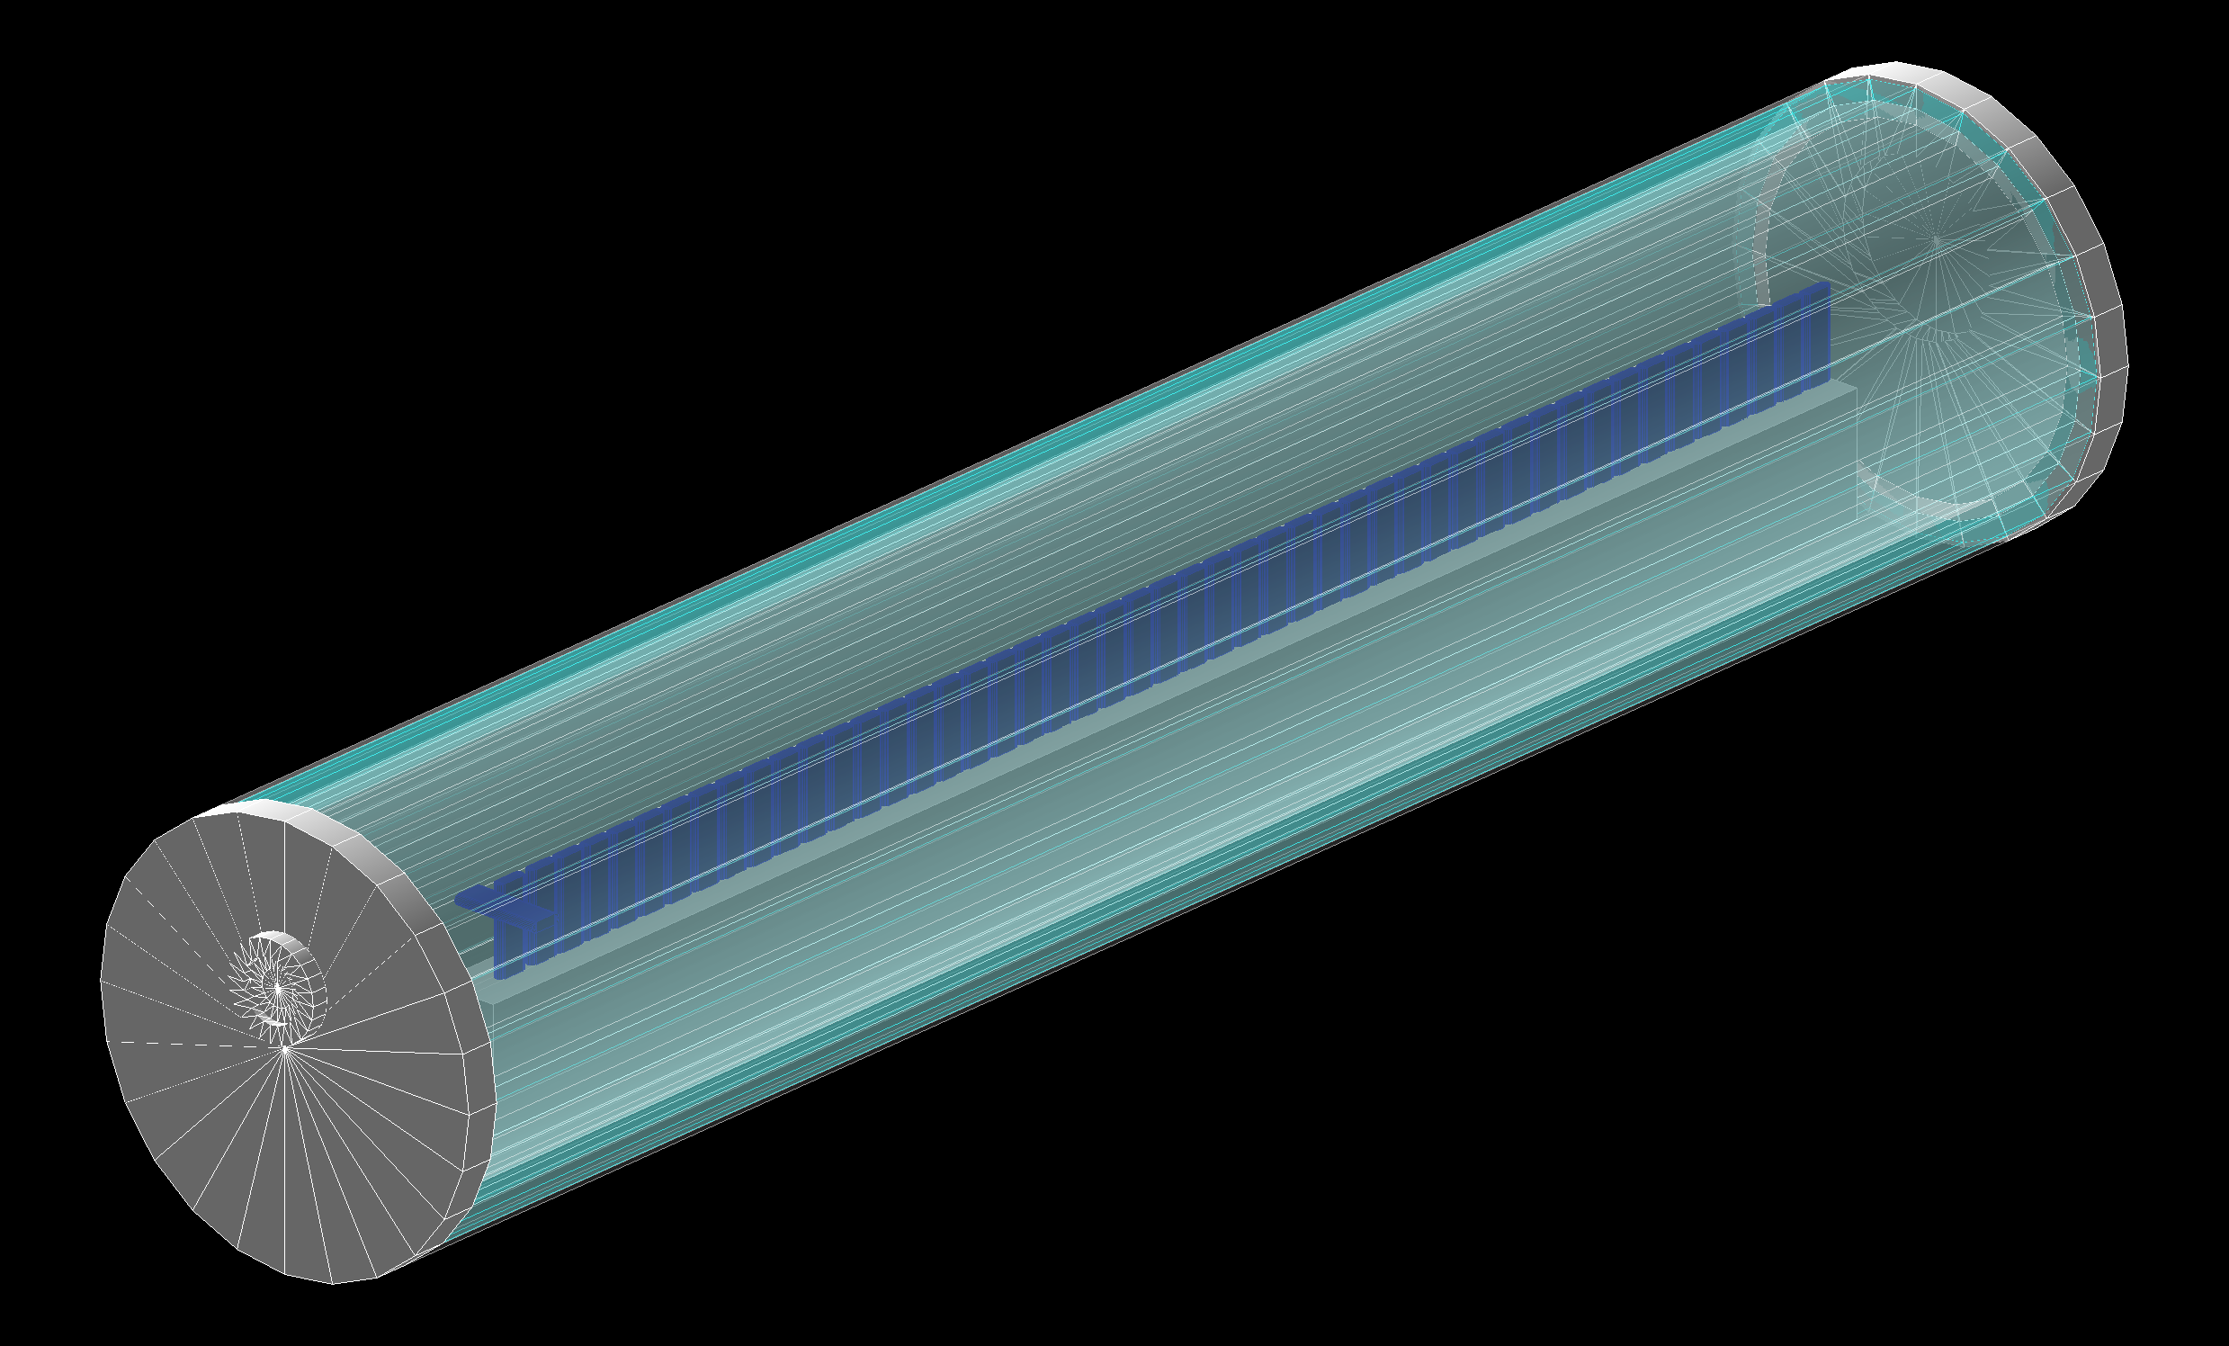
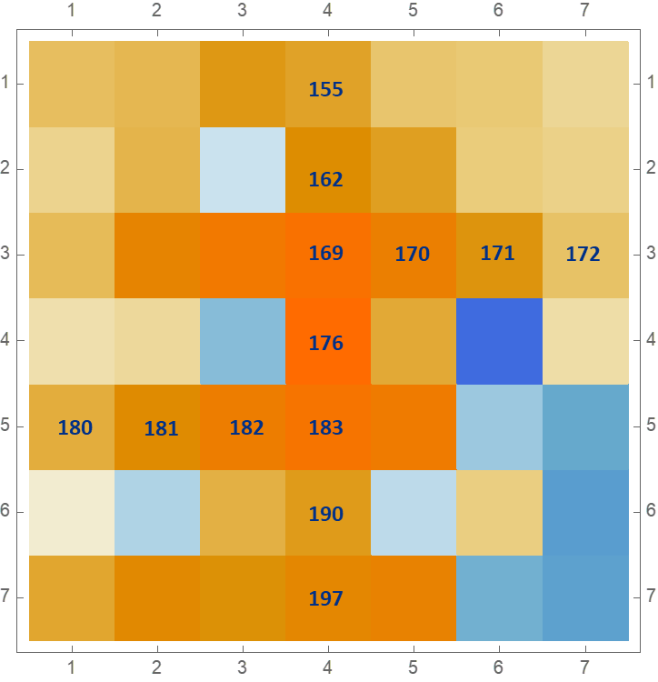
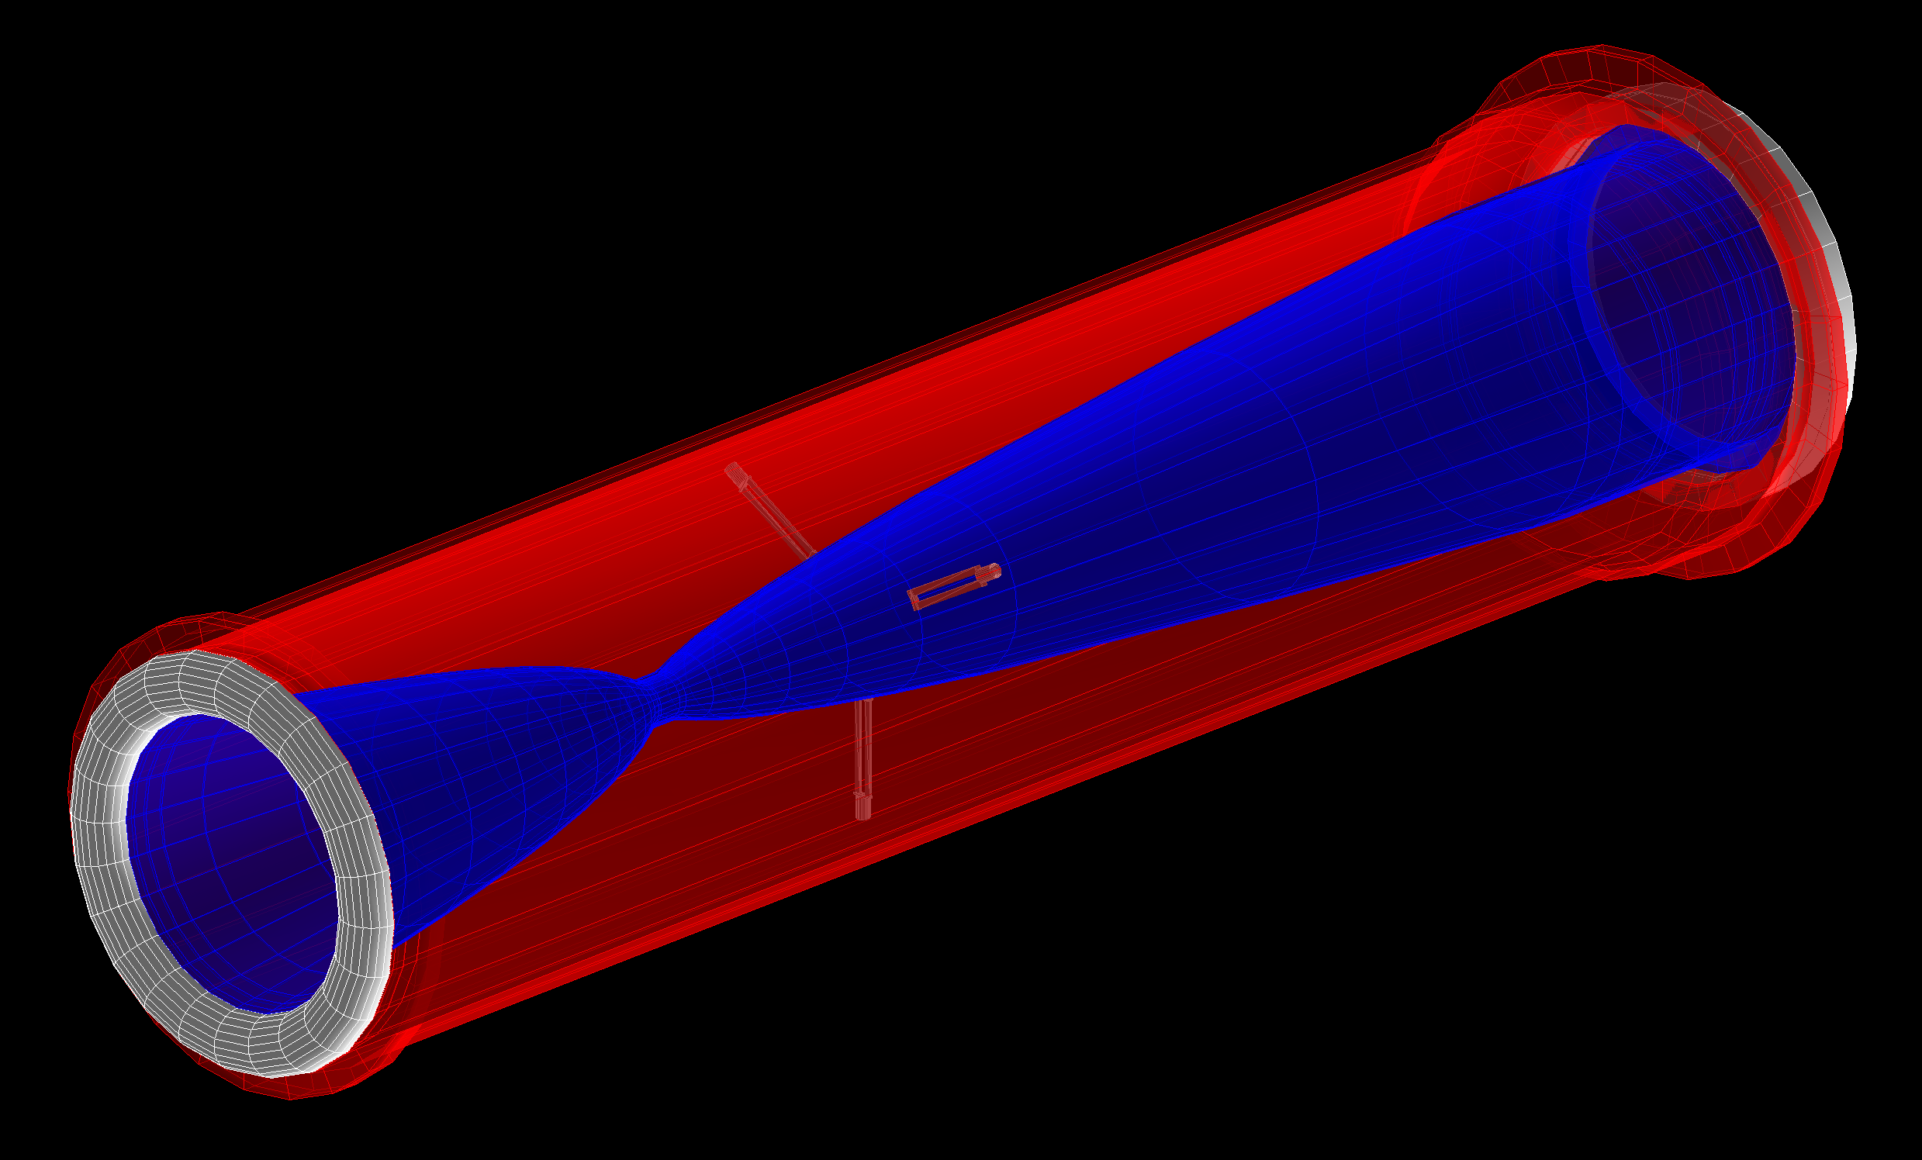
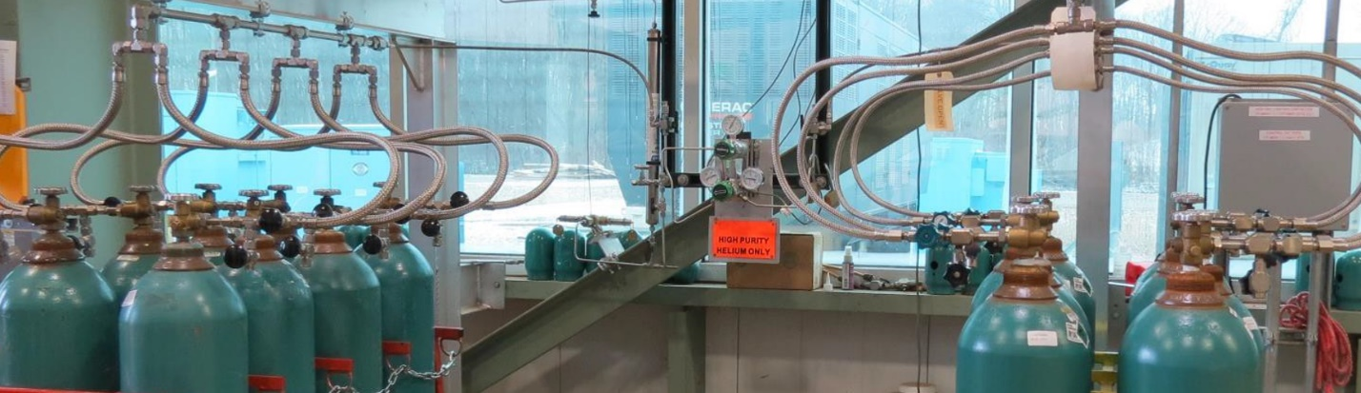
Hadron Beam Monitor (Katsuya Yonehara)
Hadron monitor studies (horn current scan) and simulations using G4beamline
Helium gas handling system
Parts received, under installation
With an improved gas flow control, an automatic gas switch system, a gas purifier, and a bubbler (gas trap) on the exhaust gas line to block backward gas injection into the chamber
New design:
5 x 5 pixels (instead of the original 7 x 7 pixels)
U. of Texas at Austin to fabricate qty. 3 HMs, ready for procurement

Slide 11
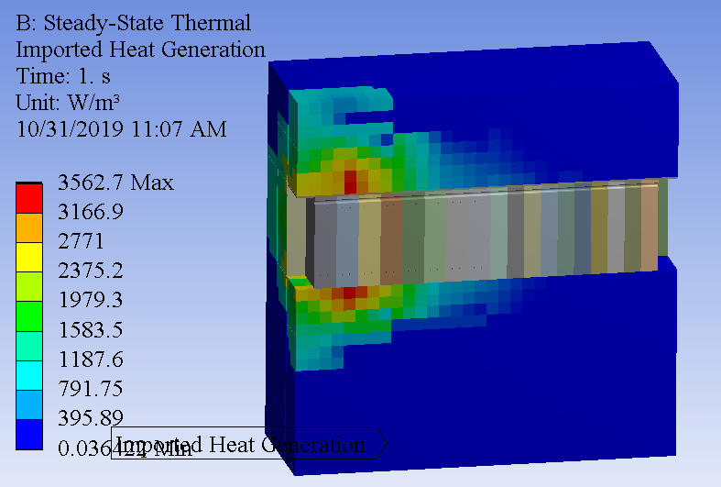
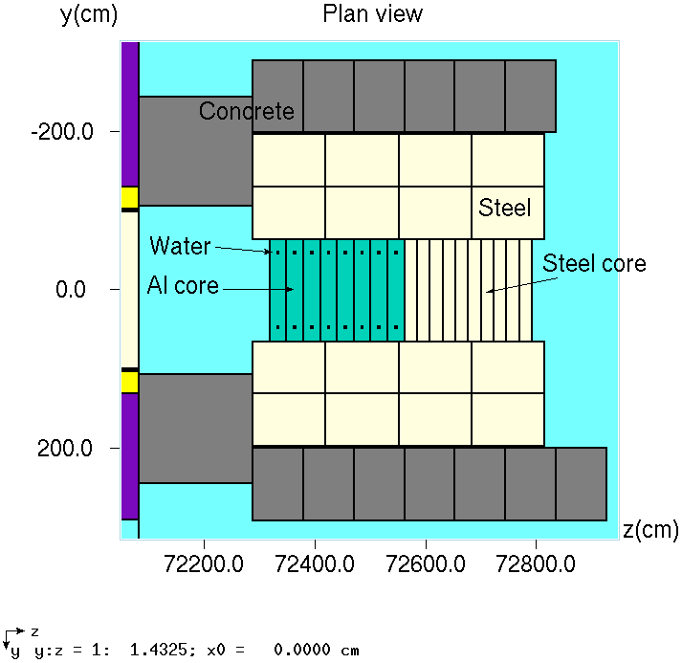
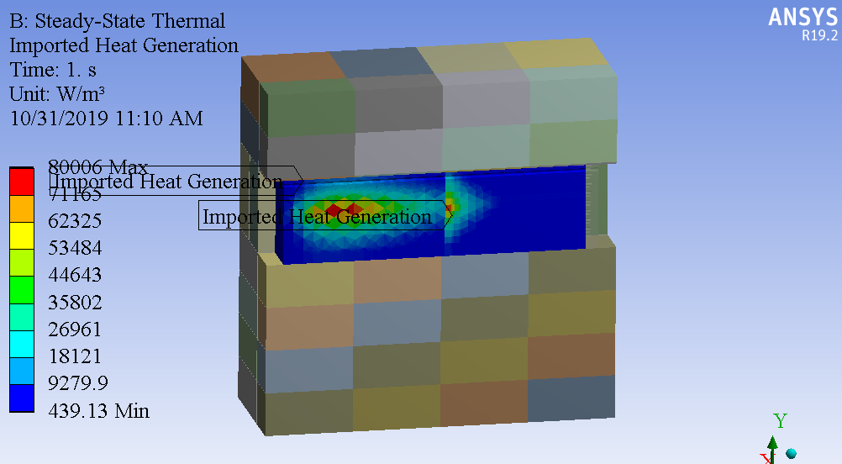
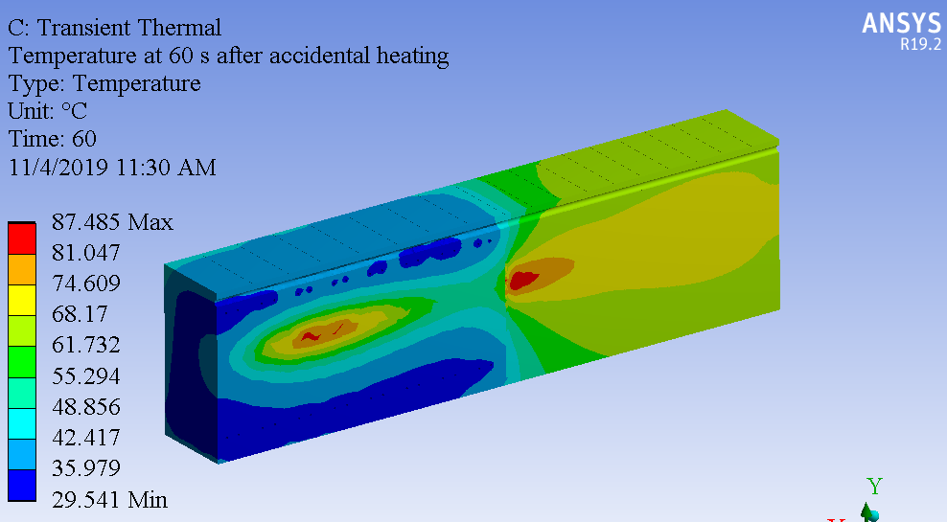
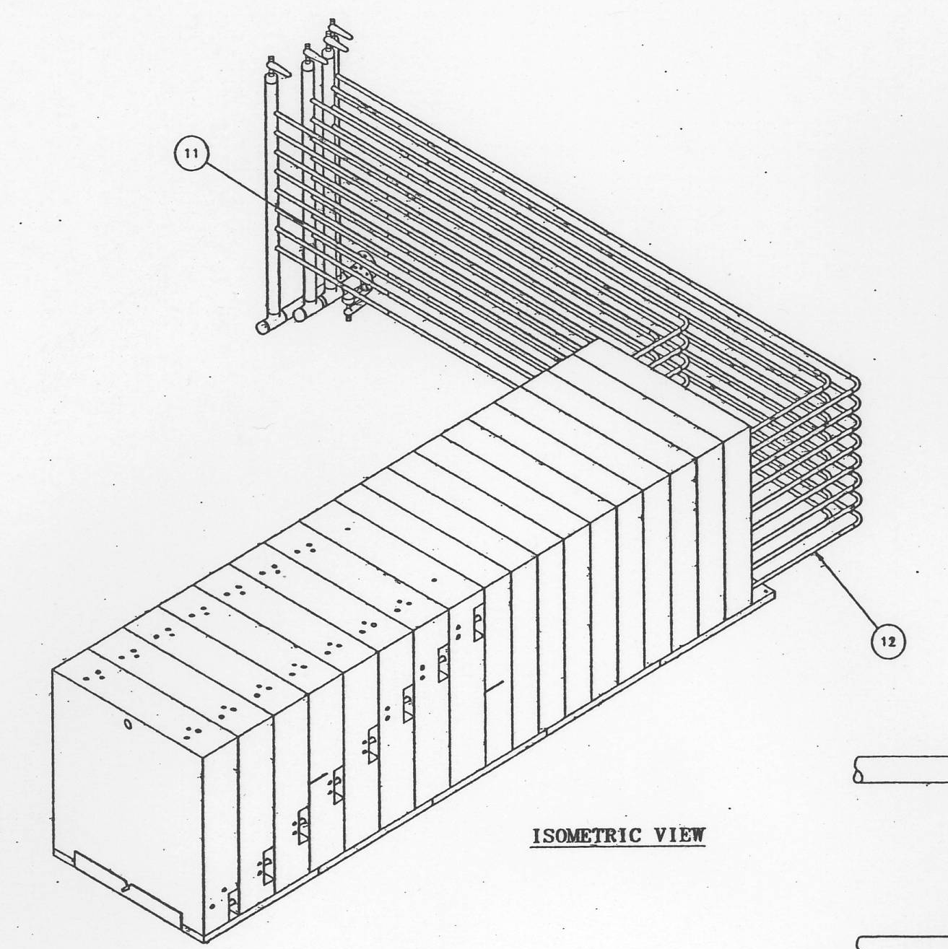
MARS/FEA Simulations (Igor Rakhno / Zhijing Tang)
MARS/FEA simulations for Beam Absorber
Conclusion: current cooling capacity is acceptable
RAW system upgrade is for addressing aging issues
Next: MARS/FEA simulations for Decay Pipe
Normal Operation | Core |  | shielding |  | Total
 | Aluminum | Steel | steel | concrete
Total ED (GeV/proton) | 4.9691 | 0.694 | 2.7362 | 0.0314 | 8.4307
Normal heating (W) | 43066 | 6015 | 23714 | 272 | 73067
Accidental Case | Core |  | shielding
 | Aluminum | Steel | steel | concrete | Total
Total ED (GeV/proton) | 32.0188 | 4.7946 | 4.6678 | 0.084 | 41.5652
Accidental heating (W) | 277496 | 41553 | 40455 | 728 | 360232

Slide 12
Monthly Performance Report – Jan. 2020
 |  |  |  | CONTRACT PERFORMANCE REPORT |  |  |  |  |  |  |  |  |  | DOLLARS IN
 |  |  |  | FORMAT 1 - WORK BREAKDOWN STRUCTURE |  |  |  |  |  |  |  |  |  | Dollars
1. CONTRACTOR |  |  |  | 2. CONTRACT |  |  |  |  | 3. PROGRAM |  |  |  |  | 4. REPORT PERIOD
a. NAME |  |  |  | a. NAME |  |  |  |  | a. NAME |  |  |  |  | a. FROM (YYYYMMDD) |  | 2020 / 01 / 01
Fermi National Accelerator Laboratory |  |  |  |  |  |  |  |  |  |  |  |  |  | b. TO (YYYYMMDD) |  | 2020 / 01 / 31
8. PERFORMANCE DATA
Work Package.WBS (2) |  | CURRENT PERIOD |  |  |  |  | CUMULATIVE TO DATE |  |  |  |  |  |  | AT COMPLETION
Work Package.WBS (3) |  | BUDGETED COST |  | ACTUAL | VARIANCE |  | BUDGETED COST |  | ACTUAL |  | VARIANCE |  |  | BUDGETED | ESTIMATED | VARIANCE
 |  | WORK | WORK | COST WORK |  |  | WORK | WORK | COST WORK
ITEM |  | SCHEDULED | PERFORMED | PERFORMED | SCHEDULE | COST | SCHEDULED | PERFORMED | PERFORMED |  | SCHEDULE |  | COST
(1) |  | (2) | (3) | (4) | (5) | (6) | (7) | (8) | (9) |  | (10) |  | (11) | (14) | (15) | (16)
A1901.01 NuMI Target Systems AIP Project Management |  | 20,451 | 20,451 | 9,011 | 0 | 11,440 | 304,044 | 304,044 | 272,693 |  | 0 |  | 31,351 | 515,653 | 484,301 | 31,351
A1901.02.01 Pre-Target Beam Window |  | 0 | 3,737 | 0 | 3,737 | 3,737 | 39,435 | 31,962 | 21,900 |  | (7,474) |  | 10,062 | 39,435 | 29,558 | 9,878
A1901.02.02 Target Baffle/Core |  | 0 | 0 | 2,568 | 0 | (2,568) | 277,495 | 277,495 | 267,315 |  | 0 |  | 10,180 | 277,495 | 267,315 | 10,180
A1901.02.03 Target Autopsy |  | 0 | 0 | 0 | 0 | 0 | 0 | 0 | 0 |  | 0 |  | 0 | 310,946 | 310,946 | 0
A1901.03.01 Horn 1 |  | 17,319 | 10,742 | 140,130 | (6,577) | (129,387) | 202,616 | 222,177 | 312,480 |  | 19,561 |  | (90,303) | 267,284 | 357,587 | (90,303)
A1901.03.02 Air Diverter T-Block |  | 32,260 | 30,724 | 0 | (1,536) | 30,724 | 197,626 | 117,347 | 99,015 |  | (80,279) |  | 18,332 | 262,011 | 165,255 | 96,756
A1901.03.03 Modules |  | 28,348 | 39,753 | 89,149 | 11,405 | (49,397) | 357,461 | 351,543 | 408,203 |  | (5,918) |  | (56,660) | 835,815 | 892,475 | (56,660)
A1901.04.01 Radioactive Water (RAW) System Upgrades |  | 22,564 | 26,147 | 13,749 | 3,582 | 12,398 | 253,747 | 248,542 | 294,587 |  | (5,205) |  | (46,044) | 449,418 | 495,607 | (46,189)
A1901.04.02 Target Chase Chiller and Air Handling Unit Upgrade |  | 12,240 | 0 | (26,259) | (12,240) | 26,259 | 346,751 | 318,902 | 359,082 |  | (27,849) |  | (40,180) | 445,626 | 481,730 | (36,104)
A1901.04.03 Target Chase Shielding Upgrades |  | 0 | 0 | 0 | 0 | 0 | 116,419 | 116,419 | 130,459 |  | 0 |  | (14,041) | 116,419 | 130,459 | (14,041)
A1901.04.04 Tritium Mitigation |  | 435 | 0 | 3,589 | (435) | (3,589) | 21,116 | 17,509 | 27,002 |  | (3,607) |  | (9,493) | 120,704 | 130,197 | (9,493)
A1901.05.01 Decay Pipe and Window Assessment/Repair Mechanism |  | 19,080 | 0 | 0 | (19,080) | 0 | 179,455 | 129,483 | 62,463 |  | (49,972) |  | 67,021 | 201,261 | 134,240 | 67,021
A1901.06.01 Hadron Absorber Instrumentation and Beam Monitoring |  | 30,731 | 3,932 | 32,299 | (26,799) | (28,366) | 349,394 | 246,449 | 179,946 |  | (102,945) |  | 66,503 | 584,594 | 518,939 | 65,654
A1901.06.02 MARS Modeling |  | 0 | 0 | 0 | 0 | 0 | 67,096 | 67,096 | 56,286 |  | 0 |  | 10,809 | 67,096 | 56,286 | 10,809
d. UNDISTRIBUTED BUDGET |  |  |  |  |  |  |  |  |  |  |  |  |  | 0 | 0 | 0
e. SUBTOTAL |  | 183,429 | 135,486 | 264,236 | (47,943) | (128,750) | 2,712,655 | 2,448,968 | 2,491,431 |  | (263,688) |  | (42,463) | 4,493,756 | 4,454,897 | 38,860
f. MANAGEMENT RESERVE |  |  |  |  |  |  |  |  |  |  |  |  |  | 0
g. TOTAL |  | 183,429 | 135,486 | 264,236 | (47,943) | (128,750) | 2,712,655 | 2,448,968 | 2,491,431 |  | (263,688) |  | (42,463) | 4,493,756
Management reserve: 674,496
Will plan for further contingency spend down

Slide 13
Summary
NuMI-TS-AIP has reached its mid-term milestone;
For contingency fund spend down, 6 activities have been added:
  Horn 1 module drives changeout
  Absorber hall RAW system upgrade
  MINOS surface chiller upgrade
  Target autopsy
  Beam absorber FEA thermal analysis
  Decay pipe FEA thermal analysis
Since the Megawatt target TA-05 installation, the maximum operational beam power has been set for 777 kW;
Horn 1 module drives changeout is the most challenging task, but the team is preparing for mock-up trainings at MI-8 in April-May before summer shutdown;
By the time when the megawatt Horn 1 is installed in summer 2020, NuMI neutrino beamline system will be able to accept beam power up to 1 MW;
Accelerator beam power roadmap: Operational cycle time is 1.2 sec since the fall of 2019;
  Spacing between cycles remains at 1.4 sec for Muon campus operation, will be ready for 900 kW operation in 2022

