Slide 1
Neutrino Beamline Absorber Hall RAW Exchange System Preliminary Design Review
Technical Design Aspects
David Hixson
February 19 & 20, 2020

Slide 2
Absorber Hall RAW Exchange System Outline
Purpose and Options
Design Requirements
Design Standards and Codes
Design Layout and Details
System Operational Parameters
Approximate Room Layout
Flow Model and P&ID
Summary
Pending Items
Questions

Slide 3
Absorber Hall RAW Exchange System Purpose and Options – Option 1
There will be two options presented; the first is Drain and Fill/Make-up of the radioactive cooling water (RAW) and Intermediate Water (INTW) systems. This option includes two independent functional sections:
Draining the Absorber RAW system into radiation safe drums located outside of Absorber Hall for radioactive waste safe disposal and hauling offsite, and Fill/Make-up supply of low conductivity water (LCW) to the Absorber RAW system, located in the LBNF Absorber Hall RAW room.
Draining the Intermediate Water system into drums located outside of Absorber Hall for safe disposal, and Fill/Make-up supply of low conductivity water (LCW) to the Intermediate Water system, located in the LBNF Absorber Hall RAW room.

Slide 4
Absorber Hall RAW Exchange System Purpose and Options – Option 2
The second option allows for Drain and Fill/Make-up of the radioactive cooling water (RAW) and Intermediate Water (INTW) systems, or Bleed and Feed (Burping) of just the radioactive cooling water (RAW) system. This option includes five independent functional sections:
Fill/Make-up supply of low conductivity water (LCW) to the Expansion/Storage Tank.
Fill/Make-up supply of low conductivity water (LCW) to the Absorber RAW or Intermediate Water (INTW) systems located in the same LBNF Absorber Hall RAW room.
Bleed and Feed (Burping) or periodically removing predetermined quantity of RAW from the Absorber RAW system during operation to reduce the contamination concentration of the RAW and thus maintain required cooling water quality.

Slide 5
Absorber Hall RAW Exchange System Purpose and Options – Option 2 (cont.)
The second option continued:
Draining the Absorber RAW cooling system and Intermediate Water (INTW) system completely during repair and maintenance modes, with Absorber RAW drainage initially pumped to a Polyethylene Storage Tank, and Intermediate Water (INTW) drainage into drums located outside of Absorber Hall for safe disposal.
Transferring all the drained Absorber RAW into radiation safe drums located outside of Absorber Hall for radioactive waste safe disposal – hauling offsite.

Slide 6
Absorber Hall RAW Exchange System Design Requirements
The Absorber Hall RAW Exchange System System shall:
Require minimal unscheduled interventions for maintenance.
The system shall meet established lab standards for safety, flow, capacity, and pressure.
The Intermediate Water System (INTW) shall be considered non-radioactive with a maximum radioactivity of 1900 pCi/ml.
Be supplied with Make-up water filtered to remove all particles larger than 5 microns.
Pumps will be constructed of PVDF plastic with Magnetic Drives to eliminate shaft seal leakage.

Slide 7
Absorber Hall RAW Exchange System Design Standards and Codes
In addition to complying with the following industrial and Fermilab standards and codes, the system design, particularly the system’s operation modes, capacity, and valve regulating & controls, is mainly based on Numi/Nova systems’ operational experience, lessons learned, and the latest feedback in operational input and upgrades.
ASME B31.3 Code for Normal Fluid Service.
ASME BPVC Section IX for Welding Process Specifications (WPS’s) and welders & pipefitters' Personal Weld Qualifications.
Both piping and vessels will adhere to FESHM Chapters 5031, 5031.1, 5031.3, 5034 as well as the Fermilab Engineering Manual.
ASTM-D-1998-15, Standard Specification for Polyethylene Upright Storage Tanks.
Piping and Tubing will be 304L or 316L ASTM A312 Stainless Steel

Slide 8
Absorber Hall RAW Exchange System System Operational Parameters
Option 1, Drain and Fill/Make-up only:
# | Option 1, Drain and Fill/Make-up only - Table-1 - Design Values
 | Functional Section | System Name | Fluid | Flow Rate (GPM) | Pressure (Psig)
 |  |  |  |  | Source | Destination
1 | Drain RAW to radiation safe drums | Absorber RAW System | RAW | 15 | 0 | 0
 | Fill/Make-up | Absorber RAW System | DI or LCW | 10 | 10 Drum Or LCW | 0
2 | Drain INTW to drums | Absorber INTW System | INTW | 15 | 0 | 0
 | Fill/Make-up | Absorber INTW System | DI or LCW | 10 | 10 Drum Or LCW | 0

Slide 9
Absorber Hall RAW Exchange System System Operational Parameters
Option 2, Fill/Make-up, Bleed and Feed (Burping), Drain, and Transfer:
# | Option 2, Fill/Make-up, Bleed and Feed, Drain, and Transfer - Table-2 - Design Values
 | Functional Section | System Name | Fluid | Flow Rate (GPM) | Pressure (Psig)
 |  |  |  |  | Source | Destination
1 | Fill/Make-up to LCW Expansion/Storage tank | LCW Expansion/Storage Tank | LCW | 15 | 150 | 5
2 | Fill/Make-up to one skid each time from LCW Expansion/Storage Tank | Absorber RAW System | LCW | 3 or 10 | 20 (pumped) | 0
 |  | INTW System |  | 10
3 | Bleed and Feed (Burp) | Absorber RAW | RAW | 3 | 25 | 0
4 | Drain to RAW holding tank | Absorber RAW | RAW | 30 | 0 | 0
 | Drain LCW to waste capture drum(s) | Intermediate LCW system | LCW | 10 | 0 | 0
5 | Drain RAW transfer to disposal | From RAW holding tank | RAW | 30 | 0 RAW holding tank | 0 RAW waste capture drum

Slide 10
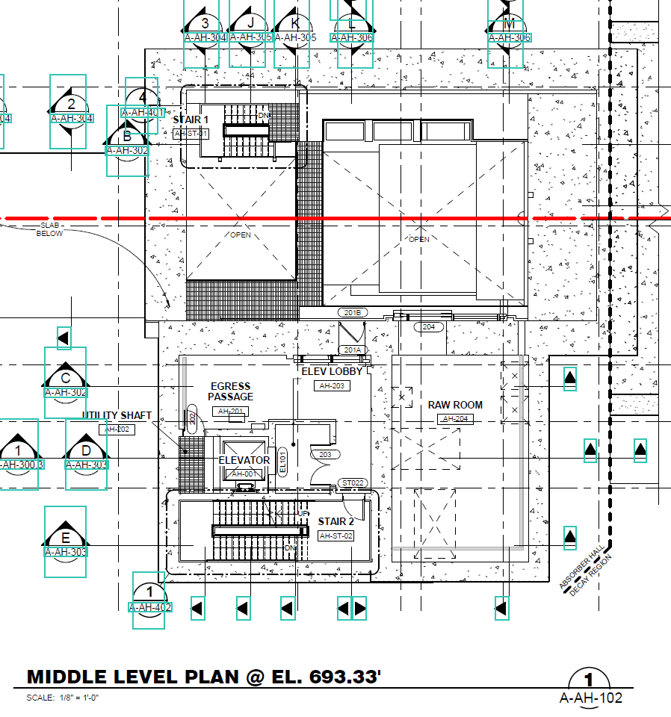
Absorber Hall RAW Exchange System Approximate Layout – General Rooms Arrangement
Rad Waste Fill Area has not been shown (Noted in 50% NSCF Design Review)

Slide 11
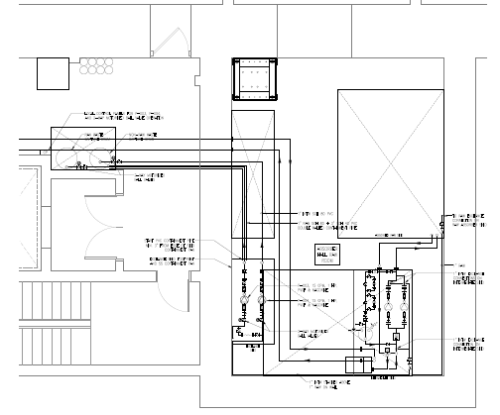
Absorber Hall RAW Exchange System Approximate General Layout – Option 1 Only
Rad Waste Fill Area has not been shown (Noted in 50% NSCF Design Review)

Slide 12
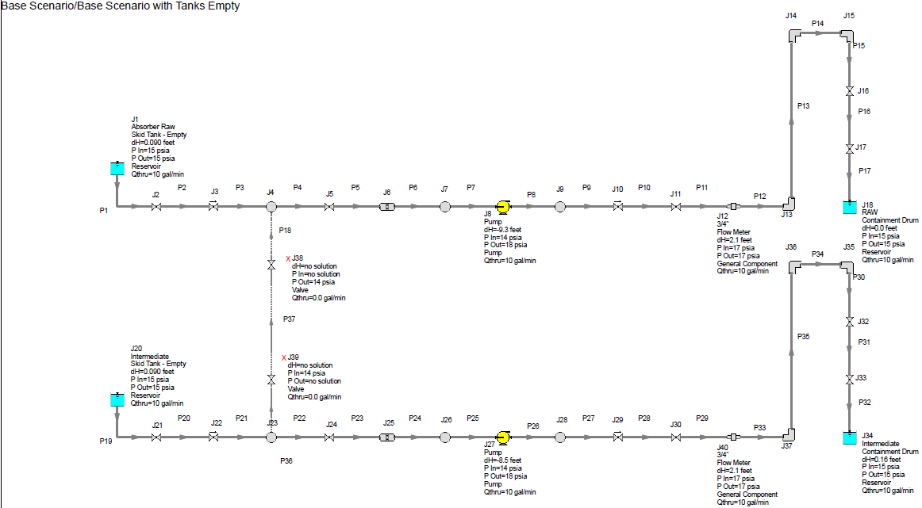
Absorber Hall RAW Exchange System Flow Models – Option 1 Only – Worst Case for RAW Pump
Flow Model PDF located in LBNF DocDB

Slide 13
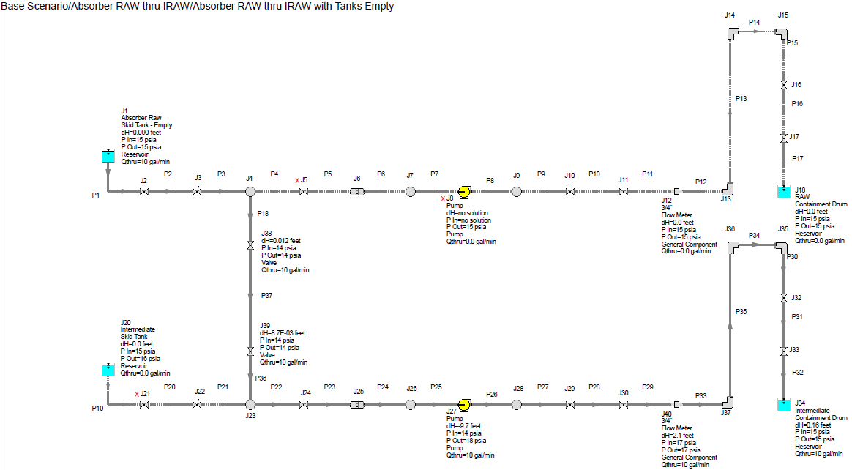
Absorber Hall RAW Exchange System Flow Models – Option 1 Only – Worst Case for INTW Pump
Flow Model PDF located in LBNF DocDB

Slide 14
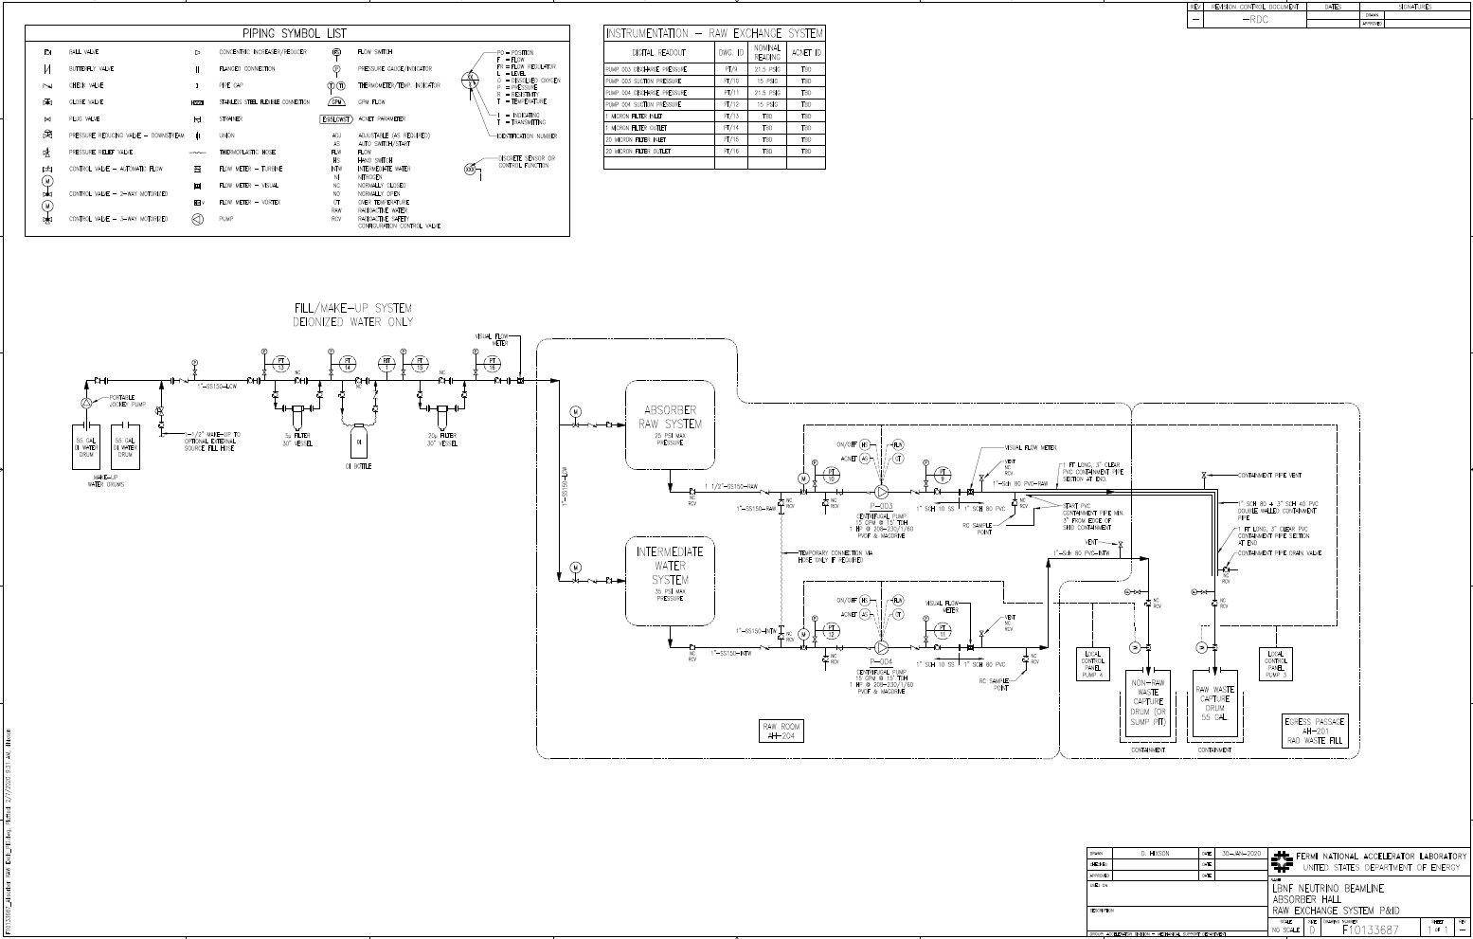
Absorber Hall RAW Exchange System P&ID Drawing – Option 1
P&ID in TeamCenter as F10133687

Slide 15
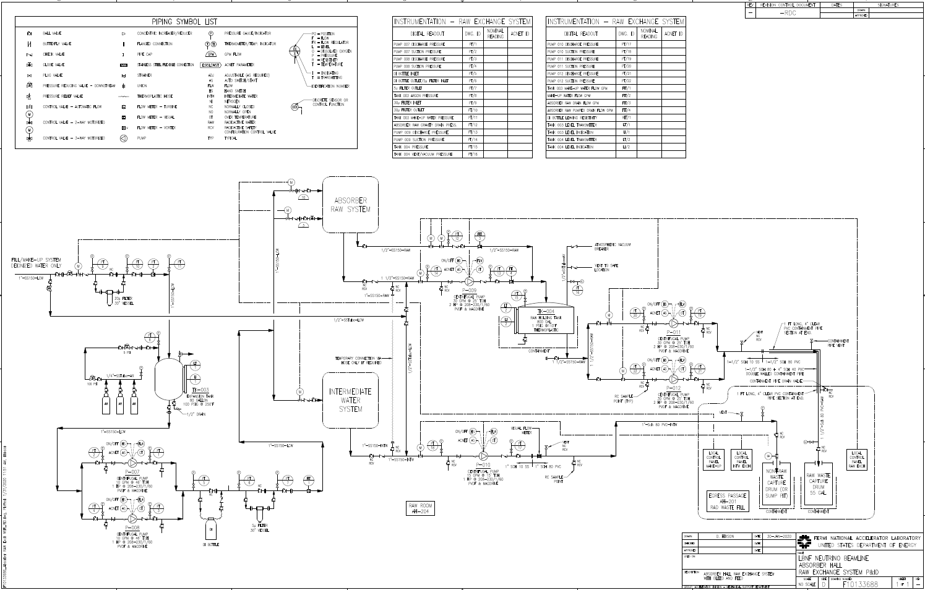
Absorber Hall RAW Exchange System P&ID Drawing – Option 2
P&ID in TeamCenter as F10133688

Slide 16
Absorber Hall RAW Exchange System P&ID - Major Equipment, Piping, Fittings, Estimate – Option 1
Major Equipment has been sized and selected
Pumps and Heat Exchangers
Piping has been sized
Final Pipe Routing may vary based upon the final RAW Room layout and
Major Valves and Fittings have been sized and selected
Flanges, Large Valves, Strainers, etc.
Item costs selected above show good equivalence to the estimate
Per LBNF DocDB 9504 - BOE form for 131.01.03.03.03.06.03

Slide 17
Absorber Hall RAW Exchange System Summary
There are two options, the first is Drain and Fill/Make-up of the radioactive cooling water (RAW) and Intermediate Water (INTW) systems.
The second option allows for Drain and Fill/Make-up of the radioactive cooling water (RAW) and Intermediate Water (INTW) systems, or Bleed and Feed (Burping) of just the radioactive cooling water (RAW) system.

Slide 18
Absorber Hall RAW Exchange System Pending Items for Final Design
Rad Waste Fill Area has not been shown
Noted in 50% NSCF Design Review
Finalize RAW Exchange Skid Footprint based on finalized RAW room layout and the other RAW skid footprints
Need a determination of which RAW Exchange Option to pursue:
Drain and Fill/Make-up of the radioactive cooling water (RAW) and Intermediate Water (INTW) systems – Option 1
- or -
Drain and Fill/Make-up of the radioactive cooling water (RAW) and Intermediate Water (INTW) systems, or Bleed and Feed (Burping) – Option 2
Coordinate and route piping to the RAW and INTW skids.
Finalize water exchange control parameters

Slide 19
Absorber Hall RAW Exchange System Questions?

