Slide 1
Neutrino Beamline Absorber Hall Intermediate Water (INTW) Preliminary Design Review
Technical Design Aspects
David Hixson
February 19 & 20, 2020

Slide 2
Absorber Hall Intermediate Water (INTW) Outline
Purpose
Design Requirements
Design Standards and Codes
Design Layout and Details
Block Diagram
System Operational Parameters
Approximate Room Layout
Flow Model and P&ID
Summary
Pending Items
Questions

Slide 3
Absorber Hall Intermediate Water (INTW) Purpose
The Absorber Hall Intermediate Water (INTW) System provides:
A means of heat transfer between conventional facilities cooling equipment and Radioactive Water (RAW) using Fermilab equipment .
A means of isolating that conventional facilities cooling equipment from any Fermilab equipment that may become radioactive.

Slide 4
Absorber Hall Intermediate Water (INTW) Design Requirements
The Absorber Hall Intermediate Water (INTW) System shall:
Require minimal unscheduled interventions for maintenance.
Have flows and capacities based on the connected load obtained from the Absorber RAW system engineer(s).
Have a nominal design temperature of 66°F.
Be considered non-radioactive with a maximum radioactivity of 1900 pCi/ml.
Be filtered to remove all particles larger than 5 microns.
Reject heat to a water chiller furnished and installed under the Conventional Facilities portion of the LBNF Project.

Slide 5
Absorber Hall Intermediate Water (INTW) Design Standards and Codes
In addition to complying with the following industrial and Fermilab standards and codes, the system design, particularly the system’s operation modes, capacity, and valve regulating & controls, is mainly based on Numi/Nova systems’ operational experience, lessons learned, and the latest feedback in operational input and upgrades.
ASME B31.3 Code for Category D Fluid Service.
ASME BPVC Section IX for Welding Process Specifications (WPS’s) and welders & pipefitters' Personal Weld Qualifications.
Both piping and vessels will adhere to FESHM Chapters 5031, 5031.1, 5031.3, 5034 as well as the Fermilab Engineering Manual.
Piping and Tubing will be 304L or 316L ASTM A312 Stainless Steel

Slide 6
Absorber Hall Intermediate Water (INTW) Block Diagram
Heat
Exch
Absorber Raw
583 kW
Chilled Water
Heat
Exch
Pumps
kW Loading obtained from Absorber RAW System Engineer(s)

Slide 7
Absorber Hall Intermediate Water (INTW) System Operational Parameters
LBNF Loading - Summary
Absorber Hall @ 2.4 MW | RAW Skid |  |  |  |  | INTW Skid
Absorber Hall Skids @ 2.4 MW Item | Design kW | Design GPM | Design TD °F | Design EWT °F | Design LWT °F | Design kW | Design GPM | Design TD °F | Design EWT °F | Design LWT °F | Notes
Absorber Skids: | 583 | 400 | 10 | 80 | 90 | 583 | 320 | 12 | 66 | 78 | HEX Sized for 583 kW and 400 GPM (per AD)
 | Chilled Water |  |  |  |  | INTW
Chilled to INTW Heat Exchanger: | 583 | 400 | 10 | 45 | 55 | 583 | 320 | 12 | 78 | 66 | HEX Sized for 583 kW
 |  |  |  |  | Filtration Loop: |  | 5 |  |  |  | Approx: 45 mins to filter 150 gallon system volume
 |  |  |  |  | Pump Size: |  | 325 | GPM
Absorber RAW Info (AD) |  |  |  |  |  |  |  | Pump Heat
Pump | 1,600 GPM @ 50 TDH (21.6 Psi) 105 Ft. Shut-off Head |  |  |  |  |  |  | Pump heat is < 5 kW and is lost in total system noise (~ 1 kW)
 | 1,600 GPM is required by the Absorber system.
 | Only 400 GPM passes through the Heat Exchanger |  |  |  |  |  |  | Absorber RAW - 2.4 MW Design Basis
Heat Exchanger | 400 GPM @ 90°F in / 80°F (10°F ΔT), 4.22 Psi ΔP |  |  |  |  |  |  | Since the 1.2 MW Beamline case kW loading is approximately equal to the
 | Calc'd Load = |  | 583 | kW |  |  |  | 2.4 MW Beamline case kW loading, the 2.4 MW Beamline Case will be
 |  |  |  |  |  |  |  | used as the design basis for the INTW system.
Chiller (by CF) | 45°F out, at 10°F ΔT (per Lee Hammond)

Slide 8
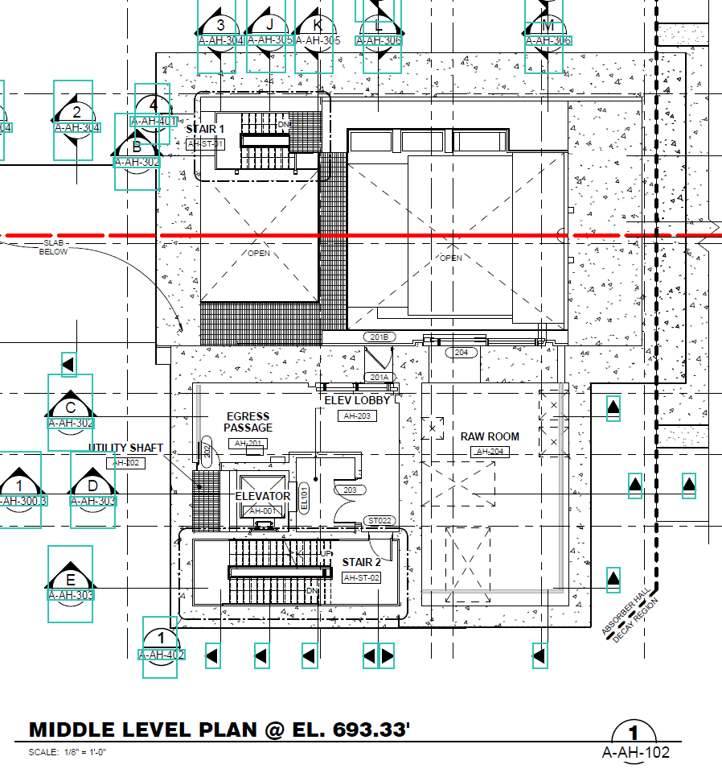
Absorber Hall Intermediate Water (INTW) Approximate Layout – General Rooms Arrangement
Routing for Chilled Water from CF Chiller still undetermined (Noted in 50% NSCF Design Review)

Slide 9
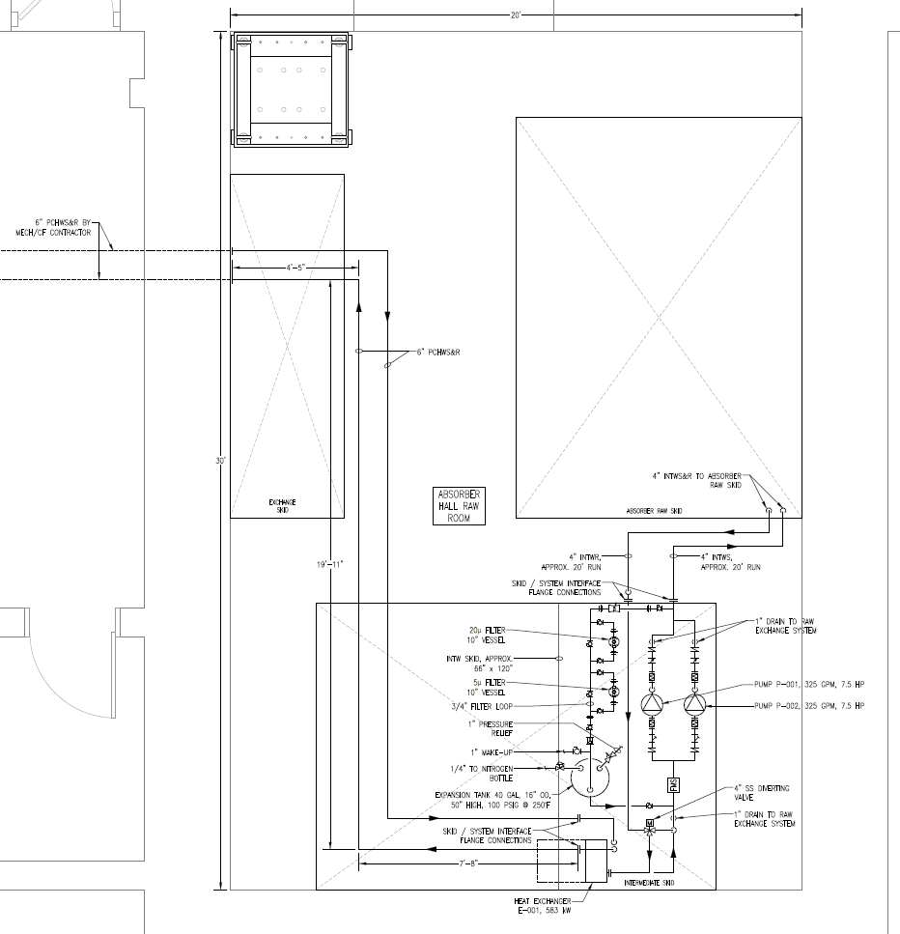
Absorber Hall Intermediate Water (INTW) Approximate General Layout
Routing for Chilled Water from CF Chiller to INTW Skid still undetermined (Noted in 50% NSCF Design Review)

Slide 10
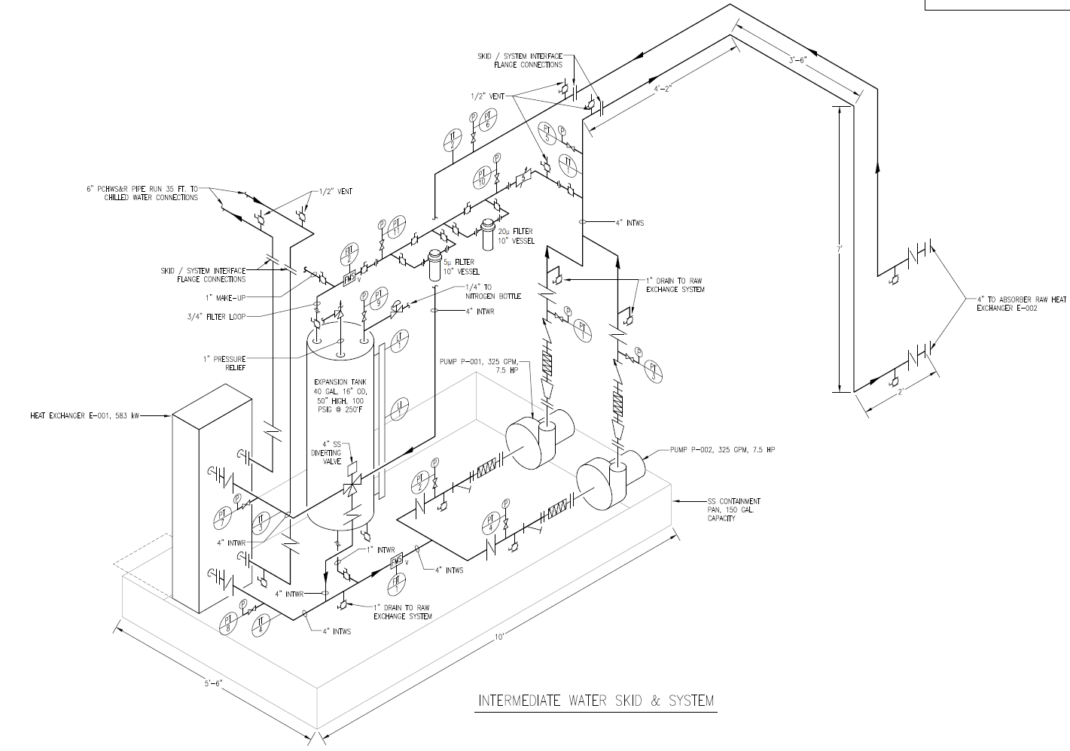
Absorber Hall Intermediate Water (INTW) Approximate Isometric
Routing for Chilled Water from CF Chiller to INTW Skid still undetermined (Noted in 50% NSCF Design Review)

Slide 11
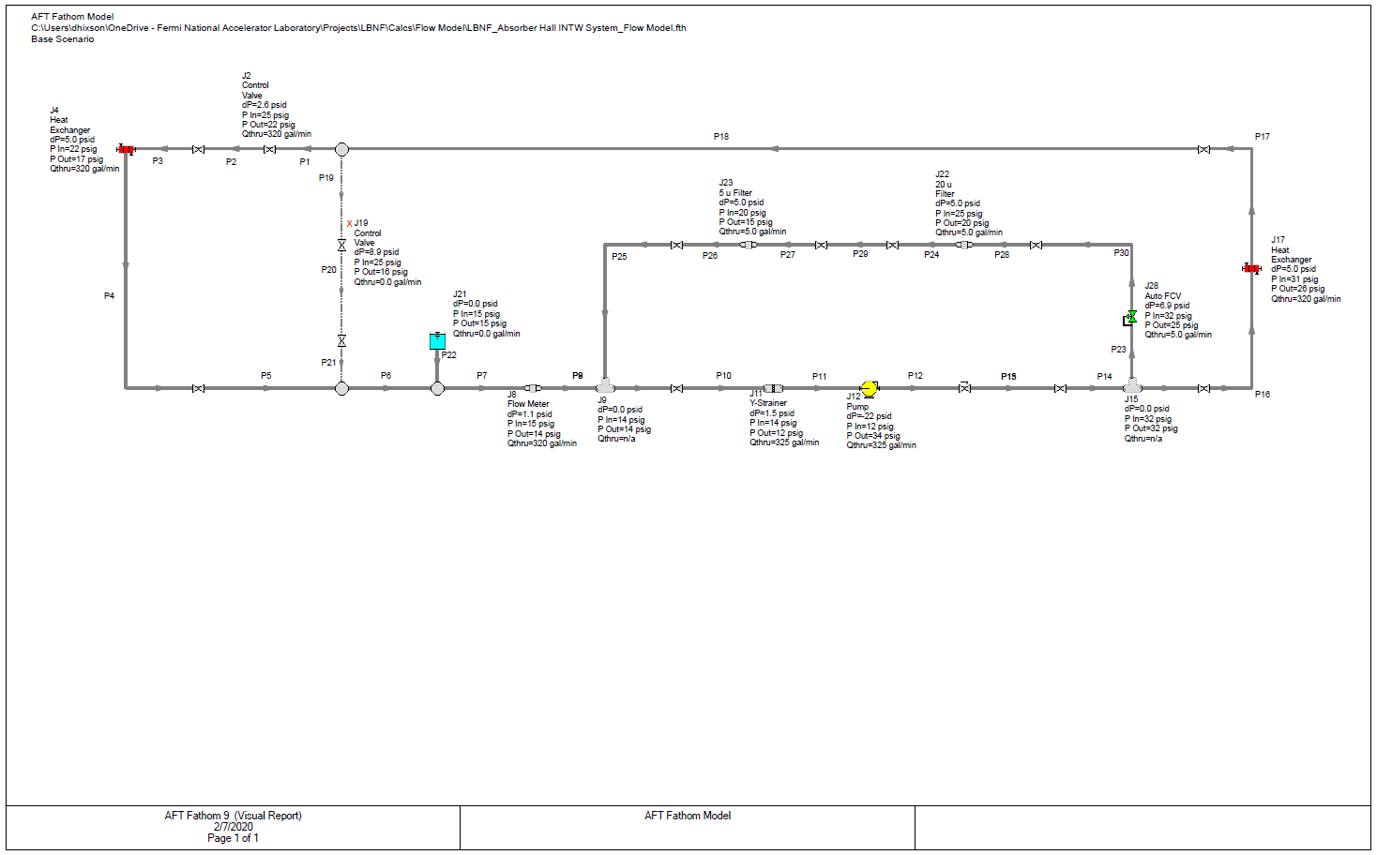
Absorber Hall Intermediate Water (INTW) Flow Model
Flow Model PDF located in LBNF DocDB

Slide 12
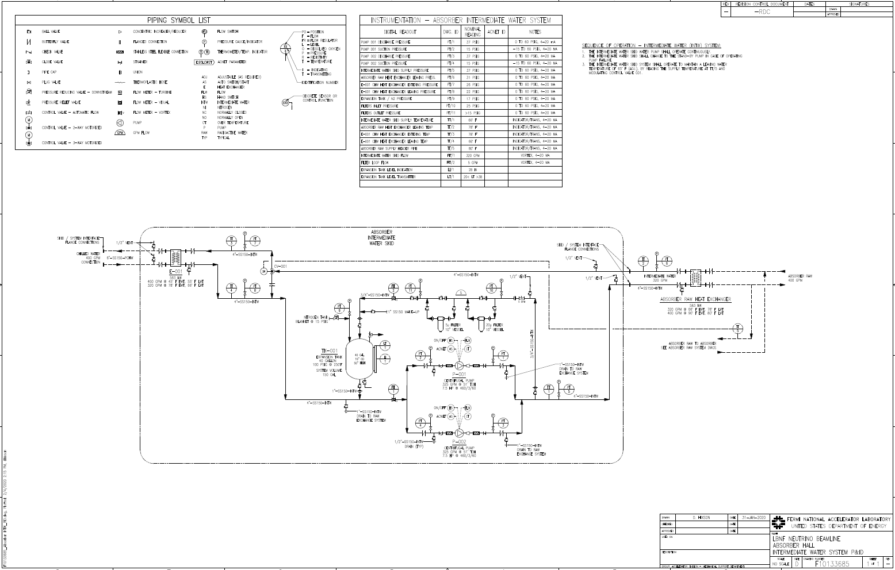
Absorber Hall Intermediate Water (INTW) P&ID Drawing
P&ID in TeamCenter as F10133685

Slide 13
Absorber Hall Intermediate Water (INTW) P&ID - Major Equipment, Piping, Fittings, Estimate
The Absorber Hall Intermediate Water (INTW) system has been designed for the 2.4 MW Beam. (see page 7)
Major Equipment has been sized and selected
Pumps and Heat Exchangers
Piping has been sized
Final Pipe Routing may vary based upon the final RAW Room layout
Major Valves and Fittings have been sized and selected
Flanges, Large Valves, Strainers, etc.
Item costs selected above show good equivalence to the estimate
Per LBNF DocDB 9504 - BOE form for 131.01.03.03.03.06.03

Slide 14
Absorber Hall Intermediate Water (INTW) Summary
A means of heat transfer between conventional facilities cooling equipment and Radioactive Water (RAW) using Fermilab equipment .
A means of isolating that conventional facilities cooling equipment from any Fermilab equipment that may become radioactive.
Have flows and capacities based on the connected loads obtained from the Absorber RAW system engineer(s).
Be considered non-radioactive with a maximum radioactivity of 1900 pCi/ml.
Be filtered to remove all particles larger than 5 microns.
Mainly based on Numi/Nova systems’ operational experience Design Layout and Details, applicable ASME Codes, FESHM, and the Fermi Engineering Manual.
Piping and Tubing will be 304L or 316L ASTM A312 Stainless Steel

Slide 15
Absorber Hall Intermediate Water (INTW) Pending Items for Final Design
CF Chilled Water piping routing to the AH INTW Skid
Noted in 50% NSCF Design Review
Finalize INTW Skid Footprint based on finalized RAW room layout and the other RAW skid footprints
Determine arrangement of equipment, piping, fittings, etc. on the final INTW Skid footprint
Coordinate and route INTW piping to each of the other RAW skids.
Finalize water temperature control parameters

Slide 16
Absorber Hall Intermediate Water (INTW) Questions?

