Slide 1
Primary Beamline Radio-Activated Water (RAW) Peliminary Design Review
Raw Systems – General Overview
Karlton E. Williams, II
February 19 & 20, 2020

Slide 2
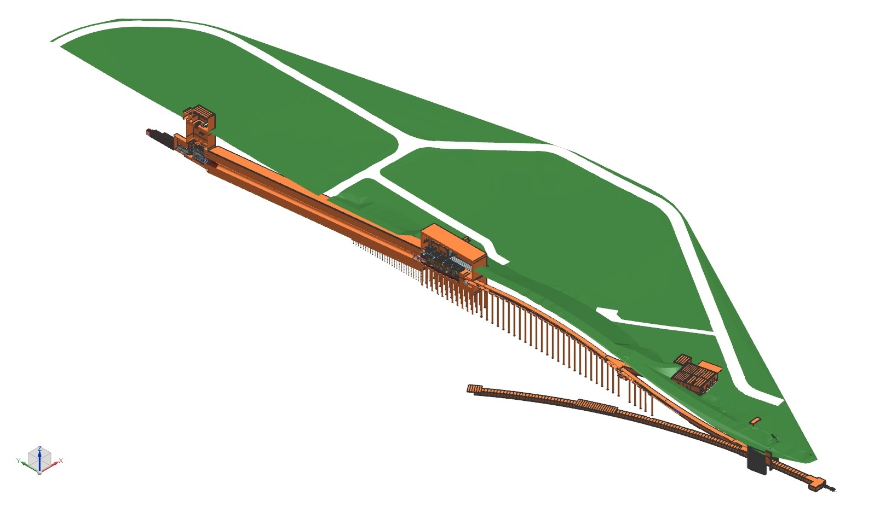
RAW System - Preliminary Design Review ISO Section View of Near Site – MI-10 to LBNF-30 Absorber Complex
Target Hall RAW Room
Nu Beam
to SURF, SD
Absorber Complex
Primary Beam Complex
Decay Pipe
Target
Complex
Absorber Hall RAW Room
Primary
Beamline
Fermilab
Main Injector
Tunnel
Proton Beam
Extraction
Proton Beam
from MI-10

Slide 3
RAW System - Preliminary Design Review Target Hall RAW Room Arrangement
BEAM
Target Chase
Target Hall RAW Room
RAW Capture Station, Air Compressors, Bottle Farm

Slide 4
RAW System - Preliminary Design Review Target Hall RAW Room Arrangement, cont.
Target Hall RAW Room
Piping Runs between RAW Room and Chase
BEAM

Slide 5
RAW System - Preliminary Design Review Absorber Hall RAW Room Arrangement
Absorber Pile
BEAM
RAW Capture Station, Air Compressors,
Bottle Farm
Absorber Hall RAW Room

Slide 6
RAW System - Preliminary Design Review Absorber Hall RAW Room Arrangement, cont.
Absorber Hall RAW Room
Absorber Pile
BEAM

Slide 7
RAW System - Preliminary Design Review Scope of Review
Review Emphasis:
The primary purpose of this review is technical in nature, to ensure the project is sufficiently mature to begin Final Design

Slide 8
RAW System - Preliminary Design Review What Is RAW?
RAW
Radio-Activated Water
Water in a closed-loop system, regulating components in a radioactive environment, where the water will become activated due to direct or indirect exposure with beam and/or activated components
System is normally filled with deionized water, maintained at a high level of filtration, and DI status maintained if necessary, as it slowly becomes activated

Slide 9
RAW Systems - Preliminary Design Review General Design Points
Neutrino Beamline lattice is well established
Components needing cooling are quite similar to those currently used in NuMI and MiniBooNE
RAW System design will follow closely with proven systems already in use, I.E., MI and NuMI
For both TH and AH, all RAW systems will have heat removed to the outside world via an Intermediate Cooling System (INTW), as a buffer between the RAW system and the outdoor chiller system (chiller system is part of NSCF)

Slide 10
RAW Systems - Preliminary Design Review Preliminary Design Package
The Preliminary Design package for each system includes the following (depending upon maturity):
System description & specifications
P&ID’s and AFT Fathom system models
Preliminary Design Report
Integrated work with the Conventional Facilities (CF) and component stakeholders have tentative layouts and piping runs
BOM for major components, instrumentation, valves, controls
Common Documents - Detailed Basis of Estimate (BOE), Gandtt Chart for schedule, Minimum Pipe Size by code

Slide 11
RAW Systems - Preliminary Design Review System Maturity
Design work at this stage is building off the Conceptual Design work as recorded over the past 10 years
Designed for 2.4MW beam, some systems can have VE for smaller heat exchangers and/or pumps at 1.2MW beam
RAW system preliminary design work at this stage is still in progress
Largest Issue in Final Design: Keeping up with design changes as component designs mature

Slide 12
RAW Systems - Preliminary Design Review System Maturity, cont.
Confidence of maturity of beamline component design is:
Excellent –
TH & AH RAW Exchange Systems
Very Good –
Shielding RAW
Absorber RAW
Absorber Intermediate
Reasonable –
Target RAW
Horn A RAW
Low –
Horns B & C RAW
H+OH Mediation System

Slide 13
RAW System - Preliminary Design Review Review Committee Charge

