Slide 1
Primary Beamline Radio-Activated Water (RAW) Peliminary Design Review
Introduction & Scope
Karlton E. Williams, II
February 19 & 20, 2020

Slide 2
RAW Systems - Preliminary Design Review Agenda
Links: Review Event Indico Page:
(Agenda and Presentations)
https://indico.fnal.gov/event/23229/
Dune DocDB Preliminary Design Files:
(Preliminary Design Files)
https://docs.dunescience.org/cgi-bin/private/DocumentDatabase
Document # 17870, 17873, 17876, 17879

Slide 3
RAW Systems - Preliminary Design Review Agenda
Wednesday, January 19, 2020
8 AM to 5 PM, WH1E
Introduction (Karl Williams)
Raw Systems General (Karl Williams)
Target Hall General (Karl Williams)
Target Hall RAW Systems
Target RAW (Raina Wang)
Horns A, B, C RAW (Karl Williams)
Shielding Panel RAW (Raina Wang)
TH RAW Exchange (Raina Wang)
TH Intermediate (Dave Hixson)
H+OH System (Dez Deshpande, Karl Williams)

Slide 4
RAW Systems - Preliminary Design Review Agenda (cont.)
Thursday, January 20, 2020
8 AM to 1 PM, WH2NE
Absorber Hall General (Karl Williams)
Absorber Hall RAW Systems
Absorber RAW (Dez Deshpande)
AH RAW Exchange (Dave Hixson)
AH Intermediate (Dave Hixson)
TH & AH Controls (Paul Kasley)
Q&A / Closing Remarks (Karl Williams)

Slide 5
RAW Systems - Preliminary Design Review Introductions
Many thanks to the Review Committee:
Chris Ader, chair
Senior Engineer, AD/ENG/MSD
Marty Murphy
Operations Specialist, AD/ENG/ENG_SUP
Lee Hammond
Senior Engineer, FE/ENGR/EngGrp
Adam Taylor
Staff Engineer, FE/ENGR/EngGrp
Thanks also to numerous contributors for drawings, technical info, guidance, etc. (many unnamed)
I’d also like to welcome all those involved with the LBNF project who took their time to participate today

Slide 6
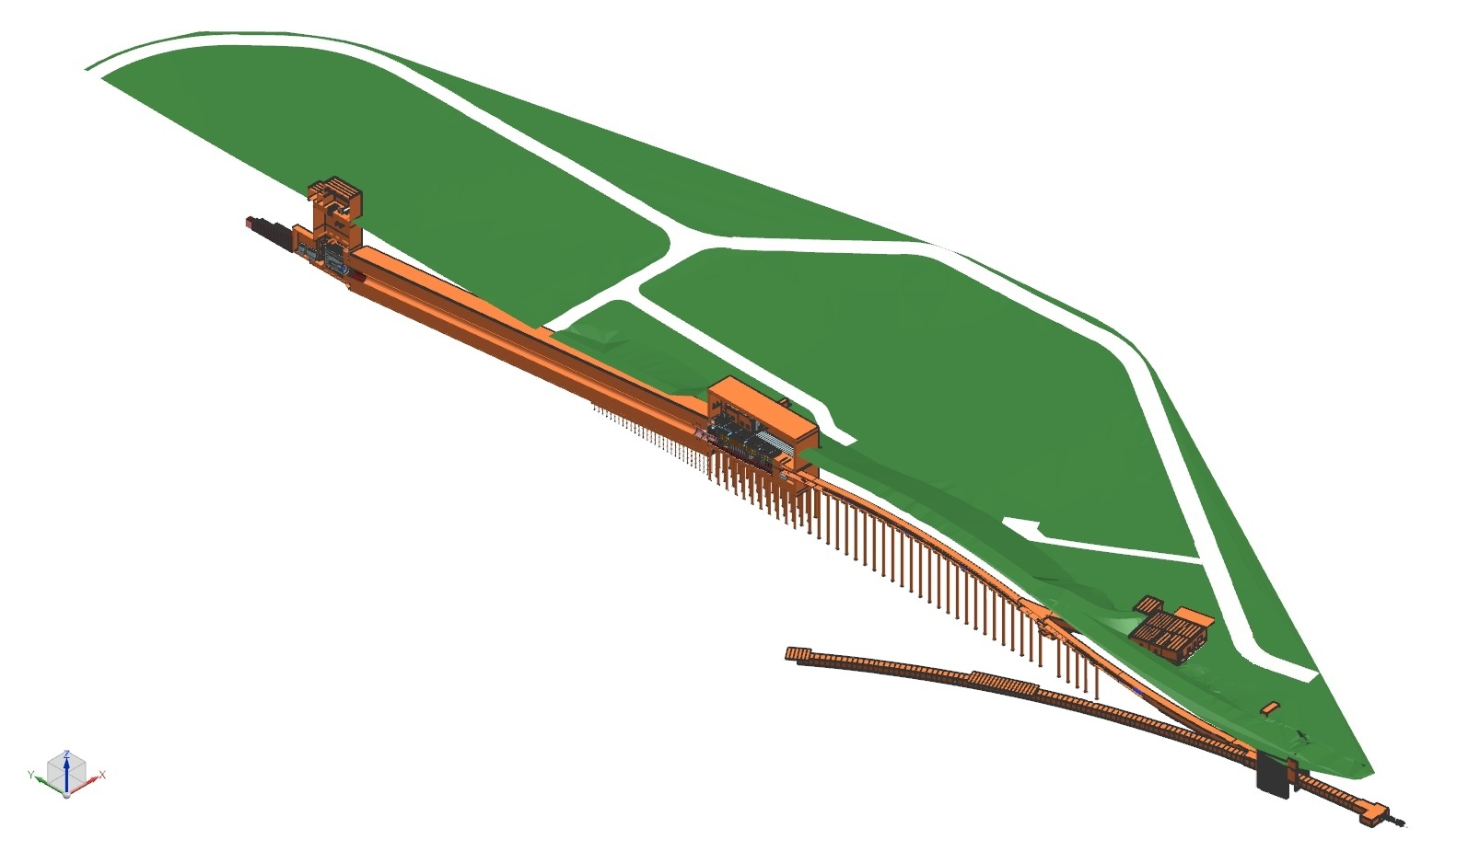
RAW Systems - Preliminary Design Review ISO Section View of Near Site – MI-10 to LBNF-30 Absorber Complex
Target Hall RAW Room
Nu Beam
to SURF, SD
Absorber Complex
Primary Beam Complex
Decay Pipe
Target
Complex
Absorber Hall RAW Room
Primary
Beamline
Fermilab
Main Injector
Tunnel
Proton Beam
Extraction
Proton Beam
from MI-10

Slide 7
RAW Systems - Preliminary Design Review Scope of Review
Review Emphasis:
The primary purpose of this review is technical in nature, to ensure the project is sufficiently mature to begin Final Design

Slide 8
RAW Systems - Preliminary Design Review Review Committee Charge
Are the interfaces with the other beamline systems and with the conventional facilities adequately identified and defined?
RAW System Interfaces (RAW_system_interfaces_valid_until_20FEB2020.xlsx, 99.6 kB)
Does the design work meet the requirements as outlined in the requirements document?
RAW System Requirements (NB_RAW_Water_Systems_Reqmts_L4_valid_until_20FEB2020.xlsx, 16.2 kB)
The documents can be found on DocDB #17870 https://docs.dunescience.org/cgi-bin/private/ShowDocument?docid=17870

Slide 9
RAW Systems - Preliminary Design Review Review Committee Charge
Is the design maturity presented for the TH and AH RAW systems at a level appropriate for the Preliminary Design Phase?
Based on acceptable progress as 50-60% of preliminary design, where 0% is beginning of preliminary design and 100% is completion of preliminary design
Understanding that Final Design will be drawing and effort intensive
Have potential design, manufacturing, and installation risks and challenges with the Neutrino Beamline components been identified, and has it been adequately planned to address these during the final design?
Are difficult design features and possible prototyping issues identified?

Slide 10
RAW Systems - Preliminary Design Review Review Committee Charge (cont.)
Have suitable engineering analyses been performed and documented, and reviewed/peer reviewed and approved, where applicable?
Are the appropriate codes and standards adequately applied to the design?
Have the ES&H issues been identified and analyzed appropriately?
Have the Fermilab Engineering Manual standards been applied to the design?
Is the level of integration with other LBNF beamline entities appropriate for this stage of the work? I.E. Are interfaces and collaborative design inputs being managed appropriately?

Slide 11
RAW Systems - Preliminary Design Review Review Committee Charge (cont.)
All LBNF RAW systems are currently undergoing estimation review through the Project Estimator. This includes the submission of sample packages to outside vendors for spot-checking of current values. With this in mind, a cursory check of the Cost and Schedule are desired:
To reflect & verify known changes, such as where flows to the shielding panels were greatly reduced
To question sufficiency of design resources in the light of known complexity of certain situations, such as selection and prototyping of horn ejector pumps
To review estimated design effort, as preliminary design effort to date has suggested that engineering and drafting resources may be under-estimated

Slide 12
RAW Systems - Preliminary Design Review Review Committee Charge (cont.)
In addition to answering the charge questions, the panel is welcome to comment and offer recommendations on other aspects of the LCW and Buswork Preliminary Design.
The panel chairperson is kindly asked to gather the findings, comments, and recommendations of the panel and summarize them along with the answers to the charge questions in a brief written report due approximately 1 week after the review.

Slide 13
RAW Systems - Preliminary Design Review
WELCOME!

Slide 14
RAW Systems - Preliminary Design Review

