Slide 1
Primary Beamline
Radio-Activated Water (RAW)
Peliminary Design Review
Horns A, B, & C RAW Systems
Karlton E. Williams, II
February 19, 2020

Slide 2
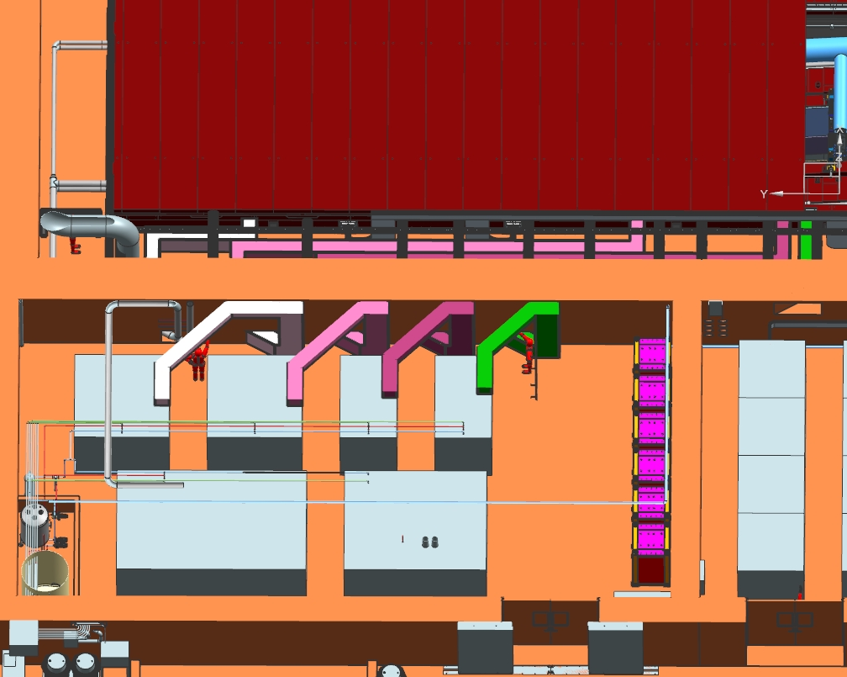
RAW System - Preliminary Design Review
Target Hall Layout For HORN RAW Systems
To Horn A
To Horn B
To Horn C
Target Chase
BEAM
Target Hall RAW Room
Horn C RAW
Horn B RAW
Horn A RAW
2
2/20/2020
Karl Williams | Horns A, B, & C RAW Systems

Slide 3
RAW System - Preliminary Design Review
Horns A, B, & C - General
Horns require many flow paths for cooling
4 manifolds each to feed spray nozzles
1 line each for hangers
Those 5 lines drain to sump tanks below horns, and are pumped back to expansion tanks via ejector pumps
1 line each for cooling modules, returns to expansion tank
1 line each for motive flow supply to ejector pumps
Plus one line for filtration
3
2/20/2020
Karl Williams | Horns A, B, & C RAW Systems

Slide 4
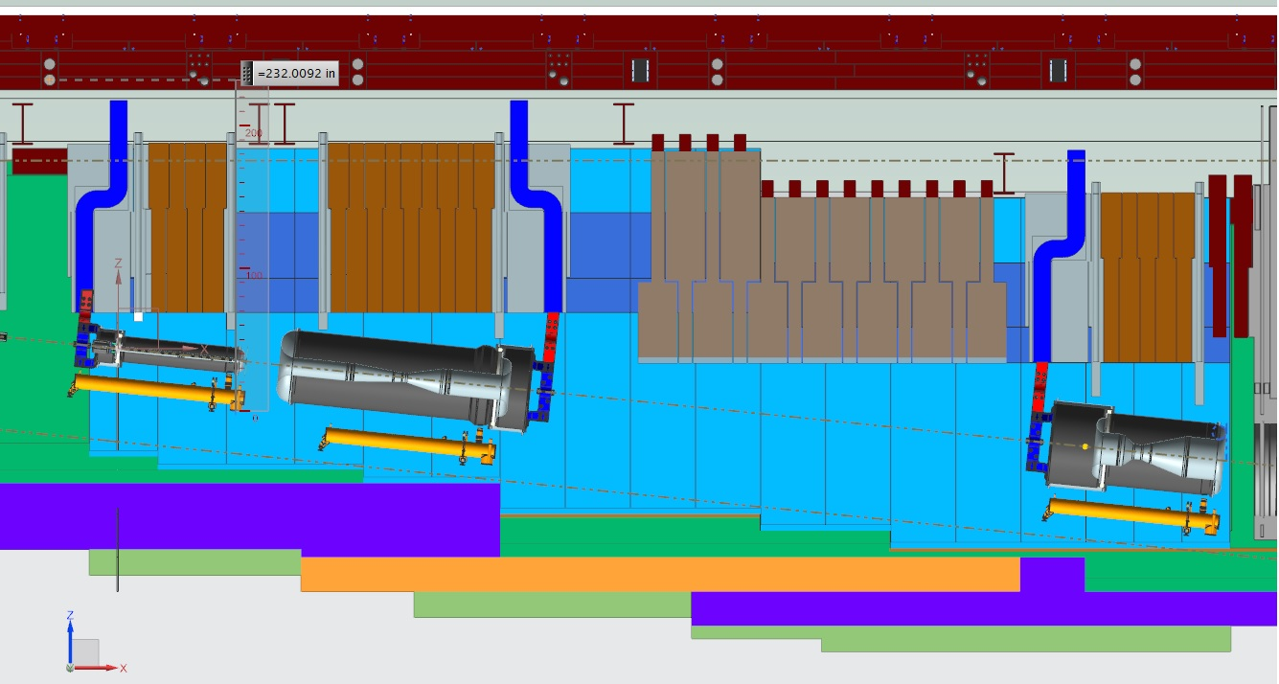
RAW System - Preliminary Design Review
Position Of Horns In Chase
4
2/20/2020
Karl Williams | Horns A, B, & C RAW Systems

Slide 5
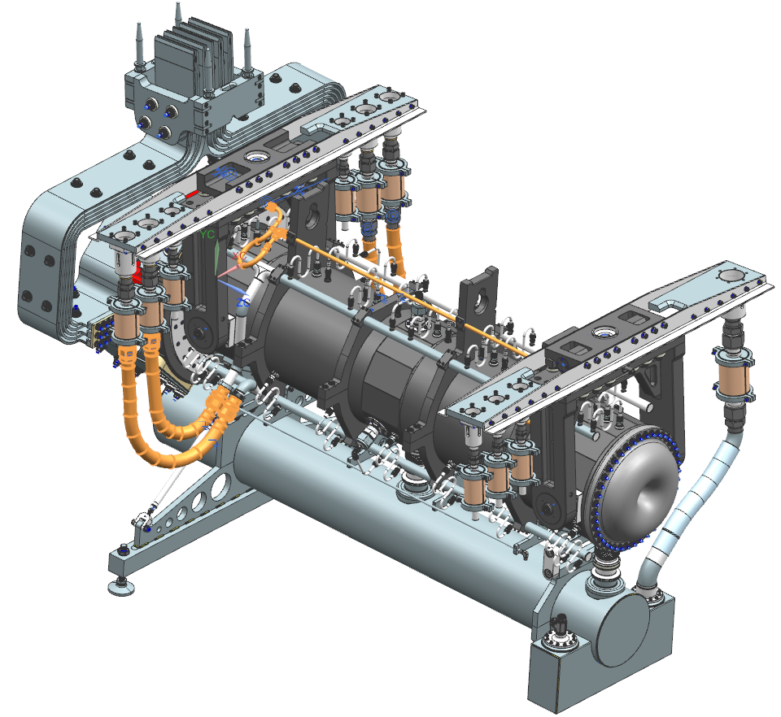
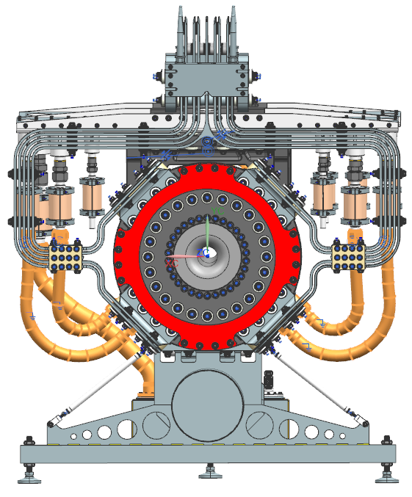
RAW System - Preliminary Design Review
Horn A Close-Up
Main water manifold flex lines.
Hanger cooling line routing.
Module & SLB spacing confirmation.
Slide used courtesy Cory Crowley, Mike Campbell
5
2/20/2020
Karl Williams | Horns A, B, & C RAW Systems

Slide 6
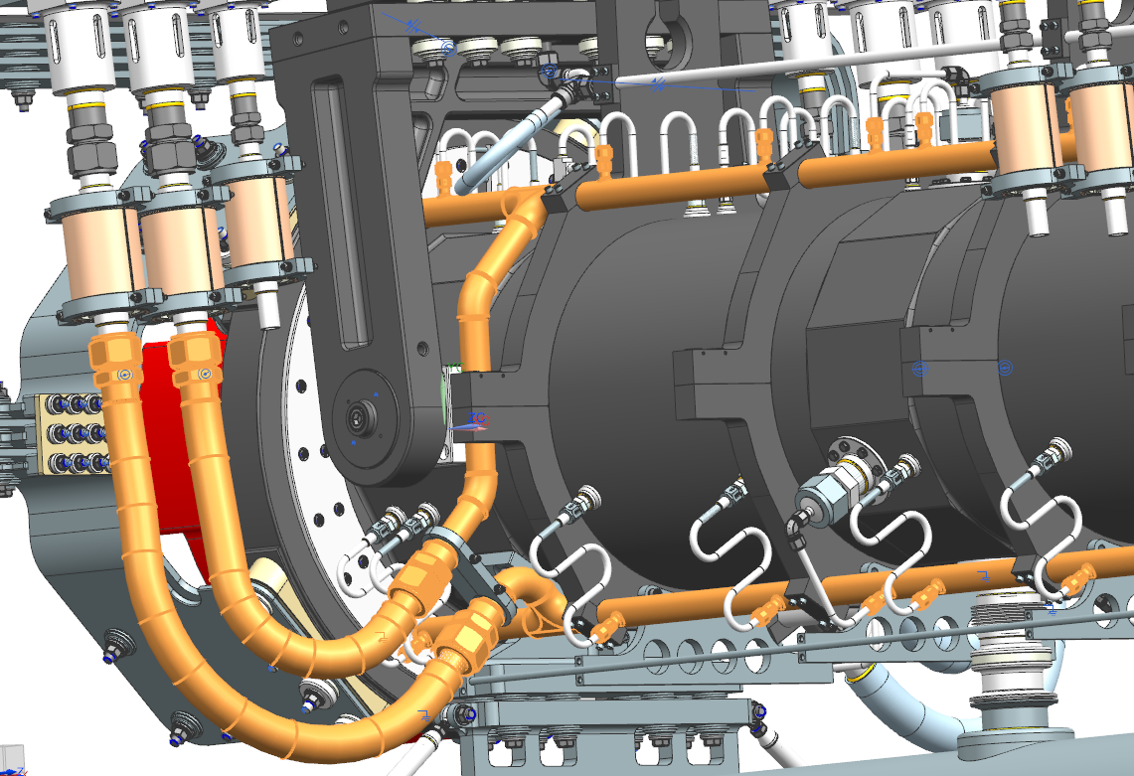
Main Manifold Flex lines
MANIFOLDS
NOZZLES
Slide used courtesy Cory Crowley, Mike Campbell
6
2/20/2020
Karl Williams | Horns A, B, & C RAW Systems

Slide 7
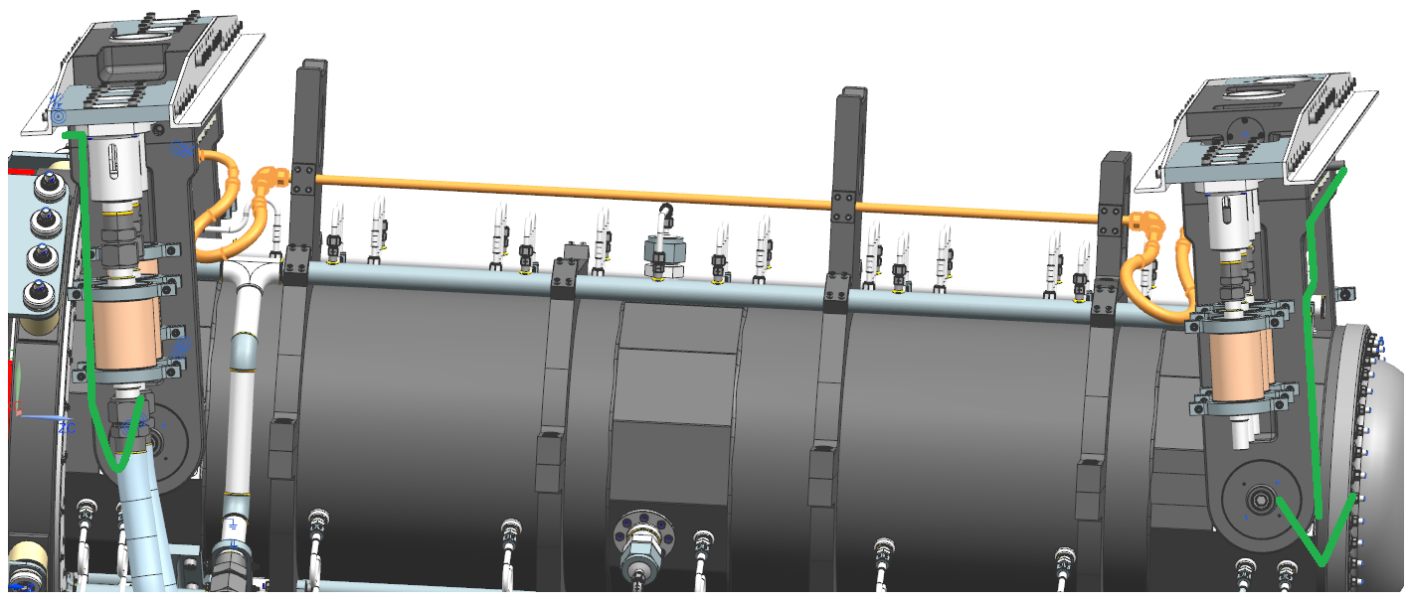
Hanger Cooling Union Line
Slide used courtesy Cory Crowley, Mike Campbell
7
2/20/2020
Karl Williams | Horns A, B, & C RAW Systems

Slide 8
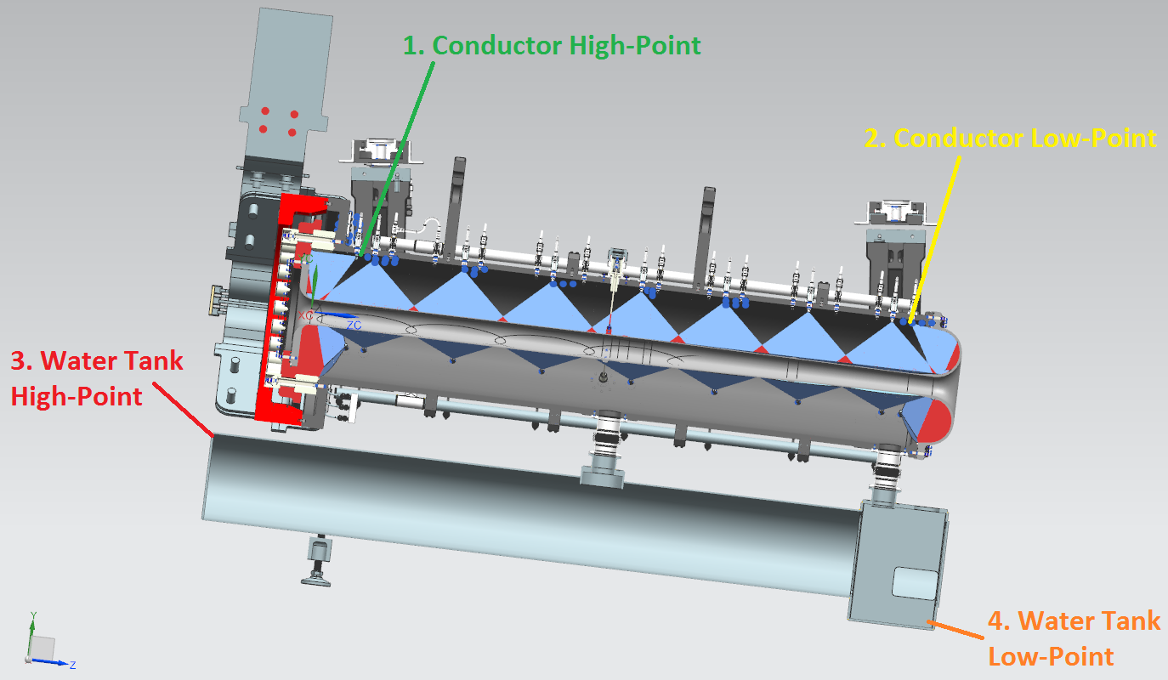
RAW System - Preliminary Design Review
Interior view of horn with spray nozzle patterns
Slide used courtesy Cory Crowley, Mike Campbell
8
2/20/2020
Karl Williams | Horns A, B, & C RAW Systems

Slide 9
RAW System - Preliminary Design Review
Horns A, B, & C – Heat Loads
LBNF Horn RAW Systems – Heat Loads (units kW)
 | Horn A |  | Horn B |  | Horn C
Heat Source | 1.2MW | 2.4MW 1 | 1.2MW 1 | 2.4MW 1 | 1.2MW 1 | 2.4MW 1
Manifold A | 8 | 16 | 7 | 14 | 4.5 | 9
Manifold B | 8 | 16 | 7 | 14 | 4.5 | 9
Manifold C | 8 | 16 | 7 | 14 | 4.5 | 9
Manifold D | 15 | 30 | 12.5 | 25 | 8.5 | 17
Modules | 3.3 | 6.6 | 3 | 6 | 6 | 12
Hangers | 1.5 | 3 | 1 | 2 | 1 | 2
Ejector Pump Supply | n/a | n/a | n/a | n/a | n/a | n/a
Filter/DI Loop | n/a | n/a | n/a | n/a | n/a | n/a
Recirc Pump | 18.6 | 29.8 | 37.2 | 37.2 | 29.8 | 29.8
SYSTEM TOTAL | 62.4 | 117 | 74.7 | 91.2 | 58.8 | 87.8
Notes:
1 – The horn & module heat load numbers for all three horns are based on actual EDEP analysis for 1.2MW. All 2.4MW numbers are 1.2MW X 2. They are fairly accurate and not actually scaled off of Horn A.
9
2/20/2020
Karl Williams | Horns A, B, & C RAW Systems

Slide 10
RAW System - Preliminary Design Review
Horns A, B, & C - Flows
LBNF Horn RAW Systems – Required Flows (units gpm)
 | Horn A |  | Horn B 2 |  | Horn C 2
Flow Source | 1.2MW | 2.4MW1 | 1.2MW1 | 2.4MW1 | 1.2MW1 | 2.4MW1
Manifold A | 8.1 2 | 16.2 | 24.3 | 24.3 | 16.2 | 16.2
Manifold B | 8.1 2 | 16.2 | 24.3 | 24.3 | 16.2 | 16.2
Manifold C | 8.1 2 | 16.2 | 24.3 | 24.3 | 16.2 | 16.2
Manifold D | 15.1 2, 4 | 30.2 | 45.3 | 45.3 | 30.2 | 30.2
Modules | 34 | 34 | 34 | 34 | 34 | 34
Hangers | 3 2 | 3 | 3 | 3 | 3 | 3
Ejector Pump Supply | 52 | 100 | 142 | 142 | 100 | 100
Filter/DI Loop | 10 | 10 | 20 | 20 | 20 | 20
SYSTEM TOTAL (Recirc Pump) | 140 | 242 | 314 | 314 | 242 | 242
Notes:
1 – Based on scaling of Horn A at 1.2 MW
2 – Values add to produce total flow required by ejector pump suction flow
3 – Horns B and C, system size governed by horn spray flow required, not heat removal
4 – Flow includes Target Mount @ 2.9 gpm
10
2/20/2020
Karl Williams | Horns A, B, & C RAW Systems

Slide 11
RAW System - Preliminary Design Review
Horns A, B, & C - Design Maturity
Horns on a later maturity schedule than most TH/AH components
EDEP modeling done for all 3 horns at 1.2MW
Work on Horn A prototype in progress
Horns B and C to follow later
Horn design for 2.4MW operation may be different than 1.2MW
11
2/20/2020
Karl Williams | Horns A, B, & C RAW Systems

Slide 12
RAW System - Preliminary Design Review
Horns A, B, & C – RAW System Design
Horn RAW System design strategy:
Preliminary design of Horn A for 1.2MW
  Includes EDEP, spray nozzle flows, as required of RAW system
  Includes hangers, modules, ejector pump
Complete prototyping of ejector pump
EDEP for cooling requirements completed for Horns B & C
Heat loads are doubled for 2.4MW operation
Flows are scaled as Horn B = 3 x Horn A, Horn C = 2 x Horn A
Use this model for basis of Horns B and C design
Prototype ejector pump work will include requirements for all 3
12
2/20/2020
Karl Williams | Horns A, B, & C RAW Systems

Slide 13
RAW System - Preliminary Design Review
Horns A, B, & C
Heat loads are similar between the 3 horns
  Original estimates had Horns B & C greater than Horn A
  Horn B is about 90% of horn A, Horn C is about 65% of Horn A
  The hangers and modules vary some as well
  Driving item is flow required for even spray within the horn interiors
  Significant contributor to hear load is recirculation pump
Horn A, heat load is dominant design requirement
  By value engineering, may be outfitted with smaller recirc pump and heat exchanger for 1.2MW beam
Horns B & C, flows for inner horn spray wands are dominant design requirement
  Require same system for either 1.2MW or 2.4MW beam power
13
2/20/2020
Karl Williams | Horns A, B, & C RAW Systems

Slide 14
RAW System - Preliminary Design Review
Horns A, B, & C
To evacuate Horn Water Tanks, Ejector (jet) Pump sizing becomes key
Motive flows required for Ejector Pumps are approximately 1.5 times that as being removed from the Horn Water Tanks
  Water from internal spray wands collects in water tanks (troughs) below the horns
  Must then be suctioned out by ejector pumps (AKA eductor or jet pumps)
  System total flow = spray wand flow + motive flow + filtration
    Approx. total system flows = 2.5 to 3 times Horn spray wand flows
  Because of high pressure and flow requirements of the motive flow stream, recirculation pumps are much larger than required for simple supplying the horn cooling flows
14
2/20/2020
Karl Williams | Horns A, B, & C RAW Systems

Slide 15
RAW System - Preliminary Design Review
Horns A, B, & C
Why ejector pumps?
  No moving parts to wear, all SS
  No electrics to burn out
  Ability to be mounted above modules for easy access & maintenance
Prototyping
  Will test single pump, and dual pumps in parallel
  Will test accurate mock-up of suction tube and fittings for realistic assessment of losses in actual circumstances
  May affect pump chosen
  May affect current suction line design
15
2/20/2020
Karl Williams | Horns A, B, & C RAW Systems

Slide 16
RAW System - Preliminary Design Review
Horns A, B, & C
Suction lifts required are 17’ for Horn A, 18.5’ for Horns B, & C
  Add approx. 5’ for friction head loss
  Sum of lift losses greatly affects ejector performance
  Discharge back pressure = 11 psid = 25’
  Require higher pressures of motive flow to acquire lift, and to overcome backpressure to return to RAW reservoir
    Motive supply pressure to ejector of 100psig or greater
    Ejector pumps will be below the hatch covers, above the modules
    Requires refinement of engineering, and prototype installation testing, which is in planning stages by J. Chikelu
16
2/20/2020
Karl Williams | Horns A, B, & C RAW Systems

Slide 17
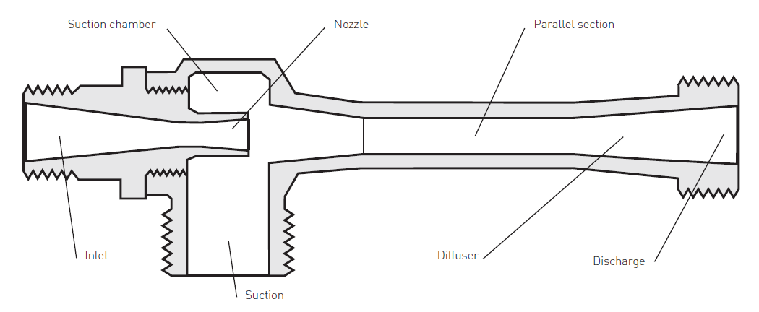
RAW System - Preliminary Design Review
Horns A, B, & C
Ejector Pump Basics:
Motive Fluid In
Discharge Out
From RAW Skid
= Motive + Suction Fluids To RAW Skid
Suction Fluid In From Horn Sump
Suction Lift Required:
Horn A = 17 ft = -7.4 psig
Horn B = 18.5 ft = -8.0 psig
Horn C = 18.5 ft = -8.0 psig
Image Credit: Pentair Penberthy Jet Pumps
To increase suction lift head, must increase motive (input) pressure and flow, and/or decrease discharge backpressure
To increase suction flow, must increase motive pressure and flow, decrease backpressure, and/or reduce required suction lift head
At our needs, motive flow required >> suction fluid flow desired
17
2/20/2020
Karl Williams | Horns A, B, & C RAW Systems

Slide 18
RAW System - Preliminary Design Review
Horns A, B, & C – AFT Fathom Modeling
Complex system to model
Manifolds - modeled each manifold with spray nozzles as a single entity with a system curve
Suction line - modeled multiple sections & sizes of suction line, from horn capture tank to ejector, as a single entity with a system curve
Discharge line - verified discharge line from ejector to expansion tank with a model
Substituted manifold and suction curves into Fathom system model
18
2/20/2020
Karl Williams | Horns A, B, & C RAW Systems

Slide 19
RAW System - Preliminary Design Review
Horns A, B, & C – AFT Fathom Modeling (cont.)
Must “fool” the model at times
  AFT Fathom models a symbolic ejector with only a suction and a discharge line, not all 3 lines
  Supply to motive line is to pressure node
  Flow from nozzles cannot be tied directly to horn capture tank
  Make links between the above entities by setting up “design alerts” if conditions between junctions or pipes are not met, then iterate until alerts are met
19
2/20/2020
Karl Williams | Horns A, B, & C RAW Systems

Slide 20
RAW System - Preliminary Design Review
Horns A, B, & C – AFT Fathom Modeling (cont.)
Files at Dune DocDB 17873
https://docs.dunescience.org/cgi-bin/private/AddFiles
Horn A main 2-18-20.pdf
Horn A manifolds A-B-C 2-18-20.pdf
Horn A manifold D 2-18-20.pdf
Horn A suction line 2-18-20.pdf
Horn A discharge line 2-18-20.pdf
20
2/20/2020
Karl Williams | Horns A, B, & C RAW Systems

Slide 21
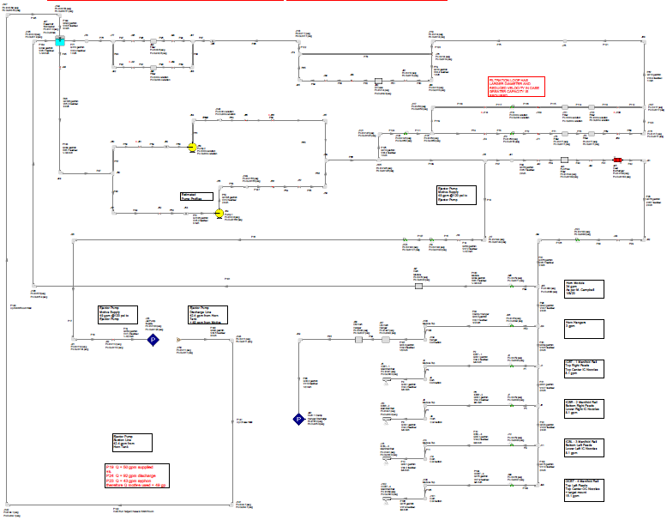
RAW System - Preliminary Design Review
Horns A, B, & C – AFT Fathom Modeling (cont.)
Expansion Tank
Recirc Pumps
Modules
Hangers
Simplified Ejector Model
Manifolds
21
2/20/2020
Karl Williams | Horns A, B, & C RAW Systems

Slide 22
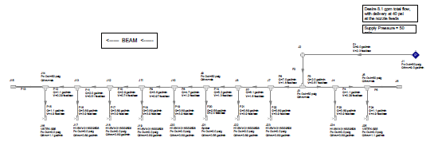
RAW System - Preliminary Design Review
Horns A, B, & C – AFT Fathom Modeling (cont.)
Manifolds A, B, C
22
2/20/2020
Karl Williams | Horns A, B, & C RAW Systems

Slide 23
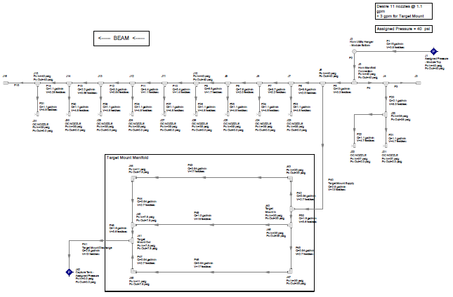
RAW System - Preliminary Design Review
Horns A, B, & C – AFT Fathom Modeling (cont.)
Manifold D
23
2/20/2020
Karl Williams | Horns A, B, & C RAW Systems

Slide 24
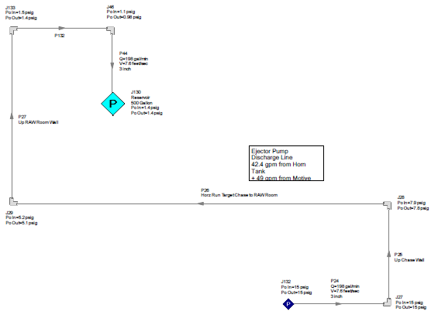
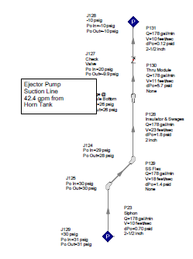
RAW System - Preliminary Design Review
Horns A, B, & C – AFT Fathom Modeling (cont.)
Suction Line
Discharge Line
24
2/20/2020
Karl Williams | Horns A, B, & C RAW Systems

Slide 25
RAW System - Preliminary Design Review
Horns A, B, & C - Piping Runs
Designed for all pipes to fit into envelope 18”h x 18”w
  4 manifold lines
  2 module lines
  1 hangers line
  1 ejector supply line
  1 ejector return line
  2 argon circulation gas lines
  1 spare line
Fully welded SS, from RAW system in RAW Room, through penetration to Target Hall, along aisle and thru penetration at battlement into Target Chase
Removable sections inside Chase flanged at battlement
All isolation valves, flow controls, at system in RAW Room
25
2/20/2020
Karl Williams | Horns A, B, & C RAW Systems

Slide 26
RAW System - Preliminary Design Review

Slide 27
RAW System - Preliminary Design Review
Hermetic Seal At Battlement Penetration

Slide 28
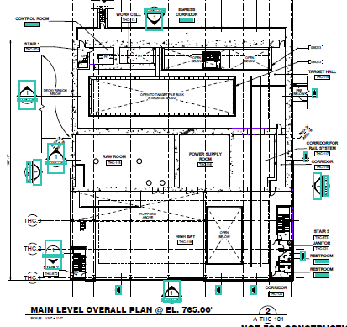
RAW System - Preliminary Design Review
TARGET HALL COMPLEX
Target Chase
Piping Path Envelope
Target Hall RAW Room

Slide 29
RAW System - Preliminary Design Review
Horns A, B, & C
Questions?
29
2/20/2020
Karl Williams | Horns A, B, & C RAW Systems

