Slide 1
Primary Beamline Target Shield Pile Cooling Panel RAW System Preliminary Design Review
Technical Design Aspects
Raina Wang
February 19, 2020

Slide 2
Purpose and Scope
Preliminary design of the Target Shield Pile (TSP) Cooling Panel radioactive water (RAW) system to cool the inner layers of steel shielding of the target chase in Target Hall for 2.4MW beamline of LBNF project.
To supply and return cooling water for:
36 cooling panels, 18 each side of the target chase
8 small panels - attached to the bottom of some t-blocks

Slide 3
Purpose and Scope – Cont.
A stand along skid: equipment, pipes, valves, fittings, and field installed instruments
Piping and piping components between the skid and the nozzles of 44 panels
First valve between:
LBNF TH Exchange System and
Intermediate Water System, which covers the pipes
Mechanical techniques for mitigating radiation risks
All other EHS related radiation dose rate evaluations and control are excluded from this system
They are the work scope of ESH or Radiation Physicist Department

Slide 4
Purpose and Scope – Cont.

Slide 5
Design Standards and Codes
ASME B31.3 Code for Normal Fluid Service
ASME BPVC Section IX for Welding Process Specifications (WPS’s) and welders & pipefitters' Personal Weld Qualifications
Both piping and vessels will adhere to FESHM Chapter 5031, as well as the Fermilab Engineering Manual
Numi/Nova systems’ general operational feedbacks for improvement

Slide 6
Design Requirements
Safe, Reliable, and Economic
Convenient for operation and maintenance
Meet water quality and capacity of operational requirements for:
1.2MW beamline – first phase
2.4 MW beamline – 2nd phase
Design depth – sufficient for cost estimating for Project Budget

Slide 7
Design Requirements – Process By Matt Slabaugh and Joseph Angelo

Slide 8
Design Capacity – 450 GPM

Slide 9
Equipment Selection and Sizing - Heat Exchanger
Capacity: 900 KW, actual 950KW
Type: Tranter Superchanger plate and frame unit
- a welded unit
- eliminate leaking
Material: SS
CS shell and cover - optional
ASME code compliance
Design condition: 150Psig @ 200ºF
MAWP: ≥200 Psig
MMDT: -20 deg. F
Hot side: Temperature – ΔT = 15deg.
Tin = 85 deg. F Tout = 100 deg. F
Flow rate – 435 GPM
Cold side: temperature - ΔT = 12 deg.
Tin = 65 deg. F Tout = 77 deg. F
Flow rate – 490 GPM

Slide 10
Equipment Selection and Sizing – Heat Exchanger

Slide 11
Equipment Selection and Sizing – Pumps, Piping, Control Valves
Sizing method: Hydraulic simulation
Sizing technology: AFT Fathom software, version 9
Multiple operation modes simulated:
Design condition (2.4MW beamline): 450 GPM
1.2MW beamline condition: 147 GPM
Results:
Pump: 450 GPM @ 143 ft TDH
Pipe header: 5” NPD and branch head 4” NPD
Control valve: 3”

Slide 12
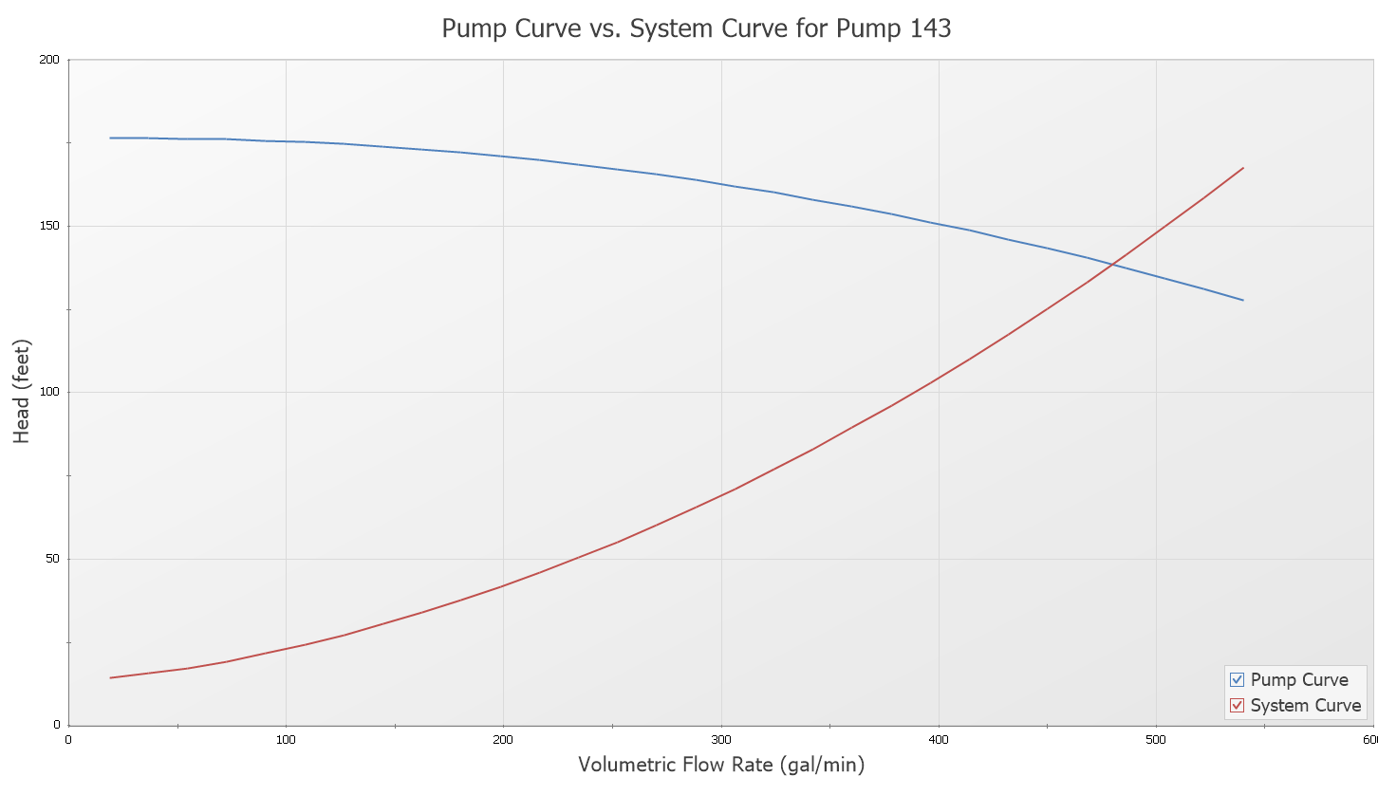
Equipment Selection and Sizing – Cont. - AFT Fathom Simulation Results

Slide 13
Equipment Selection and Sizing – Cont. - AFT Fathom Simulation Results

Slide 14
Equipment Selection and Sizing – Cont.: - AFT Fathom Simulation Results

Slide 15
Equipment Selection and Sizing – Cont. - Pump Selected, Sized
Two Centrifugal Pumps: one op / one standby
Type: Canned motor centrifugal pumps – Sealless
Capacity Index:
450 GPM @143 ft TDH, meet max. flow requirements of 2.4MW
Min. flow: 110 GPM
Min. flow meet 1.2 MW beamline requirements: 147 GPM
Cut off flow: 100 GPM
Shut off head: 175 ft
Variable speed control: Benefit and radiation degradation
- based on Numi operation experience

Slide 16
Equipment Selection and Sizing – Cont. - Pump Selected, Sized

Slide 17
Equipment Selection and Sizing – Cont. - Detailed Equipment List and Spec

Slide 18
Process Flow – Piping & Instrumentation Diagram

Slide 19
Water Quality Control
Initial fill: LCW – from TH RAW Exchange System
Impurity concentration increases with time
Control:
Argon blanketing in storage tank
Periodic burping predetermined amount of RAW
Filtration:
DI loop: 2 stage filtration in series: one 20µm / one 5µm
Impurity particle size less than: 5µm
Extra filter guard in case DI problem: <=20µm
Fermi conventional DI bottle – 4 in one Cask
Maintaining Water resistivity: 4 – 8 MΩ×cm

Slide 20
ESH – Radiation Risk Control
Risks:
Initial LCW - to be radioactiviated after short running – becoming RAW
The prompt radiation dose rates from the RAW skid – high!
Short-lived radionuclides, large concentrations of the tritium will build up in the systems
Mechanical Controls:
To prevent RAW from intermixing with the environment, the cold side cooling water of the heat exchanger is supplied by and discharged to an adjacent Intermediate Water System
Clean in place containment - for RAW leakage, spill and tritium capture
- preventing soil and surface water contamination
Remotely controlled drainage and top up with fresh water - used to keep the tritium concentrations at manageable levels
Wastewater will be disposed of as low-level radioactive waste after cooling-down or decayed
Radiation hardened materials – equipment, piping components
Electronic devices: P, T, Q, L transmitters - installed further away from high radiation area to prevent radiation degradation

Slide 21
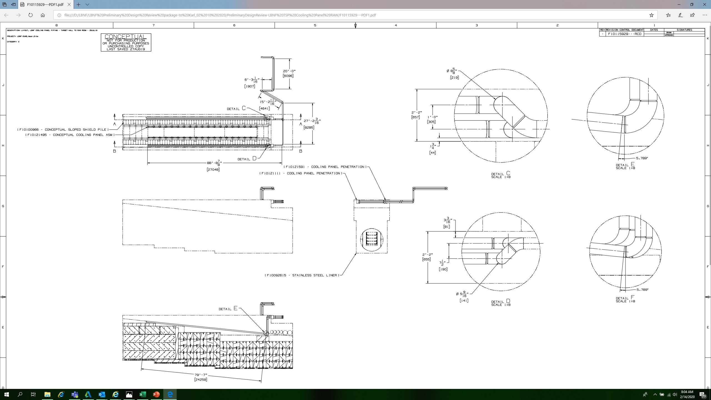
Equipment and Piping Layout - Plan View
RAW supply and return head, 5” NPD

Slide 22
Equipment and Piping Layout - 3D Top View
RAW supply and return head, 5” NPD
Target Chase
TSP Cooling Panel RAW Skid

Slide 23
Equipment and Piping Layout - 3D View
RAW supply and return head, 5” NPD
Target Chase
TSP Cooling Panel RAW Skid

Slide 24
Questions?
Thank You!
By Raina Wang
Mechanical Beamline Engineer
Feb. 19, 2020

