Slide 1
Primary Beamline Target Hall RAW Exchange System Preliminary Design Review
Technical Design Aspects
Raina Wang
February 19, 2020

Slide 2
Purpose and Scope
Preliminary design of the Target Hall (TH) RAW Exchange System for the 2.4MW beamline radioactive cooling water (RAW) systems of LBNF project
Includes four independent functional sections:
Make-up supply or Fill of low conductivity water (LCW) to all the five RAW and Intermediate Water Systems in the same RAW room of the Target Hall Complex :
Target RAW system – Target Mount, Hanger, Helium heat exchanger, and Baffle
Horn A RAW system
Horn B RAW system
Horn C RAW system
Target Shield Pile Cooling Panel RAW system
Intermediate Water System
Burping or periodically removing predetermined quantity of RAW from the 5 RAW systems during operation to reduce the contamination concentration of the RAW and thus maintain required cooling water quality.
Draining all 6 or any single RAW cooling system and intermediate water system completely during repair and maintenance modes
Transferring all the drained RAW or wastewater into radiation safe drums located outside of Target Hall for radioactive waste safe disposal – hauling offsite

Slide 3
Purpose and Scope – Cont.
A stand along area in the RAW room: equipment, pipes, valves, fittings, and field installed instruments
Piping and piping components between 6 pumps in this system and the 6 RAW skids and Intermediate Water system
except their first valve if there is one.
Mechanical techniques for mitigating radiation risks
All other EHS related radiation dose rate evaluations and control are excluded from this system
They are the work scope of ESH or Radiation Physicist Department

Slide 4
Purpose and Scope – Cont.
Horn A/B/C RAW
Target RAW System

Slide 5
Design Standards and Codes
In addition to comply with the following industrial and Fermilab standards and codes, the system design, particularly the system’s operation modes, capacity, and valve regulating & controls, is mainly based on Numi/Nova systems’ operational experience, lessons learned, and the latest feedback in operational input and upgrades.
ASME B31.3 Code for Normal Fluid Service
ASME BPVC Section IX for Welding Process Specifications (WPS’s) and welders & pipefitters' Personal Weld Qualifications
Both piping and vessels will adhere to FESHM Chapter 5031, as well as the Fermilab Engineering Manual
ASTM-D-1998-15, Standard Specification for Polyethylene Upright Storage Tanks

Slide 6
Design Requirements - General
Safe, Reliable, and Economic
Convenient for maintenance
Meet water quality and capacity of operational requirements for:
1.2MW beamline – first phase
2.4 MW beamline – 2nd phase as Designed phase
Design depth – sufficient for cost estimating for Project Budget

Slide 7
Design Capacity - depends on operation modes
Operation Modes
Every functional section is required to be in operating one skid unit each time per Numi operation procedure
meaning that no two systems will be running simultaneously,
Capacity sizing: Thus, the equipment and piping header of every functional section is sized at the same flow rate of every single unit’s flow rate
Detailed design capacity and pressure of all sections are summarized in Table -1

Slide 8
Design Capacity

Slide 9
Equipment Selection and Sizing – Pumps, Piping, Pressure Regulators
Sizing method: Hydraulic simulation
Sizing technology: AFT Fathom software, version 9
Multiple operation modes simulated:
LCW filling pump sizing
RAW skid drain Inline pump sizing
RAW transfer pump sizing
5 RAW burping pressure regulator sizing
Burping pressure: 60 to 120 psig
Destination pressure at RAW holding tank: Atm. P

Slide 10
Equipment Selection and Sizing – AFT Fathom Simulation Results – LCW pumps

Slide 11
Equipment Selection and Sizing – AFT Fathom Simulation Results – Inline Pump Selected
self-priming pump

Slide 12
Equipment Selection and Sizing – AFT Fathom Simulation Results – Transfer Pumps Selected

Slide 13
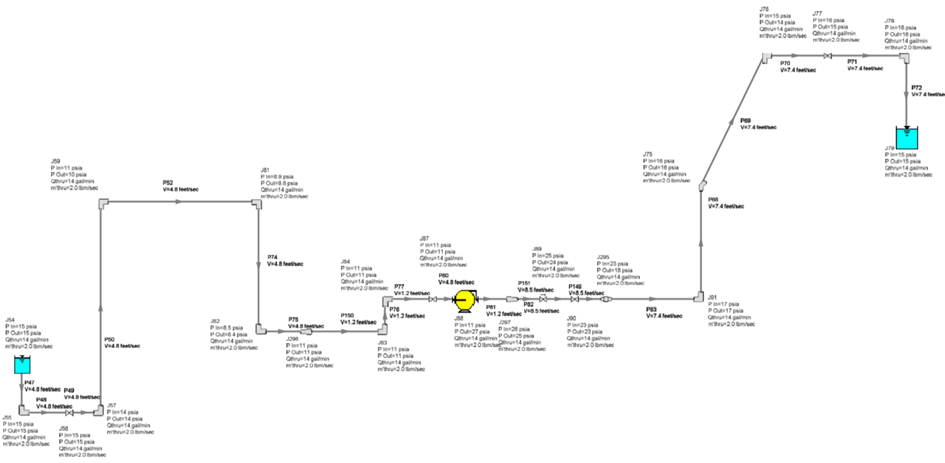
Equipment Selection and Sizing – AFT Fathom Simulation Results – Intermediate Water System Drain Pump Selected

Slide 14
Equipment Selection and Sizing – AFT Fathom Simulation Results – Horn A RAW Burping Regulator sizing
RAW burping simulations of other 4 RAW skids is similar to Horn A’s
Results of 5 operation modes simulated:
- Initial burping @ 80 and 120 psig – 2 Pressure regulators
- Different setting pressure needed.

Slide 15
Equipment Selection and Sizing – Cont. - Detailed Equipment List and Spec

Slide 16
Process Flow – Piping & Instrumentation Diagram

Slide 17
Water Quality Control
The initial water supply for filling is pretreated city water from Fermilab LBNF Target Hall Power Supply Room (see P&ID drawing F10127809).
It is then filtered by two stage cartridge filters:
one 20µm
one 5µm ultrafine
Control ultimate impurity particle size below 5um for all the downstream users
One Fermilab conventional DI bottles is used for controlling water resistivity within a range of 4 to 8 MΩ × cm.
Argon gas blanketing for the storage tank - To preventing contamination gas such as CO2 from entering the system

Slide 18
ESH – Radiation Risk Control
Risks:
Initial LCW - to be radioactiviated after short running of those RAW cooling skids – becoming RAW
The following mechanical techniques are used for mitigating RAW radiation risks and increase system reliability:
Radiation hardened materials are selected for all equipment and piping components
Clean in place containment tanks and warning alarms are designed to prevent spills and contamination of the soil and surface waters
Remotely controlled drainage and top up with fresh water will be used to keep the tritium concentrations at manageable levels. Wastewater will be disposed of as low-level radioactive waste after cooling-down
Electronic devices such as fluid measurement transmitters will be installed further away from the high radiation area to prevent radiation degradation

Slide 19
Equipment and Piping Layout - 3D Top View
Horn A/B/C RAW
Target RAW System

Slide 20
Equipment and Piping Layout - 3D View, area detail
RAW holding tank, 1200 Gal
Poly material & transfer pumps
LCW storage tank 200 Gal & pumps
DI bottle & Filter
Intermediate water system drain pump
Inline pump - burping

Slide 21
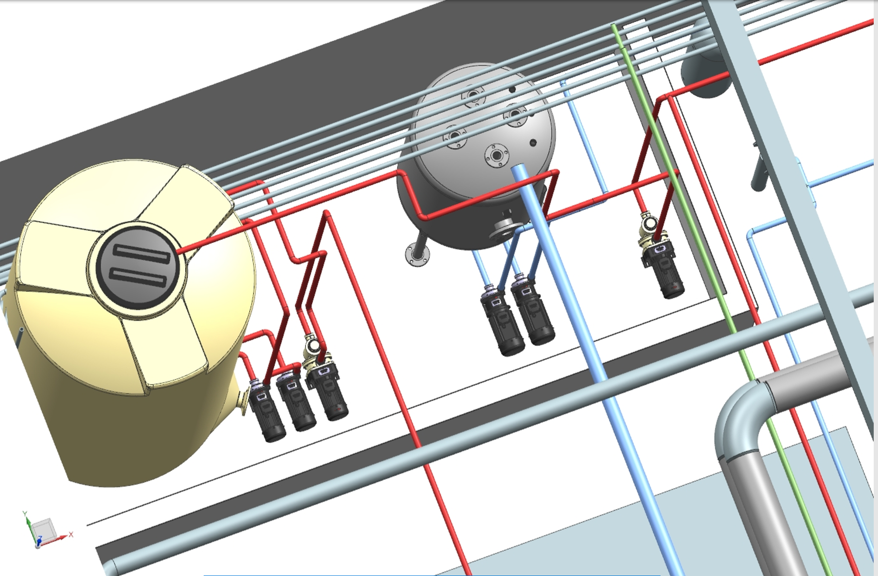
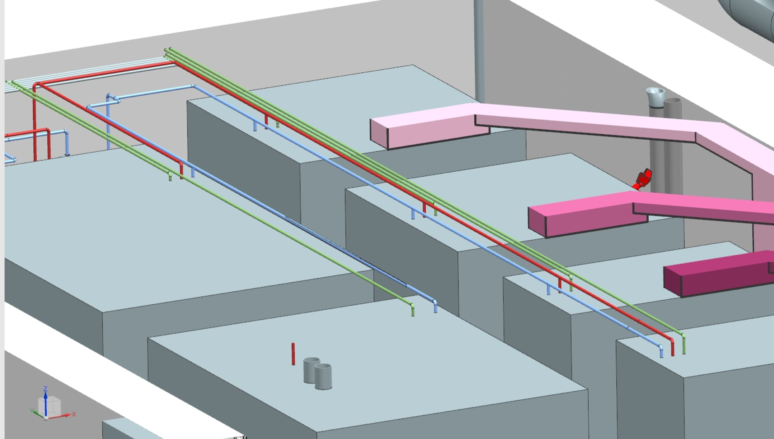
Equipment and Piping Layout - 3D View

Slide 22
Questions?
Thank You!
By Raina Wang
Mechanical Beamline Engineer
Feb. 19, 2020

Slide 23
Equipment Selection and Sizing – 1200 Gal Holding Tank

Slide 24
Equipment Selection and Sizing – LCW Pumps Selected

Slide 25
Field Instruments and Valve List & Spec _ Page 1 of 3

Slide 26
Field Instruments and Valve List & Spec _ Page 2 of 3

Slide 27
Field Instruments and Valve List & Spec _ Page 1 of 3

Slide 28
Piping and Fitting Estimating

Slide 29
Design Requirements – Process Data Provided by operation engineer - Abhishek Deshpande

Slide 30
Design Requirements – Process Data Provided by operation engineer - Abhishek Deshpande, verified by Karlton E Williams II

Slide 31
Design Requirements – NProcess Data Provided by operation engineer - Abhishek Deshpande, verified by Karlton E Williams II

