Slide 1
Neutrino Beamline Target Hall Intermediate Water (INTW) Preliminary Design Review
Technical Design Aspects
David Hixson
February 19 & 20, 2020

Slide 2
Target Hall Intermediate Water (INTW) Outline
Purpose
Design Requirements
Design Standards and Codes
Design Layout and Details
Block Diagram
System Operational Parameters
Approximate Room Layout
Flow Model and P&ID
Summary
Pending Items
Questions

Slide 3
Target Hall Intermediate Water (INTW) Purpose
The Target Hall Intermediate Water (INTW) System provides:
A means of heat transfer between conventional facilities cooling equipment and Radioactive Water (RAW) using Fermilab equipment .
A means of isolating that conventional facilities cooling equipment from any Fermilab equipment that may become radioactive.
A medium to cool the Helium Compressors located in the Compressor Room.

Slide 4
Target Hall Intermediate Water (INTW) Design Requirements
The Target Hall Intermediate Water (INTW) System shall:
Require minimal unscheduled interventions for maintenance.
Have flows and capacities based on the connected loads obtained from the various RAW systems engineers and the helium compressor cooling requirements.
Have a nominal design temperature of 65°F.
Be considered non-radioactive with a maximum radioactivity of 1900 pCi/ml.
Be filtered to remove all particles larger than 5 microns.
Reject heat to a water chiller furnished and installed under the Conventional Facilities portion of the LBNF Project.

Slide 5
Target Hall Intermediate Water (INTW) Design Standards and Codes
In addition to complying with the following industrial and Fermilab standards and codes, the system design, particularly the system’s operation modes, capacity, and valve regulating & controls, is mainly based on Numi/Nova systems’ operational experience, lessons learned, and the latest feedback in operational input and upgrades.
ASME B31.3 Code for Category D Fluid Service.
ASME BPVC Section IX for Welding Process Specifications (WPS’s) and welders & pipefitters' Personal Weld Qualifications.
Both piping and vessels will adhere to FESHM Chapters 5031, 5031.1, 5031.3, 5034 as well as the Fermilab Engineering Manual.
Piping and Tubing will be 304L or 316L ASTM A312 Stainless Steel

Slide 6
Target Hall Intermediate Water (INTW) Block Diagram
He Compressors
293 kW
(2) He Compressors Initially, (1) or (2) possible in future
Heat
Exch
Horn C Raw
102 kW
Chase/
Shielding Raw
900 kW
Heat
Exch
Heat
Exch
Horn B Raw
145 kW
Heat
Exch
Horn A Raw
135 kW
Chilled Water
Heat
Exch
Pumps
Heat
Exch
Target Raw
77 kW
kW Loading obtained from each respective RAW System Engineer

Slide 7
Target Hall Intermediate Water (INTW) System Operational Parameters
Target Hall INTW Skid @ 2.4 MW | RAW System |  |  | INTW System
Target Hall Skids @ 2.4 MW Item | Design kW | Design GPM | Design TD °F | Design kW | Design GPM | Design TD °F | Design EWT °F | Design LWT °F | Notes
Target and Baffle (Chase) RAW | 77 | 50 | 10.5 | 77 | 45 | 12 | 65 | 77 | RAW kW includes SF (RAW values per RW 2020-01-30)
Horn A RAW | 135 | 193 | 4.8 | 134 | 75 | 12 | 65 | 77 | (per KW 2019-10-01 email)
Horn B RAW | 145 | 430 | 2.3 | 145 | 85 | 12 | 65 | 77 | INTW kW includes 10% SF (per KW 2019-10-01 email)
Horn C RAW | 102 | 287 | 2.4 | 102 | 60 | 12 | 65 | 77 | (per KW 2019-10-01 email)
Chase / Shielding / Window RAW | 900 | 435 | 15 | 900 | 490 | 13 | 65 | 78 | RAW kW includes SF (RAW values per RW 2020-01-30)
RAW Subtotal: | 1,359 | 1,395 |  | 1,359 | 755 |  |  |  | (INTW EWT uncertain)
Helium Comp INTW | 438 | na | na | 438 | 120 | 25 | 65 | 90 | He Comp HP, INTW Flow, 1 GPM/5 HP @ 25°F ΔT
Totals: | 1,797 |  |  | 1,808 | 875
10% Safety Factor: | 136 |  |  | 136 | na |  |  |  | INTW kW 10% SF includes pumps, , excludes HE Comps.
Target Hall Totals: | 1,933 |  |  | 1,933 | 875 | 15 |  |  | INTW Values for 2.4 MW
 |  |  | Filtration Loop: |  | 15 |  |  |  | Approx: 50 mins to filter 500 gallon system volume
 |  |  | Pump Size: |  | 890 | GPM
HE Compressors
"The system is relatively un-designed. RAL will be doing the final design"
@ 1.2 MW, (2) compressors will run. @ 2.4 MW, (3) compressors might run with an unlikely 4th as backup
INTW will route 2-1/2" pipes to HE Compressors. This will work for 80 and 120 GPM
Horns, Target and Baffle (Chase), and Chase/Shielding/Window (RW) – 2.4 MW Design Basis The INTW system must provide stable flow to the (5) RAW Heat Exchangers. Since the 1.2 MW Beamline case loading is approximately 60% of the 2.4 MW Beamline case loading, the INTW system designed for a 1.2 MW load would provide a very modest cost savings. The rework cost incurred to upgrade the INTW system for the 2.4 MW loading would exceed the 1.2 MW load savings. The 2.4 MW Beamline Case will be used as the design basis for the INTW system.

Slide 8
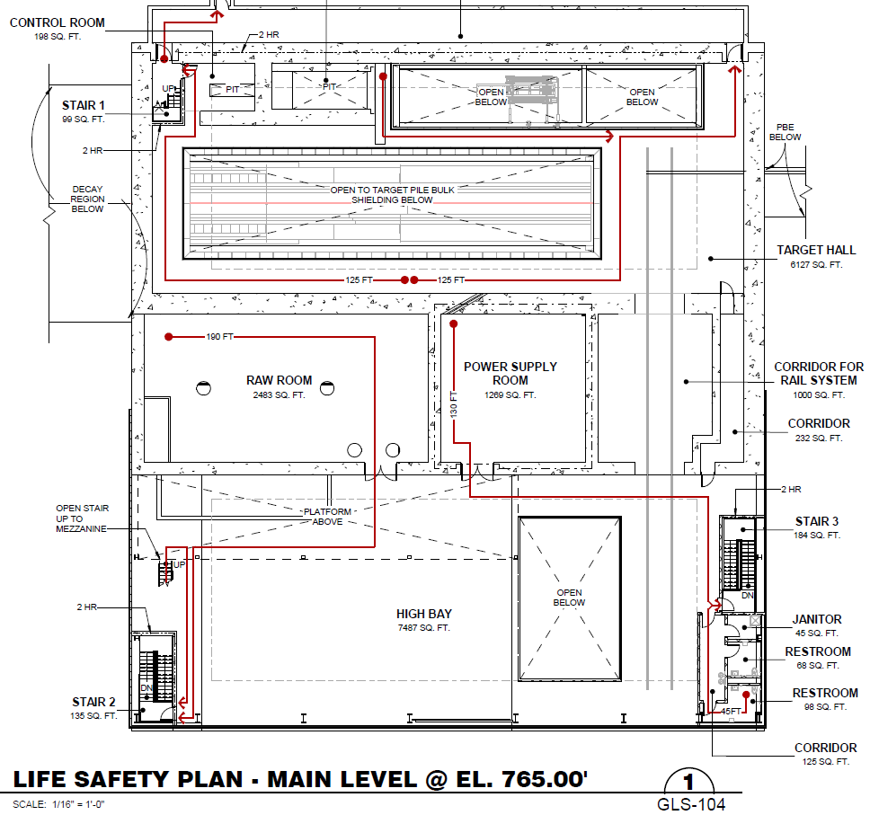
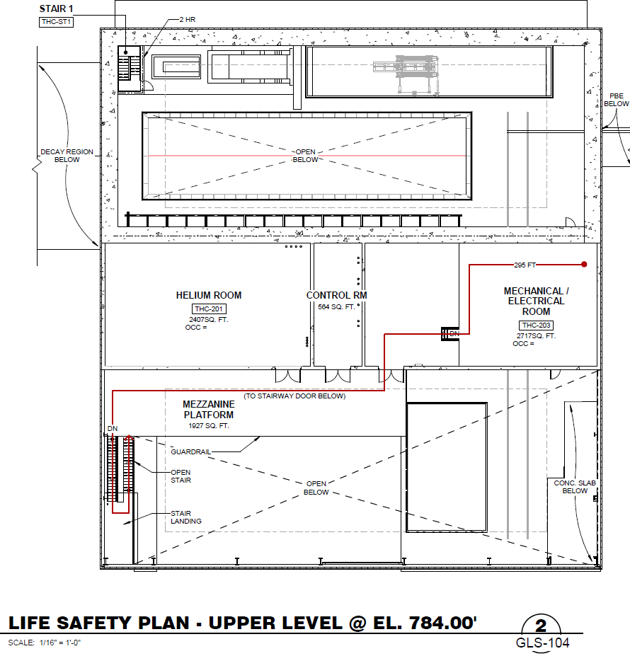
Target Hall Intermediate Water (INTW) Approximate Layout – General Rooms Arrangement
He Compressor Room directly above RAW Room
Routing for Chilled Water from CF Chiller still undetermined (Noted in 50% NSCF Design Review)

Slide 9
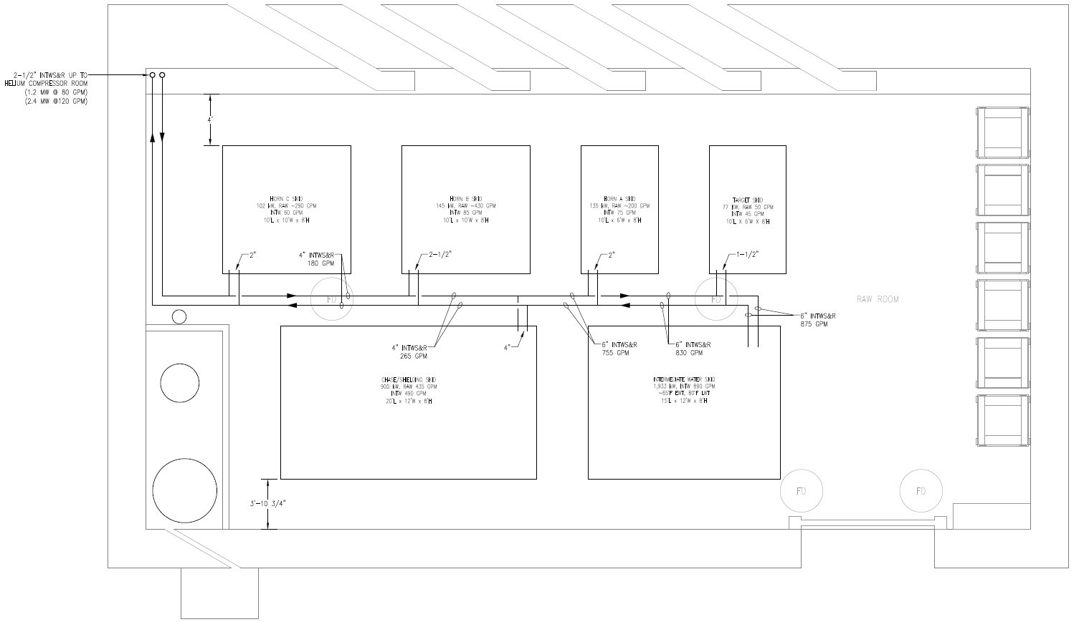
Target Hall Intermediate Water (INTW) Approximate General Layout
Piping up to He Compressor Room
Routing for Chilled Water from CF Chiller to INTW Skid still undetermined (Noted in 50% NSCF Design Review)

Slide 10
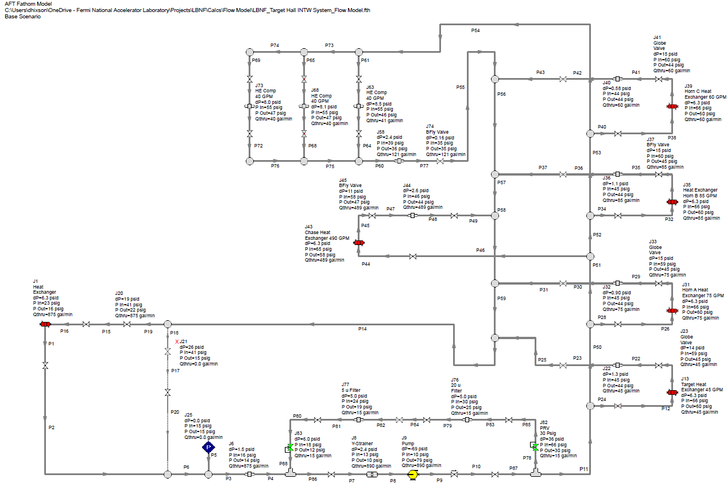
Target Hall Intermediate Water (INTW) Flow Model
Flow Model PDF located in LBNF DocDB

Slide 11
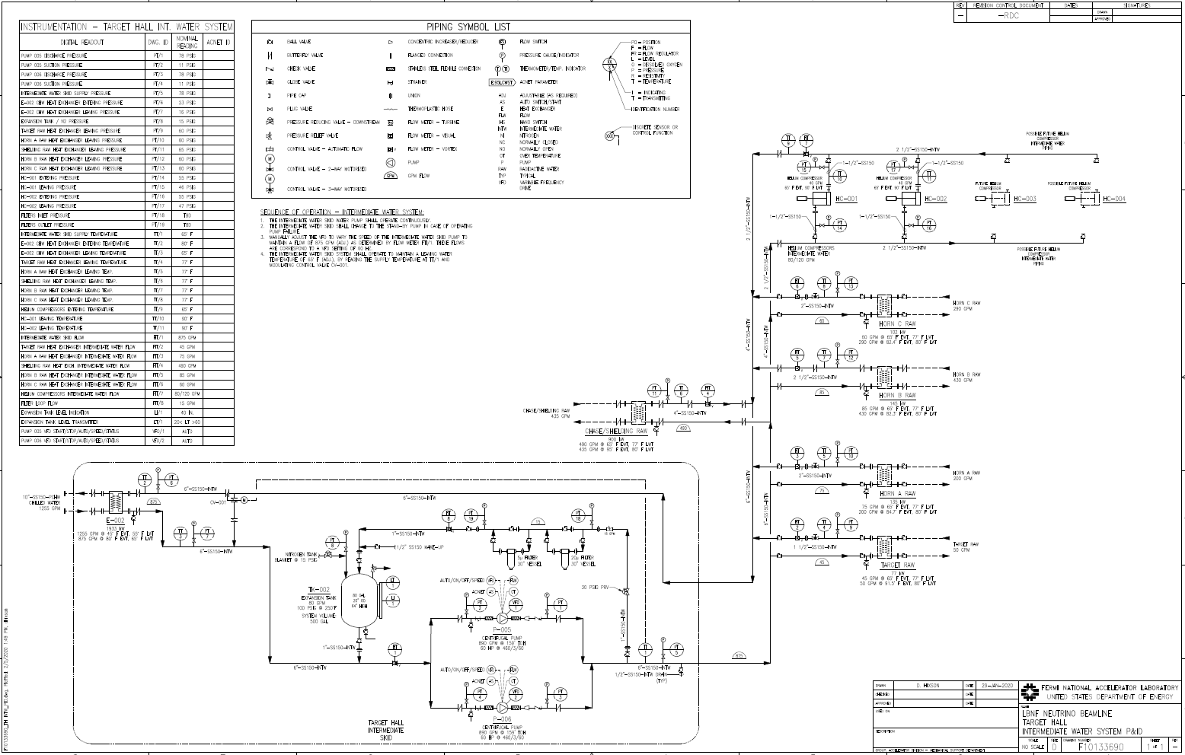
Target Hall Intermediate Water (INTW) P&ID Drawing
TH Skid will incorporate a SS containment pan for the entire TH INTW water volume
P&ID in TeamCenter as F10133690

Slide 12
Target Hall Intermediate Water (INTW) P&ID - Major Equipment, Piping, Fittings, Estimate
The Target Hall Intermediate Water (INTW) system has been designed for the 2.4 MW Beam. (see page 7)
Major Equipment has been sized and selected
Pumps and Heat Exchangers
Piping has been sized
Final Pipe Routing may vary based upon the final RAW Room layout
Major Valves and Fittings have been sized and selected
Flanges, Large Valves, Strainers, etc.
Item costs selected above show good equivalence to the estimate
Per LBNF DocDB 9501 - BOE form for 131.01.03.03.03.06.02

Slide 13
Target Hall Intermediate Water (INTW) Summary
A means of heat transfer between conventional facilities cooling equipment and Radioactive Water (RAW) using Fermilab equipment .
A means of isolating that conventional facilities cooling equipment from any Fermilab equipment that may become radioactive.
A medium to cool the Helium Compressors located in the Compressor Room.
Have flows and capacities based on the connected loads obtained from the various RAW systems engineers and the helium compressor cooling requirements.
Be considered non-radioactive with a maximum radioactivity of 1900 pCi/ml.
Be filtered to remove all particles larger than 5 microns.
Mainly based on Numi/Nova systems’ operational experience Design Layout and Details, applicable ASME Codes, FESHM, and the Fermi Engineering Manual.
Piping and Tubing will be 304L or 316L ASTM A312 Stainless Steel

Slide 14
Target Hall Intermediate Water (INTW) Pending Items for Final Design
CF Chilled Water piping routing to the TH INTW Skid
Noted in 50% NSCF Design Review
Finalize INTW Skid Footprint based on finalized RAW room layout and the other RAW skid footprints
Determine arrangement of equipment, piping, fittings, etc. on the final INTW Skid footprint
Coordinate and route INTW piping to each of the other RAW skids
Finalize water temperature control parameters

Slide 15
Target Hall Intermediate Water (INTW) Questions?

