Slide 1
IOTA/FAST Shutdown/Startup Report
Darren Crawford

Slide 2
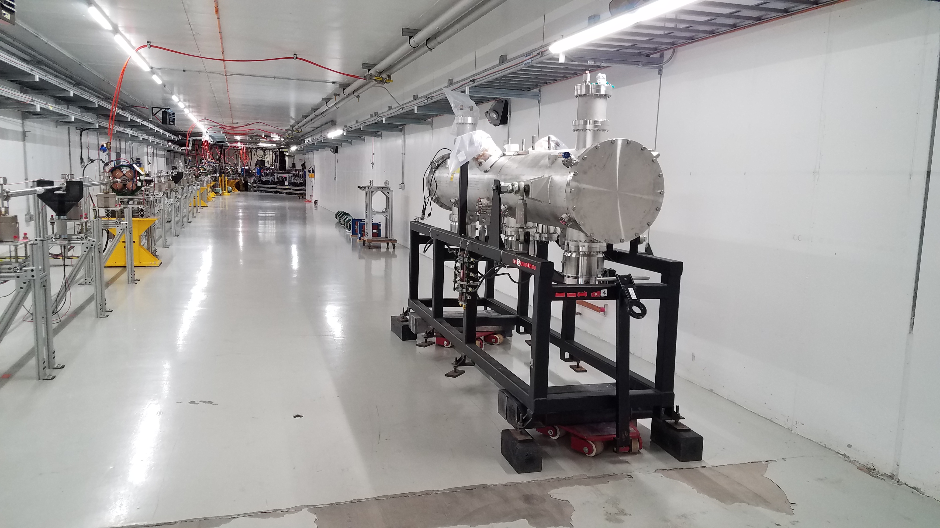
This week
Proton Source RFQ was relocated to the Cave
Roof blocks were put back in place
RSO locked roof chains
MCR Ops searched and secured the Cave
Heat tape prototype procedure testing
Alignment of pinholes that establish nominal axis for OSC

Slide 3
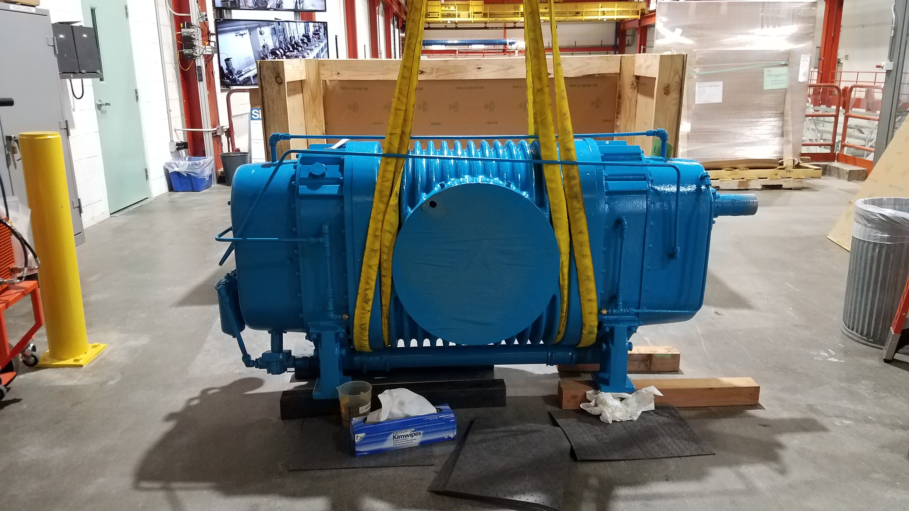
Kinney Skid Booster Pump
Tuesday January 7 at 07:14 the Kinney booster pump tripped on low oil and high vibration. When inspecting the unit locally, a waterfall was discovered coming out of the belt guard. Best guess is a bearing failure.
The rigging starts today
Installation begins on Monday
Cryo connections should occur on Tuesday and Wednesday
Cooldown to 2 K And 24 hour soak would occur on Thursday and Friday

Slide 4
So what is the schedule?

Slide 5
More schedule

Slide 6
Operators Needed for Shifts
List of Current Qualified Accelerator Operators
Chip Edstrom
Jamie Santucci
Jinhao Ruan
Sasha Valishev
Sasha Romanov
Dan Broemmelsiek
Mark Obrycki
Darren Crawford
List of Previously QAOs
Randy Thurman-Keup
Philippe Piot
Jonathan Jarvis
Rick Espinoza
Requirements:
Fermilab employee or joint appointment
Rad Worker Training
Online classroom
Practical factors
Completed OJT
OJT signed by FAST Department Head and uploaded to Approved List

Slide 7
Current Status
Cryo system is holding at 5 K
Cave interlocked
Booster pump rigging underway
Controlled access approved for RFQ vacuum work this afternoon
Next Week
Installation of Booster pump
Cooldown to 2 K
UV Drive Laser and RF Gun studies for MagBeam
Start commissioning of the FAST Linac and IOTA Ring
Relocate Proton Source klystron transformer to final position
Relocate Proton Source modulator to final position
Install Unistrut kits in Proton Source relay racks
Relocate clean room frame to Cave roof

