Slide 1
121.04.05 – Linac Installation (LI)
Curtis Baffes, L3 Manager/CAM
DOE CD-2/3a ICE
February 4-7, 2020

Slide 2
About Me:
PIP-II Roles
  L3 Manager and CAM for Linac Installation
  Installation lead for PIP2IT
  At ~0.95FTE on PIP-II
Other Fermilab experience
  Participated in build-out of FAST, PIP2IT, and CMTS1 machines
  Led design and installation of FAST 50 and 300MeV beamlines
  Led installation of 1.3GHz CC1 and CM2 cryomodules at FAST
  Led installation of first LCLS-II cryomodule in CMTS1 test stand

Slide 3
Outline
Scope/Deliverables
BoE Documents
Schedule
Cost
Performance To Date
Risks

Slide 4
WBS Definition at L3
WBS Dictionary for 121.04.05: PIP-II-doc-599
“Planning and execution of the installation of the PIP-II linac, from the Warm Front End through the HB650 upgrade section. This includes planning, design of support structures for cryomodules and warm units, disassembly of PIP2IT, logistics and transportation support for PIP2IT and installation-ready cryomodules, subsystem integration of warm units, installation of all linac systems (in the highbay, tunnel and gallery), and checkout of the linac to bring installed systems to a state of readiness for beam commissioning.”

Slide 5
L4 WBS/Control Accounts
121.04.05.01 – Project Management and Coordination
  LoE: L3 manager, CAM, Shutdown Coordinator, V&V Coordinator
  Travel
121.04.05.02 – Installation Planning
  Top-level CAD model integration and maintenance
  Installation Planning (the paper exercise)
  Alignment network design
121.04.05.03 – Support Equipment
  Cryomodule stand design and fabrication
  Warm unit structure design and fabrication
  Cryomodule transporter design and fabrication
  COTS installation tools and equipment

Slide 6
L4 WBS/Control Accounts
121.04.05.04 – PIP2IT Disassembly and Storage
  Removal of PIP2IT components from CMTF and storage
  Storage and maintenance of accepted cryomodules
121.04.05.05 – Linac Installation
  Warm Unit integration (offline)
  Warm Front End integration (including moving from storage)
    Includes “checkout”: no-beam verification of all systems
    Handoff to commissioning when Operational Readiness Clearance is obtained for attempting 2.1MeV beam
  Superconducting Linac integration
    Includes “checkout”: no-beam verification of all systems
    Includes phased cooldown
    Handoff to commissioning (in incremental steps) with Operational Readiness Clearances

Slide 7
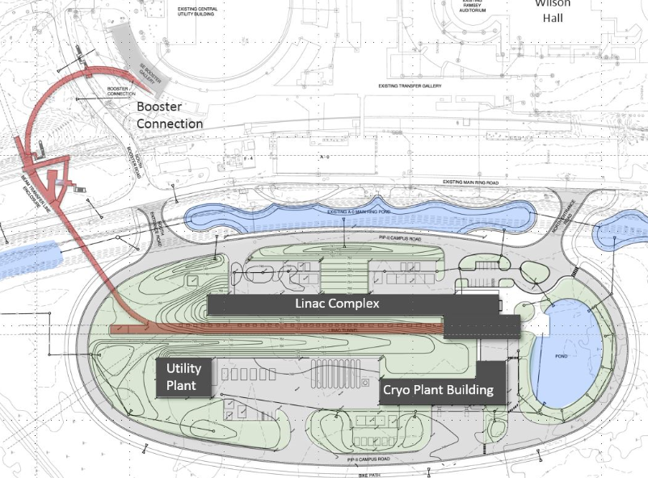
Installation “Geographic” Scope (121.04.05.05)
121.04.05.05 Installation Scope
Highbay
Linac Gallery
Linac Tunnel

Slide 8
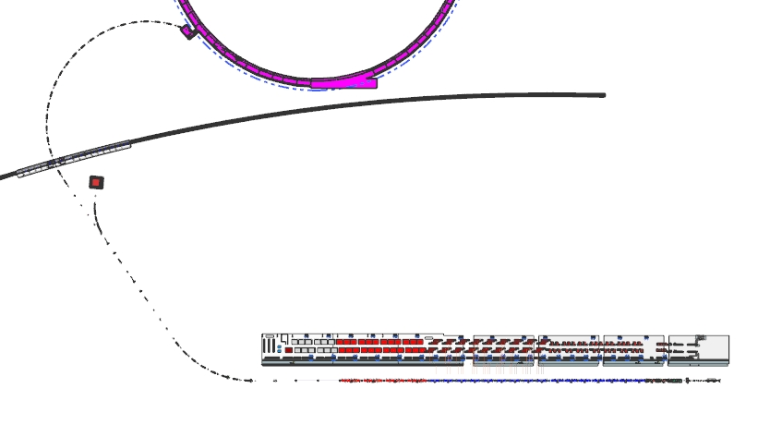
Linac vs. BTL Installation Scope
BTL Installation
Scope
Standard UHV vacuum practices
Linac Installation Scope
Low particulate vacuum practices
HB650 upgrade slots

Slide 9
BoEs
WBS Dictionary: PIP-II doc DB #599
BoE Documents:
121.04.05.01 – PM and Coordination - # 1992
121.04.05.02 – Installation Planning - # 1995
121.04.05.03 – Support Equipment - # 1998
121.04.05.04 – PIP2IT Disassembly and Storage - # 2001
121.04.05.05 – Linac Installation - # 2004

Slide 10
BoE Approach
Project Management and Coordination (121.04.05.01)
  bottom up estimate, largely LoE
Installation planning (121.04.05.02)
  bottom up estimate, informed by installation planning work to date
Support Equipment (121.04.05.03 )
  Design efforts based on recent CM stand preliminary design by our team
  Driving stand M&S costs informed by Quotes/RFI
  COTS equipment list developed and priced
PIP2IT Disassembly and Storage (121.04.05.04)
  bottom-up estimate, based on PIP2IT assembly experience
Linac Installation (121.04.05.05)
  bottom-up estimate, informed by SRF campus installation
  Solicited input from all L3s about efforts their teams will expend during the installation phase

Slide 11
Summary Schedule
Phased installation effort starting in FY23 with the Beneficial Occupancy of the Highbay Building
Key milestones at handoffs to COMM for incremental beam commissioning, beginning with the WFE
Installation effort concludes at handoff of 650MHz section for beam commissioning to straight-ahead dump
Installation Window

Slide 12
Summary Schedule
Ties to Beam Commissioning

Slide 13
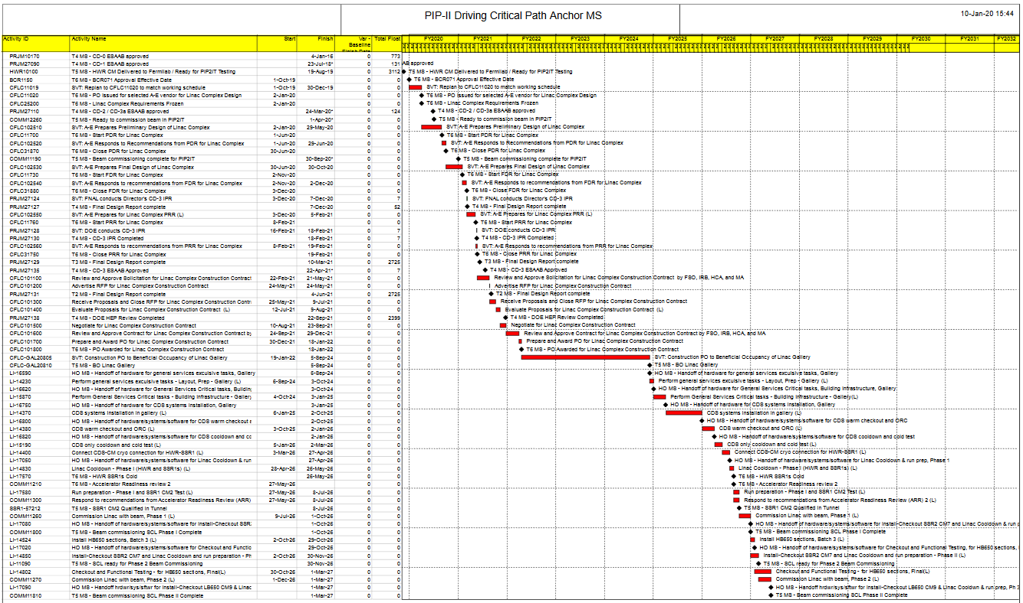
Project Critical Path – Linac Installation (LI)
Fiscal Year
24 25 26 27
LI on critical path from BO gallery to handoff to COMM for beam commissioning for straight-ahead dump
Near critical path:
controls for WFE (Lclock)
Near critical path:
SSR1 CM2 delivery
Near critical path:
LB650 CM8 installation
Comm’s SCL Beam Commissioning Phases

Slide 14
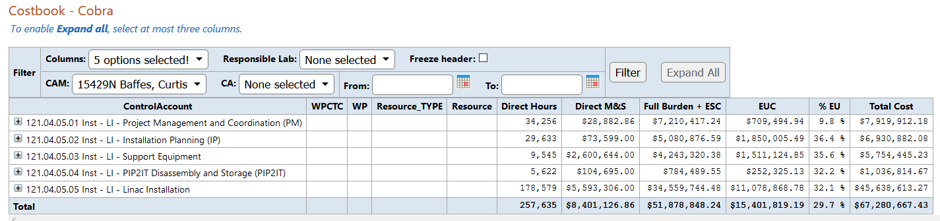
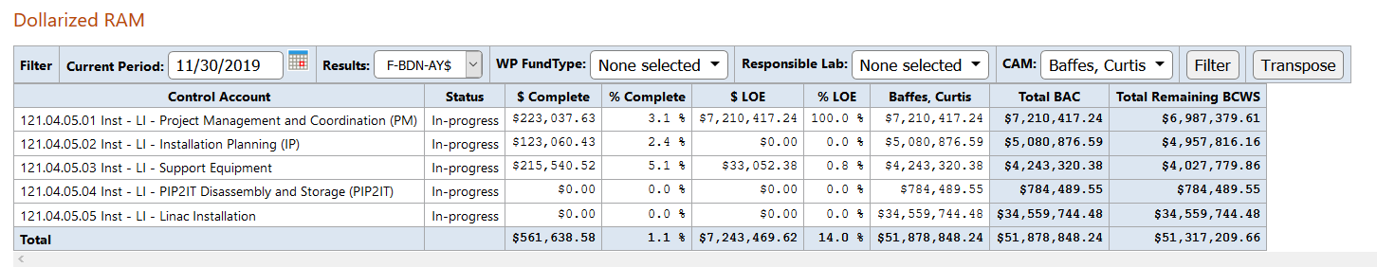
Cost Summary

Slide 15
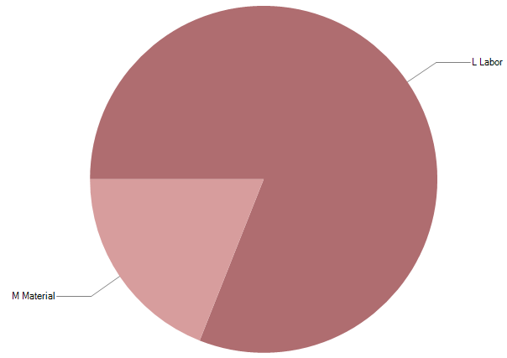

Cost Estimate
121.04.05 Inst – Linac Installation

Slide 16
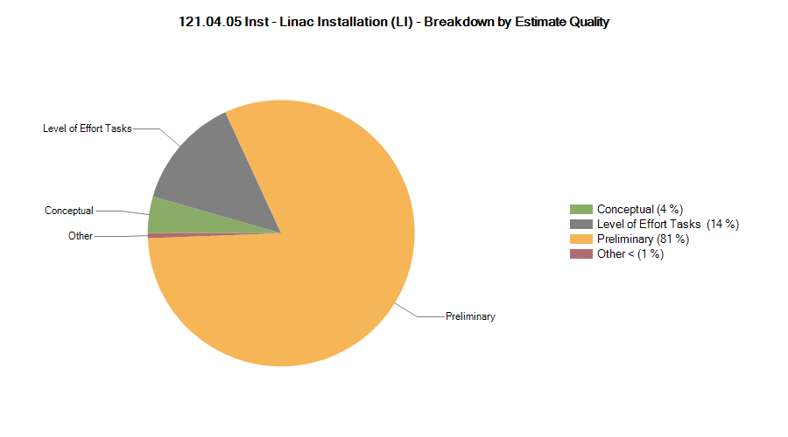
Estimate Maturity
Estimate Uncertainty follows Project guidelines (PIP-II-doc-345)

Slide 17
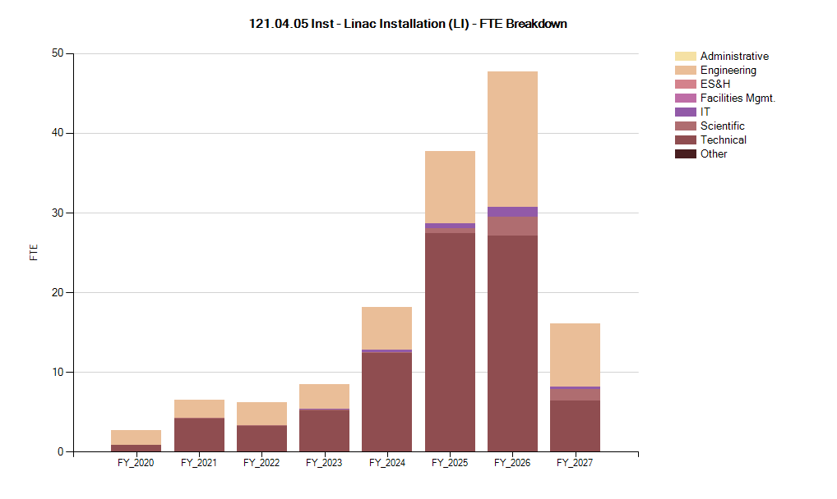
FTE Breakdown
Installation of WFE begins in highbay building
Installation of SCL begins in tunnel/gallery

Slide 18
Risks
We own 3 risks in the project risk register
​”If a subsystem delivery to this WBS element is late, then the overall installation will be less efficient. For example, if other on-time systems get installed, these may imposed physical or operational constraints that make it more difficult to install the late systems.”
“If a subsystem or critical component is damaged during installation or has a problem that is only detected after installation or checkout, then repair, rework or replacement may be needed.”
“If the project is forced by circumstances to accept for installation an incomplete or discrepant deliverable, then additional time and effort will be required to complete and integrate that deliverable, which jeopardizes cost and schedule”

Slide 19
Risk Mitigations
Design installation processes for flexibility by minimizing inter-system constraints as much as possible
Rigorously qualify delivered components for installation
  Thorough QC practices
  System level tests at PIP2IT
  Verification at Installation Readiness Review

Slide 20
End

