Slide 1
121.05.05 – Main Injector and Recycler Ring
Joseph E. Dey
PIP-II DOE CD-2/3a ICE Review
February 4-7, 2020

Slide 2
About Me:
Joseph E. Dey : Senior RF Design Engineer
  Accelerator Division RF Department
  L3 Manger for Accelerator Upgrades Main Injector and Recycler
  I have been on the project since September of 2017.
  20% of my time is spent on the project.
  Technical Experience
    NOvA Main Injector and Recycler RF L3 Manager
    Mu2e Rings RF L3 Manager/CAM
    Recycler RF AIP L2 Manager
    Main Injector and Recycler High Level RF

Slide 3
Scope
I am responsible for the following WBS
  121.05.05 – Main Injector and Recycler Ring
Description of Scope Work
WBS 121.05.05 AccU - Main Injector and Recycler Ring (MIRR)
  Labor, materials, travel, and costs associated with the management, design, procurement, fabrication, and installation of the upgrades to the Recycler and Main Injector to handle increased intensity and shorter cycle times. Includes the procurement, fabrication, installation and testing of 5 new medium bore Booster RF cavities.

Slide 4
Scope
WBS 121.05.05.01 AccU - MIRR - Project Management and Coordination (PM)
  Project management for the Main Injector and Recycler upgrades including the oversight and coordination of the technical effort, project planning and scheduling, cost estimating, risk and contingency analysis, and reporting. Includes travel costs for management, technical coordination, and vendor visits
WBS 121.05.05.02 AccU - MIRR - Main Injector (MI)
  Design, procurement, fabrication, installation, and testing of the RF system in the Main Injector.

Slide 5
Scope
WBS 121.05.05.03 AccU - MIRR - Recycler Ring (RR)
  Design, procurement, fabrication, installation, and testing of 3 new 53 MHz cavities in the Recycler.
WBS 121.05.05.04 AccU - MIRR - Booster RF
  Procurement, Fabrication, Installation and testing of 5 new medium bore Booster RF cavities.

Slide 6
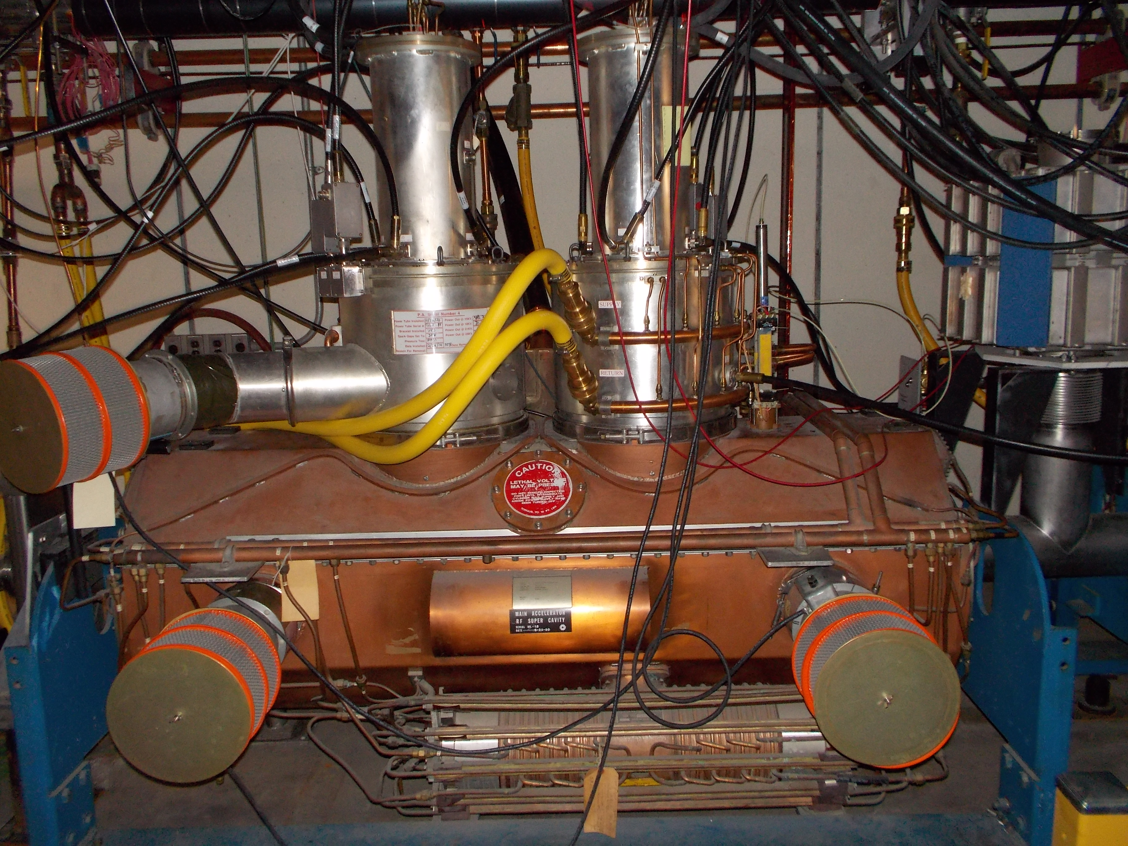
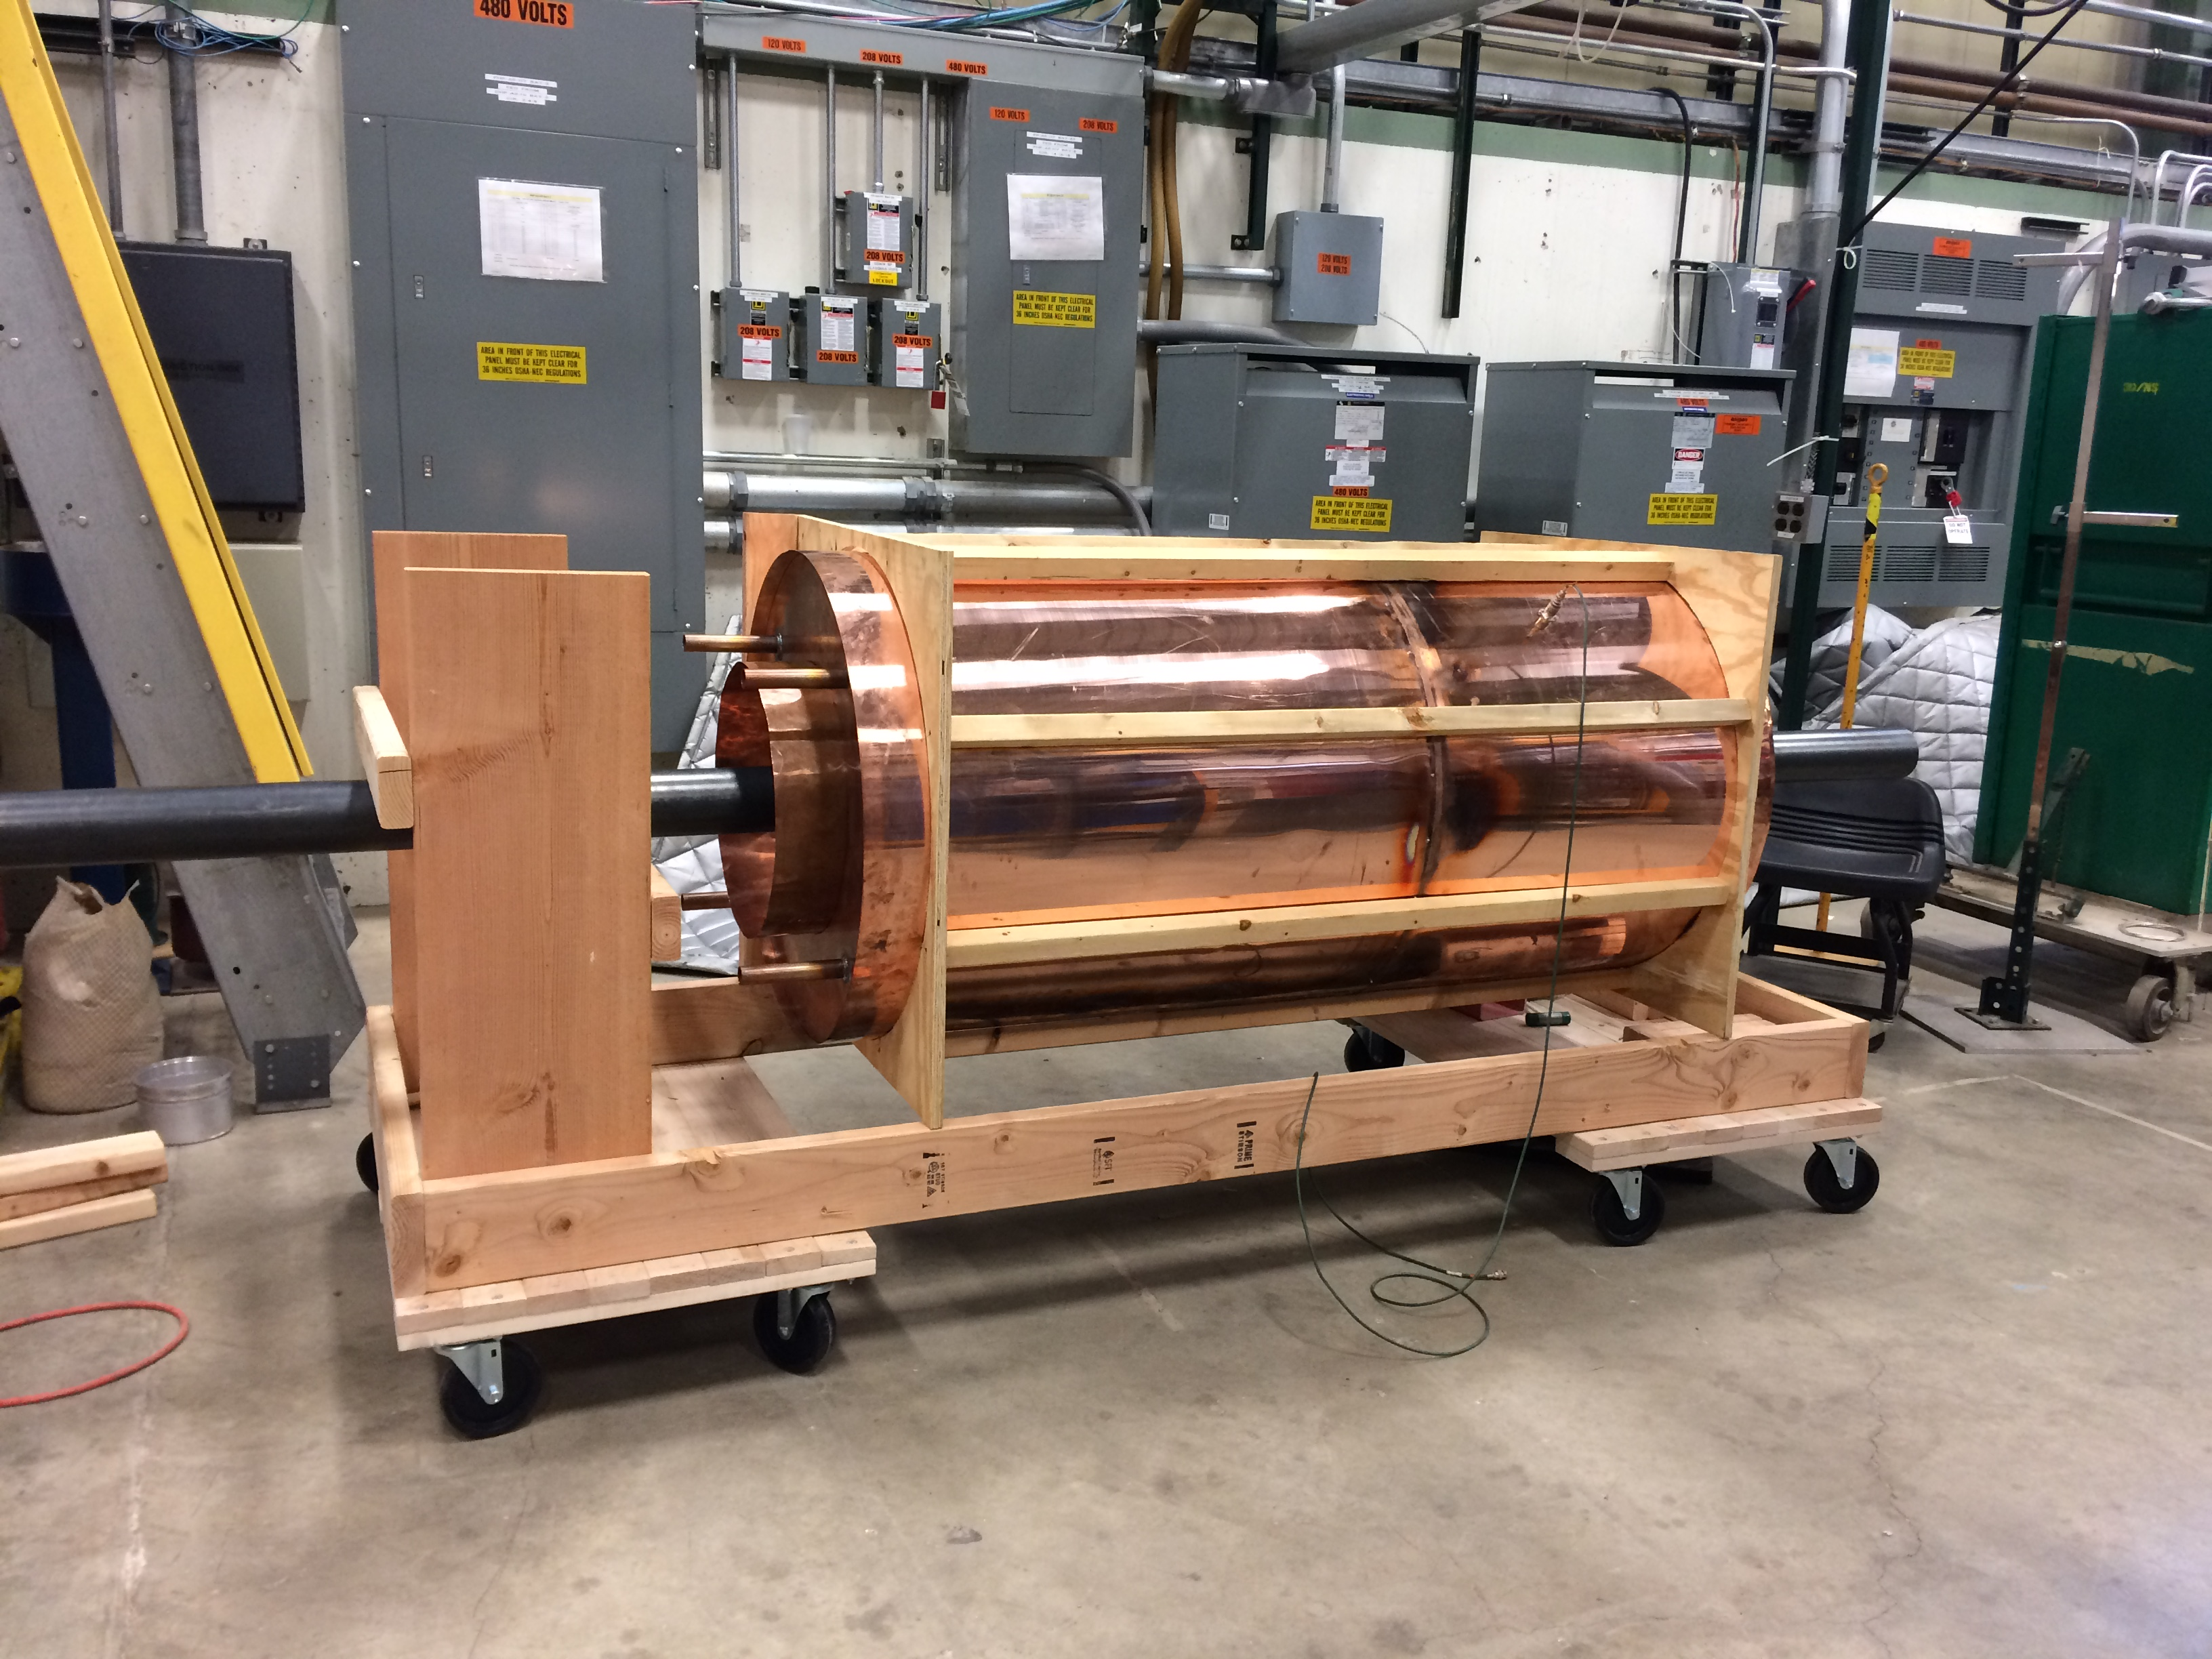
Scope Pictures
Modifying all 20 Main Injector stations to dual power amplifier operation.
Building of three Recycler cavities.

Slide 7
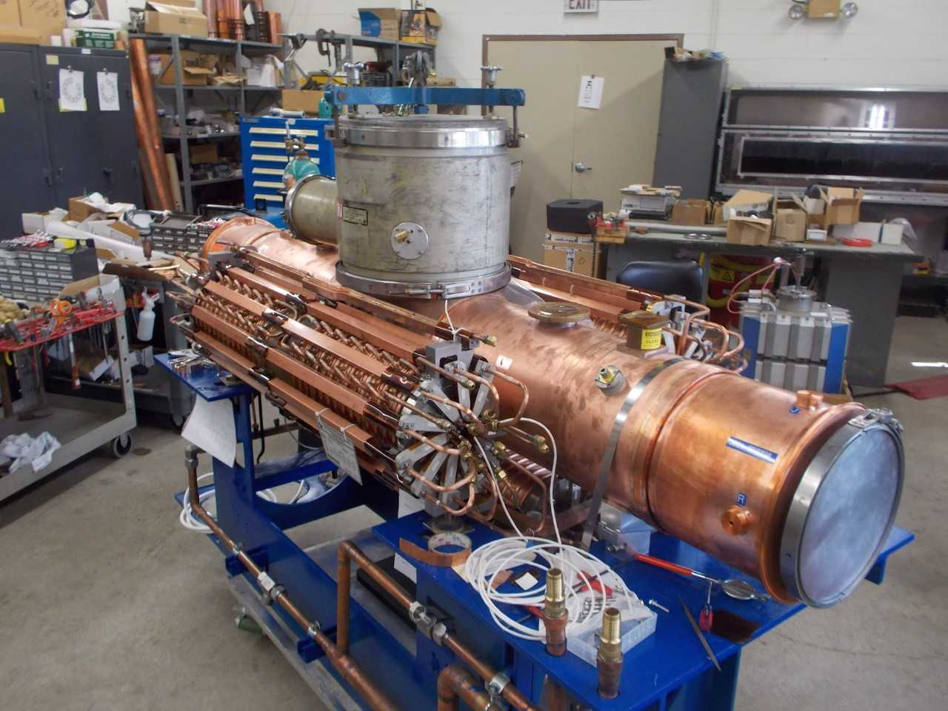
Scope Pictures
Building of five medium bore Booster cavities.

Slide 8
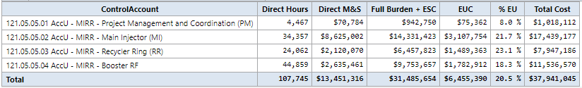
Cost Summary
Cost summary table form Cost Book

Slide 9
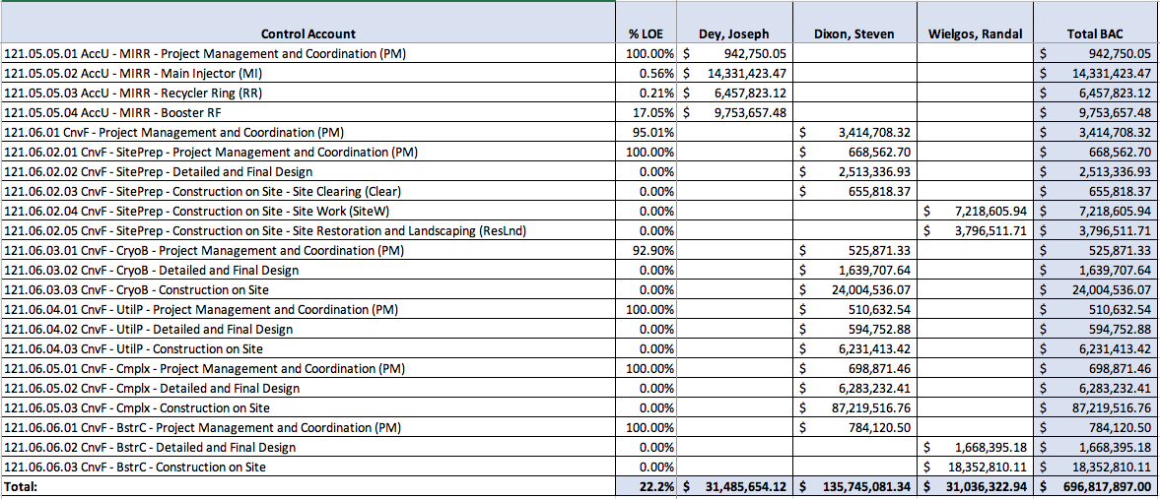
Cost Summary
RAM Table
May add some text on how you developed the cost estimates for your CAs or mention some of the key cost drivers

Slide 10
Cost Summary
Cost Estimates were formed from bids, quotes and engineering estimates.

Slide 11
Schedule Summary
MI Cavity Batch 1 Installed – September 8, 2022
RR Preproduction Ready for Installation – February 1, 2024
RR Cavities Installed – July 15, 2026
5 Booster RF Cavities tested and installed – March 15, 2027

Slide 12
Risk
RI-ID | Title | Project | Summary | Risk Type | Risk Area (RBS) | Owner | WBS / Ops Lab Activity | Risk Status | Approval Status | Start Date | Expiration Date | Probability | Technical Impact | Impact (k$) - Function | Impact (k$)
RT-121-05-007 | AccU: MI RF feeder may not be sufficient to power anode power supplies | PIP II Project | ​If the MI feeder is not sufficient to power the MI RF at higher beam power, then the feeder will need to be upgraded to meet the objective KPPs. | Threat | Technical Risk / Reliability or Performance | Ioanis Kourbanis | 121.5 Accelerator Complex Upgrades (AccU) | Open | 4 - approved | 6/10/2019 | 5/1/2026 | 50% | 0 (N) - negligible technical impact | 1-point - single value | 500

