Slide 1
WBS 121.06.02 -Site Preparation
S. Dixon, L2 Manager
DOE CD-2/3a ICE Review
February 4-7, 2020

Slide 2
About Me
PIP-II Level 2 Manager for Conventional Facilities
Relevant Experience
Licensed Architect;
Project Management Professional (PMP);
LEED Accredited Professional;
27+ years at Fermilab;
NOvA Project L2 Manager for Site and Buildings;
2014 CD-4
2015 U.S. DOE Secretary’s Award for Excellence
General Plant Project Manager for 17+ years
Short Baseline Neutrino (SBN) Near Detector Building;
Short Baseline Neutrino (SBN) Far Detector Building;
Experimental Operations Center;

Slide 3
Agenda
Project Organization
Scope
Documents

Slide 4
Project Organization
WBS 121.06
Conventional Facilities
S. Dixon
System Manager
WBS 121.06.01
Project Management
S. Dixon
WBS 121.06.02
Site Preparation
R. Wielgos
WBS 121.06.03
Cryogenics Plant Building
(S. Dixon)
WBS 121.06.04
Utility Plant
E. Alcaraz
WBS 121.06.05
Linac Complex
E. Alcaraz
WBS 121.06.06
Booster Connection
E. Alcaraz
Architect/Engineer Team
Gensler (architecture), IMEG (mechanical, electrical, plumbing)
TGRWA (structural),CMT (civil), Jensen Hughes (life safety), Syska Hennessy (commissioning), Burns and McDonnell (landscaping)

Slide 5
Scope/Deliverables
WBS 121.06.02 Site Preparation [1]
WBS 121.06.02.01 – Project Management and Coordination
WBS 121.06.02.02 – Detailed and Final Design
WBS 121.06.02.03 – Site Clearing
WBS 121.06.02.04 – Site Work
WBS 121.06.02.05 – Site Restoration & Landscaping
[1] See WBS Dictionary in PIP-II-doc-599 for complete description

Slide 6
Scope and Deliverables
Site Preparation (WBS 121.06.02)
Site Clearing
Site Work
Site Restoration and Landscaping

Slide 7
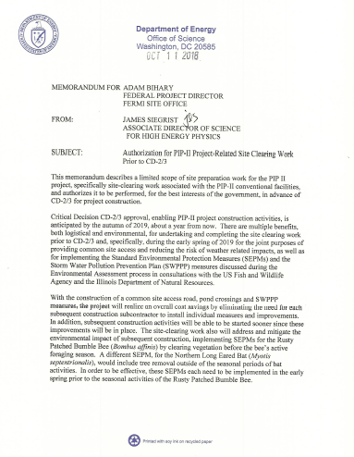
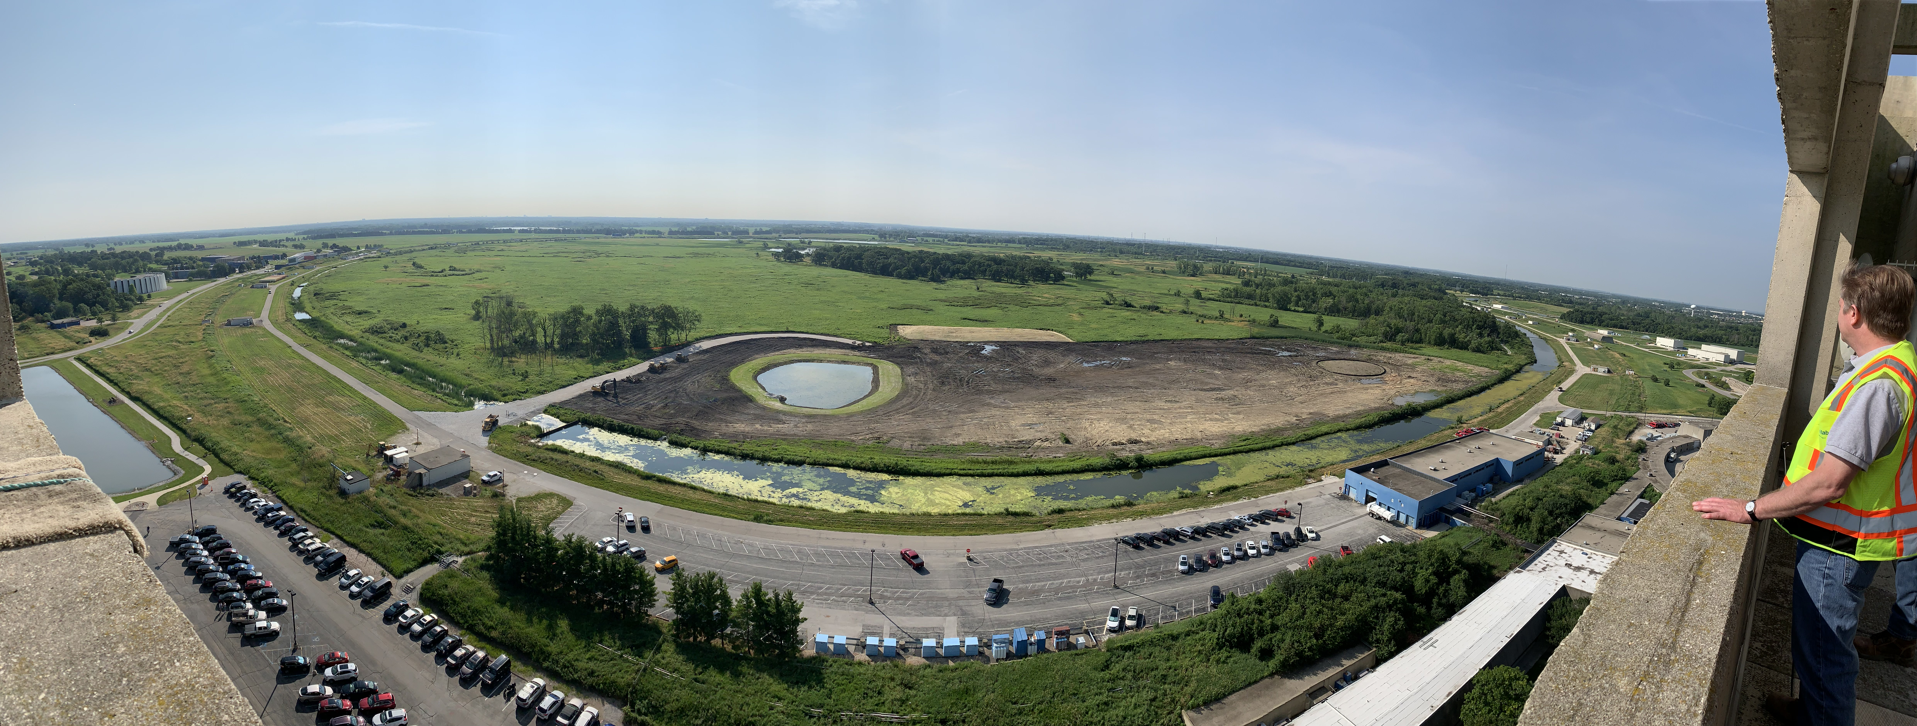
Technical Progress to Date – Site Clearing
WBS 121.06.02.03 – Site Clearing
Design completed in October 2018
Construction:
Authorized in October 2018 [1]
Construction began in March 2019
Construction complete in July 2019
Authorization for PIP-II Project Related Site Clearing Work Prior to CD-2/3
July 2019
[1] See PIP-II-doc-2524 for Authorization

Slide 8
Technical Progress to Date – Site Work
WBS 121.06.02.04 – Site Work
Designed as a separate construction package includes:
Roadway base
AZero pond rework (road crossings, retaining wall, deepening)
Storm drainage
Landscaping outside of ring road
Design completed in January 2019
Part of the CD-3a request

Slide 9
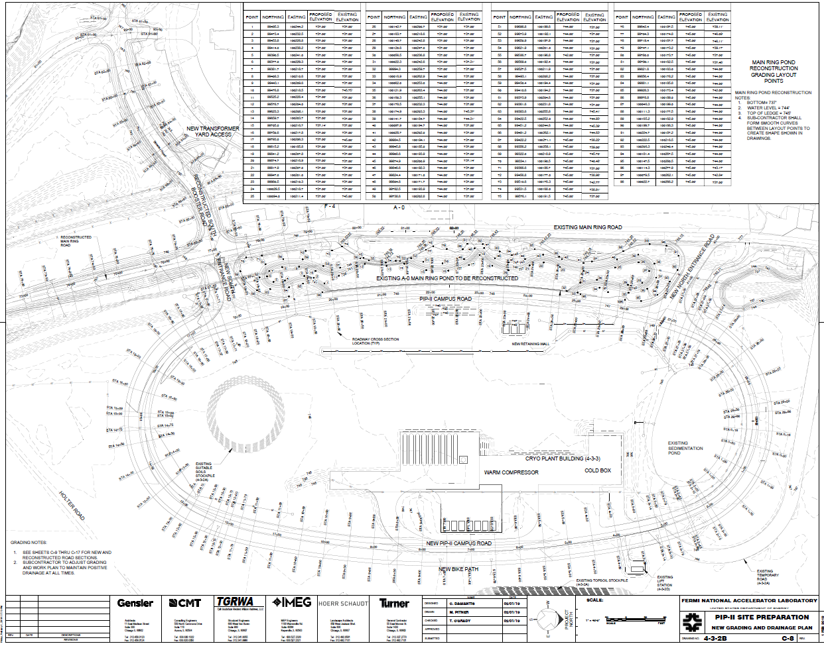
Technical Progress to Date – Site Work
WBS 121.06.02.04 – Site Work [1]
Sheet Pile Wall
AZero Pond Rework
Pond Crossings
Storm Drainage
Road Base
Landscaping Outside Road
Rough Grading
[1] See PIP-II-doc-2521 for complete document set

Slide 10
Technical Progress to Date – Site Restoration
WBS 121.06.02.05 – Site Restoration and Landscaping
Designed as a separate construction package includes:
Final road coarse
Finish grading and topsoil
Linac Pond
Landscaping
Roadway lighting
Design completed in April 2019
Part of the CD-3a request

Slide 11
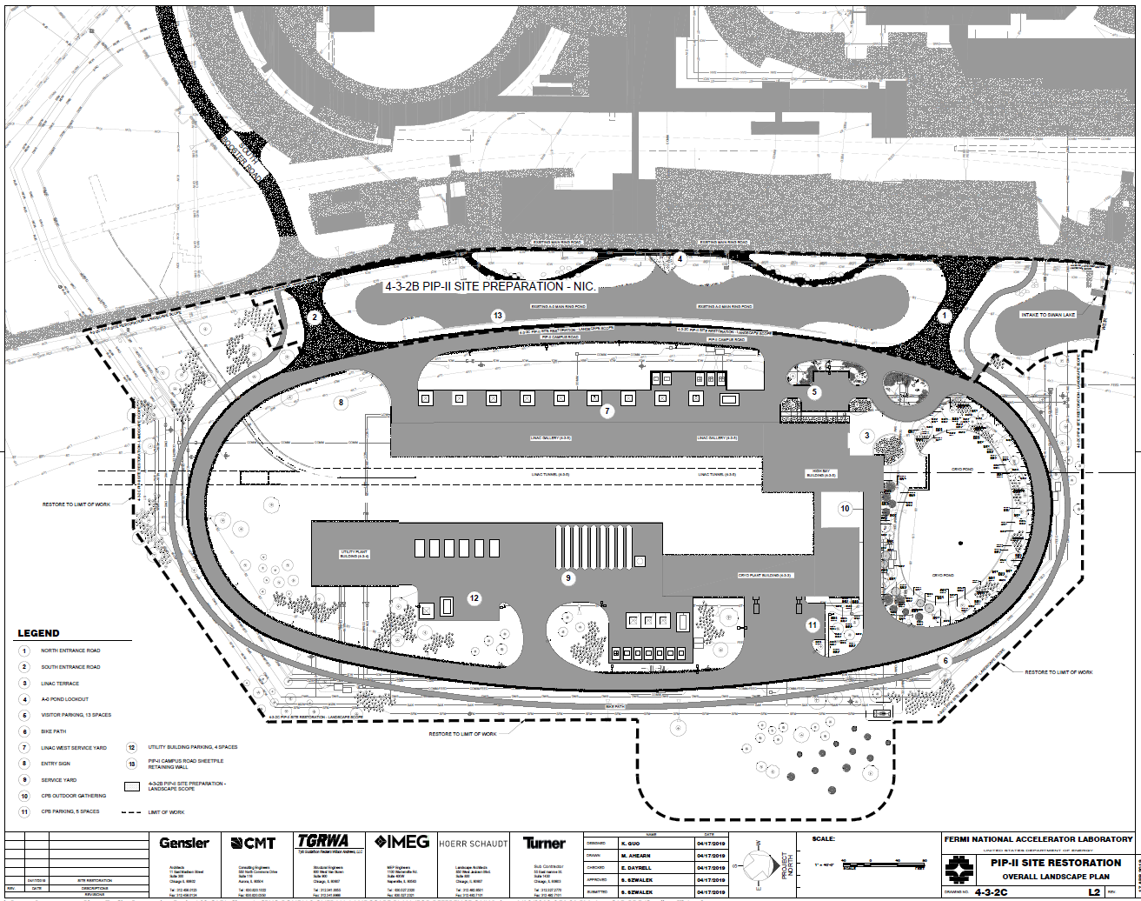
Technical Progress to Date – Site Restoration
WBS 121.06.02.05 – Site Restoration and Landscaping [1]
Landscaping
Entry Plaza
Linac Pond
Landscaping Inside Road
Roadway Lighting
[1] See PIP-II-doc-3163 for complete document set

Slide 12
Documents
PIP-II-doc-2492 - Functional Requirements Specification
PIP-II-doc-2492 – Technical Requirements Specification
PIP-II-doc-2524 – Site Clearing Construction Documents
PIP-II-doc-2521 – Site Work Construction Documents
PIP-II-doc-3163 – Site Restoration Construction Documents

Slide 13
End

