Slide 1
WBS 121.06 - Conventional Facilities
Overview and Process
S. Dixon, L2 Manager
DOE CD-2/3a ICE Review
February 4-7, 2020

Slide 2
About Me
PIP-II Level 2 Manager for Conventional Facilities
Relevant Experience
  Licensed Architect;
  Project Management Professional (PMP);
  LEED Accredited Professional;
  27+ years at Fermilab;
  NOvA Project L2 Manager for Site and Buildings;
    2014 CD-4
    2015 U.S. DOE Secretary’s Award for Excellence
  General Plant Project Manager for 17+ years
    Short Baseline Neutrino (SBN) Near Detector Building;
    Short Baseline Neutrino (SBN) Far Detector Building;
    Experimental Operations Center;

Slide 3
Agenda
Project Organization
Scope
Schedule
Risks
Basis of Estimate Development Process
Cost and Schedule Update

Slide 4
Project Organization
WBS 121.06
Conventional Facilities
S. Dixon
System Manager
WBS 121.06.01
Project Management
S. Dixon
WBS 121.06.02
Site Preparation
R. Wielgos
WBS 121.06.03
Cryogenics Plant Building
(S. Dixon)
WBS 121.06.04
Utility Plant
E. Alcaraz
WBS 121.06.05
Linac Complex
E. Alcaraz
WBS 121.06.06
Booster Connection
E. Alcaraz
Architect/Engineer Team
Gensler (architecture), IMEG (mechanical, electrical, plumbing)
TGRWA (structural),CMT (civil), Jensen Hughes (life safety), Syska Hennessy (commissioning), Burns and McDonnell (landscaping)

Slide 5
Scope and Deliverables
Conventional Facilities includes the design, procurement and construction of the utilities, roads, structures, enclosures and buildings to support the installation, assembly and operation of the technical components. [1]
WBS
  121.06.01 – Project Management and Coordination
  121.06.02 – Site Preparation – CD-3a Request
  121.06.03 – Cryogenics Plant Building - CD-3a Request 121.06.04 – Utility Plant
  121.06.05 – Linac Complex (88,600 square feet)
  121.06.06 – Booster Connection (7,800 square feet)
[1] See WBS Dictionary in PIP-II-doc-599 for complete description

Slide 6
Scope and Deliverables
Cryogenics Plant Building (WBS 121.06.03)
Utility Plant (WBS 121.06.04)
Booster Connection (WBS 121.06.06)
Site Preparation (WBS 121.06.02)
  Site Clearing
  Site Work
  Site Restoration and Landscaping
Linac Complex (WBS 121.06.05)
  High Bay Building
  Linac Tunnel
  Linac Gallery
  Beam Transfer Line

Slide 7
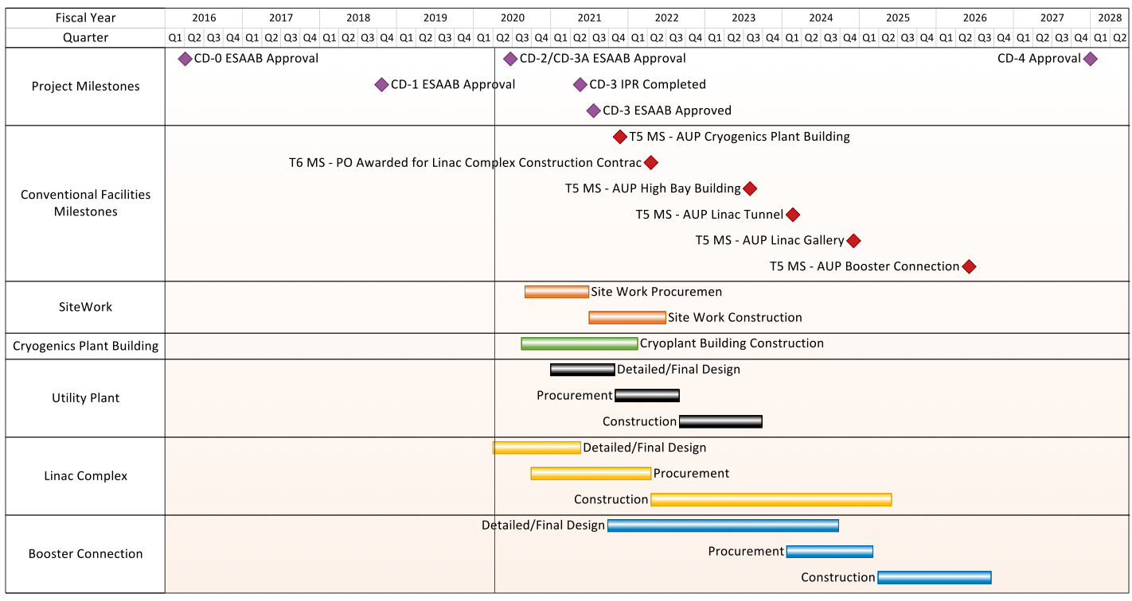
Schedule
CD-3a Requests

Slide 8
Risks and Risk Mitigation
Following the procedures contained in the PIP-II Risk Management Plan [1]
15 currently managed risks
Managed through the Risk Register
Type | Quantity
High | 1
Medium | 4
Low | 8
Opportunity | 2
Top Five Risks
RI-ID | Title
RT-121-06-001 | CnvF: Changes in subproject requirements affect Conventional Facilities
RT-121-06-042 | CnvF: Construction activities impact the Booster
RT-121-06-043 | CnvF: Construction subcontractor performance
RT-121-06-010 | CnvF: Interfaces between subprojects and conventional construction
RT-121-06-011 | CnvF: Time for long lead time items is longer than expected
Construction Escalation Strategy Updated in December 2020 [2]
[1] – Risk Management Plan can be found in PIP-II-doc-163
[2] – Construction Escalation Strategy can be found in PIP-II-doc-1299

Slide 9
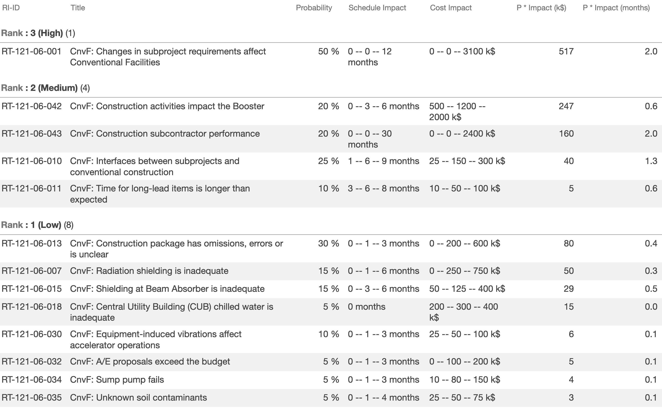
Risks – Conventional Facilities Risks
From PIP-II-doc-3271

Slide 10
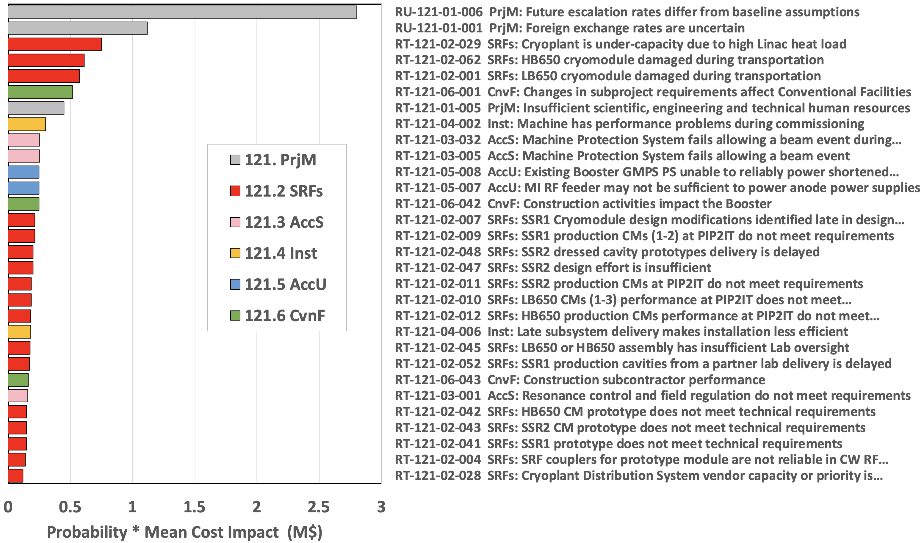
Risks – Top 30 Cost Risks
Histogram does not include standing army and escalation burn rate costs.
These are computed collectively for the whole project using the PRA MC.
From PIP-II-doc-3271

Slide 11
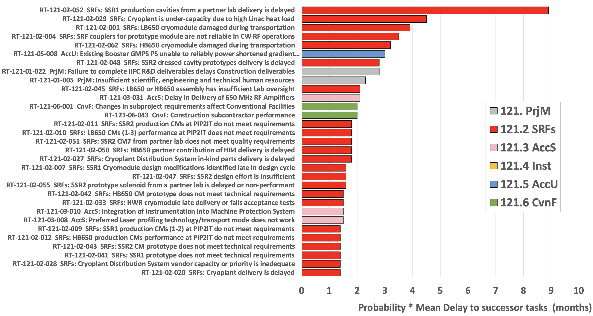
Risks – Top 30 Schedule Risk Impacts
Note: only some risks delay the project finish (if they are on or near the critical path).
Aggregate schedule risk is assessed using the PRA MC model.
From PIP-II-doc-3271

Slide 12
Basis of Estimate Development
Process

Slide 13
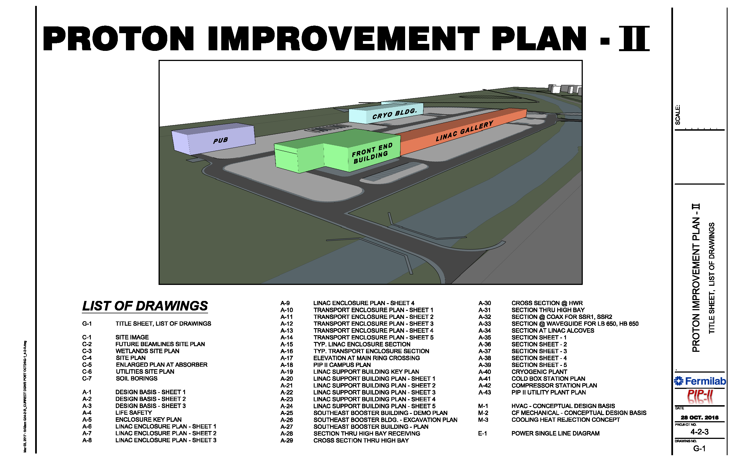
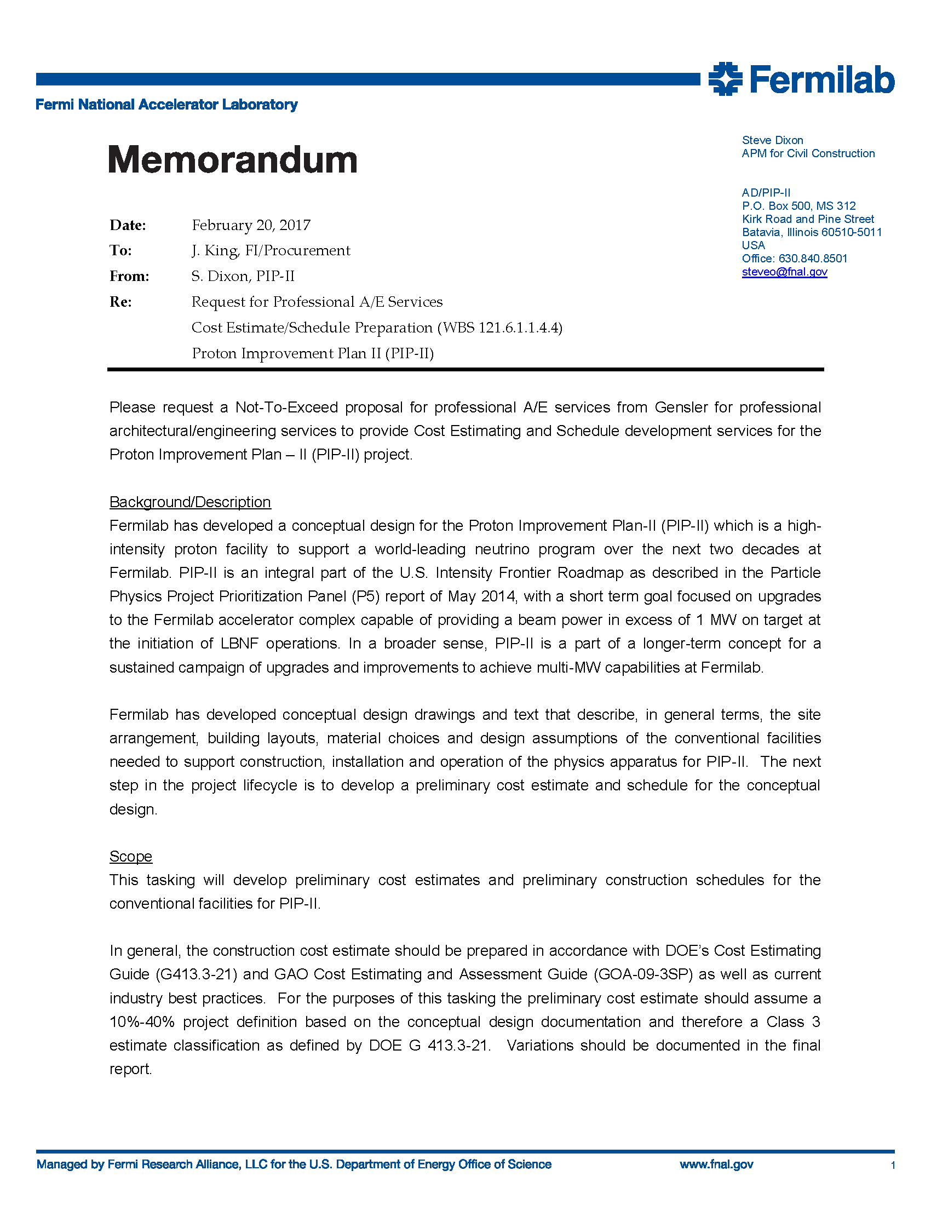
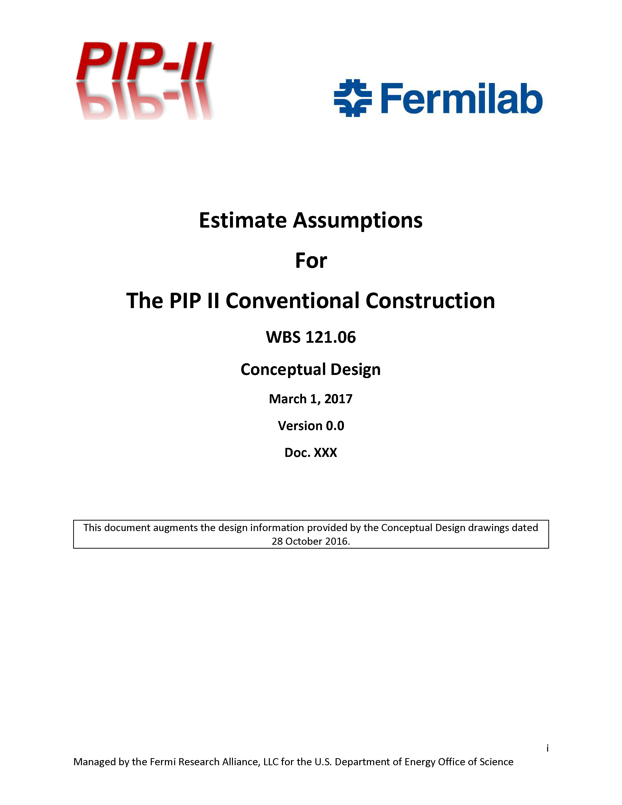
Cost Estimate Process
Drawings from PIP-II-doc-1155
Initial Tasking for A/E Team
Conceptual Design drawings and Estimate Assumptions developed with input from stakeholders
the construction cost estimate should be prepared in accordance with DOE’s Cost Estimating Guide (G413.3-21) and GAO Cost Estimating and Assessment Guide (GOA-09-3SP) as well as current industry best practices. For the purposes of this tasking the preliminary cost estimate should assume a 10%-40% project definition based on the conceptual design documentation and therefore a Class 3 estimate classification as defined by DOE G 413.3-21
Documentation can be found at PIP-II-doc-333

Slide 14
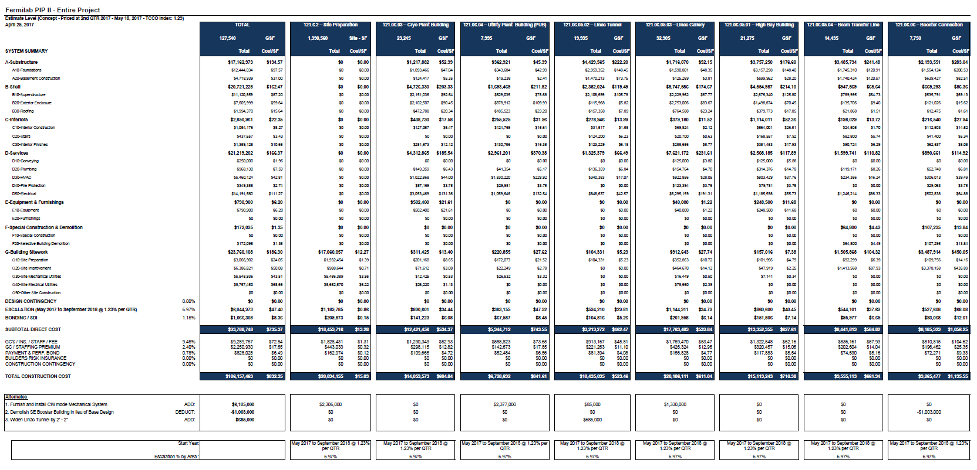
Cost Estimate Process
Original estimate completed in May 2017;
Broken down by work package;
Updated in April 2018
Documentation can be found at PIP-II-doc-333

Slide 15
Schedule Estimate Process
Drawings from PIP-II-doc-1155
Initial Tasking for A/E Team
Conceptual Design drawings and Estimate Assumptions developed with input from stakeholders
The preliminary construction schedule should instead focus on the completion of major milestones (eg: excavation complete, foundation complete, building shell complete, beneficial occupancy, etc.) within the overall schedule to provide a reasonable prediction of one possible construction scenario. This schedule information will be included in the PIP-II resource loaded schedule as a planning package that will be updated with further information and details as they become available.
Documentation can be found at PIP-II-doc-581

Slide 16
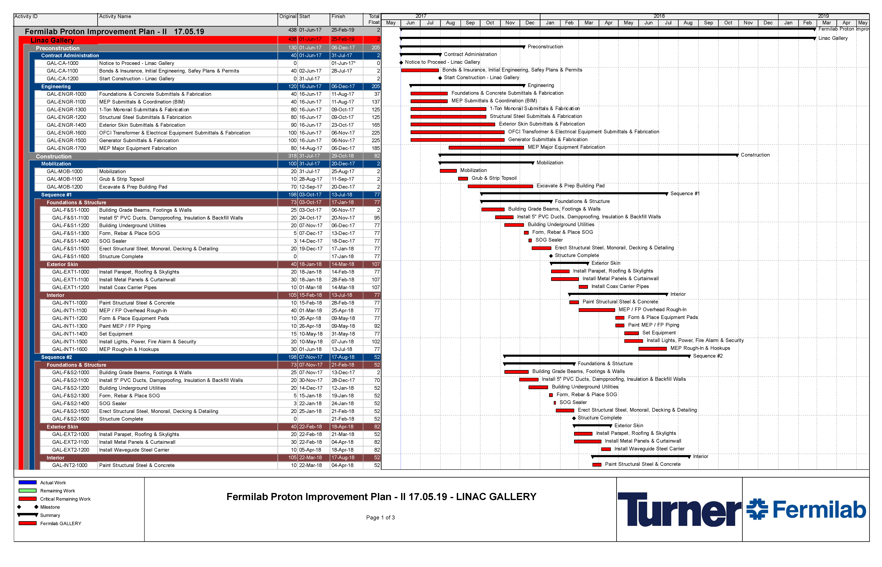
Schedule Estimate Process
Considered Planning Packages;
Technically driven schedules;
Focused on interface milestones
Durations modified based on scope adjustments
Documentation can be found at PIP-II-doc-581 and in each Basis of Estimate file

Slide 17
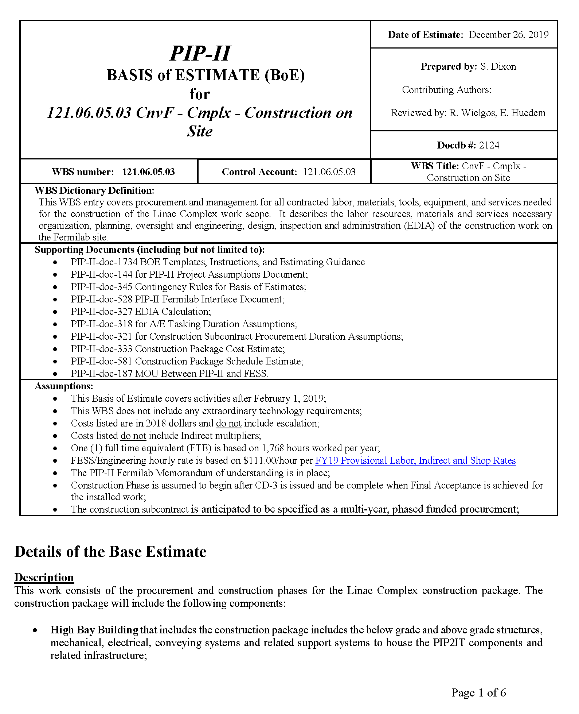
Basis of Estimate Form Example
Supporting Documents
Assumptions
Typical Basis of Estimate form

Slide 18
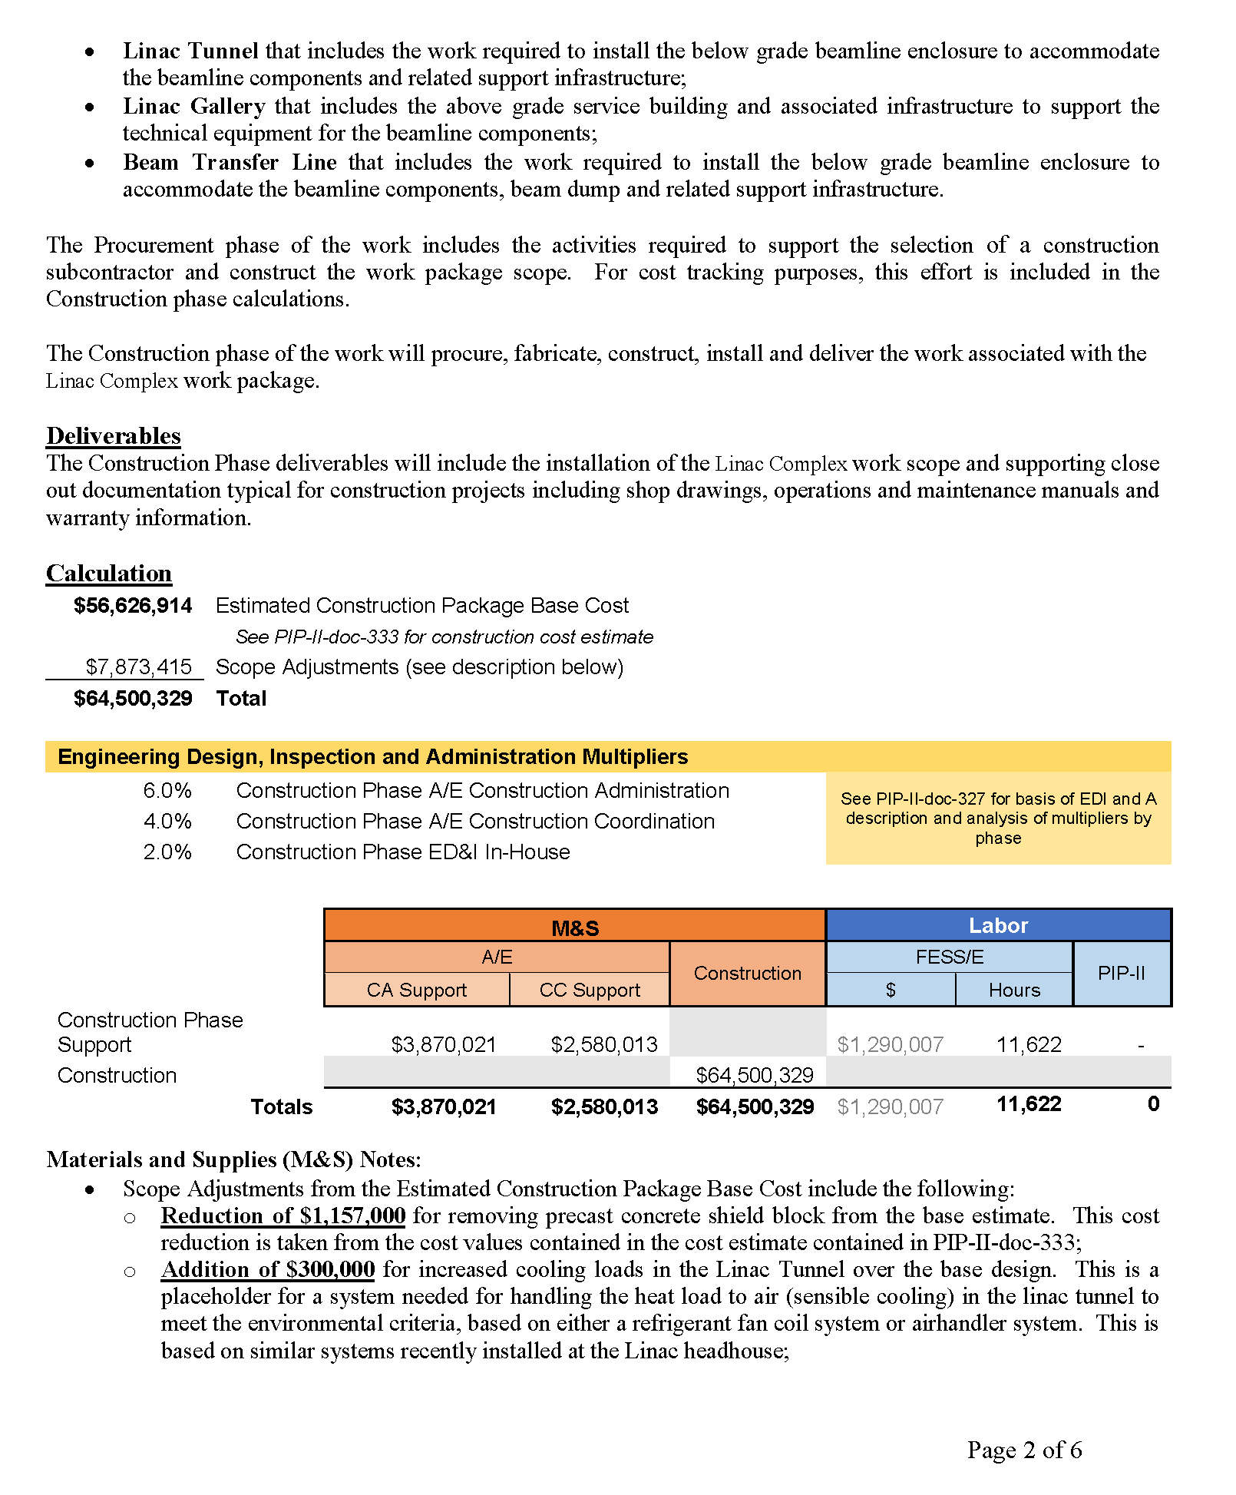
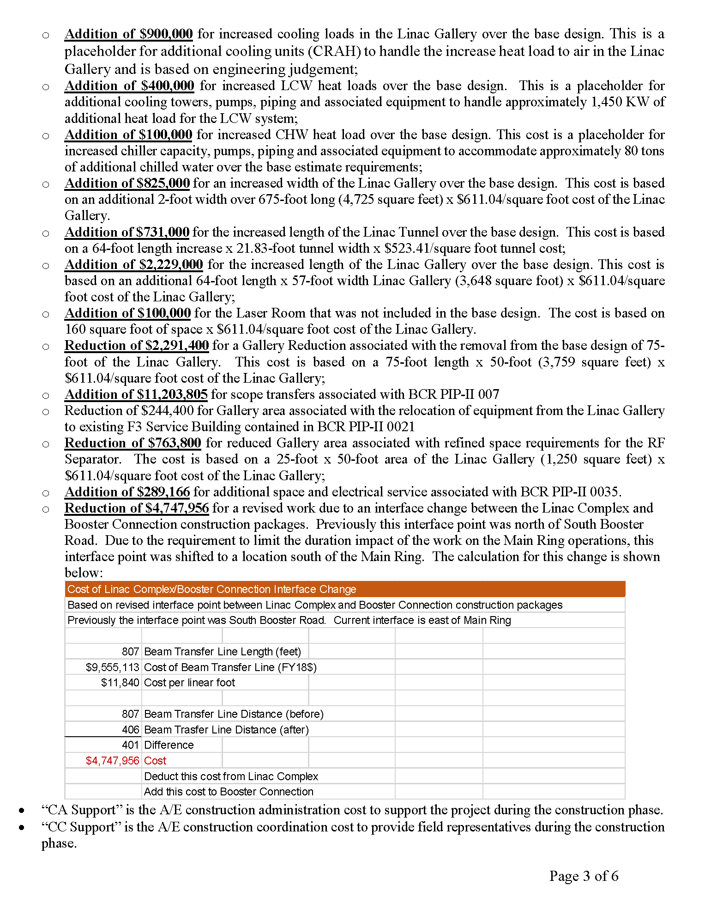
Basis of Estimate Form Example
Base Estimate(PIP-II-doc-333)
Scope Adjustments to Base Estimate
ED&I Costs
(PIP-II-doc-327)
Typical Basis of Estimate form
Construction Estimate = Base Estimate + Scope Adjustments

Slide 19
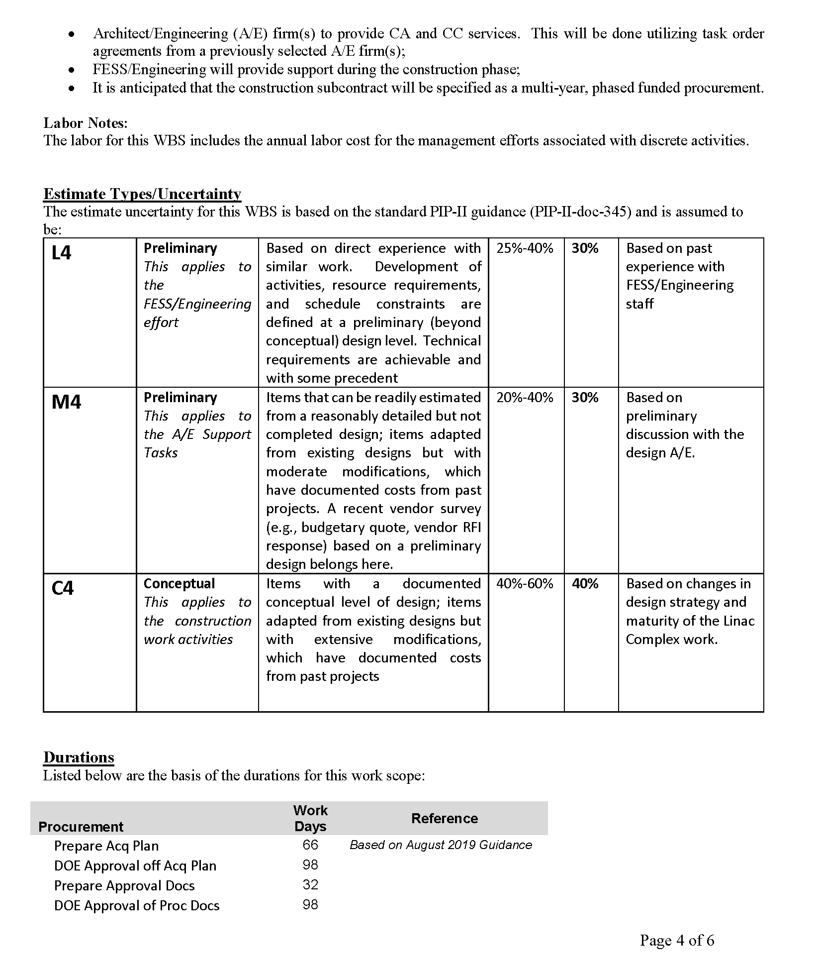
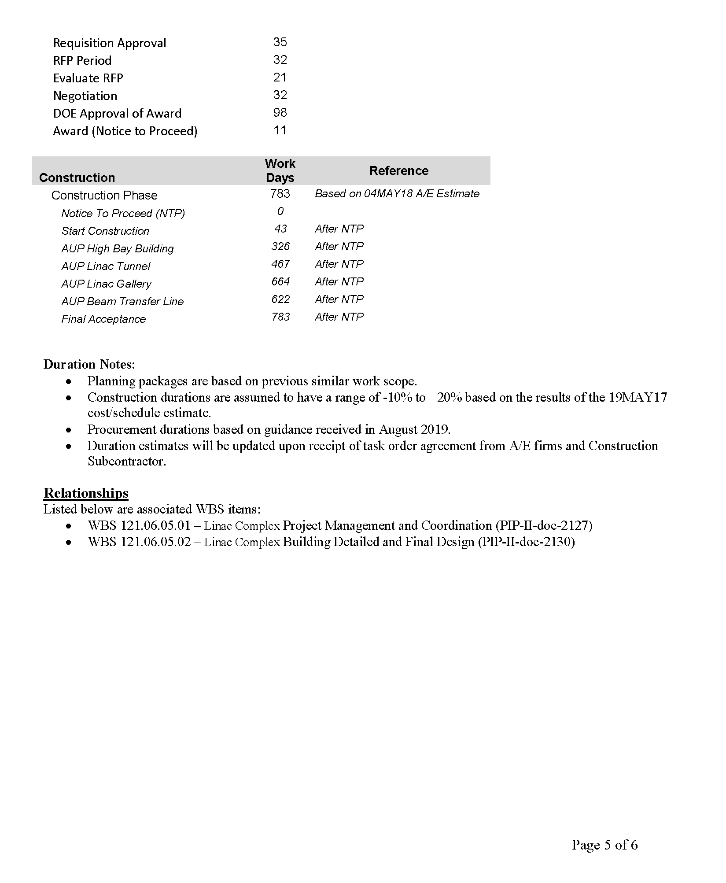
Basis of Estimate Form Example
Construction Subcontract Procurement Durations
(PIP-II-doc-321)
Construction Subcontract Durations
(PIP-II-doc-581)
Estimate Uncertainty
(PIP-II-doc-345)
Typical Basis of Estimate form

Slide 20
Basis of Estimate List

Slide 21
Cost and Schedule
Design Team
  Selection required cost/schedule estimator;
  Gensler team includes Turner Construction Company;
Overall Cost/Schedule Estimate
  One of the first design team tasks;
  Initially done based on conceptual design developed in house;
  Periodic updates (see next slide).
Construction Packages
  Design phase request for proposal includes:
    Design to construction cost target;
    Updated cost estimate at 60%, 90% and 100% deliverables.

Slide 22
Cost and Schedule Update
Timeline
  2017 - Original cost/schedule estimate based on conceptual design
  2018 – Updated cost estimate based on value engineering workshop
  March-October 2019 – Updated design of Linac Complex based on latest requirements
  November 2019 to March 2020: Updated cost/schedule estimate (reconciliation in progress)

Slide 23
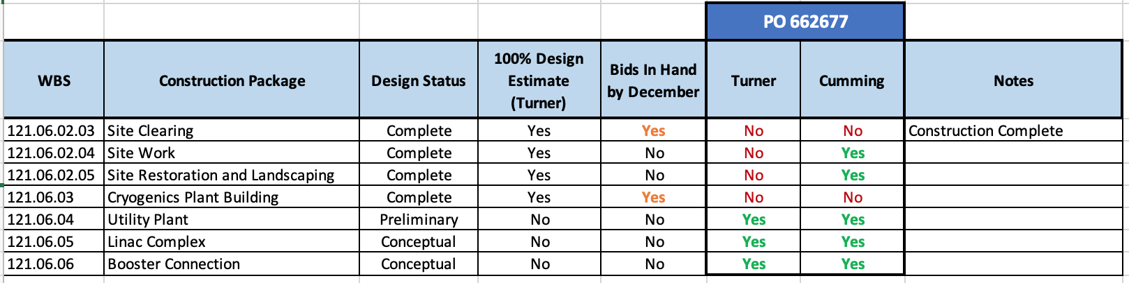
Cost and Schedule Update
Cost/schedule update by the A/E started after the completion of design update for Linac Complex and Booster Connection.
Includes estimator on Design Team (Turner) and external independent estimator (Cumming)
The reconciled cost/schedule estimate will be used as the basis for the construction cost target during design phase.

Slide 24
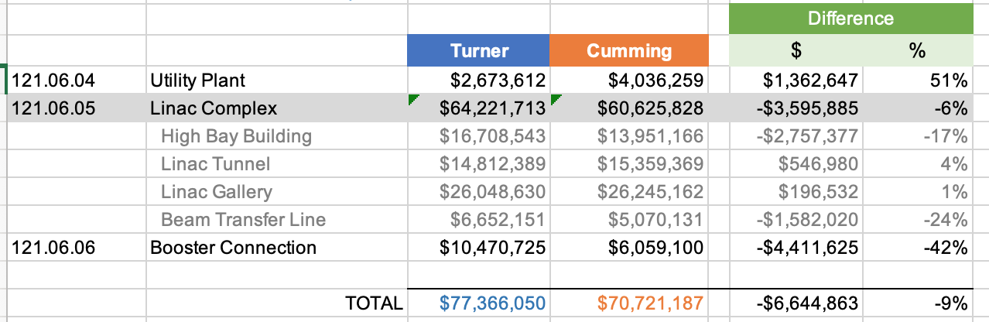
Cost and Schedule Update
PRELIMINARY
Site Preparation (121.06.02) and Cryogenics Plant Building (121.06.03) not included in table above
Reconciliation Required: Still require discussions about scope

Slide 25
Cost and Schedule Update
PRELIMINARY
Site Preparation (121.06.02) and Cryogenics Plant Building (121.06.03) not included in table above
Reconciliation Required: Still require discussions about production rate from Turner

Slide 26
End

