Slide 1

Q-pix Digital review: introduction & discussion
Kurtis Nishimura
University of Hawaii
April 3, 2020

Slide 2
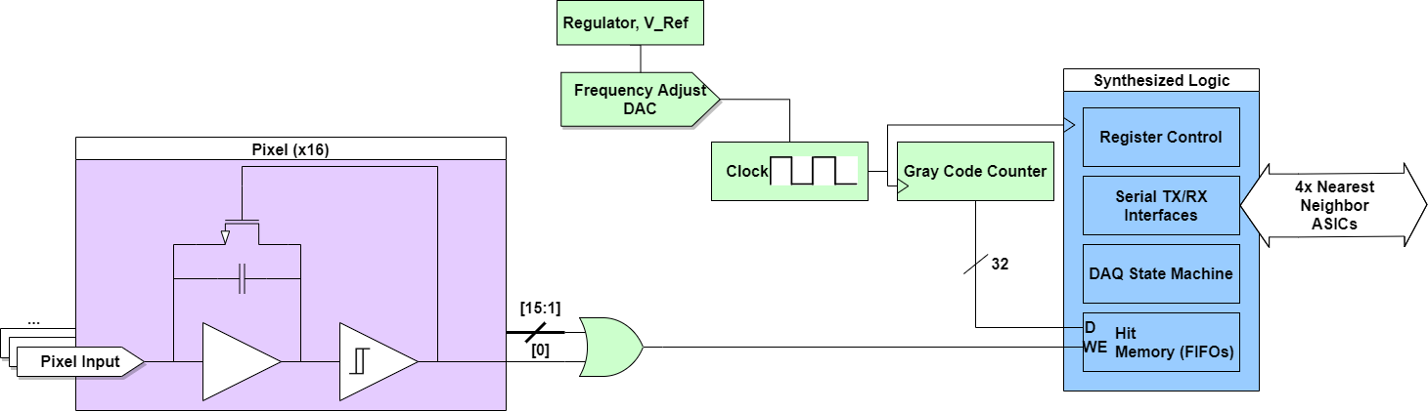
Q-Pix BLOCK Design
**Just as presented yesterday…
But not final.
Analog
Analog Design Supporting Digital
Full Digital (Synthesized)
When integrated charge reaches a threshold, a timestamp is generated.
Gray code timestamp to minimize impact of any bit errors.
Timestamps are stored in a local memory.
Upon interrogation by a neighbor, data is relayed back through serial interface.

Slide 3
Q-Pix BLOCK Design
**Just as presented yesterday…
But not final.
Analog
Analog Design Supporting Digital
Full Digital (Synthesized)
Communications are, for now, assumed to be 64-bit atomic, for example…
  Normal hit data: 32-bits timestamp, 16-bit channel mask, 8-bit ASIC position (16x16 tile), 8-bit reserved.
  Register commands: TBD register address, TBD data, 8-bit target ASIC position, spare bits…

Slide 4
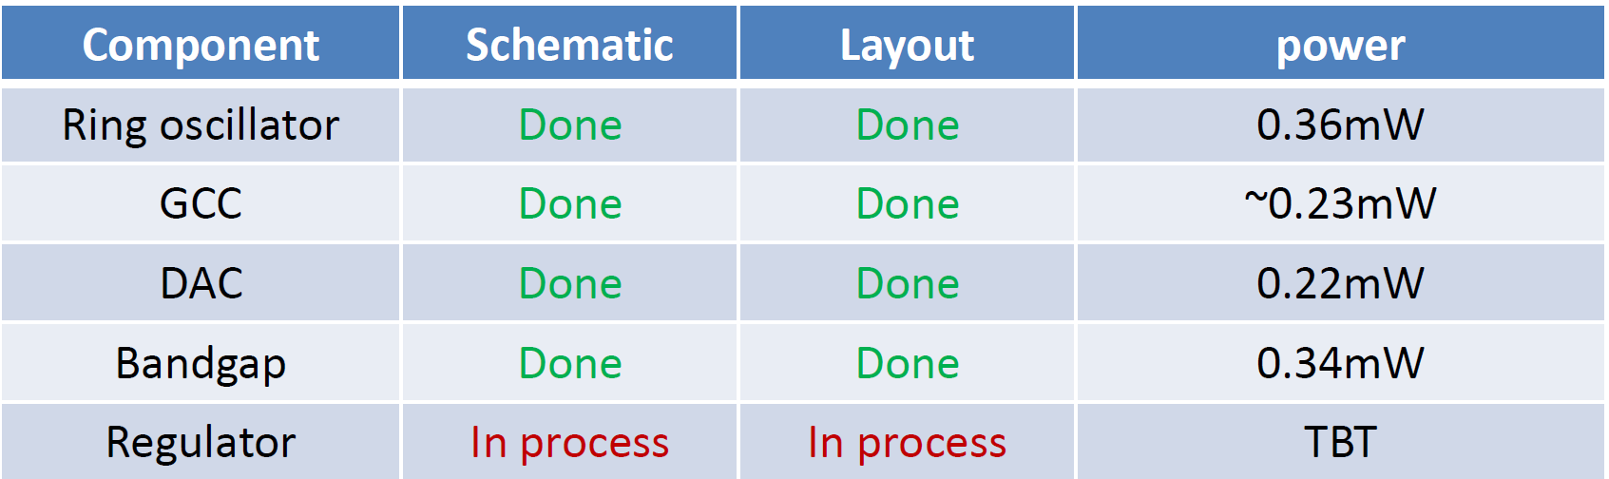
Status and readiness for review
Overall
  As evident from discussion yesterday, and from Jinyuan’s slides today, (I think) it’s not controversial to say that we’re still evaluating various conceptual designs for the ASIC architecture.
Synthesized Logic
Analog-Supporting-Digital Components
It will be some time before we’re able to actually synthesize with standard cells.
Would propose that we use this opportunity to get feedback on larger ideas and concepts.
Good opportunity now to simulate promising concepts, prototype promising concepts on FPGA.
Some discussion items in this slide on strategy for robustness, integrating with slow base clock schemes.
Gang will give more details on the design status of the existing components.
All but one of proposed components have complete schematic and layout.
Even if we don’t end up needing all of them, perhaps consider inclusion as test structures?

Slide 5

SELF ASSEMBLING DAQ
Network Built w/ One DAQ Connection on Corner
Working now with a baseline implementation that builds up a network from communication with nearest neighbors.
Since there are multiple paths to any ASIC, the network in principle should survive as long as:
  DAQ nodes can still communicate with an ASIC.
  No long dead stretches of ASICs.
Multiple paths to any ASIC reduces the chance of these kinds of failures causing loss of operational ASICs.
For example, could imagine DAQ nodes at all corners (or sides), each one can service all four tiles.
  Under normal circumstances, either 1 or 2 DAQ nodes service the tile, but this gives substantial redundancy.
Network built w/ Two DAQ Connections on Sides

Slide 6
Basic State machine Scheme
MEASURING:
  Baseline state.
  Fill any hits seen into local buffer.
  Move to REPORTING LOCAL if we get a system interrogation.
    Forward interrogation to nearest neighbors.
    Fill interrogation reply packet into end of buffer. This will mark the “collection complete” flag for the ASIC.
REPORTING LOCAL:
  Relay next hit in buffer back to where the timestamp was received from.
  Continue until all hits are exhausted, then move to REPORTING REMOTE.
  During this period, buffer any hits being received from other ASICs.
REPORTING REMOTE:
  Relay next hit received from other ASICs.
  Stay here until a given timeout period.
  Then return to MEASURING STATE to wait for the next system interrogation.
MEASURING (0)
System interrogation
More hits?
Timeout
REPORTING
LOCAL (1)
Continue…
REPORTING
REMOTE (2)
Local hits empty

Slide 7

Basic State machine Scheme
MEASURING (0)
System interrogation
More hits?
Timeout
REPORTING
LOCAL (1)
Continue…
REPORTING
REMOTE (2)
Local hits empty

Slide 8
Robustness and failure modes
On previous slide, considering that an ASIC just can’t communicate, period… but lots of other potential failure modes, for example…
  Hot channels:
    Hot channels create many hits that can tie up the network and/or cause FIFO overflow.
    Should there be a built-in mechanism to mask out chatty ASICs, or just flagged by the DAQ, and repaired via external commands?
  Partial communications failures (e.g., bit errors on the link):
    All communications can have a short CRC… only packets with correct CRC are processed or forwarded.
    Again, is this something that should be automatically recovered, or just flagged to DAQ nodes so that something can be done externally.
Note that each ASIC reports *something* for every interrogation.
  An “end of event” flag, which lets the DAQ verify that ASIC responded, but this could also be used as a calibration (e.g., here’s my current local time).
  …but if an ASIC is not seen, it’s not necessarily clear what happened.

Slide 9
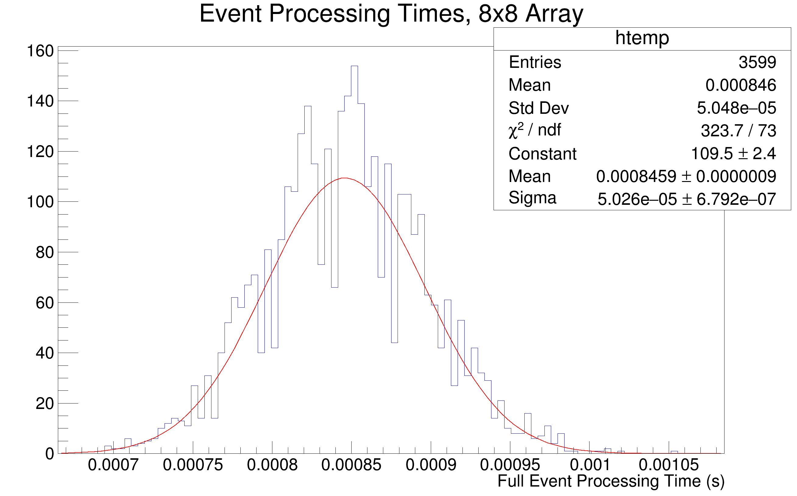
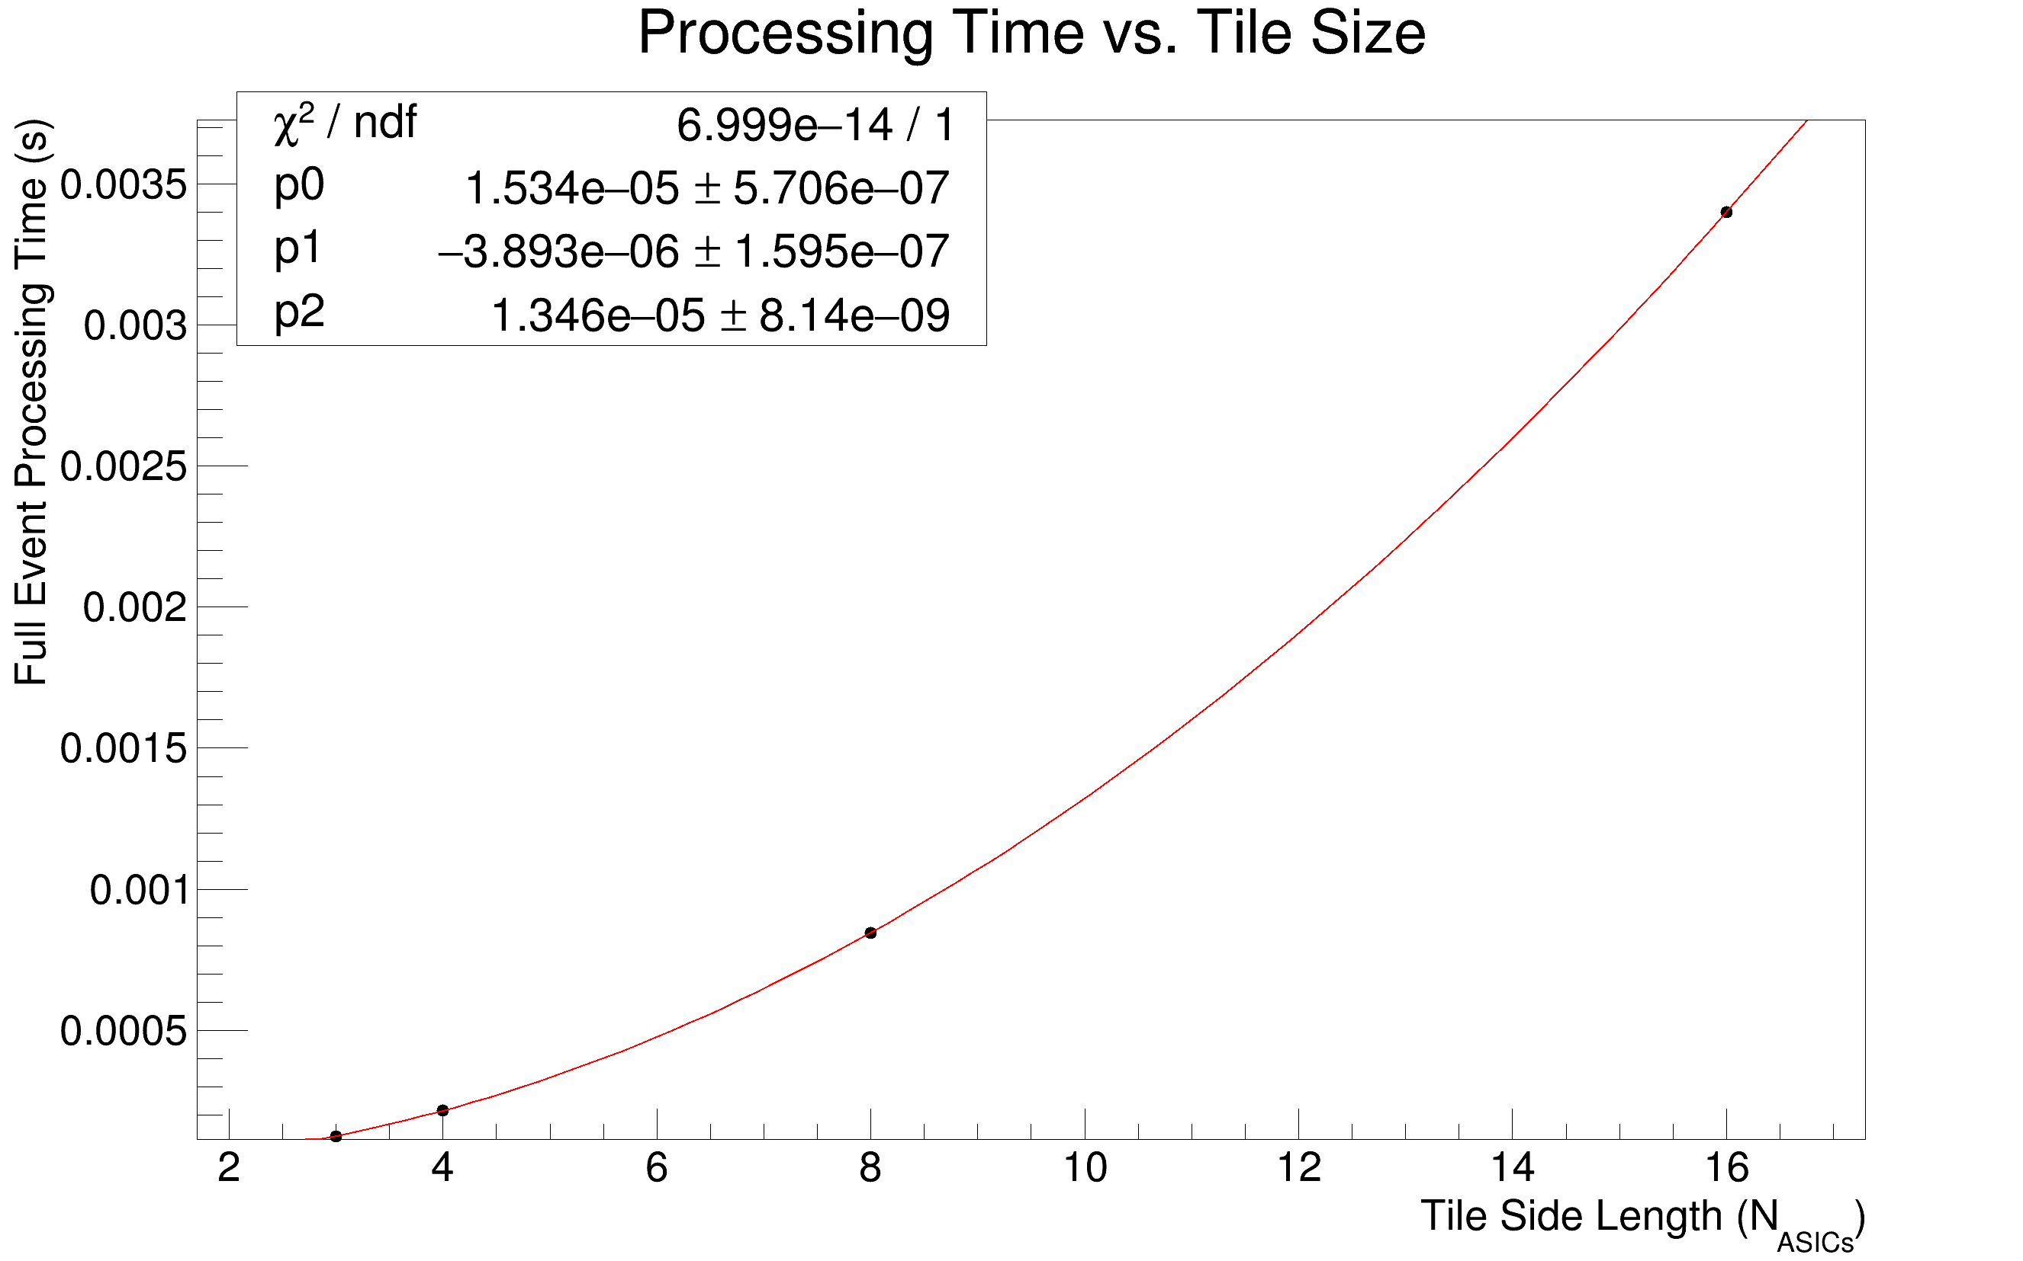
Example Simulation results
**As shown yesterday
Background rate per pixel: 0.11 Hz
No signal!
  (Model doesn’t do this yet but it’s on the list.)
Square arrays of varying size.
Single DAQ node at north west corner of array.
DAQ node interrogates corner ASIC once per second.
5.28 us per transaction (64-bit atomic UART running at 12.5 Mbaud).
One randomly thrown array configuration simulated over ~hour.
➔ 16 channel ASICs, 16x16 tiles look quite reasonable so far.

Slide 10
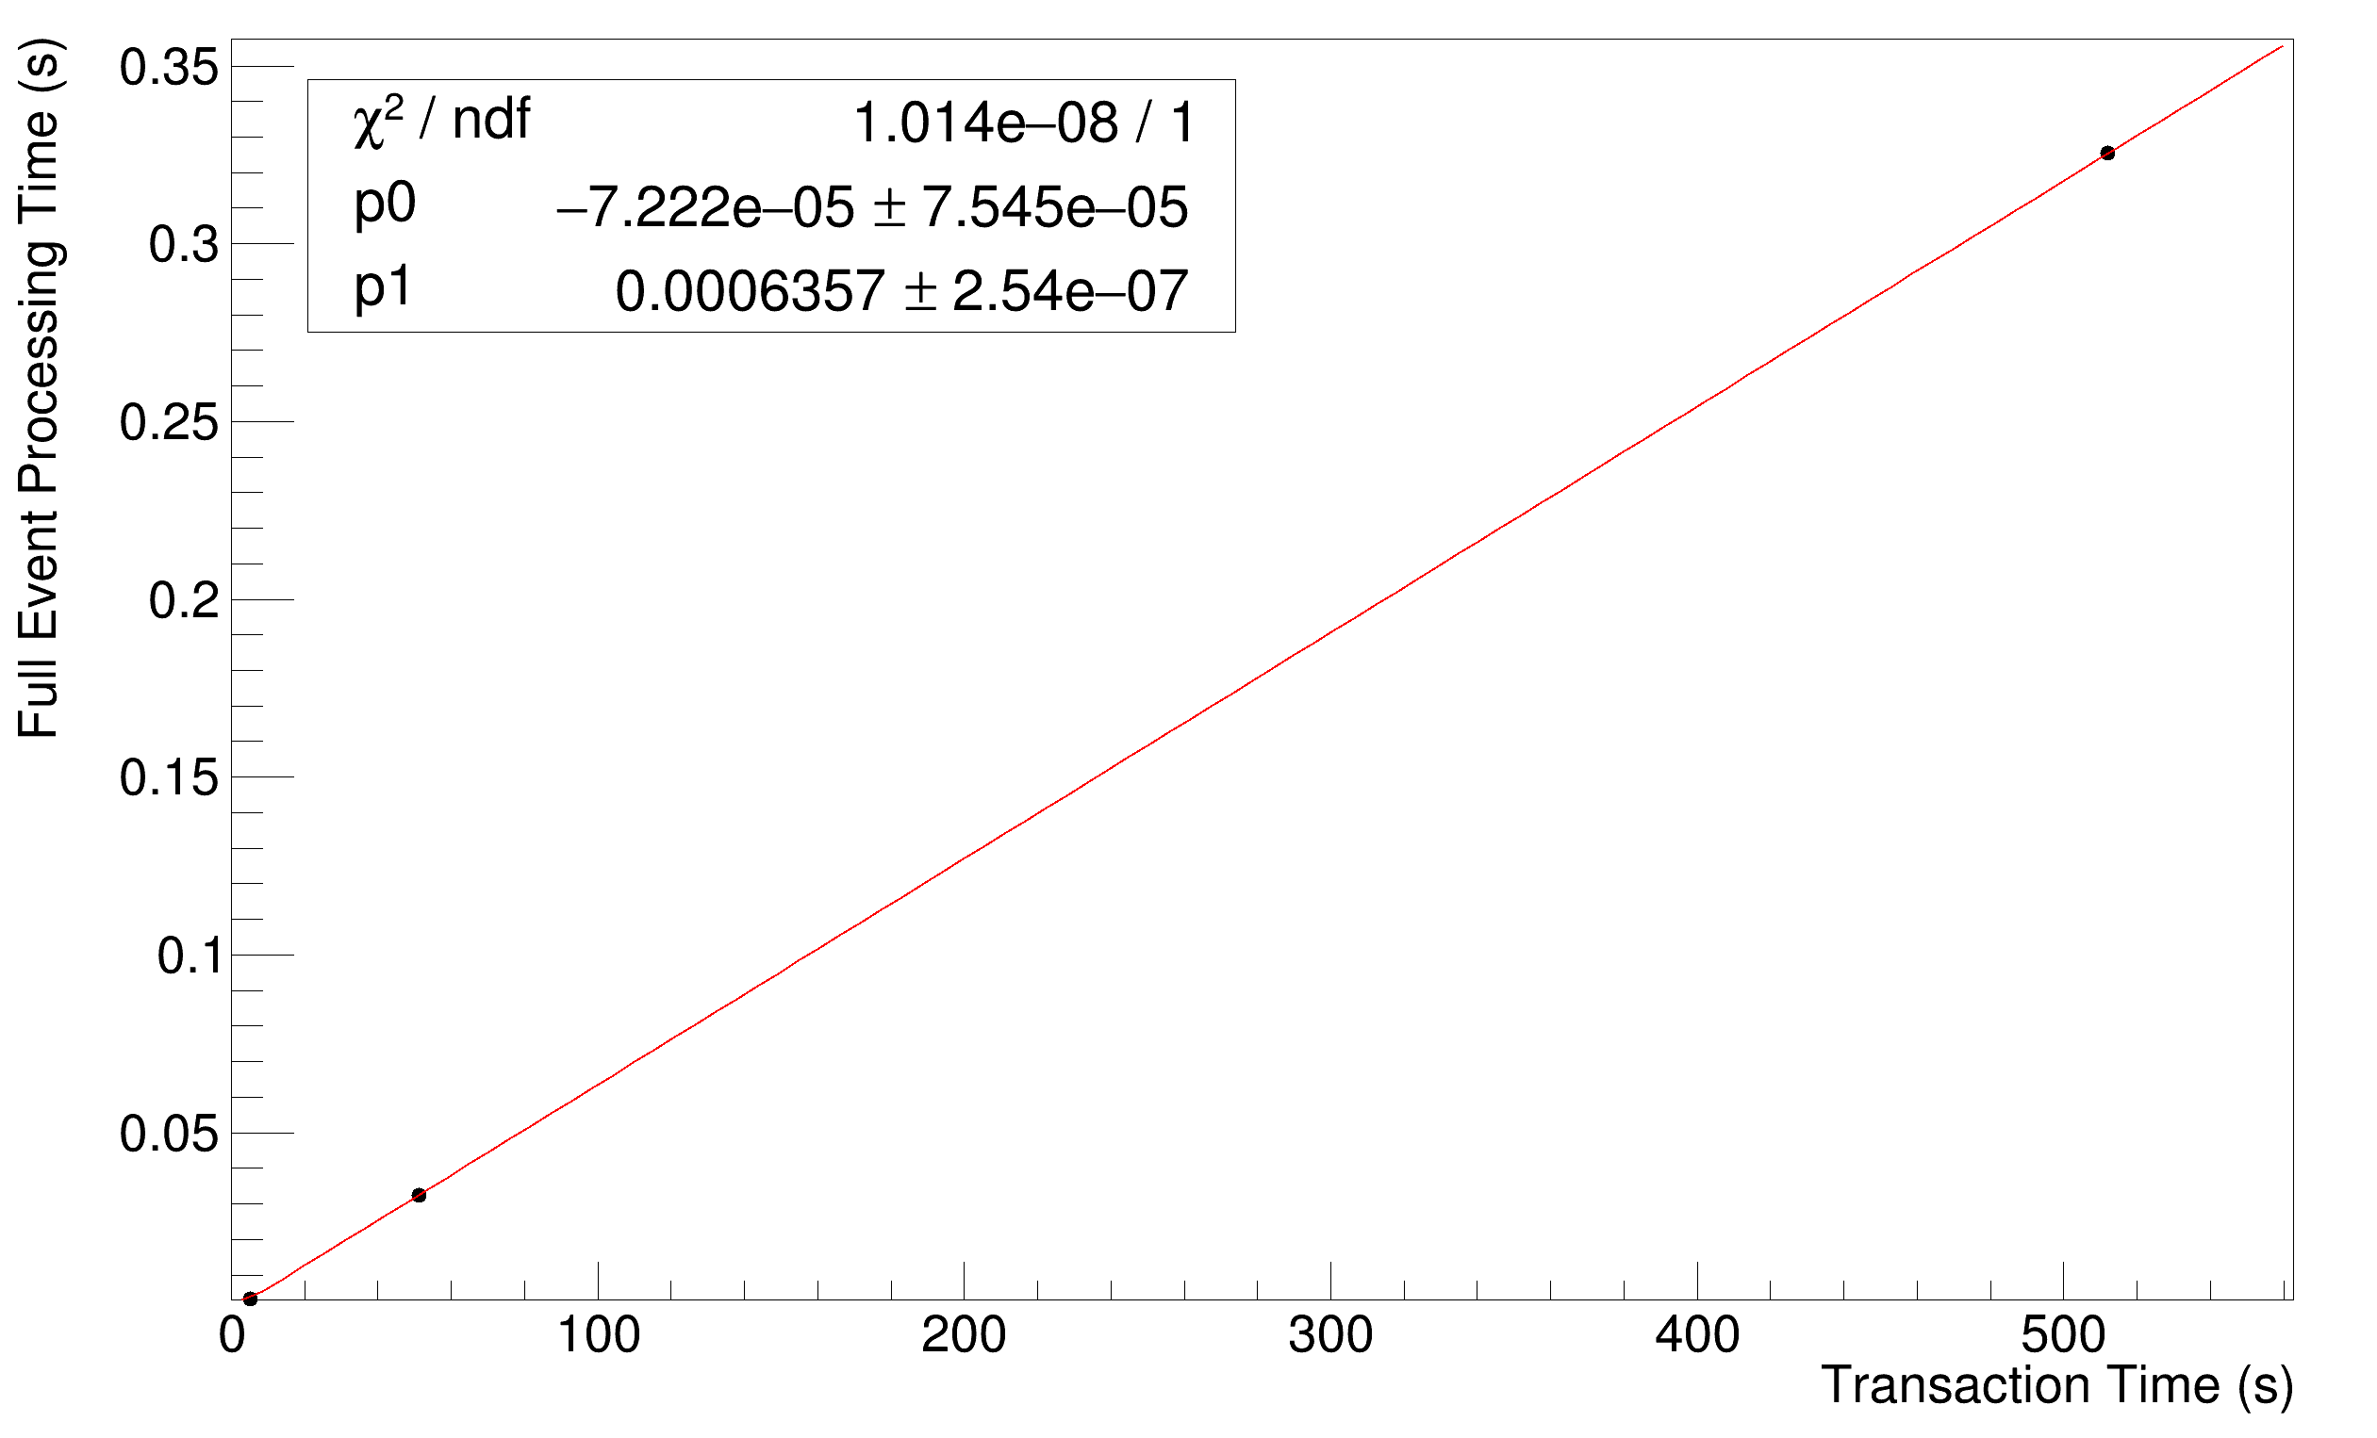
Example Simulation results - Varying Communication Rate
**As shown yesterday
Only a 16x16 tile.
Otherwise same parameters as before, but…
  12.5 Mbaud: ~5 us per transaction
  1.25 Mbaud: ~50 us per transaction
  125 kbaud: ~500 us per transaction
As expected, processing time scales linearly with transaction time.
  Note we still have no signal superimposed here, just
  same 0.11 Hz background per pixel.
➔ Concern: if we adopt Jinyuan’s on-demand fast, always-on slow oscillator scheme, would we have to run all comms at the slow rate?

Slide 11
Synthesized Digital Strategy?
For now, carrying on with simulation and FPGA prototyping of the simple baseline version.
  I think a hardware prototype of a full digital tile, even if on FPGA, will be a limited, but very valuable demonstrator.
In the meantime, will work as best as possible to get digital ASIC-flow up and running.
  Need to urgently answer questions about how much digital logic we can afford in terms of power, space.
As a wider point, would like to get some discussion and agreement on what our specifications for robustness really are… what kinds of failures do we need to tolerate, and must they all be “automatically” handled by the system or just flagged to DAQ?

