Slide 1
Univ. of Hawaii Introduction: Digital System Elements
Kurtis Nishimura
University of Hawaii
April 2, 2020

Slide 2
Q-Pix BLOCK Design
When integrated charge reaches a threshold, a timestamp is generated.
Gray code timestamp to minimize impact of any bit errors.
Timestamps are stored in a local memory.
Upon interrogation by a neighbor, data is relayed back through serial interface.

Slide 3
Q-Pix BLOCK Design
Components are divided into three parts:
Analog front-end described in Mitch’s talk (simplified version shown here).
“Analog” components supporting digital logic.
Synthesized digital logic for more complex interfaces where manual logic design is impractical.

Slide 4
“Digital” Efforts in Hawaii
What you’ll hear about today…
Synthesized logic: Vasily Shebalin, Kurtis Nishimura
Personnel: Vasily Shebalin (ramping up), Kurtis Nishimura, Shahab Kohani (joining soon)
Higher-level simulations of state machine, DAQ connectivity (Kurtis, this talk).
HDL development and simulation of selected implementations, including verification and prototyping (Vasily, next talk).
Note that we’re still slowly working through imec for NDA, will need a next round to get access to standard cells. For now we are focusing on what we can learn about the logic itself. Will shift to in-ASIC implementation when possible.
“Analog” digital components:
Personnel: Gang Liu, Gary Varner
Schematic, layout, simulation for non-synthesized digital logic components (Gang, talk after next).

Slide 5
SELF ASSEMBLING DAQ OVERVIEW
Network Built w/ One DAQ Connection on Corner
Each ASIC is connected to its nearest neighbors.
Serial communication protocol is up to us!
ASICs on the edge of a tile can connect to a “DAQ node.”
Such nodes might be an FPGA, a digital ASIC, a microprocessor… but ultimately these are gateways where data is moved from the tile to the outside world.
ASICs negotiate a network amongst themselves.
State machine for this protocol is up to us!
We need to start somewhere… so have interpreted the description in David’s Q-Pix arXiv note as a baseline.
Many questions to answer!
What data rate do we need for a background + signal hit rates?
How many ASICs can a DAQ node support, and where should they be connected?
How deep do our ASIC buffers need to be?
How often do we need to read the system out?
Network built w/ Two DAQ Connections on Sides

Slide 6
Basic State machine Scheme
MEASURING:
Baseline state.
Fill any hits seen into local buffer.
Move to REPORTING LOCAL if we get a system interrogation.
Forward interrogation to nearest neighbors.
Fill interrogation reply packet into end of buffer. This will mark the “collection complete” flag for the ASIC.
MEASURING
System interrogation
More hits?
Timeout
REPORTING
LOCAL
Continue…
REPORTING
REMOTE
Local hits empty

Slide 7
Basic State machine Scheme
REPORTING LOCAL:
Relay next hit in buffer back to where the timestamp was received from.
Continue until all hits are exhausted.
During this period, buffer any hits being received from other ASICs.
MEASURING
System interrogation
More hits?
Timeout
REPORTING
LOCAL
Continue…
REPORTING
REMOTE
Local hits empty

Slide 8
Basic State machine Scheme
REPORTING REMOTE:
Relay next hit received from other ASICs.
Stay here until a given timeout period.
Then return to MEASURING STATE to wait for the next system interrogation.
MEASURING
System interrogation
More hits?
Timeout
REPORTING
LOCAL
Continue…
REPORTING
REMOTE
Local hits empty

Slide 9
Simulating A first Protocol
ASICs are simulated in a Python framework.
Assume that all types of transactions take the same number of nominal clock cycles.
That number is parameterizable to study different communications rates.
In principle some transactions could be shorter at some minor complexity cost to the protocol.
No time added for moving between system states, this should be a very minor contribution relative to data transmission.
ASICs all manage to communicate with one another.
A parameter for their frequency is available, and frequencies are generated with a random spread about a nominal frequency, but for now this is only for simulating skew in measured hit times.
For now, no concerns with clock mismatch leading to data corruption. These (and other) failures can be added later.
Six distinct memory interfaces/FIFOs:
2x: Two buffers for local hits. When one is being emptied, the other is active for new hits. ➔ No missed hits!
4x: One FIFO per nearest neighbor ASIC to store hits until they can be forwarded.
No depth limitations on FIFOs, but recording maximum occupancies to get an idea of depths required.

Slide 10
Example of a Simple System SimulatioN
Simulate a 3x3 ASIC network, DAQ connection in upper left.
Can watch states evolve over time…
0: Measuring
1: Reporting Local Hits
2: Forwarding Remote Hits
Note that time does not move in equal sized steps. Instead time is stepped forward as needed to process transactions.
This should be a considerable speed advantage over HDL simulations where generally every clock tick will be simulated.

Slide 11
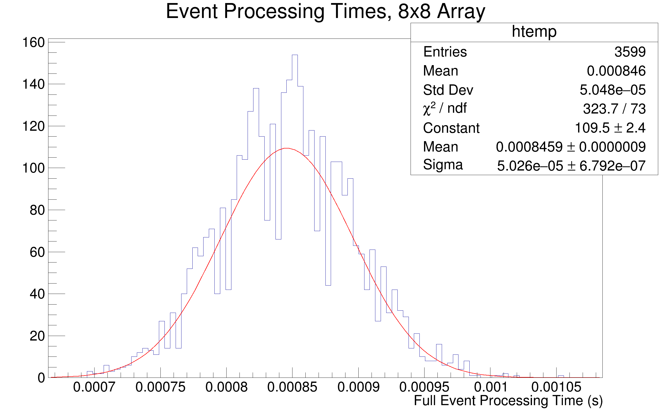
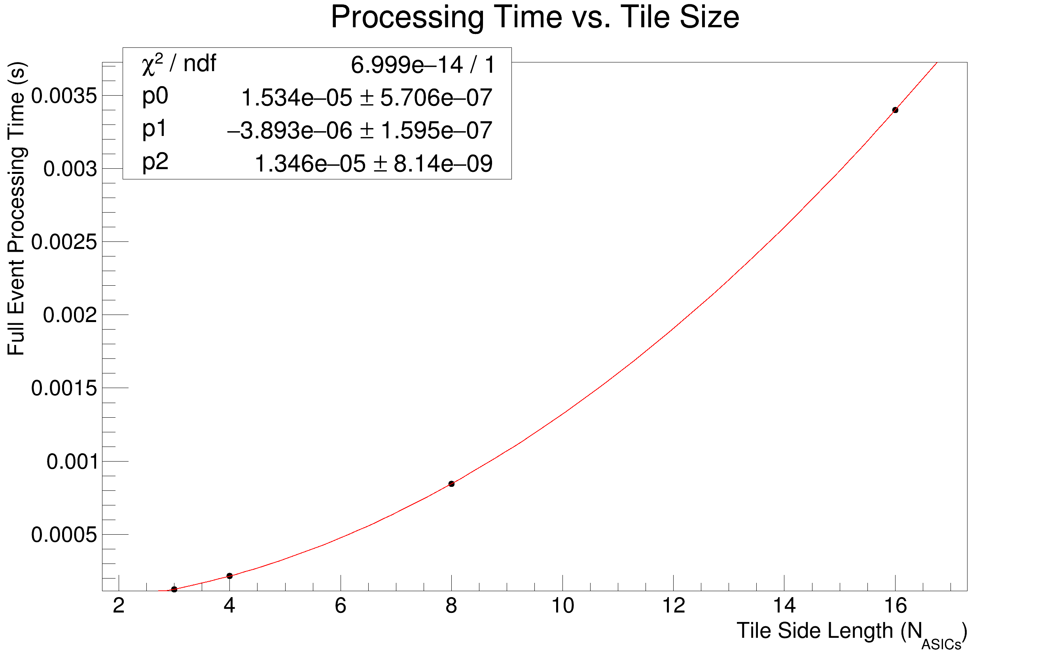
Example Simulation results
Background rate per pixel: 0.11 Hz
No signal!
(Model doesn’t do this yet but it’s on the list.)
Square arrays of varying size.
Single DAQ node at north west corner of array.
DAQ node interrogates corner ASIC once per second.
5.28 us per transaction (64-bit atomic UART running at 12.5 Mbaud).
One randomly thrown array configuration simulated over ~hour.

Slide 12
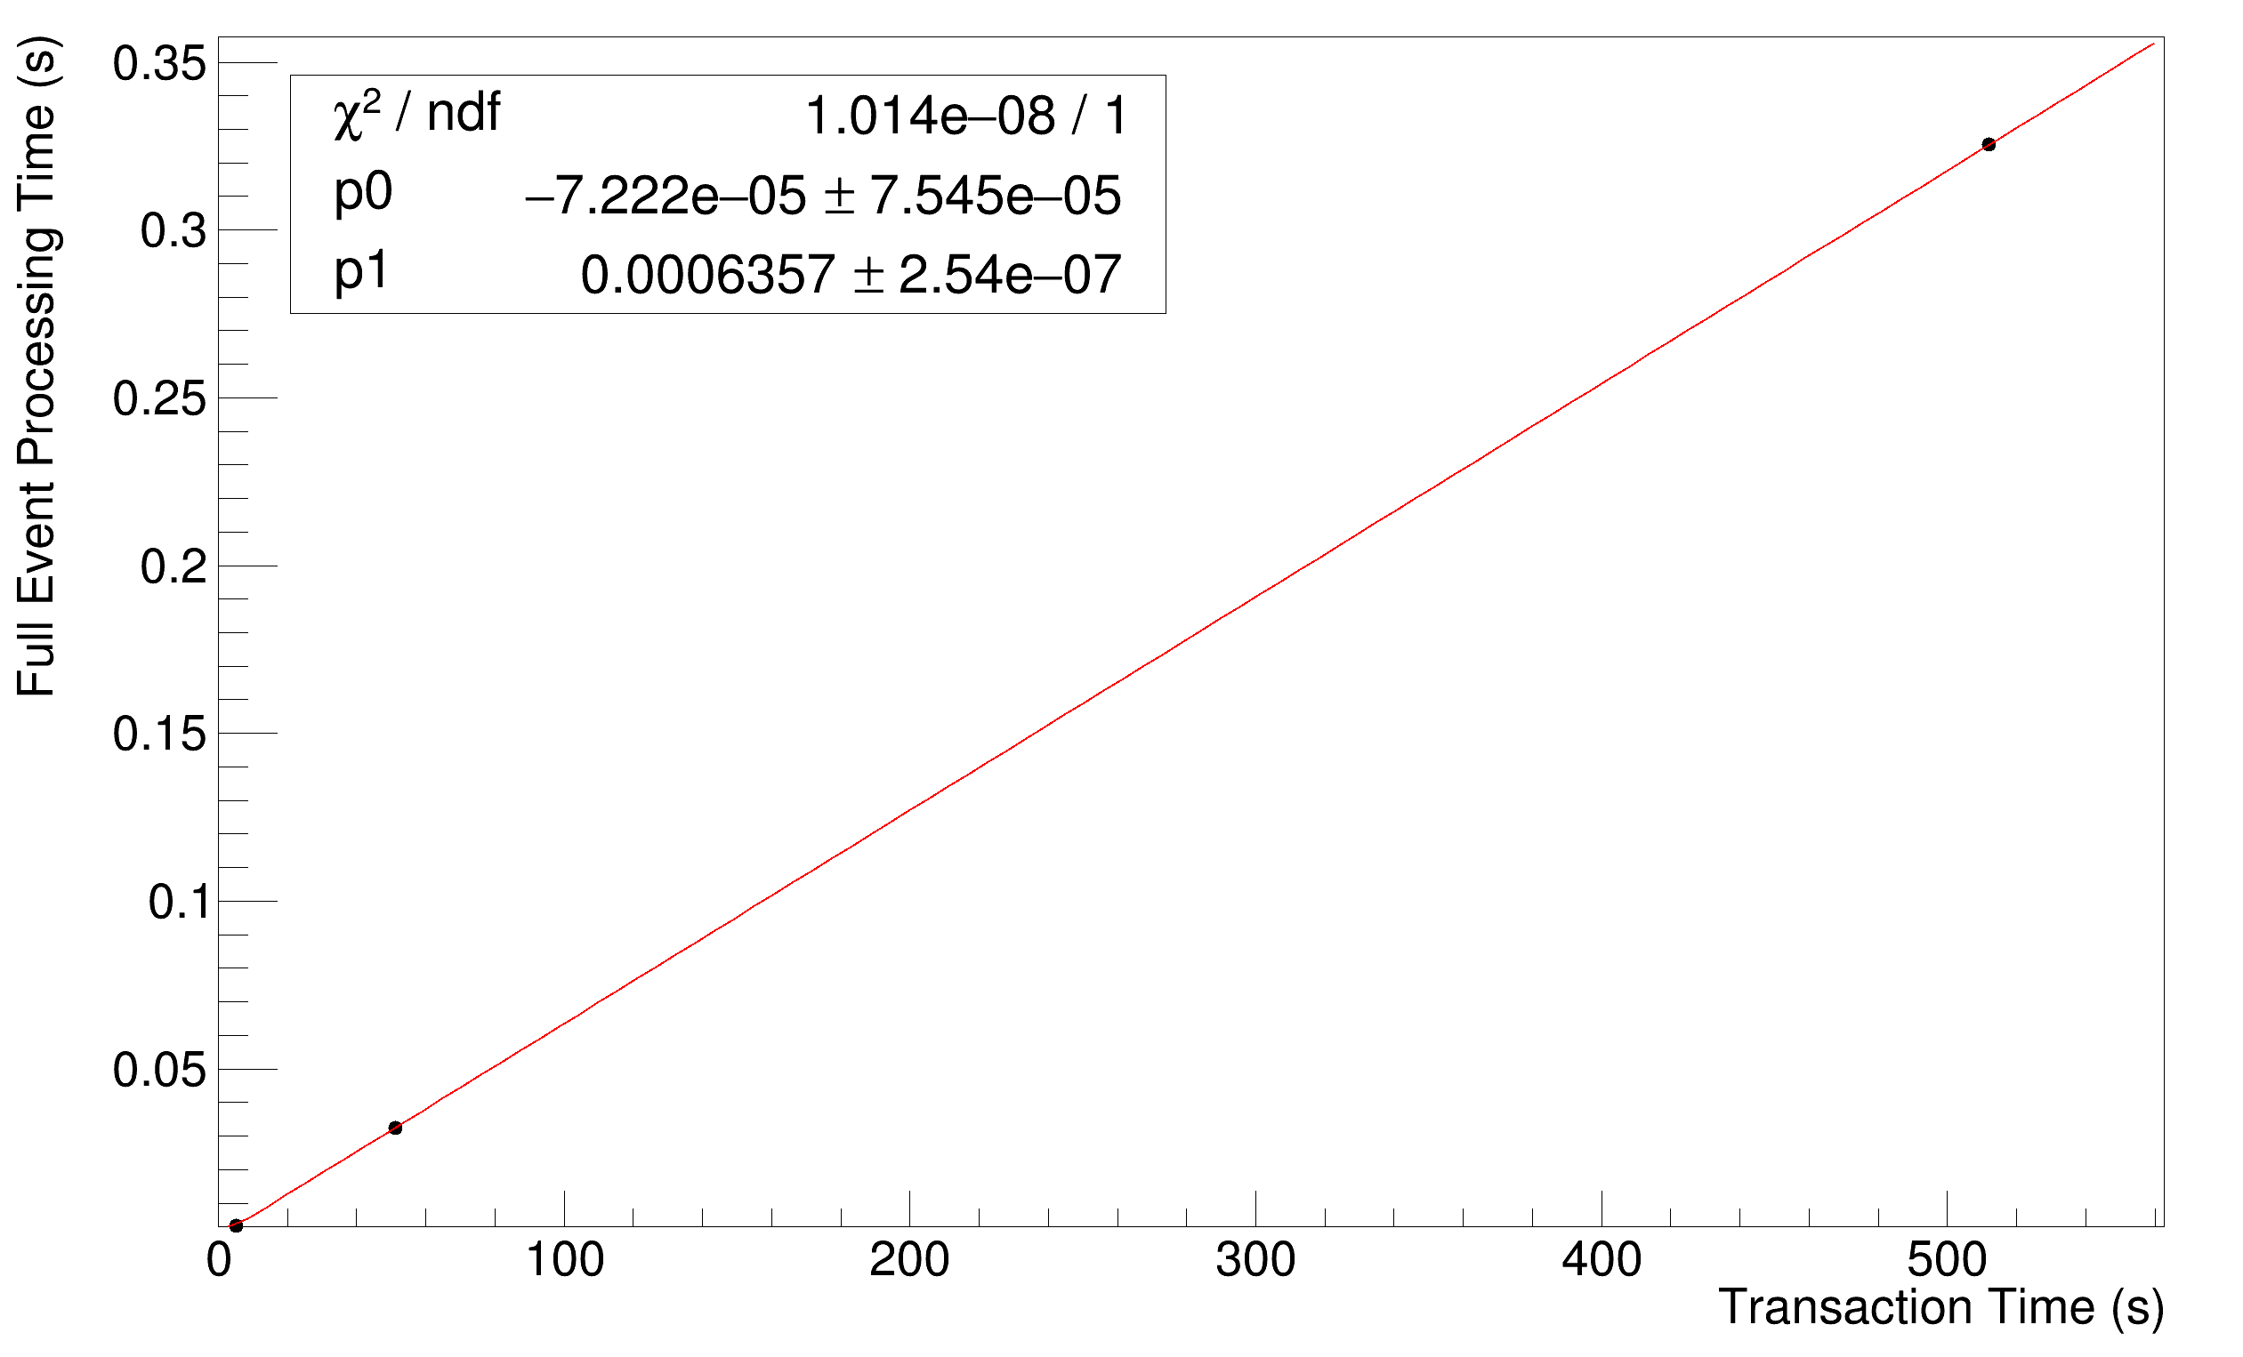
Example Simulation results - Varying Communication Rate
Only a 16x16 tile.
Otherwise same parameters as before, but…
12.5 Mbaud: ~5 us per transaction
1.25 Mbaud: ~50 us per transaction
125 kbaud: ~500 us per transaction
As expected, processing time scales linearly with transaction time.
Note we still have no signal superimposed here, just same 0.11 Hz background per pixel.
This sets a minimum allowable interrogation period.
Higher interrogation periods can accommodate slower protocols… but require deeper buffering.

Slide 13
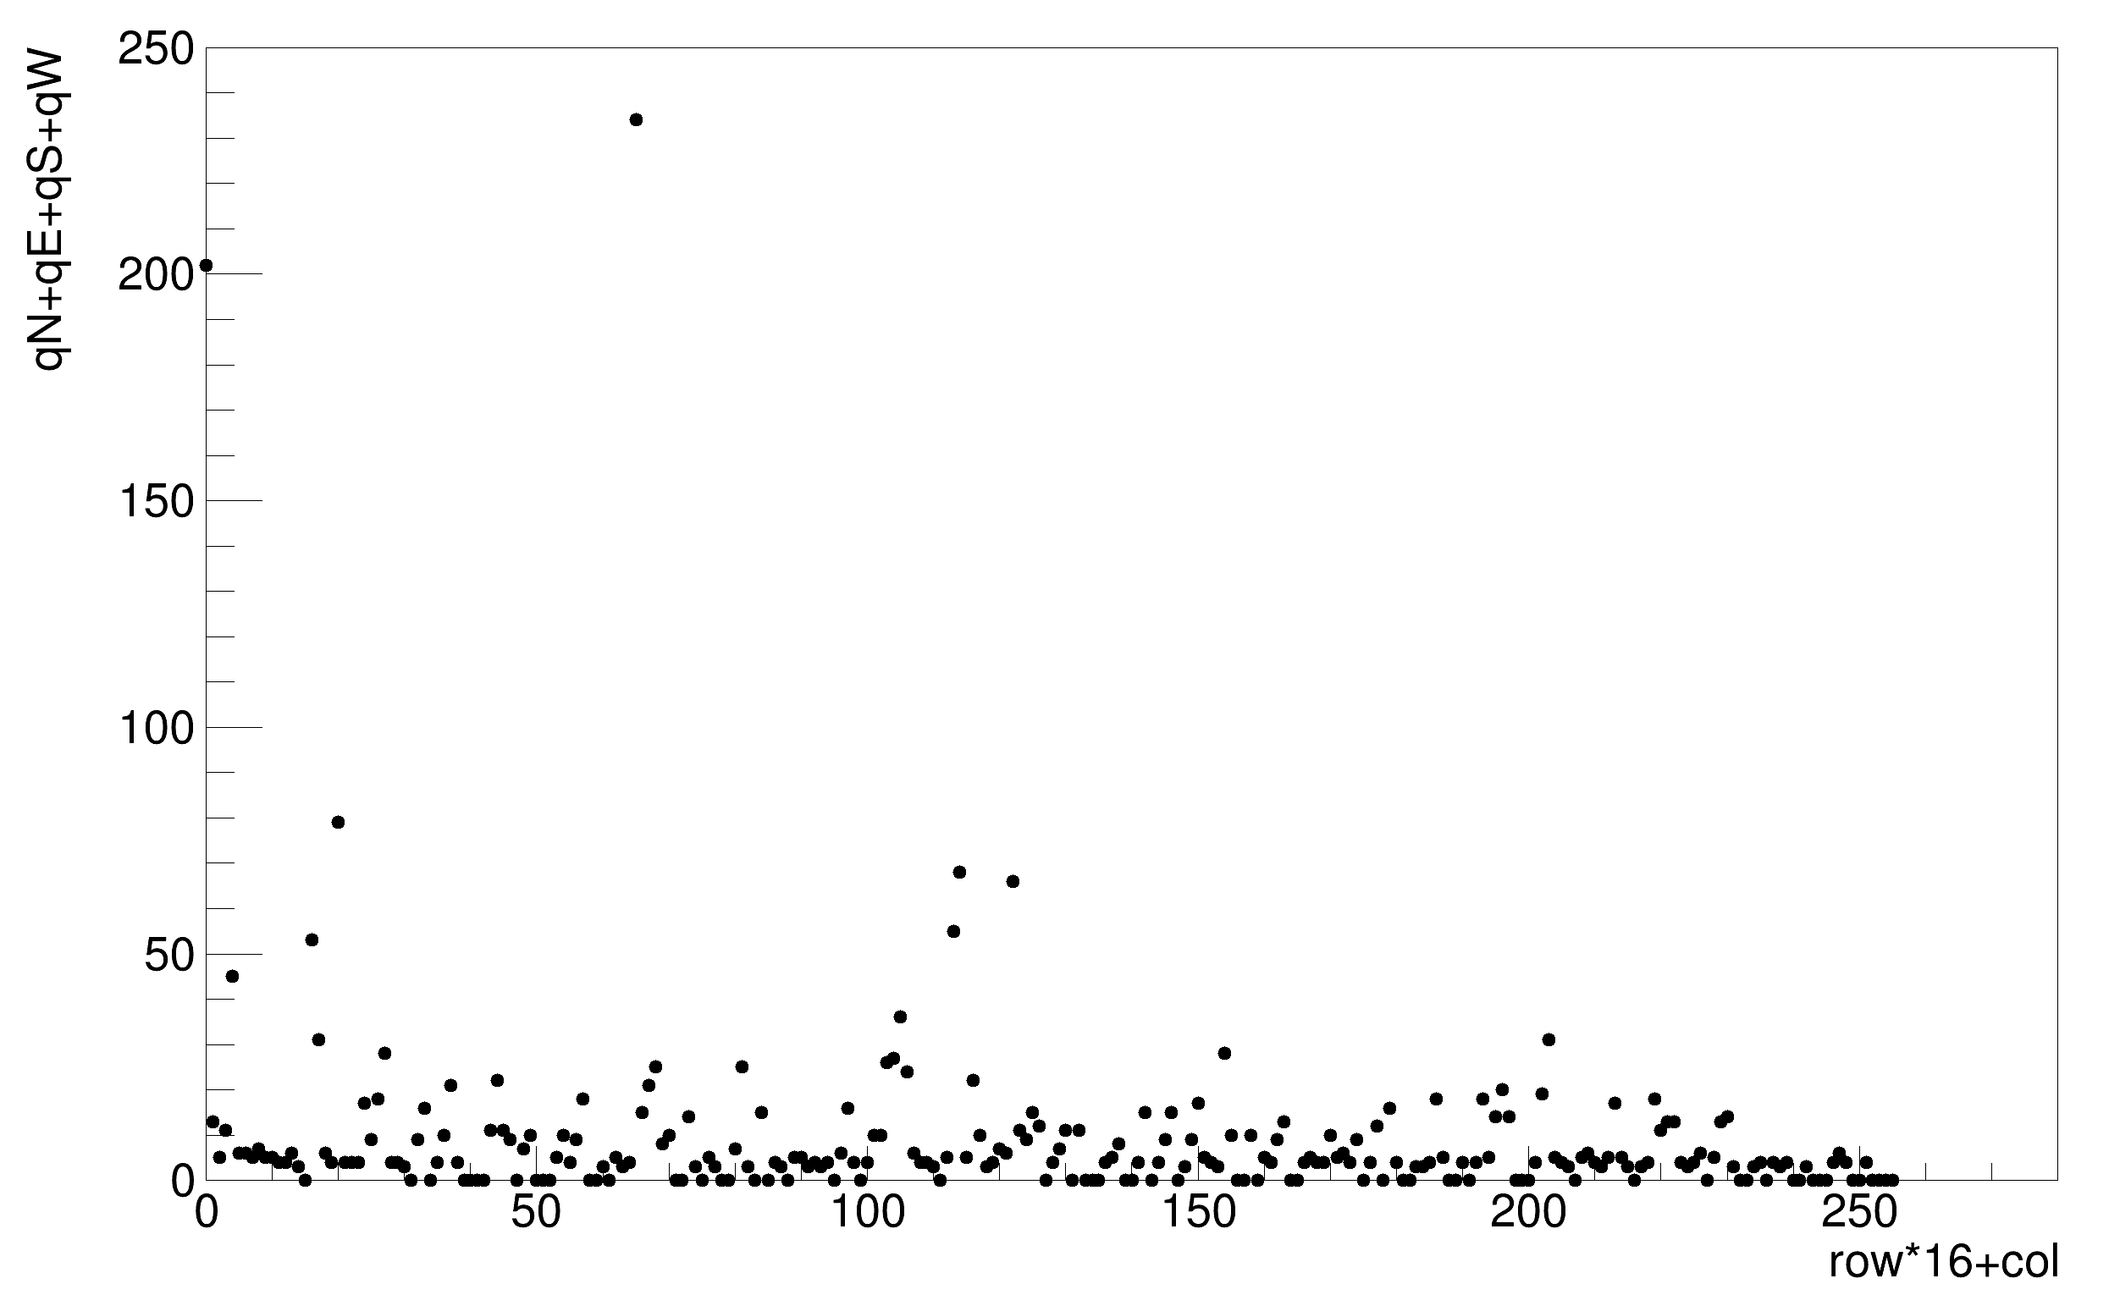
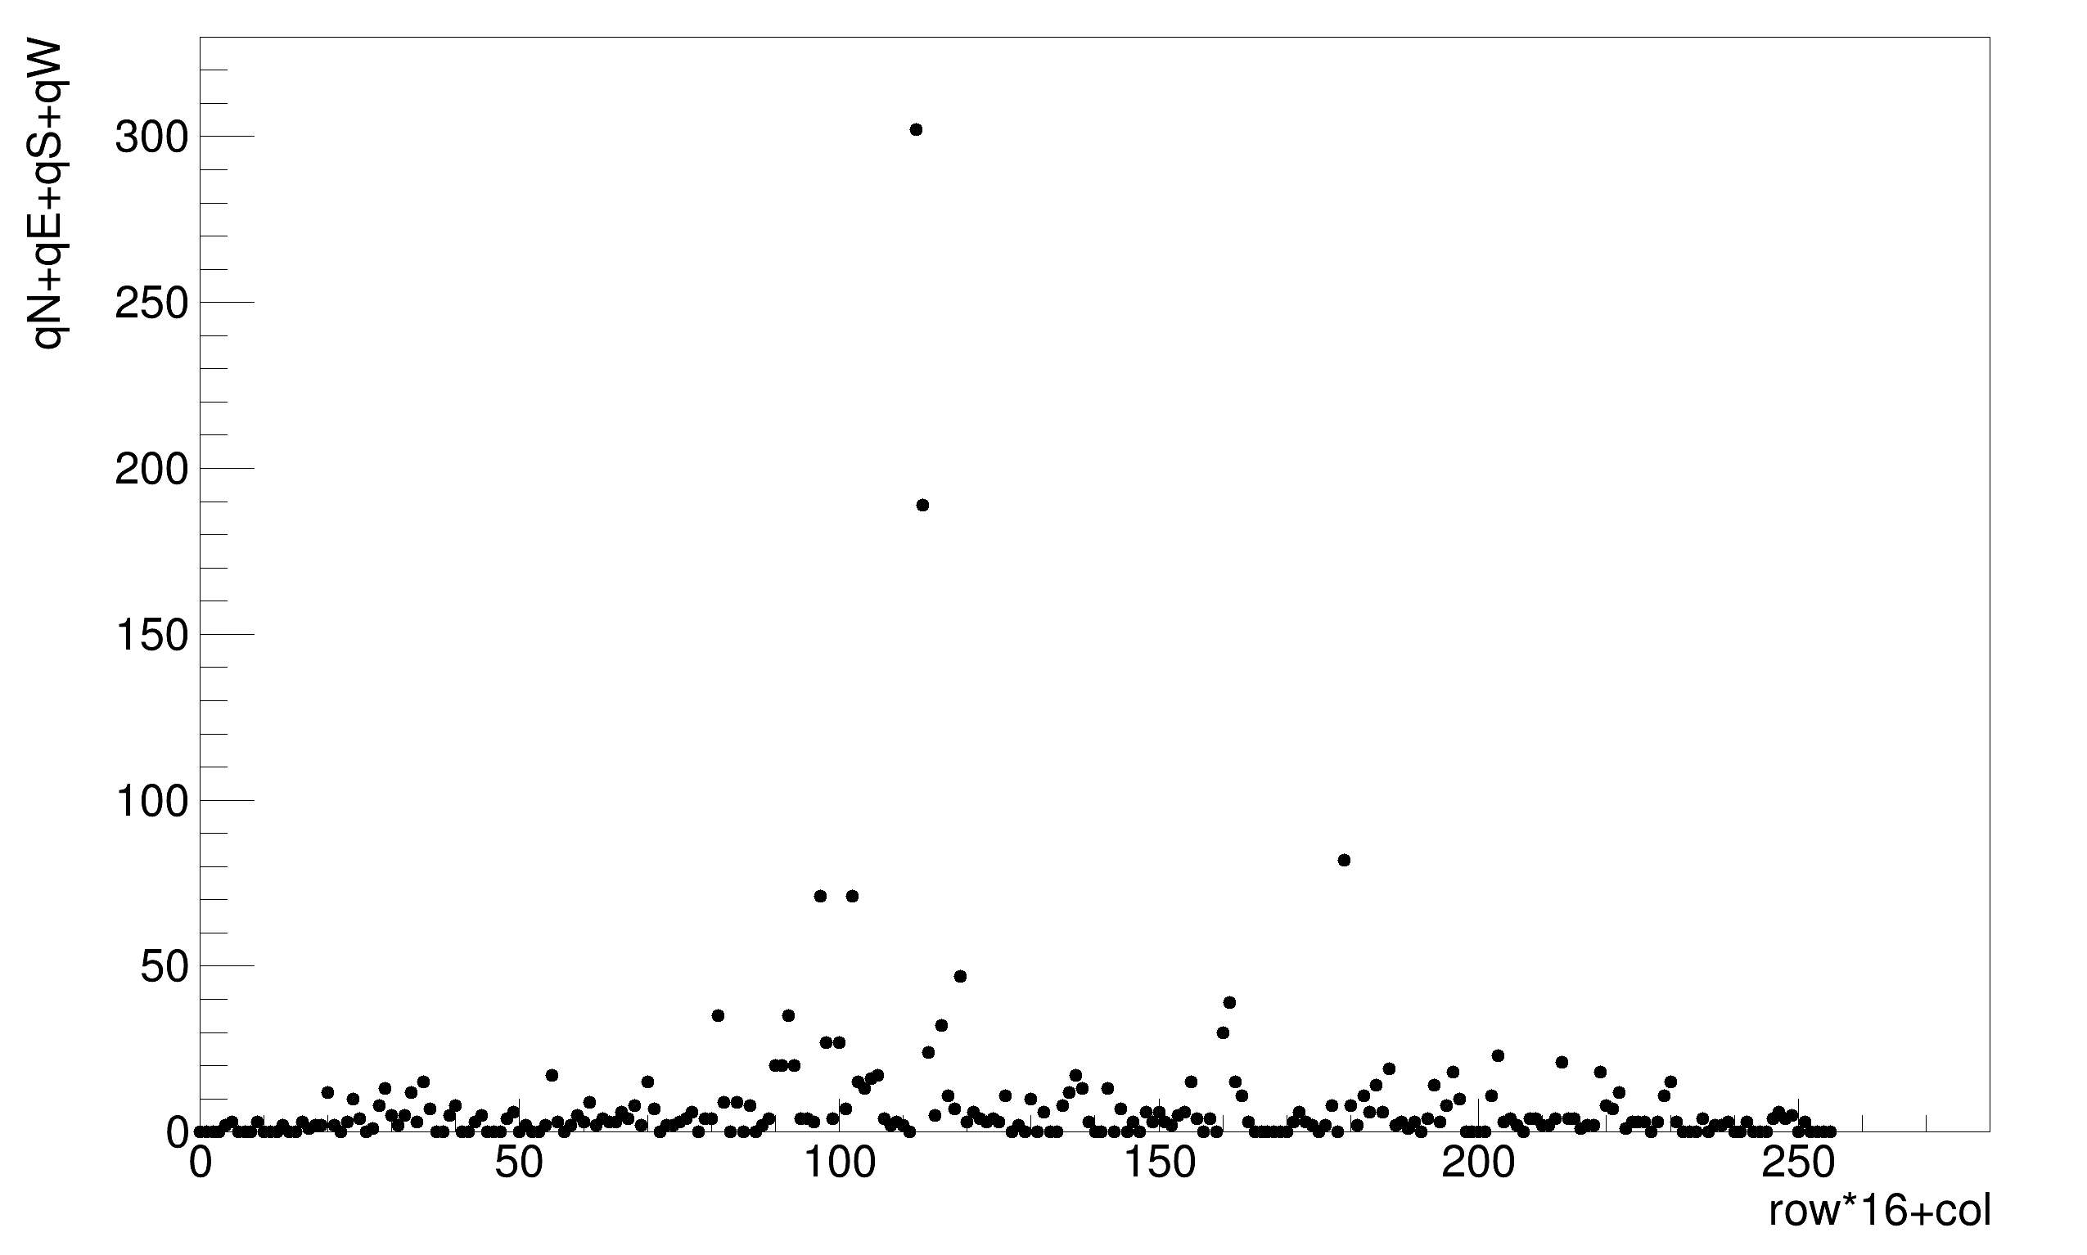
More Example Simulations Memory Requirements
Sum of Maximum Queue Depths vs. ASIC
Parameters as before, examine maximum required memory depths for different configurations.
Maximum memory requirements for a16x16 tile**:
For a single DAQ node at northwest corner (right, top).
For a single DAQ node at the center of west edge (right, bottom).
**Note that this is a single tile configuration sampled over many events. Each variation on oscillator frequencies results in a different topology due to which interrogations arrive first. Need to repeat this exercise over many tile configurations to get more confidence in results.
Will need further study to see how much area/power are required for standard digital library memory elements.

Slide 14
High-level Simulation Status And Plans
Initial simulated state machine implementation is now available in Python.
Some simple studies have been done for a few different parameters (tile sizes, communication rates).
For now only background hits are simulated.
Shahab Kohani will become more involved with and extend this effort in coming weeks.
In short term, this can help set our clock and communication specifications, determine memory requirements.
Use baseline parameters to inform first prototypes on FPGA.
In medium term:
Explore different DAQ topologies, different state machine options/implementations.
Overlay physics hits onto the Poisson backgrounds and repeat above studies.
Simulate ASIC failures for robustness studies.

Slide 15
BACKUP

Slide 16
Previous digital simulation work
ASICs must be able to communicate with one another even though they have independent clocks with slightly different nominal frequencies.
Have identified a couple straightforward implementations of asynchronous communications that are suitable for this task.
Simple UART (up to ~12.5 Mbps for nominal 50 MHz oscillator):
Transactions are atomic by word... Frequencies must be close enough (or word must be short enough) to keep from drifting by a bit or more over the full word.
For example, for a 64-bit word (would be nice, but not required), roughly ~1.5% tolerance on clock mismatch.
“Endeavor” protocol from Penn, demonstrated in AMAC ASIC (~1.5 Mbps w/ AMAC nominal 40 MHz oscillator):
“Morse code”-like, easy to read, debug.
Transactions are atomic by bit, so much more mismatch can be tolerated, ~25%.
UART with 64 data bits, 1 parity
“Endeavor”

Slide 17
Simple 3x3 ASIC Example
Consider a small array… as shown on the right.
Assume ASIC gets 2 hits in a 1 second interval, reports those, plus a timestamp it received as an end marker, indicating no-more-hits.
Numbers in each cell represent the number of words remaining to transmit.
First number is local, second number is data being relayed.
1) Timestamp transmitted
2) Timestamp received, relay to neighbors, send first data back
3) Neighbors receive, relay to neighbors, send their first data back
Those receiving data from others place it in a buffer for future transmission.
3+0

Slide 18
Simple 3x3 ASIC Example
Consider a small array… as shown on the right.
Assume ASIC gets 2 hits in a 1 second interval, reports those, plus a timestamp it received as an end marker, indicating no-more-hits.
Numbers in each cell represent the number of words remaining to transmit.
First number is local, second number is data being relayed.
1) Timestamp transmitted
2) Timestamp received, relay to neighbors, send first data back
3) Neighbors receive, relay to neighbors, send their first data back
Those receiving data from others place it in a buffer for future transmission.
2+0
3+0
3+0

Slide 19
Simple 3x3 ASIC Example
Consider a small array… as shown on the right.
Assume ASIC gets 2 hits in a 1 second interval, reports those, plus a timestamp it received as an end marker, indicating no-more-hits.
Numbers in each cell represent the number of words remaining to transmit.
First number is local, second number is data being relayed.
1) Timestamp transmitted
2) Timestamp received, relay to neighbors, send first data back
3) Neighbors receive, relay to neighbors, send their first data back
Those receiving data from others place it in a buffer for future transmission.
1+2
2+0
3+0
2+0
3+0
3+0

Slide 20
Simple 3x3 ASIC Example
Consider a small array… as shown on the right.
Assume ASIC gets 2 hits in a 1 second interval, reports those, plus a timestamp it received as an end marker, indicating no-more-hits.
Numbers in each cell represent the number of words remaining to transmit.
First number is local, second number is data being relayed.
1) Timestamp transmitted
2) Timestamp received, relay to neighbors, send first data back
3) Neighbors receive, relay to neighbors, send their first data back
Those receiving data from others place it in a buffer for future transmission.
0+4
1+1
2+0
1+2
2+0
3+0
2+0
3+0

Slide 21
Simple 3x3 ASIC Example
Consider a small array… as shown on the right.
Assume ASIC gets 2 hits in a 1 second interval, reports those, plus a timestamp it received as an end marker, indicating no-more-hits.
Numbers in each cell represent the number of words remaining to transmit.
First number is local, second number is data being relayed.
1) Timestamp transmitted
2) Timestamp received, relay to neighbors, send first data back
3) Neighbors receive, relay to neighbors, send their first data back
Those receiving data from others place it in a buffer for future transmission.
0+5
0+2
1+1
0+4
1+1
2+0
1+0
2+0
3+0

Slide 22
Simple 3x3 ASIC Example
Consider a small array… as shown on the right.
Assume ASIC gets 2 hits in a 1 second interval, reports those, plus a timestamp it received as an end marker, indicating no-more-hits.
Numbers in each cell represent the number of words remaining to transmit.
First number is local, second number is data being relayed.
1) Timestamp transmitted
2) Timestamp received, relay to neighbors, send first data back
3) Neighbors receive, relay to neighbors, send their first data back
Those receiving data from others place it in a buffer for future transmission.
0+6
0+2
0+2
0+3
0+2
1+1
0+0
1+0
2+0

Slide 23
Simple 3x3 ASIC Example
Consider a small array… as shown on the right.
Assume ASIC gets 2 hits in a 1 second interval, reports those, plus a timestamp it received as an end marker, indicating no-more-hits.
Numbers in each cell represent the number of words remaining to transmit.
First number is local, second number is data being relayed.
1) Timestamp transmitted
2) Timestamp received, relay to neighbors, send first data back
3) Neighbors receive, relay to neighbors, send their first data back
Those receiving data from others place it in a buffer for future transmission.
0+7
0+2
0+2
0+3
0+2
0+2
0+0
0+0
1+0

Slide 24
Simple 3x3 ASIC Example
Consider a small array… as shown on the right.
Assume ASIC gets 2 hits in a 1 second interval, reports those, plus a timestamp it received as an end marker, indicating no-more-hits.
Numbers in each cell represent the number of words remaining to transmit.
First number is local, second number is data being relayed.
1) Timestamp transmitted
2) Timestamp received, relay to neighbors, send first data back
3) Neighbors receive, relay to neighbors, send their first data back
Those receiving data from others place it in a buffer for future transmission.
0+8
0+2
0+2
0+3
0+1
0+2
0+0
0+0
0+0

Slide 25
Simple 3x3 ASIC Example
Consider a small array… as shown on the right.
Assume ASIC gets 2 hits in a 1 second interval, reports those, plus a timestamp it received as an end marker, indicating no-more-hits.
Numbers in each cell represent the number of words remaining to transmit.
First number is local, second number is data being relayed.
1) Timestamp transmitted
2) Timestamp received, relay to neighbors, send first data back
3) Neighbors receive, relay to neighbors, send their first data back
Those receiving data from others place it in a buffer for future transmission.
0+9
0+2
0+2
0+3
0+0
0+1
0+0
0+0
0+0

Slide 26
Simple 3x3 ASIC Example
Consider a small array… as shown on the right.
Assume ASIC gets 2 hits in a 1 second interval, reports those, plus a timestamp it received as an end marker, indicating no-more-hits.
Numbers in each cell represent the number of words remaining to transmit.
First number is local, second number is data being relayed.
1) Timestamp transmitted
2) Timestamp received, relay to neighbors, send first data back
3) Neighbors receive, relay to neighbors, send their first data back
Those receiving data from others place it in a buffer for future transmission.
0+10
0+2
0+2
0+2
0+0
0+0
0+0
0+0
0+0

Slide 27
Simple 3x3 ASIC Example
Consider a small array… as shown on the right.
Assume ASIC gets 2 hits in a 1 second interval, reports those, plus a timestamp it received as an end marker, indicating no-more-hits.
Numbers in each cell represent the number of words remaining to transmit.
First number is local, second number is data being relayed.
1) Timestamp transmitted
2) Timestamp received, relay to neighbors, send first data back
3) Neighbors receive, relay to neighbors, send their first data back
Those receiving data from others place it in a buffer for future transmission.
0+11
0+2
0+1
0+1
0+0
0+0
0+0
0+0
0+0

Slide 28
Simple 3x3 ASIC Example
Consider a small array… as shown on the right.
Assume ASIC gets 2 hits in a 1 second interval, reports those, plus a timestamp it received as an end marker, indicating no-more-hits.
Numbers in each cell represent the number of words remaining to transmit.
First number is local, second number is data being relayed.
1) Timestamp transmitted
2) Timestamp received, relay to neighbors, send first data back
3) Neighbors receive, relay to neighbors, send their first data back
Those receiving data from others place it in a buffer for future transmission.
0+12
0+2
0+0
0+0
0+0
0+0
0+0
0+0
0+0

Slide 29
Simple 3x3 ASIC Example
Consider a small array… as shown on the right.
Assume ASIC gets 2 hits in a 1 second interval, reports those, plus a timestamp it received as an end marker, indicating no-more-hits.
Numbers in each cell represent the number of words remaining to transmit.
First number is local, second number is data being relayed.
1) Timestamp transmitted
2) Timestamp received, relay to neighbors, send first data back
3) Neighbors receive, relay to neighbors, send their first data back
Those receiving data from others place it in a buffer for future transmission.
0+12
0+1
0+0
0+0
0+0
0+0
0+0
0+0
0+0

Slide 30
Simple 3x3 ASIC Example
Consider a small array… as shown on the right.
Assume ASIC gets 2 hits in a 1 second interval, reports those, plus a timestamp it received as an end marker, indicating no-more-hits.
Numbers in each cell represent the number of words remaining to transmit.
First number is local, second number is data being relayed.
1) Timestamp transmitted
2) Timestamp received, relay to neighbors, send first data back
3) Neighbors receive, relay to neighbors, send their first data back
Those receiving data from others place it in a buffer for future transmission.
0+12
0+0
0+0
0+0
0+0
0+0
0+0
0+0
0+0

Slide 31
Simple 3x3 ASIC Example
Consider a small array… as shown on the right.
Assume ASIC gets 2 hits in a 1 second interval, reports those, plus a timestamp it received as an end marker, indicating no-more-hits.
Numbers in each cell represent the number of words remaining to transmit.
First number is local, second number is data being relayed.
1) Timestamp transmitted
2) Timestamp received, relay to neighbors, send first data back
3) Neighbors receive, relay to neighbors, send their first data back
Those receiving data from others place it in a buffer for future transmission.
0+11
0+0
0+0
0+0
0+0
0+0
0+0
0+0
0+0

Slide 32
Simple 3x3 ASIC Example
…and so on…
In this example, it takes 26x 64-bit transactions to read out the full array.
At 1 Mbps, this is ~1.7 ms.
At 115 kbps, this is ~14.5 ms.
0+10
0+0
0+0
0+0
0+0
0+0
0+0
0+0
0+0

