Slide 1
DUNE SP HV System: updates and plans for the SP Far Detector and ProtoDune-II
Francesco Pietropaolo (CERN)
on behalf of the HVS Consortium
HVS Preliminary Design Review, June 9th, 2020

Slide 2
Outline
HVS-SP design update:
System overview
Lessons Learnt from ProtoDUNE-I
Evolution since the last PDR (June 2019) and TDR
Value engineering upgrades
Plans toward the final design:
Ash River tests
ProtoDUNE-II

Slide 3
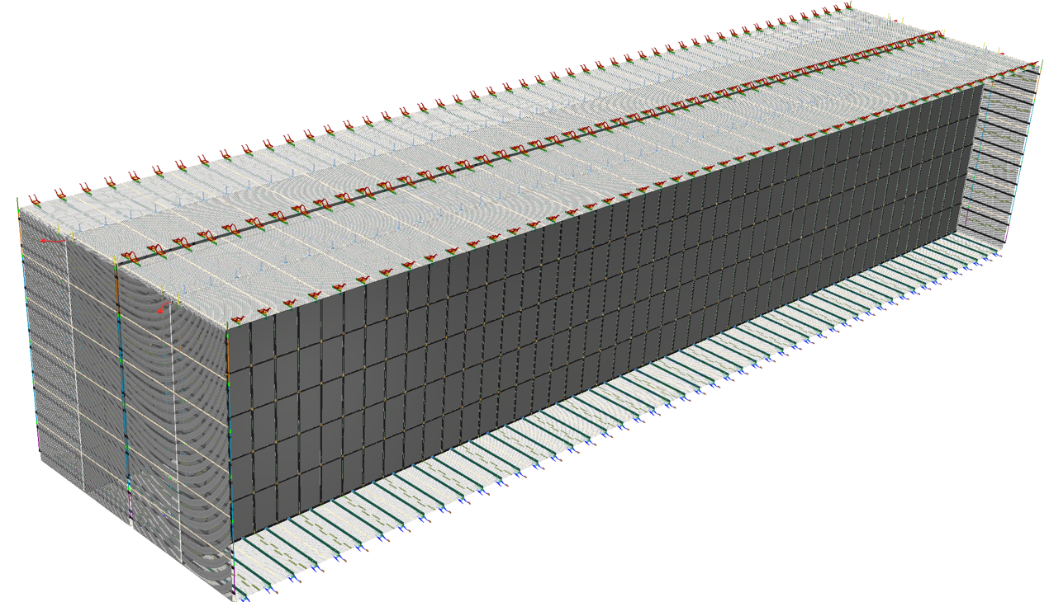
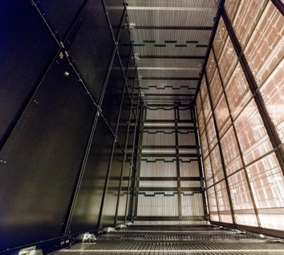
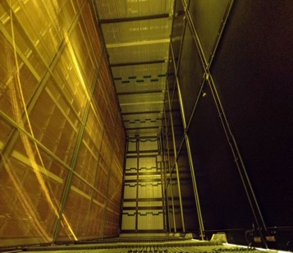
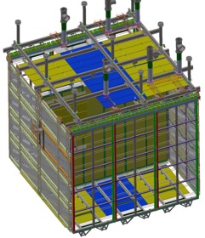
HVS Consortium Scope for the SP FD
Design, fabricate, test and assemble:
100 CPA resistive panels forming two cathode arrays (1400m²)
100 top + 100 bottom field cage modules, 48 End Wall field cage modules (2000m²)
2 sets of HV power supplies, cables, ripple filters, and feedthroughs
Digitizers for HVPS and ground plane monitoring
Cameras for HV monitoring
Top Field Cage
CPAs
58m
12m
Endwall Field Cage
Bottom Field Cage
Compared to ProtoDUNE SP:
CPA: 33x
T/B FC: 17x
EW FC: 4x
14m
As part of these calls, we would like to cycle through a series
of thirty minute presentations from the each of the SP consortia. We would like for the first fifteen minutes of each presentation to summarize consortium plans moving forward towards ProtoDUNE-II and the first far detector module. Then, we would like to see the second fifteen minutes of each presentation used to advertise areas in which the consortium could benefit from the participation of additional collaboration institutes. Essentially, the idea would be to present a list of uncovered deliverables with a goal of soliciting additional participation from the collaboration.

Slide 4
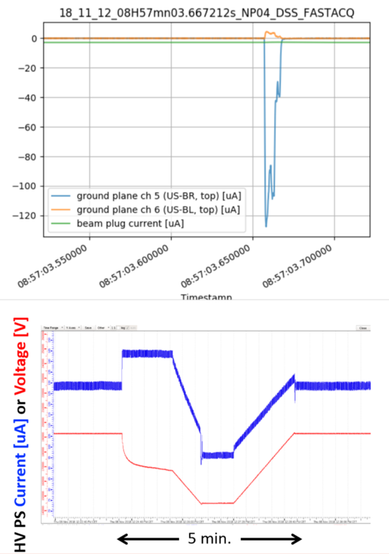
Lessons Learnt from ProtoDUNE:
The HVS goal of 180kV on CPA (the highest in a SP LAr-TPC) was reached and maintained soon after the LAr fill (Sept 2018).
Remarkable uptime was achieved:
during beam run: > 98%,
during long term stability run: ~ 99.5%.
Just two classes of instabilities recorded through out the detector live-time:
Fast discharges: O(10/day), ~10ms duration; self recovering
Sustained excessive current (“streamers”): nearly all from the same specific location. Recovered by lowering the voltage using an auto-suppression script.
No system degradation observed over nearly two years of operation
Adequate monitoring and HV controls allowed the remarkable uptime
CPA alignment measured with cosmic muons shows tilts but mostly within requirement
The behavior of the “streamers” possibly explained as a charging up effect of insulating materials in the strong e-field regions outside of the field cage

Slide 5
HVS high level requirements
ID | Description | Spec (Goal)
SP-FD-1 | Minimum drift field | 250 V/cm (500 V/cm)
SP-FD-11 | Minimum drift field uniformity | < ±1% [in 99.8% volume]
SP-FD-12 | Cathode HV power supply ripple contribution to system noise | < 100 electrons
SP-FD-17 | Cathode resistivity | > 1MOhm/sq. (1GOhm/sq.) [upper limit 10 Tohm/sq.]
SP-FD-24 | Local electric field | <3 0 kV/cm (with specific exceptions to be tested separately (e.g. HV feed through)
SP-FD-29 | Detector uptime | > 98% (> 99%)
SP-FD-30 | Individual detector module uptime | > 90% (> 95%)
SP-HV-1 | Power supply stability | > 95% uptime
SP-HV-2 | Provide redundancy in all HV connections | Two-fold (Four-fold)
Most HVS requirements fulfilled in ProtoDUNE-I operation (lessons learnt documents)
The “TDR” design (based on ProtoDUNE-I HV system) successfully passed the PDR in June 2019.

Slide 6
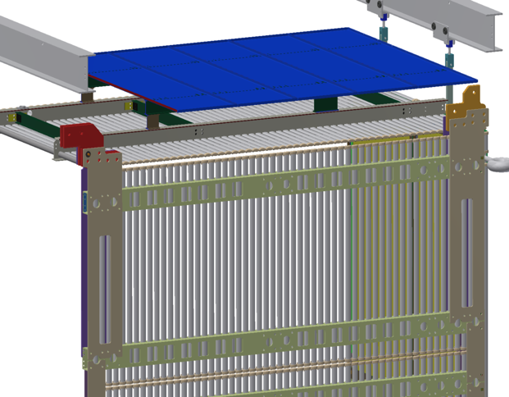
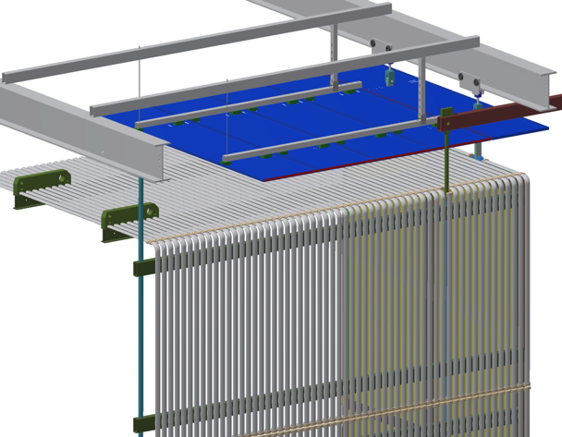
Improving the FC Design
2019 TDR FC design
A further optimization of the field cage was proposed and developed:
Eliminating nearly all insulating materials on the outside of the field cage to reduce the probability of surface charging in the high E field region;
Increasing field cage to top ground plane distance, and remove bottom ground plane to further reduce E field, and stored energy (GPs moved out of HVS scope);
Introducing bent profiles at the EndWall field cage corner edges to improve drift field uniformity.
Value engineering:
The changes result in simplified design, lighter, more robust construction, and significantly lower material cost.
All FC assembly and testing will be done underground; only shipping of the ”prepared and QC’ed components” of the field cage is required
Present FC design

Slide 7
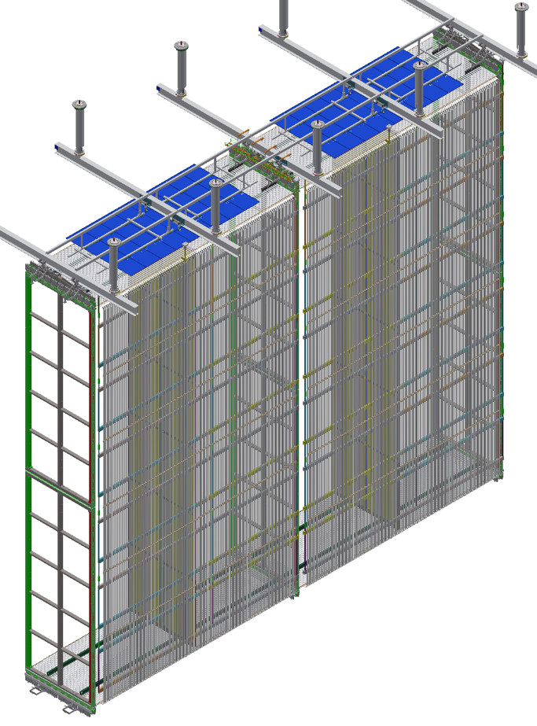
The New HVS Design
2 End Wall FC’s each made of:
24 EW identical modules (4 columns of 6 tall, 2m x 3.5m), with top/bottom modules hosting bent aluminum profiles
25 mostly identical CPA/TBFC/GP rows, each made of:
2 CPA’s: 6 units each (1.15m x 4 m)
8 Top/Bottom FC module (3.5m x 2.3m)
4 Top Ground Planes (4 units each: 2.3m x 0.5m) hung independently to the DSS beams
Assembly & Installation of FC modules:
Performed fully underground (NP02 experience on FC)
about 1 month for each EW
1 week for each CPA/TBFC/GP slice: deployment of FC at the end of installation.

Slide 8
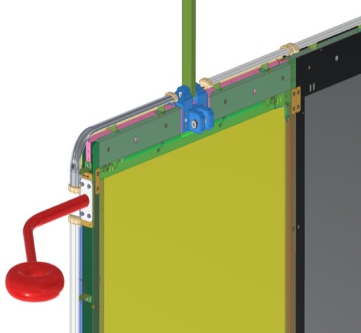
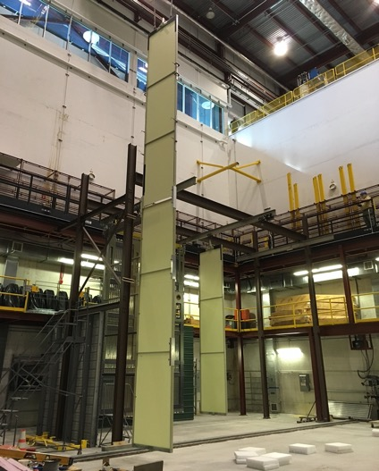
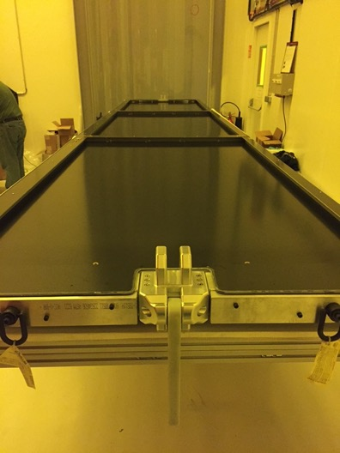
CPA
Constructed from 50 side by side panels.
Each Panel is 1.15m in width and 12m tall, formed with 6 vertically stacked Resistive Kapton laminated modules.
Hanging through a single link.
HV bus is integrated in each CPA Panel for electrical interconnection between panels
Resistive Field Shaping Strips to ensure E-field uniformity around the frame
“Donut” shaped receivers attached to the outermost CPA panels to receive HV feedthrough tip contact
Minor modifications wrt TDR and protoDUNE-I (bent profiles at corners, FFS layout, double sided HV bus)

Slide 9
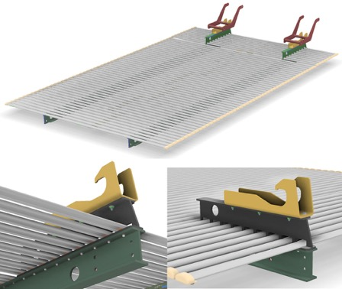
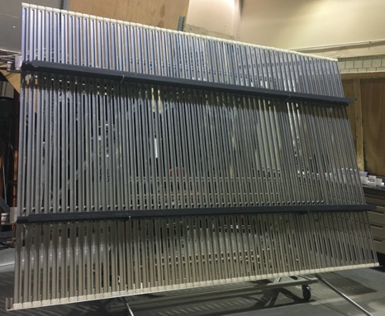
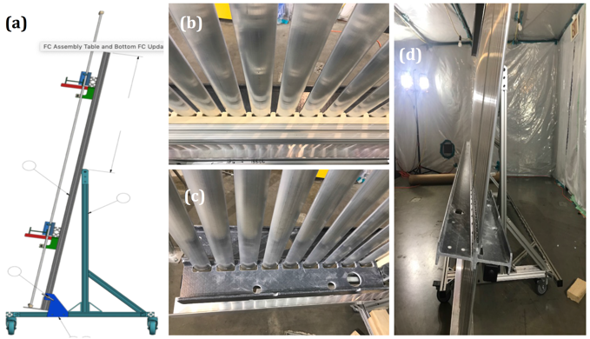
Top/Bottom Field cage modules
Very simplified structure wrt TDR solution
No change in dimensions (2.3 x3.5 m2).
Same electrodes shape and 6 cm pitch
No standoffs for Ground Planes
Lighter FRP 4 inch I-beams
Profiles sitting outside the beams
Non-metallic hinge on FC for CPA connection
Simpler aluminum latches to APA
Newly developed assembly tooling, successfully prototyped in UTA and SBU
Full assembly to be performed underground with limited crew (assembly time and manpower under test)

Slide 10
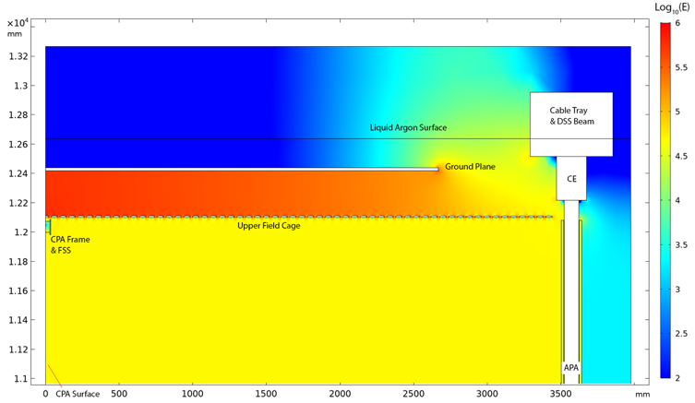
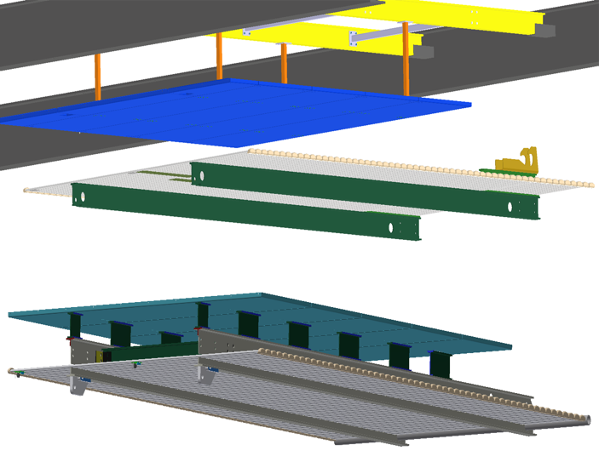
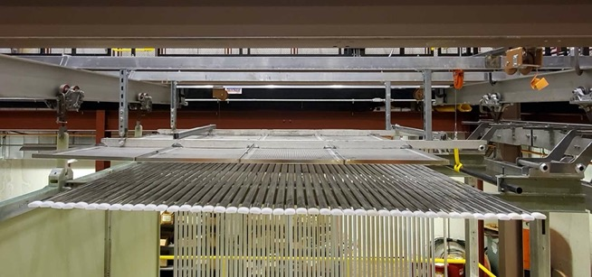
Ground Planes
Used to confine the E-field below the Liquid surface
New wrt TDR:
Hanging from DSS
No GP’s at the bottom
30 cm distance above Top field cage Modules
No insulators connecting FC to GP
Moved out of HVS scope except for current monitoring system
New design
Old design

Slide 11
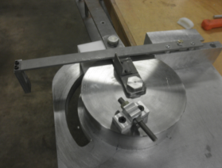
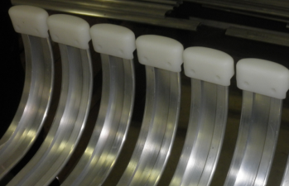
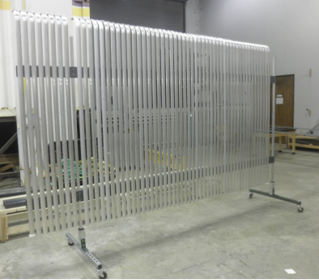
End Wall Field cage modules
Significant modifications with respect to ProtoDUNE (and TDR)
Panel height 2m (it was 1.5 m)
Aluminum profiles sittings outside of smaller cross section FRP box beams
Aluminum holding bars for easy connection of 6 panels forming a wall.
Bent profiles (successful prototyping at LSU/CERN/ANL) in the top & bottom most panels to minimize E-field distortions at the edges of the FC
Full panel assembly to be performed underground with dedicated tooling and supporting structures
Including bending of required profiles.

Slide 12
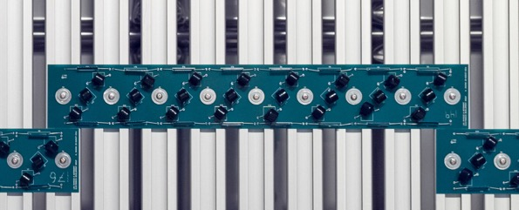
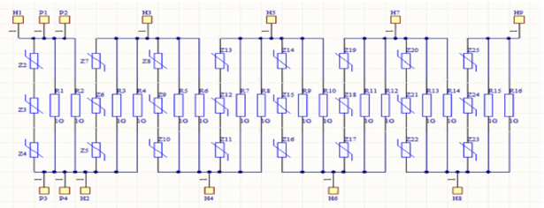
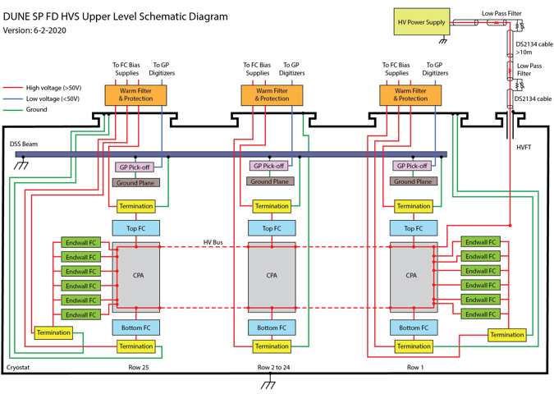
Divider boards & electrical interconnections
NO change with respect to TDR
Two 5 GOhm resistors in parallel in each step of 3 kV / 6 cm
For redundancy: 3 varistors in series (opening at 1.7 kV each), in parallel with the resistors
In case of resistor failure, DV goes from 3kV to ~5 kV
Under study the use of 2 varistors:
allowed if max E-field = 500 V/cm
less components to mount
less E-field distortions (~3.5 kV across a gap) in case of failure
Well defined QA/QC plans (LSU)
Similar interconnection scheme as for ProtoDUNE and TDR

Slide 13
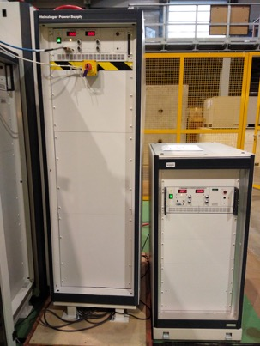
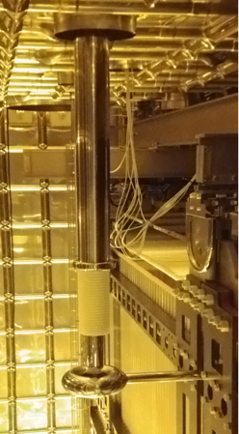
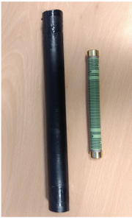
HV distribution
NO change with respect to TDR
Power Supply: Heinzinger 300 kV options (200 kV also possible if no E-Drift > 500 required)
Commercial cable provided by Heinzinger and rated 300 kV (usable with both PS)
HV Feedthrough: same design as the one successfully tested in ProtoDUNE, modified accordingly to required length
Residual ripple filtering system: dry resistive filter stages with ground breaking (design according to Lessons Learnt in ProtoDUNE)
HV cable with stress relief insulator
Sliding contact
50 MOhm HV resistor covered with HV stress relief shrink tube

Slide 14
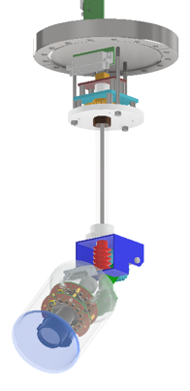
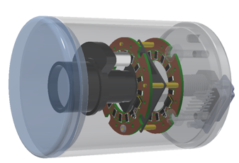
HV monitoring & grounding
Similar to TDR & ProtoDUNE
Ground planes current pickoff monitors (100 channels)
Termination current on each voltage divider chain (208 channels)
HV-PS voltage/current and ramping up/down features
(discharge monitors on HV filters)
Addition in HVS scope:
Cold cameras (~12) similar to those used in ProtoDUNE-SP and DP to visually minitor critical spots: HV feedthrough, end wall edges
Grounding scheme follows DUNE prescriptions, as successfully applied in ProtoDUNE-I

Slide 15
Design Status & Timeline
The new field cage design concept was presented at the initial preliminary design review in June 2019
received strong endorsement by the review committee.
The detailed design has been developed.
Full HV system 3D models of the SP FD have been posted to EDMS for integration.
The HV system safety analysis is mostly completed
Several iterations with the DUNE Compliance Office are underway to make the design fully compliant (goal is the Final Design Review)
A plan is developed to prototype the new field cage modules and the installation procedures at Ash River:
for the ProtoDUNE II configuration first (phase 1) in the spring of this year
for the FD configuration (phase 2) starting this fall

Slide 16
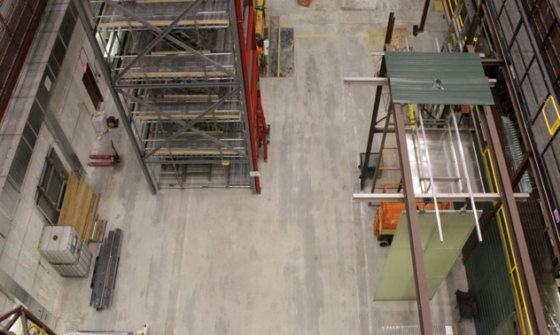
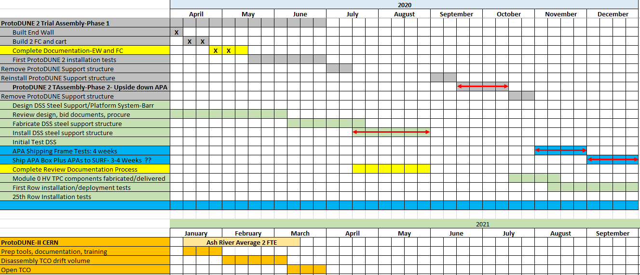
Ash River Trial Assembly schedule
Multiple rounds of mechanical trials already started for the HVS:
ProtoDUNE-II installation trial
FD HVS/APA installation trial: double drift, 2 CPA panels, 4 TBFC modules, 12 EW Modules.
ProtoDUNE II

Slide 17
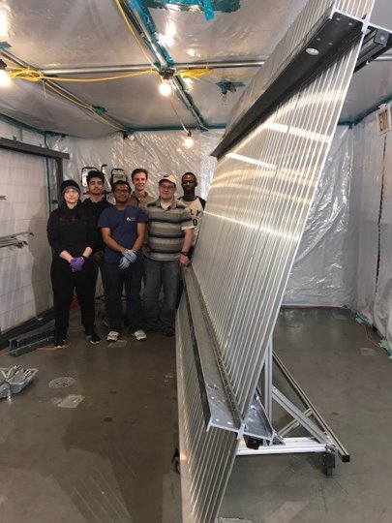
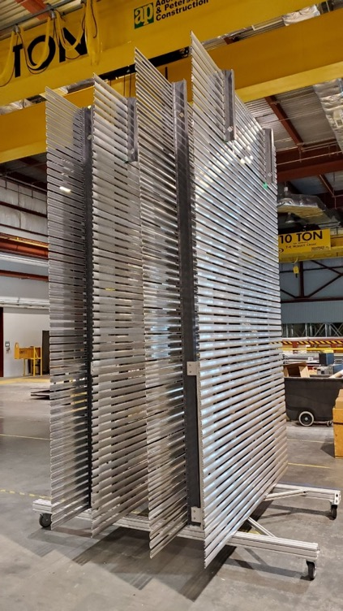
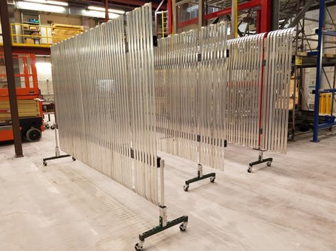
Prototyping Activities: FC Production factories
In the past months, full scale FC modules were constructed at the future factory sites (LSU, SBU, UTA).
The new assembly tools were also developed and constructed by the factories.
All parts for first Ash River tests were shipped out.
The FC modules assembled by the Ash River Minnesota University crew.
Phase 1 exercise is presently ongoing (~1 month delay due to present confinement restrictions) conducted by Ash River crew and remote assistance from Production Univ./Labs.

Slide 18
QA/QC
HVS coordinator appointed
working closely with production sites and DUNE QA/QC reps.
Co-leading the development of mobile app integrating checklist / traveler system for accurate, real time recording of QC information
Procedures being finalized (also based on ProtoDUNE experience) for all the HV system construction phases:
development and design
Electrical/mechanical analysis; material testing in cold; small scale test validation
prototyping
Ash River trial assemblies (modules, ProtoDUNE scale, FD scale)
ProtoDUNE–II / Module 0
production
screening of critical components;
tagging components & implementation of electronic checklists / traveler documents
Installation
planned checklist to ensure correct function and interconnect of installed components

Slide 19
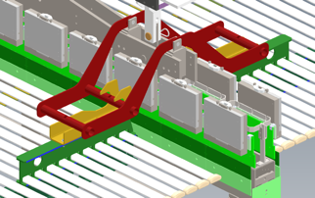
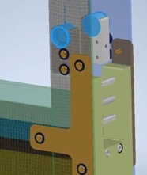
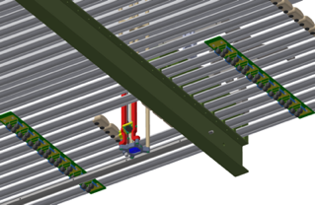
Interfaces with other consortia
Well advanced with most detector consortia.
Interface documents with DSS, facility, installation under development.
Consortia | EDMS number | Key Interface Items
APA | 2088738 | Field cage support on APA frames
PDS | 2088721 | PD calibration flashers and fibers on CPA
CE | 2088706 | FC termination and ground plane monitor cable routing, warm filters on SHV feedthroughs, termination bias supplies
CALCI | 2145142 | FC openings for lasers, target mirror assemblies on FC profiles
DAQSC | 2145154 | HV vs. LAr level interlock, ground plane and HVPS digitizers, cold camera power supplies
Installation | 2145184 | Installation activities in UG cleanroom, cryostat
Facility | 2145170 | HV feedthrough locations; rack and cable trays; liquid and gas flow in cryostat
DSS | 2339392 | Support of the CPA/FC modules on DSS; ground plane design, support, and installation; cable routing

Slide 20
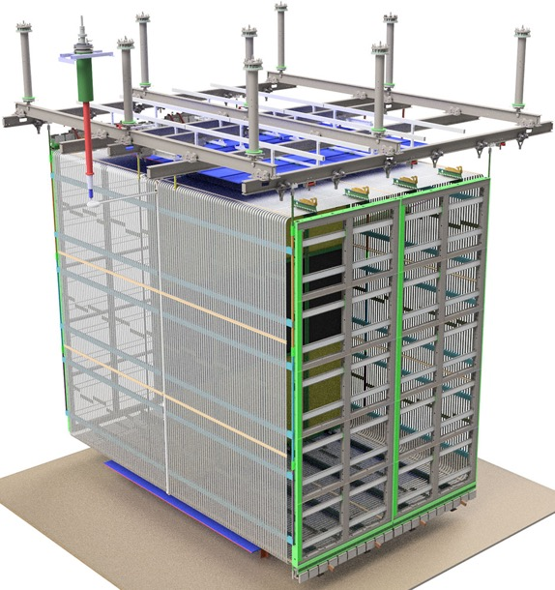
HV Plans for ProtoDUNE II
TPC in ProtoDUNE Run 2:
2/3 of the volume of the first run to better mimic the installation sequence of the Far Detector.
TPC will be ~ centered in the beam direction with large clearance beyond EWFC’s (similar to the FD case)
2 of the 4 APAs will have inverted orientation (electronics at the bottom).
HVS goals for ProtoDUNE Run 2
validate the design / installation of the new field cage modules and the new ground plane configuration
verify performance and compare long term stability and E-field uniformity.
Conceptual design of the ProtoDUNE II

Slide 21
HV system for ProtoDUNE II
The CPAs will be reused with minor modifications to reflect current design changes
The HV distribution (HVPS - cable - filters - HV feedthrough) will be unchanged (with possibility to use resistive cable if available)
Top/bottom and End Wall field cage modules will be replaced with new modules (FD module 0)
Most of the resistive divider boards reused.
Parts for the FC modules will be prepared at production sites (LSU, SBU, UTA) and shipped to CERN to be assembled on site similar to what is planned for the FD.
Mechanical connections to APAs and DSS will represent the FD design as much as possible.
Few keys differences wrt FD with impact on HVS. F.I.:
Special support structure required to tie the bottom of the upright APA to bottom FC and top of the inverted APA to the top FC.
Different top/bottom clearance
Goal: combined Far Detector final design review & / ProtoDUNE II PRR by the end of this year, to start part procurement and production for ProtoDUNE at the beginning of 2021.

Slide 22
Plan toward the Final Design Review
Structural analysis is progressing in direct contact with the DUNE compliance office.
Prototyping activities at University production sites and Ash River are also progressing reasonably well despite of the current travel restrictions.
Open interface issues (ground planes, ports for cameras, CALCI related items) are going to be addressed with priority.
QA/QC procedures are being optimized and will be applied to the prototyping tests for validation.
Component procurement, manufacturing plans, and an effective shipping plan of the HVS components are being developed.
Cost and schedule of the entire HVS have been captured. Most of the M&S costs are supported by vendor quotes and correctly reflect the new HV system design.
Labor estimates for the production and installation is being refined based on our current prototyping experience.

Slide 23
Summary
The HV System in ProtoDUNE SP operated at the goal voltage of 180kV (highest in a large LArTPC) with >99% uptime during long term operation.
At the design level, actions were taken to mitigate the occasional HV instabilities observed in ProtoDUNE by increasing the FC to ground plane distance, and removing the exterior insulating FC support structures.
As a value engineering case, a significant reduction of the estimated material and labor of the FC production and assembly has been achieved.
Field cage assembly and testing procedures have been highly simplified and will mostly take place at the underground far detector site.
The plan toward the Final Design Review and ProtoDUNE-II is defined and well advanced (no major critical issues identified).

Slide 24
Backup slides

Slide 25
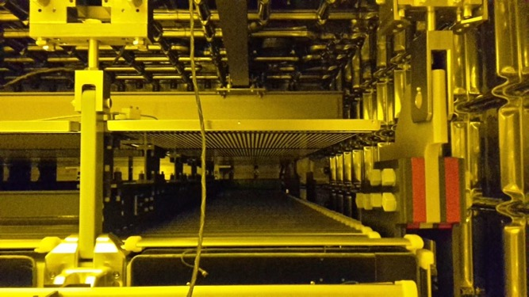
Understanding instabilities
NO excess noise recorded on APA electronics with any HV instability
Some excess activity recorded on Photon Detectors close to affected GP only in coincidence with streamers
NO evidence of direct relation with LAr purity (maybe stream quenching)
Very likely NO instability current from EndWalls to Ground Planes
Origin of streamer still under investigation:
path from CPA to ground through FRP surface?
End Wall supports?
GP standoffs/CPA hangers ?
Broken diffuser fiber?
Mitigation in DUNE HVS design
Increase GP distance from FC
Remove GP-FC FRP spacers

Slide 26
CPA planarity in ProtoDUNE
Analysis from CPA crossing muons
CPA tilt/shift mostly within limits
Lesson learnt under consideration to further improve planarity

