Slide 1
3.9 GHz Cryomodule Transportation Plan
Brian Hartsell for the Cryomodule Transportation Team
3.9 GHz CM Transportation Review
13 February 2020

Slide 2
Outline
LCLS-II 1.3 GHz transport strategy
Past experience and lessons learned
Differences between LCLS-II 1.3 GHz and 3.9 GHz relating to transportation
3.9 GHz ‘fresh look’ internal design review
Testing using 3.9 GHz dummy cryomodule

Slide 3
Transportation experience
Successfully transported FLASH 3.9 GHz cryomodule from Fermilab to DESY in April 2009.
Members from this team are part of the LCLS-II 3.9 GHz transport team.
FLASH was a very different transport (multi-modal, international), but ideas were borrowed from this transport since it is a similar style.
LCLS-II 1.3 GHz cryomodules
Successfully transported 17 1.3 GHz cryomodules from Fermilab to SLAC since 2018 failures.
Members of this team are directly involved with the 3.9 GHz shipping plan.
Many lessons learned from this experience are integrated into the LCLS-II 3.9 GHz shipping plan.

Slide 4
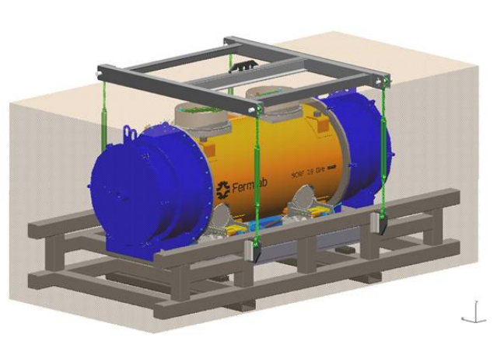
FLASH 3.9 GHz Cryomodule Transport
Challenging transport involving two types of transportation (air, driving over land) and two handoffs via forklift between modes of transport.
Loaded on a transport fixture and driven to the airport
Handoff from trailer to plane
Flown across the Atlantic
Handoff from plane to trailer
Driven to DESY and unloaded from transport fixture
Implemented cold mass restraints and stabilizers in place of warm FPCs.
Also inserted foam between shields and vacuum vessel.

Slide 5
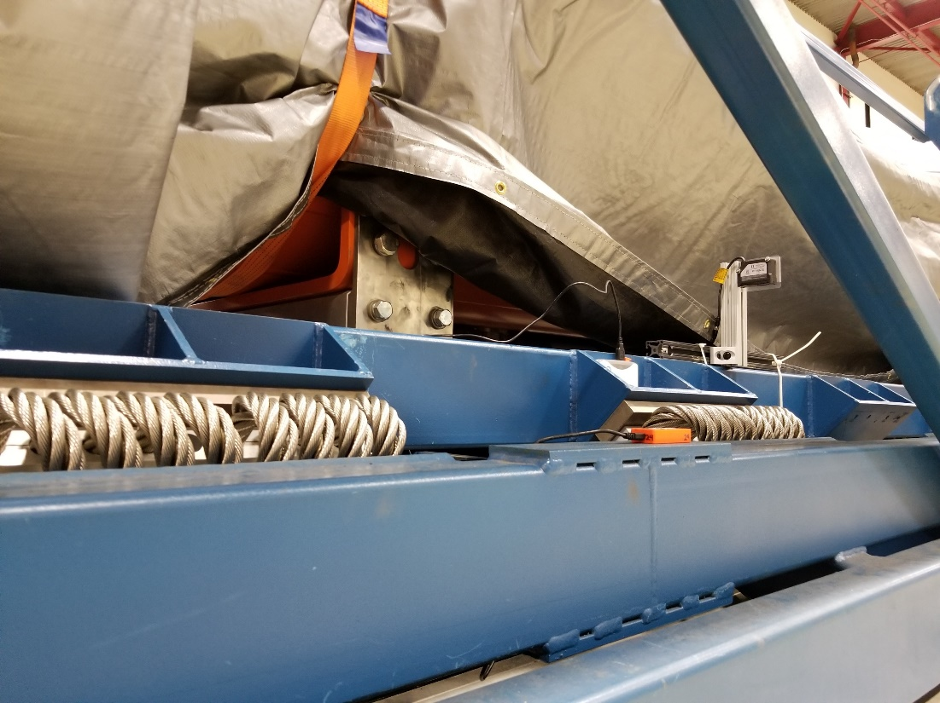
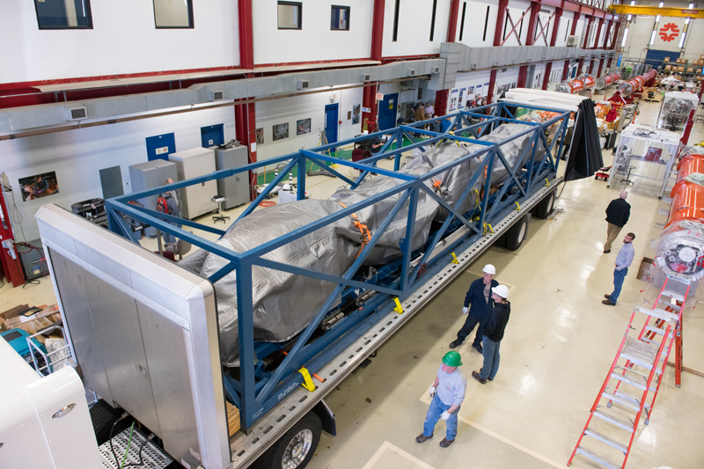
LCLS-II 1.3 GHz shipping: Quick summary
Cryomodules are transported over the road using an isolation frame mounted on an air ride trailer.

Slide 6
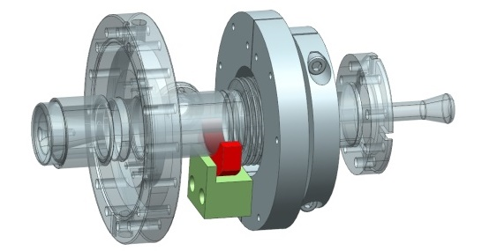
LCLS-II 1.3 GHz shipping: Quick summary
Failures during shipping and shipment tests of the cold coupler bellows led to optimization of the transportation system and development of stabilization for sensitive parts.
Image and design courtesy Jefferson Lab

Slide 7
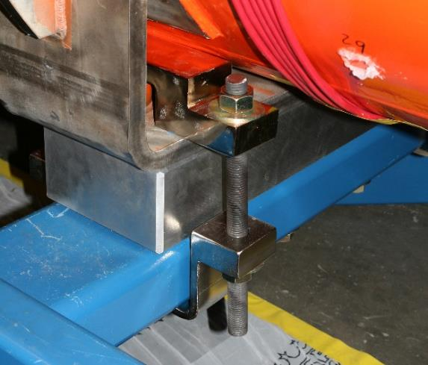
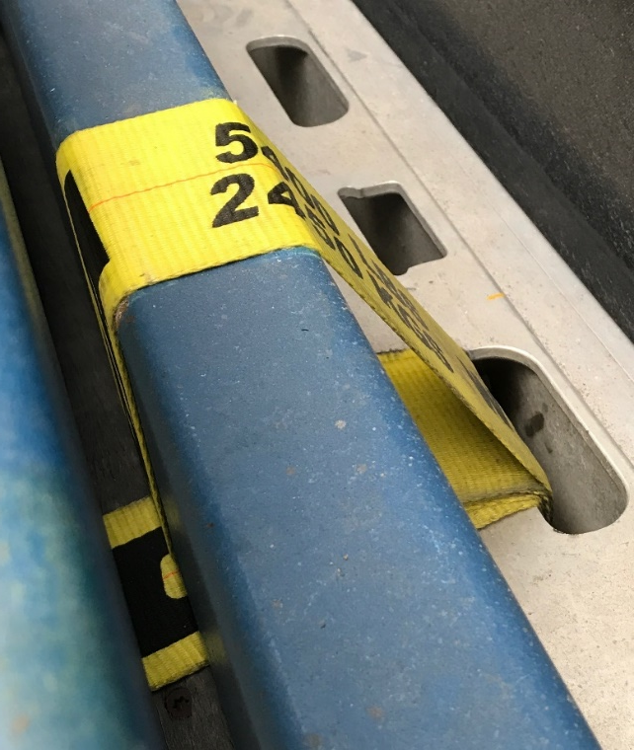
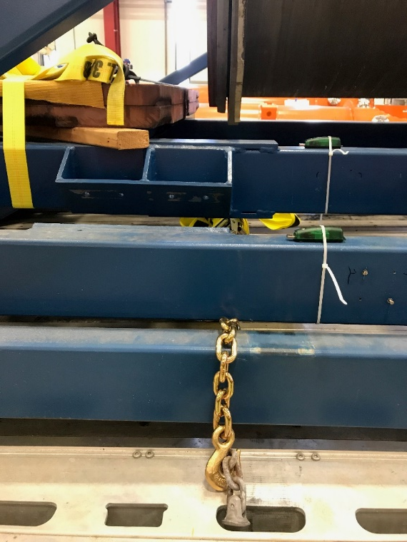
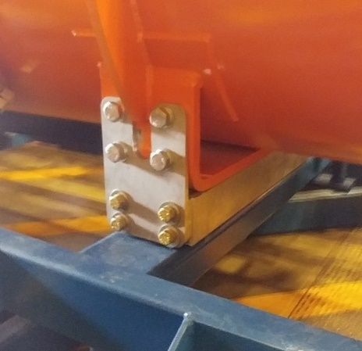
Lessons learned from 1.3 GHz shipping: Frame
Rigidly fix the isolation frame to trailer.
Optimize spring selection and placement to provide low resonant frequency and optimal attenuation.
Springs placed away from cryomodule mount locations are not effective due to inner frame flex.
Use of ‘shear plates’ to hold CM to the frame.

Slide 8
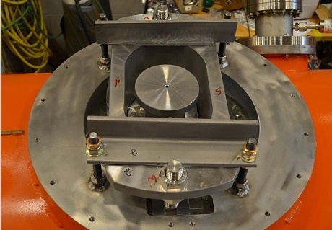
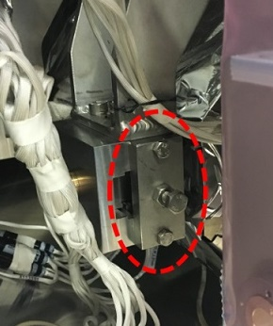
Lessons learned from 1.3 GHz shipping: Restraints
The coupler cold bellows was identified as a source of 1.3 GHz beamline leaks that developed during shipping.
Methods to limit movement of this bellows were implemented:
Cold mass support restraints added.
Cavity string restraints installed.
Image and design courtesy Jefferson Lab

Slide 9
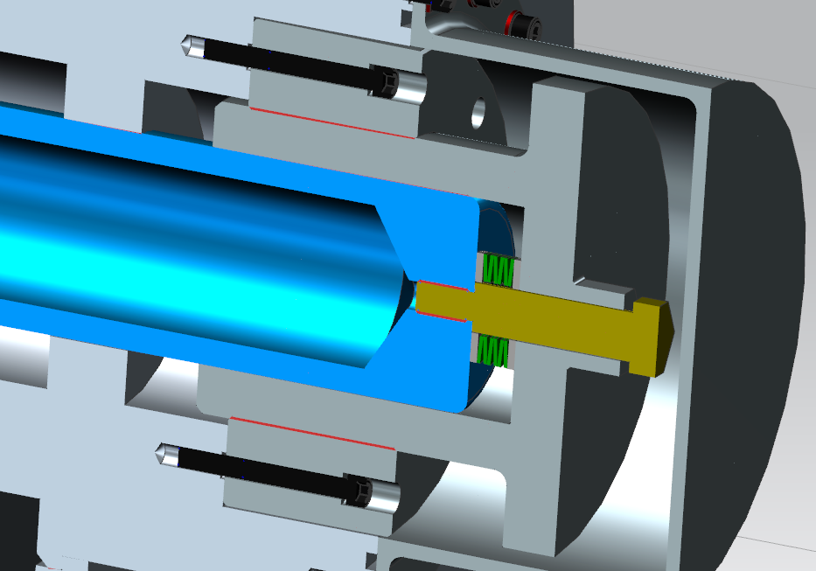
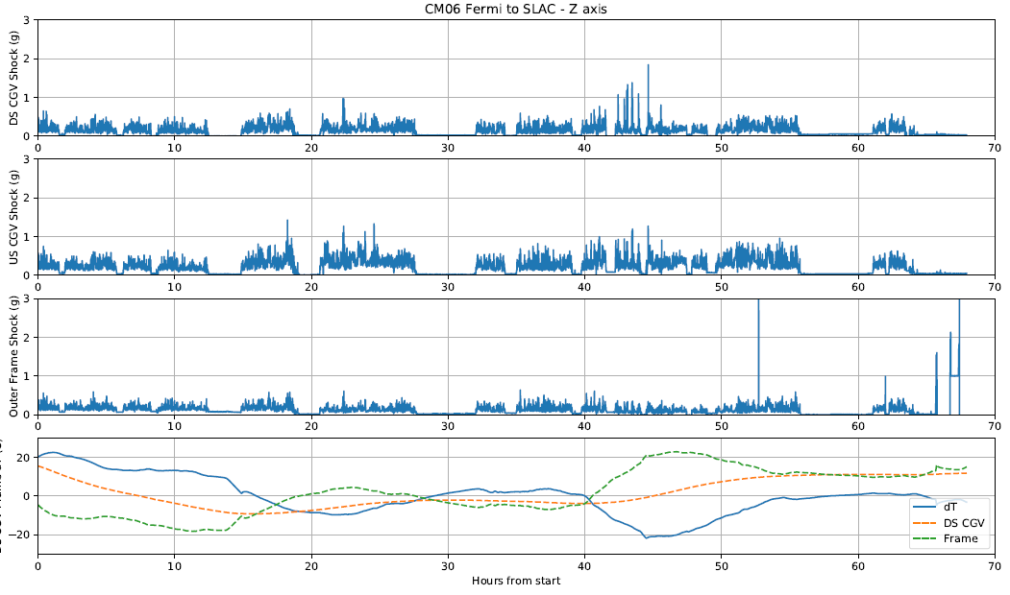
Lessons learned from 1.3 GHz shipping: Thermal Transients
Differences in thermal expansion coefficients between the HGRP and vacuum vessel and/or temperature differential between the two leads to possible loss of contact between transport cap and HGRP adapter.
Implemented spring washers in the transport cap.
Install blankets on the cryomodule to slow transients.

Slide 10
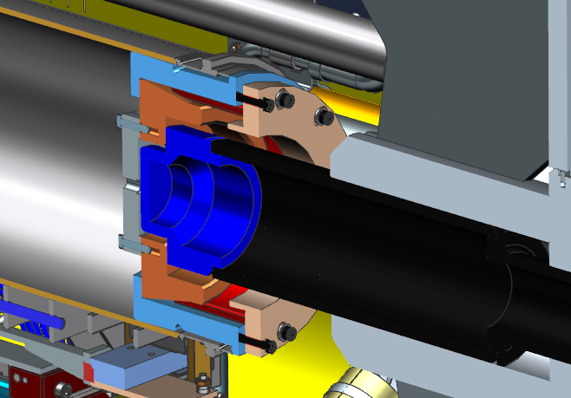
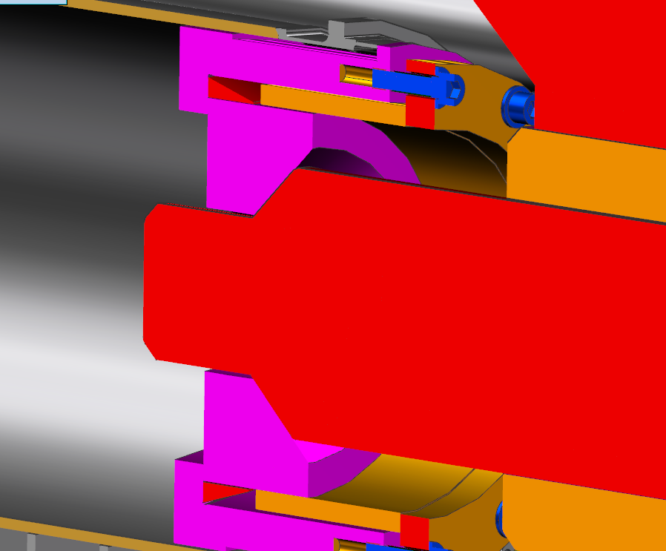
Lessons learned from 1.3 GHz shipping: Cold mass stabilization
Planar interface between transport cap and HGRP adapter used for F1.3-06 allowed for movement during thermal contraction or high shock loading
Reverted to the XFEL transport system with a conical interface.
LCLS-II used on F1.3-06
XFEL

Slide 11
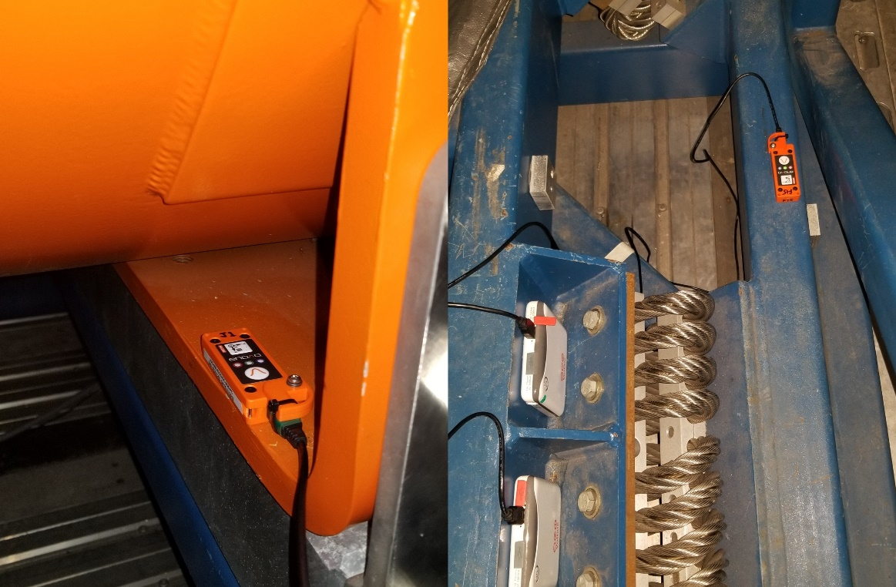
Lessons learned from 1.3 GHz shipping: Sensors and their placement
Sensor placement plays a large role in transfer function quality, especially when the frame is relatively flexible.
Slam Sticks were qualified for use on 1.3 GHz shipments.

Slide 12
Lessons learned from 1.3 GHz shipping
Incorporate testing with a dummy load as much as possible.
When a real cryomodule is not needed, do not use it.
Integrate offline testing (shaker table, fatigue, modal, etc) during the evaluation of sensitive components.

Slide 13
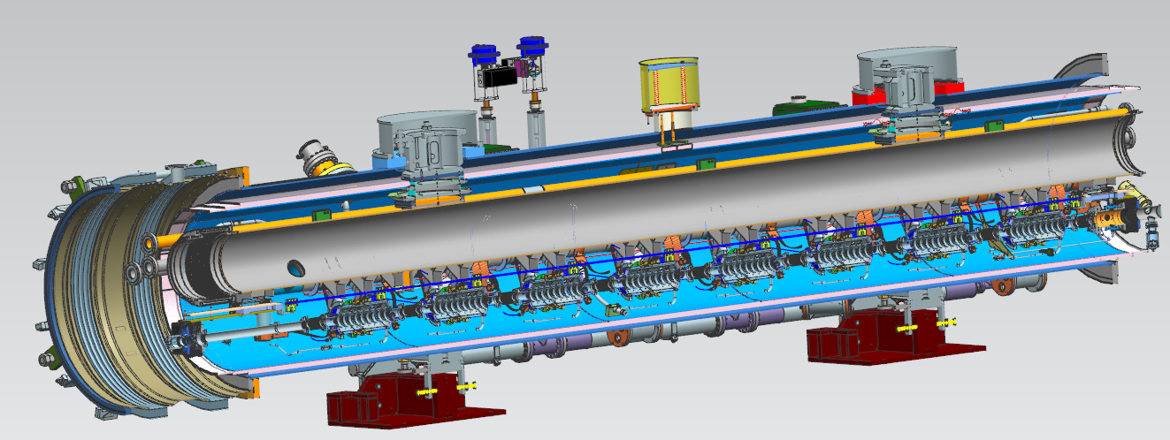
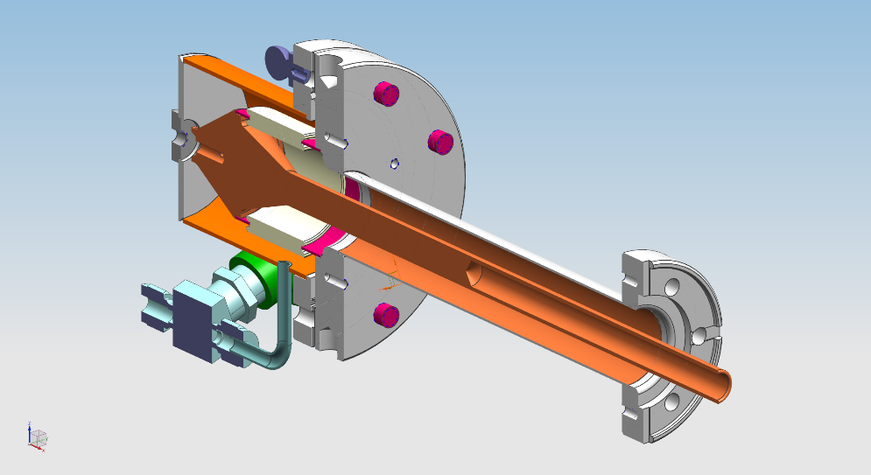
LCLS-II 1.3 GHz and 3.9 GHz cryomodules
Differences relevant to transport:
Different input coupler design (no cold bellows).
Fixed couplers on both sides of the CM.
No magnet on 3.9 GHz CM.
No tuner access ports on 3.9 GHz CM.
Cavities are smaller and lighter, shorter string with two support posts.
Two coupler pumping lines
Shipping equipment (caps, inserts) interfaces stay the same.

Slide 14
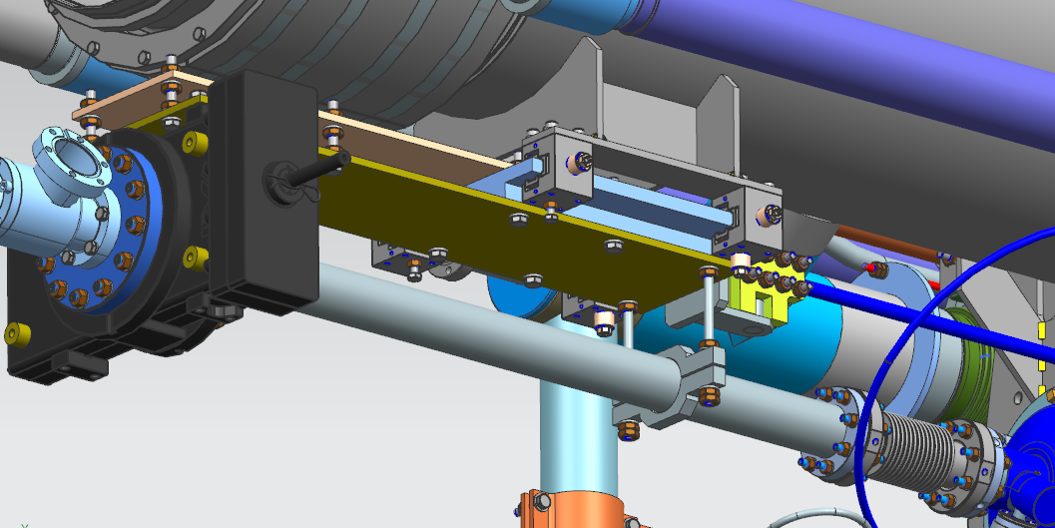
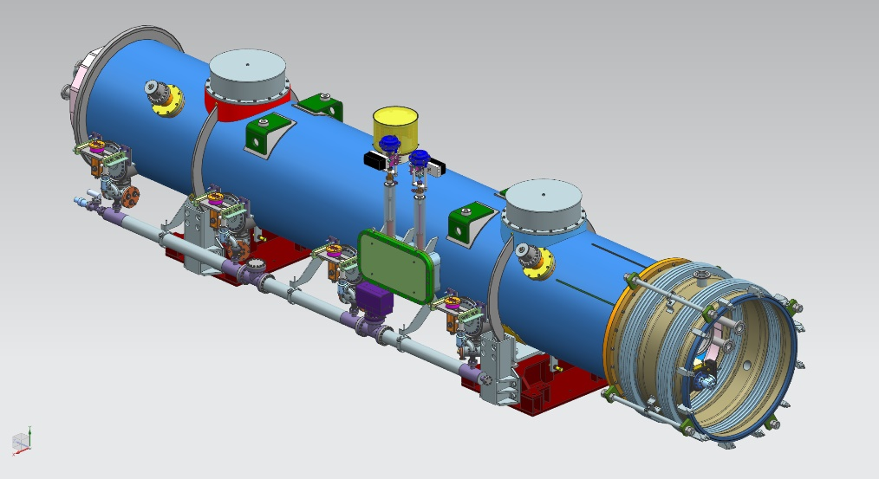
Fresh look review
An internal to Fermilab “fresh look” at the design was conducted with a particular focus on shipping.
Findings summarized in Teamcenter ED0010367, also attached to Indico page for reference.

Slide 15
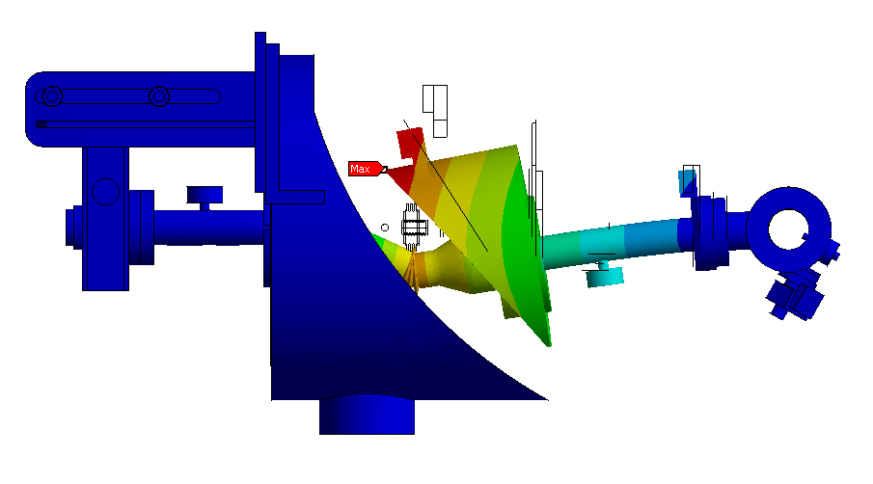
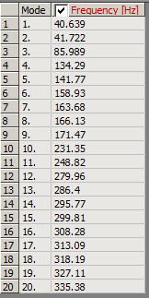
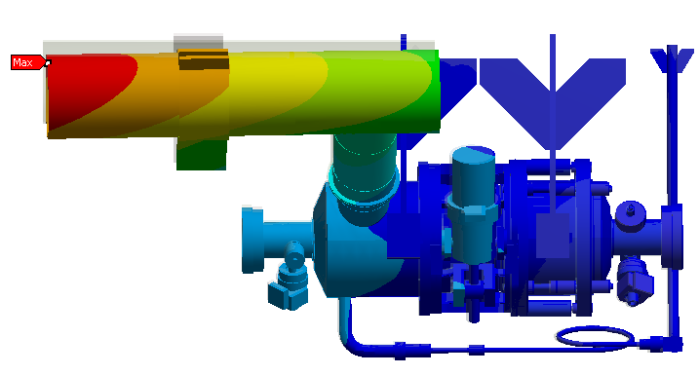
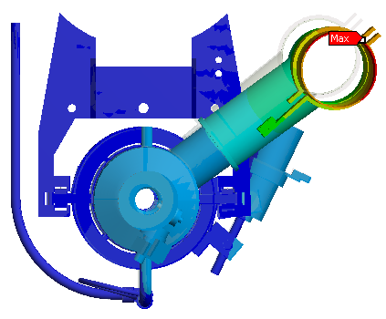
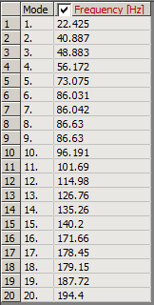
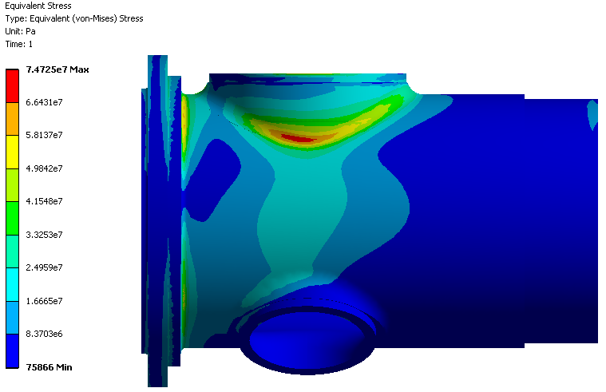
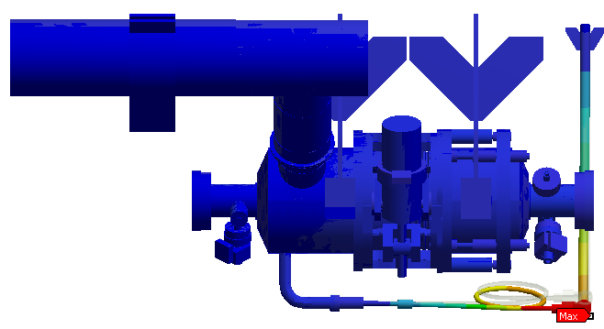
Fresh look - simulations
FEA was conducted by Sergey Cheban to support the fresh look consisting of modal and static structural analyses.
Examples shown below:

Slide 16
Fresh look - simulations
Simulations uncovered these areas of focus:
Coupler pull-out on cavity and associated coupler vibration
Tested on shaker table
Will use FLASH style coupler supports during transport.
Upstream cold gate valve vibration
Found to not be an issue during hammer testing.
Thermal shields are still unconstrained
Keep using foam inserts
Two phase pipe has a relatively low resonance due to bellows.
Will be monitored during test shipments.

Slide 17
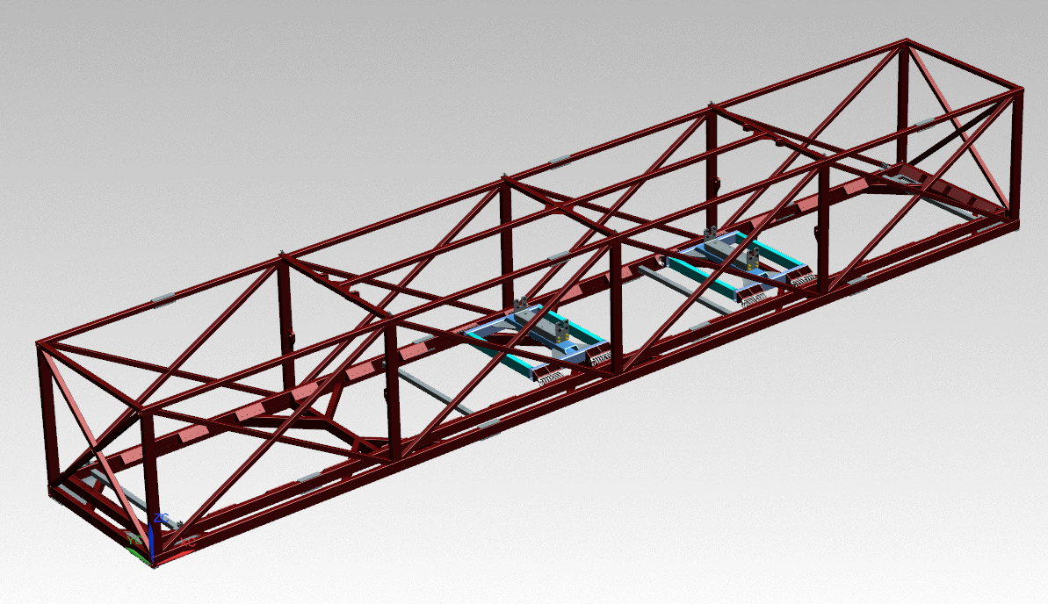
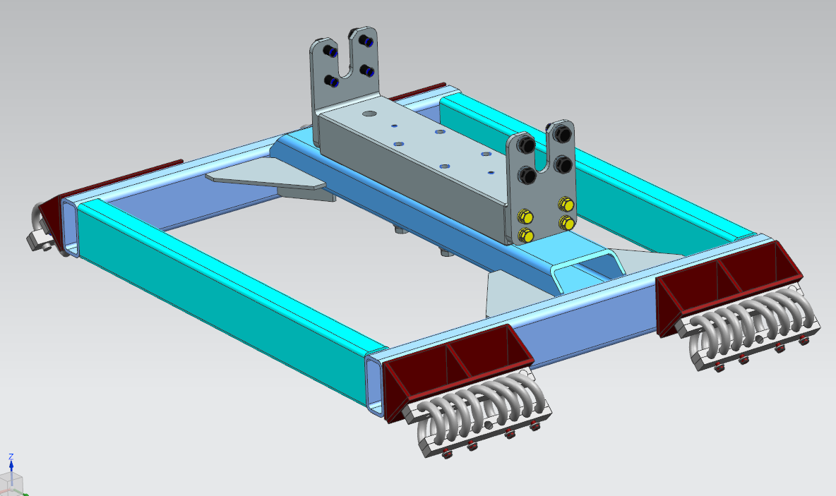
3.9 GHz Transport System
Re-use ‘outer frame’ of 1.3 GHz cryomodule transport frame.
Fabricated new platforms for mounting the cryomodule.
Reduces possible resonant modes from the inner frame.
Springs selected by scaling weight difference between 1.3 and 3.9 GHz.

Slide 18
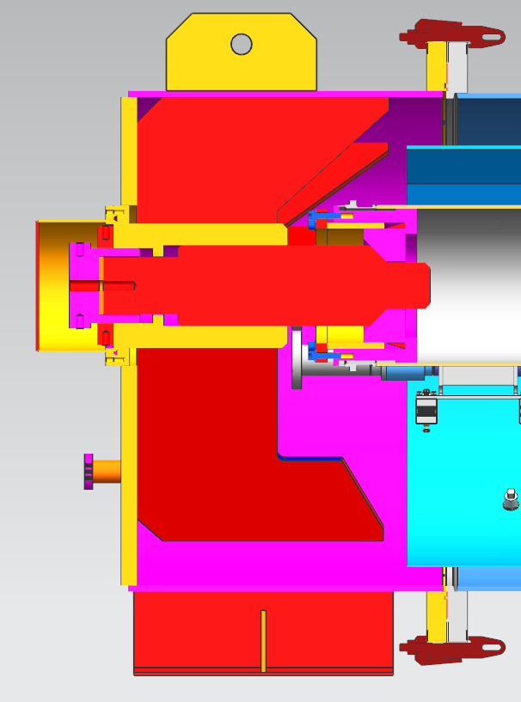
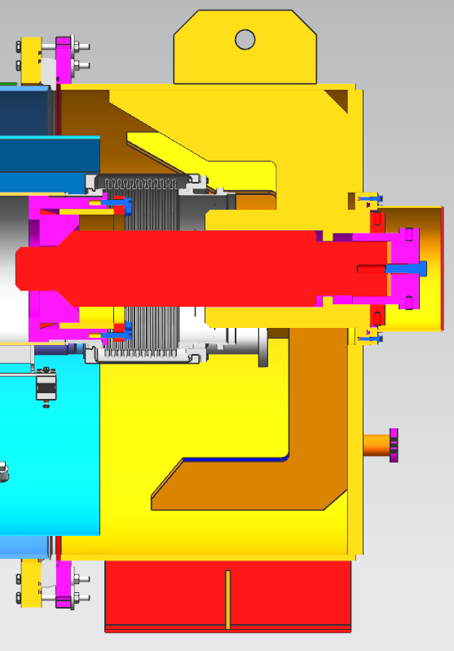
3.9 GHz Transport System
Use XFEL transport caps and HGRP insert with no modifications needed for cold mass stabilization.

Slide 19
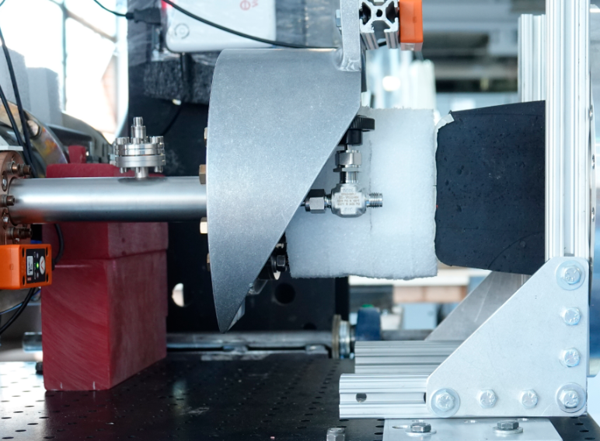
3.9 GHz Transport System
Use FLASH style coupler supports – the same configuration as last round of shaker table testing (see Nikolay’s presentation):

Slide 20
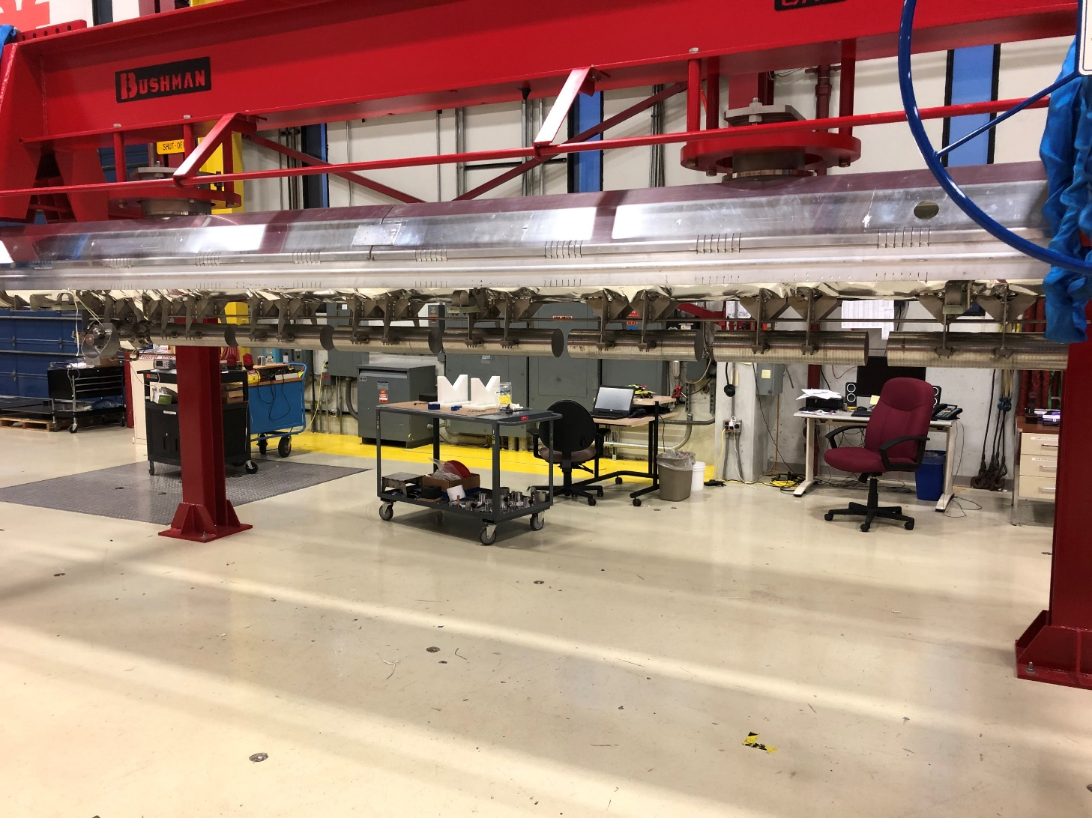
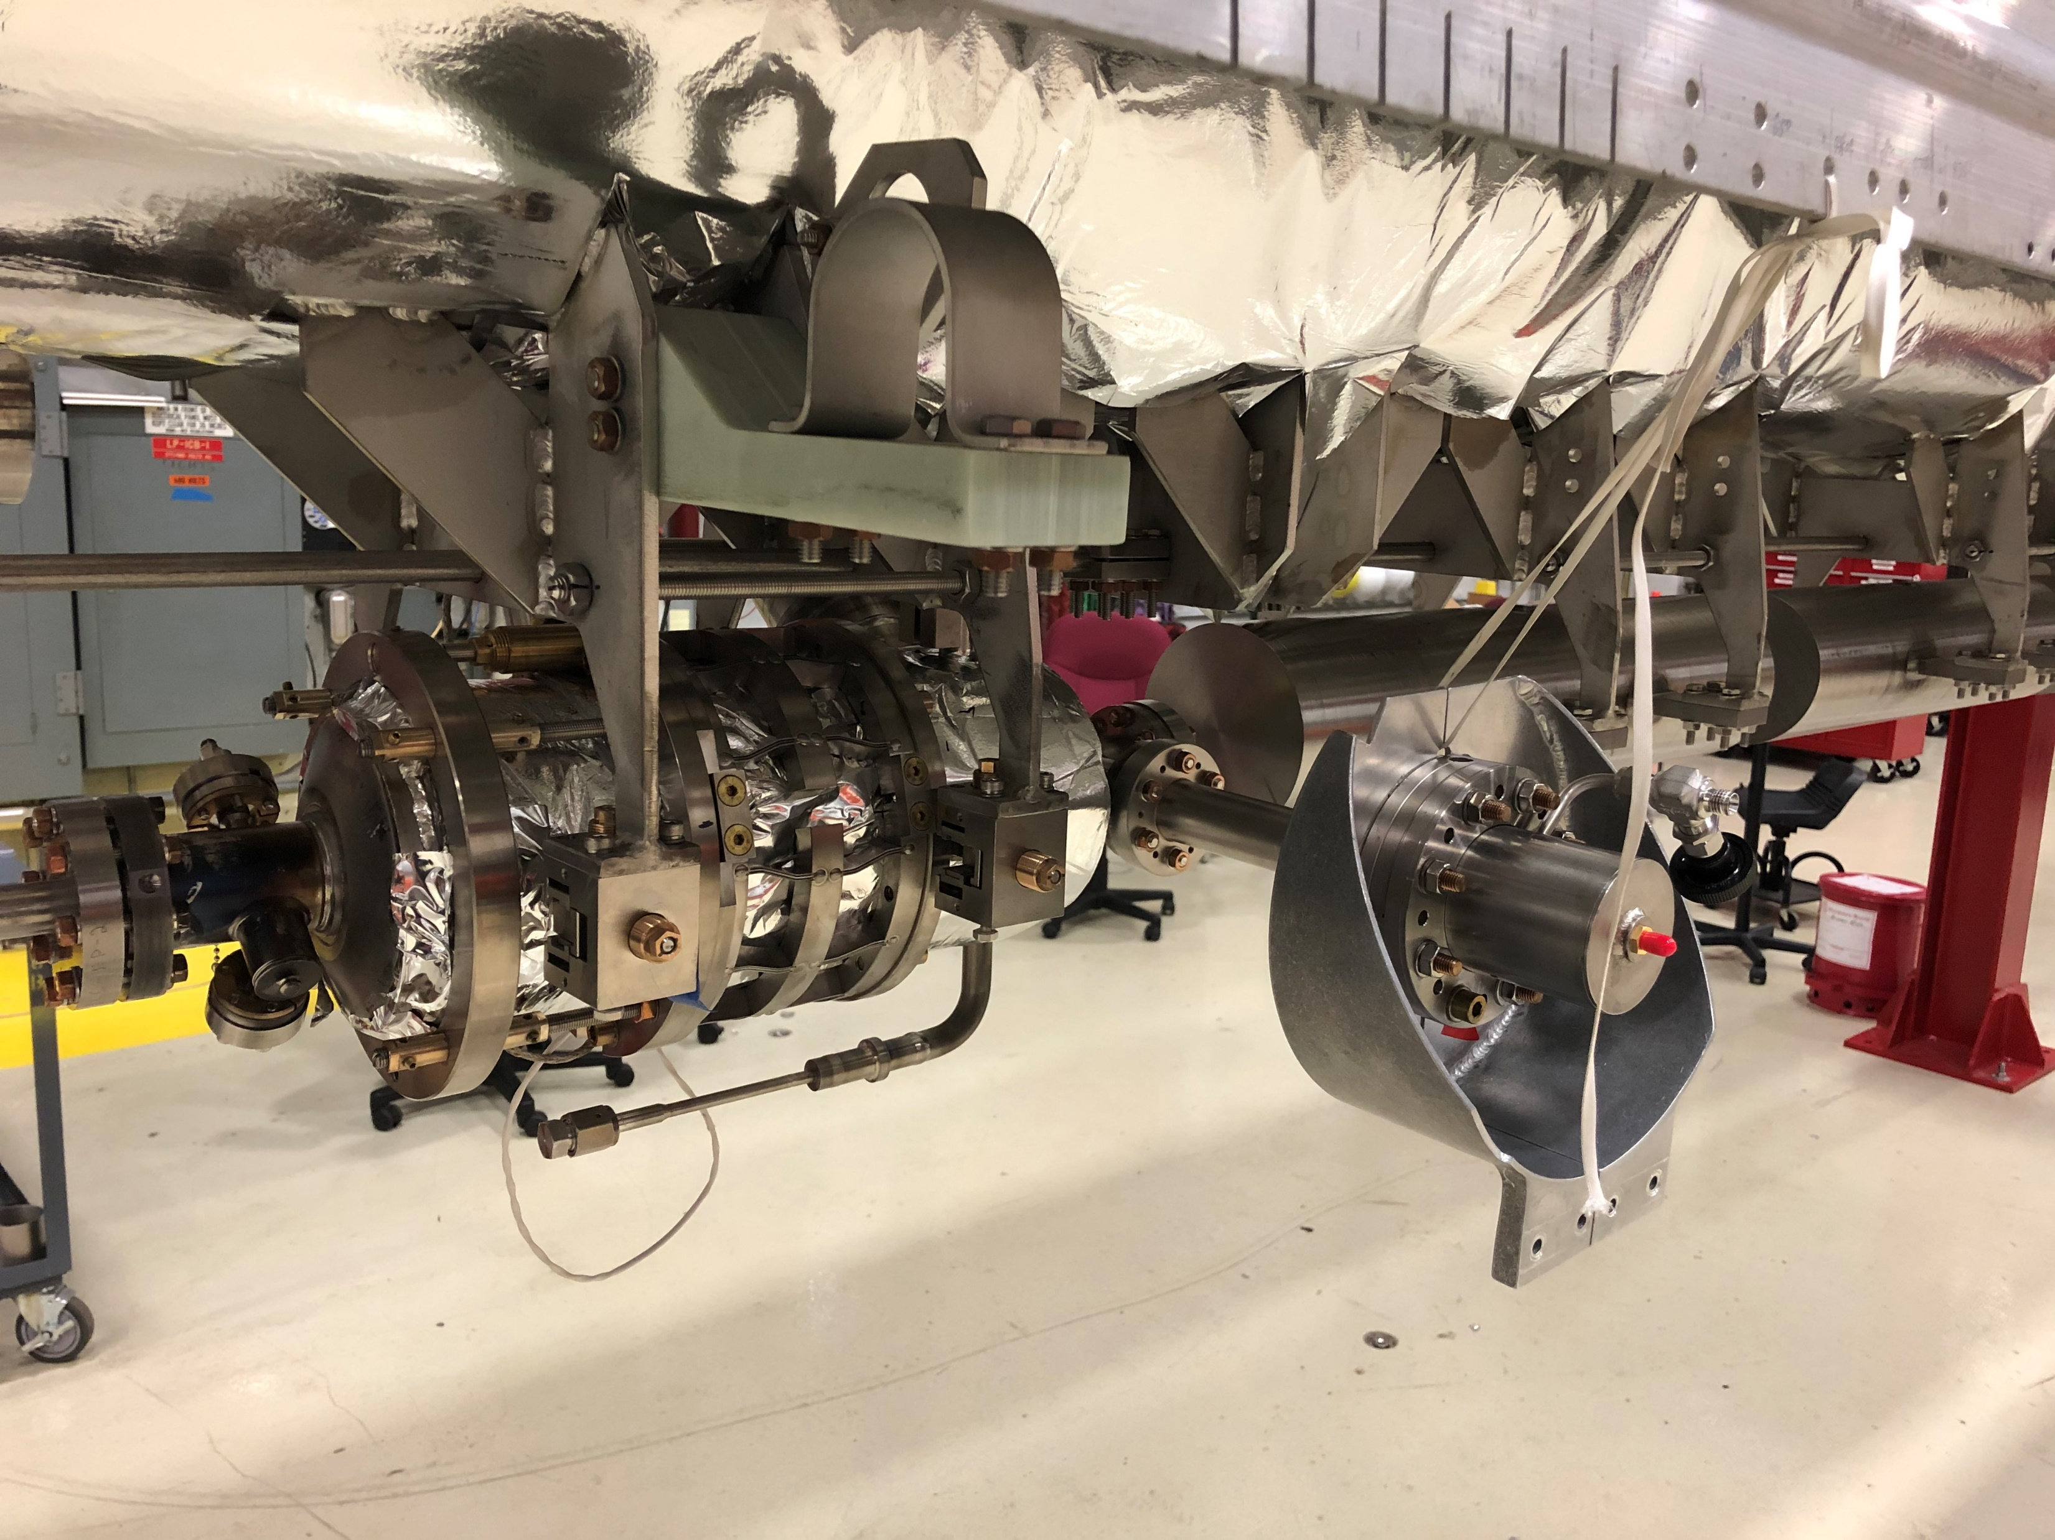
Testing with dummy load
A ‘dummy’ 3.9 GHz cryomodule was created to replicate the weight of a real CM by attaching steel slugs in place of 7 cavities.
One real cavity was included (#1) so it could be instrumented and the coupler was supported in a FLASH style configuration.

Slide 21
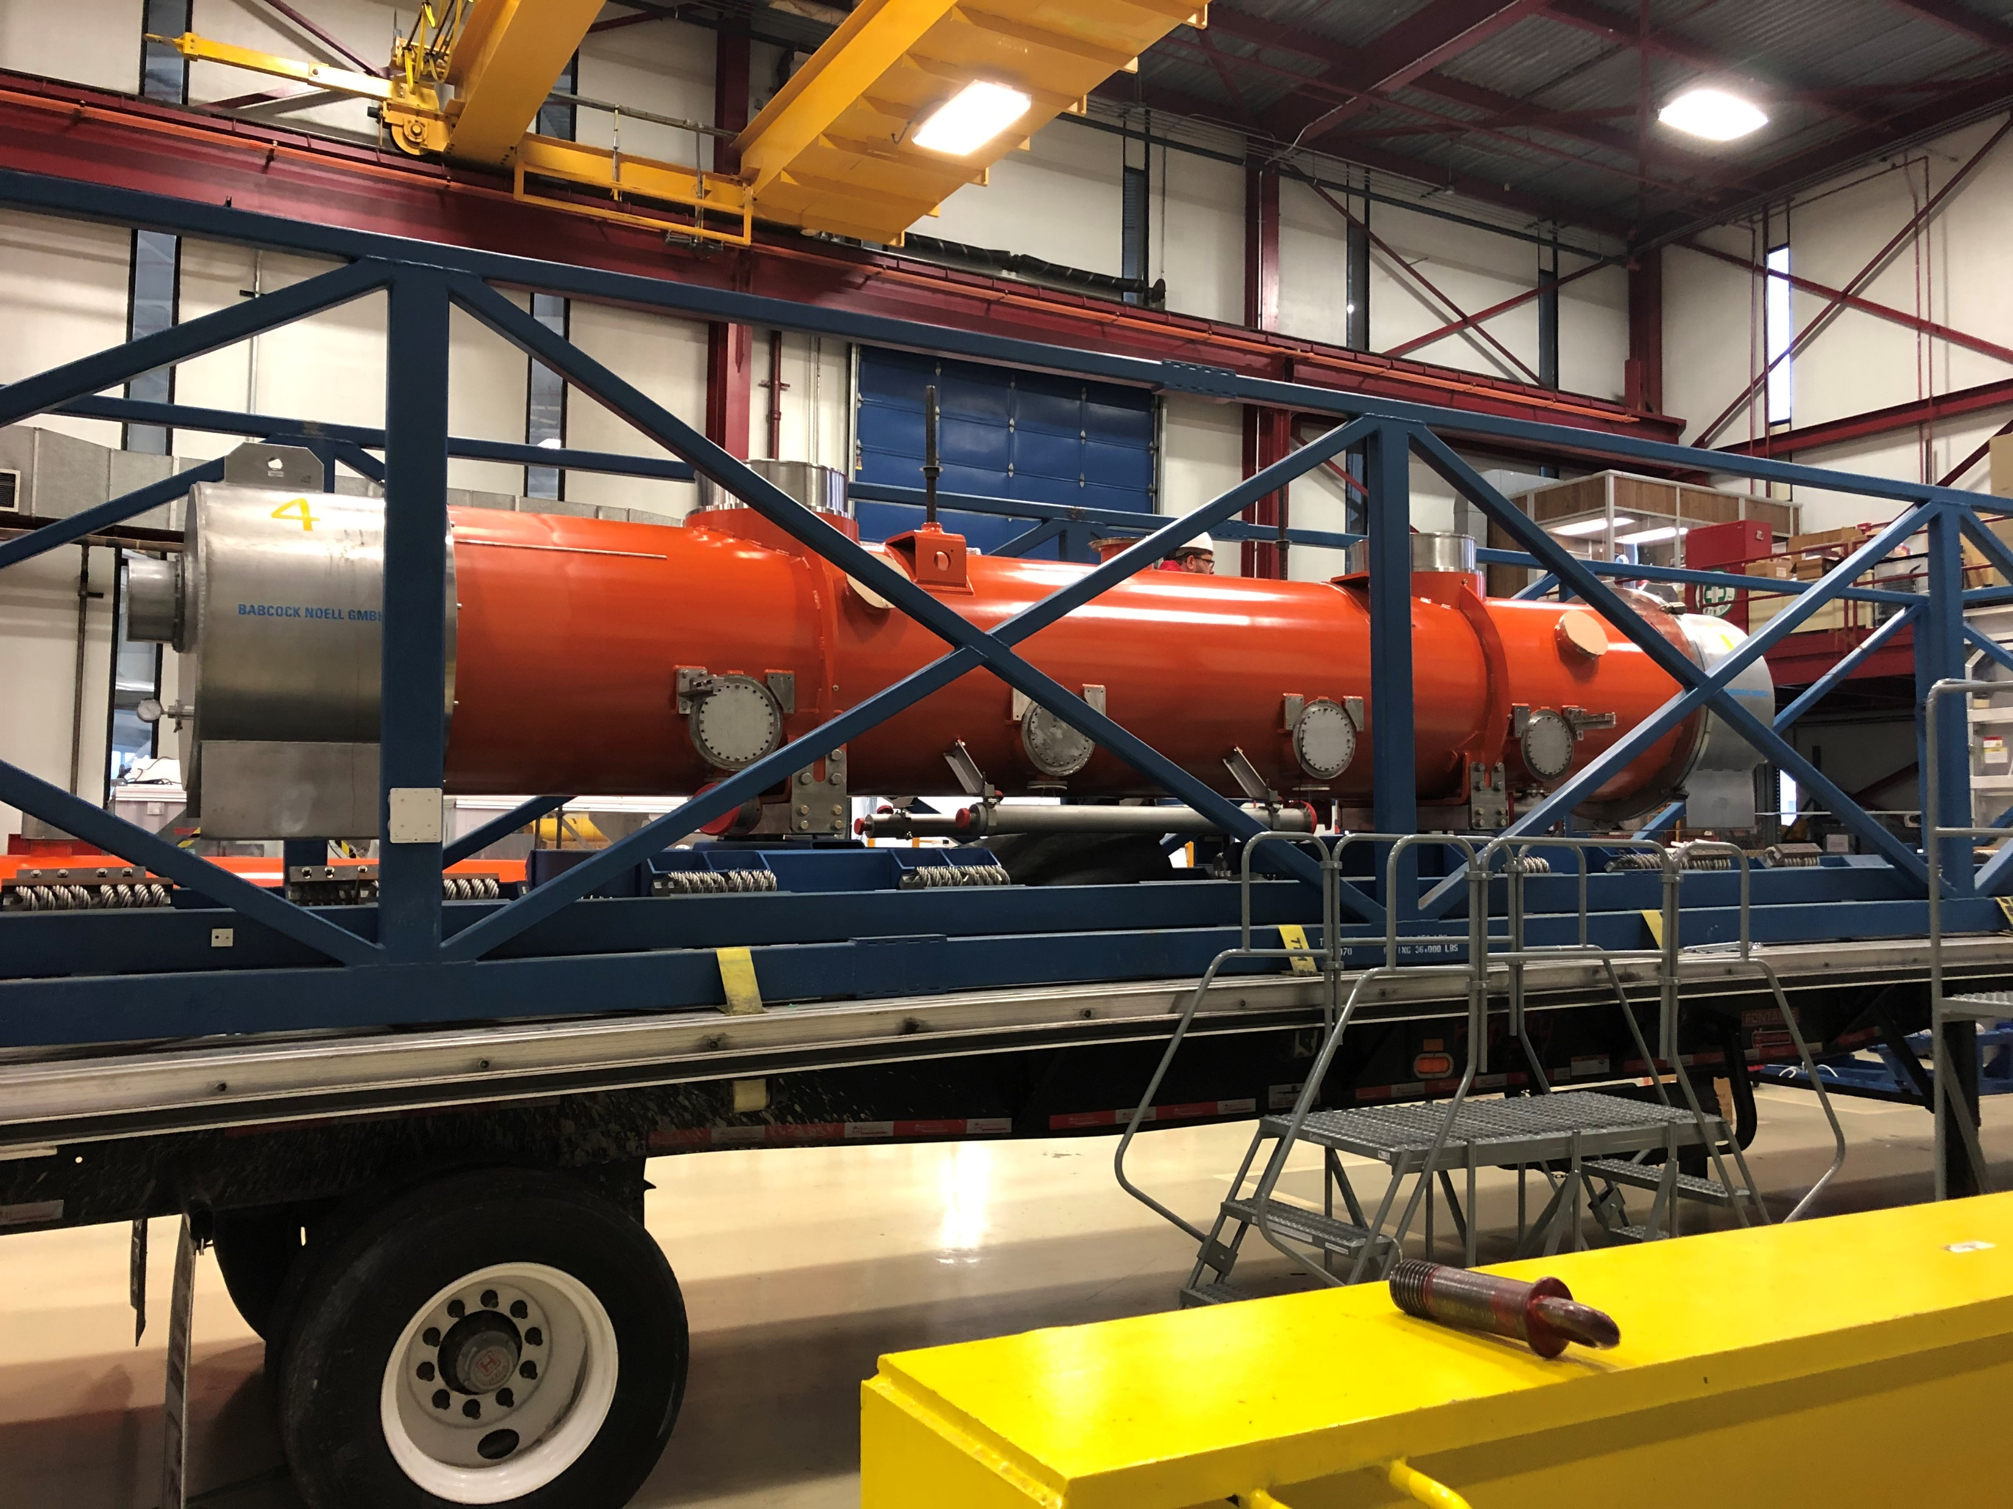
Testing with dummy load
Instrumentation placed on:
Both upstream and downstream frame and cryomodule foot
Cavity 4 dummy
Cavity 1 (real): Upstream, Downstream, 50K flange
More details in test results ppt
Started with on-site test, short road test off site on 88, then full road test to SLAC.
Much more information on test results in separate talk, but tests went well with peak shock values on test to SLAC of 0.8g.

Slide 22
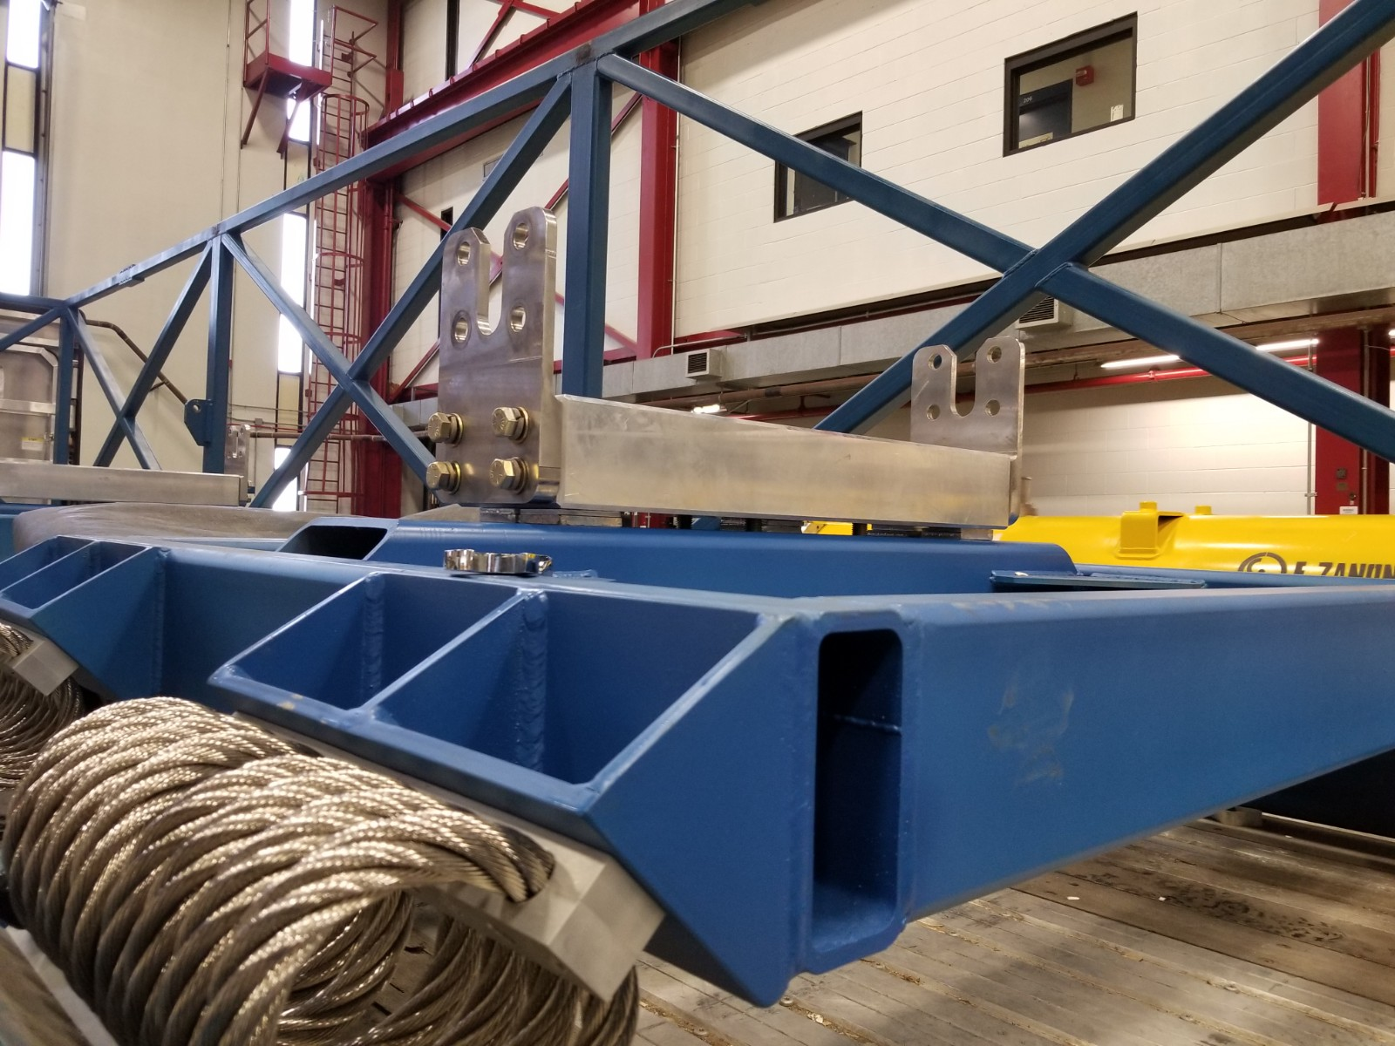
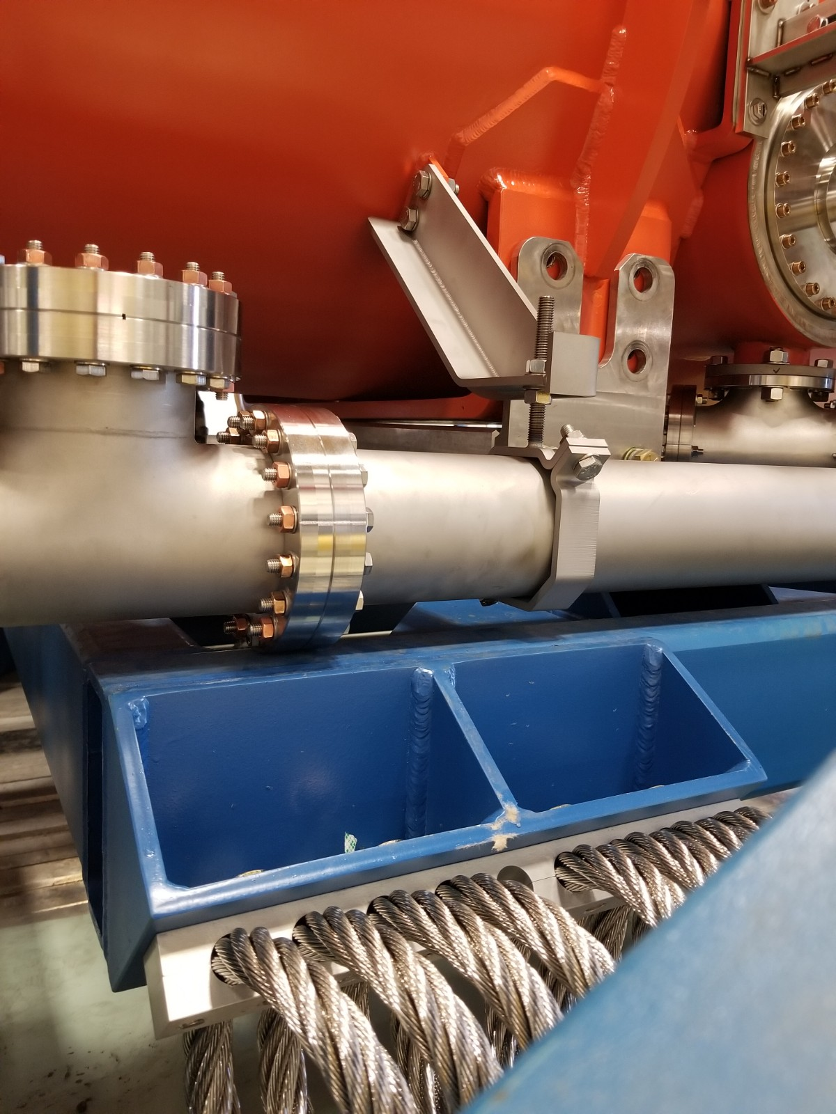
Issues found with CMTF transport
During transportation of F3.9-01 to CMTF, interference between the coupler pumping line and transport frame were discovered and temporary shims were added for transport.
Action items to resolve this:
Fabricate spacer plate to replace temporary shims (due 2/14)
Orient coupler pumping line RAVs upward.

Slide 23
Transport testing with live 3.9 GHz CM
From the FDR in January, 2019:
Begin work with live CM once:
Simulations are complete
Any needed mitigations for sensitive components are in place
Physical testing for these components may be conducted
Dummy load testing is successful
Transport specifications that adequately protect sensitive components have been developed.
Based on calculations, testing, simulation.
Examples: maximum displacement, maximum shock, sustained loading.
A successful review is conducted on live CM test plan and mitigations.

Slide 24
Planned testing with ‘real’ 3.9 GHz CM
Implement spacer identified during CMTF transport.
Testing will progress through a similar progression as the dummy load using Fermilab drivers and equipment, which tends to have a rougher ride.
Low speed, on-site testing
Short road test
Long road test
Instrumentation on frame, vacuum vessel, cold gate valves, cavity 8, 2-phase pipe, and all 50K flanges.
Integrate lessons learned from each test into successive transport tests.
A final pre-shipment review will be held with SLAC.

Slide 25
Transport to SLAC
Other considerations:
All preparation work will have a written procedure, documented in traveler form with signoffs.
Prior to shipping to SLAC, a final shipping configuration drawing will be released.
The usual drivers with Landstar will drive the shipment.
Interface with SLAC receiving team to ensure a finalized acceptance and handling plan is in place.

Slide 26
Transport to SLAC
Documentation:
Transport specification (SLAC document LCLSII-4.1-PP-0703) - No evidence to suggest the 1.5g shock limit for transportation needs to be revised for 3.9 GHz.
Procedure and traveler for 3.9 GHz shipment preparation is in place at Vector 464422
Successful 1.3 GHz transport prep traveler used as a basis
DFMEA, PFMEA (TC# ED0011566, attached to Indico)
Successful transport of 3.9 GHz cryomodule to CMTF documentation used as a basis.
Hazard analysis completed

Slide 27
Summary
An experienced team is working on this project.
We understand the differences between 1.3 and 3.9 GHz transports and have implemented lessons learned.
A plan is in place to safely ship LCLS-II 3.9 GHz cryomodules to SLAC.
Documentation for the plan includes a traveler, procedures, DFMEA, PFMEA, and hazard analysis.
Dummy load testing went well and gives us confidence in the plan.
We believe we are ready to start testing on a ‘live’ 3.9 GHz cryomodule.

