Slide 1
Introduction to LCLS-II 3.9 GHz CM and Transport
Tug Arkan
LCLS-II 3.9 GHz CM Transportation Review
February 13, 2020

Slide 2
Outline
Chronology
Design
Assembly
CM Transport Plan
Summary
Lessons learned applied

Slide 3
Chronology
Final Design Review (FDR) was held on Jan 30-31, 2017
Delta-FDR was held on Jan 29-30, 2019
Internal “fresh look to design” initiative using lessons learned from 1.3 GHz CM. Four meetings were held between March and May 2019. A final report is written and shared with the project stakeholders.
Drawings & specs revision based on the fresh look findings and recommendations
Parts were already in house. Revised drawings are released. Parts are modified, additional parts are procured.
Travelers are revised using fresh look recommendations and lessons learned from 1.3 GHz CMs assembly
F3.9-1 assembly is done between July 2019 and December 2019
F3.9-1 testing is done between December 2019 and February 2020
F3.9-2 assembly is done between September 2019 and February 2020. (transported to CMTS on February 11, 2020)

Slide 4
DESIGN

Slide 5
Cryomodule Exterior Features
J. Kaluzny
Tunnel Wall Side
Tunnel Aisle Side
Vacuum Vessel Relief
Support Post Cover
Liquid level Feedthrough
Valve Welding Access
Coupler Pumping Line
Cryogenic Valves
Instrumentation Flanges
Vacuum Bellows
Support Stands
Coupler Pumping Line
No Access Ports!

Slide 6
Cryomodule Coldmass Features
J. Kaluzny
Two support posts
Couplers on both sides
Instrumentation through shield
Two-phase pipe – liquid level cans
Aluminum pipes – thermal intercepts

Slide 7
Cavity String Features
J. Kaluzny
Cavities smaller than 1.3 cryomodule
Two-phase pipe is similar
Liquid level cans
Pipes, bellows
Blade tuner
BPM
No magnet
One cooldown fill line per cavity

Slide 8
Design Changes since FDR (Jan 2017)

Slide 9
Fresh look to design
Fresh Look meetings held to explore the 3.9 GHz design and evaluate sensitive components and the ability to design for transportation:
Topic 1: Cavity supports, and gate valves supports
Topic 2: Thermal intercepts and cryogenic pipe supports
Topic 3: Warm coupler and Cold coupler
Topic 4: Cavity HOMs and HOM feedthroughs
Report and Responses to recommendations are in Teamcenter: ED0010367
See B. Hartsell talk

Slide 10
ASSEMBLY

Slide 11
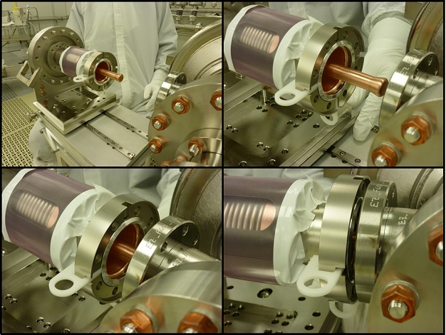
Lessons Learned applied to 3.9 GHz CM assembly in the cleanroom
Cavity fasteners torque check& adjust post vertical test before starting the string assembly in the MP9 cleanroom
Al/Mg seals hardness certified by the vendor
Delrin holders for NW40 size (and smaller) Al/Mg seals: NW78 size seals can be slightly deformed and will not fall once placed in the flange during assembly, small size seals need holders.
BPM electrical feedthroughs titanium grade 5 fasteners
Bellows between Cav#1 and upstream end gate valve (microphonics optimization)
Gate valves and right-angle valves leak check to verify that sealing through before assembling these valves to the cavity string
Reduce torque for M6 size hardware from 20 N-m to 13.5 N-m
Final torqueing and verification of the string assembly fasteners before string rolls out to WS2

Slide 12
Lessons Learned applied to 3.9 GHz CM assembly at WS2
Optimized orbital welding programs for 316L stainless steel welding (to compensate wall thickness variations, sulfur content etc.)
Welding of the warm/up-cool down capillaries, tee from 2-phase pipe to HGRP and 2-phase pipe invar rods radial clamps after Z longitudinal of the cavities are done.
Shimming optimizations to ensure that the liquid level probes housing at the ends of the 2-phase pipe are welded and assembled leveled and free to allow HGRP contraction and expansion
Invar rod reinforced clamps for Cav#1 and Cav#8 where the reacted vacuum forces are highest
Leveling and alignment of the upper cold mass to the cavity string with the help of alignment group using laser tracker. Plumb bobs and mechanical means for alignment do not work well for CW CMs where the 2-phase pipe is connected to the HGRP
Increased attention for fasteners locking mechanism (at least two such as torqueing, lock washers, Belleville washers, Loctite etc. to prevent loosening during operation and transports (ED0011128)
White gloves handling of the magnetic shielding parts

Slide 13
Lessons Learned applied to 3.9 GHz CM assembly at WS3
Increased attention for fasteners locking mechanism (at least two such as torqueing, lock washers, Belleville washers, Loctite etc. to prevent loosening during operation and transports (ED0011128)
Additional scrutiny for thermal intercepts assembly hardware
RF group support during the RF cables 5K and 50K thermal intercepts installation
HOM notch frequency tuning as the last step before installation of the lower heat shields
Install lower heat shields one by one and inspect to ensure that shield does not have any contact with internals of the cavity string including RF cables. Weld lower heat shields and inspect again for any contact
Ensure that upper cold invar rod hole locations are measured during incoming QC. This will ensure that we can complete the vertical alignment of the cavities without any interference between invar rod and cavity helium vessel titanium pin

Slide 14
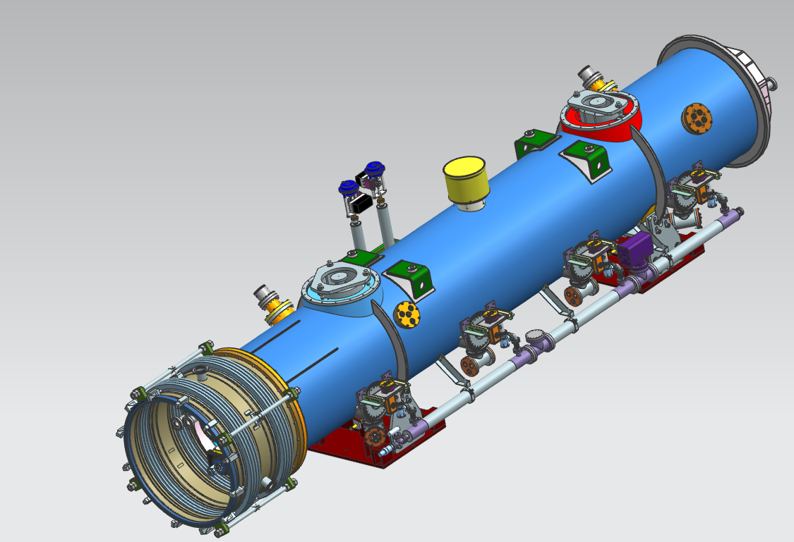
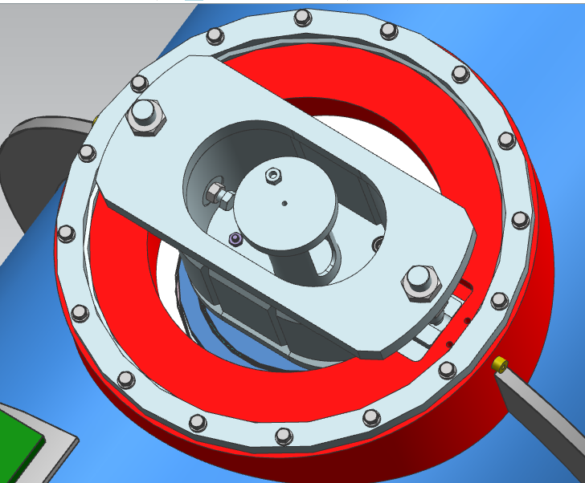
Lessons Learned applied to 3.9 GHz CM assembly at WS4
MLI pre-made blankets
Full incoming QC of the vacuum vessel, especially sealing surfaces for the O-rings
RF measurements and full electrical checks after cold mass is inserted into the vacuum vessel before the alignment
Tightening and torqueing scheme and sequence of the cold mass support fasteners to ensure contraction/expansion and secure the cold mass inside the vacuum vessel during CM transport
Fixture support, all the fasteners (vertical & horizontal) are in contact with vacuum vessel, torqued to spec
Sliding support horizontal fasteners have a 0.075 mm gap, not in contact with vacuum vessel

Slide 15
Lessons Learned applied to 3.9 GHz CM assembly at WS5
Increased attention for fasteners locking mechanism (at least two such as torqueing, lock washers, Belleville washers, Loctite etc. to prevent loosening during operation and transport (ED0011128)
N-type RF connectors (hermetically sealed) vacuum leak tightness reliability with proper torqueing of the connectors on the bench then during installation of the RF cables
Insulating vacuum leak check duration shortening with optimized pumps/purge setup and ICB production floor doors, exhaust/ceiling fans configuration to minimize helium background contamination negative effects

Slide 16
TRANSPORTATION PLAN

Slide 17
CM transportation experience
B. Hartsell
Successfully transported FLASH 3.9 GHz cryomodule from Fermilab to DESY in April 2009.
Transportation to DESY: 2 trucks, plane and hands off between
LCLS-II 1.3 GHz cryomodules
To date, successfully transported seventeen 1.3GHz cryomodules from Fermilab to SLAC after a failed shipment (F6) in January 2018.
Many lessons learned from these experiences are integrated into the LCLS-II 3.9GHz shipping plan.
See B. Hartsell talk

Slide 18
What has been done so far?
R. Stanek
Fresh Look meetings held to explore the 3.9 GHz design and evaluate sensitive components and the ability to design for
transportation ✓
Analysis (1.5g load in 3 directions) showed a possible concern about local stress in the coupler pull out area ✓
Three shaker table tests were performed: looking at various configurations ➔ all good ✓
No failures and FLASH-like dampening of cold coupler proved effective
Final shaker table test ➔ Realistic configuration with blade tuner, CM-like supports, warm coupler removed, dampening - all looked good
Test fit new 3.9 GHz inner frame ✓
Transport of cavity string/UCM from MP9 to ICB ✓
18

Slide 19
Successful Integrated shaker table test (cavity/coupler/tuner)
Damping fixture to support cold coupler (successfully used for FLASH CM)
Accelerometers
See N. Solyak & T. Khabiboulline talks
19

Slide 20
Cavity String/UCM Transport
F3.9-1 and F3.9-2 cavity strings successfully transported
Record of Decision process used to trigger shipment for F3.9-1
For this on-site move - very slow transport speed
No issues were noted
20

Slide 21
F3.9-01 String/UCM On-site Transport Vibration Summary
Slam Stick sensors on:
CGVs
Cav 5 coupler and 50K shield
Inner/Outer Frame
Overall excitation was low,
<0.5g on the inner frame, decent isolation frame performance.
Low resonance excitation on UCM components, indicating little to no danger from vibration
See J. Holzbauer talk

Slide 22
3.9 GHz Dummy CM
(See B. Hartsell talk)
“Dummy” 3.9 GHz CM
Using existing cold mass, dummy cavities (SS rounds with tabs) supported to UCM, one cavity (C1 position) supported with the actual FPC shipping support, etc.
Final spring configuration determined from this data
Road Tests: on-site, short, long set of tests

Slide 23
3.9 GHz CM in Transport Frame
Many similarities to 1.3 GHz transport but some key differences
Uses same transport end caps, same outer frame and same “types” of isolation springs but different stiffness
Dummy CM road test and transport to CMTS gave opportunity to gather real data
(See B. Hartsell talk)

Slide 24
Installation of 3.9GHz FPC Warm Ends at SLAC
See C. Grimm talk
3.9 GHz CMs will be shipped with warm couplers removed
This uses the same technique utilized for the successful transport of the FLASH 3.9 GHz CM transport to DESY (2009)
Minimizes concern associated with possible transportation loads
This configuration was successfully tested on the shaker table
This configuration was also successfully tested on the Illinois road tests when we had a cavity in position one
Reinstallation of warm couplers at SLAC
Trained and experienced Fermilab staff will do the work
Performed similar work for F1.3-07
Work will be done under the control of a specific traveler
In accordance with FMEA
Existing tooling will be used
All tools used for installation will be shipped from FNAL to SLAC prior to installation
Do not see any issues with performing this work at SLAC

Slide 25
Summary
An experienced team is working on this project
Lessons learned (design, assembly, previous transports) are applied
A solid transportation plan backed with extensive analysis and data from conducted tests is in place to safely ship LCLS-II 3.9 GHz cryomodules to SLAC

