Slide 1
3.9 GHz cavity/coupler Shaking Test summary
Nikolay Solyak, Valeri Poloubotko, Ken Premo, Rich Stanek,
Roman Pilippenko.
3.9GHz Transport review, Feb.13,2020

Slide 2
Coupler Transportation Tests Summary
Three Shaking table tests were done for 3.9 GHz coupler, assembled on dressed cavity, Each test has different configuration and focused on particular issue:
Configuration with full (cold and warm parts) coupler
  Shaking Test to measure effect of high stresses/deformation on coupler-to-cavity pull-out area. Confirm that coupler will survive after 0.5M cycle
  2. Transport configuration with cold coupler constrained damping fixture (like used for FLASH 3.9GHz CM transportation)
  Shaking test to measure damping performance
  Shaking test of integrated cavity (coupler, tuner, support system) to investigate damping and possible effect of transportation on cavity deformation (“banana” effect): ➔ frequency, field flatness, safety gaps on tuner.
  3. Typically we also performed “Hammer test” to measure coupler mechanical resonances in the system and damping

Slide 3
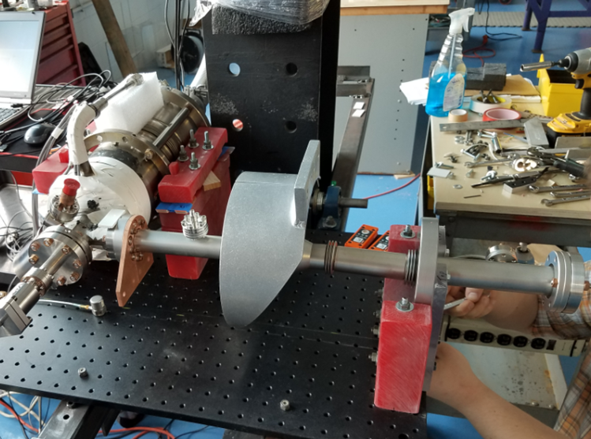
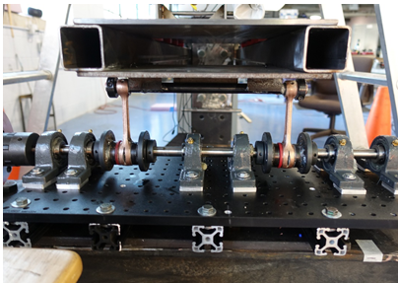
Where Shaking test
Report from company
Rebuilt vibration mechanism

Slide 4
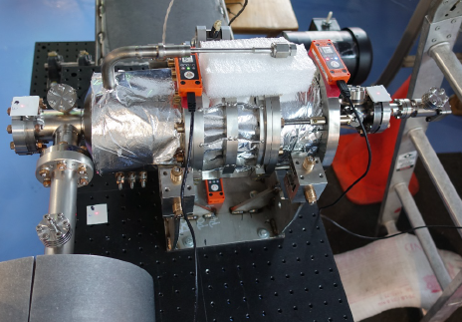
Basic Diagnostics
  Vacuum gauge; leak check before and after test
  Three SSX (accelerometers) at critical locations
  Three laser trackers for position measurements
  Vibration frequency control
  Additional diagnostics:
    4 Strain gauges on coupler pull-out
    RF: cavity frequency and spectrum,
    Tuner safety gaps.

Slide 5
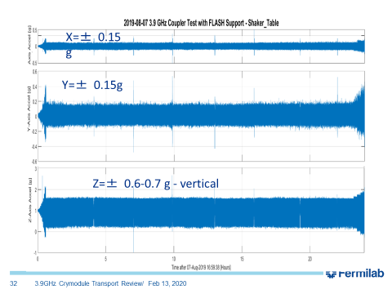
Testing protocol
In all cases amplitude of vibration was set (by installation) to +/-2mm with typical shaking frequency 7Hz for 24hours ~0.7Mcycles.
At the beginning of test a short frequency scan is perform to check system and collect data for analysis of resonances and amplitude amplification at the system.
At the end of each test frequency shortly (15-20min) increased up to 8.5-9Hz to provide larger acceleration (above 1.5g).

Slide 6
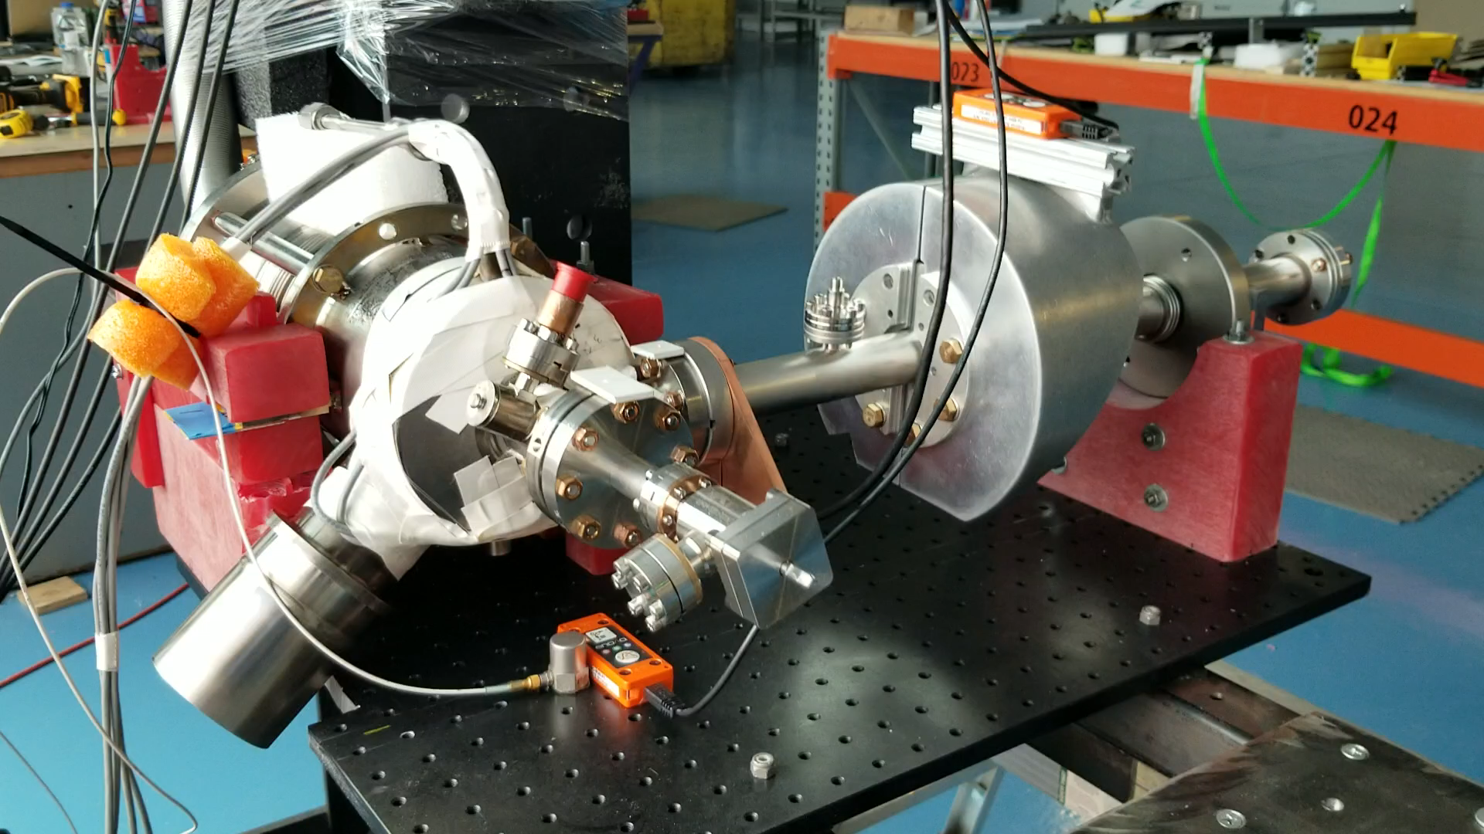
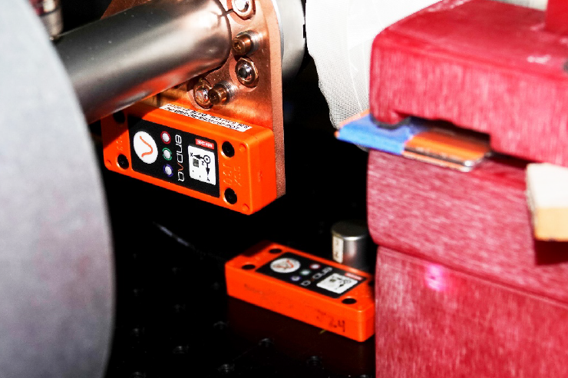
Shaking Table Test #1 (June 13-14, 2019)
Configuration with full coupler
Goal: Check possibility of damage coupler pull-out (vacuum leak).
J25
J24

Slide 7
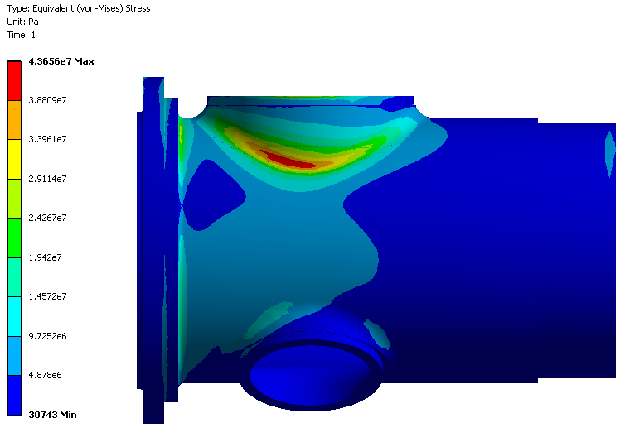
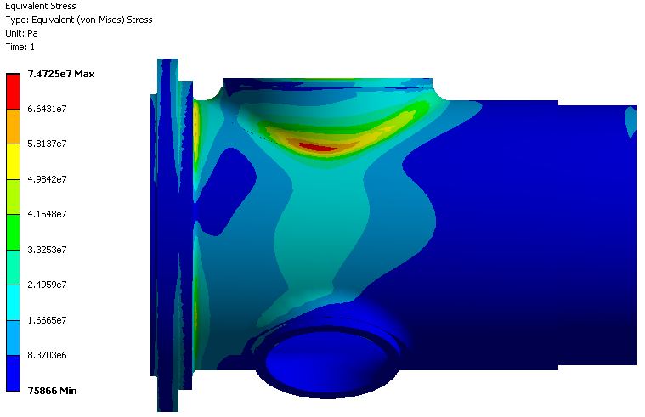
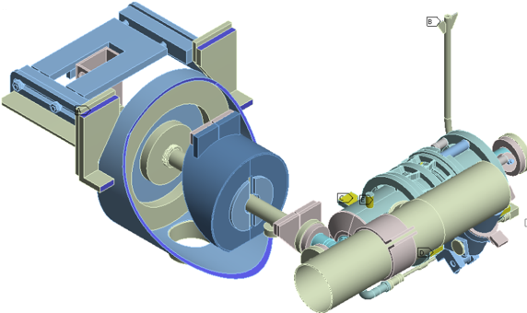
0.6G 0.2G 0.2G
1.5G 1.5G 1.5G

Slide 8
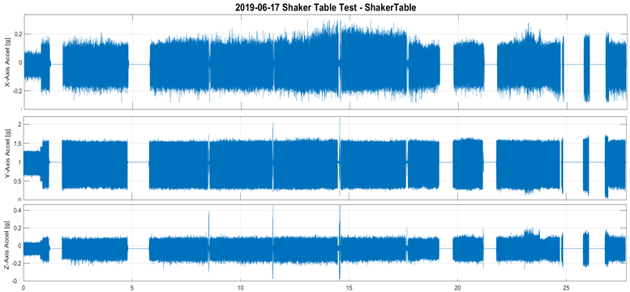
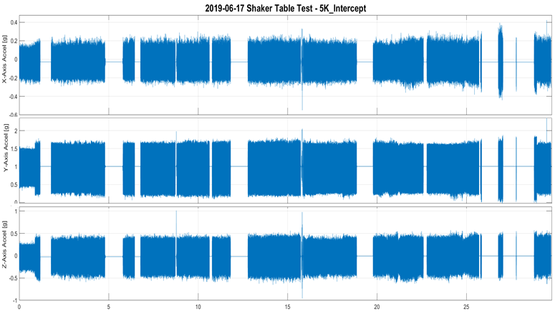
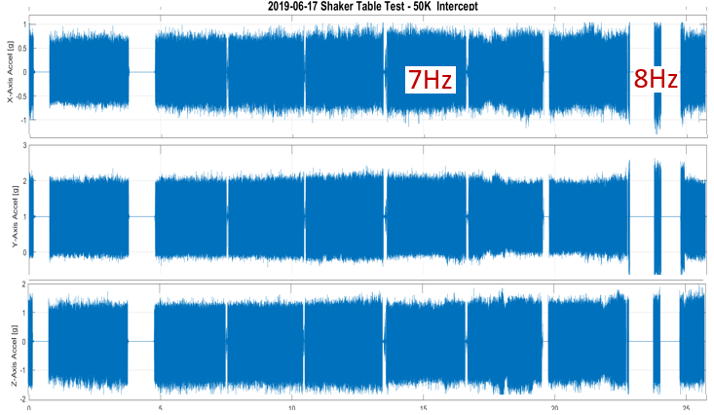
Accelerometer raw data

Slide 9
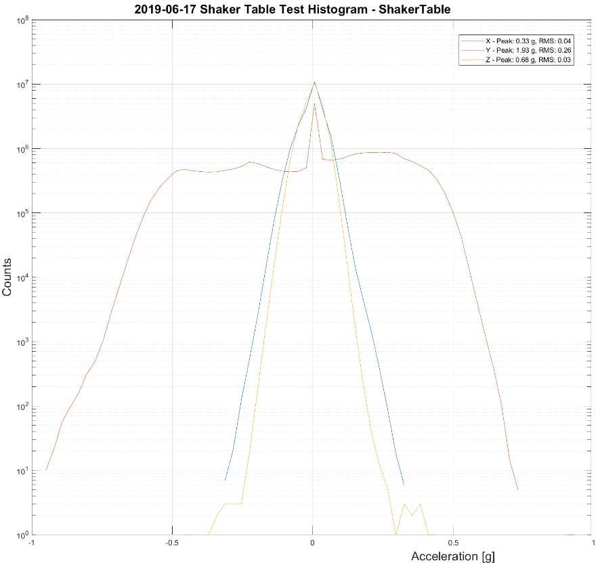
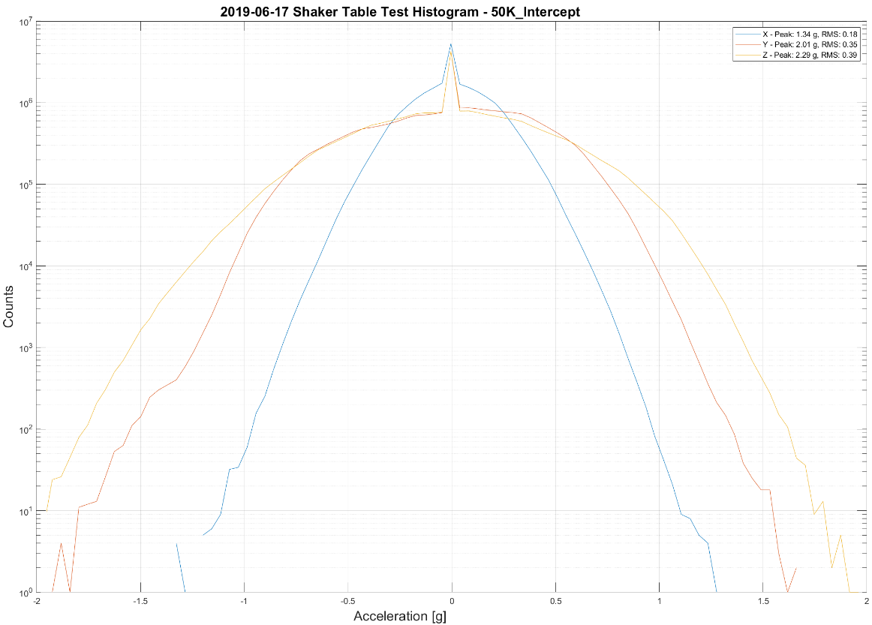
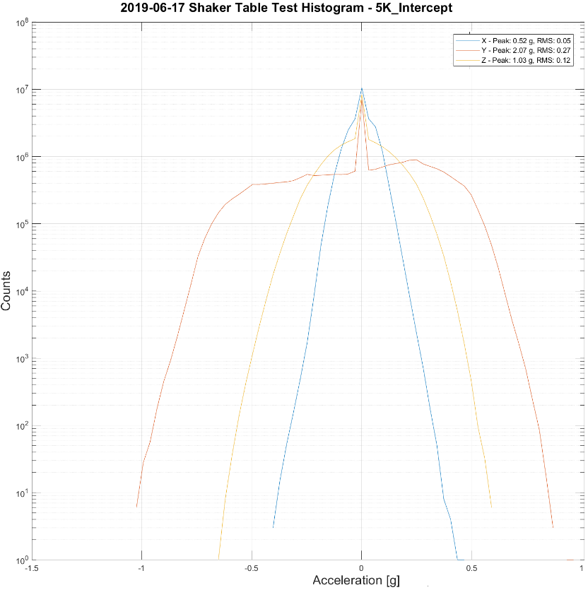
Histograms
Table: Y=±0.8g
50K shroud: Y=±2g
Amplitude almost doubled (up to ±2g) on 50K shroud
5K: Y=±0.85g
CM Transportation data is more quite than Shaking table data

Slide 10
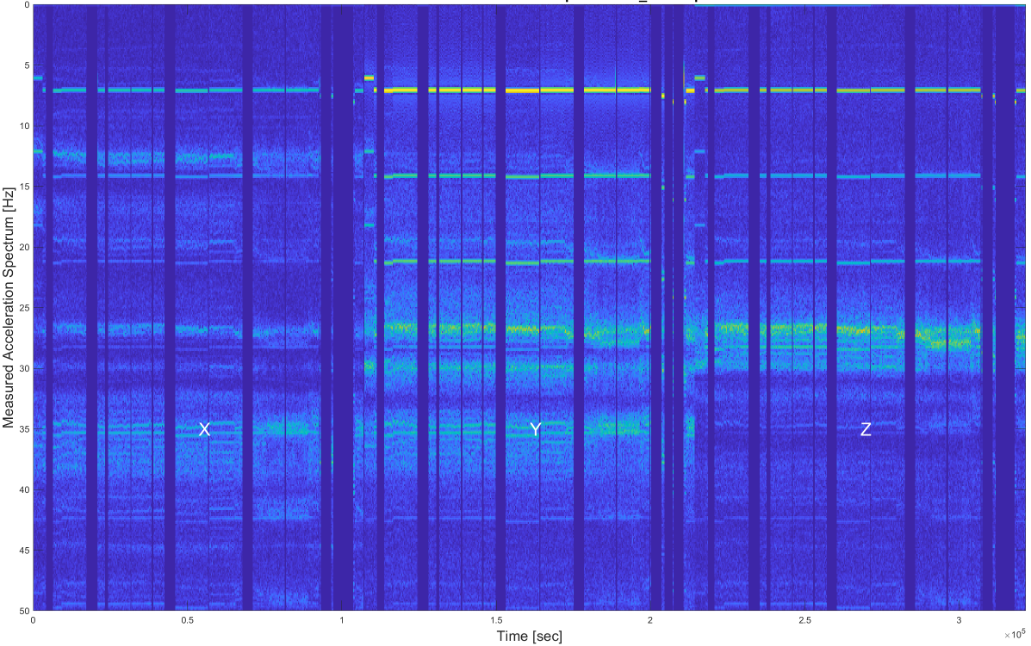
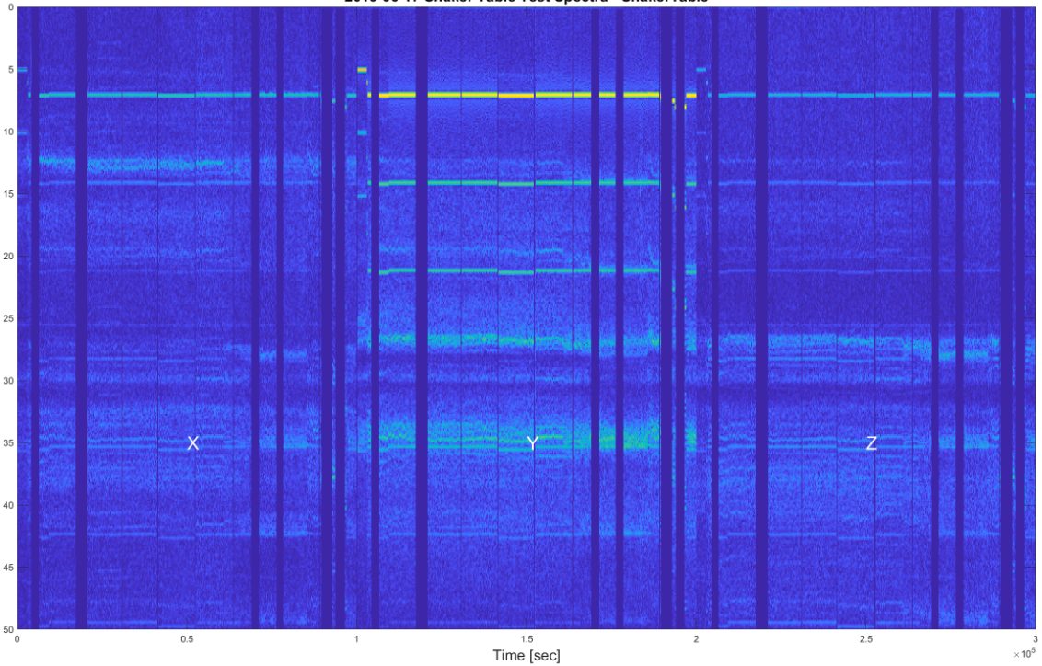
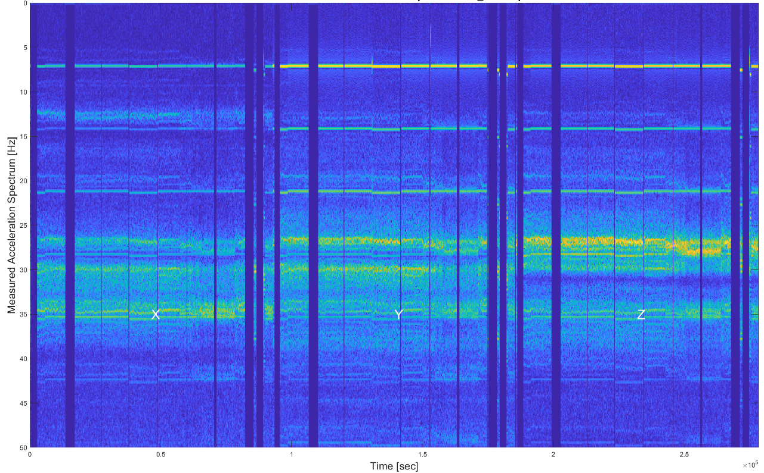
Spectra (Jeremiah)
Strong resonance in Z of the 50K shroud. Lines around 27, 29, and perhaps 35 Hz with the strongest being the 27 Hz in Z.
Clear enhancement in Z on 50K shroud. The driving term in Z from the table is small ±0.1 g, where the shroud response is around ±1.6 g in the same direction.

Slide 11
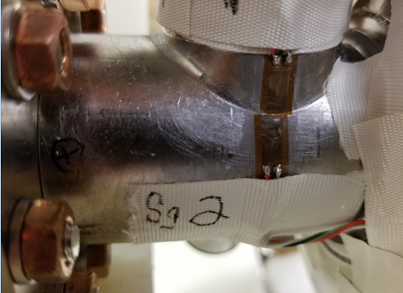
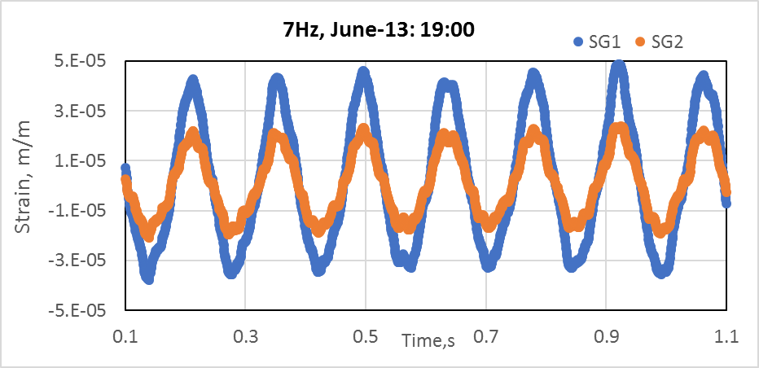
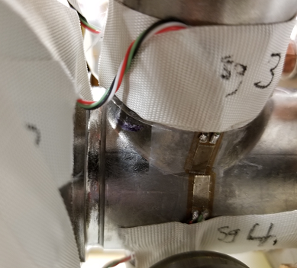
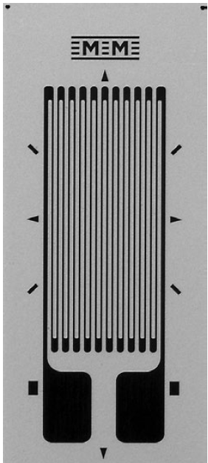
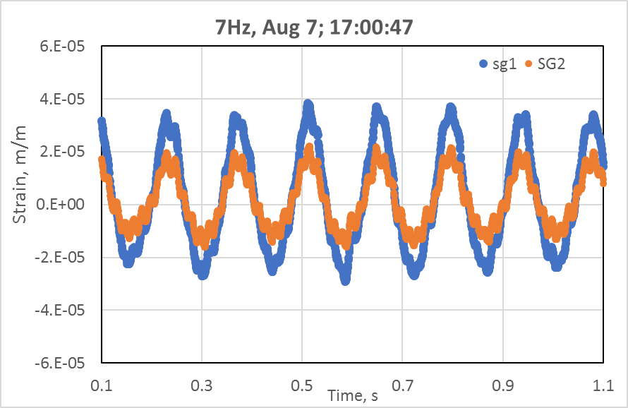
Strain gauges installed on both sides of cavity-to-coupler pull-out
Agreement with ANSYS at 02g/06g/0.2g + 1g static
test#1
Less stresses in test#2

Slide 12
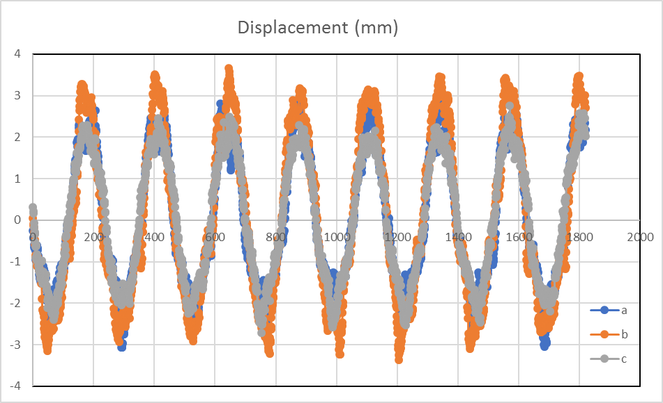
Laser tracker data measured for Table, 5K and 50K shroud
@ 7 Hz
Larger amplitudes (3 vs. 2mm-table) at 50K shroud end (d)

Slide 13
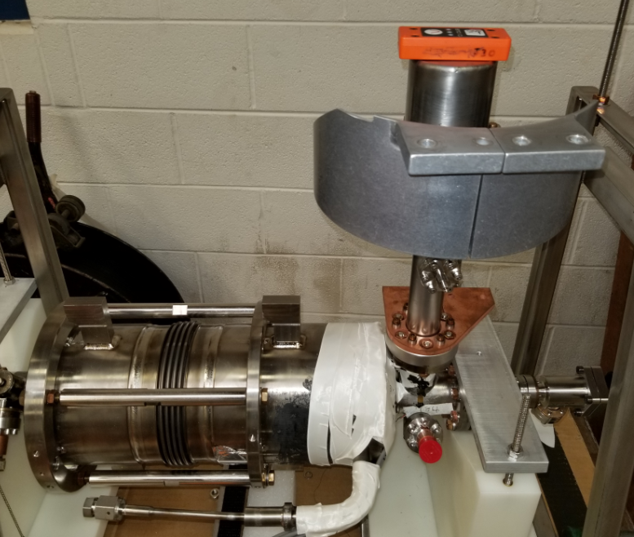
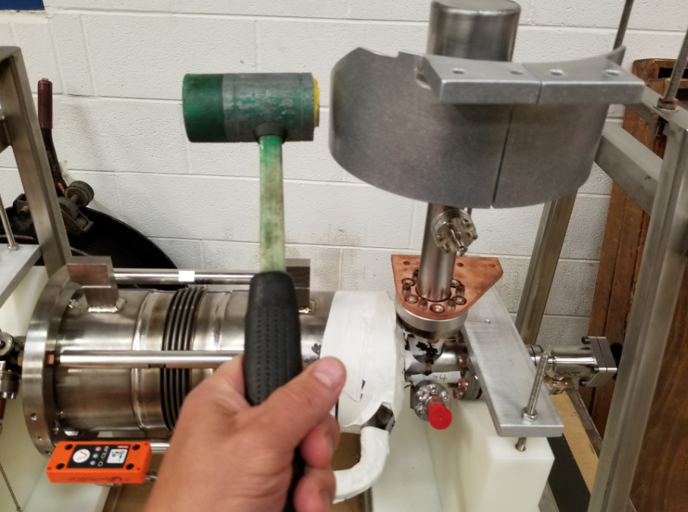
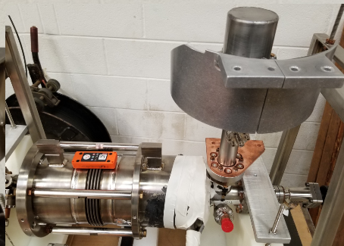
Hammer tests
SSX on Coupler
SSX on He supply
SSX on cavity

Slide 14
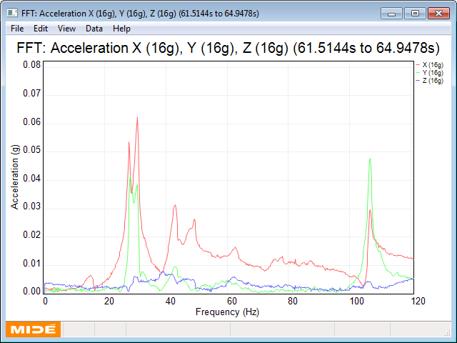
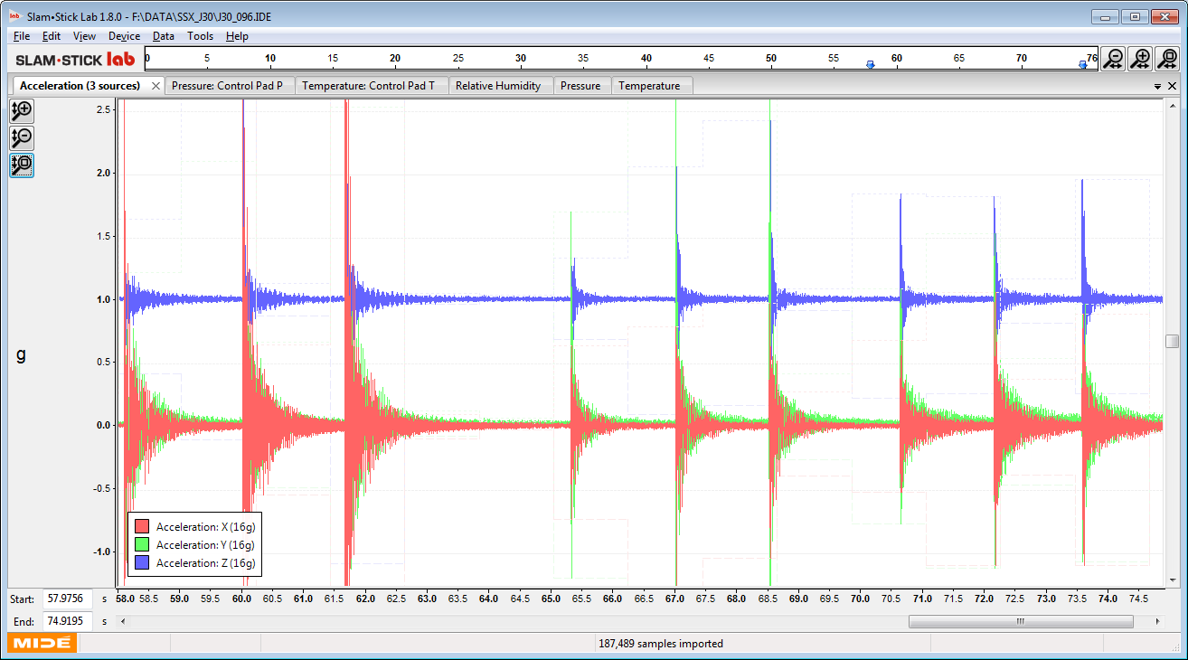
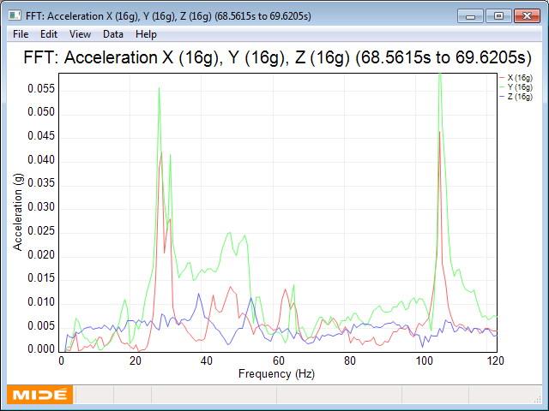
Hammer test:
SSX position: Coupler
Excitation:
coupler
Excitation:
cavity
Excitation:
He supply
Excitation source: Coupler
27,31 Hz
Q~20
Conclusion
Excitation source: cavity
105Hz
  Coupler has two resonances 27, 31 Hz with Q~10-20
  All cavity resonances are above 100 Hz
  He supply pipe has resonance at ~51 Hz with Q~50, if not damped by foam
27,31 Hz

Slide 15
Summary of Test #1
Conclusion/observation after test:
  At 50K shroud data show strong resonance lines around 27, 29, and perhaps 35 Hz with the strongest being the 27 Hz in Z.
  Resonance peaks are consistent with “Hammer test” data
  Amplitude of oscillation of shroud is x2 higher vs. on Table (±1.2g vs. ±0.6g)
  Strain gauges data is matched with ANSYS simulation (for 02g/0.6g/0.2g)
  Coupler survive in test, no visible deformations, Vacuum is still good, no leak developed
  In test coupler experienced ~0.7Mcycles with up to 1.5g acceleration w/o damage, no issues found except resonances, and amplitude amplification. Possible problems for CM transportation in this configuration.

Slide 16
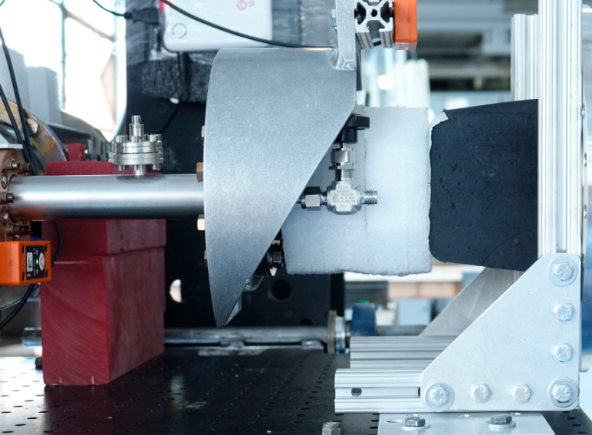
Shaking Table test#2 (Aug19,2019) cold coupler constrained
3.9 GHz cryomodule for FLASH was transported without coupler warm part using specially designed supporting fixture to dump coupler vibration. Transportation did not show any problems.
Goal : demonstrate that FLASH like transportation configuration will work for LCLS-II 3.9GHz cryomodule.

Slide 17
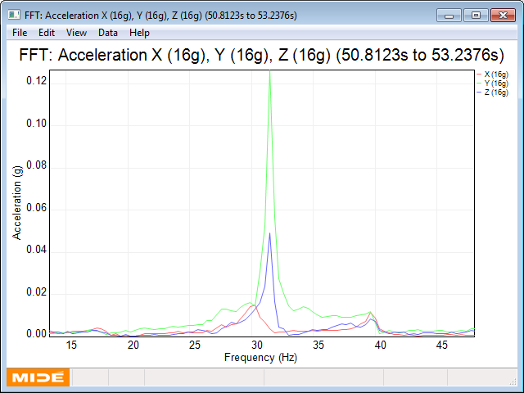
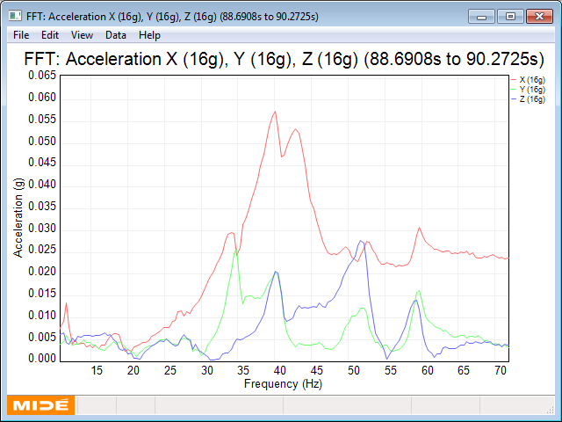
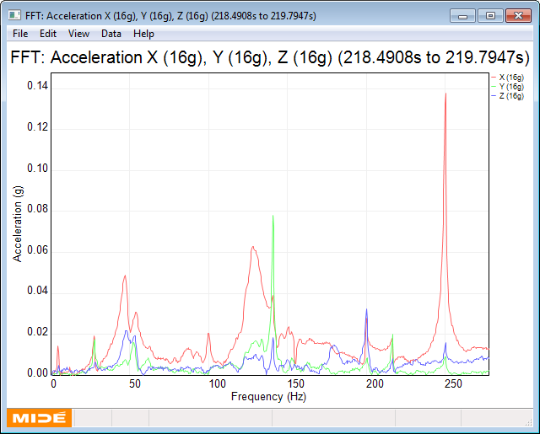
Spectrum vs. foam compression (transportation fixture)
“Hammer test” of 3.9GHz coupler assembled w/o warm part using FLASH-like transportation fixture
No contact
Touch contact-0mm
Compression 4mm
Resonance ~ 31 Hz
Amplitude ~ 0.1; Q ~30
Freq shifted to 40Hz
Amplitude ~ 0.05, Q ~3-4
Freq shifted up ~47 Hz
Amplitude 0.05; Q ~ 3-4
Recommended compression 2-4mm

Slide 18
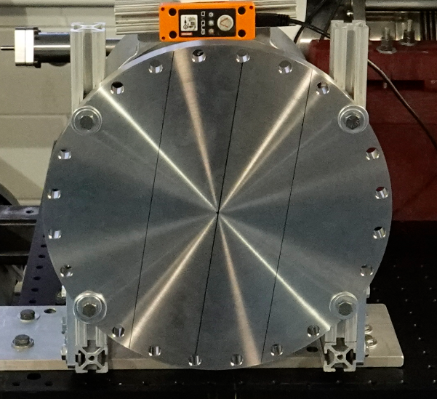
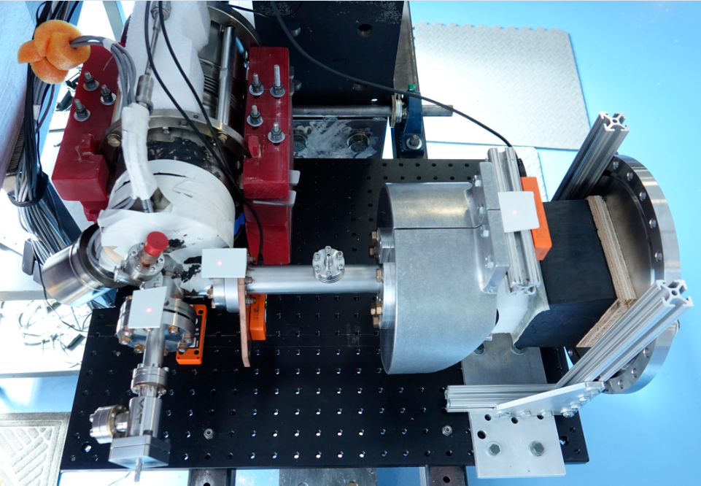
Cavity and coupler installation pictures
Foam insertion is push to coupler can and compressed by rubber block by ~2.4mm

Slide 19
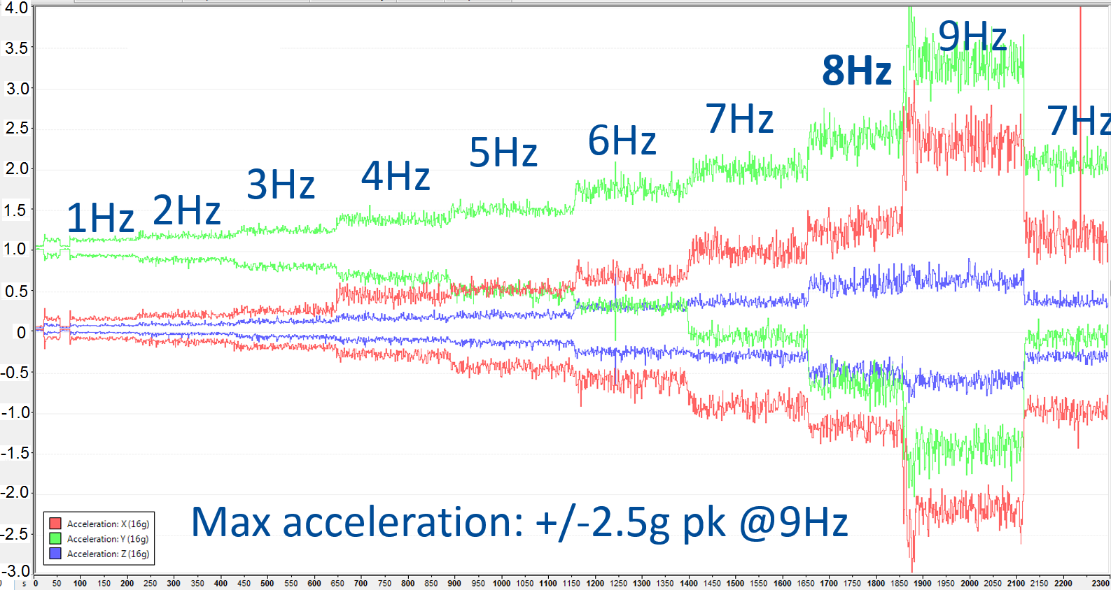
Initial frequency scan: 1…9 Hz (SSX-J24 50K)
50K_shield (J24)
9Hz
8Hz
7Hz
7Hz
5Hz
6Hz
3Hz
4Hz
1Hz
2Hz
Max acceleration: +/-2.5g pk @9Hz
Max Acceleration (vert): $V=±\text{0.5}\text{g} @5Hz; ±1$g @7Hz;
Major data are taken at 7 Hz

Slide 20
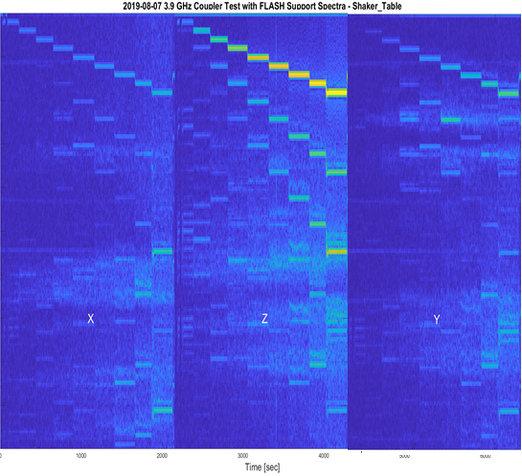
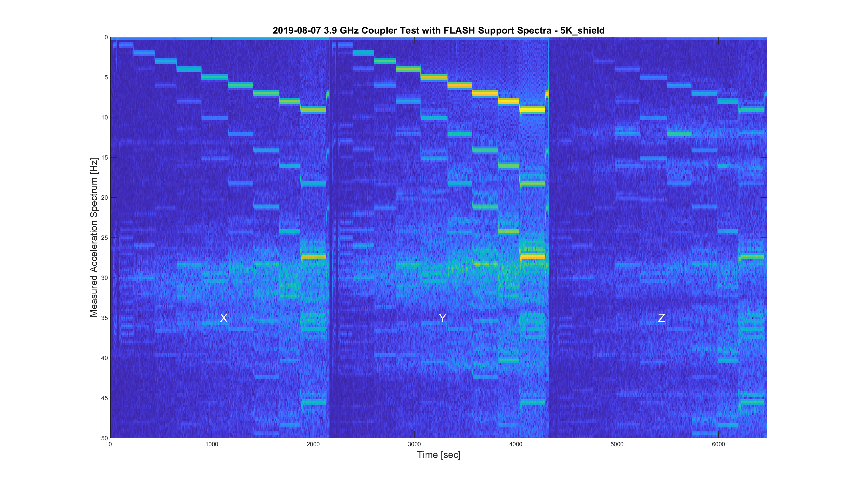
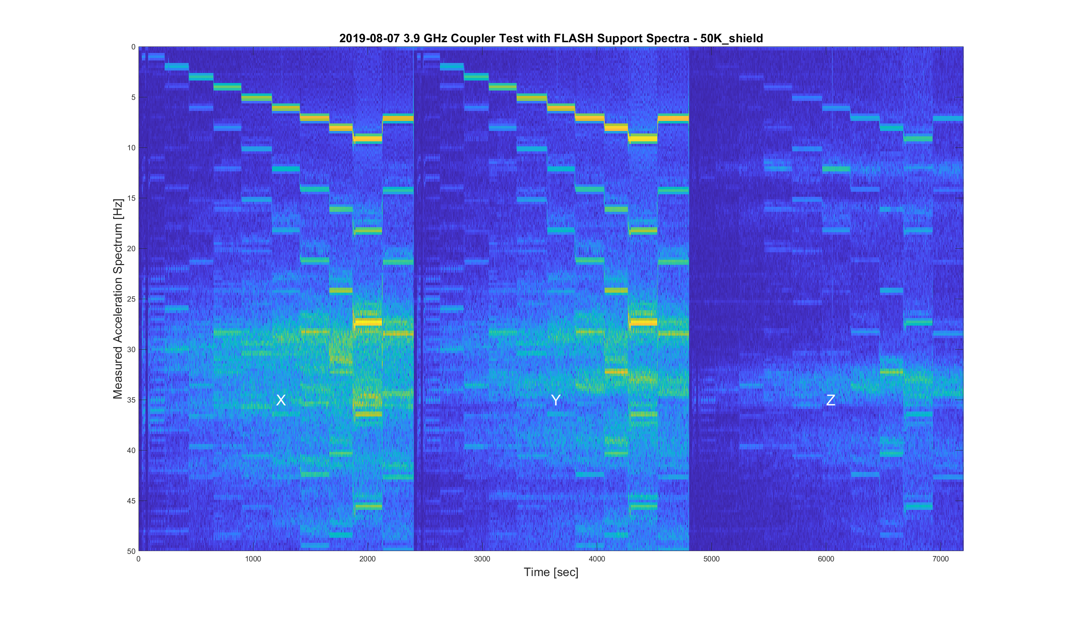
Spectrums of oscillation
27 Hz line resonance seen in Z on 50K shroud and 5K also, amplitude is small

Slide 21
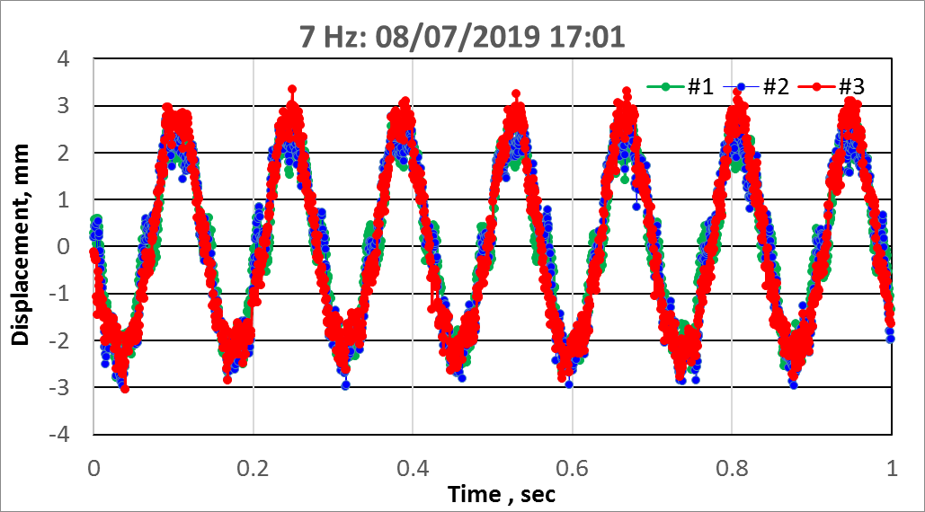
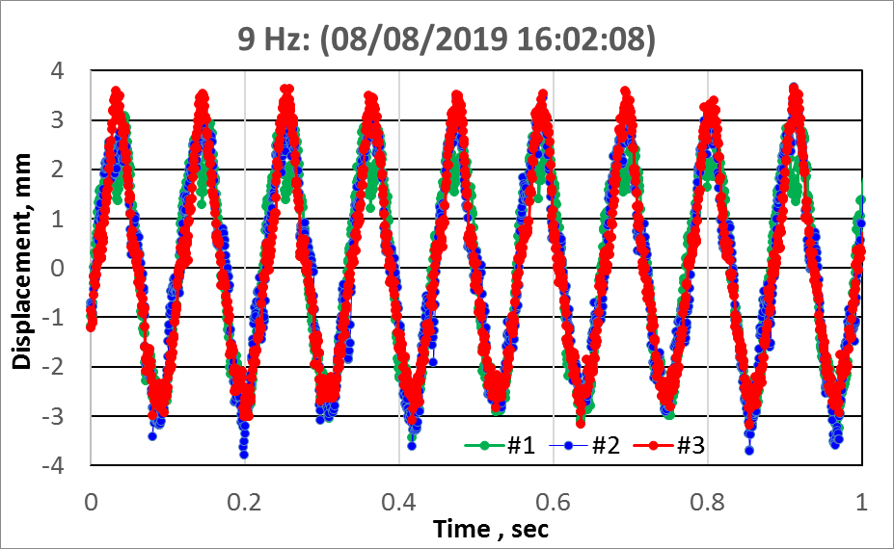
Laser tracker data
test#2 (Aug 27,2019)
Small Amplification of amplitude on 50K shroud

Slide 22
Summary of test#2
Goal of test: to check that FLASH like shipping configuration for 3.9 GHz coupler support damp shock/vibration coming from transportation. Also check that stresses on coupler port is low enough and will not damage material and open vacuum leak.
Standard Protocol: 7Hz with +/- 2mm amplitude for 24 hours (~0.77Mcycles) to provide ≤ 1g peak acceleration. Frequency scan from 1 to 9 Hz to identify resonances- beginning of test. At the end of test frequency increased up to 9.0 Hz to collect events with highest acceleration.
Conclusion/observation after test:
  FLASH like support of cold coupler effectively damp oscillation of 50K shroud.
    Amplitude of 50K shroud reduced, resonances dumped to Q ~ 3
    Strain gauge data show less stresses vs. full assembly with warm part
  No vacuum leak after test

Slide 23
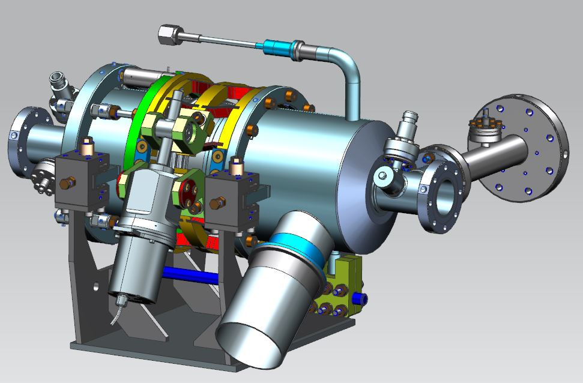
3.9 GHz cavity + coupler + tuner. (Nov.8-9, 2019)
Integrated Shaking Table Test (#3):
Goal for this test:
Check if possible cavity deformation during transportation: which can cause frequency shift, change field flatness and change loading of piezo in tuner.
Cavity assembled with tuner and coupler in the same configuration as in real CM (frame support)
Transportation fixture connected to cold coupler to damp oscillations (reduce coupler vibration and stresses)
Standard testing protocol with 7.5Hz frequency run

Slide 24
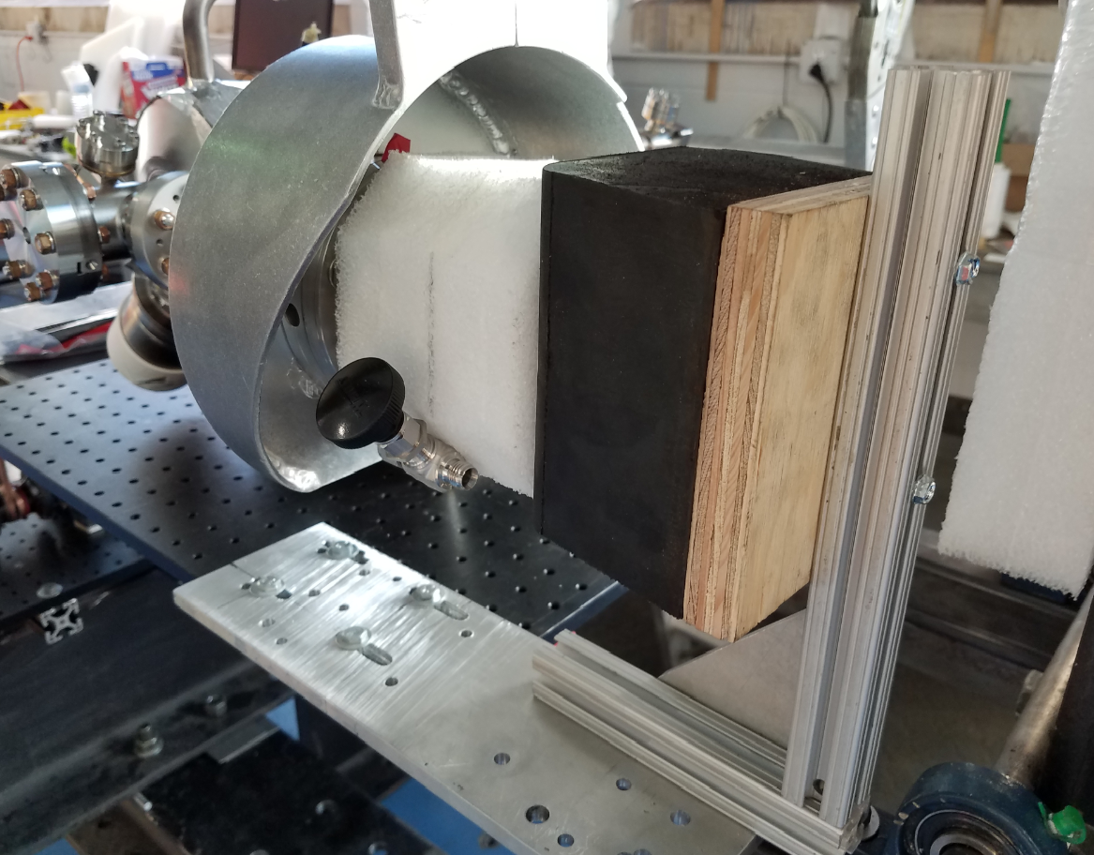
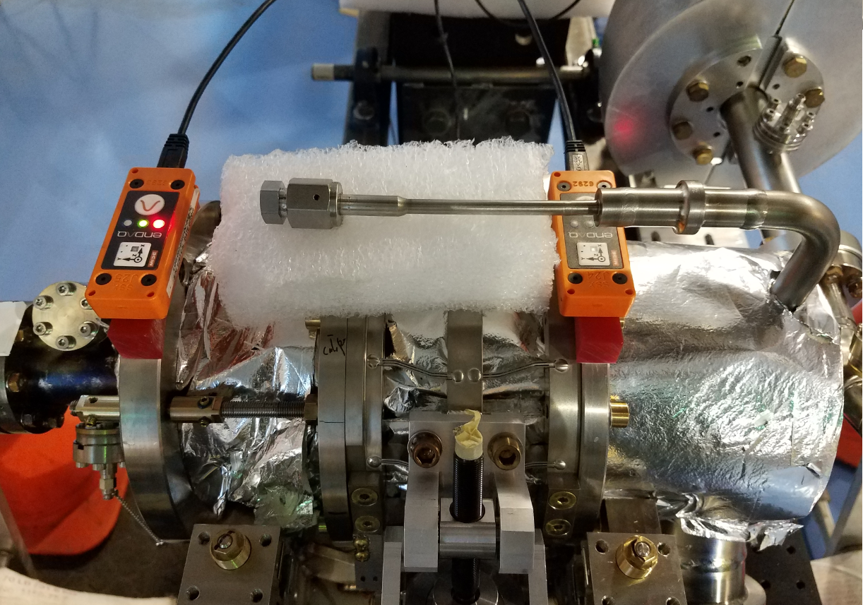
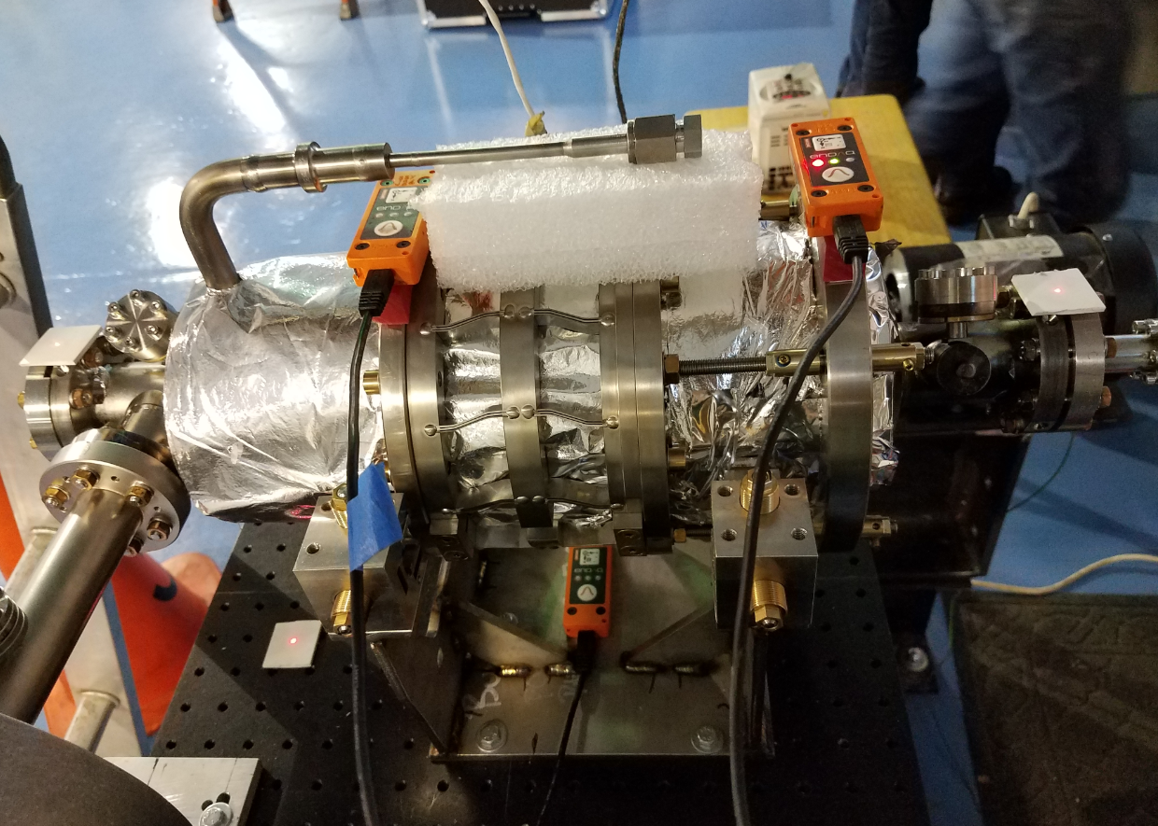
Cavity configuration on the shaking table.
Cavity supported by frame, foam to damp He line vibration, damping fixture for cold coupler

Slide 25
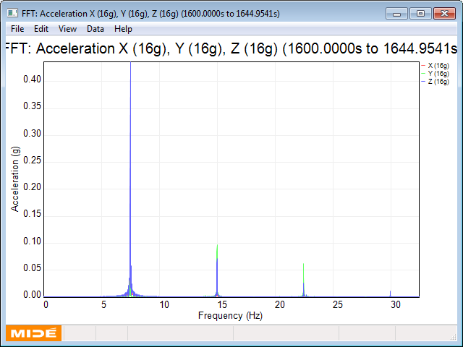
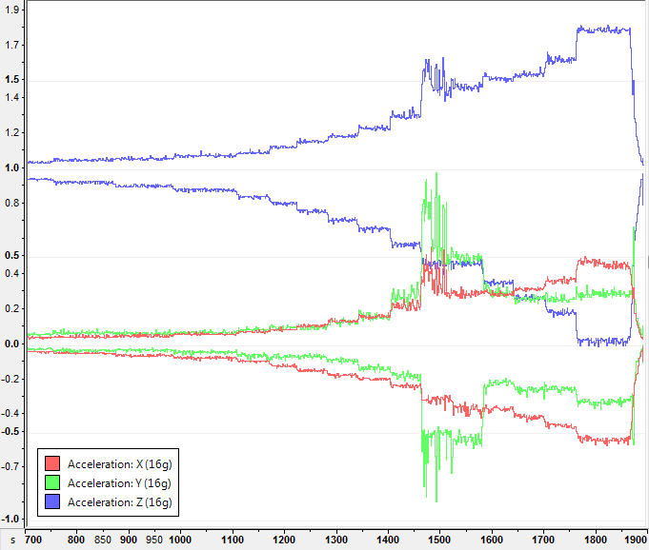
Frequency scan
Resonance,
unstable
Spectrum at 7.5Hz
3 Hz
3.5 Hz
4 Hz
4.5 Hz
5 Hz
6 Hz
7 Hz
5.5 Hz
9 Hz
6.5 Hz
7.5 Hz
8.5 Hz
8 Hz
Frequency choice for 24Hrs run: 7.5Hz
(vs.7Hz in previous tests)

Slide 26
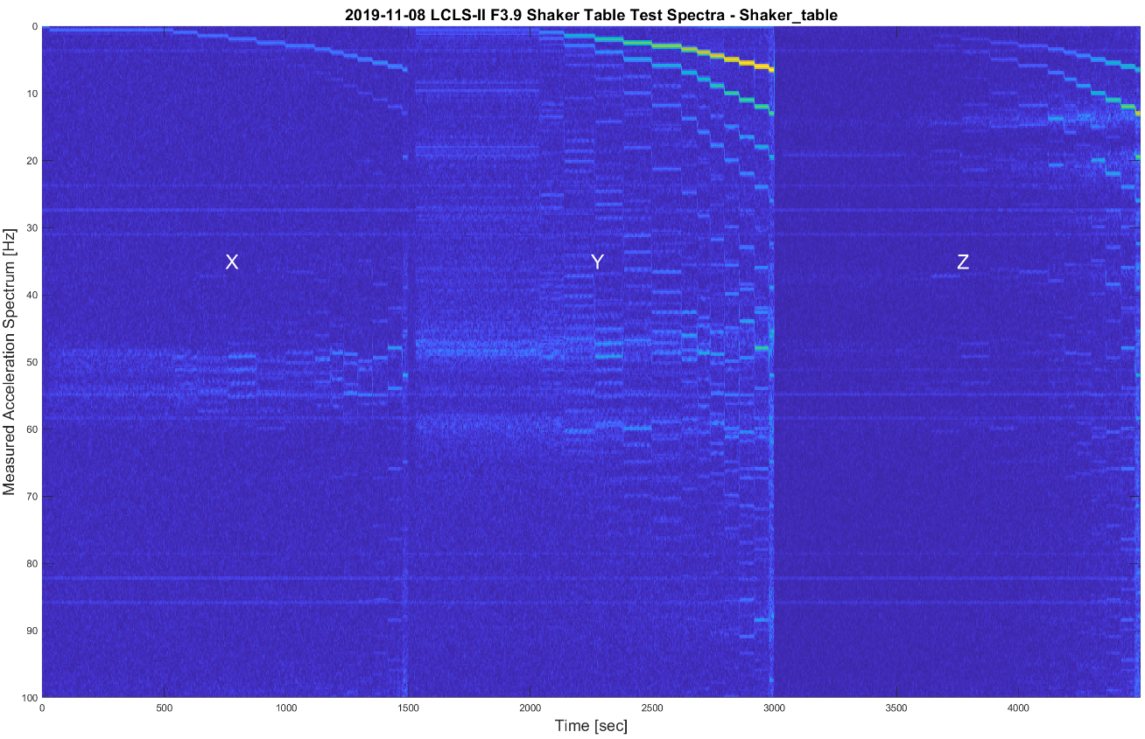
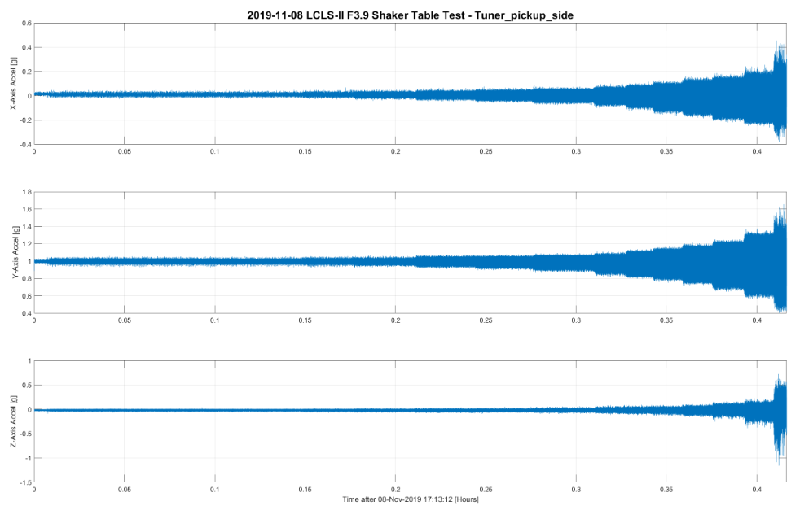


Spectrograms
X-Y motion coupled on cavity
No high Q resonances,
No issues

Slide 27



Laser Tracker data
Start of test
Middle of test
End of test
Small reduction of displacement from the coupler end

Slide 28


Cavity Frequency measurements
Mode spectrum was measured before and after the shaking test with fixed and relaxed position of locking rods
Frequency change after shake test is small, +25 kHz (mostly due to Temp change).
Spectrum distortion is also small ➔ no field flatness change.
T. Khabiboulline
Cavity deformation (banana effect)
Objectives to measure of load from tuner on the cavity by measuring gaps between Nuts on the 4 safety rods and flange, welded to the He Vessel.
  - We do not observed any changes.

Slide 29
Summary for Test#3
Conclusion/observation after test:
  No vacuum break (freq. measurement) - leak check after test
  No any measurable deformation in the cavity shape:
    4-Gap measurements on safety rods before and after test
    Frequency shift
    No Field flatness deformation ➔Spectrum measurements before and after the test (with open/close gaps)
  NO any problems was identified.

Slide 30
Conclusions from Shaking Table Tests
As a result of Shaking Table and Hammer tests we identified safe configuration of the coupler in 3.9GHz cryomodule and required fixture for transportation. Fixture effectively damps coupler oscillations and significantly reduce risk of failure and deformation of most critical components: coupler, cavity and tuner

