Slide 1
Cavity Tuner configuration for LCLS-II 3.9 GHz CM Transport
Timergali Khabiboulline
LCLS-II 3.9 GHz CM Transportation Review
February 13, 2020

Slide 2
Outline
Cavity protection before cold mass
Cavity in cold mass
Tuner constrains cavity during CM assembly, transportation and test
Tuner positions at different stages of assembly and test
CM transport configuration
Summary

Slide 3
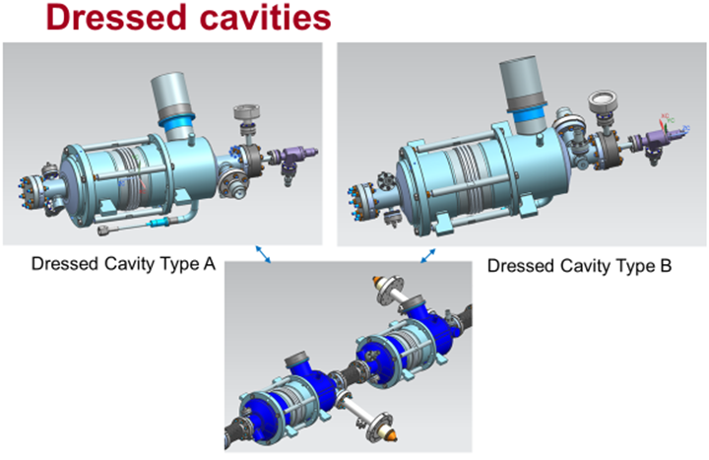
Cavity configuration on delivery

Slide 4
Cavity configuration on delivery
Dressed and ready for VTS cavity is constrained by 4 rods for transportation from vendor to FNAL
Cavity arrives installed in transportation container with integrated safety measures
Cavity RF QC provided before and after transportation
No change in main RF parameter has been observed

Slide 5
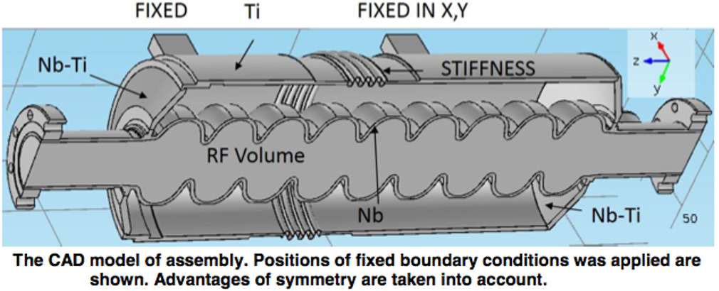
Mechanical modes of dressed cavity
Mechanical modes of dressed 3.9 GHz cavity supported by HV support lugs were simulated
Lowest frequency > 200 Hz corresponds to 1st transverse mode
1st longitudinal mode frequency > 500 Hz for tuner 40 kN/m stiffness
Situation will not change significantly when tuner added and locked by 4 safety rods

Slide 6
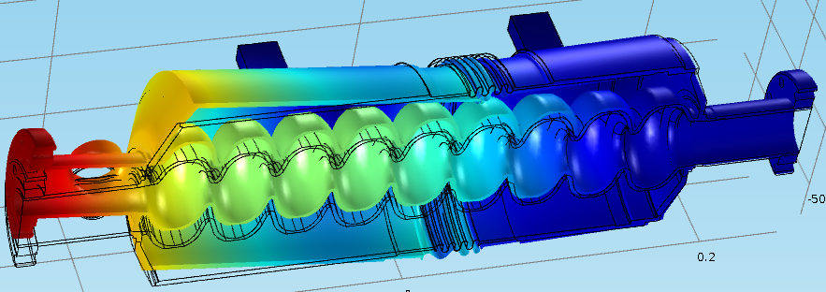
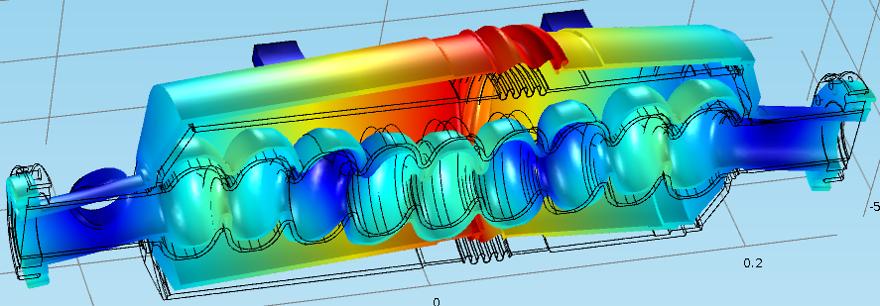
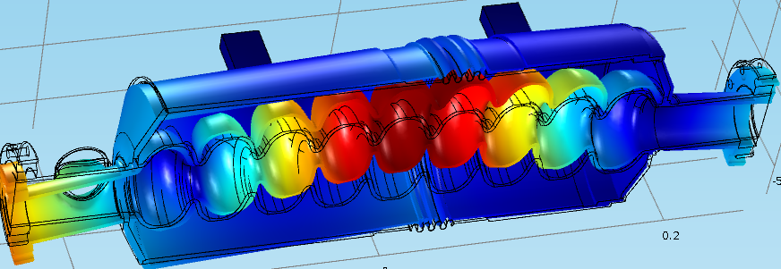
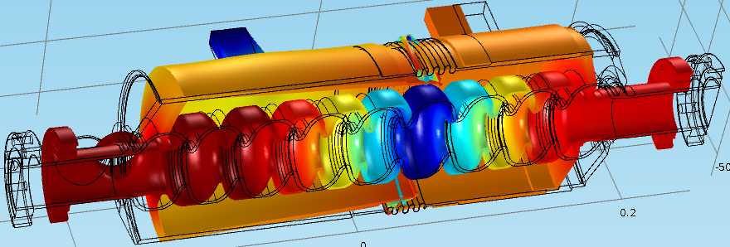
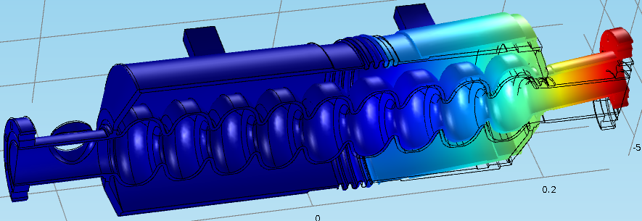
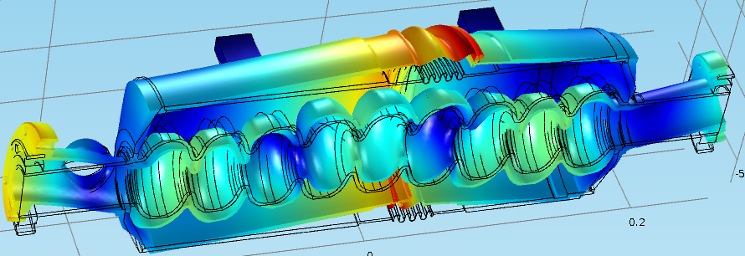
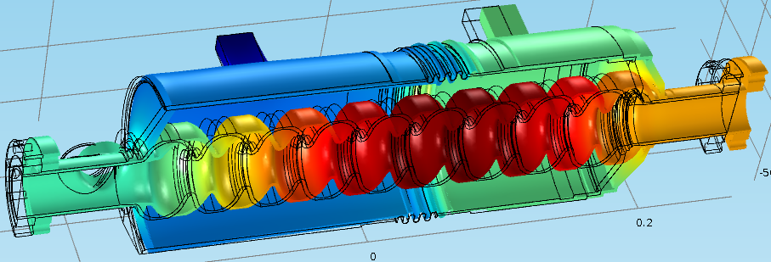
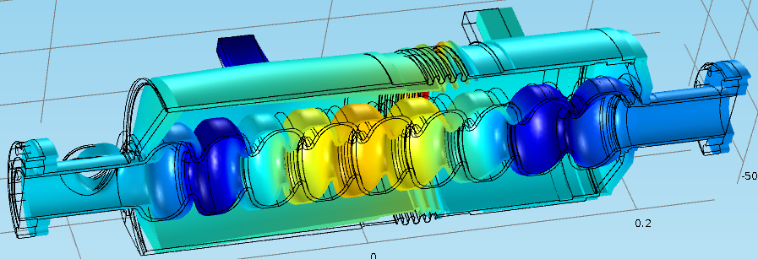
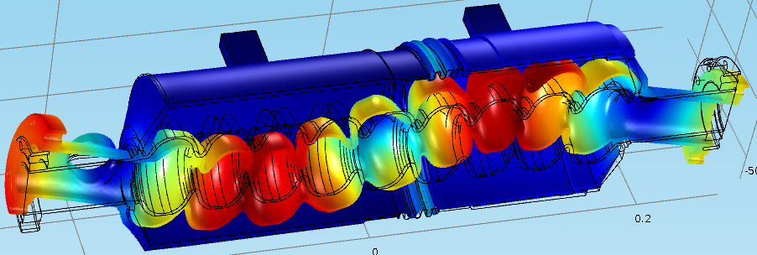
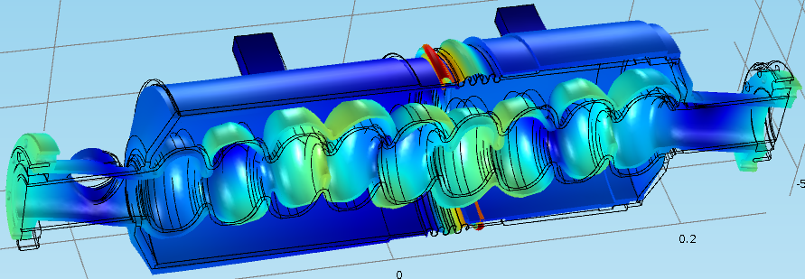
Cavity modes
Stiffness of the Tuner = 40 kN/mm
T#1
T#5
F, Hz
219
F, Hz
720
T#2
L#2
F, Hz
232
F, Hz
785
T#3
T#6
F, Hz
371
F, Hz
866
L#1
L#3
F, Hz
506
F, Hz
1076
T#4
T#7
F, Hz
526
F, Hz
1101

Slide 7
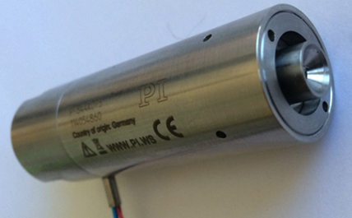
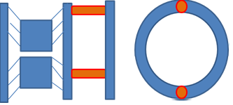
Tuner design
‘Slim’ blade tuner design is preferred to minimize significant re-engineering of the dressed cavity/helium vessel while providing room for a larger 2-phase chimney
Designed and built by LASA, Milano for the 3.9 GHz cavities fabricated for XFEL project
Modified to allow fast tuning by means of piezo tuners
Encapsulated piezo designed for the LCLS-II 1.3 GHz cavities will fit well for this task
Experienced RF & microphonic team at Fermilab to set up and commission tuner
Encapsulated piezo stack for Fast tuner
Schematics of the modification of the INFN tuner by adding 2 encapsulated piezo stacks

Slide 8
Tuner design
Slow Tuner: (1:50 planetary gear)
Range: 0.3mm → 750 kHz;
Resolution: 6-10Hz/step;
Load: 0.8 kN / piezo
Fast Tuner:
Tuning range: 10um → 18kHz
Resolution = 0.8Hz

Slide 9
Tuner design
Design Verification test of the cold dressed cavity/tuner system confirmed that tuner performance met or exceed specifications
Developed (and confirmed with tests) procedure of the tuner assembly on the dressed cavity (including setting safety gaps)
Dressed cavity/magnetic shielding/tuner integration efforts lead to small modifications that were incorporated into production drawings for tuners and magnetic shielding
Cool down and warm up during cold test of 1st CM at CMTF didn’t show any issues

Slide 10
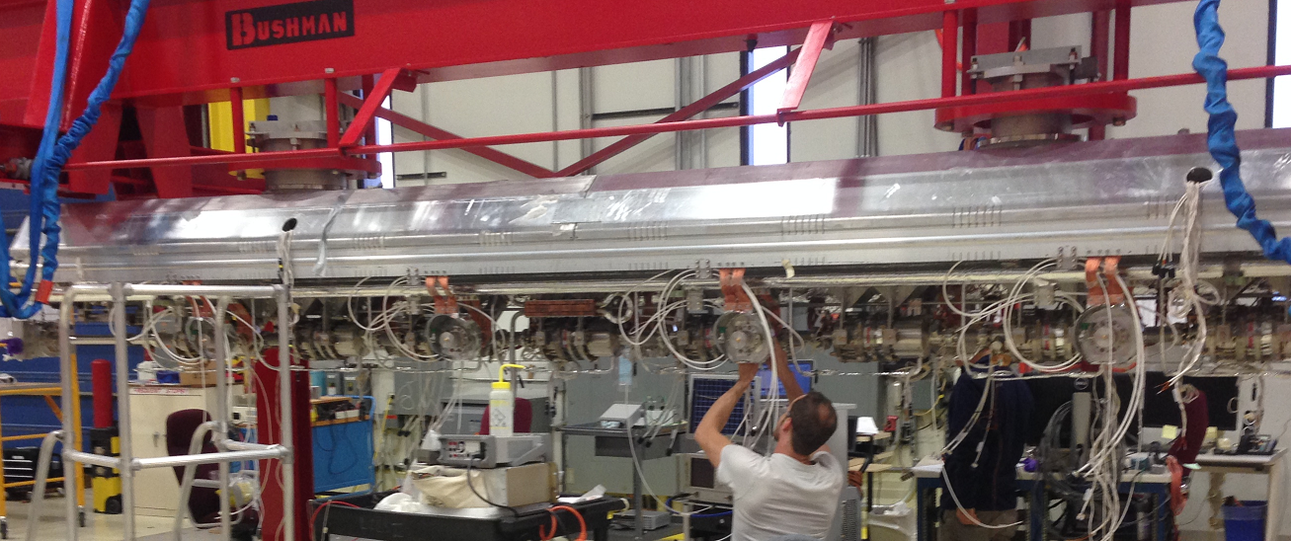
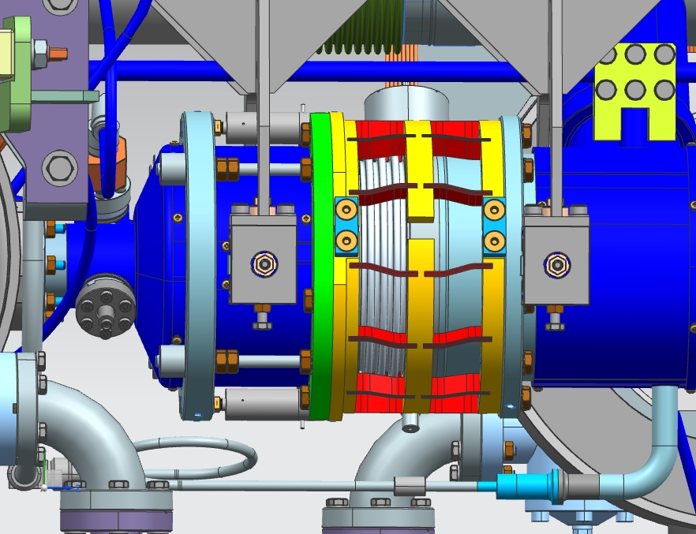
CM ASSEMBLY
In cold mass the dressed cavity with Tuner supported by 4 lugs on gas return pipe
Lug support fixture allows motion longitudinally - in direction of cavity axes
Additionally cavities interconnected by invar rod constraining longitudinally
All RF cables connected to cavity have ~ 0.7 m long half loops in order to avoid any stressed on HOM and pickup port of the cavity during cool down and transportation

Slide 11
Successful integrated shaker table test (cavity/coupler/tuner)
Damping fixture to support cold coupler (successfully used for FLASH CM)
Accelerometers
11

Slide 12
Successful Integrated shaker table test (cavity/coupler/tuner)
For shaker table test, cavity compressed with safety rods (closing safety gap) of the Tuner. We compressed cavity on ~500N.
We confirmed that cavity will be protected in this configuration by
measuring cavity frequency before & after shaking
measuring tuner dimensions by using shims
12

Slide 13
TRANSPORTATION PLAN
For transportation tuner configuration will be same as for shaker table test. Cavity compressed with safety rods.
F3.9-01 was transported to CMTF and back to ICB successfully in this configuration of tuner

Slide 14
Tuner Position at Various Conditions
State Table defines position of tuner under various conditions of vacuum/pressure
Also defines when RF and Tuner teams need to be contacted => to assure position
Testing and Transport teams are well aware of this requirement which is needed only for 3.9 GHz
This table has been incorporated into travelers

Slide 15
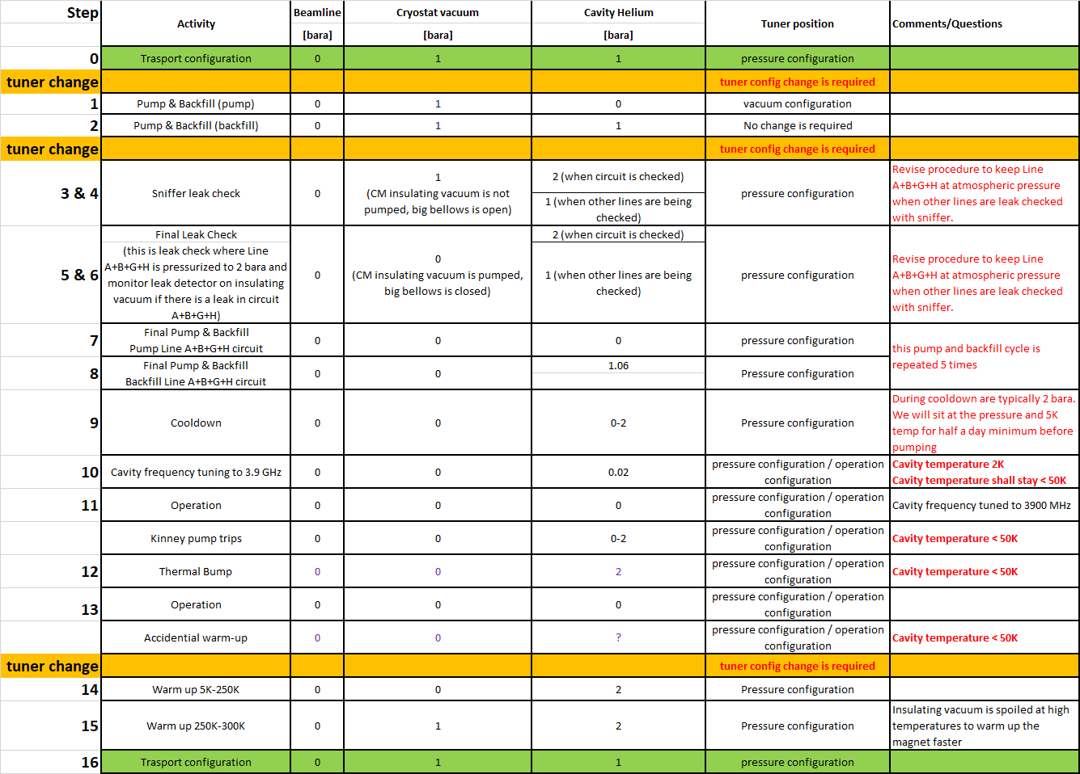
Tuner State Table

Slide 16
Summary
Internal mechanical modes of dressed cavity have frequency well above frequencies of vibrations developing during CM transportation
Tuner safety rod gaps are closed for transportation. This ensures absence of any loose parts of cavity/tuner assembly
Shaker table confirmed that cavity will be protected in approved transportation configuration
F3.9-01 was transported to CMTF and back to ICB successfully in this configuration of tuner

