Slide 1
3.9 GHz FPC Warm end Installation at SLAC
Ken Premo/Chuck Grimm
LCLS-II 3.9 GHz Cryomodule Transportation Review
13 February 2020

Slide 2
Installation of 3.9GHz FPC Warm Ends at SLAC
Process and procedures
Process will follow 3.9 GHz warm end installation used at FNAL
Special hard copy traveler will be developed, similar to F1.3-07
Sign offs on hard copy will be scanned as record of installation in Vector
FMEA will be developed before work starts
Tooling
Existing tooling design will be utilized
All tools used for installation will be shipped from FNAL to SLAC prior to installation
Packaging of components
Warm end components will be packaged for shipment after removal from tested cryomodule
Serialize coupler positions
Warm end components will utilize the same configuration as shipped from vendor
Components will be bagged and purged with N2
Same shipping restraints as used with delivery from vendor

Slide 3
Installation of FPC Warm Ends at SLAC
Experienced FNAL personnel will do the installation work
Personnel with hands on experience on coupler installation
Sixteen 3.9 GHz warm end installations have been successfully completed on F3.9-01 and F3.9-02
Many 1.3 GHz warm end installations have been done
Ergonomics
Ideally the CM will be at a height that is best for warm coupler installation, but we can work with whatever is expected
SLAC to provide information on expected CM height
Initial correspondence is SLAC is flexible on height, but may be lower than we normally install couplers
SLAC support needed
Leak check support (machine and operator)
Soft wall clean room
Logistics support (badging/training etc.)
Similar support as used for F1.3-07 warm end installation

Slide 4
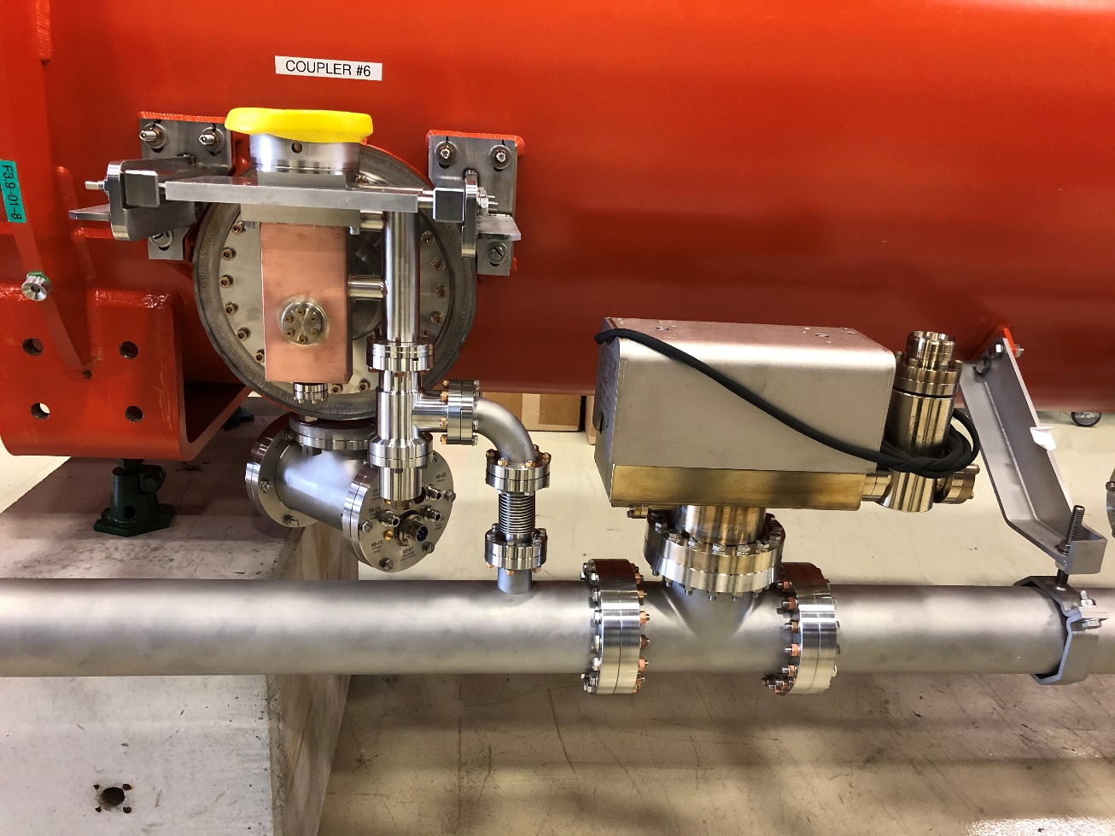
Installation of FPC Warm Ends at SLAC
Components removed for transport, components remaining for transport
FPC Mounting Brackets
Ion Pumps
Under Vacuum
Coupler Pumping Line
Blank-off Flanges Added

Slide 5
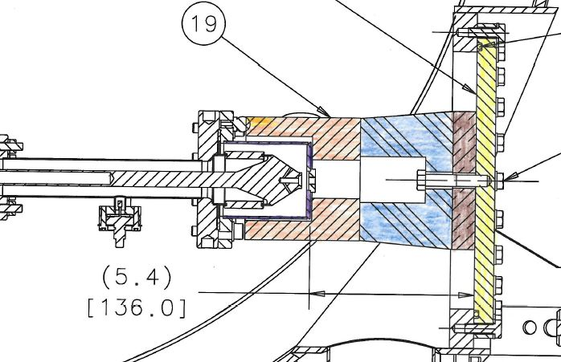
Installation of FPC Warm Ends at SLAC
Coupler transport support flange replaces warm FPC

Slide 6
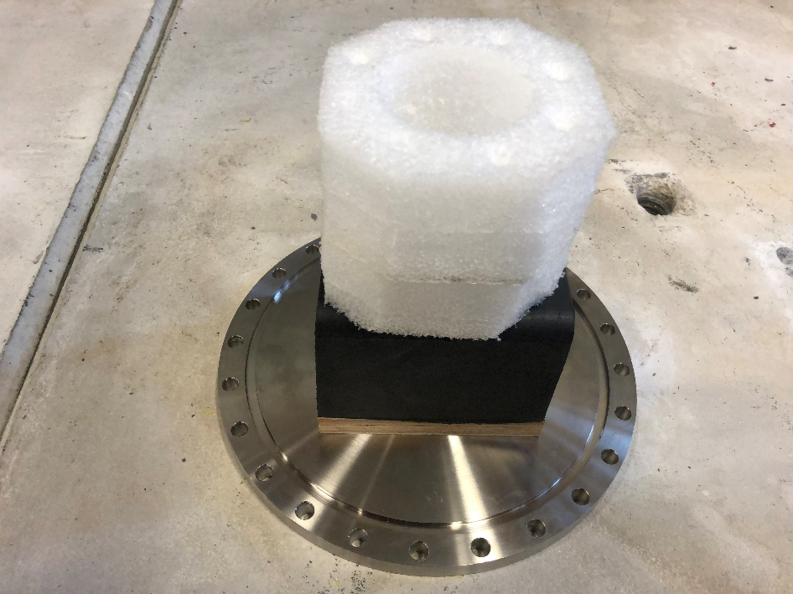
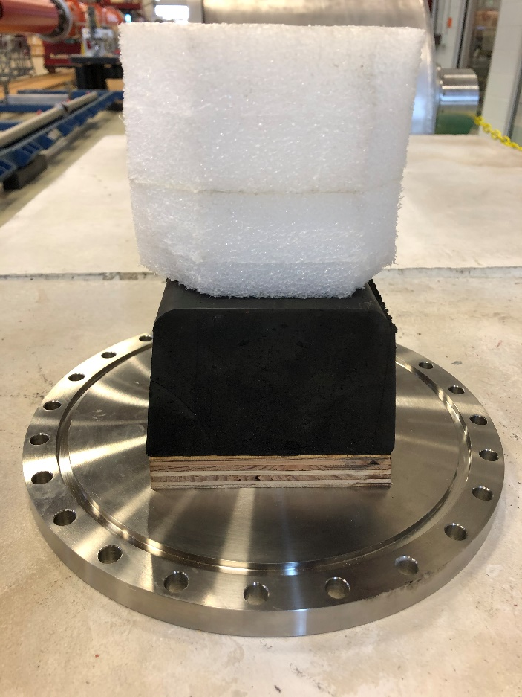
Installation of FPC Warm Ends at SLAC
Coupler transport support flange replaces warm FPC
Same as for FLASH transport
Closed Cell
Foam
Rubber Bumper
Wood Spacer
Coupler Shipping Flange

Slide 7
Summary
3.9 GHz CMs will be shipped with warm couplers removed
This uses the same technique utilized for the successful transport of the FLASH 3.9 GHz CM transport to DESY (2009)
Minimizes concern associated with possible transportation loads
This configuration was successfully tested on the shaker table
This configuration was also successfully tested on the Illinois road tests when we had a cavity in position one
Reinstallation of warm couplers at SLAC
Trained and experienced Fermilab staff will do the work
Performed similar work for F1.3-07
Work will be done under the control of a specific traveler
In accordance with FMEA
Existing tooling will be used
All tools used for installation will be shipped from FNAL to SLAC prior to installation
Do not see any issues with performing this work at SLAC

