Slide 1
3.9 GHz Cryomodule Transportation Testing Results
Brian Hartsell for the Cryomodule Transportation Team
3.9 GHz CM Transportation Review
13 February 2020

Slide 2
Outline
Cold Mass Impulse Testing
Summary of road tests with dummy cryomodule
Instrumentation setup
Data from tests and lessons learned

Slide 3
Impulse Testing of the 3.9 Cold Mass
Before transport of the cold mass from MP-9 to ICB, gentle impulse testing was done on all accessible (and assembled) parts of the cold mass to identify any strong/high Q resonances, especially any with potential for significant displacement
Several resonances were found, mostly cryo feed piping, but these were virtually identical to the 1.3 module, and the supports designed for 1.3 were adapted to the 3.9
None of the identified resonances posed significant transport risk, even before mitigation

Slide 4
3.9 GHz Dummy Cryomodule Road Test Summary
Test | Length (mi) | Notes
ICB to CMTF (on-site) | 2 | Max speed 15 mph
On-site | ~10 | Max speed 40 mph
Off-site | ~55 | Max speed 55 mph, majority of trip on highway
Fermilab to SLAC | ~2400 | Max speed 55 mph, southern route

Slide 5
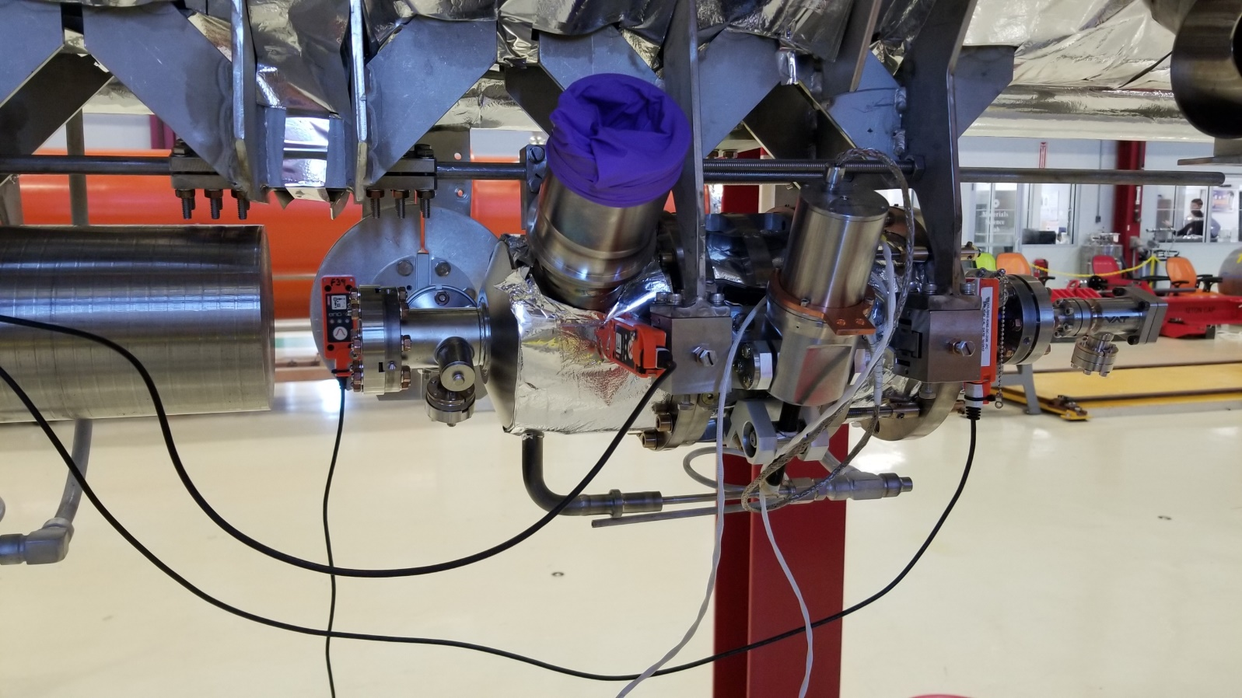
Instrumentation setup
Slam sticks placed on the following areas of the dummy cryomodule:
Cavity 1 upstream and downstream mounts, 50K flange
Cavity 4 dummy hanger
Frame upstream and downstream
CM base upstream and downstream

Slide 6
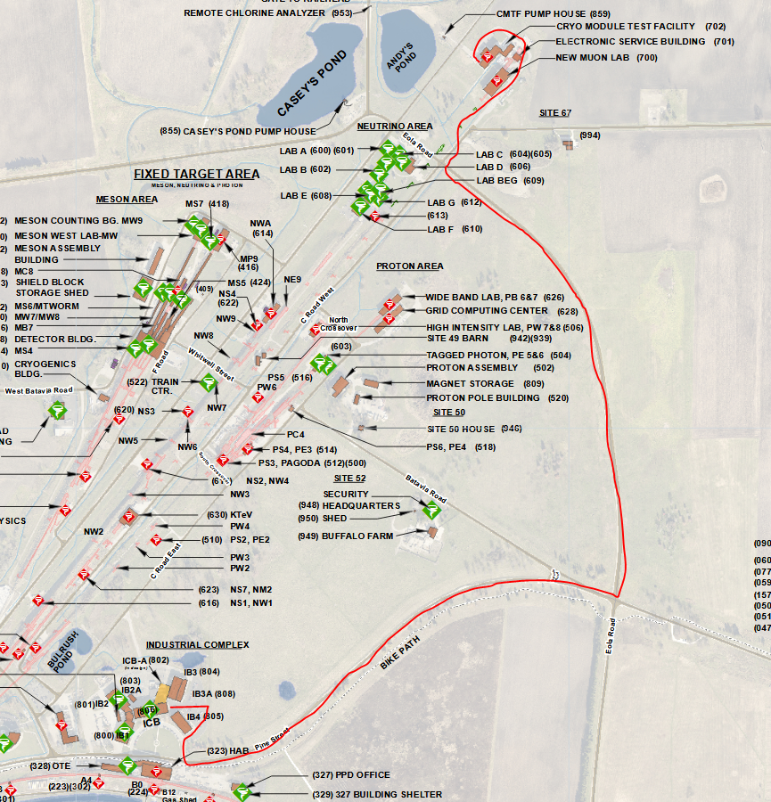
ICB to CMTF
Test intended to verify frame performance for a low-speed transport to the test facility.
Cryomodule was transported with caps and inserts installed, coupler on cavity 1 supported in FLASH style configuration.
Test run 02 Dec 2019.

Slide 7
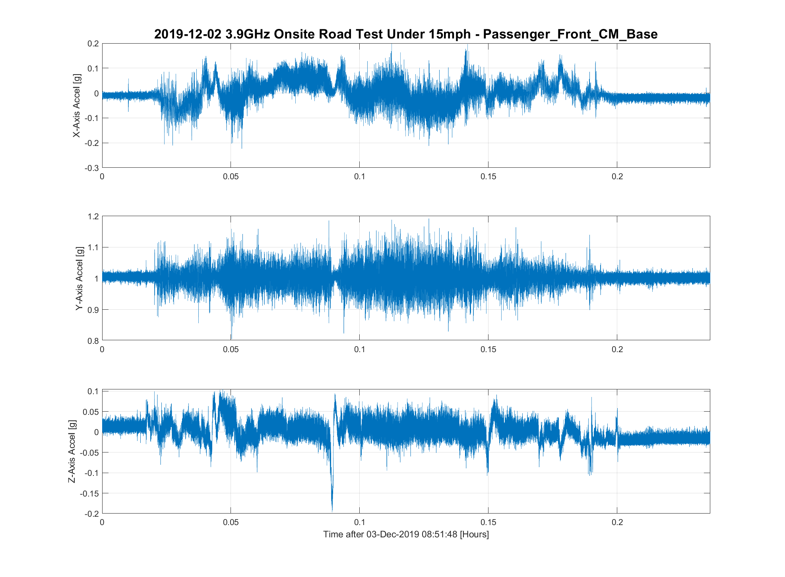
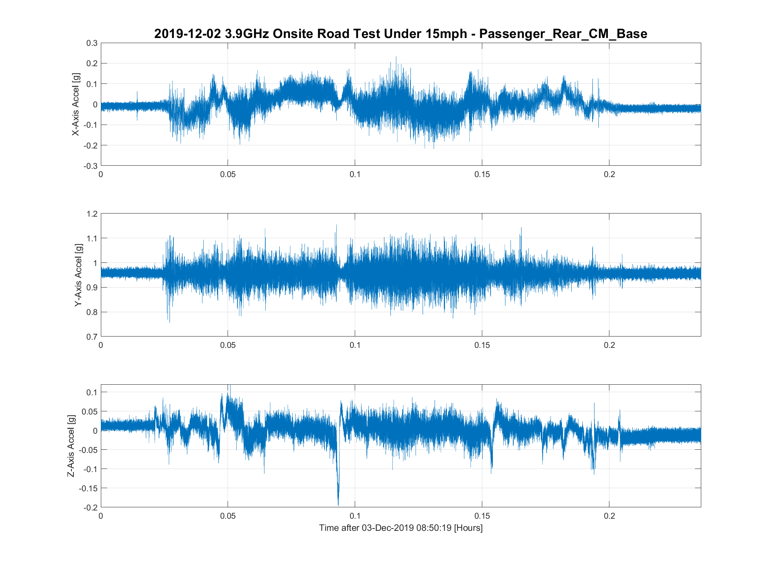
ICB to CMTF
Generally low shock levels observed at the cryomodule feet under 0.2g. A quiet transport, as expected at such low speed.
Coordinate system is beam coordinates – X is beam left/right, Y is beam up/down, Z is along beamline axis.

Slide 8
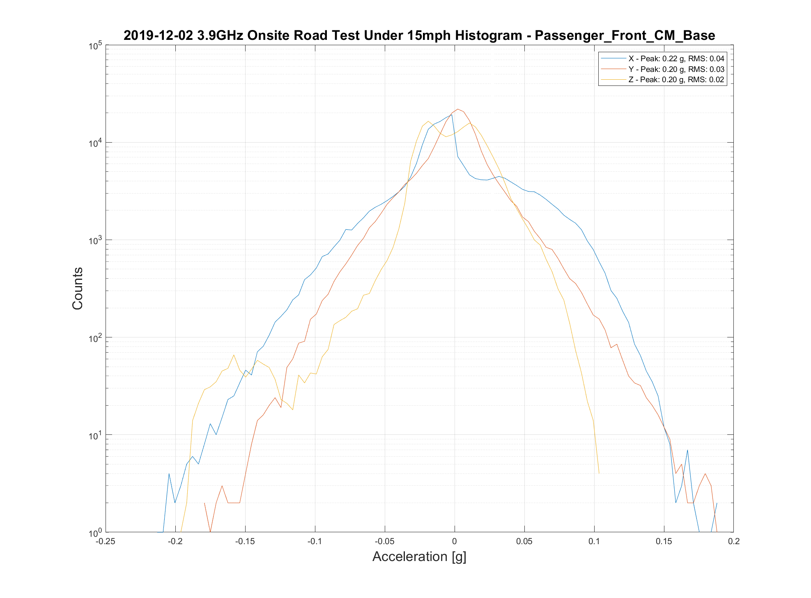
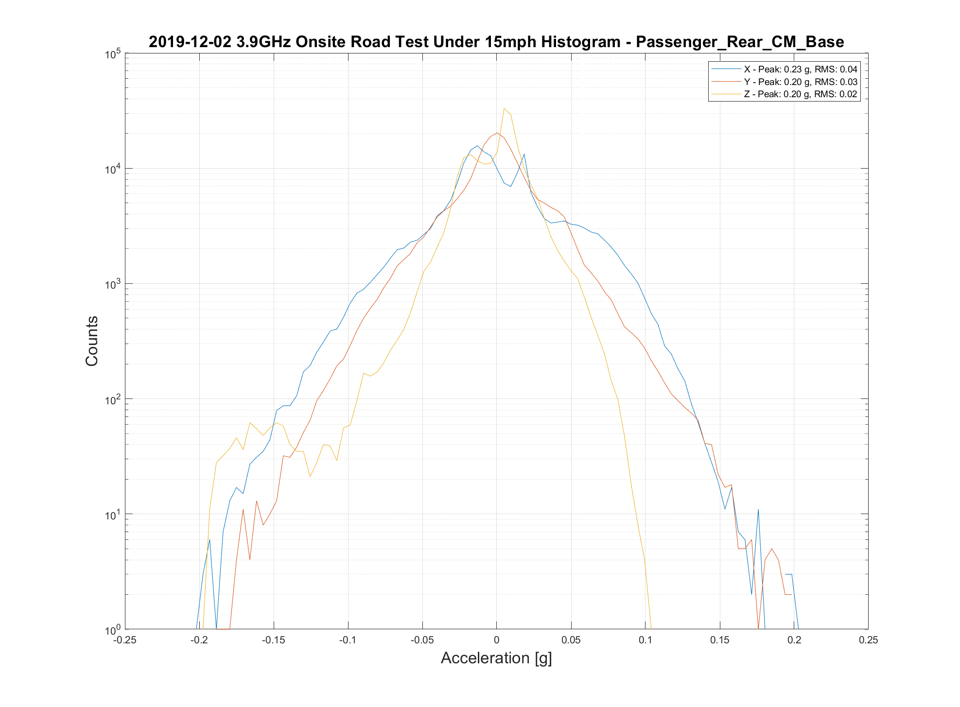
ICB to CMTF
Another view of the cryomodule foot sensor data in histogram form. Again, a quiet transport.

Slide 9
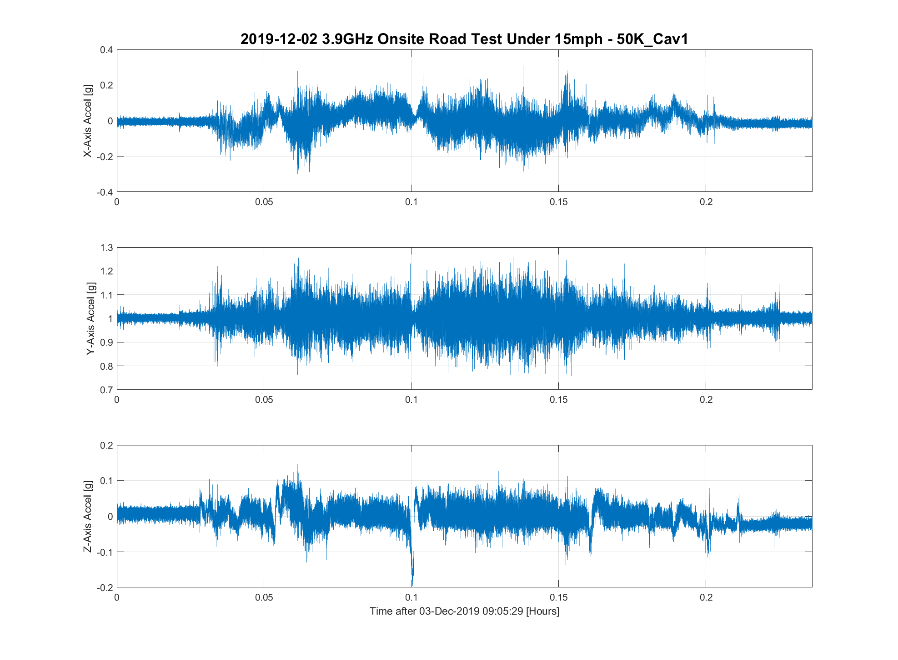
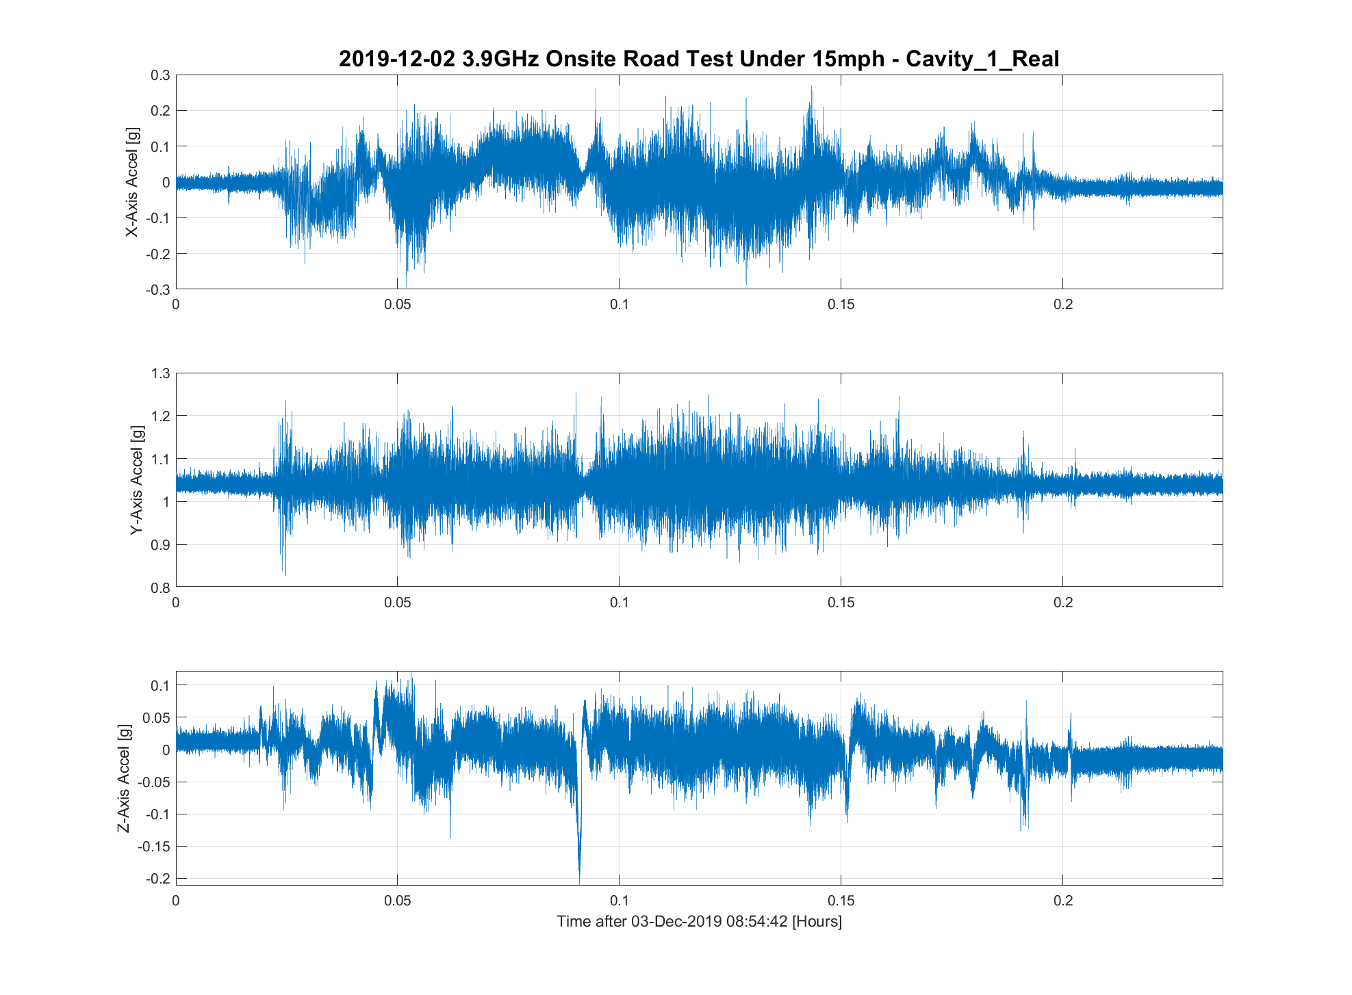
ICB to CMTF
Similar performance observed inside the cryomodule on cavity 1 and the 50K flange.

Slide 10
ICB to CMTF
Using this transport test as supporting data, a record of decision was submitted to SLAC (TC# ED0011292) and approved to ship to CMTF.
F3.9-01 has been transported to and returned from CMTF and F3.9-02 has been moved to CMTF with similar performance observed.

Slide 11
On-site testing (high speed)
After moving to CMTF, the test moved to higher speed on-site roads with a maximum speed of 40 MPH.
Test was run in the same day with the same setup as the low-speed test.
Test ran for approximately a half hour and covered about 10 miles with two runs along our main ‘high speed’ road, Discovery, a roughly one mile stretch without stops.

Slide 12
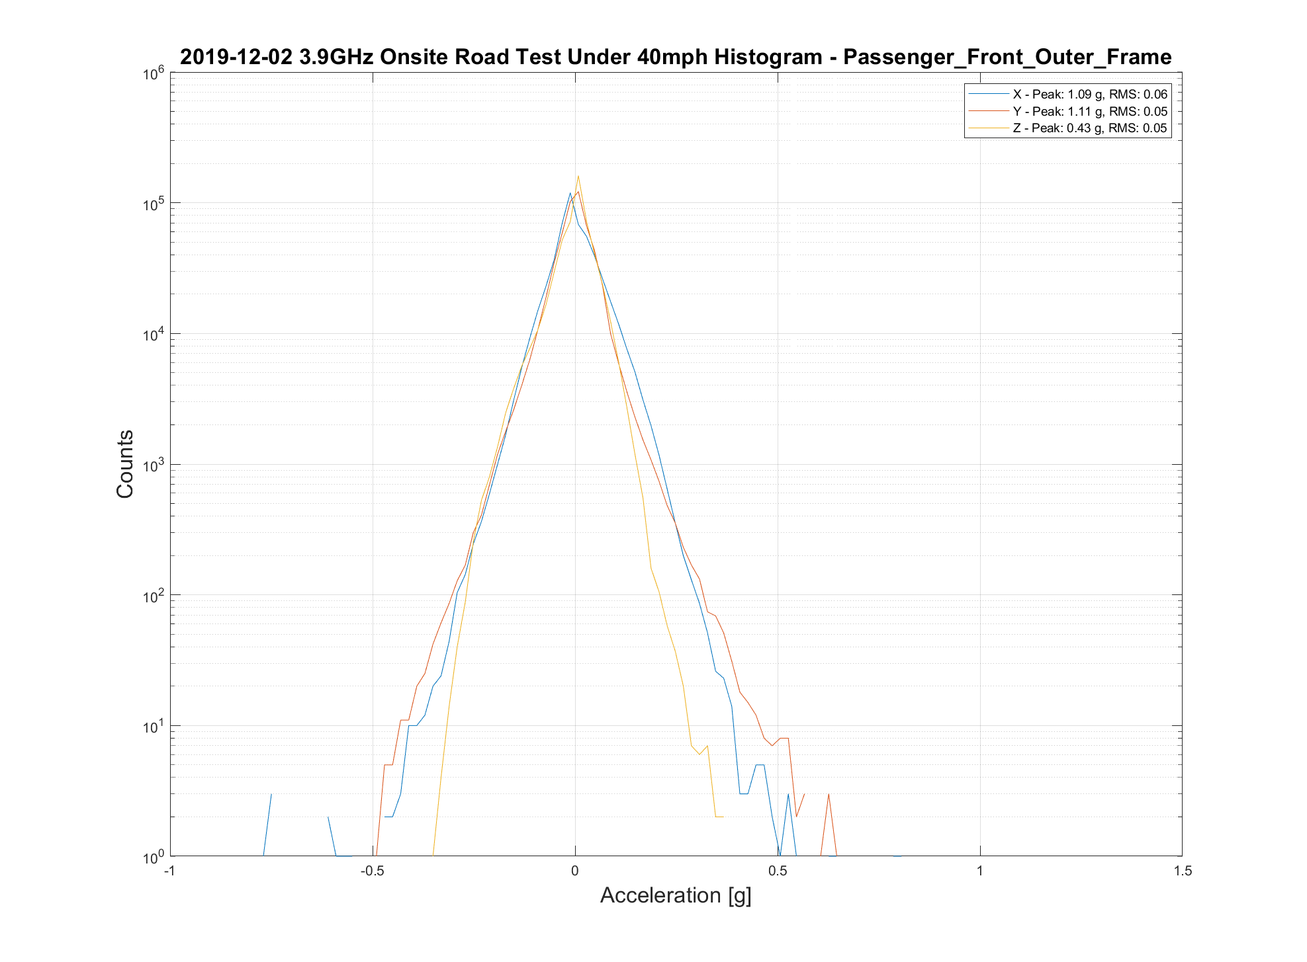
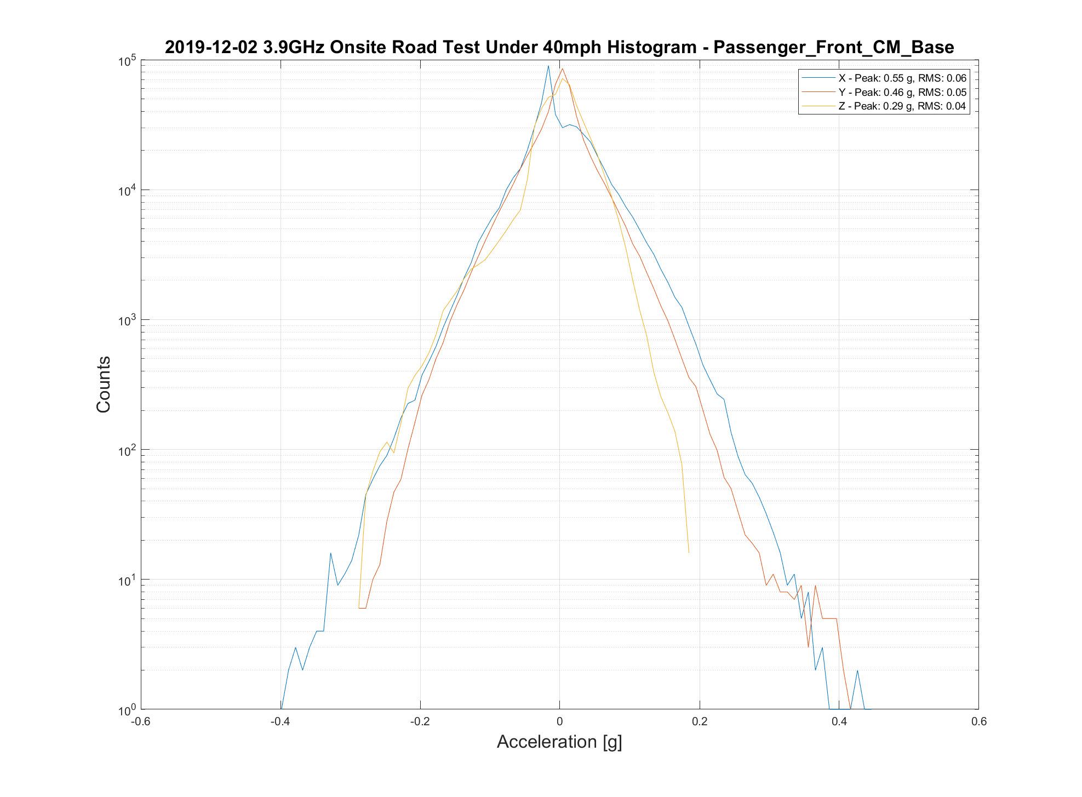
On-site testing (high speed)
Here we can observe the frame starting to isolate the cryomodule from road noise with a reduction in peak shocks and a tightening of the distribution.

Slide 13
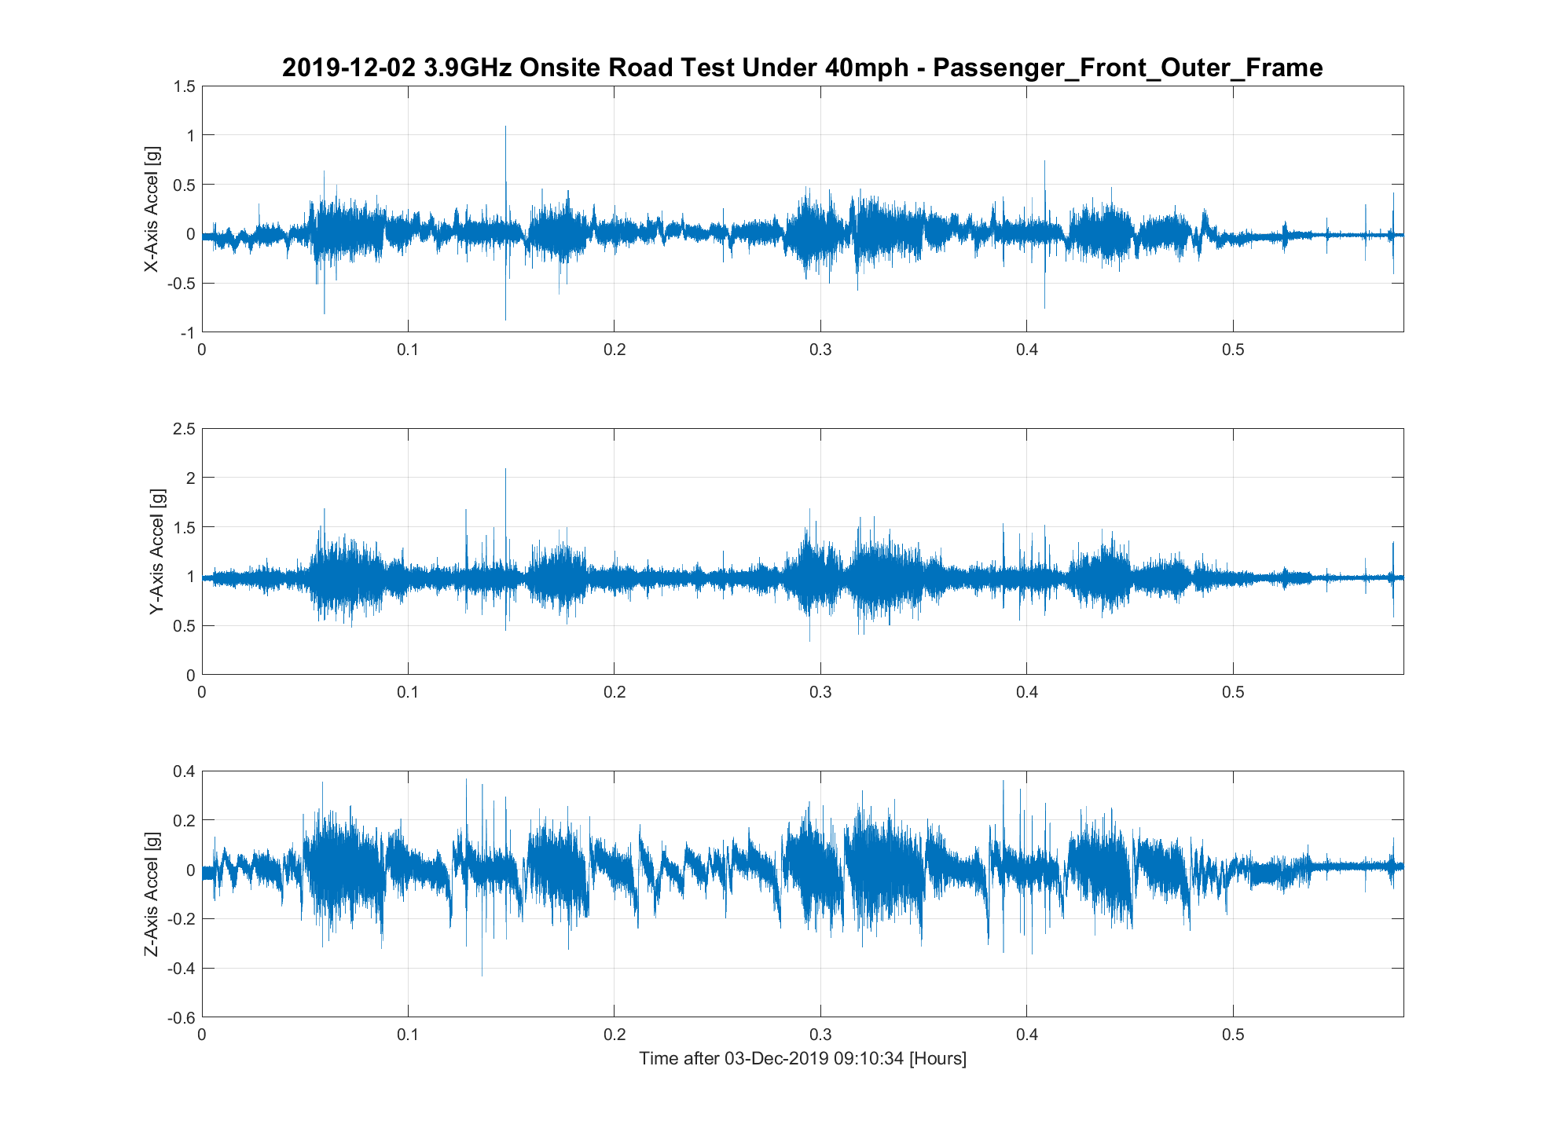
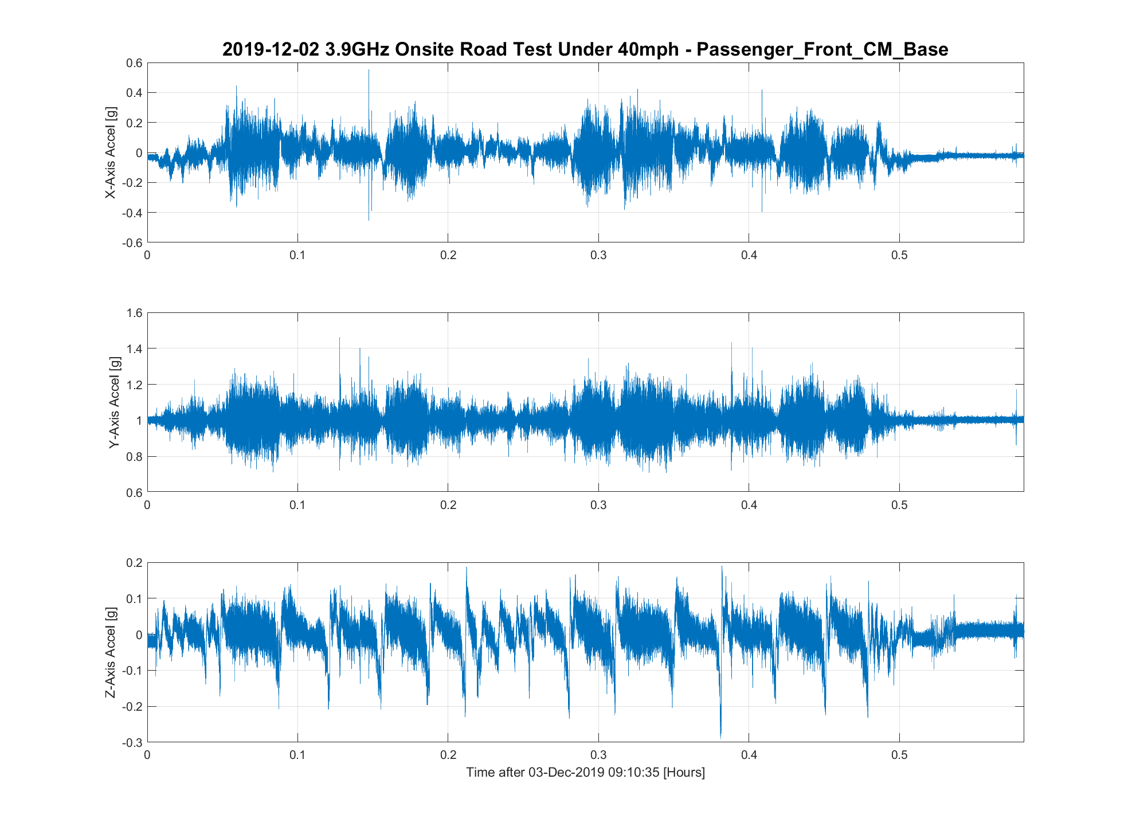
On-site testing (high speed)
Another view in time series form. Note larger shocks around 0.15 hours and 0.42 hours well isolated by frame.

Slide 14
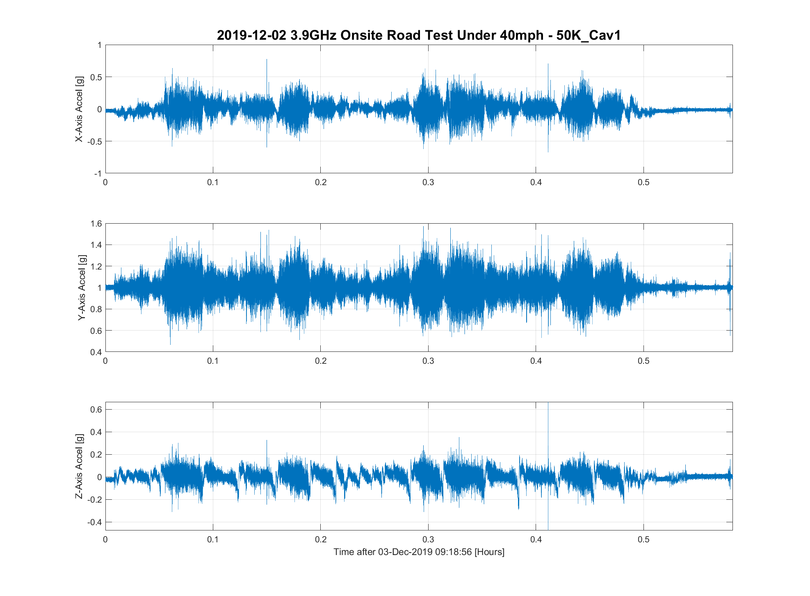
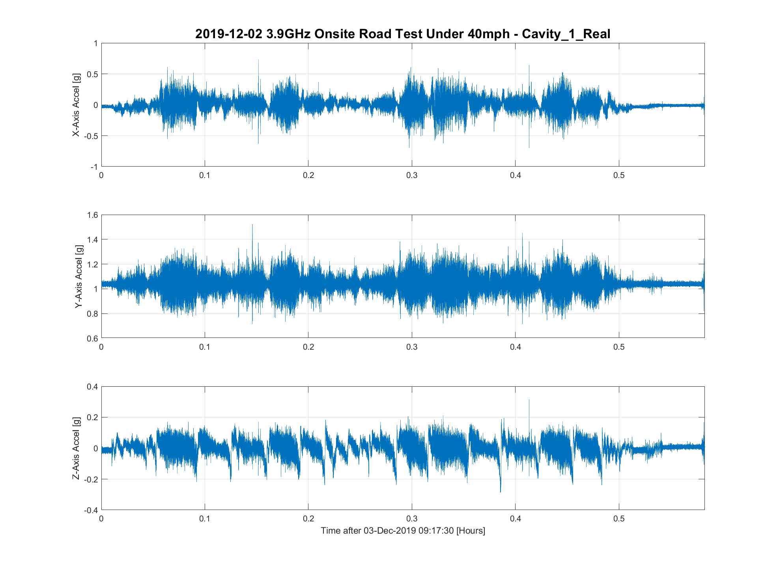
On-site testing (high speed)
Cavity 1 had similar performance to the cryomodule base with slight amplification at the 50K flange, but numbers are acceptable.

Slide 15
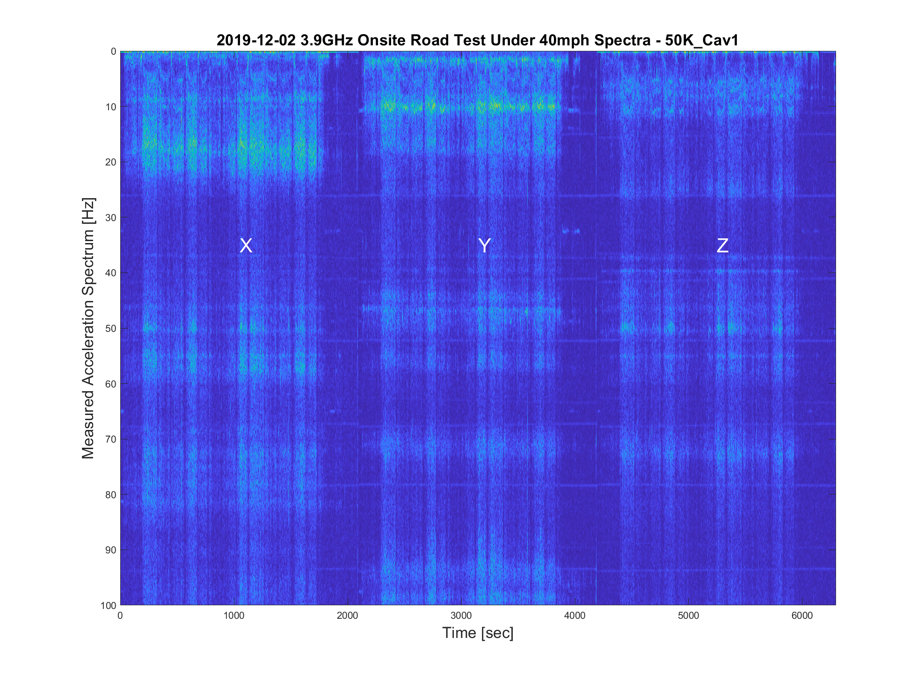
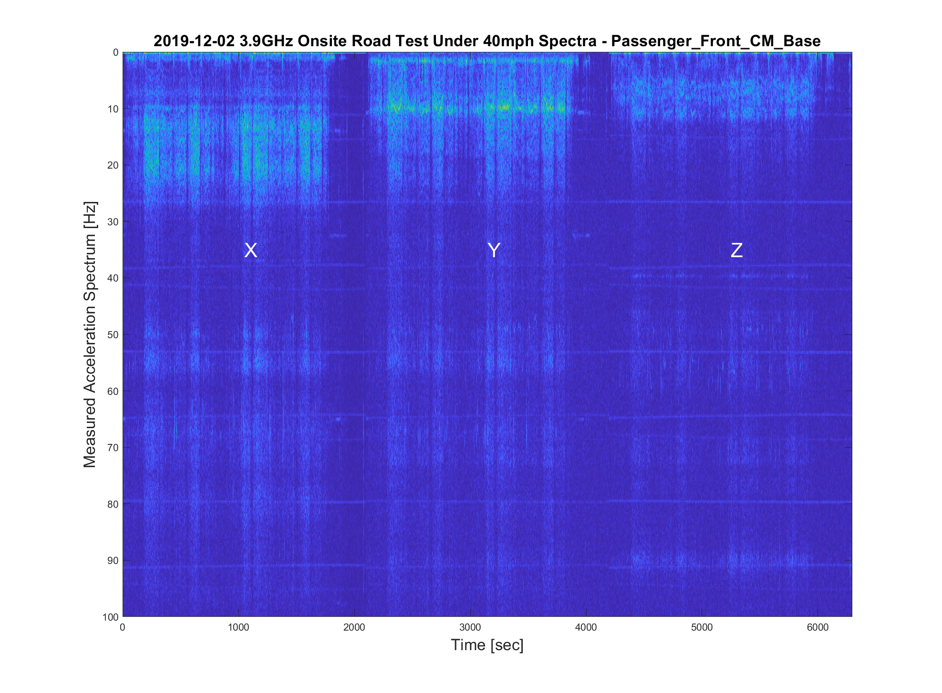
On-site testing (high speed)
Spectrogram of cavity 1 50K flange shows no evidence of strong resonance in the 40 Hz area, weak resonance at ~46 Hz compared to cryomodule base.

Slide 16
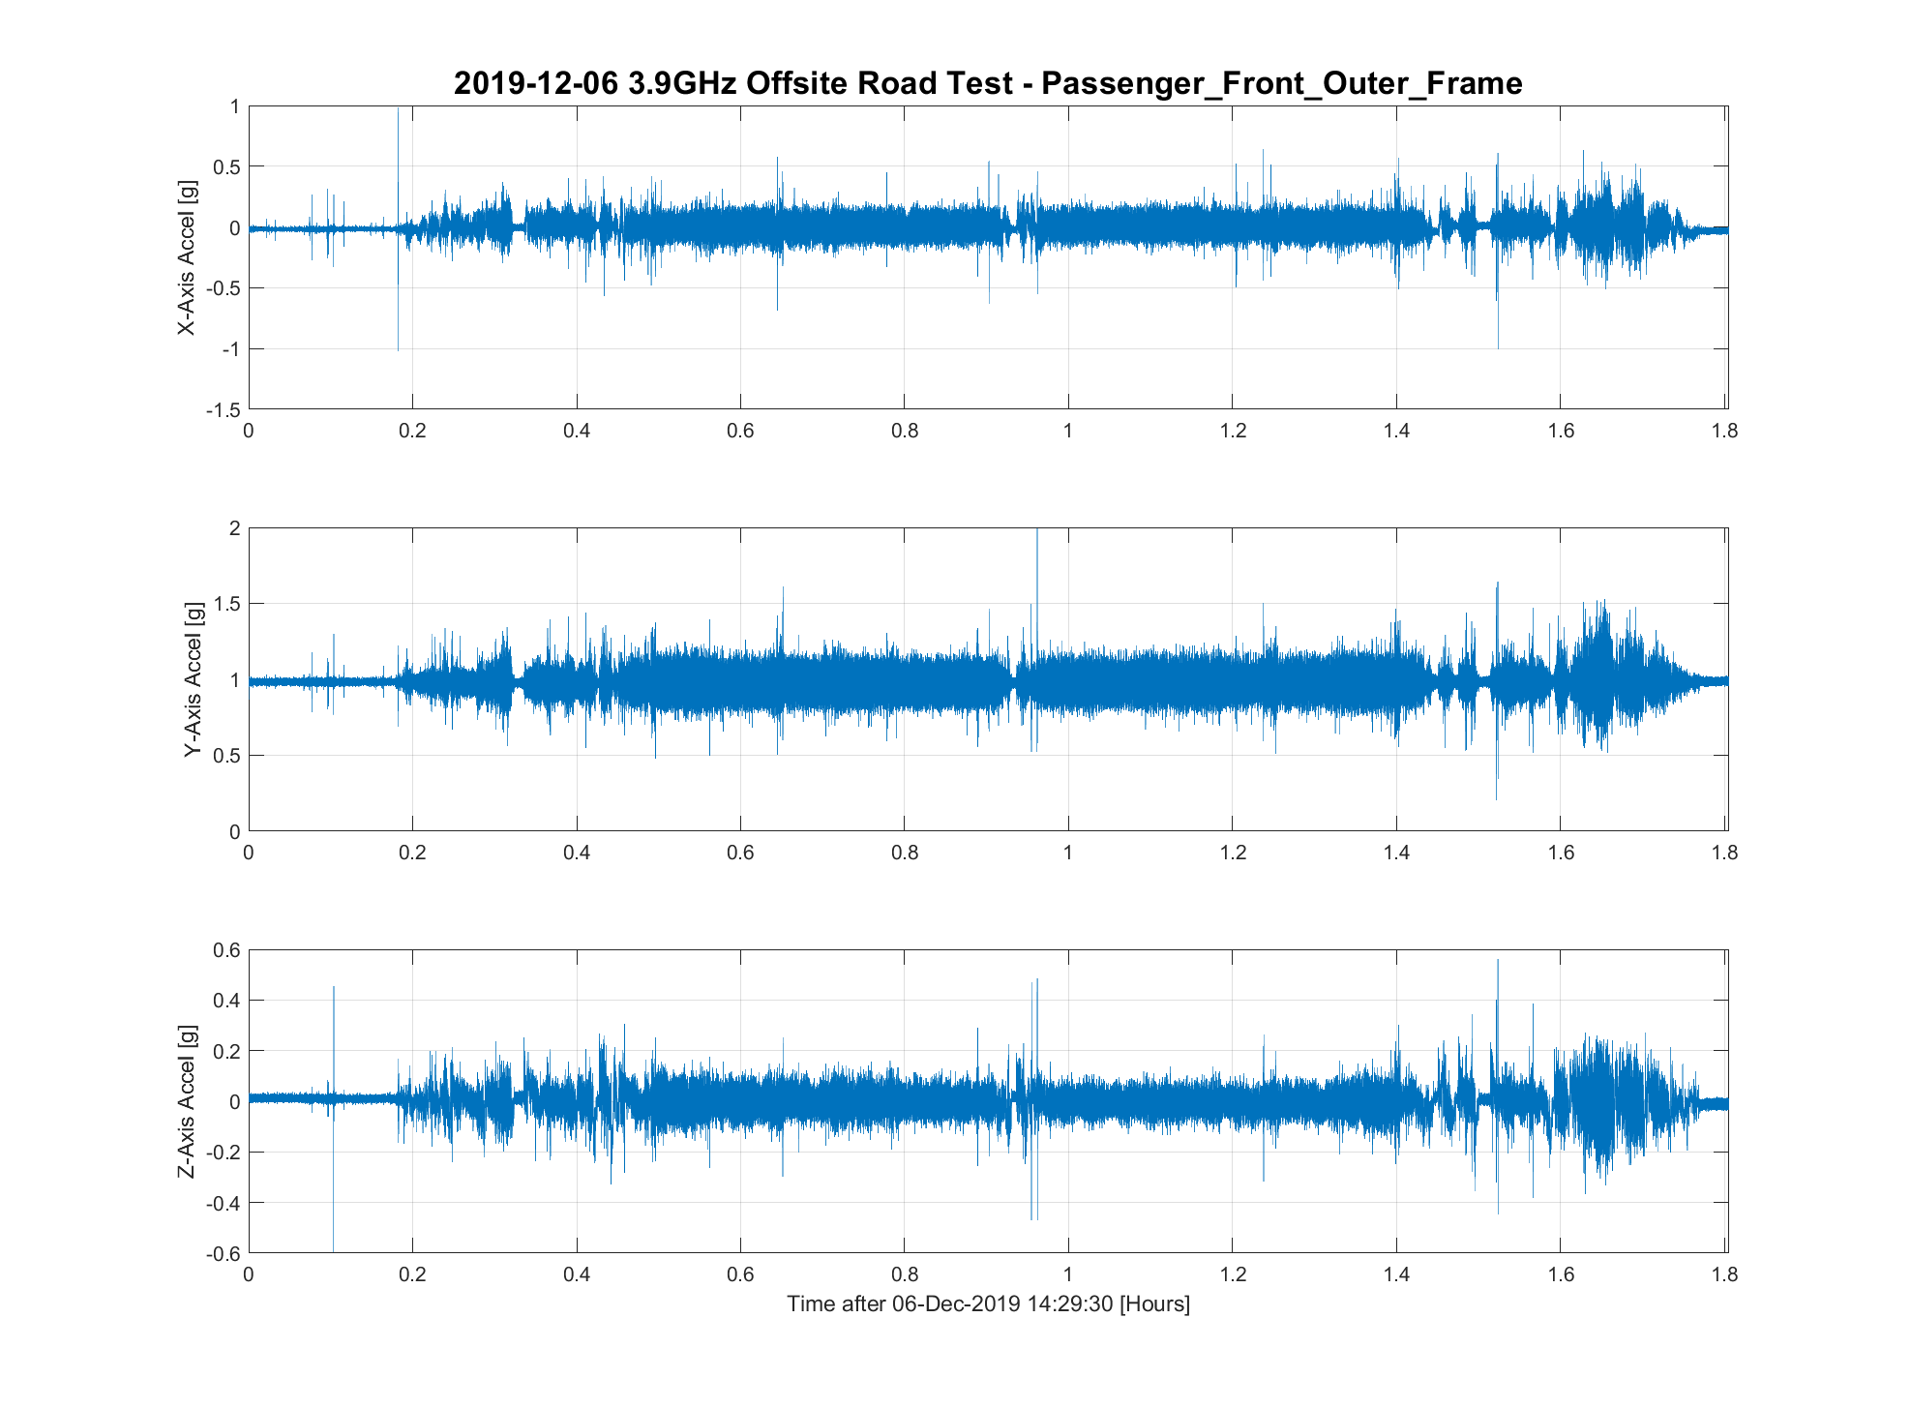
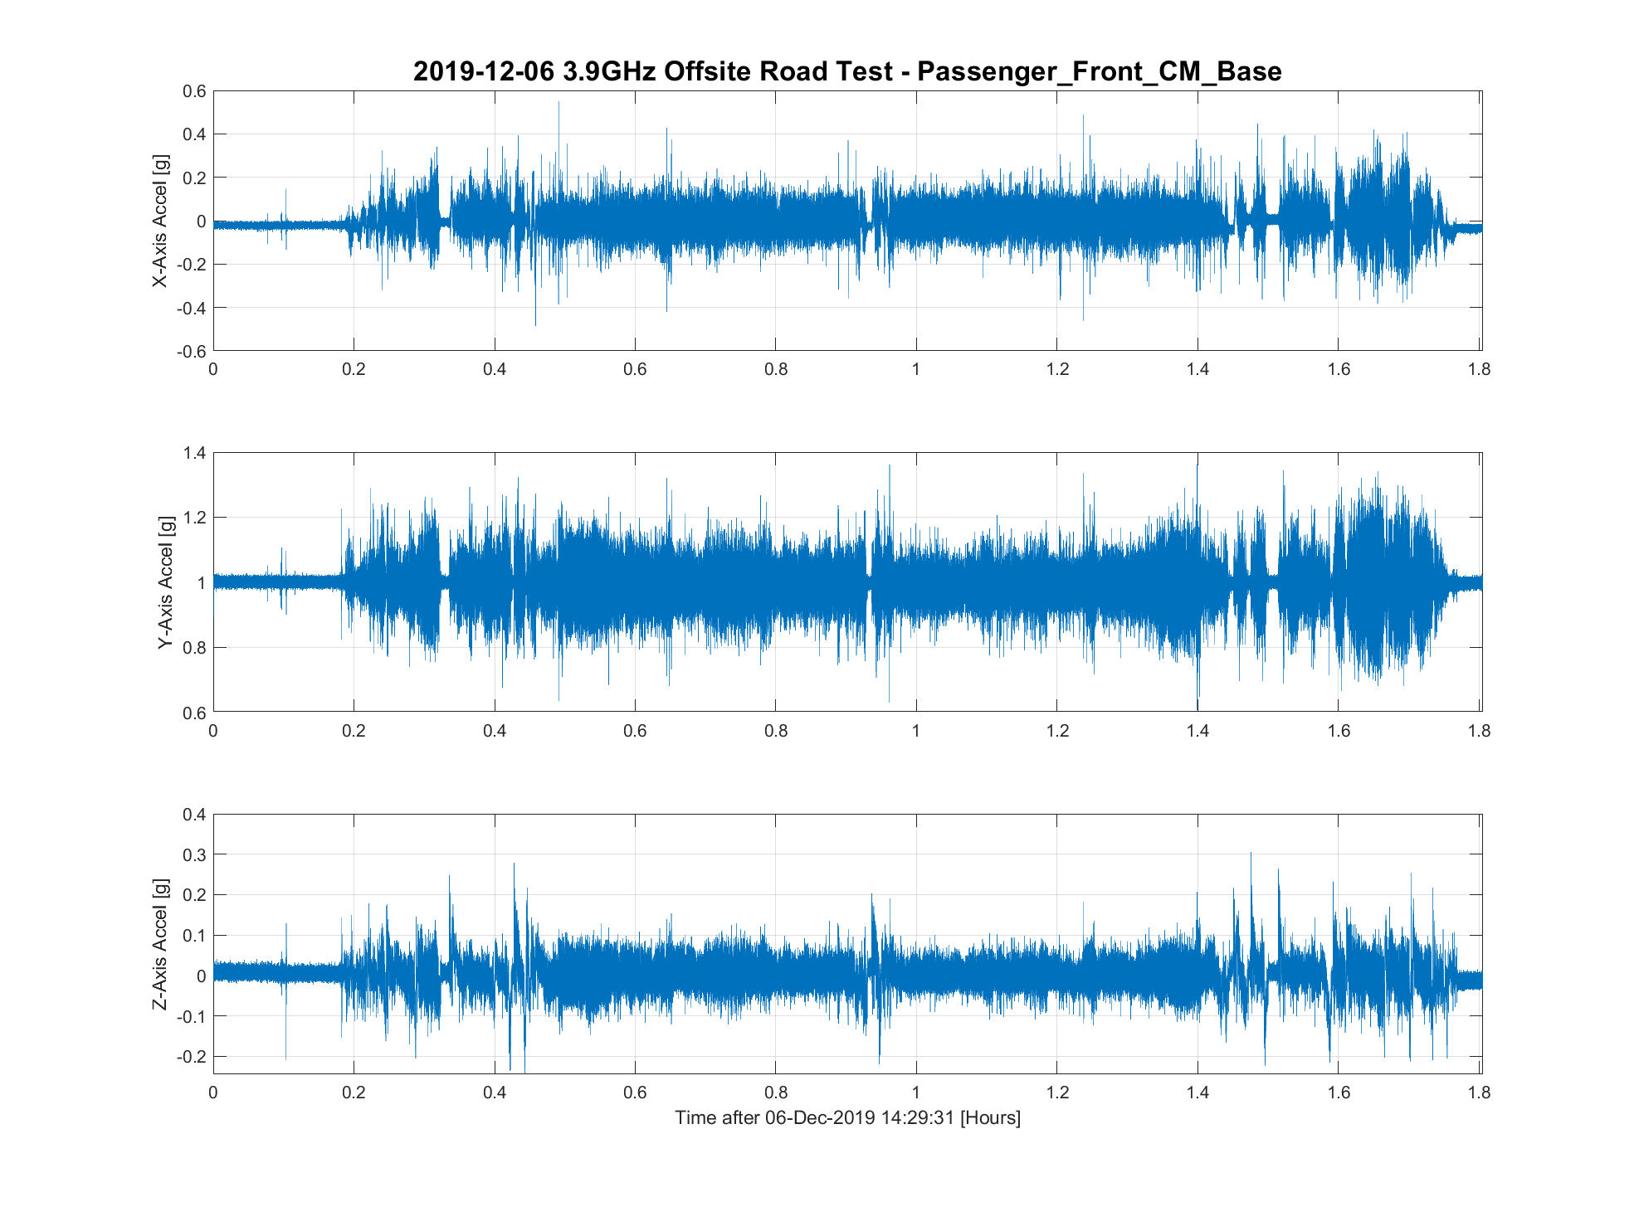
Off-site testing
Analysis of on-site testing data showed no issues, so an off-site test was run 06 Dec 2019.
Same test setup as previous on-site run. Maximum speed limited to 55 MPH on highway.
Frame design begins to shine with this test. Time series plots of trailer vs cryomodule foot below.

Slide 17
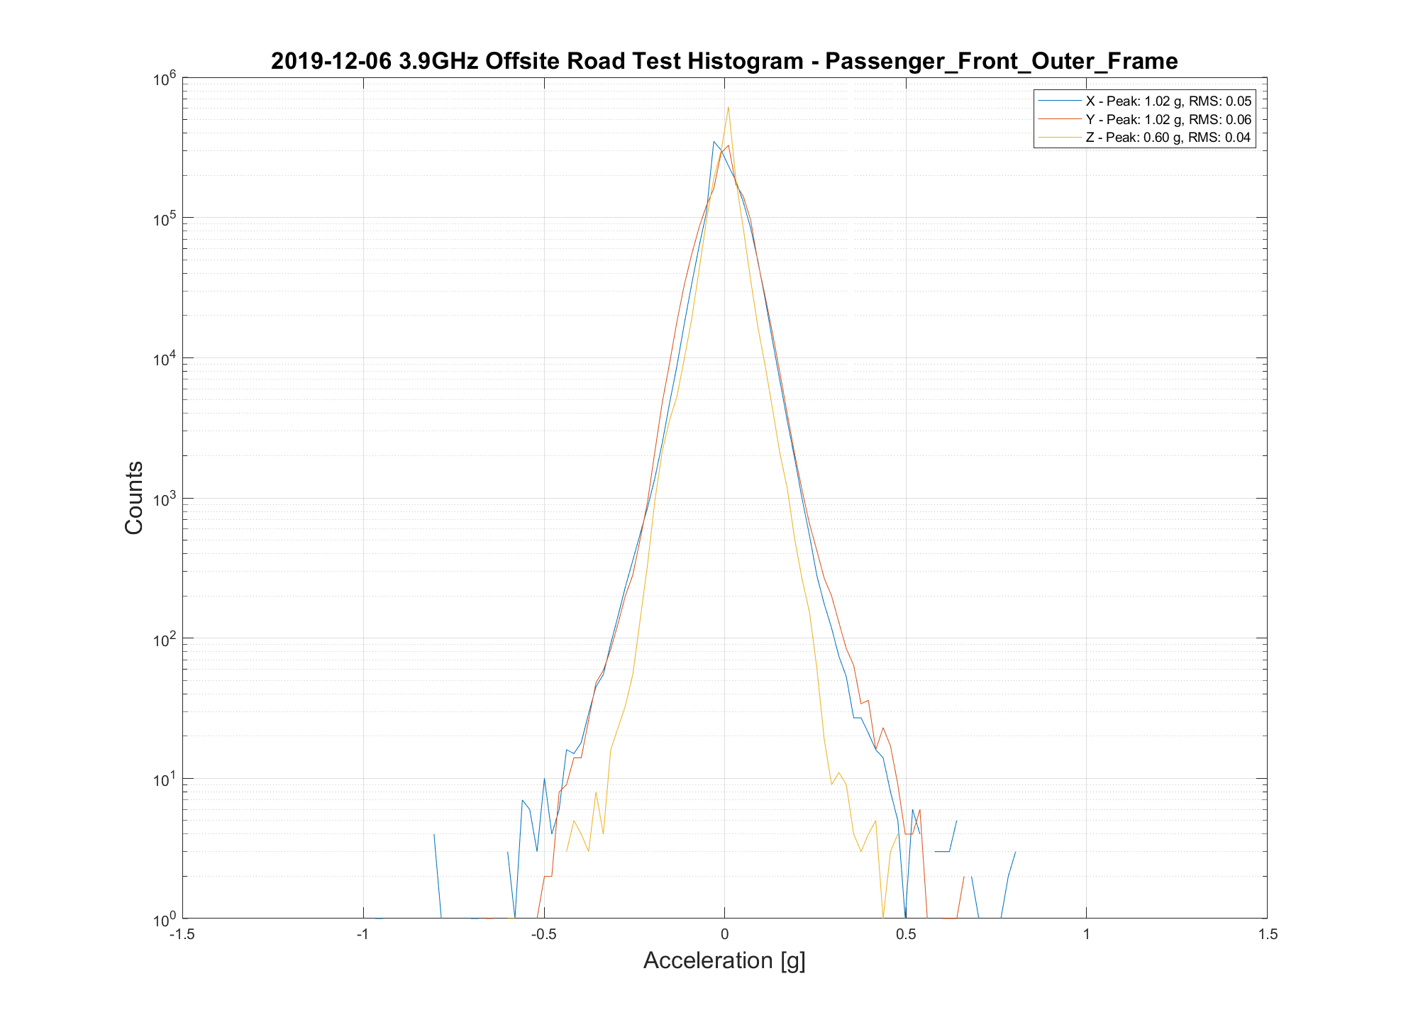
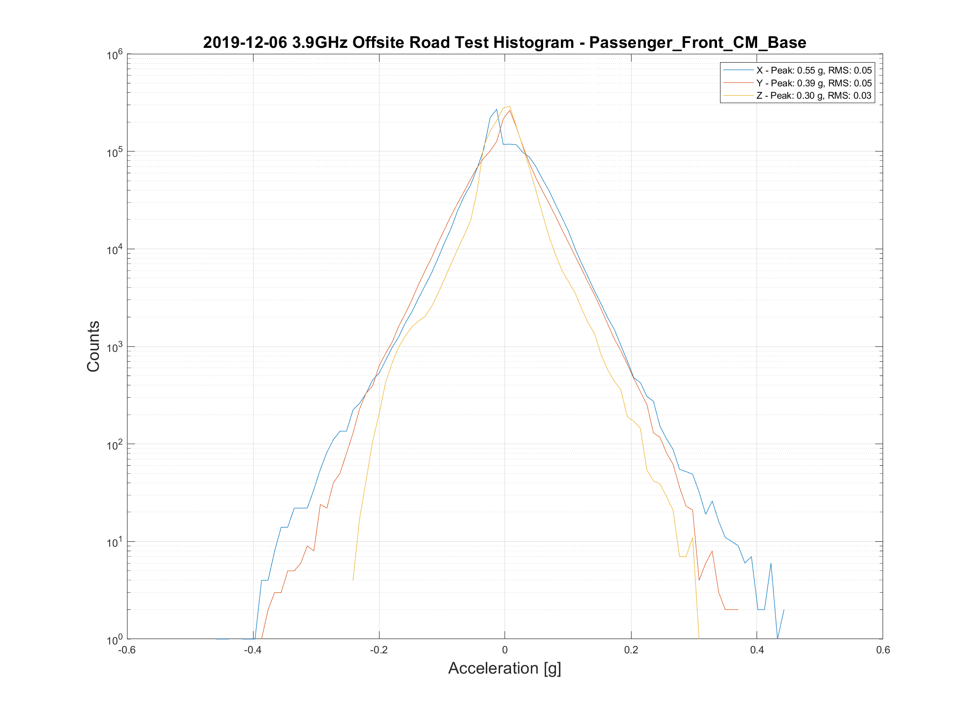
Off-site testing
Histogram view of the data from last slide. Note the reduction in peak shocks and tightening of the distribution.

Slide 18
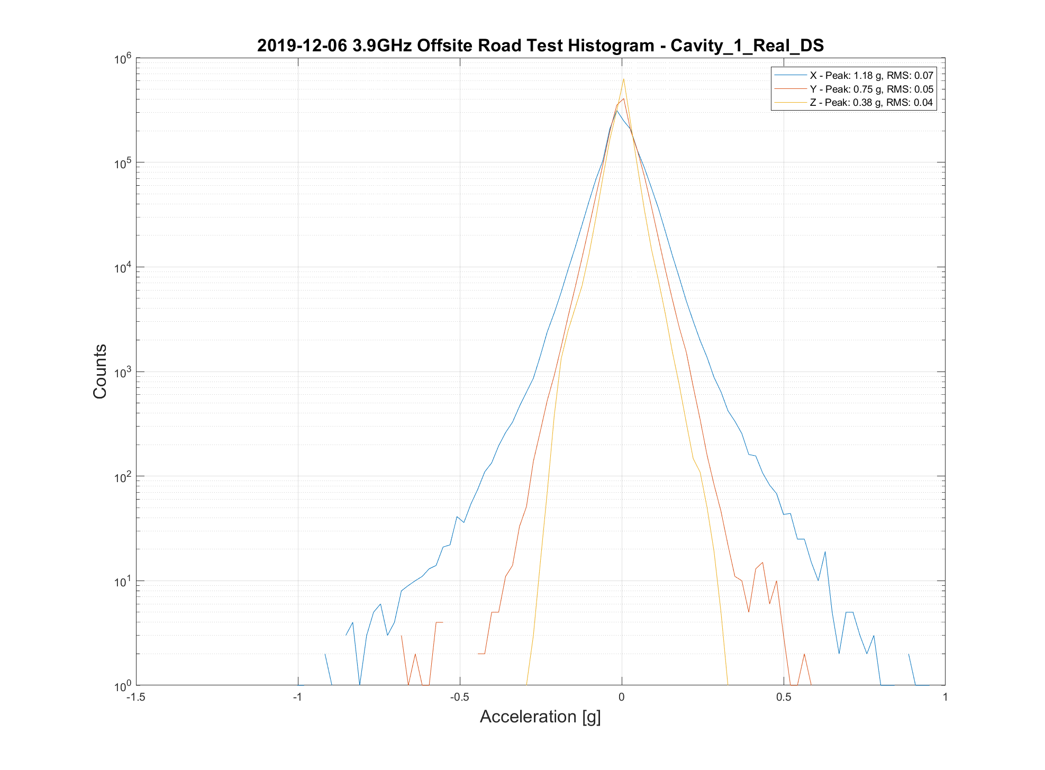
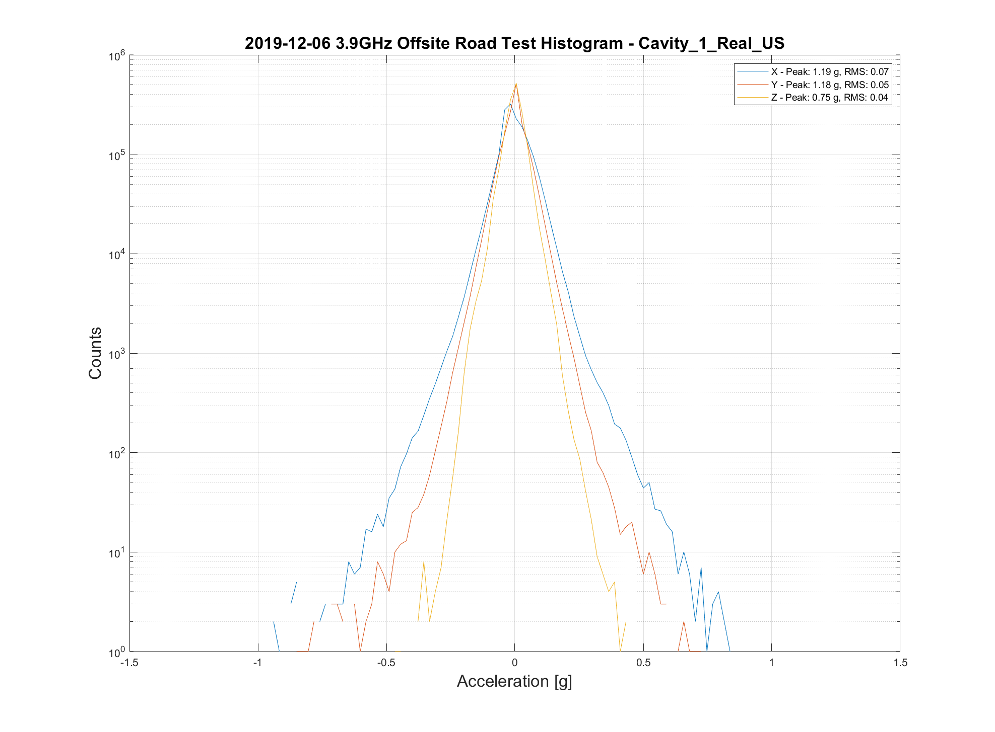
Off-site testing
Cavity 1 shows slightly higher level of vibration but well below limits.

Slide 19
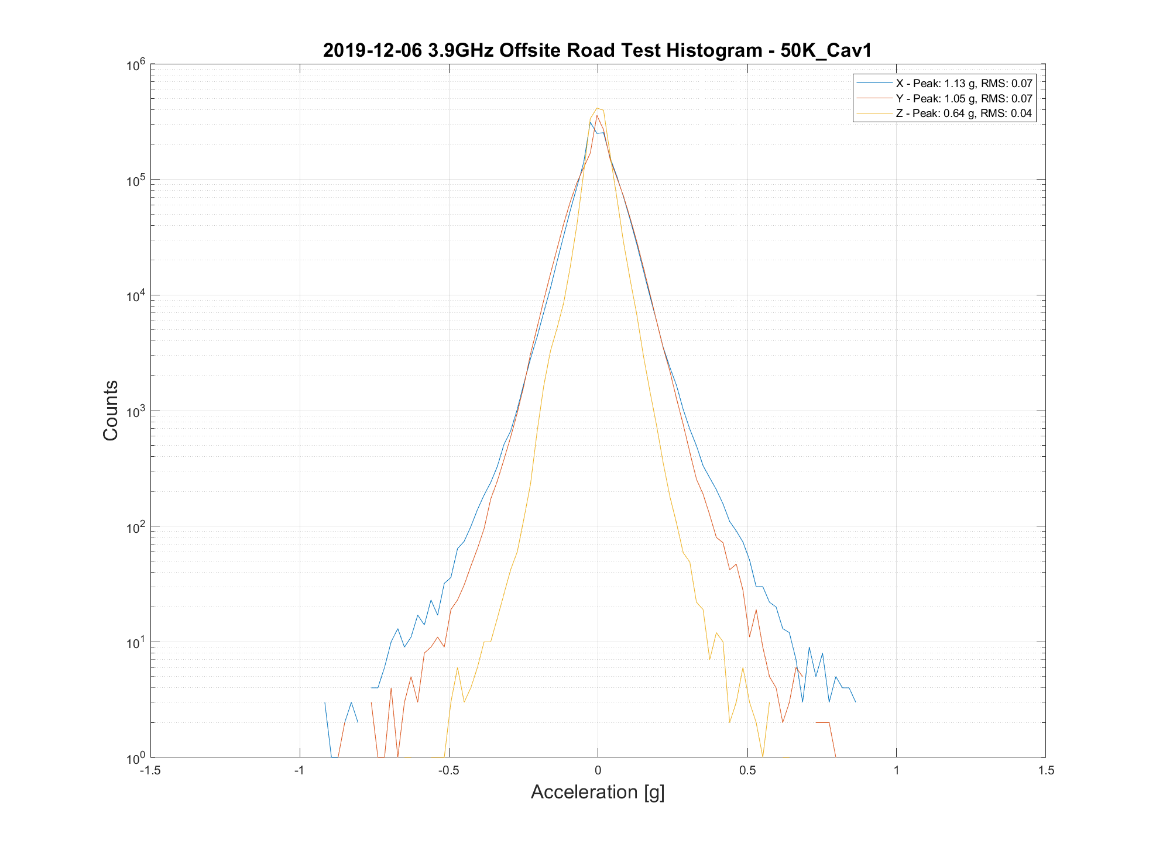
Off-site testing
50K flange shows similar vibration levels to the cavity.

Slide 20
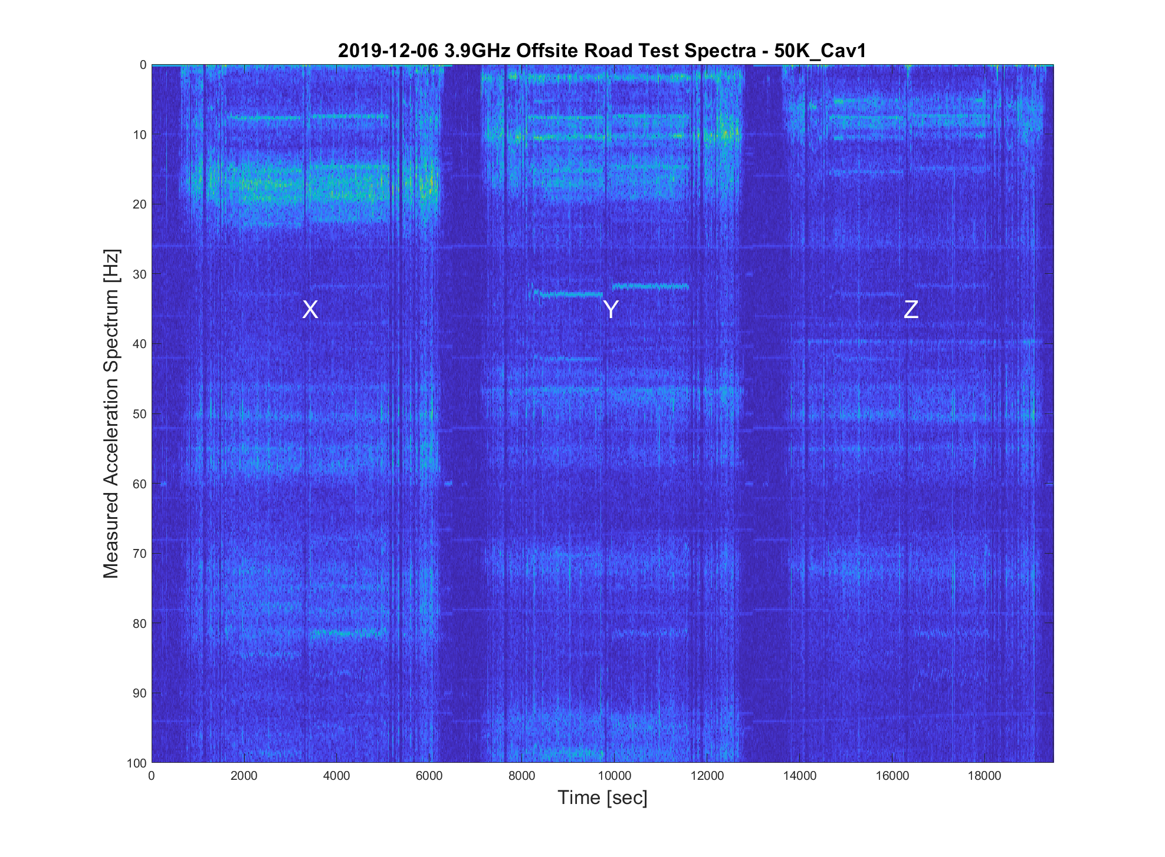
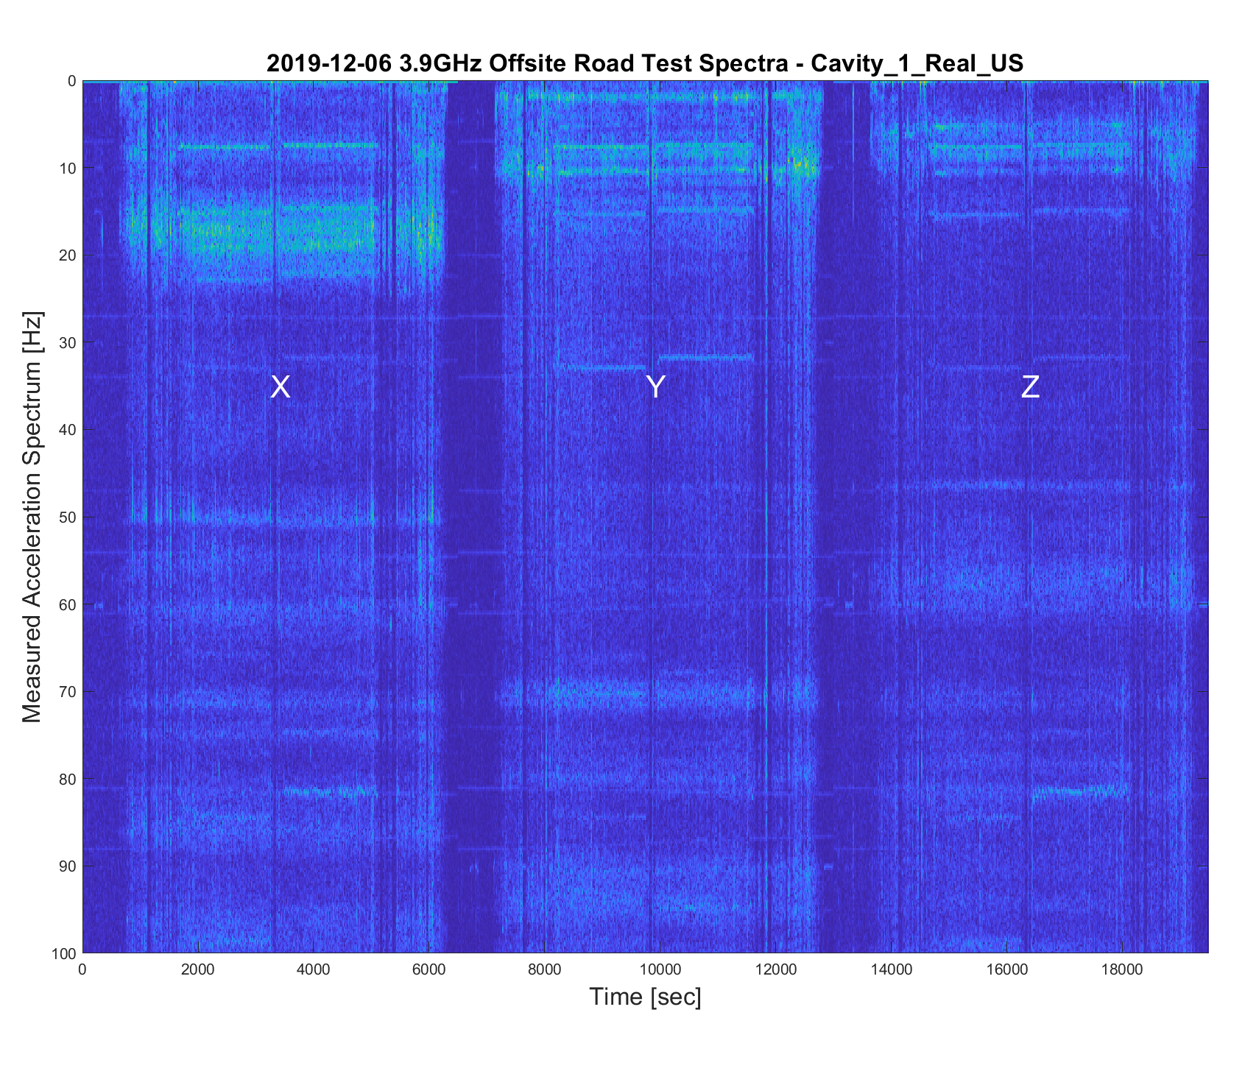
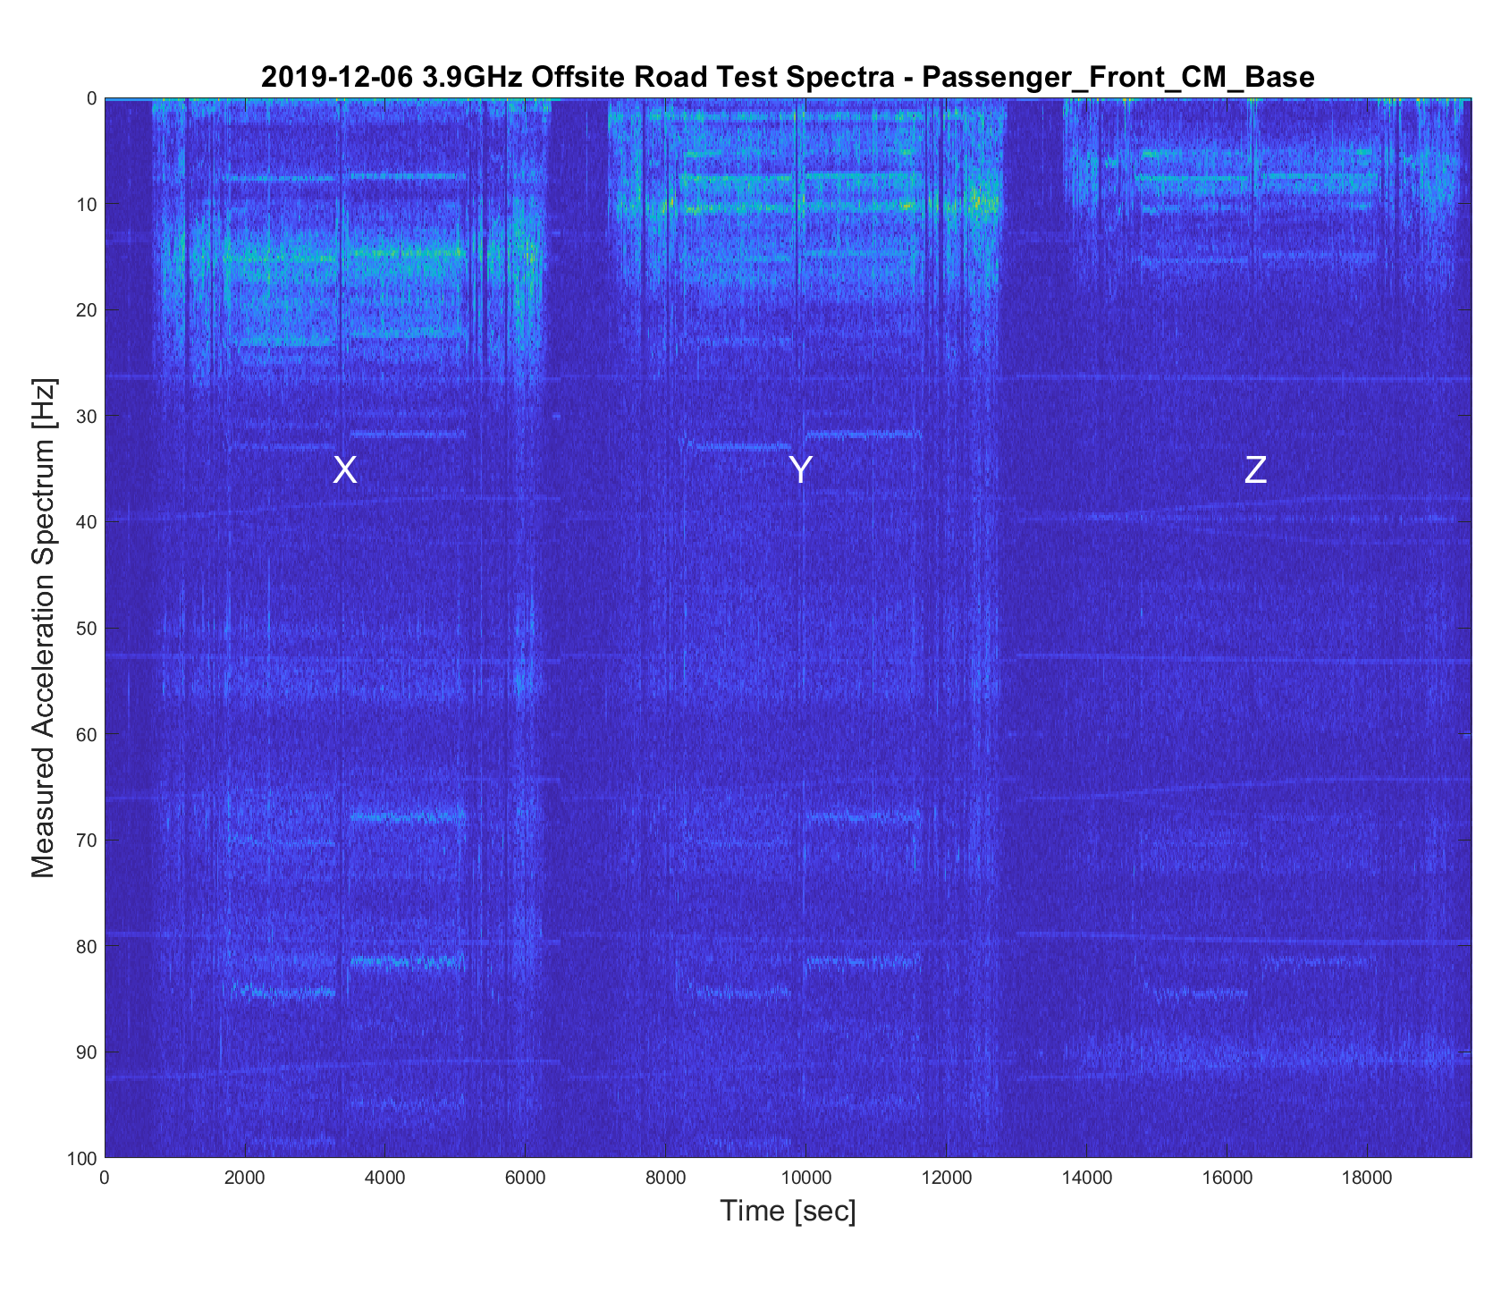
Off-site testing
Spectrograms show cav1 50K flange has similar vibration environment to cavity 1. No strong resonances found.
Cavity 1 and its 50K flange show weak resonances at ~46 Hz and ~55 Hz not found on cryomodule base.

Slide 21
Off-site testing - Conclusions
With this data we felt confident in shipping the dummy cryomodule to SLAC.
During testing of the real cryomodule, we will continue to monitor 50K flange vibration.
Similar vibration spectra as the cavity, but amplified since on a cantilever.
Worst case for vibration.

Slide 22
Shipment to SLAC
Dummy cryomodule was sent to SLAC on 17 Jan 2020.
Cavity 1 was needed for testing. The cold string was removed from the cryomodule and cavity 1 was replaced with a steel slug.
Transport prep procedures were again followed to prepare the dummy cryomodule for transport to SLAC.
Instrumentation was only placed on outer frame and cryomodule foot both upstream and downstream, total of 4.

Slide 23
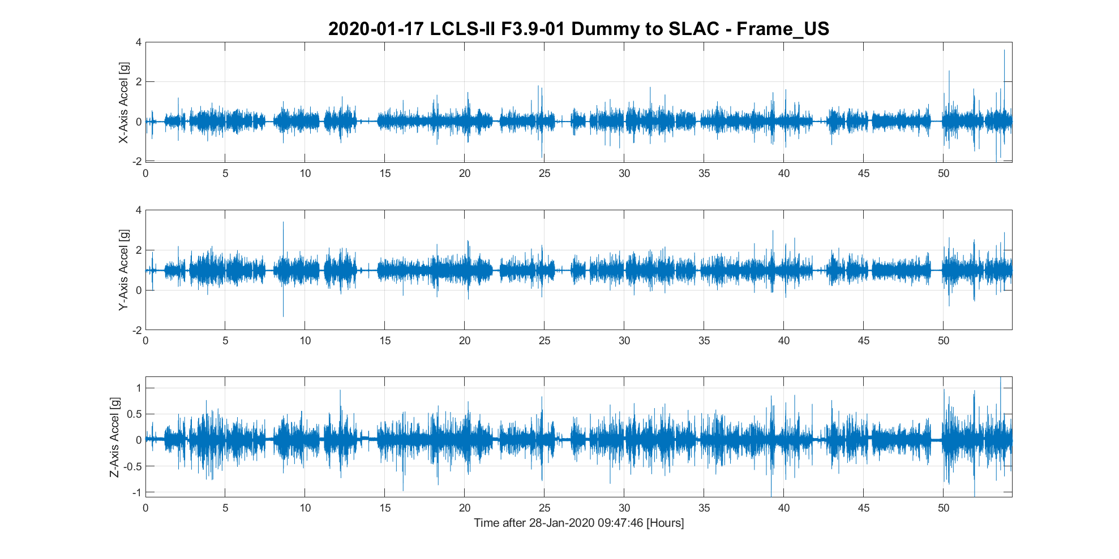
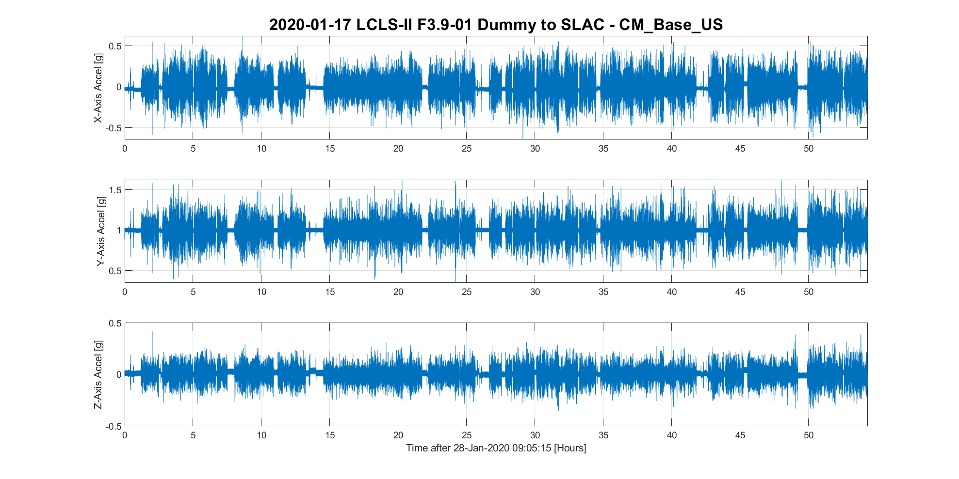
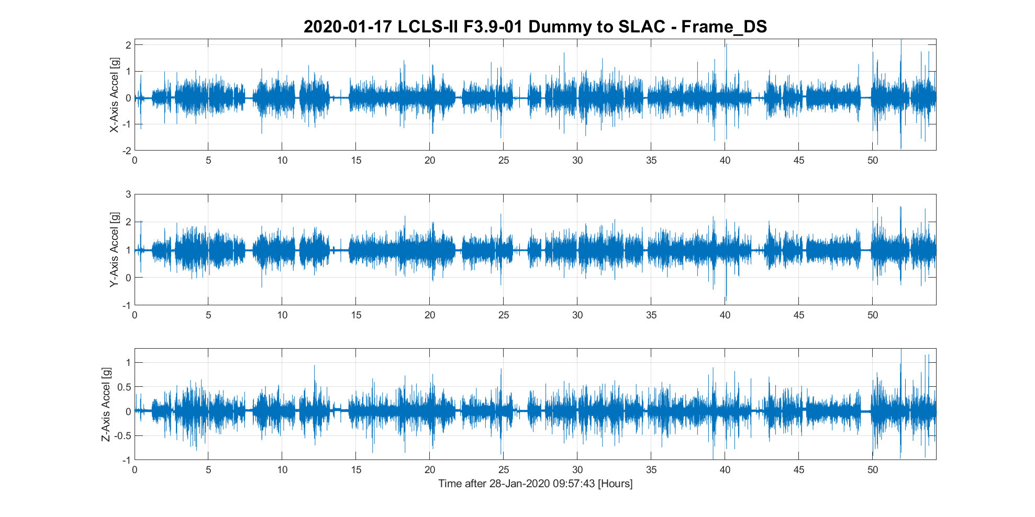
Shipment to SLAC
Time series plots show low shock levels at the cryomodule mounting points and good isolation.

Slide 24
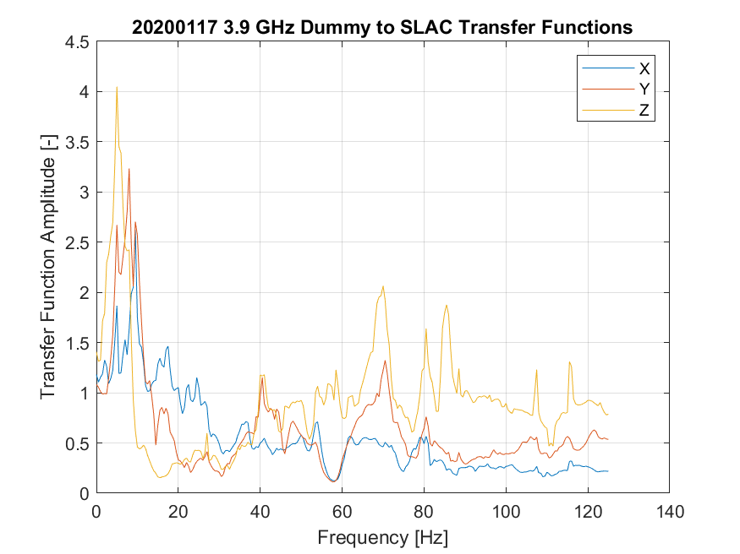
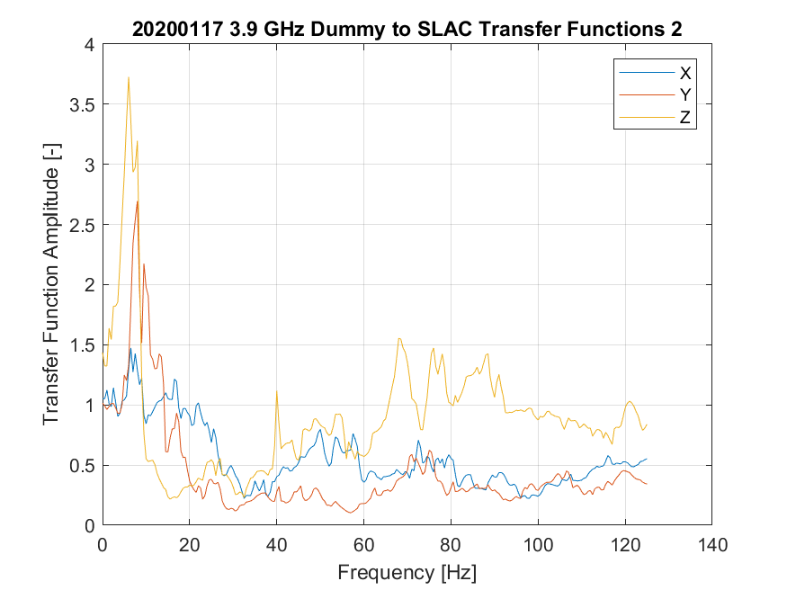
Shipment to SLAC
Transfer functions for inner to outer frame were calculated for both front and rear and show generally good attenuation past 10-15 Hz with the exception of Z at 60+ Hz.

Slide 25
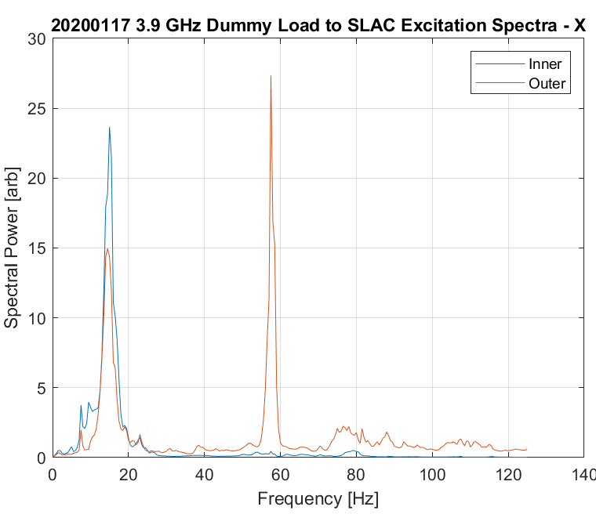
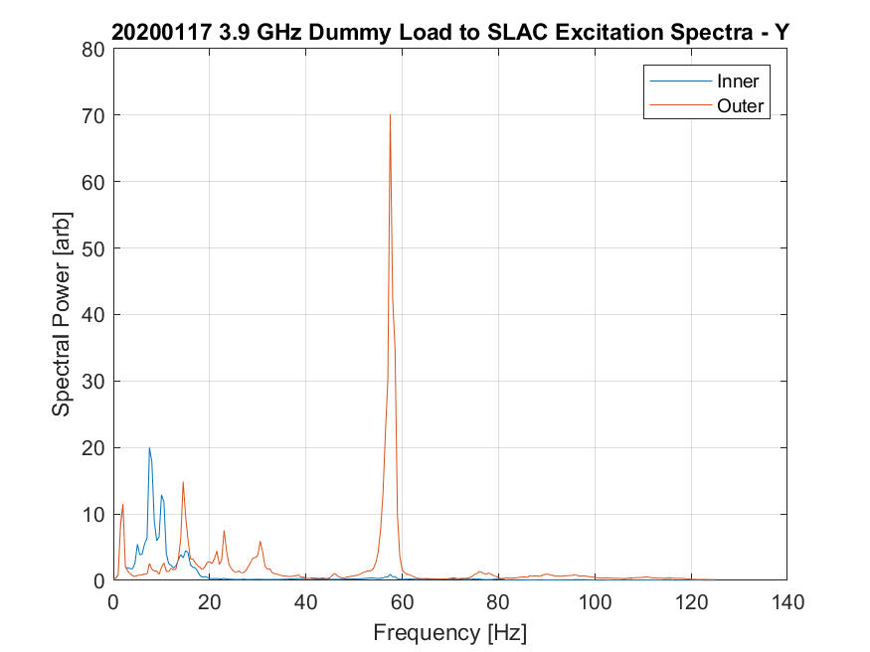
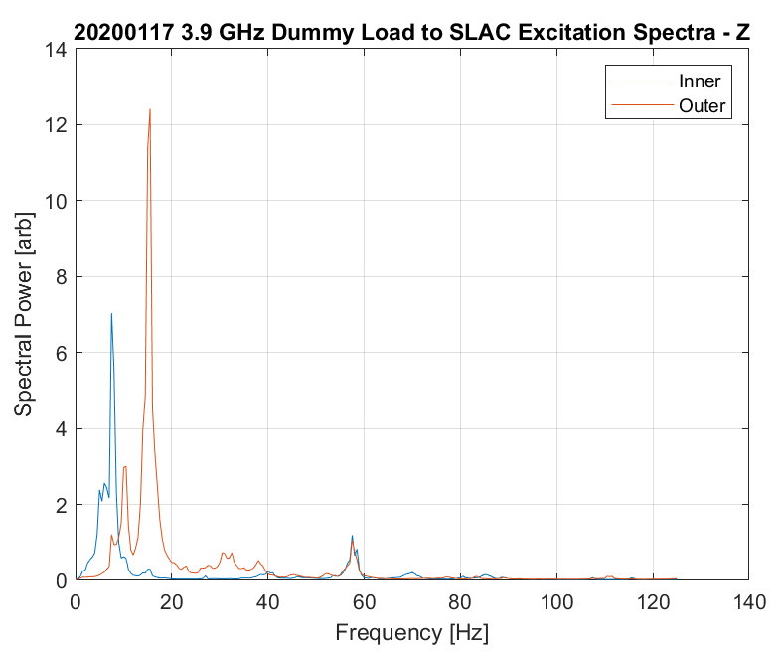
Shipment to SLAC
Excitation spectra calculated for all axes. Note the spectral power in the 40-55 Hz range (coupler resonance) on the inner frame is very low.

Slide 26
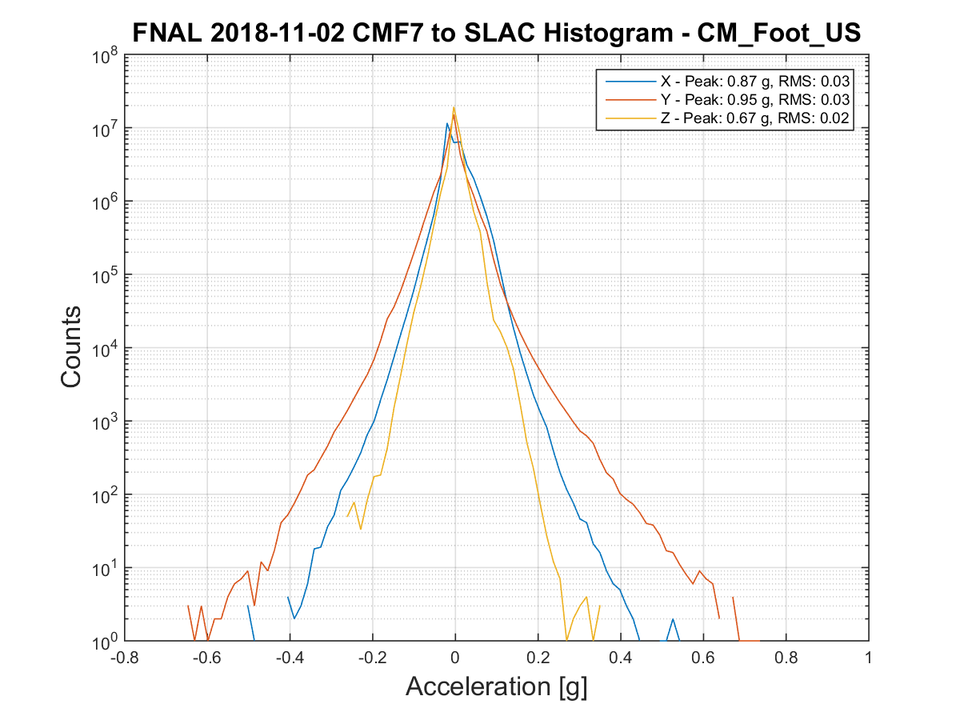
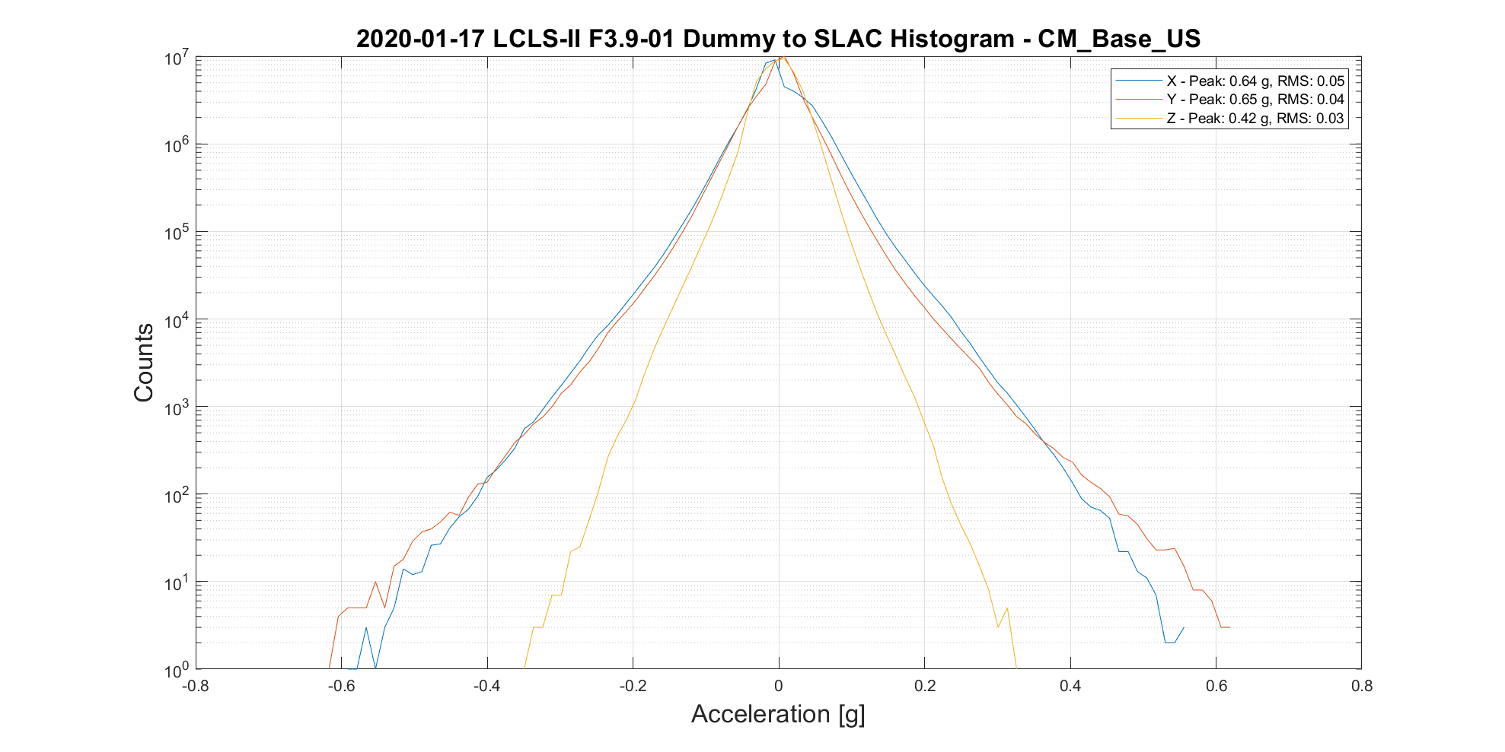
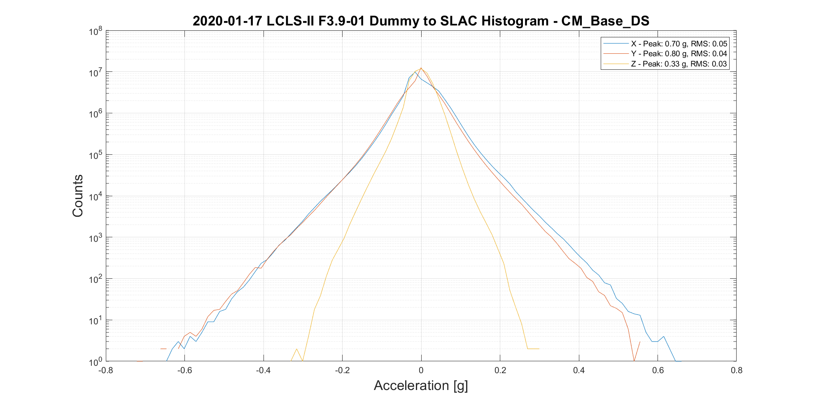
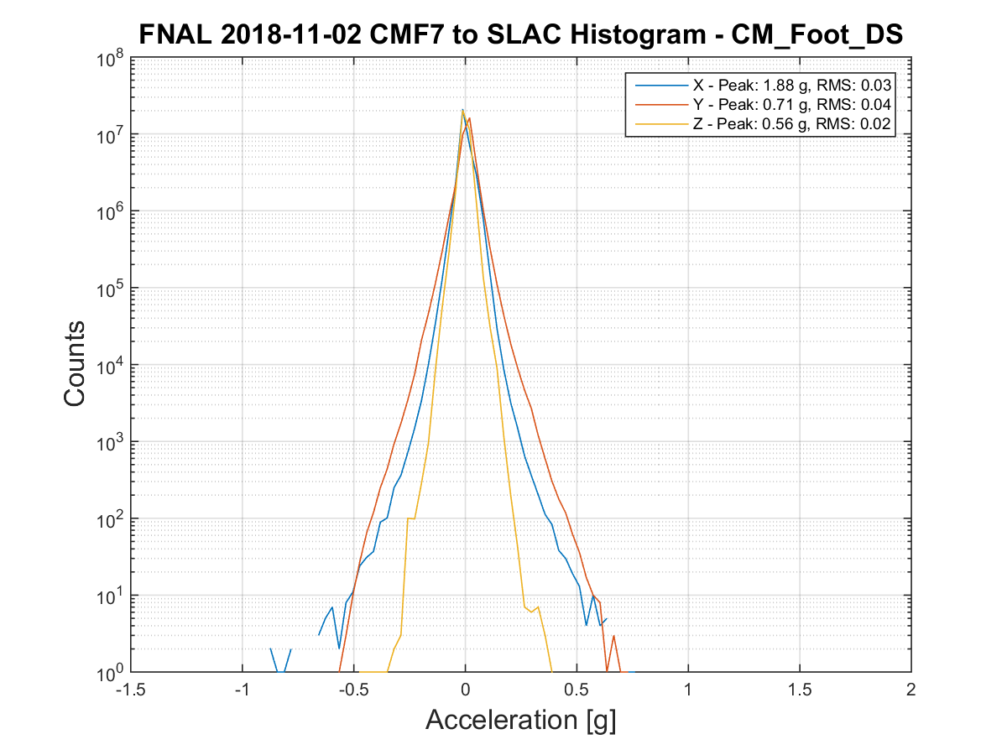
Shipment to SLAC
Histogram views at the cryomodule mounting points (left) compared to F1.3-07 to SLAC (right). Similar performance.

Slide 27
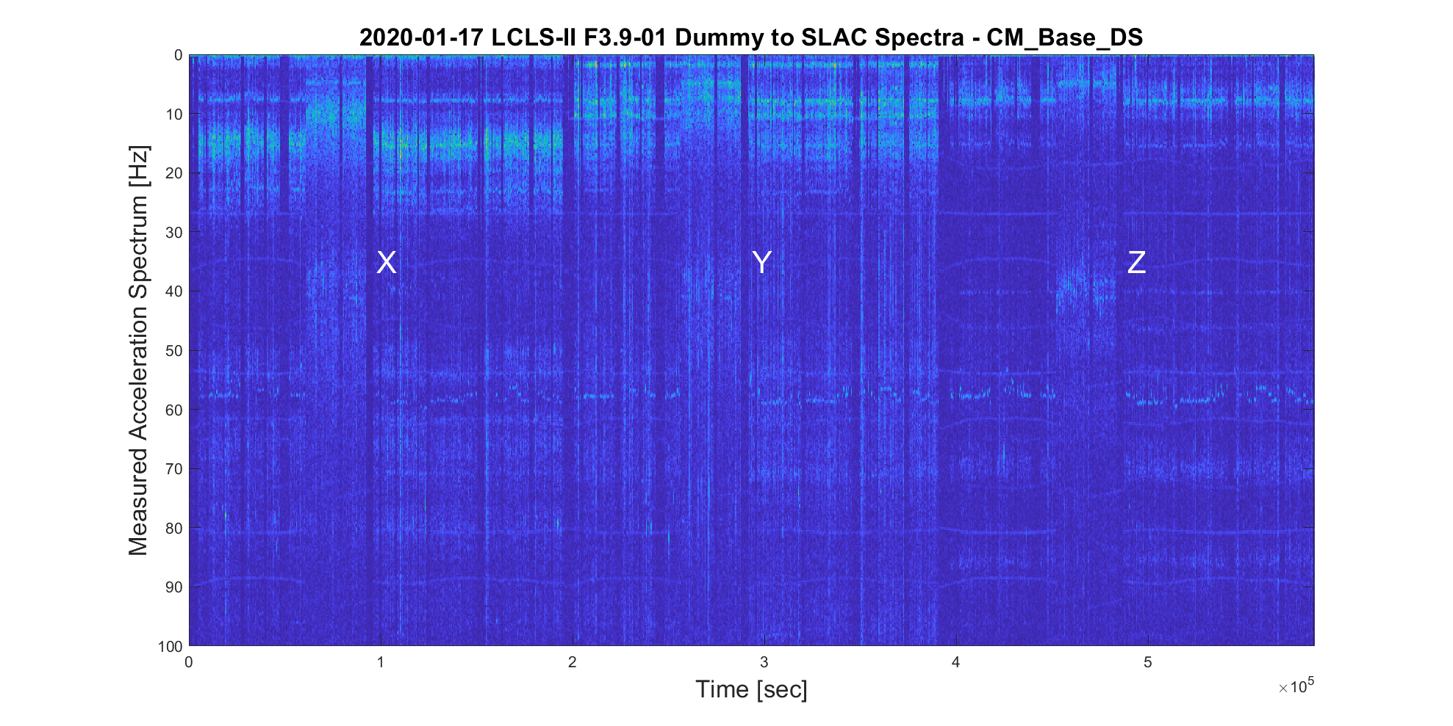
Shipment to SLAC
Spectrograms show similar vibration environment at the cryomodule foot to earlier tests.

Slide 28
Summary
A progressive series of tests were carried out, building on the success of each earlier test.
No showstoppers were identified.
Isolation frame performance is similar to LCLS-II 1.3 GHz.
Predicted 40 Hz resonance of coupler is present but weak.
Most likely partially attenuated by the foam stabilizers.
50K flange vibration will continue to be monitored during live cryomodule tests.

