Slide 1
HRS Rigging Plan and the New FESHM Chapter 10200 (still to be issued).
Dave Pushka
TSD Topical Meeting
20 February 2020

Slide 2
Goals:
Share information for the new FESHM Chapter 10200 for lifting.
Describe work our department will do for receiving the Mu2e HRS

Slide 3
The Mu2e HRS (Heat and Radiation Shield)
Nominal dimensions of the HRS are 151 inches long, 59 inches in diameter, and weighs approximately 63,400 pounds (31.6 tons).
The shipping frame weighs approximately 7200 pounds with all shipping restraints installed.
This lifting permit has been written prior to the release of FESHM 10200. It is assumed that the released version of FESHM 10200 satisfactorily addresses all the comments provided during the lab wide review and that this plan will not require additions when the chapter is released.

Slide 5
Scope:
This lift plan is for receiving the HRS from the delivery truck (backed into the upper level of the Mu2e building) and lowering the HRS onto the installation tooling at the lower level.
Discussion:
The HRS should be orientated on the truck so that the bell end is facing the rear of the truck. Contract with HRS fabricator has this requirement in it.
The lifting beam shown in this plan is to be delivered with the HRS. It will be load tested at the vendor’s facility prior to shipping. Engineering note to be completed and signed off after load test but prior to shipment.
The frame (shown in blue in the below images) used to deliver the HRS will be used as part of the installation tooling.
The lifting beam cannot be sized to lift both the HRS and the shipping frame at the same time due to limitations on the lifting beam size (it must fit into the HRS bore).
Intent is to use both cranes positioned so that the sling angles are vertical and no reduction in capacity needed.

Slide 6
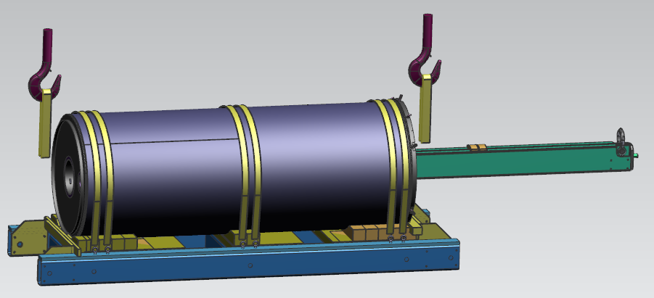

Slide 7
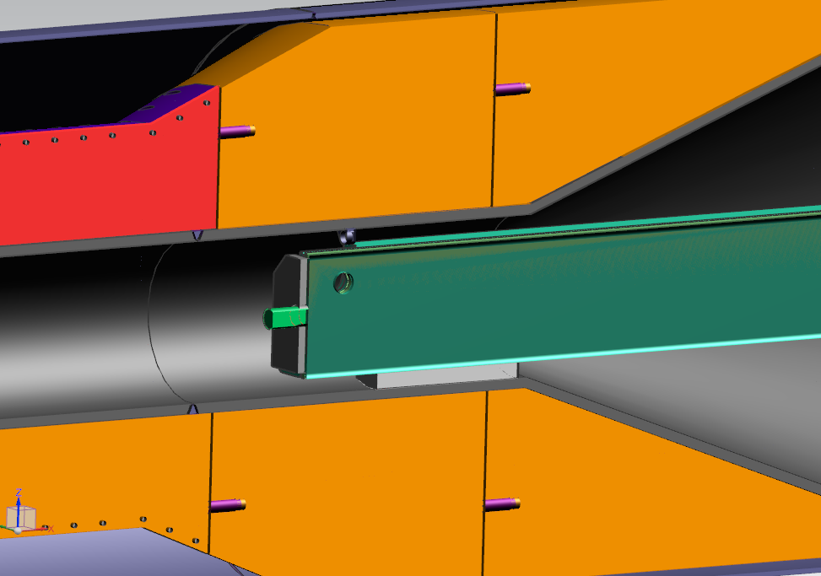

Slide 8
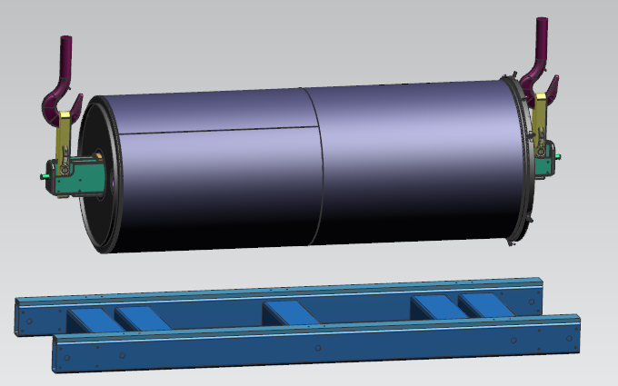
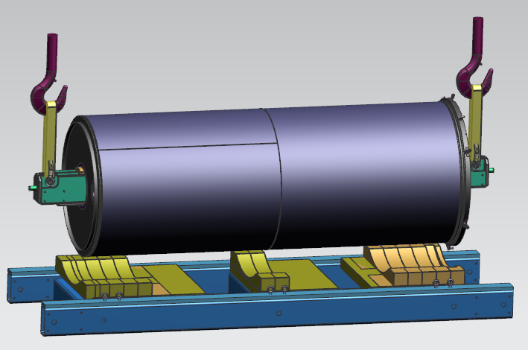
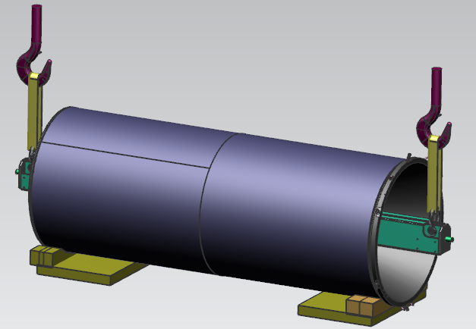

Slide 9
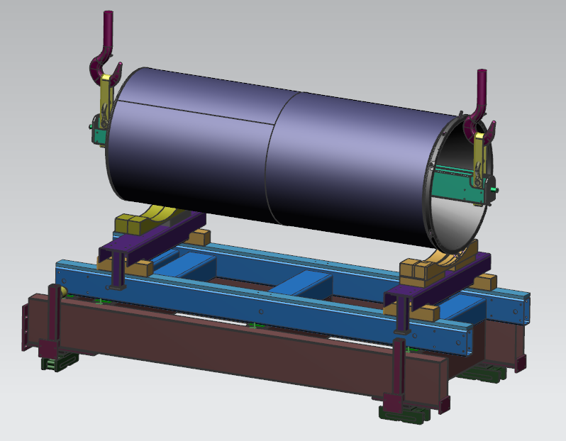

Slide 10
