Slide 1
DUNE communicators virtual meeting
Stefan Söldner-Rembold and Ed Blucher
Feb. 11, 2020

Slide 2
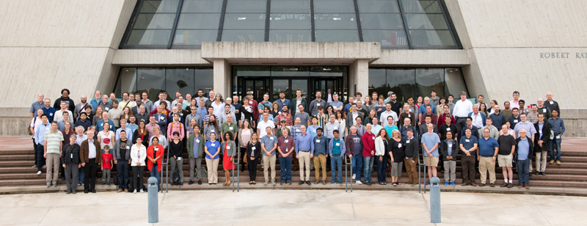
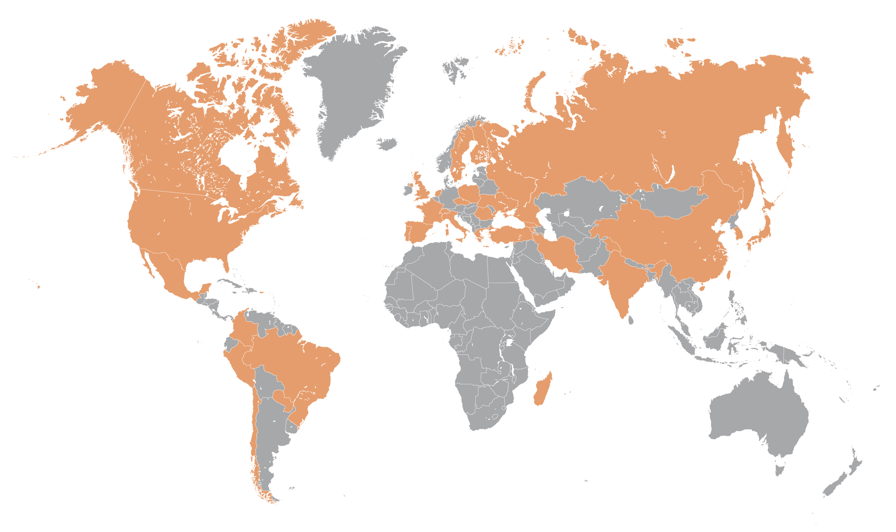
Meet the international DUNE collaboration
1,000+ scientists
180+ institutions
30+ countries
All working together to bring this one-of-a-kind experiment to life. You are part of it!

Slide 3
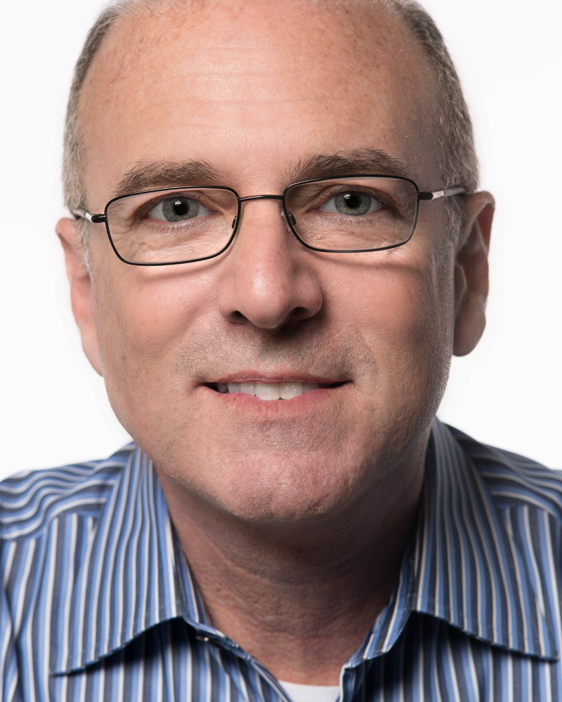
Who we are
Stefan Söldner-Rembold
Head of Particle Physics Group
University of Manchester
DUNE co-spokesperson since 2018
Ed Blucher
Professor, Department of Physics
University of Chicago
DUNE co-spokesperson since 2017

Slide 4
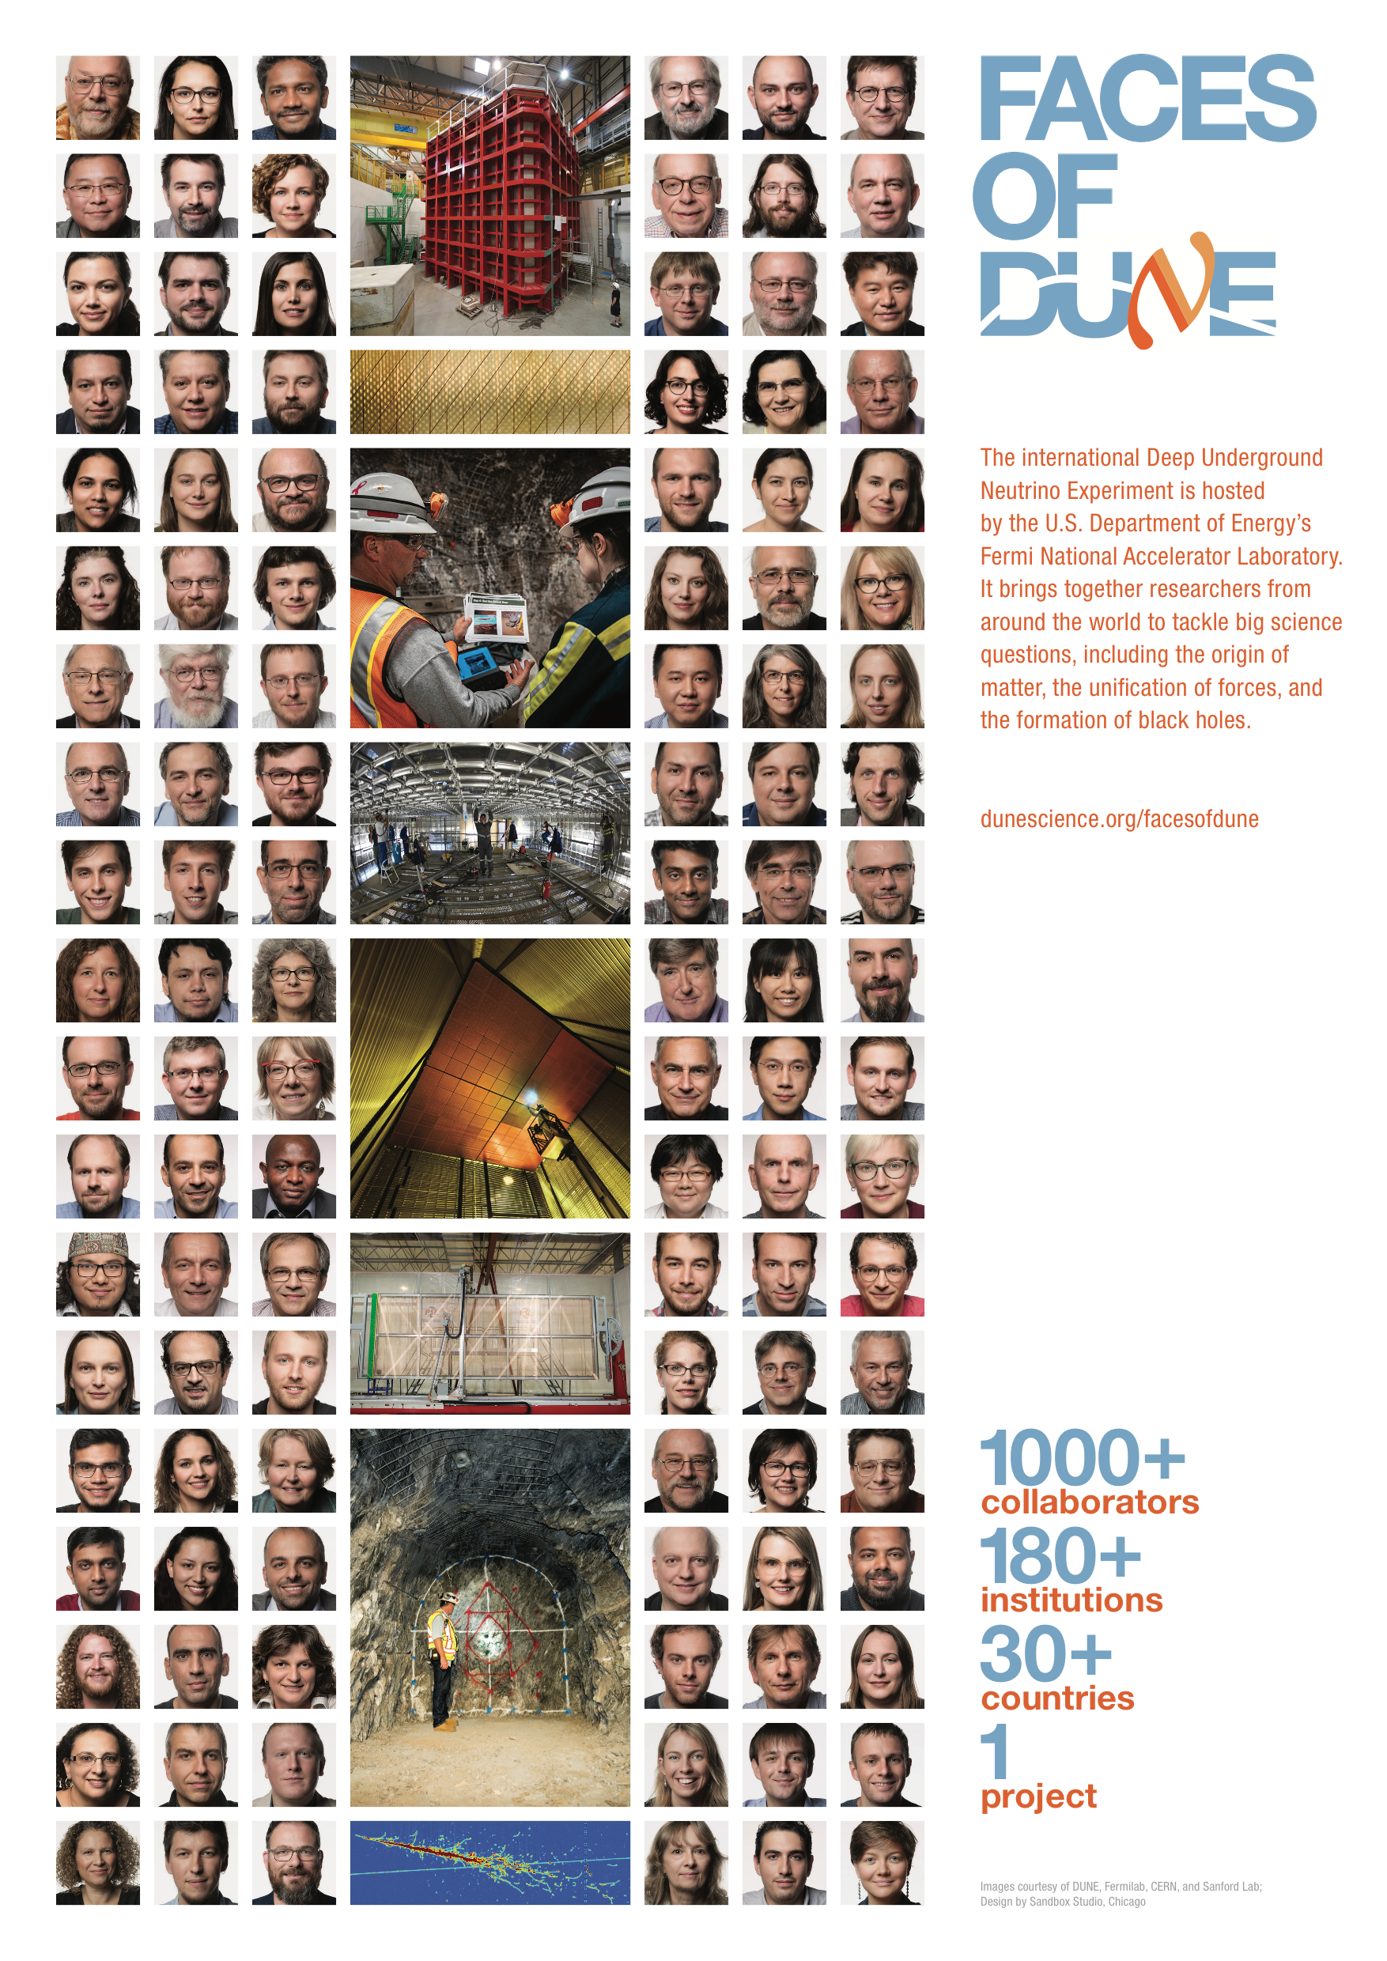
Faces of DUNE
171 profiles of DUNE scientists from institutions around the world
Read all the profiles at dunescience.org/facesofdune/
Two posters that together feature all Faces of DUNE are available for printing (A3 format and 11”x17” format): https://www.dunescience.org/facesofdune/faces-of-dune-posters/

Slide 5
So what is DUNE?
Deep Underground Neutrino Experiment

Slide 6
What will DUNE do?
Origin of matter Discover what happened after the big bang: Are neutrinos the reason the universe is made of matter?
Unification of forces Move closer to realizing Einstein’s dream of a unified theory of matter and energy
Black hole formation Use neutrinos to look into the cosmos and watch the formation of neutron stars and black holes in real time

Slide 7
Observation of neutrino oscillations with DUNE

Slide 8
DUNE, LBNF and PIP-II
DUNE is the experiment and includes the particle detectors.
The Long-Baseline Neutrino Facility (LBNF) includes the beamline and the support structures for the DUNE detectors.
The PIP-II accelerator will power the experiment, sending particles through Fermilab’s accelerators and through the earth to the DUNE detectors.

Slide 9
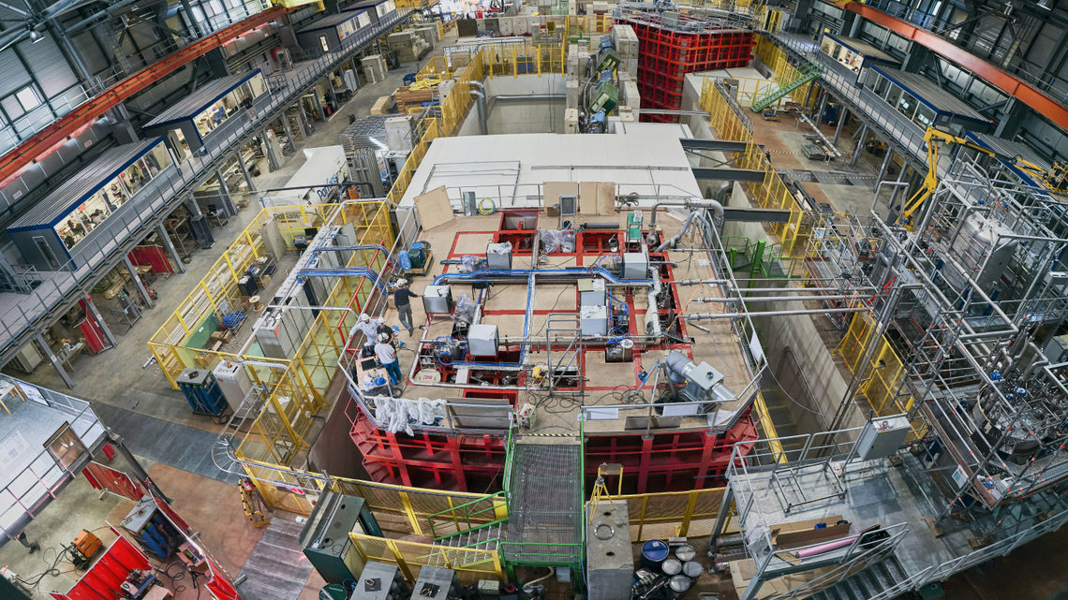
Large prototype detectors are taking data
Two prototype detectors for DUNE (called ProtoDUNE), located at CERN, are both taking data.
The first physics paper based on the data collected with the first ProtoDUNE detector will be published in the near future.

Slide 10
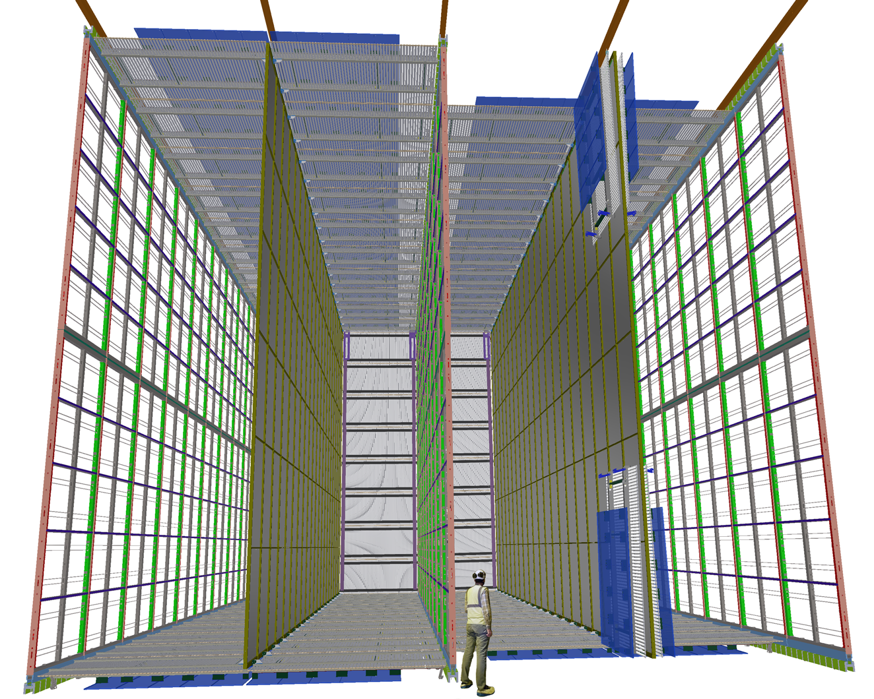
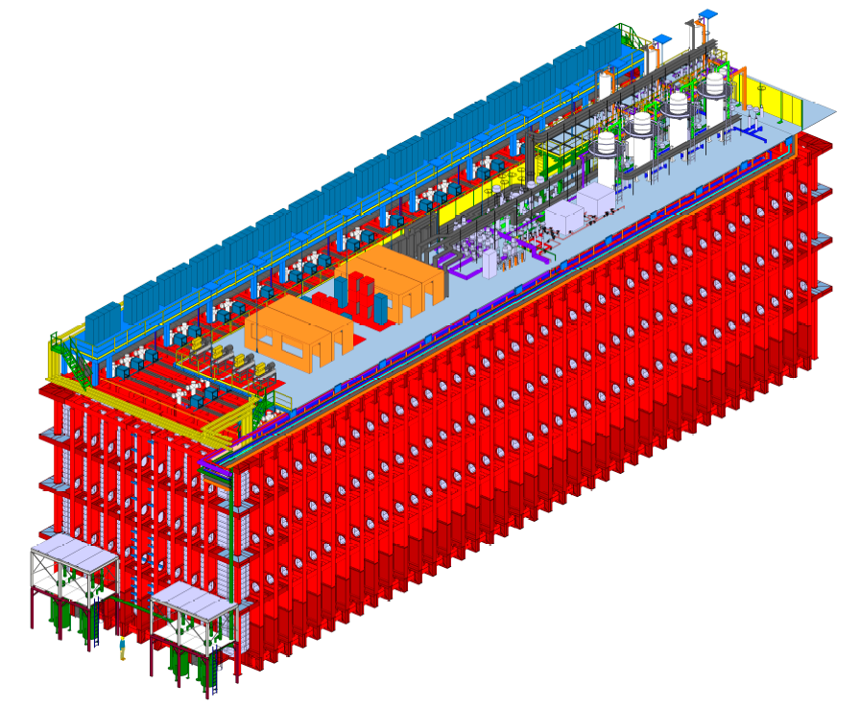
Ready to build components for the far detector
The DUNE Technical Design Report was published yesterday. Fermilab’s story published today: https://news.fnal.gov/2020/02/dune-collaboration-finalizes-the-blueprint-for-the-ultimate-neutrino-detector/
This report includes the specs and blueprints for the DUNE far detectors.

Slide 11
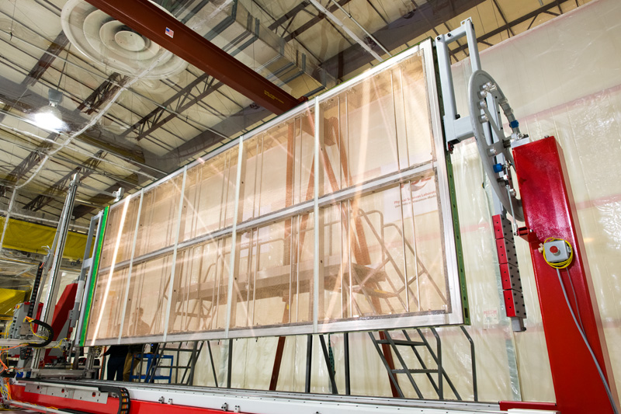
Institutions around the world working on DUNE
Institutions around the world are getting ready to build DUNE components.
Some institutions are already making major contributions to ProtoDUNE at CERN.
Check with your DUNE representative to find out what your institution is contributing.

Slide 12
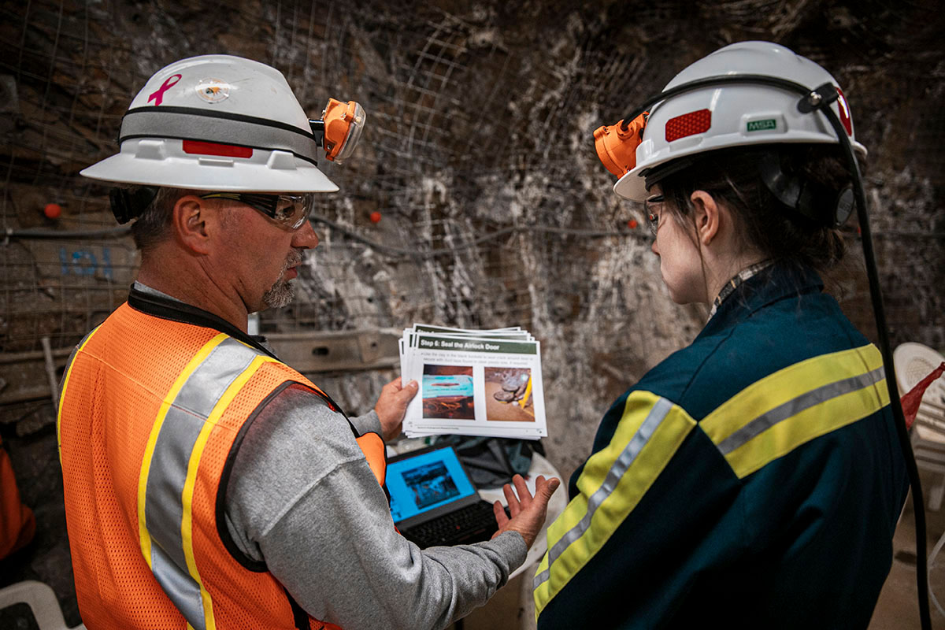
Getting ready to excavate caverns in South Dakota
Pre-excavation work is underway at the DUNE far site, located at Sanford Underground Research Facility in South Dakota.
LBNF team is building a conveyor system to remove 800,000 tons of rock from one mile (1.5 km) underground.

Slide 13
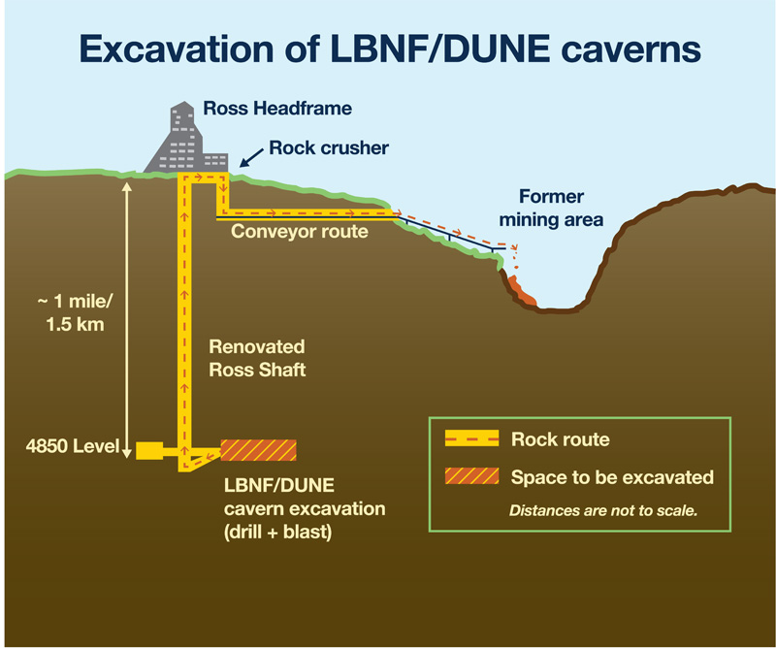
How to remove 800,000 tons of rock

Slide 14
Work has begun on the Fermilab site
Ground was broken at Fermilab for the LBNF near site, which will house the DUNE near detector, in November 2019.
The DUNE near detector will be a technological marvel, aiming to lead to extraordinary discoveries.

Slide 15
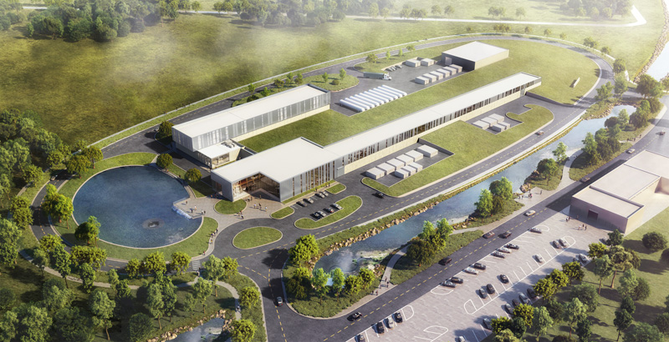
PIP-II accelerator moving forward
After a groundbreaking in March of 2019, pre-construction work has started on the PIP-II facility at Fermilab.
PIP-II will power DUNE with the world’s most intense neutrino beam
Components of the accelerator are under construction at institutions around the world.

Slide 16
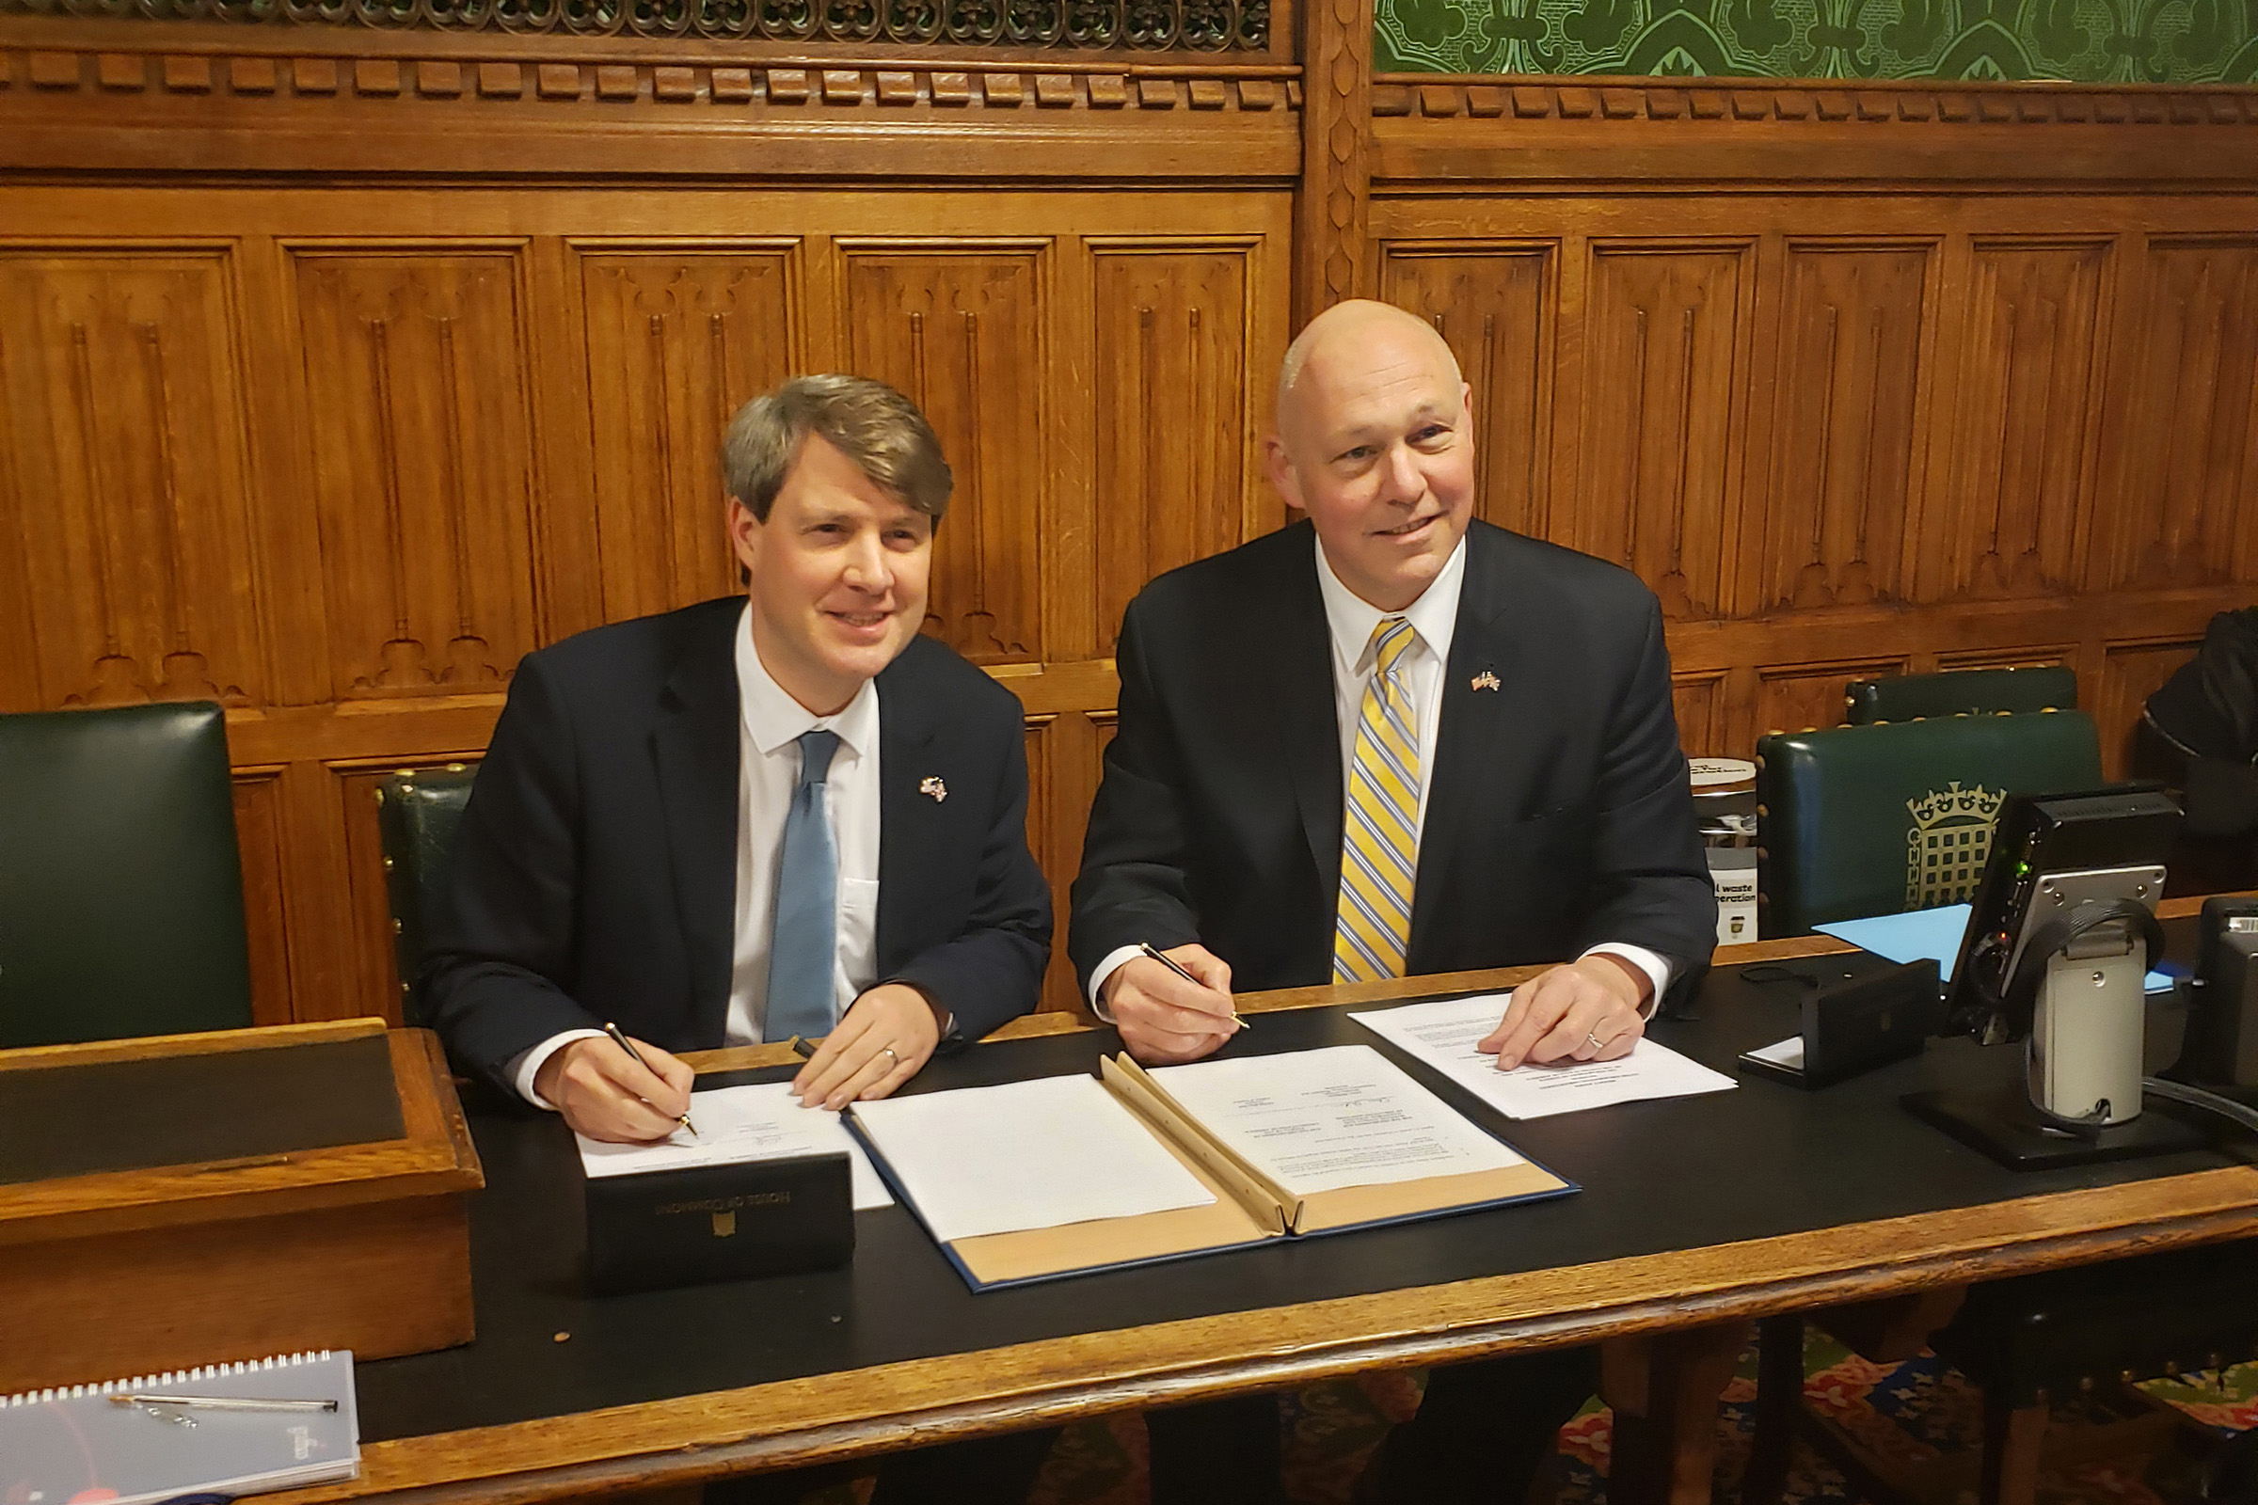
International partnerships
Latest example: The U.S. Department of Energy recently signed an agreement with the UK for £65 million in LBNF/DUNE/PIP-II work.
Agreements with more countries are in the works. DUNE continues to attract international partners and build the collaboration.
For the latest on international partnerships and DUNE, visit this link: http://www.fnal.gov/pub/science/lbnf-dune/international-partnerships.html

Slide 17
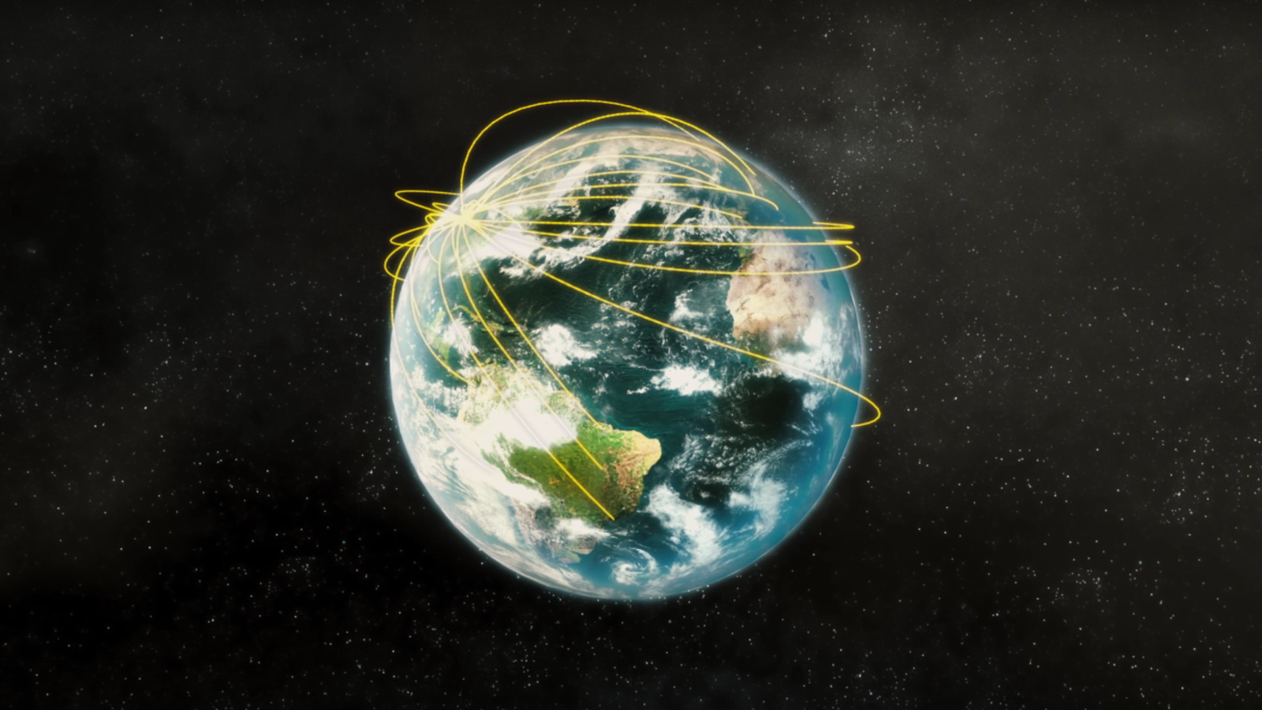
Now it’s your turn
Watch the LBNF/DUNE animations: https://www.youtube.com/watch?v=AYtKcZMJ_4c https://www.youtube.com/watch?v=nv13DswIKr8
Visit the LBNF/DUNE website: https://fnal.gov/dune
Follow DUNE and Fermilab:
@DUNEscience
@Fermilab
Contact Fermilab press officer: Andre Salles, media@fnal.gov
Get out the word about your institutions’ work on DUNE.

