Slide 1
Accounting, Monitoring and Logging in the EGI era. .... are we there yet?
Steven Newhouse
EGEE Technical Director & Interim EGI Director

Slide 2
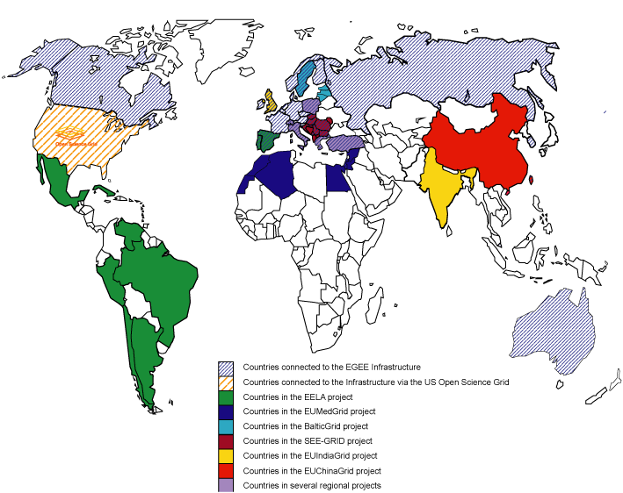
What is the EGI era?
We have been ‘experimenting’ with grids for ~10 years
European Data Grid
EGEE
EGEE-II
EGEE-III
We have established a
global user community
We have demonstrated
a global production infrastructure
Sustainability in Europe will be achieved through the
European Grid Infrastructure (EGI)

Slide 3
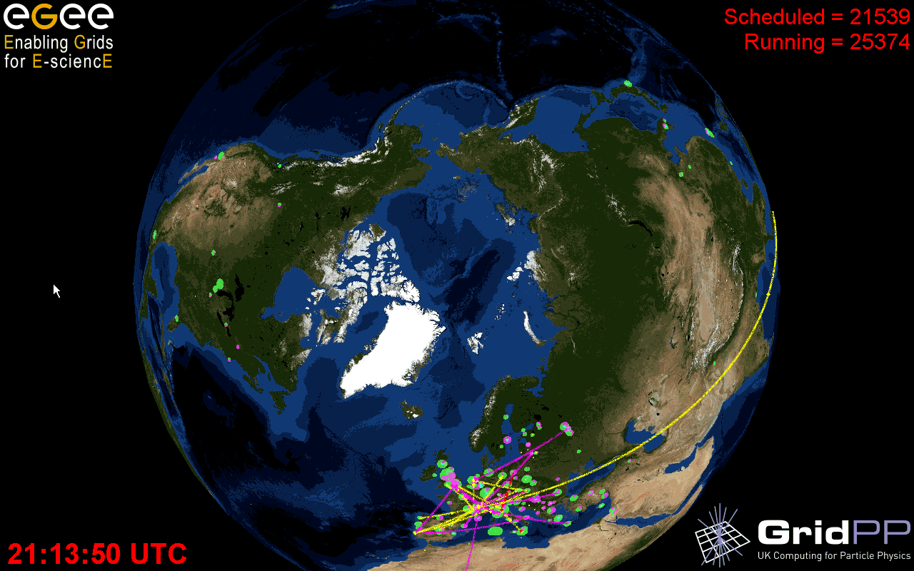
~280 sites
48 countries
>80,000 CPUs
>20 PetaBytes
>17,000 users
>330,000 jobs/day
Archeology
Astronomy
Astrophysics
Civil Protection
Comp. Chemistry
Earth Sciences
Finance
Fusion
Geophysics
High Energy Physics
Life Sciences
Multimedia
Material Sciences
…
Notes:
3

Slide 4
What is EGI?
SSC
SSC
SSC
VO
VO
VO
VO
VO
VO
VO
VO
VO
Other Grids
Other Grids
EGI.eu
(Coordinating Body)
NGI
NGI
NGI
NGI

Slide 5
Who are the EGI Stakeholders?
National Grid Infrastructures (NGIs)
Many strong independent national grid activities
Encompass different resources
Storage
Desktop cycle stealing
Commodity clusters
Commodity HPC clusters
Supercomputers?
Interface internal resources & users groups to external resources
Multi-National Research Collaborations
Spanning multiple NGIs
Collaborations outside of Europe
European & International Research Organisations

Slide 6
General Requirements
EGI is a coordinating body
Specify just enough for interoperation
Specify standards (or specifications where available)
Specify the criteria not the delivery
Focus on the quality not the implementation
Different NGIs work in different ways
Large, Medium & Small
Independent & regional federation
Provide a default distribution... but expect alternatives!
There to enable multi-national research collaborations

Slide 7
Monitoring
Purpose:
Check that the infrastructure is there... and working?
Uses:
Find problems (and fix them) before users get disrupted
Basis for availability and reliability site/region metrics
Challenges:
User (VO) perspective may be different from the infrastructure
Probes need to encompass all aspects of the service
Probes need to encompass all deployed middleware

Slide 8
Logging
Purpose:
Record what is happening where
Uses:
Record activity for investigation during security incidents
Help track and diagnose support issues
Can be used as a basis for accounting
Challenges:
Logs need to be kept securely for audit
Logs need to be kept confidential as can contain private data
Logs need to be available to help desk staff
Logs need to be consistent across different services
Logs need to be consistent from different providers

Slide 9
Accounting
Purpose:
Record what is being used by who, and where, and why
Use:
Understand how communities are using resources
Federate accounts from multiple infrastructures
Challenges:
Desire to move from central to decentralised accounting
Finding the balance between privacy and detail
Going beyond compute to storage and network use
Paying for use
Quotas for individuals, sites and VOs

Slide 10
Activity within EGEE
Monitoring at the ROC and site
Discover locally and fix locally
Availability and reliability monitoring
Public ‘wall of shame’ has improved metrics over the last year
Already operating a federated accounting systems
OSG & NorduGrid usage integrated as part of WLCG
Move to regionalised accounting deployments
Italian Grid integrates their system with the EGEE core
Multiple European systems: APEL, DGAS, SGAS
Converge, diverge or standardise?

Slide 11
Summary
From a homogeneous to a heterogeneous infrastructure
Big challenges for those who have been focused just on EGEE
Normal for those involved in WLCG
To standardise or not to standardise – that is the question?
Clear statement from the EU that standards should be adopted
Europe has clear experience that can be brought to OGF
Usage Records, Resource Usage Service, ...
Integration with HPC resources
Users would like to see integrated authentication & authorisation
Why not accounting?
Possibly even logging if supported by the job flow
Delivering a service makes monitoring, logging & accounting essential

Slide 12
Register now at http://egee09.eu-egee.org
Any questions?

