Slide 1
CCD + OCIO All-Hands Report
Jon Bakken
February 17, 2020

Slide 2
Agenda
Changes to CCD & OCIO organizations
SharePoint
Project Updates for:
Telecom
Email-MFA
Everbridge
IT Job Descriptions
Workforce Planning
CCD Washington DC budget briefing slide
Climate survey progress
Teams demo
Notes:
Liz – I think you should talk about the importance of Safety & Security, new people in computing, & about the projects you consider most important – Federation, Workforce Planning, Data Service. (there may be others)
Eric Schlatter – should talk about WPC/Impact
Jon – I will talk about the org changes in CCD & OCIO, email-MFA, Enterprise Architecture, IT Job Descriptions work, slides Mark made for Workforce Planning, slide we made for Kate for DC budget briefing, talking in computer-speak versus English, maybe ServiceNow FedRamp, maybe Sharepoint upgrade, maybe ATT wiring issues, maybe climate survey progress.
Jim always has good things to say.

Slide 3
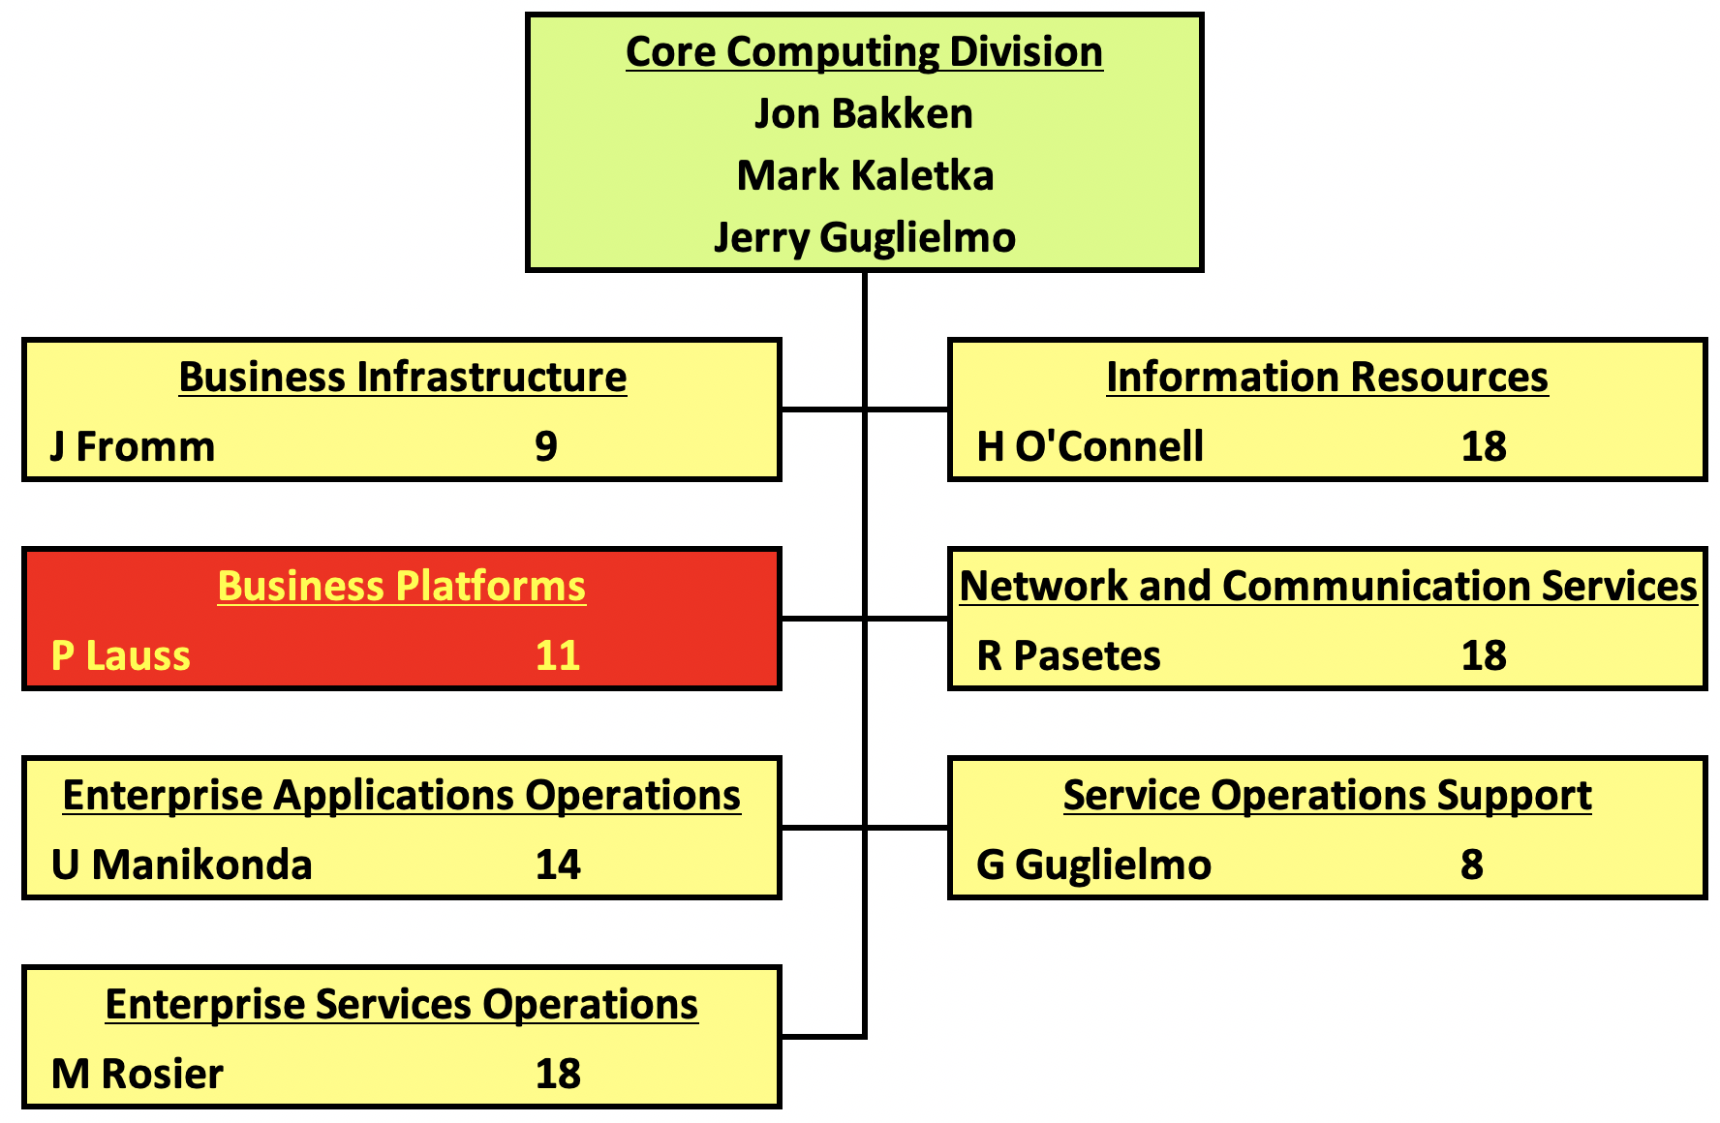
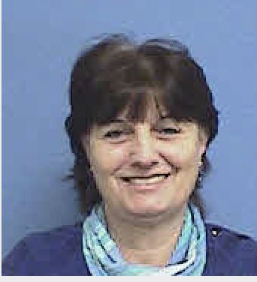
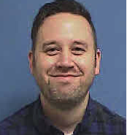
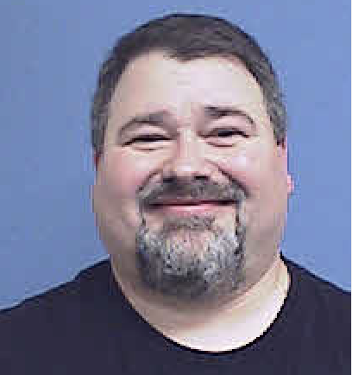
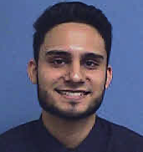
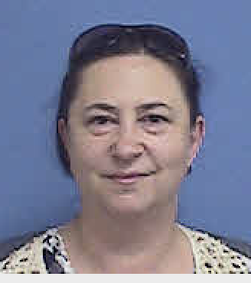
$32.1M CCD budget w/ OH
M&S = $13.7M no OH
~95% are fixed costs
SWF = $14.2M no OH
~80% operations
~20% projects
SCD’s
MargheritaWiersma
New Hire
Joel Senders
Mar 2
NEW
SCD’s
Natalia
Ratnikova
Sep
New Hire
Shazil Ansari
111 staff, 39 contractors

Slide 4
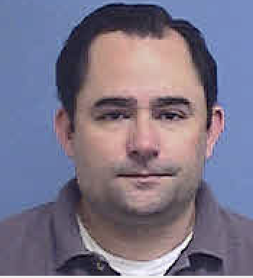
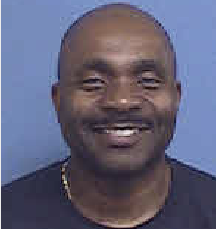
New CCD Department: Business Platforms = BP
BP Mission – Provide highly available & reliable:
Business platforms that host lab-wide enterprise services
Efficient & easy-to-use desktop environments so others can accomplish their tasks
We serve our user community by applying best practices to obtain high availability, cost savings, & most of all reliability.

Slide 5
BP Responsibilities
OS Server Support ​
Application Presentation using ​ Citrix Xen App​, Xen Desktop, Microsoft Remote App ​
Exchange/EMAIL, SMTP Services, Listserv​
Proxy services
Desktops & Laptops: 2728​
Servers: 536​
​
Mac JAMF Clients: 790​
Windows SCCM Clients: 3140​
SEP Anti-Virus Clients: 3749​
Viruses Stopped Per Week: ~35​
Mailboxes: Over 2,800​
Mailing Lists: Over 5,000​
Email Addresses: Over 11,000​
Emails per Month: Over 8.5M
Usable computer environment for most employees​, Laptop/desktop/tablet​
Central management for user systems & related applications​ Configuration, patching, troubleshooting, recommendations
Malware & Bug Protection & Compliance Enforcement, Symantec, SCCM, JAMF​
Productivity Software to Analyze, Communicate, & Share, Outlook, PowerPoint, Word, Adobe, Excel​
Assistance for special needs environments​, LabView, SCADA, DAQ, ESH&Q​

Slide 6
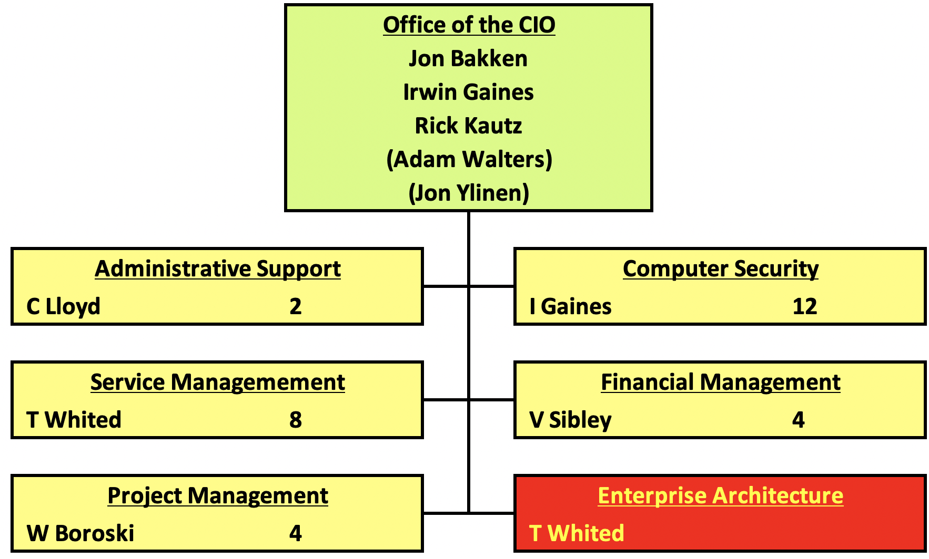
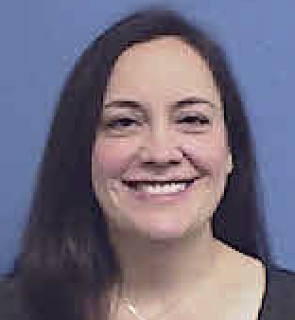
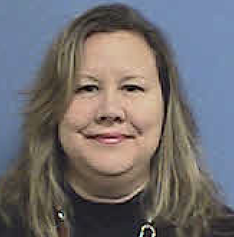
$6.6M OCIO budget w/ OH
M&S = $1.0M no OH
SWF = $4.6M no OH
SCD’s
Krista
Majewski
Mar 2
NEW
Headcount: 44 Staff

Slide 7
Restarting Enterprise Architecture with a more prominent role
Tammy Whited is our new Enterprise Architect
Craig Mohler & Rennie Scott are Co-Deputy Enterprise Architects
New methodology is modeled after the very successful CSBoard & the CCDM meetings.
There will be an EABoard, chaired by Tammy, Craig & Rennie.
Topics discussed at EABoard are strategic, not simple design choices.
There will be a “core team” for the EABoard – similar to the cyber security group, consisting of Liz, Jon, Jim, Mark, & Stu at least. More depending on the topic.
All Department Heads can attend EABoard & provide input.
EABoard recommends. Recommendations are rarely overruled. Liz has final say.
Items in the ITIL Change board – need sign-off from the EABoard.

Slide 8
Telecom Feb 8 00:00 – 06:00
AT&T, telecom, & networking executed a change to move the AT&T fiber servicing our phone system in order to accommodate the IERC construction project.
Significant because Main Control Room, Com Center, & Emergency Operations Center lost phone service
ESH distributed emergency radios,
CCD redirected VoIP phones calling x3131 to the DuPage or Tri-Counties 911 center
AD shut off their beam to ensure that personnel were safe.
At 00:02: AT&T Georgia notified the local AT&T team that they were in the middle of a nationwide software upgrade – preventing the local team from moving forward with the planned change.
AT&T suggested that we abort. Rejected since this change was on the critical path for the IERC construction site-prep project. Restart 02:50
Change, including testing, completed successfully before 6 AM!
Outstanding work by Ray Pasetes, Tim Niemiec, Mitch Novak, & the teams from ESH, FESS, AD, & the Office of Communications

Slide 9
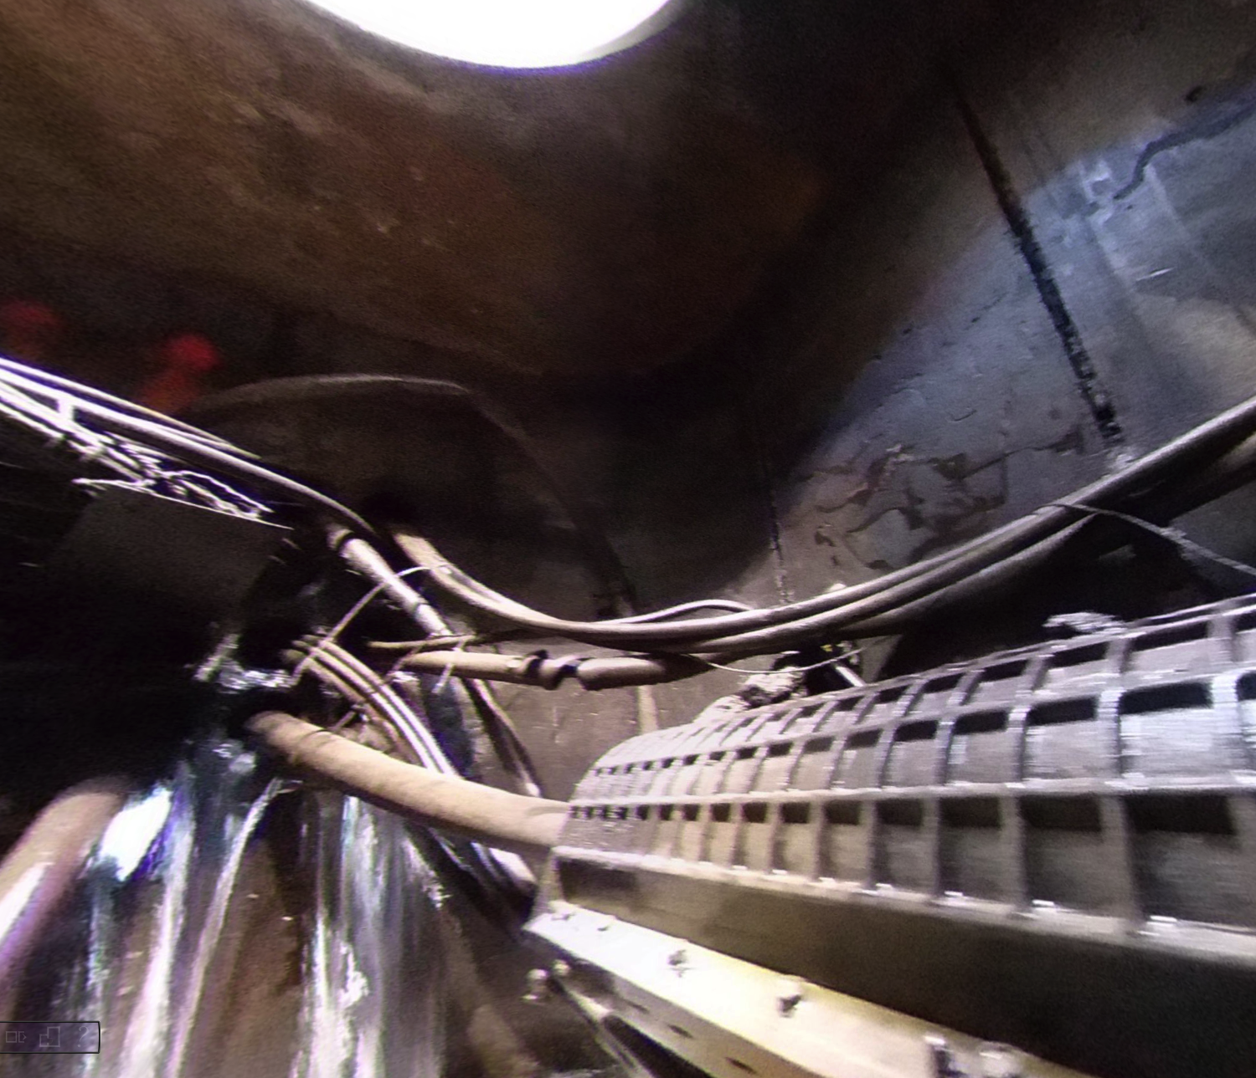
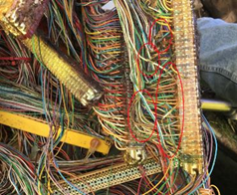
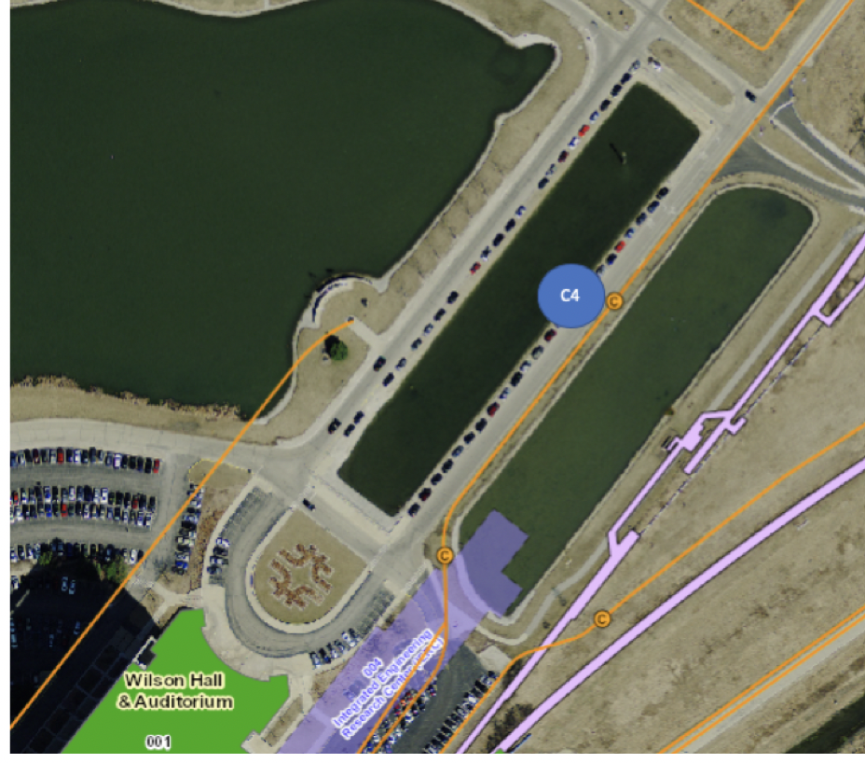
Telecom Work needed “soon”
AT&T, telecom, & networking need to re-route 6 copper cable bundles (2400 wires) that carry phone & FIRUS signals & one air pipe in manhole C4 into the new IERC communications duct in order to accommodate the IERC construction project.
900+ phone lines that services 3 main areas in the lab:
The Industrial Center complex buildings
Buildings, tunnels, enclosures along the fixed-target line
Buildings in the Site-38, Site-39, Fuel Depot, Vehicle maintenance, Warehouse/Shipping & Receiving area. This includes the fire station.
Re-splicing the copper & re-rerouting the cabling into the new ducts will take ~5 days of outage per cable. AT&T will work on one cable at a time.
By the way, manhole C4 is buried in 25 ft of concrete that must be dug out to provide a 10ft work area before the splicing & routing can start.
Breaking any cables during the excavation would require significant repair work
These wires are old, & they have paper jackets. Air is constantly blown through the ducts to keep the wires dry. Loss of air pressure will cause the wires to become wet & short out

Slide 10
SharePoint - Upgraded from Version 2013 to 2019
Carried out starting last Wednesday at 10 PM & continued through Sunday. Successfully finished within expected timeframe.
Access was down from Wed 10 PM to Thus 6AM & the rest of the time the system was available read-only.
All sites were upgraded, the financial MFA is working & the hybrid O365 mode is connected & working
SharePoint is an enterprise application – upgrading requires significant planning & testing
Finding a time to perform the upgrade is difficult because so many depend on SharePoint to do their work
One key feature of 2019 version is the capability to perform patches & upgrades without downtime!
Great work by Bob S, Ping W, Kimberly M, Muntasar A, Mohammed Y, Norman H, Vyto G, Andrey B, Darryl W, Michael K, Keenan N, Saul G, Fang W, & Yolanda V

Slide 11
Email & Multifactor Authentication – PEMP Goal
Reading/Sending email or using O365 apps while using the FNAL network, including VPN: NO change
Reading/Sending email or using O365 apps while not on FNAL network or VPN’d into lab: You will need MFA-RSA credentials to access email or the O365 apps.
Make sure you have an RSA device or RSA APP – get it now
Clients that use IMAP (Thunderbird) will not work at home
Effective March 24
OWA (Outlook Web client at mail.fnal.gov) will work at home, but requires MFA
Side Note: October 13, 2020: Microsoft ends support for Basic Authentication methods, including POP & IMAP
Project being led by Joe K, Irwin G, Saul G and Authentication & Security teams

Slide 12
Email & Multifactor Authentication, con’t.
MFA Session Timeout = 30 days
If you are the Fermi network or on VPN → username/password.
If you are offsite or on Eduroam/Guest → username/password + RSA challenge
Inactivity timeout = 14 days
Guest network = Same as if you were at home
Token is not tied to an IP address – you can move between FGZ, cellular, Starbucks without reauthenticating
If you get email alerts – read the mfa.fnal.gov FAQ for advice
Rollout:
March 17 – Everyone in CCD & OCIO
March 24 – Disabling IMAP when not on FGZ/VPN network
March 24 – Everyone in SCD
March 31, April 7, April 14 – rest of lab, divided into 3 groups
April 21 – Visitors & Contractors

Slide 13
Everbridge Change – Rollout in March
Contact information currently in the Everbridge emergency management system will be uploaded to Workday
No one has to log into Everbridge ever again
All information will be stored in Workday – go to WorkDay after the rollout to verify your info is correct & to make any changes.
There isn’t any change in the way Everbridge emergency messages are sent
Be aware that the word “contact” is overloaded. Be alert when changing this information:
Everbridge contact: If there is a tornado at the lab, we need your contact information so we can alert you to the trouble. We don’t need your spouse’s info.
Current Workday contact: If you are hurt at the lab, we need to know who to contact to let them know about your situation. We don’t need your information.
Project leaders are Lauri C, Craig M, Julie M, Heather S, Jackie Z

Slide 14
Review of IT Job Descriptions – Due Summer 2020
Every 5 years IT jobs are reviewed. Mark Kaletka, Jerry Guglielmo, Stu Fuess & AD’s Jim Patrick are working with HR’s Pete Cholewinski as the team evaluating the job descriptions. Jon, Jim, Liz approve the final set. Discussion topics include:
Is the dual path tech/mgt structure working well?
Should this be expanded to other IT job families?
How do we create rapid promotions at lower levels of job families?
Restructure families to better utilize existing pay grades (positions below current ones)?
Create multiple levels within pay grades?
Assign a Computing/IT Associate II position (A3) across job families?
Are there any new families that need to be created?
Should any be retired/heavily revised?
Are current titles/nomenclature still relevant in the market?
Gridding out the IT jobs to maximize career pathing opportunities:
Address that starting some families at A4 & others at A5 may make lateral transfer opportunities difficult/confusing
Streamlining minimum education & experience requirements by level

Slide 15
Current IT Jobs
Proposed IT Jobs

Slide 16
Workforce Planning – 10-year projection
Bill Boroski, Mark Kaletka, Julie Marsh – part of the lab wide team who developed FNAL’s 10 year workforce plan.
CCD’s approach to workforce:
CCD personnel provide IT infrastructure support for all aspects of the laboratory’s program including LBNF & PIP-II, & for modernization of the lab's business functions
CCD’s workforce is aligned with our IT service management strategy & offerings. Lab capabilities map to service offerings.
Organization & roles reflect our service offerings & are managed to our service catalog & SLA’s.
Majority of CCD effort (> 80%) goes to operation of existing services, remainder toward implementing new services/projects.

Slide 17
CCD 10 year projection of FTE’s
FY20 is SWF budget uploaded to BPS at start of FY20, all FTE’s shown fully budgeted in FY20
FY21 addresses services in which we’re currently understaffed
Database hosting, enterprise applications, network, & IT server hosting are our most critical
Brings us to a more sustainable baseline
FY22-30 assumes:
Maintain baseline for operations, service improvements, & some new services
Shed operation of legacy systems & technologies (this itself requires effort)
Contractors (M&S) for implementing major new projects, services, or technologies
Support for SURF/LBNF
Network ramp-up for LSST
Succession planning is considered
For some FY’s, plans for expected retirements lead to temporary peaks in effort
We expect to fill openings resulting from normal turnover, to maintain baseline effort

Slide 18
Slide shown at DC Budget Briefing – Core Computing
Efficiency actions:
Provide standardized support to Project, Experiment, Operation & Mission Support functions
Reinvigorated lab-wide IT identification & prioritization system
Leverage contractors
Streamline operations through use of cloud services
Major Efforts :
Implementing over 15 major IT security & business support systems, including: MFA, Site Access, eMarketplace, VoIP, eBS, BPS, Workday & Oracle Procurement modules
Supported Workforce & Strategic Planning initiatives
Future Initiatives:
Build out of Oracle eBS Procurement tools (AME, Metrics)
Integrating Site Access, FVA, S&T matrix, & Badging processes
Design & support for DUNE & LSST high-performance networks
Build out of tools to support HR (Applicant Tracking), ESH (IMPACT), FESS (SS Property)

Slide 19
Computing Focus Group
Members
Jo Fazio Craig Mohler (co-leads) Julie Marsh Brian McKittrick Keenan Newton Kevin Pedro Rennie Scott Marcia Teckenbrock Steve Timm
Formed in response to discussion had at the CCD/SCD/OCIO meetings following the release of the results from the Climate Survey
Has been meeting regularly since October.
Five themes identified & discussed or discussing: Management Style, Career Development, Sexual Harassment, Communication & Diversity
Have come up with recommendations—Collaborating with senior management & HR to review potential actions that can be taken to address feedback that was supplied as a result of the Climate Survey
The Computing Focus Group is very interested in feedback from other computing people.

Slide 20
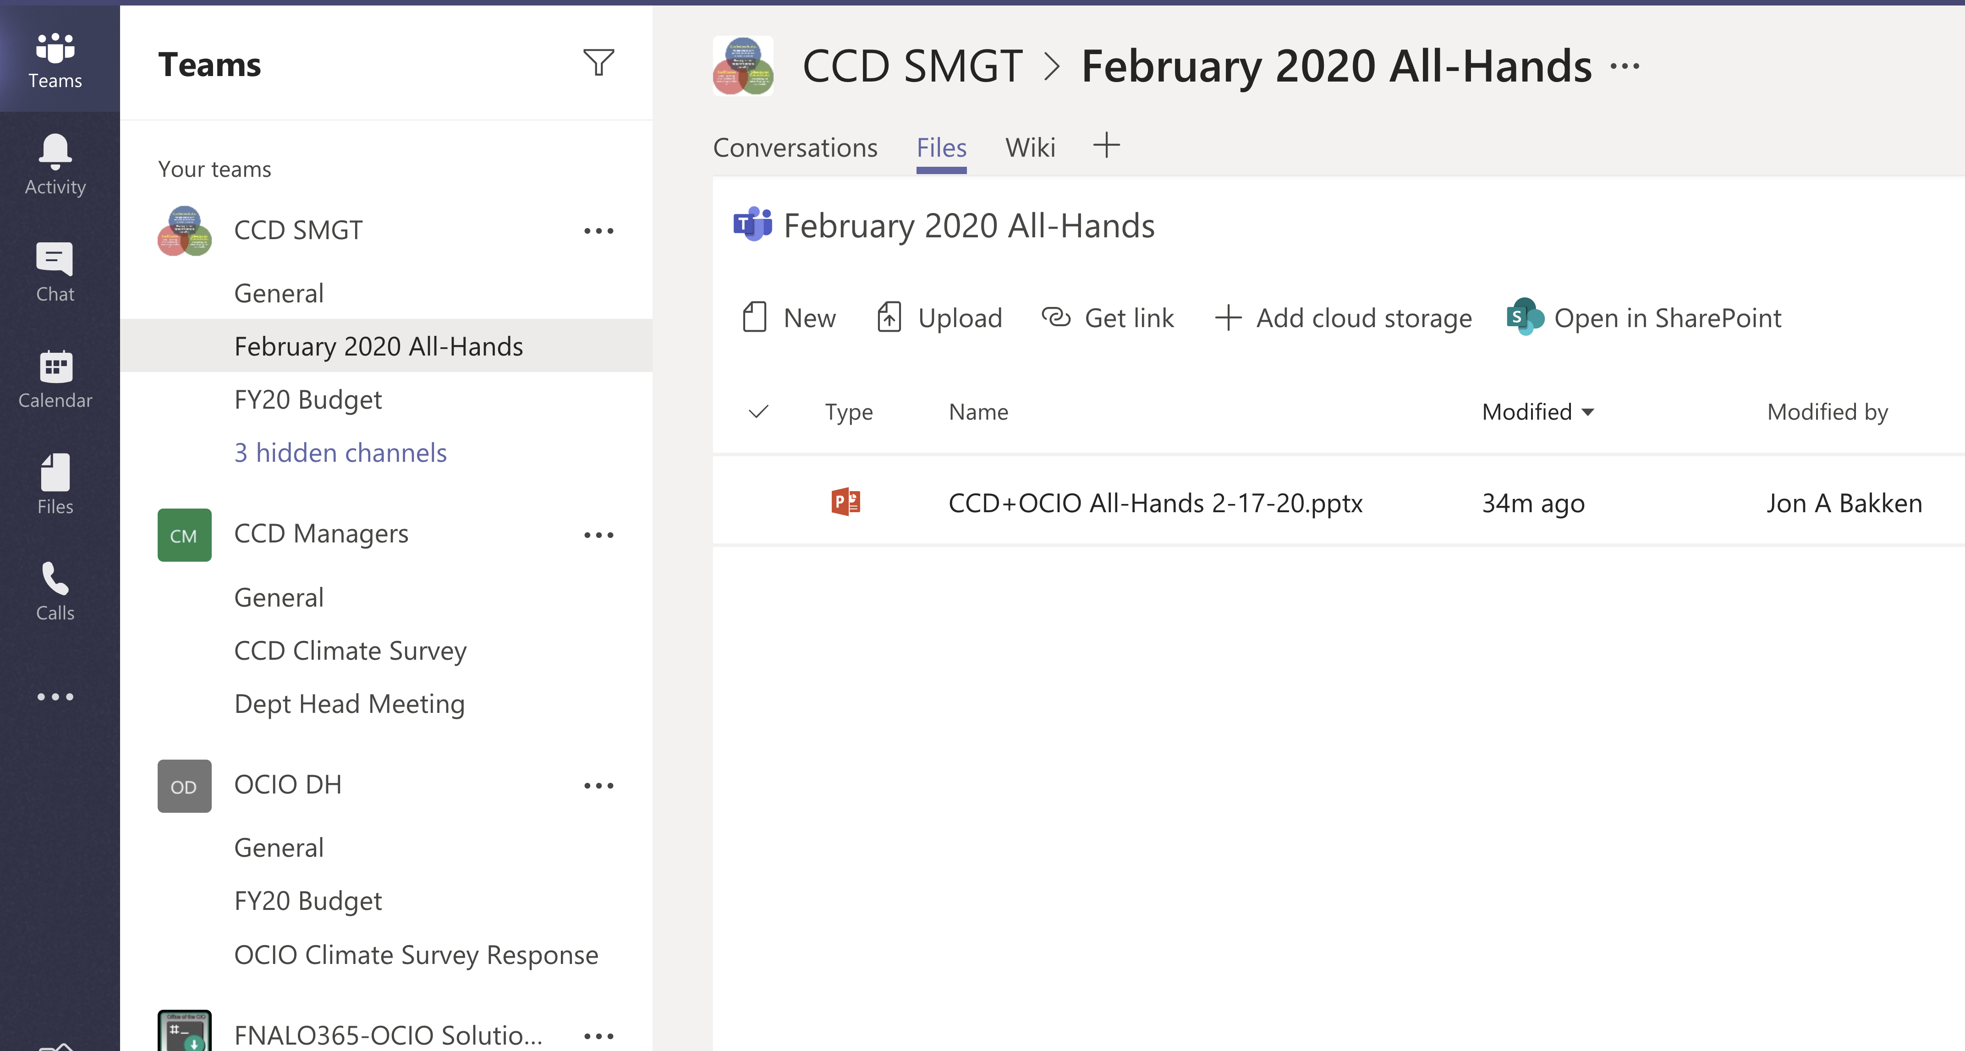
Teams
Teams = an O365 application that sits on top of SharePoint & makes it like “Google Docs”. Thanks to Andy H for addressing issues that allow collaboration with the DOE Fermi Site Office
736 Active Users
116 Teams
93 Channels

Slide 21
Teams Demo
I announced in a Senior Staff Meeting that I thought using Teams was as good as Google Docs, and that data was stored on lab-owned equipment. Jim A had the correct response: Prove it by doing a demo at the All-Hands.

