Slide 1
DUNE Laser Periscope Design Progress
Calibration Meeting 2-20-20
Jan Boissevain

Slide 2
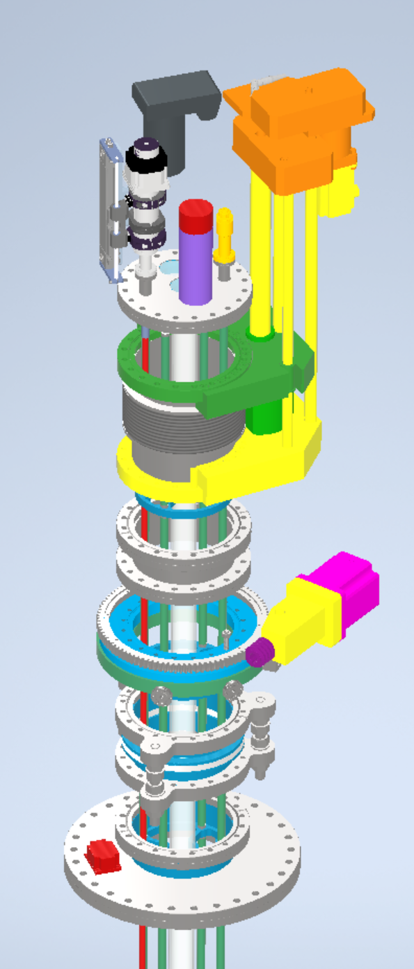
DUNE Laser Periscope
Moveable Mirror Actuator
Camera placeholder magically supported – can view either viewport
Explode
Laser Periscope Insert
Alignment Target Actuator
UHVD Linear Translation Component
PMT placeholder – can view center viewport (shown retracted)
Conflat 8” Nipple
Thermionics RNN-600
Port Aligner
Inclinometer
Conflat 14” to Conflat 8” Adapter

Slide 3
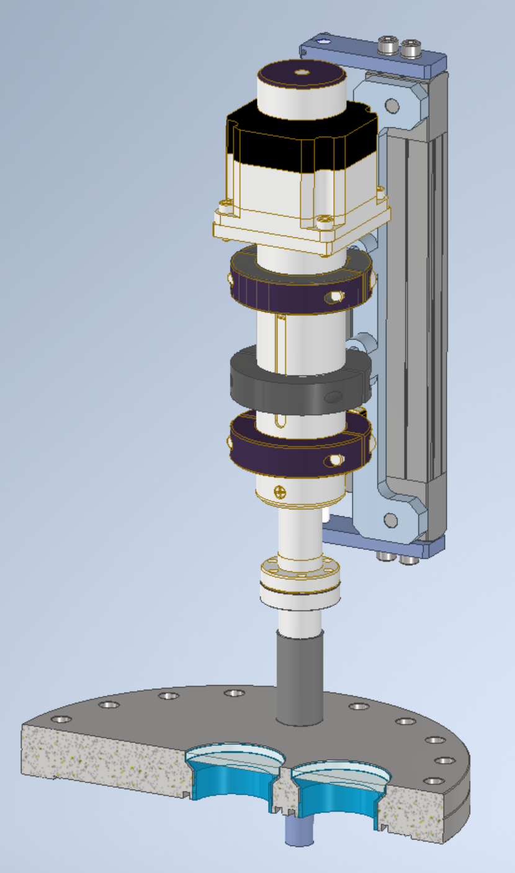
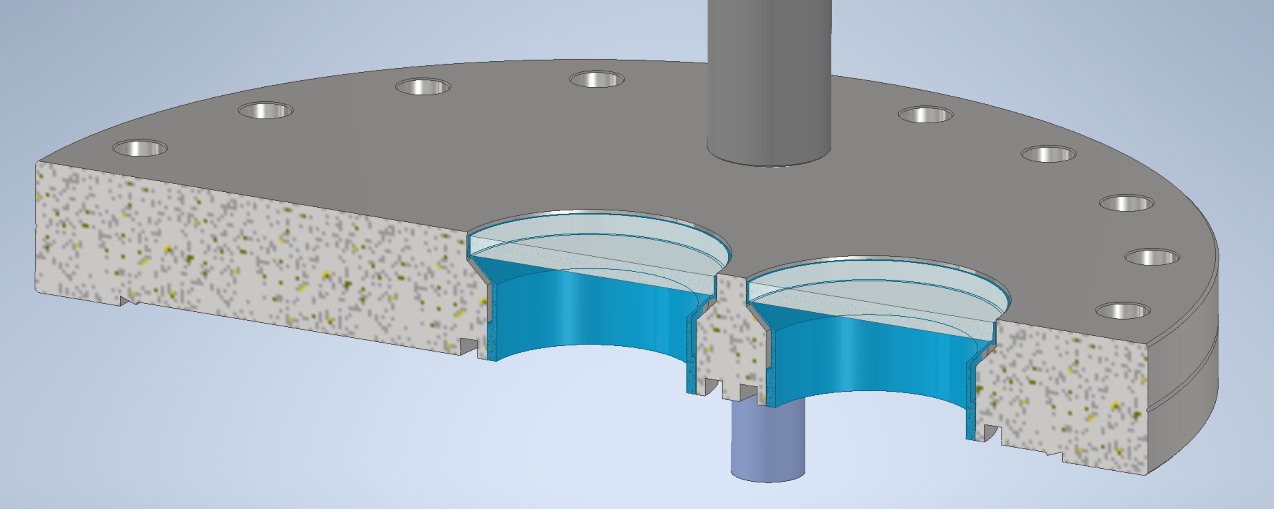
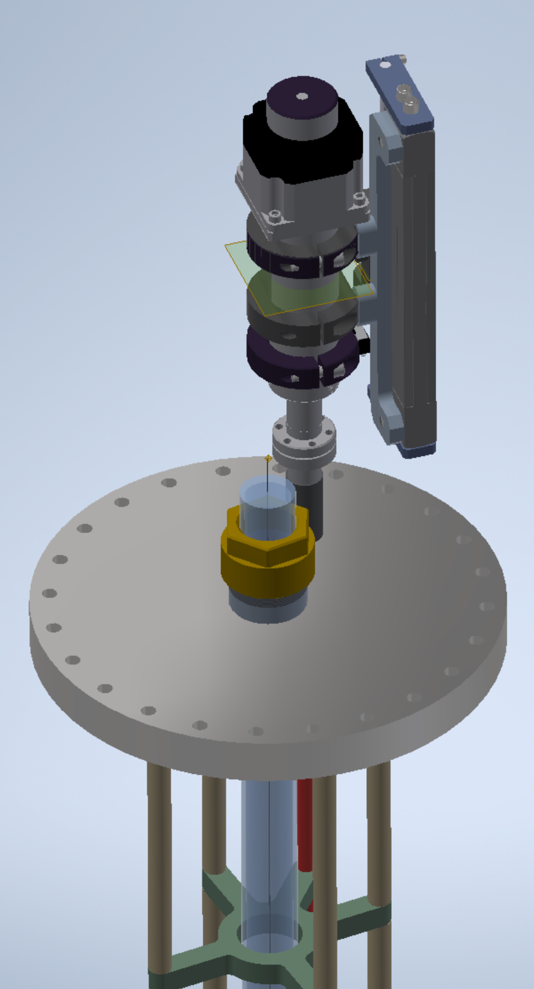
Change From SBND Laser Periscope Starting Point
Moveable Mirror Actuator
Insulator Seal 107330 View Ports welded to top flange (Ø34.6mm) – one port centered, one port offset by 2”
SBND

Slide 4
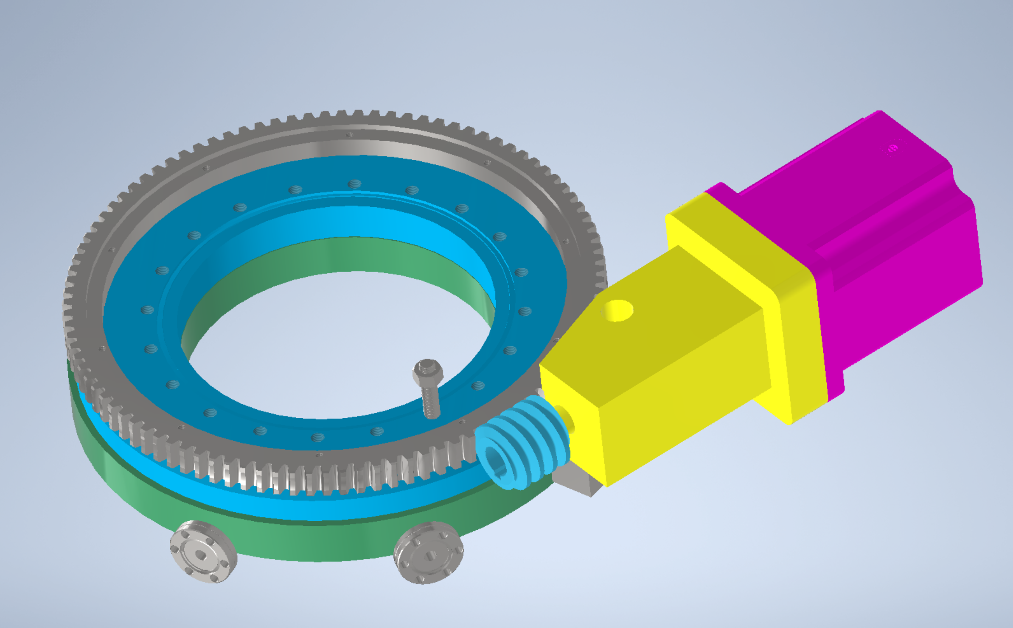
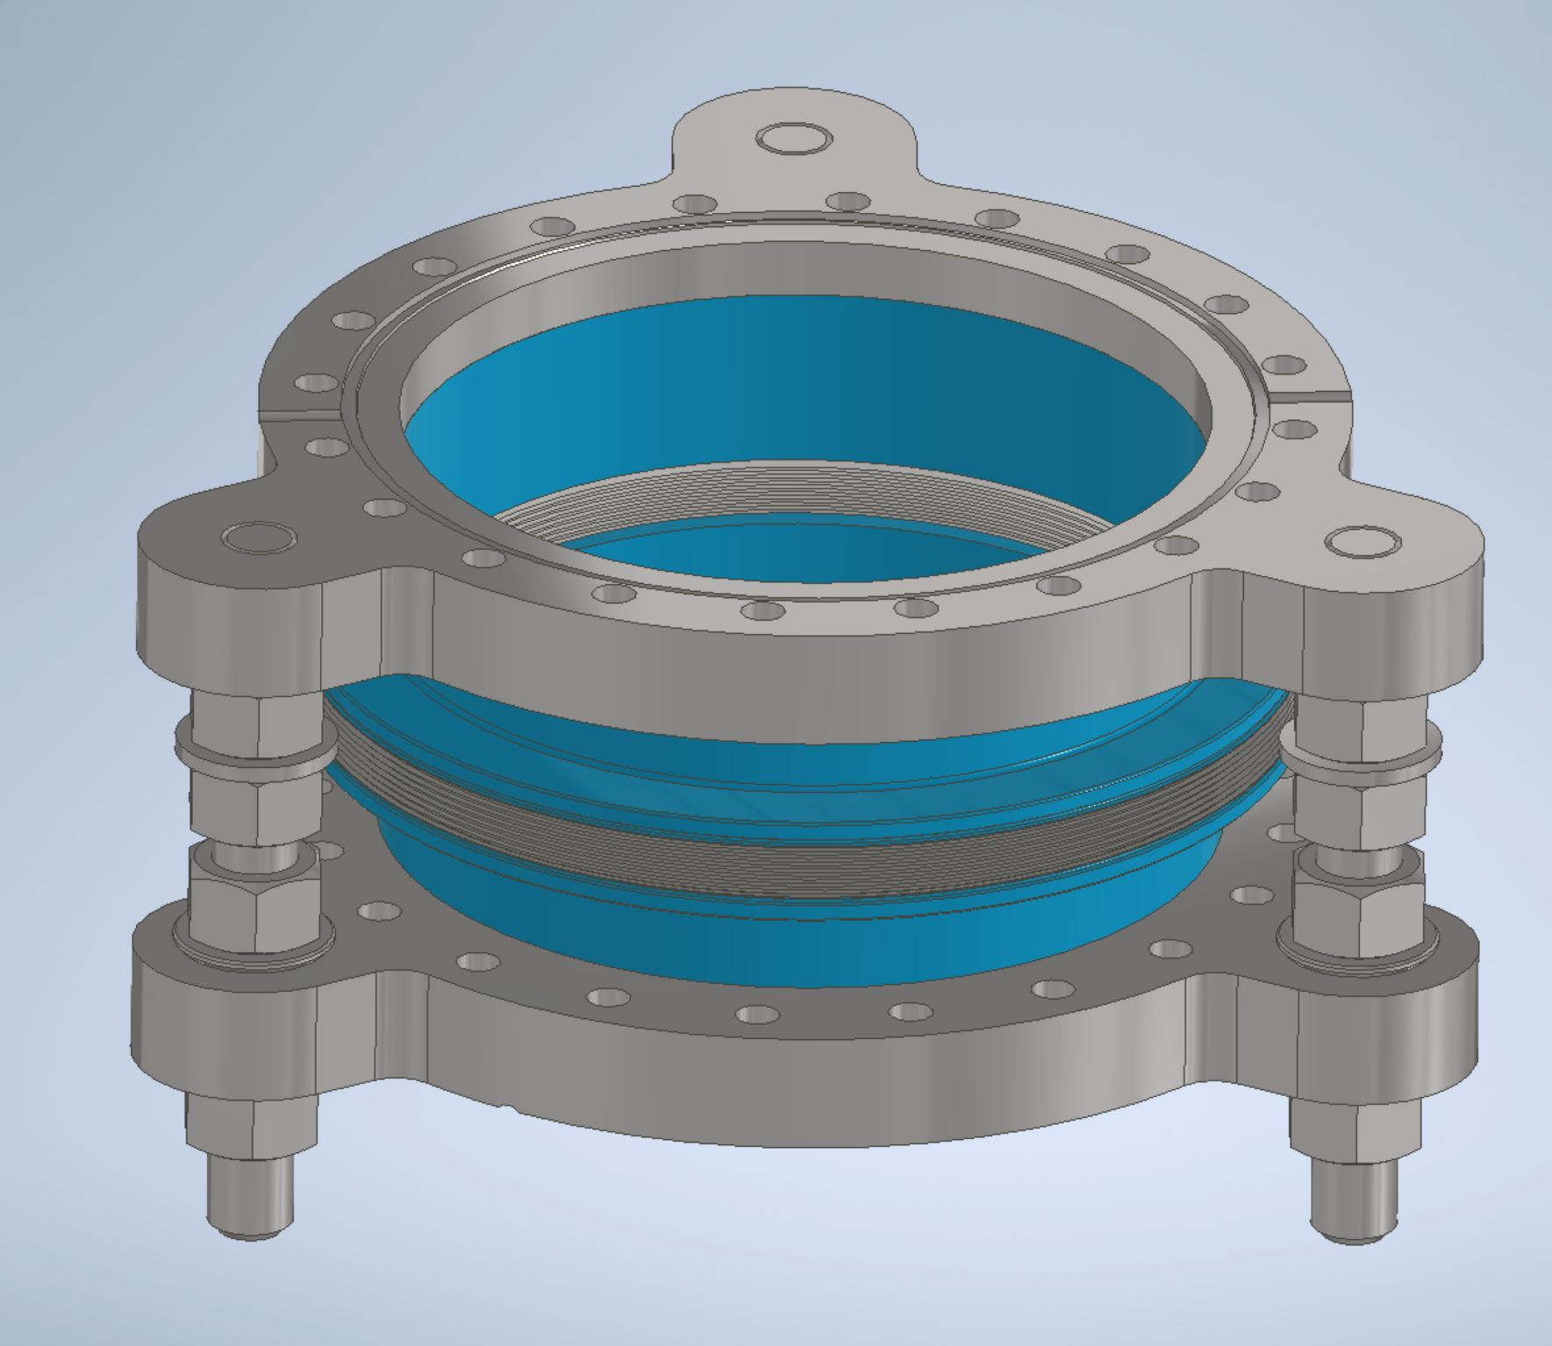
Thermionics RNN-600 – differentially pumped rotation component
UHV Port Aligner PA150H
Propose to connect to port purge

Slide 5
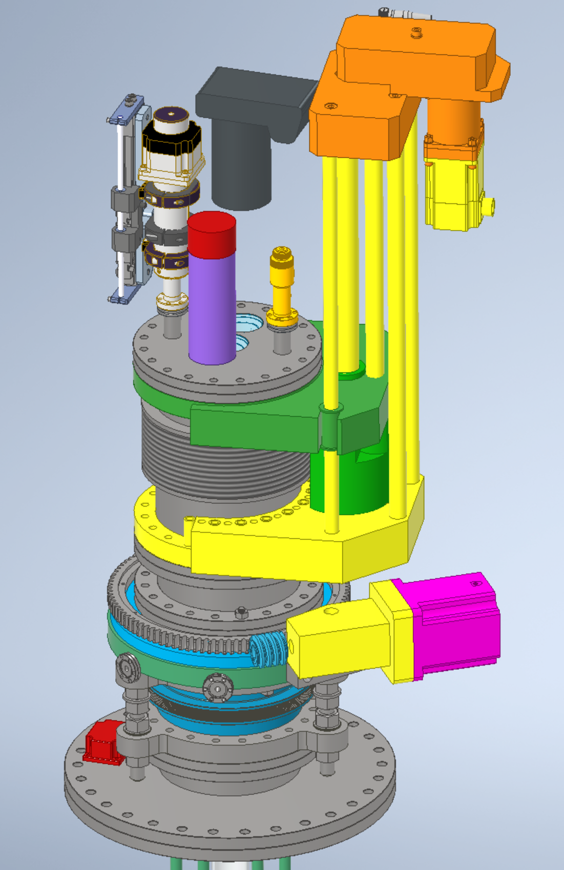
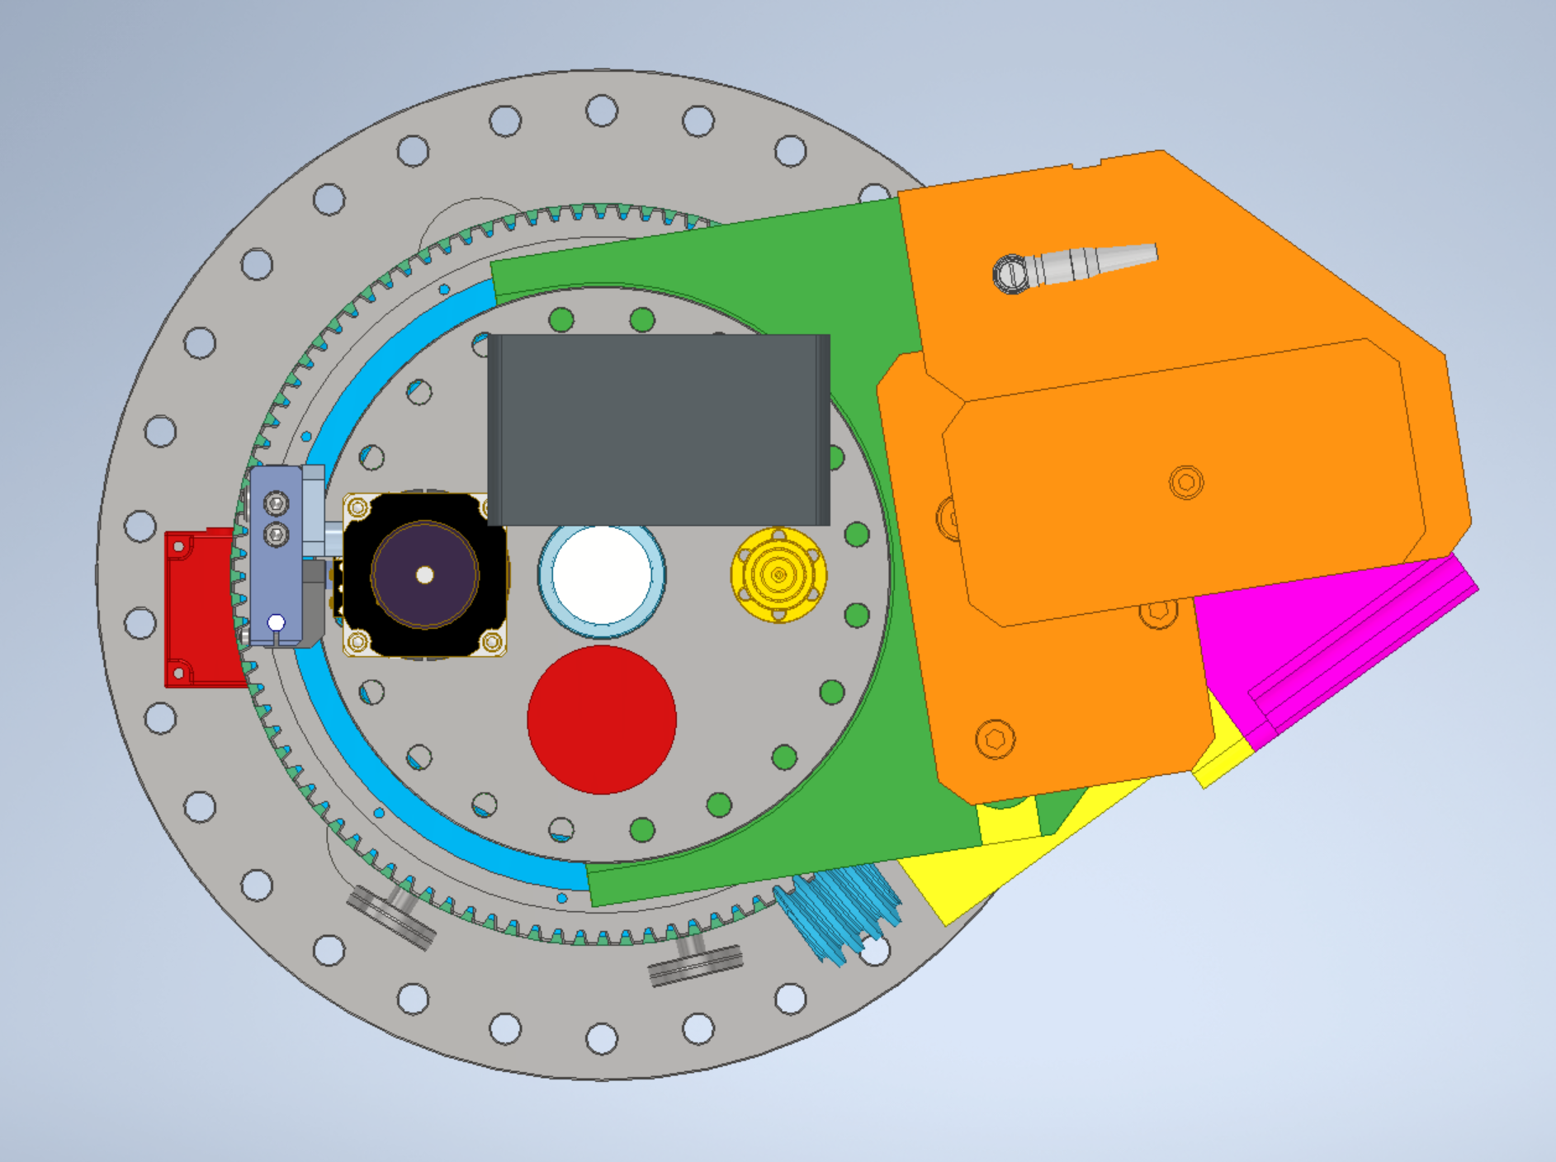
Moveable Mirror Actuator
Sony A6000 w lens
Alignment Target Actuator
Hamamatsu 580 w base + shield

Slide 6
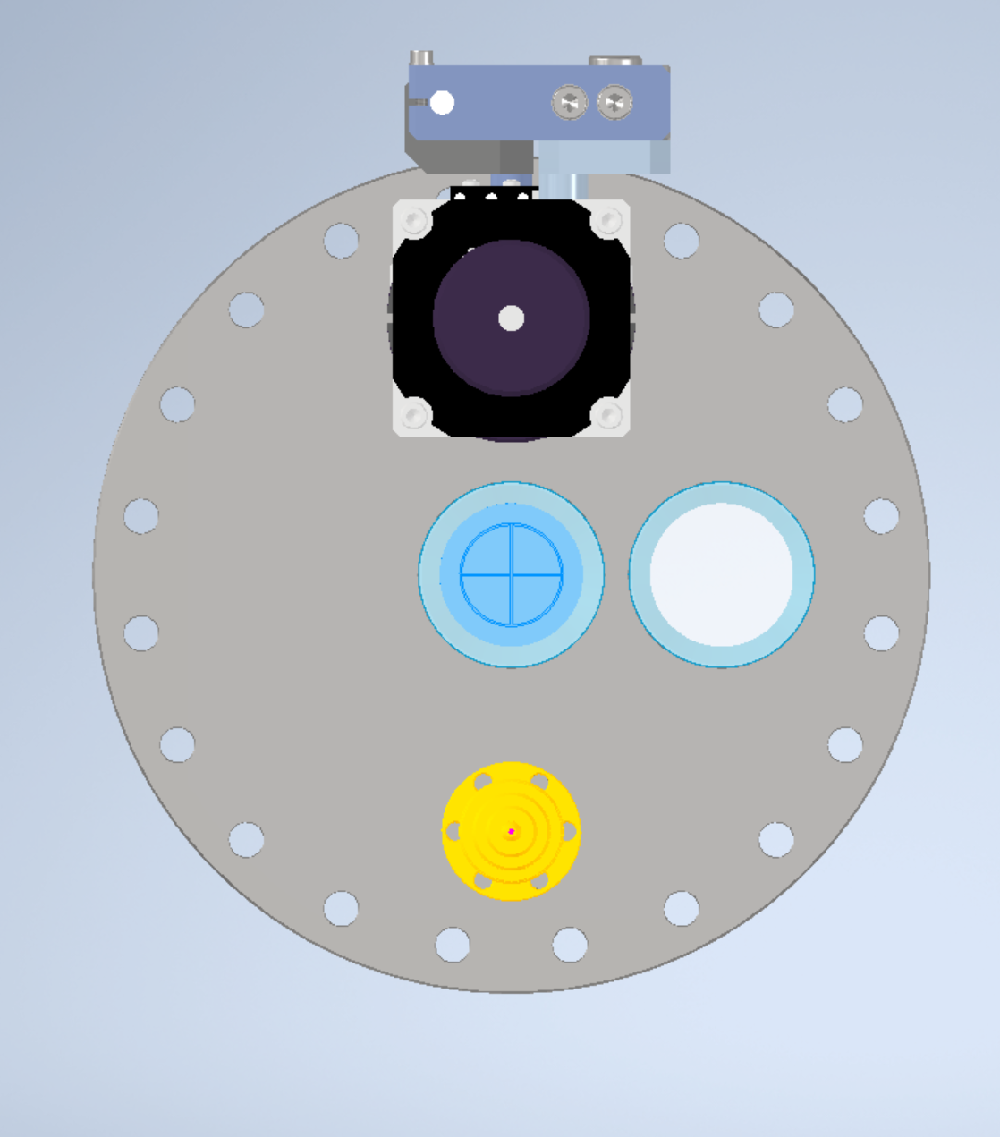
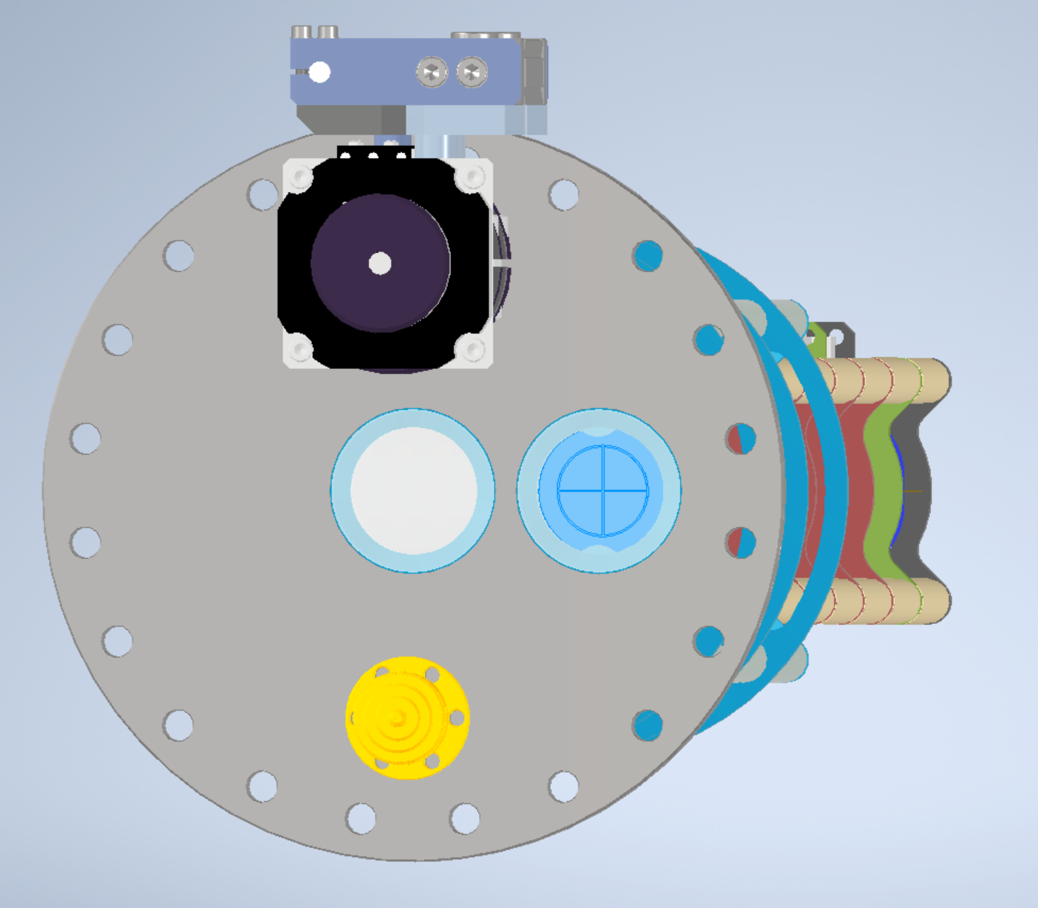
Alignment Target in position
Camera can view target when the alignment target is in position
Alignment Target Actuator

Slide 7
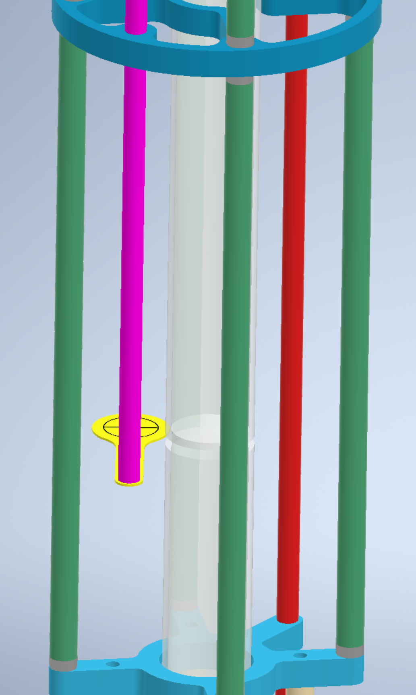
40mm x 2.5mm wall x 1515mm long fused silica tube shown x2
Laser Alignment Target Retracted
3268mm
Lower Laser Periscope Subassembly – allows installation into DUNE without a hatch

Slide 8
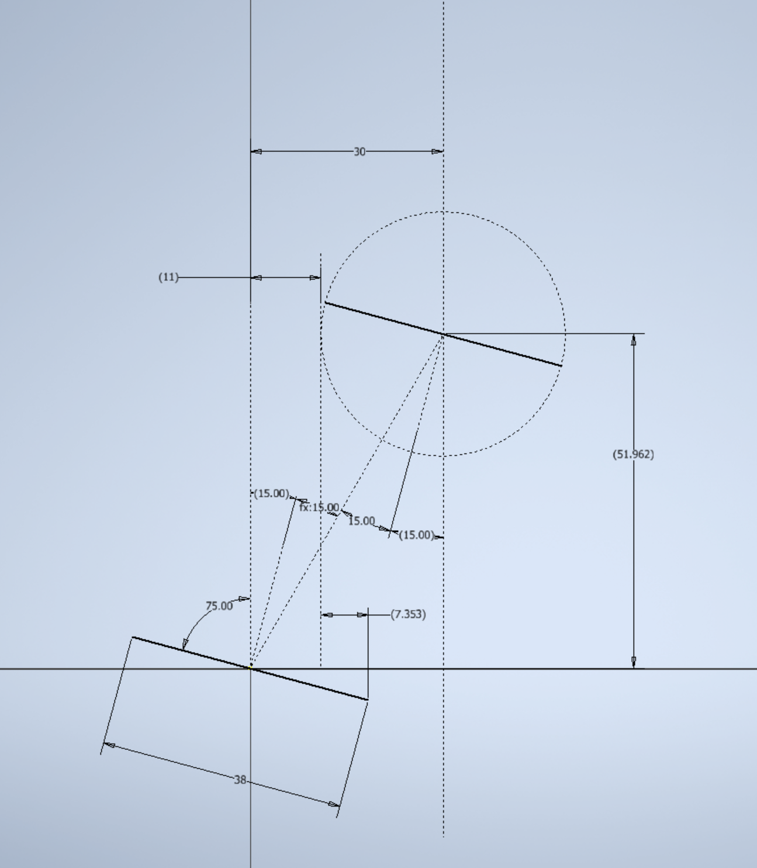
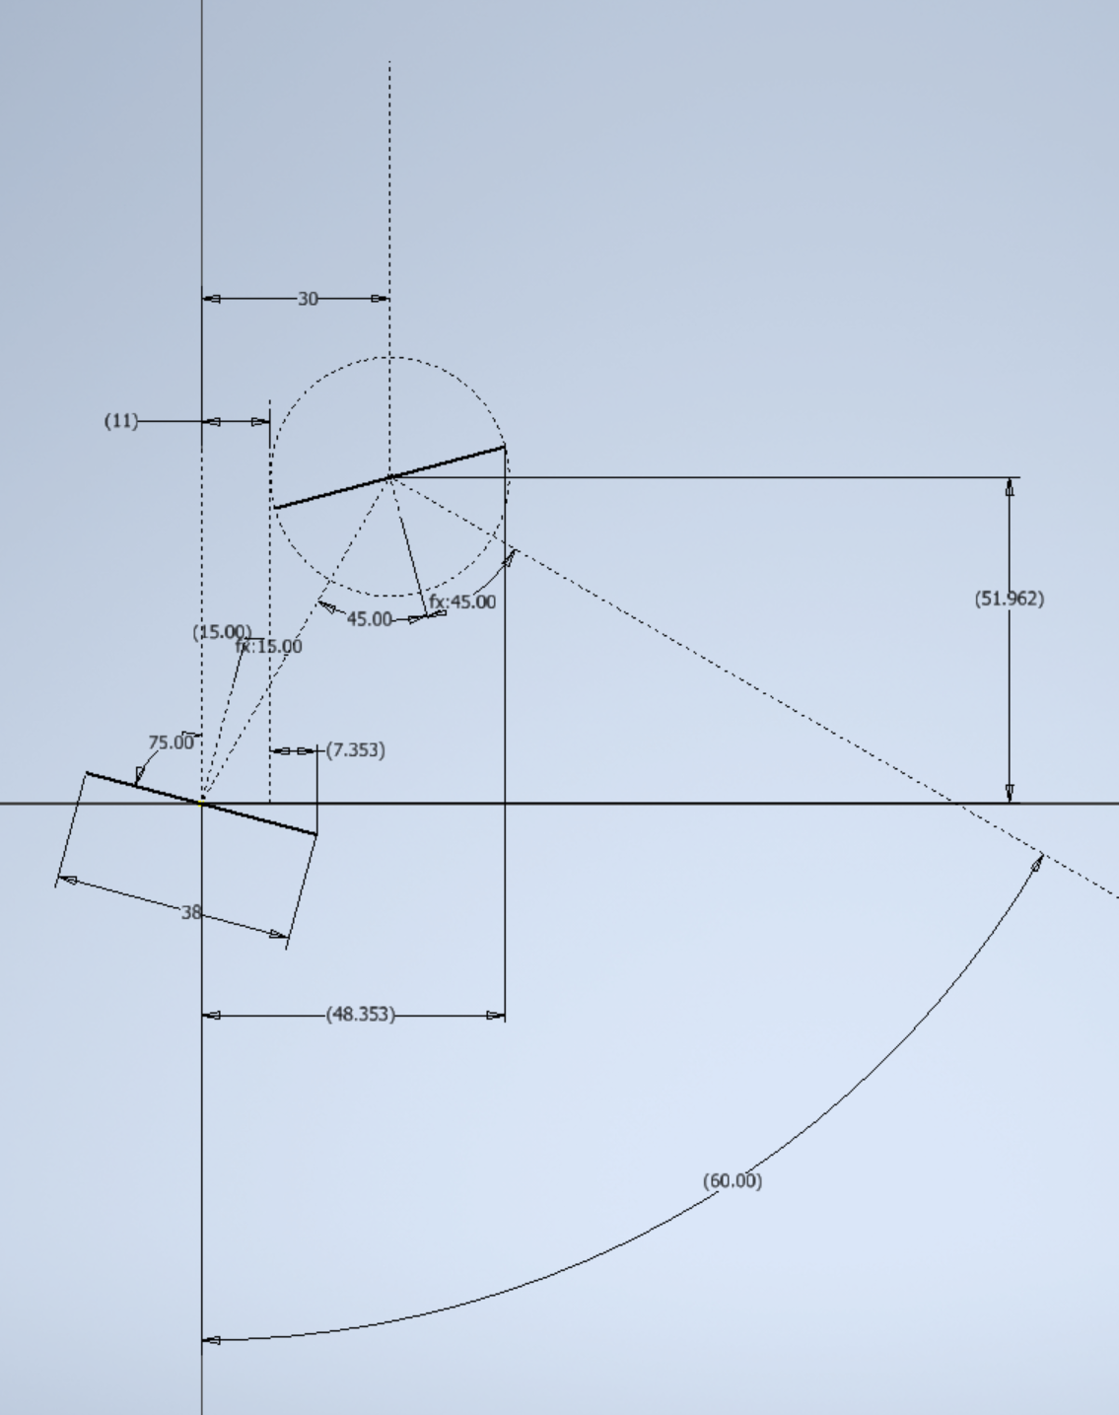
Rotating Mirror Positions -1
Laser Path
Laser Path
Moveable Mirror
Fixed Mirror
Laser Path After Reflections

Slide 9
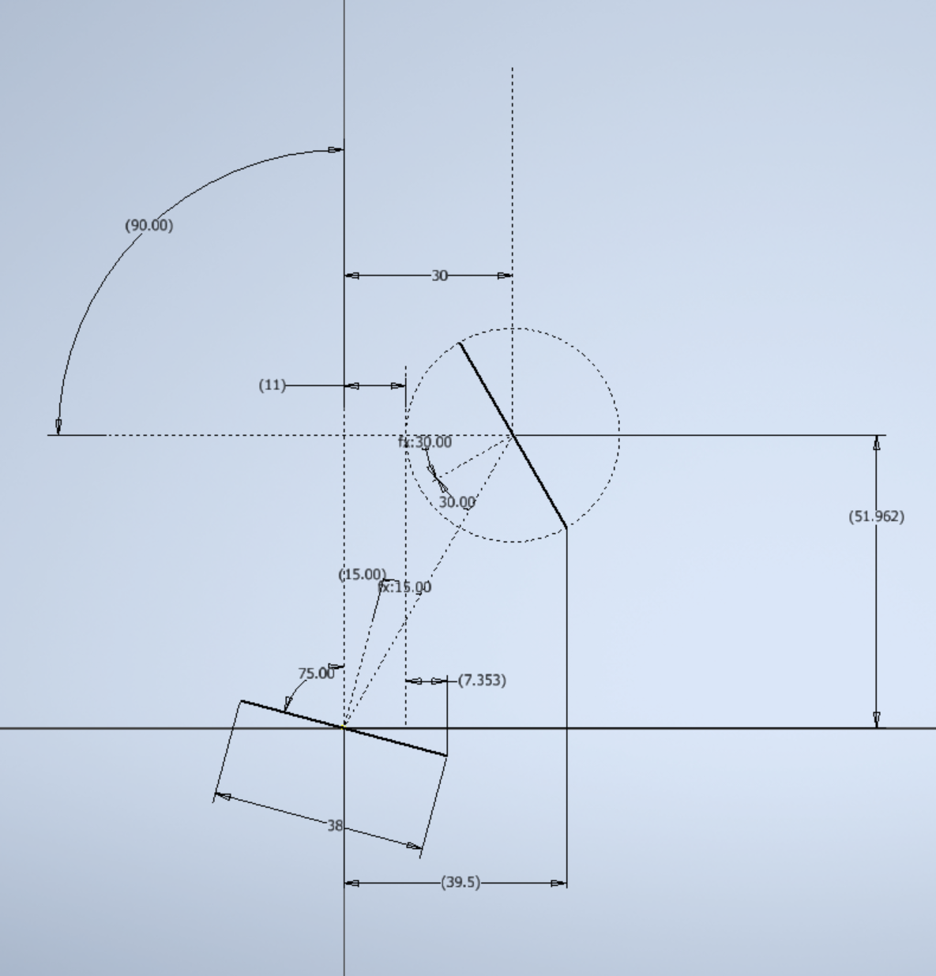
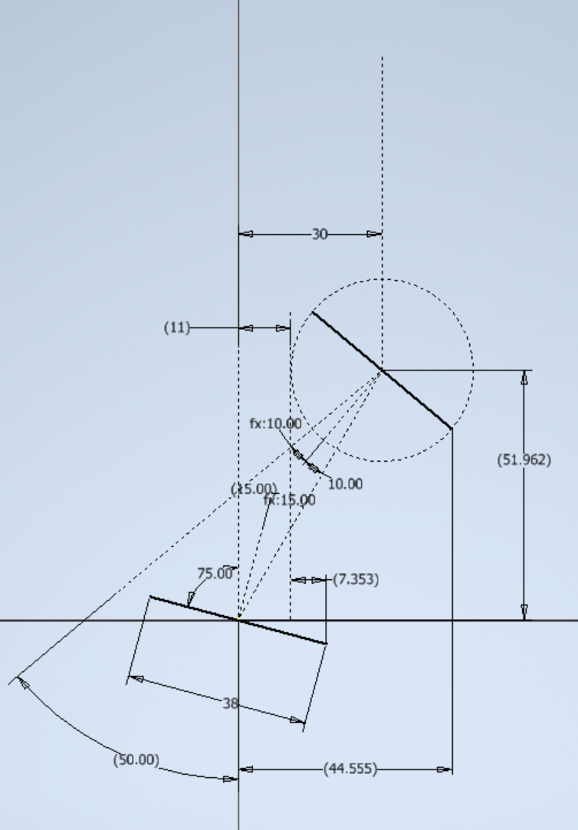
Rotating Mirror Positions -2

Slide 10
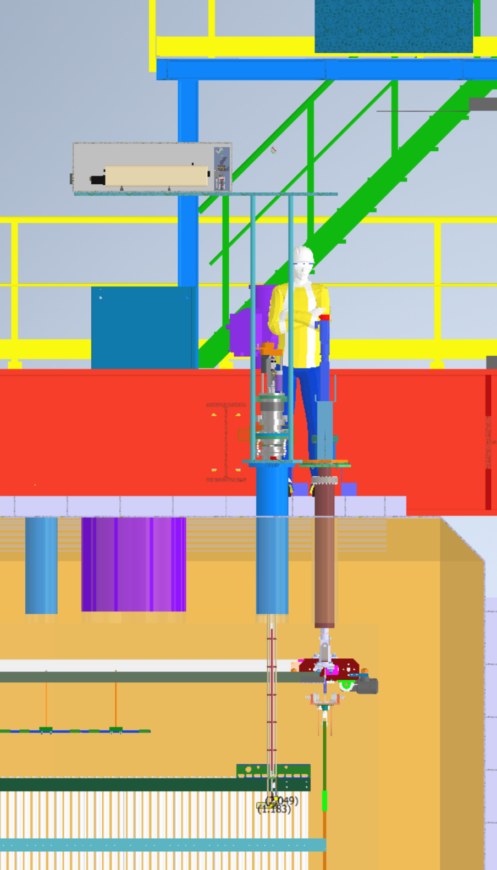
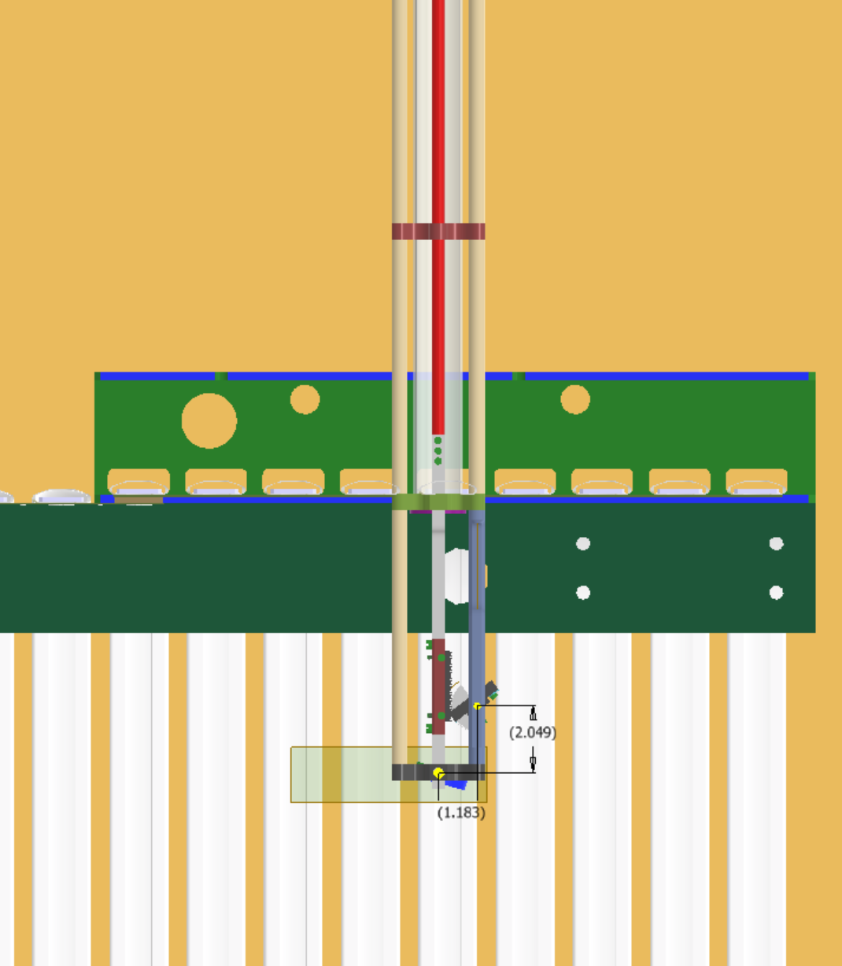
DUNE
Flange top
2484mm
G10 I-Beam bottom

Slide 11
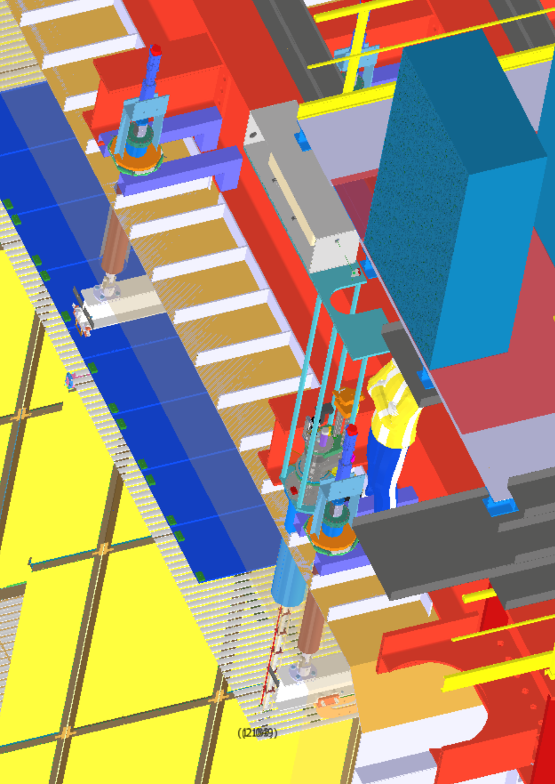
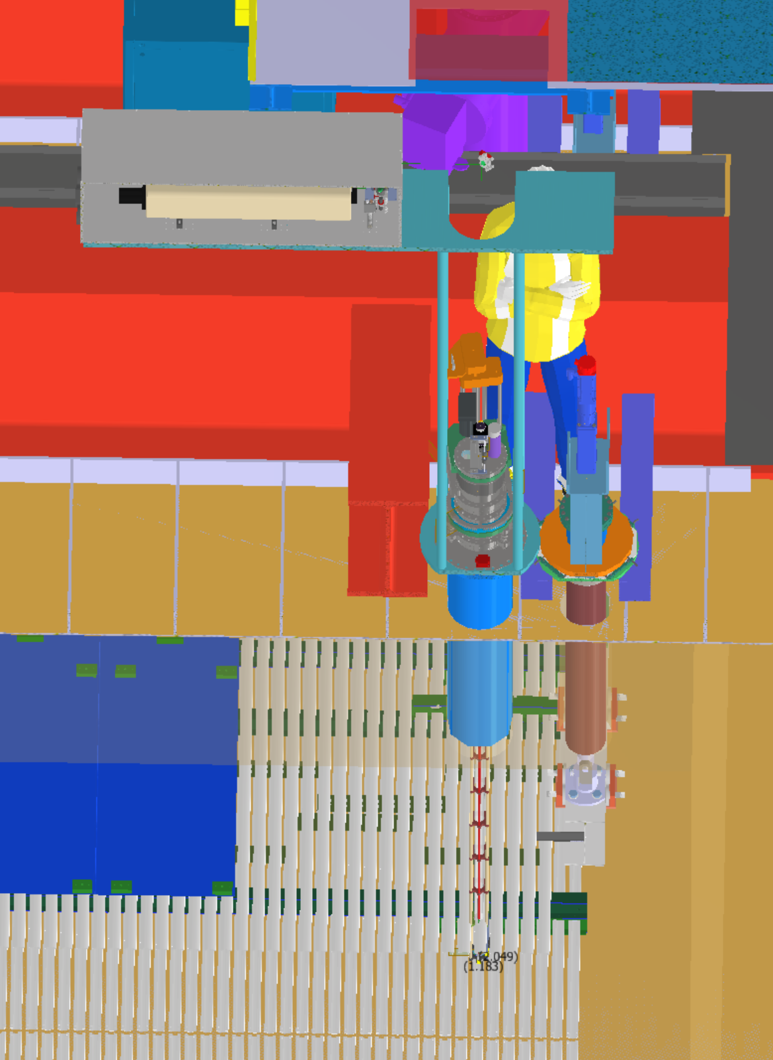
Mirror
DUNE
First Try at a Laser Table

Slide 12
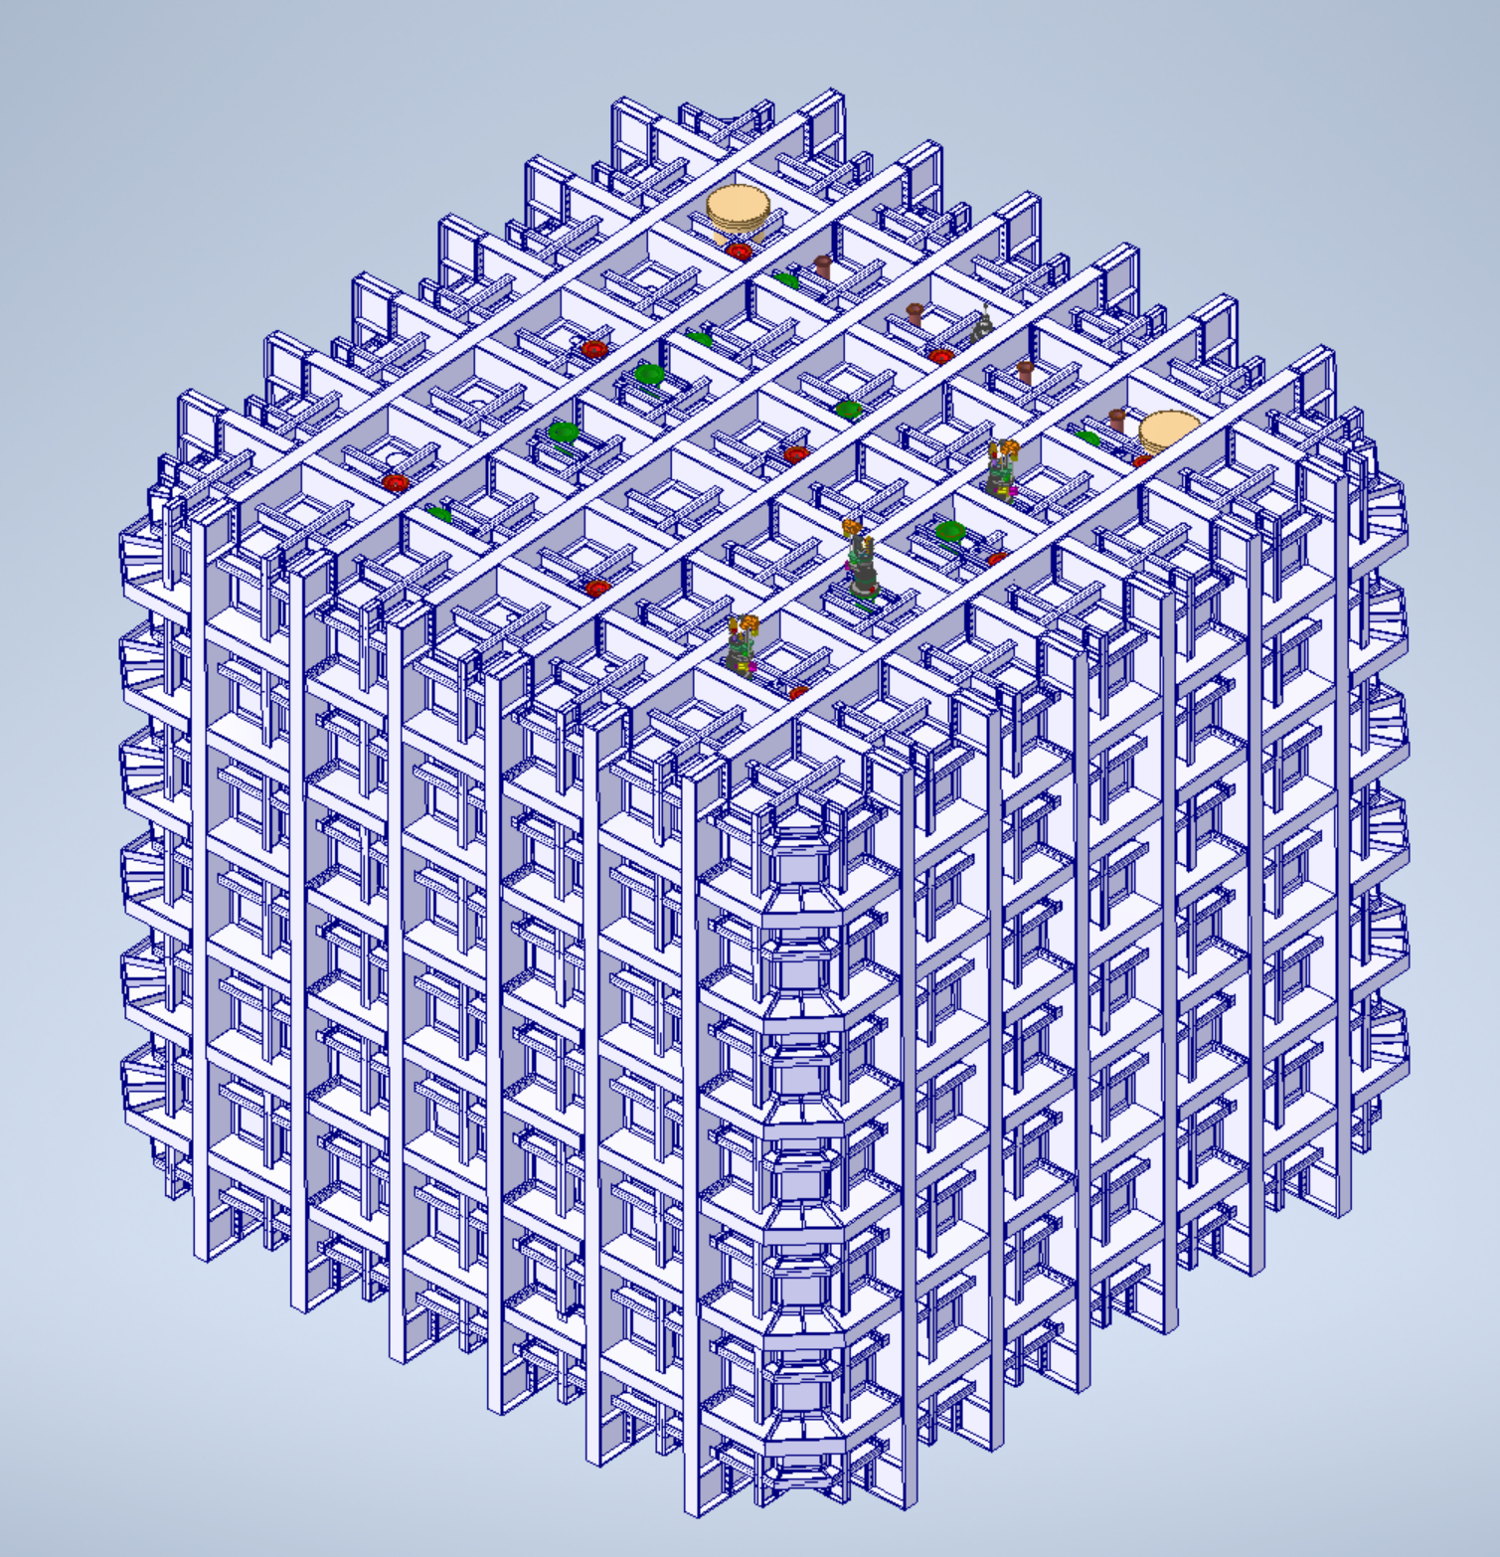
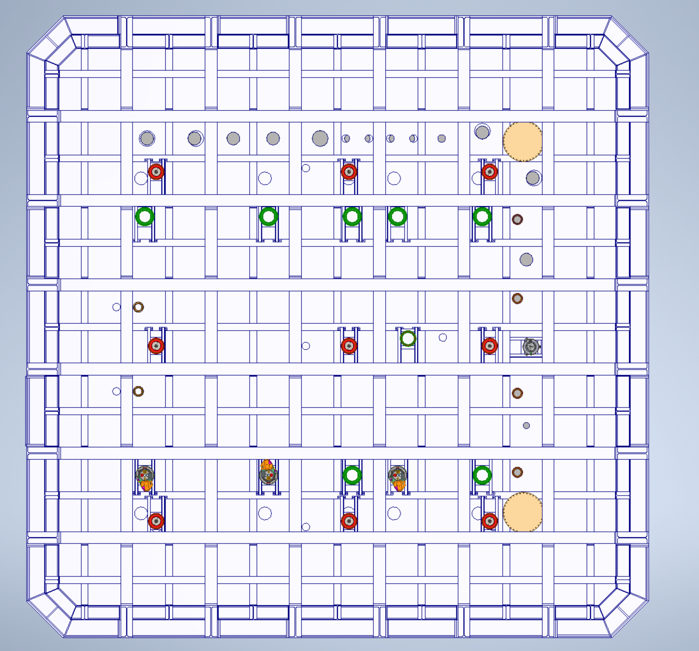
Possible Laser Periscope Locations
Beam
Location 1
Location 2
Location 3

Slide 13
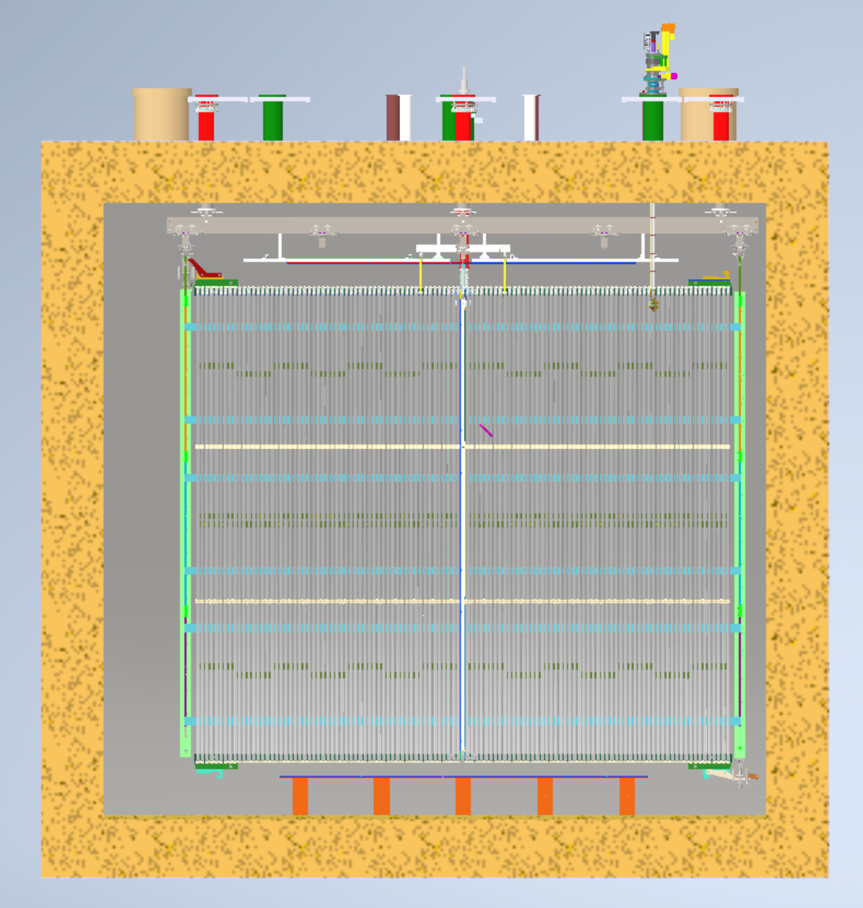
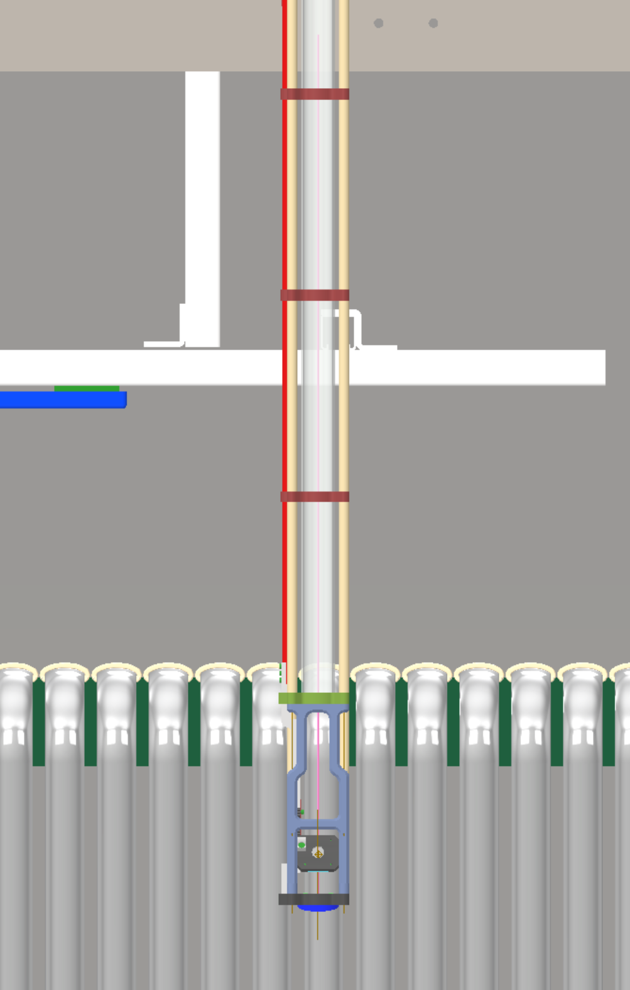
ProtoDUNE II
Location 1
2597mm
Dimension is from this surface to the flange top

Slide 14
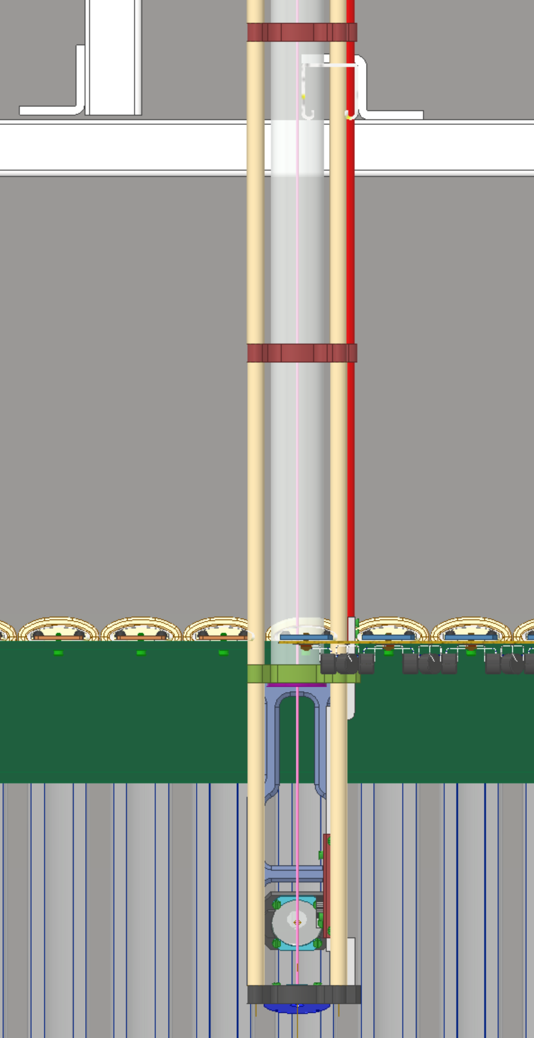
ProtoDUNE II
Location 2
Interference

Slide 15
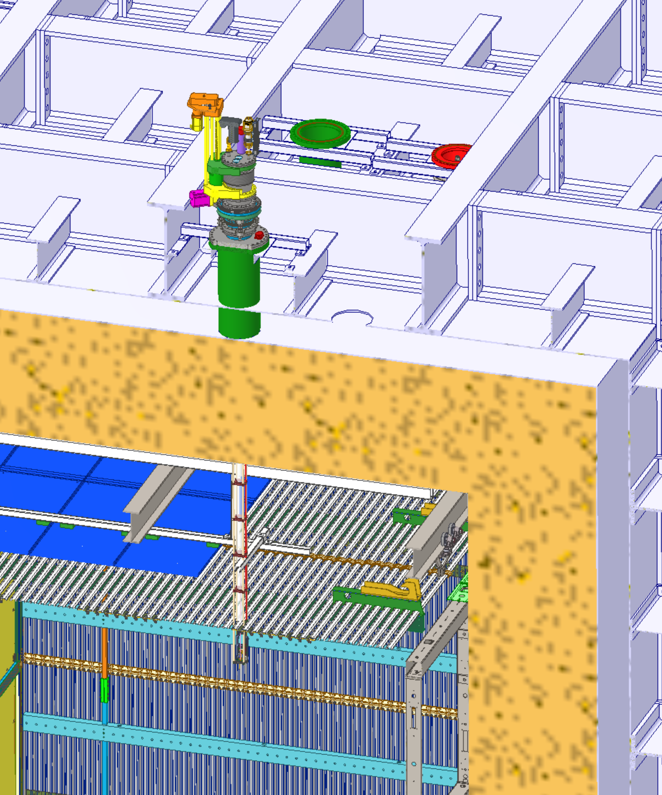
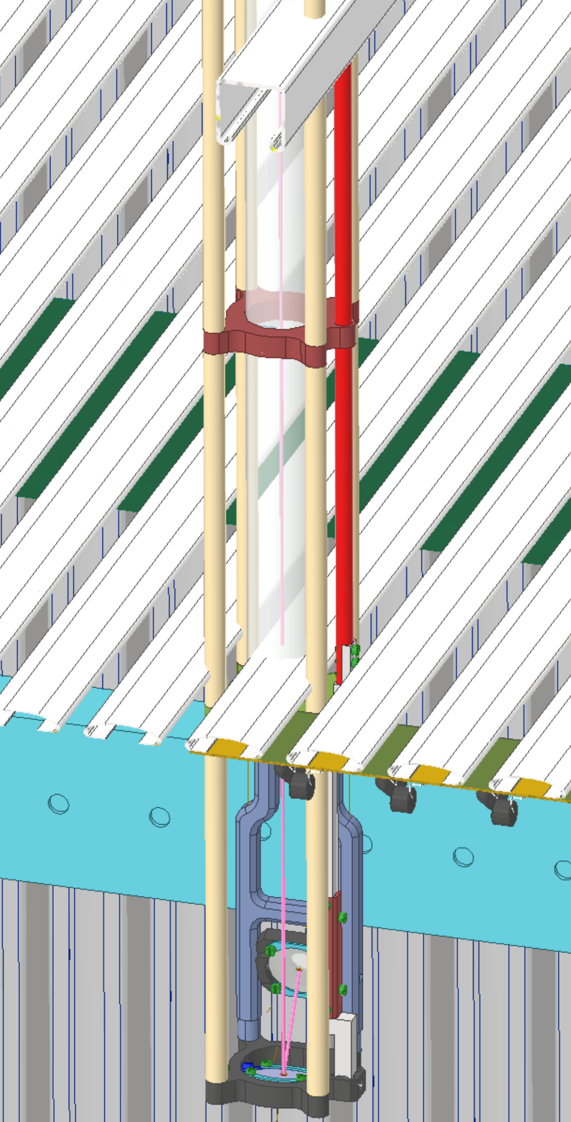
Preferred Port Location 2
Interference Problem

Slide 16
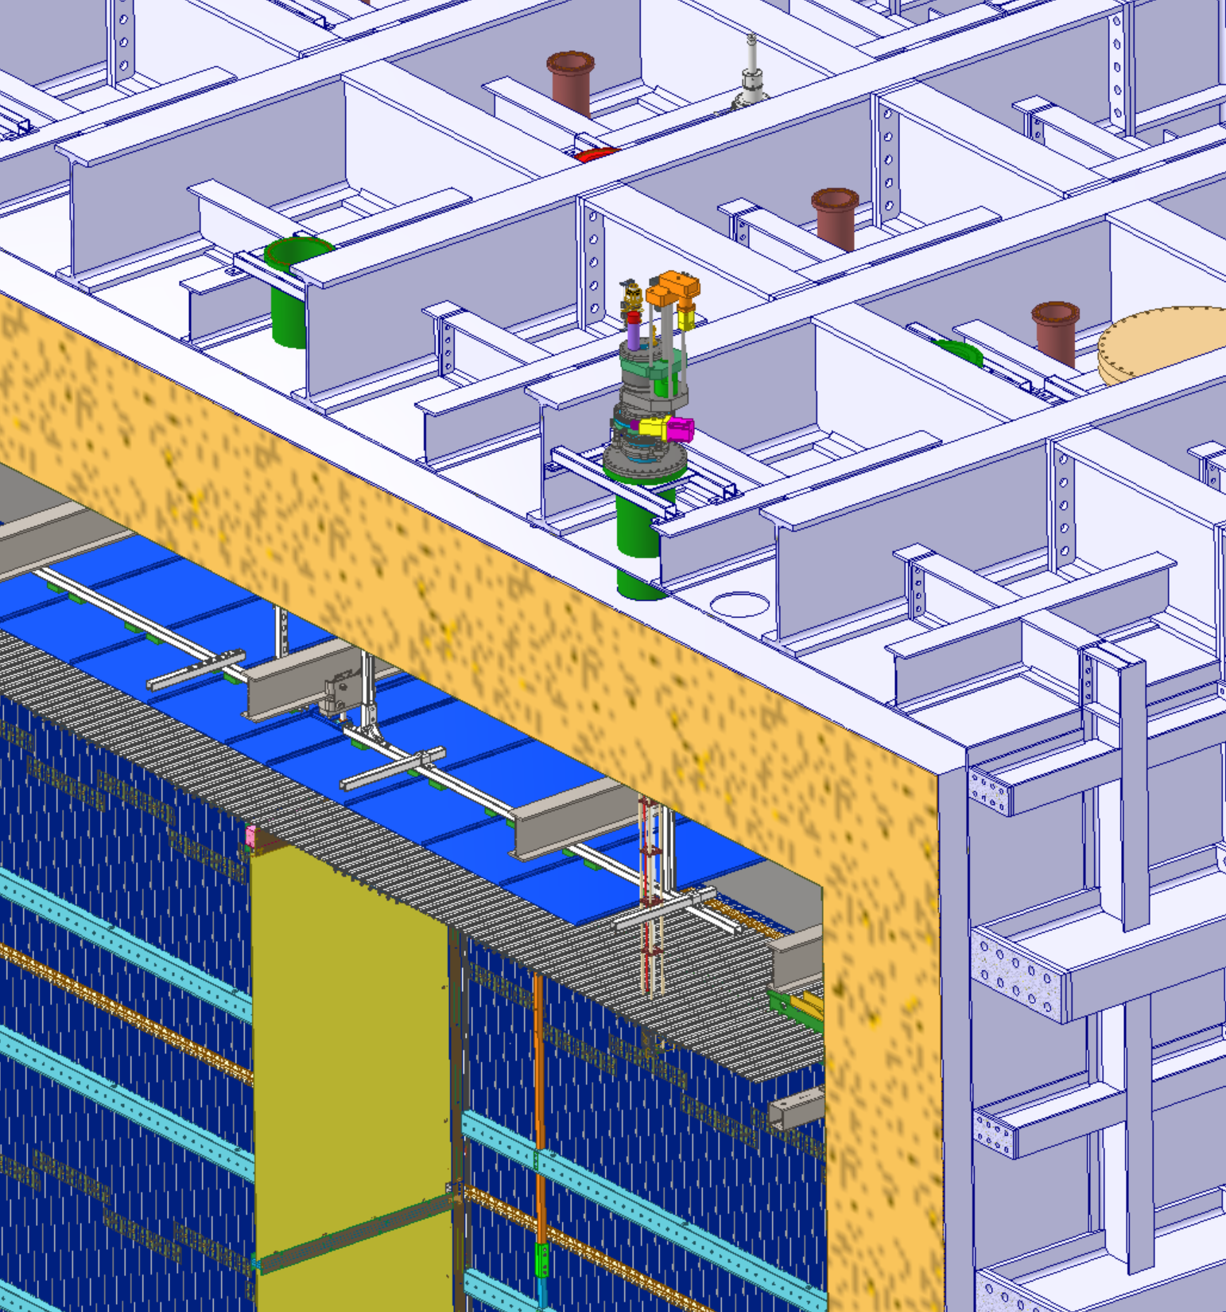
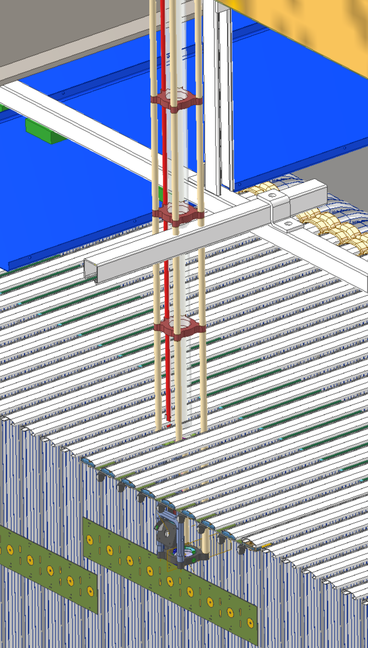
Location 3

