Slide 1
PIP-II Report
PIP-II L2 Managers
Project Management Group
19-Feb-2020

Slide 2
WBS 121.01 Project Management
Reviews
  IPR and ICE were successful.
  Thanks to the team and our international partners for a very strong showing.
Resource Loaded Schedule
  Updates based on IPR recommendations underway. WBS for Cryomodules has been determined.
Staffing
  Fernanda G. Garcia last day was 14-Feb-2020. Jerry Leibfritz acting L2.
  Yemi Tomori (project controls contractor) leaving to take permanent position elsewhere. OPSS working with contract firm on replacement.

Slide 3
CD-2/3a IPR
Subcommittee | WBS | # Recommendations (not including “proceed to CD-2/3a”) | Themes
Accelerator Systems | 121.03 | 3 | Update HPRF labor budget for CD-2, Design suggestions for CD-3
Accel. Upgrades, Linac Install/Comm | 121.04, 121.05 | 1 | Additional booster injection simulations before CD-3
SRF Cryo | 121.02 | 4 | CM cost review, cryoplant capacity and availability
Conventional Fac. | 121.06 | 1 | Update RLS
ESH | 121.01 | 0
Cost and Schedule | 121.01 | 1 (6 subparts) | Update RLS (see detail below)
Project Management | 121.01 | 6 | 5 recommendations for CD-3 related to QA, storage/logistics, eng. codes/standards, procurement tracking. Repeat of RLS recommendation.
Answers to all charge questions “yes”. Only qualified “yes” of consequence was related to RLS.
Prior to CD-2 ESAAB:
    Finalize draft PPD Milestones,
    Incorporate new cost model to reflect revised indirect rates,
    Adjust future planned values based on prior EV performance,
    Finalize project schedule to correct logic and work organization issues, and
    Reassess quantitative risk and contingency analysis.
    Completion of these updates should be verified by DOE/OPA and DOE/HEP
Other ESAAB drivers not mentioned in the closeout report include French Funding and alignment of DOE leadership

Slide 4
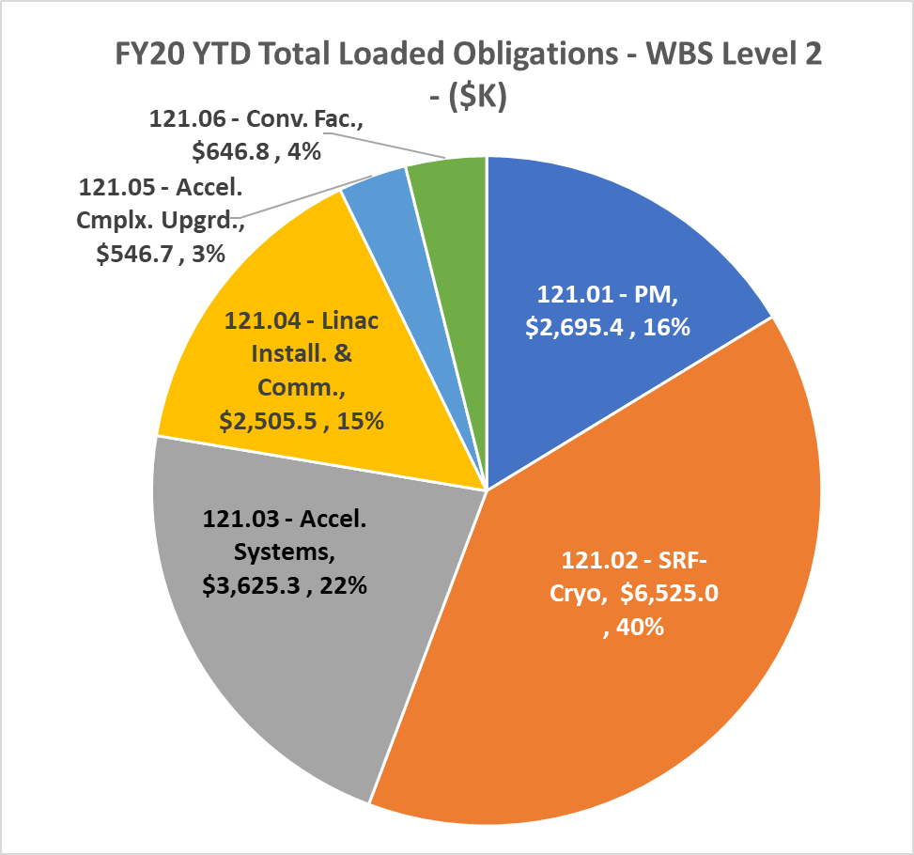
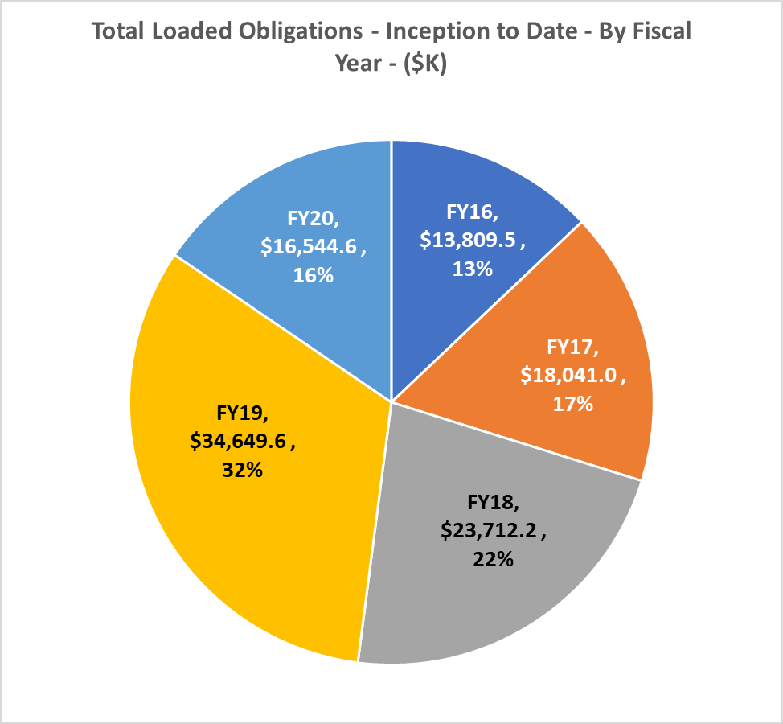
Financials through Jan. 2020
YTD FY20 | Inception to Date

Slide 5
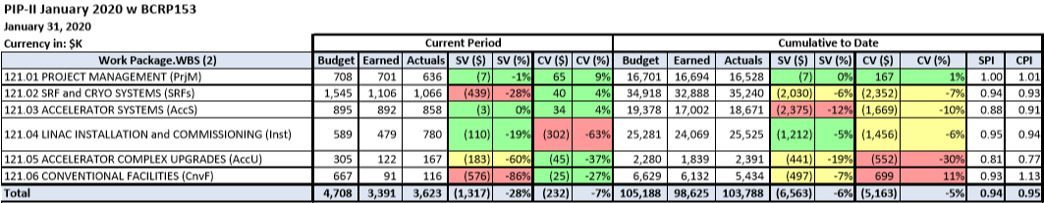
EVMS
Current period variances related to HB650MHz CM prototype, PIP2IT HWR preparation, delay of Linac Complex design contract (delayed due to funding)
CPI same as previous months. SPI down 0.01 due to delay in Linac Complex design contract.

Slide 6
Procurement Update – Conventional Facilities
Cryogenics Plant Construction - $16M

Slide 7
Procurement Update – Conventional Facilities
LINAC Complex Construction - $63M

Slide 8
Procurement Update – Material
Niobium Sheet & Tube - $1.6M
Niobium (Requisition 297482, 650 MHZ)
Status | Dates | FY | Description
Complete | Jul-Nov | 19 | 15 Day Synopsis, 45 Day Solicitation
Complete | Nov | 20 | Evaluation
In Work | Nov | 20 | License
Complete | Dec | 20 | DOE Notification (SAT, BAA)
Complete | Jan | 20 | Award
Current Issues: Corona Virus, Factory is Operating. 1 person currently infected.
Bare Cavity Assemblies $300K
Current Issues: Buy American Act BAA Trigger, Evaluation in-process.
Bare Cavity Assemblies (Requisition 302069)
Status | Dates | FY | Description
Completed | Nov | 20 | 15 Day Synopsis
In Work | Nov | 20 | 45 Day Solicitation
Award | Mar | 20 | Award
Other Efforts: Planning, Linac Complex Site Work Acquisition Plan,
Review, Controls, IDIQs, Expediting

Slide 9
Technical Integration
Two DCR’s were submitted last month :
  DCR-2020-001 (Power Ratings of Straight Ahead and Beam Absorber Line Dumps);
  DCR-2020-002 (BTL Design Changes)
Working with OPSS on potential fBCR tool modifications for fDCR;
Continue active coaching of upcoming technical reviews;
Updating Availability Analysis;
Advancing Naming Convention;
Planning for the P2MAC meeting in March/April 2020.

Slide 10
PIP-II International Partners January achievement
All Partners (PC & TC) participated in the CD-2/3a review:
  “Partner Laboratories were well represented and spoke during the review. They successfully communicated their passion for the project and their reasons for contributing to PIPII”
PPDs CD-2/CD3a review feedback:
  “The project PPD documents are well written with enough detail to effectively establish clear boundaries with the partner laboratories about deliverable scope and schedule milestones”
  “…EHS and QA content of the PPDs look appropriate and well considered”
  “Though the PPDs (Parts I and II) are in mature draft.”

Slide 11
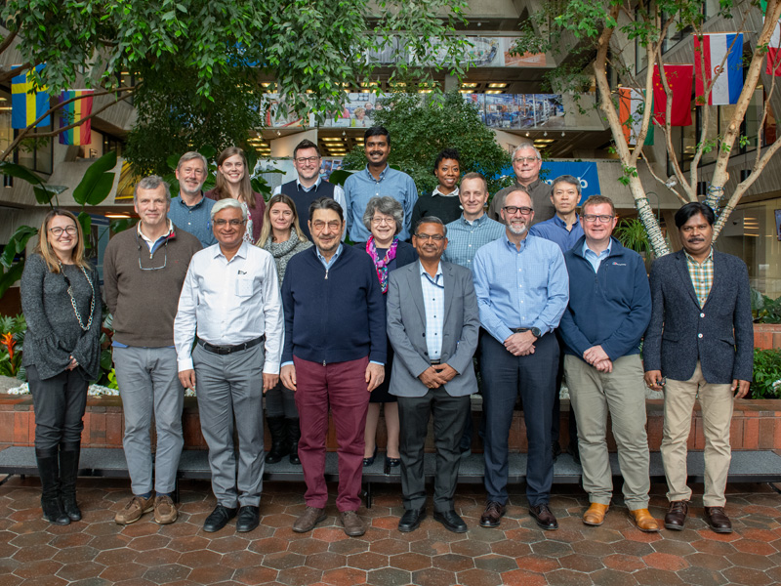
P2PEB #4 on January 31,2020
Some highlights:
  PPD Part 1 feedback from DOE
  Launched “Technical Collaboration Workshop”
  Project updates:
    Design Principle Coordination Group
    Device Naming Convention discussion
    ESH and Q Management plans

Slide 12


PPD Part 2 Status
PPDs Part 2 are in the last check process and P6 integration. The goal is to have PPDs ”ready to be signed” and P6 aligned for the end of March. CAMs, PCS, iPM, iTIM will work together to meet the completion date.
UKRI/STFC: Nb specification and Transport frame design to be checked. P6 and STFC schedule need to be re-aligned
ITALY/INFN: Prototype cavities delivery to be checked.
P6 and INFN schedule need to be re-aligned
FRANCE/CEA: CAM/L2M/L3M to perform final check.P6 need to be aligned.
FRANCE/IN2P3: IN2P3 detailed schedule (mpp file) need to be updated to improve consistency with P6. P6 needs to be aligned.
INDIA/DAE: T6 and I-MS to be validated by CAM/L2M/L3M as well as final check. P6 needs to be aligned.
.
POLAND/WUST: P6 and WUST schedule need to be re-aligned, including revision of DOE costs.

Slide 13
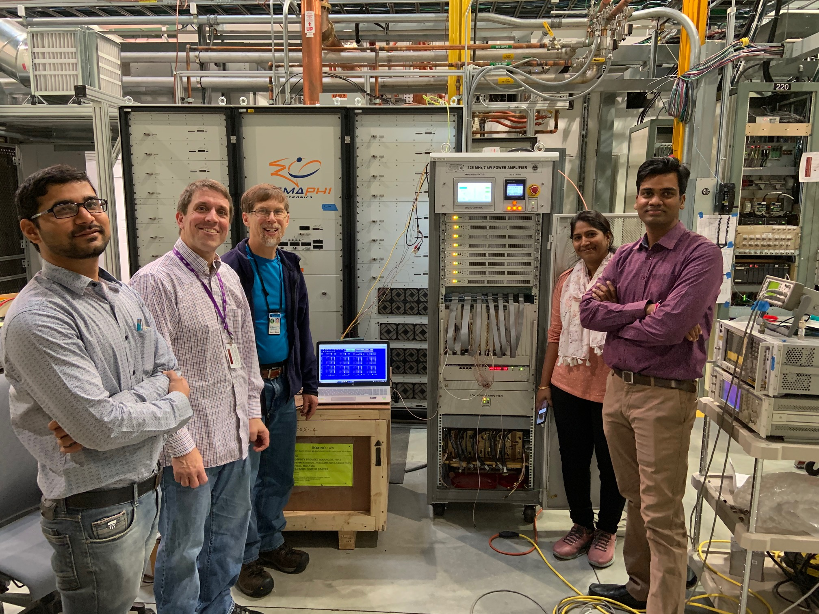
Also additional partner activities, e.g.
UK Project Annex signed Jan, 2020.
WUST I-CRADA signed Jan, 2020.
First 7 kW SSA commissioned with help of 3 ECIL engineers
Second DAE cryo-engineer arrived
HB650 cavity arrived from RRCAT

Slide 14
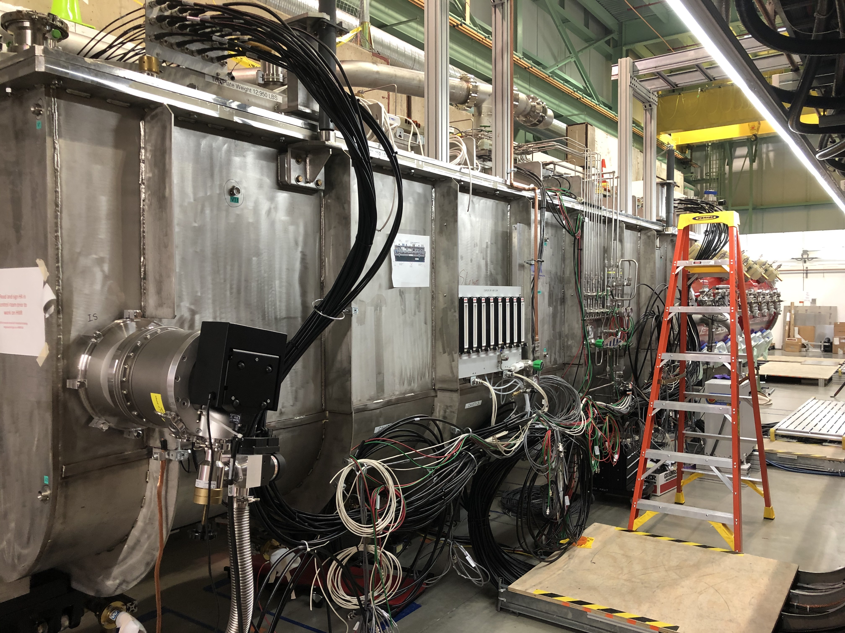
WBS 121.2 HWR
HWR Cryomodule Installation
  Engineering notes
    Beam line relieve analysis is in progress
    All other engineering notes resolved.
  ORC
    Pending the last engineering note approval
HWR Test
  Test plan is in place and traveler released
PMG SRFCRYO Update
10/16/2019

Slide 15
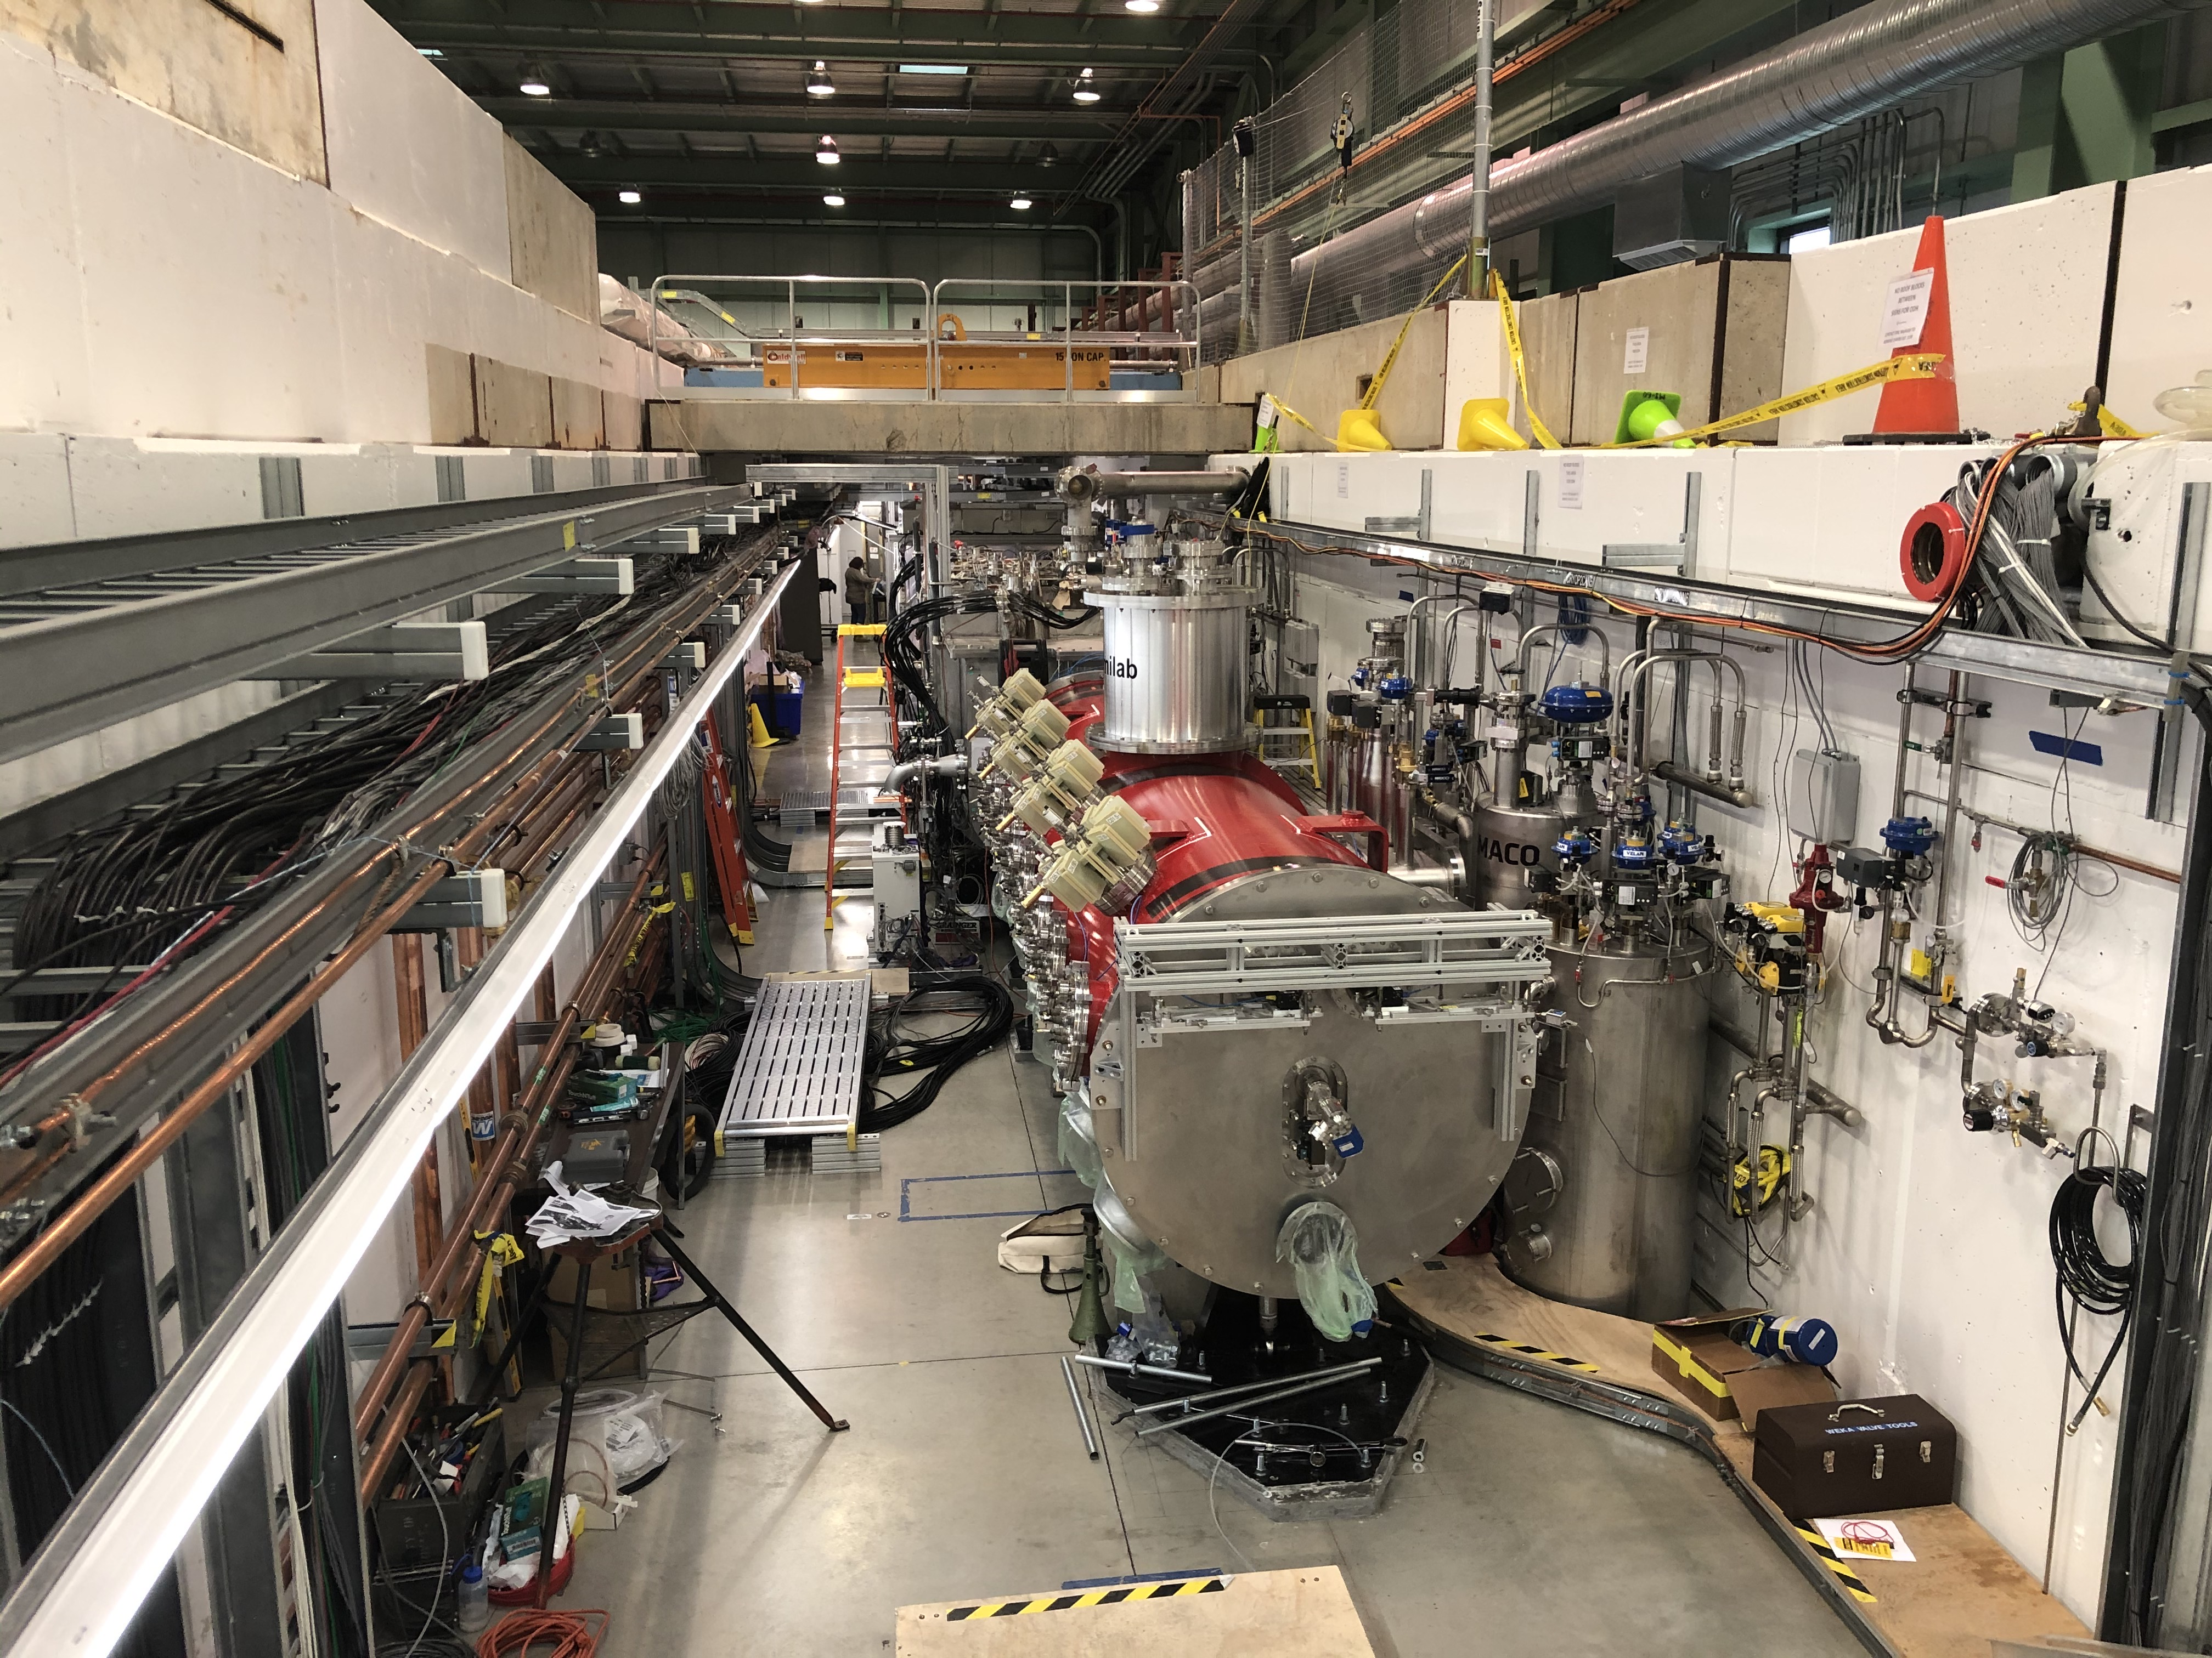
WBS 121.2 SSR Cryomodules
SSR1: installation is in progress at PIP2IT test cave
  Engineering notes
    Beam line relieve analysis is in progress
    All other engineering notes resolved.
  ORC
    Pending the last engineering note approval
    Test plan drafted. Travel is being developed.
SSR2: Niobium PO awarded and vendor started production preparation
SSR2: Cavity procurement is in progress
  In Director’s office
PMG SRFCRYO Update
10/16/2019

Slide 16
WBS 121.2 SRF Updates – 650 Cryomodules
Status and plans of four HB650 5-cell cavities
B9A-AES-007; Cavity received re-HPR. The latest test achieved Q=4.5e10 at 18.9MV/m, 2K, quenched at 23.6MV/m w/ Q of 3.7e10, maximum Rad~17mR/h, 2K. Qualified in VTS. Cavity proceeds to jacketing.
B9A-AES-008; qualified in VTS. The Ti dome weld as the 1st step of jacketing was completed. Cavity was RF QC’d and tuned. It is being prepared to second phase of jacketing.
B9A-AES-009: had cold EP and VTS, quench at 21MV/m w/ Q of 4.6e10. Additional cold EP 3um and VTS are planed. *
B9A-AES-010: STC test is in progress. Cavity ramped to 8MV/m before multipacting limited. Multipacting processing is in progress (14 MV/m reached).
B92A-RRCAT-502: received from RRCAT. Cavity is to be processed (pending new test cage and seal hardware from machine shop)
* VTS requirement: Q of 4e10@19MV/m, quench >23~24 MV/m (18.8MV/m + 20%)
PMG SRFCRYO Update
10/16/2019

Slide 17
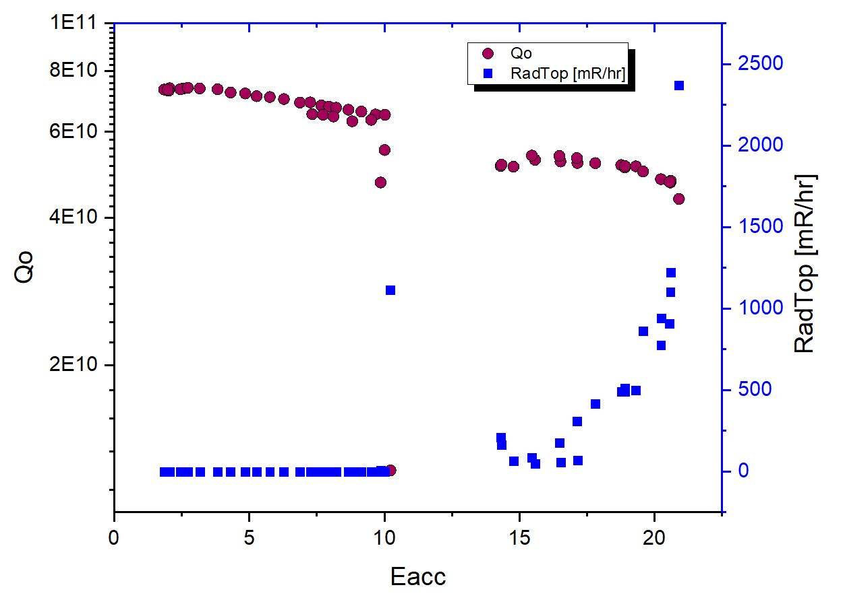
HB650 5-cell VTS result
B9A-AES-007, post N-dope + EP(7um@15C) + re-wash x2
Eacc=21MV/m w/ Q of 4.4e10 at 2K, FE limited
VTS spec
Cryomodule spec

Slide 18
HB650 5-cell VTS result
B9A-AES-007, post additional EP(3um@15C)
Qualified for jacketing
VTS spec
Cryomodule spec

Slide 19
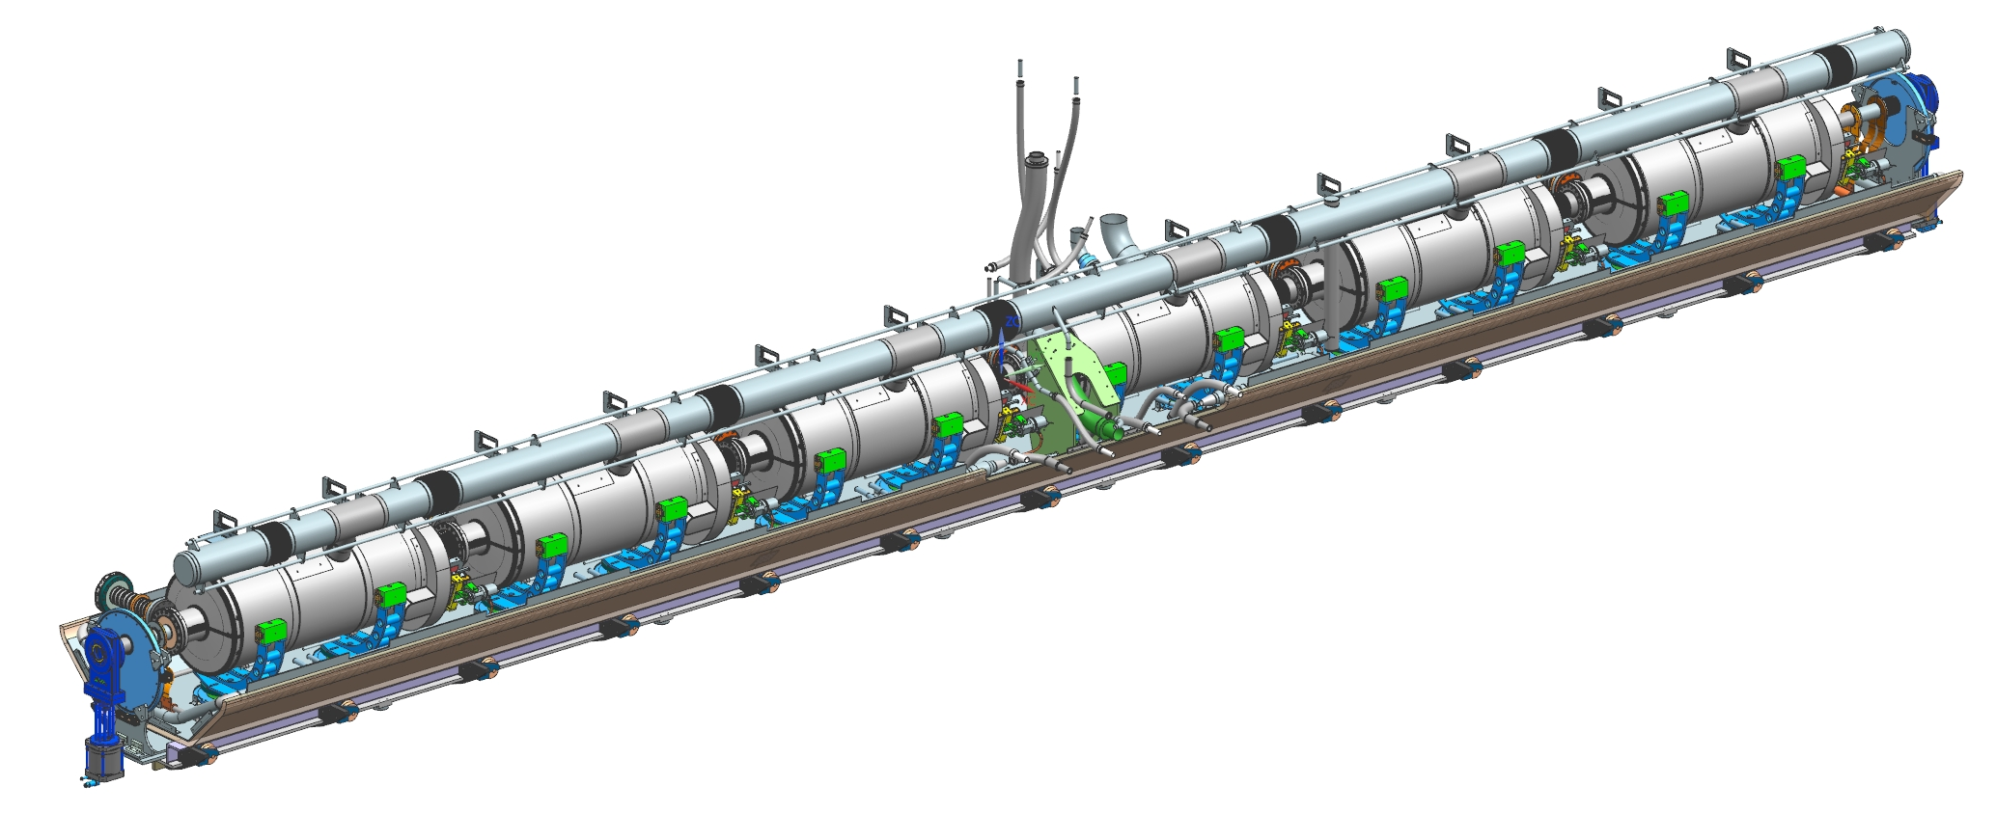
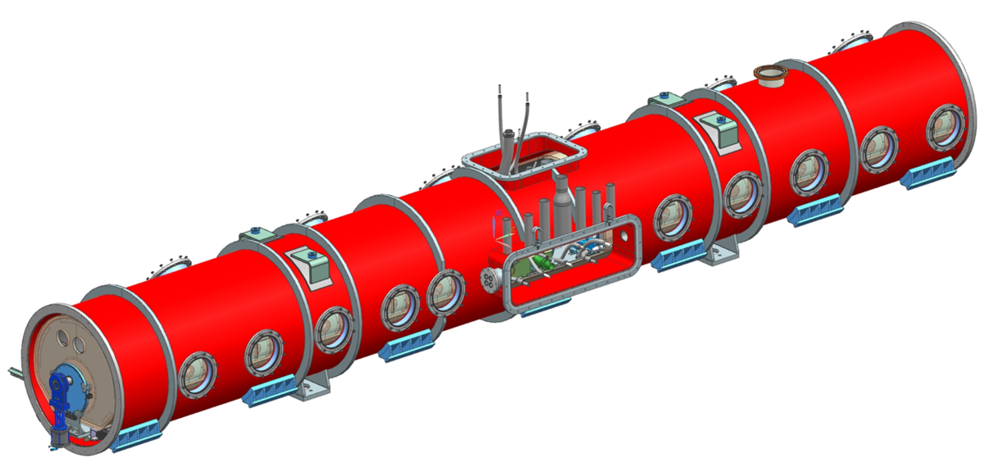
WBS 121.2 SRF Updates – 650 Cryomodules
Niobium specification:
Technical specification is converged
Discussion with partner lab is scheduled
Cryomodule Design:
HB650 final design is in progress
  CEA Design team visiting Fermilab in March
LB650 Cavities:
INFN ESS MB704 received. Processing is being prepared.
MSU cavity S65-01 was tested at MSU. Cavity achieved 21 MV/m (2.1e10 @ 16 MV/m).
  Possible high magnetic field in MSU test stand.
MSU cavity S65-02 was tested at Fermilab. Low field and Q₀ (12.5 MV/m, ~4e9) Optical inspection showed rough surface, surface defects. Cavity received heavy BCP and non-ideal EP after n-doping
PMG SRFCRYO Update
10/16/2019

Slide 20
WBS 121.02 - Cryogenics
Cryoplant vendor selected (Air Liquide).
Cryoplant award is expected end of this month.
Cryoplant integration preliminary design is in progress
CDS final design is in progress.
  Developed U-tubes & Bayonets QA/QC Plan
  Updated F10101611 CDS Integrated 3D Model
PMG SRFCRYO Update
10/16/2019

Slide 21
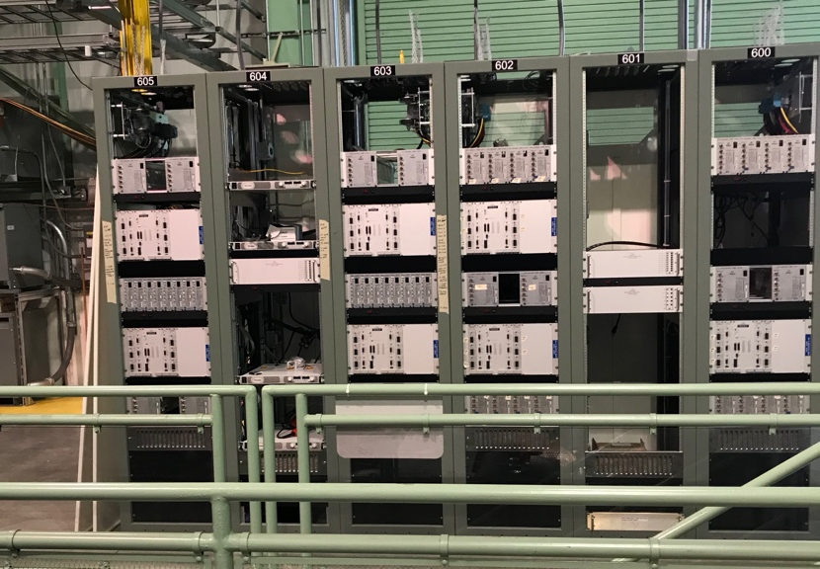
WBS 121.03 – Accelerator Systems Updates
MPS
MPS crate at PIP2IT powered up
Controls
IDIQ for long-term Controls contractor(s) support on the street; we are responding to questions from potential vendors
Vacuum
NEG/Ion pump test
Prepping for PIP2IT ion source turn-on
Magnets/PS
relay racks for the PIP2IT half-wave resonator magnet power supplies are in place at CMTF (see photo)

Slide 22

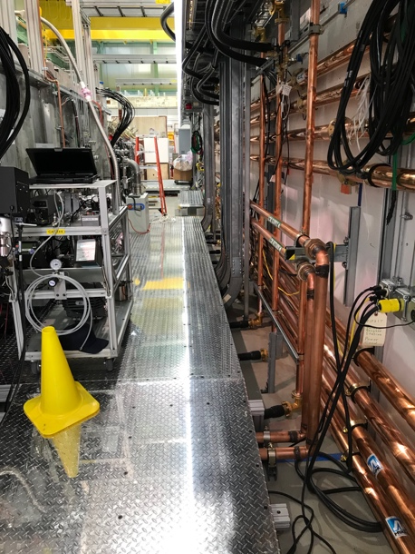
WBS 121.03 – Accelerator Systems Updates
RF
The first 7 kW SSR1 amplifier from India is qualified; ECIL engineers were here for two weeks
RF distribution for HWR is complete
Commissioning of the HWR resonance control system has begun
STC Operational Readiness Clearance obtained and cold cavity testing has begun
Working on renewal of the LLRF collaboration with LBNL through the end of the FY

Slide 23
WBS 121.03 – Accelerator Systems Updates
Instrumentation
Laser profile monitor work continues
Wire scanner assembly in progress
Acc Sys overall
Physics Requirements Documents all written & approved
  Refinement is the next step
BCRs entered into P6
  Increase Project Management Labor scope
  Fix issues discovered during pre CD-2 review BOE peer review
  Mature planning packages into activities
CD-2 review
Responding to recommendations
  Focus on EVMS, HPRF labor, and non-ionizing radiation hazard mitigation

Slide 24
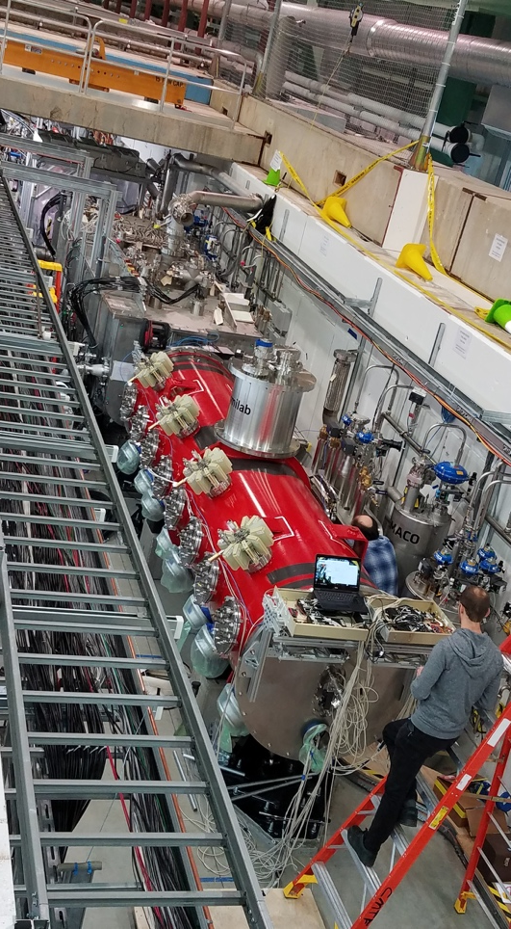
Updates - WBS 121.4 Linac Installation and Commissioning
Test Infrastructure – PIP2IT
      HWR
      All installation work complete (u-tubes, vacuum, cabling)
      Ready for cooldown
      Waiting for final cavity note approval to begin cooldown
      pSSR1
        pSSR1 received January 13, 2020 at PIP2IT
        Insulating vacuum complete, couplers installed
        Beamline vacuum work & cable terminations in progress
        Expect to be ready for cooldown in early March
      HEBT
      HEBT dump construction underway
      Vacuum component processing in cleanroom and beam line girder assembly ongoing

Slide 25
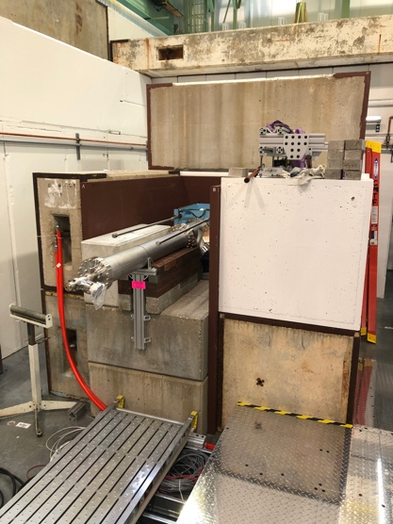
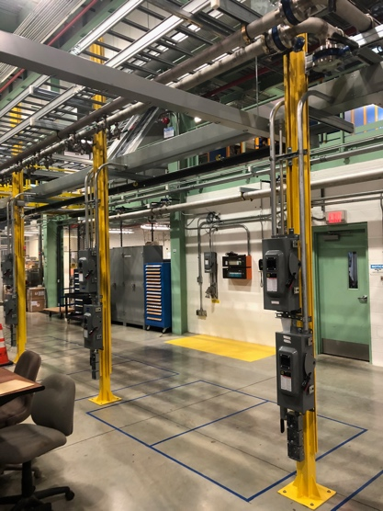
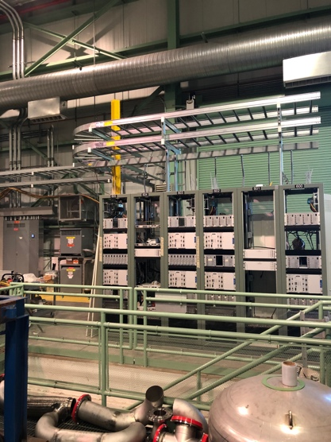
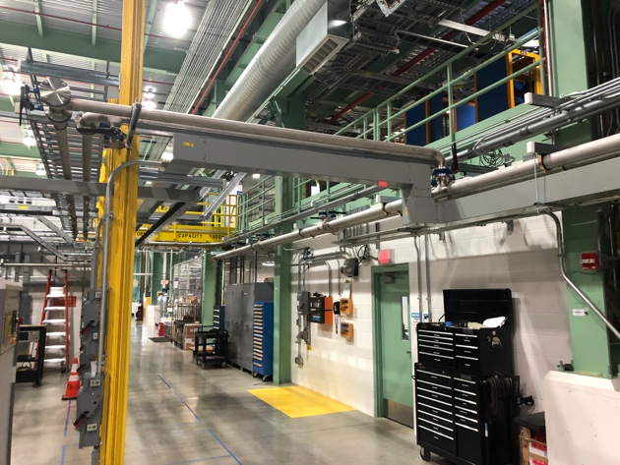
Updates - WBS 121.4 Linac Installation and Commissioning
Test Infrastructure – PIP2IT (cont.)
      Infrastructure work
        LCW infrastructure for SSR SSA’s complete
        Electrical infrastructure outside PIP2IT cave progressing well
          Provide power for the 7kW SSA’s for SSR1 (and 20kW SSA’s for SSR2)
            First SSA tested, 7 more units due at end of month
          Installation and electrical infrastructure for 6 Magnet PS racks
LCW
HEBT Dump
SSA LCW and Electrical Infrastructure
PS Racks

