Slide 1
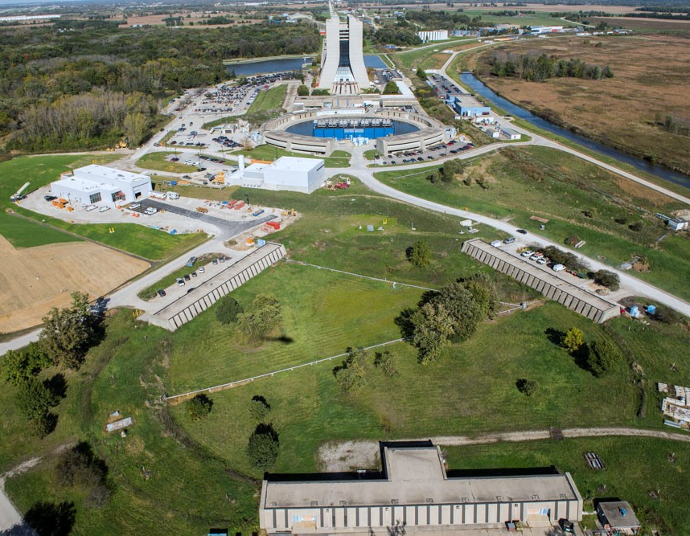
Muon Campus Beamline Design History
and Mode Changing between g-2 & Mu2e
March 5, 2020
Jim Morgan

Slide 2
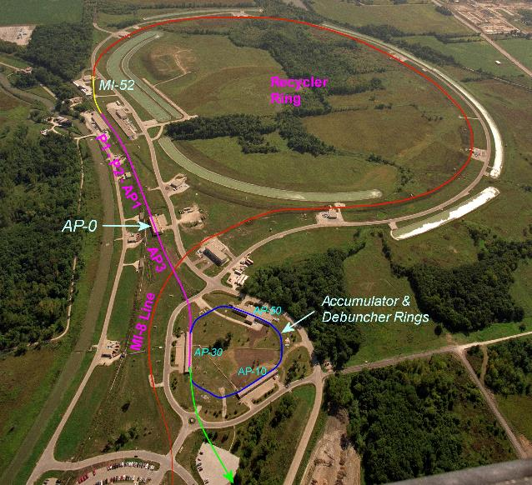
Back in late 2011…
Collider Run II ended in September 2011
Mu2e was working towards CD-1
  8 GeV proton beam
  Partial turn in Recycler, bunch formation in Accumulator
  H=4 bunches extracted one at a time from Accumulator to Debuncher
  Resonant extraction from Debuncher
  Protons transported through external beamline to Mu2e target
g-2 experiment had been discussed since at least 2008 and was now preparing for CD-0 Review
To reduce Mu2e costs, Task Force in October 2011 recommended eliminating Accumulator and adopting “g-2 scheme” for bunch formation in the Recycler
Mu2e external beamline

Slide 3
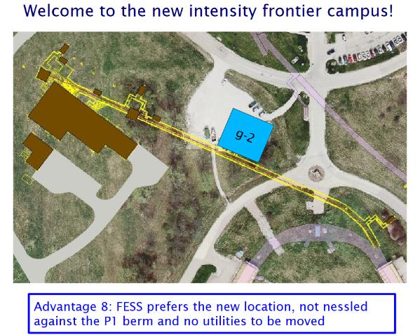
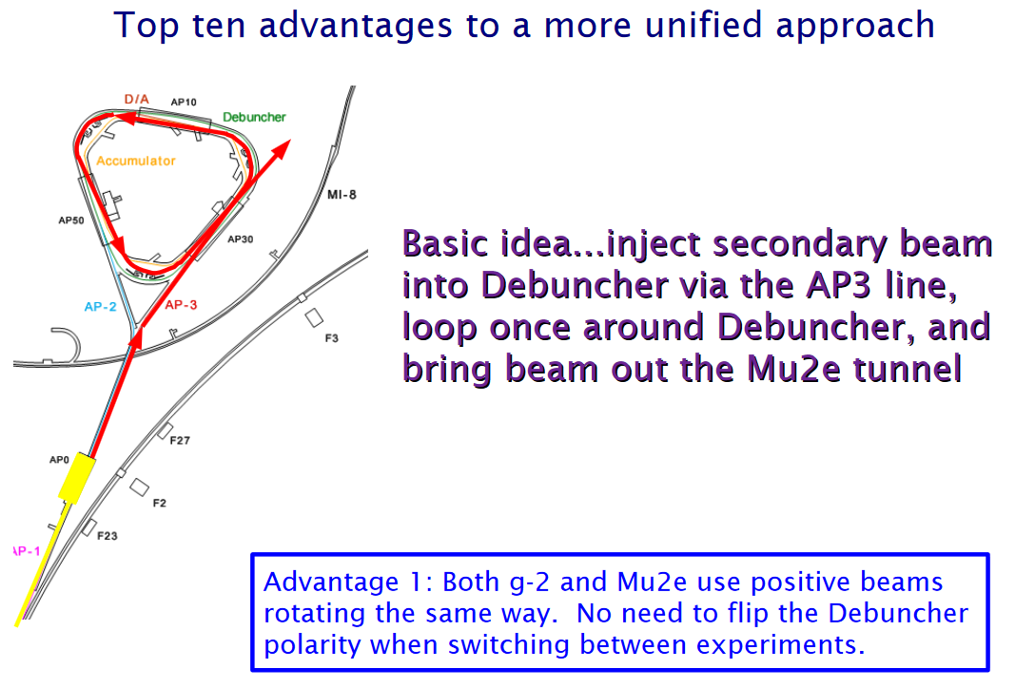
Chris Polly already had a vision of a Muon Campus
Chris Polly presentation

Slide 4
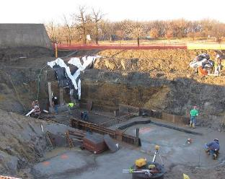
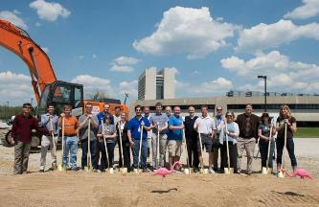
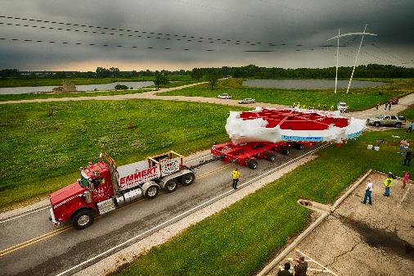
2012-2015 The Muon Campus takes shape
g-2 received CD-0 in fall 2012, CD-1 in fall 2013
Mu2e received CD-1 approval in July 2012 (CD-0 was November 2009)
Most of the major design features of the Delivery Ring and beamlines were in place by the end of 2012
  New beamline tunnel construction schedule required early decisions on M4/M5 Line geometry to transport beam to the experiments
Spring 2013 MC-1 construction begins (beamline design in progress)
Tunnel construction starts in Fall 2014
Mu2e Building construction begins in Fall 2015
May 2013, MC-1 Groundbreaking
July 2013 – The Big Move
Winter 2014-15, M4/M5 tunnel construction

Slide 5
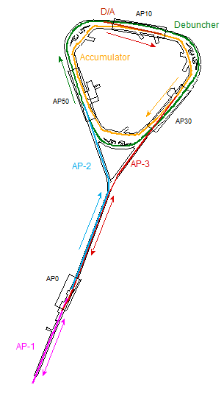
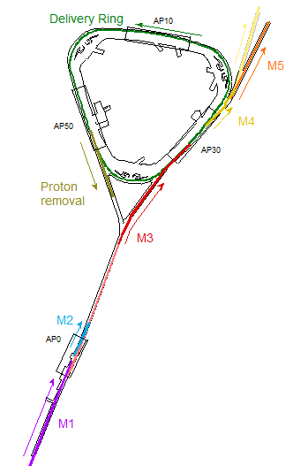
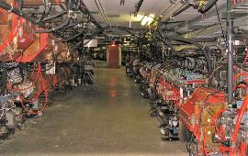
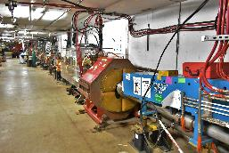
Repurposing Pbar into the Muon Campus
Target Station
Target Station
Antiproton
production
Muon Campus
(g-2 operation)

Slide 6
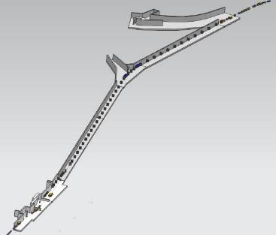
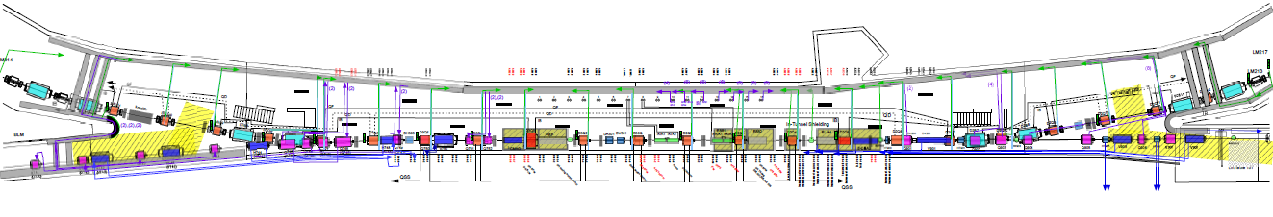
M3 Line and Delivery Ring used for both Mu2e and g-2
  Original Pbar AP-3 Line target bypass bend geometry remained in place
Quadrupole count in bypass region was increased from four to eight during design process
  M2/M3 design has high quadrupole density and low beta functions to maximize muon transport
Power supplies were specified to operate at 8 GeV currents
H812 dipole is “switch” between 3.1 GeV g-2 secondary beam and Mu2e 8 GeV protons
Optics for RR to DR 8 GeV protons (Mu2e mode) not fully designed, dispersion not matched
Rings Enclosure
D30 straight
M3
M2
H812
Target Vault
Delivery Ring D30 Straight Section
injection of beam from target
extraction towards g-2 ring

Slide 7
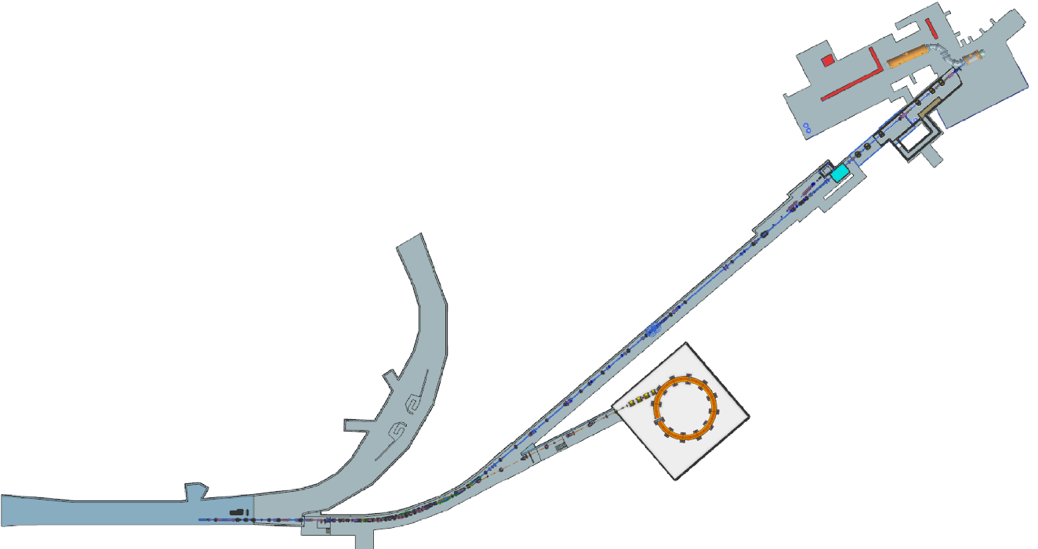
Extraction Lines, with shared section of M4 Line
Elevation to Storage Ring height for g-2 done in 3 steps
  ELAM/Q205/C-Magnet to V901 (32” dogleg)
  V906 to V907 (16” upward)
  V907 to V003 (69.5” upward, level after V003)
Elevation change for Mu2e done in two steps
  ELAM/Q205/C-Magnet to V901 (32 dogleg”)
  V906 to V907 (16” dogleg)
Both M4 and M5 have major horizontal bends
  M5 has 27.1°Left Bend made up of three dipoles
  M4 has 40.7 ° Left bend made up of six dipoles
Mμ2e
M4 Beamline
Delivery Ring
g-2
M5 Beamline
V907

Slide 8
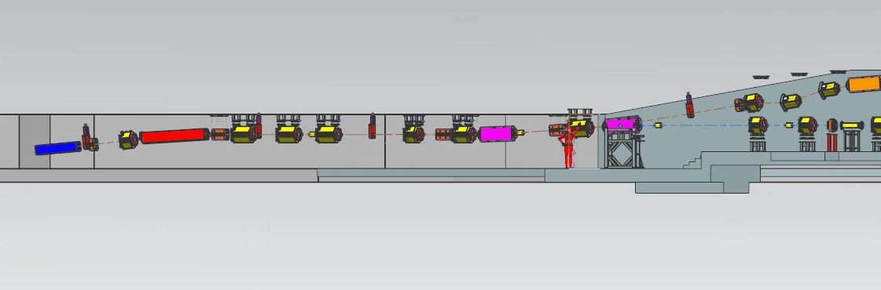
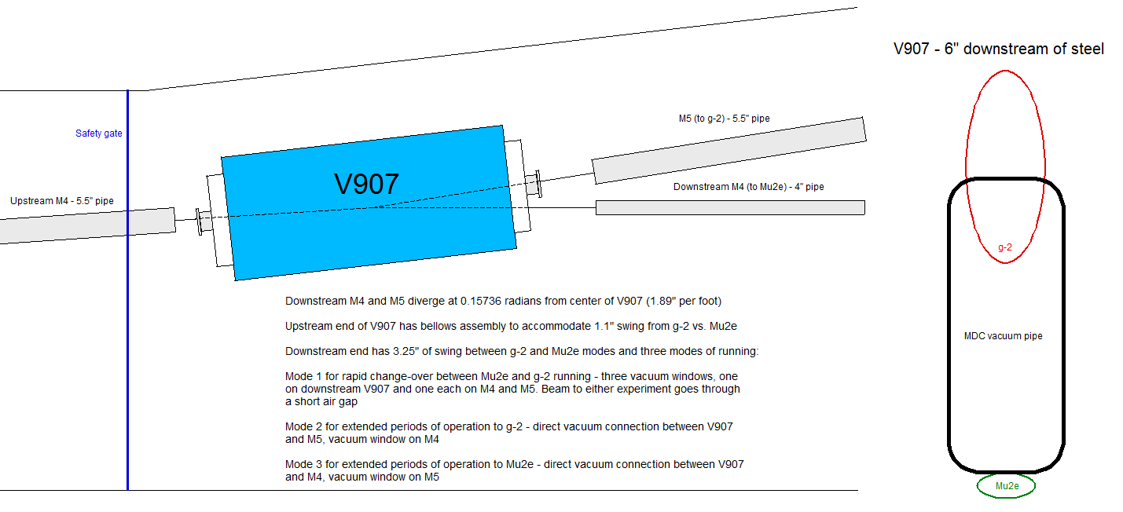
The g-2 and Mu2e Common Section
Vertical Split at V907
Extracted beam from Delivery Ring (DR)
M-5 (g-2) Beamline
Existing Pbar Rings Enclosure
M-4 (Mu2e) Beamline

Slide 9
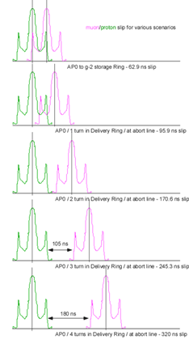
Differences between Mu2e & g-2
g-2 – 3.1 GeV Muons
  Protons from the Recycler are sent to the AP-0 Target Station via P1, P2 and M1
    1E12 protons per pulse at 11.4 Hz
  A 3.1 GeV secondary beam from the Target Station is sent into the M2 and M3 Lines
    Pions decay to muons along the secondary beam path
  Beam circles the Delivery Ring four times to separate protons from muons in time
  Secondary protons are kicked into the DR Abort Line
  Muons are extracted and sent to through the M4 & M5 Lines to the g-2 Experiment
Intentional Accelerator
Standby Period
Target Station
g-2 operation
Downstream D30 Crossover Pipe

Slide 10
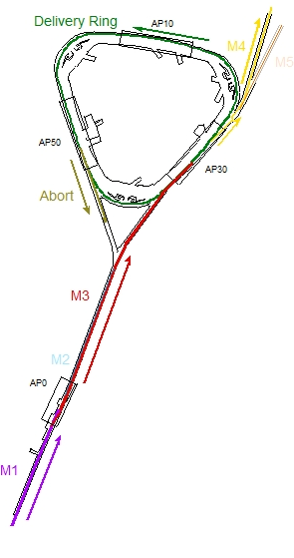
Differences between Mu2e & g-2
Mu2e – DR resonantly extracted 8 GeV protons
  Protons from the Recycler bypass the Muon Target Station via the upstream M3 Line
    Recycler to Delivery Ring beam path is through P1, P2, M1 and M3 beamlines
  1E12 protons per pulse at 2.86 Hz (4 pulses every 1.33 seconds over 444 ms, beam off 889 ms)
  Protons circulate in the Delivery Ring for 43 ms and are resonantly extracted
    Protons remaining at the end of spill are sent to Delivery Ring Abort
    Original Pbar rad shielding needs to be augmented to handle this much beam
  Beam is extracted with two electrostatic septa and a Lambertson
    Protons are transported from the Delivery Ring to Mu2e via the M-4 Line
    M-4 Line ends at Mu2e Target in the Production Solenoid
Intentional Accelerator
Standby Period
Mu2e operation
Downstream D30 Crossover Pipe

Slide 11
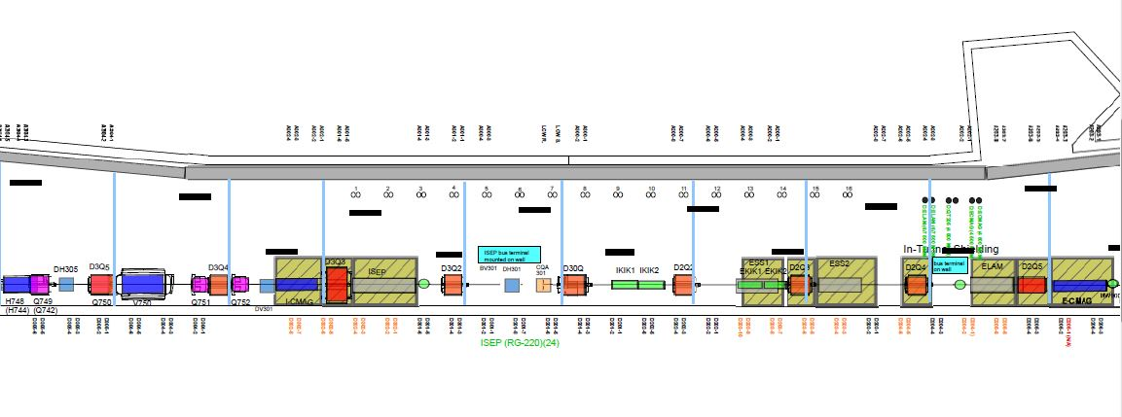
Delivery Ring D30 Straight Section
Upstream Mu2e electrostatic septa will
be located where Extraction Kicker is now
Beam Direction
Injection
Extraction

Slide 12
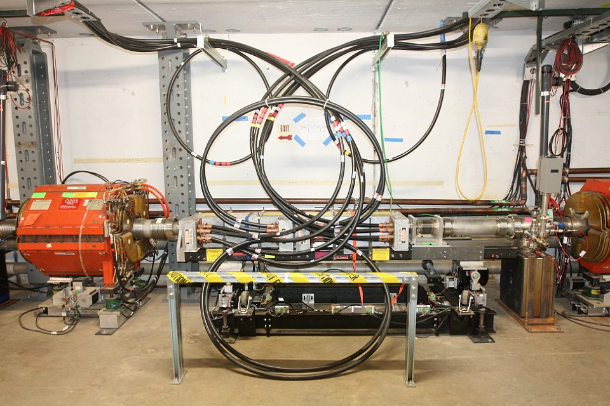
Extraction kickers

Slide 13
Mu2e/g-2 mode switching
Difficult – Extraction systems are not compatible
  Single-turn extraction with proton removal for g-2, resonant extraction for Mu2e
  Mu2e upstream Electrostatic septa will be located where Extraction Kicker is now
  Removing septum and installing kicker will be challenging due to septum rad levels
    Roughly 1,000 – 3,000 mr/hr @ 1 ft after 24-hour cooldown during normal Mu2e operation
    Vacuum connections, high voltage connections, removing anchors and moving etc.
  Preliminary concepts exist for a relocated and compact extraction kicker
    Can’t go just anywhere, must have proper phase relationship with Lambertson
    D30 region where injection and extraction regions are located has very little available room
    May be able to use single kicker instead of two, with modification and proper placement
Not too difficult – Reconfiguring Mu2e Abort
  Should take less than a day
Not too difficult – Change charging supplies in pulsed devices
  Injection Kicker, Injection septum and Abort septum, should take less than a day
Not Difficult – Changing magnet currents and reconfiguring beamlines
  Already have software to do this in 5 - 10 minutes
Not difficult – Repositioning V907 dipole vertically
  Special pitching magnet stand and controller installed over summer
  Vacuum windows used for shorter duration changes, perhaps 3% muon loss
  Vacuum spool pieces used for longer periods, but switch takes about two days
Intentional Accelerator
Standby Period
Downstream D30 Crossover Pipe

Slide 14
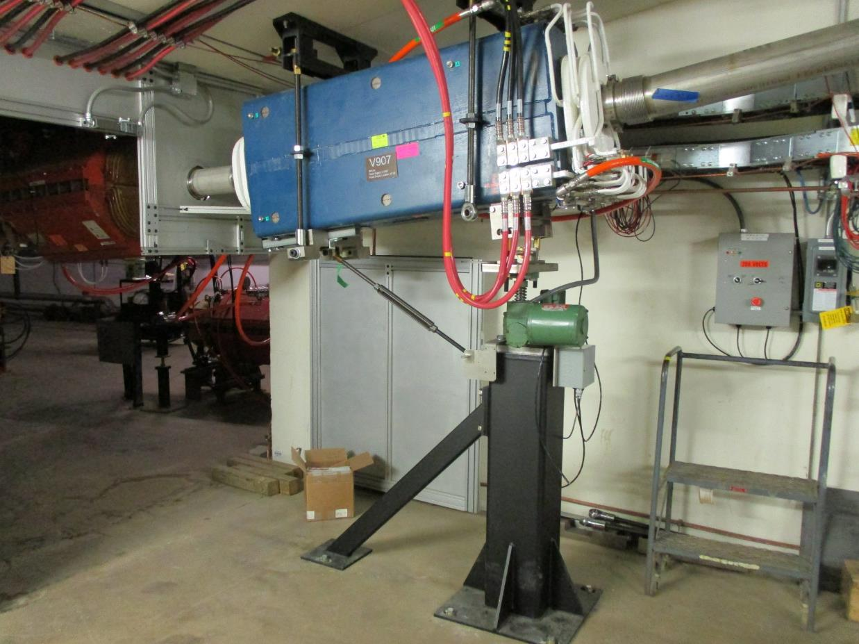
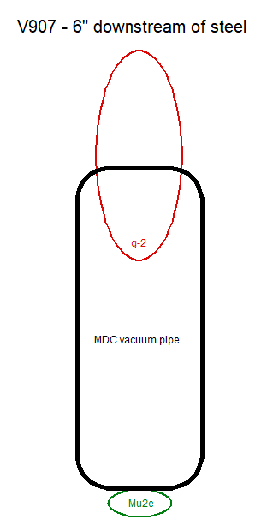
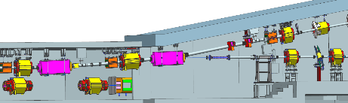
V907 pitching dipole stand
M5 Line to g-2
M4 Line to Mu2e
3.25”
M5 Beamline
91.3 mr up bend to M5
66.4 mr down bend to M4
V907
M4 Beamline
Delivery Ring

Slide 15
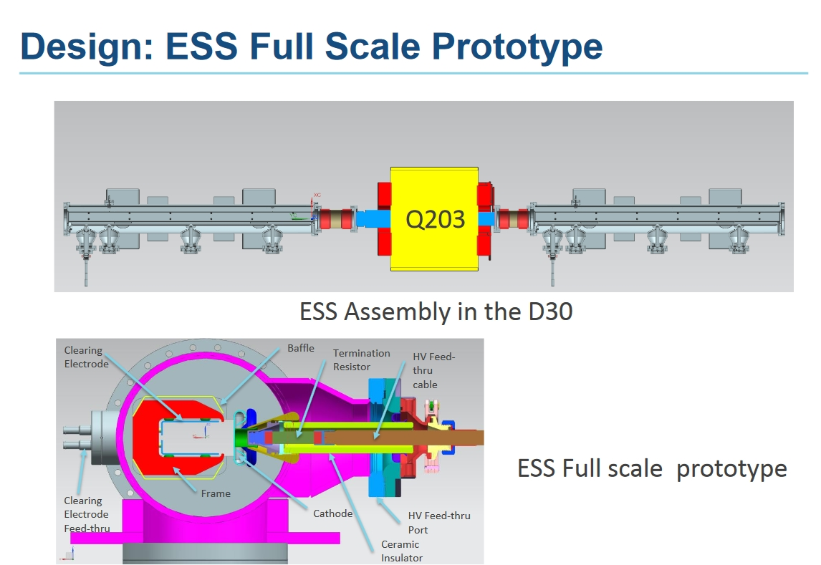
Delivery Ring D30 Straight Section
Upstream Mu2e electrostatic septa will
be located where Extraction Kicker is now
Beam Direction
Q205
ESS1
ESS2

Slide 16
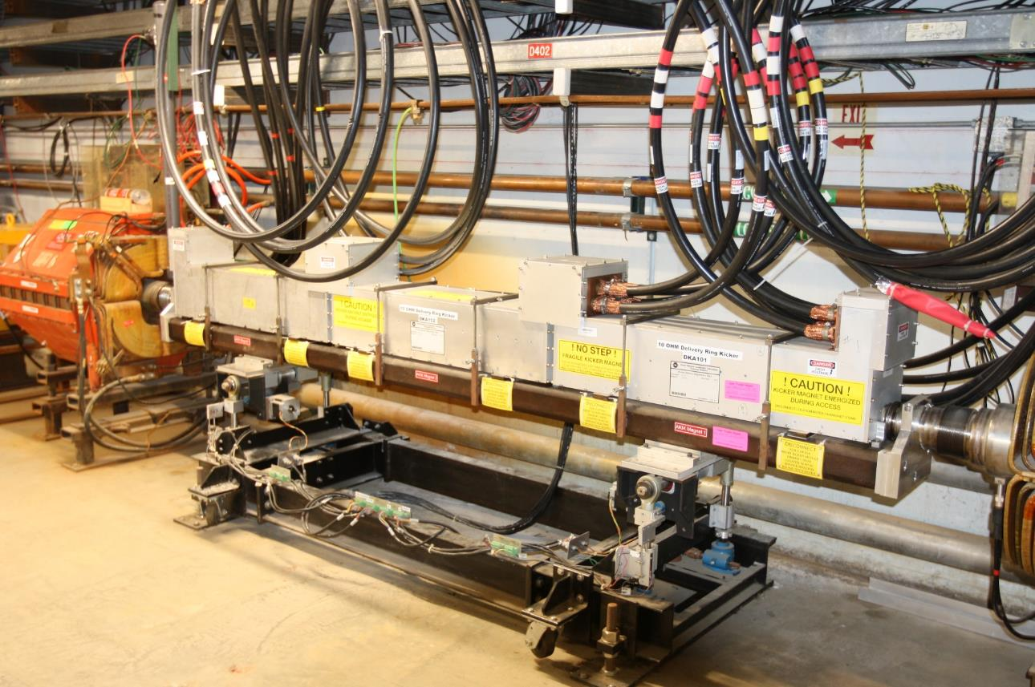
Muon Abort Kicker configured for g-2 proton removal
Needed for Mu2e
one kicker module

Slide 17
Single module Extraction Kicker
If enough space exists upstream of ESS1, can one kicker work there?
  In principal yes, but location matters and ESS1 will occupy the ideal location
  To maintain present performance, design kicker strength is 7.2 mr
  Insertion length of about 1.2 m required, including vacuum bellows for motion-control
  Single EKIK module too weak, need IKIK module or something similar
  Need mature mechanical design for ESS1 to know if concept will work
Ideally, aperture would be larger and kicker stronger
  Can use MI/RR ceramic kicker tube that has 14% larger aperture, but thicker walls
  Ferrite gap increases from 50 mm to 61 mm, reducing strength by 22%
  Would need longer kicker and/or lower impedance (8.33 Ω 20% stronger than 10 Ω)
  Module length would need to increase to about 1 m, insertion length 1.3 m
It would be best to increase the aperture of all kickers for Mu2e
Intentional Accelerator
Standby Period
ESS1
Kicker would need to fit here
Downstream D30 Crossover Pipe

Slide 18
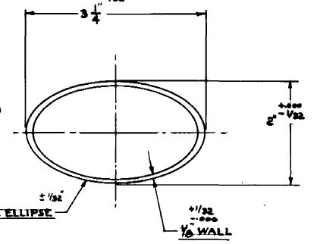
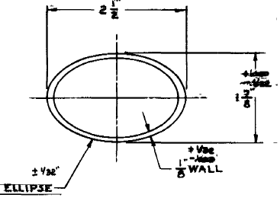
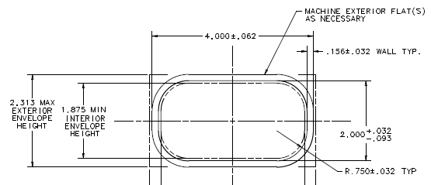
Existing Pbar/Muon kickers and possible alternative
EKIK module
  12.5 Ω system, 52 mm ferrite gap
  Produces magnetic field of 538 G with 60 kV power supply voltage
  Magnetic length 0.78 m, integrated field 0.42 kG-m @ 60 kV (4.1 mr kick @ 3.1 GeV)
IKIK module
  10 Ω system, 50 mm ferrite gap
  Produces magnetic field of 771 G with 60 kV power supply voltage
  Magnetic length 0.92 m, integrated field 0.71 kG-m @ 60 kV (6.9 mr kick @ 3.1 GeV)
“IKIK like” module, built to fit MI/RR ceramic tube
  8.33 Ω system, 61 mm ferrite gap
  To produce a magnetic field of 784 G with 60 kV power supply voltage
  Magnetic length 1.00 m, integrated field 0.78 kG-m (7.6 mr kick @ 3.1 GeV)
Intentional Accelerator
Standby Period
Downstream D30 Crossover Pipe

Slide 19
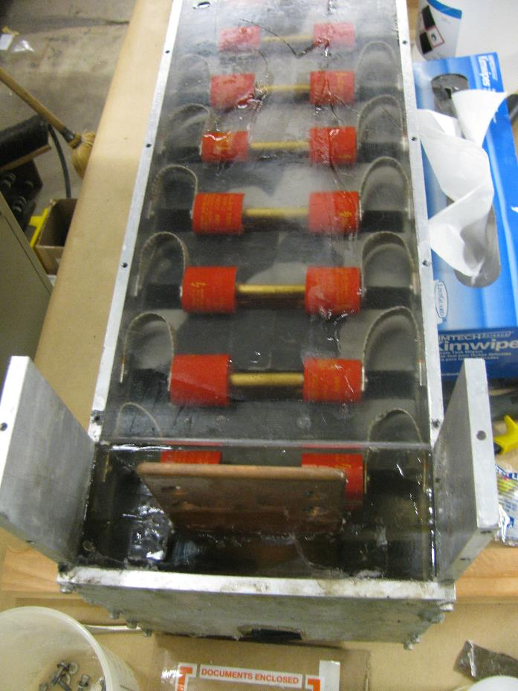
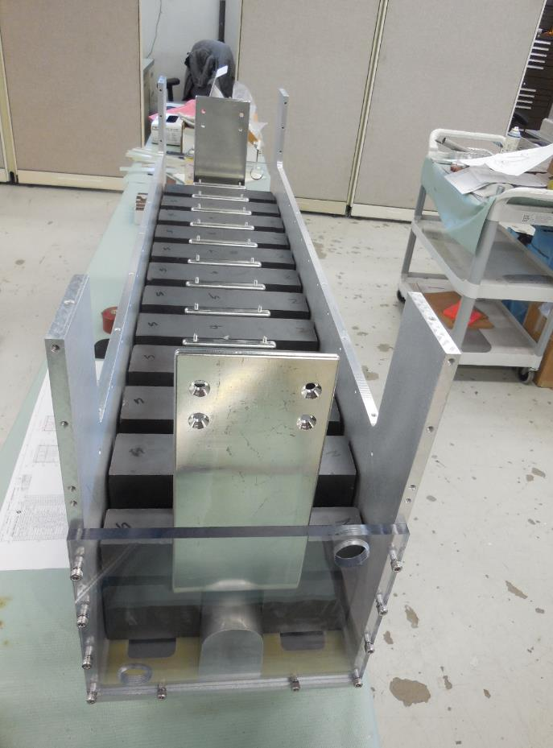
IKIK module disassembly and rebuild
Intentional Accelerator
Standby Period
Downstream D30 Crossover Pipe

Slide 20
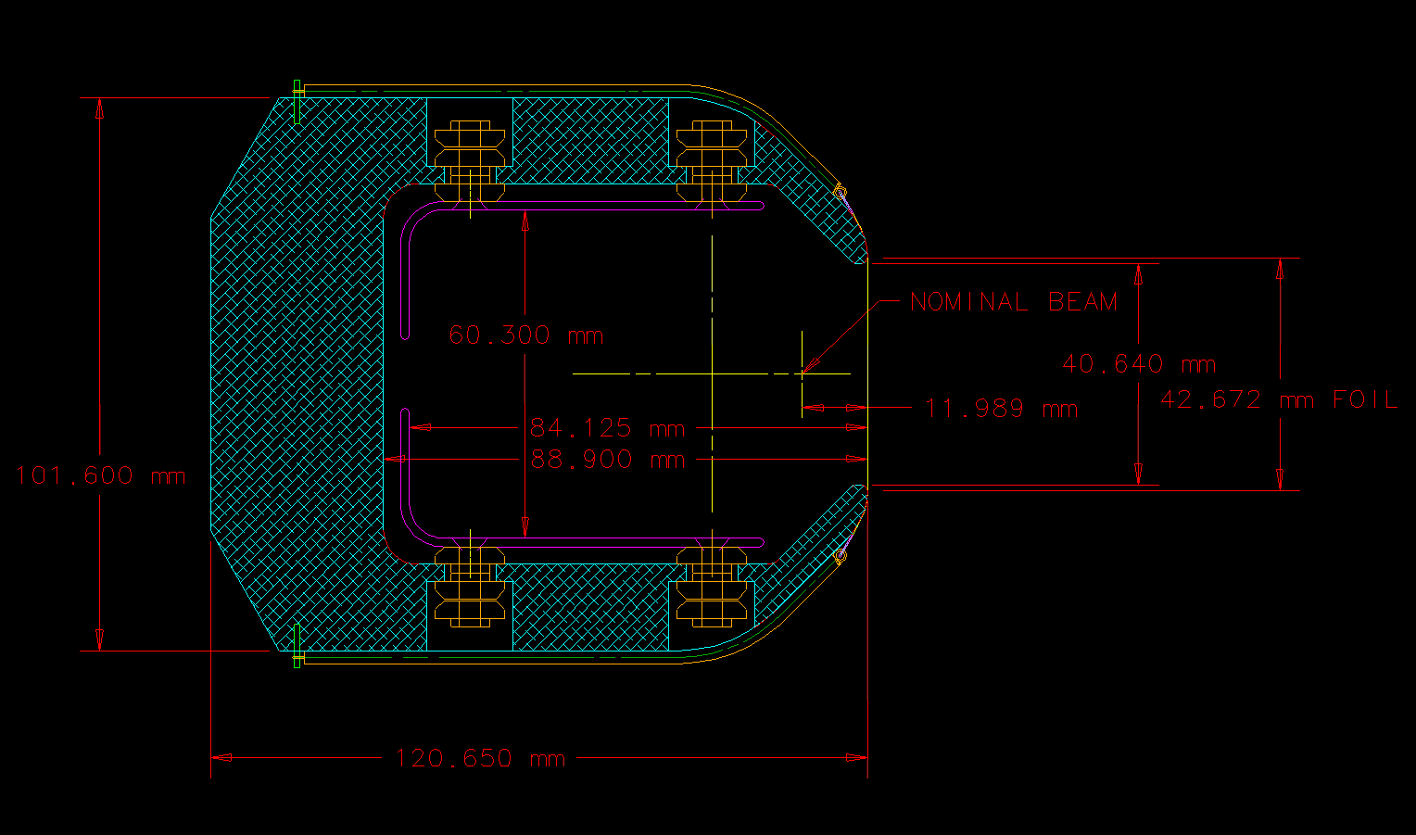
Electrostatic septa aperture

Slide 21
Electrostatic septa aperture and possible Kicker tubes
MI/RR
Tube
IKIK
Tube
g-2 beam

Slide 22
Conclusion
Present configuration supports mode changing between Mu2e and g-2
  Operating currents can be changed within a few minutes
  V907 magnet pitch can be changed in a few minutes
    Vacuum windows are used during periods of frequent mode changes
  Reconfiguring Delivery Ring Abort requires a shift or two
  Charging supplies for kickers and septa should work with both modes
    Original plan had different charging supplies for the two modes, but it appears that the higher current supplies required for Mu2e are fast enough for g-2
    If charging supplies need to be changed after all, it would take about a shift
  Swapping electrostatic ESS1 and Extraction Kicker will take the longest time
    On the order of days, need to remove Mu2e rad shielding and break vacuum
    Manipulating ESS1 will become more complicated as rad levels increase (1-3 Rem @ 1 ft?)
What is needed to reduce mode changing to a shift or two
  Need new extraction kicker scheme that doesn’t require ESS1 to be removed
    Most available space does not have the proper phase advance
  May have enough room upstream of ESS1 to squeeze in a single kicker
    Hard to make single kicker strong enough with adequate aperture
Reversing polarity for g-2 to run µ- has additional implications
  Polarity of most of the beamlines downstream of the AP-0 Target Station and Delivery Ring need to be flipped
  Switching polarity would probably take days, possibly a week or more
  Negative polarity configuration for g-2 precludes Mu2e operation, including studies
Increasing the aperture of all kickers would be a good idea for Mu2e
Intentional Accelerator
Standby Period
Downstream D30 Crossover Pipe

