Slide 1
Mu2e with PIP II.
Ioanis Kourbanis
Proton PMG/AEM
03/05/2020

Slide 2
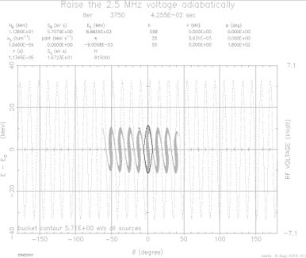
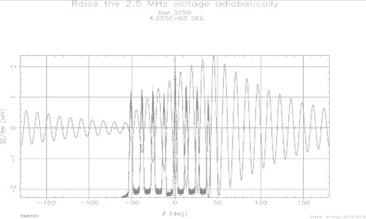
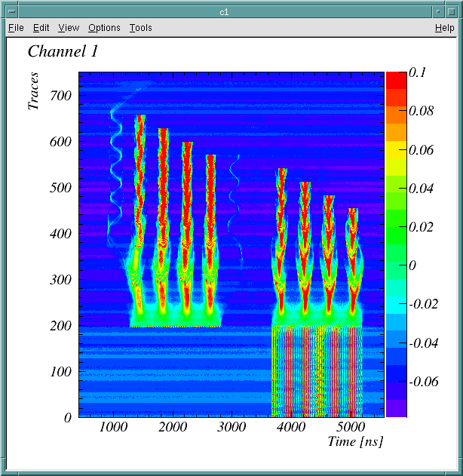
Beam to Muon Campus Experiments
We are using the Recycler to deliver beam with the required time structure to the muon campus experiments (g-2, mu2e).
One Booster batch with 81 53MHz bunches is transformed into 4 2.5 MHz bunches which are extracted to the muon rings.
  Initially only one Booster batch was injected but we are now using two Booster batches per cycle.
  Beam loading limits the max beam intensity to 8E12 per cycle.

Slide 3
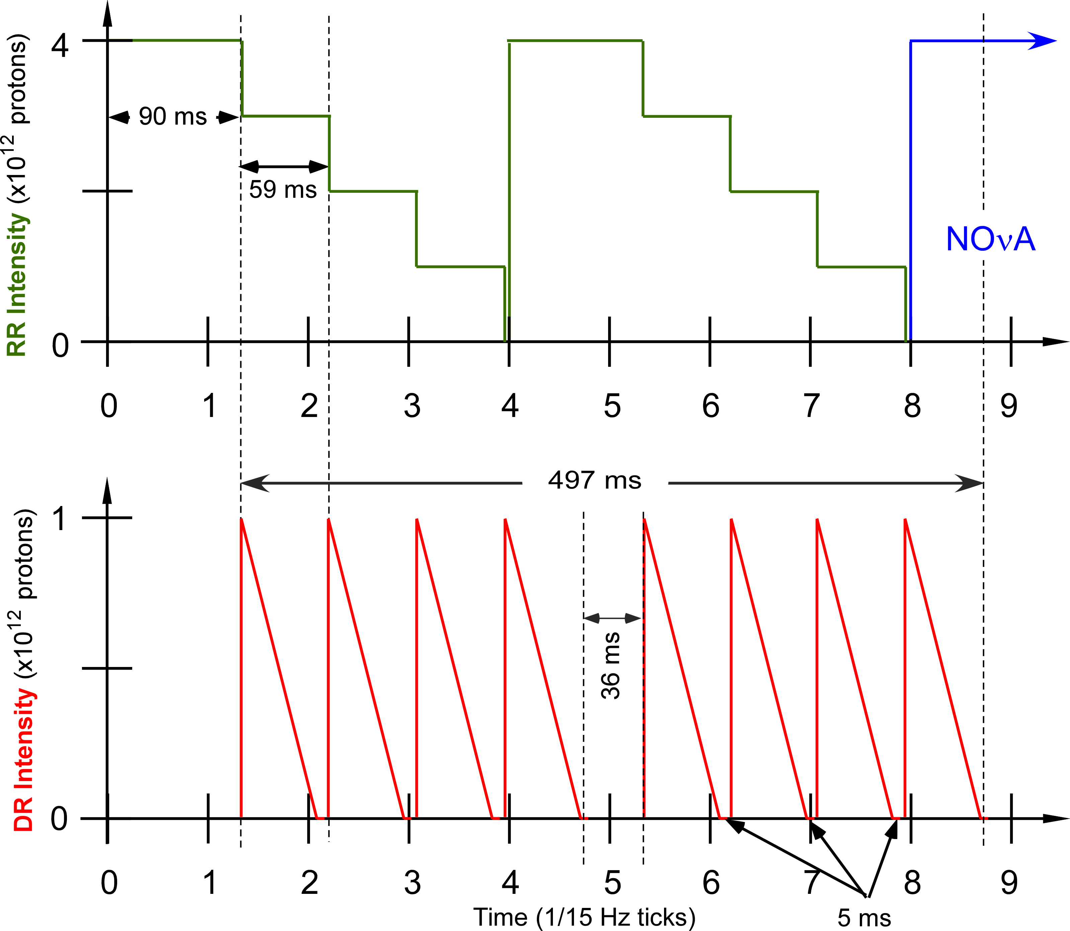
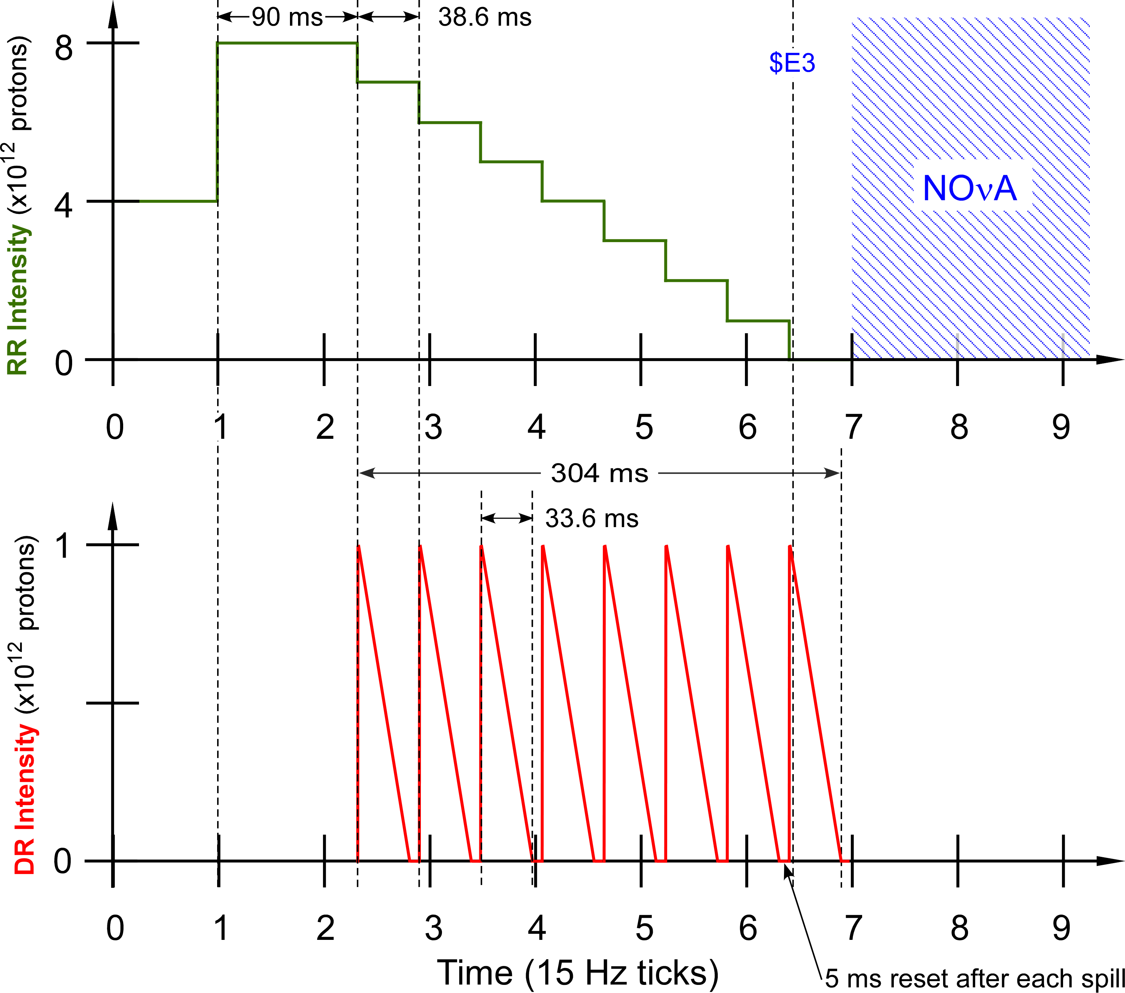
Mu2e beam delivery schemes (15 Hz, 1.33 sec MI cycle)
Initial scheme
Two cycles with one Booster batch each(54 msec spill).
Not enough time for the NOvA SS cycle.
New scheme with two Booster batches per cycle. Enough time for the NOvA cycle, not acceptable peak intensity increase for Mu2e.Need an extra 15 Hz tick. Increase spill time to 43 msec.

Slide 4
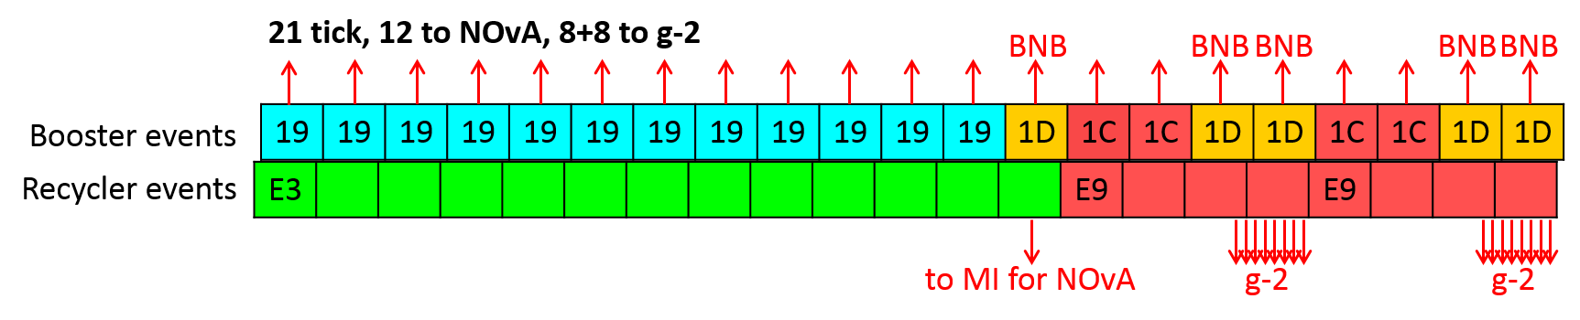
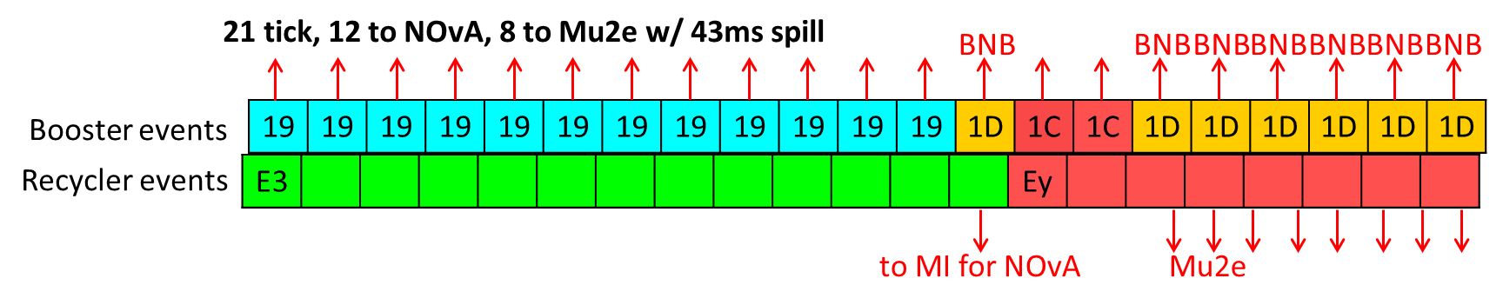
Current Muon Campus Running scenario (15 Hz, 1.4 sec)
NOvA: 665 KW
BNB: 3.57 Hz
g-2: 4.1E16 p/hr
1.4 sec
NOvA: 665 KW
BNB: 5.00 Hz
Mu2e: 2.1E16 p/hr with 43 ms spill vs 54ms design

Slide 5
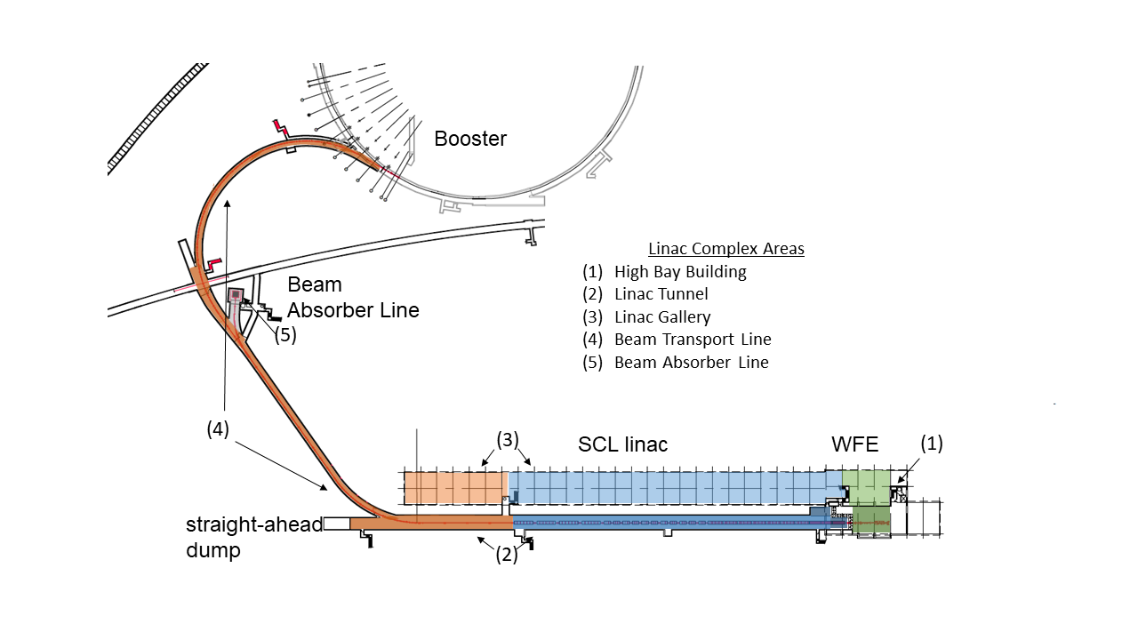
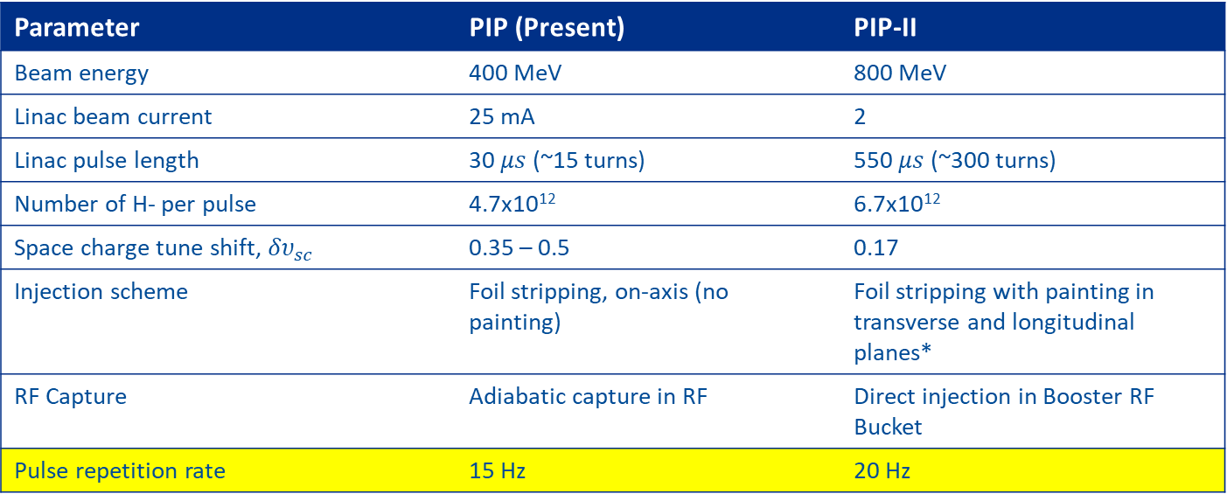
PIP II
Parameter | PIP (Present) | PIP-II
Beam energy | 400 MeV | 800 MeV
Linac beam current | 25 mA | 2
Linac pulse length | 30 $μs$ (~15 turns) | 550 $μs$ (~300 turns)
Number of H- per pulse | 4.7x10¹² | 6.7x10¹²
Space charge tune shift, ${δυ}_{sc}$ | 0.35 – 0.5 | 0.17
Injection scheme | Foil stripping, on-axis (no painting) | Foil stripping with painting in transverse and longitudinal planes*
RF Capture | Adiabatic capture in RF | Direct injection in Booster RF Bucket
Pulse repetition rate | 15 Hz | 20 Hz

Slide 6
Longitudinal Painting with PIP II Linac Beam
Off Momentum Injection (V. Lebedev, PIP II CDR) el~0.06 eV-sec
On Momentum Injection (B. Chase, P. Derwent) el=0.063eV-sec

Slide 7
Implications for Mu2e
The longitudinal emittance requirements from the Booster with the PIP II linac are the same (el≤0.1 eV-sec).
  No issues with Mu2e bunches
The Mu2e cycles require only 4E12 ppp from the Booster.
  Will be able to achieve required intensities faster.
The Booster will be operating at 20 Hz allowing 1.2 sec MI cycle operation without impacting the Mu2e beam delivery.

Slide 8
Muon Campus running with 20 Hz and 1.2 sec
g-2: 4.8E16 p/hr (16% more beam)
BNB: 6.66 Hz
1.2 sec
24 Ticks, 12 to NOvA,8+8 to g-2
BNB
BNB
BNB
BNB
BNB
BNB
BNB
BNB
Booster Events
19 | 19 | 19 | 19 | 19 | 19 | 19 | 19 | 19 | 19 | 19 | 19 | 1D | 1C | 1C | 1D | 1D | 1D | 1C | 1C
1D | 1D | 1D | 1D
Recycler Events
E3 |  |  |  |  |  |  |  |  |  |  |  |  | E9 |  |  |  |  | E9
To MI for NOvA
Mu2e: 2.4E16 p/hr (16.5% more beam)
BNB 8.33 Hz
24 Ticks, 12 to NOvA, 8 to Mu2e w/ 43 msec spill
Booster Events
19 | 19 | 19 | 19 | 19 | 19 | 19 | 19 | 19 | 19 | 19 | 19 | 1D | 1C | 1C | 1D | 1D | 1D | 1D | 1D
1D | 1D | 1D | 1D
Recycler Events
E3 |  |  |  |  |  |  |  |  |  |  |  |  | Ey

Slide 9
Impact of the 1.2 sec MI cycle on the different experiments
 | Now | 1.2 sec (15Hz) | 1.2 sec (20Hz)
NOvA (kW) | 665 | 776 | 776
BNB* (Hz) | 3.57-5.00 | 3.33-3.33 | 6.7-8.3
g-2 (E16p/hr) | 4.1 | 2.3 | 4.8
Mu2e (E16p/hr) | 2.1 | 1.1 | 2.4
*Intensity on BNB Cycles varies. Rep. rate depends on mode of operation. Rep rate for g-2/Mu2e running in red/green.
For NOvA we assume 4.3E13 ppp; for g-2/Mu2e 4.0E12 ppp is assumed.

Slide 10
Conclusions
No change in the longitudinal distribution of the beam delivered to Mu2e is expected after PIP II.
  No change in longitudinal emittance coming from Booster.
Switching to 20 Hz Booster will allow us to run with 1.2 sec MI cycle and deliver the planned beam power to the muon campus experiments.
  Protons per hour to Mu2e will increase by 16%.

