Slide 1

Beyond T2K and NOvA : Super Beams with Super Detectors
N. Saoulidou, Fermilab
NUSS 15-JULY-2009 Fermilab

Slide 2
Outline
The ultimate goals in ν physics and in particular in ν oscillation physics
Phase I experiments and the plan for Phase II
The “Ingredients” needed in order to achieve the ultimate goals:
  Neutrino Beams
  Neutrino Detectors
A possible phased neutrino oscillation program in JAPAN and US for the next decade(s)
Summary / Conclusions

Slide 3
The ultimate goals in ν physics
EXPERIMENT (Accelerator ν’s)
What is the value of the third mixing angle θ₁₃ ?
Do neutrinos violate CP symmetry ?
Which neutrino is the heaviest one?
EXPERIMENT (natural ν’s)
What are the neutrino masses ?
Are neutrinos their own anti-particles? (Majorana-Dirac)
THEORY
How do neutrino masses relate to quark masses?
How does neutrino mixing relates to quark mixing?
Origin of Matter – antimatter asymmetry in the Universe?

Slide 4
The ultimate goals in ν oscillations physics
1)What is the value of the “third” mixing angle (Reactor experiments, NOVA, T2K…)
2)Is there CP violation in the neutrino sector ?? (which might explain why we are here !!!)
3) What is the ordering of the neutrino masses!!!! (NOvA)
Are there sterile neutrinos??? (MiniBoone)
What is after all, the neutrino MASS?? (absolute value not mass squared difference) (kinematics of beta decay)
Atmospheric
Cross Mixing
Solar
0νββ decays
U=
Majorana phases
- Do “man made” v_{μ} ‘s oscillate?
- What is “precisely” the mass squared difference and the mixing angle? (K2K- MINOS)
- Are neutrinos and anti neutrinos the same ?? (Majorana particles)(neutrino-less double beta decays)

Slide 5
ν_{μ} -> ν_{e} oscillations
To a good approximation oscillation probability:
CP Violating
CP Conserving
Matter Effects

Slide 6
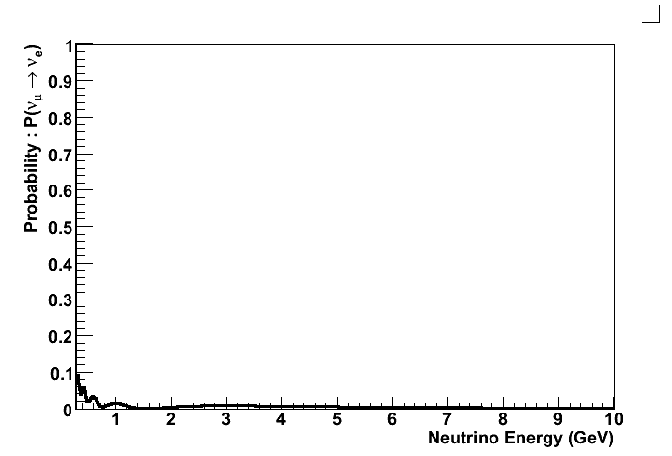
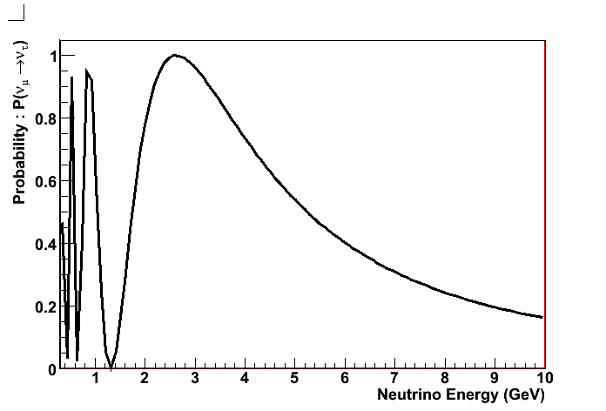
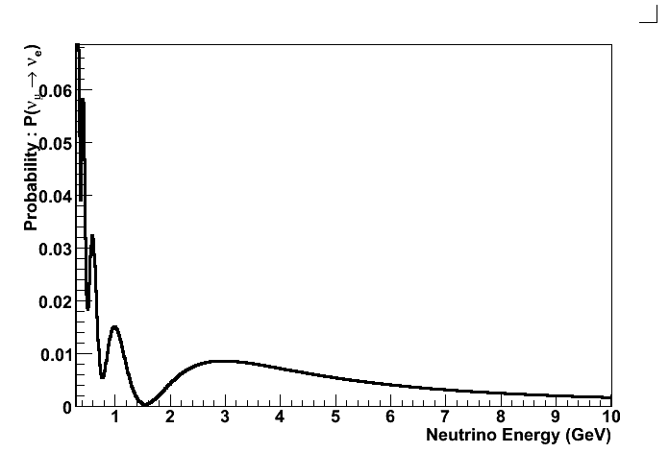
P(ν_{μ} ->ν_{e}) not as simple as P(ν_{μ} ->ν_{τ}) …
Small effect
P(ν_{μ} ->ν_{e})
P(ν_{μ} ->ν_{τ})
ZOOM IN
Rich structure
P(ν_{μ} ->ν_{e})
Large effect simple structure

Slide 7

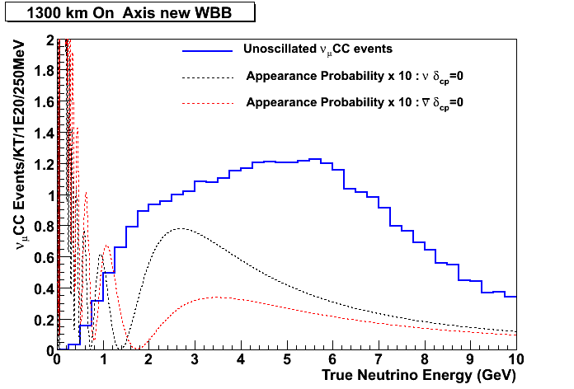
Degeneracies (ghost solutions) …
Oscillation Probability depends on, at least, 3 parameters
θ₁₃ , δ_{cp}, sign(Δm²₃₁)
Multiple Combinations of the 3 parameters can yield the “same” number of events, especially if parameters are “doing” similar things (like CPV and matter effects)
CPV or not?
WHAT DO WE NEED :
Large Number of neutrinos since we know the effects are small (θ₁₃ < 11 ⁰)
b) Multiple measurement of number of events as a function of energy , E , and as a function of distance, L.
c) Longer Baselines to enhance matter effects
d) Nature to be kind to us !!!

Slide 8
We need to study oscillation phenomenon as a function of energy
CP Conserved
2nd
1st
1st Maximum : Is telling us the neutrino mass hierarchy
2nd Maximum : Is telling us if CP Violated

Slide 9
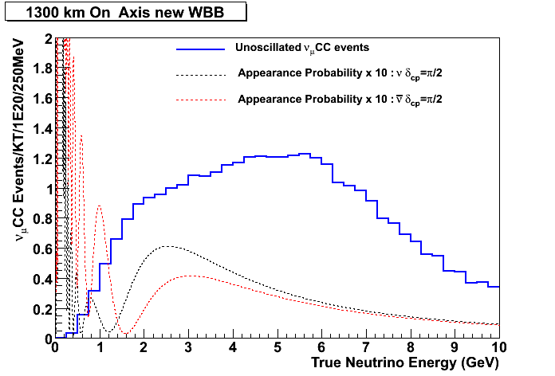
We need to study oscillation phenomenon as a function of energy
CP Violated
2nd
1st
1st Maximum : Is telling us the neutrino mass hierarchy
2nd Maximum : Is telling us if CP Violated

Slide 10
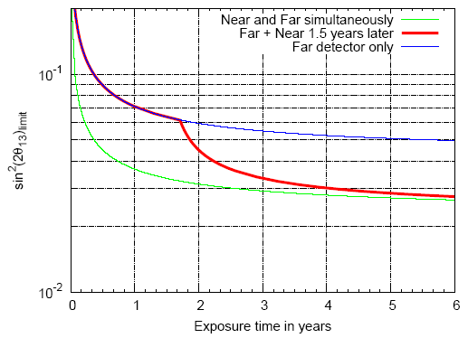
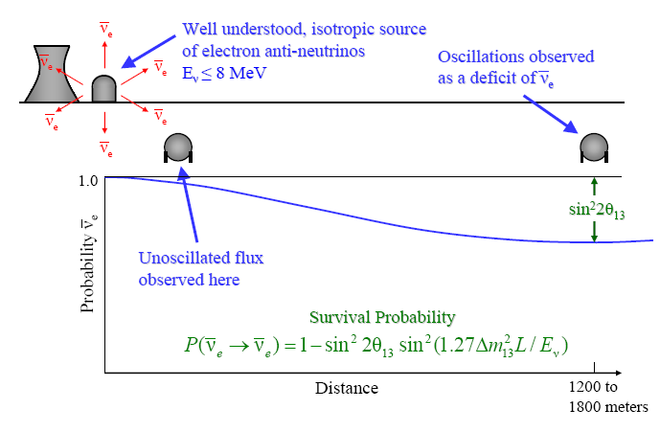
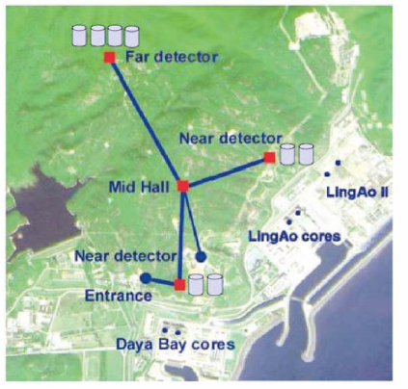
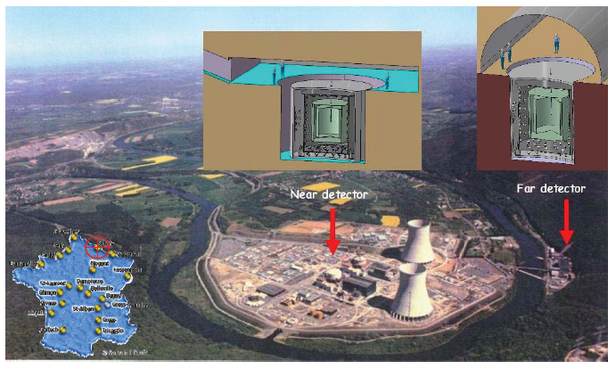
Hunt for a non-zero θ₁₃ (“cleanly”): PHASE I
Reactor Experiments : Double CHOOZ & Daya Bay
Double CHOOZ
Daya Bay
sin²2θ₁₃ (90% C.L.)
sin²2θ₁₃ (90% C.L.)
sin²2θ₁₃
Run Time (Years)

Slide 11
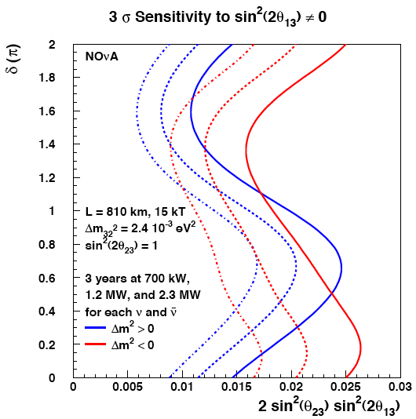
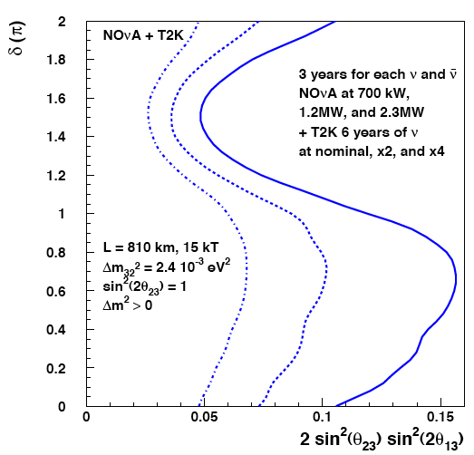
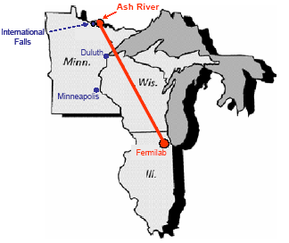
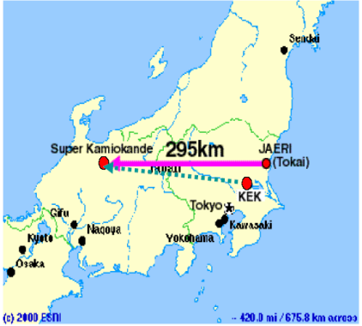
Hunt for a non-zero θ₁₃ (+more): PHASE I
Accelerator Experiments : NOvA & T2K
NOvA
T2K
BONUS from NOvA Experiment : Depending on the value of the third mixing angle NOνA is the only Phase I experiment that could determine the neutrino mass hierarchy (and generally speaking anything additional to θ₁₃)

Slide 12
PHASE II: Measure CPV, extend θ₁₃ reach, extend neutrino mass hierarchy reach
Numerous studies over the past several years have laid out options for achieving the ultimate goals :
  Extend θ₁₃ reach beyond Phase I ( sin²2θ₁₃ below 0.01 )
  Study of CP Violation in the neutrino sector
  Extend neutrino mass hierarchy reach beyond Phase I (sin²2θ₁₃ below 0.05)
In the Future Long Baseline Neutrino Study (Joint Fermilab – BNL study) we explored indicative configurations of detectors (and detector masses), off axis and on-axis locations and protons on target (beam power).
The same exercise has been done from our Japanese Colleagues as well with respect to future extensions of the JPARC current neutrino program

Slide 13
PHASE II: Measure CPV, extend θ₁₃ reach, extend neutrino mass hierarchy reach
Conclusions from all studies are the same. In order to achieve the goals of Phase II one needs:
  Massive cost effective detectors that are larger than those of Phase I ( > 20 KT )
  Intense neutrino beams with intensity possibly higher than that of Phase I ( > 700 KW )
  The ability to break inherent degeneracies between genuine CP violation and “Fake CP violation” from matter effects.

Slide 14
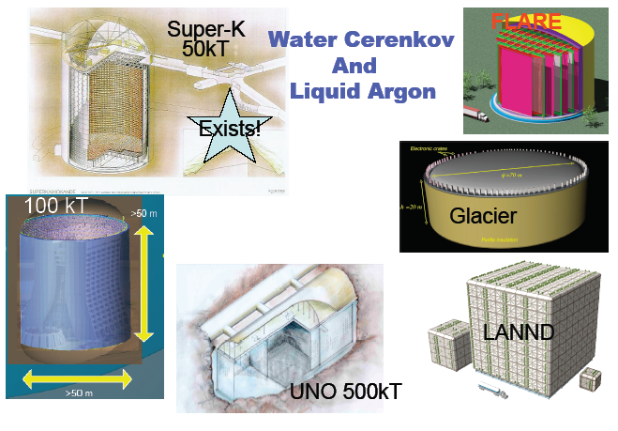
Ingredients for achieving the ultimate goals (1)
We need Statistics : Massive Detectors!
  Massive Detectors (Liquid Argon,Water Cherenkov, Liquid
  Scintillator, etc) that are scalable in the XXX Kt scale

Slide 15

LAr Neutrino Events : (MC)
ν_{e} Signal
πº Background

Slide 16
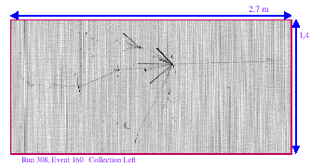
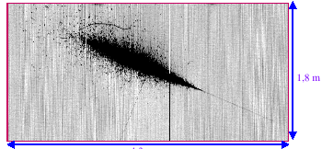
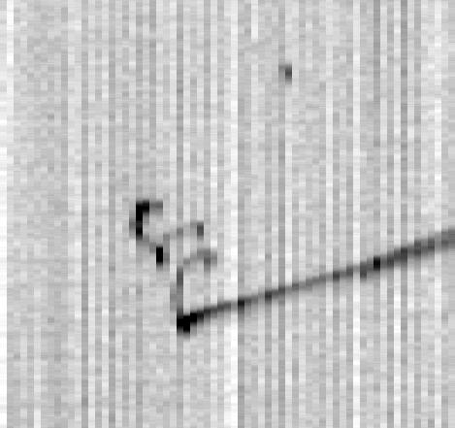
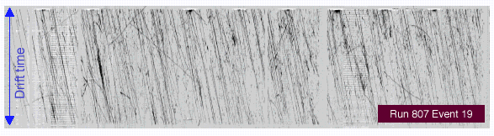
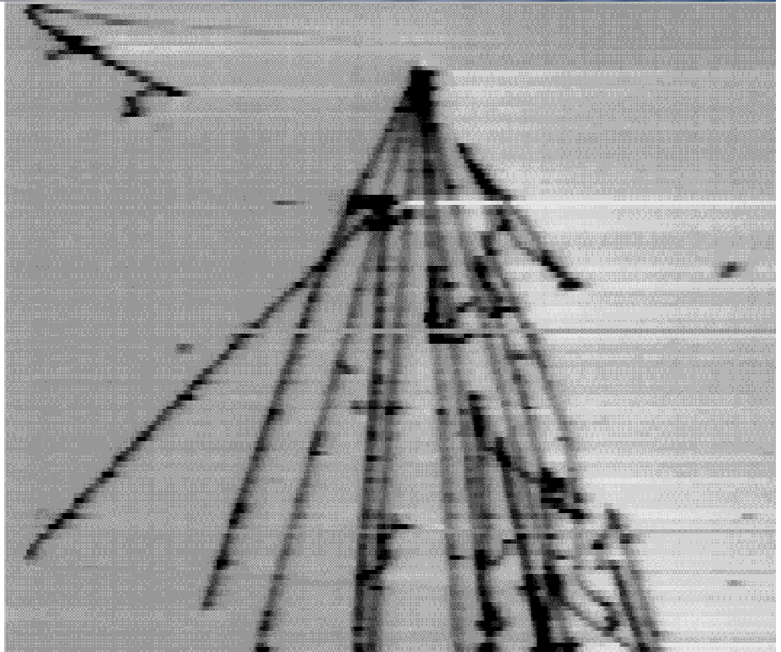
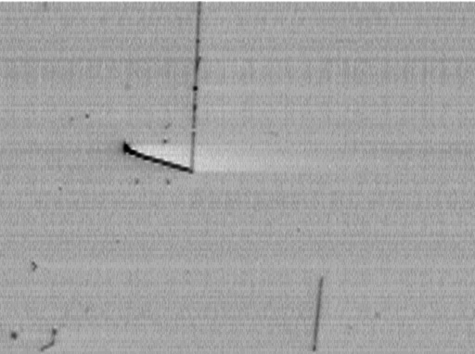
ICARUS T600 : Neutrino Events (Data)
Hadronic interaction
EM shower
(2.5 MeV)
e⁺ e⁻ pair (24 MeV)
Muon bundle
e₁ (9 MeV)
μ
Collection view

Slide 17
Water Cherenkov : Neutrino Events (MC)
ν_{e} Signal
πº Background

Slide 18
Water Cherenkov vs Liquid Argon Detectors
All detector technologies are challenging, for the sizes we are interested in, and both have :
Advantages AND Disadvantages
Water Cherenkov:
Proven technology Low efficiency
@ 50kT Scale : SuperK Low Background Rejection
Need large underground caverns
Liquid Argon :
High efficiency Not proven
High Background Rejection technology at large scale
Need smaller underground caverns
Working on shallower depths
or in the surface(?)

Slide 19
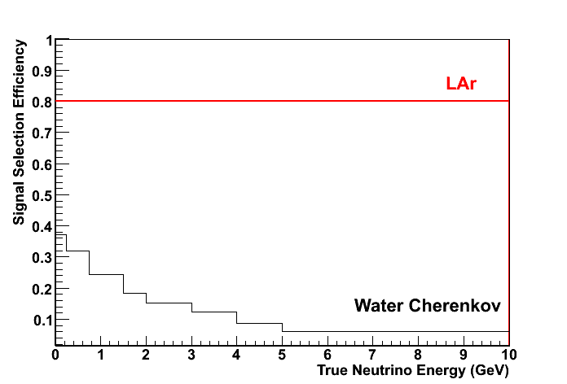
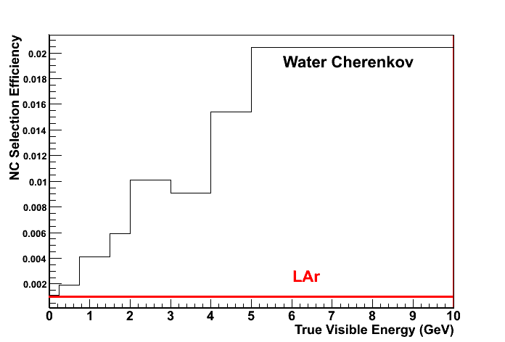
Comparison of Water Cherenkov and LAr detector technologies
Given their assumed efficiencies and background rejections the following :
“Detector Mass Equivalent Law” holds, which has been independently checked by two groups (BNL and FNAL)
1 : ~4
OR
100kt LAr ~ 400 kt WC
Indicative
Signal Efficiency
NC Contamination
Indicative

Slide 20
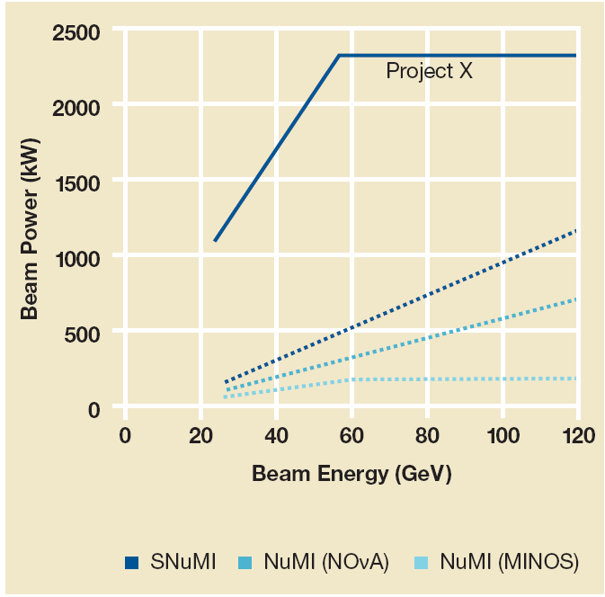
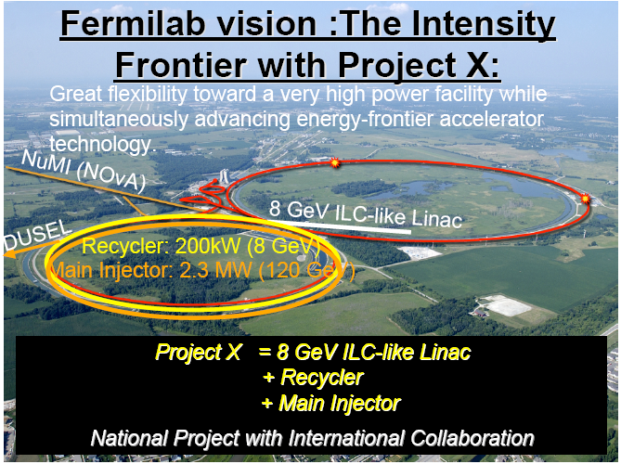
Ingredients for achieving the goals of Phase II: Powerful Neutrino Beams, Project X (US)
We need Statistics : Powerful Beams!
  Two options for neutrino beams and experiment baselines exist in the US since it is a big country…

Slide 21
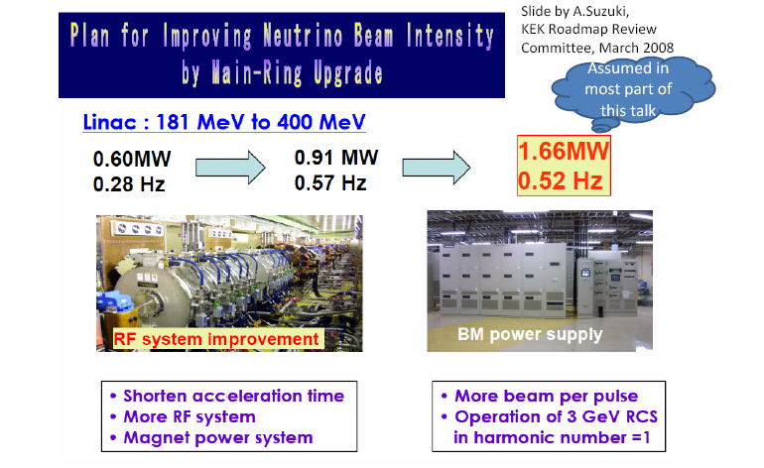
Ingredients for achieving the goals of Phase II: Powerful Neutrino Beams, JPARC (JAPAN)

Slide 22
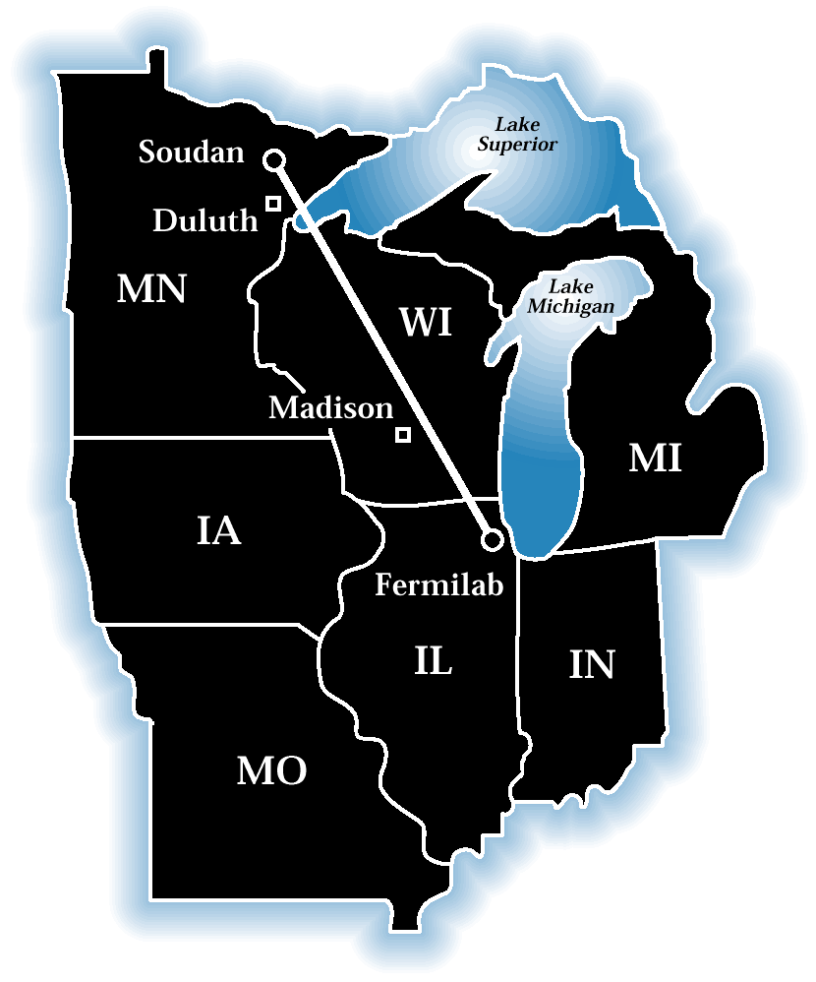
Neutrino beam and experiment baselines :
Two Options for Baselines,two Beams(US)
(A) L ~800 Km and
NuMI Off Axis Narrow Band Beam.
Implications on Detector Technology:
If detector not in Soudan Mine, then it has to be on the ~ surface :
Water Cherenkov detectors not an option for that reason.
LAr TPCs need to be able to operate ~ surface.
Implications on ν beam and baseline :
If L >>> 800 km then NuMI beam axis many km above ground, so beam can only be off Axis Narrow Band Beam.

Slide 23
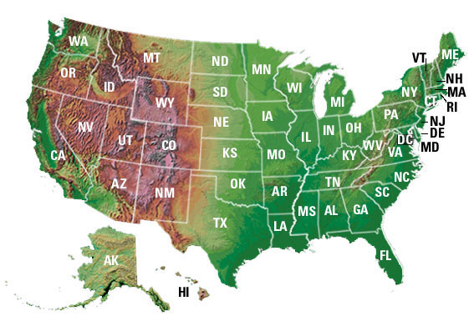
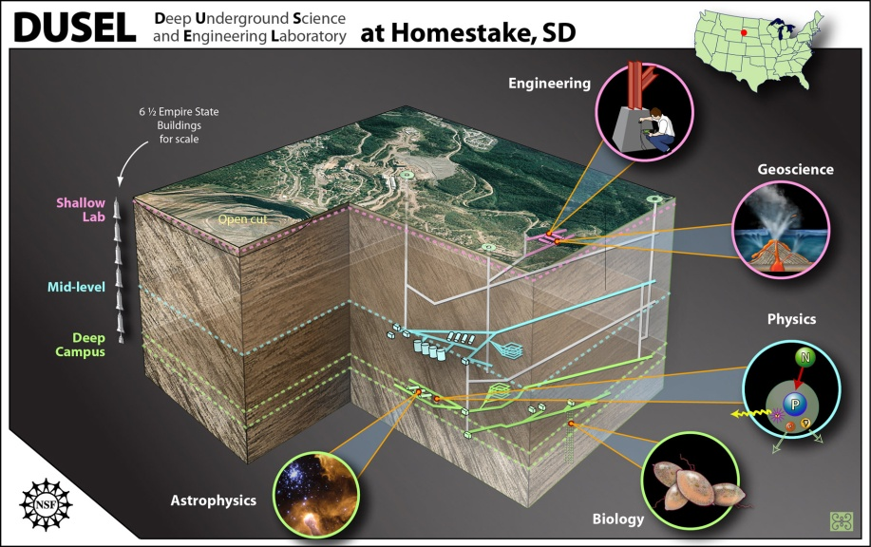
Neutrino beam and experiment baselines :
Two Options for Baselines,two Beams(US)
Soudan, Ash River
(B) L ~ 1300 Km (Fermilab-> DUSEL)
New On Axis Wide Band Beam
Implications on Detector Technology:
Water Cherenkov
(Homestake Mine at 4850 ft level )
OR LAr TPC
(Homestake Mine 300 ft level, or ~ surface)
Implications on ν beam :
New beam has to be designed and constructed
DUSEL
FNAL

Slide 24
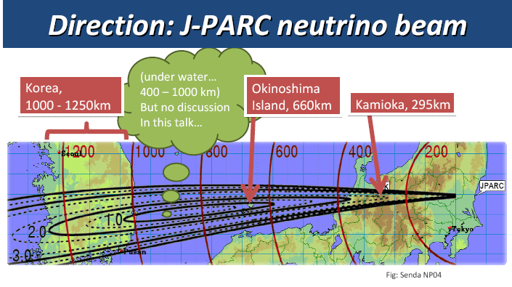
Neutrino Beams and Experiment Baselines: Three options for Baselines, One beam (JAPAN)

Slide 25
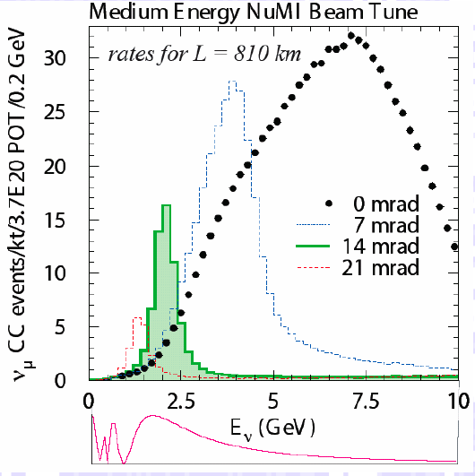
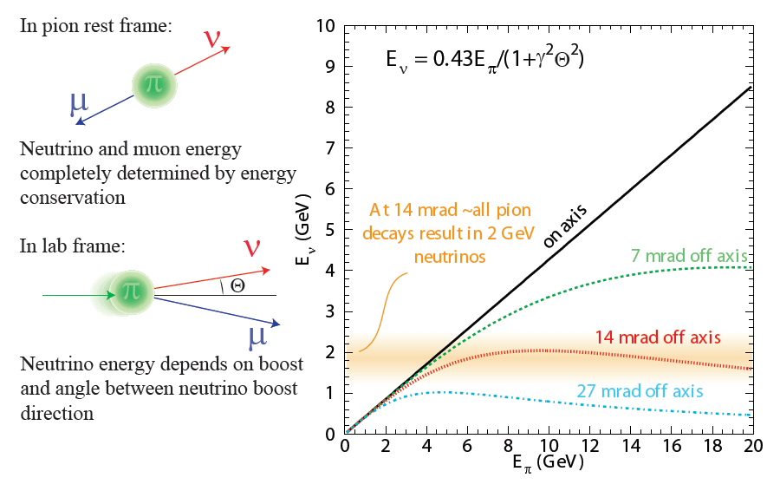
Off Axis Neutrino Beam: Capabilities & Advantages
The Beams (NUMI and JPARC) exists
There is a well defined upgrade plan
The off – axis idea of obtaining a NBB is attractive: It reduces the NC background resulting from high energy neutrinos.

Slide 26
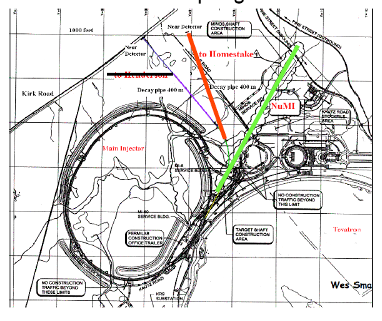
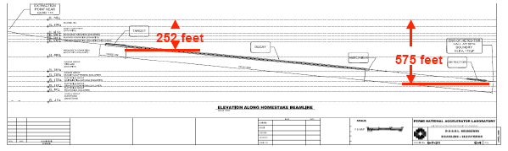
Wide Band Neutrino Beam in the US : Status
Such beam does not exist, but is in the design phase.
In general, design of target station and horns for beam power > 1 MW non trivial (R&D needed)

Slide 27
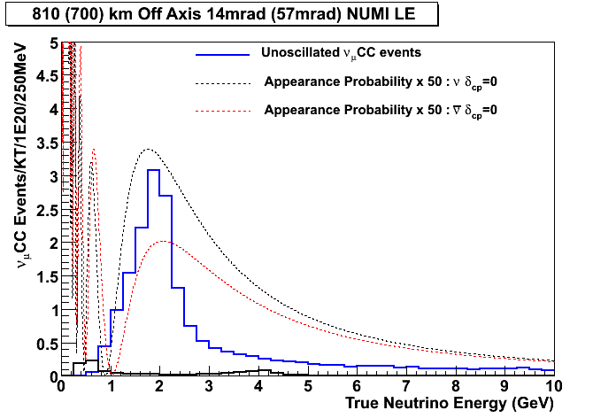
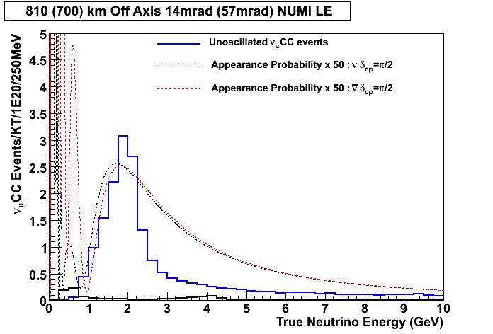
Wide Band Neutrino Beam: Advantages
ON AXIS WBB : 1st and 2nd Oscillation Maxima 1 Detector
δcp = 0
δcp = π/2
OFF AXIS NBB : 1st and 2nd Oscillation Maxima 2 Detectors
δcp = 0
δcp = π/2

Slide 28
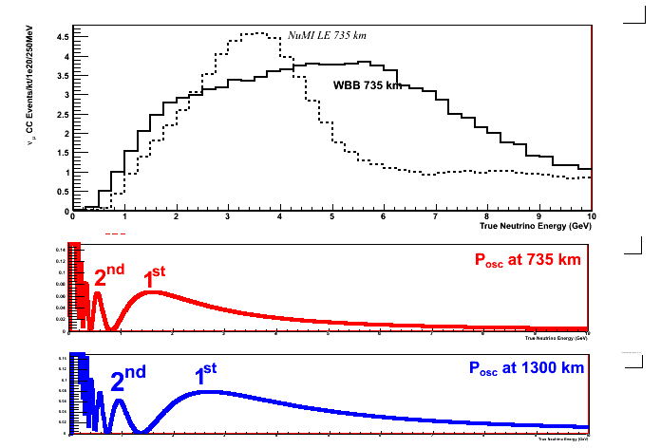
Longer baseline (>>L) AND a new Wide Band Beam : What can they do for us???
With new Wide Band Beam :
1)Increase “useful” flux (at first and second oscillation maxima)
2)With increasing L oscillation maxima “appear” in more “favourable” positions in the neutrino energy spectra
3)Thus study of first and second oscillation maxima is easier (one detector instead of two, higher rates, etc)
4) With increasing L matter effects increase and hence potential for mass hierarchy determination is increasing

Slide 29
Discovery Potentials:Technical details
θ₁₃ Discovery Potential :
Null hypothesis : θ₁₃ = 0
Both δ_{cp} and sign of Δm²₃₁ allowed to float in the fit
δ_{cp} Discovery Potential :
Null hypothesis : δ_{cp} = 0 or δ_{cp} = π (take worst χ²)
Both θ₁₃ and sign of Δm²₃₁ allowed to float in the fit
Mass Hierarchy Discovery Potential :
Fit the energy spectrum to θ₁₃ , δcp and both signs of Δm²₃₁ in order to determine
Δχ² = χ²_{true hierarchy}- χ²_{false hierarchy}
*We do not fix the mass hierarchy in any of the Discovery Potentials shown, which corresponds to the “worst case scenario”.
** We assume 5% systematic error on the background
*** We do not let the rest of the oscillation parameters float.

Slide 30
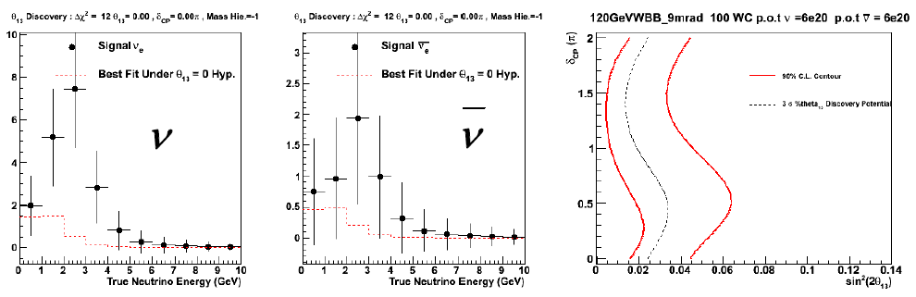
ν Oscillations : Example of measurement
True Point
Black : Data
Red Dotted : Null Hypothesis ( θ₁₃ = 0)
Black Dotted Line : 3 σ Sensitivity
Red Lines : 90% C.L. contour from the fit to the data on the left
With this data we are able to exclude the hypothesis that θ₁₃ = 0 to high significance : Δχ² = 12 => Significance = 3.5 σ
This is why this true point we choose is to the right of the 3 σ sensitivity curve on the right panel, and quite close to the 3 σ limit.

Slide 31
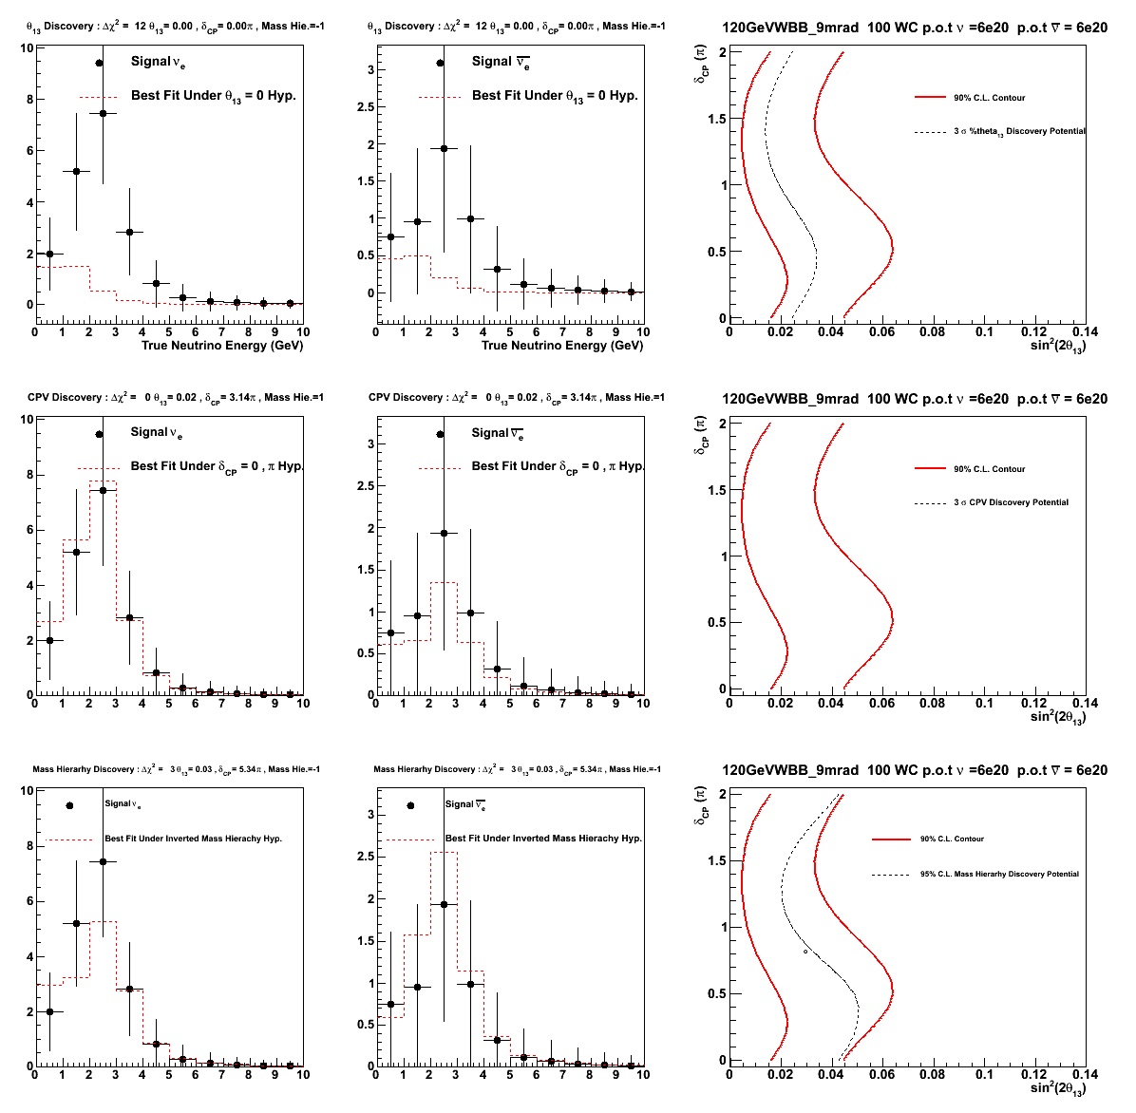
ν Oscillations : Example of measurement
Black : Data Red : Null Hypothesis
Parameter
Discovery
θ₁₃
YES
CPV
NO
Mass Hierarchy
NO

Slide 32
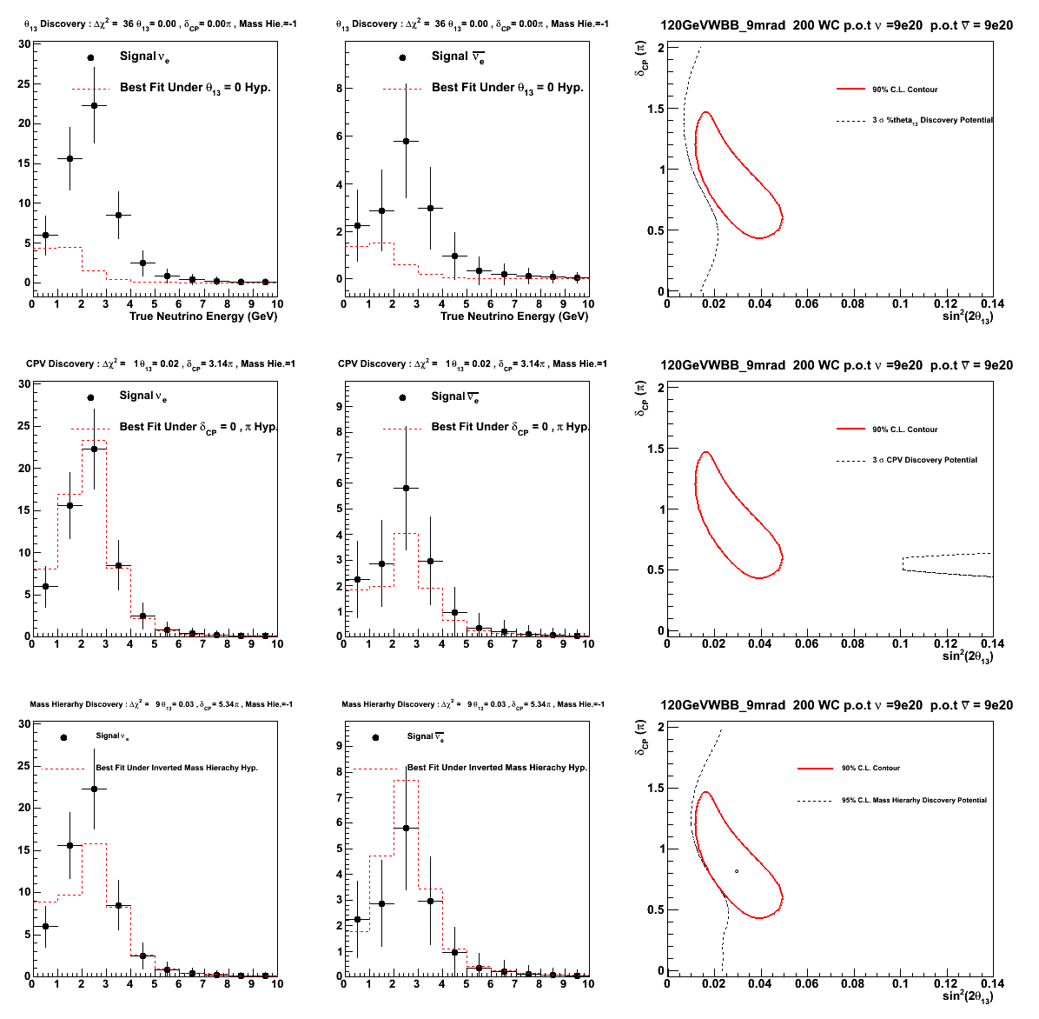
ν Oscillations : Example of measurement
Black : Data Red : Null Hypothesis
Parameter
Discovery
θ₁₃
YES
CPV
NO
Mass Hierarchy
YES

Slide 33
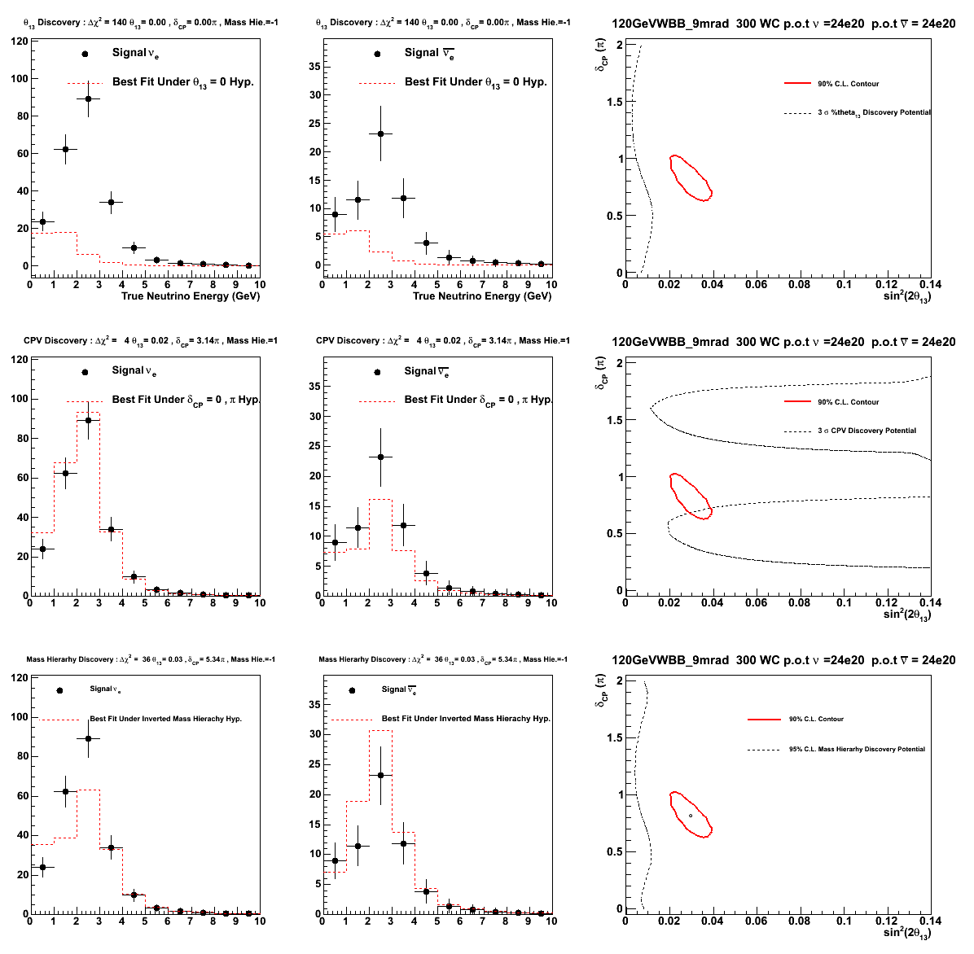
ν Oscillations : Example of measurement
Black : Data Red : Null Hypothesis
Parameter
Discovery
θ₁₃
YES
CPV
NO
Mass Hierarchy
YES

Slide 34
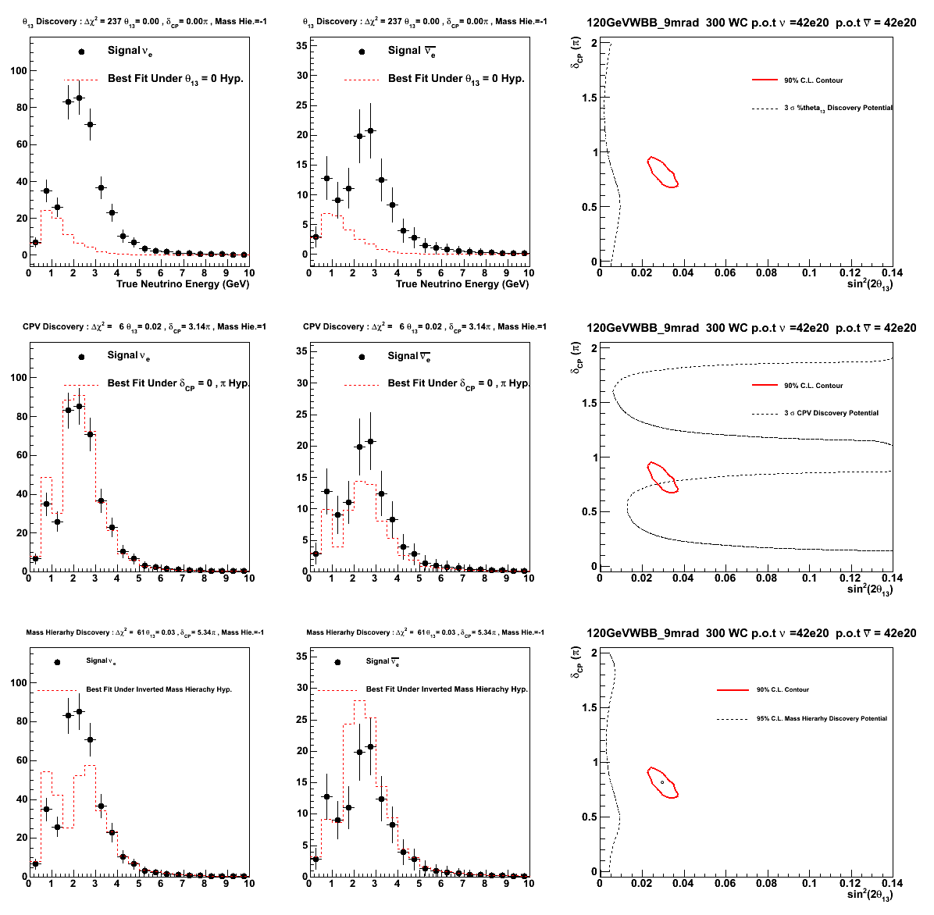
ν Oscillations : Example of measurement
Black : Data Red : Null Hypothesis
Parameter
Discovery
θ₁₃
YES
CPV
NO
Mass Hierarchy
YES

Slide 35
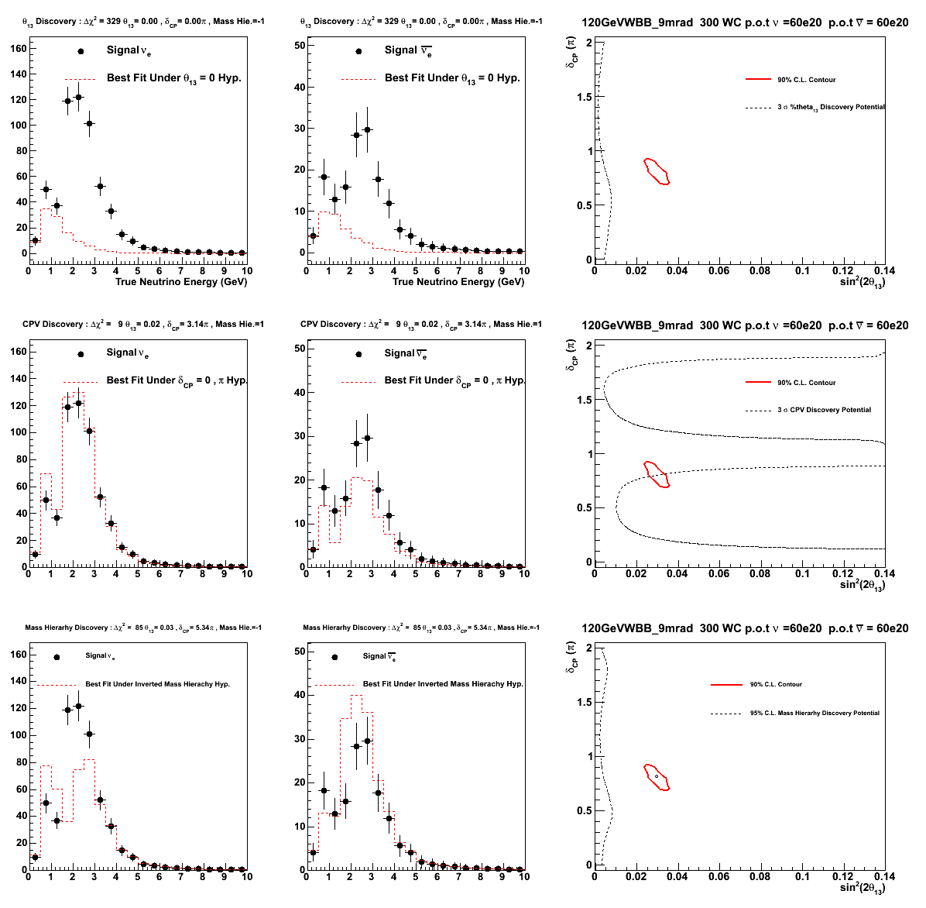
ν Oscillations : Example of measurement
Black : Data Red : Null Hypothesis
Parameter
Discovery
θ₁₃
YES
CPV
YES
Mass Hierarchy
YES

Slide 36
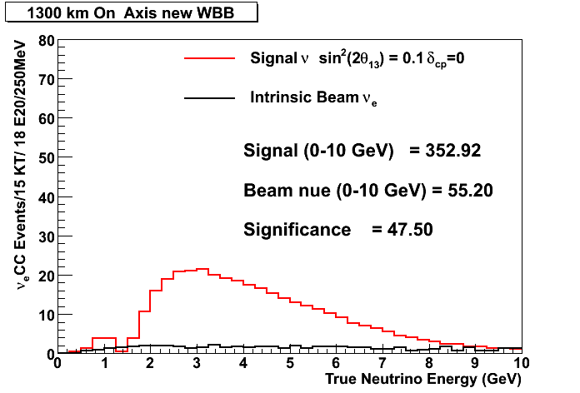
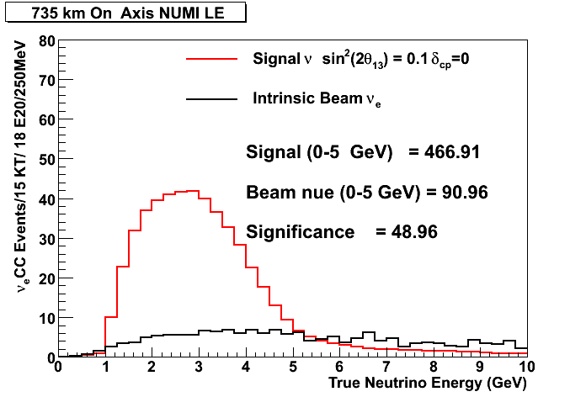
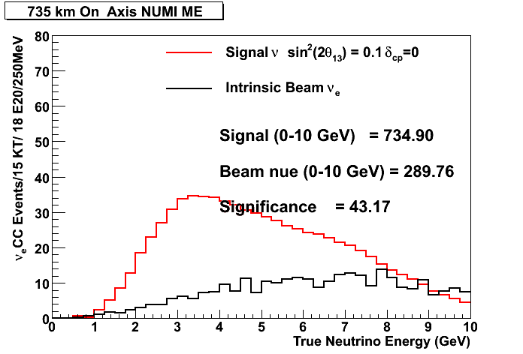
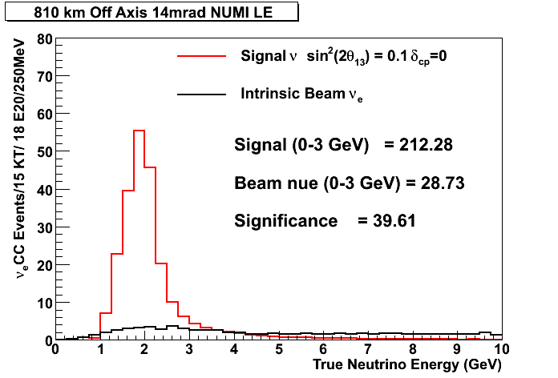
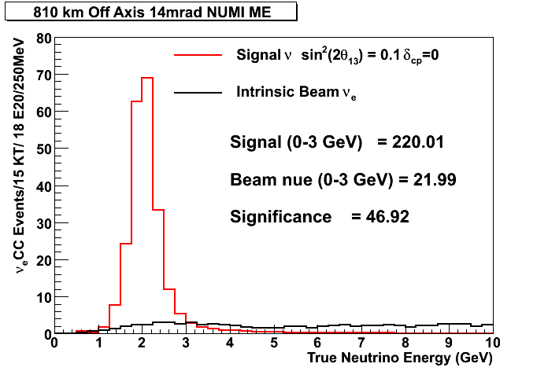
Neutrino beams @ different on–off axis locations we consider in order to define the Future Strategy (US)
On-Axis 1300km new WBB
On Axis 735km NuMI LE
On Axis 735km NuMI ME
Disappearance minimum (appearance maximum) at given Δm₂₃²: Signal events do not scale as 1/L², backgrounds do.
Off Axis NuMI LE
Considered all these options with various Detector Technologies and Beam Powers and concluded on a possible staged approach to get to the physics of interest
Off Axis NuMI ME

Slide 37
Staged approach to achieve the ultimate goals (US)
1) Start with NuMI off Axis beam at 810 km (NOvA) and 700 KW
2) Upgrade detector, ie add 5kt LAr with NuMI on Axis Beam at 735 km and 700 KW (equivalent to increasing statistics. Equivalent to ~doubling NOvA, with the benefit of proving or not a promising detector technology that is scalable)
3) Increase Beam Power : Project X yields 2.3 MW , (equivalent to increasing statistics)
4) Improve the Neutrino Beam (new WBB), Increase Detector Mass (equivalent to increasing statistics) and Increase Baseline

Slide 38
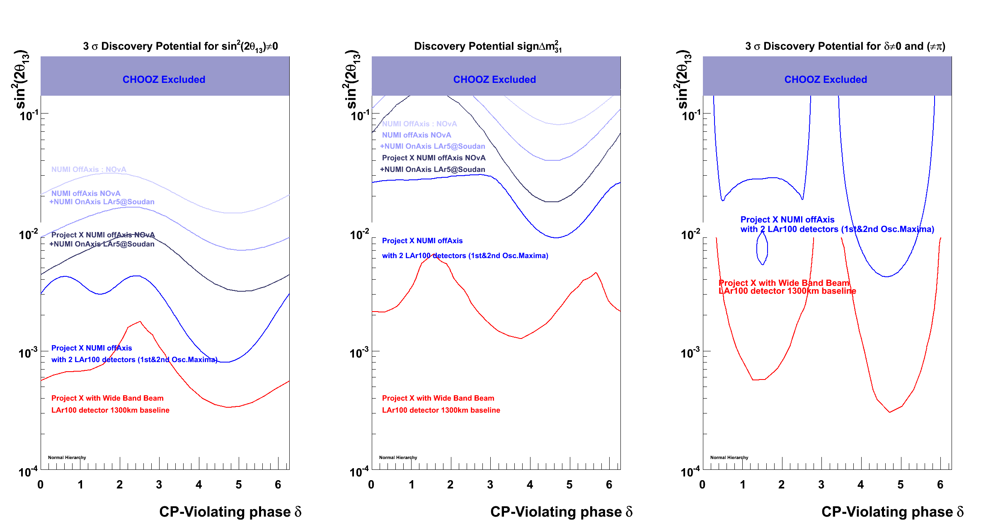
Physics Reach : FNAL with one 100KT Lar Detector in DUSEL
NOvA - NOvA+5ktLAr - NOvA+5ktLAr+PX - NOvA+100kt LAr +PX 100ktLAr (OR 500kt WC) +New WBB+PX at DUSEL

Slide 39
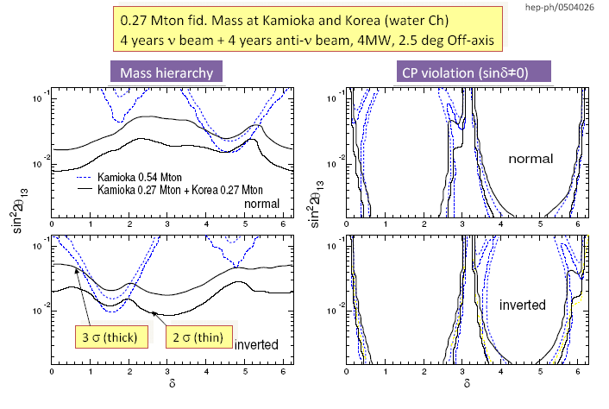
Physics Reach : JPARC with two 0.27 MT WC in Kamioka and Korea

Slide 40
Summary
We have learned (and are still learning) a lot with respect to neutrino masses and mixings …
In the near future we hope to have new “POSITIVE” results on θ₁₃ from Double CHOOZ , Day Bay, T2K and NOvA.
The next generation of accelerator neutrino oscillation experiments will try to DEFINITIVELLY address the following very challenging questions:
    What is the value of the third mixing angle θ₁₃ ?
    Is θ₂₃ exactly 45 degrees or not?
    What is the ordering of the neutrino masses ?
    Is CP Violated in the neutrino sector ?
To address the above questions we need very intense neutrino beams and massive detectors. Both JAPAN and US are developing future strategies in order to perform these measurements should Nature turns out to be kind and θ₁₃ is not “experimentally” zero …

Slide 41
Backup

Slide 42
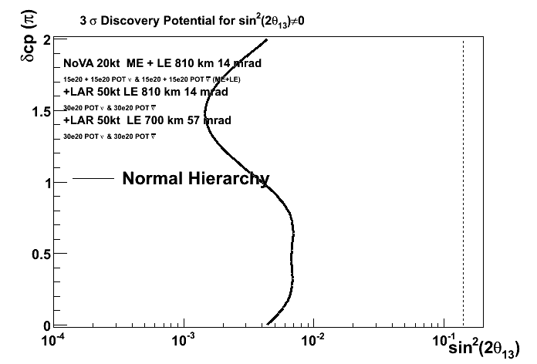




BNL- FNAL Joint Study: θ₁₃ discovery potential
If the same detector technology used , off axis NBB and on axis WBB approaches give ~similar reach
NuMI Off Axis 50 kt LAr 1st Max.+ 50 kt LAr 2nd Max.
NuMI Off Axis 100 kt LAr
WBB On Axis 300 kt WC
WBB On Axis 100 kt LAr
100kt of LAr equivalent with > 300 kt of Water Cherenkov

Slide 43




BNL- FNAL Joint Study: δ_{CP} discovery potential
If the same detector technology used :
On Axis WBB has much higher reach on CP Violation due to
more information on 2nd oscillation maximum and
b) higher L that increase matter effects.
NuMI Off Axis 50 kt LAr 1st Max.+ 50 kt LAr 2nd Max.
NuMI Off Axis 100 kt LAr
100kt of LAr equivalent with > 300 kt of Water Cherenkov
WBB On Axis 300 kt WC
WBB On Axis 100 kt LAr

Slide 44




BNL- FNAL Joint Study: mass hierarchy discovery potential
If the same detector technology used :
On Axis WBB has much higher reach on the mass hierarchy due to
more information on 2nd oscillation maximum and
b) higher L that increase matter effects.
NuMI Off Axis 50 kt LAr 1st Max.+ 50 kt LAr 2nd Max.
NuMI Off Axis 100 kt LAr
100kt of LAr equivalent with > 300 kt of Water Cherenkov
WBB On Axis 300 kt WC
WBB On Axis 100 kt LAr

Slide 45
100 kt LAr
BNL Globes
300 kt WC

Slide 46

LAr5 @ SOUDAN (LE)

Slide 47

LAr5 @ L = 1300 km

Slide 48



The effect of longer baseline (>>L) and a new Wide Band Beam
- With increasing L oscillation maxima (and minima) “appear” in more “favourable” positions in the neutrino energy spectra (higher energies),
- Thus study of first and second oscillation maxima is easier (one detector instead of two, higher rates, etc)

Slide 49

NuMI Neutrino Beam: Capabilities & Advantages
Plot courtesy : B. Zwaska
Project X
SNUMI
ANU
There exists a well defined upgrade plan for the NuMI Beam
With Project X, beam power and hence neutrino beam intensity can increase by a factor of 3 with respect to ANU

Slide 50


The effect of longer baseline (>>L) and a new Wide Band Beam with the same detector and the same exposure :
Example : 30 kt of Lar, 700 KW Beam Power,
3 year of neutrino + 3 years of anti-neutrino running
BLUE : NuMI 735 km On Axis RED : WBB 735 km On Axis BLACK : WBB 1300 km On Axis

Slide 51
Detector Technologies & Capabilities
Liquid Scintillator (NOvA) :
- Signal selection efficiency : 27% (fiducial volume efficiency included)
- NC contamination ~ 0.5% for the off axis Beam concept.
LAr and Water Cherenkov :
- Signal selection efficiency : 80% LAr , ~15% WC (After fiducial volume)
- Practically no NC contamination for LAr, NC contamination at the ~ 1-2% for Water Cherenkov ( assuming 1-2% NC contamination for LAr as well does not introduce a big difference in sensitivities)
No energy smearing, true visible energies used :
For the NuMI off axis Beam no energy binning is used (normalization information only)
For the WBB 250 MeV bins are used (shape+normalization information)

