Slide 1
Vacuum Design and Analysis
Beth Klein
Primary Vacuum Preliminary Design Review
March 10, 2020

Slide 2
Agenda
Overview of Vacuum Layout
Vacuum Profile Plots
Magnet and Device Interfaces
Typical Weldment Drawings
Instrumentation and Controls
Compressed Air and Nitrogen
Turbocart Design
Main Injector Interface

Slide 3
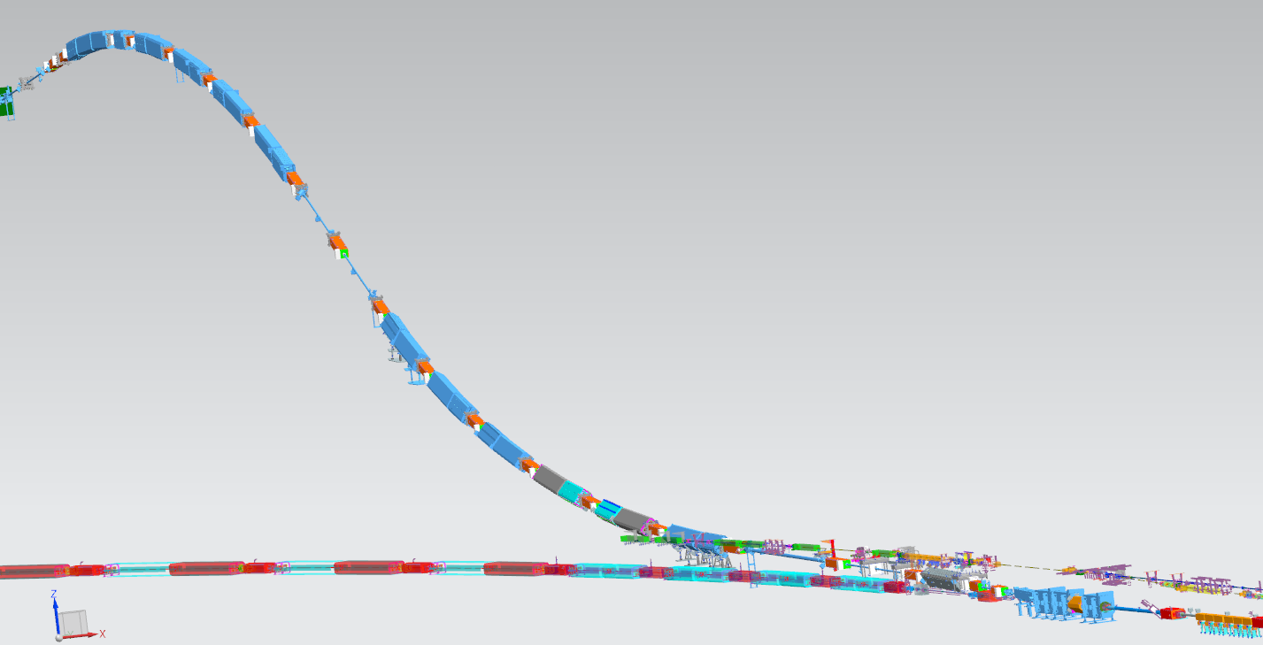
Primary Beamline Vacuum Sectors
BV214
BV221
BV210
BV203
Lambertsons
Kickers
Main Injector
Main Injector
BV200

Slide 4
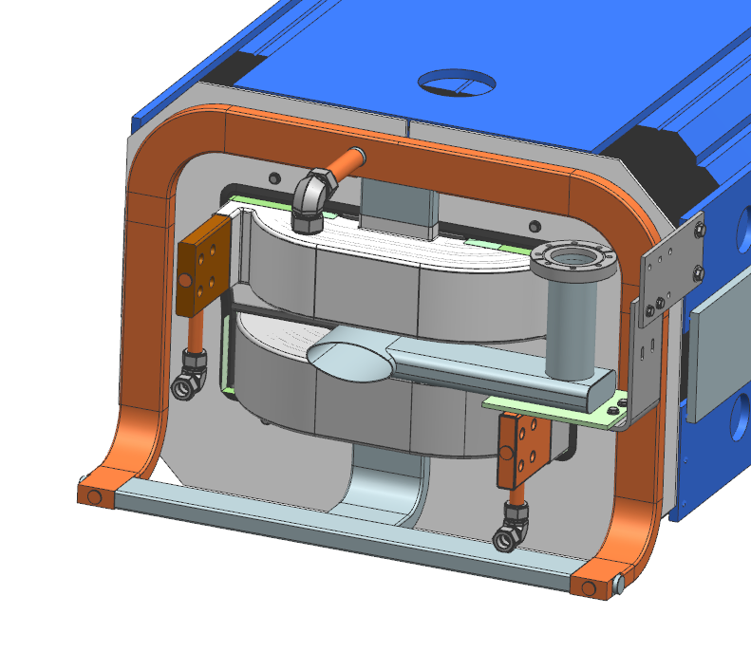
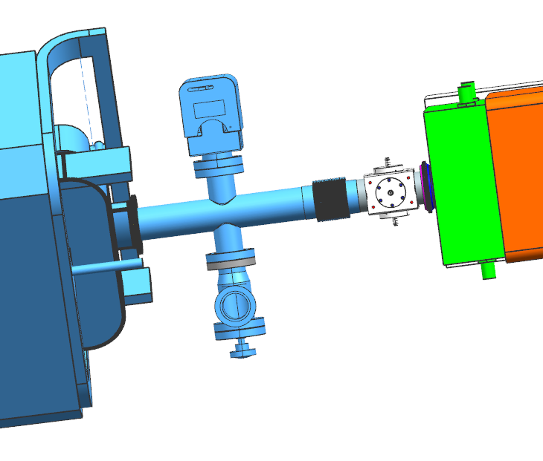
Vacuum Design
Mostly 3” tubing with some 4” tubing
Quadrupoles have 3” tube
Dipoles have MI elliptical tubing: 2.09”x4.84”
Dipole beam tube marked for early procurement
6” tube through the wall
Typical dipole pump port
Elliptical Tubing
Typical pump port
BPM
3” tubing
RF Slots

Slide 5
Primary Beamline Vacuum Profile
Vacuum system requirements:
Average total pressure of 1.0E-7 Torr or below
Maximum local total pressure of 1.0E-5 Torr or below
Assumptions:
Outgassing Rate = 1E-10 $\frac{Torr∙L}{s∙{cm}^{2}}$
316L SS tubing
No bake, ultrasonically cleaned
Results:
Average Pressure = 7.44E-8 Torr 7.79E-8 Torr
Maximum Local Pressure = 1.83E-7 Torr 1.91E-7 Torr
7.79E-08

Slide 6
Primary Beamline Vacuum Profile for 20% failed pumps
Vacuum system Specification:
Average total pressure of 1.0E-7 Torr or below in case of failure of up to 20% of total number of pumps
Assumptions:
Outgassing Rate = 1E-10 $\frac{Torr∙L}{s∙{cm}^{2}}$
316L SS tubing
No bake, ultrasonically cleaned
Results:
Average Pressure with 20% of pumps off = 1.34E-7 Torr
Local Maximum Pressure with 20% of pumps off = 2.98E-7 Torr
1.34E-07
7.79E-08

Slide 7
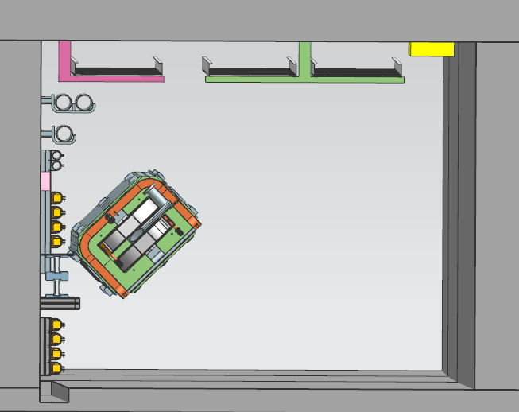
Primary Beam Enclosure Tunnel Cross Section
Cable Trays
Dipole Magnet

Slide 8
Magnet and Device Interfaces
All flanges will use metal seals
Magnet/Device | Interface 1 | Interface 2 | Quantity of Device/Magnet
Dipole A | Transition Plate - Elliptical to 6" | Transition Plate - Elliptical to 3" | 13
Dipole D | EVAC Flange ISO 160 | Transition Plate - Elliptical to 3" | 12
Quadrupole - 3Q60 | 4" QD Flange |  | 4
Quadrupole - 3Q120 | 4" QD Flange |  | 17
Lambertson | 19" QD Flange |  | 3
Kicker | 6" Conflat flange |  | 6
C-magnet | 4" QD Flange |  | 1
Corrector magnet | Beam tube captured by aperture |  | 23
Multiwire | 4" QD Flange |  | 12
BPM | 4" QD Flange | Welded 3" OD Beam Tube | 24
Toroid | 4" QD Flange |  | 2
Wall Current Monitor | 4" QD Flange |  | 1
Gate Valve | 6" Conflat flange |  | 5
Beam Window | 4" QD Flange |  | 1

Slide 9
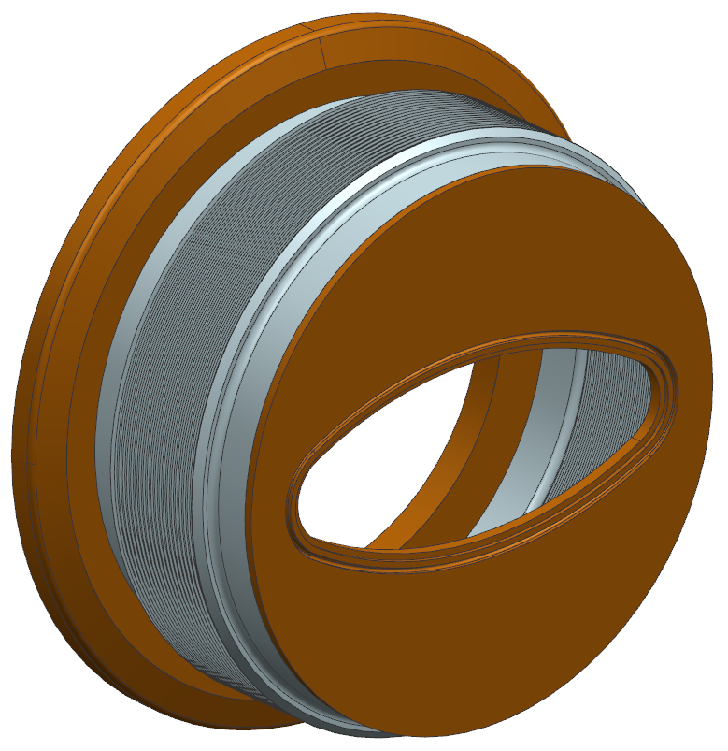
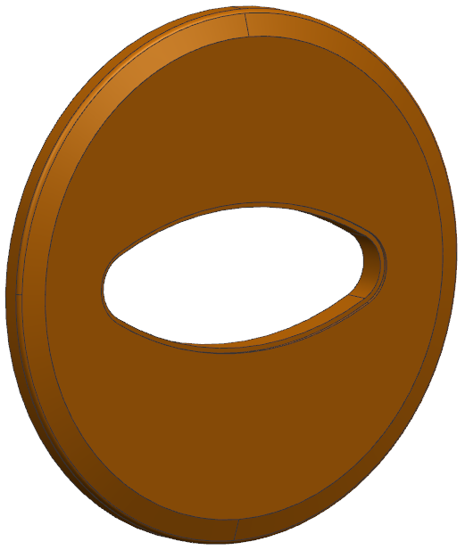
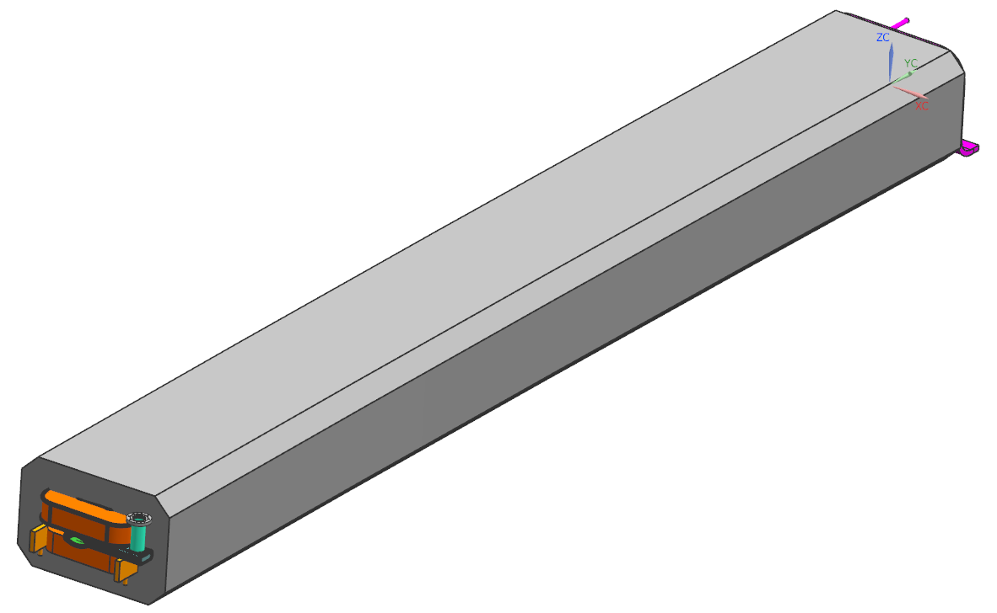
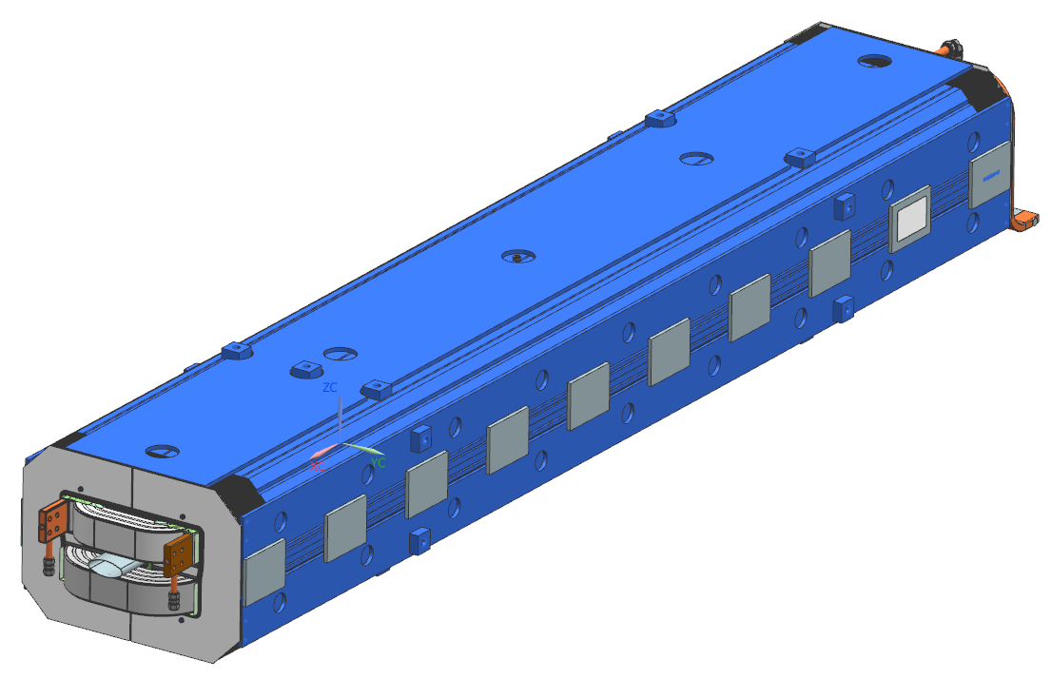
Dipole Beam Tube
Dipole A - Transition plate and then bellows and EVAC flange will be welded prior to bringing in tunnel
Dipole D - EVAC flange will be welded on dipole beam tube prior to bringing in tunnel
Elliptical to transition plate – inside weld
Dipole D
Dipole A

Slide 10
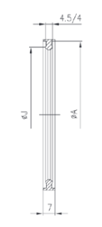
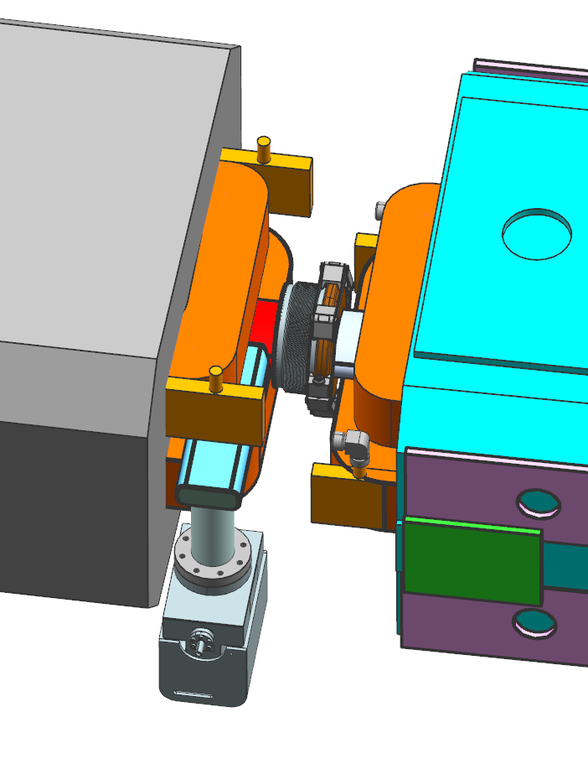
Dipole – Dipole Connection
Only flange will have to be made up in tunnel
Dipole A
Profile of knife edge seal
Transition Plate
Dipole D
EVAC Chain Clamp
6” Edge-Welded Bellows
EVAC Flanges

Slide 11
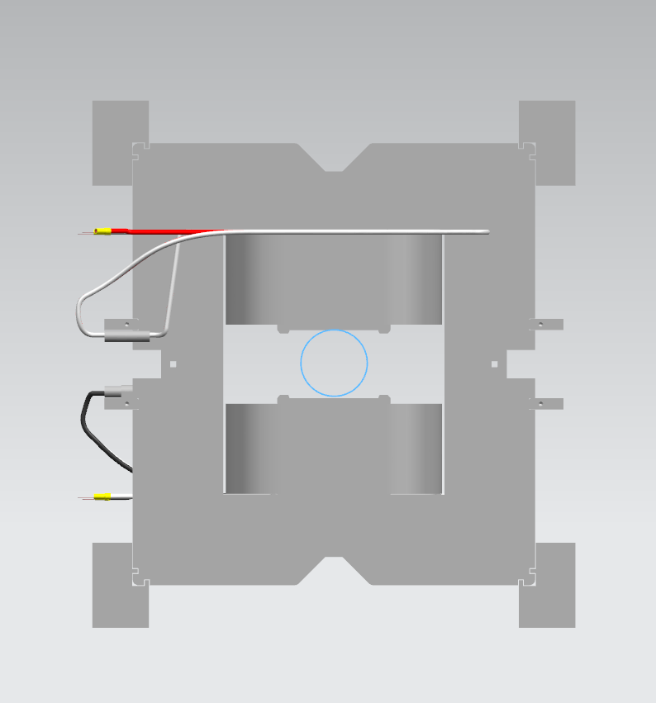
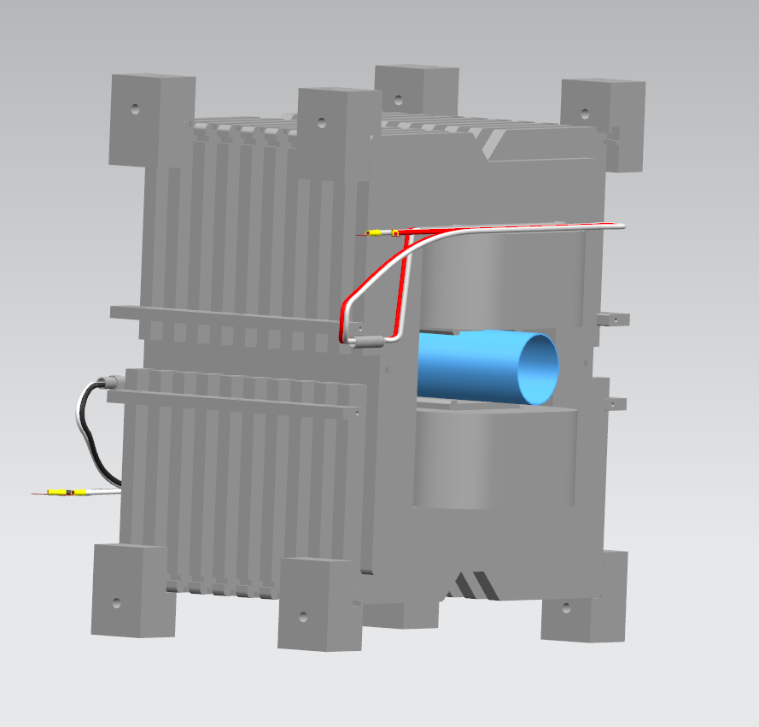
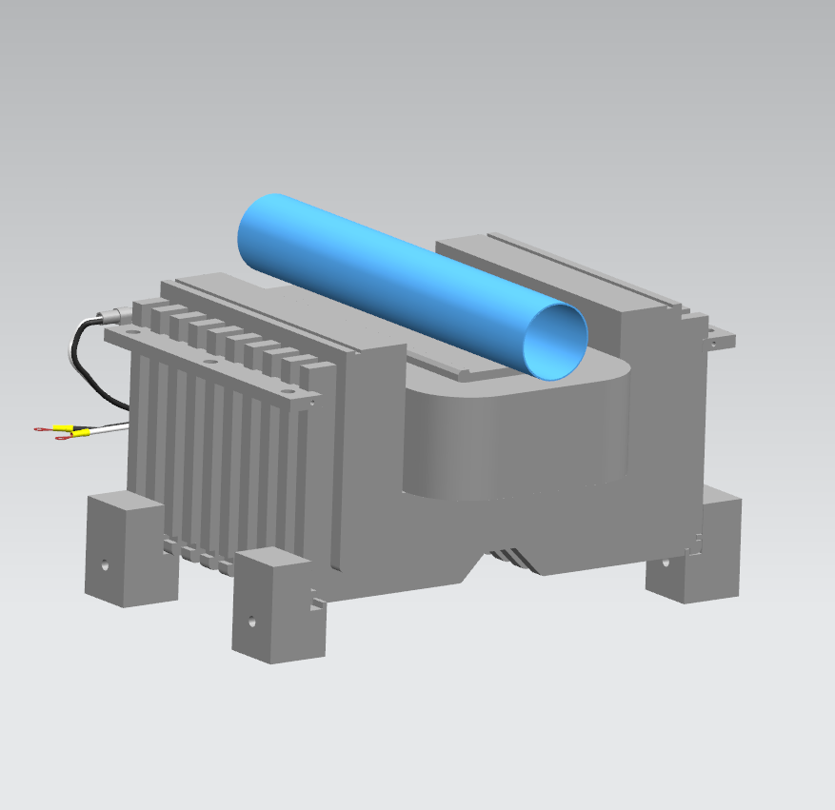
Corrector Magnet Interface
Magnet aperture equals beam tube OD and captures beam tube
Split magnet during installation

Slide 12
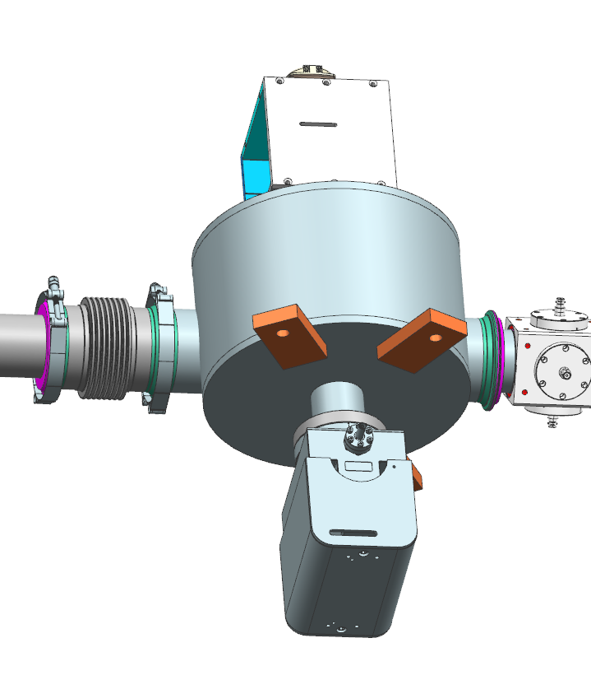
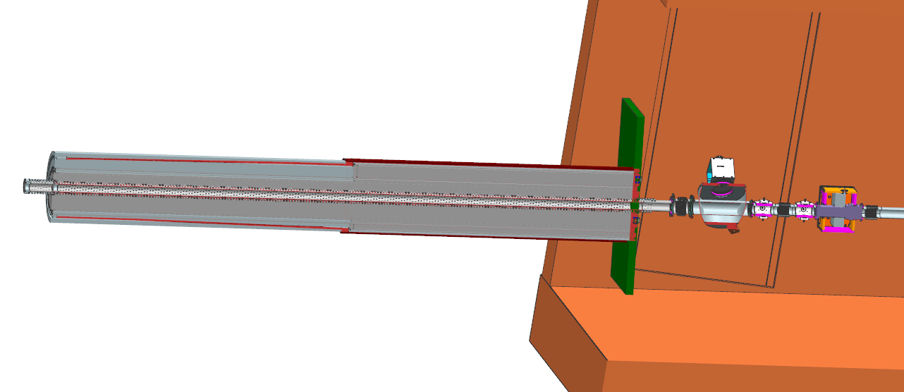
Primary Beam Window
Typical 4” QD Flange
LBNF Primary Beam Window
Target Hall US Wall
Beam

Slide 13
Wall Penetration Weldment

Slide 14
Typical Weldment Drawing

Slide 15
Instrumentation and Controls
Name | Device
IP101D1 | Lambertson Ion Pump
IP101D2
IP101D3
IP101D4
IP102A1 | Lambertson Ion Pump
IP102A2
IP102A3
IP102A4
IP102B1 | Lambertson Ion Pump
IP102B2
IP102B3
IP102B4
BV200 | Gate Valve
IP200 | 45 L/s Ion Pump
PG200 | Pirani Gauge
 | Turbo Cart Valve
IP201A | 45 L/s Ion Pump
IP201B | Ion Pump
IP201C | Ion Pump
IP202A | Ion Pump
IP202B | Ion Pump
 | Turbo Cart Valve
PG202 | Pirani Gauge
IP203A | 200 L/s Ion Pump
IP203B | 200 L/s Ion Pump
BV203 | Gate Valve
PG203 | Pirani Gauge
IP2040 | 45 L/s Ion Pump
IP2041 | 45 L/s Ion Pump
IP2042 | 45 L/s Ion Pump
 | Turbo Cart Valve
IP2051 | 45 L/s Ion Pump
IP2052 | 45 L/s Ion Pump
IP2060 | 45 L/s Ion Pump
IP2061 | 45 L/s Ion Pump
IP2062 | 45 L/s Ion Pump
IP2071 | 45 L/s Ion Pump
IP2072 | 45 L/s Ion Pump
IP2080 | 45 L/s Ion Pump
IP2081 | 45 L/s Ion Pump
IP2082 | 45 L/s Ion Pump
 | Turbo Cart Valve
Name (cont) | Device (cont)
IP2091 | 45 L/s Ion Pump
PG209 | Pirani Gauge
IP2092 | 45 L/s Ion Pump
BV210 | Gate Valve
IP210A | 45 L/s Ion Pump
PG210 | Pirani Gauge
IP210B | 45 L/s Ion Pump
IP211A | 45 L/s Ion Pump
 | Turbo Cart Valve
IP211B | 45 L/s Ion Pump
IP211C | 45 L/s Ion Pump
IP2120 | 45 L/s Ion Pump
IP2121 | 45 L/s Ion Pump
IP2122 | 45 L/s Ion Pump
 | Turbo Cart Valve
IP2131 | 45 L/s Ion Pump
PG213 | Pirani Gauge
IP2132 | 45 L/s Ion Pump
IP2140 | 45 L/s Ion Pump
IP2141 | 45 L/s Ion Pump
IP2142 | 45 L/s Ion Pump
BV214 | Gate Valve
IP2151 | 45 L/s Ion Pump
PG215 | Pirani Gauge
IP2152 | 45 L/s Ion Pump
IP2160 | 45 L/s Ion Pump
IP2161 | 45 L/s Ion Pump
 | Turbo Cart Valve
IP217A | 45 L/s Ion Pump
IP217B | 45 L/s Ion Pump
IP217C | 45 L/s Ion Pump
IP219A | 45 L/s Ion Pump
IP220A | 45 L/s Ion Pump
IP221A | 45 L/s Ion Pump
IP221B | 45 L/s Ion Pump
 | Turbo Cart Valve
IP222A | 45 L/s Ion Pump
IP222B | 45 L/s Ion Pump
PG222 | Pirani Gauge
BV221 | Manual Gate Valve
PG223 | Pirani Gauge
 | Turbo Cart Valve
IP223A | 45 L/s Ion Pump
Pneumatic Gate Valves
LBNF line is broken into 4 vacuum sectors by gate valves
Sector lengths: 56m, 100m, 70m, 85m
All metal gate valve DS of Lambertsons
Last gate valve is manual
Right angle Valves
2 per sector plus 1 after last gate valve
All metal valve DS of Lambertsons

Slide 16
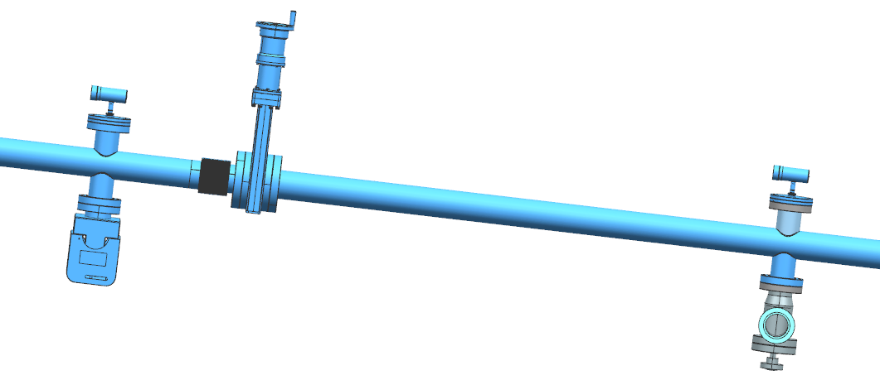
Instrumentation and Controls
PLC controlled, ethernet where possible
Cables
Cable trays will be used to run cables to LBNF-5 Controls Room
This includes MI extraction items (Lambertson pumps, BV200, Pirani’s, etc)
Cable lengths range from 300 to 1100 feet
Ion pumps
Ion pumps will read pressures - no ion gauges
All 45 l/s except (2) 200 l/s on each side of wall mainly place 20’ apart
Pirani Gauges
2 per sector plus 1 after last valve
Pirani Gauge
Manual Gate Valve
Turbo Cart Valve
Ion Pump

Slide 17
Instrumentation and Controls
Interlocks
Main Injector/NuMI scheme will be used
The vacuum system will interlock section valves with pressure differential
2 sets of ion pumps in each sector for permitting
Alarms generated for average pressure
The vacuum system will interlock beam extraction with total pressure

Slide 18
Compressed Air and Nitrogen Systems
Compressed Air System
Design is similar to NuMI/NOvA and the Main Injector systems
Operates beamline vacuum gate valves
Incorporates small receiver tanks in the enclosure due to the length of the piping system (~ 1,000 ft)
Compressors and dryers located in LBNF-5
Nitrogen System
Used for letting up beamline vacuum
Nitrogen cylinders and manifold located in LBNF-5

Slide 19
Compressed Air System P&ID Drawing

Slide 20
Nitrogen System P&ID Drawing

Slide 21
Turbocart
Turbocart with 80/20 frame

Slide 22
Turbocart Components
Beamline
Beamline pump out port
70-90 L/s turbo pump
Cold cathode gauge
Pirani gauge
Turbo bypass valve
+/- 2” stroke bellows
Leak checking valve
Anti-suckback valve
500 L/min scroll pump
Turbocart with frame hidden and beamline section shown

Slide 23
Main Injector Interface
Changes to MI vacuum for LBNF extraction include:
Installing the Kicker magnets and Lambertson magnets
Switching location of wide aperture Q101 and 102
Removal of injection Lambertson upstream of Q101 – will no longer be injecting into MI from 8 GeV
Current MI
MI Lambertson
Q102
Q101
Q100
LBNF Lambertson Magnets
For LBNF extraction
LBNF Kicker Magnets

Slide 24
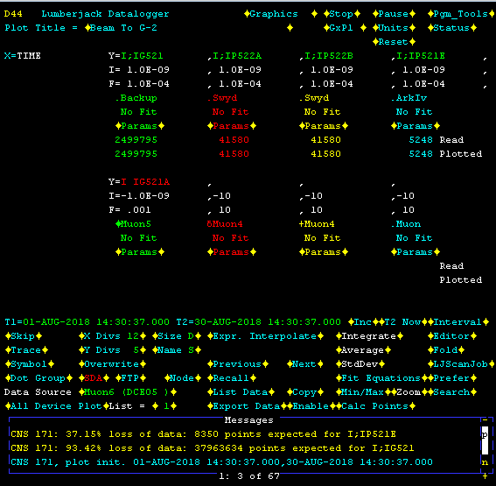
Lambertson Magnet Bakeout
August 2018 – Lambertson Magnet Bakeout in MI
Reusing NuMI ILA Lambertsons for LBNF
Ranges between 2E-8 Torr and 4E-9 Torr
Steady state vacuum after bake, no beam

Slide 25
Kicker Magnets Vacuum Profile
ITO coating: Outgassing Rate = 2.35E-11$\frac{Torr∙L}{s∙{cm}^{2}}$
Areodag: Estimated Outgassing Rate = 1.9E-11 $\frac{Torr∙L}{s∙{cm}^{2}}$
Stainless Steel: Outgassing Rate = 1E-10 $\frac{Torr∙L}{s∙{cm}^{2}}$
45 L/s pumps

