Slide 1
Introduction
Kevin L. Duel
Primary Vacuum Preliminary Design Review
March 10, 2020

Slide 2
Links to More Information
Indico event page (presentations):
https://indico.fnal.gov/event/23424/
DUNE DocDB 18159 preliminary design files:
https://docs.dunescience.org/cgi-bin/private/ShowDocument?docid=18159

Slide 3
Agenda
Introduction - Kevin
Technical Presentations – Beth, Kevin
Break
Cost & Schedule - Kevin
Summary, Questions & Discussion

Slide 4
Introductions
Many thanks to the Review Committee
Lucy Nobrega – Chair
Senior Engineer AD/MSD
Alex Chen
Principal Engineer AD/MSD
Denton Morris
Engineering Physicist III AD/MID
Thanks to the engineers, drafters, technicians, engineering physicists etc. who contributed to the material being presented today!

Slide 5
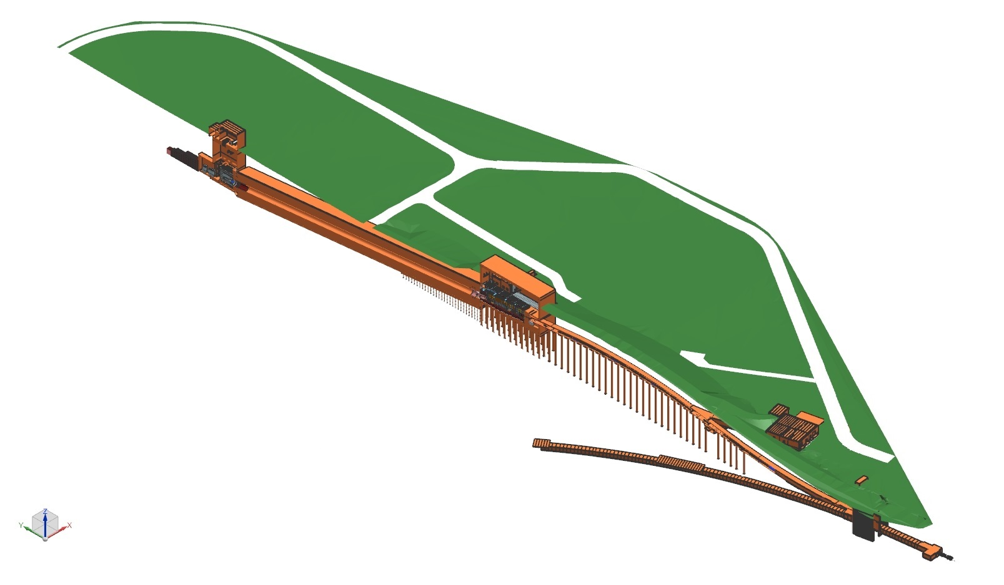
ISO Section View of Near Site – MI-10 to LBNF-30 Absorber Complex
Nu Beam
to SURF, SD
Area of vacuum system
Absorber Complex
Decay Pipe
LBNF-5 Service Building
Target
Complex
Primary
Beamline
Fermilab
Main Injector
Tunnel
Proton Beam
Extraction
Proton Beam
from MI-10

Slide 6
Installation Area of Vacuum System Overview – Primary Beamline Enclosure and LBNF-5
Vehicle Access Corridor (MVA)
LBNF-5 Service Building Controls Room & Pump Room (for compressed air, N₂)
DS End: Primary Beam Window
MI10 Alcove
Beamline Components
US Start: MI Kickers at Q100

Slide 7
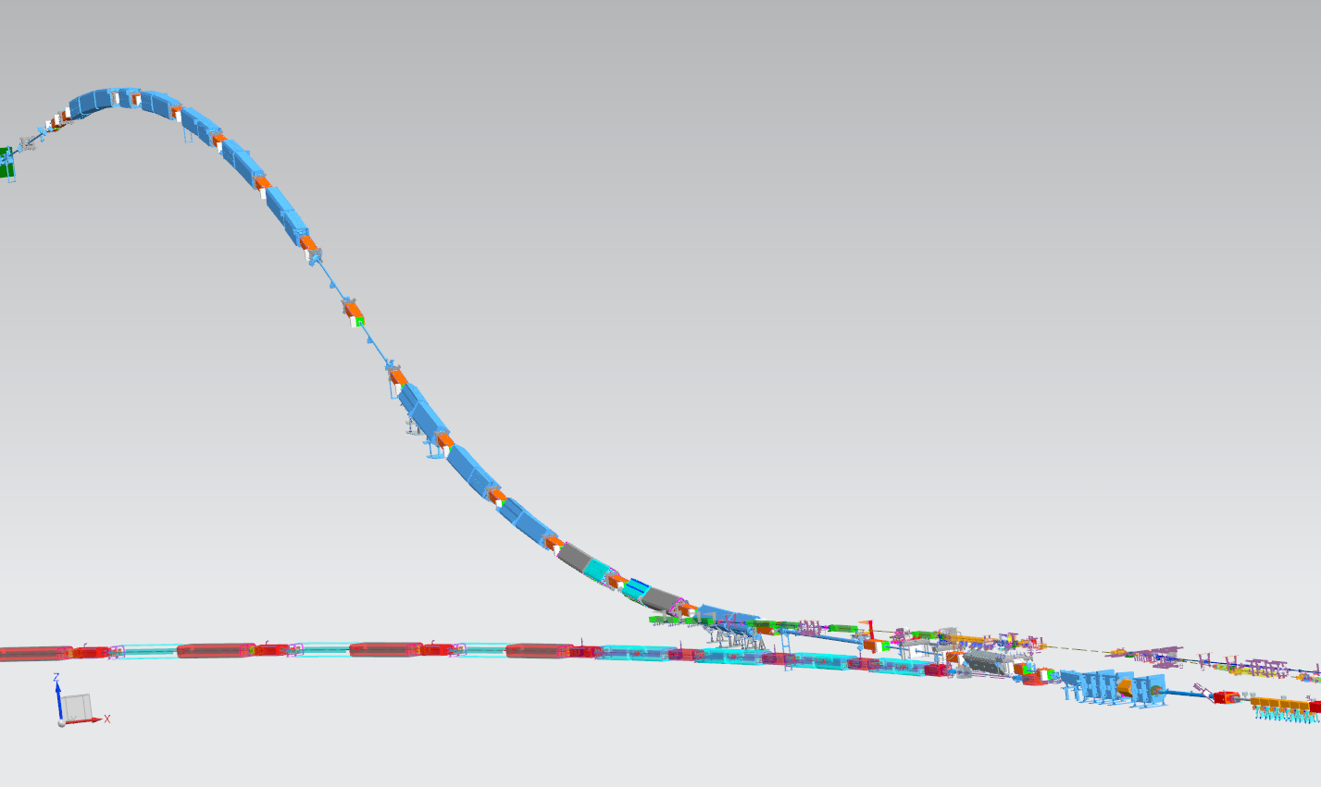
Primary Beamline Magnets and Vacuum
25 dipoles
21 quads
23 correctors
Vehicle Access Corridor Junction (MVA)
DS End: Primary Beam Window
MI Wall Penetration
Lambertsons
US Start: MI Kickers at Q100

Slide 8
General Design Points
Primary Vacuum system approximately 1,000 ft long from extraction at MI-10 to the primary beam window in the Target Hall
Design is similar to existing systems for Main Injector, Main Injector transfer lines, and NuMI
MI dipole and NuMI quad magnet designs
Reusing ILA Lambertsons currently being used for NuMI
New kickers with ANU beam tube design
1x10⁻⁷ Torr or better average pressure requirement
60 ion pumps, 5 sector valves, 2 Pirani gauges and 2 pump out ports per sector, turbo carts
Standard UHV practice regarding materials, cleaning and handling

Slide 9
Review Charge
Review Emphasis:
The focus of this review is primarily technical in nature and a brief review of cost and schedule will be given.
Does the design meet the technical requirements?
Are all interfaces adequately identified and defined?
Are Fermilab standard vacuum practices adequately applied to the design together with any applicable codes/standards?
Have ES&H issues been identified and analyzed appropriately?
Have long lead procurement items been identified?
Have all major risks been identified and does a mitigation strategy exist?

Slide 10
Review Charge
Is the design maturity at a satisfactory level giving confidence for the Primary Vacuum sub-system to be recommended to proceed to CD-2/CD-3a and Director’s readiness review?
Based on acceptable progress for preliminary design as a minimum of 50 to 60% at the time of this review, with 100% equal to “ready for procurement”.
Is there an adequate confidence level on cost and schedule estimates?
Is the final design schedule start date appropriate when taking considerations such as the design maturity of interfacing systems?
In addition to the charge questions, please comment and offer recommendations on other aspects of the vacuum design.

Slide 11
Agenda
Introduction - Kevin
Technical Presentations – Beth, Kevin
Break
Cost & Schedule - Kevin
Summary, Questions & Discussion

